Slide 1
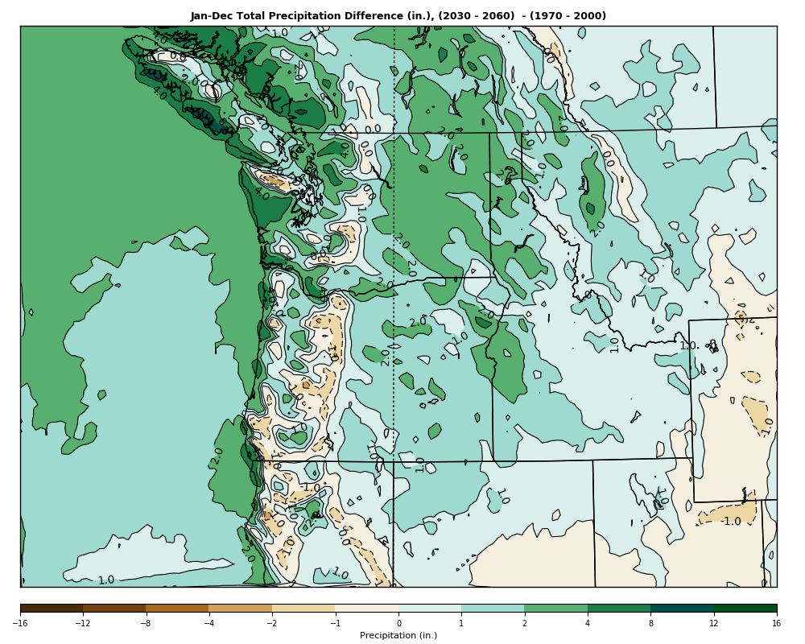
High-Resolution Regional Climate Modeling Over the Pacific Northwest
Cliff Mass, Eric Salathe,
Rick Steed, and Jeff Baars
As well as department undergraduates
Calen Randall, Jacob Hendrickson and Daniel Arens

Slide 2






Rick Steed
Jeff Baars
Eric Salathe
Jacob Hendrickson
Calen Randall
Daniel Arens

Slide 3


Major Sponsor: Amazon Catalyst Program
Provided large cloud computing resources
And personnel support

Slide 4
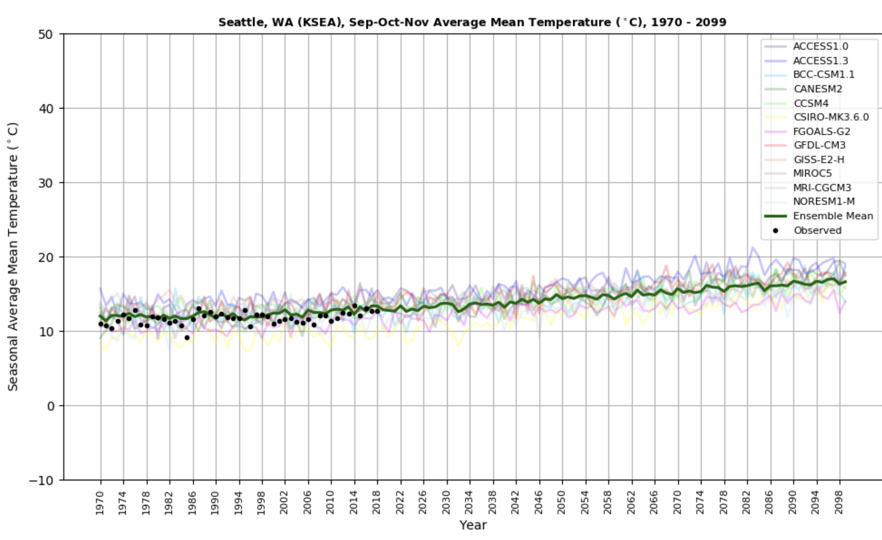
The Northwest Regional Climate Modeling Project
Run an ensemble of high-resolution regional climate simulations for 130 years (1970-2100)
Uses WRF model at 12-km grid spacing over the Northwest.
Driven by 12 CMIP-5 GCMs using RCP8.5 scenario
Now running RCP4.5.

Slide 5
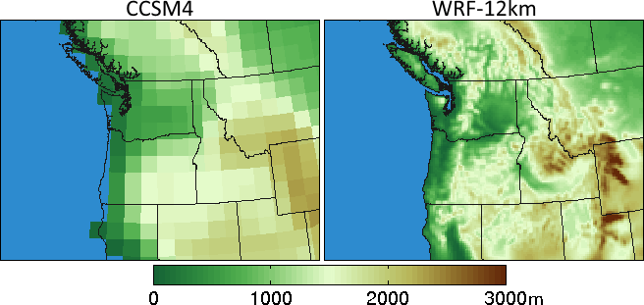
Some Major Questions to Be Addressed
Does higher resolution (adequate for major mesoscale features) alter the regional response to global warming compared to GCMs?
CCSM
WRF-12 km

Slide 6
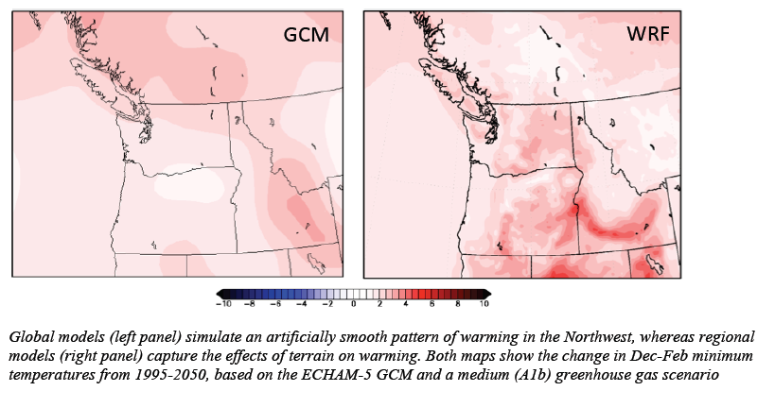
Some Major Questions to Be Addressed
Does dynamical downscaling produce different regional responses than statistical downscaling?
Are there important feedbacks and physical processes associated with global warming that are missing or deficient in GCMs?

Slide 7
Question Regarding Uncertainty
Does an ensemble of high-resolution simulations provide insights into uncertainties regarding regional impacts of global warming?
Do high-resolution climate simulations increase or decrease spread/uncertainty in GW response compared to GCMs?

Slide 8
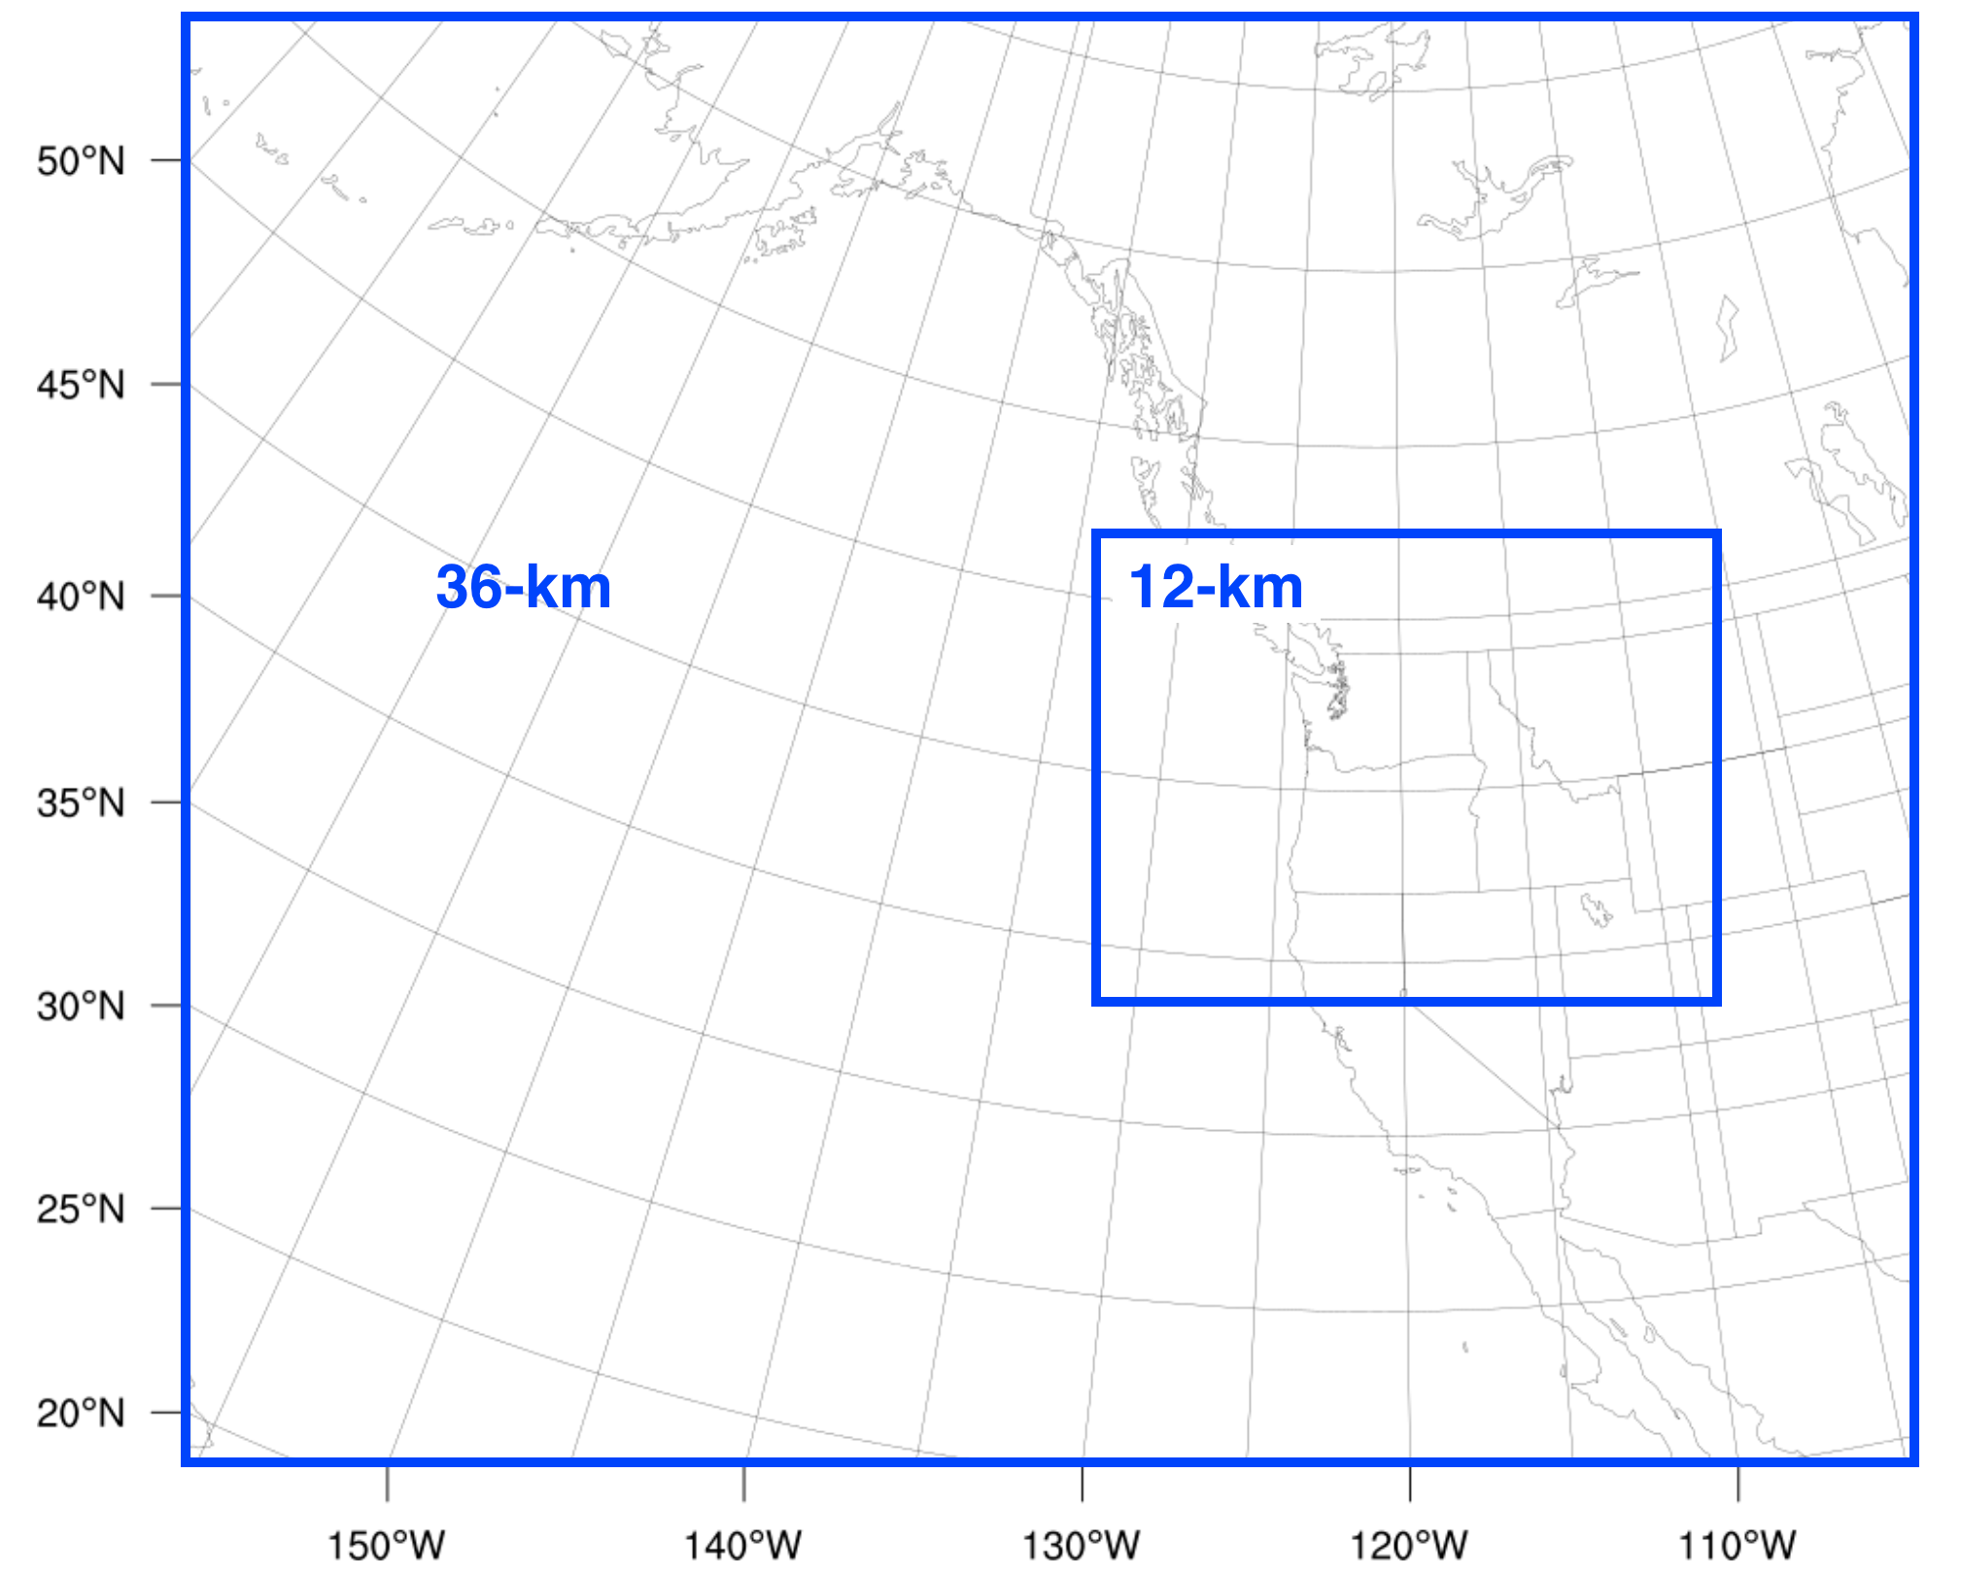
Dynamical Downscaling: GCMs to WRF
Global GCMs have a typical grid spacing of ~150 km
Nested WRF with 36/12-km grids spacing
Grid nudging of 36 km outer WRF grid to parent GCMs
Used proven WRF physics options used in NW operational WRF runs.
Ran from 1970-2100

Slide 9
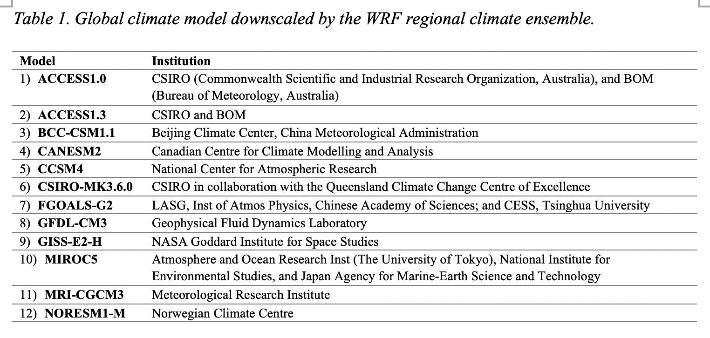
An Ensemble of High Resolution WRF Regional Climate Simulations

Slide 10
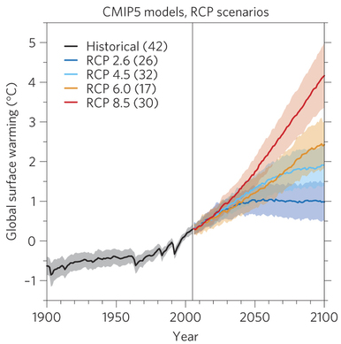
All Twelve GCMs Runs Driven by RCP8.5
Unrealistically aggressive greenhouse gas emissions.
Useful for providing a large signal to noise ratio.
Currently, redoing with more realistic RCP 4.5

Slide 11
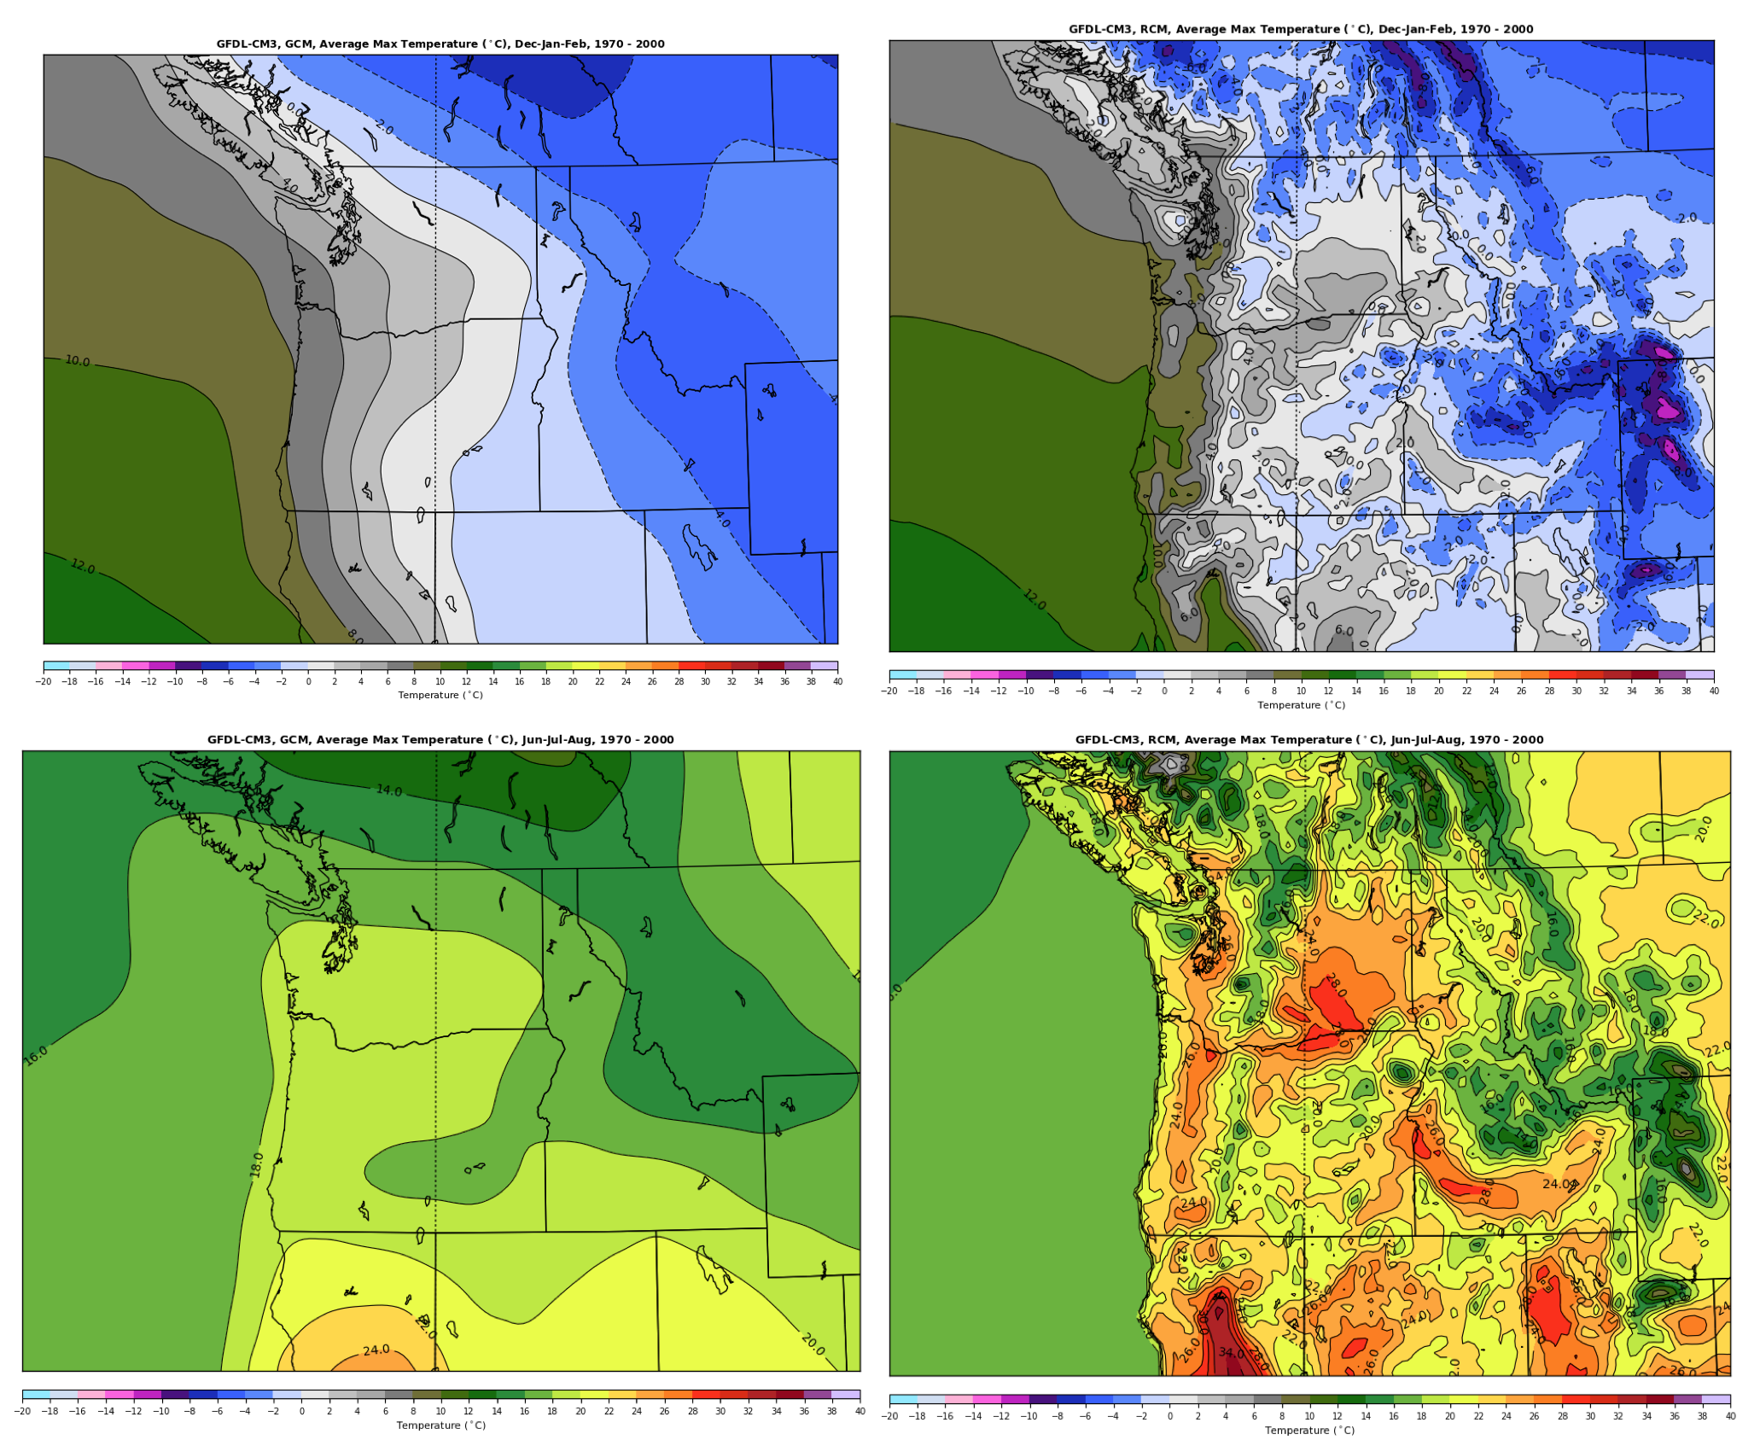
The Effects of Resolution for One GCM (GFCL-CM3) over the Contemporary Period (Winter Max. Temperatures)

Slide 12
Summer Comparison GCM Versus RCM

Slide 13
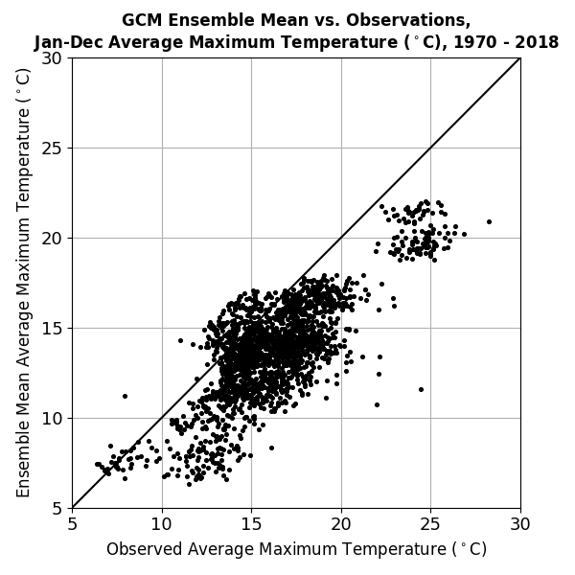
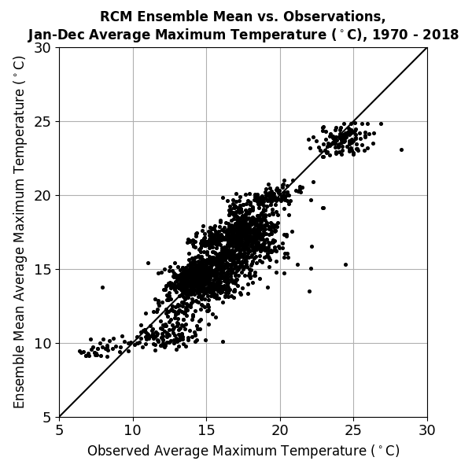
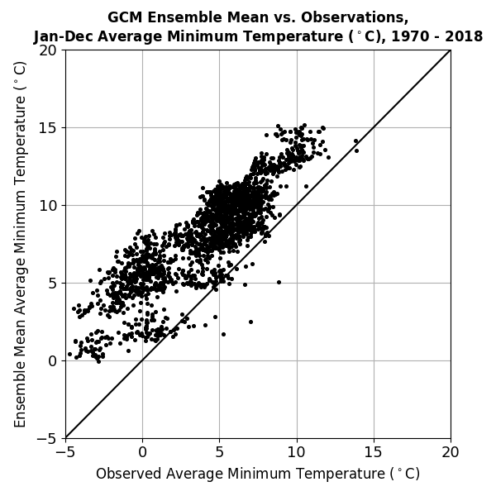
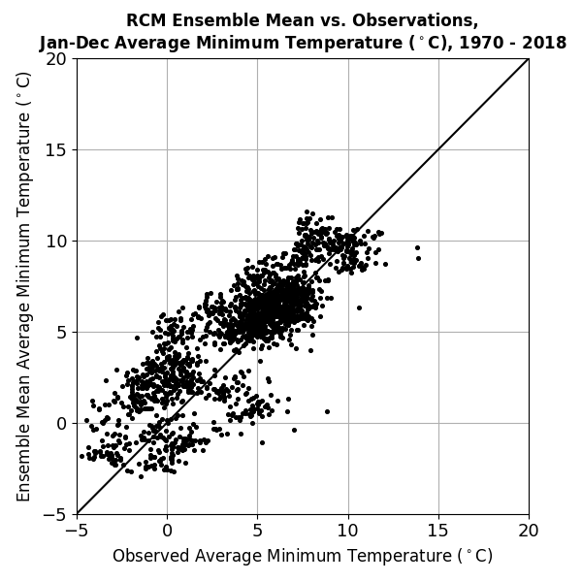
Verification GCM vs RCM
GCM
RCM
Maximum
Temperatures
Minimum
Temperatures

Slide 14
Ensemble Mean Changes from
1970-2000 (contemporary to
2030-2060 or
2070-2100

Slide 15
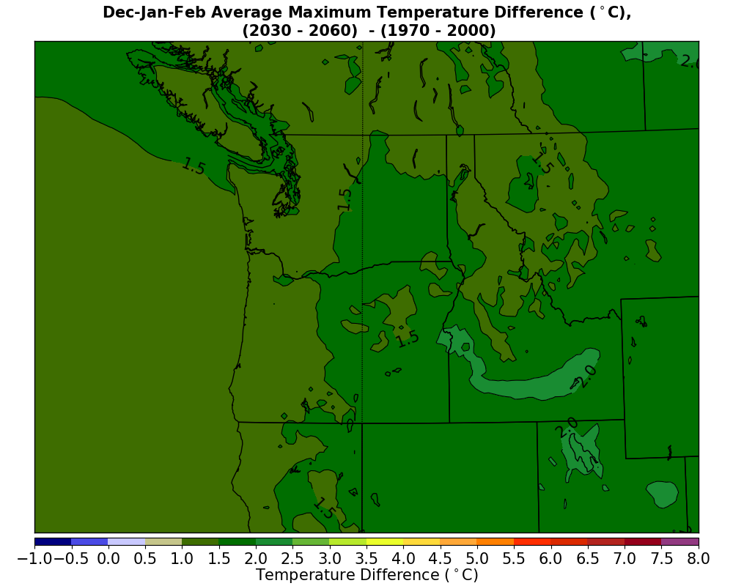
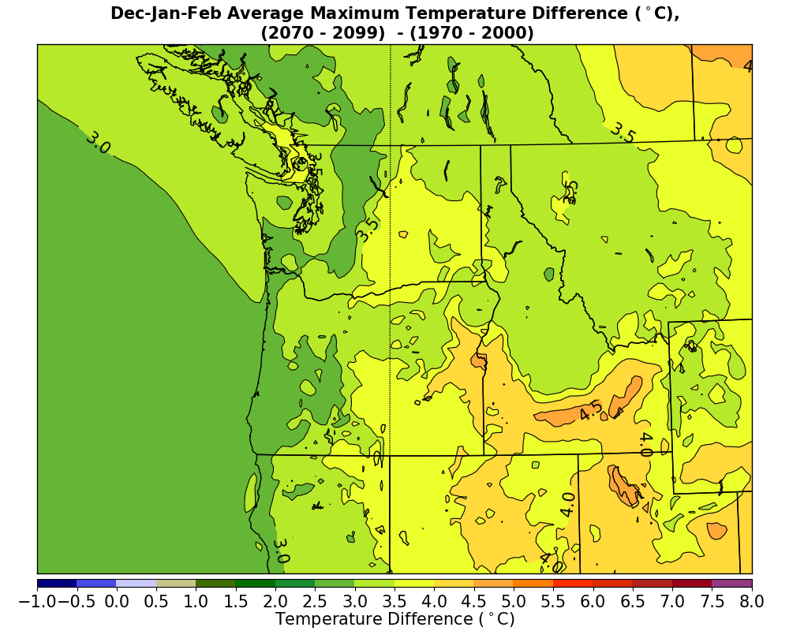
Winter Maximum Temperature Changes
1970-2000 to 2030-2060
1970-2000 to 2070-2100

Slide 16
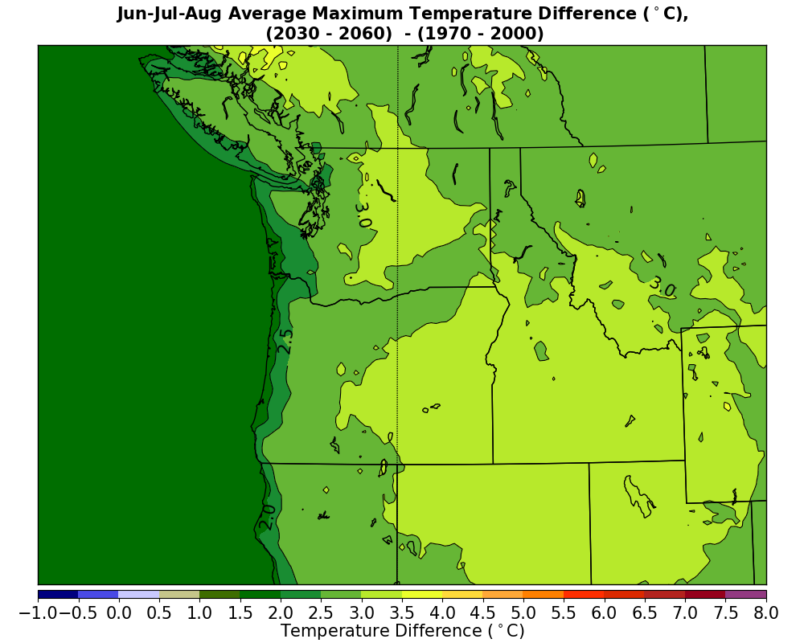
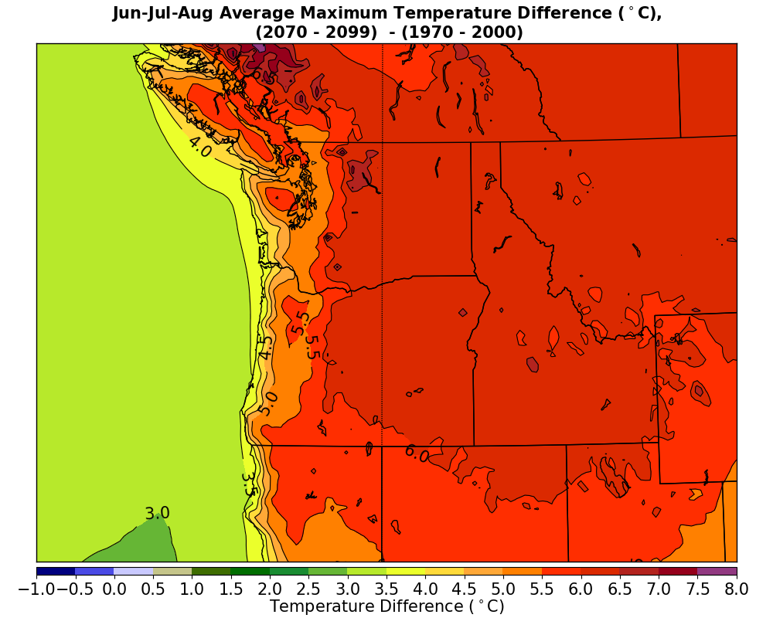
Summer Maximum Temperature Changes
1970-2000 to 2030-2060
1970-2000 to 2070-2100

Slide 17
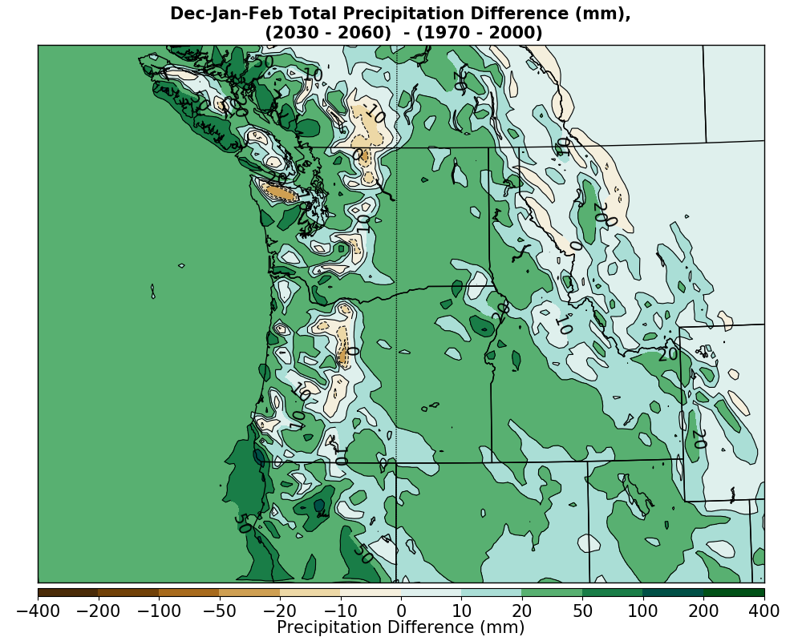
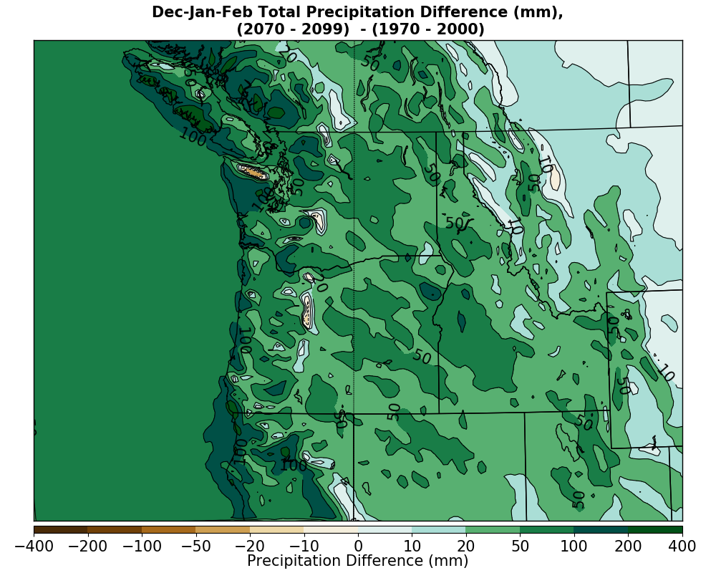
Winter Precipitation Changes
1970-2000 to 2030-2060
1970-2000 to 2070-2100

Slide 18
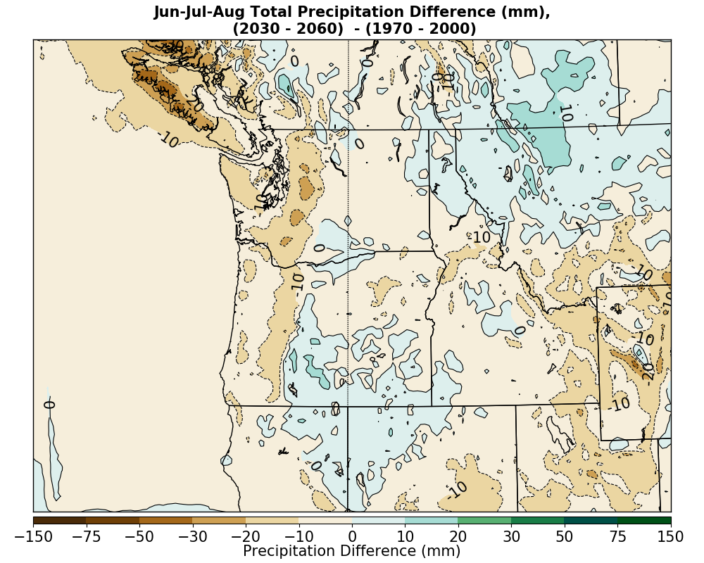
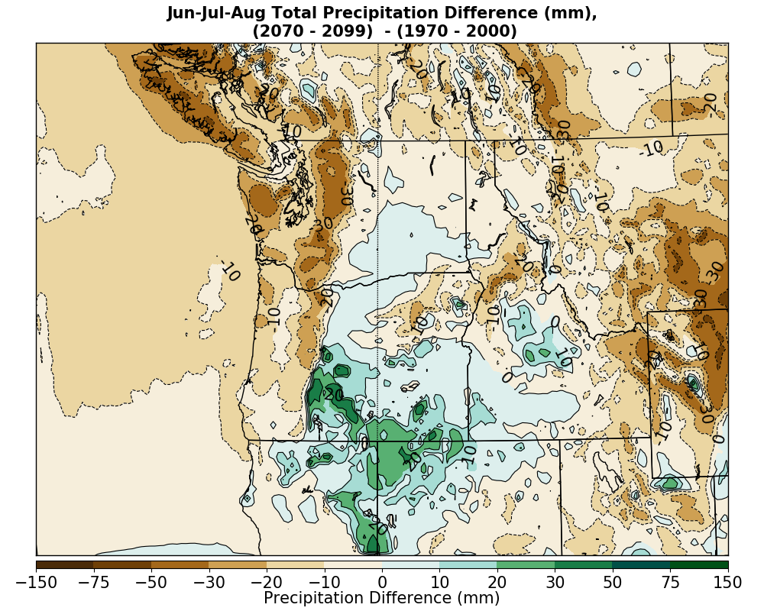
Summer Precipitation Changes
1970-2000 to 2030-2060
1970-2000 to 2070-2100

Slide 19
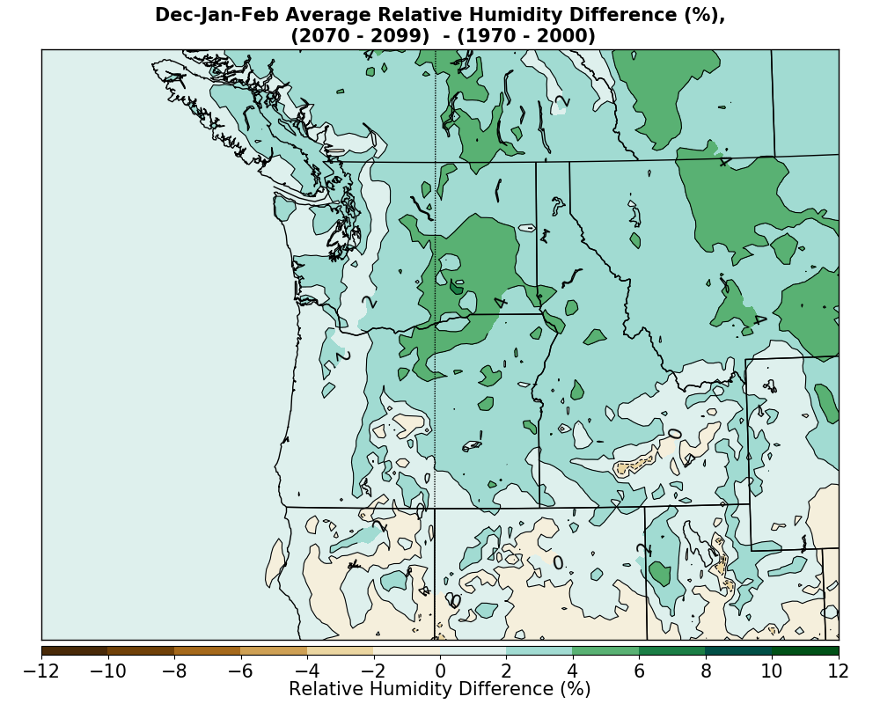
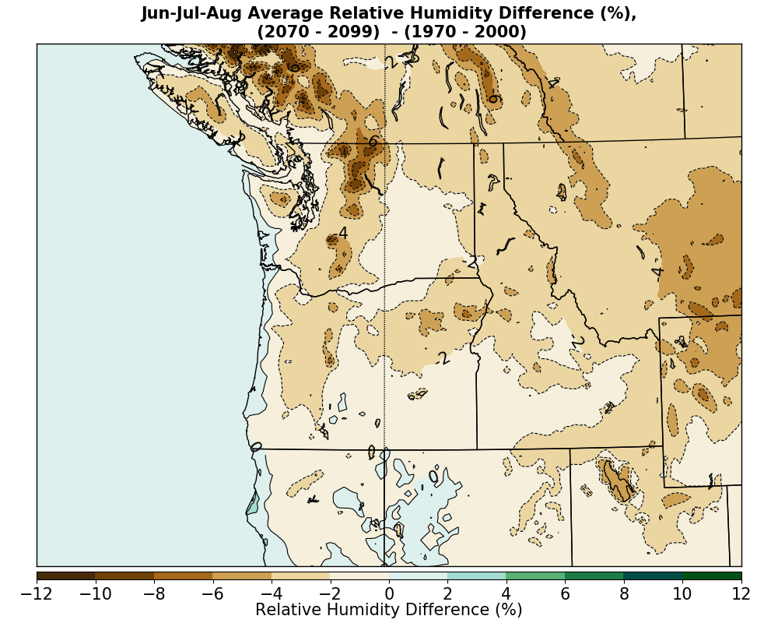
Relative Humidity Changes
1970-2000 to 2030-2060
1970-2000 to 2070-2100

Slide 20
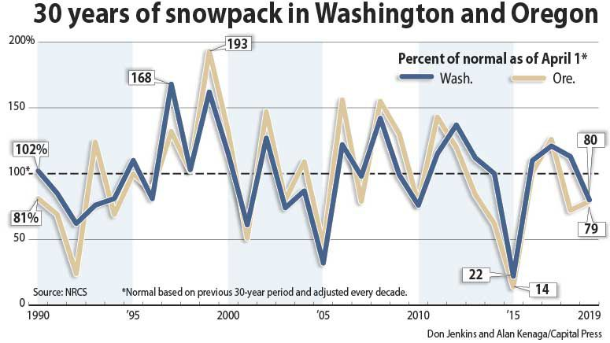
Snowpack

Slide 21
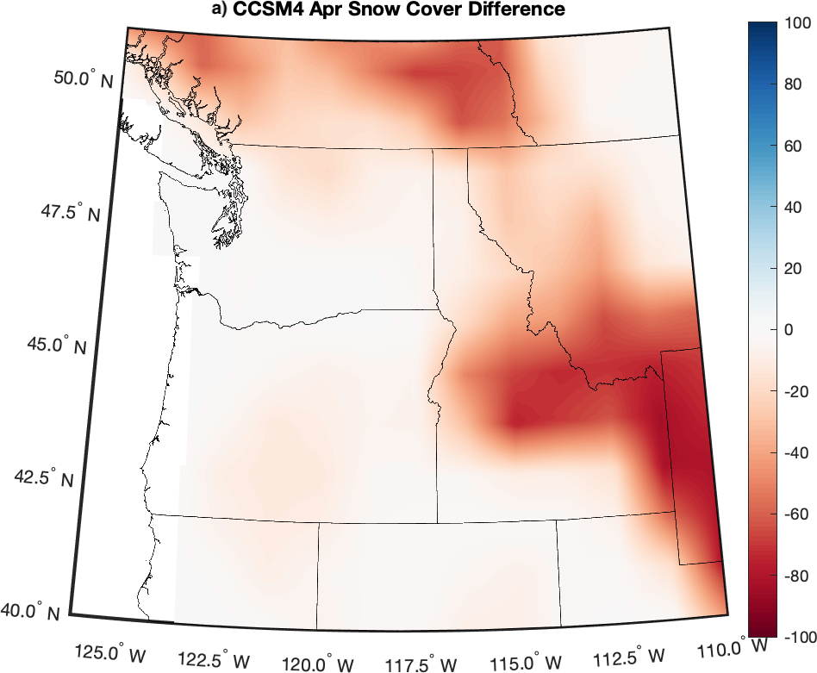
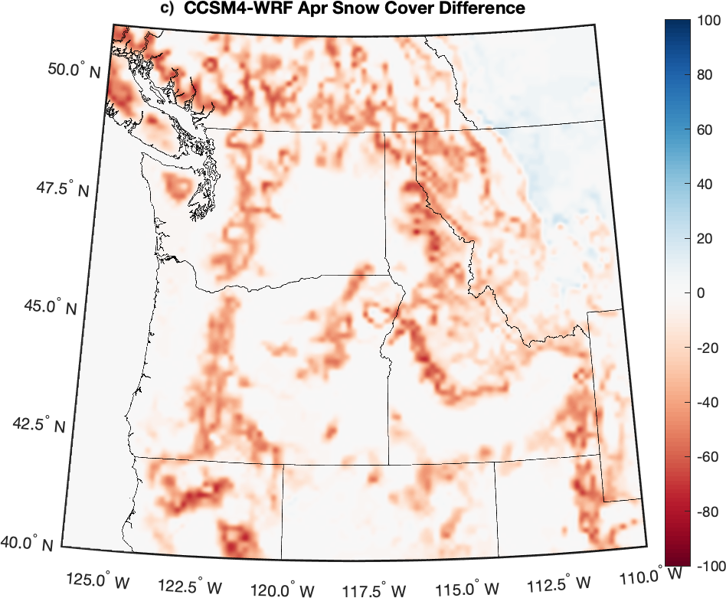
Snow Coverage and Feedbacks are Radically Different Between GCMs and Dynamically Downscaled Runs
Change in percentage of years with snow cover on April 1 between the contemporary (1970-2000) and end of century (2070-2090)

Slide 22
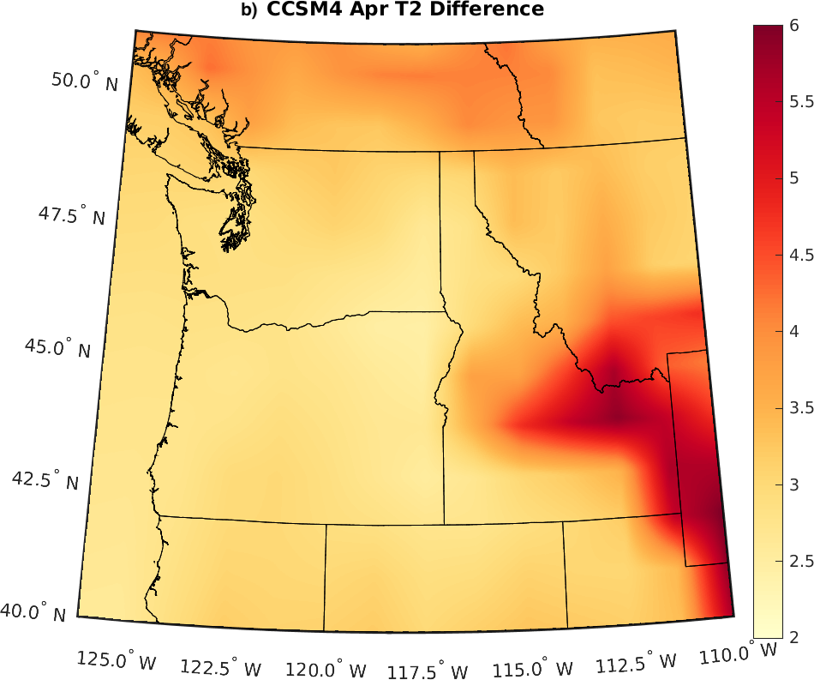
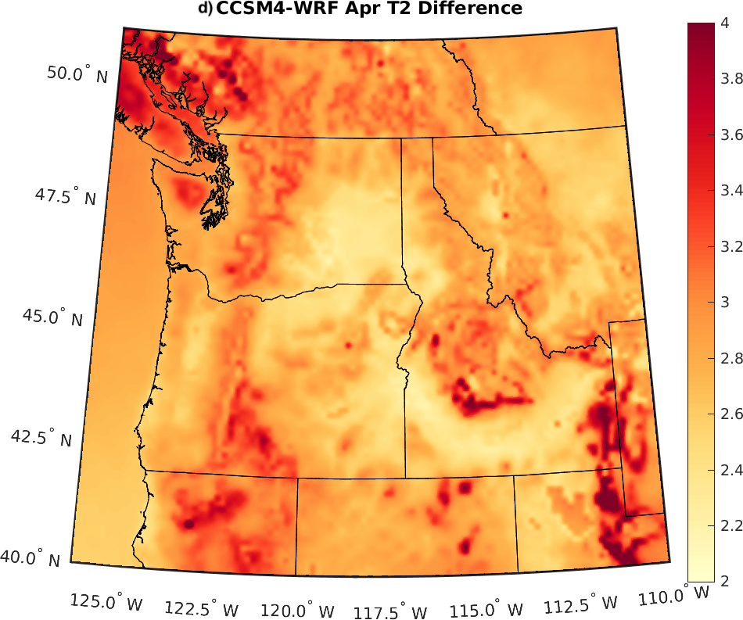
Large Thermodynamic Implications
April differences (2070-2099) -(1970-1999)
Enhanced warming from snowpack reduction is very different between the two

Slide 23
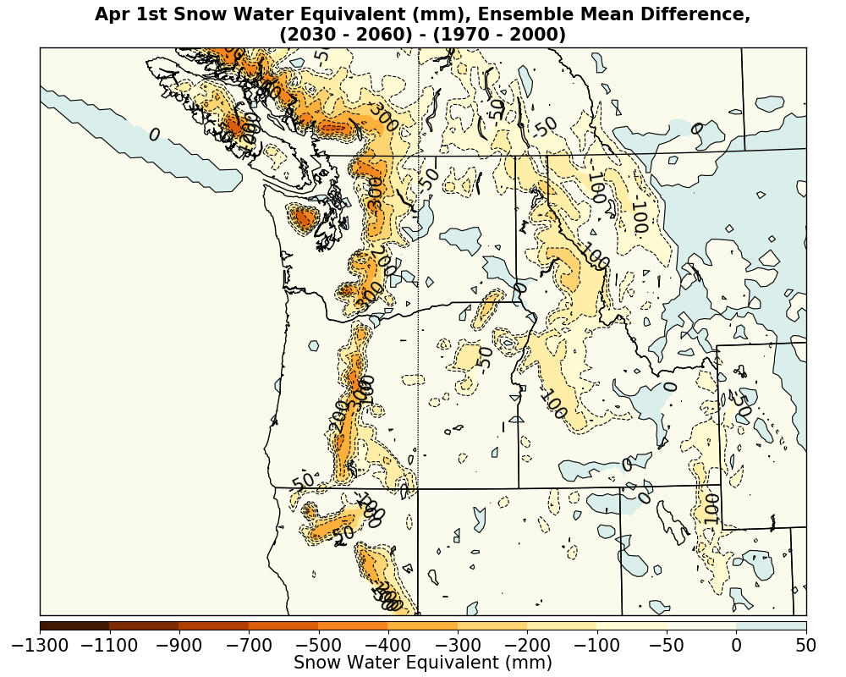
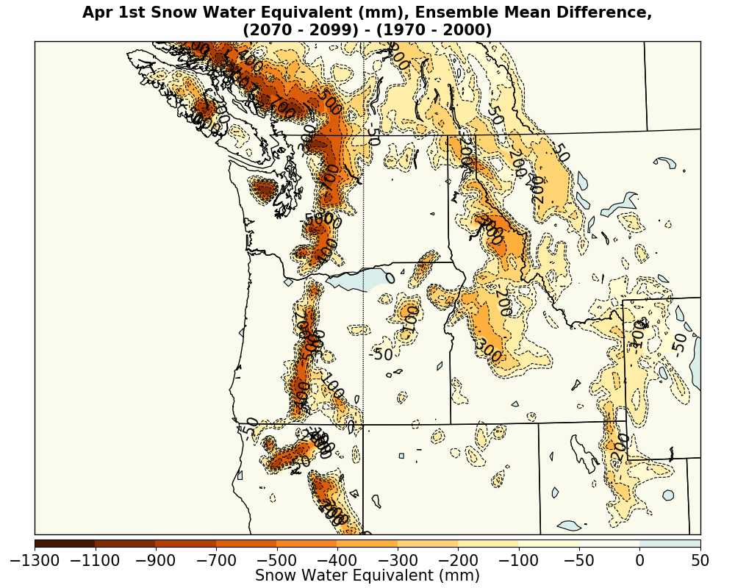
Snowpack (SWE) Changes on April 1
1970-2000 to 2030-2060
1970-2000 to 2070-2100

Slide 24
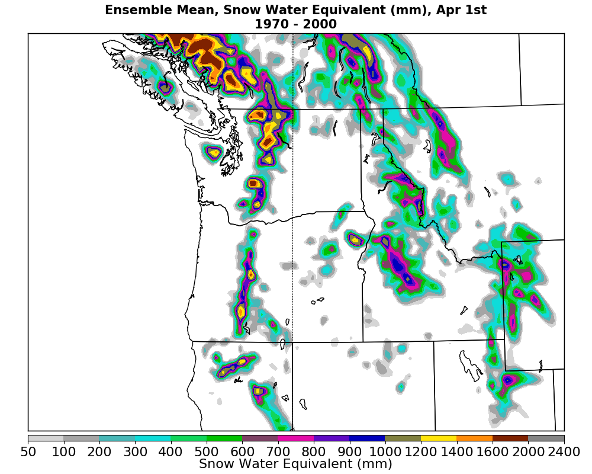
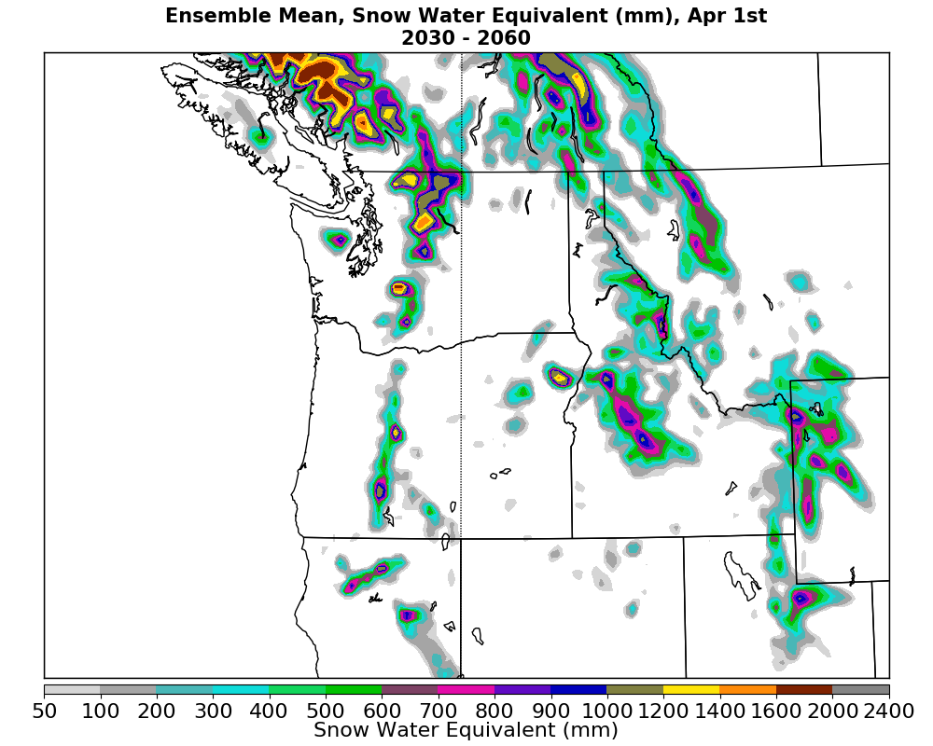
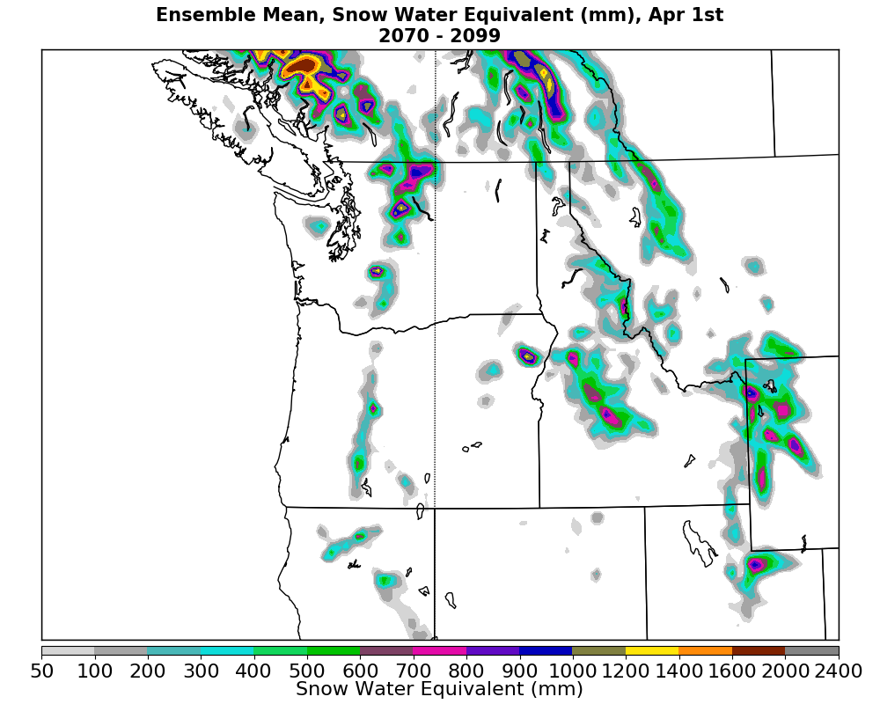
Ensemble Mean April 1 Snowpack (SWE)
1970-2000
2030-2060
2070-2099

Slide 25
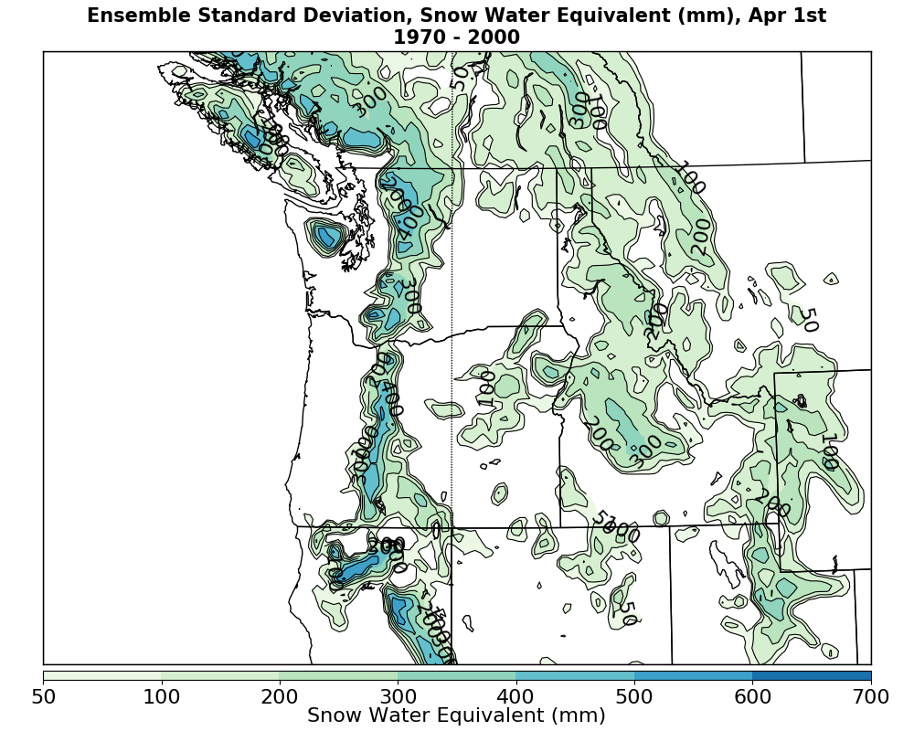
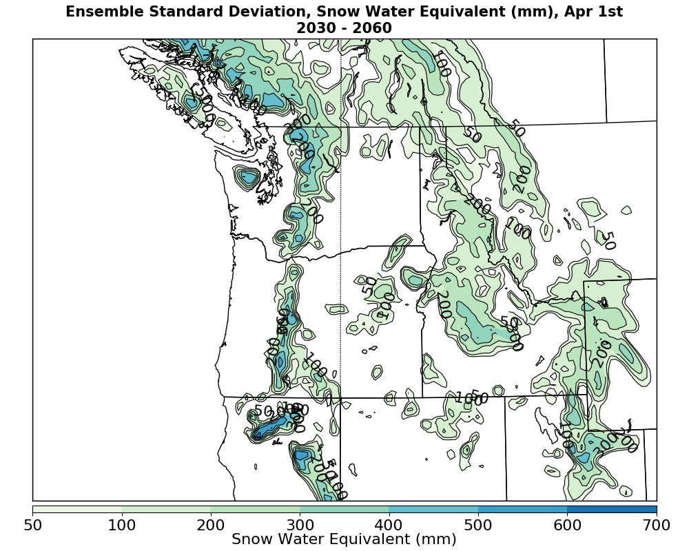
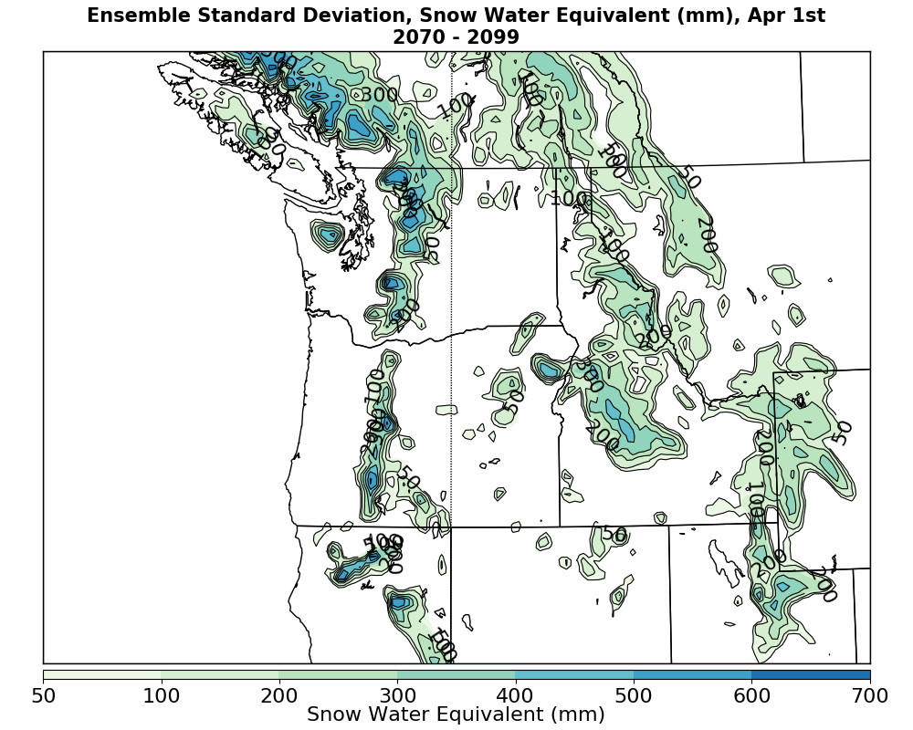
Ensemble Standard Deviation of April 1 Snowpack
Largest standard deviation on the western slopes of Cascades

Slide 26
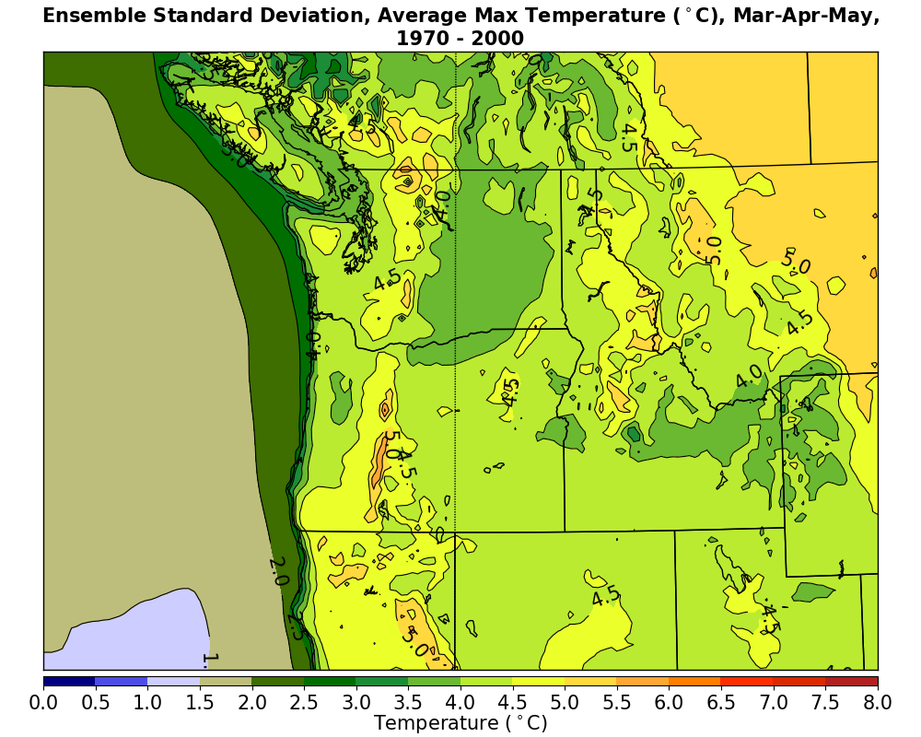
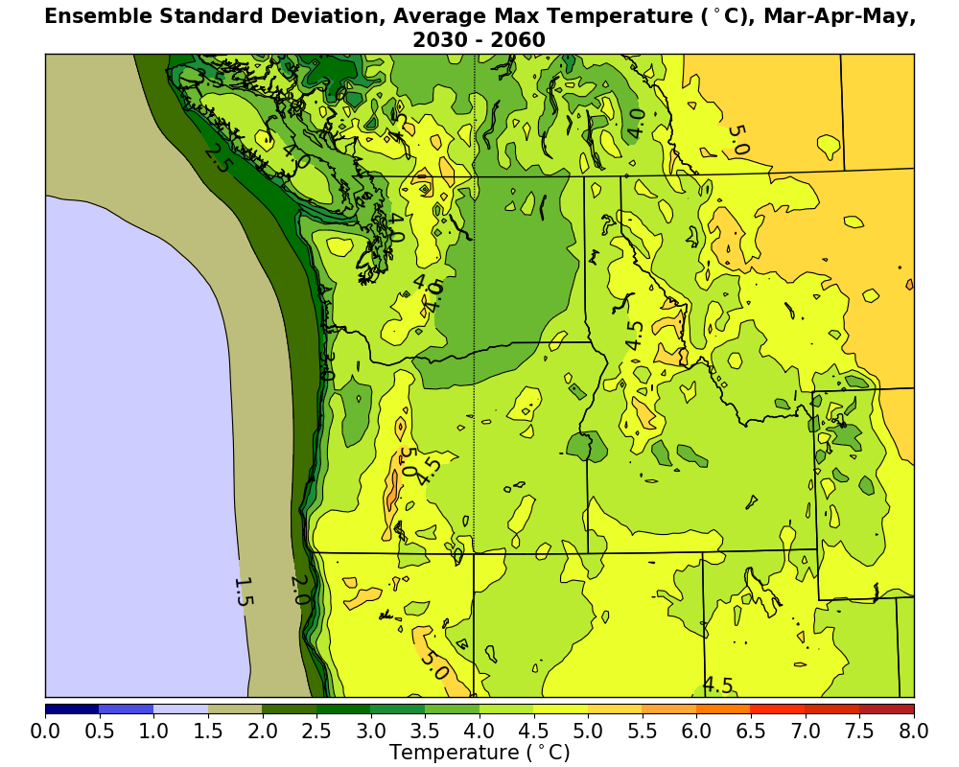
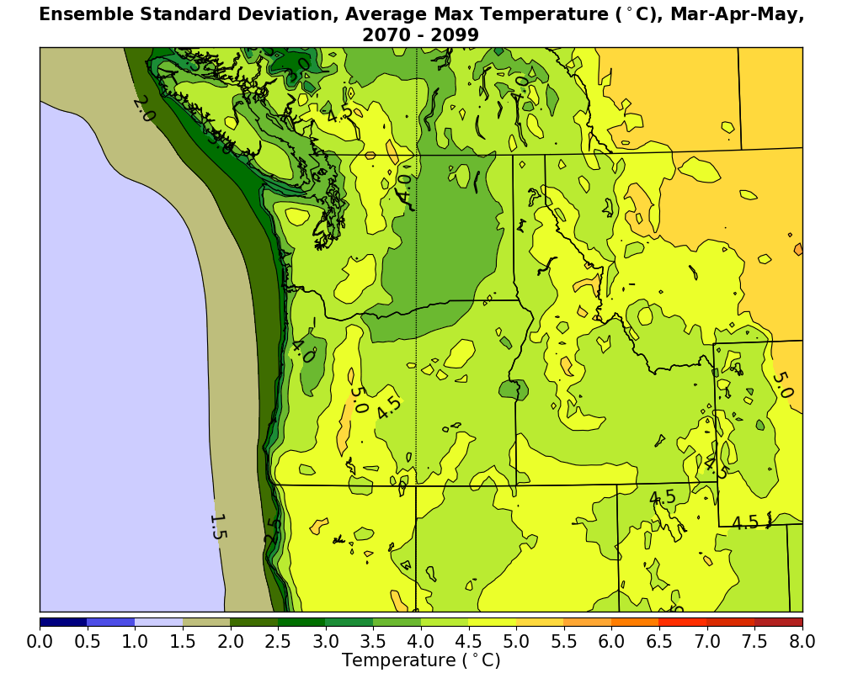
Ensemble Standard Deviation of March-May 2-m Temperature
As temperature warms and snowpack melts out, less variability in spring temperatures among members
Little variability in high terrain of southern BC north of Whistler.

Slide 27

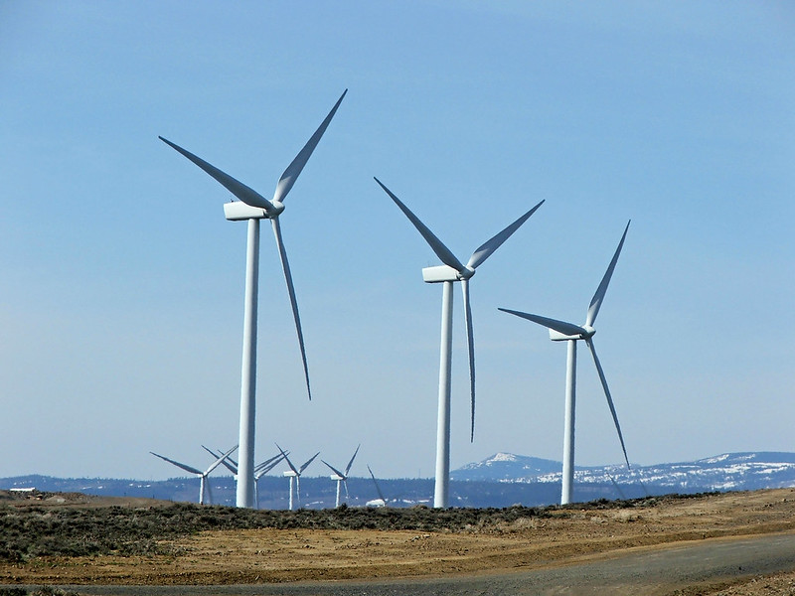
Wind Projections

Slide 28
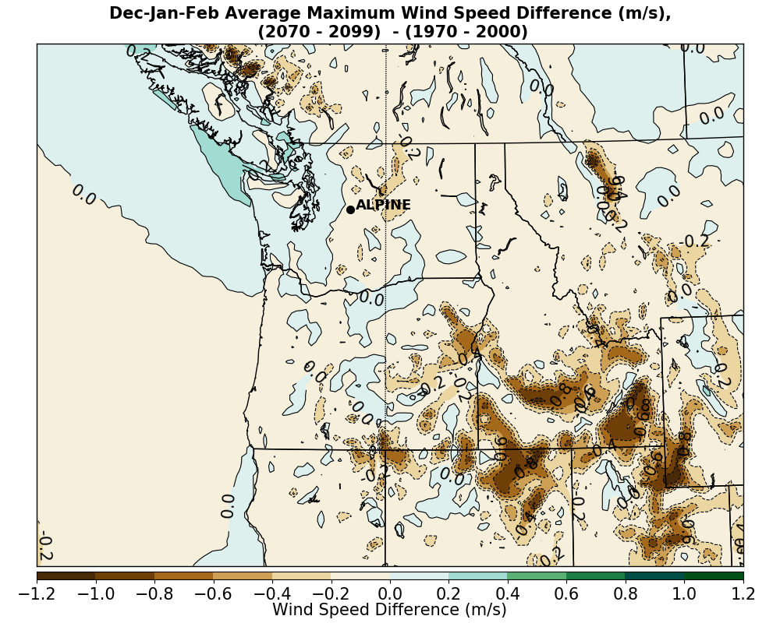
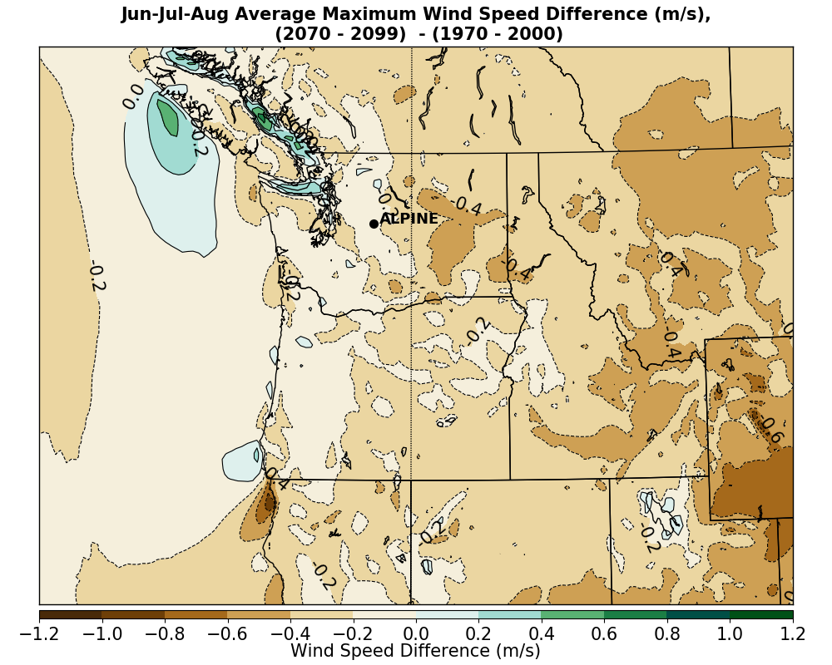
Ensemble Average Maximum Wind Speed Change (full period)
Less Wind Energy Potential
Not much Change In Windstorm Potential

Slide 29
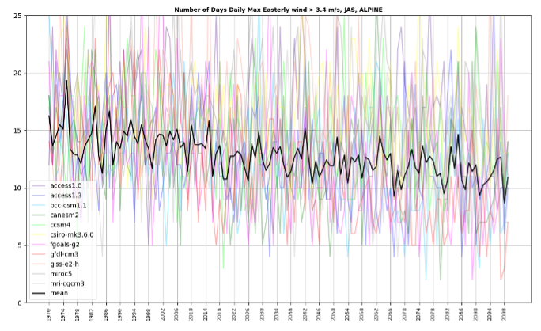
Strongest Easterly Winds In JAS Are Projected to Decline: Major Implications for Wildfires
Number of days per year with a daily maximum easterly wind component greater than one standard deviation (6.6 kt, 3.4 ms⁻¹) from the mean.
Individual ensemble members shown with colors and the ensemble mean is black.

Slide 30
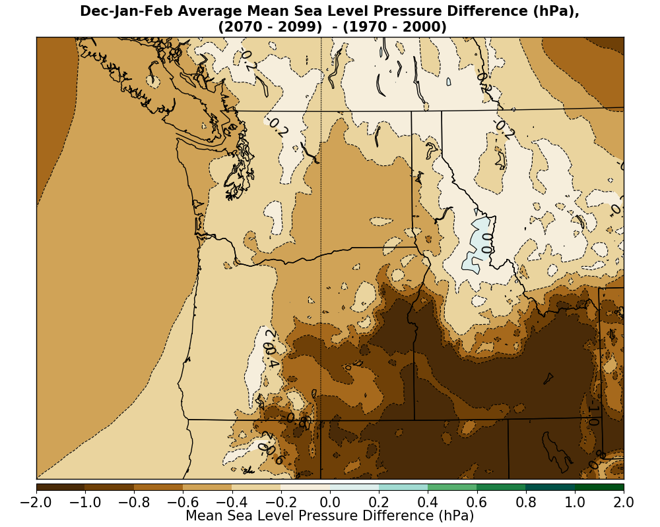
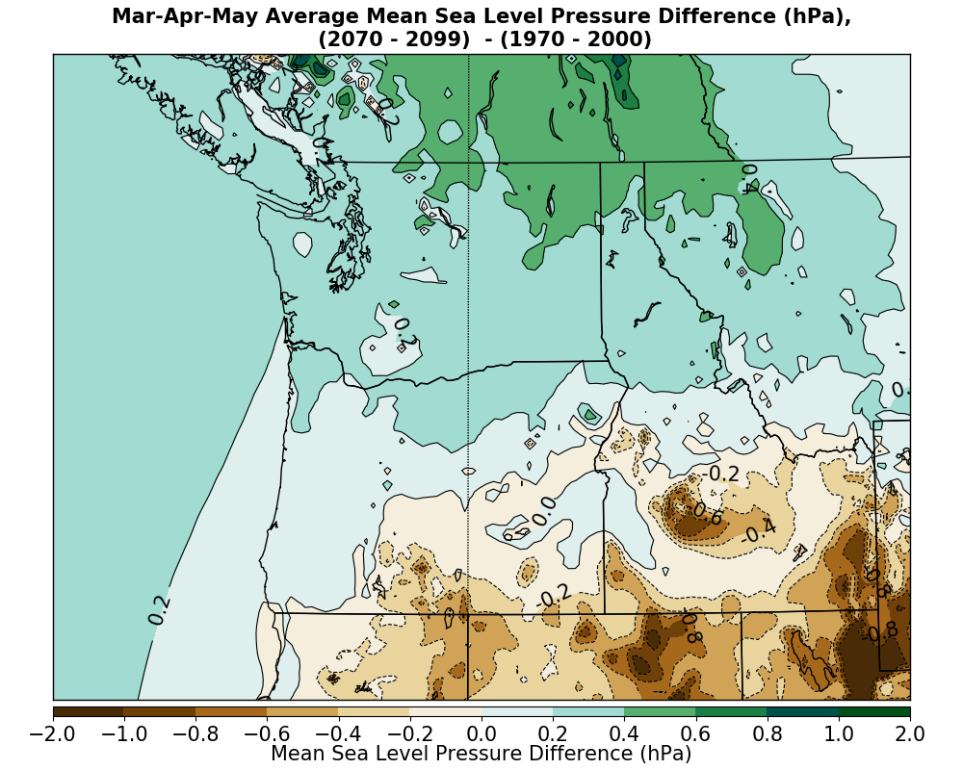
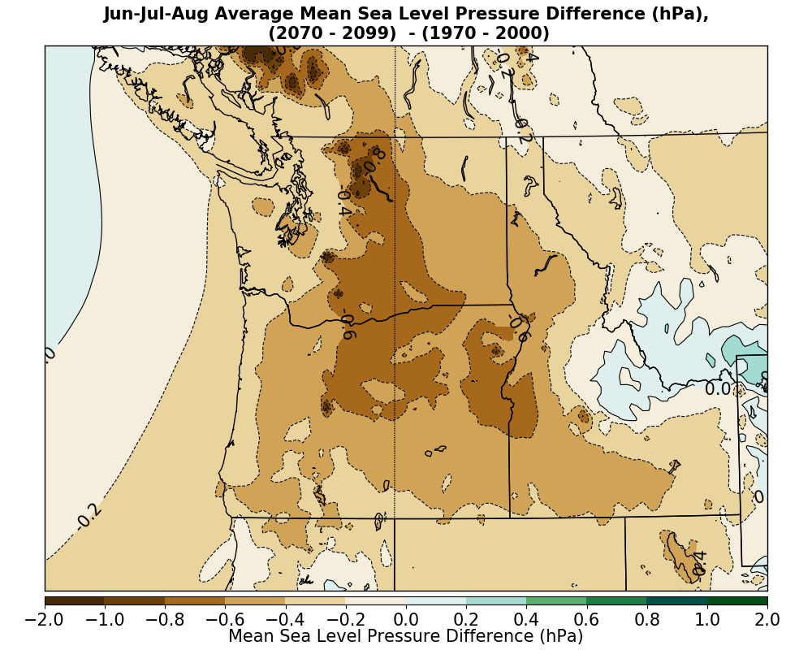
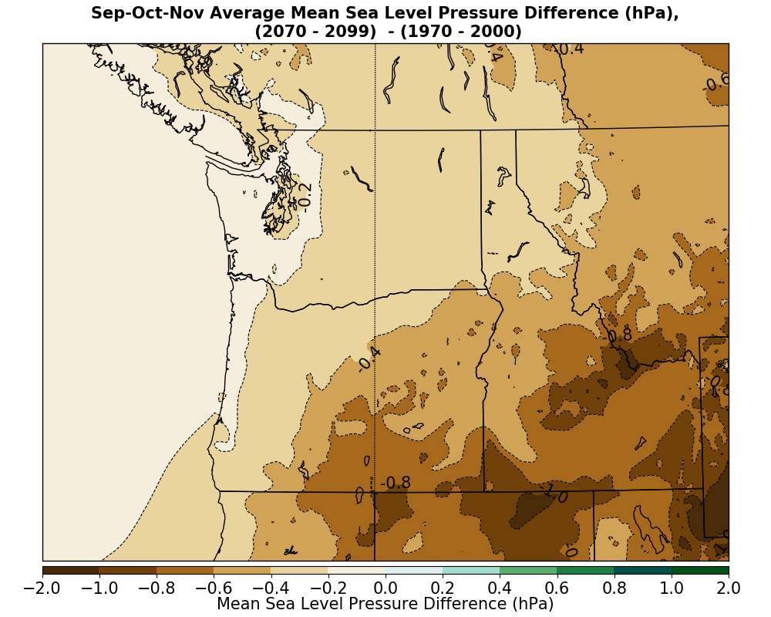
Why are the winds changing?
Changes to the regional SL pressures.

Slide 31
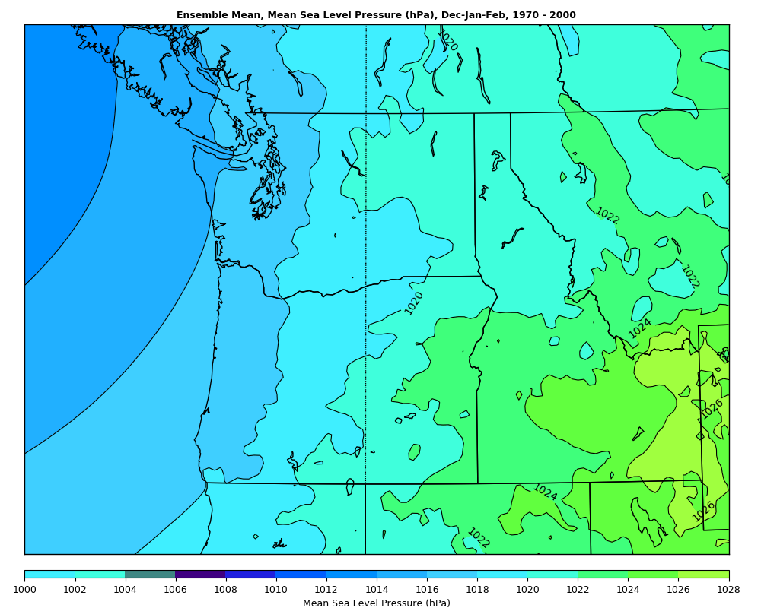
Substantial pressure falls over SW portion of the domain leads to weaker winds
1970-2000
Mean Pressure
DJF
Winter
DJF

Slide 32
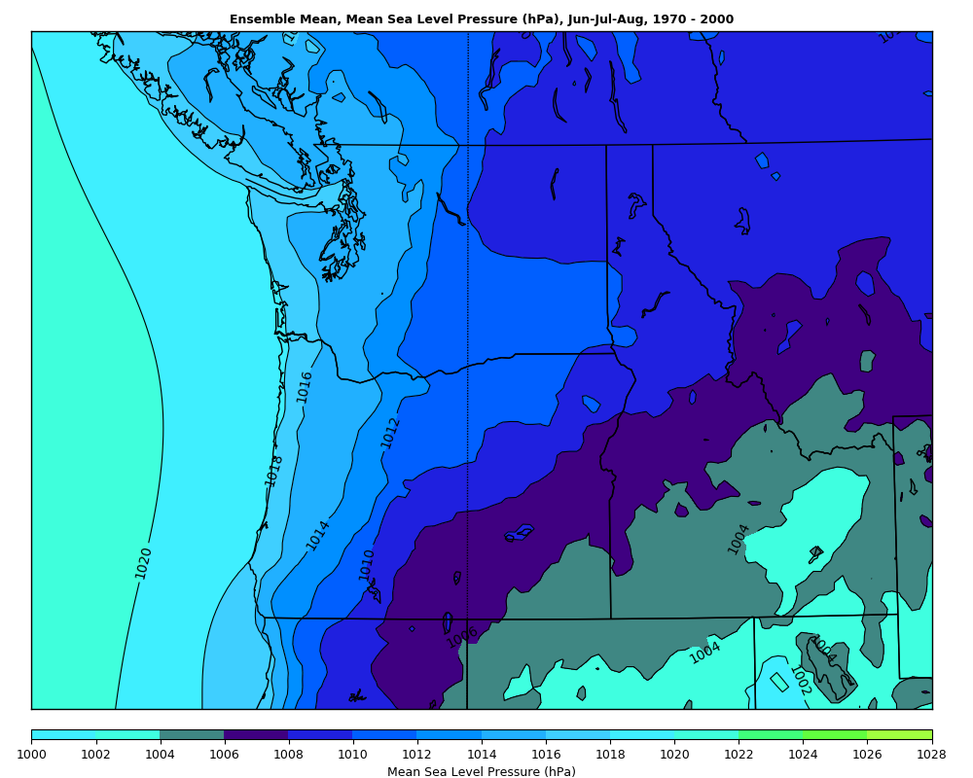
Summer
JJA
1970-2000
Mean Pressure
JJA
Preferential pressure falls to east of Cascade crest, because warming is greater there.
Preferential pressure falls to the east, works AGAINST easterly flow across the Cascades

Slide 33
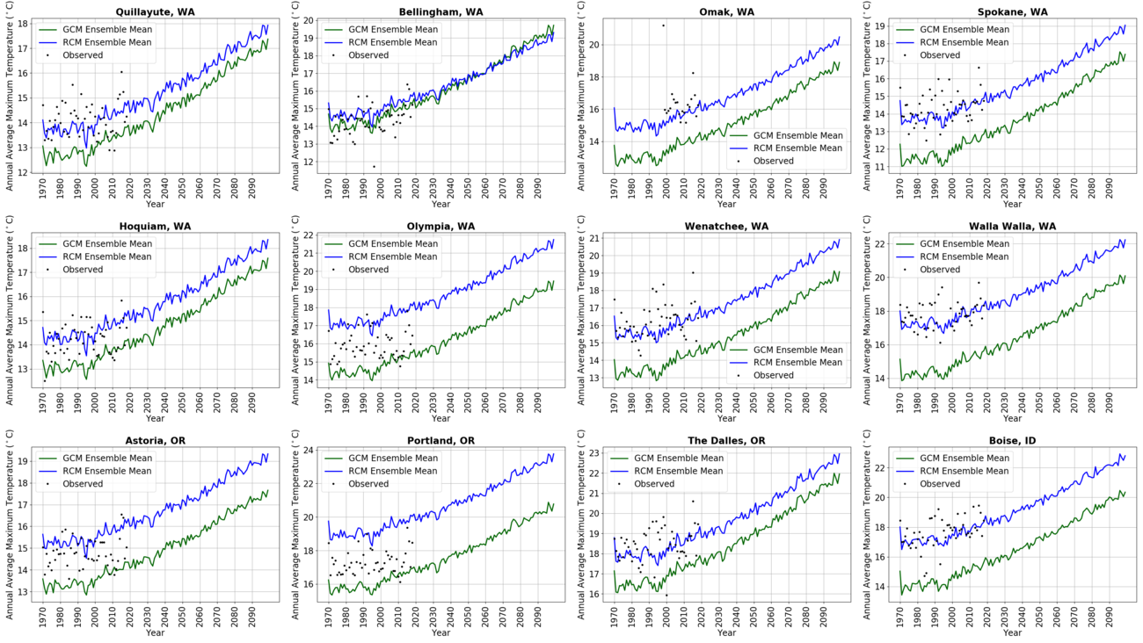
Individual Station Viewpoint: Annual Average Maximum Temperature
RCM
Generally
Higher
Temperature
RCM generally
more realistic
Black dots
are observed

Slide 34
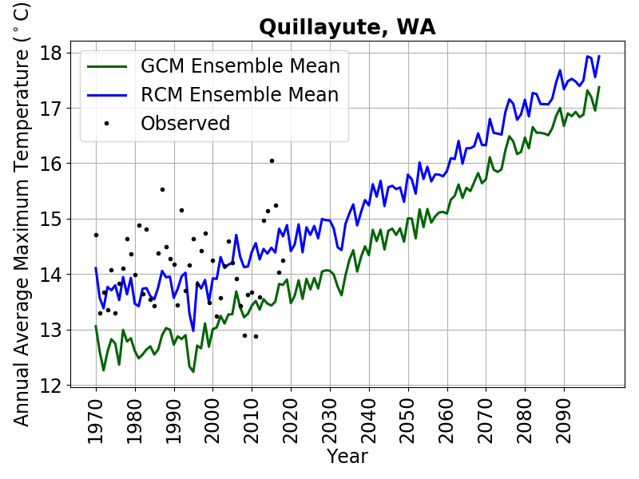

Similar trends in RCM and GCMs away from terrain. Little trend ~1970-2000

Slide 35

Seasonal Trends: Average Maximum Temperatures

Slide 36

Percent of days in July above the 90th percentile in maximum temperature based on 1970-2000.
Color lines show a subset of the RCM ensemble members and the black dots show the observed values.

Slide 37

Seasonal Precipitation Trends: Wetter Winters, Slightly Drier Summers

Slide 38


Transect of the fractional change in mean January daily precipitation from 1970-1999 to 2070-2099 for the GCM and WRF ensembles; the gray band indicates one standard deviation above and below the mean of the WRF ensemble

