Slide 1
The Relationship Between Northeast Pacific Sea Surface Temperatures and Air Temperatures over the Pacific Northwest
Clifford Mass, Calen Randall, Robert Conrick, and David Ovens
University of Washington
Seattle, Washington

Slide 2
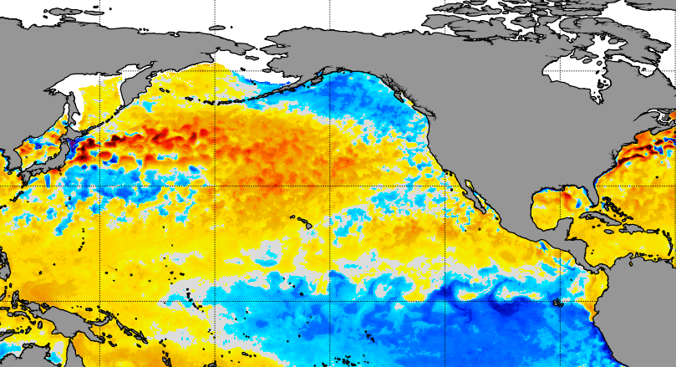
How do sea surface temperature anomalies over the Northeast Pacific influence air temperatures over the Pacific Northwest?

Slide 3
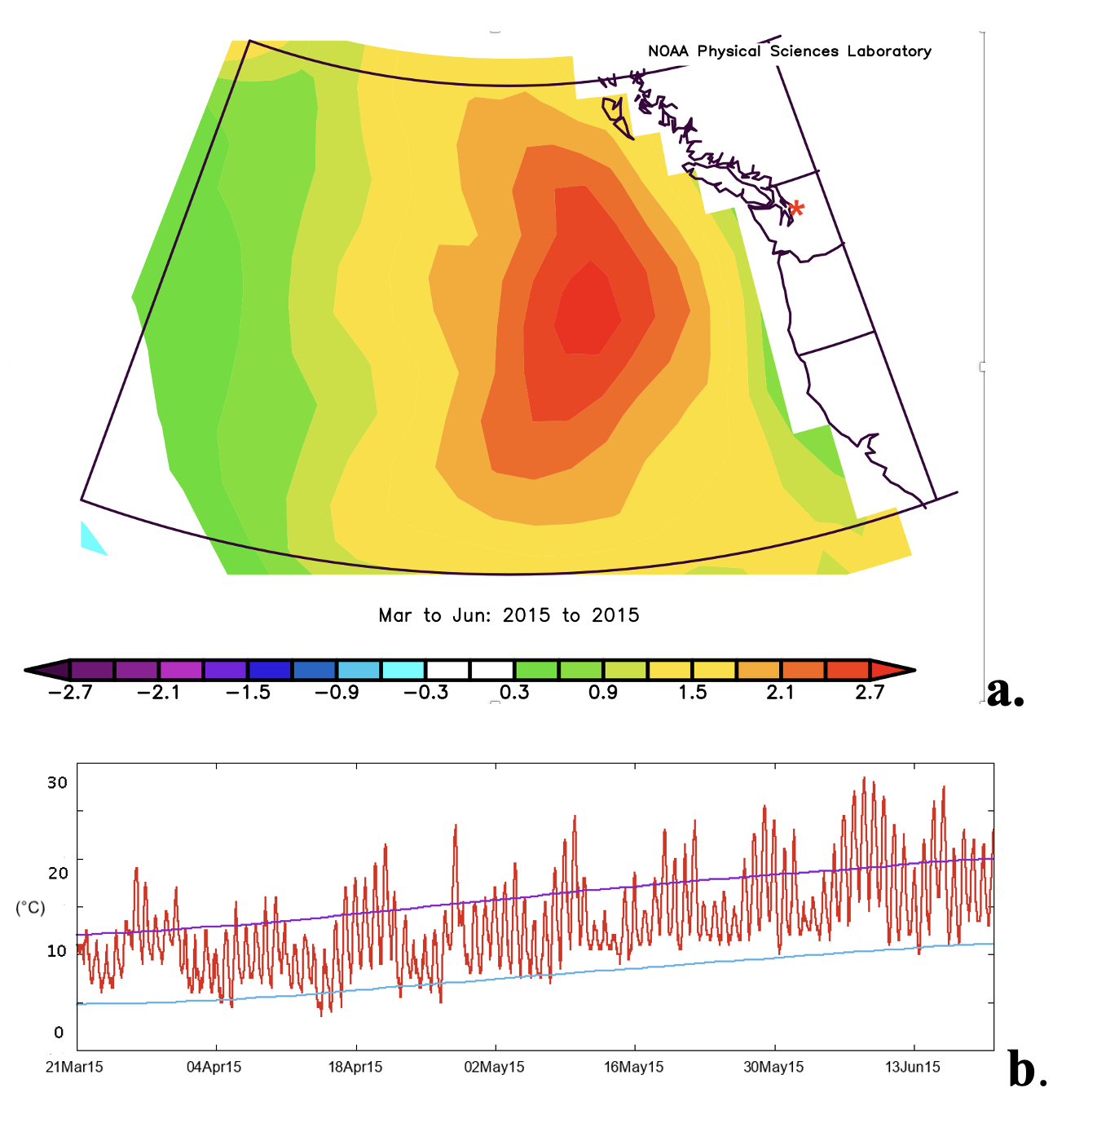
There is a Lot Anecdotal Evidence…
May to June 2015 SST Anomaly
SeaTac Airport

Slide 4
SeaTac Airport When SSTs Were Warm

Slide 5

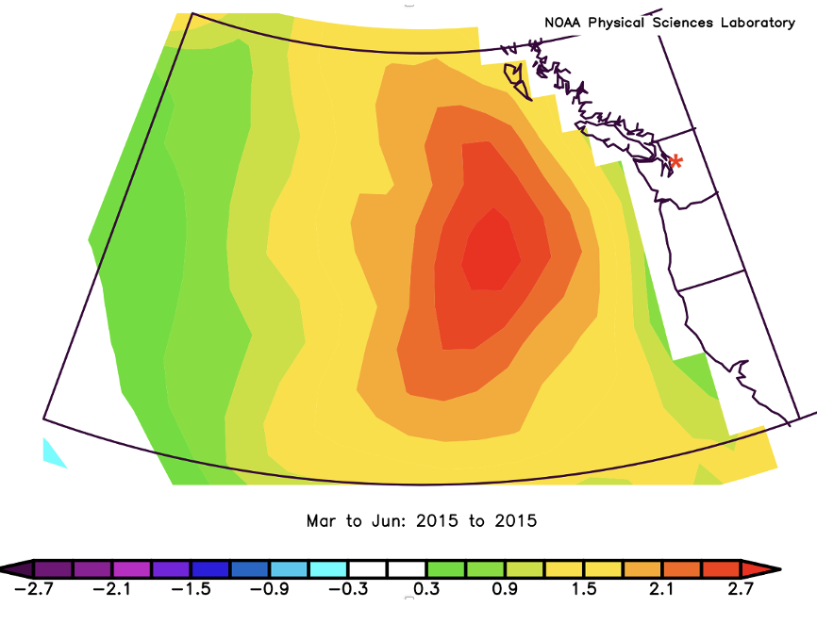
Warm Anomalies Known as “The BLOB” A.K.A. “marine or ocean heatwaves”

Slide 6
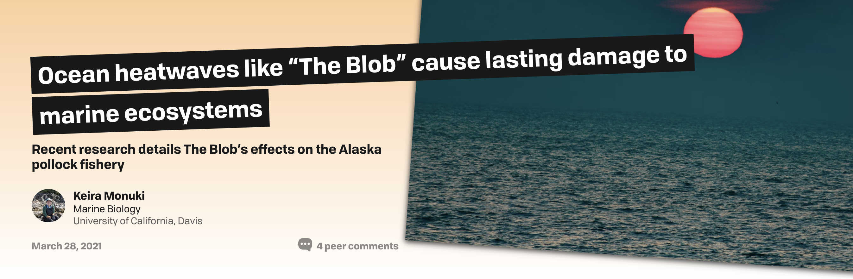
Several Studies Have Shown Substantial Ecological Impacts of the Blob

Slide 7
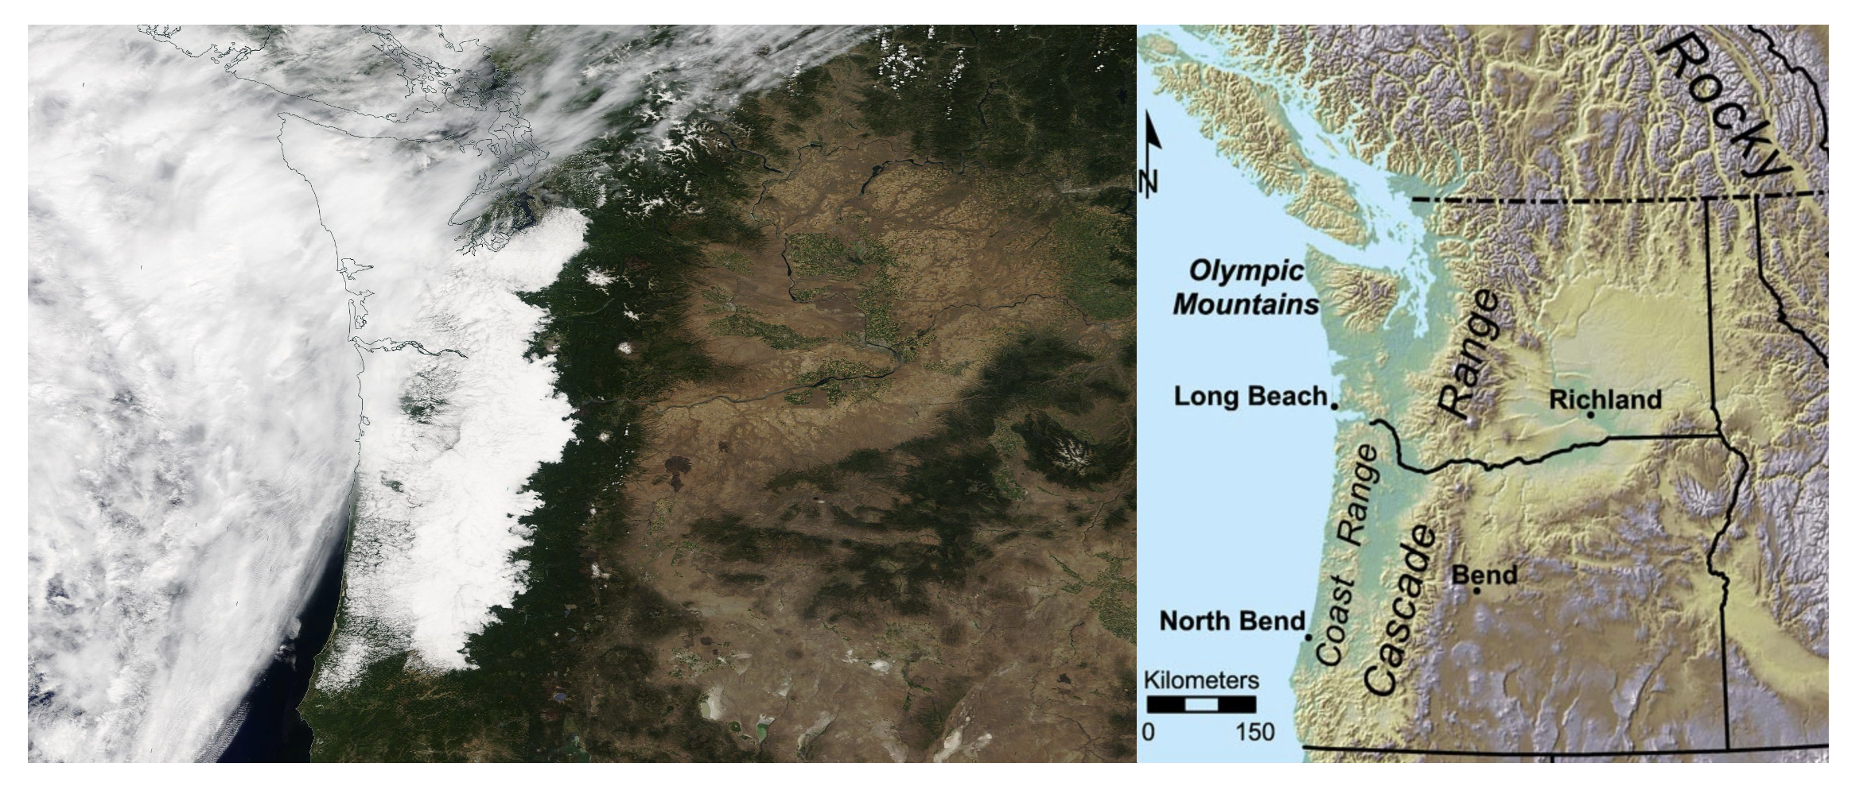
Regional Terrain Plays A Role in Limiting The Eastward Influence of Marine Influence, But By How Much?

Slide 8
Lots of Questions
How does NE Pacific SST influence air temperatures over the Pacific Northwest?
How far does this influence extend inland and vertically over the region. Terrain effects?
What is the seasonality of the influence?
How does the correlation between SST and air temperatures change with lag times and temporal smoothing?
Is there the potential for extended forecast skill using eastern Pacific SST?

Slide 9
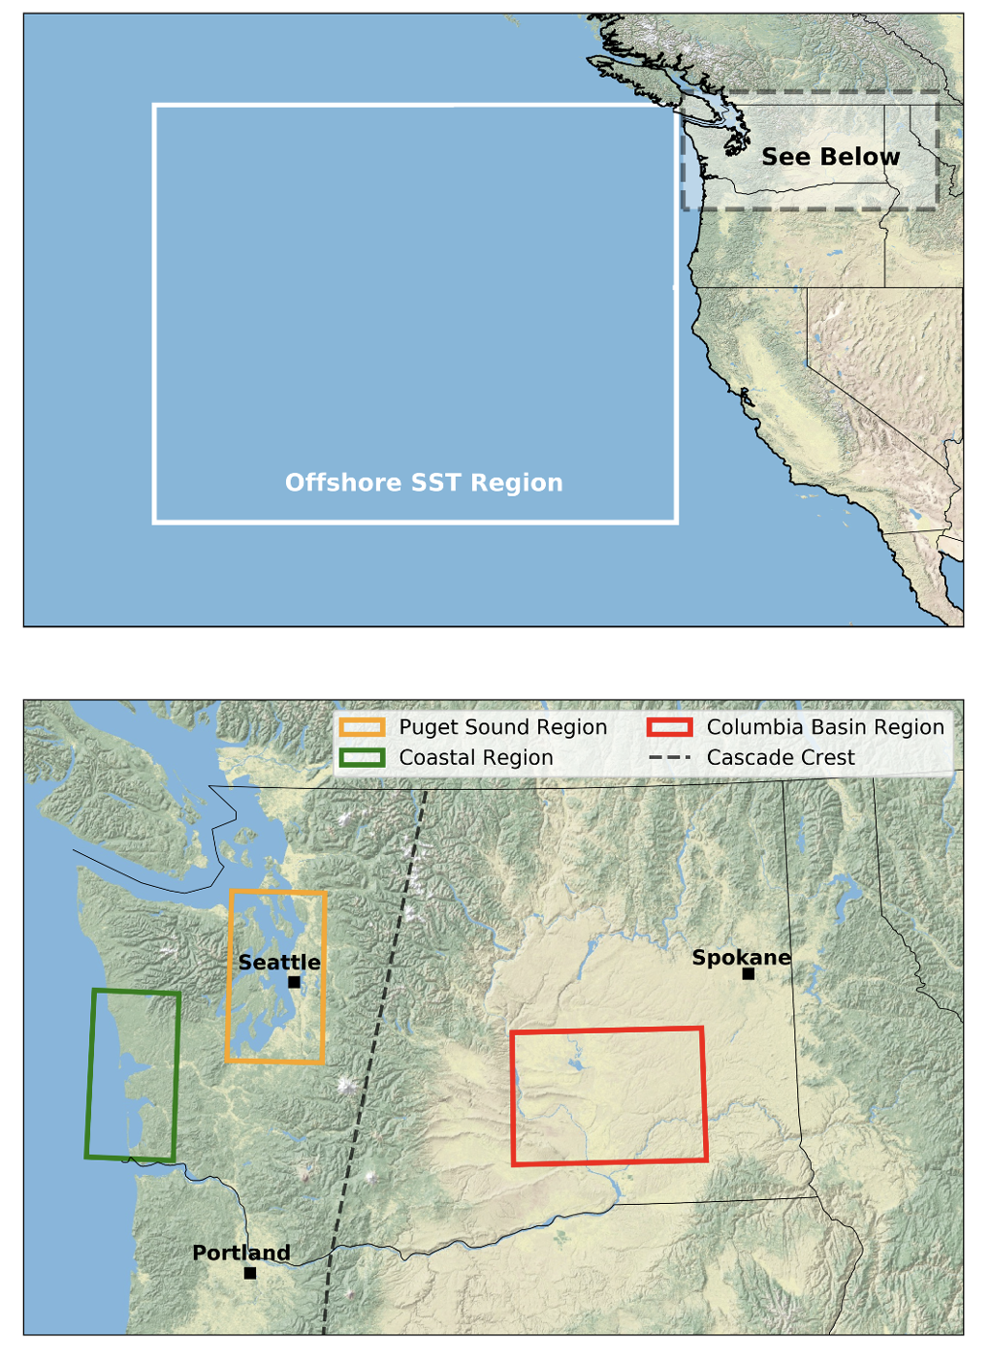
SST and Surface Air Temperature Regions
SST
Regions Considered
Coastal
Puget Sound
Columbia Basin
Air Temperatures

Slide 10
Observational Data Sources
Daily SST from NOAA Optimum Interpolation SST analyses for January 1, 1982 through December 31, 2020.
Surface air temperature and specific humidity data were acquired from the gridMet gridded data set from the University of California Merced's Climate Lab (Abatzoglou 2013).

Slide 11
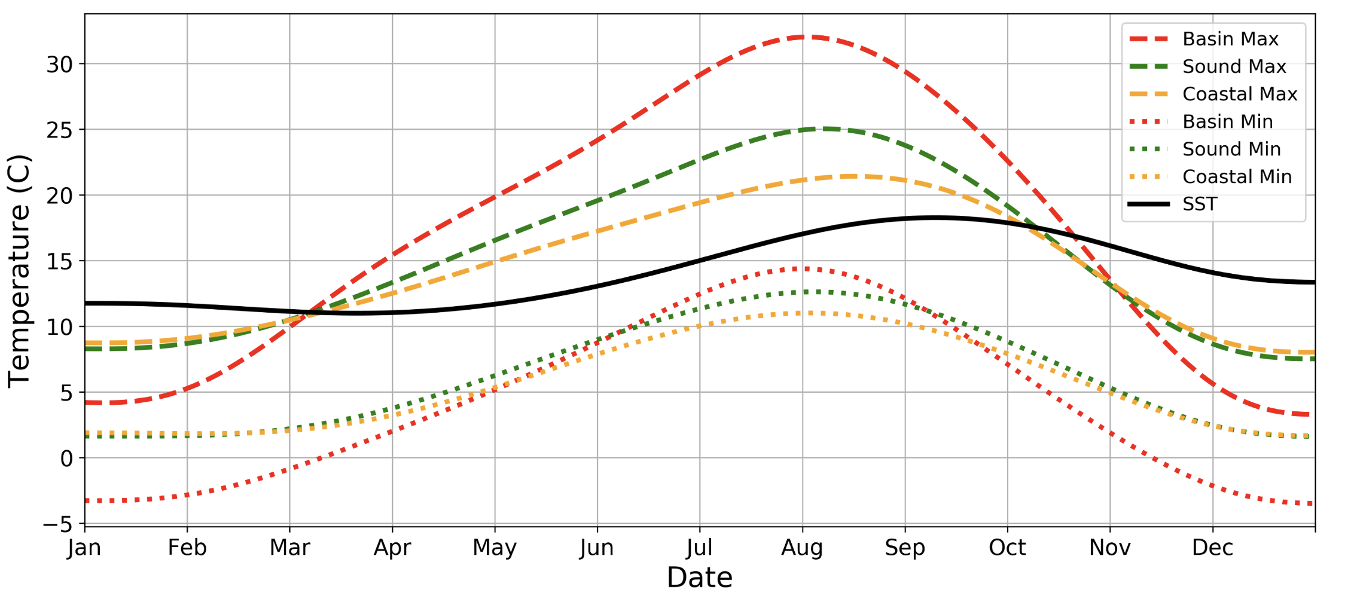
Climatology of SST and Surface Air Temperatures

Slide 12
Relatively Modest Annual Variation in Pacific SST, Max in September

Slide 13
Max Air Temps Peak in Early August. Warmer Than SST From March-October. Columbia Basin Has Largest Variation

Slide 14
Min Air Temps Peak in Early August, Cooler than SST for the Entire Year, Columbia Basin Has the Largest Variation

Slide 15
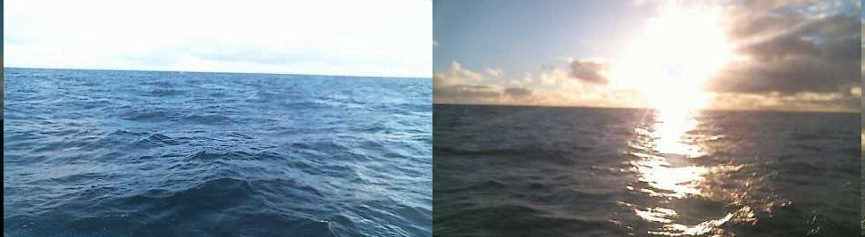
How Long Do NE Pacific SST Anomalies Typically Persist? ?

Slide 16
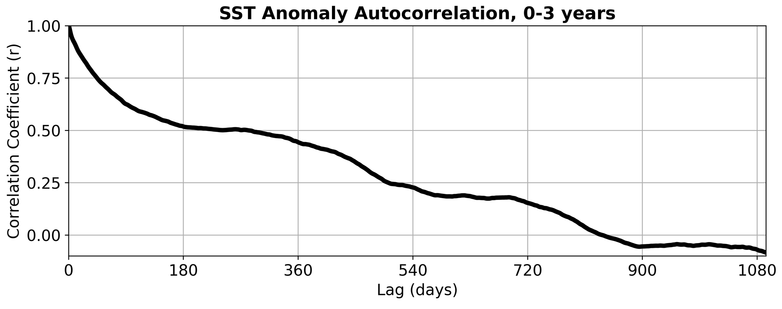
Northeast Pacific SST Autocorrelation
Drops to about 0.5 in 6 months

Slide 17
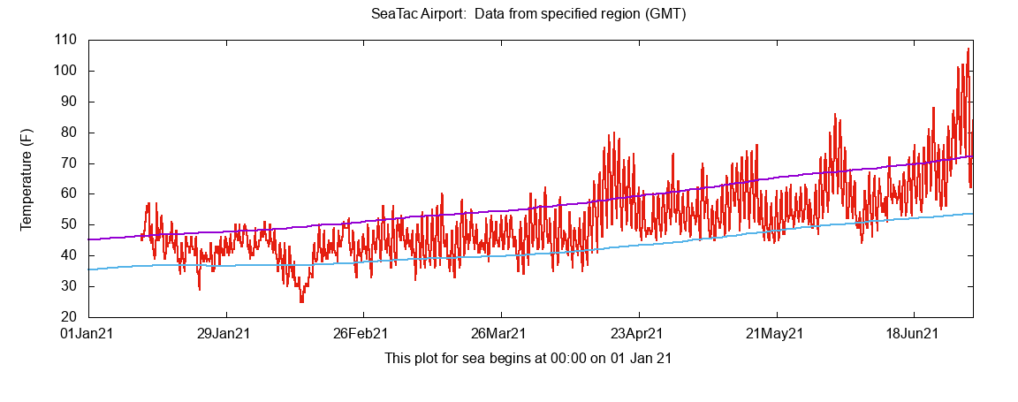
It Might Make Sense to Low-Pass Filter Land Observations (and SST) Because of High Frequency Synoptic Variability That Could Obscure the SST Signal

Slide 18
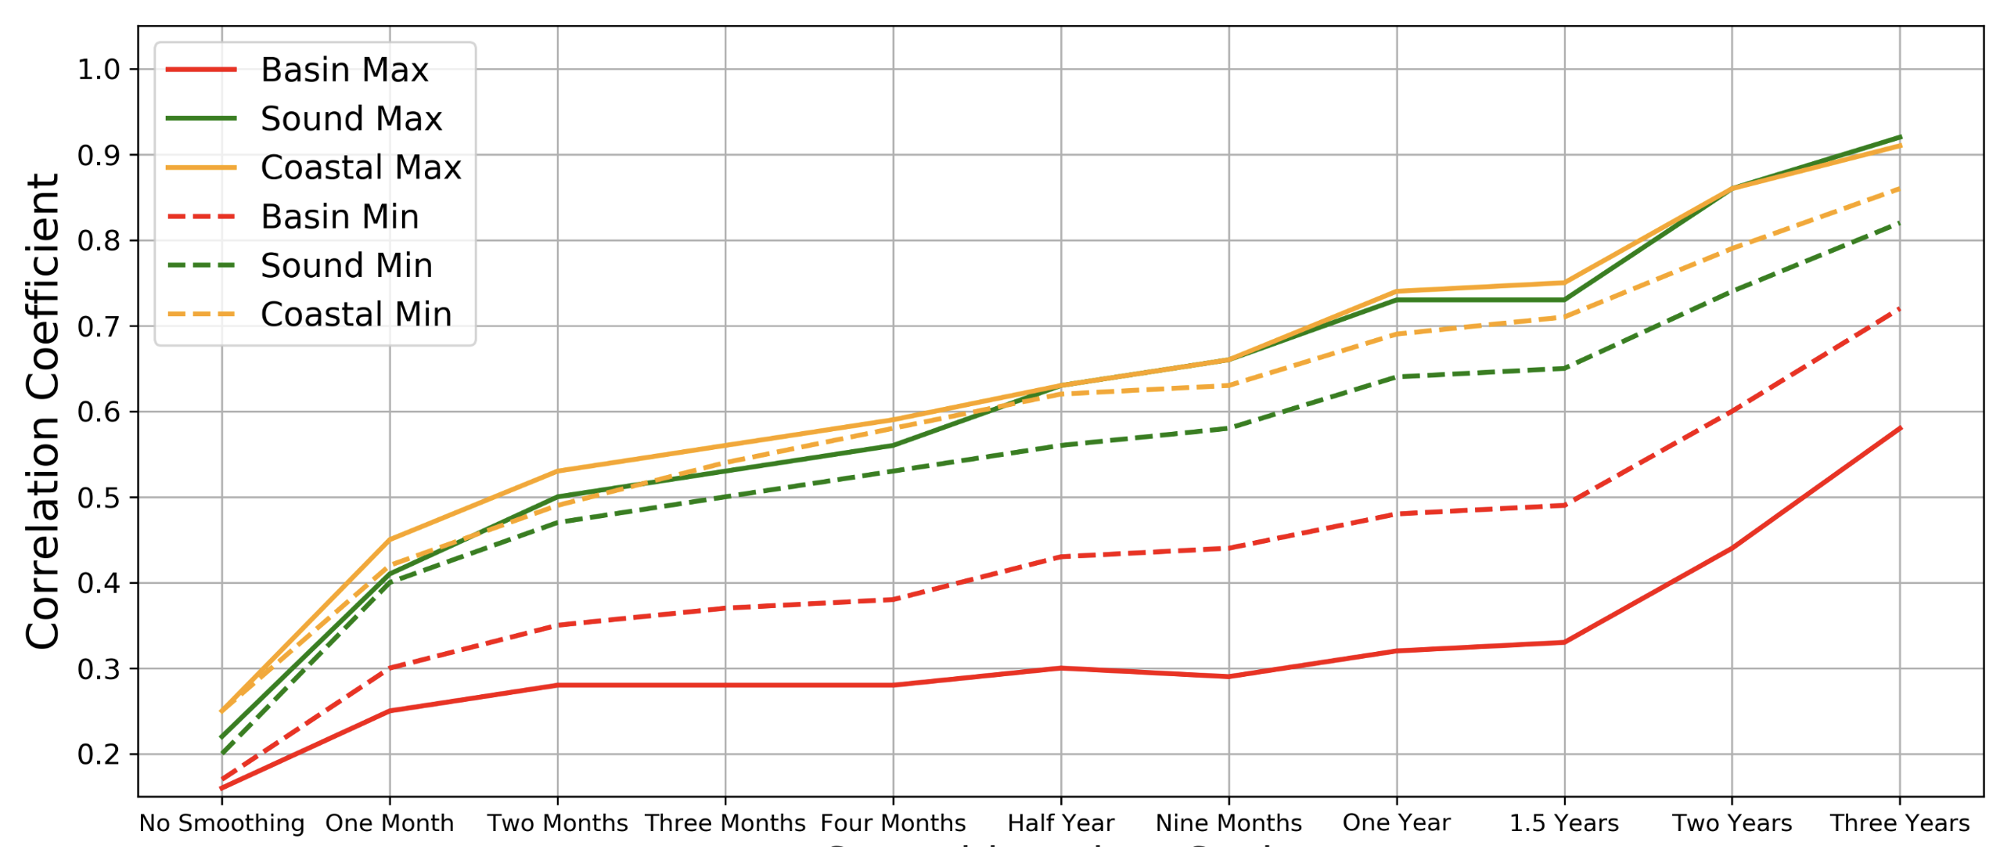
Correlation Coefficient Between SST and Land Surface Temperatures for Various Low Pass Filters
Filtering Out Synoptic Variability Improves Correlation

Slide 19
One-month low pass filter has big effect: increases correlation
Filtering Out Synoptic Variability Improves Correlation

Slide 20
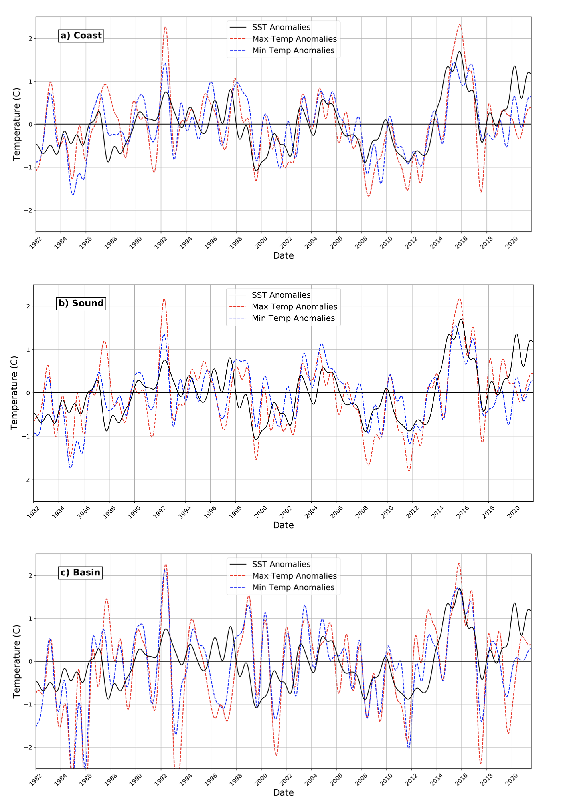
The qualitative relationship between 6 month low-pass filtered SST and land air temperatures

Slide 21
Comparing Anomalies from Climatology

Slide 23
Visually not as good

Slide 24
Much Lower Correlation for Columbia Basin (red)

Slide 25
Columbia Basin Max Temperature Has a MUCH lower correlation than Minimum
But the OPPOSITE is true for Puget Sound.

Slide 26
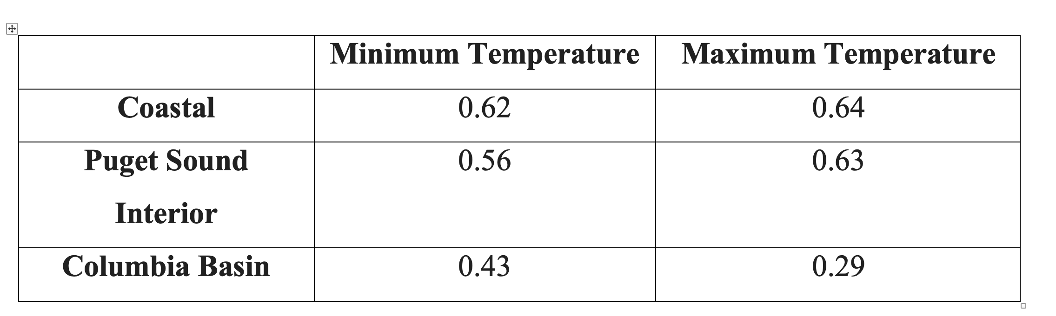
Correlation Between SST Anomalies and Max/Min Surface Air Temperature Anomalies (six-month low pass filter)

Slide 27
How do we physically explain these differences?
The lower correlations for the Columbia Basin make sense: the Cascades reduce the inland marine influence

Slide 28
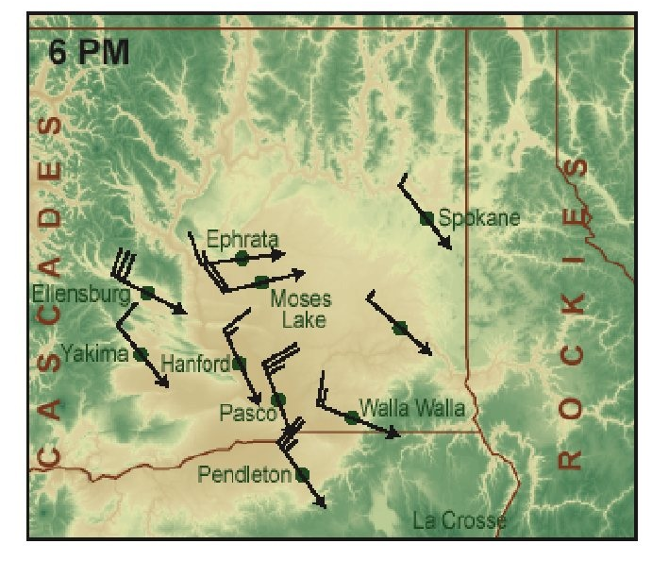
Why over eastern WA is minimum temperature more correlated with SST than max?
Hypothesis:
During the day, there is substantial vertical mixing over eastern WA, that brings higher level air down to the surface
The air aloft often has non-oceanic trajectories.
At night, low-level flow from western Washington (more marine influenced) moves across and down the eastern slopes of the Cascades

Slide 29
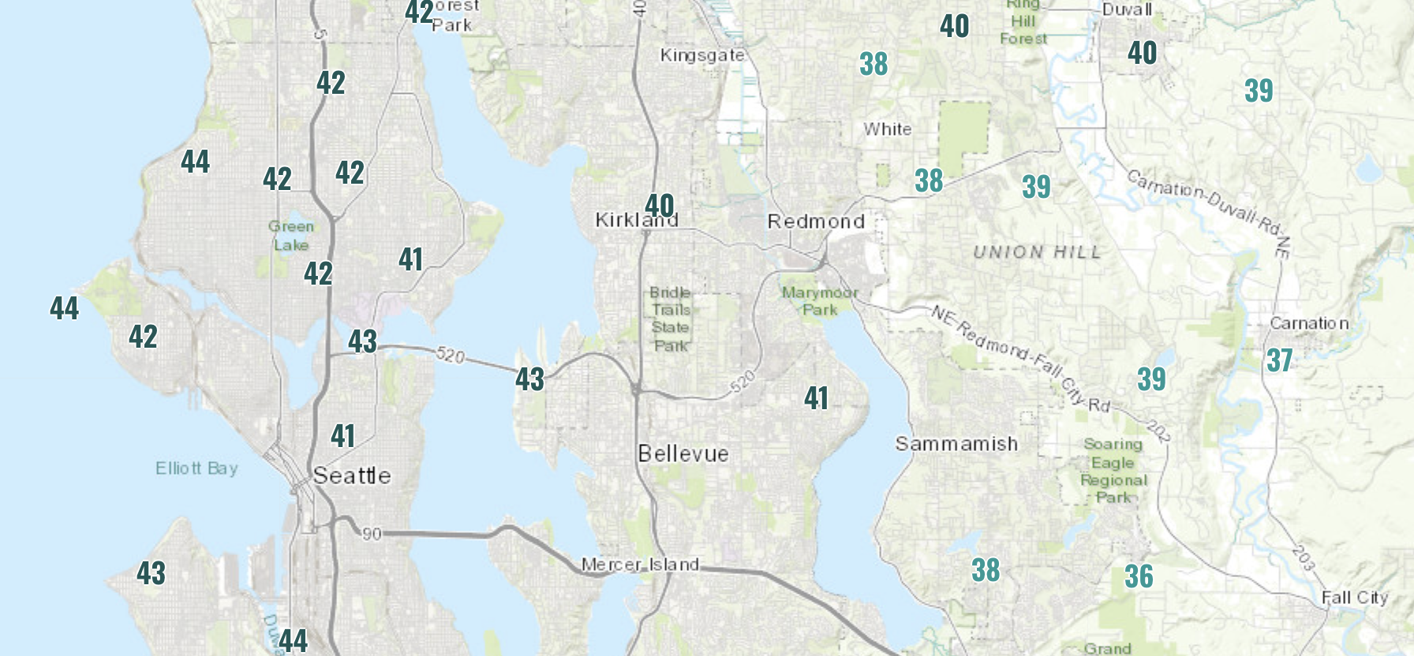
The opposite is true over Puget Sound. Why?
Hypothesis:
Marine influence extends to greater depth
Vertical mixing is less than over eastern Washington
During day, mixing simply brings down marine influence.
At night, local effects have more impacts (e.g., drainage/slope flows, urban heat island, Puget Sound, etc.).

Slide 30
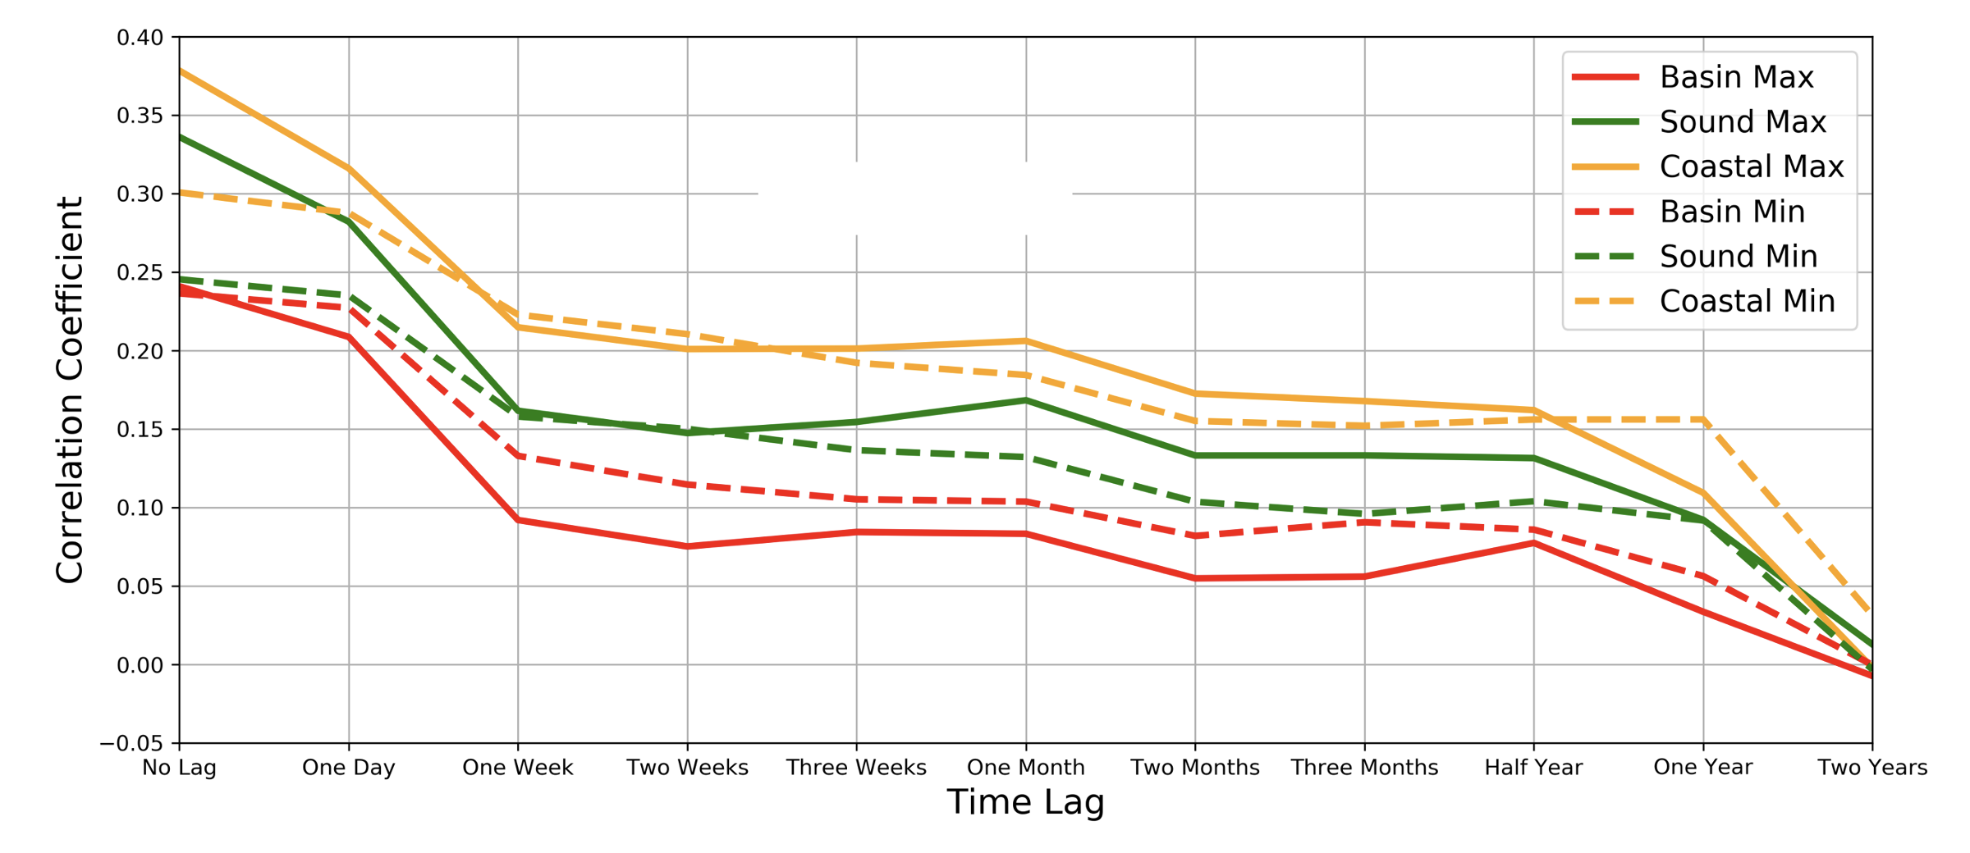
How Does Correlation Change With Lag Between Pacific SST and Surface Air Temperature? (no filter)

Slide 31
Correlation Drops Rapidly at One Week, Then Stabilizes for ~ The Next Half Year.
Limited predictability for unfiltered time series, best on the coast

Slide 32
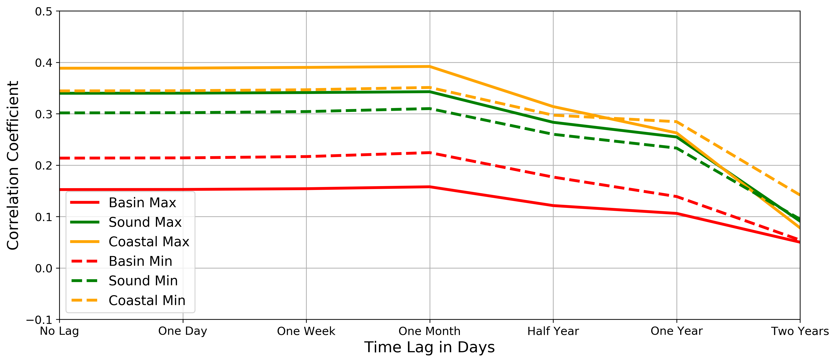
Using One-Month Low-Pass Filter, Skill Keep Up For Longer Lags. Implication: Some Prognostic Skill

Slide 33
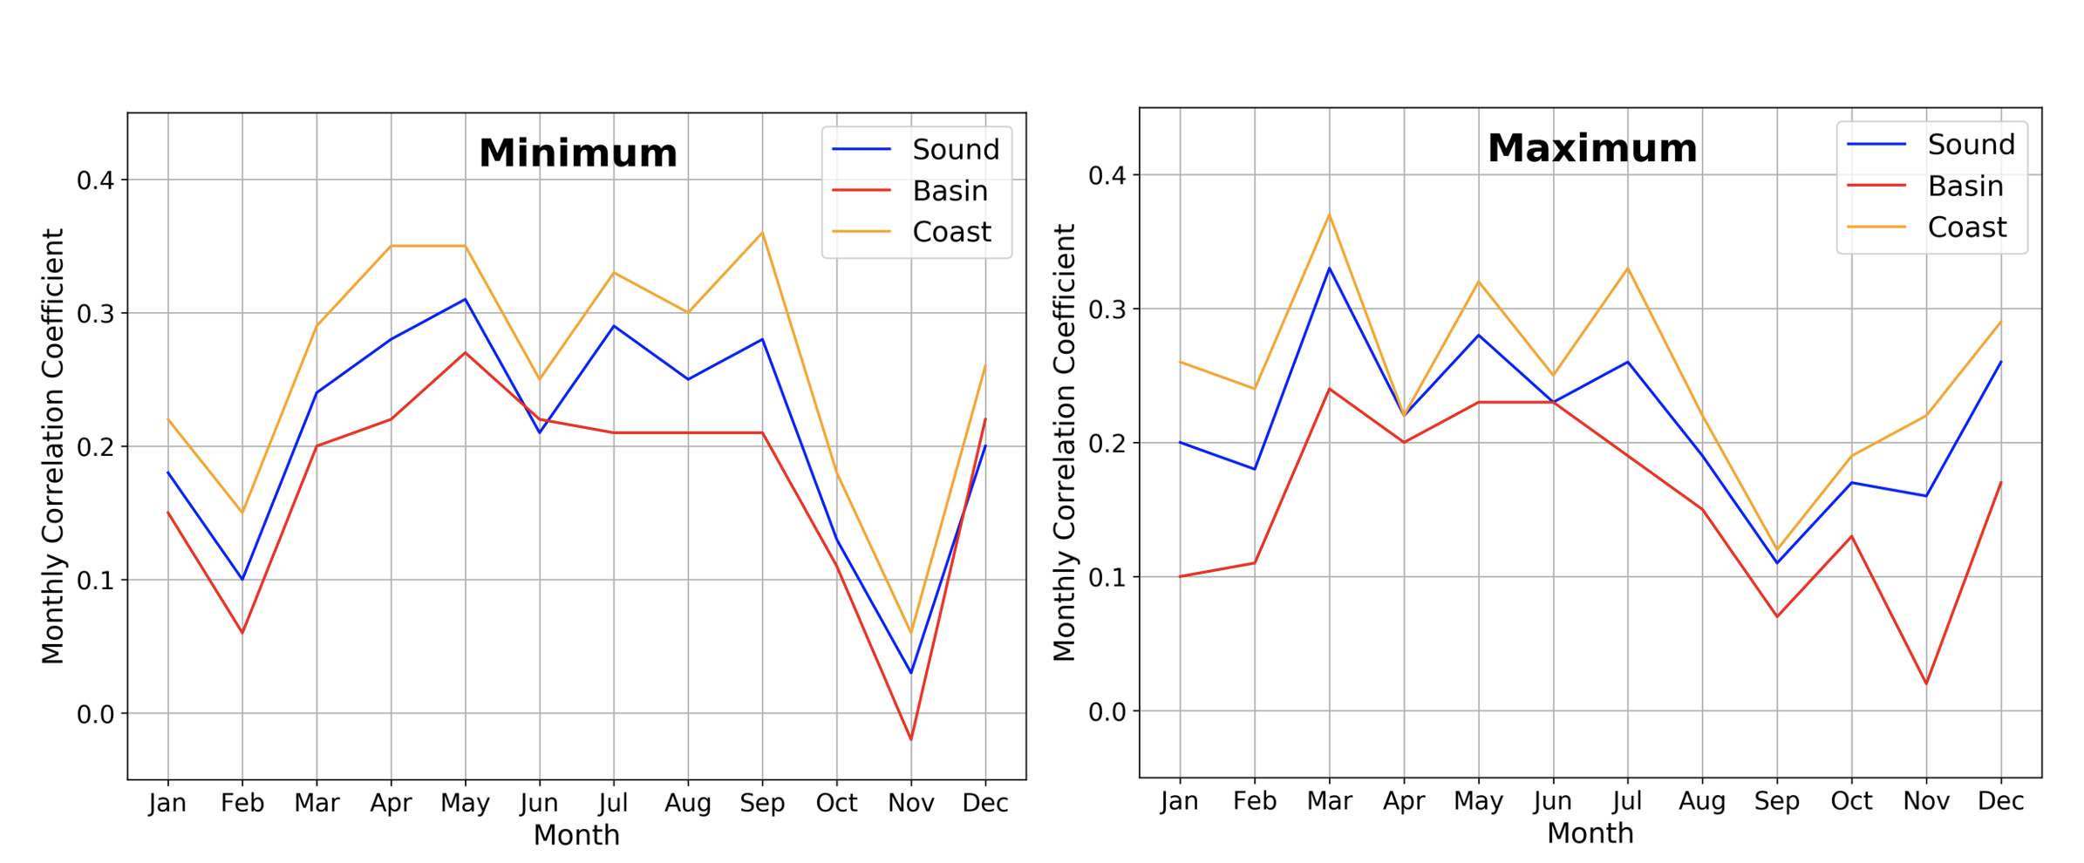
Seasonality of the Correlation with SST

Slide 34
Minimum Temp
Highest Correlation During
Warm Season
Stormiest Month

Slide 35
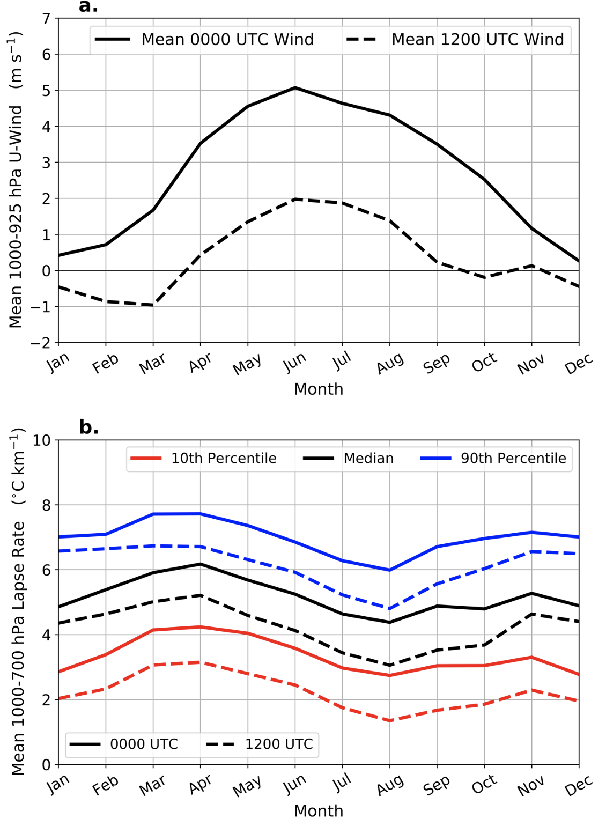
Why?
Synoptic activity is strongest in November
Low-level onshore flow is stronger during warm season
Low-level onshore flow enhances marine influence

Slide 36
Maximum Temp
Highest Correlation During March
Drops during
Early Fall
Stormiest Month

Slide 37
Quillayute Radiosonde Data
Why?
The vertical lapse rate is largest/most unstable in spring (March/April)
Most stable late summer.

Slide 38
Quillayute Radiosonde Data
In Spring, enhanced mixing of marine influence moving in aloft
Thus, temperature feels greatest impact of marine influence in afternoon during spring

Slide 39
Quillayute Radiosonde Data
In late summer, more stable. Onshore flow is weakening. Sun is still fairly strong
Thus localized heating and terrain/local waters are more dominant that offshore flow.

Slide 40
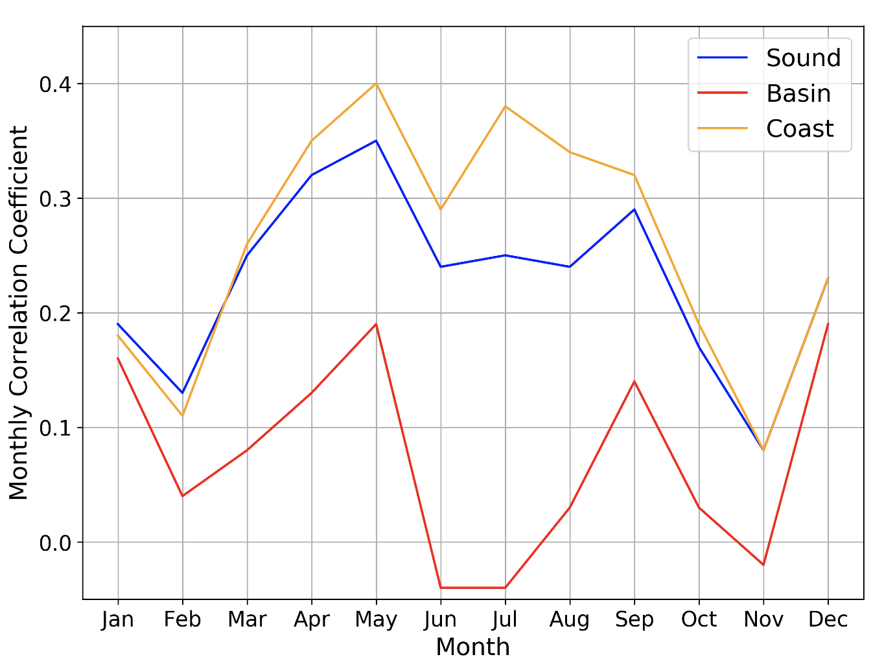
SST Correlation with Specific Humidity

Slide 41
SST Correlation with Specific Humidity
For coastal zone, highest correlation when onshore flow is largest.
East of Cascades, correlation is always low

Slide 42
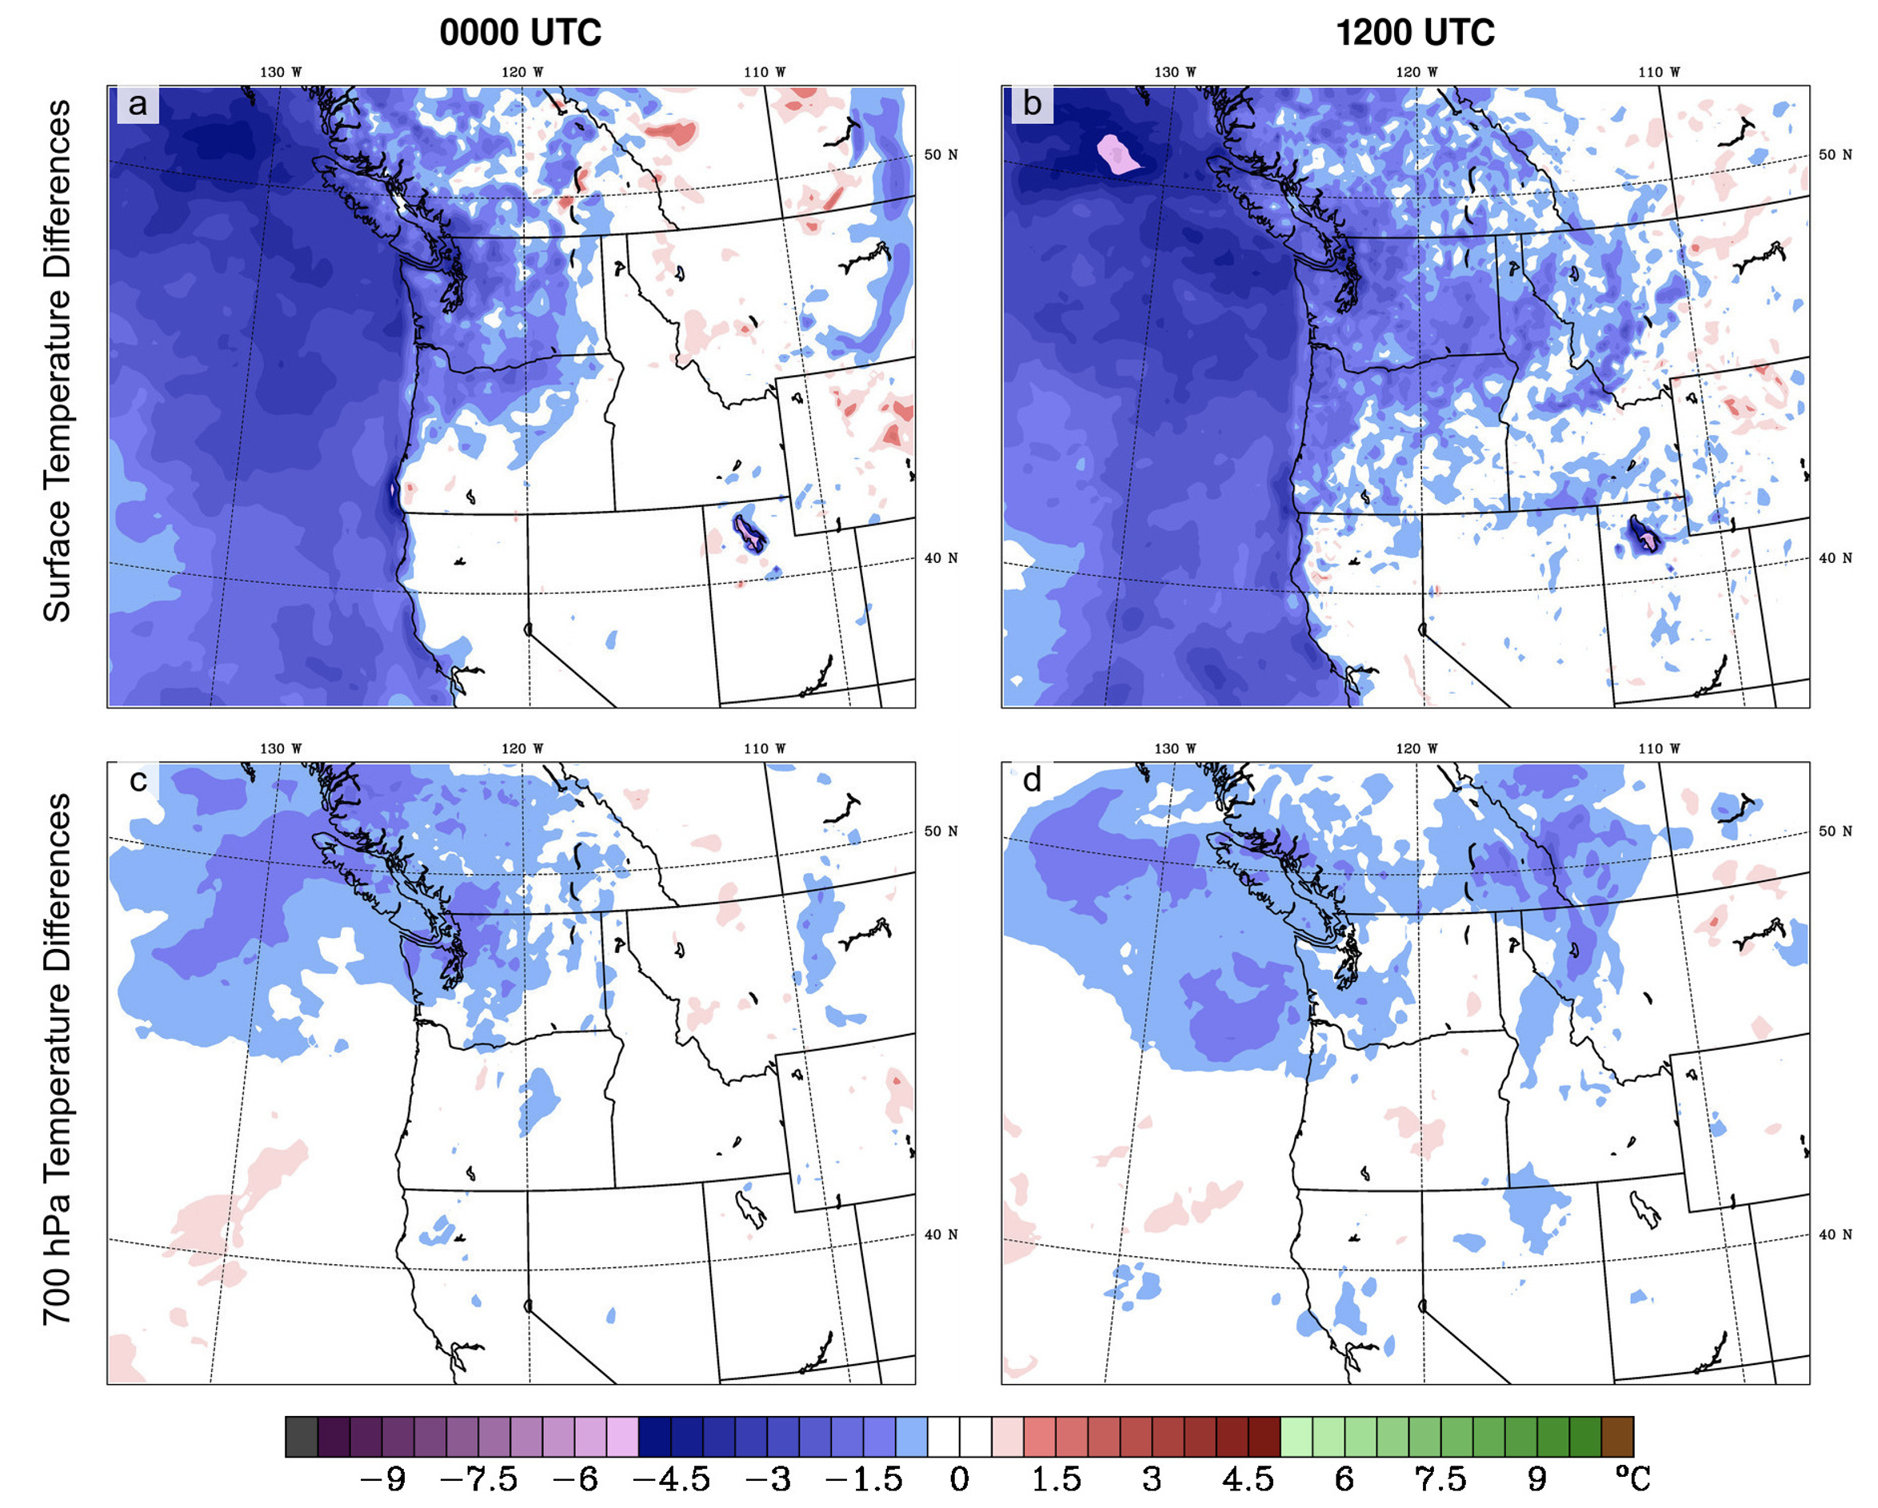
Simulating the SST Influence With the WRF Model?
Run WRF with two parallel simulations (180 h)
One uses climatological SST and the other SST for an anomalous warm or cold period.
Take the differences between the two runs.

Slide 43
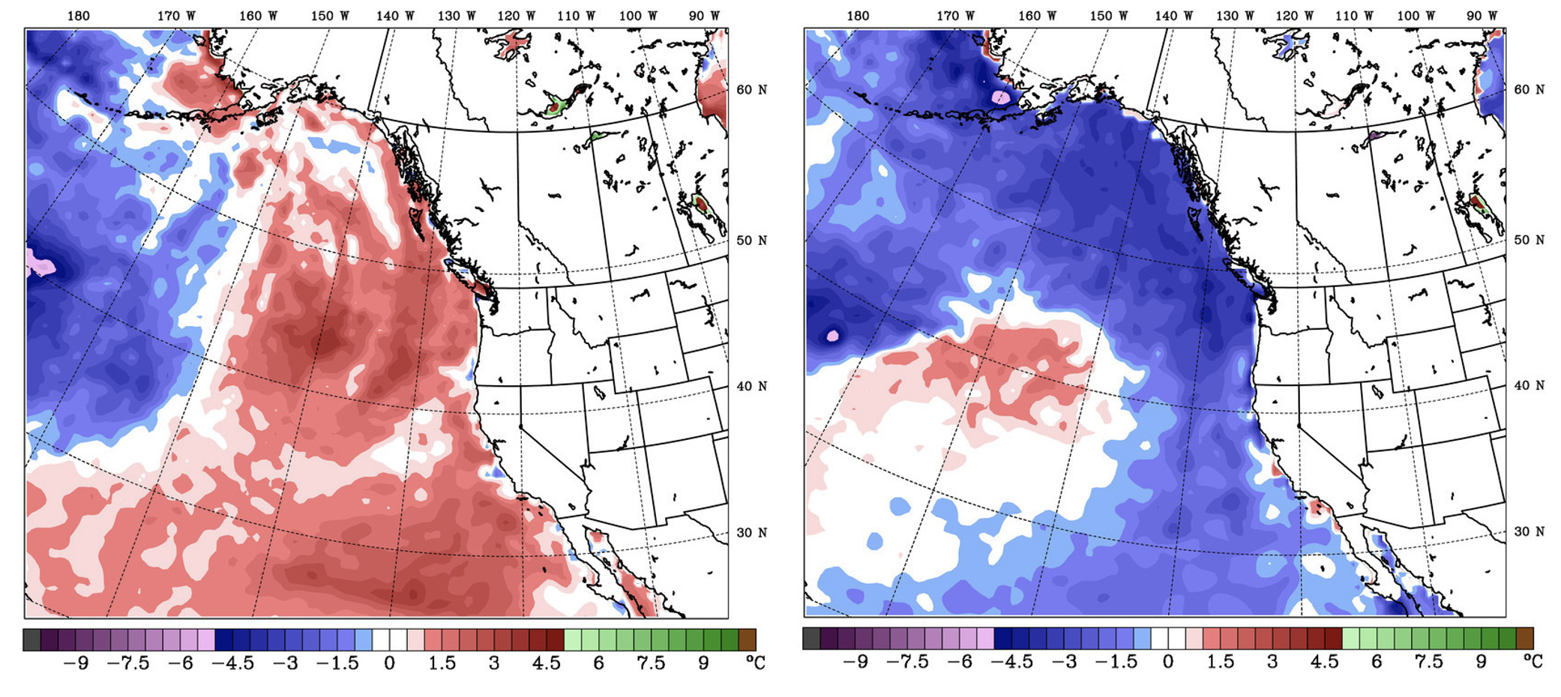
Two Periods Considered: Warm and Cold SST Anomalies

Slide 44
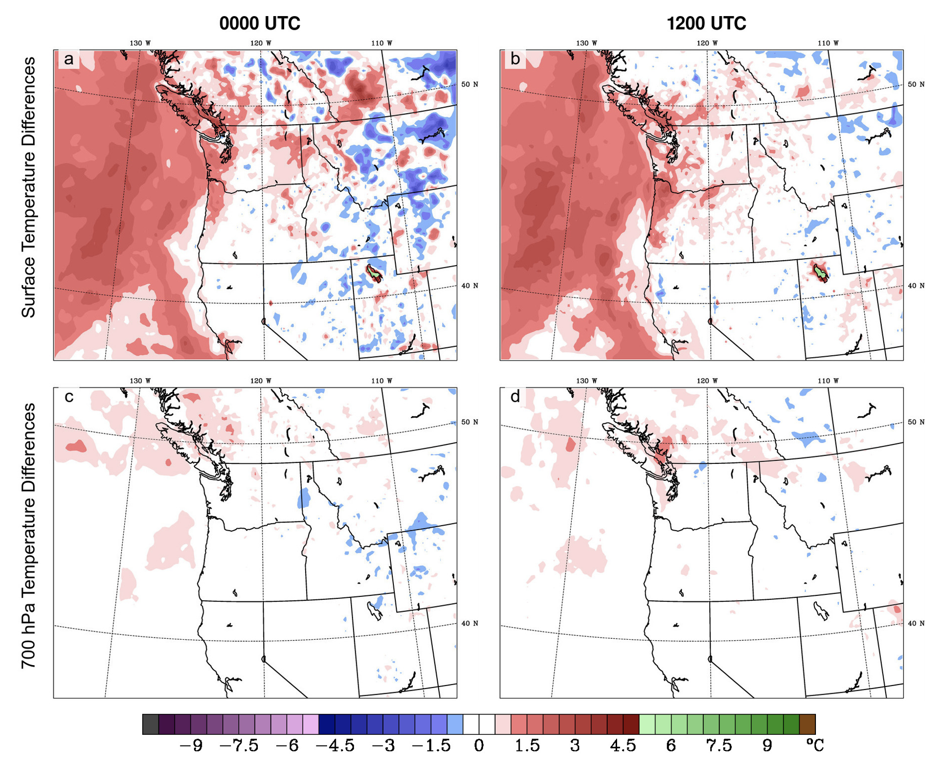
Warm Anomaly Period: Differences in Surface Air Temperatures for 108-180 h
Surface
700 hPa

Slide 45
Cold Anomaly Period: Differences in Surface Air Temperatures for 108-180 h
Surface
700 hPa
Cold period influence extends further inland and in the vertical

Slide 46
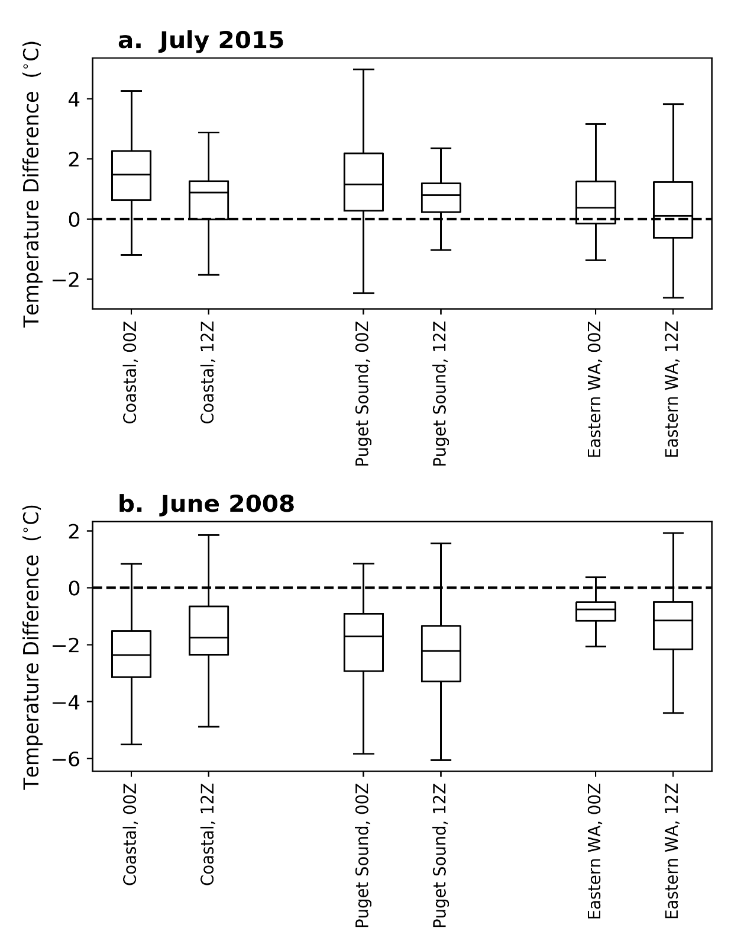
Effects on Simulated Surface Air Temperatures Between the Coast and the Columbia Basin
Warm Period
Cold Period

Slide 47
Warm Period

Slide 48
Cool Period

Slide 49
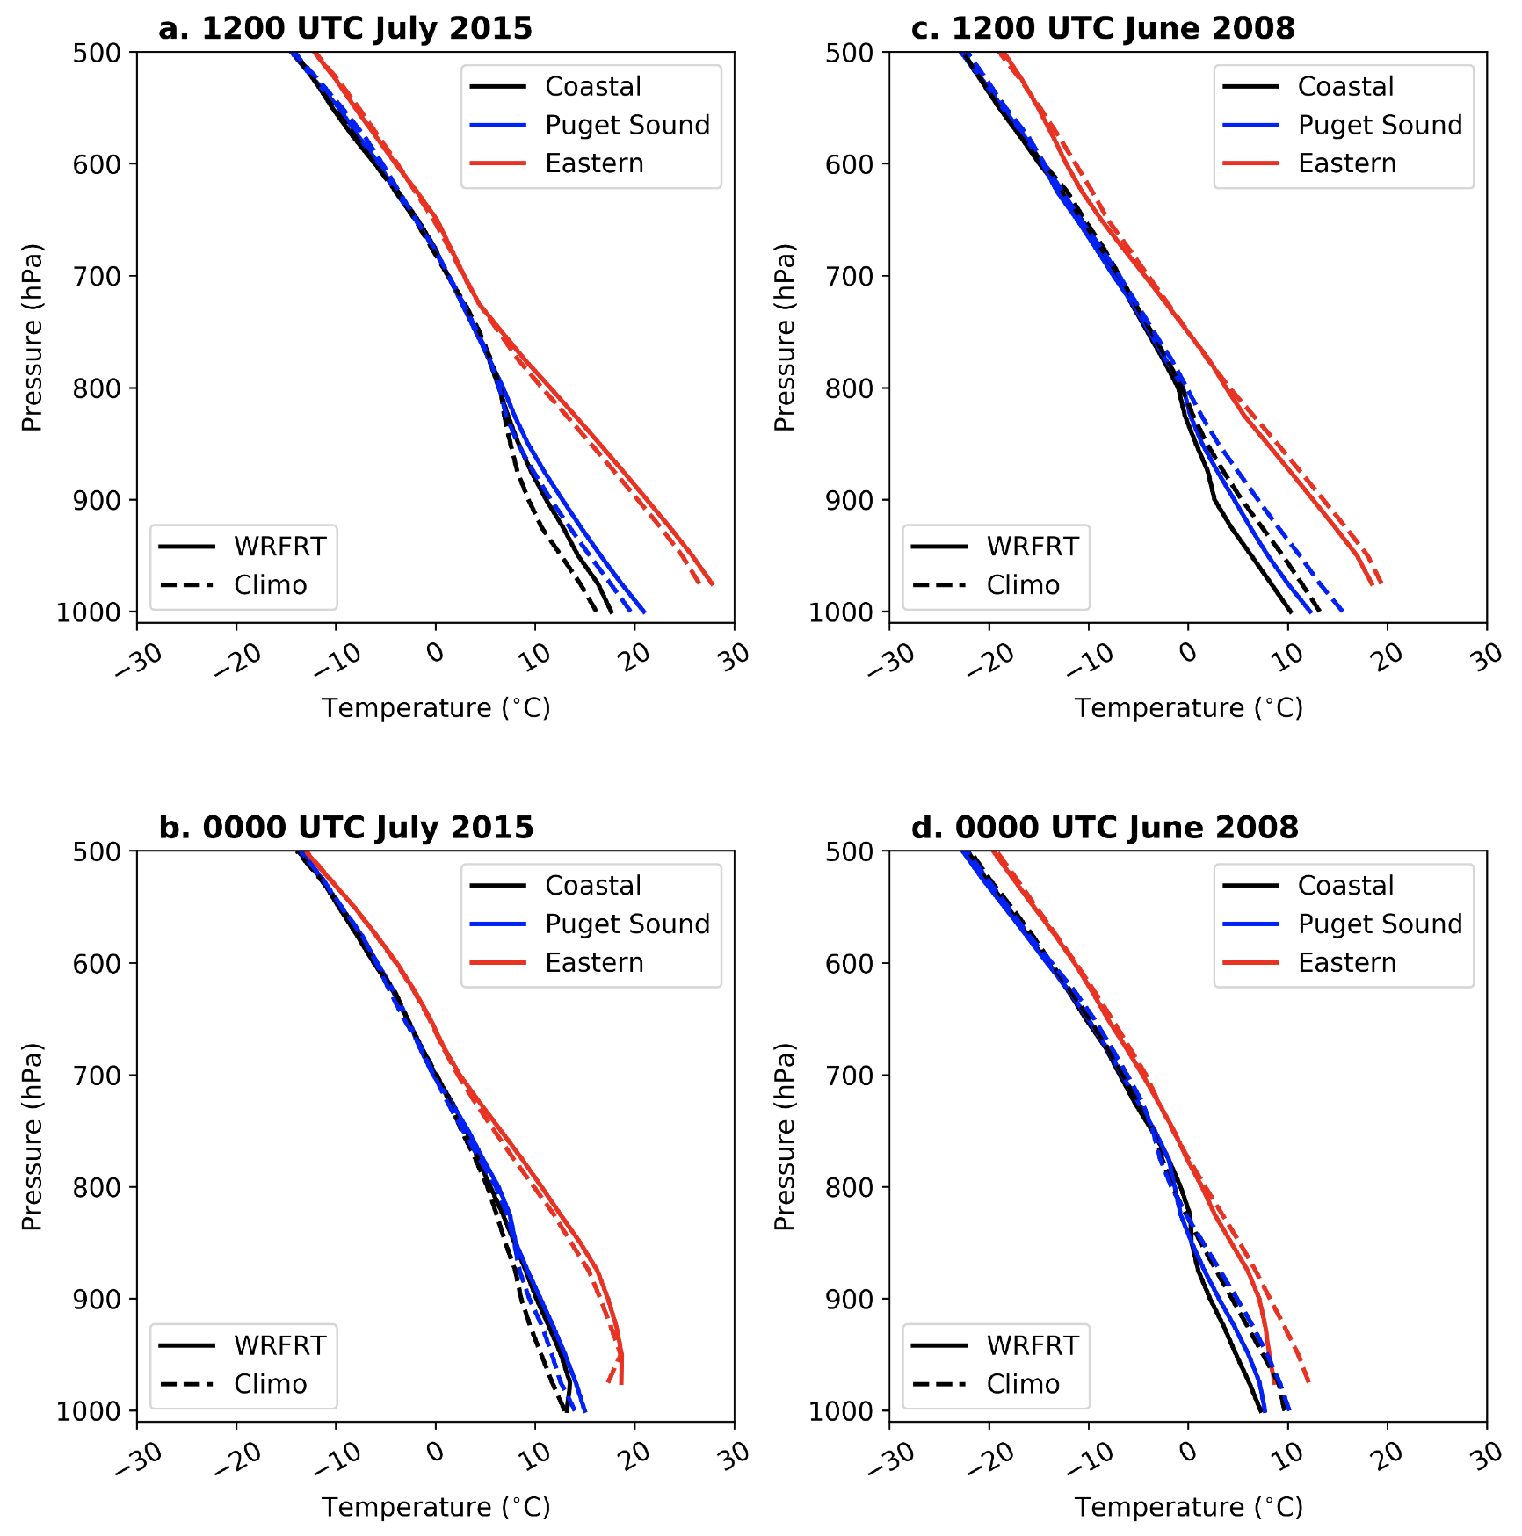
How Deep is the Influence Over Land?

Slide 50
Warm Period: Warming extends to ~750 hPa

Slide 51
Cool Period: Warming extends to ~800 hPa

Slide 52
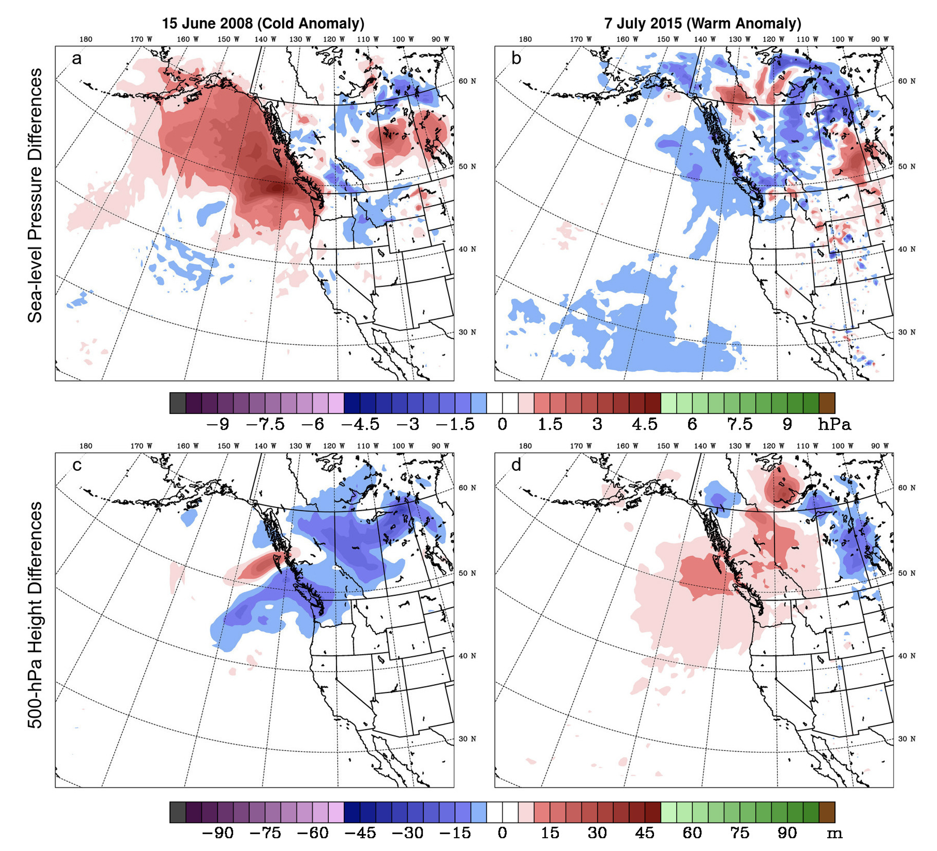
Effects on Sea Level Pressure and 500 hPa Heights

Slide 53
Sea Level Pressure Anomalies
H
L

Slide 54
500 hPa Height Anomalies
H
L
Cold Anomaly
Warm Anomaly

Slide 55
Conclusions
SSTs over the northeast Pacific are modestly correlated with both maximum and minimum surface air temperatures over the Pacific Northwest.
Correlations increase when high-frequency variability is filtered out.

Slide 56
Conclusions
Correlations decline across the Cascades, which isolates eastern WA from the maritime influence
Low pass filtering increase the correlation between SST and inland temperatures

Slide 57
Conclusions
Correlations can vary between high and low temperatures and for various seasons.
One can provide plausible physical hypotheses of why these variations occur
Model simulations of periods with both warm and cold northeast Pacific SST climatological anomalies indicate lower-tropospheric warming or cooling over the coastal zone that weaken east of the Cascade crest, consistent with observations.

Slide 58
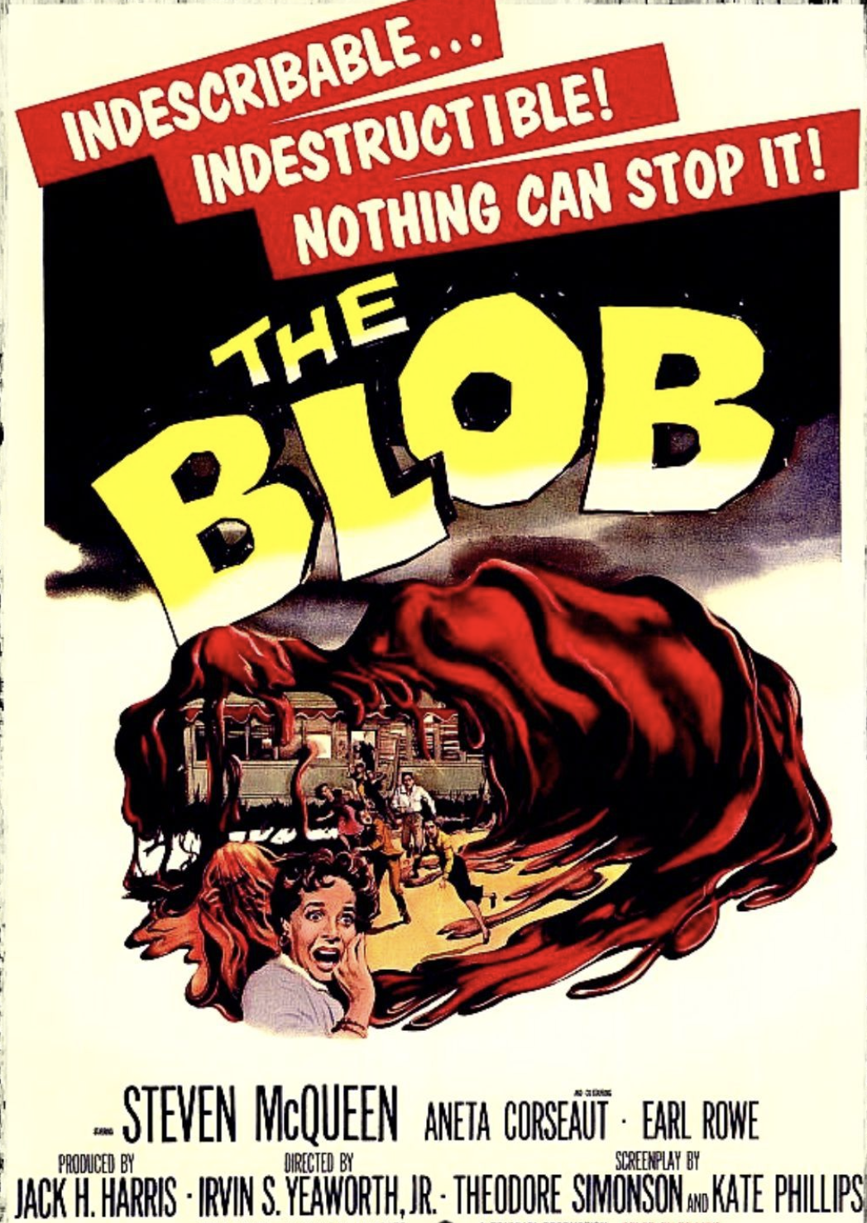
The END

