Slide 1
Diurnal Winds
Atmospheric Sciences 101
Autumn 2025

Slide 2
Understanding Local Diurnal Winds
Diurnal means varying over a day
Sea Breezes and Land Breezes depend on differences in heating and cooling between land and water.
Upslope and downslope winds are forced by the differences in heating and cooling between higher terrain and lowlands.

Slide 3
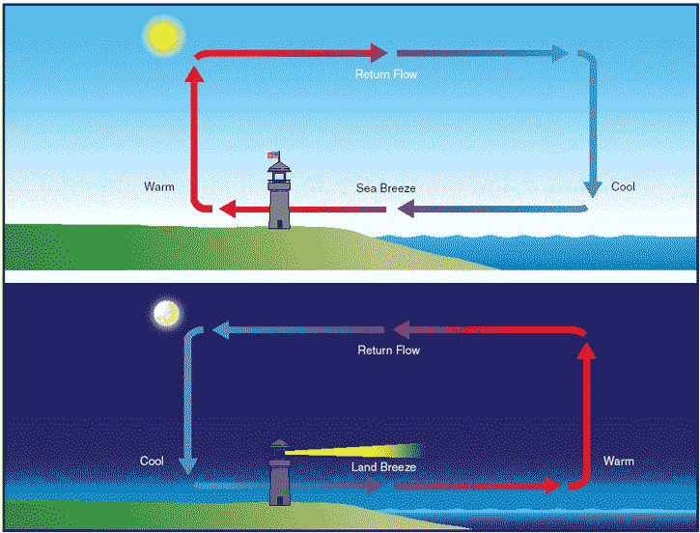
Sea and Land Breezes
Day
Night
These are 3D circulations

Slide 4
Sea and Land Breezes
Sea breezes occur when the land becomes warmer than the water during the day
Land breezes occur when land becomes cooler than the water at night.
Land heats and cools more readily than water.

Slide 5
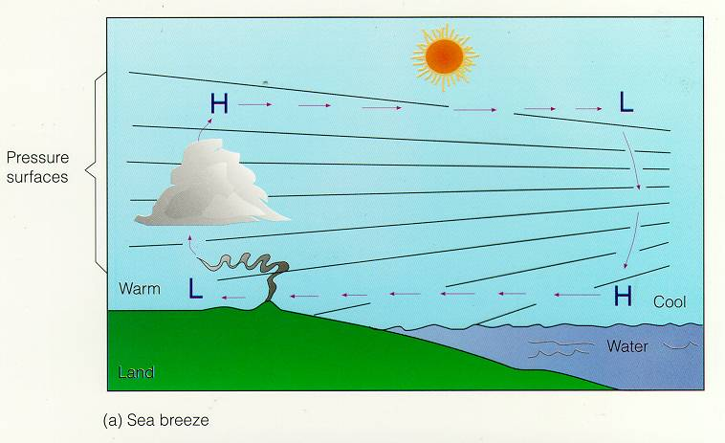
Sea Breeze Forced by Pressure Differences!
Return Flow

Slide 6
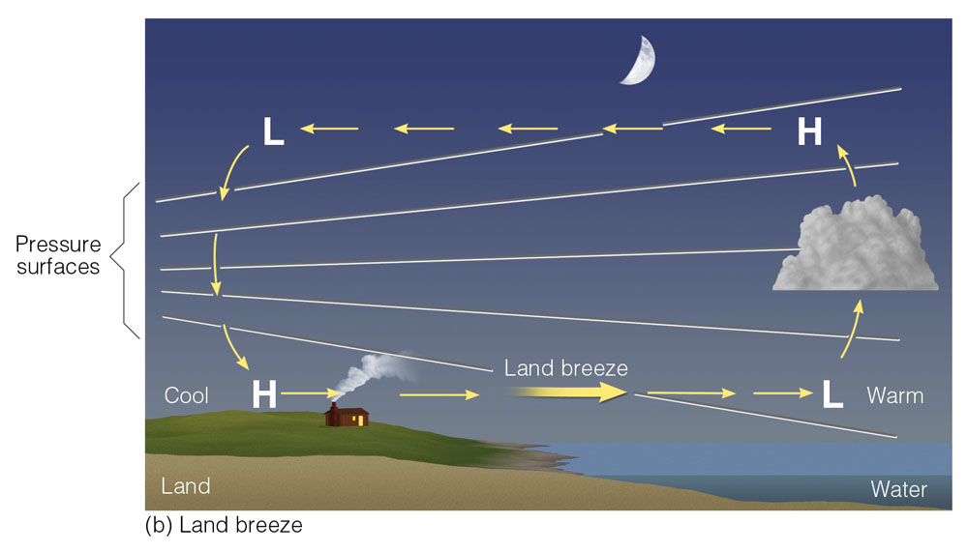
Land Breeze Circulation
Return Flow
Notes:
Figure 7.5: Development of a sea breeze and a land breeze. (a) At the surface, a sea breeze blows from the water onto the land, whereas (b) the land breeze blows from the land out over the water. Notice that the pressure at the surface changes more rapidly with the sea breeze. This situation indicates a stronger pressure gradient force and higher winds with a sea breeze.

Slide 7
Sea Breeze Facts
Found over coastal regions during the day
Best developed in late spring and summer when the sun is strongest and temperature contrasts largest.
Can cool the coast by 5-15F, sometimes more.
Tends to suppress clouds over water but enhances clouds them over land.
Starts at the coast and extends landward and seaward, 20-50 km or more

Slide 8
Sea Breeze Clouds over Land (where upward motion)
Return Flow

Slide 9
Land Breeze Circulation: Clouds over Water
Return Flow
Notes:
Figure 7.5: Development of a sea breeze and a land breeze. (a) At the surface, a sea breeze blows from the water onto the land, whereas (b) the land breeze blows from the land out over the water. Notice that the pressure at the surface changes more rapidly with the sea breeze. This situation indicates a stronger pressure gradient force and higher winds with a sea breeze.

Slide 10

Sea Breeze Front: sharp leading edge of cooler air

Slide 11
Can See the Influence of Sea and Land Breezes on Clouds
Clouds tend to occur with sea breeze front
Why? Upward motion there

Slide 12
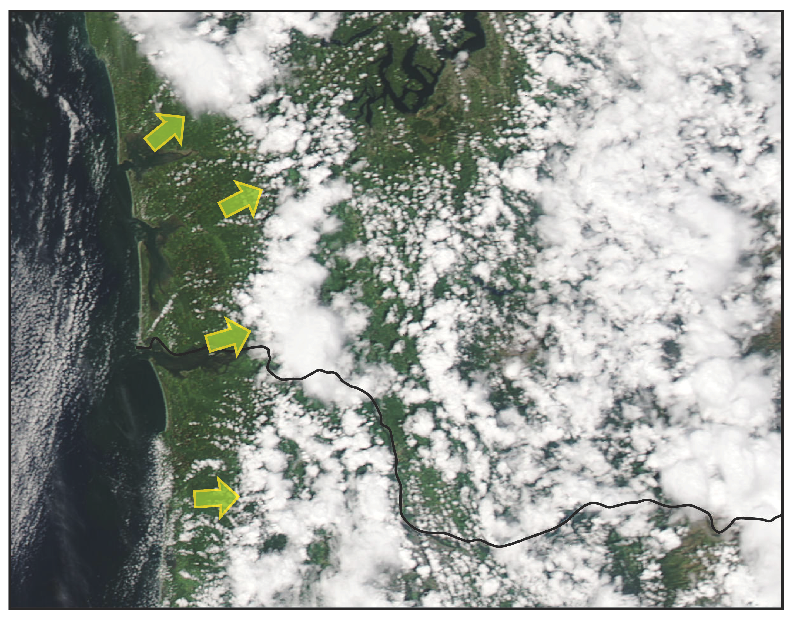
Washington Coast Sea Breeze Front

Slide 13
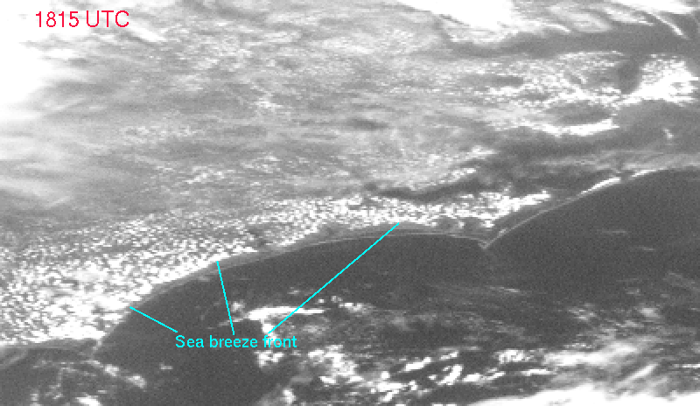

Slide 14
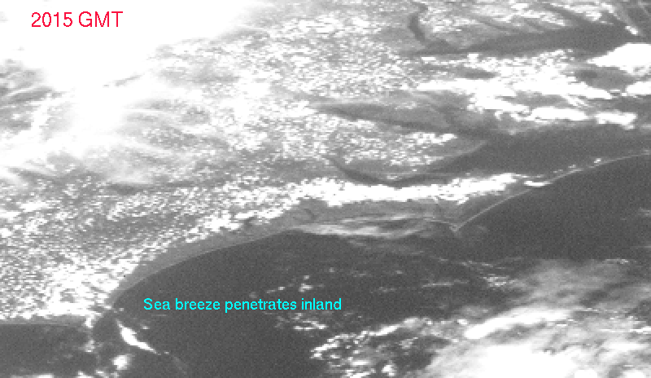

Slide 15
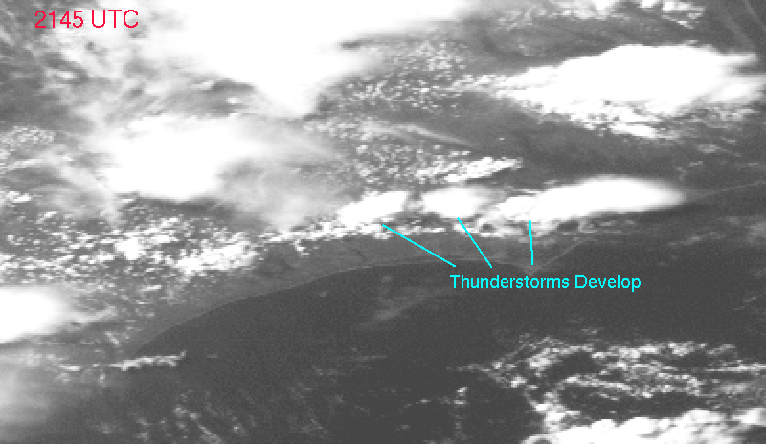

Slide 16
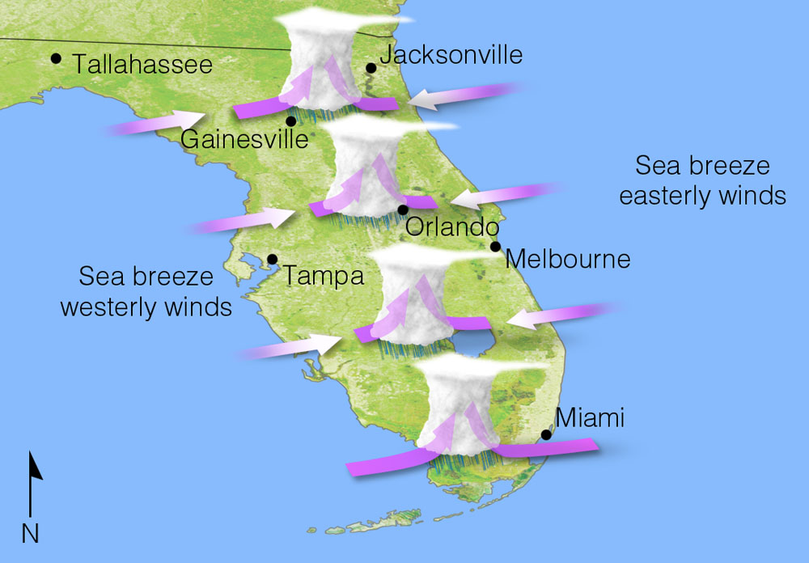
Colliding Sea Breezes Can Produce Strong Upward Motion
Notes:
Figure 7.6: Typically, during the summer over Florida, converging sea breezes in the afternoon produce uplift that enhances thunderstorm development and rainfall. However, when westerly surface winds dominate and a ridge of high pressure forms over the area, thunderstorm activity diminishes, and dry conditions prevail.

Slide 17
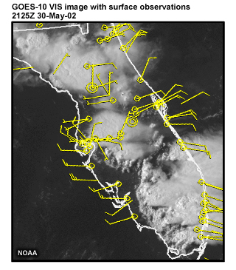

Slide 18
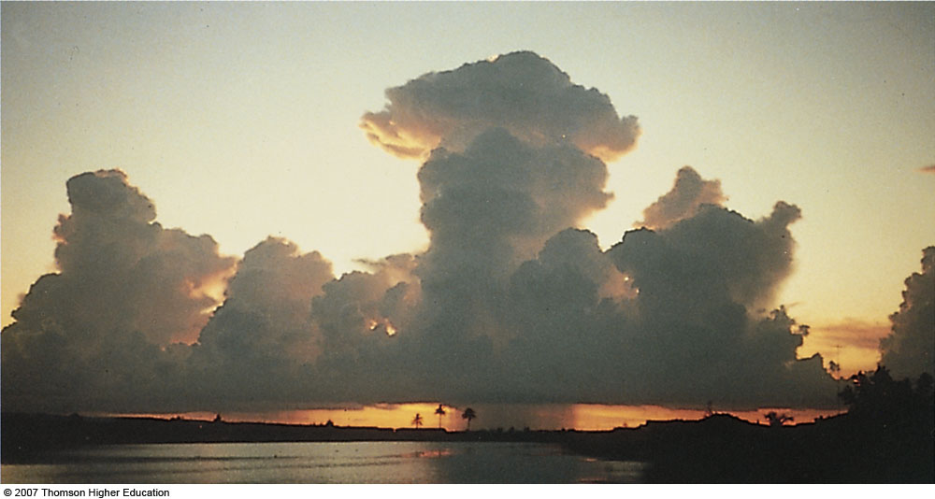
Middle of Florida
Fig. 7-7, p. 176
Notes:
Figure 7.7: Surface heating and lifting of air along a sea breeze combine to form thunderstorms almost daily during the summer in southern Florida.

Slide 19
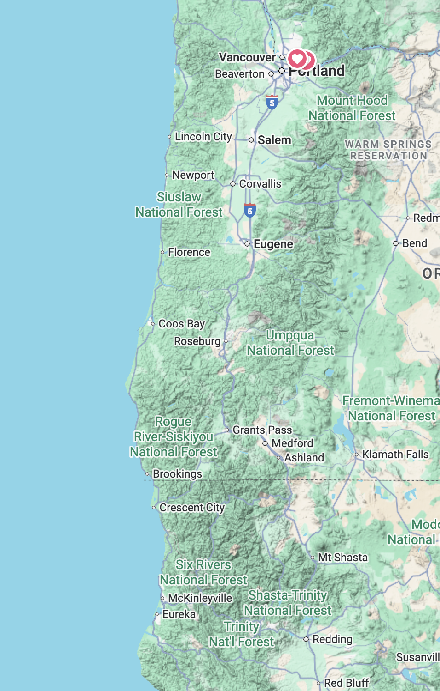
Sea Breeze Winds Along the Southern Oregon Coast
Gusts frequently reach 30-35 knots during the summer afternoons.
Very painful to stay on the beach!
Strong pressure gradient normal to the coast between the warm land areas and the cold upwelling water.
Temperatures differences increase during the day, results in strong winds

Slide 20
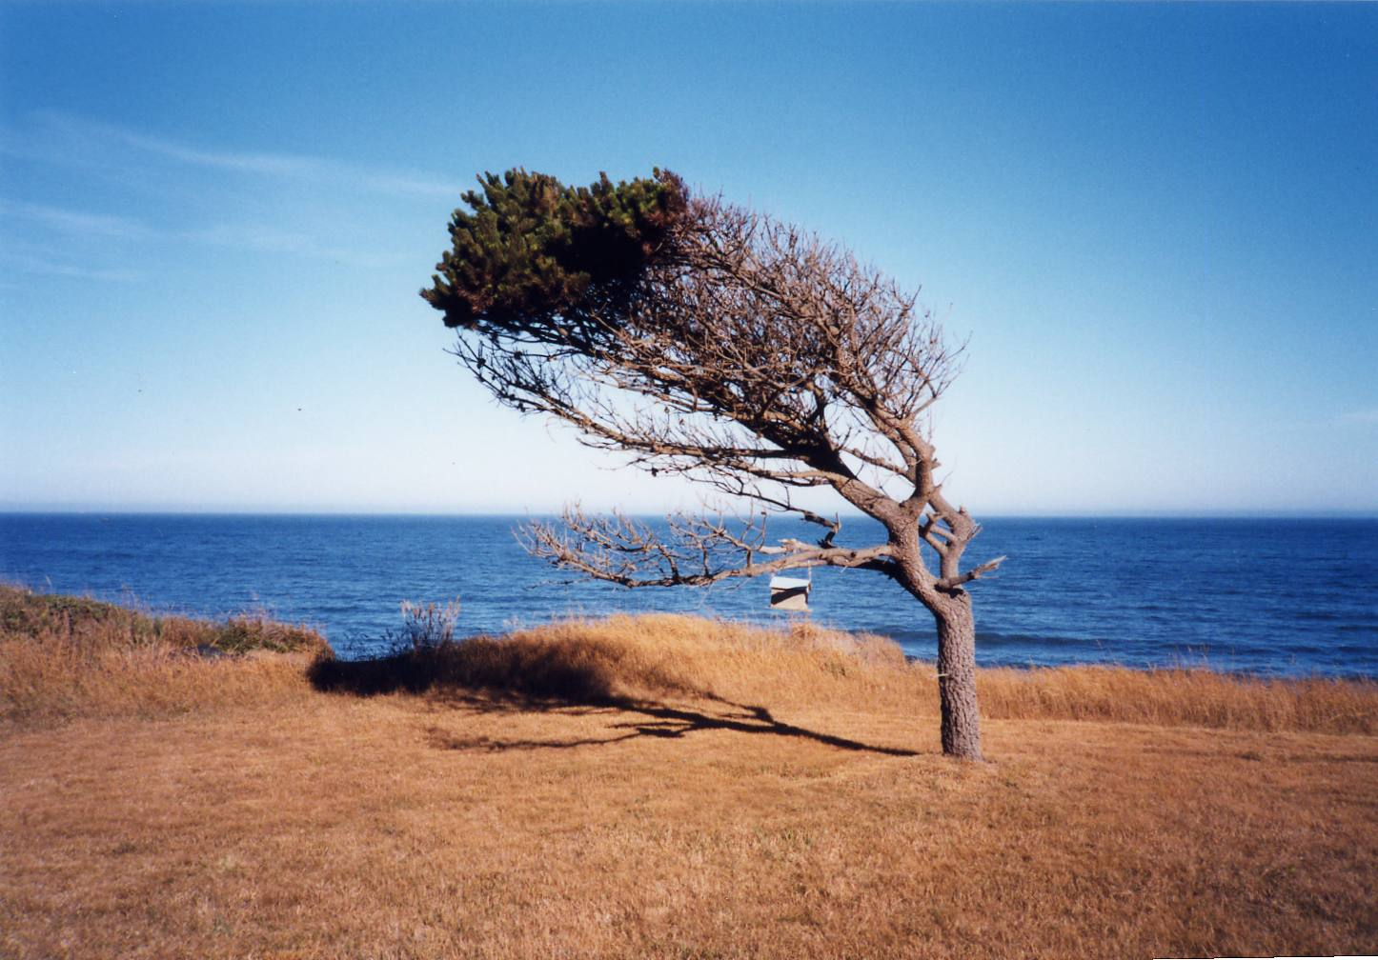
Southern Oregon Coast Near Brookings

Slide 21
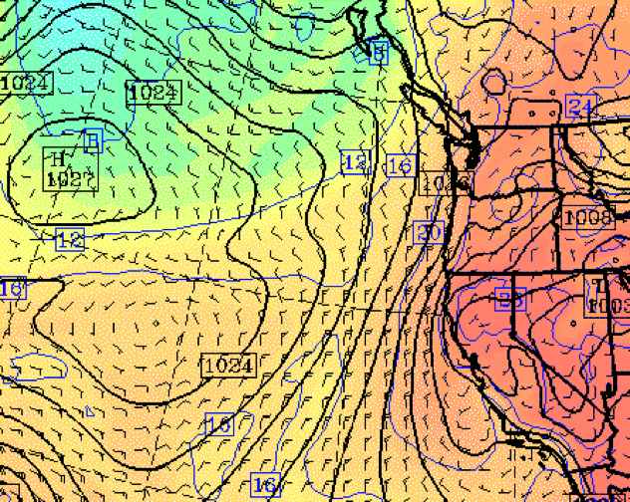

Slide 22
2-minute average July-August winds along the Northwest coast.

Slide 23
Western Washington Sea Breezes

Slide 24
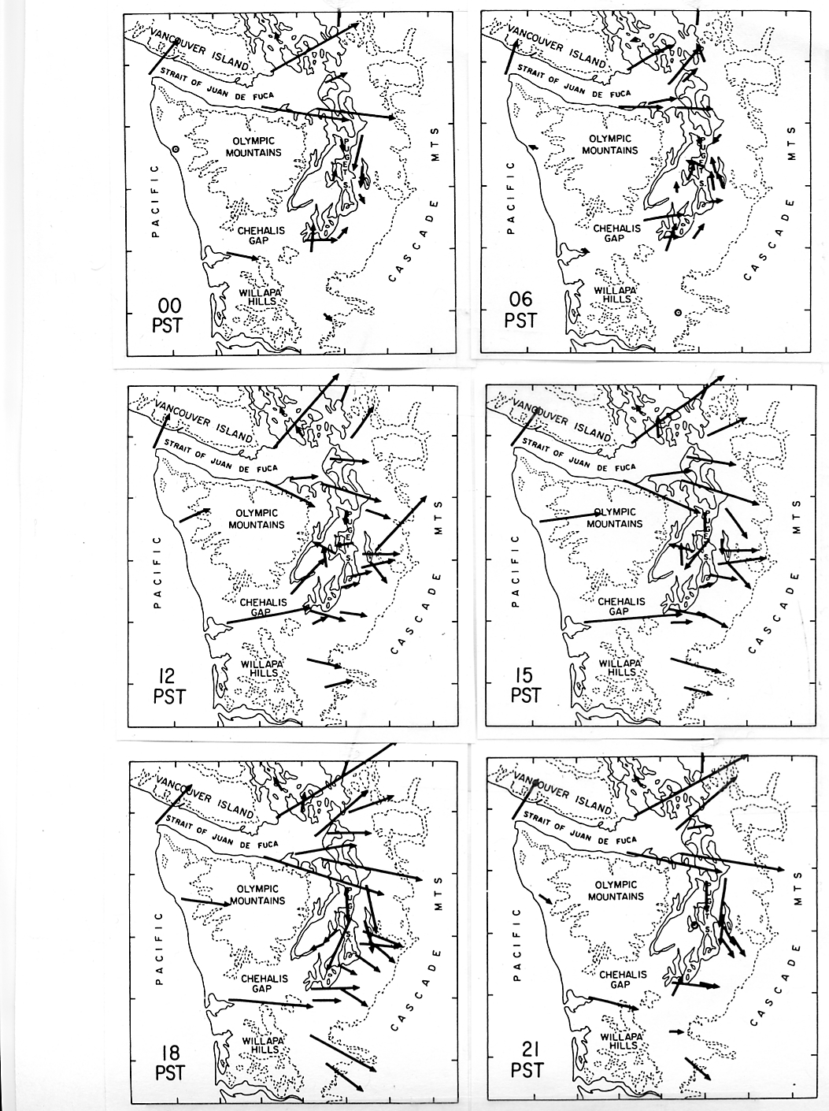
Summer
Diurnal
Winds

Slide 28
Called the
Sound Breeze

Slide 29
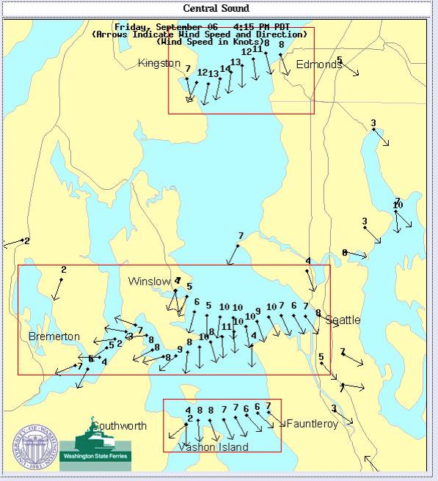
The Sound Breeze
Viewed Using
Ferry Data

Slide 30
Land Breezes Tend to Be Weak in the Northwest
Why? Our cold water!
The land rarely cools down below the water temperature during the summer.
Local minimum temperatures generally in the low to mid-50s…similar to the temperature of the Sound and the Pacific Ocean.
But our land can get cooler than the water in winter during unusually cold periods.

Slide 31
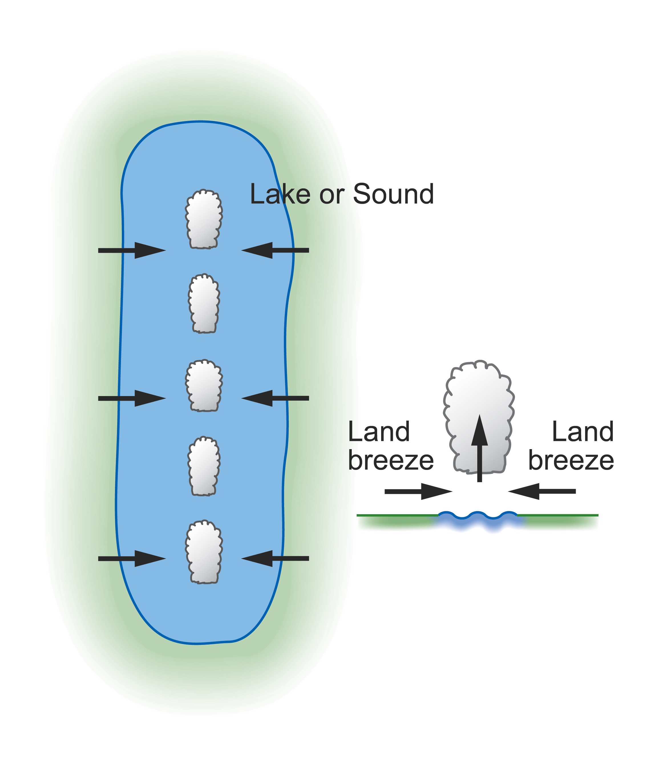
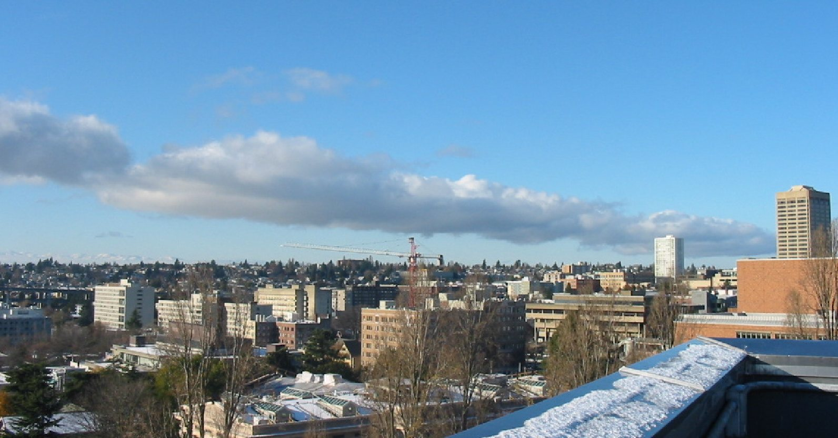
Land Breeze example during a cold period.

Slide 32
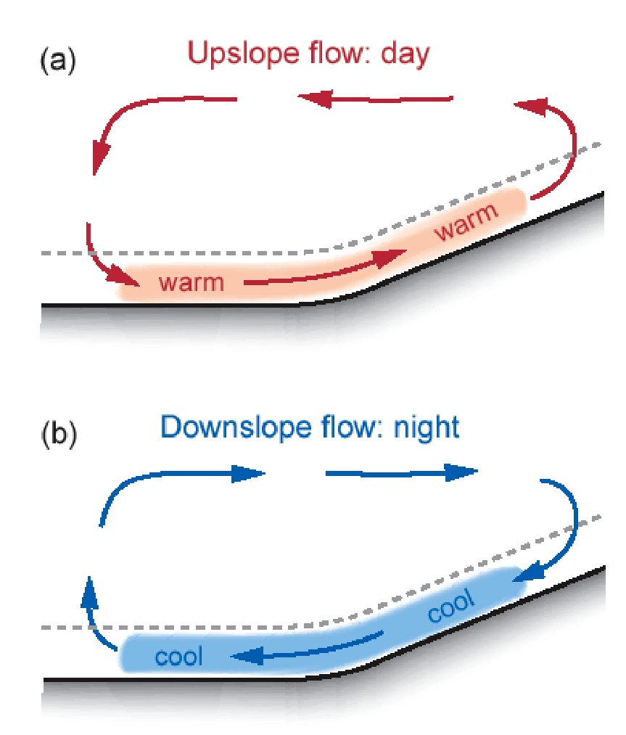
Slope Winds

Slide 33
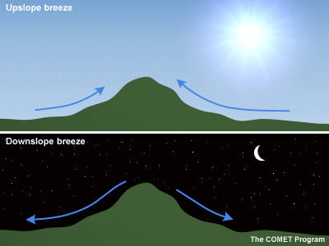
Slope Winds
Upslope Flow on Heated Slopes
Downslope Flow on Cooled Slopes

Slide 34

That is why hang gliders like to jump off above heated slopes

Slide 35
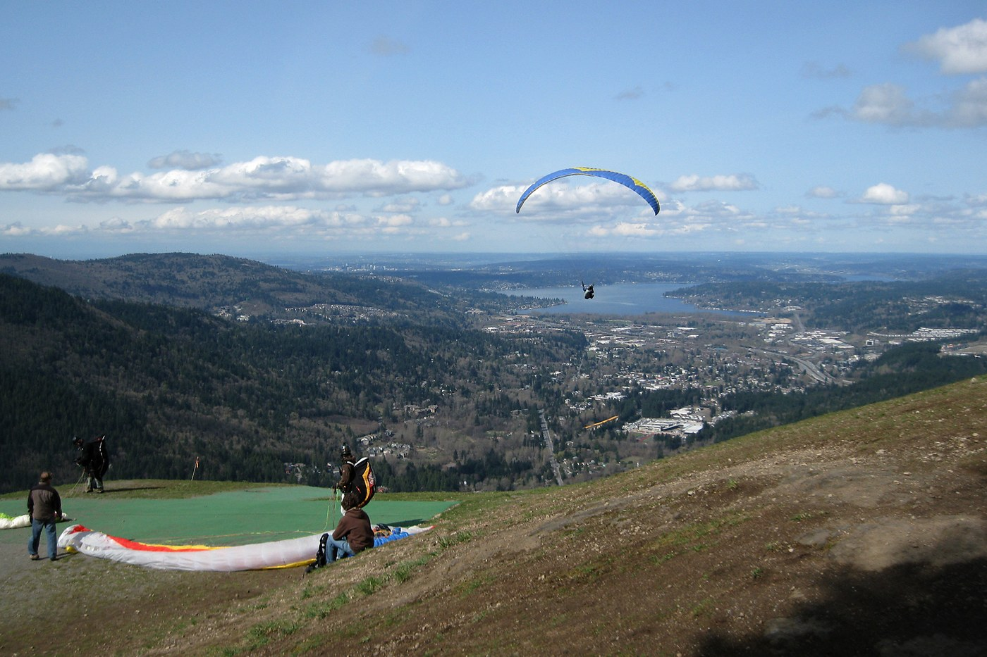
Poo Poo Point, Tiger Mountain

Slide 36
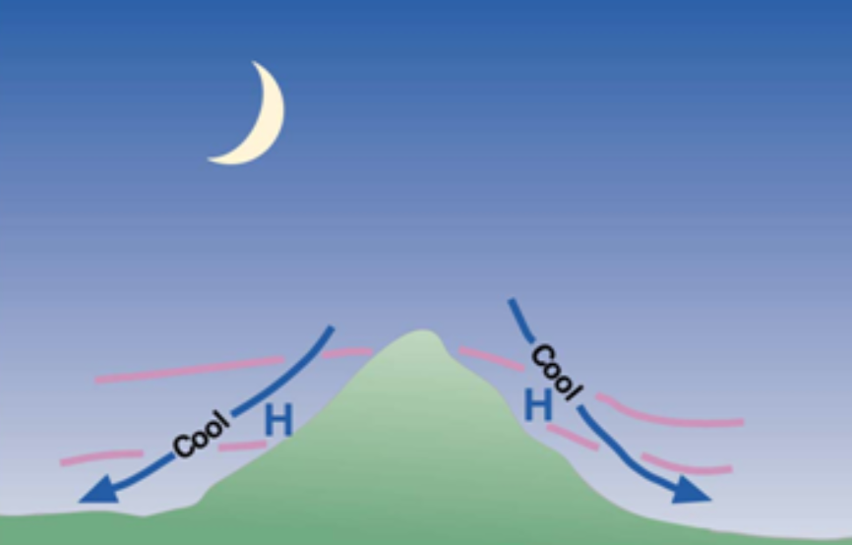
Diurnal Downslope Flow Driven by Nighttime Cooling Along Slopes

Slide 37
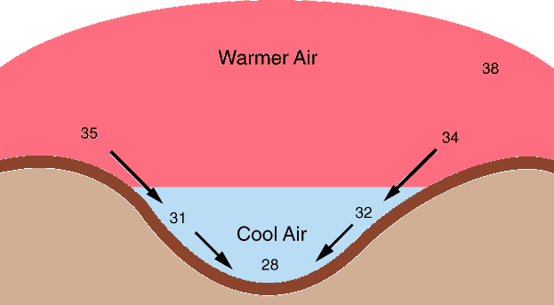
Low temperatures are generally cooler in low spots on cold, cloud-free nights, with downslope flow

Slide 38
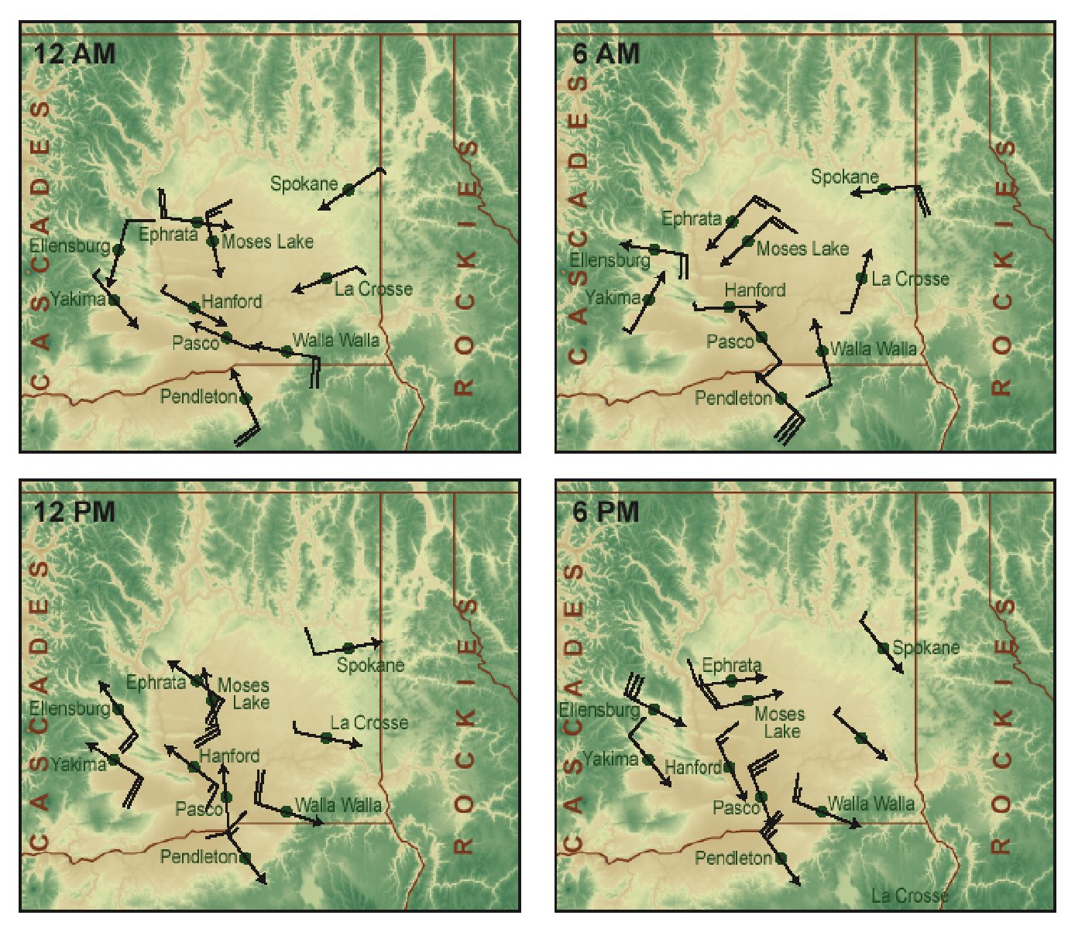
Eastern Washington slope flows

Slide 39
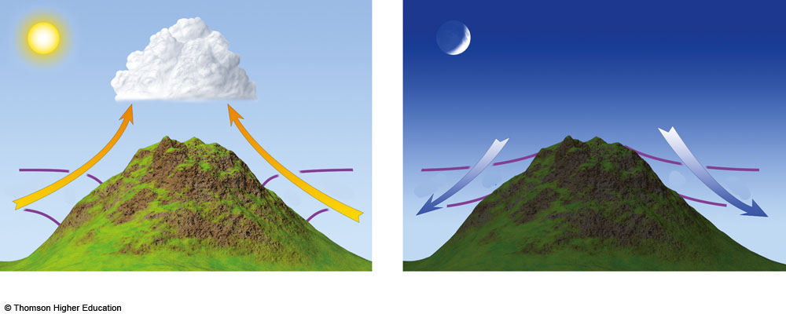
Influence on Clouds of Upslope and Downslope Flow
Warm
Cool
H
H
Cool
L
L
Warm
Upslope During Day
Downslope Flow at Night
Editable Text
Fig. 7-11, p. 178
Notes:
Figure 7.11: Valley breezes blow uphill during the day; mountain breezes blow downhill at night. (The L’s and H’s represent pressure, whereas the purple lines represent surfaces of constant pressure.)

Slide 40
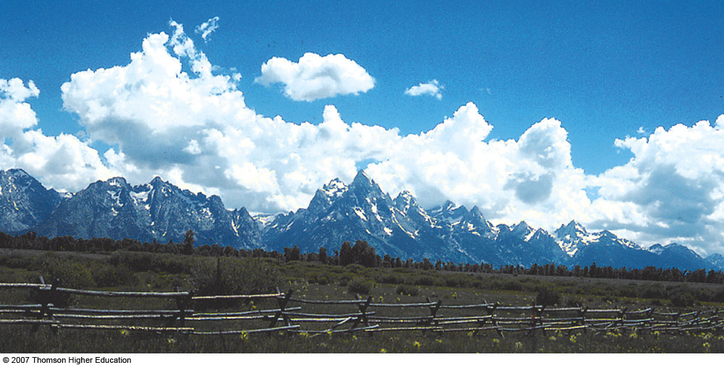
Fig. 7-12, p. 179
Notes:
Figure 7.12: As mountain slopes warm during the day, air rises and often condenses into cumuliform clouds, such as these.

