Slide 1
Atmospheric Stability
Autumn 2024
Why do cumulus clouds develop?
Why are temperature inversions associated with air pollution?
Why do hot air or helium balloons rise?

Slide 2
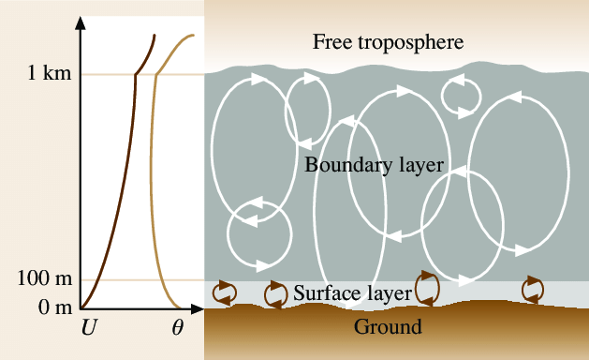
Atmospheric Vertical Stability
A stable atmosphere has weak or little mixing in the vertical
An unstable atmosphere has a large amount of mixing in the vertical

Slide 3
Why is this Important?
A stable atmosphere with little mixing is associated with air pollution, fog, and strong surface temperature inversions in winter.
An unstable atmosphere is associated with lots of atmospheric mixing, with good air quality and sometimes convection/thunderstorms.
Meteorologists spend a lot of time trying to figure out whether the atmosphere will be stable or unstable

Slide 4
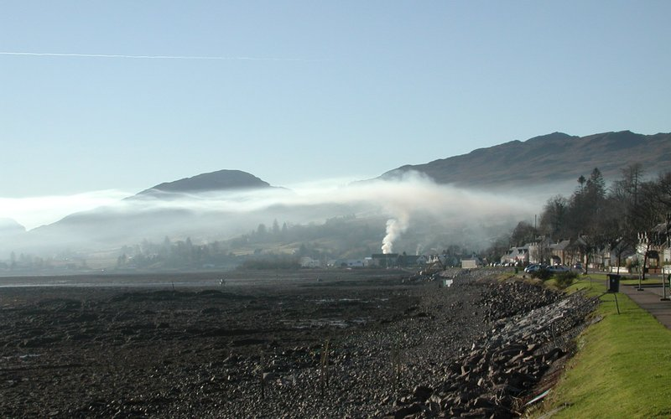
Stable Situation

Slide 5
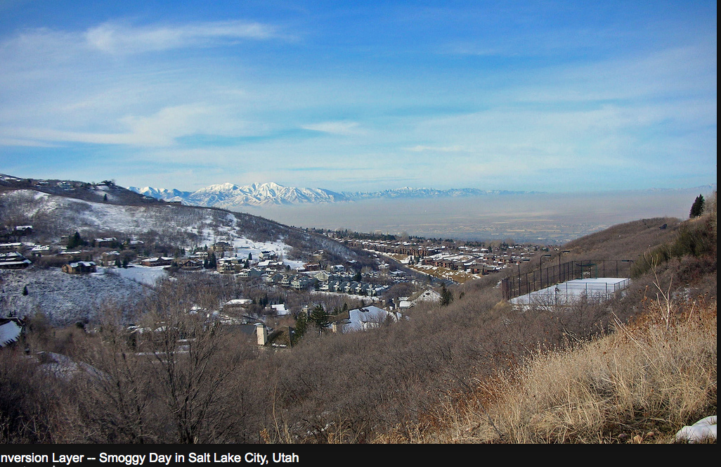
Stable

Slide 6

Stable

Slide 7
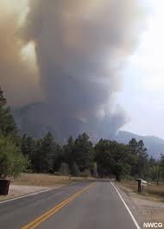
Unstable

Slide 8
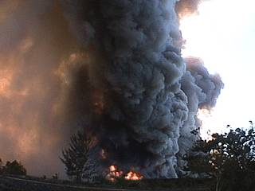
Unstable

Slide 9
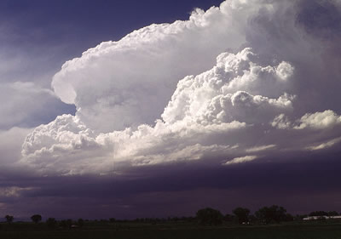
Unstable

Slide 10

Unstable

Slide 11

Lava Lamp: Instability

Slide 12
Atmospheric Stability
At various times, the atmosphere can be: stable unstable neutral

Slide 13
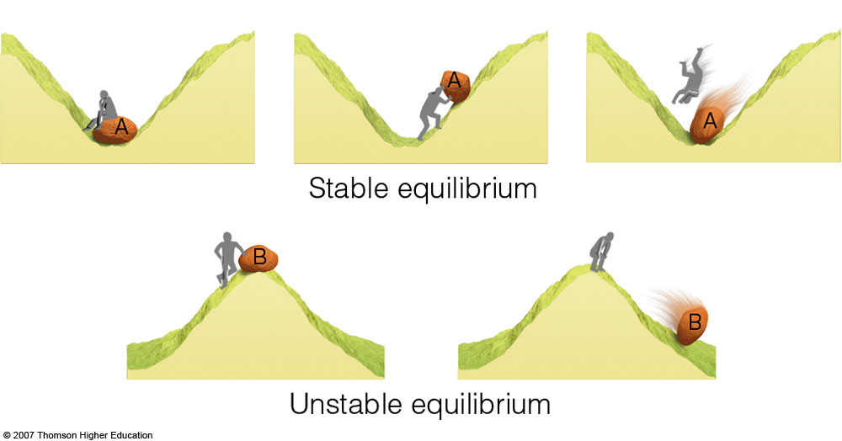
Stable and Unstable Analogs
If you push something in a stable situation, it will return to its original location, the opposite during unstable conditions.

Slide 14

Neutral
Move it and it will stay in the place you left it.

Slide 15

In the real atmosphere, we don’t deal with rocks, but with air parcels
Reminder. An air parcel is an identifiable collection of air…think of a balloon.
As we discuss stability, we need to keep in mind some essential ideas.

Slide 16
Essential Ideas
The density of an air parcel depends on its temperature
  Increase temperature >balloon expands> less dense
  Decrease temperature > balloon shrinks> more dense

Slide 17
Essential Ideas
The equation that expresses this relationship is the perfect (or ideal) gas law.
  P = ρ R T
  P is pressure (Nm⁻²), ρ is density (mass/volume, kg m⁻³), T is temperature (°K), R is the gas constant

Slide 18
Essential Ideas
With a little algebra, you can solve for density:
  ρ = P/(RT)
  Thus, holding pressure constant, if T increases, then ρ (density) decreases (less dense)
  This is going to be important!

Slide 19
An Important Point
There is a distinction (and often a difference) between conditions within an air parcel and its surrounding environment.
Not necessarily the same!
Air parcel
environment

Slide 20

T_{e}
is not necessarily the same as T_{p}
T_{p}
T_{e}
Temperature
Of the Air Parcel
Up
Temperature
Of the Environment
In contrast, the pressure in the parcel and the environment at the same level are generally the same

Slide 21
Now let’s understand stability

Slide 22
Basic Rules
If an air parcel is warmer than its surrounding environment, then it is less dense than the environment at that level and tends to rise.

Slide 23
Basic Rules
If an air parcel is the same temperature as the environment at that level, it has the same density as the environment at that level and will stay at that level.

Slide 24
Basic Rules
If an air parcel is colder than the environment at the same level, it is denser than the environment and will sink.

Slide 25

None of this should surprise you.
A hot air balloon is warmer and less dense than the environment and rises.
A lead balloon sinks
A helium balloon rises because helium is less dense than than the gases in the atmosphere.

Slide 26
But why does an air parcel of hot, less-dense air rise?
And why doesn’t all the air in the atmosphere fall down to the surface?

Slide 27
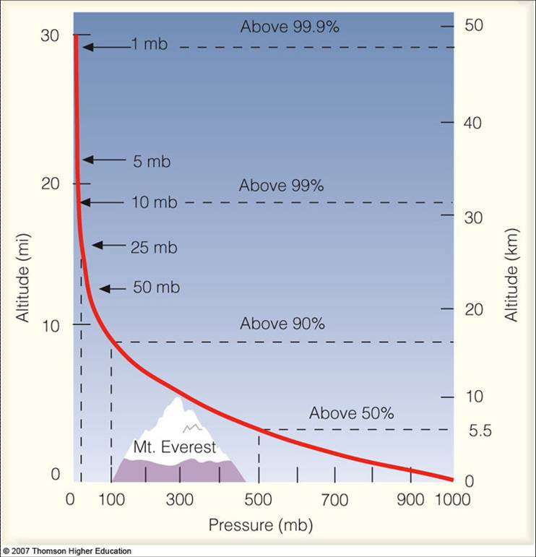
Air has weight. Why doesn’t the atmosphere collapse?

Slide 28
Imagine an air parcel with the same density as the environment (ρ_{e} =ρ_{p}). The parcel has weight. Why doesn’t it fall?
P_{T}
environment
ρ_{e}
ρ_{p}
Parcel
Upward
Pressure
Force
P_{B} > P_{T}, so there is an upward force that balances out the weight. Stays put
P_{B}
Weight

Slide 29
Hydrostatic Balance
The difference in pressure between the top and bottom of the air parcel produces an upward-directed pressure gradient force.
This force balances gravity (the weight of the air parcel)
Called HYDROSTATIC BALANCE.
Most of the atmosphere is in hydrostatic balance and that is why the atmosphere doesn’t collapse.

Slide 30

But what happens if an air parcel is warmer than the environment?
Example, a hot air balloon
An air parcel can be warmed by a number of processes (e.g., warm surface, latent heating, etc.)

Slide 31
Warmer than the environment
If the parcel warms, its density becomes less. Consider a parcel warmer than the environment.
P_{T}
environment
ρ_{e}
ρ_{P2}
Parcel
P_{B} > P_{T}, so there is an upward force. No change.
But the density and weight is less. Thus, the parcel rises.
Up
P_{B}
Weight inside circle is less

Slide 32
Bottom Line
If an air parcel is warmer and thus less dense than the environment at that level, it rises
If the parcel is the same temperature as the environment, it stays in place
If the parcel is colder than the environment, it is denser that air of the environment and sinks
https://www.youtube.com/watch?v=ydXJVSO-jXU (hot air balloon video)

Slide 33
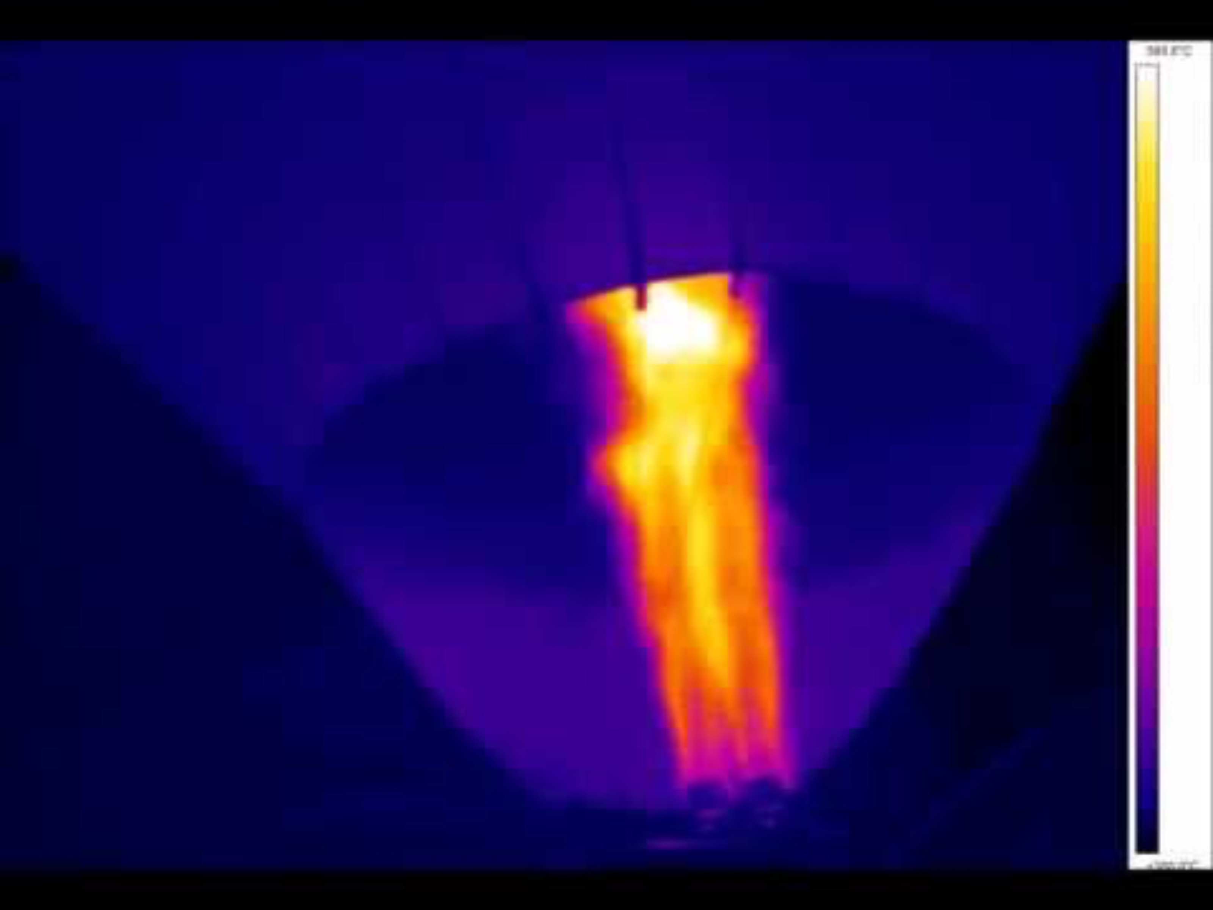

Slide 34
Now let’s apply these concepts to the atmosphere
The stability of air depends on how temperature changes with height

Slide 35
Lapse Rate
Lapse rate (Γ): the rate of change of temperature with height
Γ = - ΔT/Δz Δ means change, z is height
So, if temperature falls by 5C in 1000 meters (1 km) in the vertical, the lapse rate is 5C per km.

Slide 36
Average Lapse Rate in the Troposphere
6.5 C per km
3.6 F per 1000 ft
Thus, you would expect, on average, that Snoqualmie Pass at ~ 3000 ft, would be about 11 F cooler than Seattle.

Slide 37
Dry adiabatic lapse rate
The dry adiabatic lapse rate, Γ_{d} , is the rate of change of temperature with height of an unsaturated air parcel when it is forced up or down.

Slide 38
Dry adiabatic lapse rate
The value of Γ_{d} is 9.8 C per km
When an unsaturated air parcel rises it cools by 9.8C per km. Cooling due to adiabatic expansion.
When an unsaturated air parcel sinks it warms by 9.8C per km. Warming by adiabatic compression.

Slide 39
Reminder!
The term adiabatic is used to denote situations where there are no sources of heating or cooling. No release of latent heat, no radiation, no nothing.
By comparing Γ_{d} with the environmental lapse rate Γ_{e}, one can tell the vertical stability of unsaturated air parcels.

Slide 40
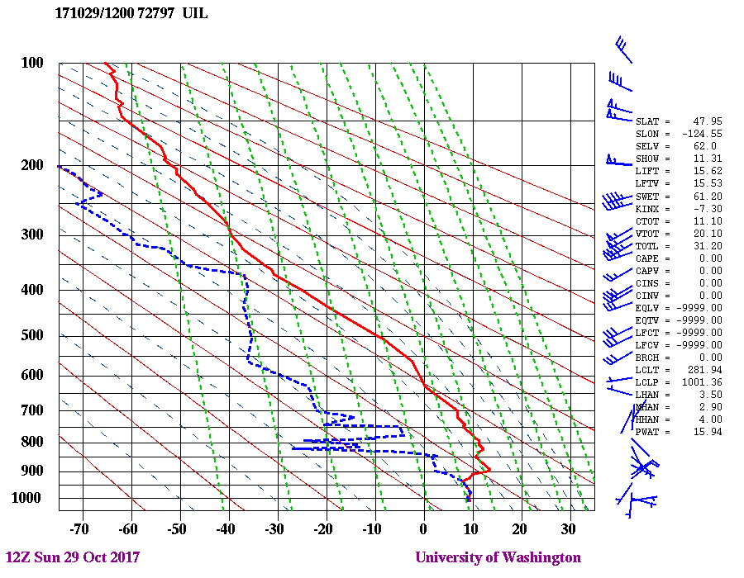
Let us learn how this works

Slide 41
Consider the situation where air remains unsaturated

Slide 42
Case 1: Environmental lapse rate =dry adiabatic lapse rate
Γ_{d} = Γ_{e}
Neutral situation– parcel stays put when pushed
Same temperature as environment
1 km .2C .2C
Γ_{d = 9.8 C per km}
Γ_{e = 9.8 C per km}
0 km
10C 10C
Parcel Environment

Slide 43
Case 2: Environmental lapse rate greater than dry adiabatic lapse rate
Γ_{e} > Γ_{d}
Unstable, parcel is warmer than environment, rises
1 km .2C -5C
Γ_{e} =15C per km
0 km
10C 10C
Parcel Environment

Slide 44
Case 2: Environmental lapse rate greater than dry adiabatic lapse rate
If parcel is warmer than the environment, it is less dense, and thus would continue to rise
1 km .2C -5C
Γ_{e} =15C per km
0 km
10C 10C
Parcel Environment

Slide 45
Case 3: Environmental lapse rate is less than dry adiabatic lapse rate
Γ_{e} < Γ_{d}
Stable, parcel is cooler than environment
1 km .2C 5C
Γ_{d = 9.8 C per km}
Γ_{e} =5C per km
0 km
10C 10C
Parcel Environment

Slide 46
Case 3: Environmental lapse rate <dry adiabatic lapse rate
If parcel is cooler than environment it is denser, and will end to sink back to original position
1 km .2C 5C
Γ_{e} =5C per km
0 km
10C 10C
Parcel Environment

Slide 47
We can evaluate vertical stability by plotting the environmental sounding and the dry adiabatic lapse rate on a thermodynamic diagram

Slide 48
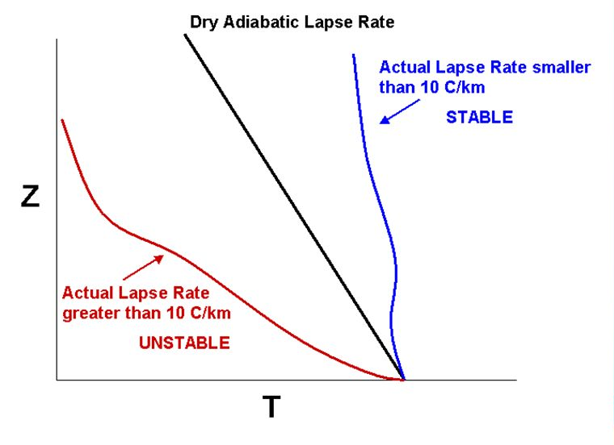

Slide 49
Atmospheric Stability
At various times, the atmosphere can be: stable: push a parcel up or down and returns to original starting location unstable: push a parcel up or down and it keeps on going. neutral: push a parcel up or down and it keeps on going.

Slide 50
Summary (unsaturated)
Γ_{e} > Γ_{d} unstable
Γ_{e} = Γ_{d} neutral
Γ_{e} < Γ_{d} stable
How can we make the atmosphere unstable?
  Increase the environmental lapse rate: Γ_{e}
How do we do this?
  Increase temperatures near the surface
  Cool aloft

Slide 51
Increasing Lapse Rate (warming surface or cooling aloft)
cool
Z
Γ_{d}
Γ_{d}
warm
Temp

Slide 52
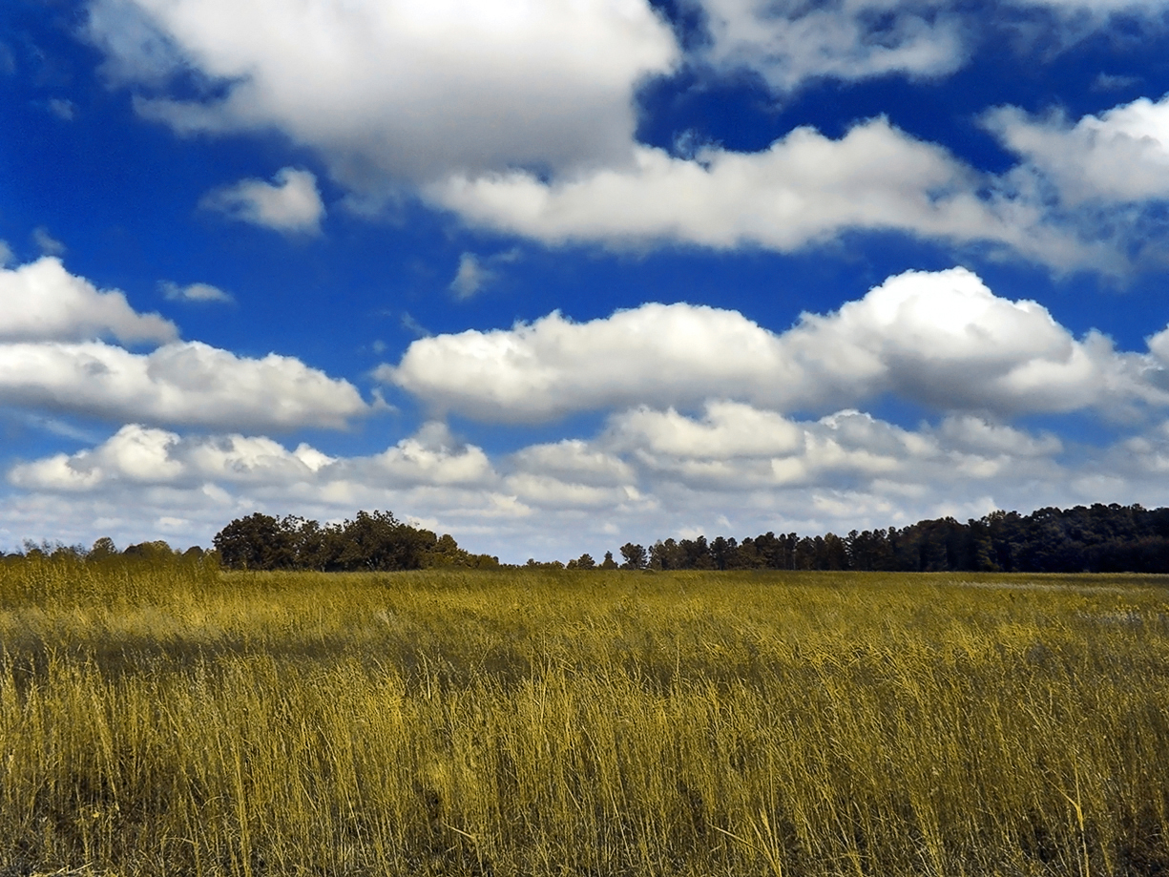
Increasing Lapse Rate
Summer/warm time of the year, sun heats the surface. Lapse rate increases. Unstable atmosphere develops, with up and down motions.

Slide 53
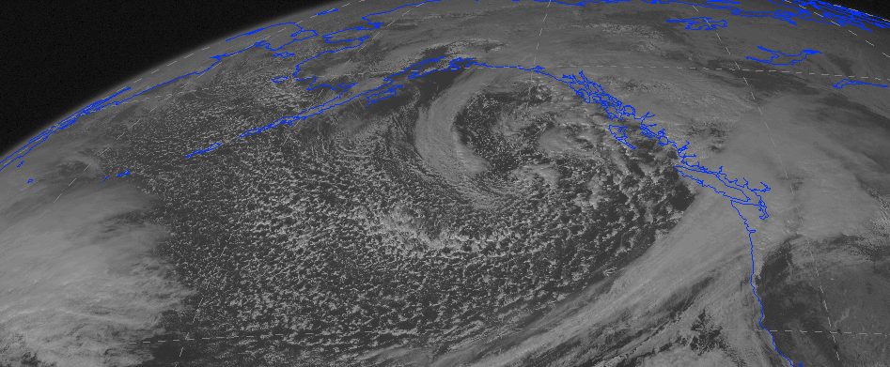
Increasing Lapse Rate
In winter, cooler air moving in aloft above warm water can increase lapse rate, resulting in instability and post-frontal showers.

Slide 54
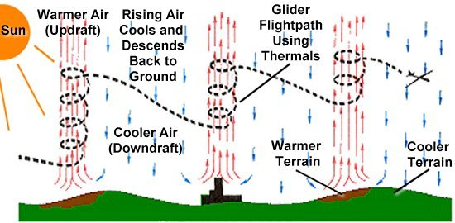
In the atmosphere, instability results in convection

Slide 56
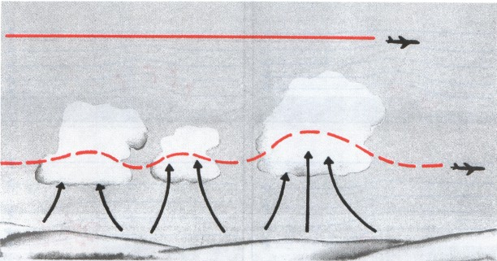
Can result in cumulus clouds and bumpy flights before landing on warm days

Slide 57
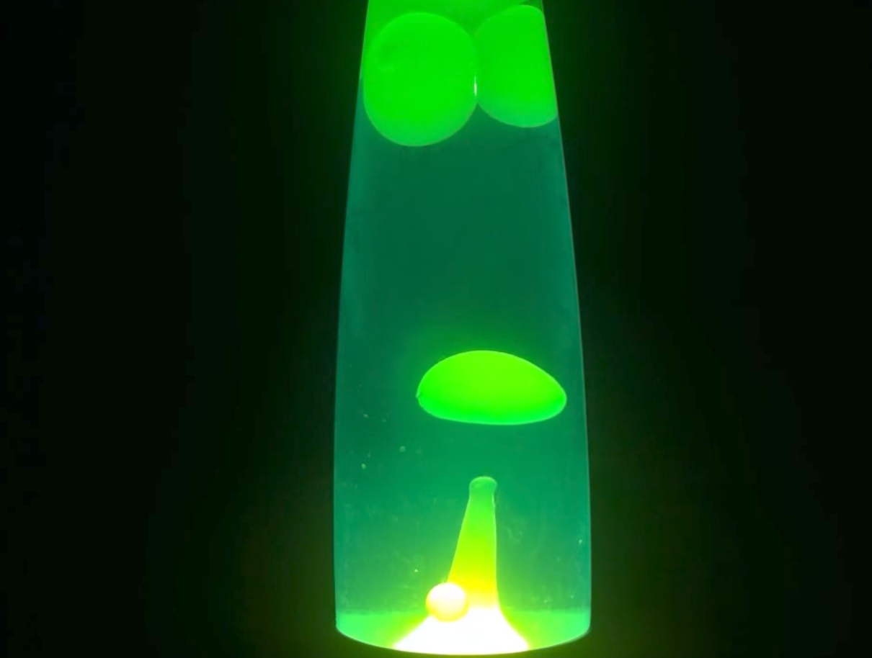
https://www.youtube.com/watch?v=vBf1UkSUQQ0

Slide 58
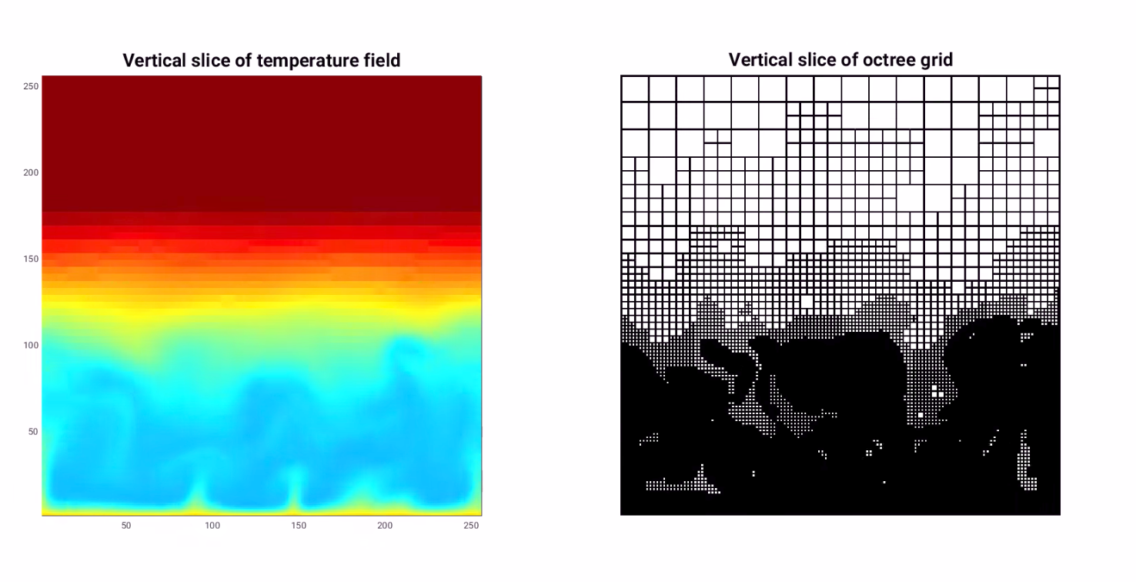
Simulation https://www.youtube.com/watch?v=nnJazkb9mNI

Slide 59
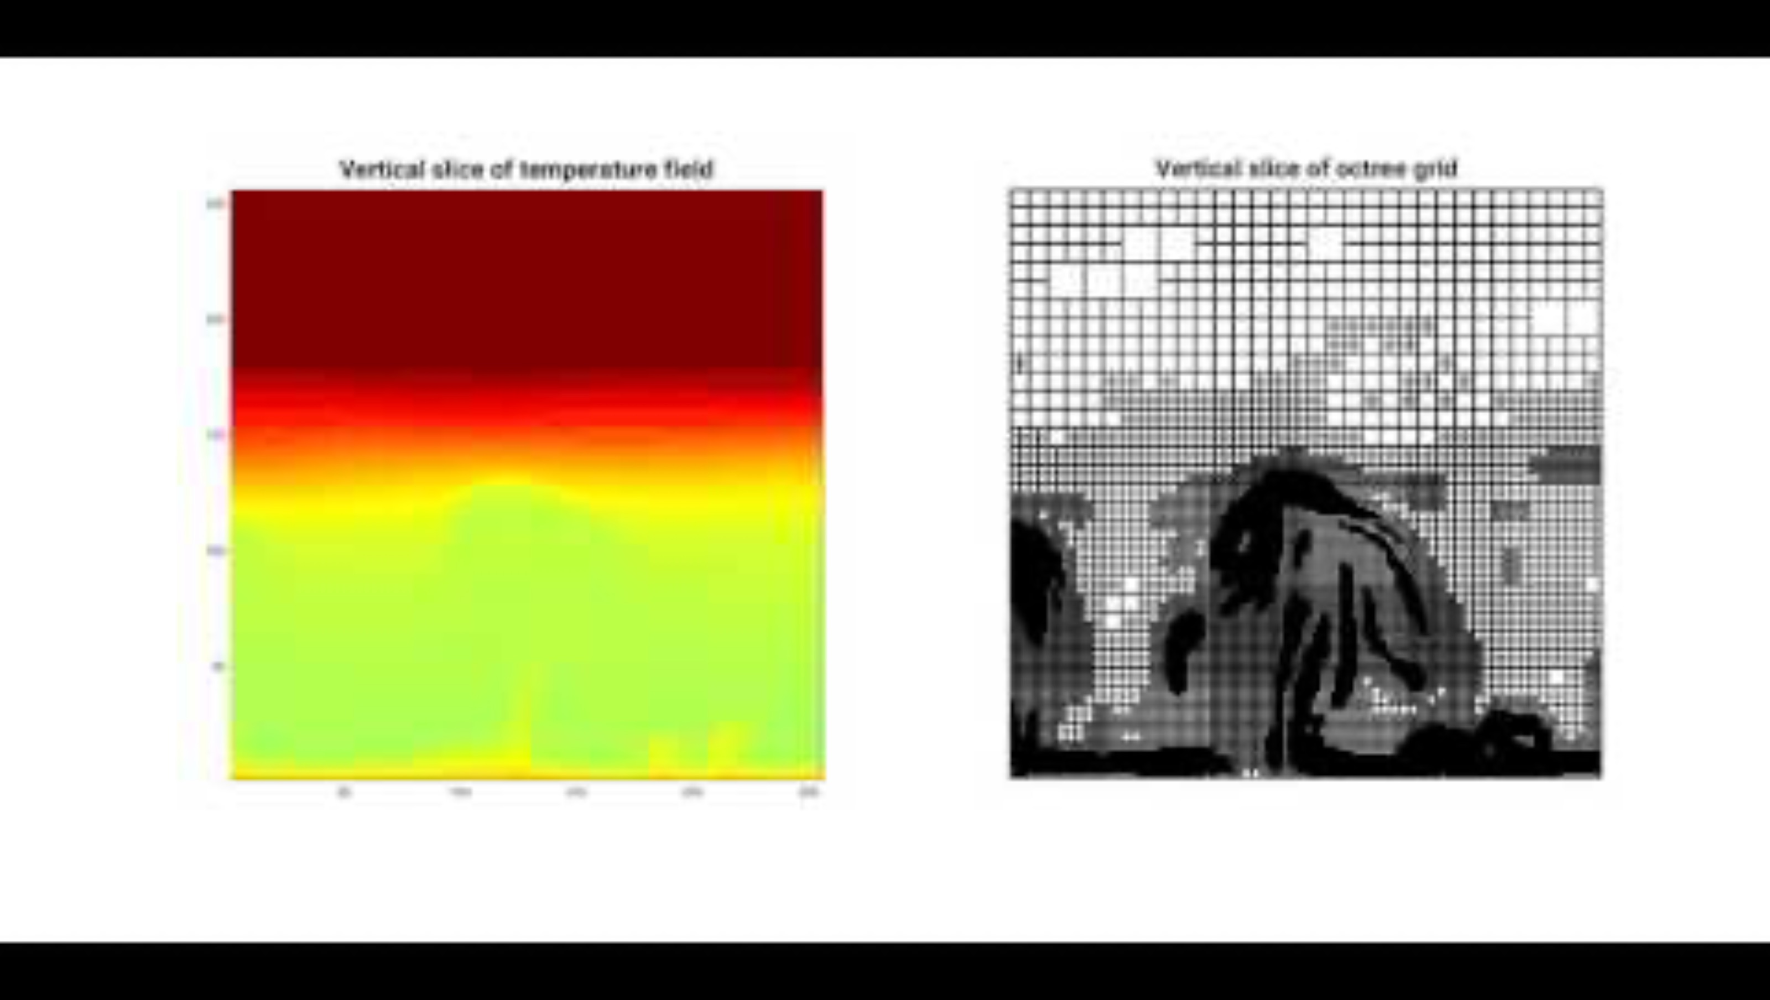

Slide 60
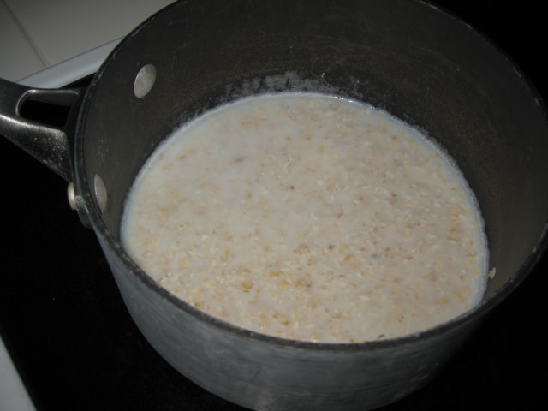
Instability and Convection Can Also Occur in the Kitchen

Slide 61
Now let’s add a complication: saturation
Instability and convection can be completely dry…air remains unsaturated.
But if air has enough water vapor, rising air cools to saturation, producing clouds...usually cumulus clouds

Slide 62
Now let’s add a complication: saturation
But this leads to another issue--when air becomes saturated and rises more, water condenses out producing latent heating.
Thus, saturated air cools less when rising

Slide 63
Saturated Adiabatic Lapse Rate
(a.k.a., moist adiabatic lapse rate)
The lapse rate becomes Γ_{s}= 6.5 C per km when air rises when saturated
Γ_{s}= 6.5 C per km
Saturation
Γ_{d}= 9.8 C per km

Slide 64
How do we calculate instability in a saturated atmosphere? No Problem! Just replace with saturated adiabatic lapse rate
New Rules for saturated air:
Γ_{e} > Γ_{s} unstable
Γ_{e} = Γ_{s} neutral
Γ_{e} < Γ_{s} stable

Slide 65
Easier to get instability when air is saturated!
Since Γ_{s} is less than Γ_{d}, it much easier to get instability in a moist, saturated atmosphere—like the U.S. East Coast in summer!

Slide 66
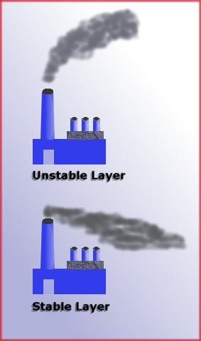
Instability can help mix pollutants in the vertical, stable air keeps it at low elevations

Slide 67
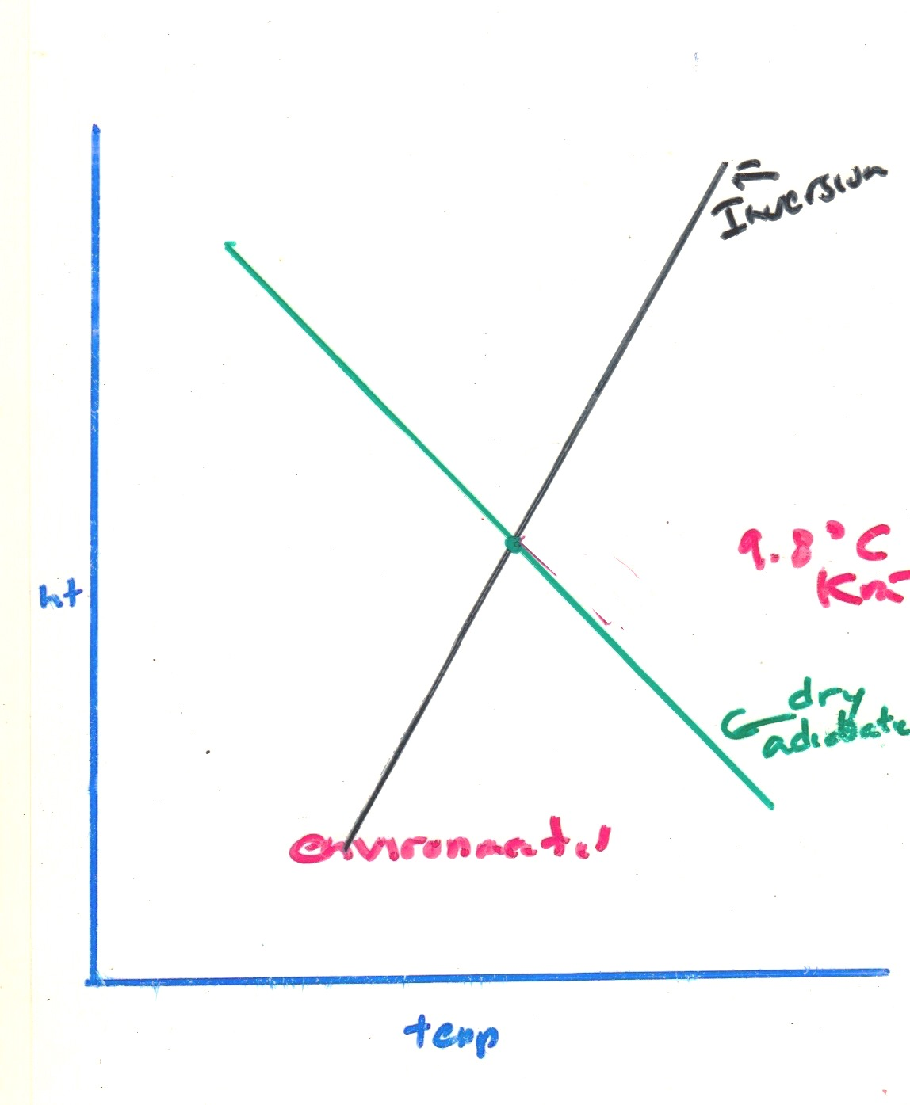
Inversions
Inversion layers, in which temperature increases with height, are VERY stable.

Slide 68
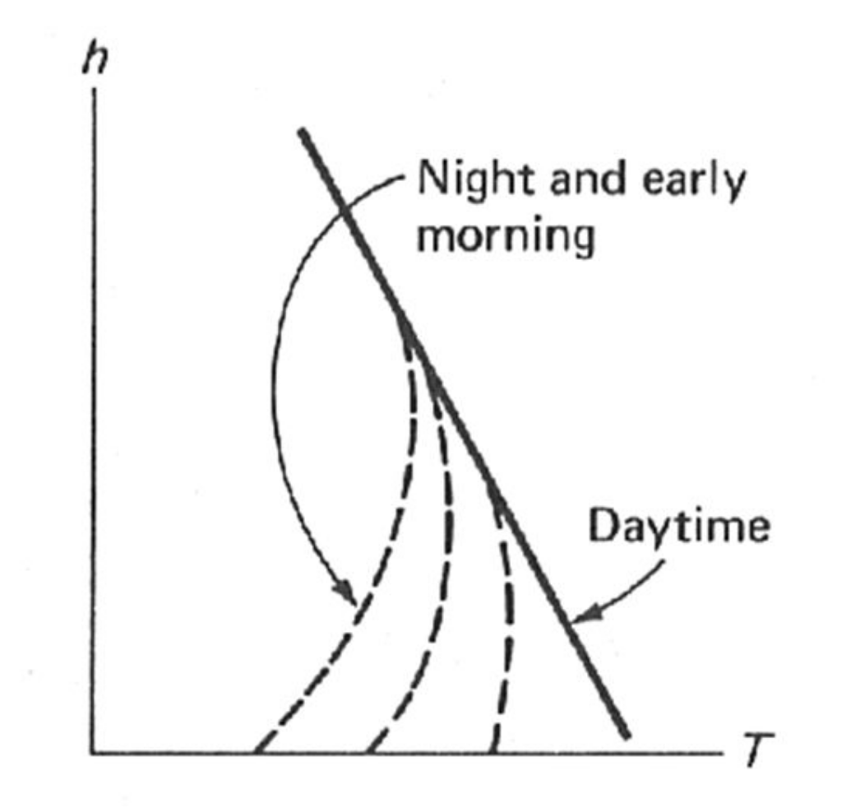
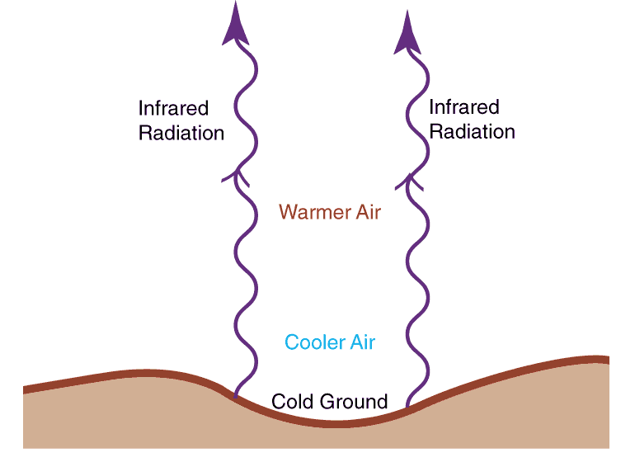
How do inversions form? Two major ways
Radiation inversions: cooling at the surface as earth radiates infrared radiation to space.

Slide 69
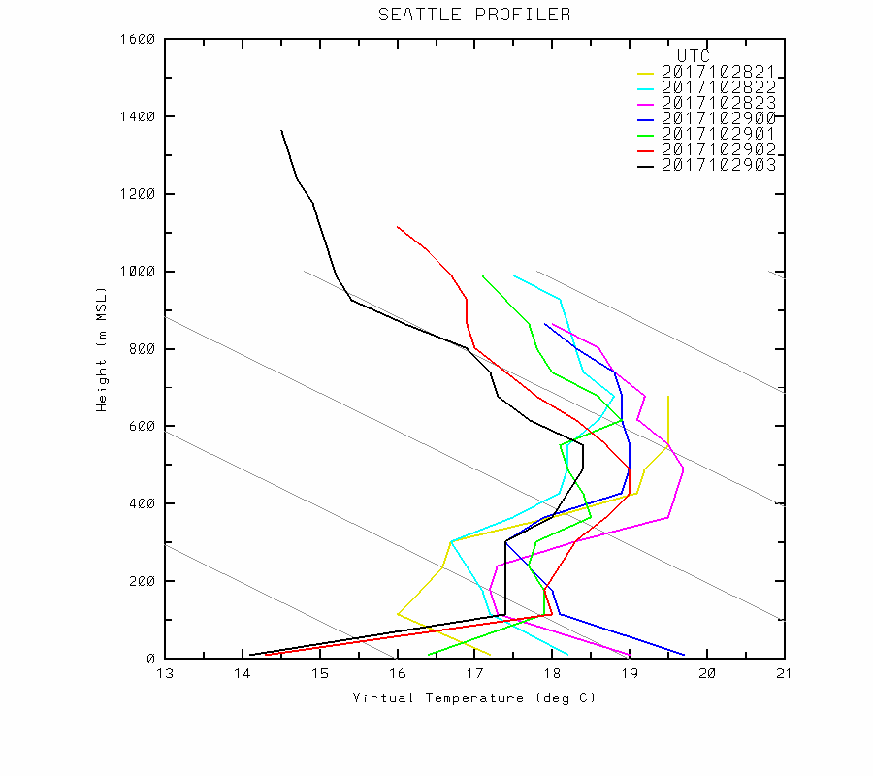

Slide 70
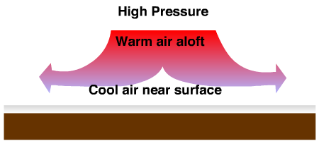
Subsidence Inversion
Sinking air aloft, often associated with high pressure.
Greater sinking aloft produces more adiabatic warming aloft.
No sinking at surface. No adiabatic warming.

Slide 71
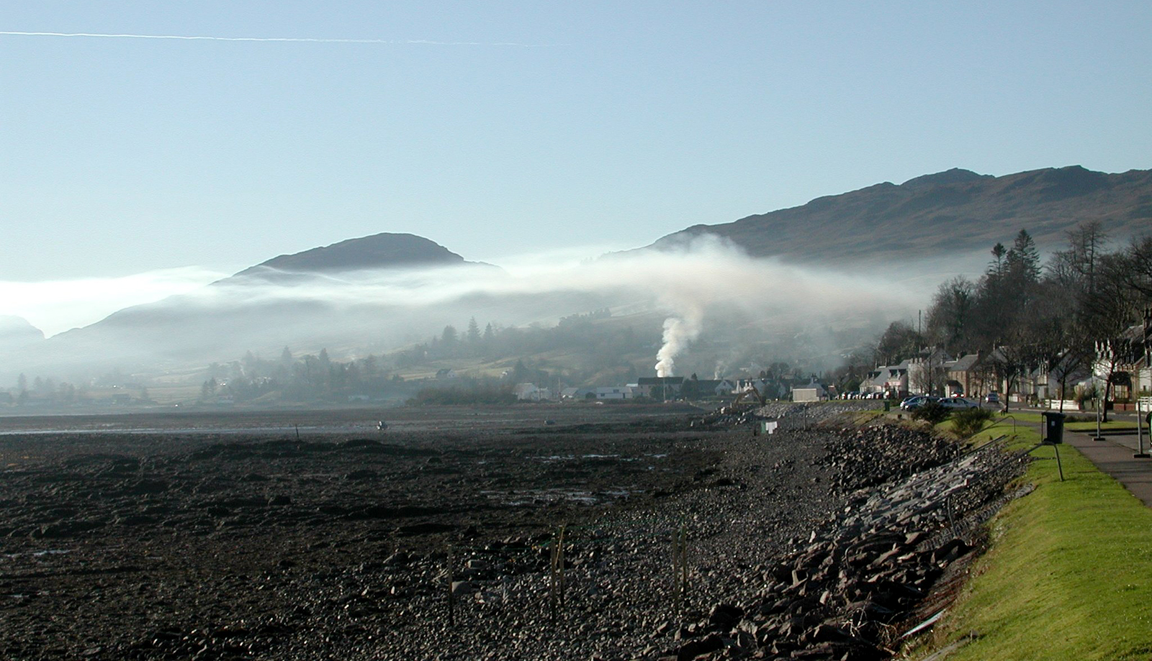
Inversions
Both radiation and subsidence inversions can happen at the same time.

Slide 72
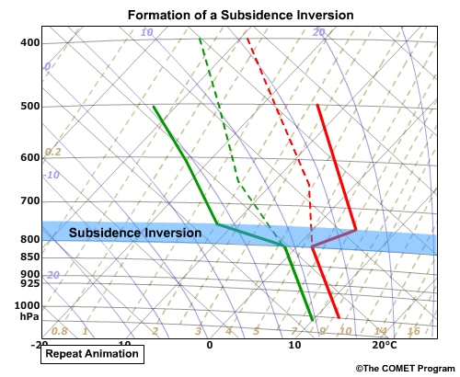
Inversion on a Sounding Chart

Slide 74
Meteorologists evaluate stability by comparing environmental soundings (mainly from radiosondes), with the dry and saturated adiabatic lapse rate shown on thermodynamic charts.
s
Not in this class!

Slide 76
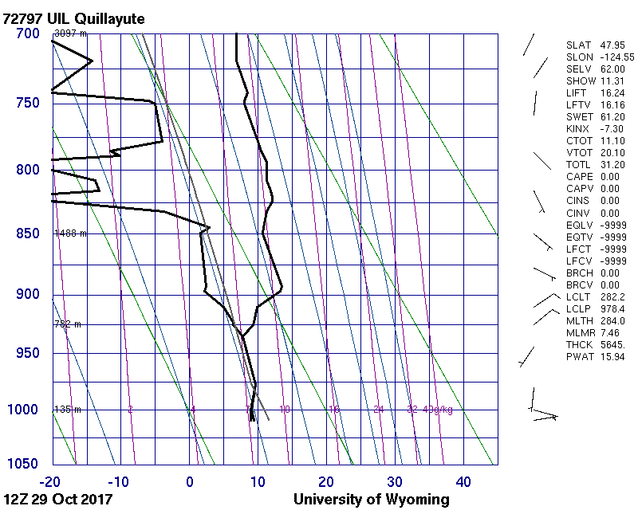

Slide 78
