Slide 1
Surface Weather Map
Intro
Also known as the
Surface Synoptic Chart
ATMS 370
Autumn 2023

Slide 2
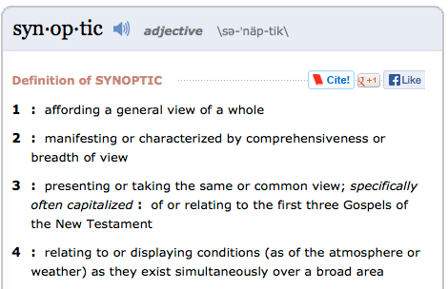
synoptic

Slide 3
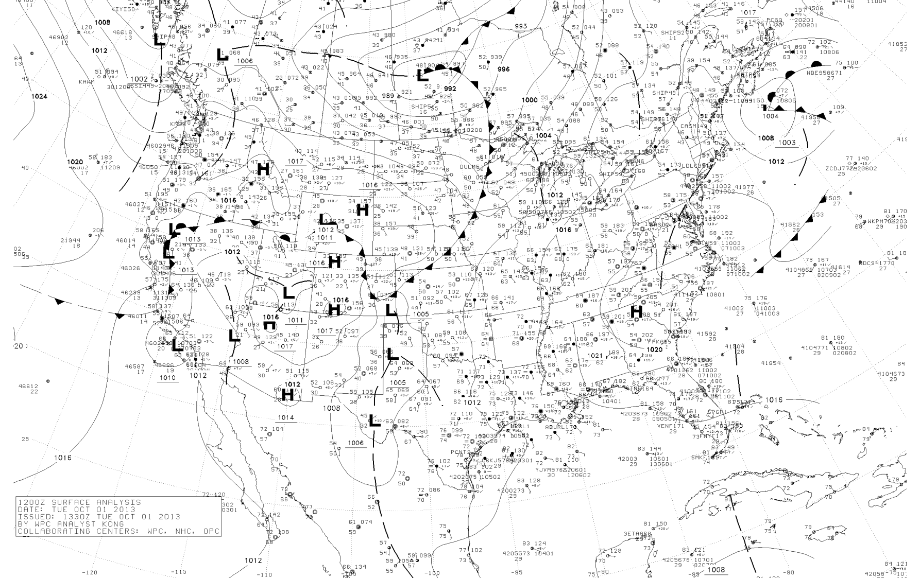
Available here: http://www.atmos.washington.edu/data/vmaproom/

Slide 4
Why Surface Weather Maps?
Summarizes weather conditions at the surface (where we are!)
Using a progression of charts can see how weather is evolving.
Summarizes our conceptional model of the atmosphere (e.g., fronts).

Slide 5
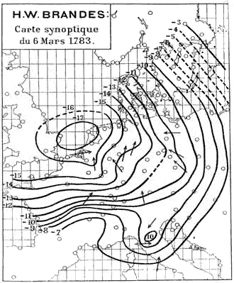
First Surface Weather Map
Created by H. W. Brandes in 1820 for March 6, 1783.
The arrows indicate wind direction and the lines show the deviation of pressure from average conditions

Slide 6
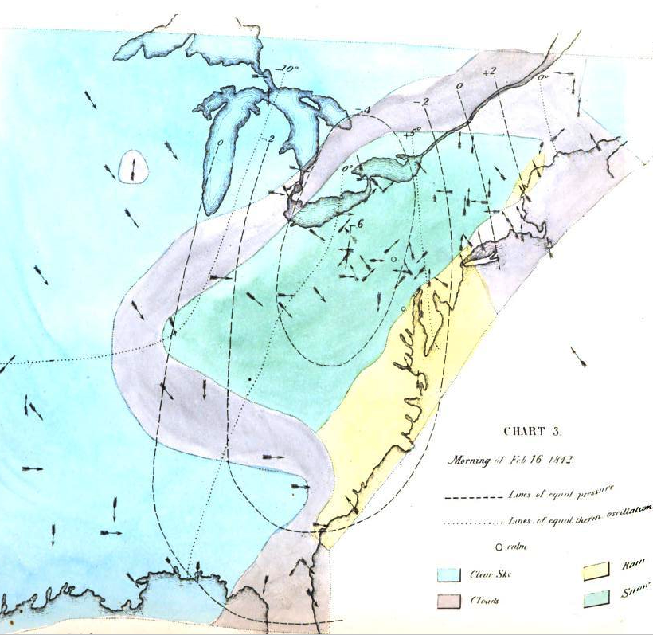
One of the weather maps created by Elias Loomis in his groundbreaking paper on the storms of February 1842.
Surface wind direction is indicated by arrows and the deviations from average pressure are shown by the dashed lines. Temperatures are indicated by dotted lines and the sky or precipitation type by the color shading. This map indicates a strong low-pressure center over the Ohio Valley, rain on the coast, and snow-laden northwesterly winds to the west.

Slide 7
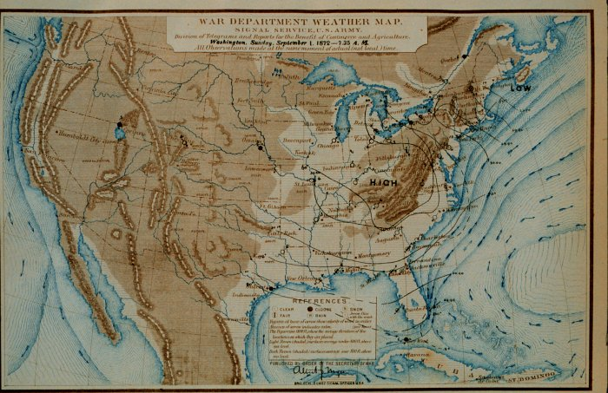
First Real-Time Weather Maps
Example 1872!

Slide 8
No Fronts!

Slide 9
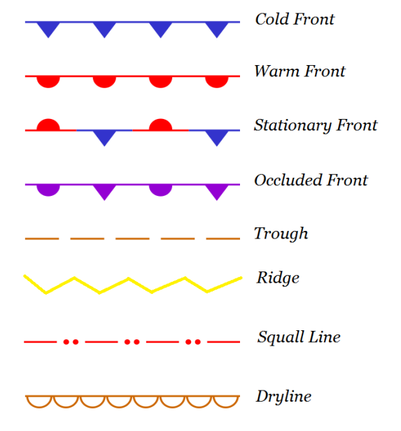
Current Surface Charts have fronts and other features

Slide 10
Four Main Types of Fronts

Slide 11
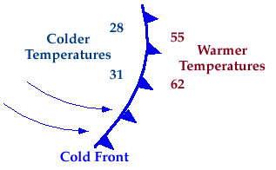
Cold Front
Cold Front: Cold air displacing warm air

Slide 12
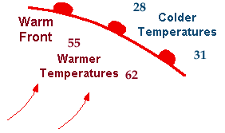
Warm Front
Warm air displacing cooler air

Slide 13
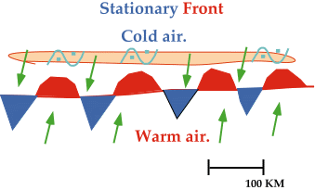
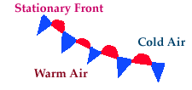
Stationary Front
Neither warm or cool air is winning.

Slide 14

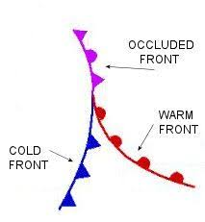
Occluded Front (a hybrid)
More later

Slide 15
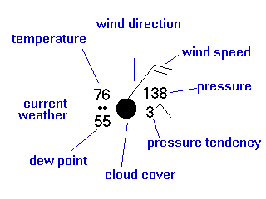
Surface observations are plotted using a station model

Slide 16
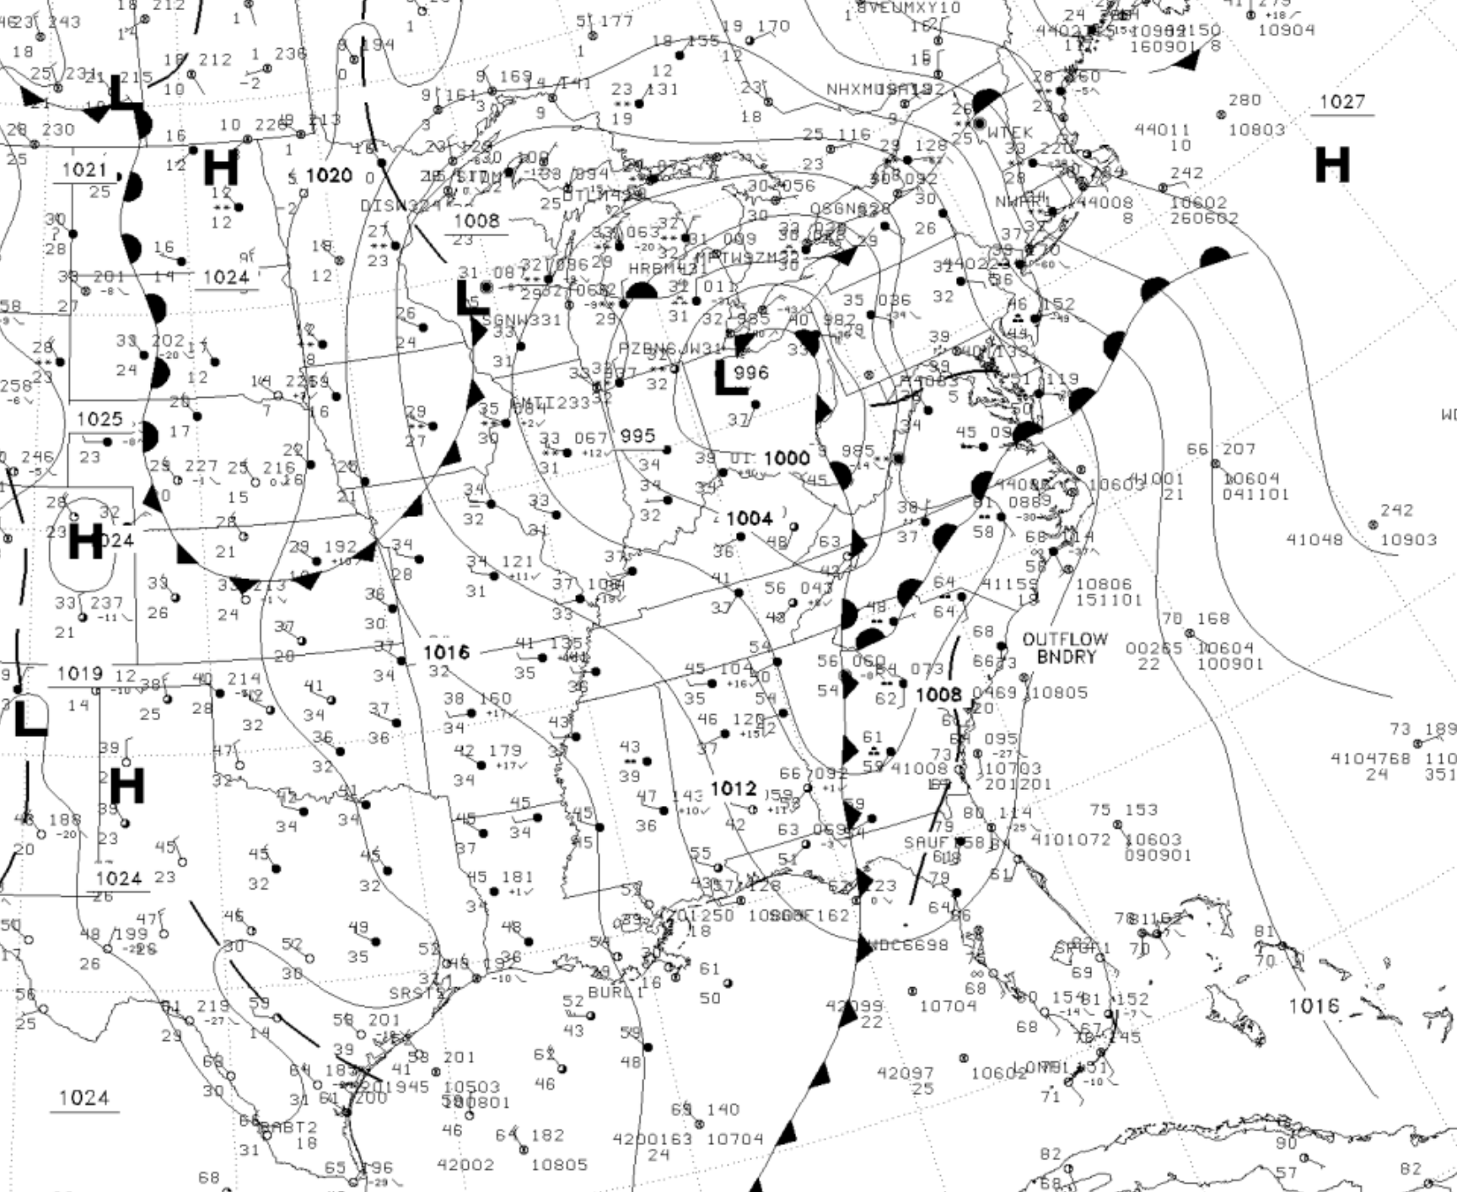
Then Isobars Are Drawn

Slide 17
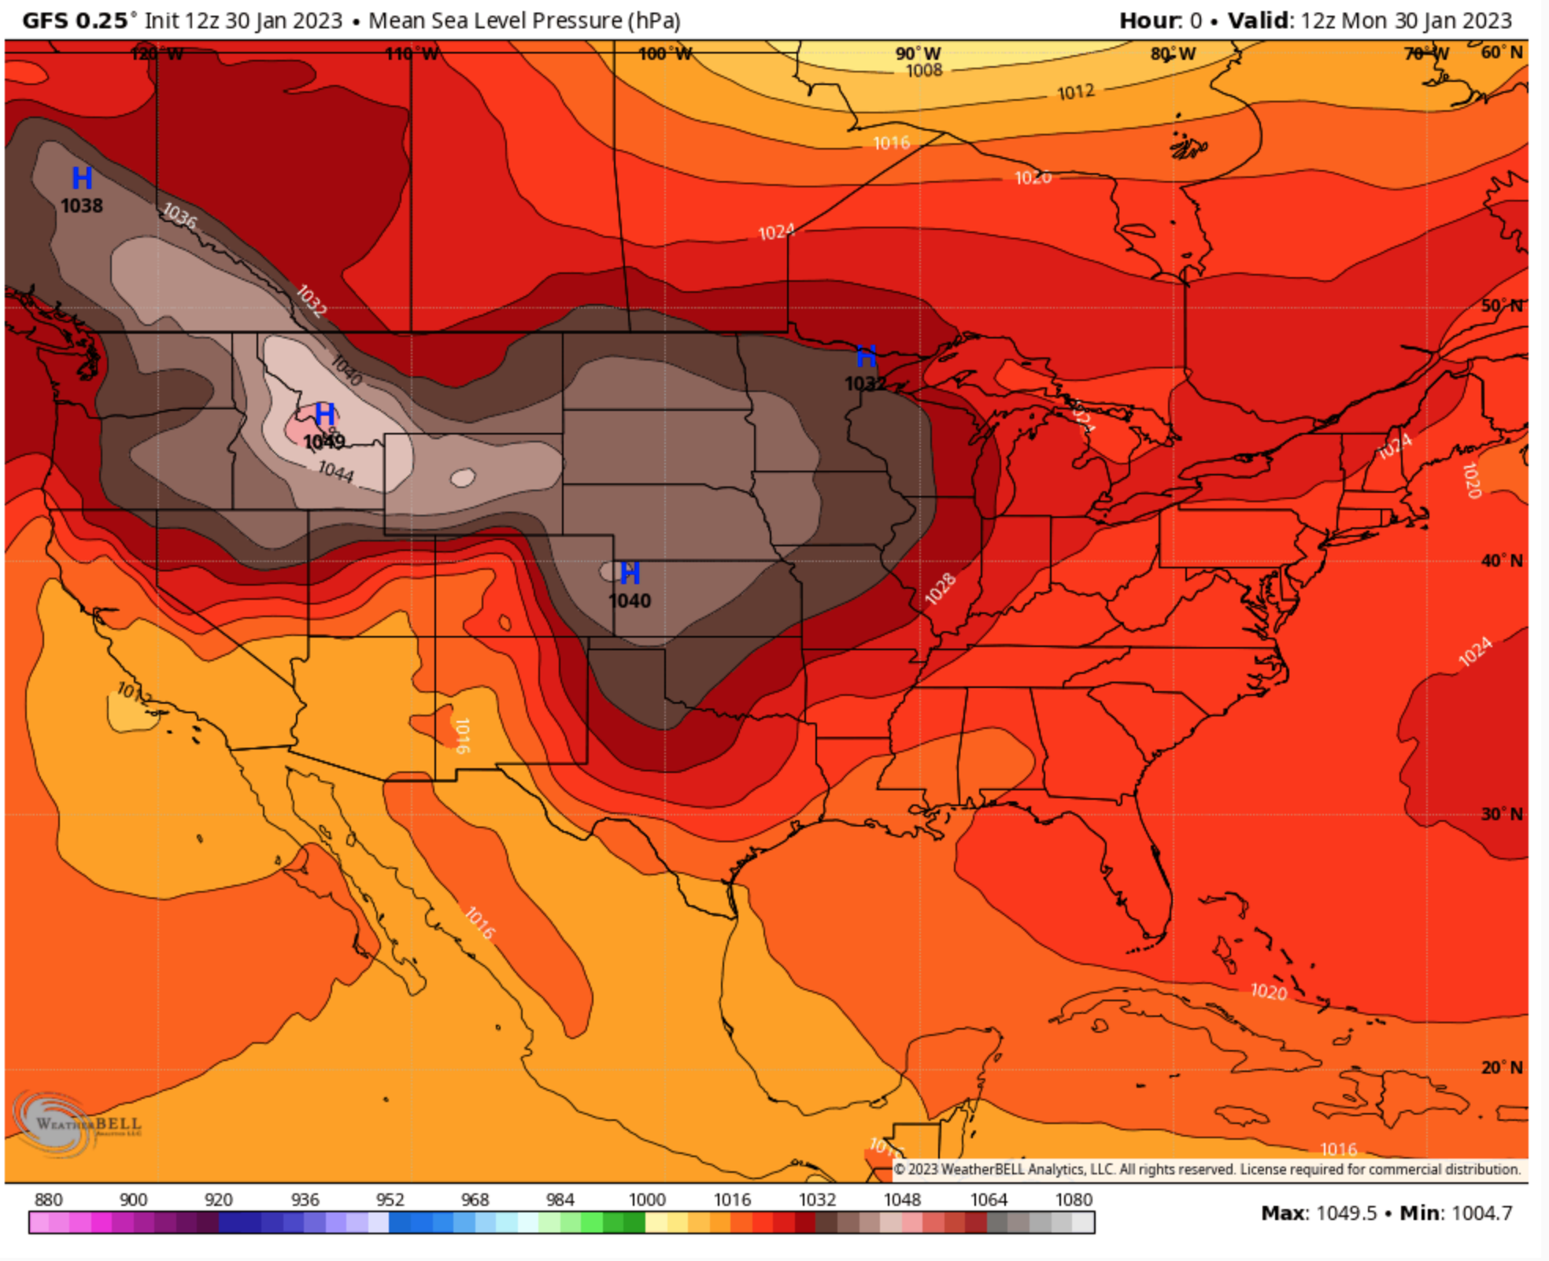
Yes, you could start with an automated pressure analysis

Slide 18
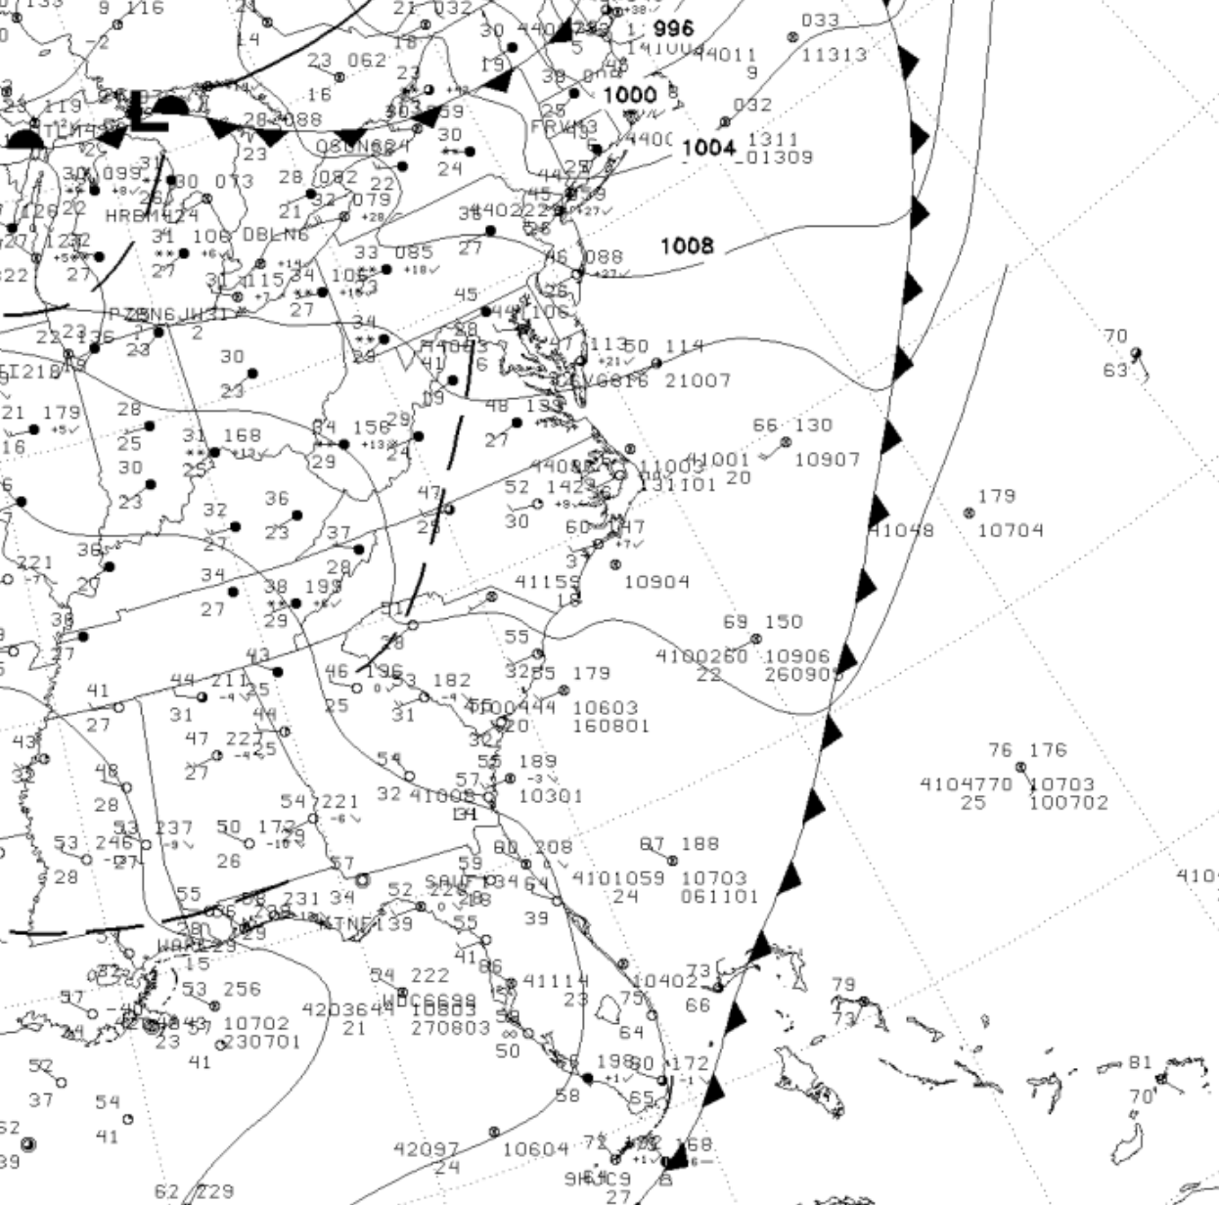
Why is manual pressure analysis still useful?
Tremendous learning tool
Humans can often do better over data sparse regions ..such as over the oceans.

Slide 19
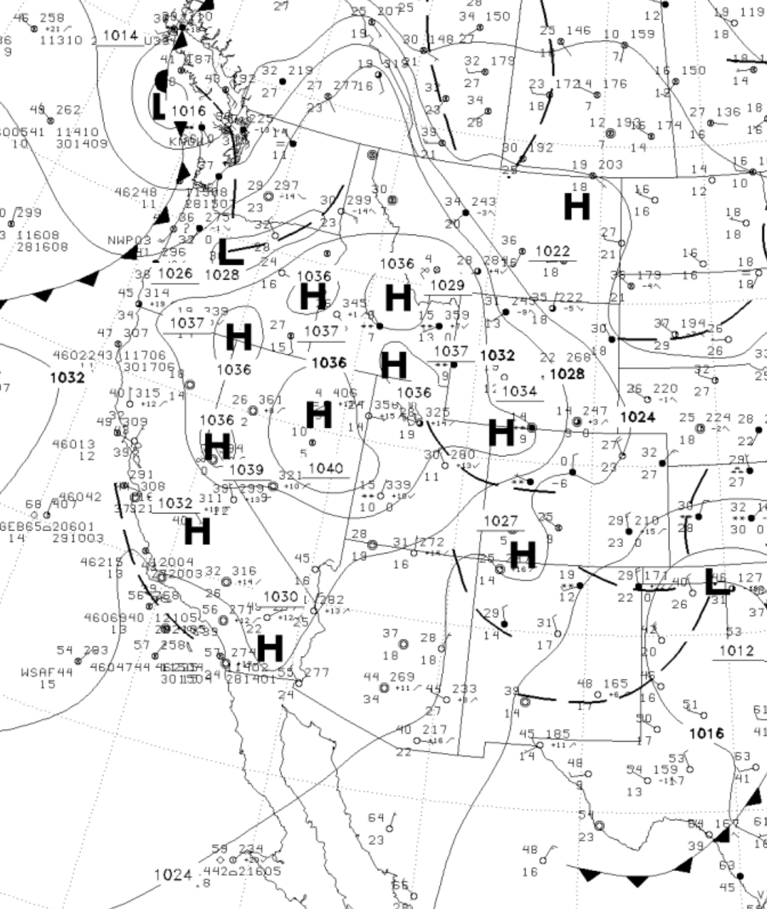
Sea Level Pressure Isobaric Analysis
Standard: every 4 hPa
Centered around 1000 hPa (1000, 1004, 1008, etc.)
Keep in mind reduction issues over high terrain (often excessive high pressure over high terrain)

Slide 20
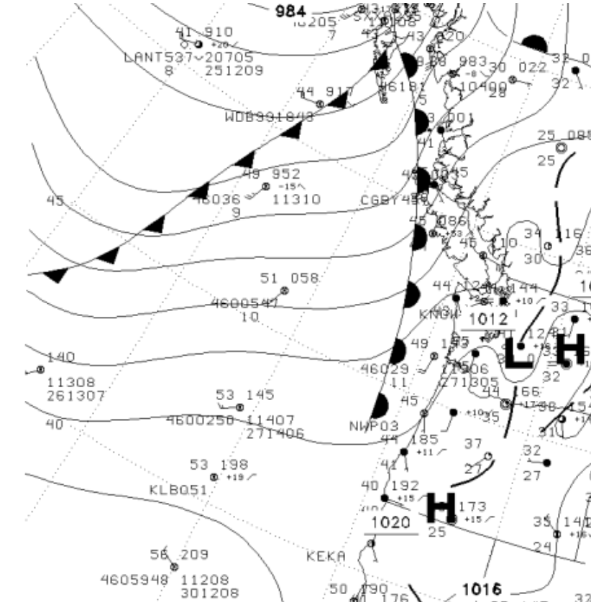
Surface Winds Give You Information About Pressure
Winds are roughly parallel to isobars over the ocean
Winds blow down the pressure gradient near terrain

Slide 21
General Rules: Cross Isobar Angle of Winds With Isobars
Ocean: 10-20°
Land (no major terrain): 20-40°
Mountainous regions: 60-90°

Slide 22
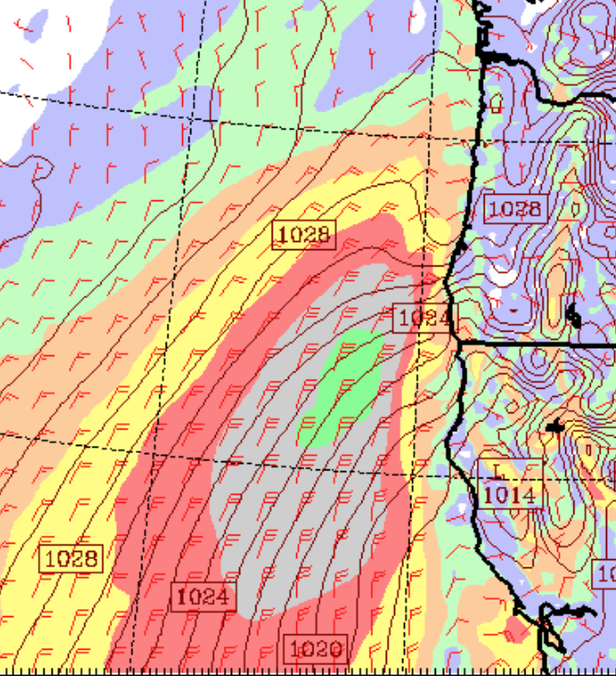
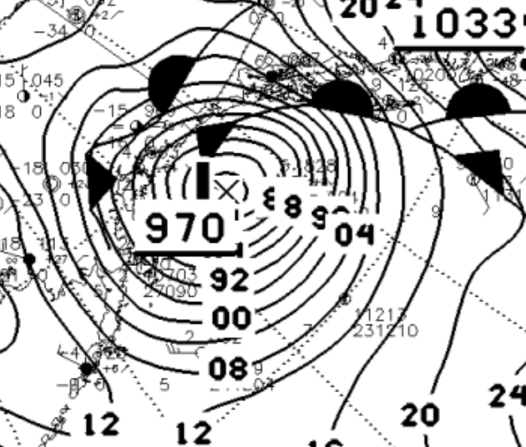
Stronger Pressure Gradients with Stronger Winds

Slide 23
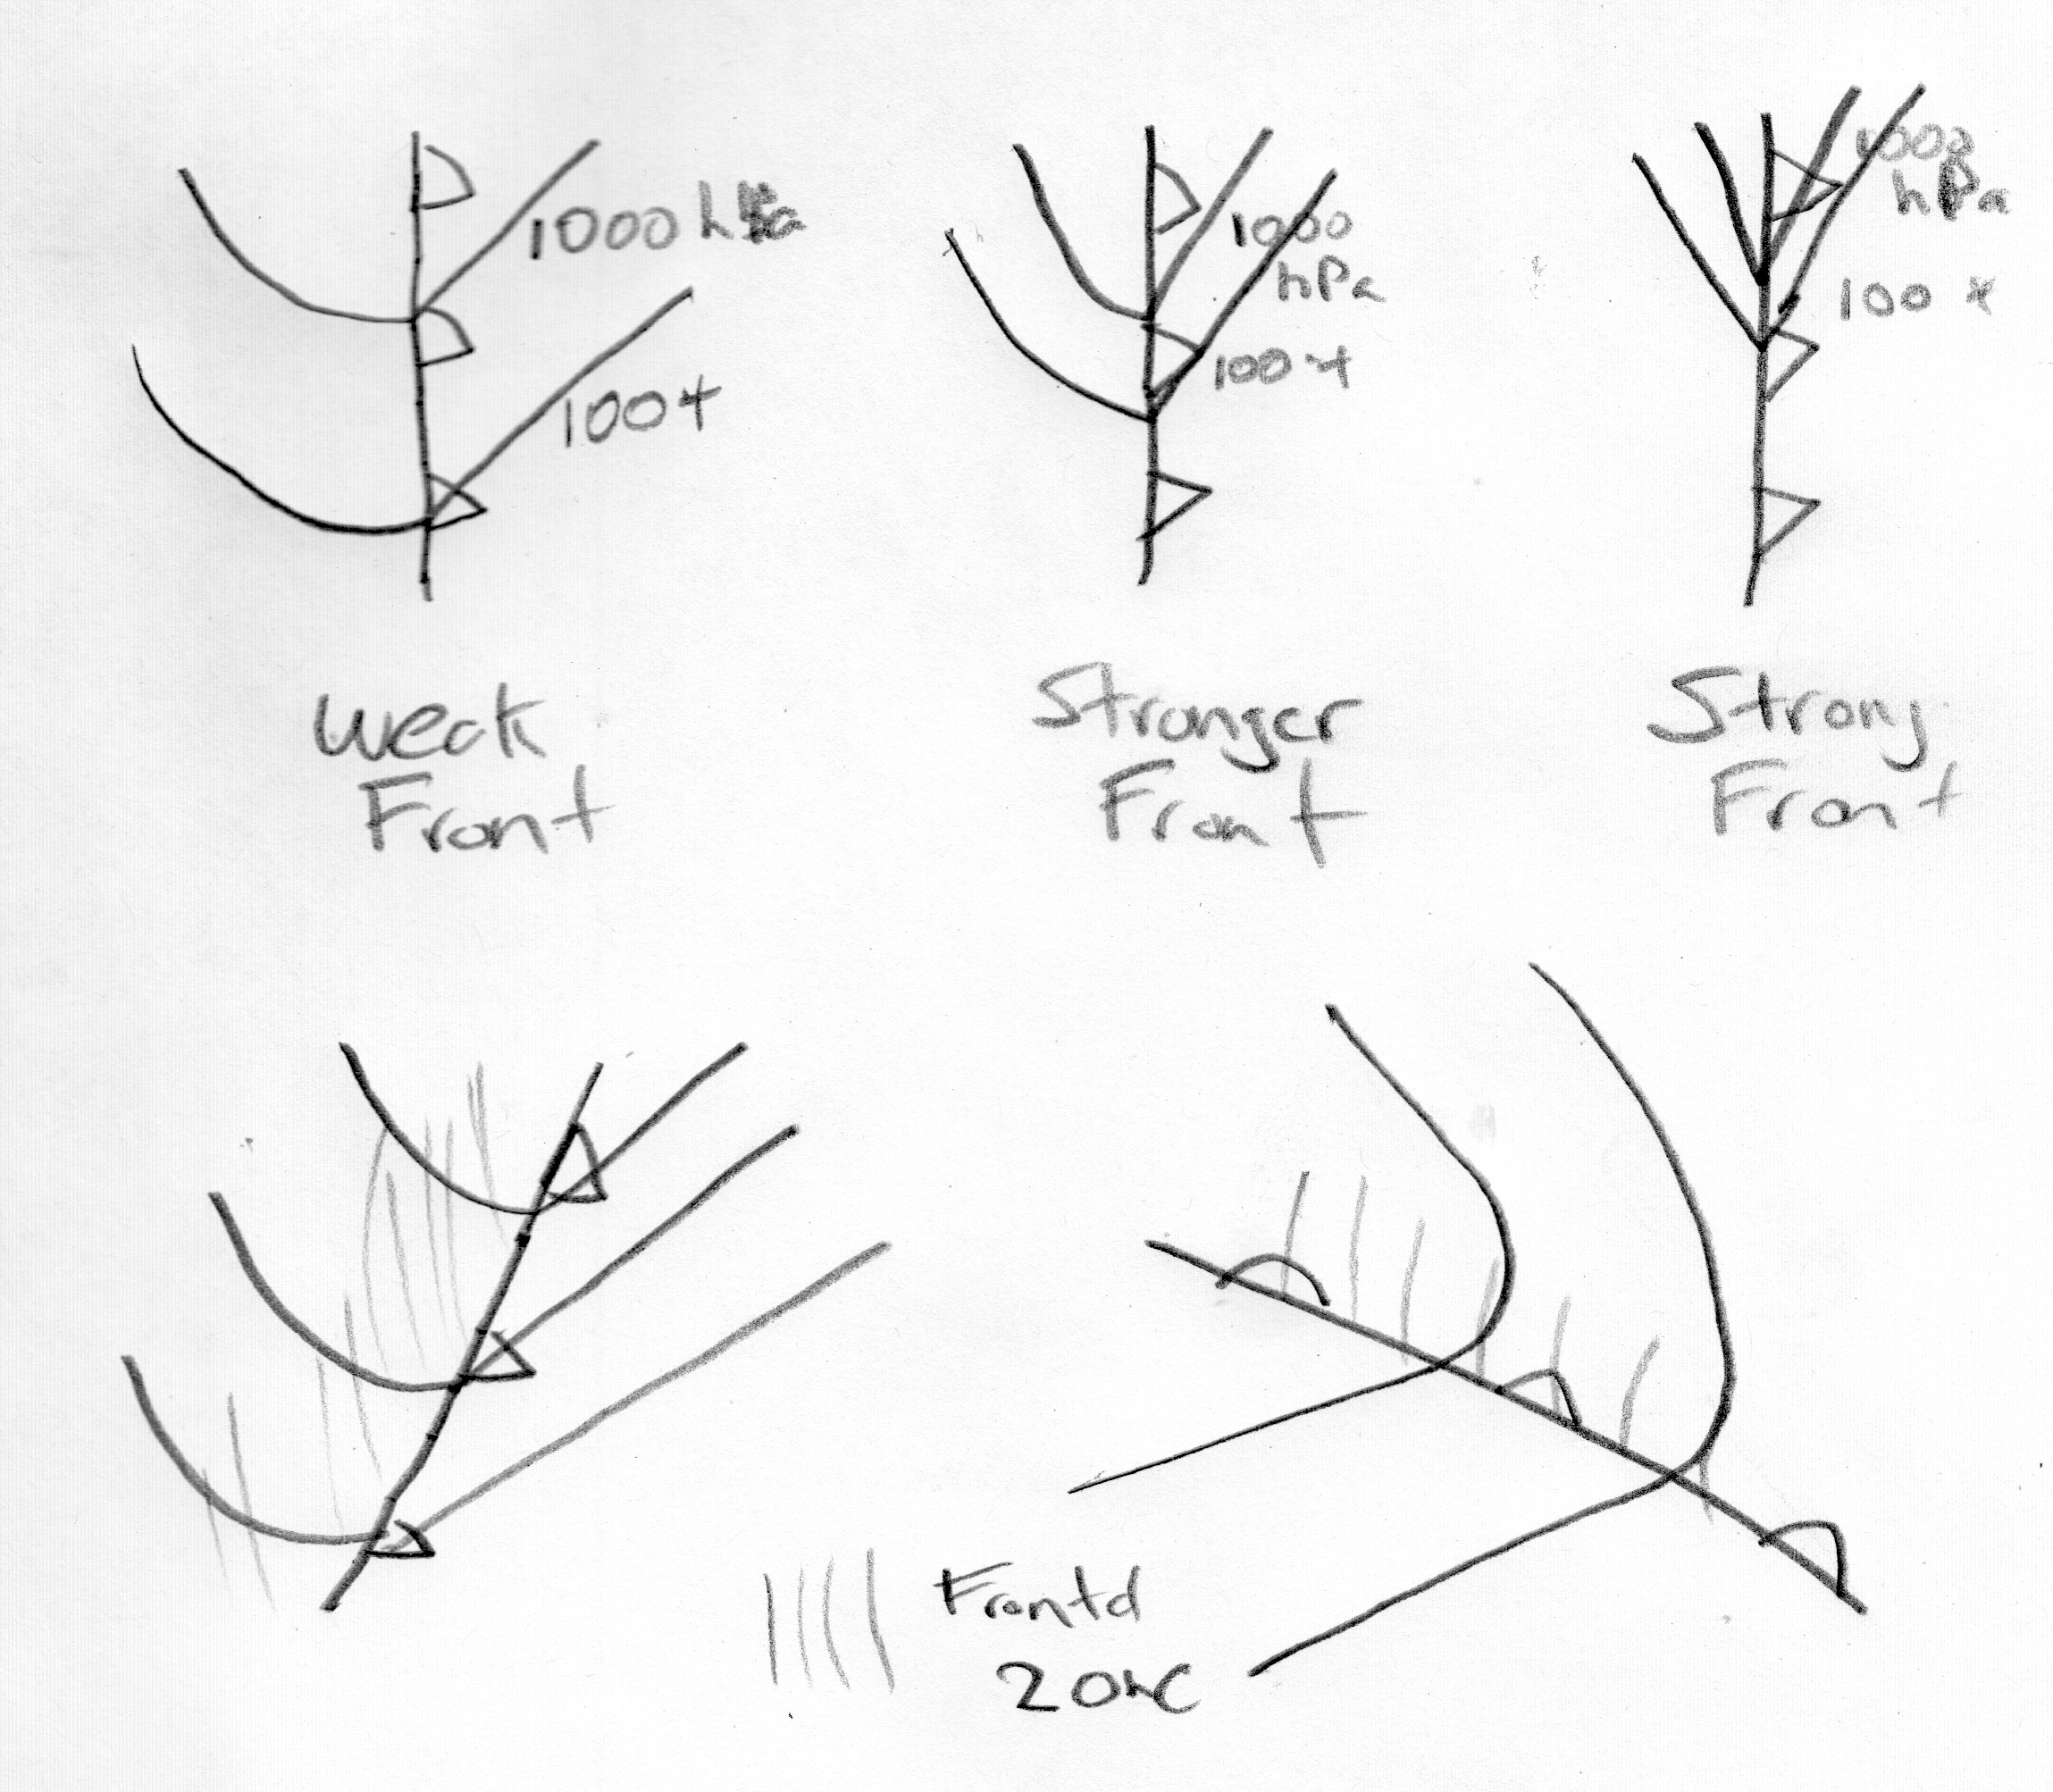
Knowing Where Fronts Provides Information About Pressure
Fronts are in troughs of lower pressure
Pressure “kinks” with fronts
Sharper, more intense fronts, sharper kink
The curvature of isobars should be on frontal zone side of fronts.

Slide 25
The Quality of National Weather Service Pressure Analyses Vary:
The Good, The Bad, and the Ugly

Slide 26
The Good

Slide 27
The Bad

Slide 28
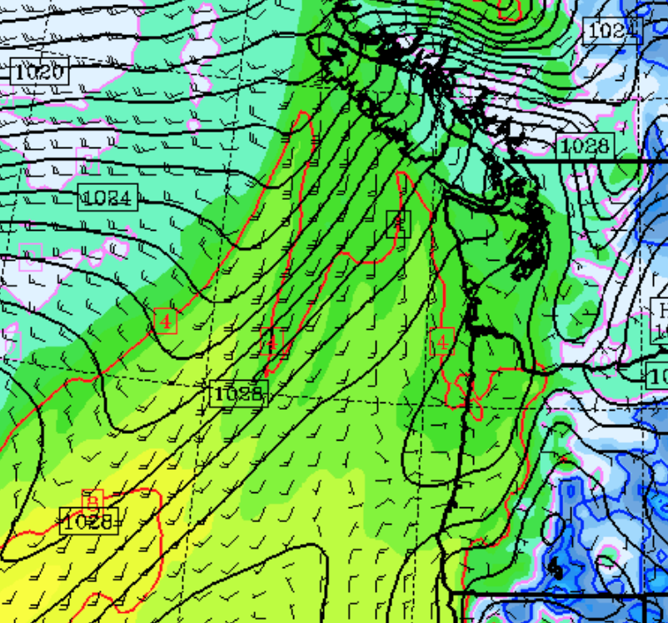
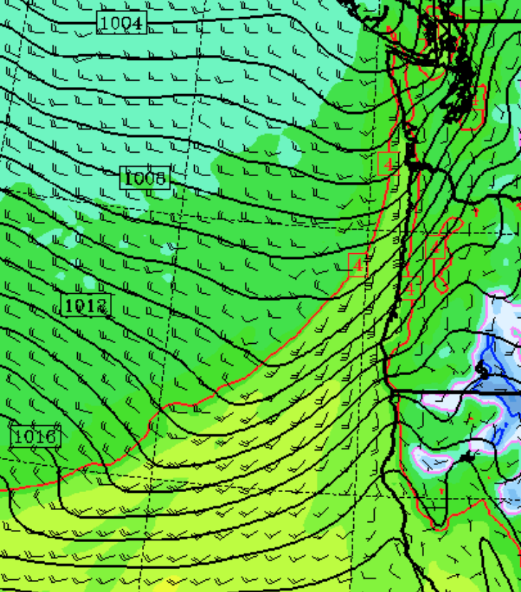
The Model

Slide 29
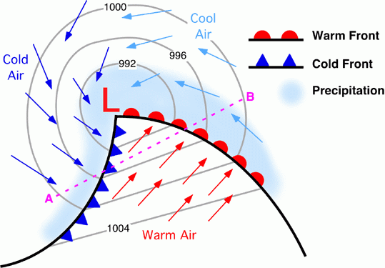
Isobars relatively straight in warm sectors
Fronts Tend to Be in Pressure
Troughs

Slide 30
Frontal Analysis by Parameter
Knowing how key parameters vary across fronts is a major aid for frontal analysis

Slide 31
Temperature
Never Forget: fronts lead the temperature gradient. They are NOT in the middle of the temperature gradient

Slide 32
Front
51 52 53 54 58 65 67 68 68
Frontal
Zone
relatively uniform cool air
relatively uniform warm air

Slide 33
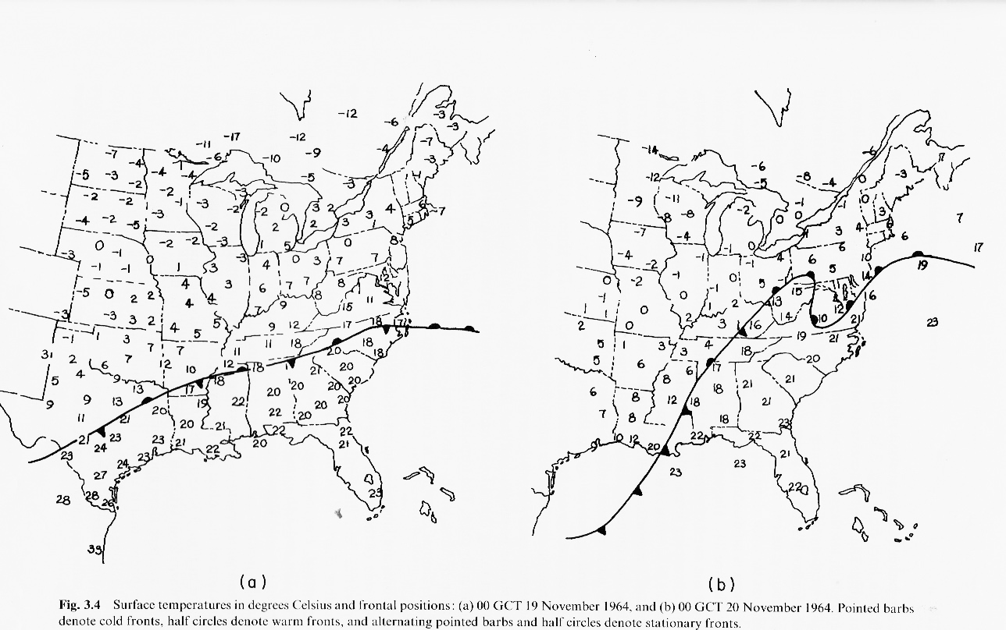
Fronts and Temperature

Slide 34
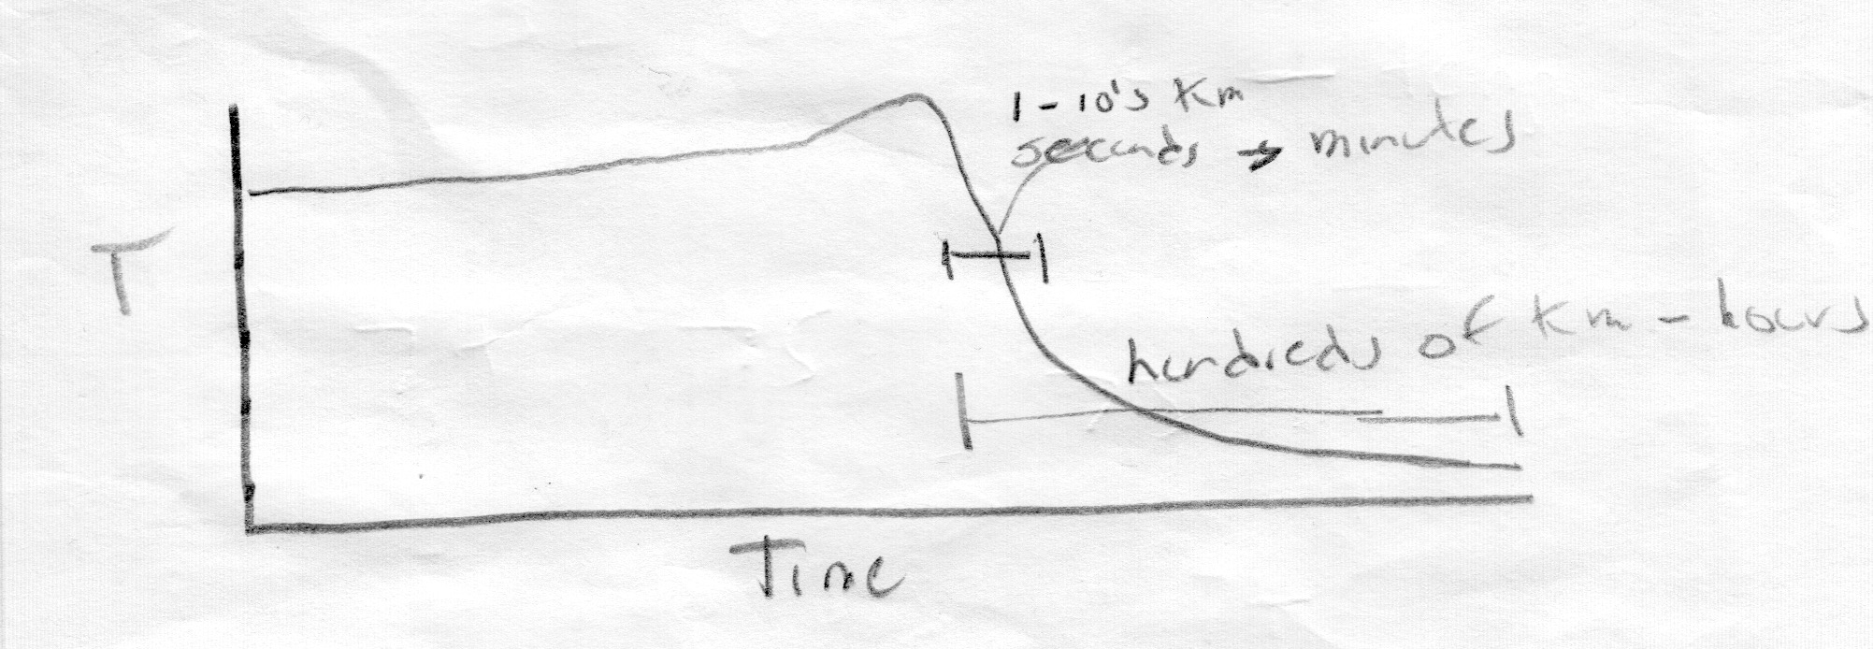
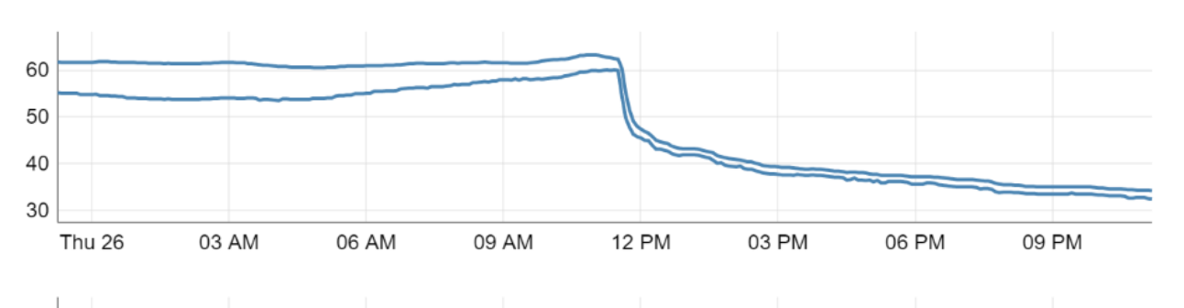
Temperature Variation Across Fronts Generally Not Linear
The Largest Temperature Change Often in First Few km

Slide 35
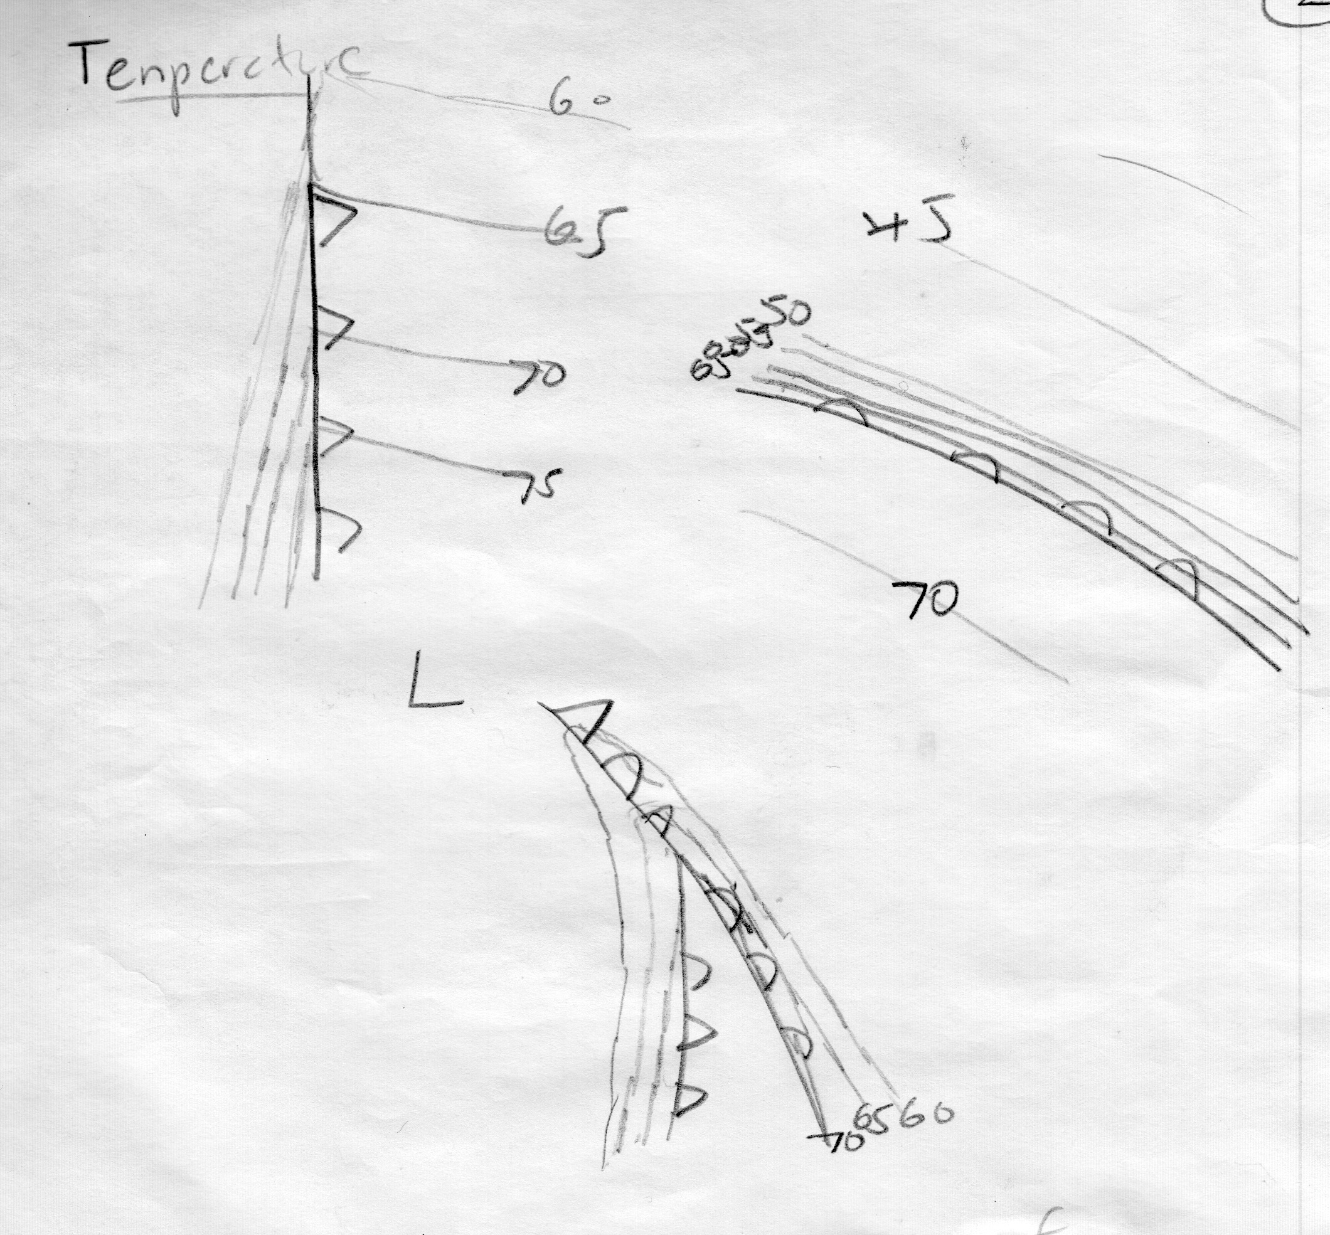
Surface Temperature Variations with Various Fronts

Slide 36

Temperature Changes with Fronts Over the Ocean
Air-sea interactions can have profound effects

Slide 37
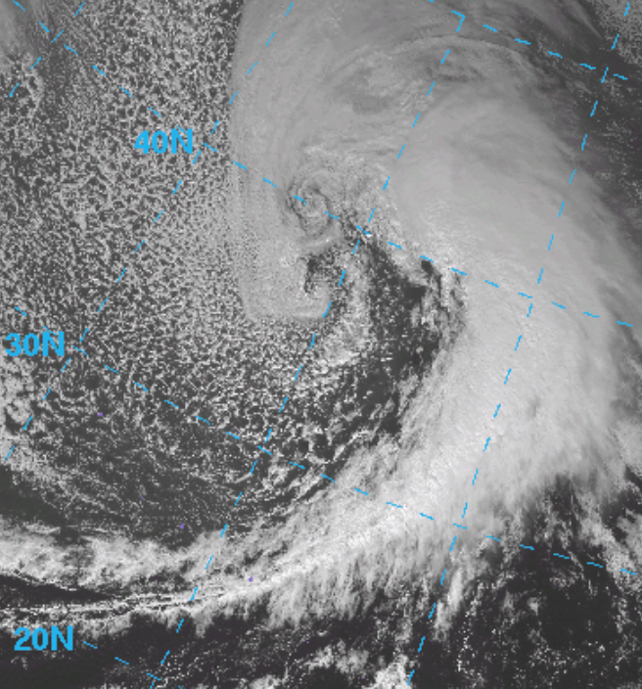
Low-level temperature variations greatly weakened by warming of cold air
Western oceans surface temperature decline of 2-8F, over land 5-30F.
Temperature gradients over ocean often stronger at 850 hPa than near the surface

Slide 38
Air-Sea temperature differences (from buoys and ships) can be useful
Warm sector: air can be warmer than ocean
Behind cold front: air colder than water
Air colder
Than water
Air warmer
Than water

Slide 39
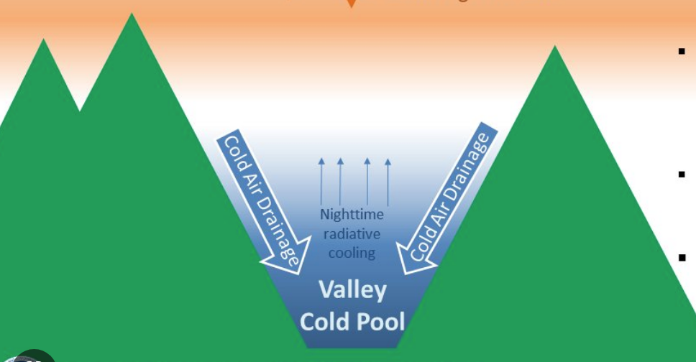
In deep valley’s, particularly high mountain valleys sometimes little change of temperature with frontal passage
In such situations, pressure change can be a better marker of frontal passage

Slide 40
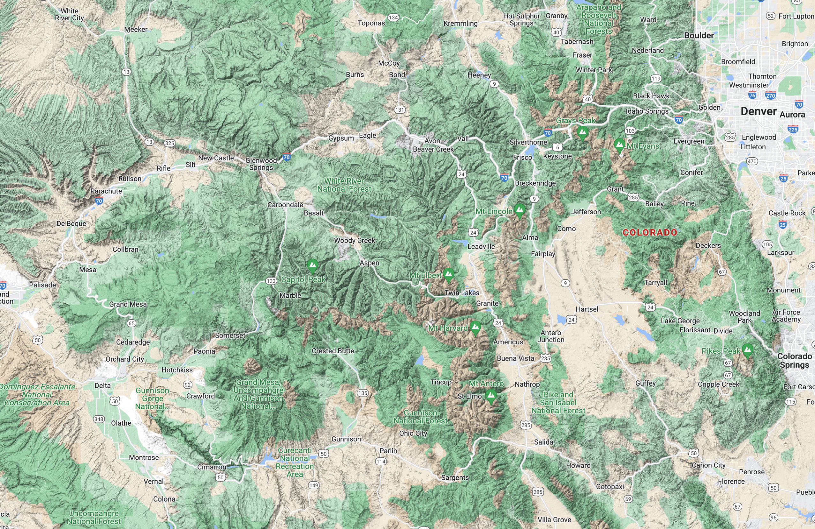
Colorado

Slide 41
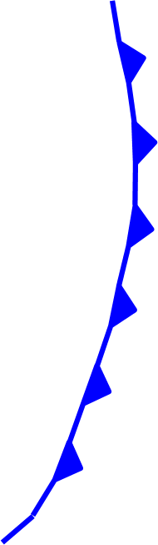
Dew point temperature
Declines across frontal zone.
Sometimes is more useful than temperature (e.g., southeast US)
No clouds
In cold
air
Cloudy
Warm sector

Slide 42
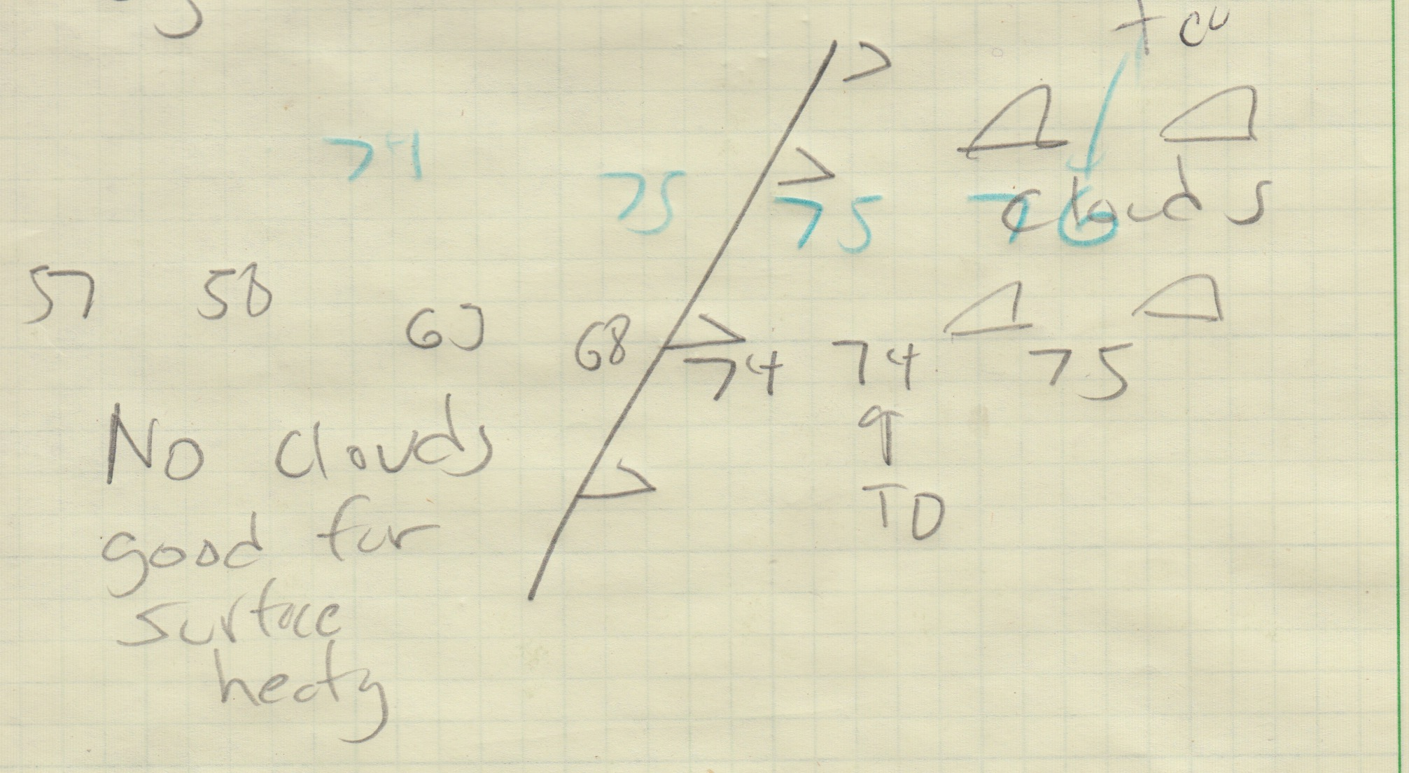

Slide 43
Dew point
Small dew point changes from fronts off the ocean.
In winter, can get BIG dew point drops in NW (and elsewhere), with passage of Arctic Fronts.

Slide 44
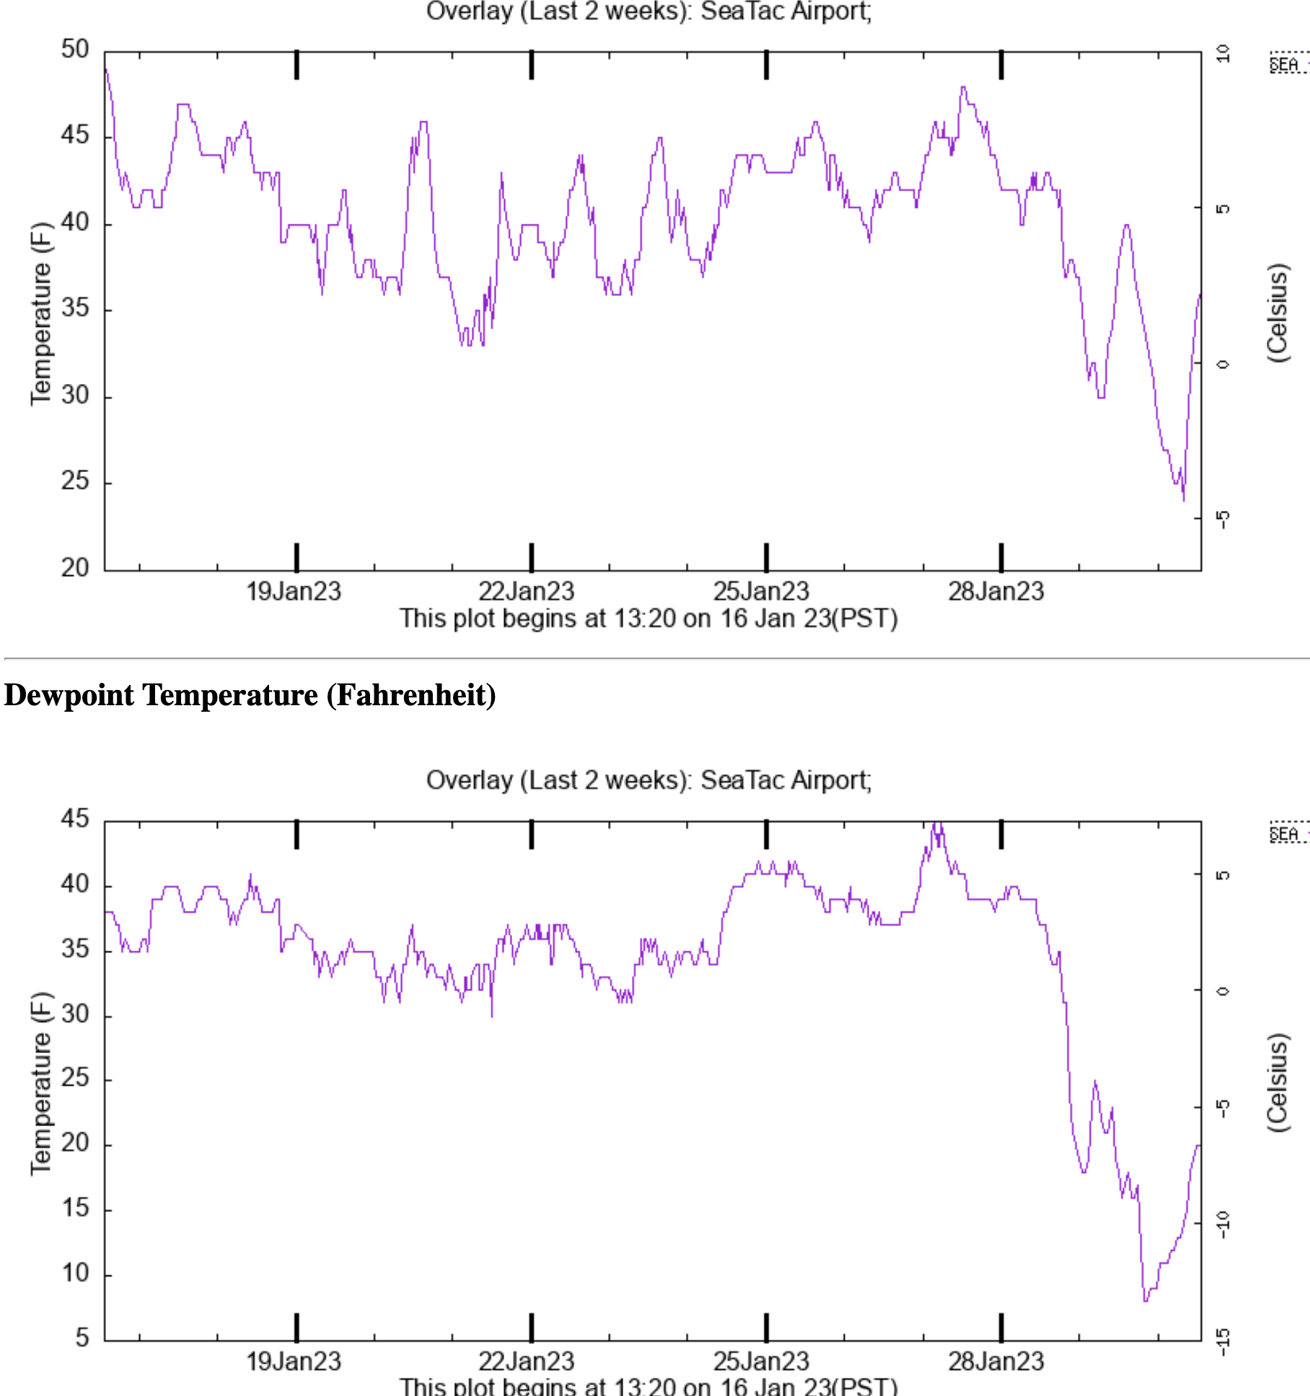

Slide 45
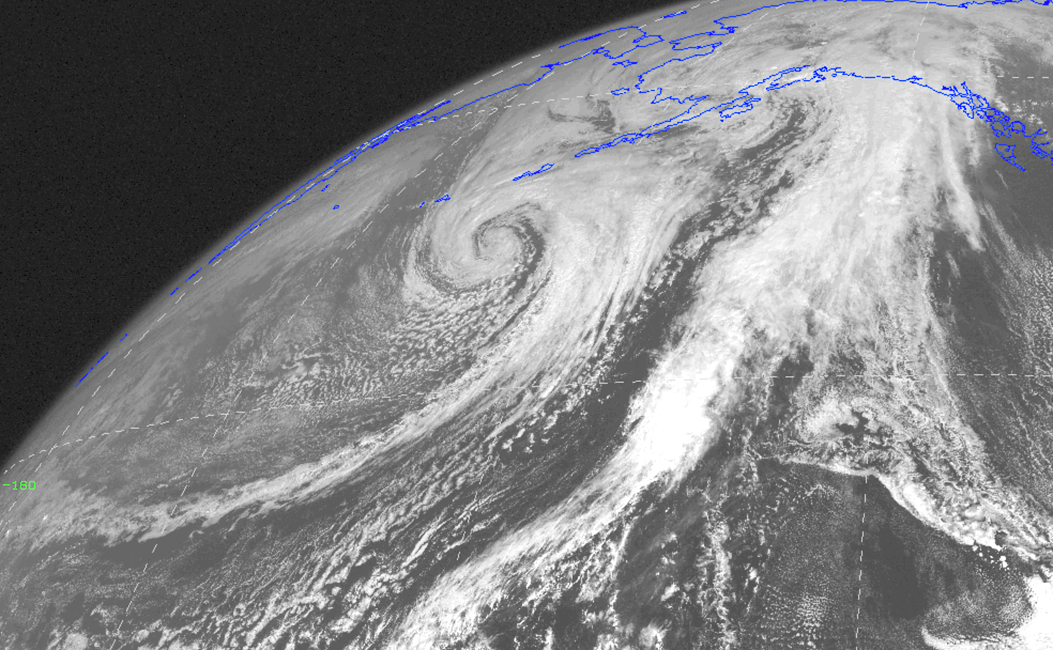
Fronts are associated with bands of clouds

Slide 46
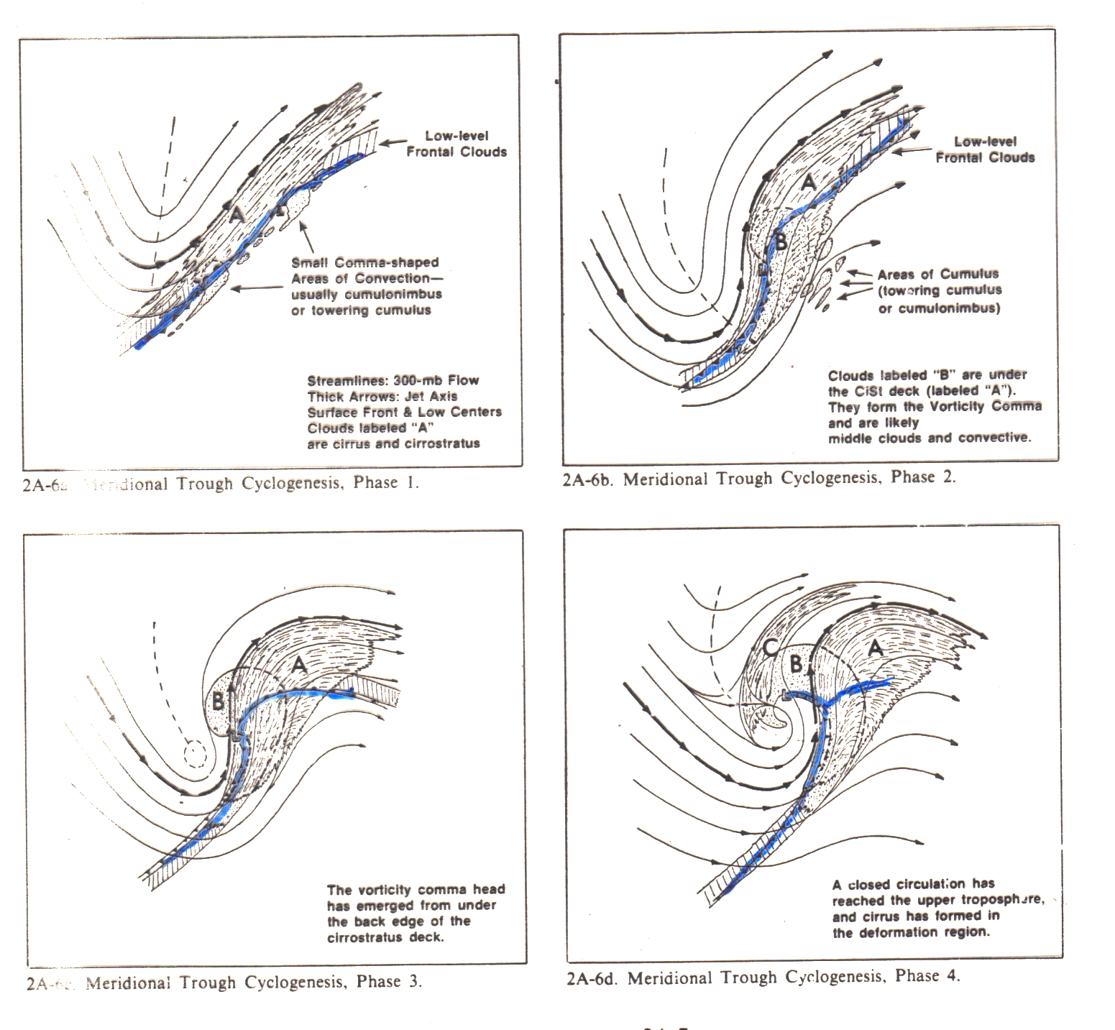
Typical Cyclogenesis
L
L
L

Slide 47
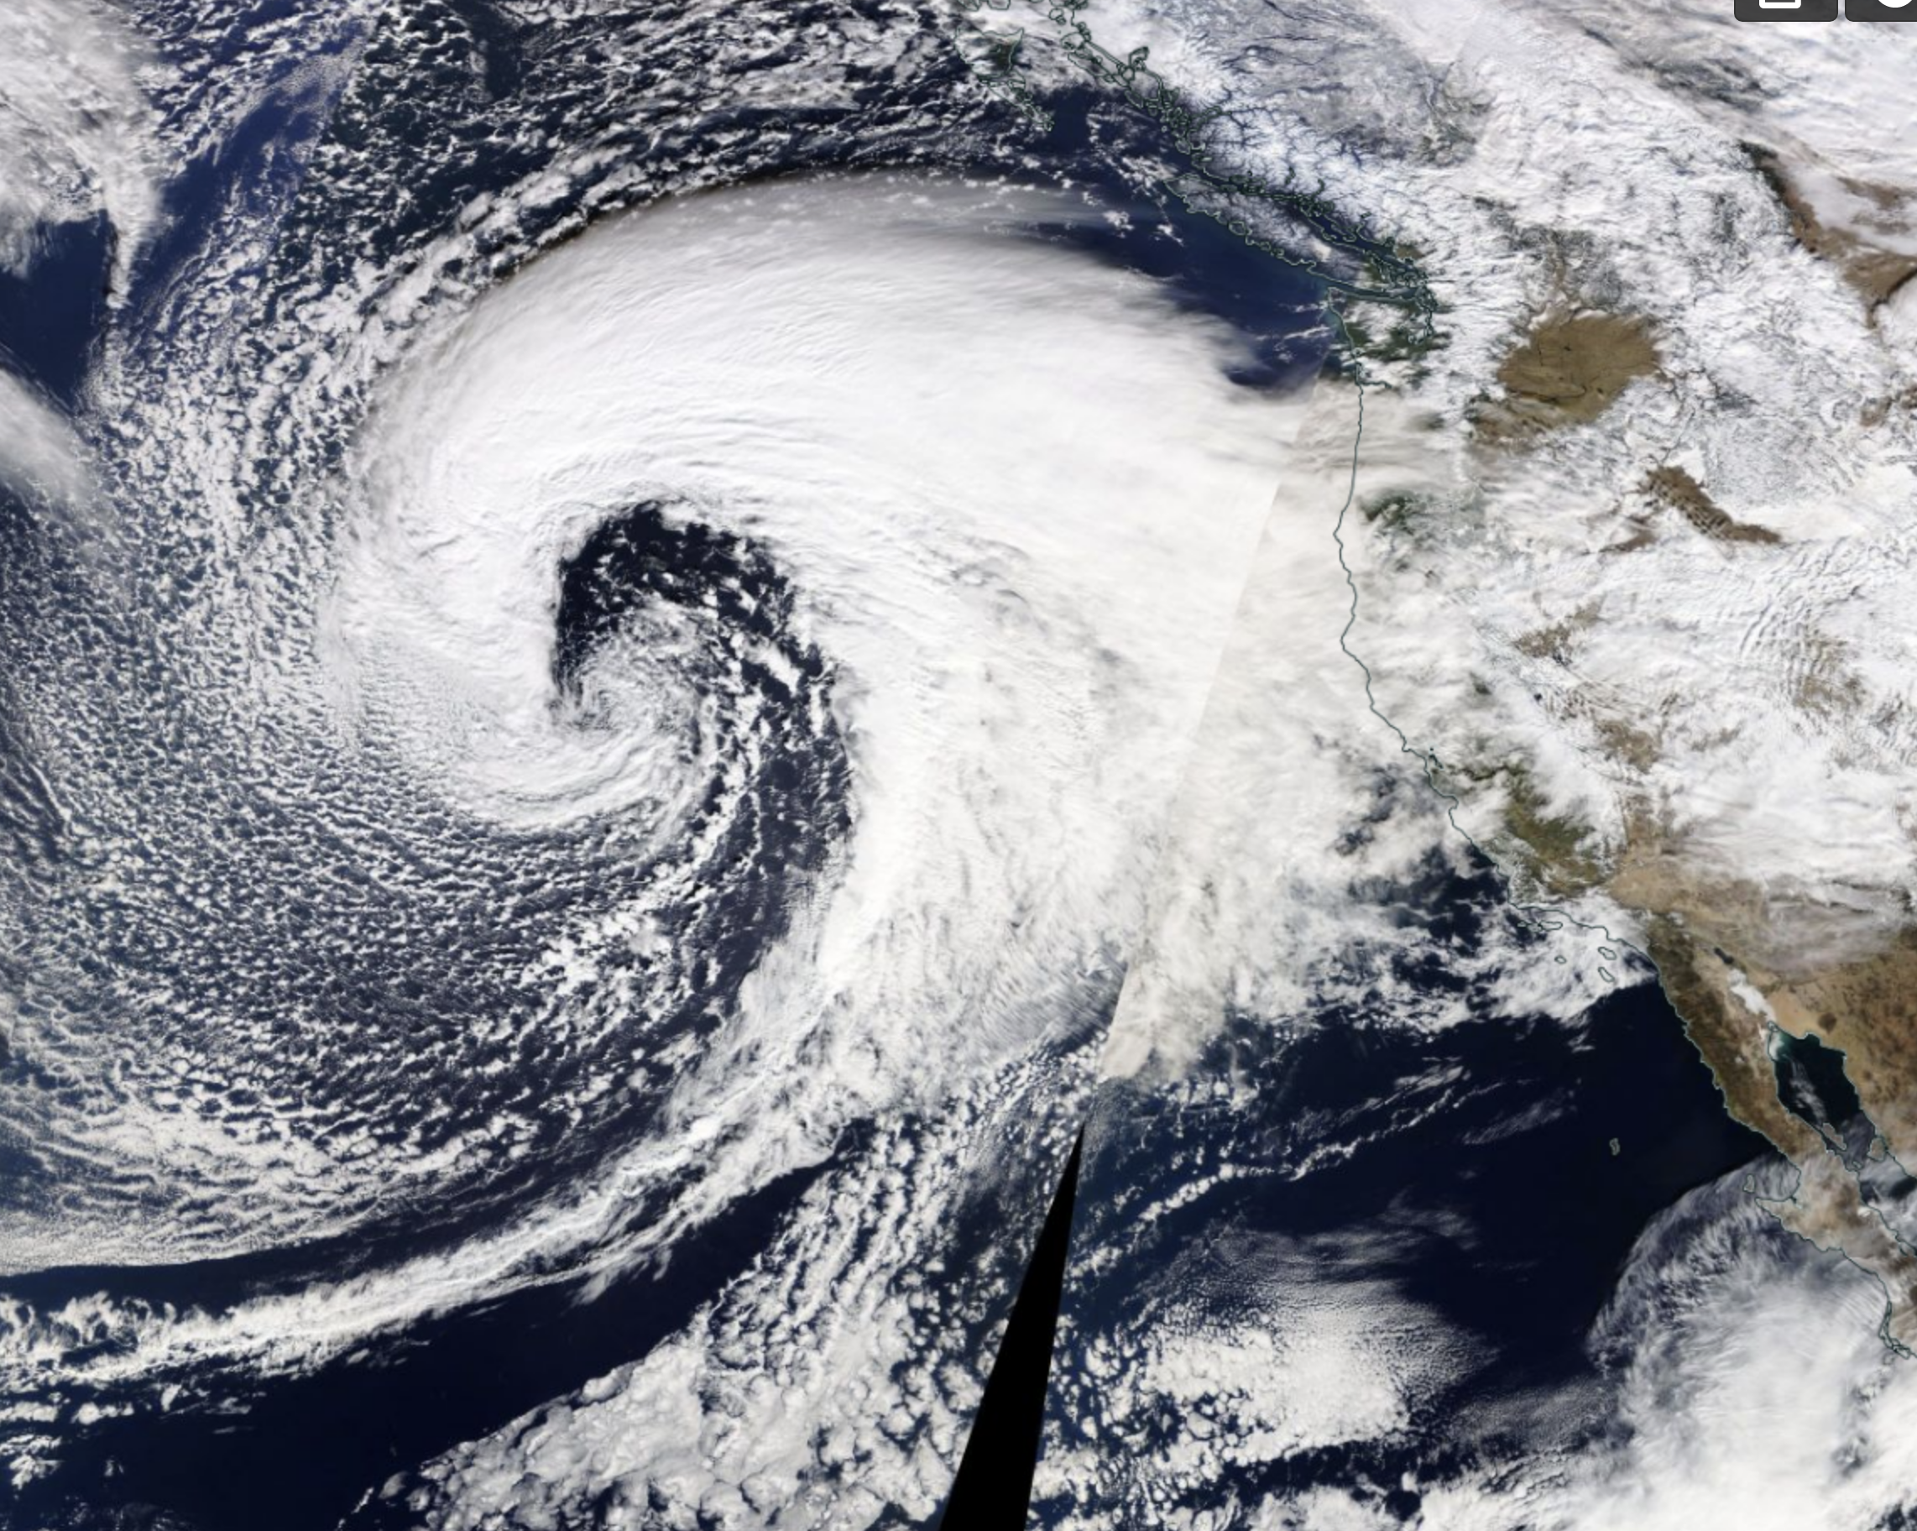

Slide 48
Much more later when we talk about satellite meteorology

Slide 49
Surface Wind Variations
In N. Hemisphere wind generally veers in time (turns clockwise) with frontal passage.

Slide 50

Clockwise Turning with Frontal Zone Passage
Note there is a component of cold air towards cold front
Frontal
Zone
Clockwise
turning

Slide 51


Clockwise Turning in Frontal Zone
Note there is a component of cold air towards away from warm front
Frontal
Zone
Clockwise
turning

Slide 52
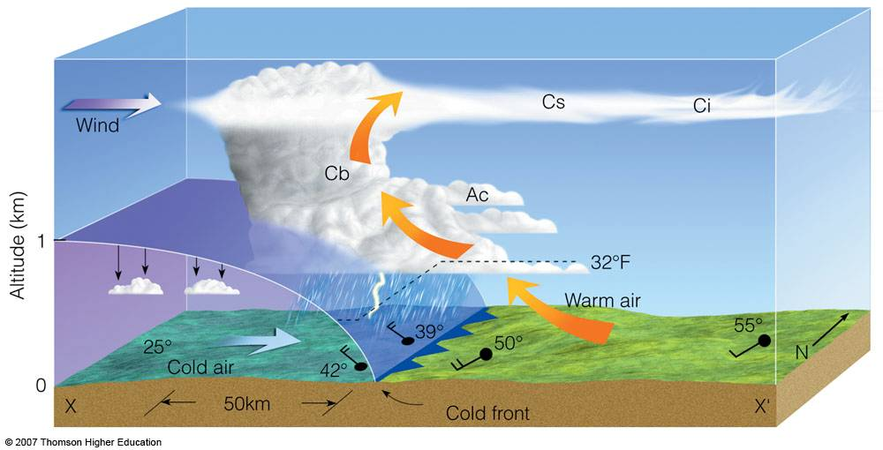
The Motion of the Front is Controlled by the Direction of the Cold Air in the Frontal Zone

Slide 53
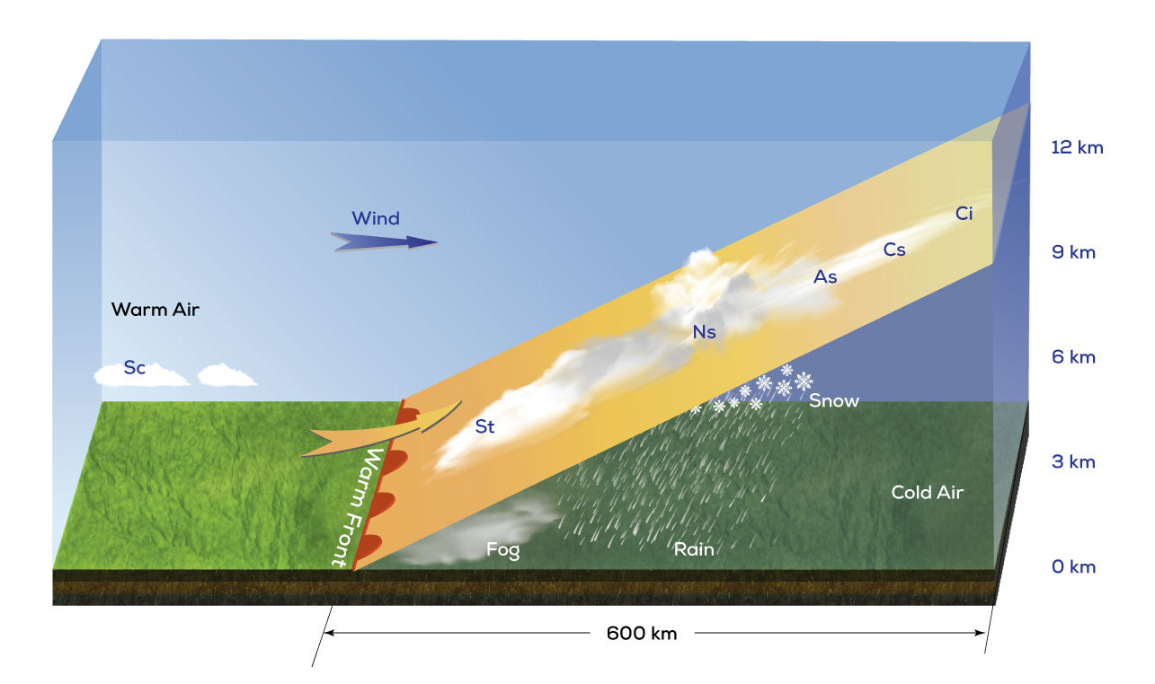

Slide 54
Stationary Fronts: Winds and isobars tend to be parallel to the front, but substantial wind shear
H
p+Δp
p
L
p
p+Δp
H

Slide 55
Stationary Front Alternative
H
p
p+Δp
p+Δp
P+2Δp
H

Slide 56
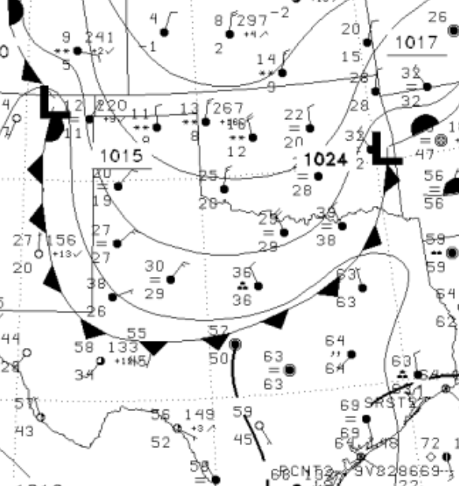
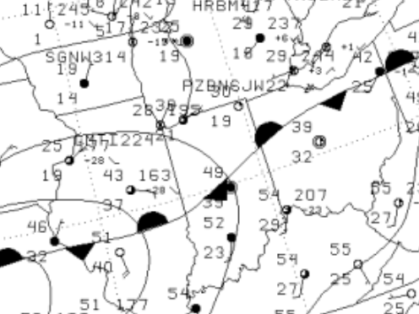
Thus, winds behind front inform on type of front and where is will move!

Slide 57
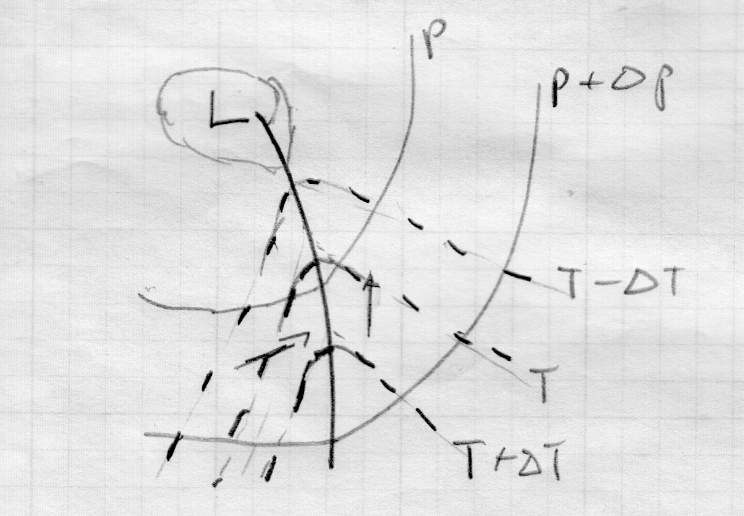
Occluded Front: Curved isobars on both sides (makes sense…frontal zones on both sides)

Slide 58
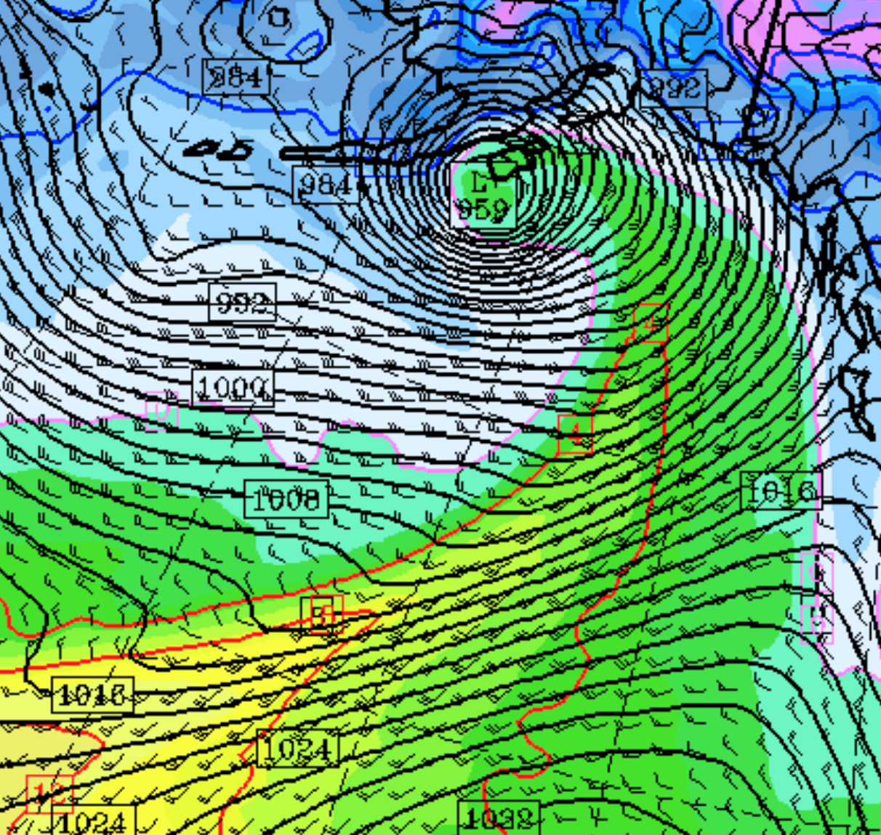
Occluded front temperatures gradient and wind shear weaken towards the low

Slide 59
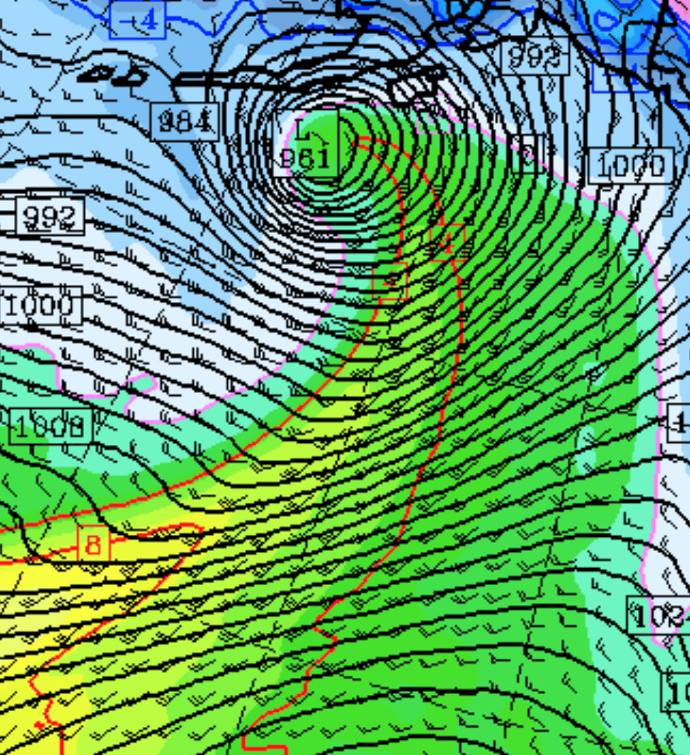
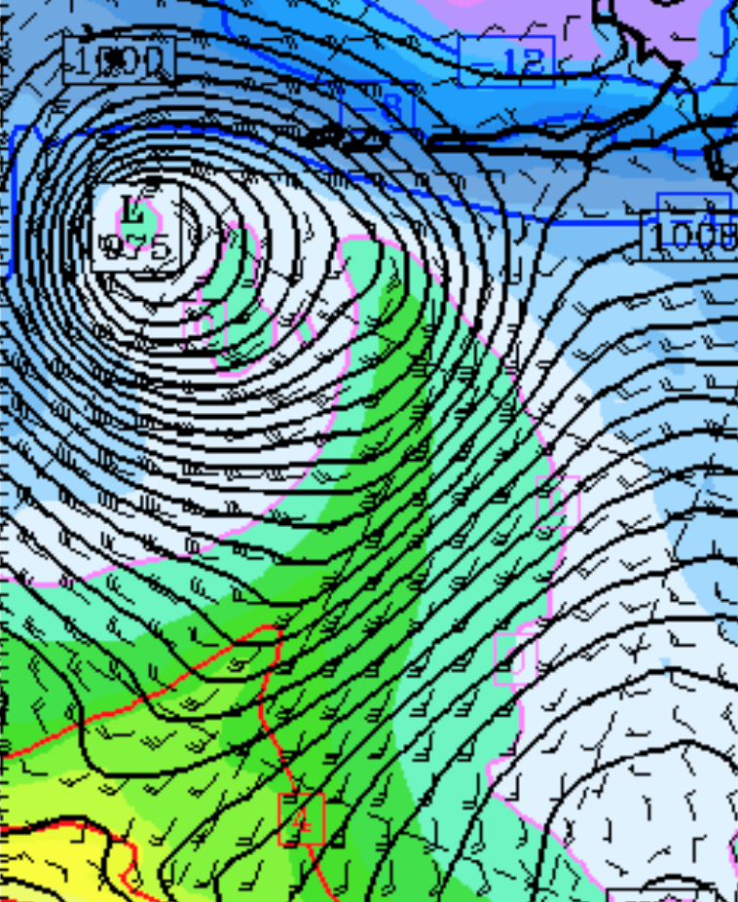

Slide 60
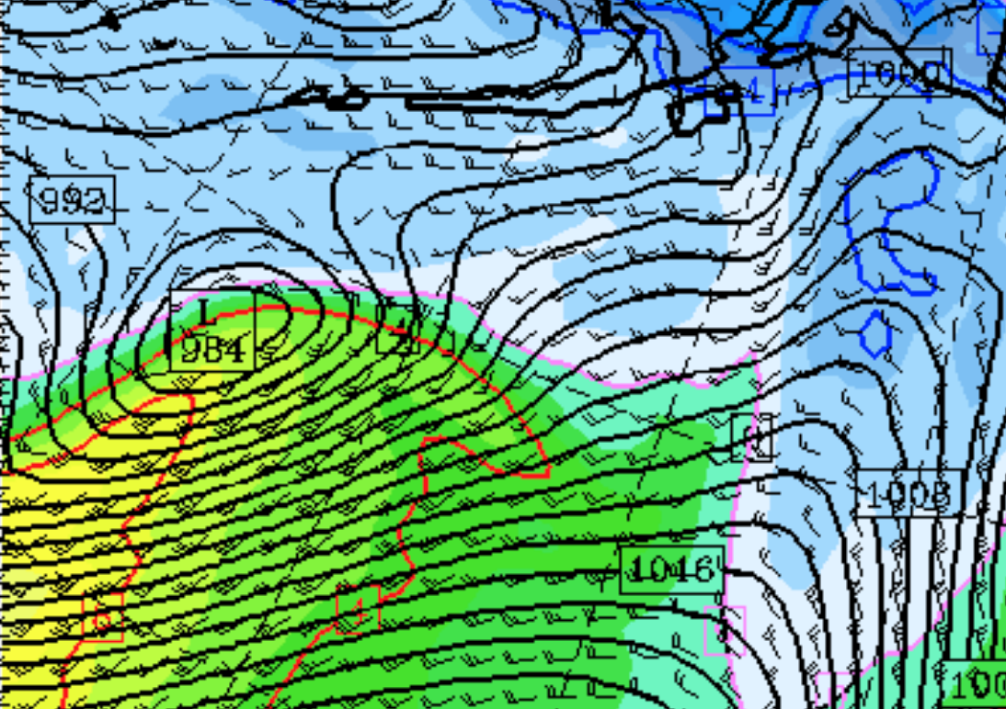
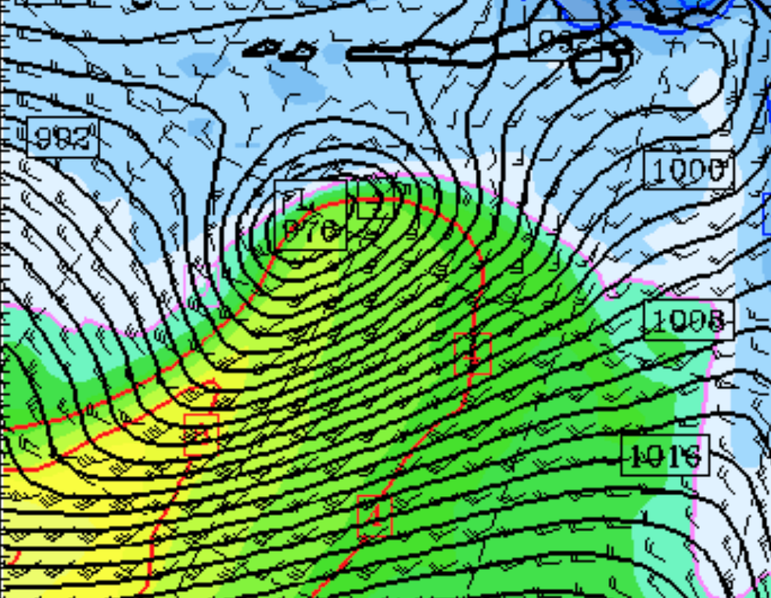
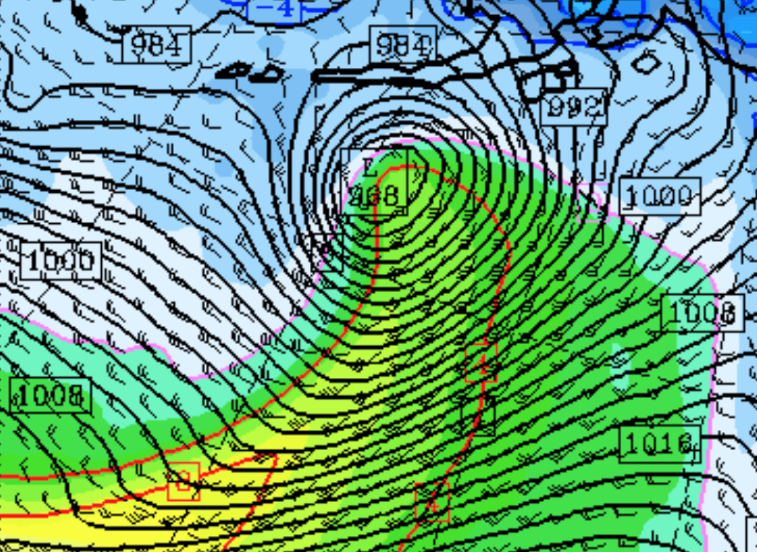
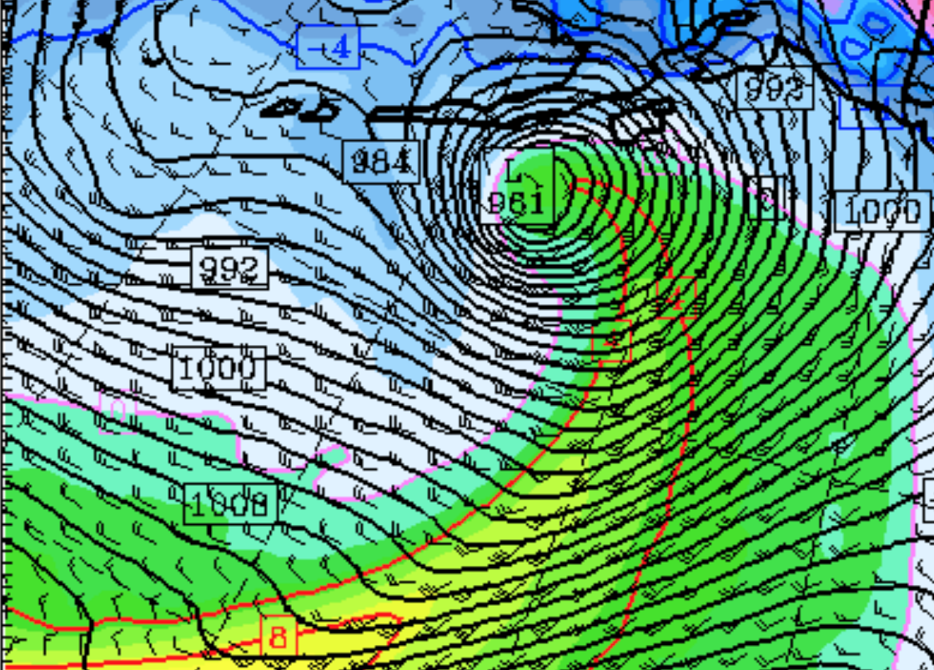
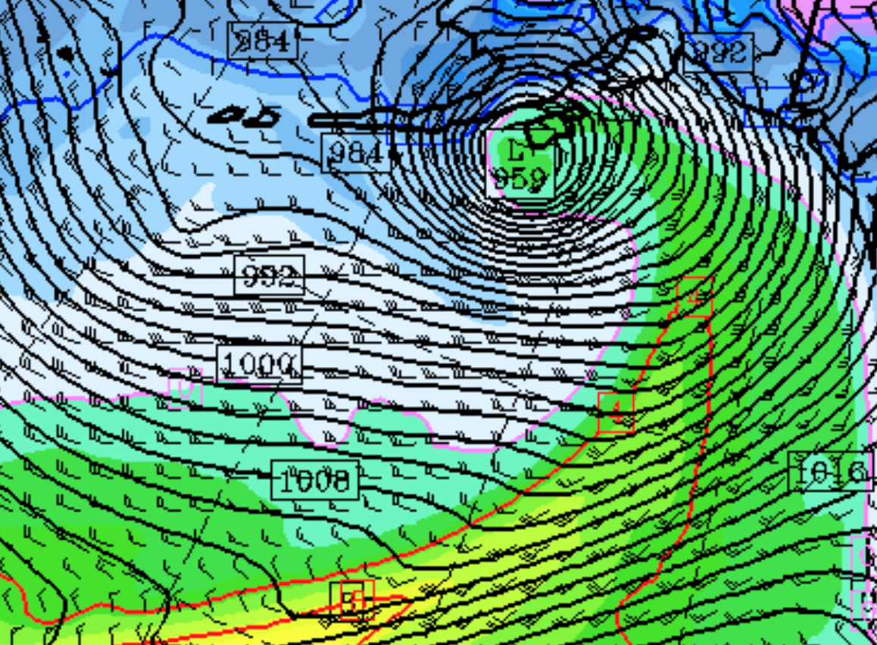
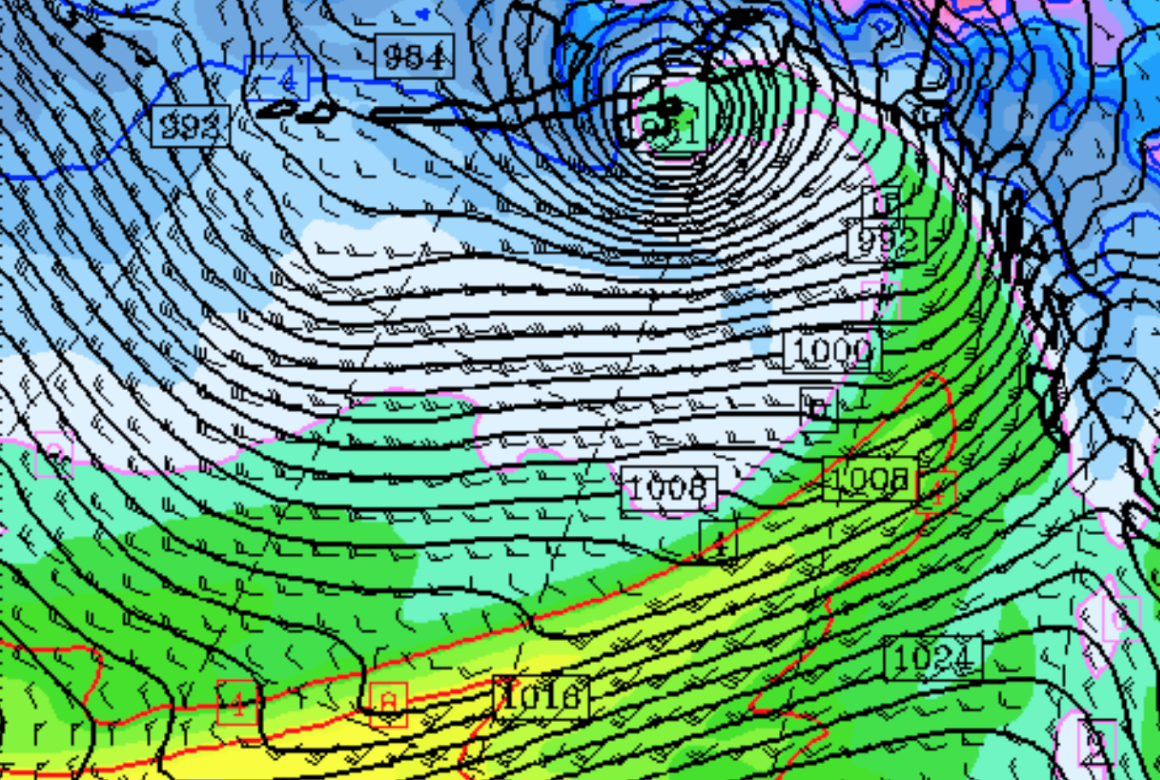

Slide 61
Pressure Tendency

Slide 62

-
-
-
-
+
-
+
+
Rising behind
Cold front
Falling in front
Of warm front
-
+
-
+
+
+
Biggest declines in front of Low

Slide 63


Slide 64

Pressure Change at Some Location
After cold
front
Warm
front
approaches
Warm
sector

Slide 65

Keep in mind typical diurnal pressure variations!
Pressure tends to be highest around 10-11 AM
Lowest around 4 PM
Significant pressure falls during early afternoon

Slide 66
Consistency
Fronts should not only be consistent with the flow in frontal zone, but consistent in time.
Should NOT jump around, go backwards without reason, etc.
Plotting previous positions on your chart can be helpful.

Slide 67


Earlier
Later

Slide 68
Sometimes fronts CAN jump forward
“Strange” behavior due to surface drag and vertical mixing.

Slide 69


Slide 70
Cold Fronts Generally Move Faster than Warm Fronts why?

Slide 71
Naturally strong wind component with cold frontal zones

Slide 72

More unstable behind cold front, mixes higher momentum down to the surface

Slide 73

Fronts are associated with precipitation, generally most intense near the front and on the cold air side

Slide 74


Slide 75


Slide 77
Oceanic Cyclone and Frontal Structure

Slide 78

Shapiro-Keyser Model of Oceanic Cyclones

Slide 79
Major Elements of S-K Model
Weak cold front (why do you think?)
Northern part of cold front is very weak (“fractured”)
Not much evidence of classic occlusion (well defined tongue of warm air projected to low center).

Slide 80
Major Elements of S-K Model
“T-Bone” structure: cold front intersects the warms front at approximately a right angle
Strong back bent (or bent back) warm front.
Warm air seclusion near the low center.

Slide 81

Simulation of the QE-2 Storm (Sept. 1978)

Slide 82

Simulation of the QE-II Storm

Slide 83

Neiman
and
Shapiro
1993

Slide 84


Slide 85

Air-Sea Interactions Warm the Cold Air, Weakening the Cold Front
Weak

Slide 86

Cross Section Across Ocean Cold Front

Slide 87

Cross Section Across Warm Front

Slide 88

Cross Section Across Warm Front and Associated Low-level Jet

Slide 89

Warm
Seclusion
Stage

Slide 90

Cross Section Across Warm-Air Seclusion: Circulation Weakens With Height

Slide 91

Strongest Winds With Back-Bent Warm Front

Slide 92


Slide 93


Slide 94

December 27, 2022

Slide 95


