Slide 1
Thickness
Thickness is the difference in the geopotential height between two pressure surfaces.

Slide 2
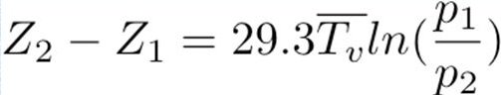
Key equation: hypsometric equation z₂-z₁ is thickness

Slide 3
Thickness is proportional to the mean virtual temperature of the layer between two pressure surfaces
Thus, the difference in the geopotential height between two pressure levels is related to the intervening temperatures.
Warmer Tv is associated with high thickness
Cooler Tv associated with lower thickness
Horizontal distribution of thickness can provide the distribution of temperature in the layer.

Slide 4
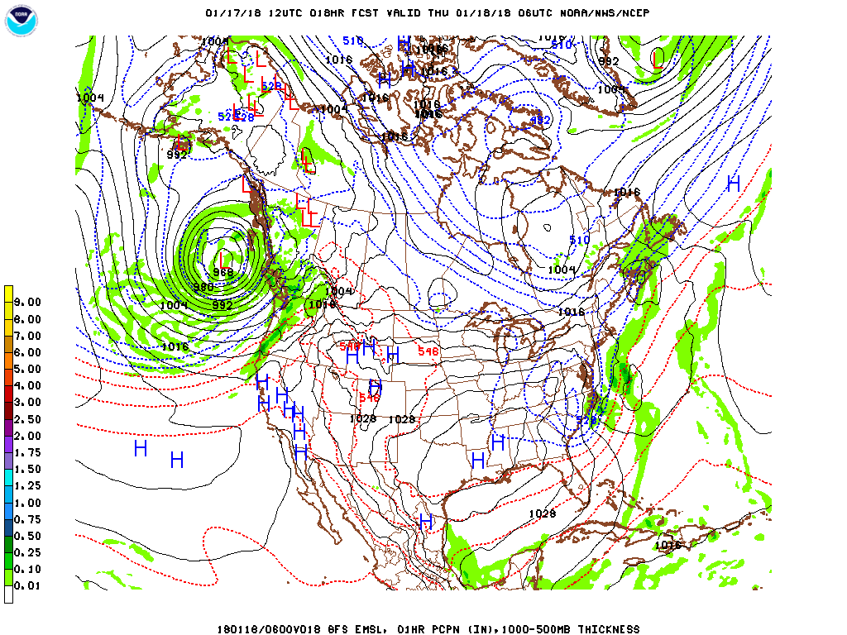
1000- 500 hPa thickness is the most popular…gives a measure of the mean temperature of the lower troposphere
Rule of thumb: 60 m change in 1000-500 hPa thickness associated with a 3C change in mean virtual temperature of the layer
Often given in decameters (dm)

Slide 5
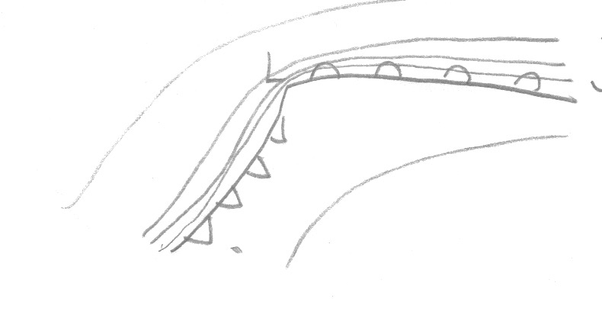
Uses of thickness: (1) a good measure of lower tropospheric temperature gradients (baroclinicity)…good way to find fronts.
Lower
Higher

Slide 6
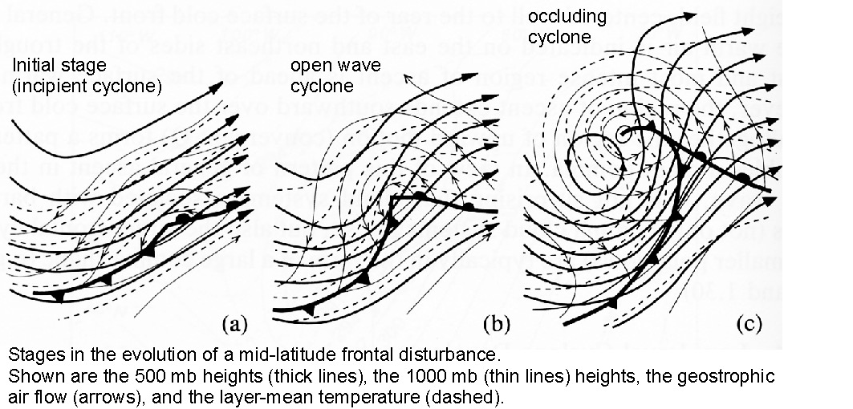

Slide 7
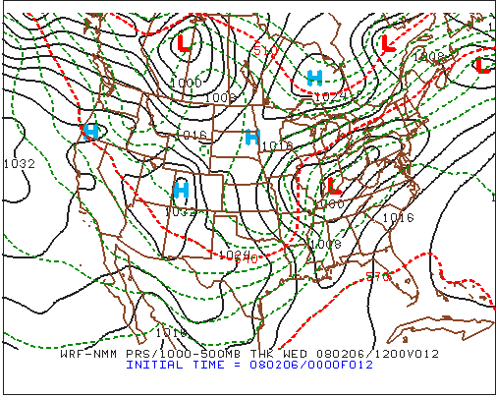

Slide 8
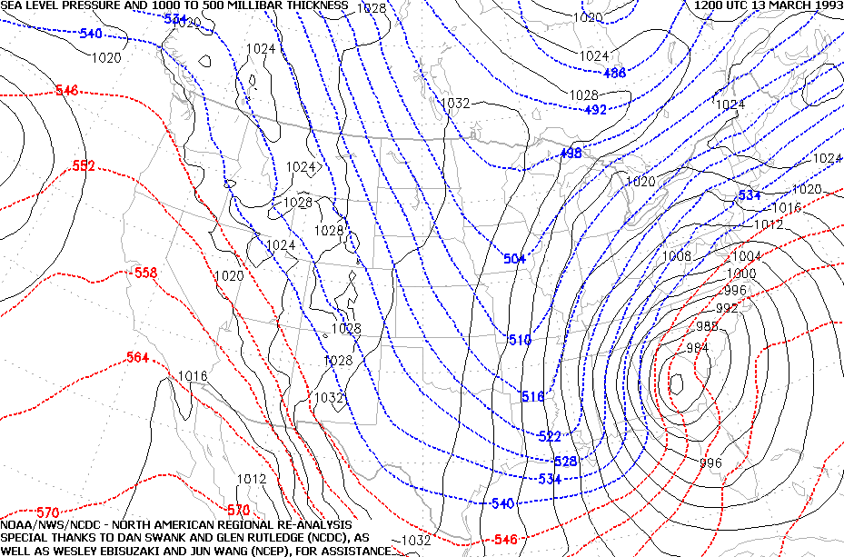

Slide 9
Useful for forecasting: e.g. rain-snow line Rain-snow interface (50% chance of snow if precip) : ~ 5400 m continental ~ 5220 m marine Why?

Slide 10
1000-850 hPa thickness heavily used by the NWS for snow forecasting
50/50% at 1300 meter 1000-850 hPa thickness

Slide 11
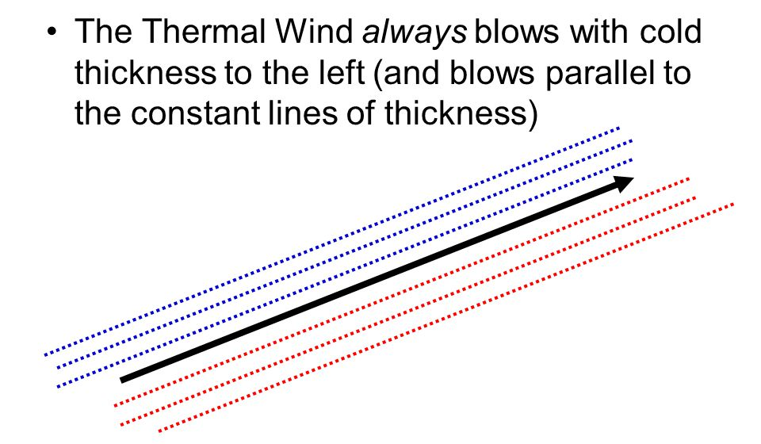
Thickness is related to the thermal wind vector (more in next lecture)

