Slide 1
Global Warming and the Media
Cliff Mass
February 28

Slide 2
Some Questions
What is the role of the media in communicating about global warming?
What are some of the dangers and issues in discussing this topic?
How can one get reliable information?

Slide 3
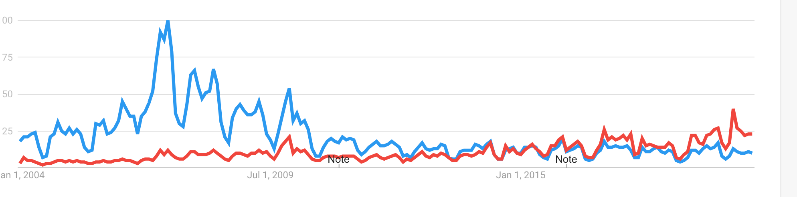
Global Warming Versus Climate Change: Which Term Should You Use?
How has concerns changed over time?
General move from global warming to climate change
Global Warming
Google Trends
Climate Chang

Slide 4
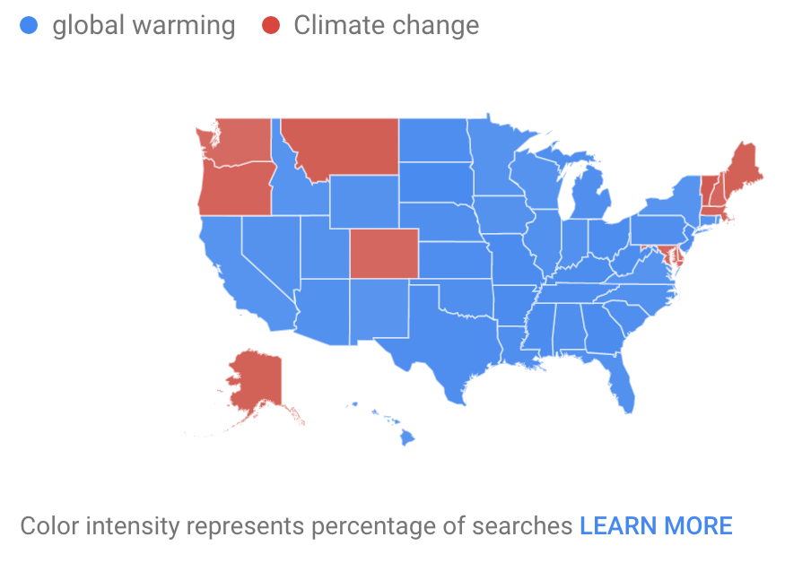
Varies Geographically

Slide 5
My Own Take
Much better to use global warming…which is generally associated with anthropogenic (human-caused) change.
Climate change is too vague, with climate changing for many reasons.
Most folks don’t think about it much in their daily lives.

Slide 6
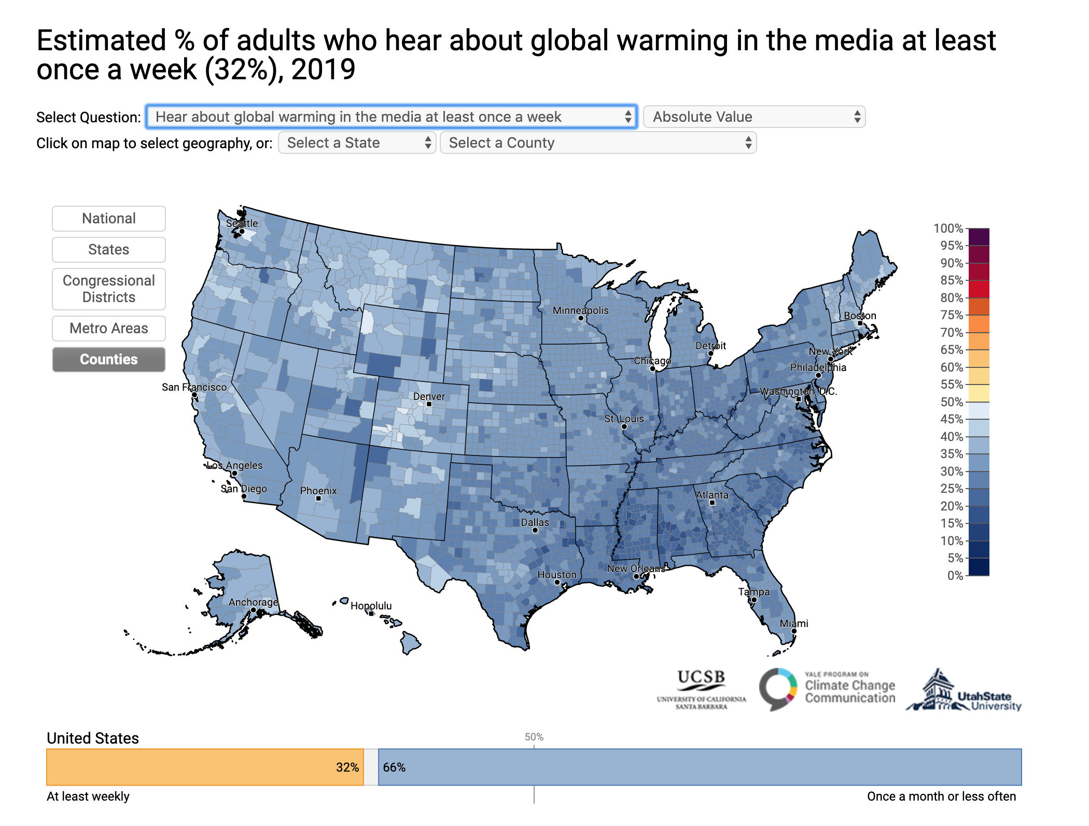

Slide 7
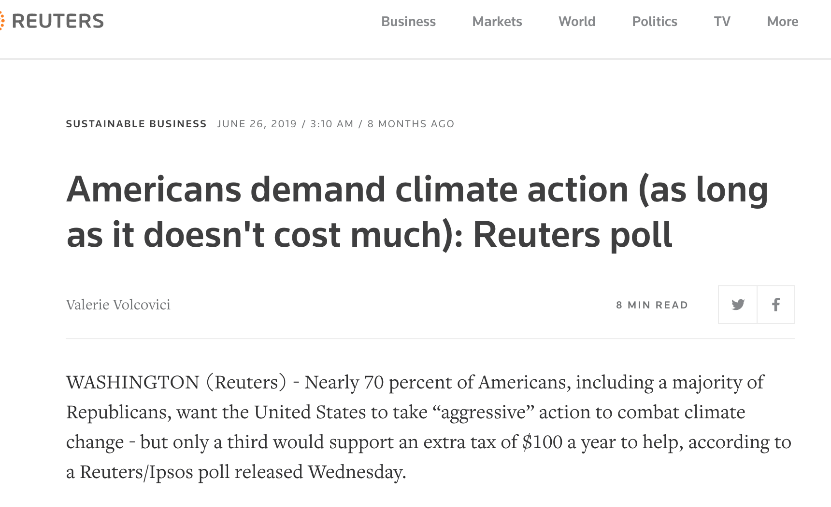

Slide 8
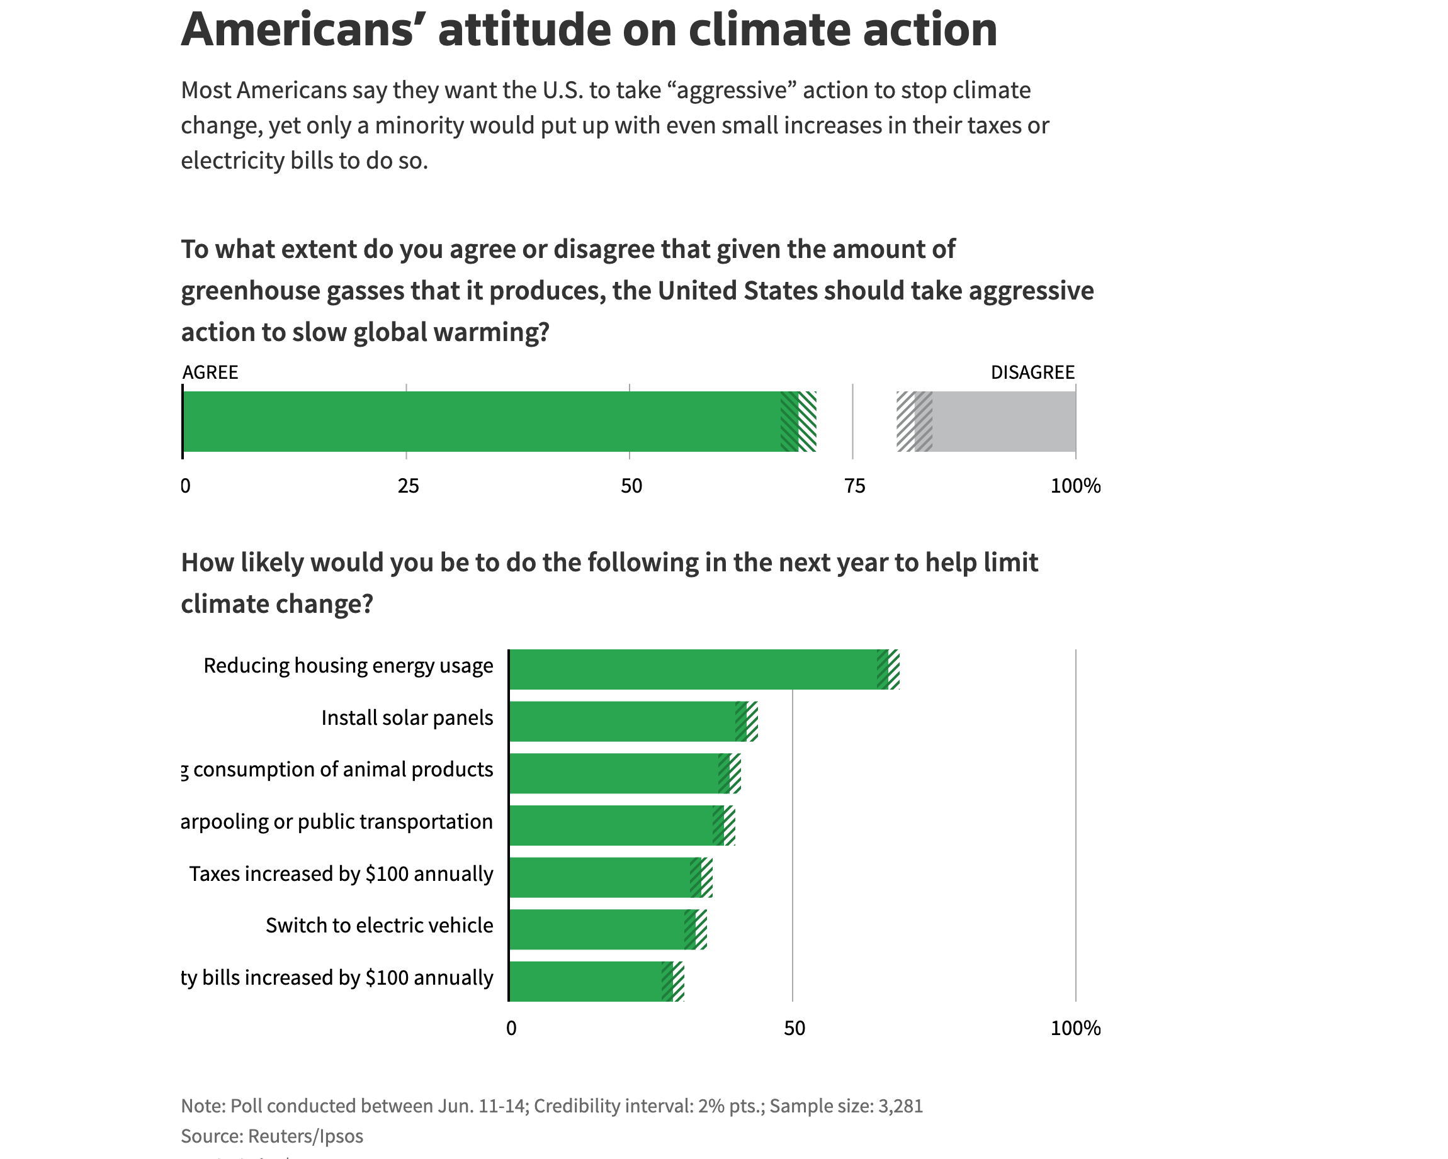

Slide 9
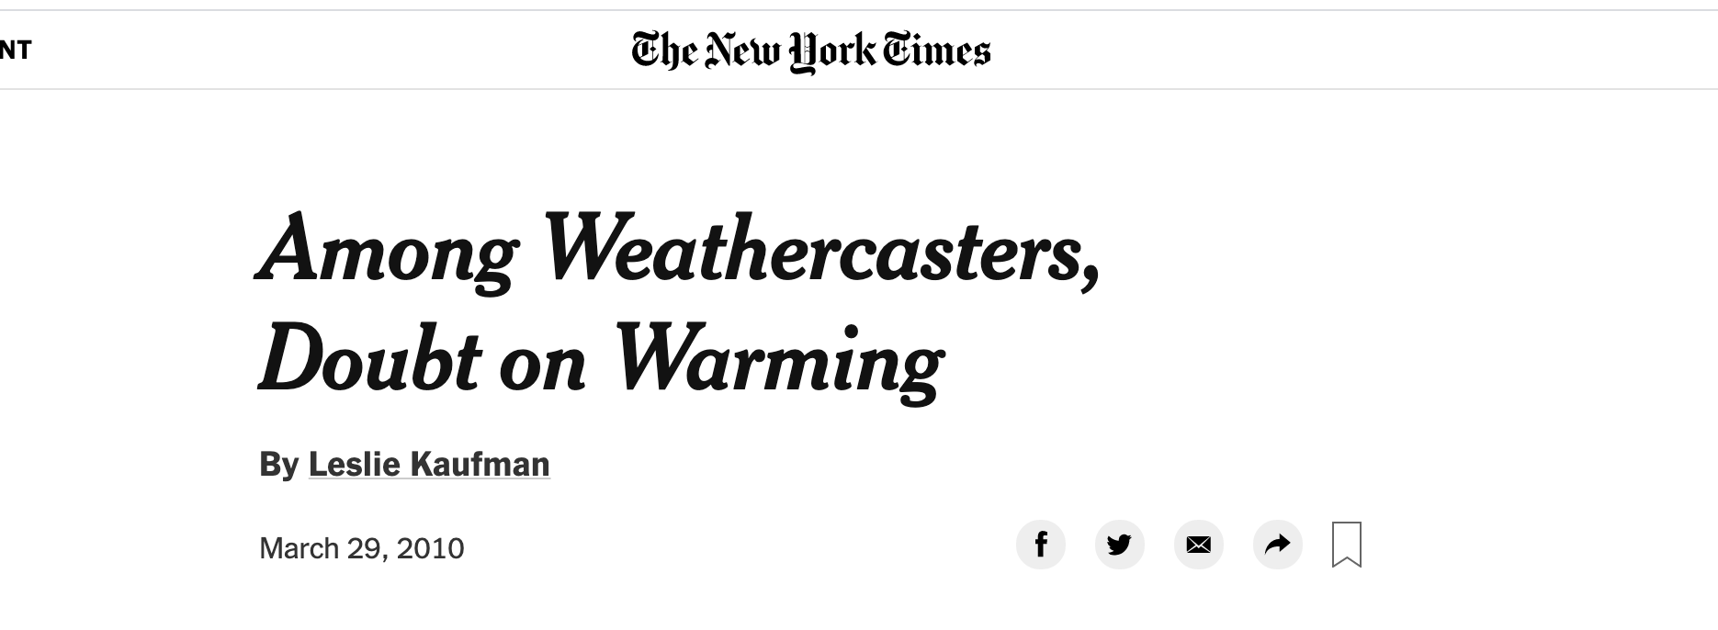
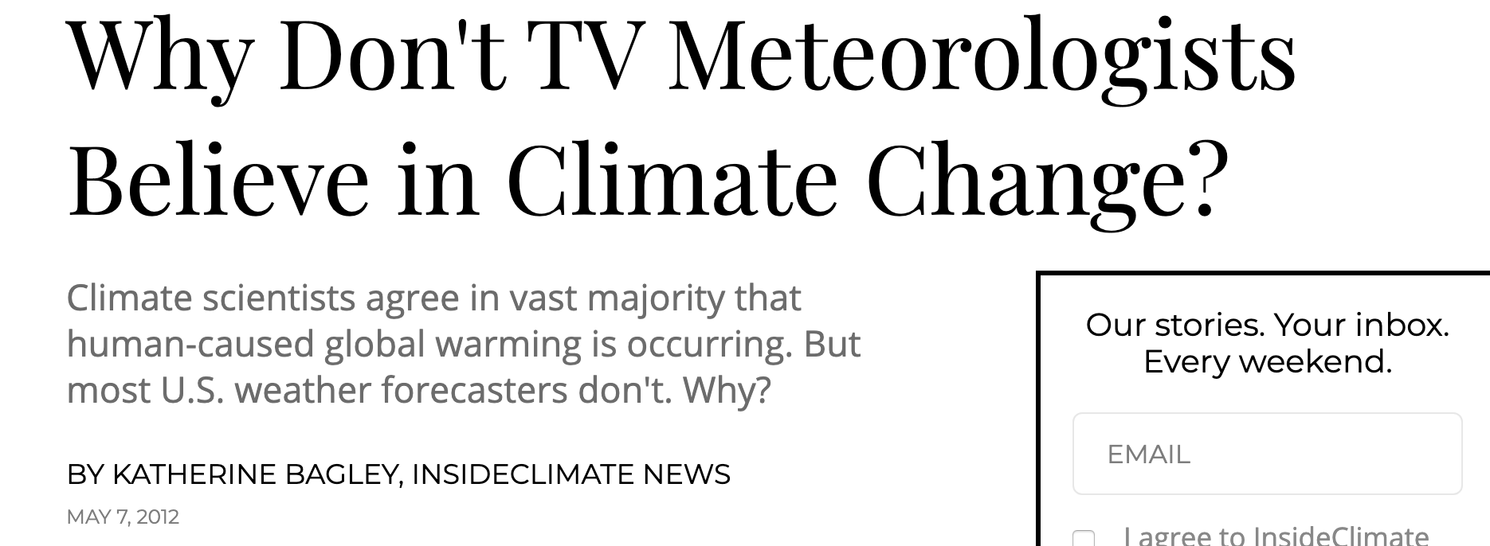
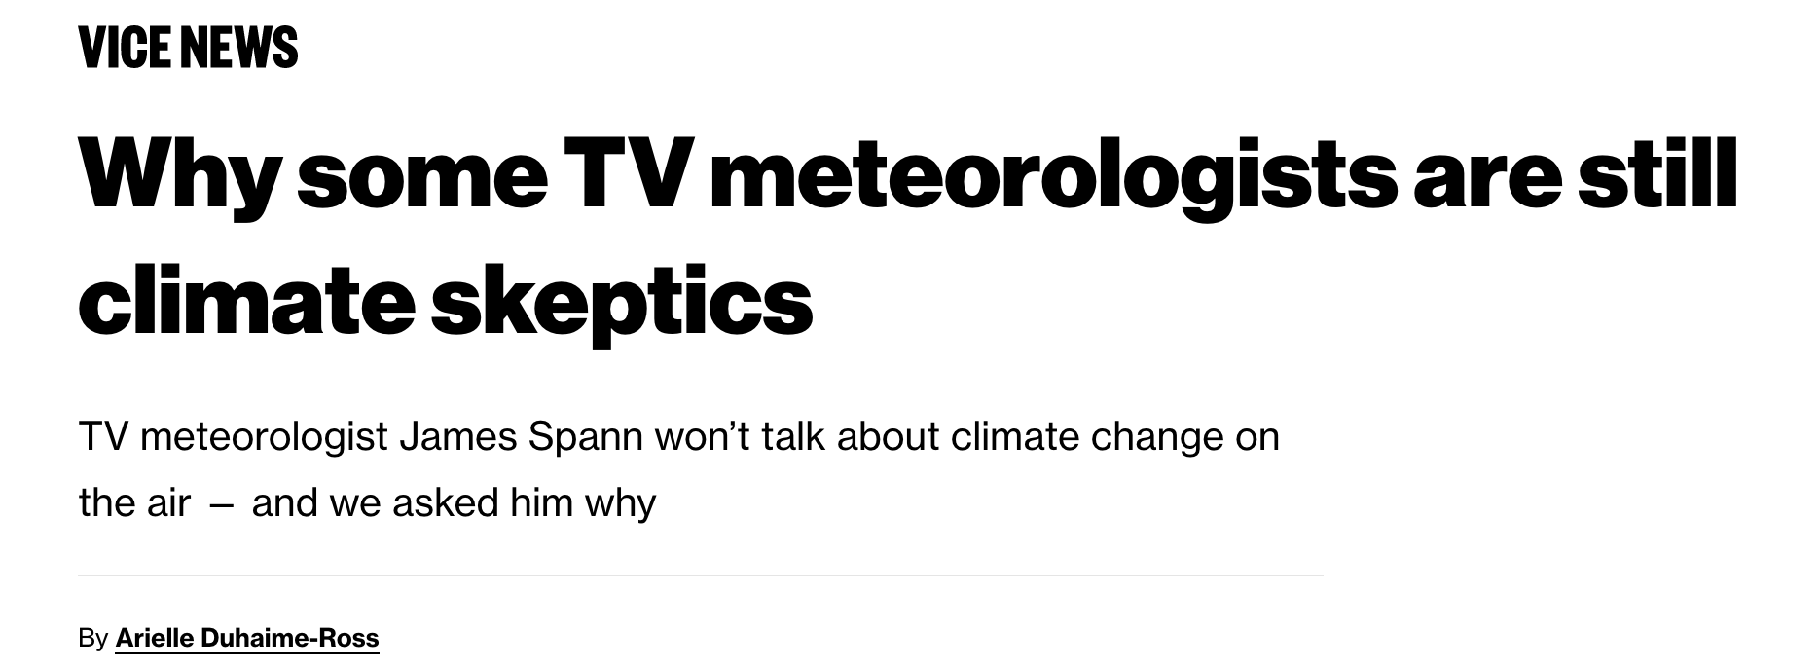
There has been some controversy about some TV weathercasters being more skeptical about global warming

Slide 10
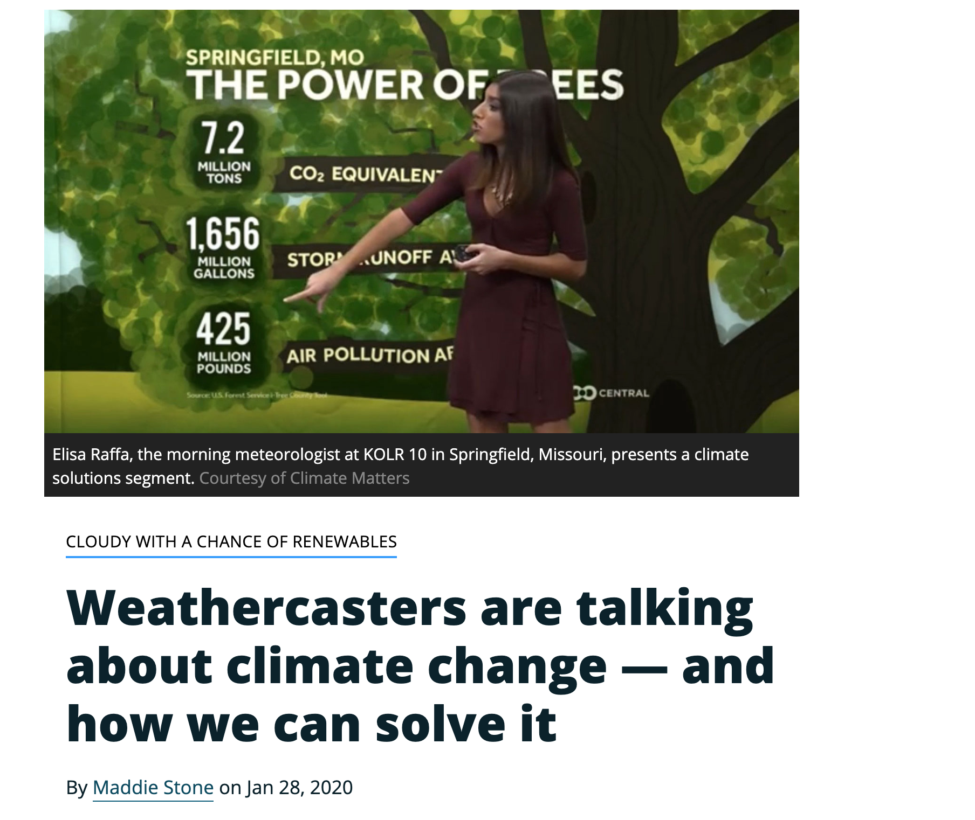
But that has faded in recent years

Slide 11
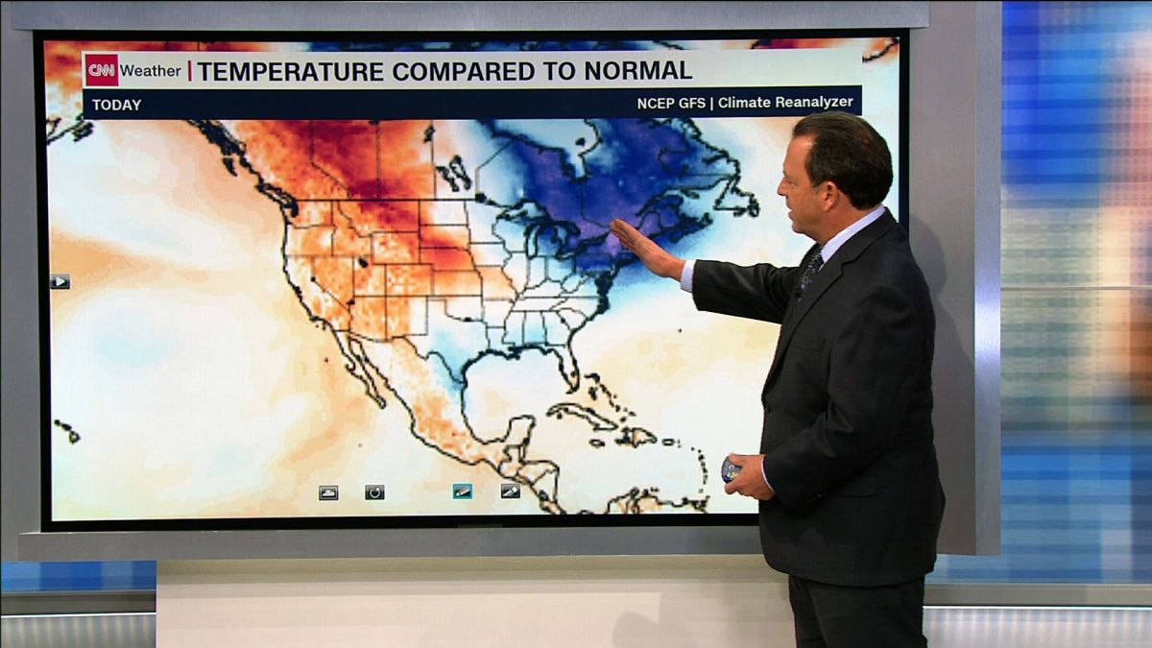
TV Weathercasters
Often serve the role of a “station scientist”
Central responsibility is to provide an accurate weather forecasts, describe the local and national weather situation, and educate folks about meteorology.
Are increasingly being asked to talk about global warming/climate change.
To what degree should TV weathercasters do this?

Slide 12
TV Weathercasters and Climate
Many have decent basic understanding of meteorology—so start off better informed than most viewers.
Many do not have much background in climate science
Substantial pressure to connect extreme weather events with climate change.
Issue: Some aspects of global warming forecasting are solid (earth will warm as greenhouse gas concentrations change), but some are rife with uncertainty (connections with extreme weather, local implications).
Talking about climate change has the danger of getting political or stirring politically active viewers.

Slide 13
Some Media Have Gone Into Full Advocacy Mode
Often Major Errors in Climate Change Stories

Slide 14
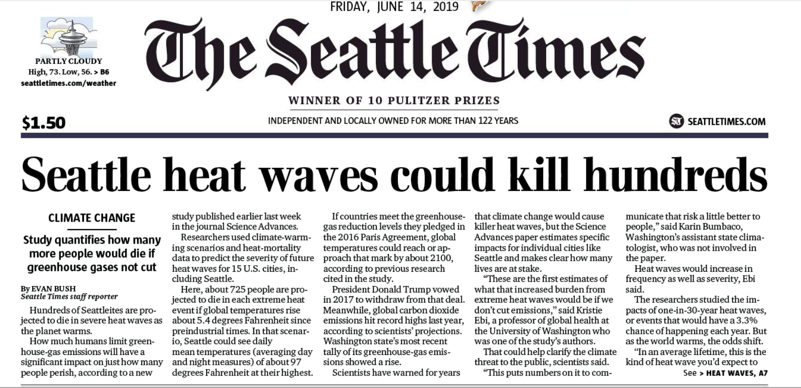
725 will die in each heat wave!
Assumes unreasonable warming and that no one will buy an air conditioner during this century

Slide 15
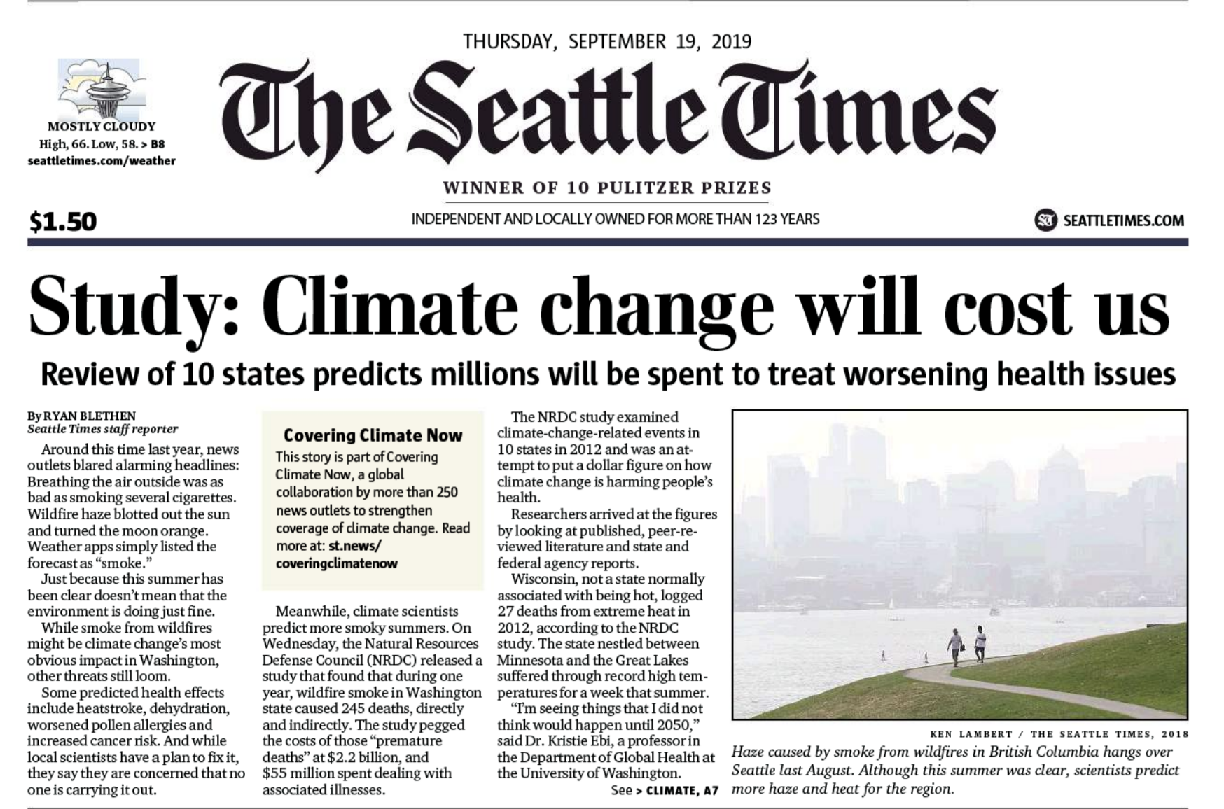

Slide 16
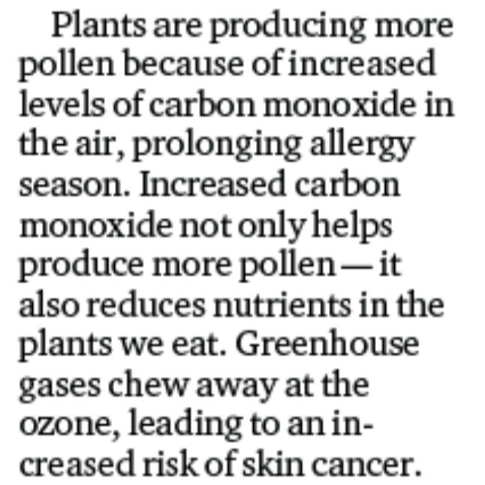
Unbelievable error

Slide 17
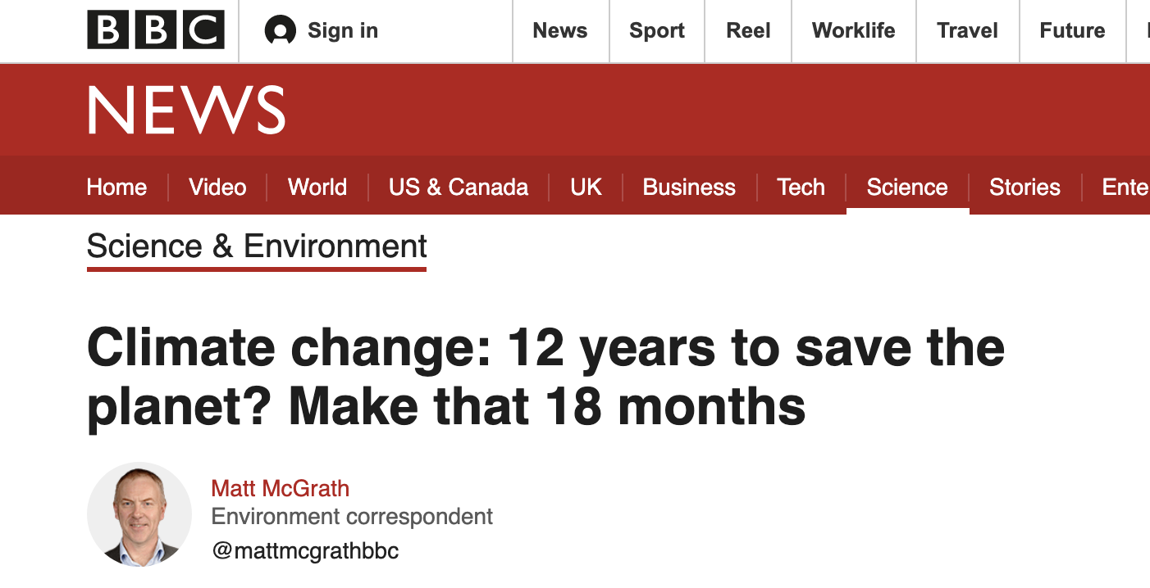

Slide 18
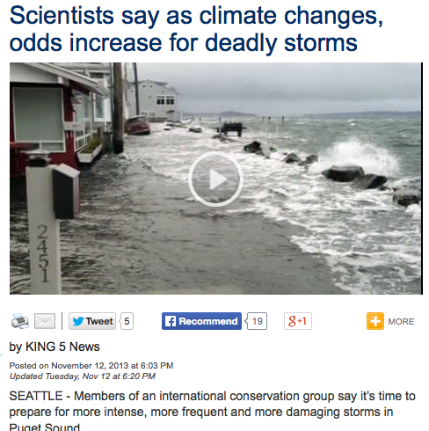

Slide 19
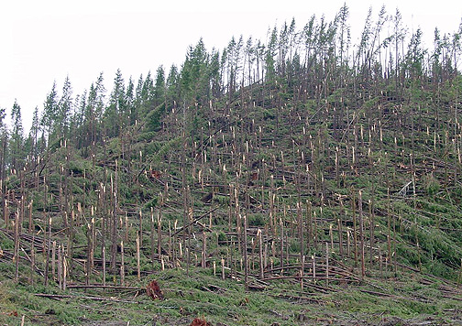
Northwest Windstorms
The real answer appears to be no. No increasing trend in observations and none suggested by climate models.
UW investigated this issue for Seattle City Light

Slide 20
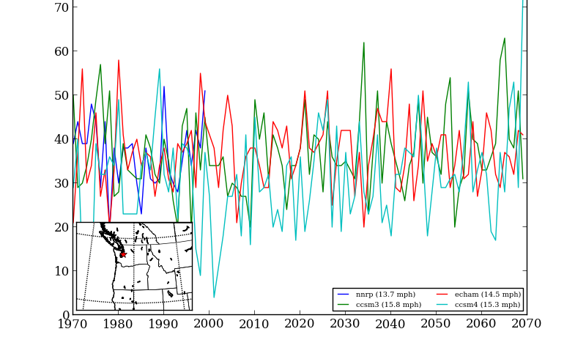
Number of times per year winds exceed a high-wind threshold (DJF) at Seattle for several simulations

Slide 21
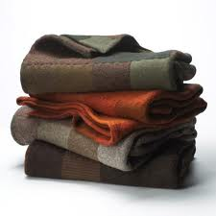
Major Challenge
How does one communicate about a highly complex phenomenon like climate change in an EFFECTIVE and ACCURATE WAY.
Takes deep knowledge of a subject to explain it simply and accurately.
Should not go beyond one knowledge and use trust sources and experts.

Slide 22
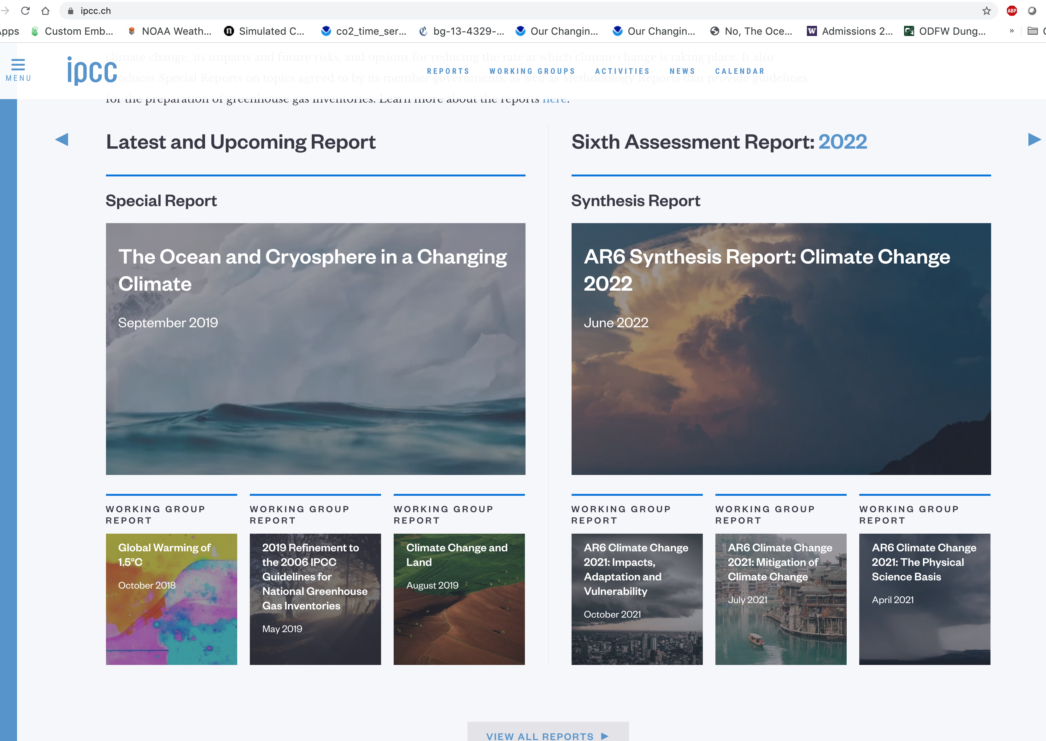
Excellent Source of Climate Change Data: IPCC Reports

Slide 23
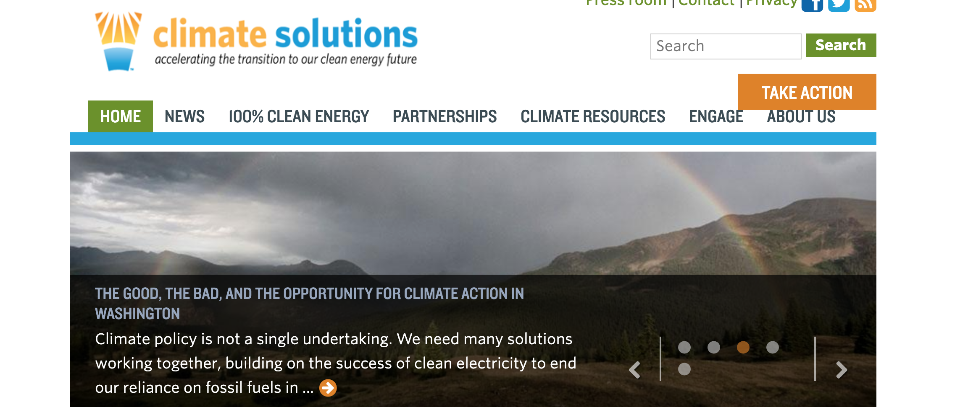
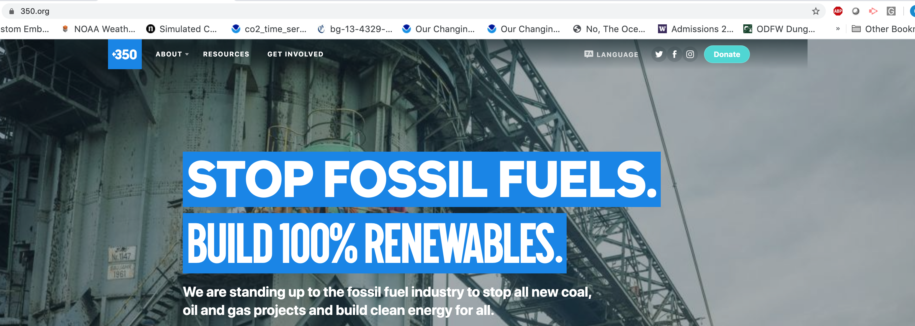
Poor Sources: Advocacy Groups and NGOs

Slide 24
It is critical for responsible media not to hype or exaggerate global warming impacts, but to go with the best peer-reviewed, consensus science
Important to keep in mind that not every peer-reviewed paper is correct. Thus, important to look for consensus statements of groups such as the IPCC.
Hyping climate change to “get people to do the right thing” is not an appropriate role for a media representative.
Sticking to consensus science, may get complaints by advocacy groups on the right or the left. Or advocacy media.

Slide 25
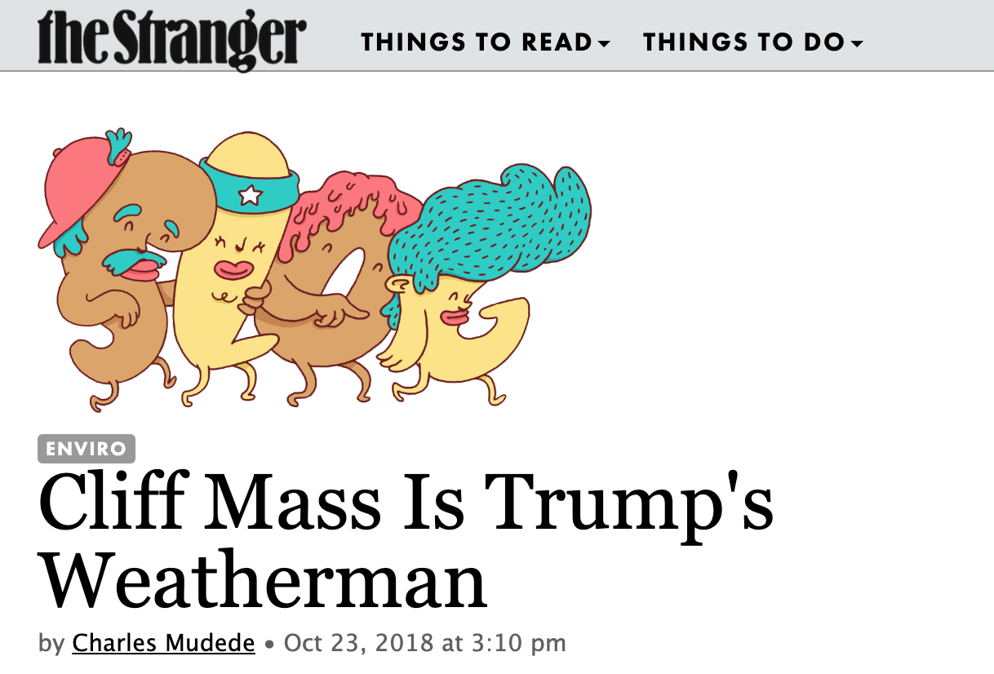
I have learned this the hard way

Slide 26
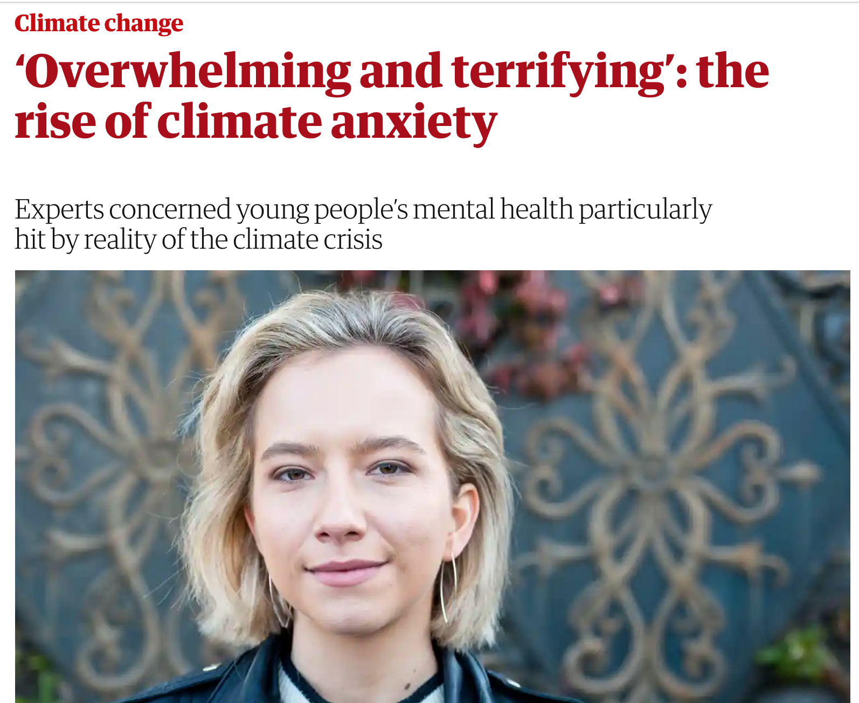
Ethical Dimensions: Exaggeration, hyping, and existential threat stories can hurt the most vulnerable

Slide 27

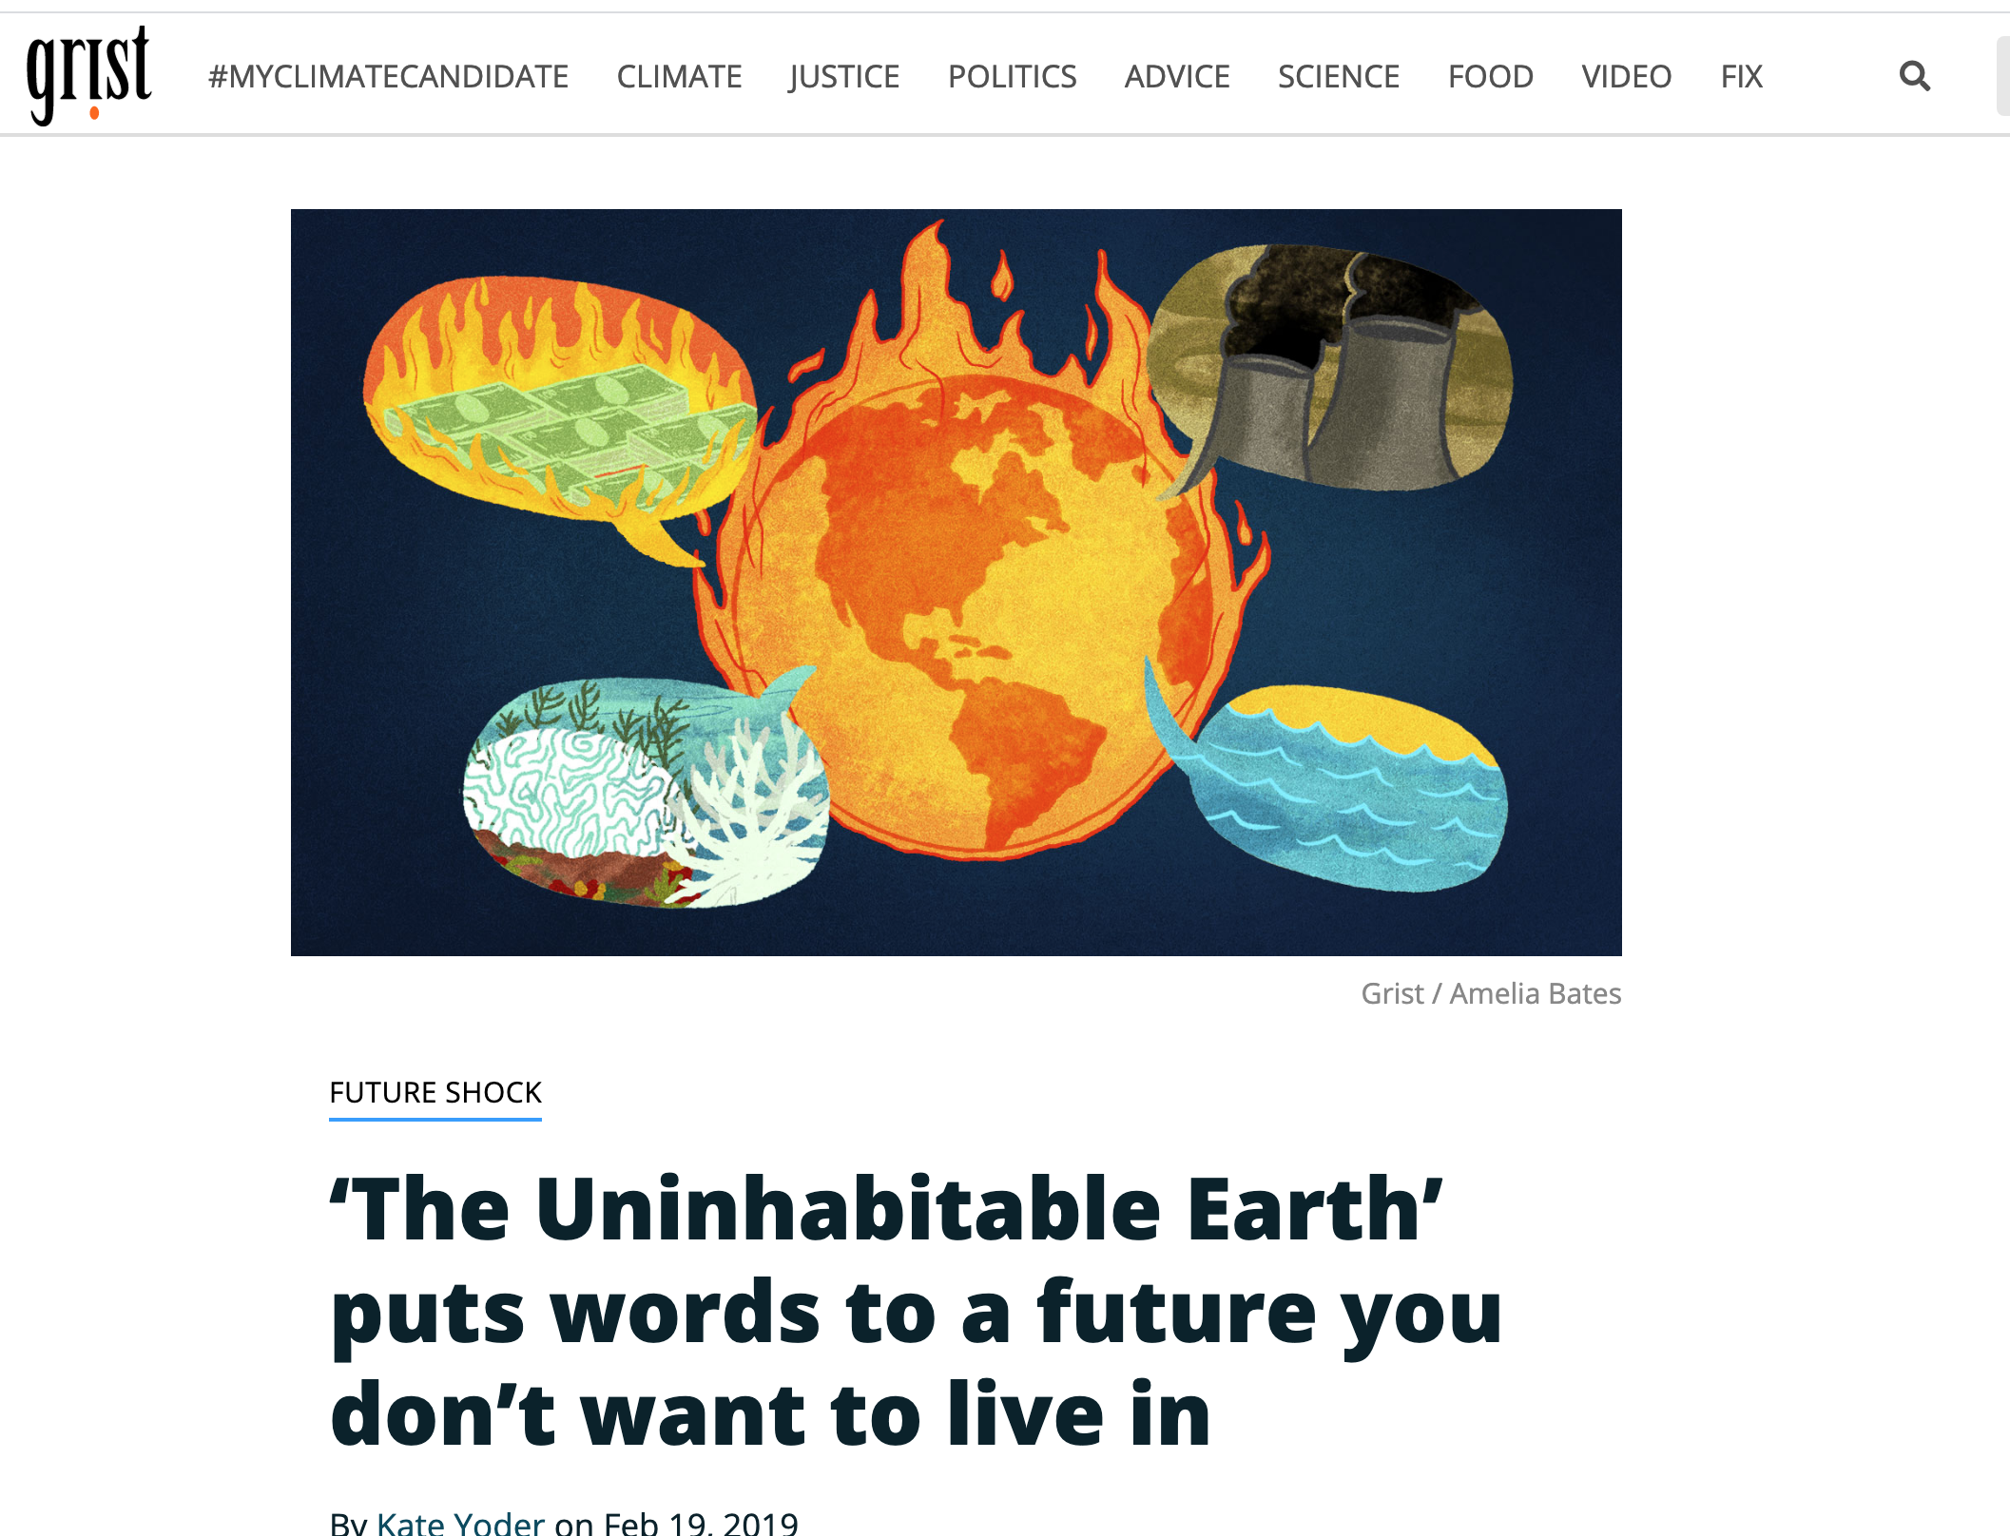

Slide 28
Should one bring up climate change on air?
Sometimes, it is unavoidable, particularly after an extreme weather event.
Stick to science and keep away from politics.
Make sure information about uncertainties is clear.
The media must be seen as a source of objective information, not advocacy.

Slide 29
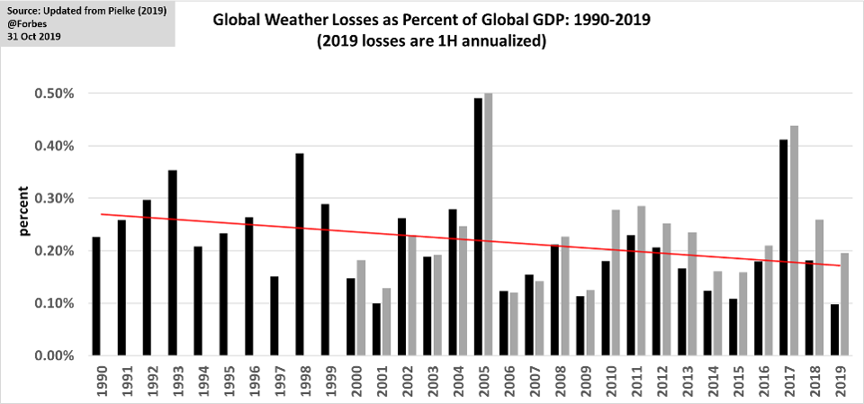
Many positive stories about climate change and related subjects
Becoming clear that the worst is not going to happen
Major advances in technology (solar and wind, safe fission, storage technologies)
Major potential for adaptation
Improved forecasting and richer societies are less prone to environmental disaster

Slide 30
The End

