Slide 1
Global Warming and the Media
Cliff Mass
February 25, 2022

Slide 2
Some Questions
What is the role of the media in communicating about global warming?
What are some of the dangers and issues in discussing this topic?
How can one get reliable information?

Slide 3
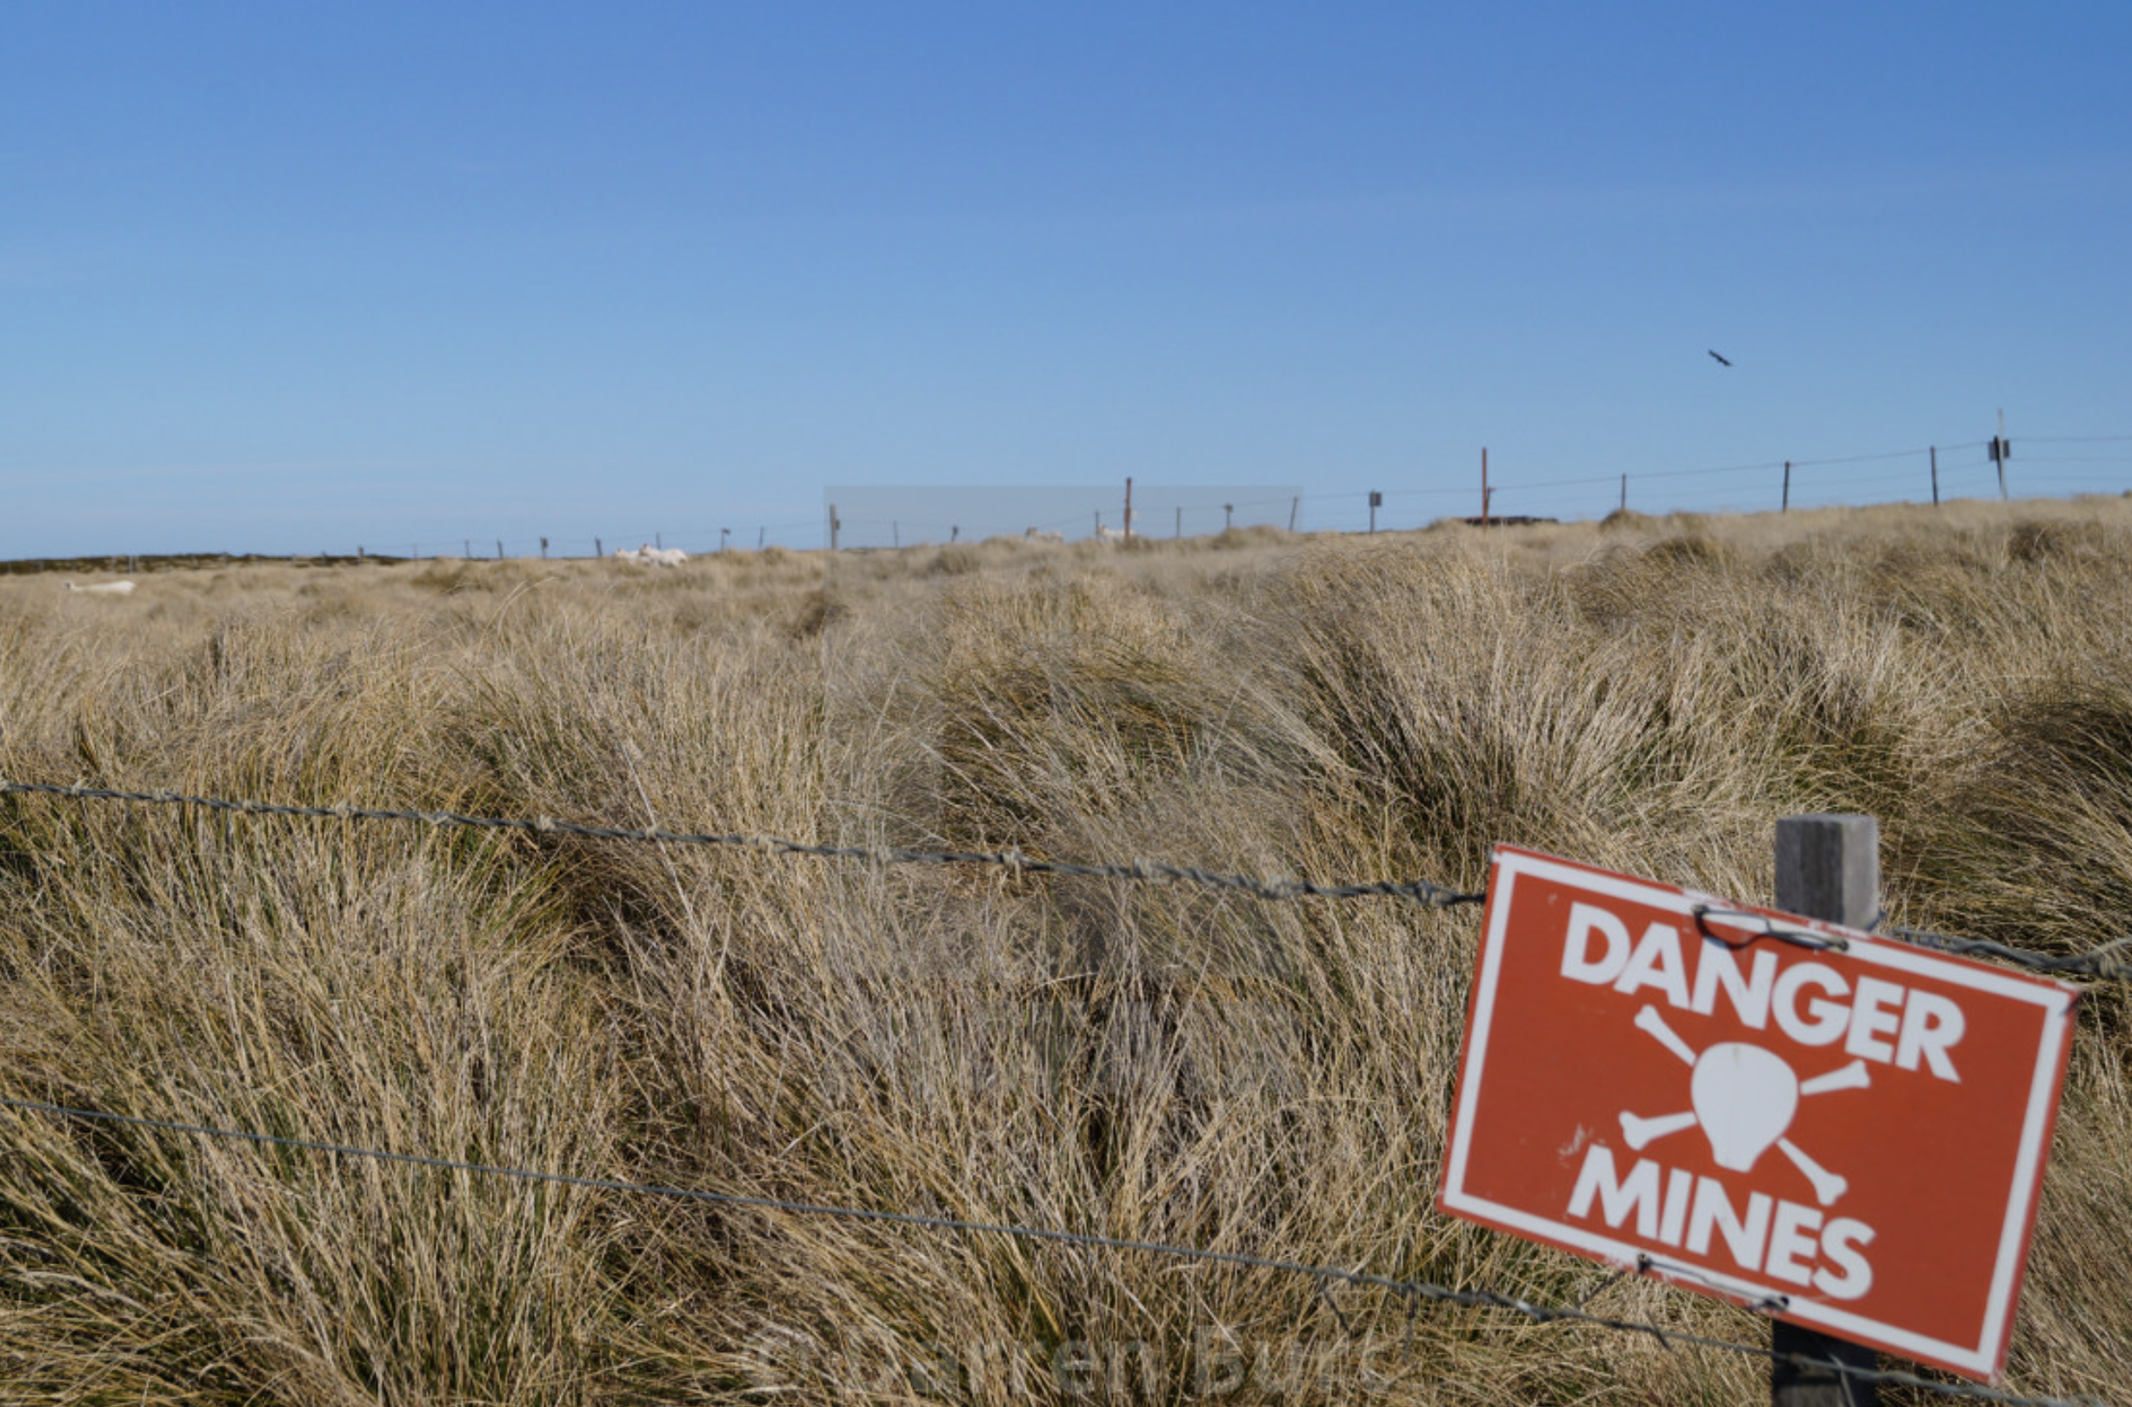
A minefield

Slide 4
Minefield
Your job is to provide that most scientifically supportable information, based on the most reliable sources.
Strong pressure from politically motivated listeners, advocacy groups, and others to follow their “line.”
There are important areas of uncertainty, and those need to be communicated.

Slide 5
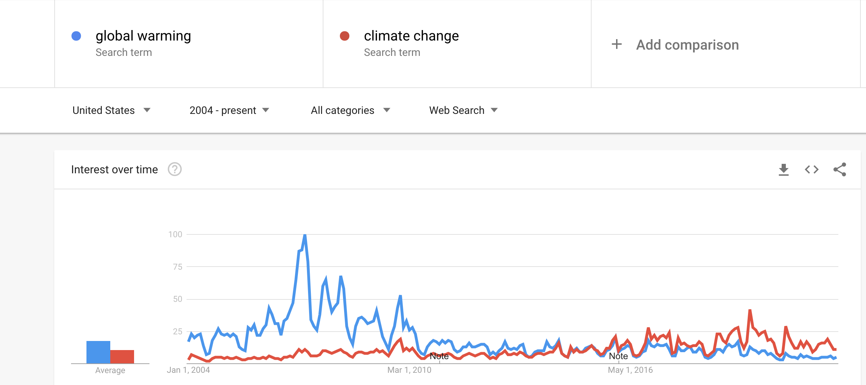
Global Warming Versus Climate Change: Which Term Should You Use?
How have concerns changed over time?
General move from global warming to climate change
Google Trends

Slide 6
It is interest to see what people think…and it is more nuanced than one would expect…..

Slide 7
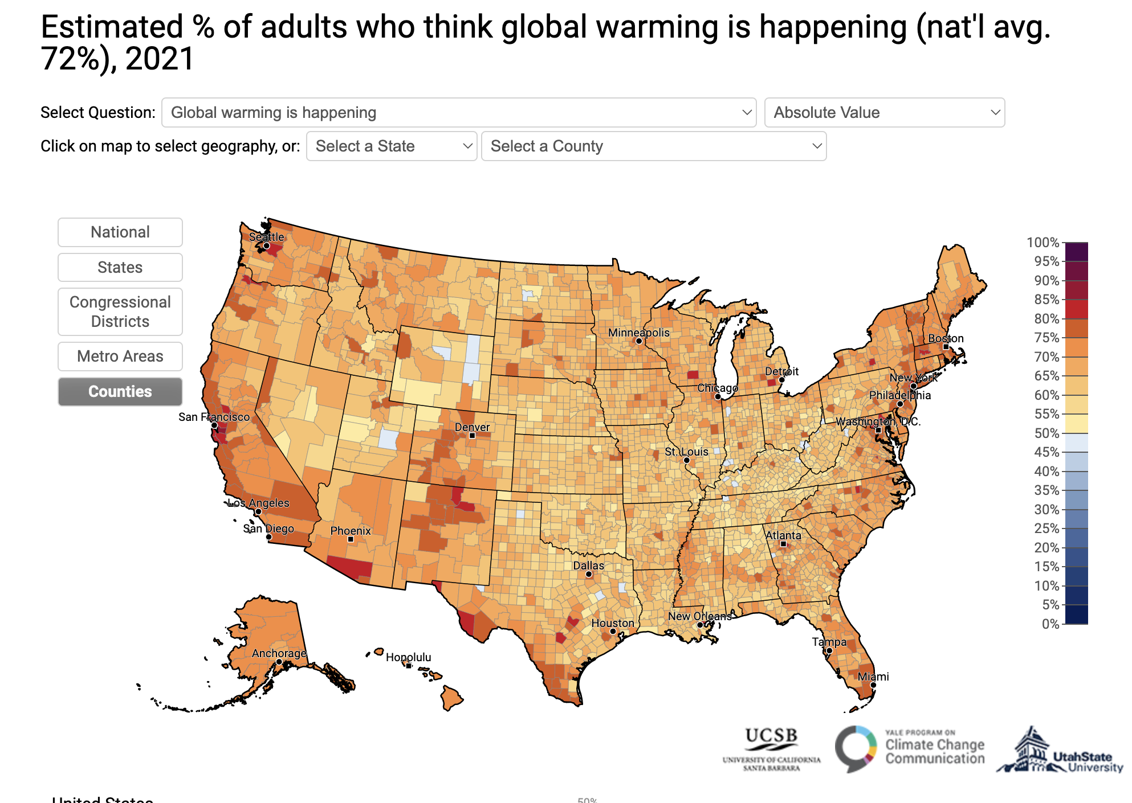

Slide 8
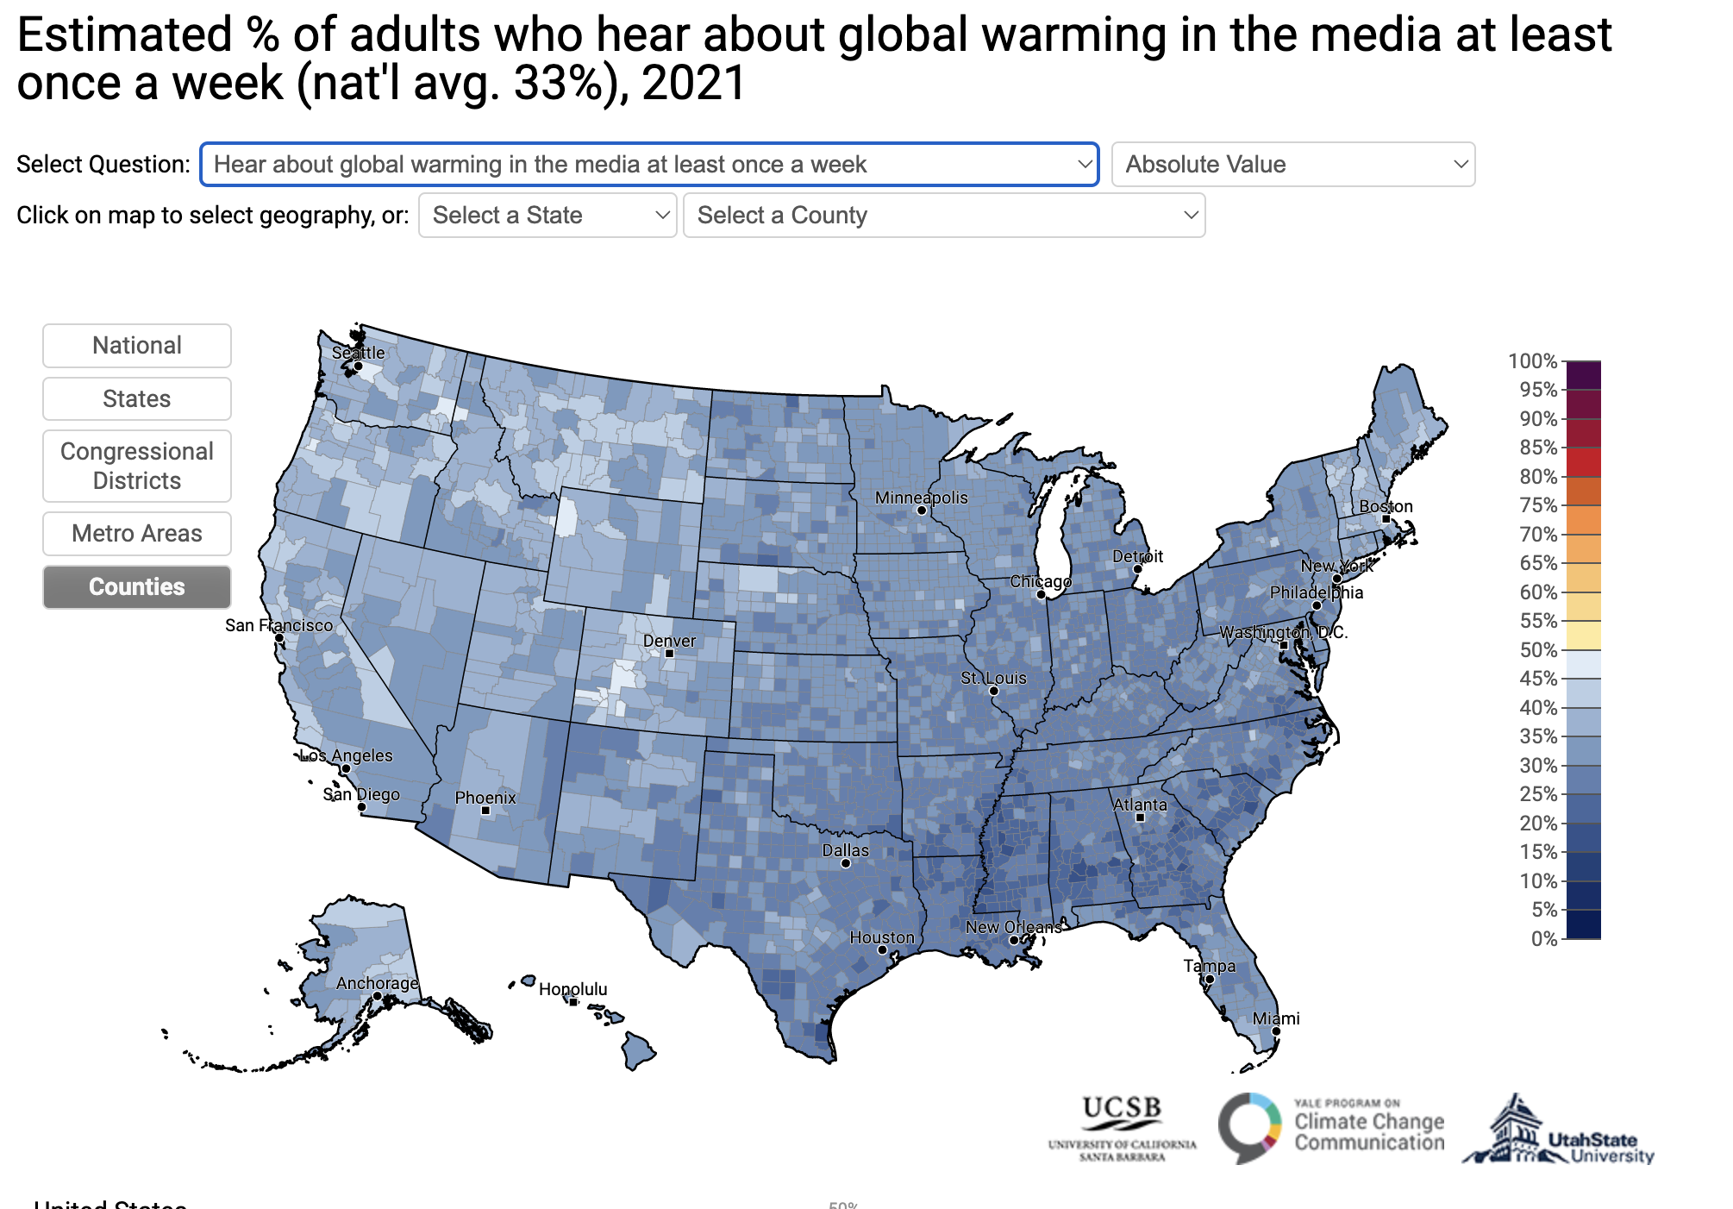

Slide 9
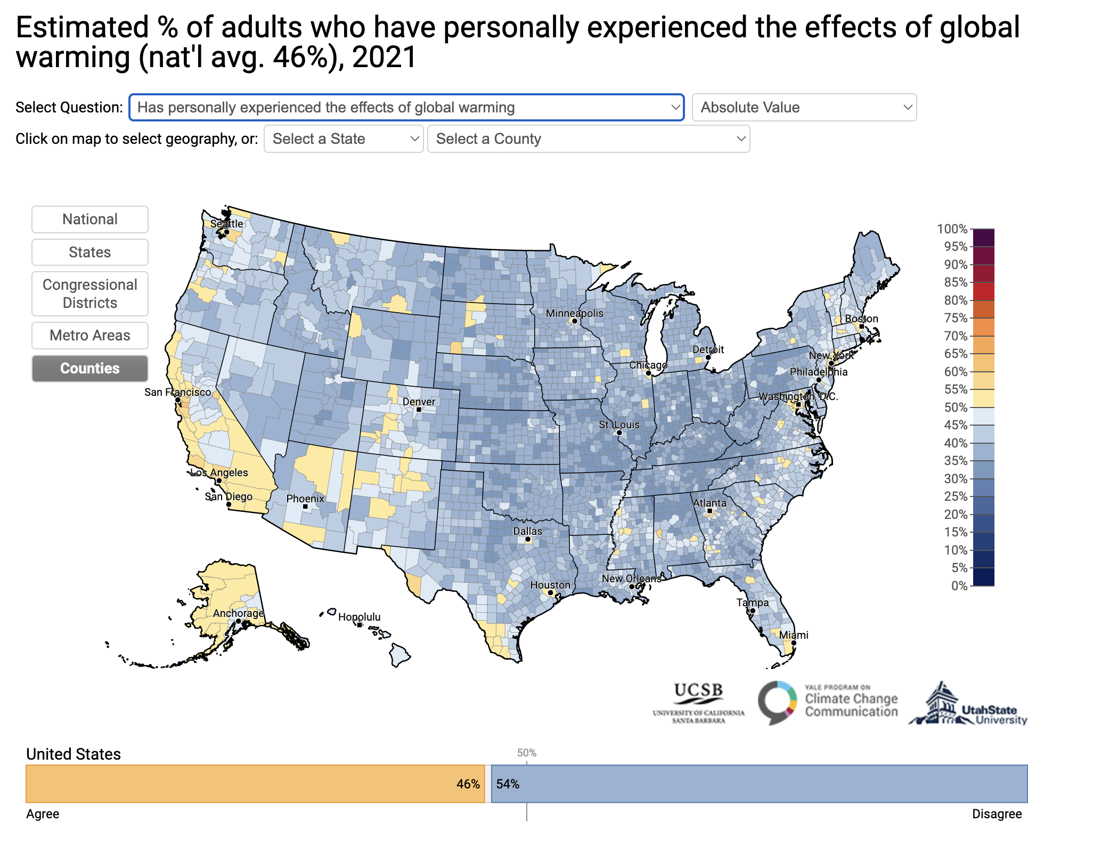

Slide 10
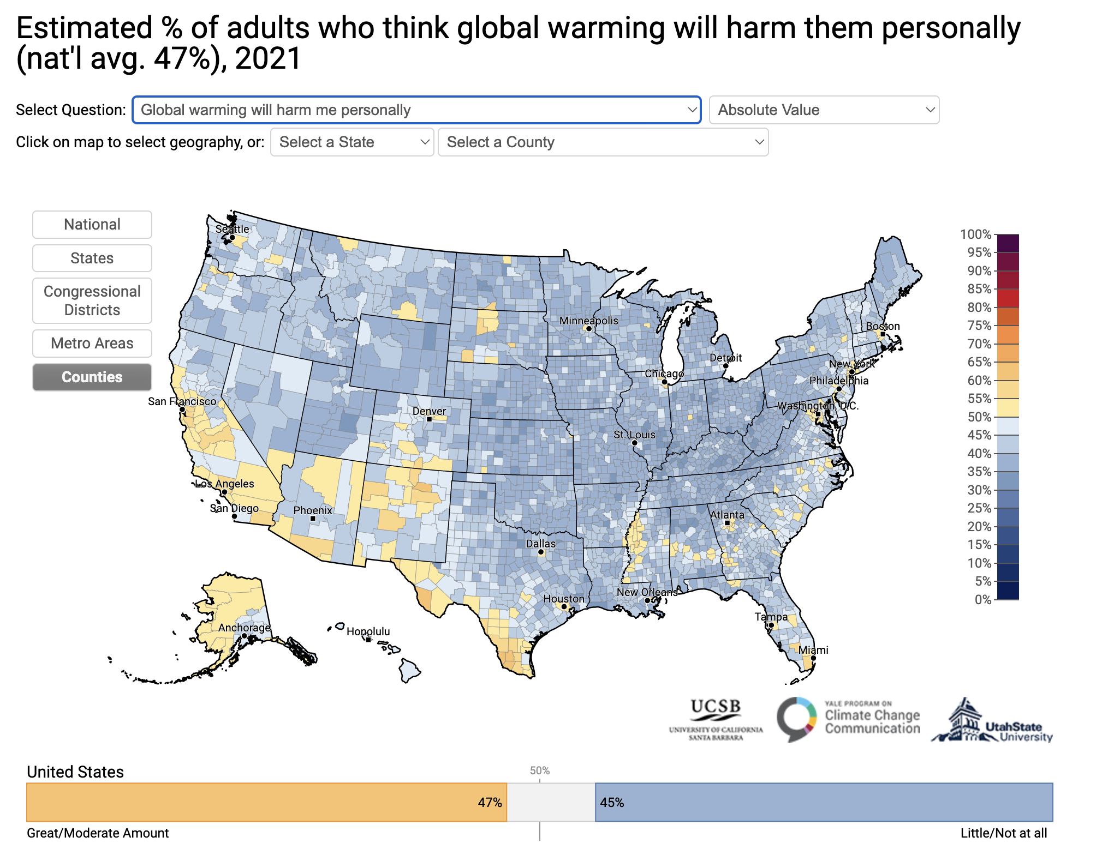

Slide 11
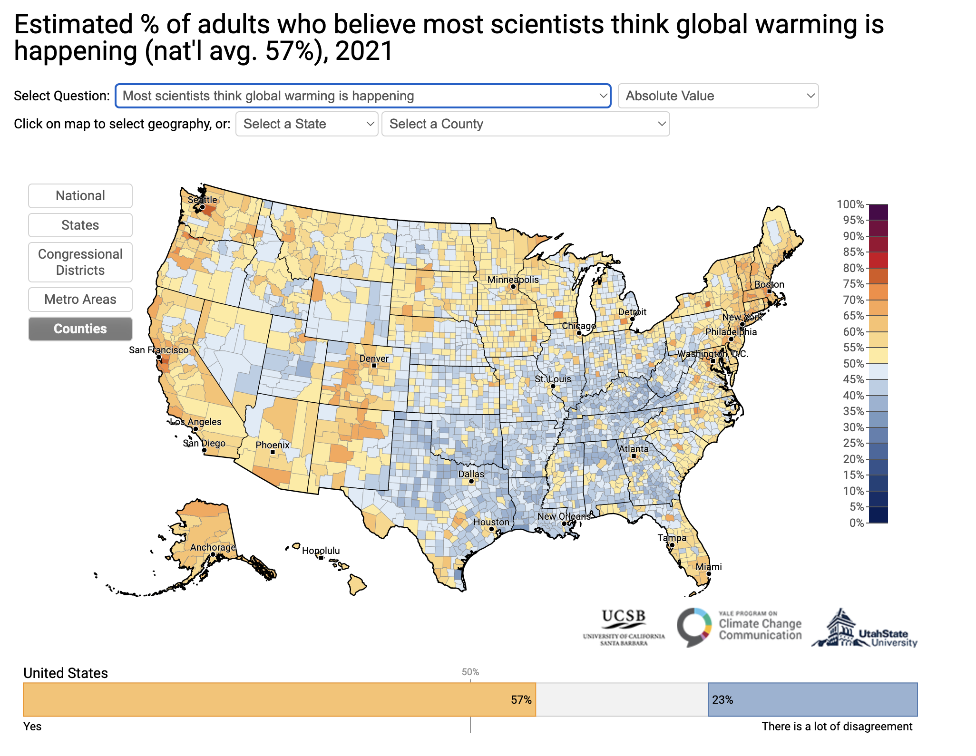

Slide 12
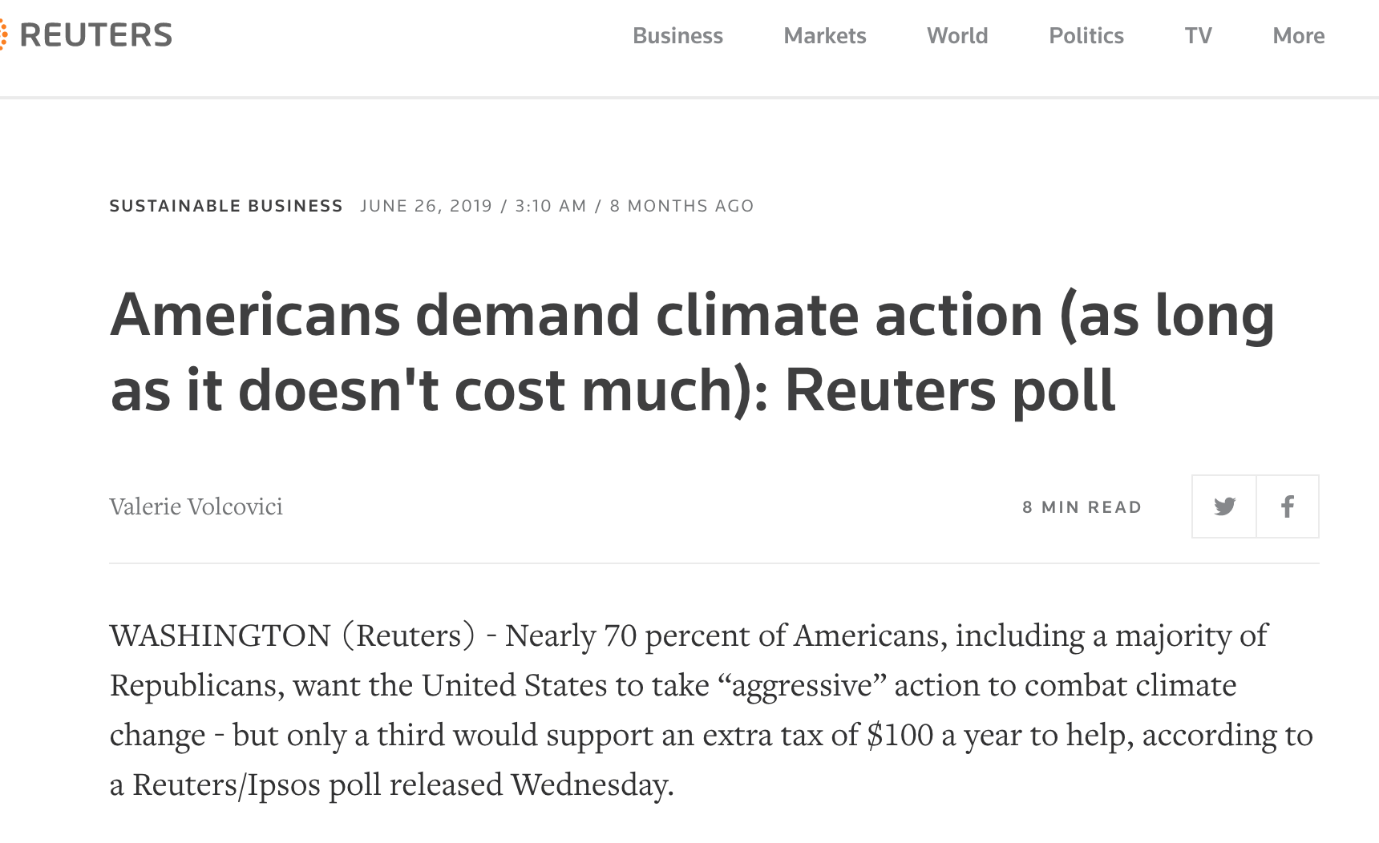

Slide 13
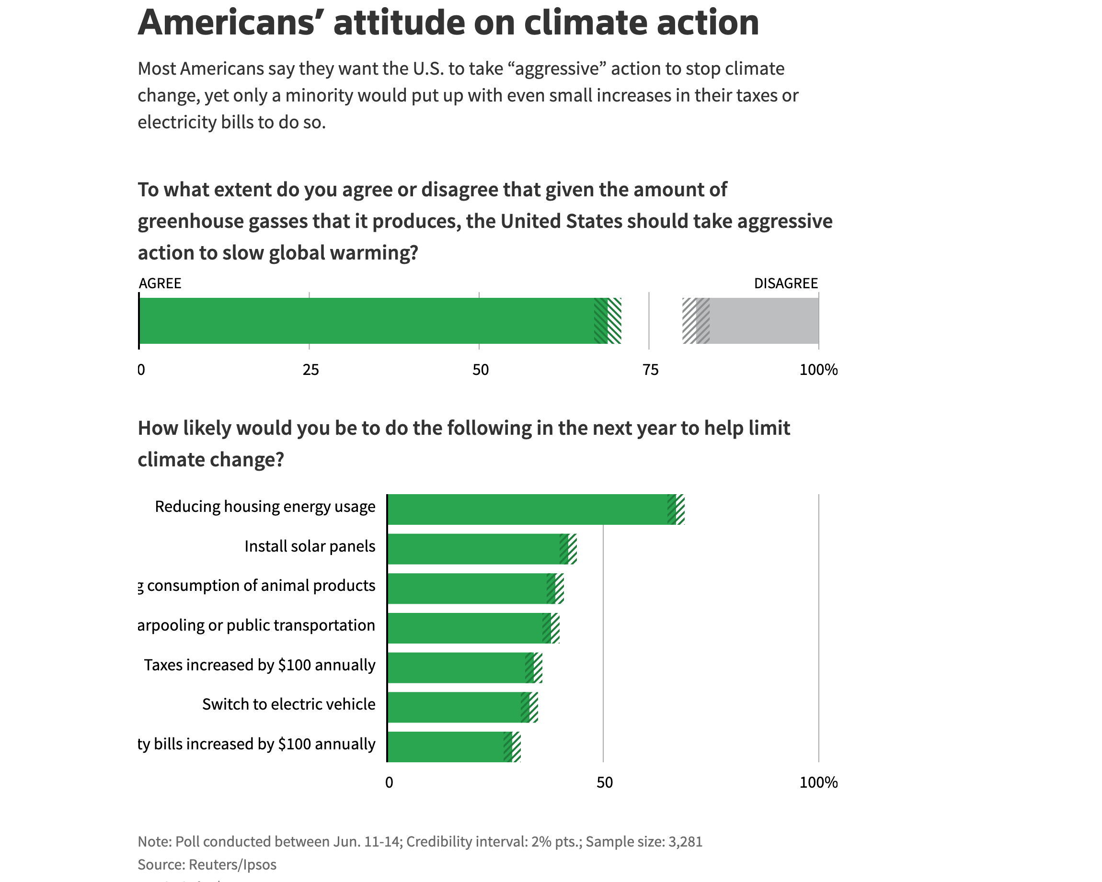

Slide 14
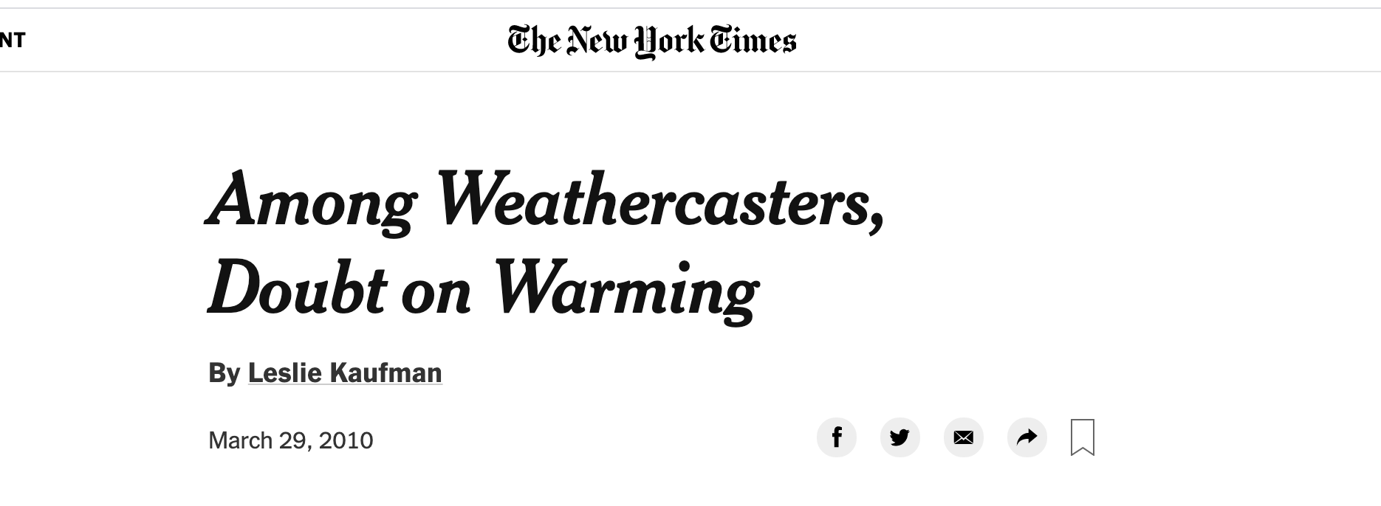
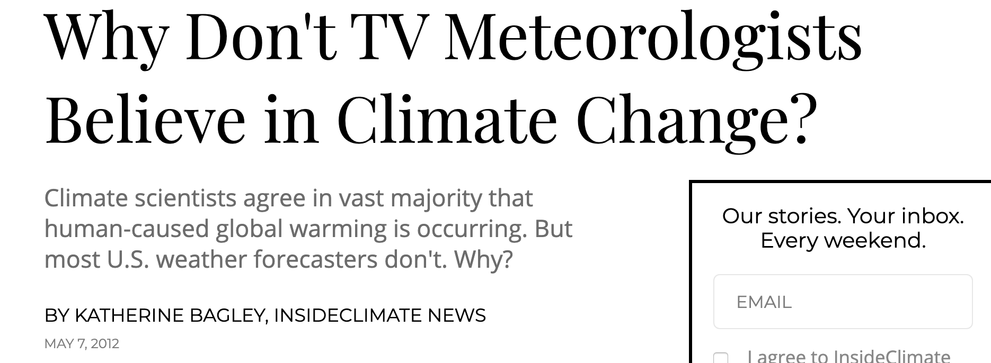
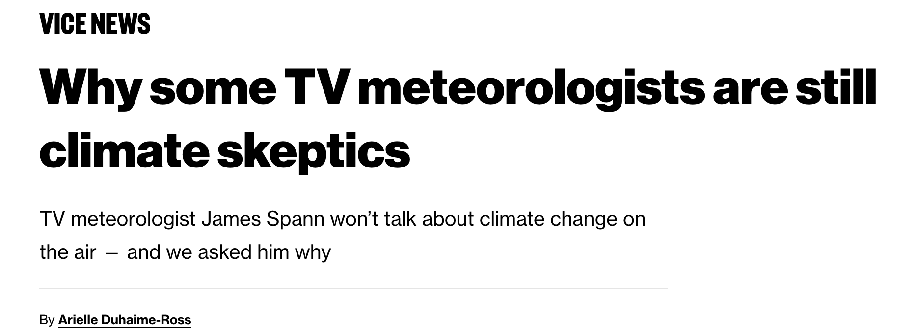
There has been some controversy about some TV weathercasters being more skeptical about global warming

Slide 15
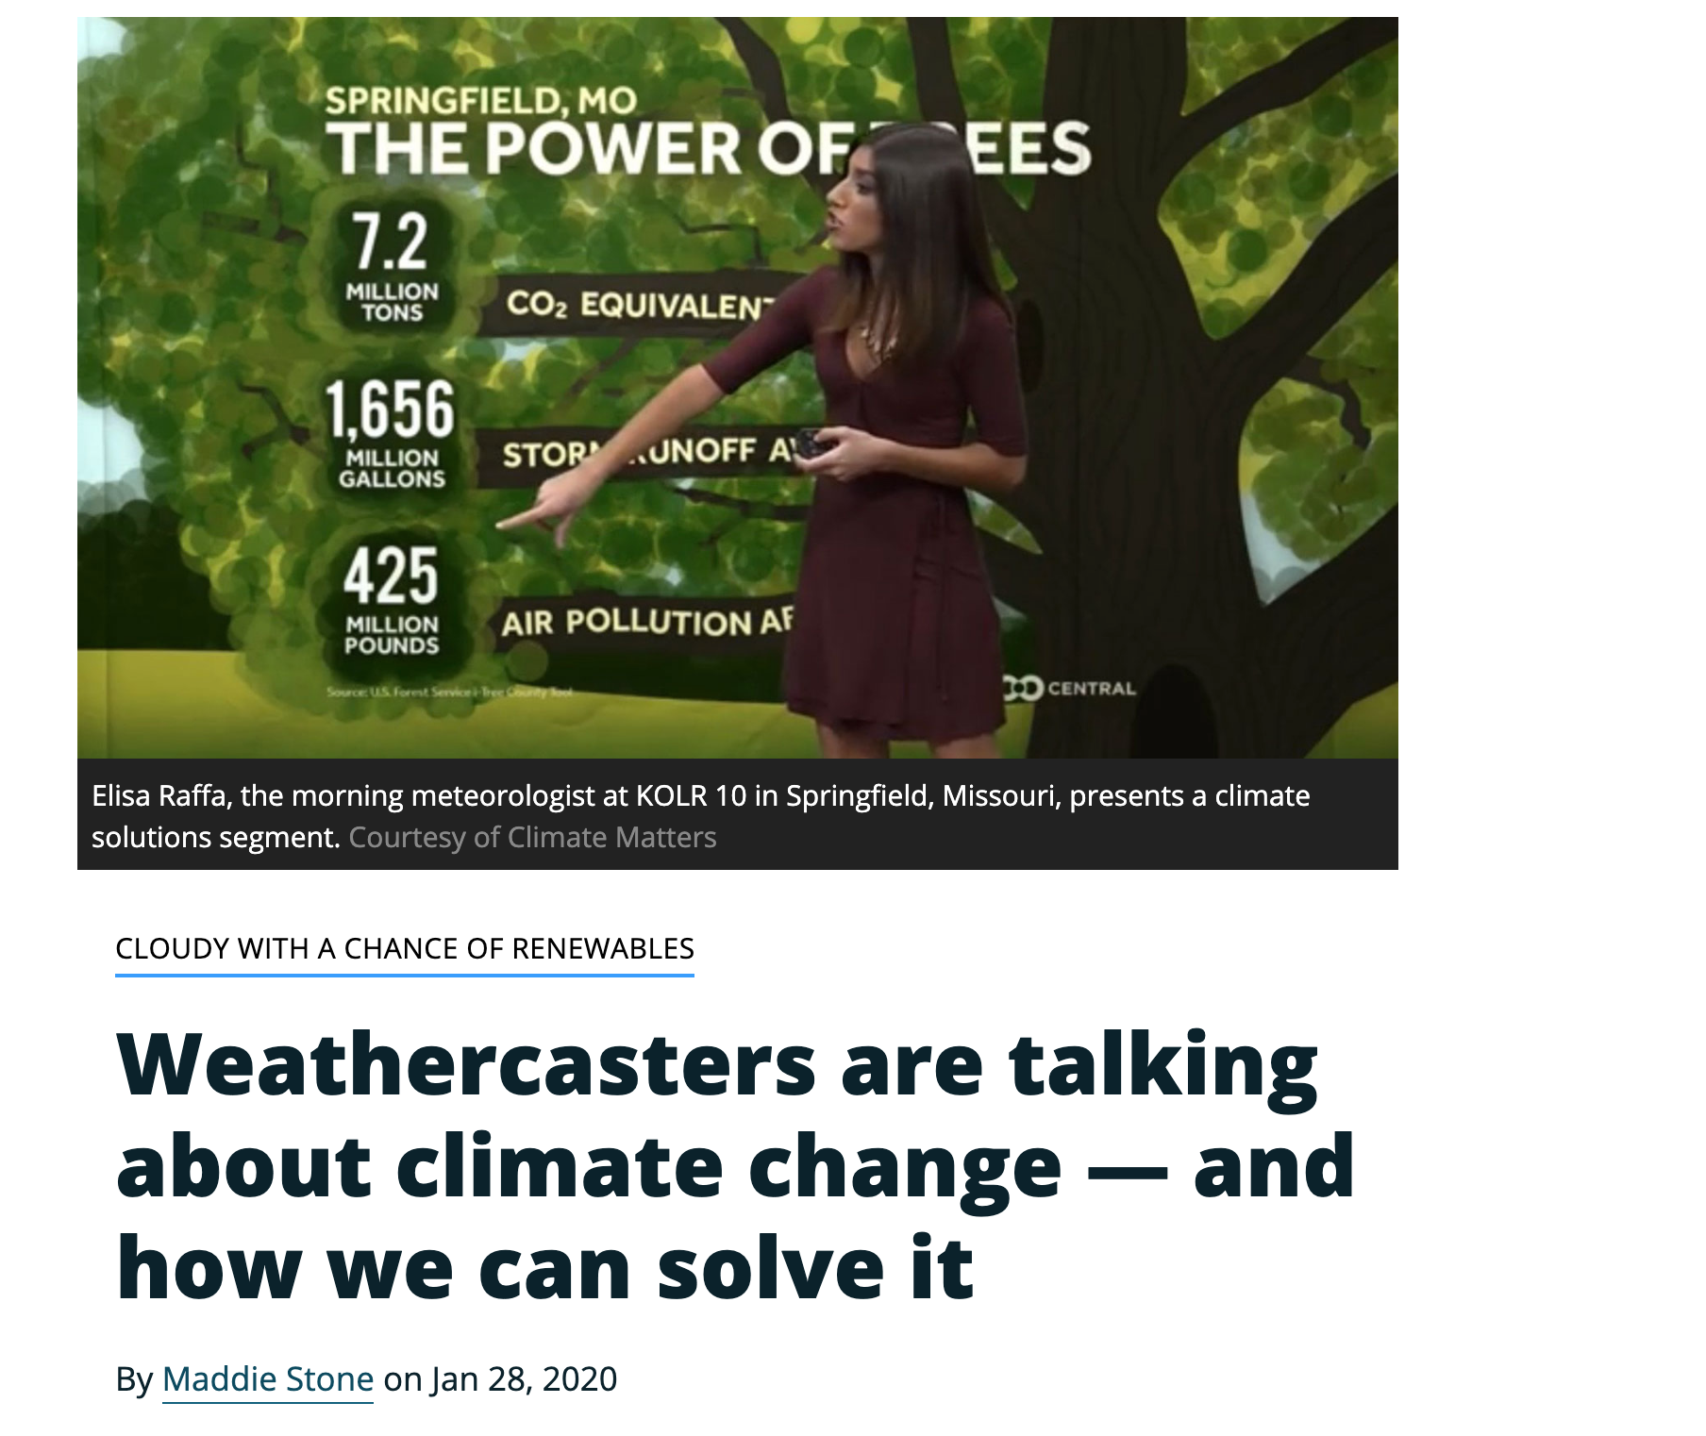
But that has faded in recent years

Slide 16
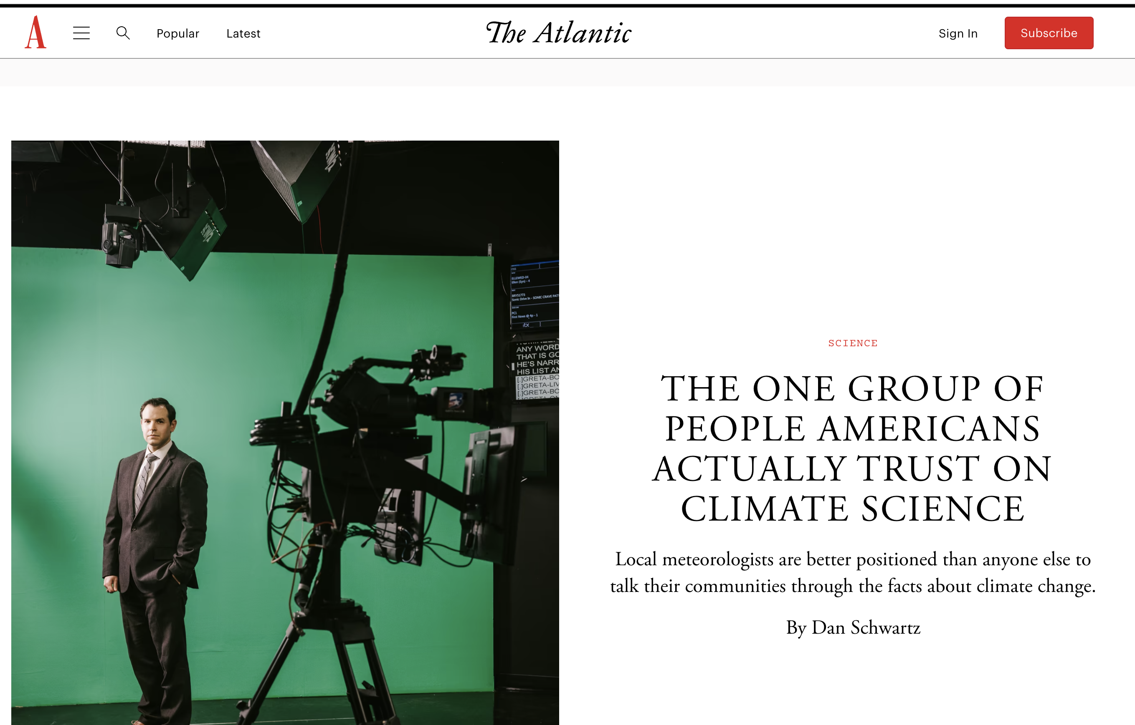
Increasing Pressure on TV Weathercasters To Convince the Public

Slide 17
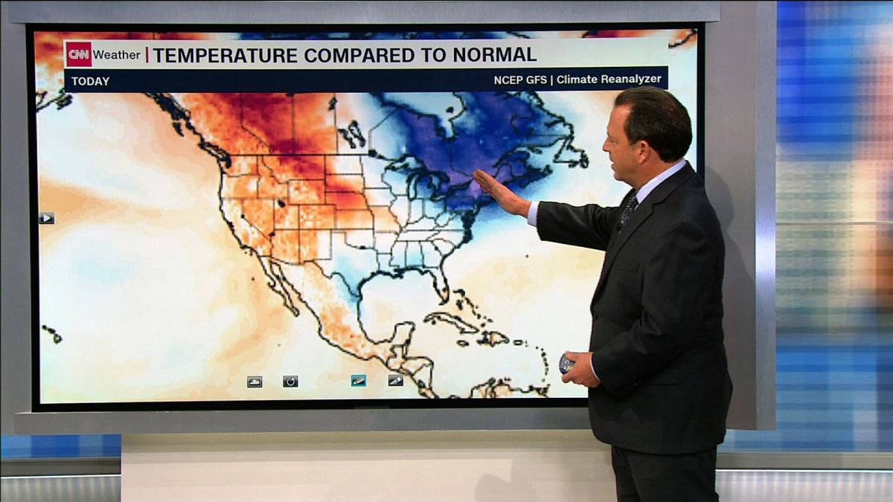
TV Weathercasters
Often serve the role of a “station scientist”
Central responsibility is to provide an accurate weather forecasts, describe the local and national weather situation, and educate folks about meteorology.
Are increasingly being asked to talk about global warming/climate change.
To what degree should TV weathercasters do this?

Slide 18
TV Weathercasters and Climate
Many have decent basic understanding of meteorology—so start off better informed than most viewers.
Many do not have much background in climate science
Substantial pressure to connect extreme weather events with climate change.
Talking about climate change has the danger of getting political or stirring politically active viewers.

Slide 19
Some Media Have Gone Into Full Advocacy Mode
Often Major Errors in Climate Change Stories

Slide 20
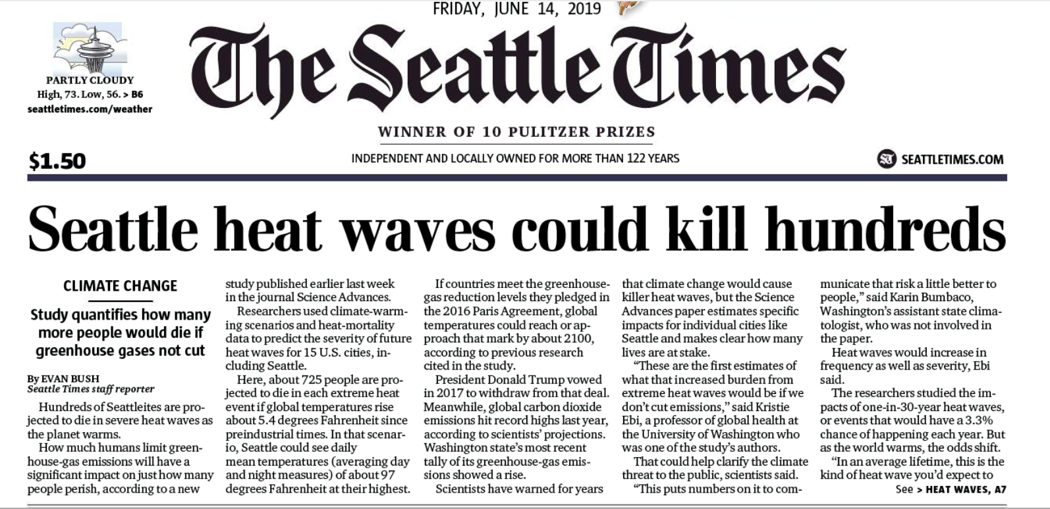
725 will die in each heat wave!
Assumes unreasonable warming and that no one will buy an air conditioner during this century

Slide 21
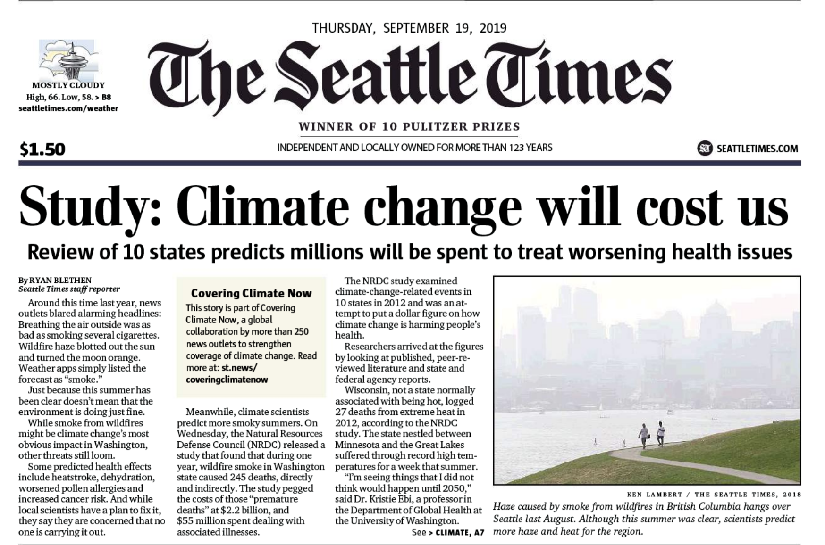

Slide 22
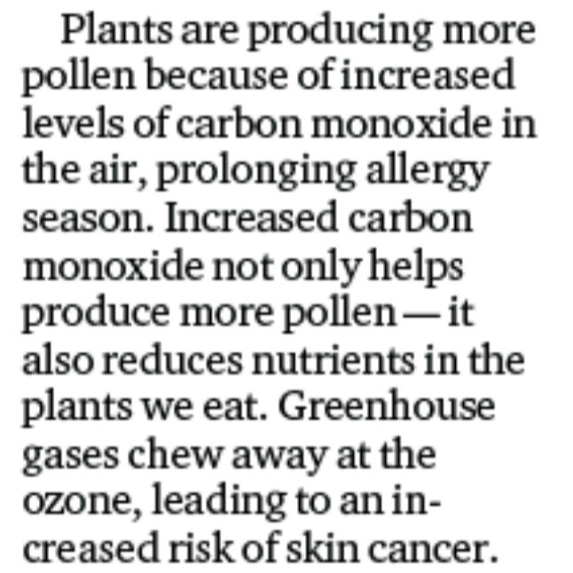
Unbelievable error

Slide 23
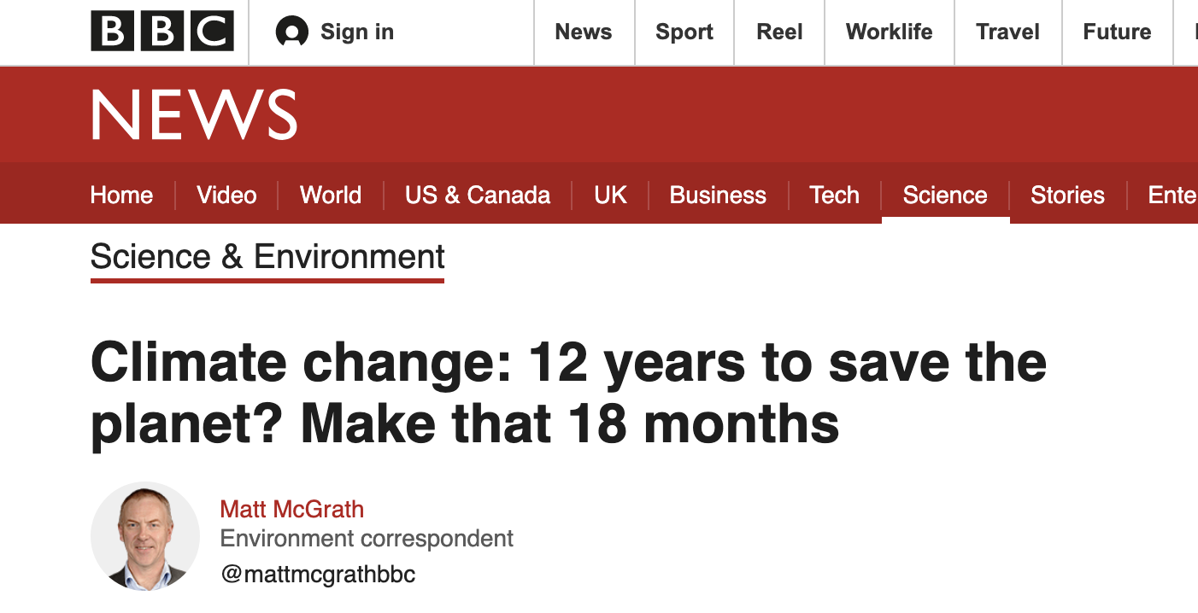

Slide 24
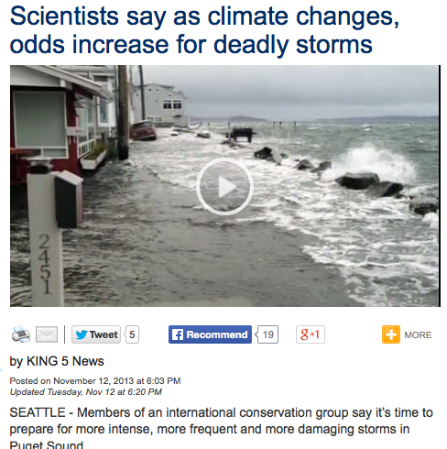

Slide 25
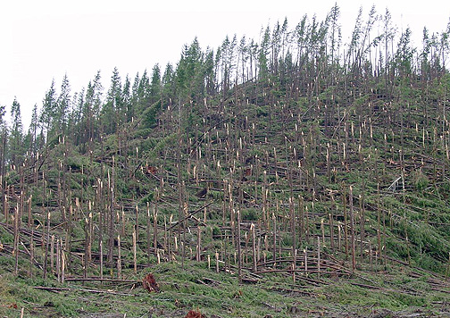
Northwest Windstorms
The real answer appears to be no. No increasing trend in observations and none suggested by climate models.
UW investigated this issue for Seattle City Light

Slide 26
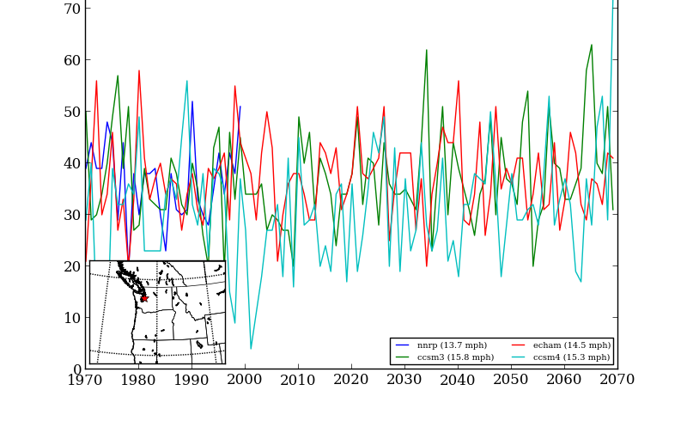
Number of times per year winds exceed a high-wind threshold (DJF) at Seattle for several simulations

Slide 27
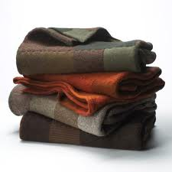
Major Challenge
How does one communicate about a highly complex phenomenon like climate change in an EFFECTIVE and ACCURATE WAY.
Takes deep knowledge of a subject to explain it simply and accurately.
Should not go beyond one knowledge and use trusted sources and experts.

Slide 28
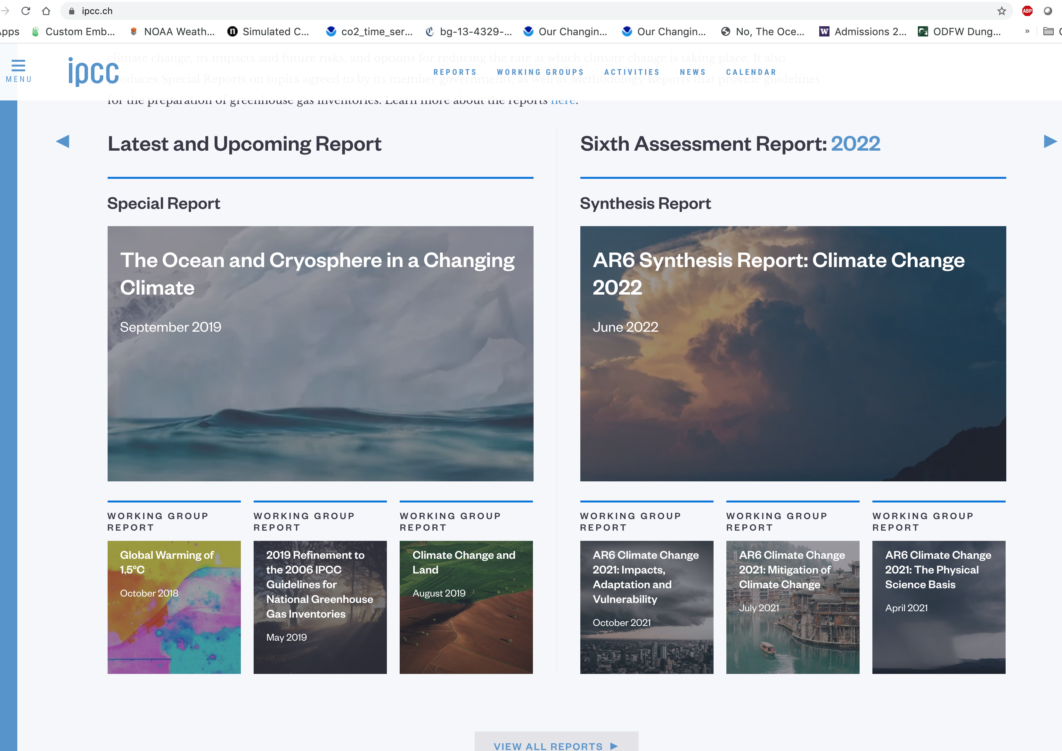
Excellent Source of Climate Change Data: IPCC Reports

Slide 29
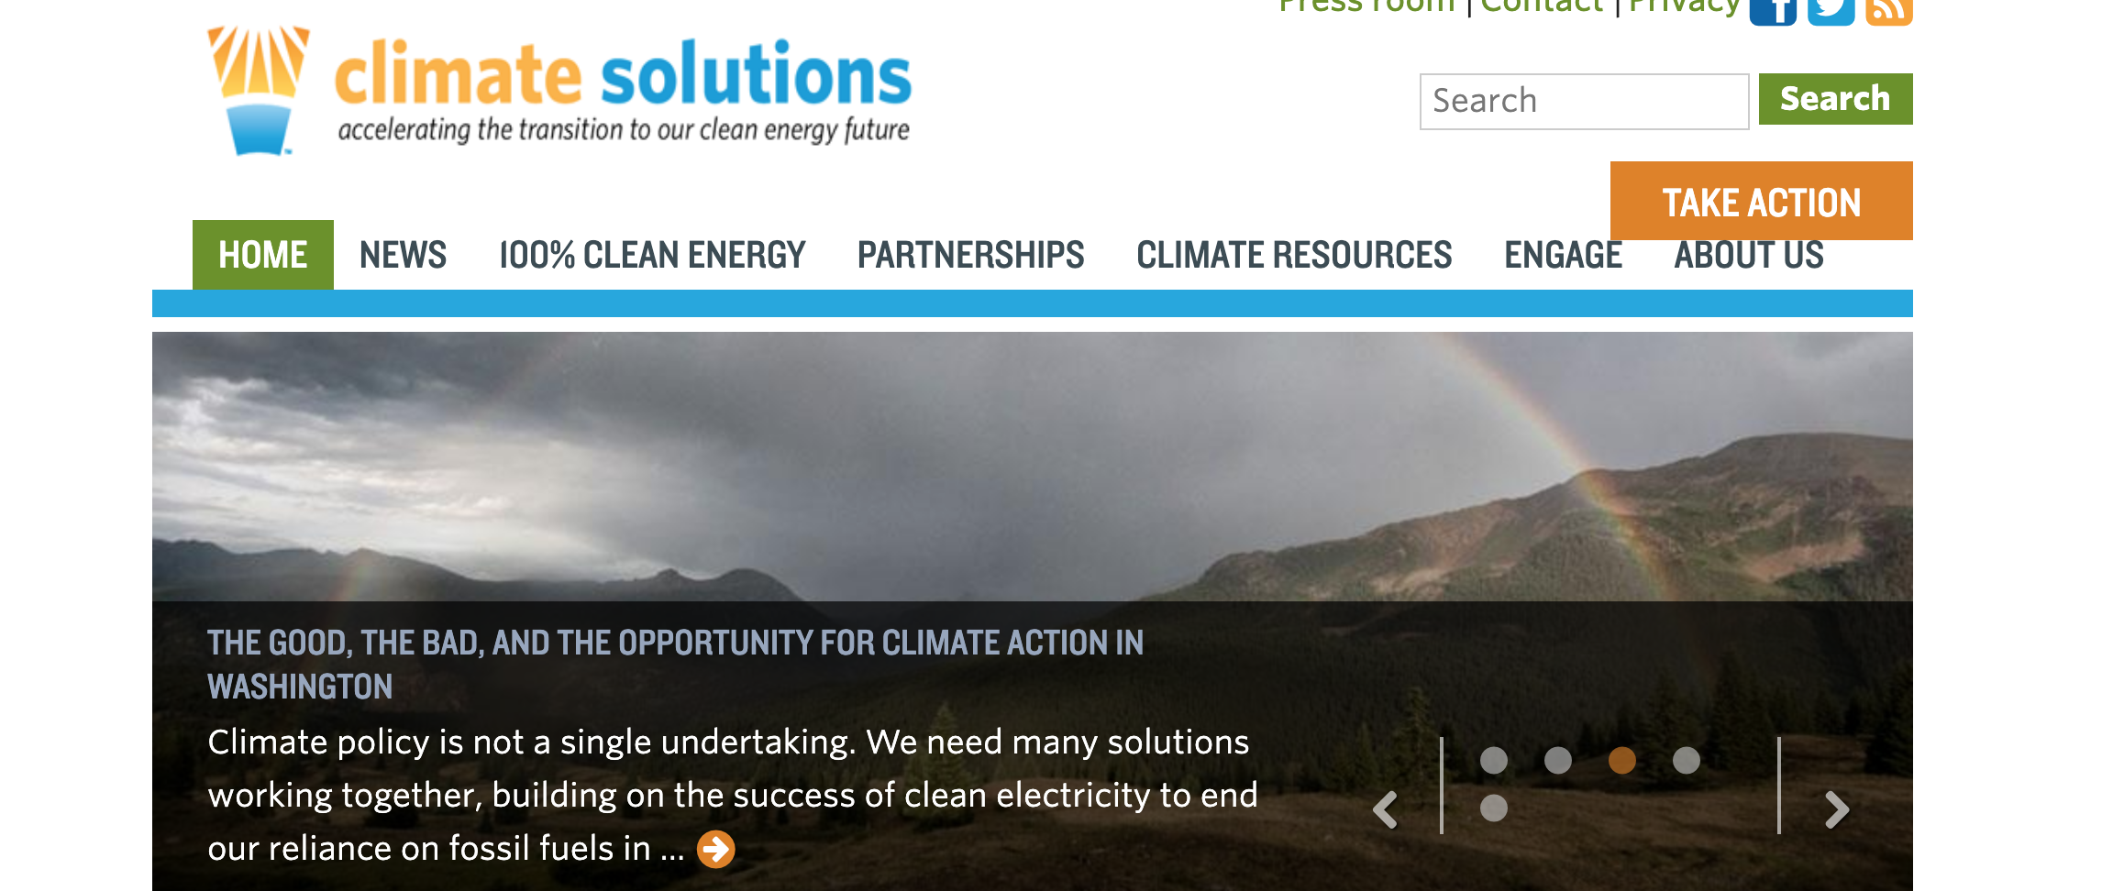
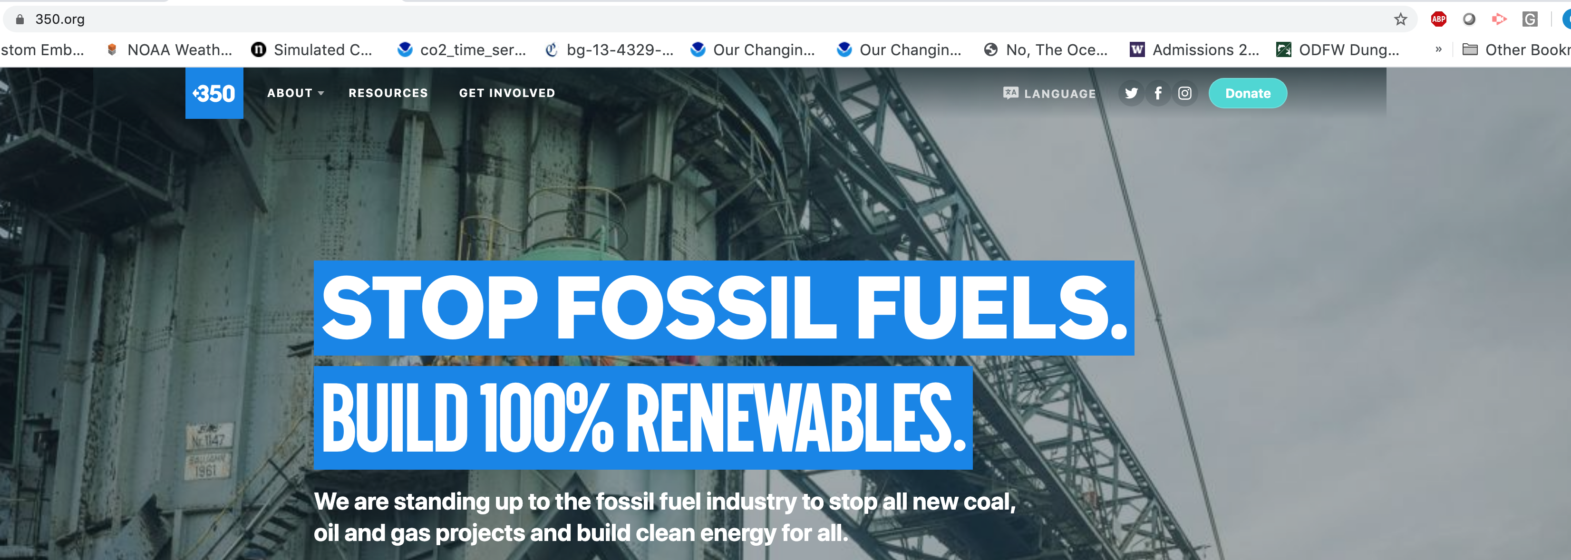
Poor Sources: Advocacy Groups and NGOs

Slide 30
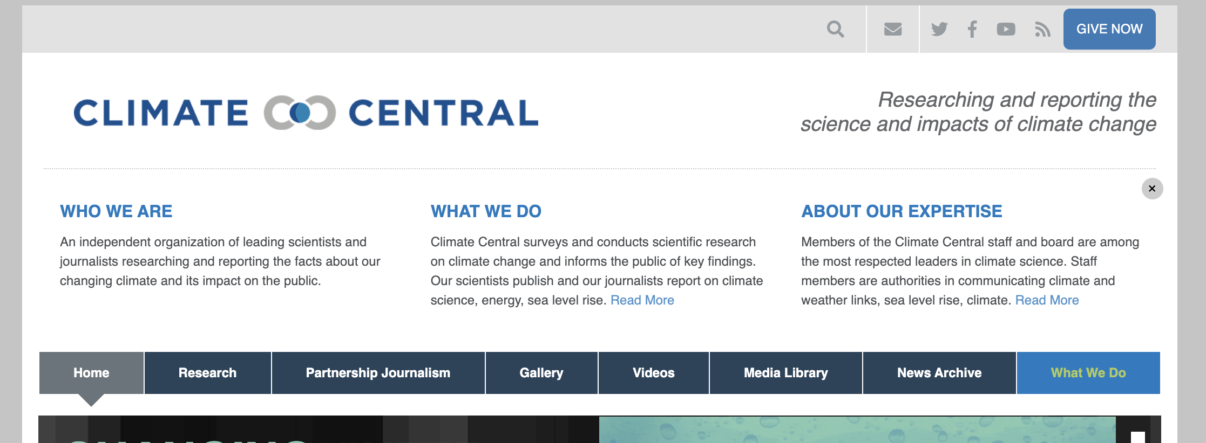
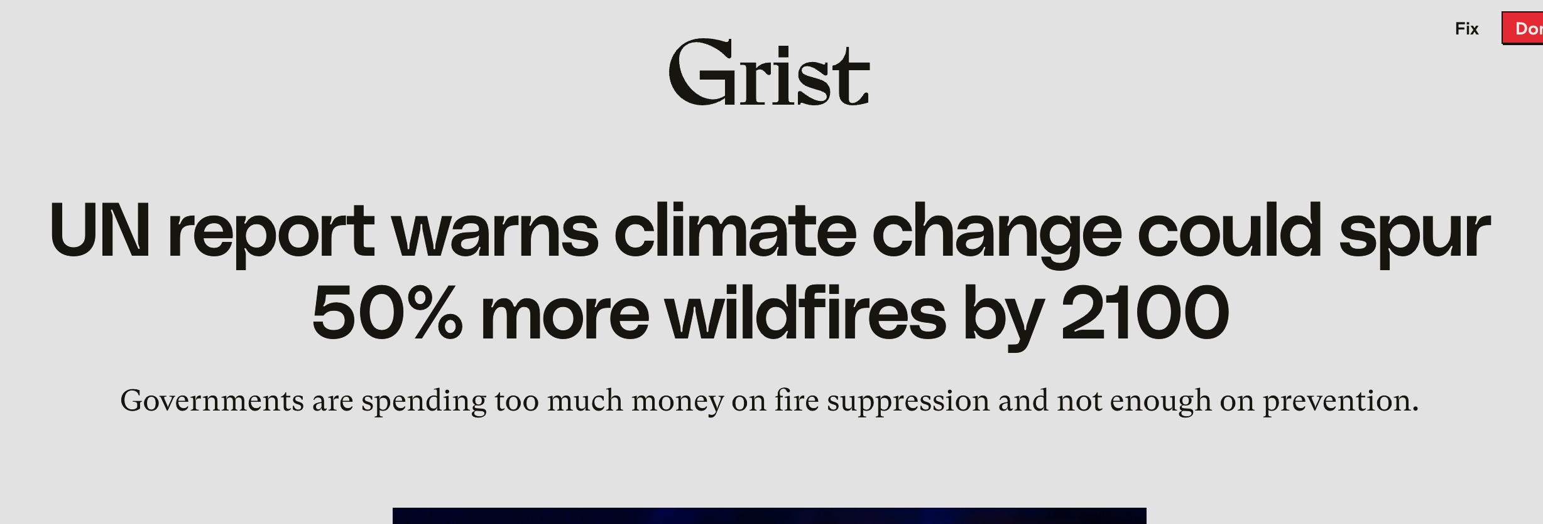
Large Increase in Online Information Services on GW

Slide 31
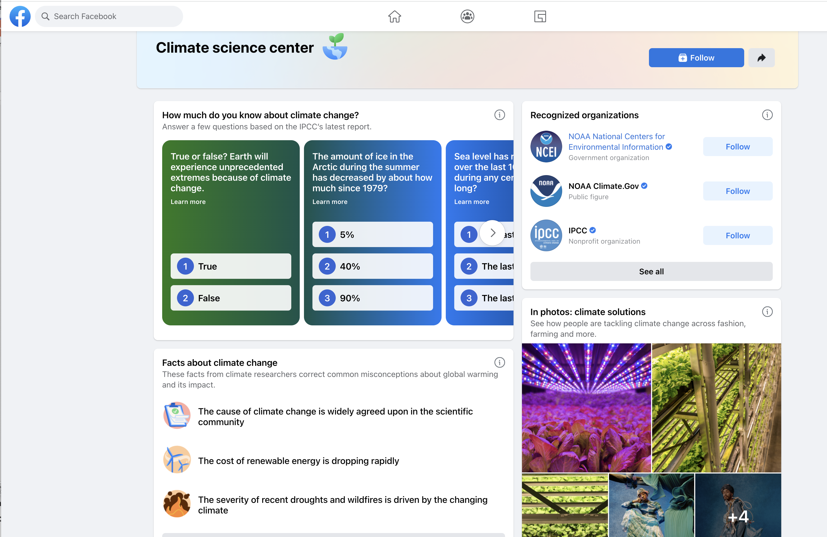
And Now Social Media Sites Are Starting to Censor “Wrong” Materials and Provide “Guidance”

Slide 32
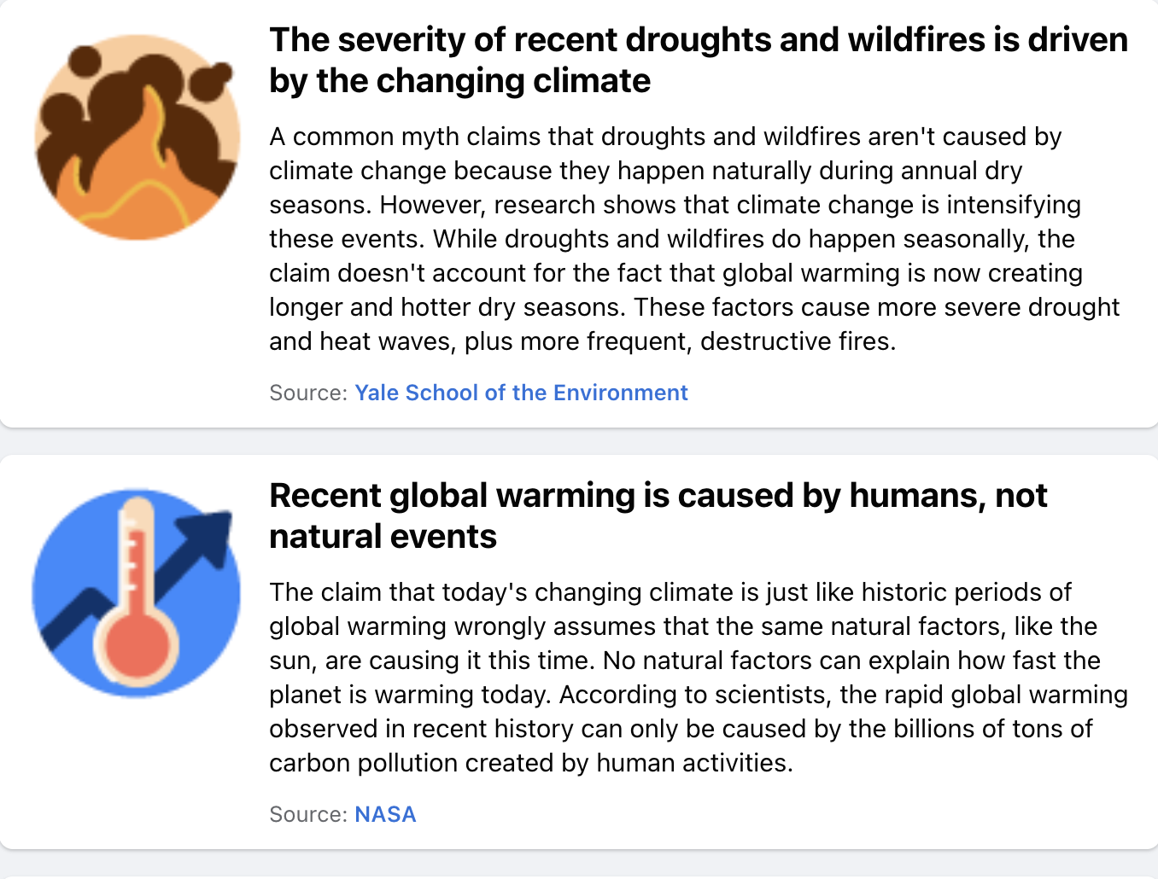

Slide 33
It is critical for responsible media not to hype or exaggerate global warming impacts, but to go with the best peer-reviewed, consensus science
Important to keep in mind that not every peer-reviewed paper is correct. Thus, important to look for consensus statements of groups such as the IPCC.
Hyping climate change to “get people to do the right thing” is not an appropriate role for a media representative.
Sticking to consensus science, may get complaints by advocacy groups on the right or the left. Or advocacy media.

Slide 34
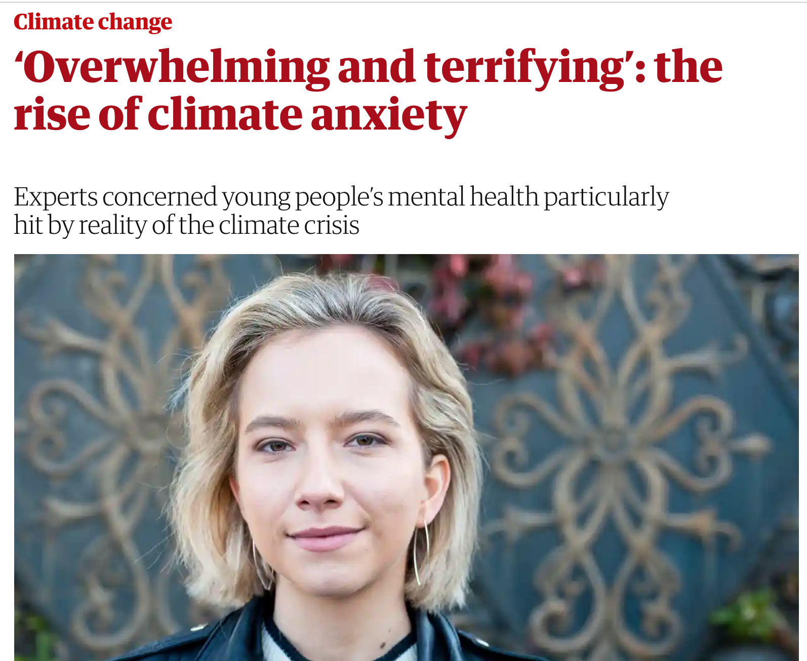
Ethical Dimensions: Exaggeration, hyping, and existential threat stories can hurt the most vulnerable

Slide 35

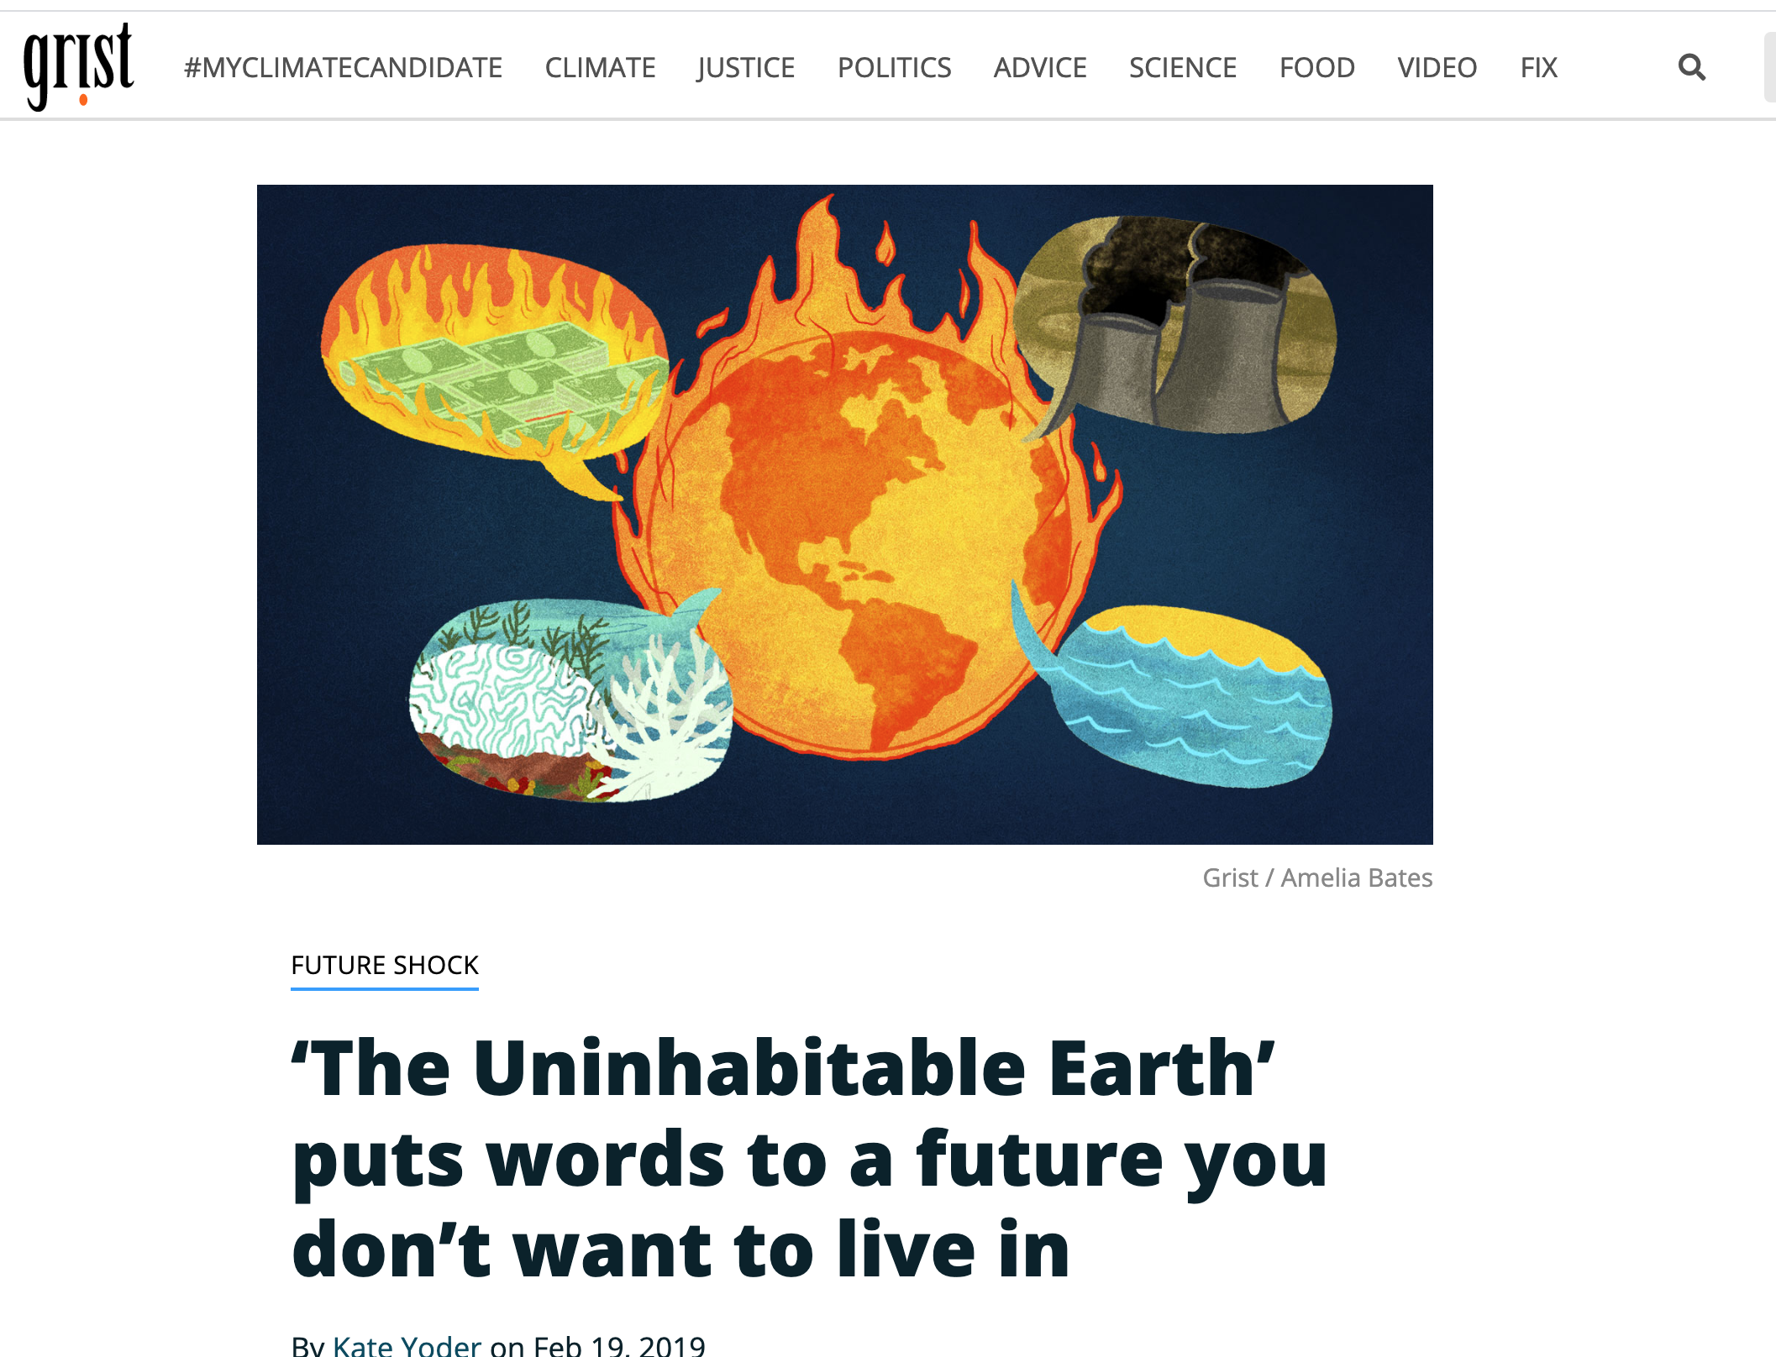

Slide 36
Should one bring up climate change on air?
Sometimes it is unavoidable, particularly after an extreme weather event.
Stick to science and keep away from politics.
Make sure information about uncertainties is clear.
The media must be seen as a source of objective information, not advocacy.

Slide 37
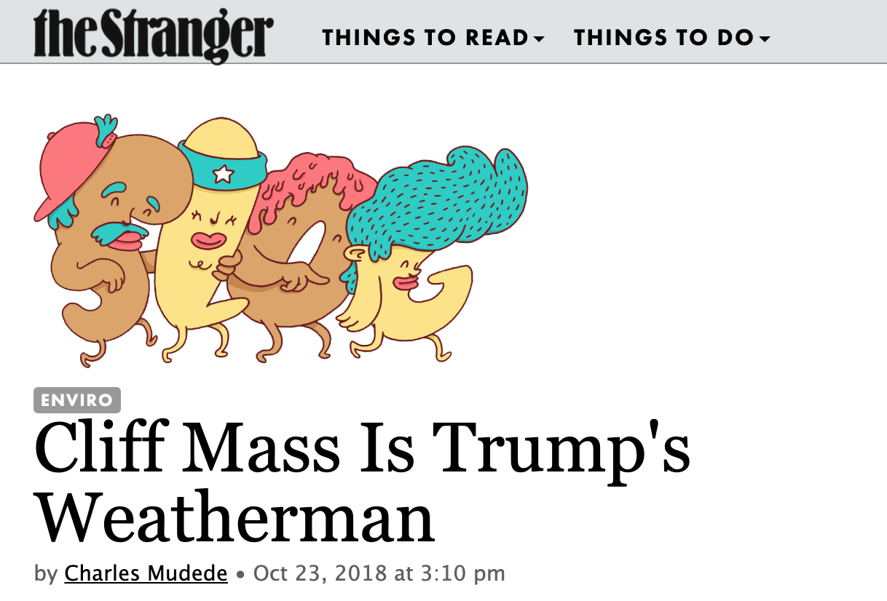
I have learned this the hard way of some of the dangers….

Slide 38
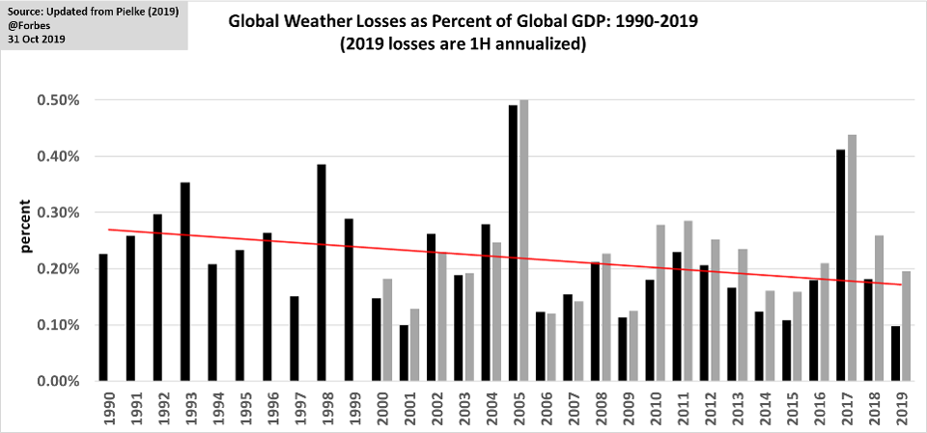
Many positive stories about climate change and related subjects
Becoming clear that the worst is not going to happen
Major advances in technology (solar and wind, safe fission, storage technologies)
Major potential for adaptation
Improved forecasting and richer societies are less prone to environmental disaster

Slide 39
The End

