Slide 1
Temperature Prediction
ATMS 452
Spring 2026

Slide 2
Surface Temperature Measurements
2-m above surface
In shade
Should be over a natural vegetated surface
(often not the case)

Slide 3
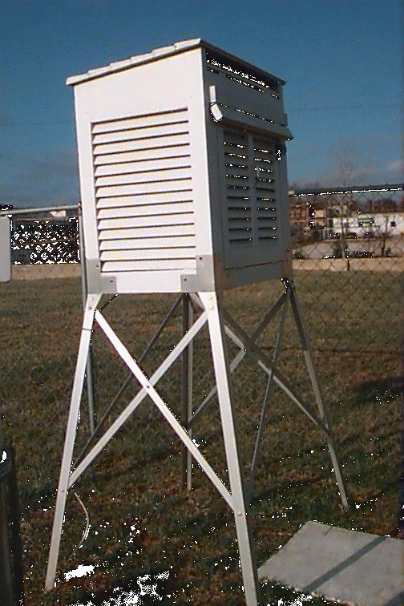
Stevenson Screen
AKA: Cotton Region Shelter
The Old Traditional Approach

Slide 4
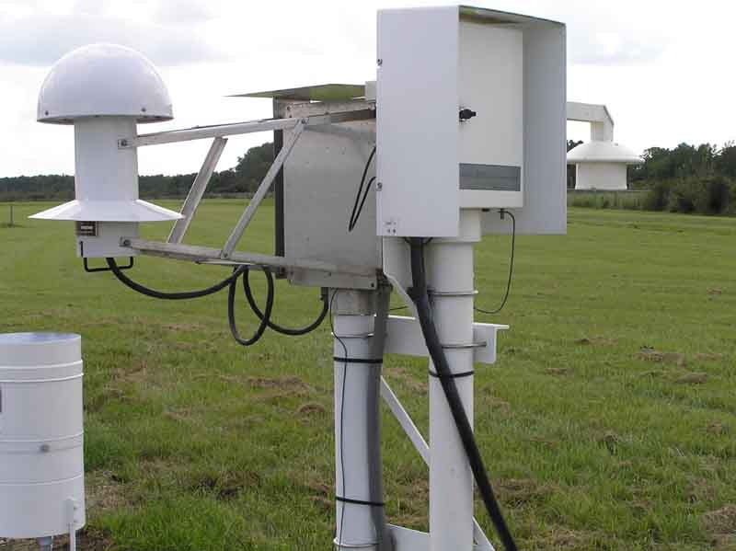
Today: ASOS Temperature/Humidity Sensor Standard NWS/FAA instrumentation
Vulnerable to fan failures

Slide 5
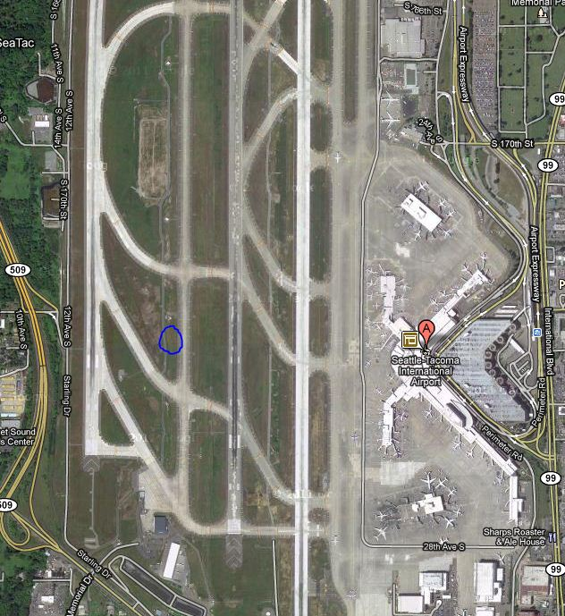
Sea Tac
Example
ASOS Typically placed
on runway
Grassy strip

Slide 6
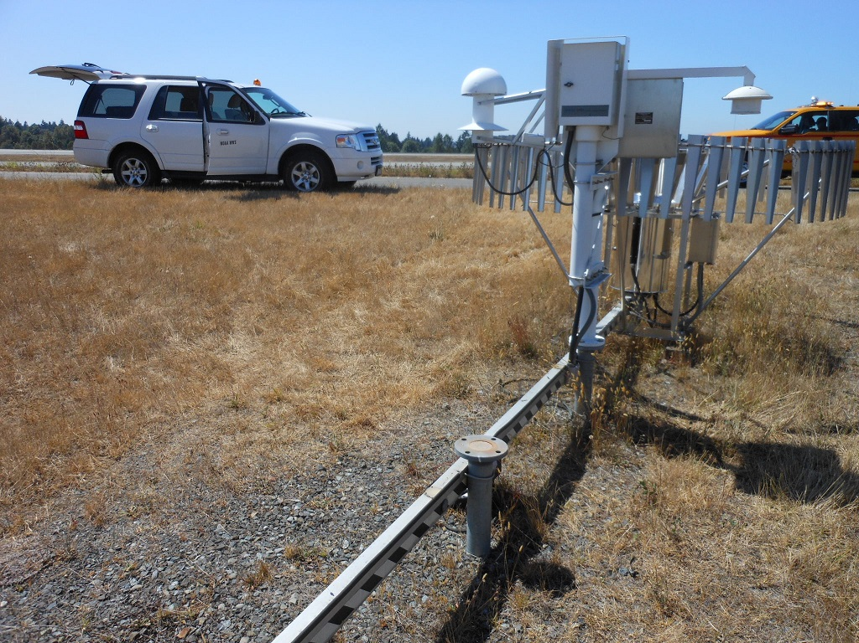
SeaTac Airport

Slide 7
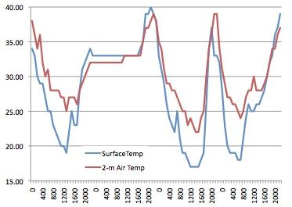
Remember: Temperature at the surface can be very different than at 2-m
Marblemont WA, December 2011

Slide 8
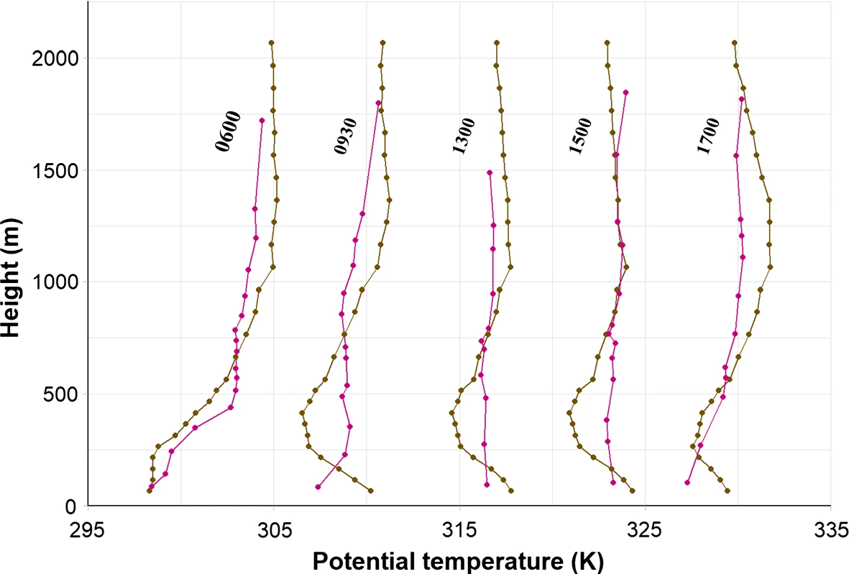
2-m versus surface temperatures
2-m air temperature is often much warmer than surface during cool, winter nights
2-m air temperature is often much colder than surface on warm, summer days

Slide 9
Why Not Simply Use Model Temps Directly?
Model surface elevation may be very different than actual surface elevation due to limited model resolution.
  Differences can be in the hundreds of meters or more in steep terrain.
  Improves as resolution increases
  Where model terrain is too high, temps too cold

Slide 10
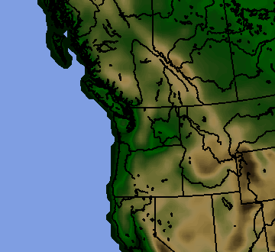
36-km terrain UW WRF

Slide 11
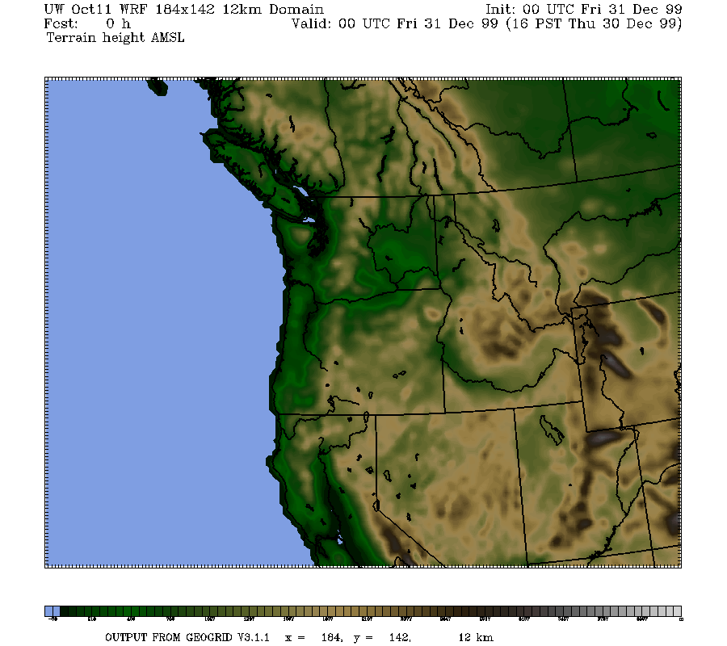
12-km

Slide 12
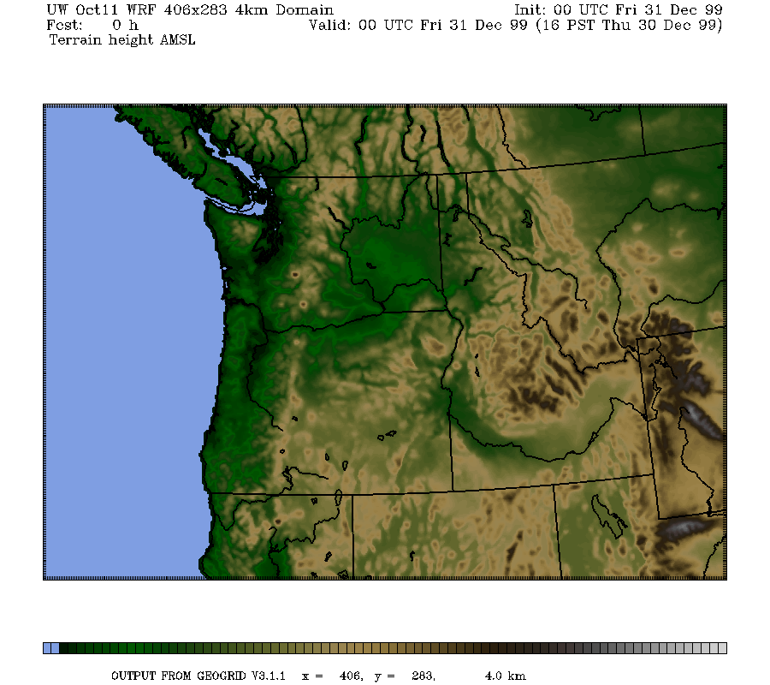
4-km

Slide 13
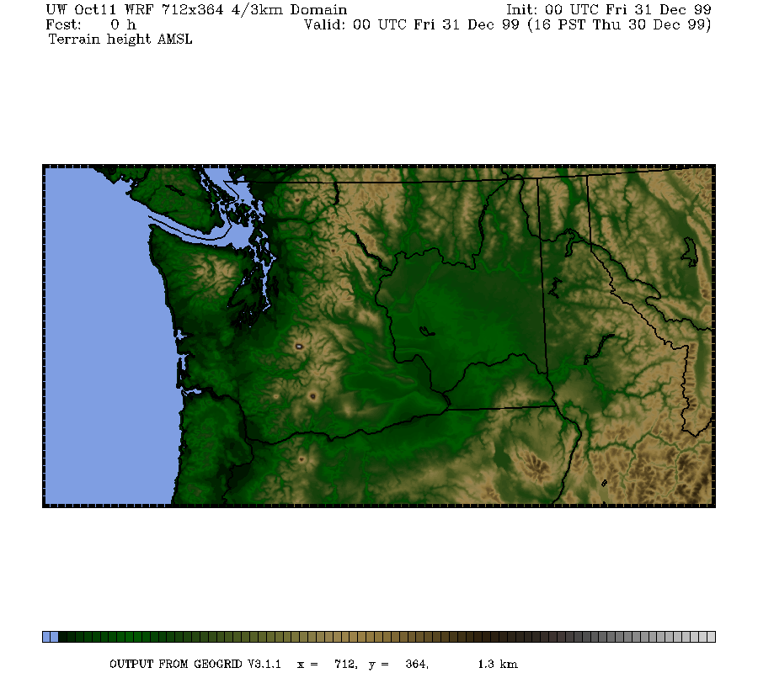
1.3 km

Slide 14
Why Not Simply Use Model Temps Directly and Go Home?
(2) Model resolution is often inadequate for properly simulating important features that influence temperature.
  Examples include the Columbia River Gorge and drainage flows in valleys
  Coastal temperature contrasts

Slide 15
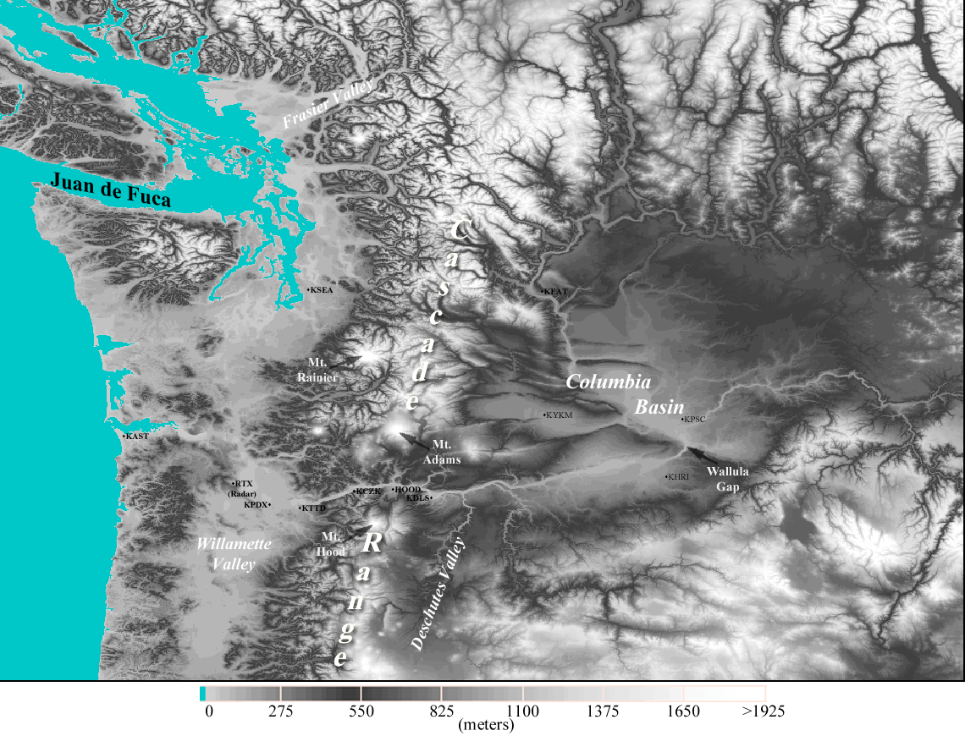
Near Sea Level Gap
On Border of WA and OR
Notes:
Use this slide to introduce where the Gorge is and the nature of the gap flow scenario.
Spend some time pointing out important features like:
The mountain barrier, the Columbia Basin and how it provides a topographically confined air shed and note how the Gorge is the only drain
Then switch gears and point out other gaps on this map (Frasier, JDF, Stampede, Chehalis) and mention important results of each
Frasier - cold outflow, Juan de Fuca - easterly gales, westerly gales, PSCZ, Chehalis - PSCZ, Stampede - downslope windstorms, CRG - Cold outflow, gales, wintry precipitation
So meteorological phenomena driven by gaps are obviously very important, especially in the PNW.

Slide 16
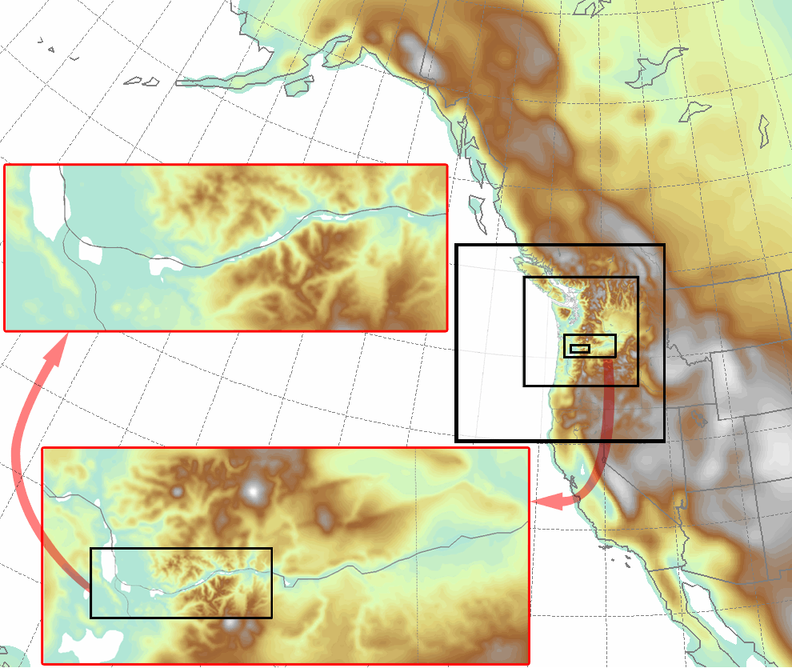
Columbia Gorge Flow Simulation
Notes:
Some leakage over McKenzie and Santiam Passes
NOTE: There are two layers of images

Slide 17
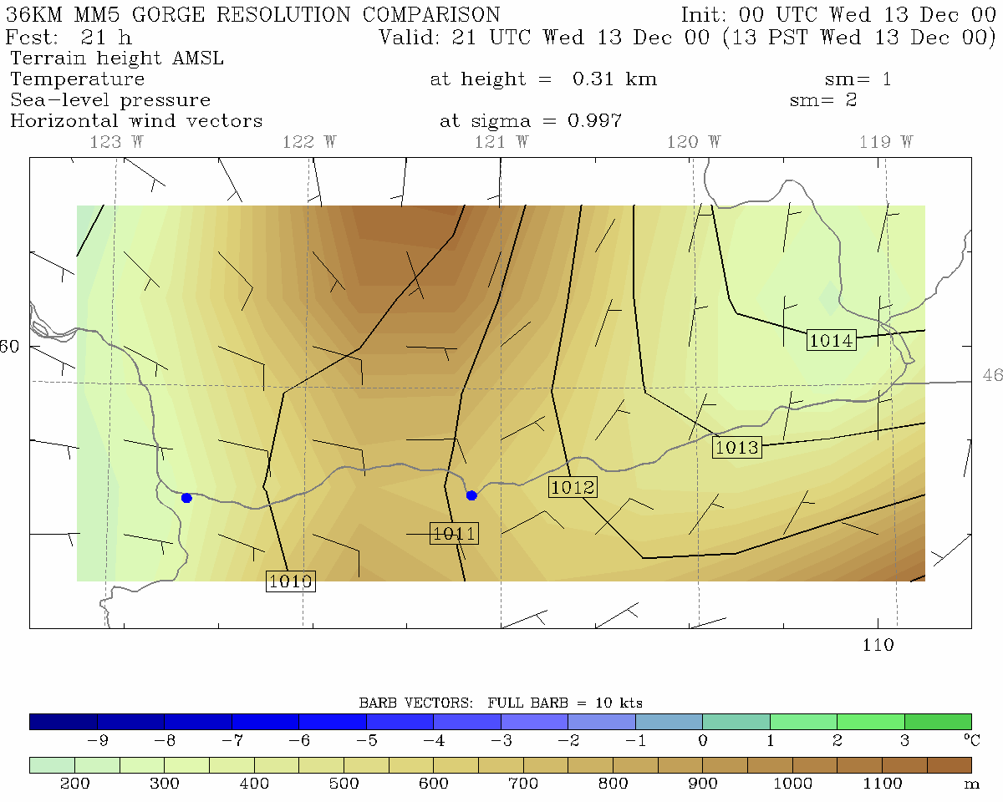
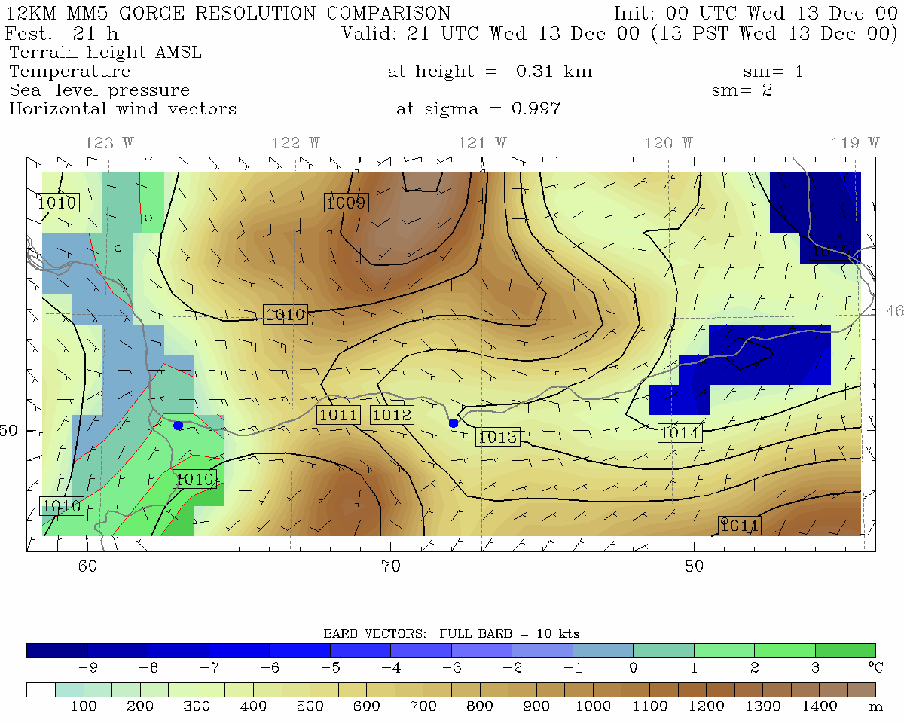
36 km grid spacing
12 km grid spacing
Portland
The Dalles
Portland
The Dalles
Pass Height = 700 m
Pass Height = 600 m

Slide 18
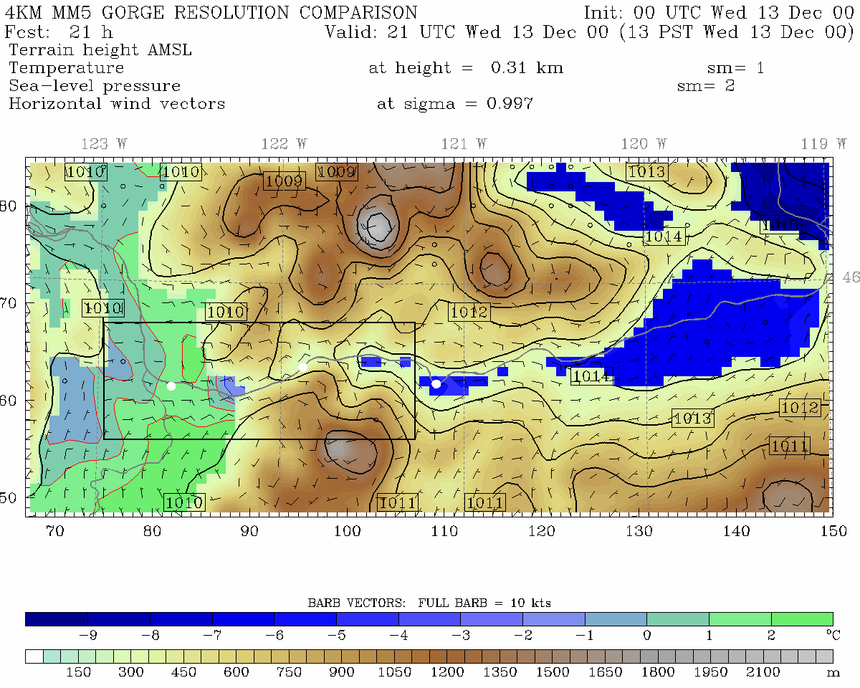
4 km grid spacing
12 km grid spacing
Portland
Cascade Locks
The Dalles
Portland
The Dalles
Pass Height = 400 m
Pass Height = 600 m

Slide 19
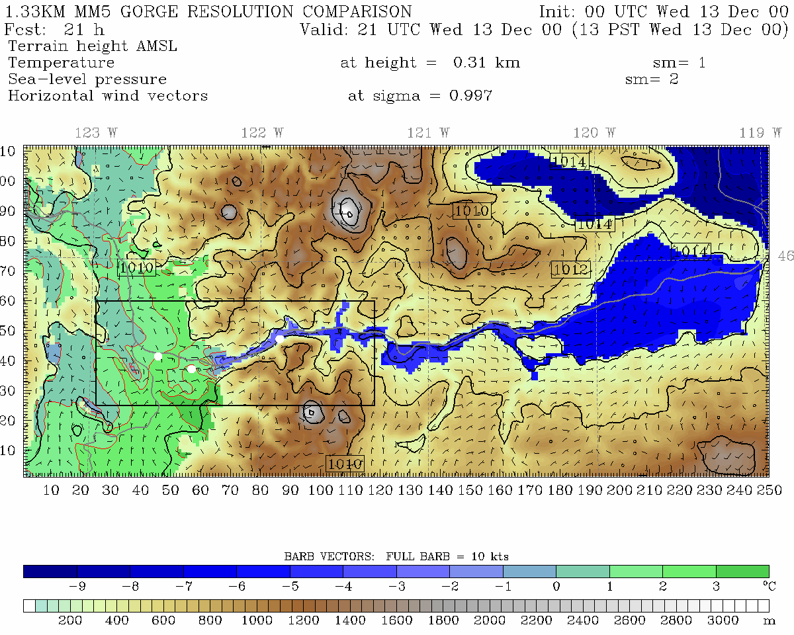
1.33 km grid spacing, Pass Height = 150 m
•
Portland
Cascade Locks
The Dalles
Troutdale
Notes:
Min pass height is at far right of domain near Cascade Locks

Slide 20
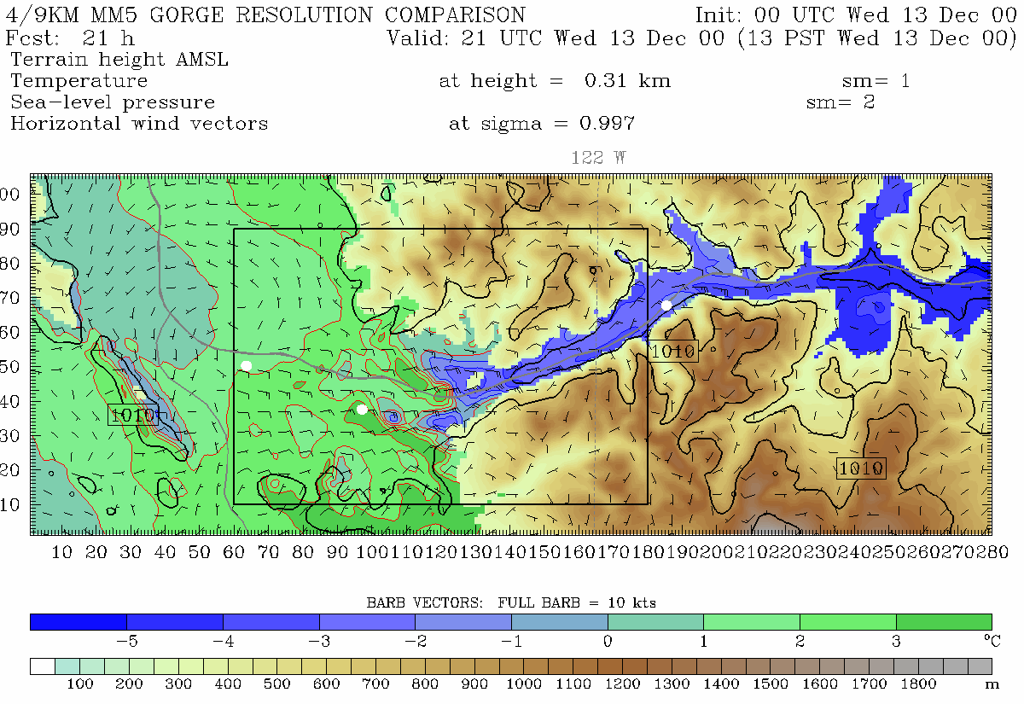
444.4 m grid spacing, Pass Height = 100 m
Portland
Troutdale
Cascade Locks
Notes:
Min pass height is at far right of domain near Cascade Locks (same place as 4/3 domain)
This plot is from 310 m. Note, vortex. See this on radar data too. Zoomed in plot will be from 150 m

Slide 21
Model temperatures may be seriously in error due to deficient model physical parameterizations
Examples: Problems in planetary boundary layer physics, radiation, surface energy fluxes, cloud and precipitation processes.
  Example 1: overmixing of PBL under stable conditions can result in the inability to maintain shallow cold air masses. Result: warm bias
  Example 2: improper soil moisture modeling (too wet or dry) can greatly influence temperatures. (too wet produces too cool temps, vice versa)

Slide 22
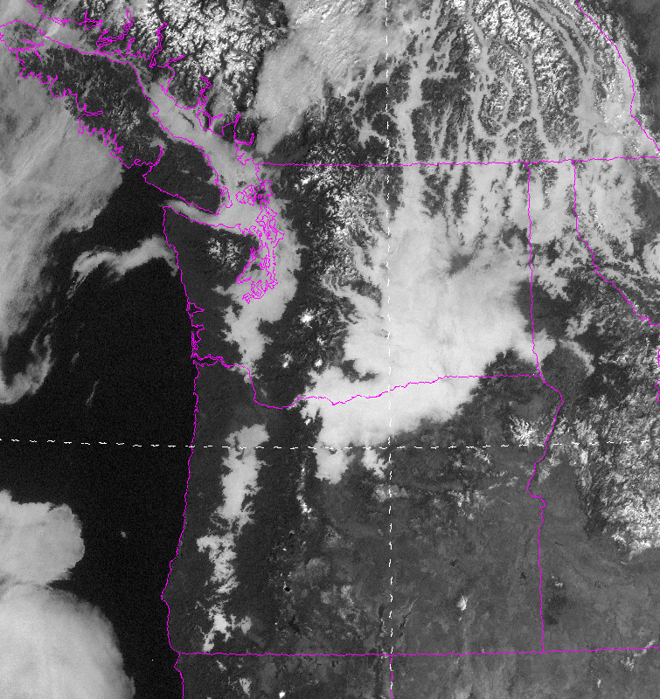

Slide 23
PBL Problem Example:
Shallow Fog…Nov 19, 2005
Reality: fog persisted at low elevations for days
Model maintained a deep inversion, without the observed shallow mixed layer of cold air a few hundred m deep.
Model could not maintain moisture at low levels

Slide 24
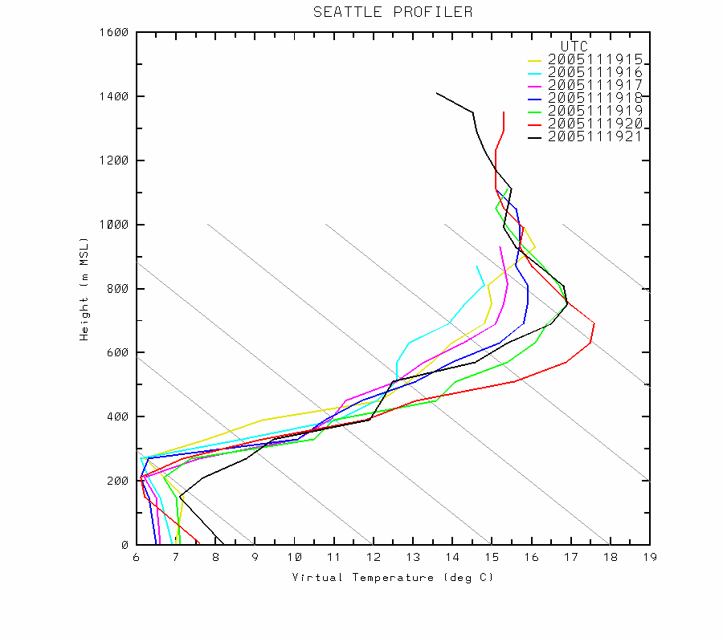
Observed Sounding

Slide 25
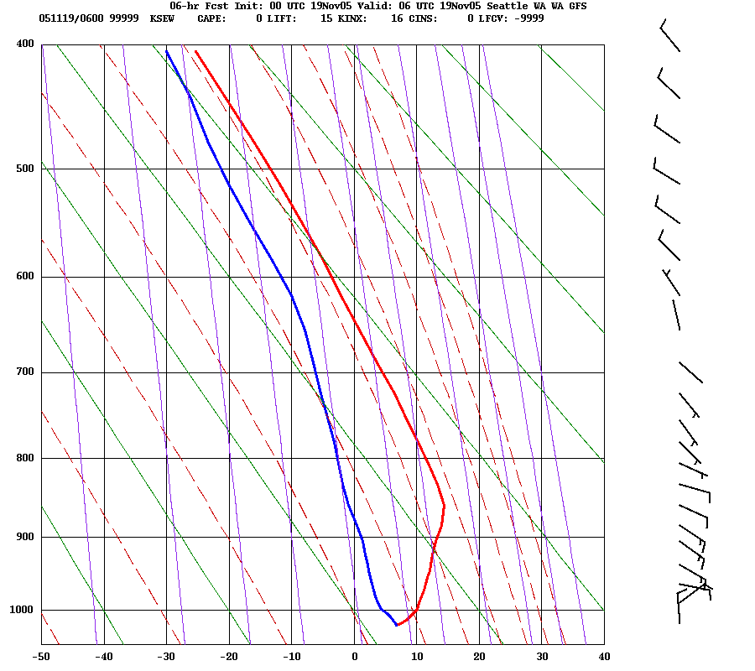
WRF Model

Slide 26
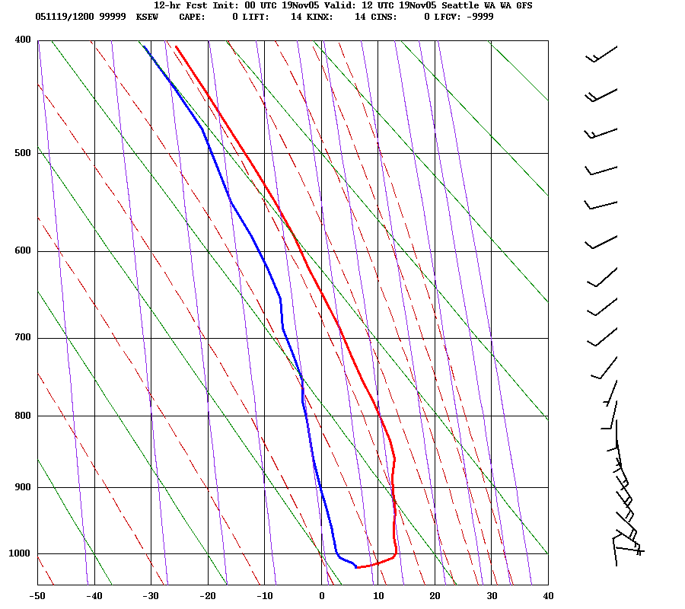

Slide 27
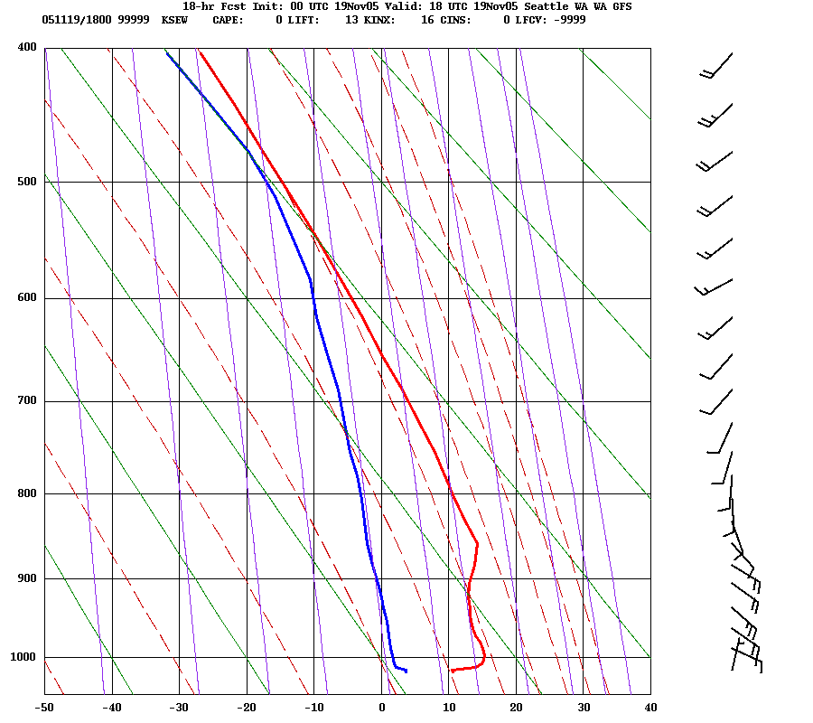

Slide 28
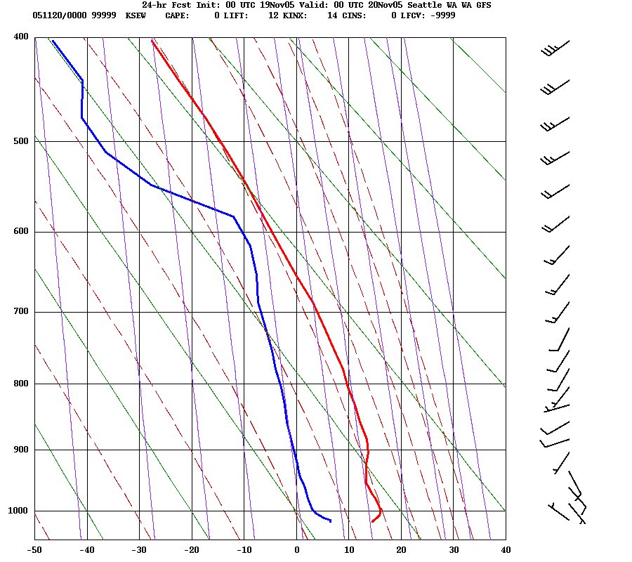

Slide 29
Other reasons why you can’t simply take the model temps
Models can also have synoptic and timing errors that can undermine temperature forecasts.
Errors in cloud distributions (which often occur) can greatly influence temperatures

Slide 30
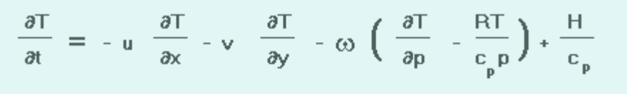
Back to Basics: First Law of Thermodynamics
Local Temperature Change =
Horizontal Advection +
Vertical Advection/adiabatic heating-cooling +
Diabatic Heating and Cooling

Slide 31
Horizontal Advection
Often dominates away from terrain (level areas) and near coastlines.
Large near strong fronts
Usually largest in the lower troposphere.
Models are good at this if they have enough resolution.

Slide 32
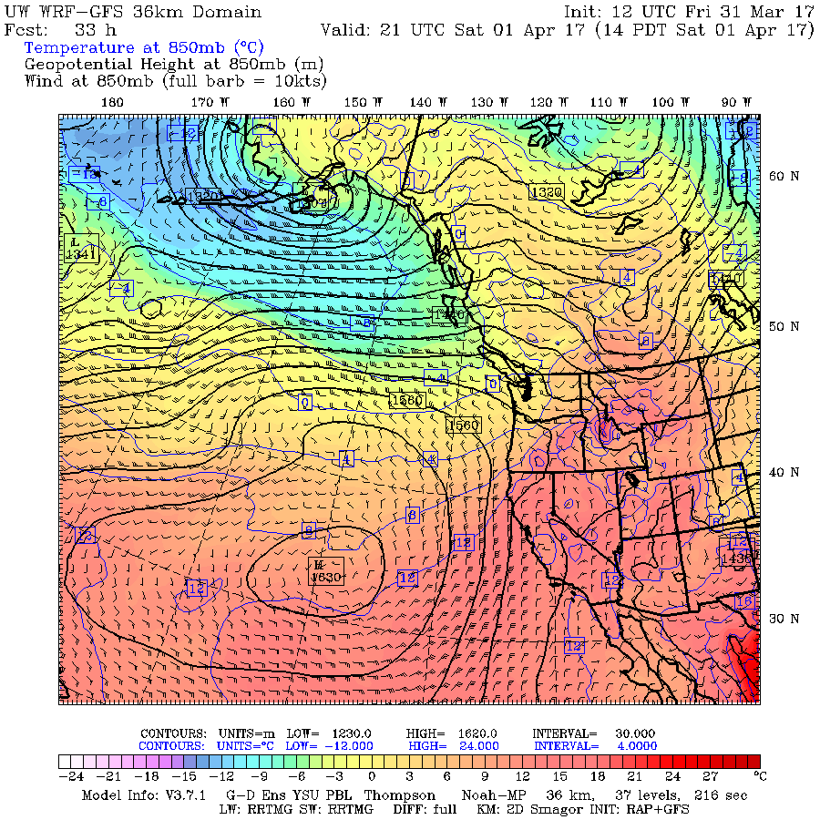
Here is advection strong?

Slide 33
Adiabatic heating/cooling
Can be VERY significant near topographic barriers
Warming with downslope flow
Cooling with upslope flow.

Slide 34
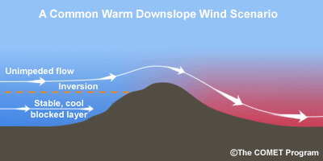
Downslope Warming
Large compressional warming during downslope flow
Often large over Cascade foothills (e.g., Cascades-North Bend), but apparent all over the world, including to the lee (east) of the Rockies--the Chinook Wind.
In Europe called the Foehn Wind.

Slide 35
Downslope Warming
Usually, air comes from mid-levels where potential temperature is higher than at the surface.
A drop in dew point usually accompanies downslope flow, since air is drier aloft

Slide 36
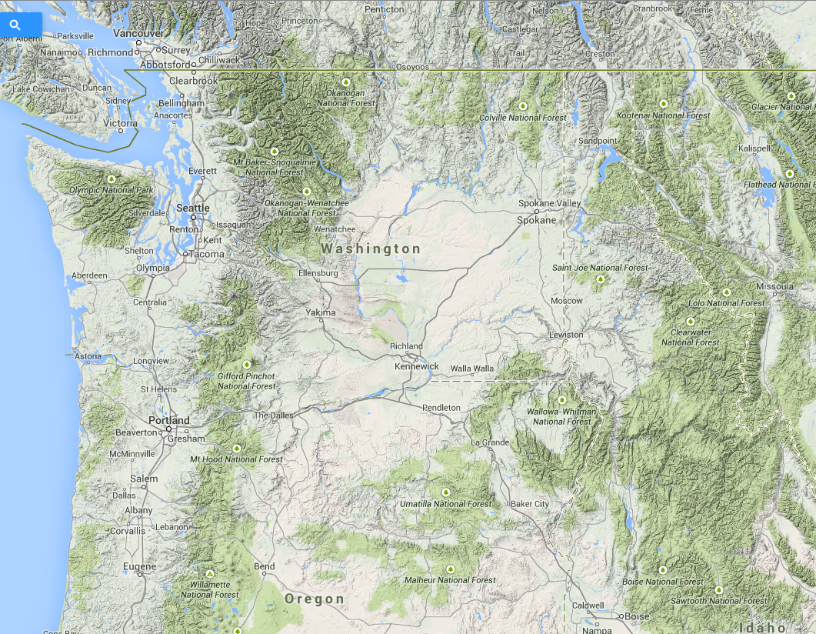

Slide 37
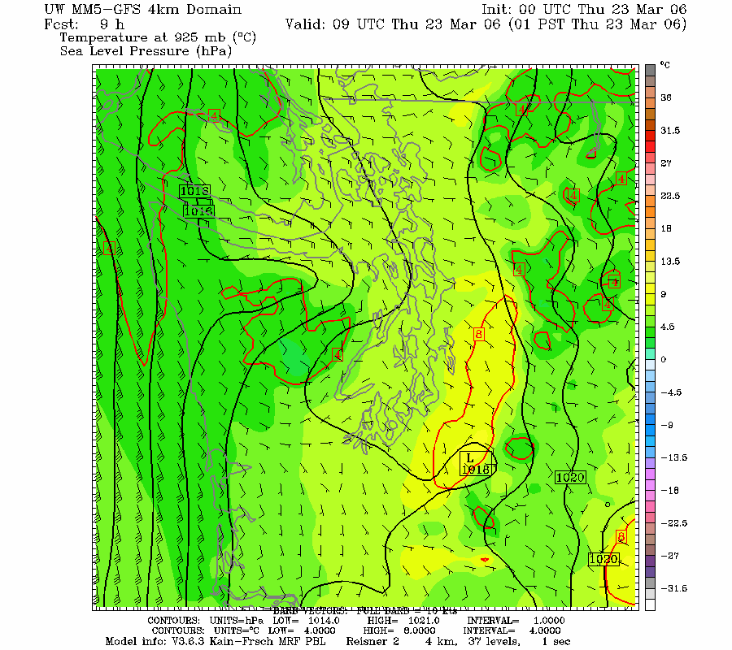

Slide 38
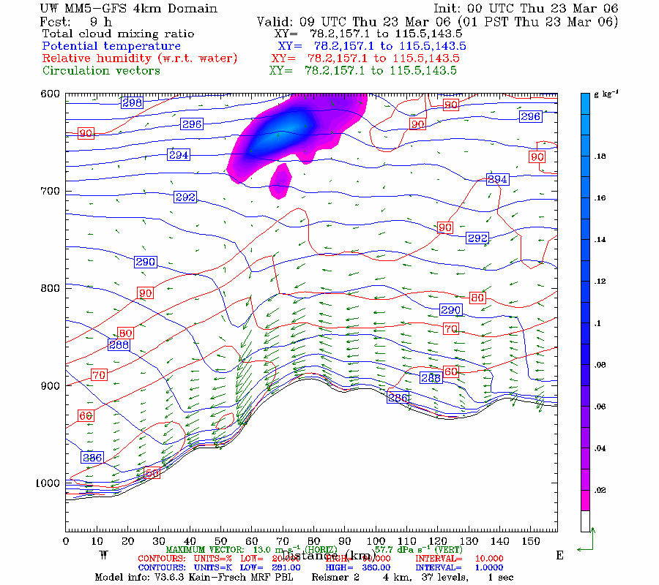

Slide 39
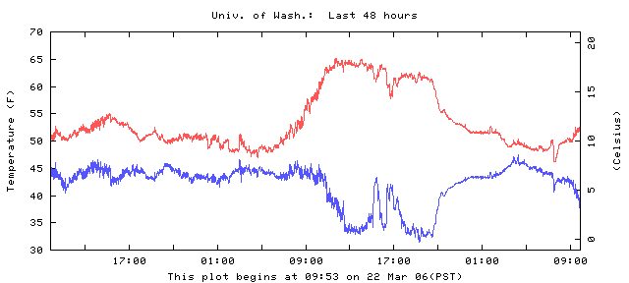
Downslope Example at the Surface
Why drop in dew point temperature?

Slide 40
The warmest temperatures are often at the bottom of the terrain slope during downslope flow

Slide 41

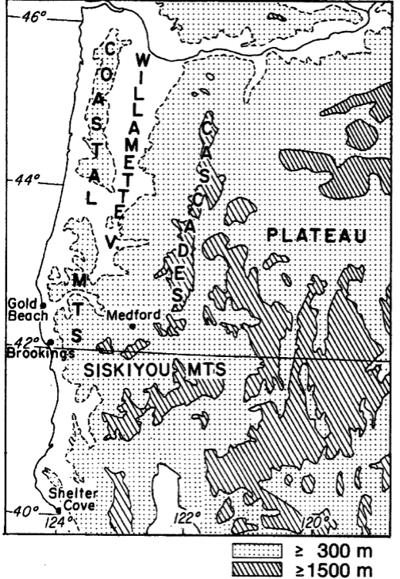
Brookings: The Classic
Northwest Example
Located in the “Banana Belt” of Oregon

Slide 42
February 27, 1985

Slide 43
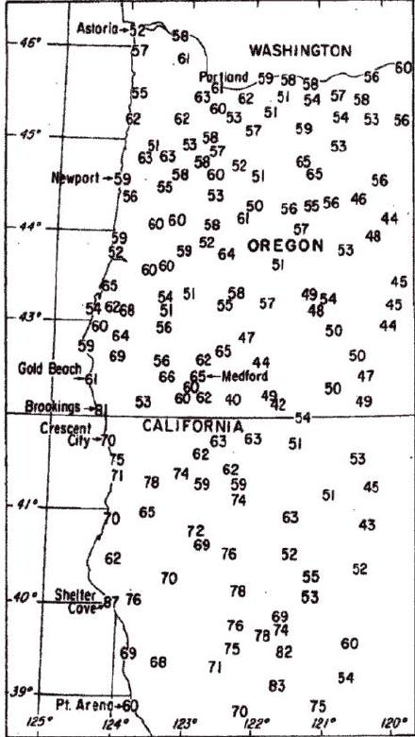

Slide 44
Another example
https://cliffmass.blogspot.com/2013/04/the-banana-belt-of-brookings-oregon.html

Slide 45
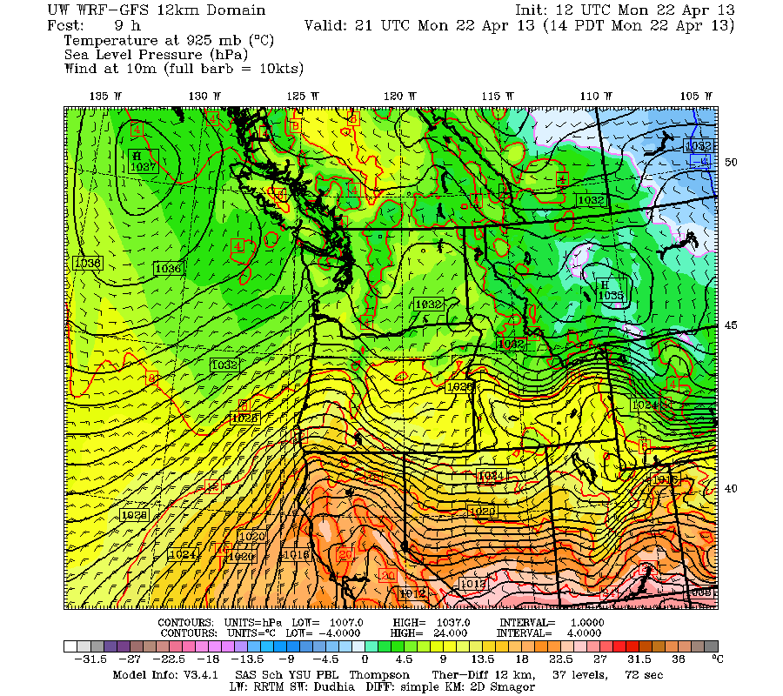
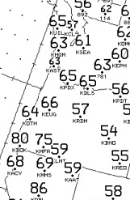

Slide 46
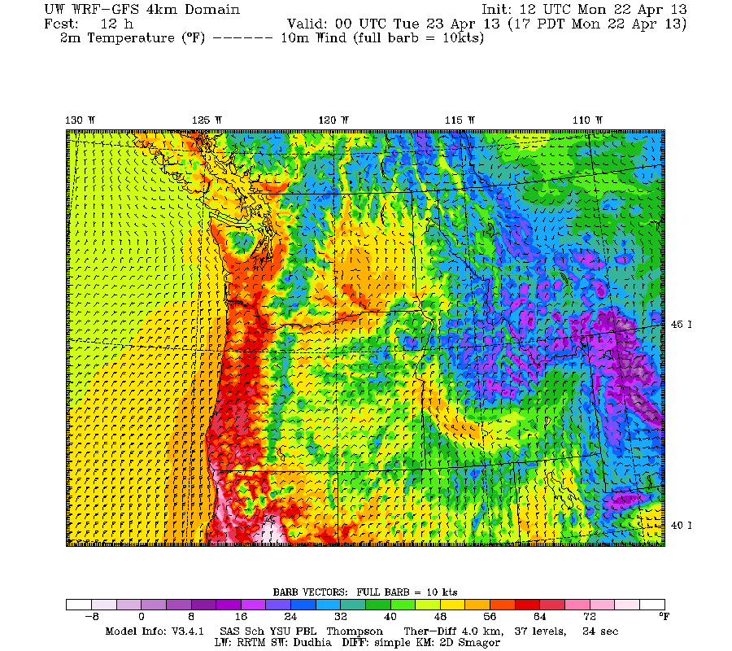

Slide 47
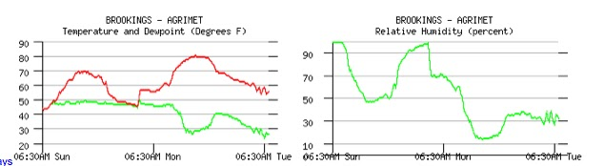
Relative Humidity Plummets with Downslope Flow
Can be crucial for wildfire prediction and management

Slide 48
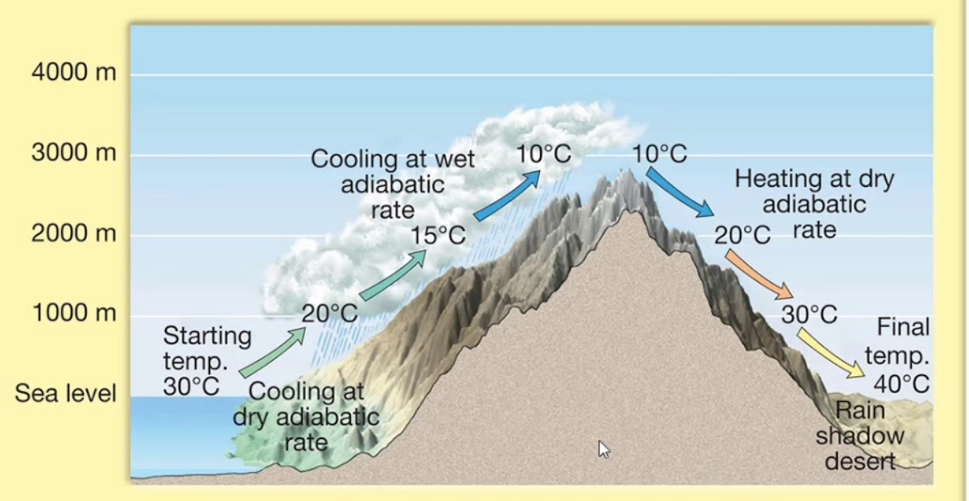
Adiabatic cooling in upslope flow occurs but is harder to see

Slide 49
Adiabatic cooling is there but harder to see, Why?
Clouds and precipitation accompanying upward motion have significant temperature effects
Adiabatic ascent leads to saturation/latent heating which results in a lesser cooling rate for rising air
  Saturated adiabatic lapse rate is smaller than dry adiabatic lapse rate.

Slide 50
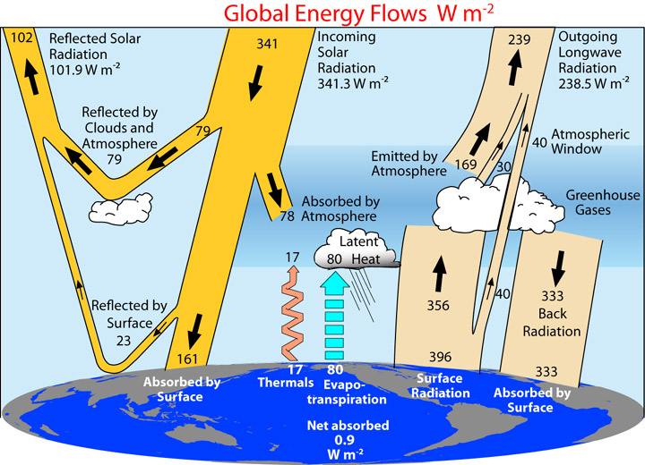
Radiation Effects on Surface Air Temps
  Direct radiational heating and cooling of the air is relatively small (except in dust/smoke layers)
  Indirectly, very large influence on air temp through modulation of ground temperature and communication into the boundary layer by turbulence.

Slide 51
Radiation Effects on Surface Air Temps
  Surface heating by the solar flux and cooling by IR flux dominate surface and near-surface temperatures.
  Clouds have a major effect on surface radiational heating/cooling.
  Smoke can too.

Slide 52

Clouds, Radiation and Surface Temps
Clouds lessen surface warming during day by reducing solar radiation, scattering/reflecting solar to space.
Clouds decrease cooling at night by intercepting IR radiation and reradiating IR back to the surface.
Thin cirrus: only minor influence (1-2F daytime cooling)
Thick altostratus: 5-10F cooling
or more.

Slide 53
One can see association between changes in clouds and temperature on short-time scales

Slide 54
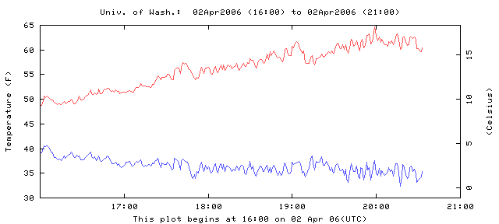
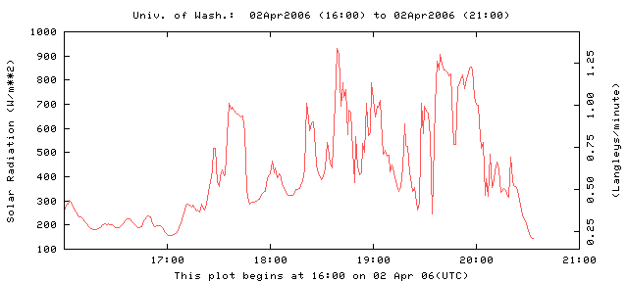

Slide 55
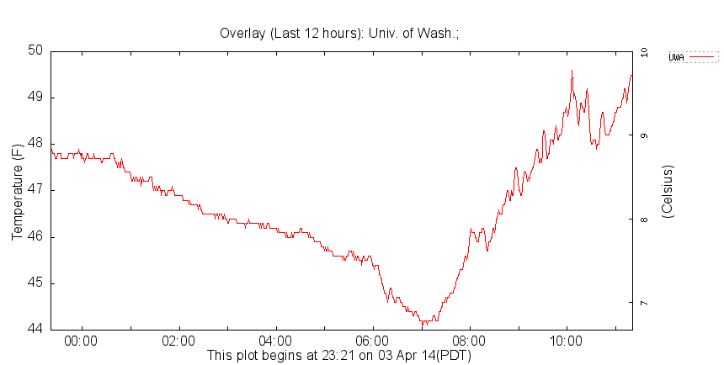
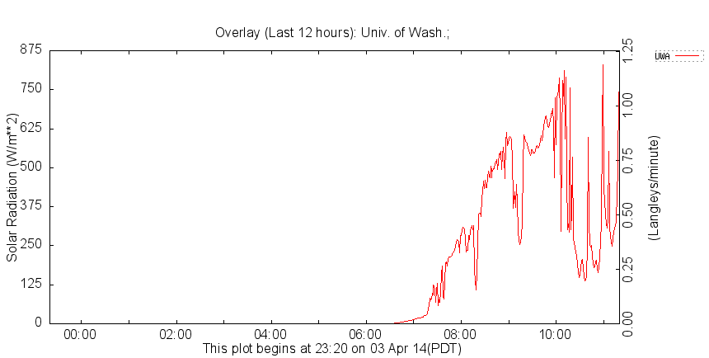
w

Slide 56
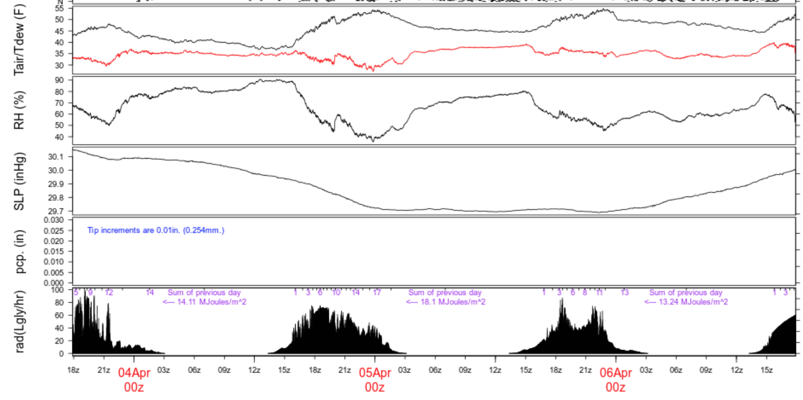

Slide 57
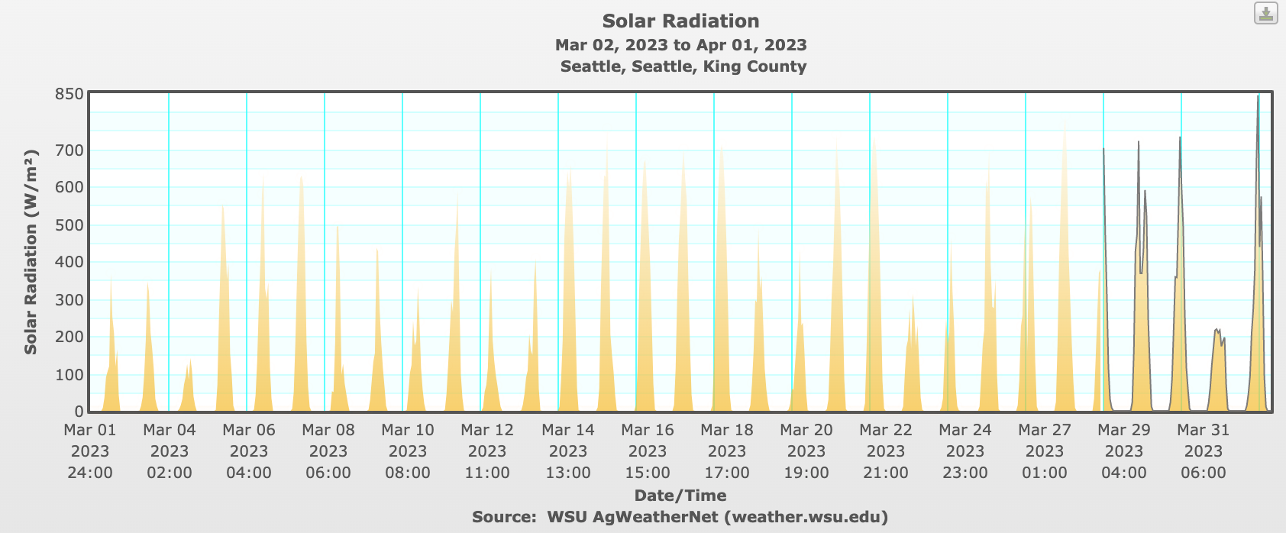
Lots of day-to-day variability in solar radiation reaching the surface due to clouds

Slide 58
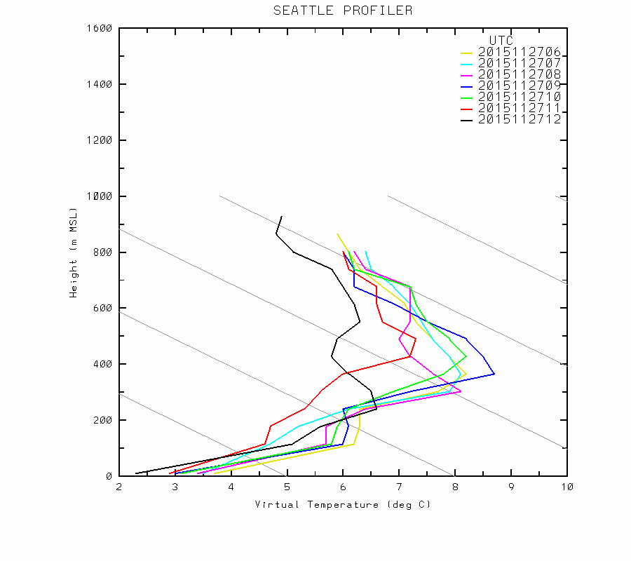
Surprising Effect of Clouds
When there are low-level inversion conditions, surface temperatures can WARM when low-level clouds move in aloft!
Why?

Slide 59
Reason: Cloud Aloft Radiates at a Higher Temperature Than the Surface!

Slide 60
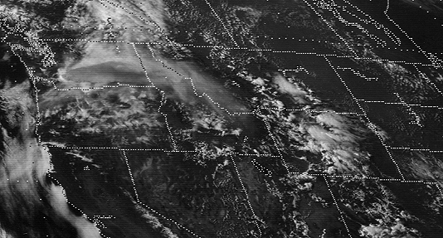
Impacts of Dust and Smoke
Mt. St Helens, 1980

Slide 61
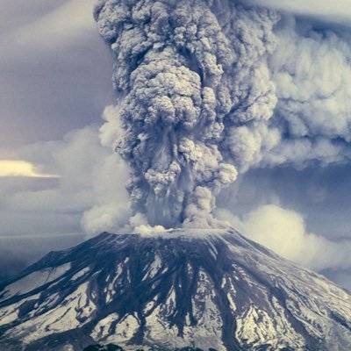
Mount St. Helens: May 1980

Slide 63
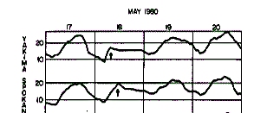
Mount St. Helens
When Smoke Moved in Overhead:
No radiation got in, nothing got out

Slide 64
Volcanic Dust Clouds
Can greatly decrease temperatures during the day.
Can keep temperatures up at night (particularly if the volcanic dust cloud is low)

Slide 65

Wildfire Smoke Can Reduce Max Temps by 1-20F

Slide 66
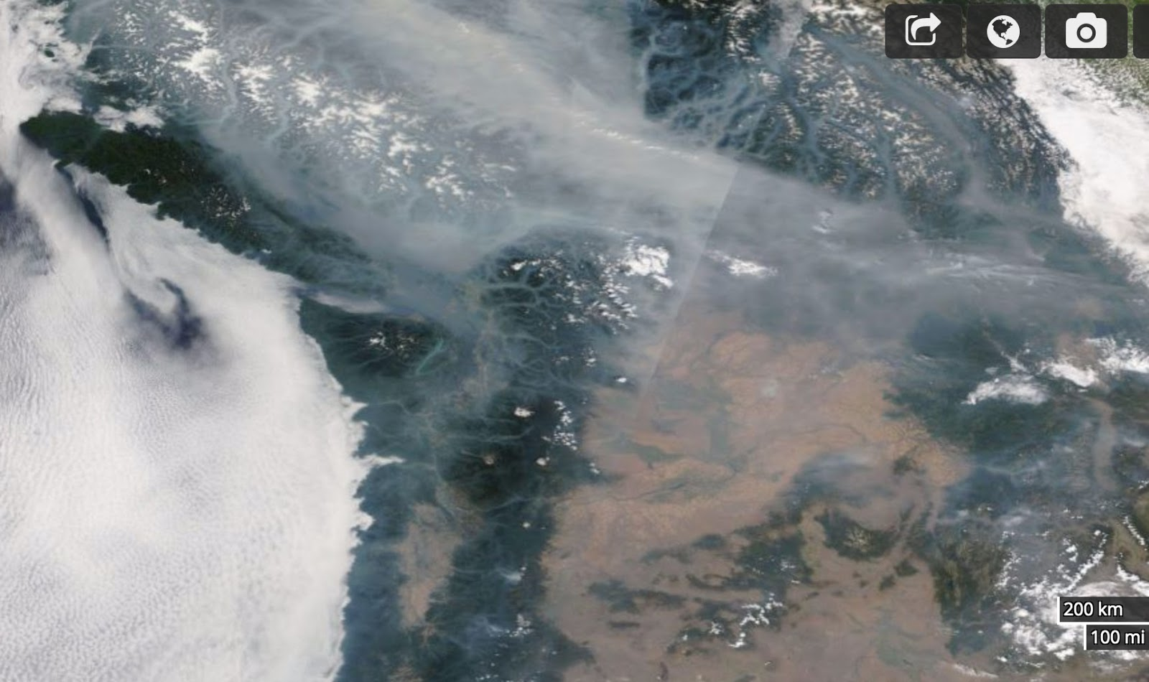
August 9, 2017

Slide 67
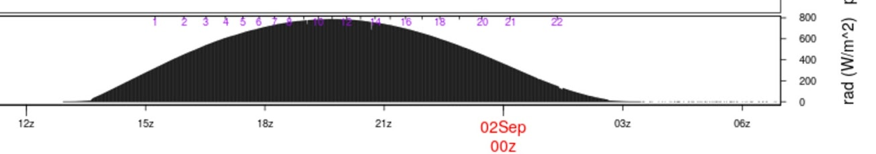

Smoke impacts on solar radiation can be profound (25-35% drop in solar flux at surface)

Slide 68

Different between WRF forecast (no smoke) and observed
WRF
Too
WARM
With
Smoke

Slide 69

Seattle

Slide 70

Several Models Now Consider Radiative Effects of Wildfire Smoke
UW WRF has added smoke radiative effects.
NOAA HRRR model has smoke effects.
Not in GFS/NAM

Slide 71

IR Opacity of Water Vapor Influences Surface Temps
Increased water vapor content enhances IR opacity (H₂0 vapor is an active greenhouse gas)
Better absorption and emission of IR with more water vapor.
Less water vapor increases surface IR cooling under clear conditions.
That is why deserts cool very rapidly at night. Why Washington DC stays hot all night.

Slide 72

Air Moisture Content has a Large Impact

Slide 73

Drier Areas Have Large Diurnal Range
Pasco, WA (eastern Washington)

Slide 74

SeaTac Airport

Slide 75

Turbulence Effects
Variations in lower tropospheric turbulence and mixing can have a huge impact on surface air temperatures
Strong winds produce more turbulence and thus more vertical mixing/turbulent heat fluxes
Lower vertical stability also enhances turbulence.
2-m temperature can vary with the degree of turbulence, particularly at night

Slide 76
Turbulence and Temperature
Generally, higher temps on windy nights with more turbulence. Destroys or weakens inversions.
Lower temps on calm nights (with clear or nearly clear skies). Surface-based inversion. Lack of mixing down of warm air
December 24, 1983 example (next).

Slide 77

Winds in mph

Slide 78

December 24, 1983
Strong wind swath: higher temps
Low temps that night

Slide 79
Humans can create strong winds and turbulence that alter surface temperatures (e.g., wind machines in orchards)
Mixes warmer air from aloft down to the surface

Slide 80


Orchard Fans
Fans in orchards and vineyards—
can save vulnerable crops

Slide 81


Slide 82


Slide 83

Phase Changes of Water
Can have a large impact on temperature and thus the type of precipitation.
Condensation, freezing, and deposition release latent heat
Evaporation, sublimation, and melting cause cooling (require or absorb heat).

Slide 84


Slide 85


Water is the Battery of the Atmosphere

Slide 86

Phase Change of H₂0 Have Major Energy/Temperature Implications
S to L. Requires heat of fusion. 79.7 cal gm⁻¹
L to V. Requires heat of vaporization: 539 cal gm⁻¹
S to V, sum of both.
Releases energy when you go the other direction (V to L, L to S, V to S).
Condensation is a major warming source

Slide 87
Evaporation at the surface
Evaporation from a wet or moist surface requires energy and produces cooling.
Much of the incoming solar radiation on a moist surface is used to evaporate H₂0, not for sensible heating.
Ratio of two expressed in the Bowen Ratio

Slide 88
Bowen Ratio
Bowen ratio=
energy used for sensible heating
energy used for evaporation and sublimation
~10 deserts,
2-6 arid regions, .
4-.8 temperate forests/grasslands, .
2 tropical rain forest,
.1 tropical ocean

Slide 89

Variations in surface moisture can produce significant temperature variations…both in time and space.
Moist areas can be 1-5F cooler than dry areas.

Slide 90

Irrigated Fields: 1-5F cooler than surrounding dry areas

Slide 91

Massive Irrigation in Eastern WA

Slide 92

Temperature

Slide 93

Dewpoint

Slide 94

California
Central Valley
Huge
Irrigated
Area

Slide 95

Cooler and higher humidity. Sprayers also cool the air!

Slide 96

Role of Soil Moisture in the June 2021 Northwest Heatwave

Slide 97

Was dry before heat wave, re-ran with climatological moisture
Drier conditions made it warmer!

Slide 98
Evaporation of precipitation is a powerful cooling agent but generally short lived
Most of the cooling occurs during the first hour of precipitation.
Air cools to the wet bulb temperature (T_{w})
Ends when air becomes saturated.
Can produce large cooling (10-20F in very dry air)

Slide 99


Idea used in Swamp Coolers

Slide 100

Exterior coolers in dry climate

Slide 101


Evaporation and resulting saturation/cooling on a sounding

Slide 102



Slide 103


Slide 105

Condensation (e.g., dew) on ground
Can slow cooling near ground as latent heat is released.

Slide 106
Dew/condensation begin
Temperature
Dew Point Temp

Slide 107

Freezing of water releases latent heat of fusion
Used in orchards to protect sensitive buds

Slide 108


Slide 109
Critical damage often occurs around 26F, so latent heat release can sometime save crops

Slide 110

Melting and Sublimation of Snow Cools the Atmosphere
Can cause a drop in freezing (or melting) levels and snow levels.
Freezing or melting level (0 C elevation).
Snow level (level at which snow has all melted)—about 300 m (1000 ft) below freezing level.
Isothermal
Layer (OC)

Slide 111
Isothermal
0C

Slide 112

Melting of falling snow
Associated with a “bright band” on weather radars (melting snowflake is like a huge raindrop)
Produces an isothermal (32F) melting layer between the freezing and snow levels.

Slide 113

Bright Band

Slide 114


Slide 115

Can see bright band on radar imagery

Slide 116
Melting of falling snow
Heavier precipitation produces greater cooling and lowering of freezing level (more melting!)
Evaporation (sublimation) into unsaturated air can also drop freezing level, but effect is short-lived.

Slide 117

In marginal temperature conditions for snow, melting can bring snow level down to surface in heaviest precipitation…rain elsewhere
Locally seen in convergence zones

Slide 118


Snohomish, WA
April 4, 2005

Slide 119

Varying Surface Properties Affect Temperature
Surface characteristics can have large impact on surface temperatures. Examples:
  Albedo
  Soil conductivity
  Soil/water thermal capacity
  Soil moisture

Slide 120
Surface: Snow Versus No Snow
Snow promotes cooling in four ways:
  Reflects solar, emits IR, reduces conduction of heat from below, takes energy to melt snow
Potentially,10-15F or more cooling effect from snow
Cold temperature records often associated with snow.
Can have intense low-level horizontal temp gradients on snow boundaries

Slide 121

SNOW IS A COOLING MACHINE
In locations that get snow, record cold temperatures are inevitably associated with snow cover

Slide 122

colder

Slide 123
Surface moisture
Moist surfaces produce cooling by evaporation
Drier surfaces are warmer (Bowen ratio larger)
Forecaster needs to keep this in mind (often not handled well in models)
Wet surfaces can produce surface air cooling of 1-5F and a surface temperature gradient where moisture gradients exist.

Slide 124



Slide 125


Real-Time Soil Moisture Maps are Available and Useful

Slide 126
Influence of water bodies
Water has large heat capacity, with slowly changing temperature
Tend to be warmer than land surfaces during winter, cooler in summer
Creates large temperature gradients along coastal zones
As models gain resolution, doing a better job at this.

Slide 127


Slide 128

A January
Morning
6-7:30 AM

Slide 129
Summer

Slide 130
Conduction of heat from below the surface can significantly influence surface temperatures

Slide 131


Bridges often are often the first (or only) places to ice up.

Slide 132

Bridges
Bridges have air under them, air being an excellent insulator.
The road surface can radiate IR to space and thus the bridge deck cools rapidly.
Roadway surfaces in contract with the soil are warmed by the heat conduction from below.
The conduction of warmth is largest early in the winter season when soils are relatively warm.

Slide 133

SnowWatch Temps One Morning
Bridge

Slide 134

Diurnal temperature signal in soil weakens with depth

Slide 135


Slide 136

Urban Heat Island Effect
Concrete/asphalt/bricks have great thermal mass: warm during day and release heat at night.
Also heat released by combustion
Drier surfaces in urban areas…less evaporation/evapotranspiration

Slide 137

Urban heat islands occur in our major cities

Slide 138

Urban Heat Island Example: London

Slide 139

Seattle’s urban core is often 2-10F warmer than it would have been without concrete and buildings

Slide 140


Slide 141


New York City Area

Slide 142

IMPACTS OF LOCAL DIURNAL CIRCULATIONS ON TEMPERATURE
Sea and land breezes
Upslope and downslope flows

Slide 143

Sea/land breeze circulations

Slide 144
A sea breeze can cap or slow coastal temperature rises mid-day by advecting cool marine air inland
Often cuts off diurnal rise during late morning/early afternoon as cool marine air moves in with the sea breeze.

Slide 146

Sea Breeze Front on the WA coast

Slide 147

Comparison of the daily temperature cycle between observations (blue dashed) and model simulation (red triangles) for a coastal location (Boston, MA) on 10 August 1997 impacted by the passage of a sea breeze front.

Slide 148

Same thing is true in NYC

Slide 149
Sea breezes and resultant daytime cooling can occur on:
ocean coasts
coasts of bays
near large lakes
near large rivers
and even over land where there are differences in temperature (e.g., due to snow or soil moisture distributions!)

Slide 150

Washington State sea breezes—big influence on temperature

Slide 152

The Sound Breeze
Brings Afternoon Cooling During Summer
Over Central Sound

Slide 153

Diurnal
Slope
Winds

Slide 154
Diurnal slope winds
Can have a large influence on low-level temperatures
Importantly, drainage/downslope winds produce cooling at bottom of slopes at night and early morning
Example: Salt Lake City eastern suburbs downstream of gaps often cool 10-15F compared to surrounding areas.

Slide 155



Slide 156


Slide 157


Slide 158

Cold, dense air tends to settle into lower elevations

Slide 159

Even on the microscale

Slide 160

Also in Eastern WA

Slide 161

Mesoscale Cold Pools
Cold air can collect in mesoscale basins…such as the Columbia Basin of eastern Washington, the Willamette Valley, Central Valley of CA, and many more

Slide 162


Slide 163
Near Sea Level Gap
On Border of WA and OR
Notes:
Use this slide to introduce where the Gorge is and the nature of the gap flow scenario.
Spend some time pointing out important features like:
The mountain barrier, the Columbia Basin and how it provides a topographically confined air shed and note how the Gorge is the only drain
Then switch gears and point out other gaps on this map (Frasier, JDF, Stampede, Chehalis) and mention important results of each
Frasier - cold outflow, Juan de Fuca - easterly gales, westerly gales, PSCZ, Chehalis - PSCZ, Stampede - downslope windstorms, CRG - Cold outflow, gales, wintry precipitation
So meteorological phenomena driven by gaps are obviously very important, especially in the PNW.

Slide 164


Slide 165



Slide 166

February 3, 2022

Slide 167

Eastern
Washington
Cold
Pool
Climatology

Slide 168
Cold Pool Forecasting Issues
Models often mix out cold air too readily…resulting in warm temperature biases at low levels.
Cold pools are often capped by inversions, which can be very persistent.
Mixing out of cold pools is a difficult forecasting problem…often takes a strong synoptic system capable of mixing out the inversion overhead.

Slide 169

Gap Winds and Temperatures
Often cooler air in and immediately downstream of gaps.
Often lower dew points within and downwind of gaps.
Local examples: Columbia River Gorge, Fraser River Valley

Slide 170
Columbia Gorge: Near Sea Level Gap
On Border of WA and OR
Notes:
Use this slide to introduce where the Gorge is and the nature of the gap flow scenario.
Spend some time pointing out important features like:
The mountain barrier, the Columbia Basin and how it provides a topographically confined air shed and note how the Gorge is the only drain
Then switch gears and point out other gaps on this map (Frasier, JDF, Stampede, Chehalis) and mention important results of each
Frasier - cold outflow, Juan de Fuca - easterly gales, westerly gales, PSCZ, Chehalis - PSCZ, Stampede - downslope windstorms, CRG - Cold outflow, gales, wintry precipitation
So meteorological phenomena driven by gaps are obviously very important, especially in the PNW.

Slide 171
1.33 km grid spacing, Pass Height = 150 m
•
Portland
Cascade Locks
The Dalles
Troutdale
Notes:
Min pass height is at far right of domain near Cascade Locks

Slide 172

T on
150 m
Surface
Portland
Troutdale
Notes:
Min pass height is at far right of domain near Cascade Locks (same place as 4/3 domain)
This plot is from 310 m. Note, vortex. See this on radar data too. Zoomed in plot will be from 150 m
Recall mesoscale plots. Good T and wind agreement.

Slide 173

Wintry precipitation at PDX (Portland)
  Almost exclusively E or SE (outflow from the Gorge)
  Tendency towards E for snow and SE for freezing rain
Notes:
Some leakage over McKenzie and Santiam Passes
NOTE: There are two layers of images

Slide 174

Cold Air Moving Out of the Fraser River Valley

Slide 175

Cold Air Moving Out of the Fraser River Valley

Slide 176

Onshore Versus Offshore Flow
Onshore (cool) versus offshore (warm) flow during summer
Found all over the world (e.g., Australia, S. Africa)
Very profound in summer in coastal areas with cold water offshore
50F

Slide 177
Question:
Here in western WA which season brings the largest one-day temperature declines?
?

Slide 178

The Summer!

Slide 179

Warming then sudden cooling during the warm season. Why??

Slide 180
The Reason
Temp changes between onshore and offshore flow.
Onshore flow is off the cool ocean (cool temps)
Offshore flow is warm during the summer (warm temps). Downslope adds warming
Rapid summer cooling known as the onshore or marine push over the NW.
Similar situation in coastal regions around the world.

Slide 181


Slide 182


Slide 183


Slide 184


Slide 185


Slide 186


Key Feature: The West Coast Thermal Trough
Produced by Offshore/Downslope Flow

Slide 187


Slide 188

The West Coast Thermal Trough: the Most Important Warm Season Mesoscale Feature of the West Coast
An inverted pressure trough based out of the Central Valley of CA that can extend into the Pacific Northwest
925 hPa heights and temperature

Slide 189


Slide 190


Slide 191

East West Vertical Cross Section

Slide 192
Some interesting temperature details
Warmest weather occurs on the last warm day when trough is overhead and about to move east of the Cascades
When trough is to the south, northerly flow pulls cool air in form the north.

Slide 193

Southerly Buster…SE Australia…just like the push

Slide 194
Each area has local weather features that influence temperature. Over Puget Sound, a good example is the PS Convergence Zone , which can produce localized areas of cooling

Slide 195


Slide 196

Can be 10-15F cooler in convergence zone than in clear zones to north and south

Slide 197
How to approach a temperature forecast
Always be aware of climatology (min, max, average, records)
Make use of the forecast funnel: synoptic scale to mesoscale to microscale
For most locations, good to start with 850 hPa temperature evolution.
Why? Often the first level above surface influence (for near SL stations)
Then add local details

Slide 198

Look at 850 hPa for the big picture

Slide 199

A good approach for warm day maxima
Full sun, no marine influence
Take 850 hPa temps down to SLP and add 1-4F to get maximum
Why does this work so well?

Slide 200


During Day, Lower Atmosphere is Close to Adiabatic

Slide 202

12Z sounding, SLP:1027 hPa
~16C or 61F

Slide 203
Approach to Temp
If synoptic scale forecasts are reasonable and you have high-resolution mesoscale models available, you can start with these temperatures IF they have enough resolution for the problem you are dealing with.
When model resolution is inadequate, manually adjust near complex terrain and near coastlines
Deal with poor land use distribution (e.g., urban areas) or snow/moisture surfaces distribution

Slide 204
Consistent Model Temperature Weaknesses
Keep in mind that many models have inadequate (too small) diurnal cycles
Nearly all mix too much in the vertical….thus, mixing out shallow cold air in stable situations—producing a warm bias.

Slide 205

Always Keep in Mind Verification Statistics of Models

Slide 206

Errors can vary seasonally

Slide 207


Errors Vary Spatially

Slide 208
Statistical Post-Processing Can Improve the Temperature Forecasts of Models
Old: MOS
New: NBM

Slide 209

NBM Improves Model Forecasts of Temperature

Slide 210


Slide 211


Slide 212


Slide 213
MOS and NBM (National Blend of Models) temps are hard to beat on “typical” days

Slide 214
Private Sector Temps are often better than the NWS Forecasts
Why? Better post-processing of model output

Slide 215


https://vlab.noaa.gov/web/mdl/mos-verification

