Slide 1
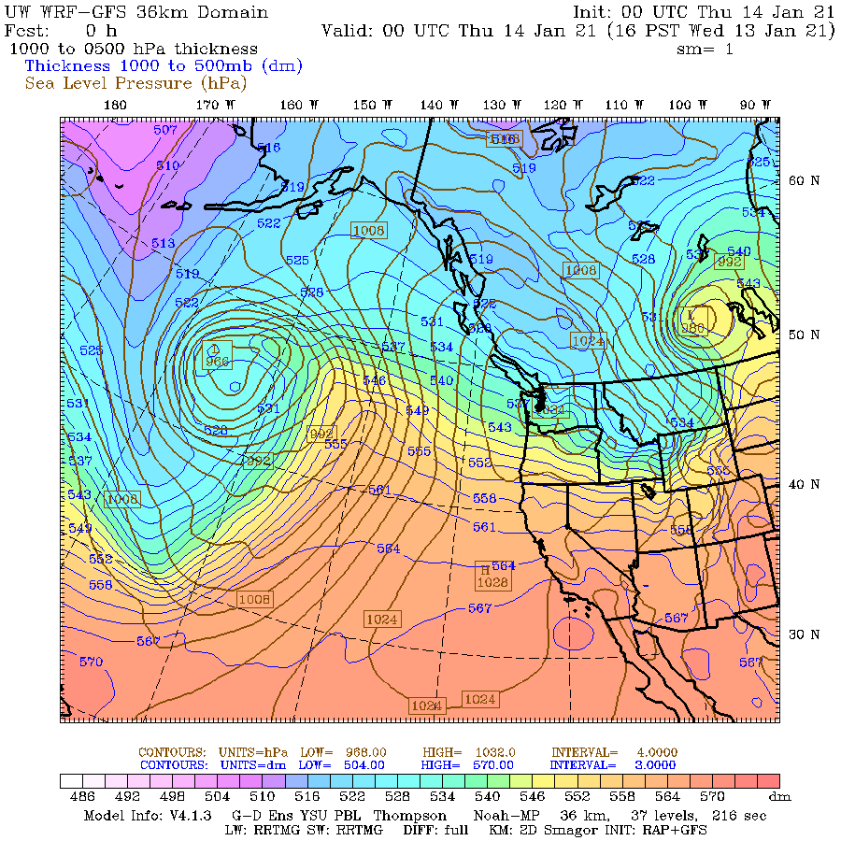
Thickness
One of the most important and used concepts in synoptic meteorology
Appears on many maps you will use.

Slide 2
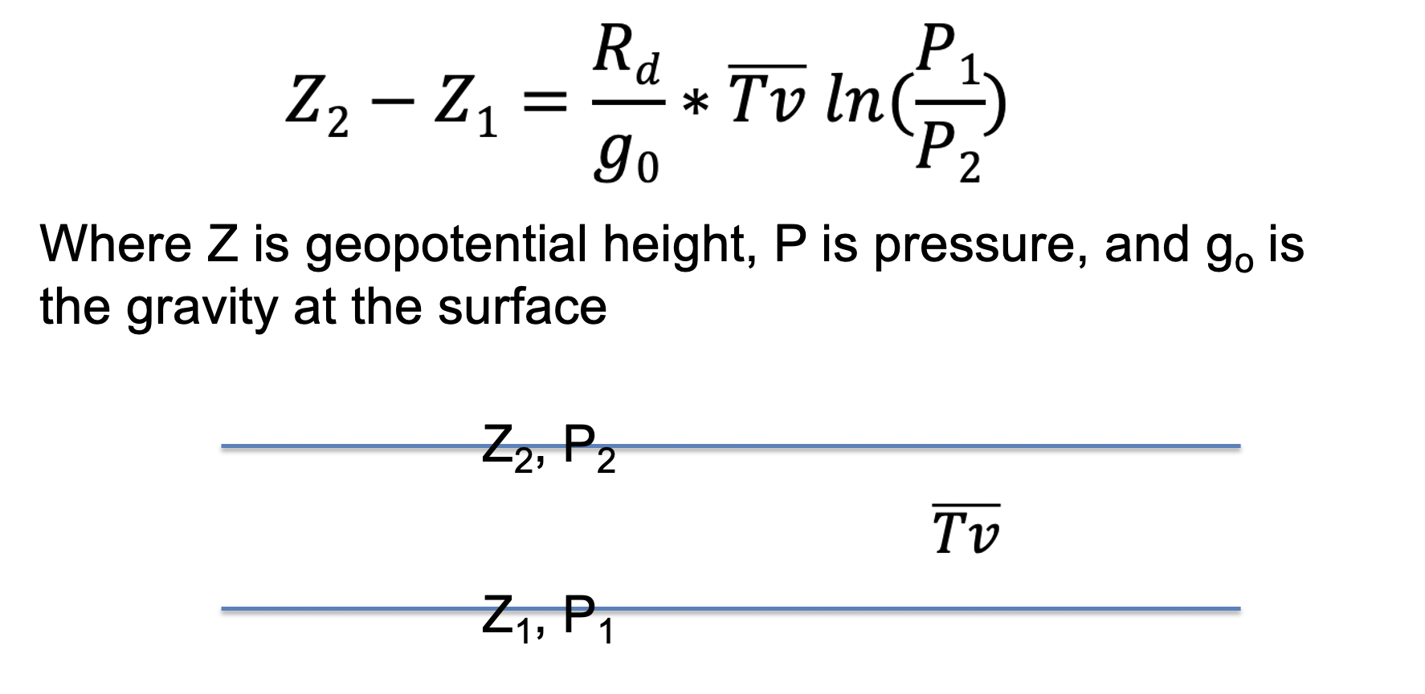
Thickness is the difference in geopotential height between two pressure surfaces.
To derive a relationship, start with the hypsometric equation (Z₂ – Z₁ is thickness).

Slide 3
Thickness is proportional to the mean virtual temperature of the layer.
Thus, the geopotential height at two levels is related to the intervening temperature distribution between them

Slide 4
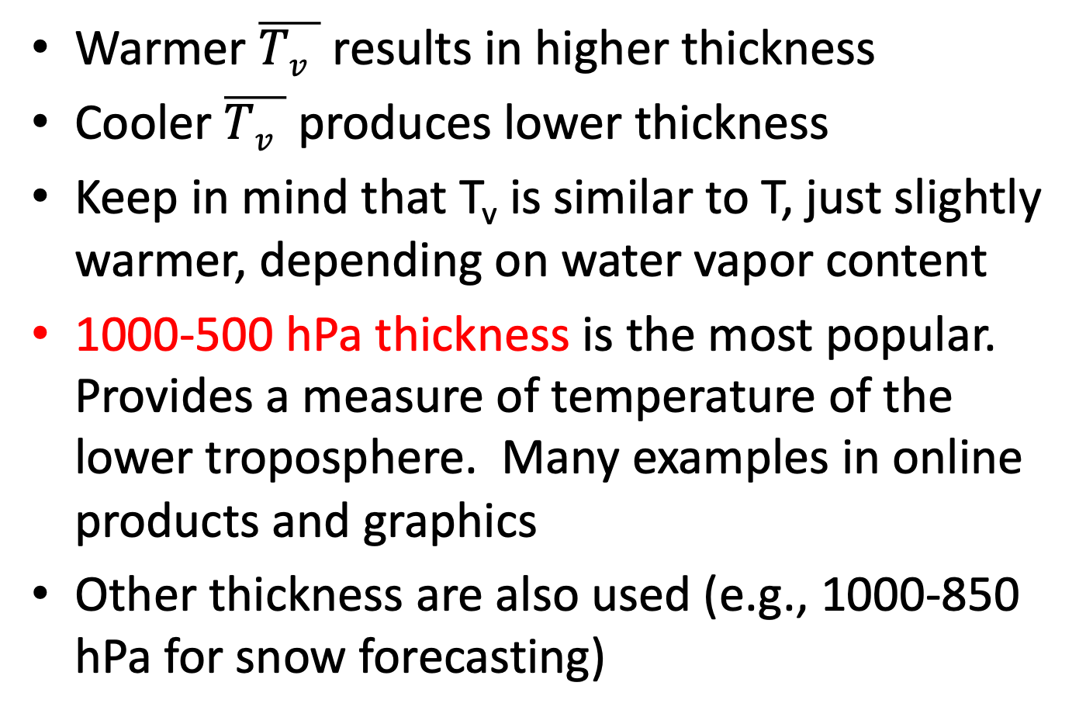
Thickness
Warmer $\overline{Tv }$ results in higher thickness
Cooler $\overline{Tv }$ produces lower thickness
Keep in mind that T_{v} is similar to T, just slightly warmer, depending on water vapor content
1000-500 hPa thickness is the most popular. Provides a measure of temperature of the lower troposphere. Many examples in online products and graphics
Other thickness are also used (e.g., 1000-850 hPa for snow forecasting)

Slide 5
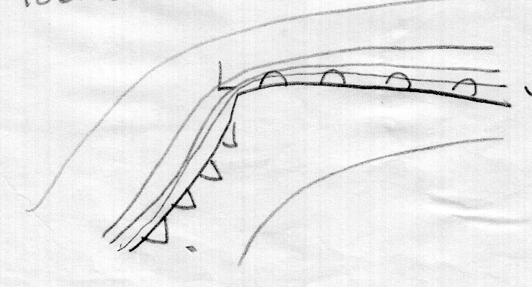
Thickness
For every 60 m change in 1000-500 hPa thickness, temperature in the layer changes by 3C
1000-500 hPa thickness is good measure of lower tropospheric temperature and temperature change (baroclinicity).
Can use to find frontal regions and more.
Tight packing on
cold side of front
Lesser
thickness
Larger thickness

Slide 6
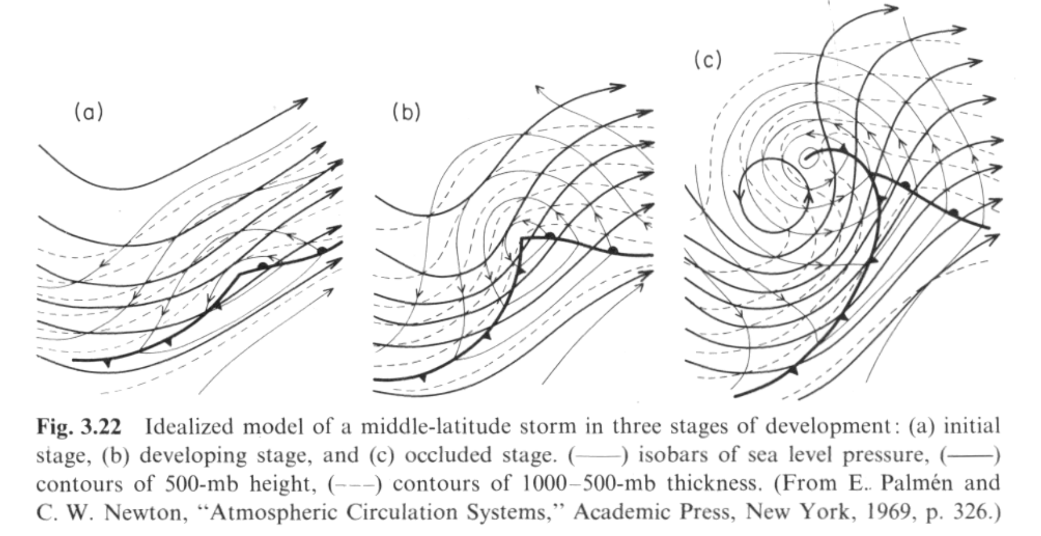
Classic Figure: Palmen and Newton

Slide 7
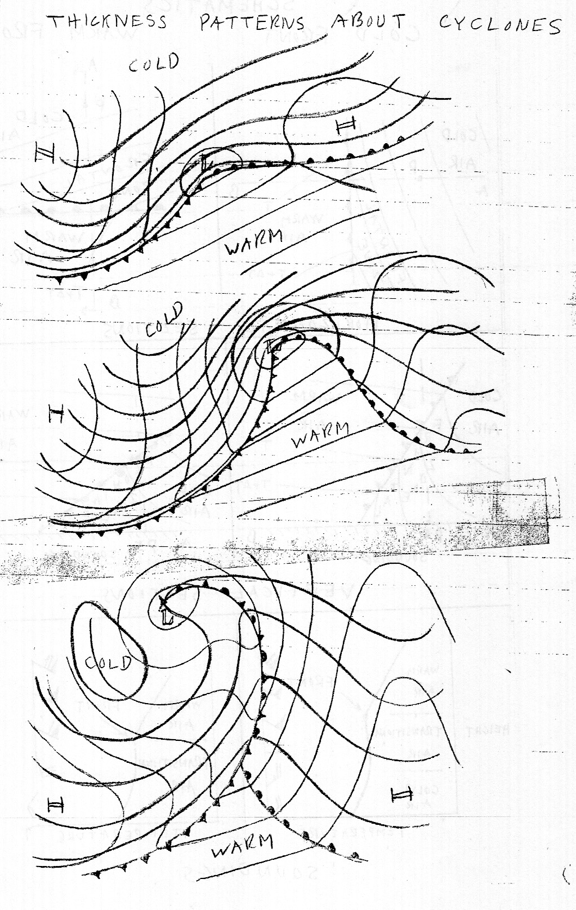
Another
Version

Slide 8
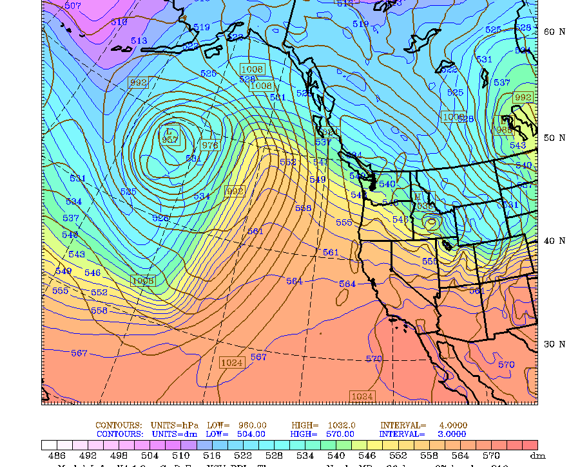
You need to be able to relate thickness to fronts since numerical model DON’T Indicate fronts

Slide 9
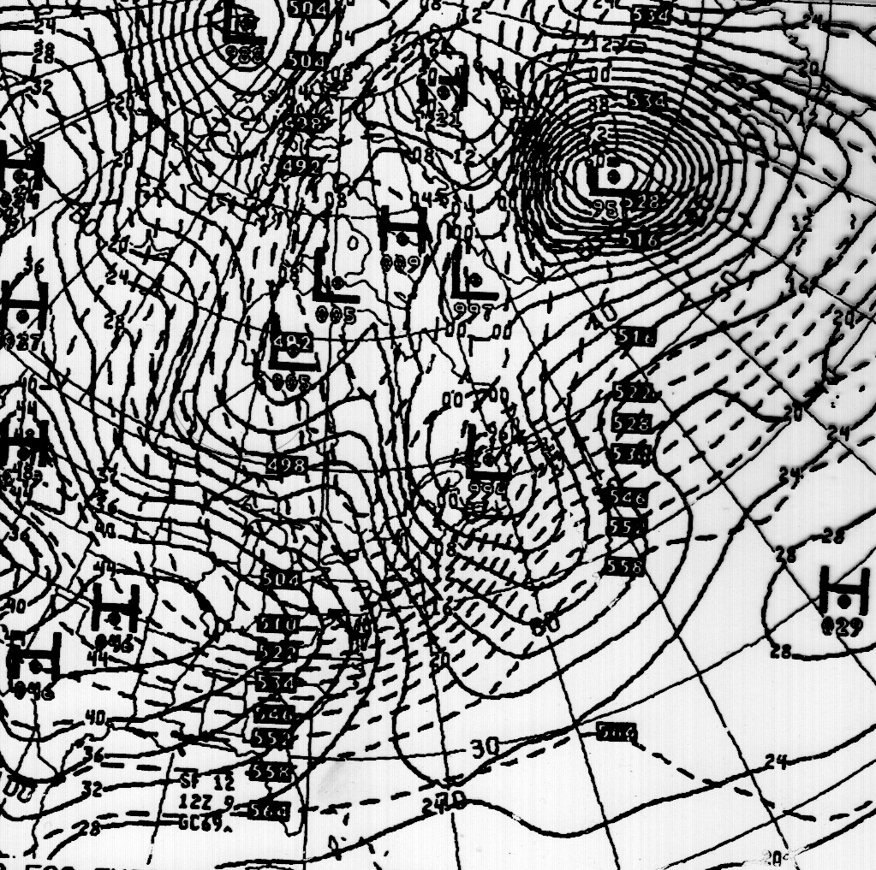
Generally given in decameters (dm)
“540” indicates 5400 m thickness

Slide 10
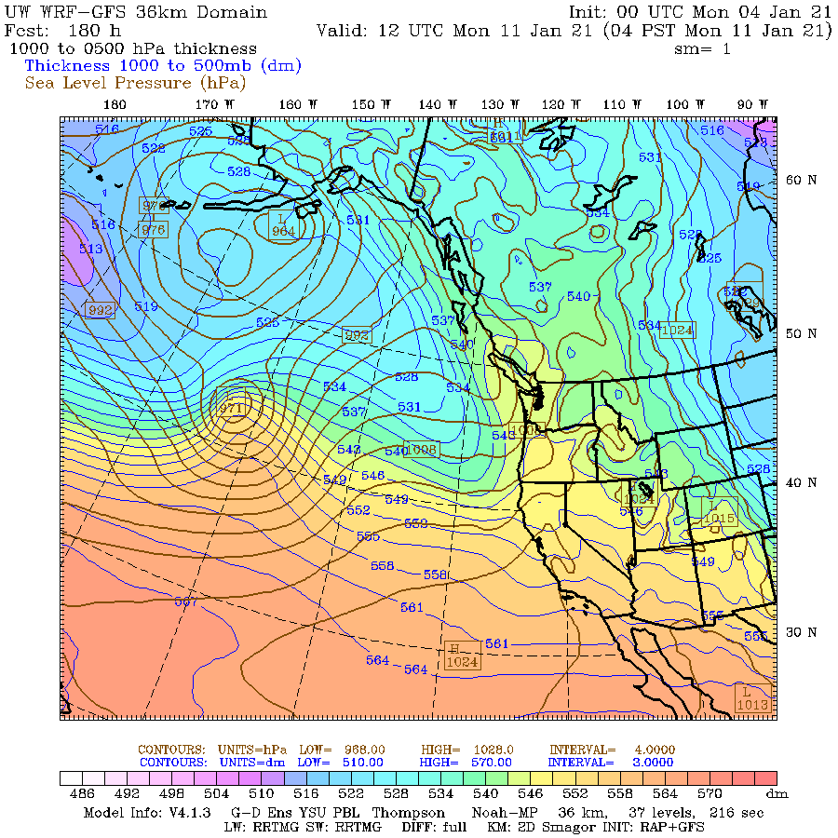

Slide 11
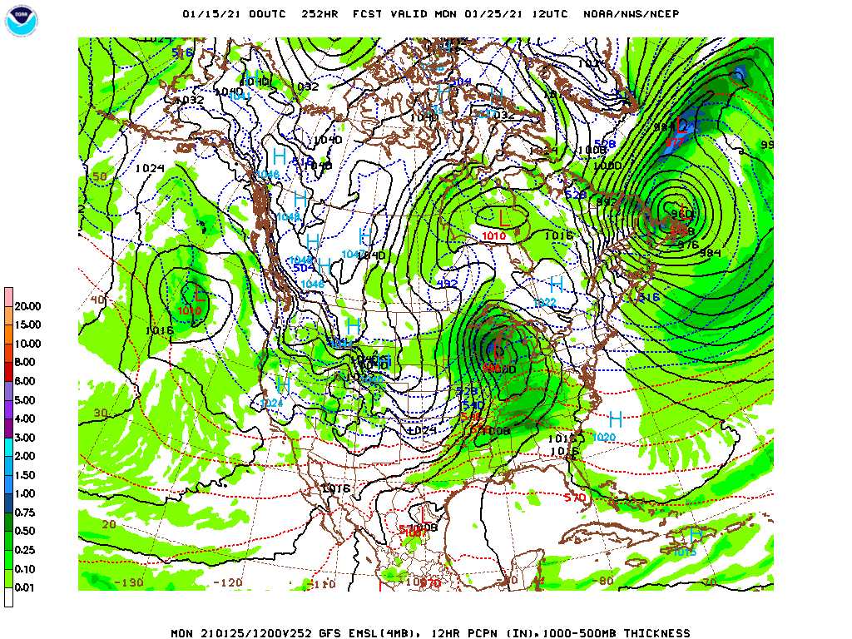

Slide 12
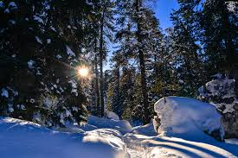
Thickness Useful For Forecasting, Particularly For Deciding on Rain versus Snow
Rain/snow 50-50% line for continental areas often ~5400 m thickness (1000-500 hPa)
Colder/lower thickness is better for snow
For Seattle and West coastal areas the 50% percentile for snow using 1000-500 hPa thickness is 5220 m. Why?

Slide 13
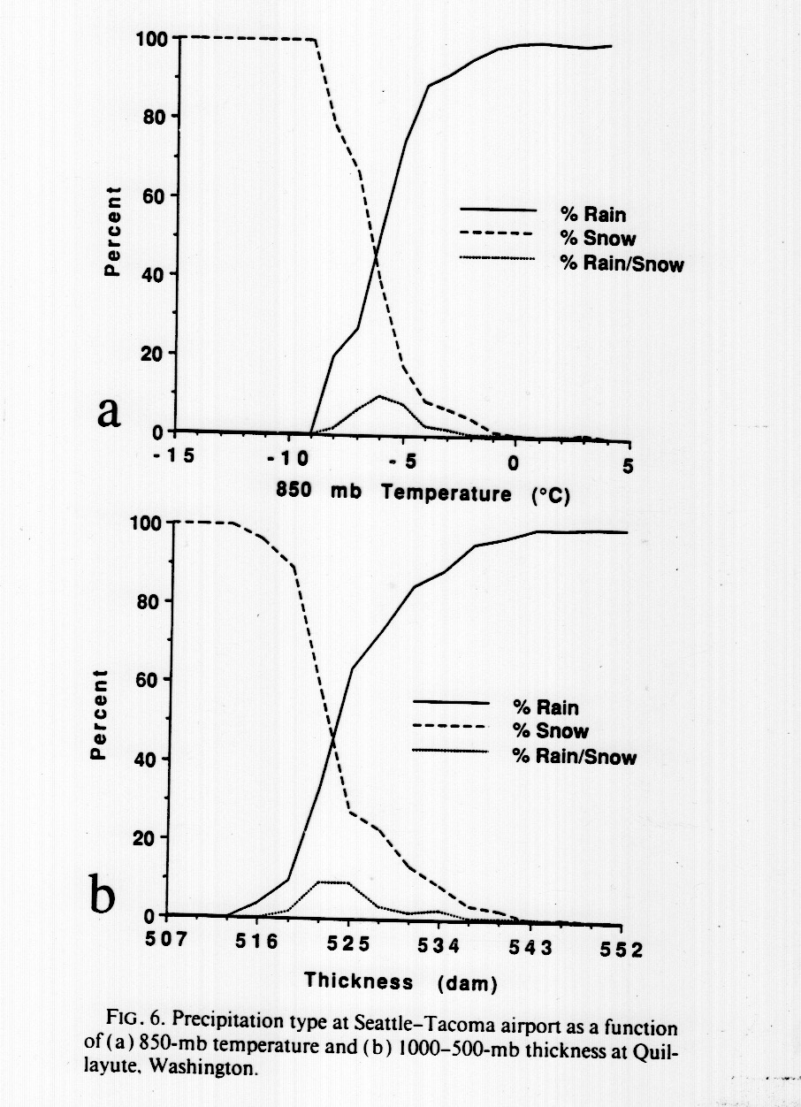
Why?
Warm water and resulting warmer air near the surface results in needing much cooler air aloft to get snow to the surface.

Slide 14
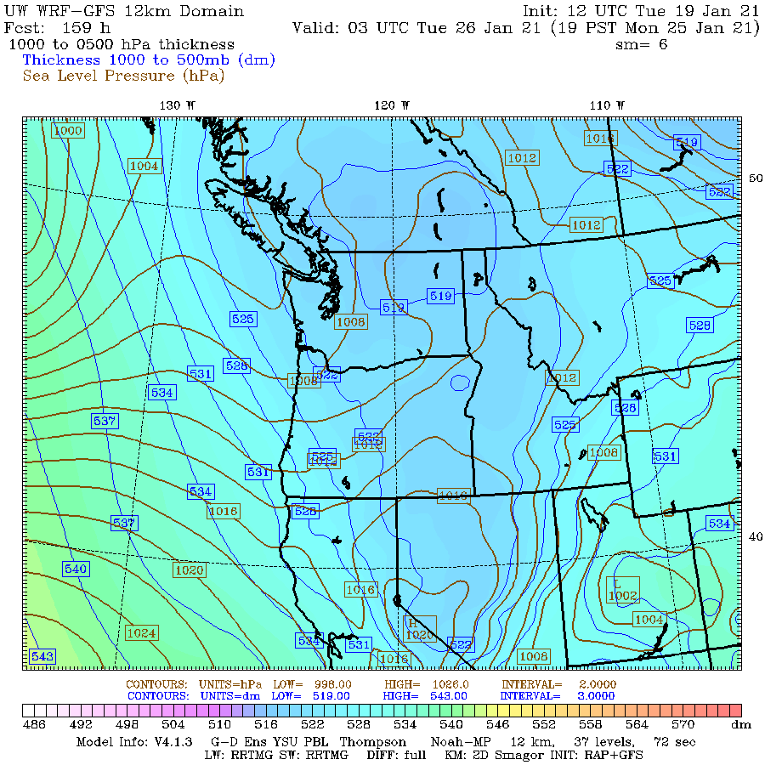

Slide 15
Thickness
In Cascades 5400 m 1000-500 hPa thickness works reasonably well. More continental.
Seattle NWS forecast office likes to use 1000-850 hPa thickness of 1300 m for 50% line for lowland snow
As we shall see, thickness is related to another important concept: thermal wind.

Slide 16
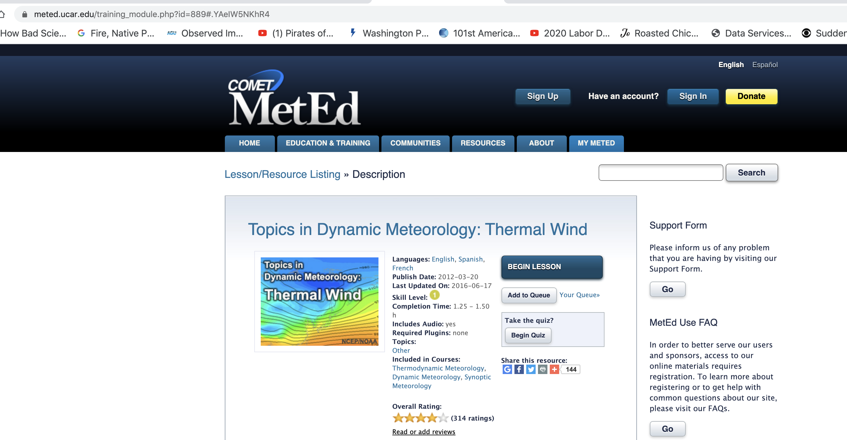
Homework Assignment
Go through COMET METED Thermal Wind Online Lesson

Slide 17
COMET Thermal Wind Module
You need to set up a login…free.
You don’t have to hand anything in. Do the exercises you wish to if you want to deepen your understanding.

Slide 18
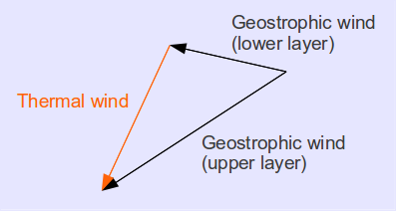
The Thermal Wind
The thermal wind, V_{T}, is a vector defined as the difference between the geostrophic wind at two levels of the atmosphere.
The name is really a misnomer, since it is not a wind, but a difference of the geostrophic winds between two levels.

Slide 19
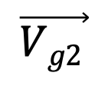
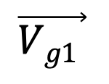
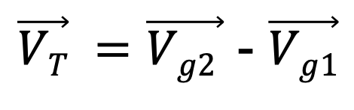
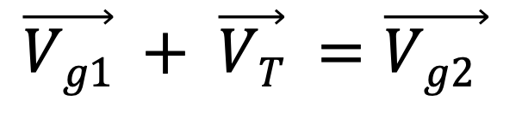
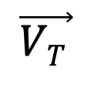
The Thermal Wind is the Vector Difference of Geostrophic Winds at Two Levels
2
$$\vec{Vg1 }$$
$$\vec{VT }$$
1
$$\vec{Vg2 }$$
$$\vec{Vg1} + \vec{VT} =\vec{Vg2 }$$
$\vec{VT} =\vec{Vg2 }$ - $\vec{Vg1}$

Slide 20
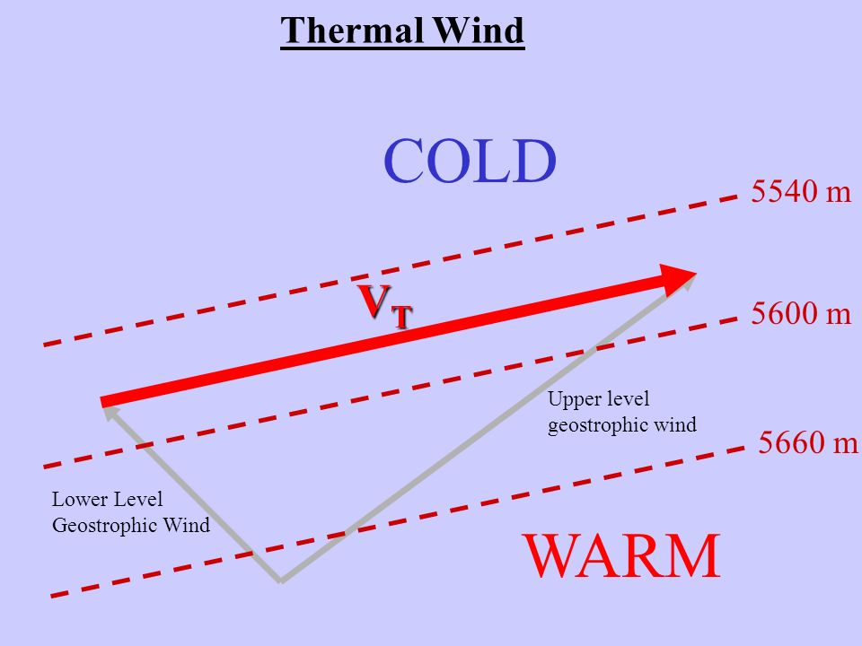
Thermal Wind and Thickness
The thermal wind vector is parallel to thickness lines
Higher thickness to the right of thermal wind.
The magnitude of the thermal wind vector is proportional to the horizontal gradient of thickness (or the mean temperature gradient of the layer).

Slide 21
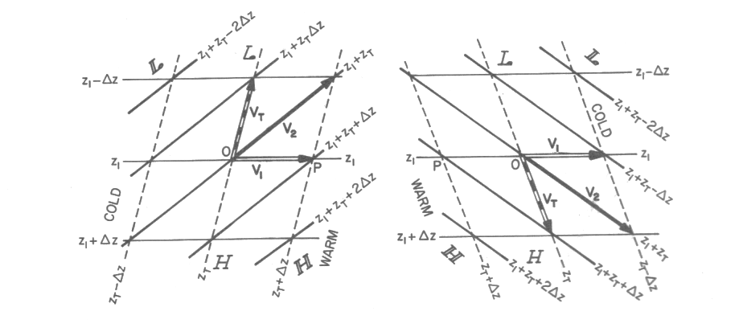
You can convince yourself
Red is thickness

Slide 22
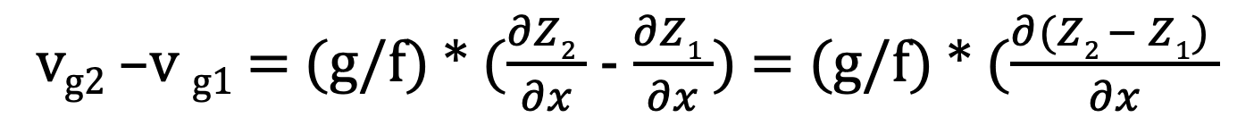
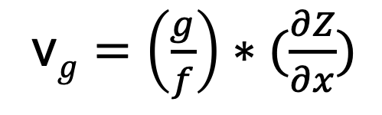
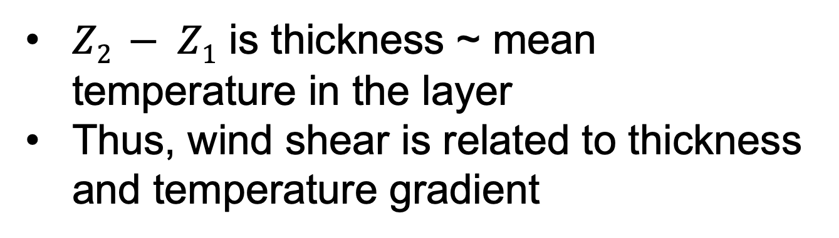
Thermal Wind And Thickness
Mathematical Illustration
One (N-S) component of geostrophic wind
v$g=\left(\frac{g}{f}\right)∗(\frac{∂Z}{∂x})$
v_{g2} –v _{g1} = (g/f) * $(\frac{∂Z2 }{∂x}$ - $\frac{∂Z1 }{∂x}$) = (g/f) * $(\frac{∂(Z2 − Z1) }{∂x}$
$Z2 − Z1$ is thickness ~ mean temperature in the layer
Thus, wind shear is related to thickness and temperature gradient

Slide 23
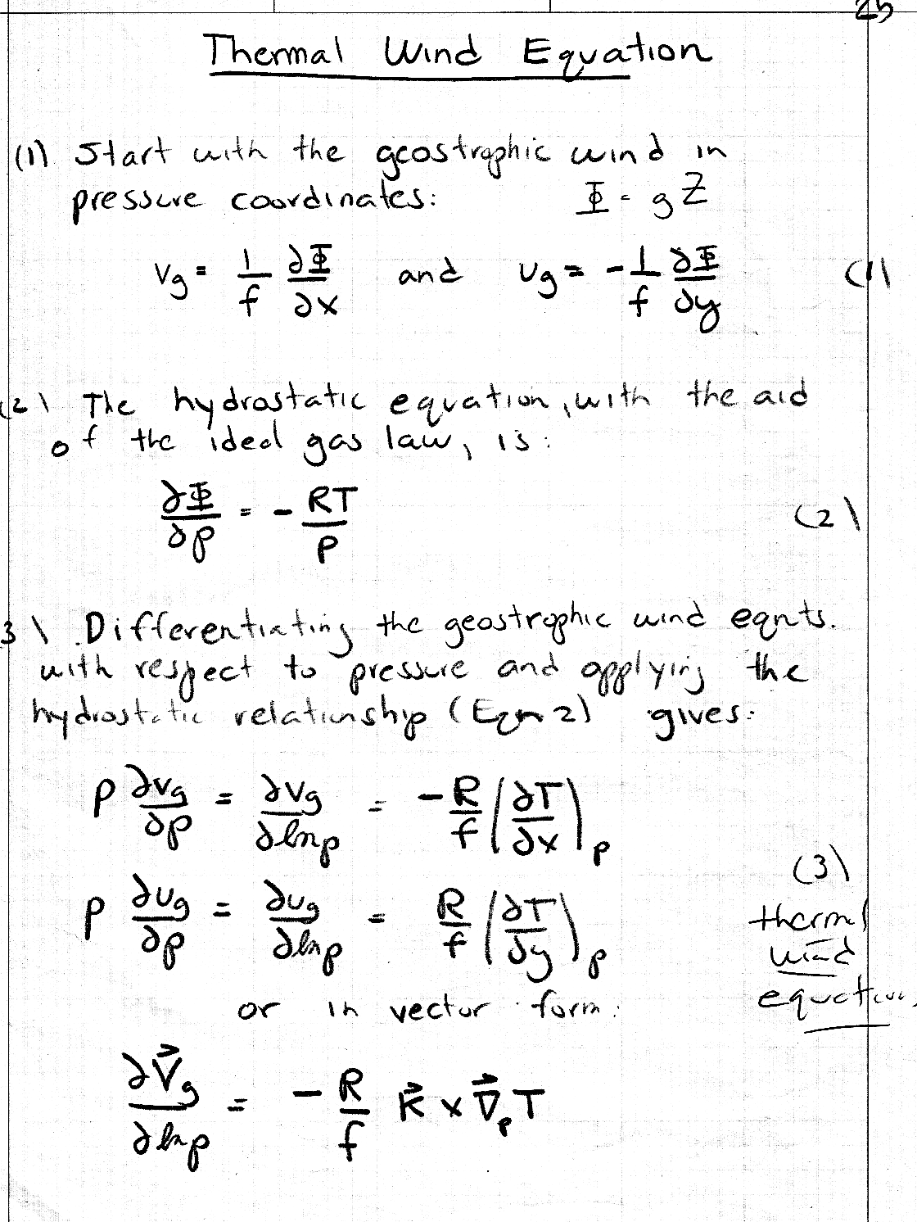
Derivation of Thermal Wind Equation Handout

Slide 24
Believe it or Not!
Much of the atmosphere is in approximately thermal wind balance (follows the thermal wind equation).
Why? Because most the atmosphere is ~geostrophic and in hydrostatic balance.
Thus, in most of the atmosphere, vertical wind shear is related to horizontal temperature gradients.

Slide 25
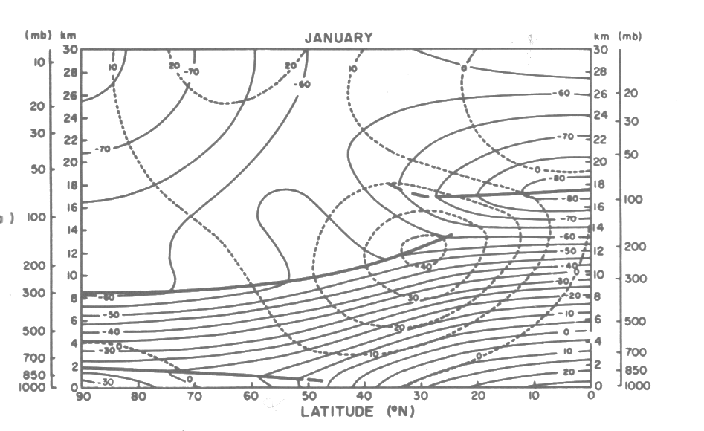
N-S Vertical Cross Section
Winds in ms⁻¹, temps in C

Slide 26
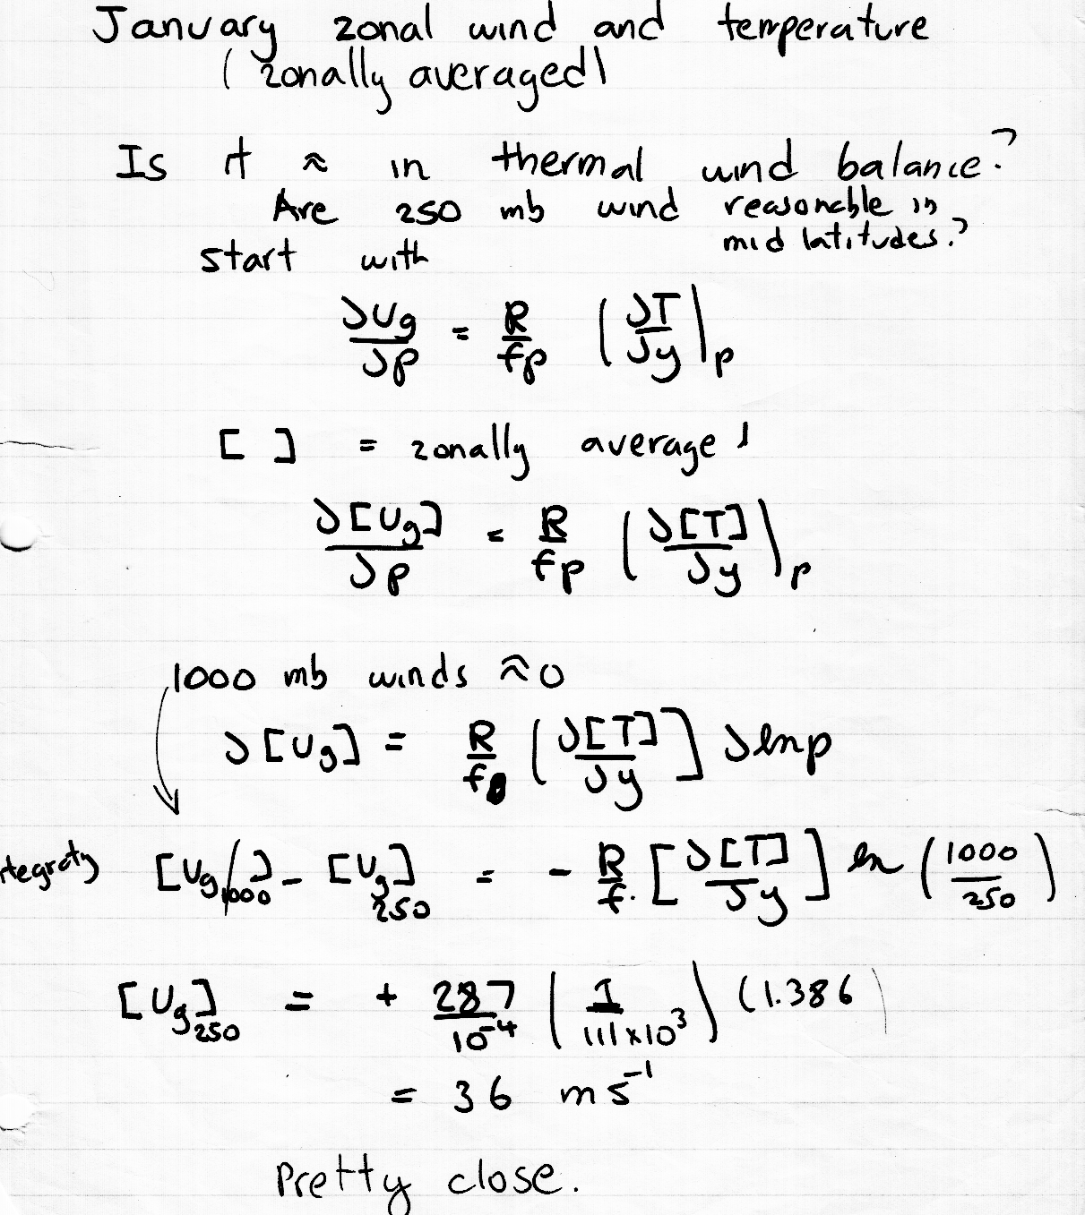
Back of the envelope calculation using thermal wind is quite reasonable

Slide 27
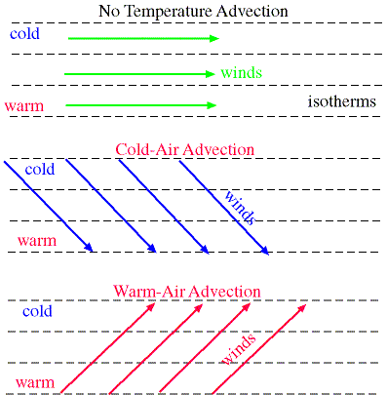
Temperature Advection
Geostrophic wind shear in the vertical is associated with horizontal temperature gradients.
The turning of the geostrophic wind with height is related to temperature advection.

Slide 28
Temperature Advection
Backing (counterclockwise turning with height) of the the geostrophic wind: cold advection
Veering (clockwise turning with height) of the the geostrophic wind: warm advection
Thus, if the actual winds are ~geostrophic (not bad assumption above boundary layer) one can determine temperature advection from a single sounding

Slide 29

Thus, if you were on a desert island with a radiosonde unit, you cold tell whether warm or cold air was approaching

Slide 30
Does this make sense?
Backing (counter) Veering (clock)
Cold advection
Warm advection

Slide 31
Frontal Zones
In cold frontal zones, winds back with height
  Cold advection
In warm frontal zones wind veer with height
  Warm advection
In areas of little temperature advection, there is little turning with height

Slide 32
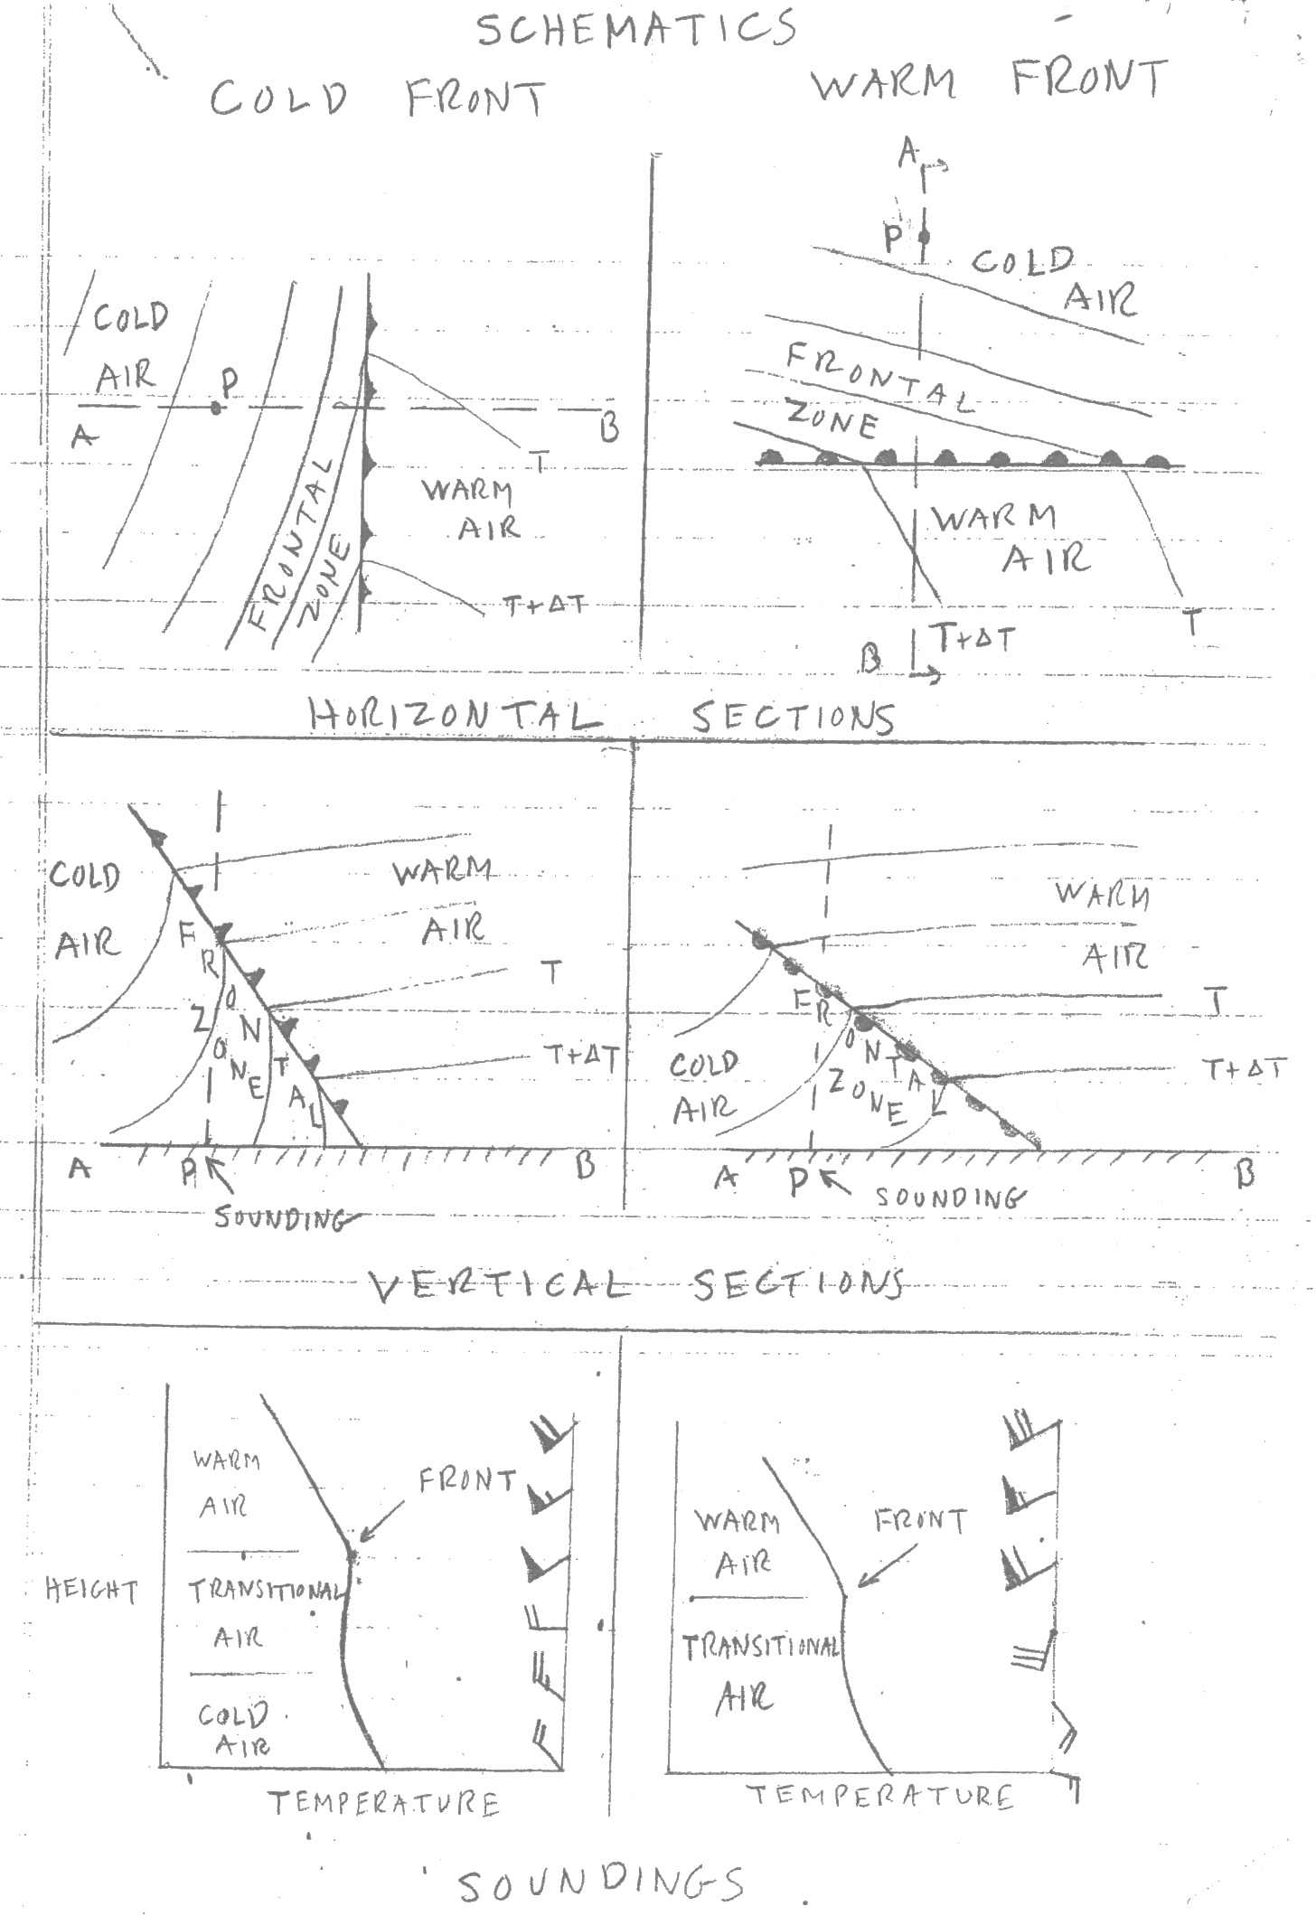

Slide 33
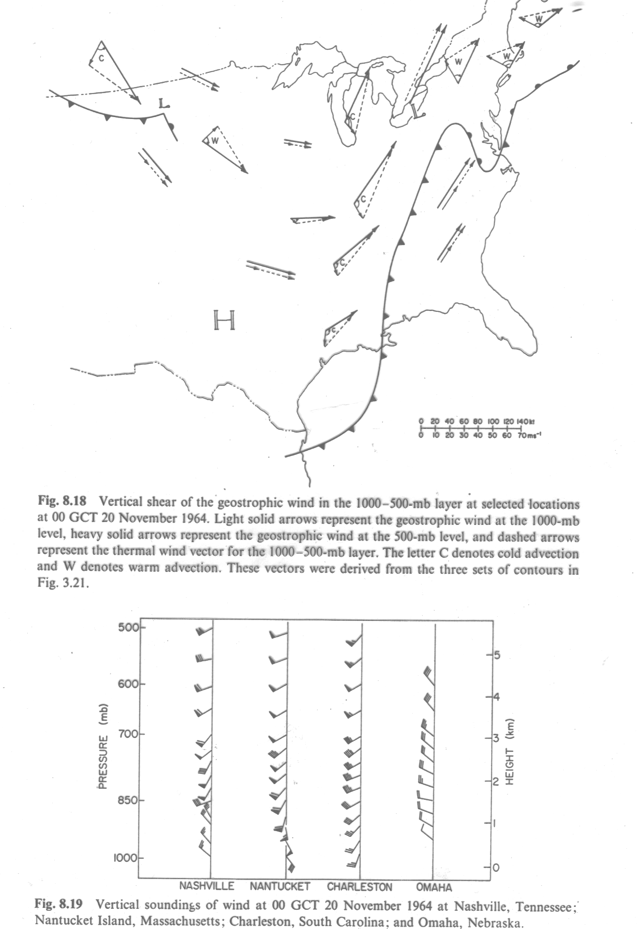

Slide 34
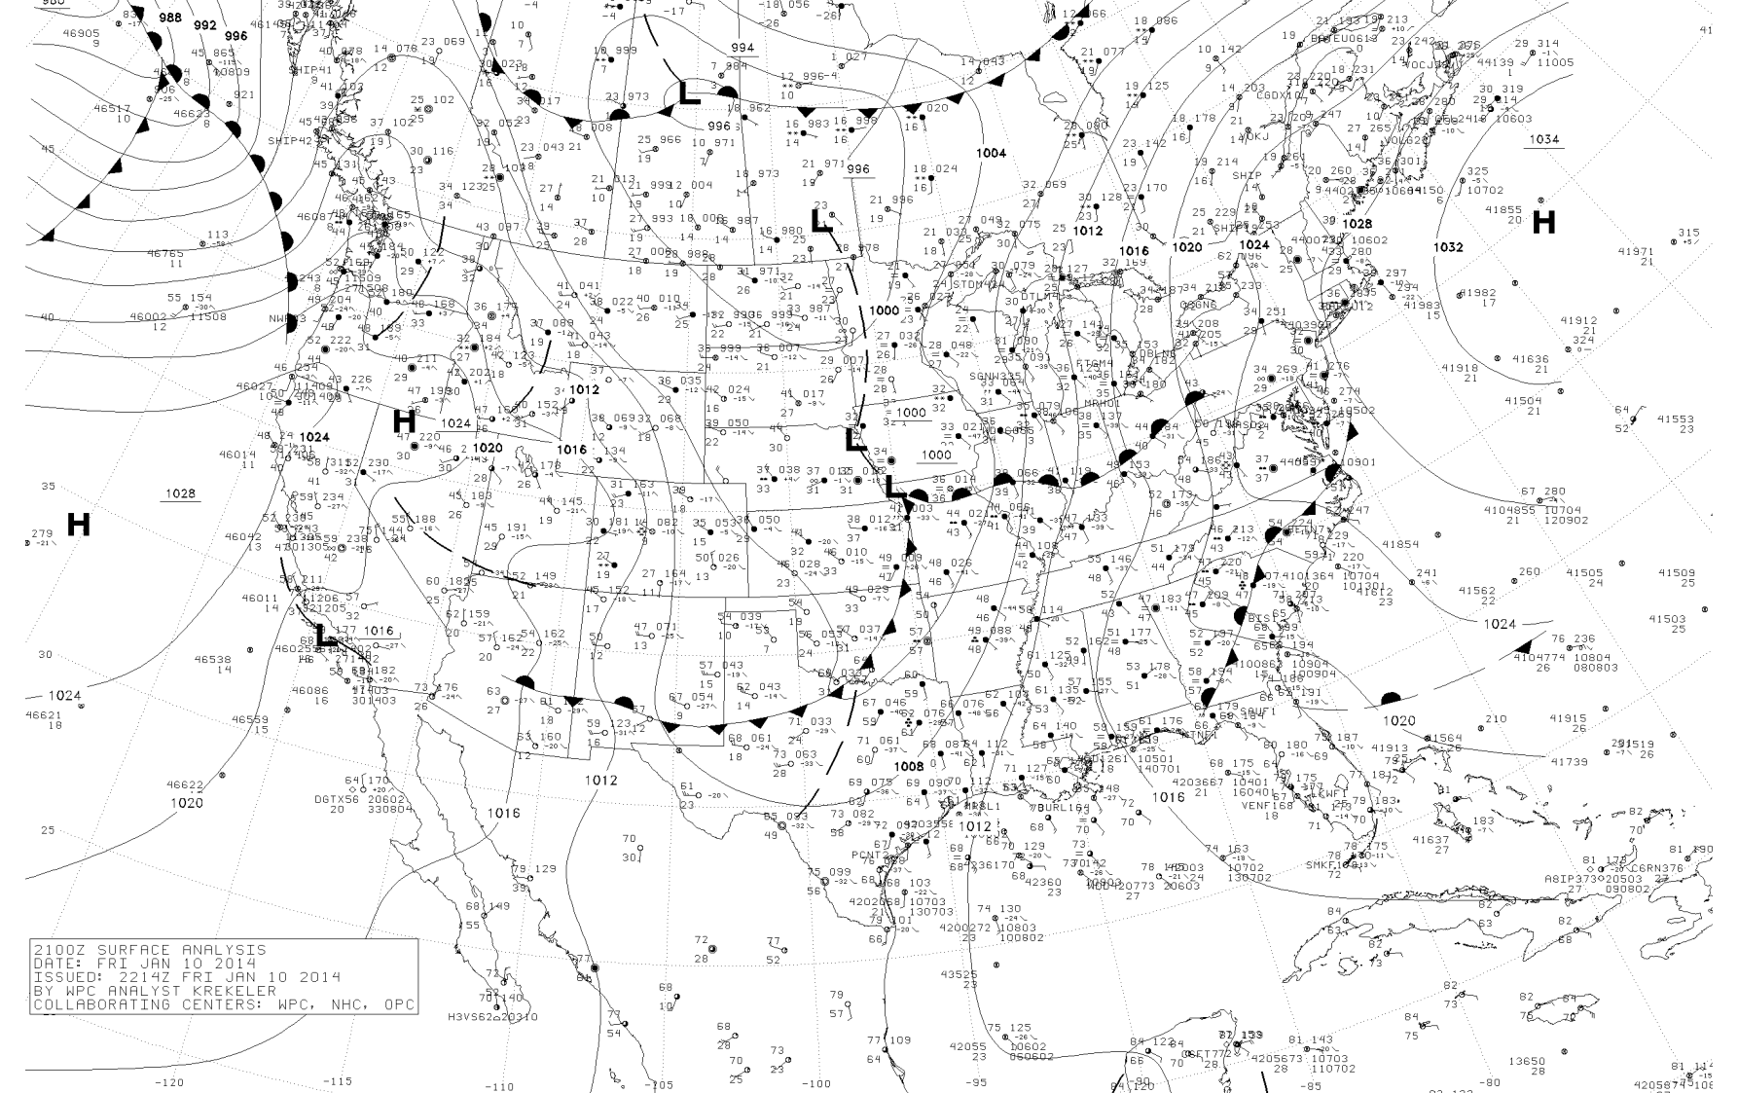
Warm Front Approaching UIL

Slide 35
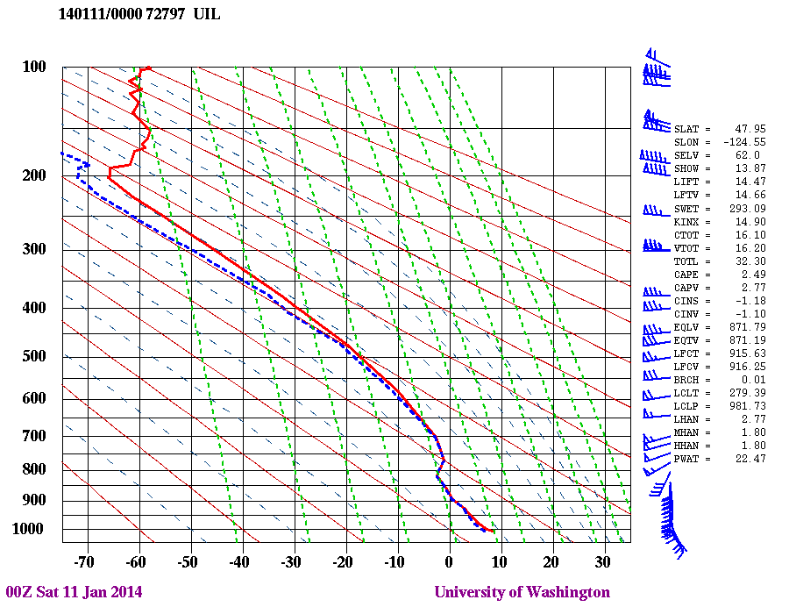
Clockwise rotation

Slide 36
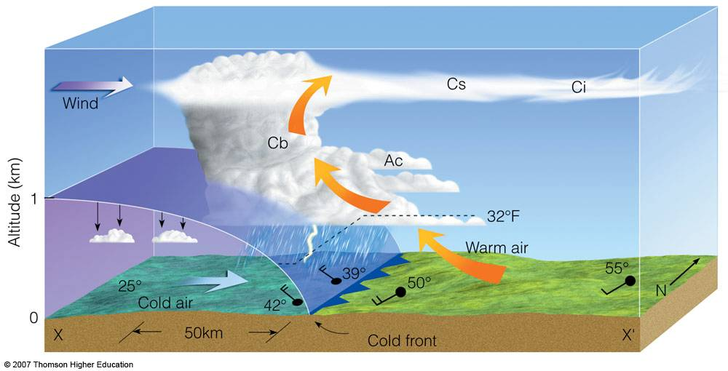
Approaching Cold Front: backing

Slide 37
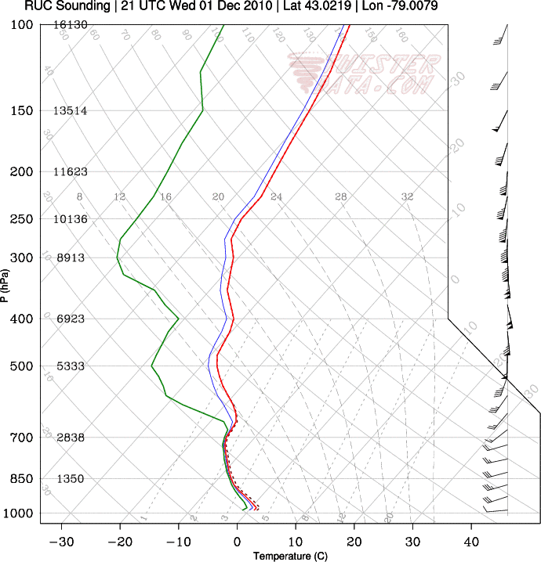
Cold advection sounding

Slide 38
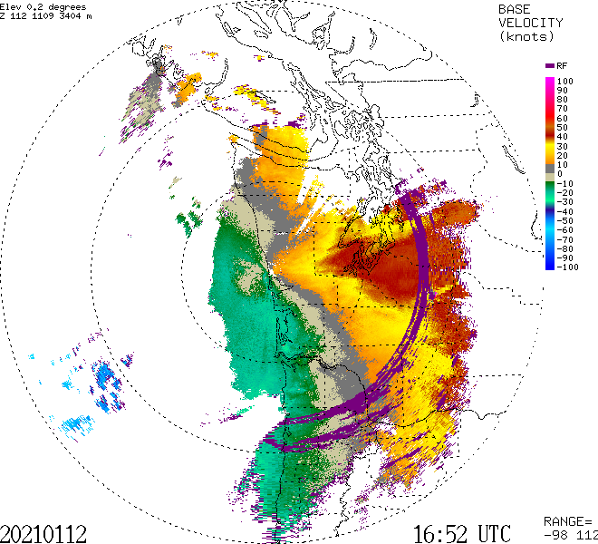
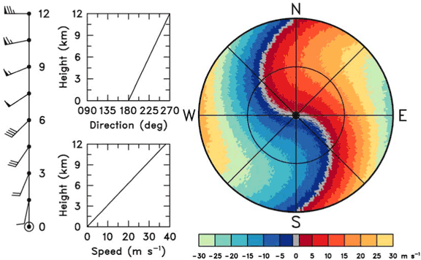
Weather Radar and Temperature Advection
You can tell whether warm or cold advection is occurring by looking at the Doppler velocities
Specifically, the zero radial velocity line (usually gray)

Slide 39
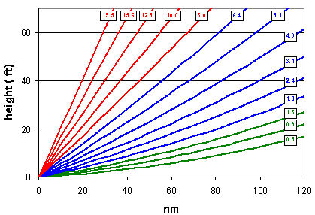
Radar imagery is generally depicted on a tilted surface
Scans in azimuth ( 0 to 360°) at a series of increasing scan angles from the horizontal.

Slide 40
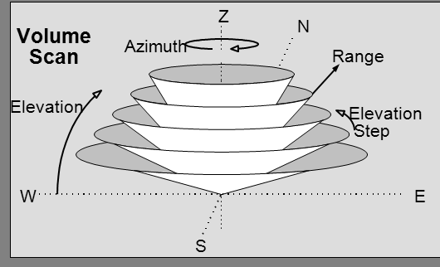

Slide 41

Each radar elevation angle shown on a polar-type chart with range circles, with the beam ascending with distance

Slide 42
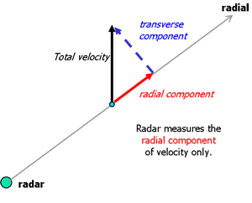
Radar Doppler Velocities Give Radial Wind Component

Slide 43
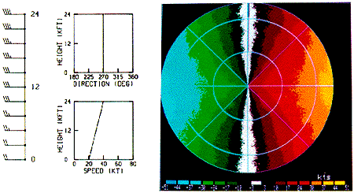
No turning, no advection

Slide 44
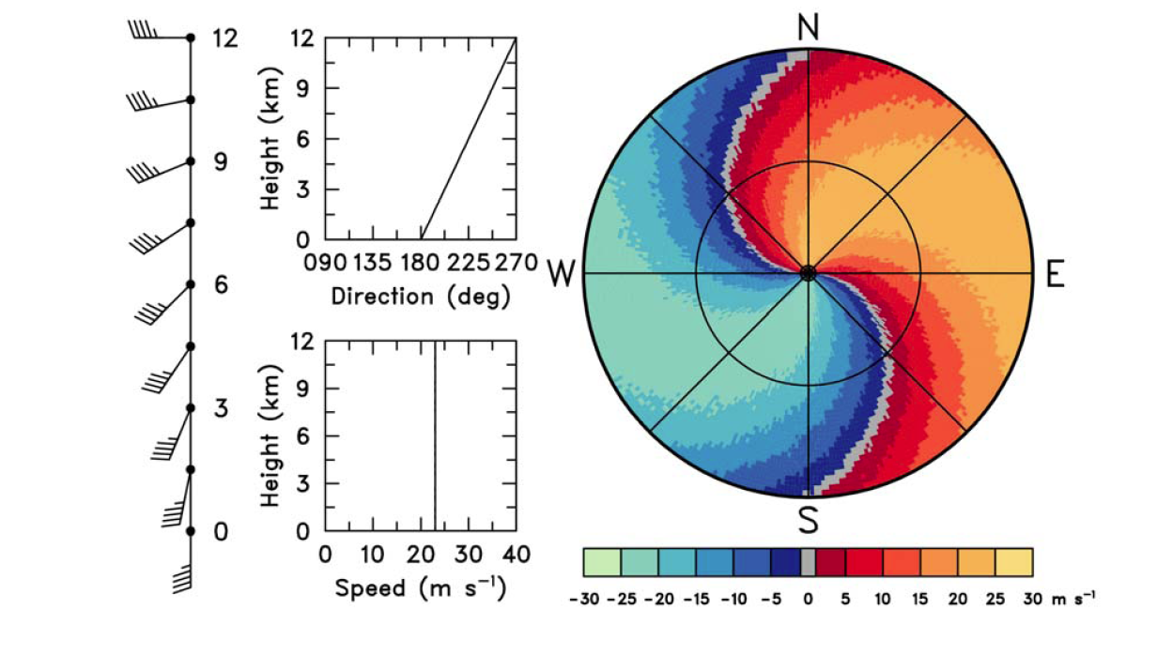
“ S “ shape: veering

Slide 45
“ S “ shape: veering

Slide 46
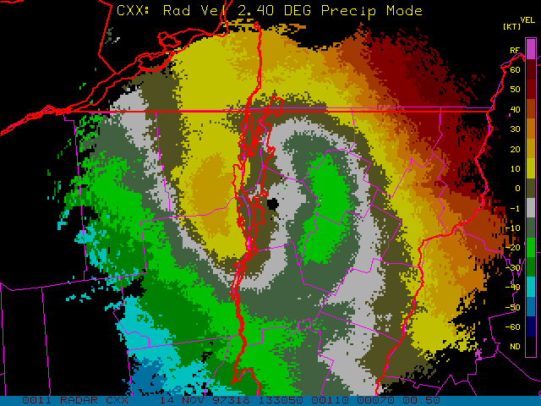

Slide 47
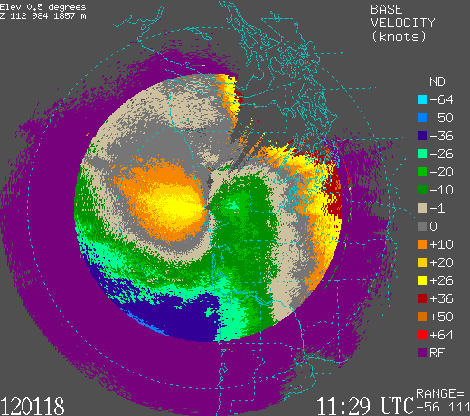

Slide 48
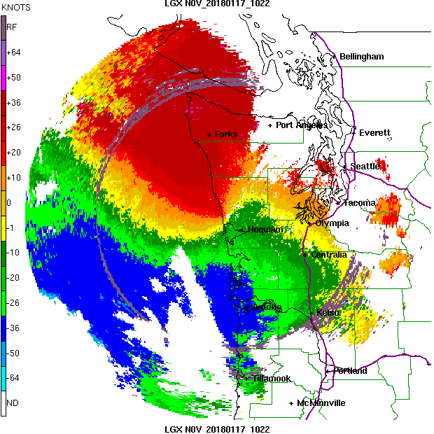

Slide 49
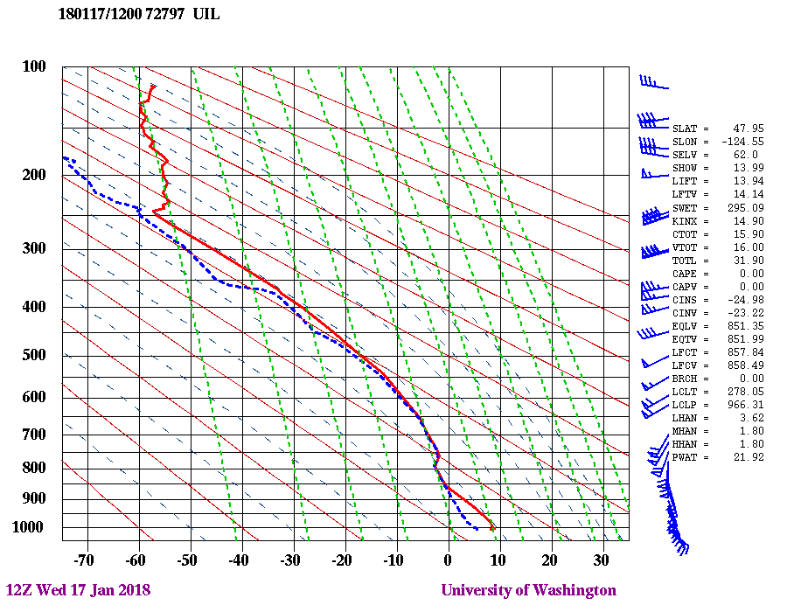

Slide 50
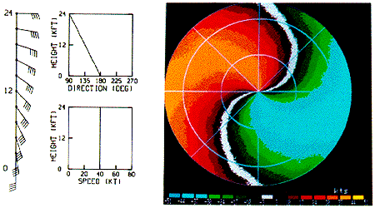
Backing: Backwards S

Slide 51
Fronts and Wind Shear Example:
January 11, 2014
Washington Coast

Slide 52
Warm Front Approaching UIL

Slide 54
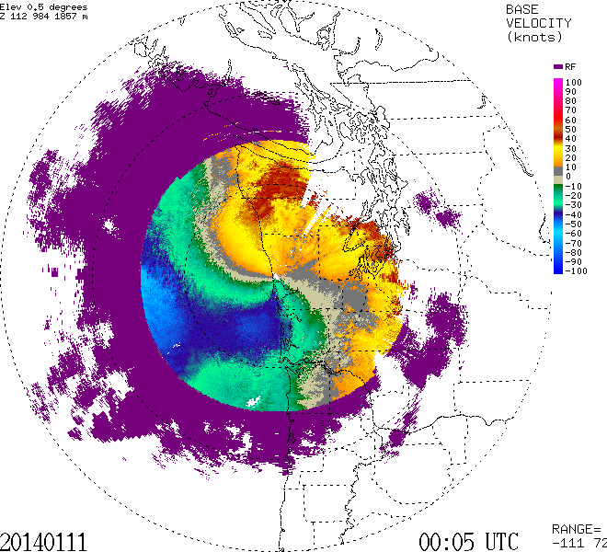

Slide 55
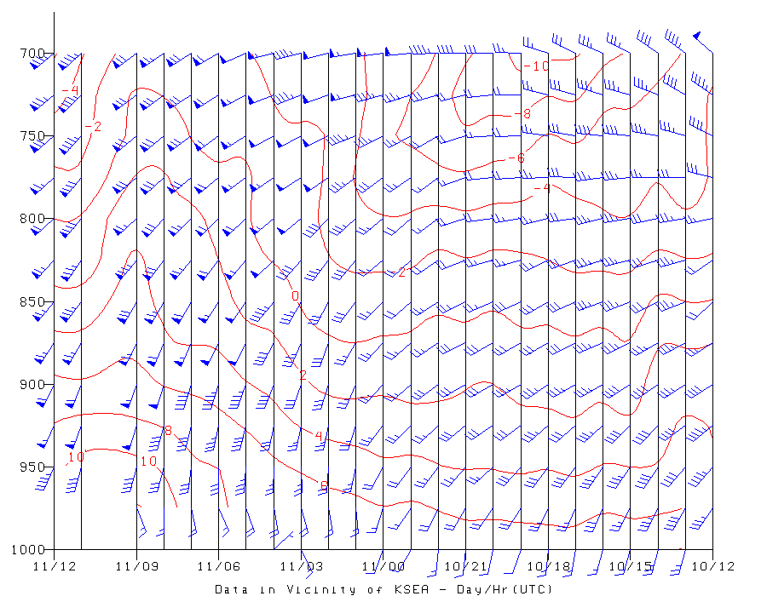

Slide 56
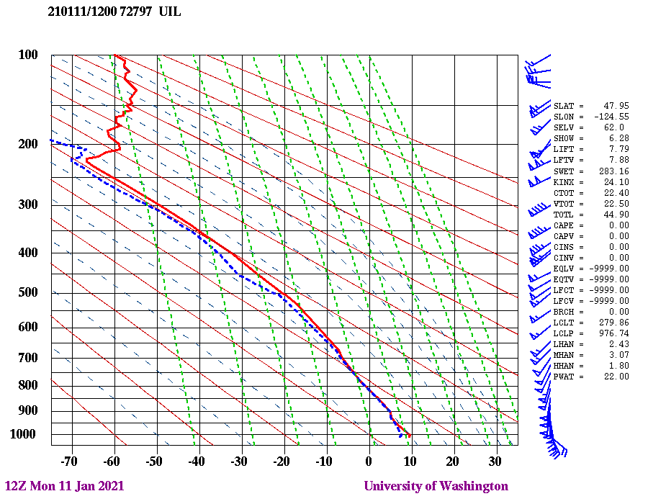

Slide 57


Slide 58


