Slide 1
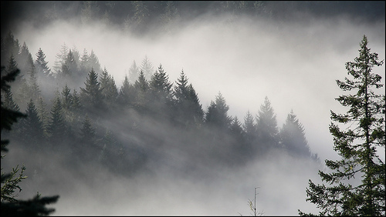
Is Society Being Given Accurate Information Regarding Northwest Climate Change?
Cliff Mass, Atmospheric Sciences
University of Washington

Slide 2
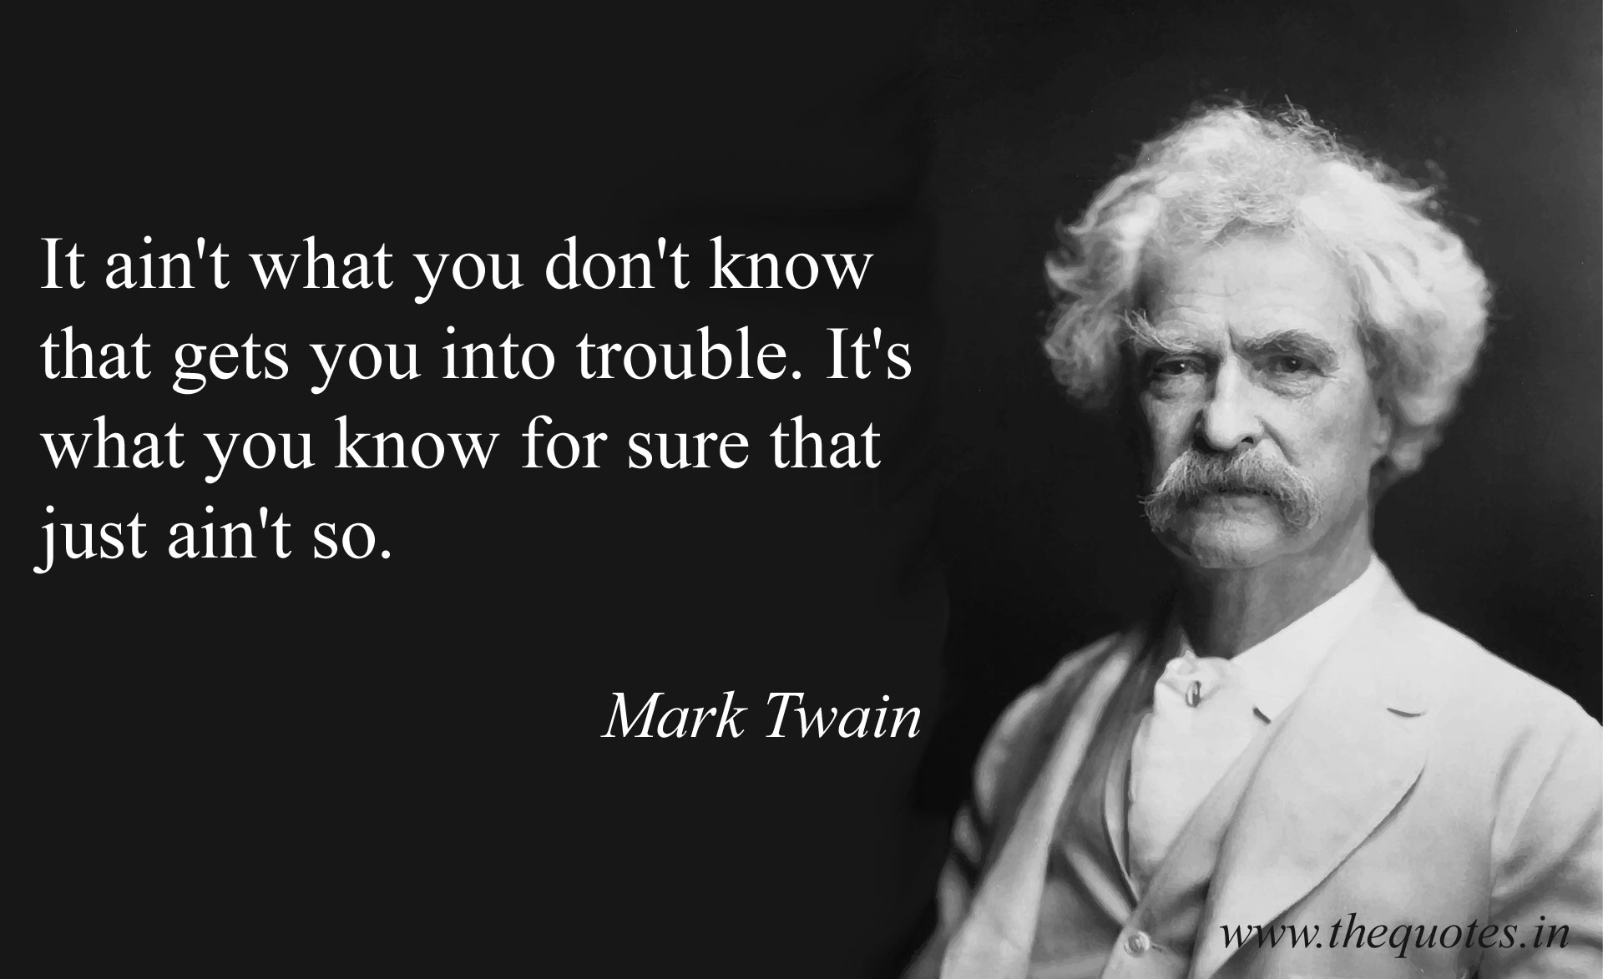

Slide 3
Key Messages
Global warming and its impacts on the Northwest are serious issues.
There has been a huge amount of hype and misinformation in the media and by some politicians.
This is a solvable problem, that is not quite as dire as being communicated by some.

Slide 4
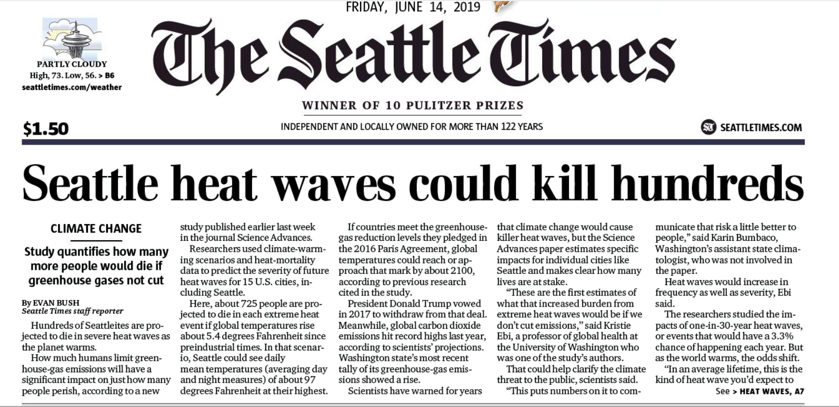
There has rarely been so much misinformation and exaggeration about any public issue of importance

Slide 5
Claim: 725 will day in Seattle from a single heat wave Nonsense: Assumes that no one buys an air conditioner plusunrealistic warming

Slide 6
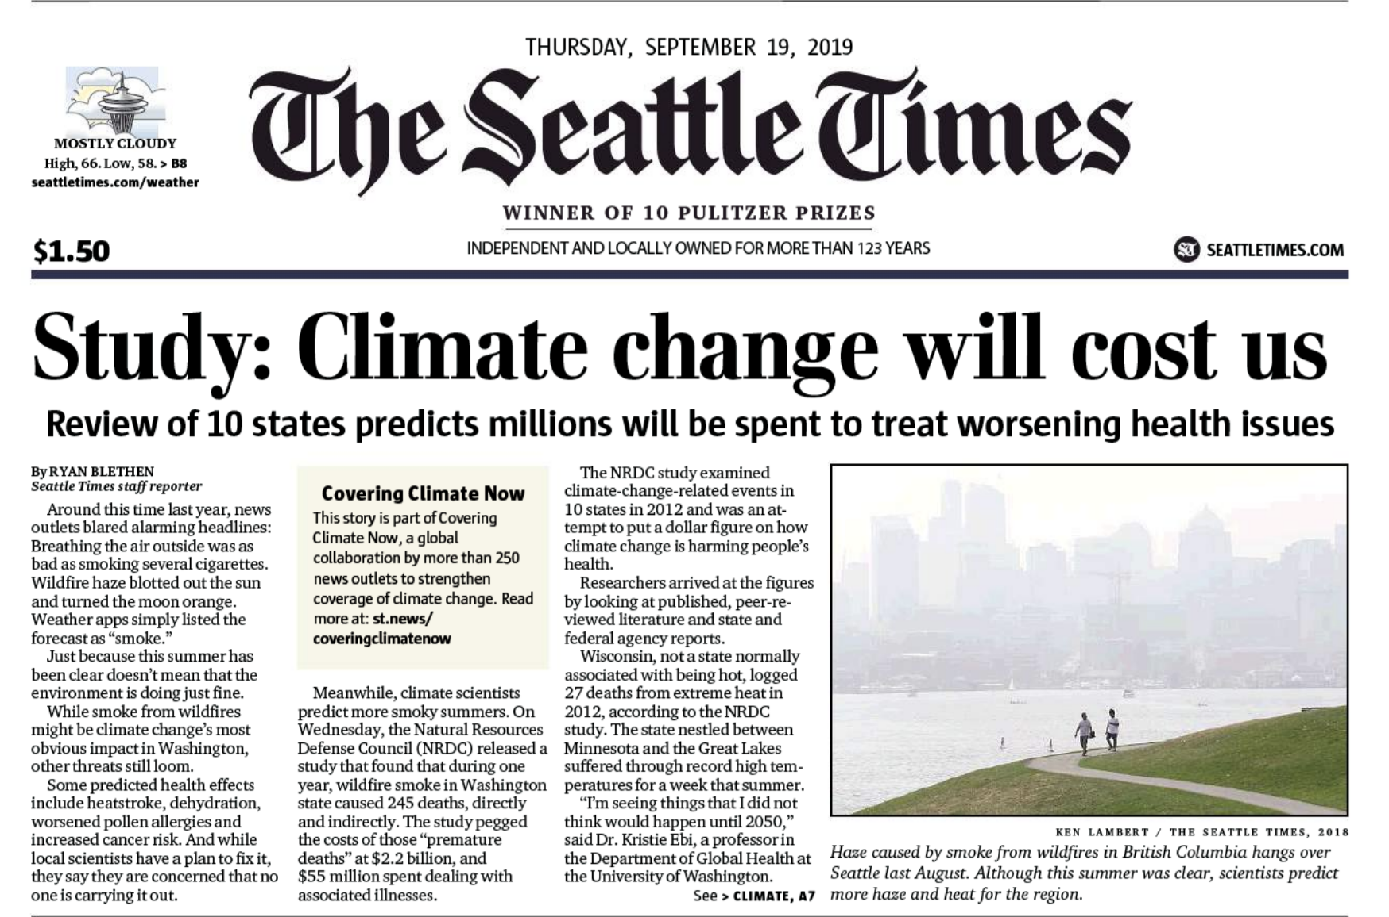
Another

Slide 7
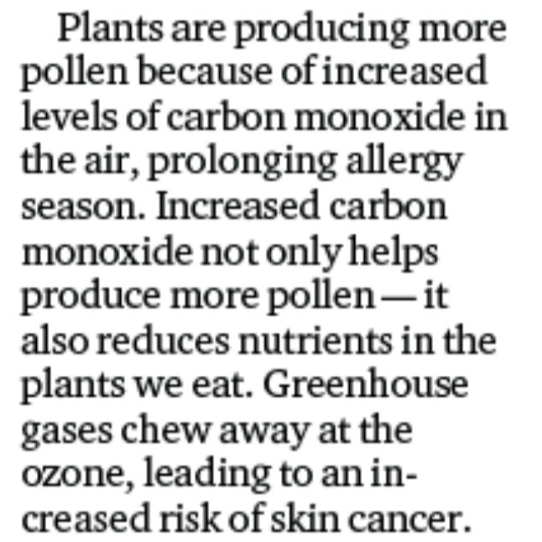
Wrong Gas!

Slide 8
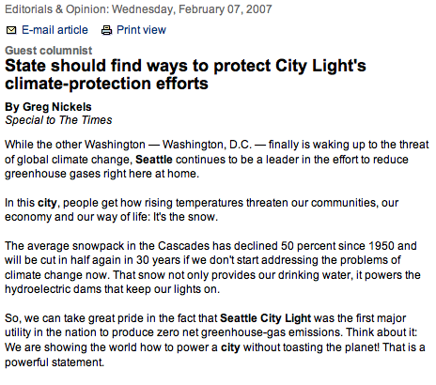
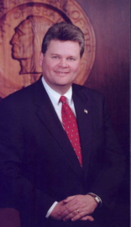
Seattle’s Mayor and others suggested our snowpack had declined by 50%

Slide 9
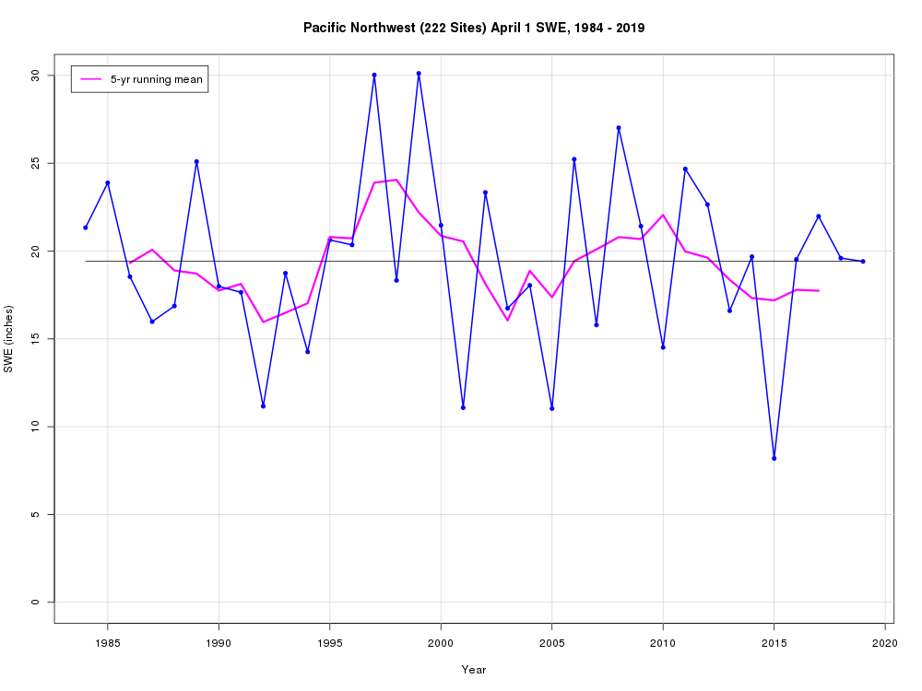
Little trend in Cascade snowpack over the last 30 years (Mark Albright UW)

Slide 10
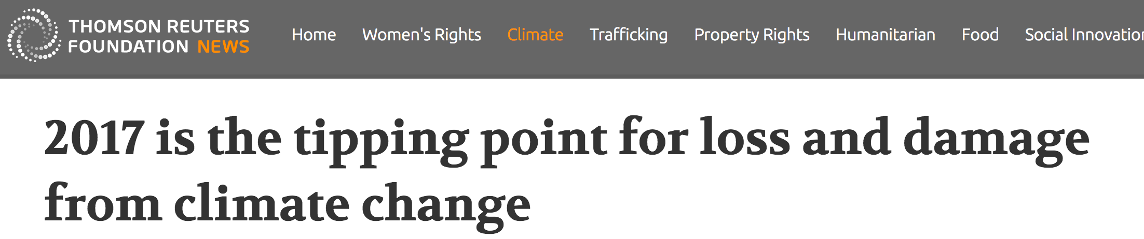
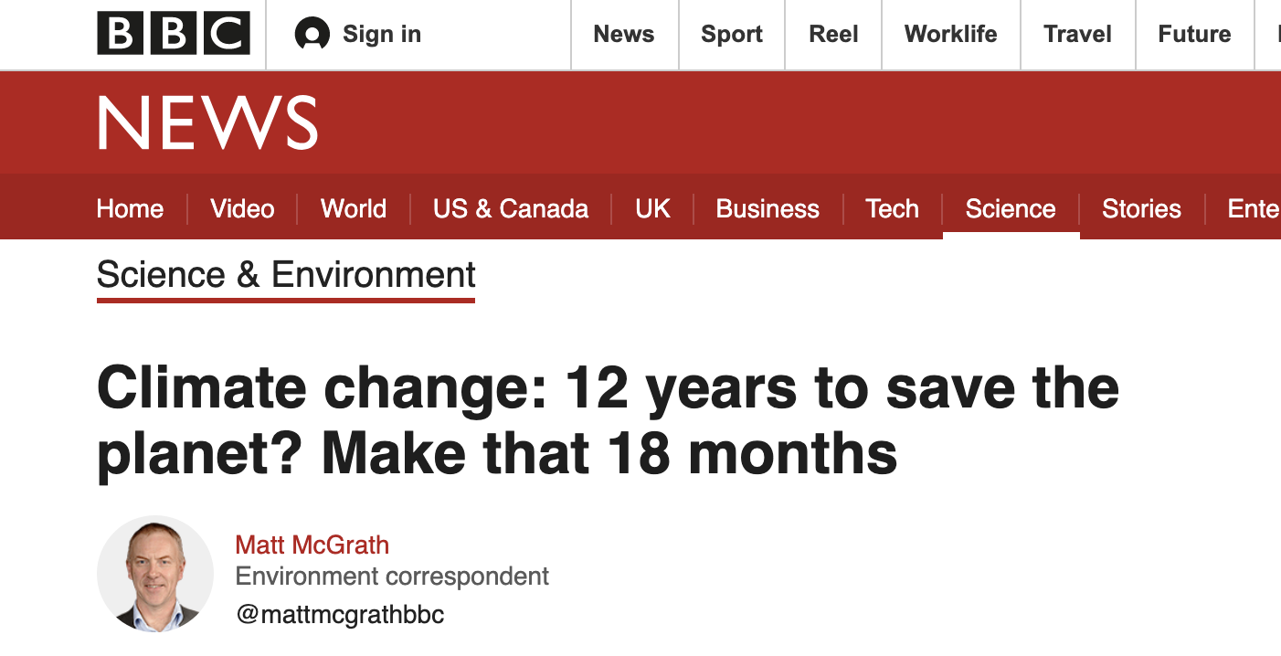
Tipping Points

Slide 11
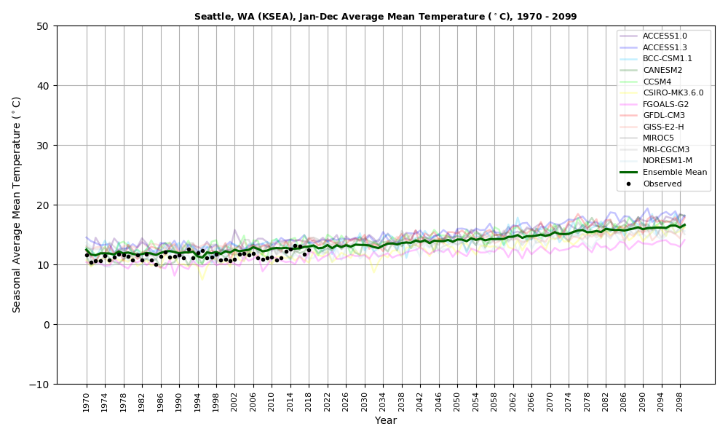
State of the Art Climate Models Show No Tipping Points

Slide 12
West Coast Wildfires and Climate

Slide 13
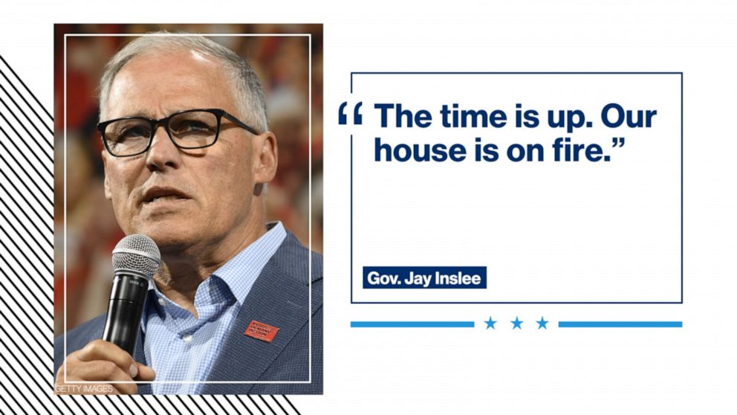

Slide 14
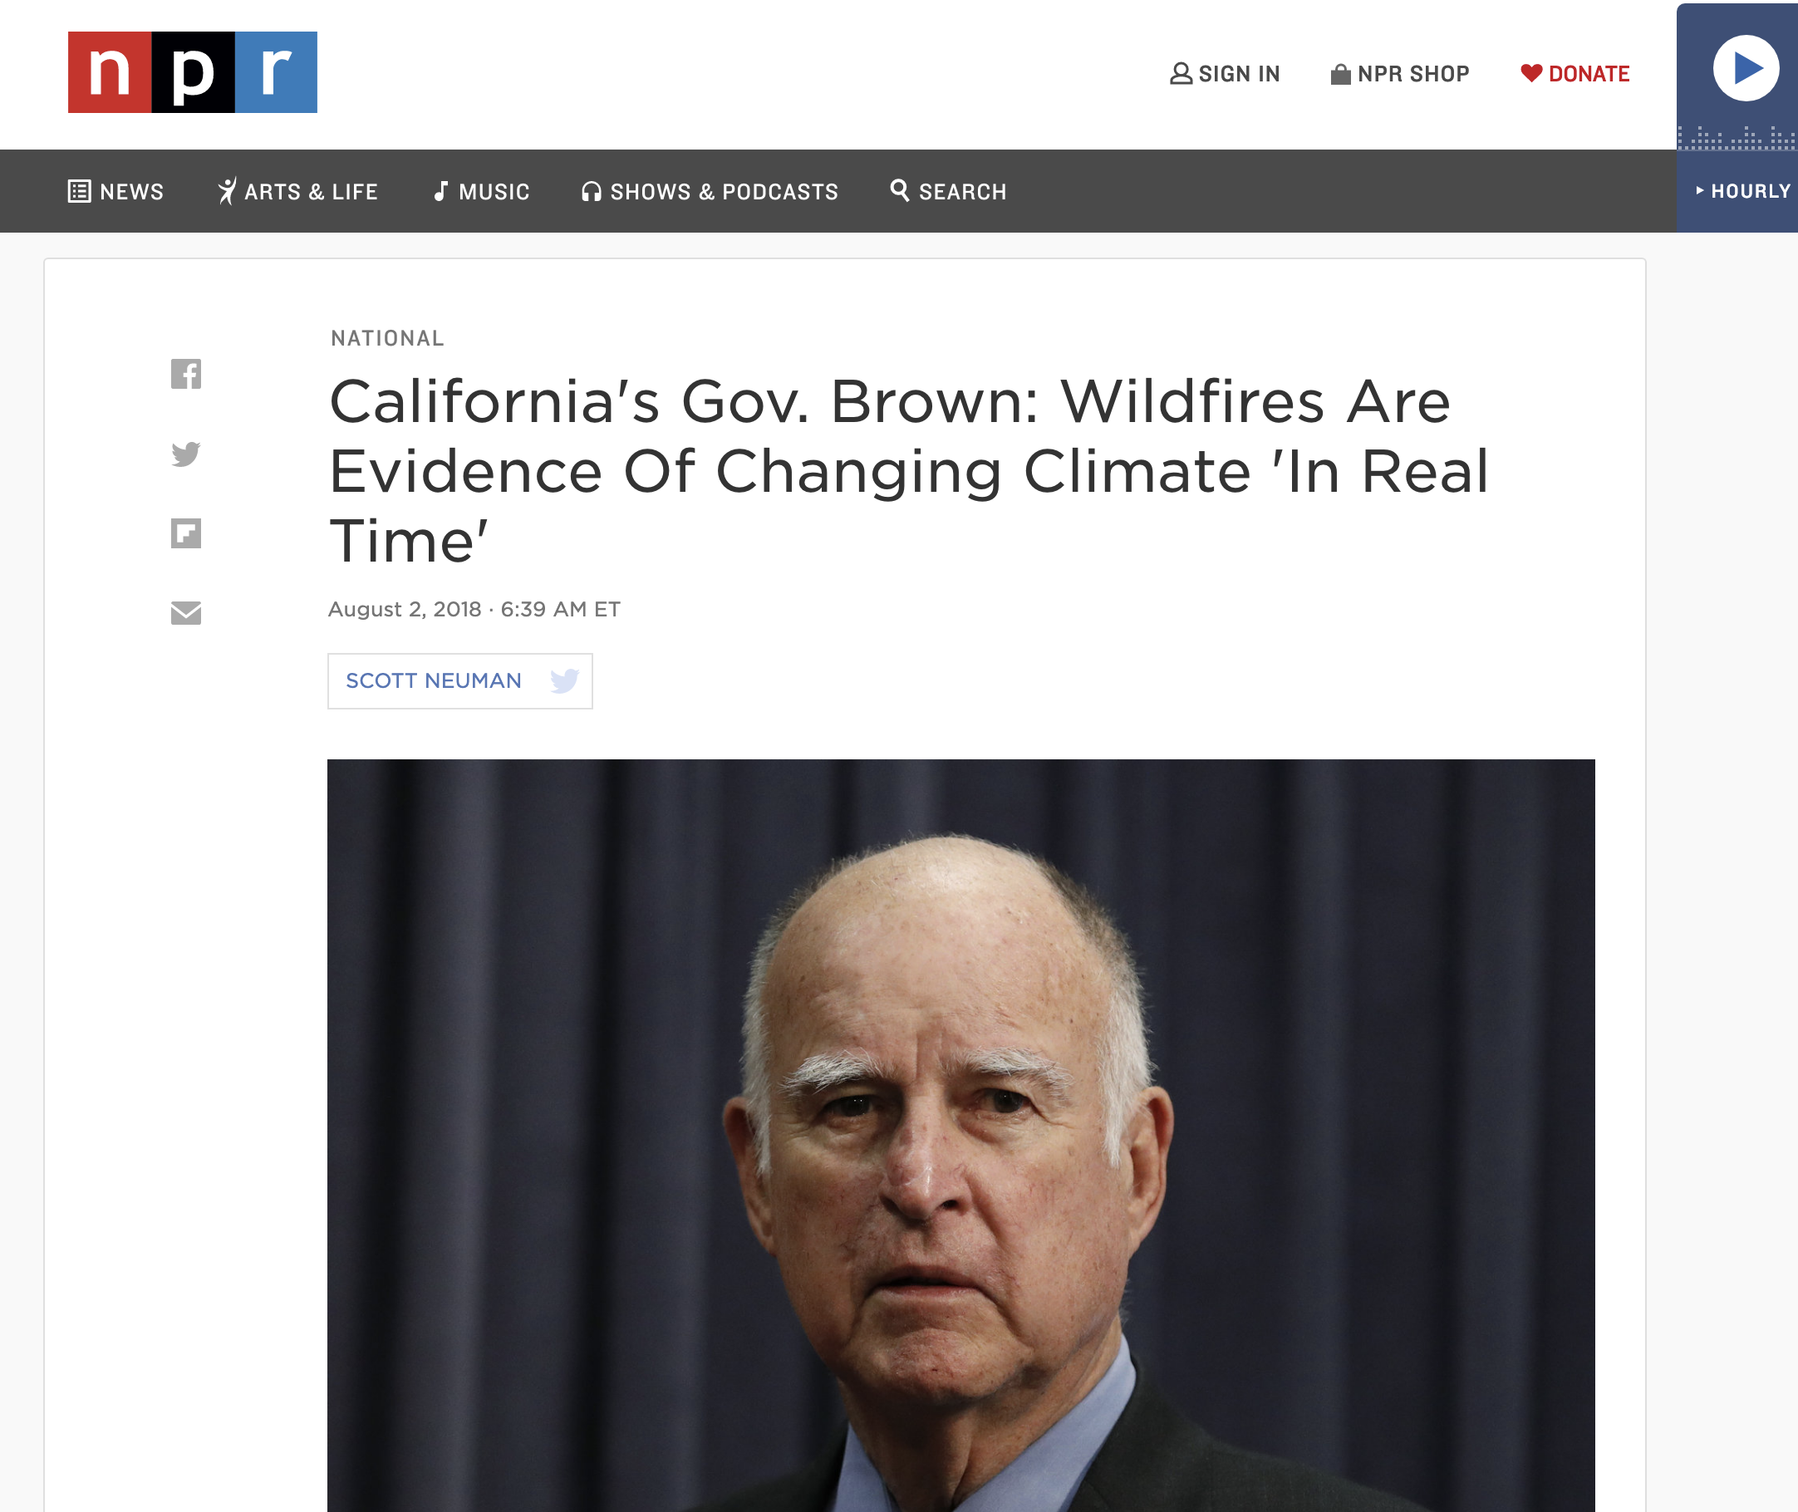

Slide 15
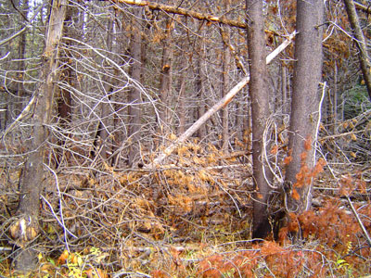
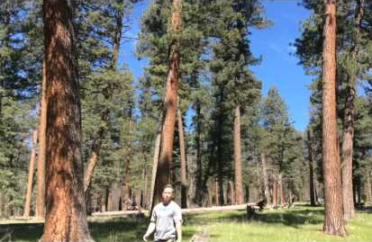
Increasing Risk of Major Wildfires
Climate change is a small part of this.
Suppression has produced unhealthy forests with lots of fuels ready to burn.
Now
Original

Slide 16
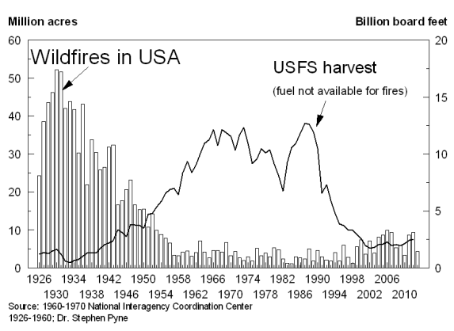
More fires in the early 20th century. Followed by suppression. Followed by new policies

Slide 17
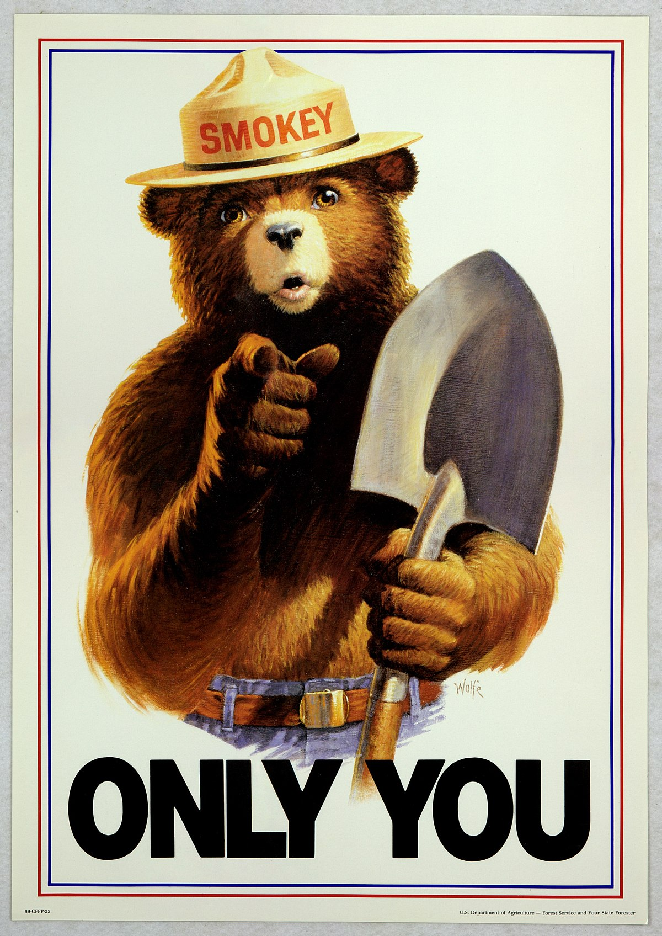

Slide 18
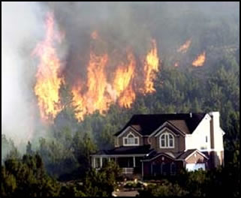
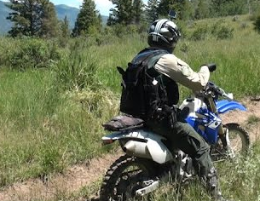
Increasing Wildfire Risks
Huge increases of population in the urban/fire interface
Large increase of recreation use of forests.

Slide 19
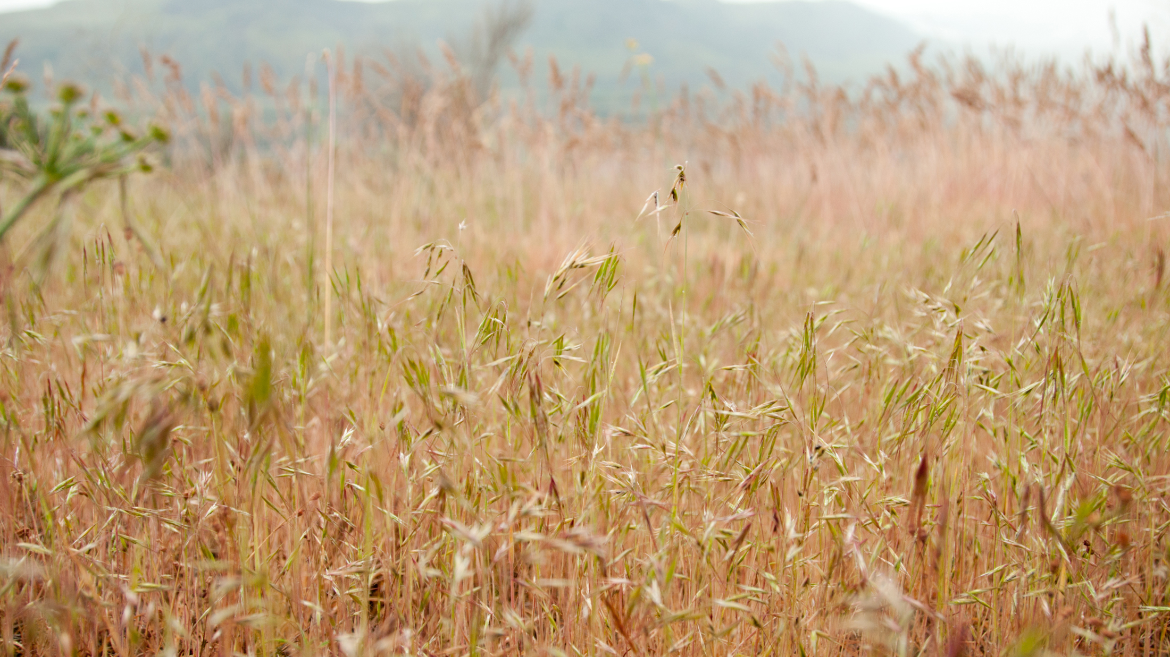
Invasive, Flammable Grasses like Cheatgrass

Slide 20
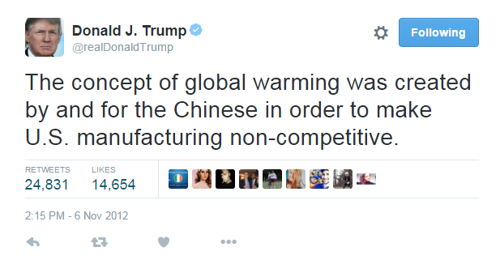
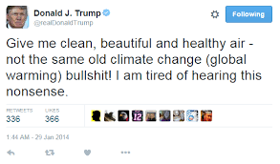
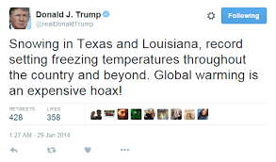
Problems Also on the Other Side

Slide 22
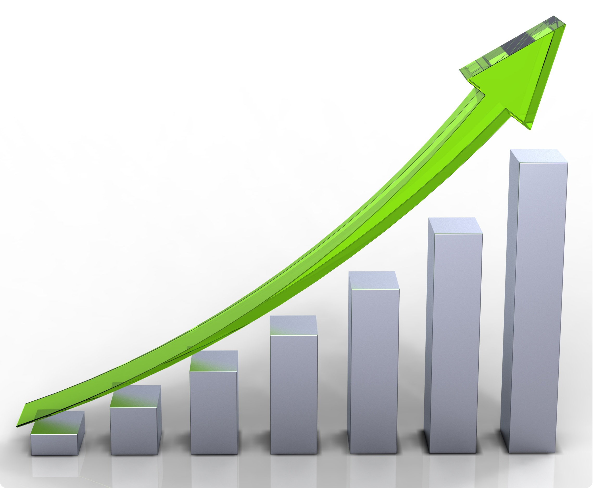
Climate Change in the Northwest
Past climate change in the NW was mainly the result of natural variability and human impacts on surface conditions
But there is now a new player, whose impacts will increase in time.

Slide 23
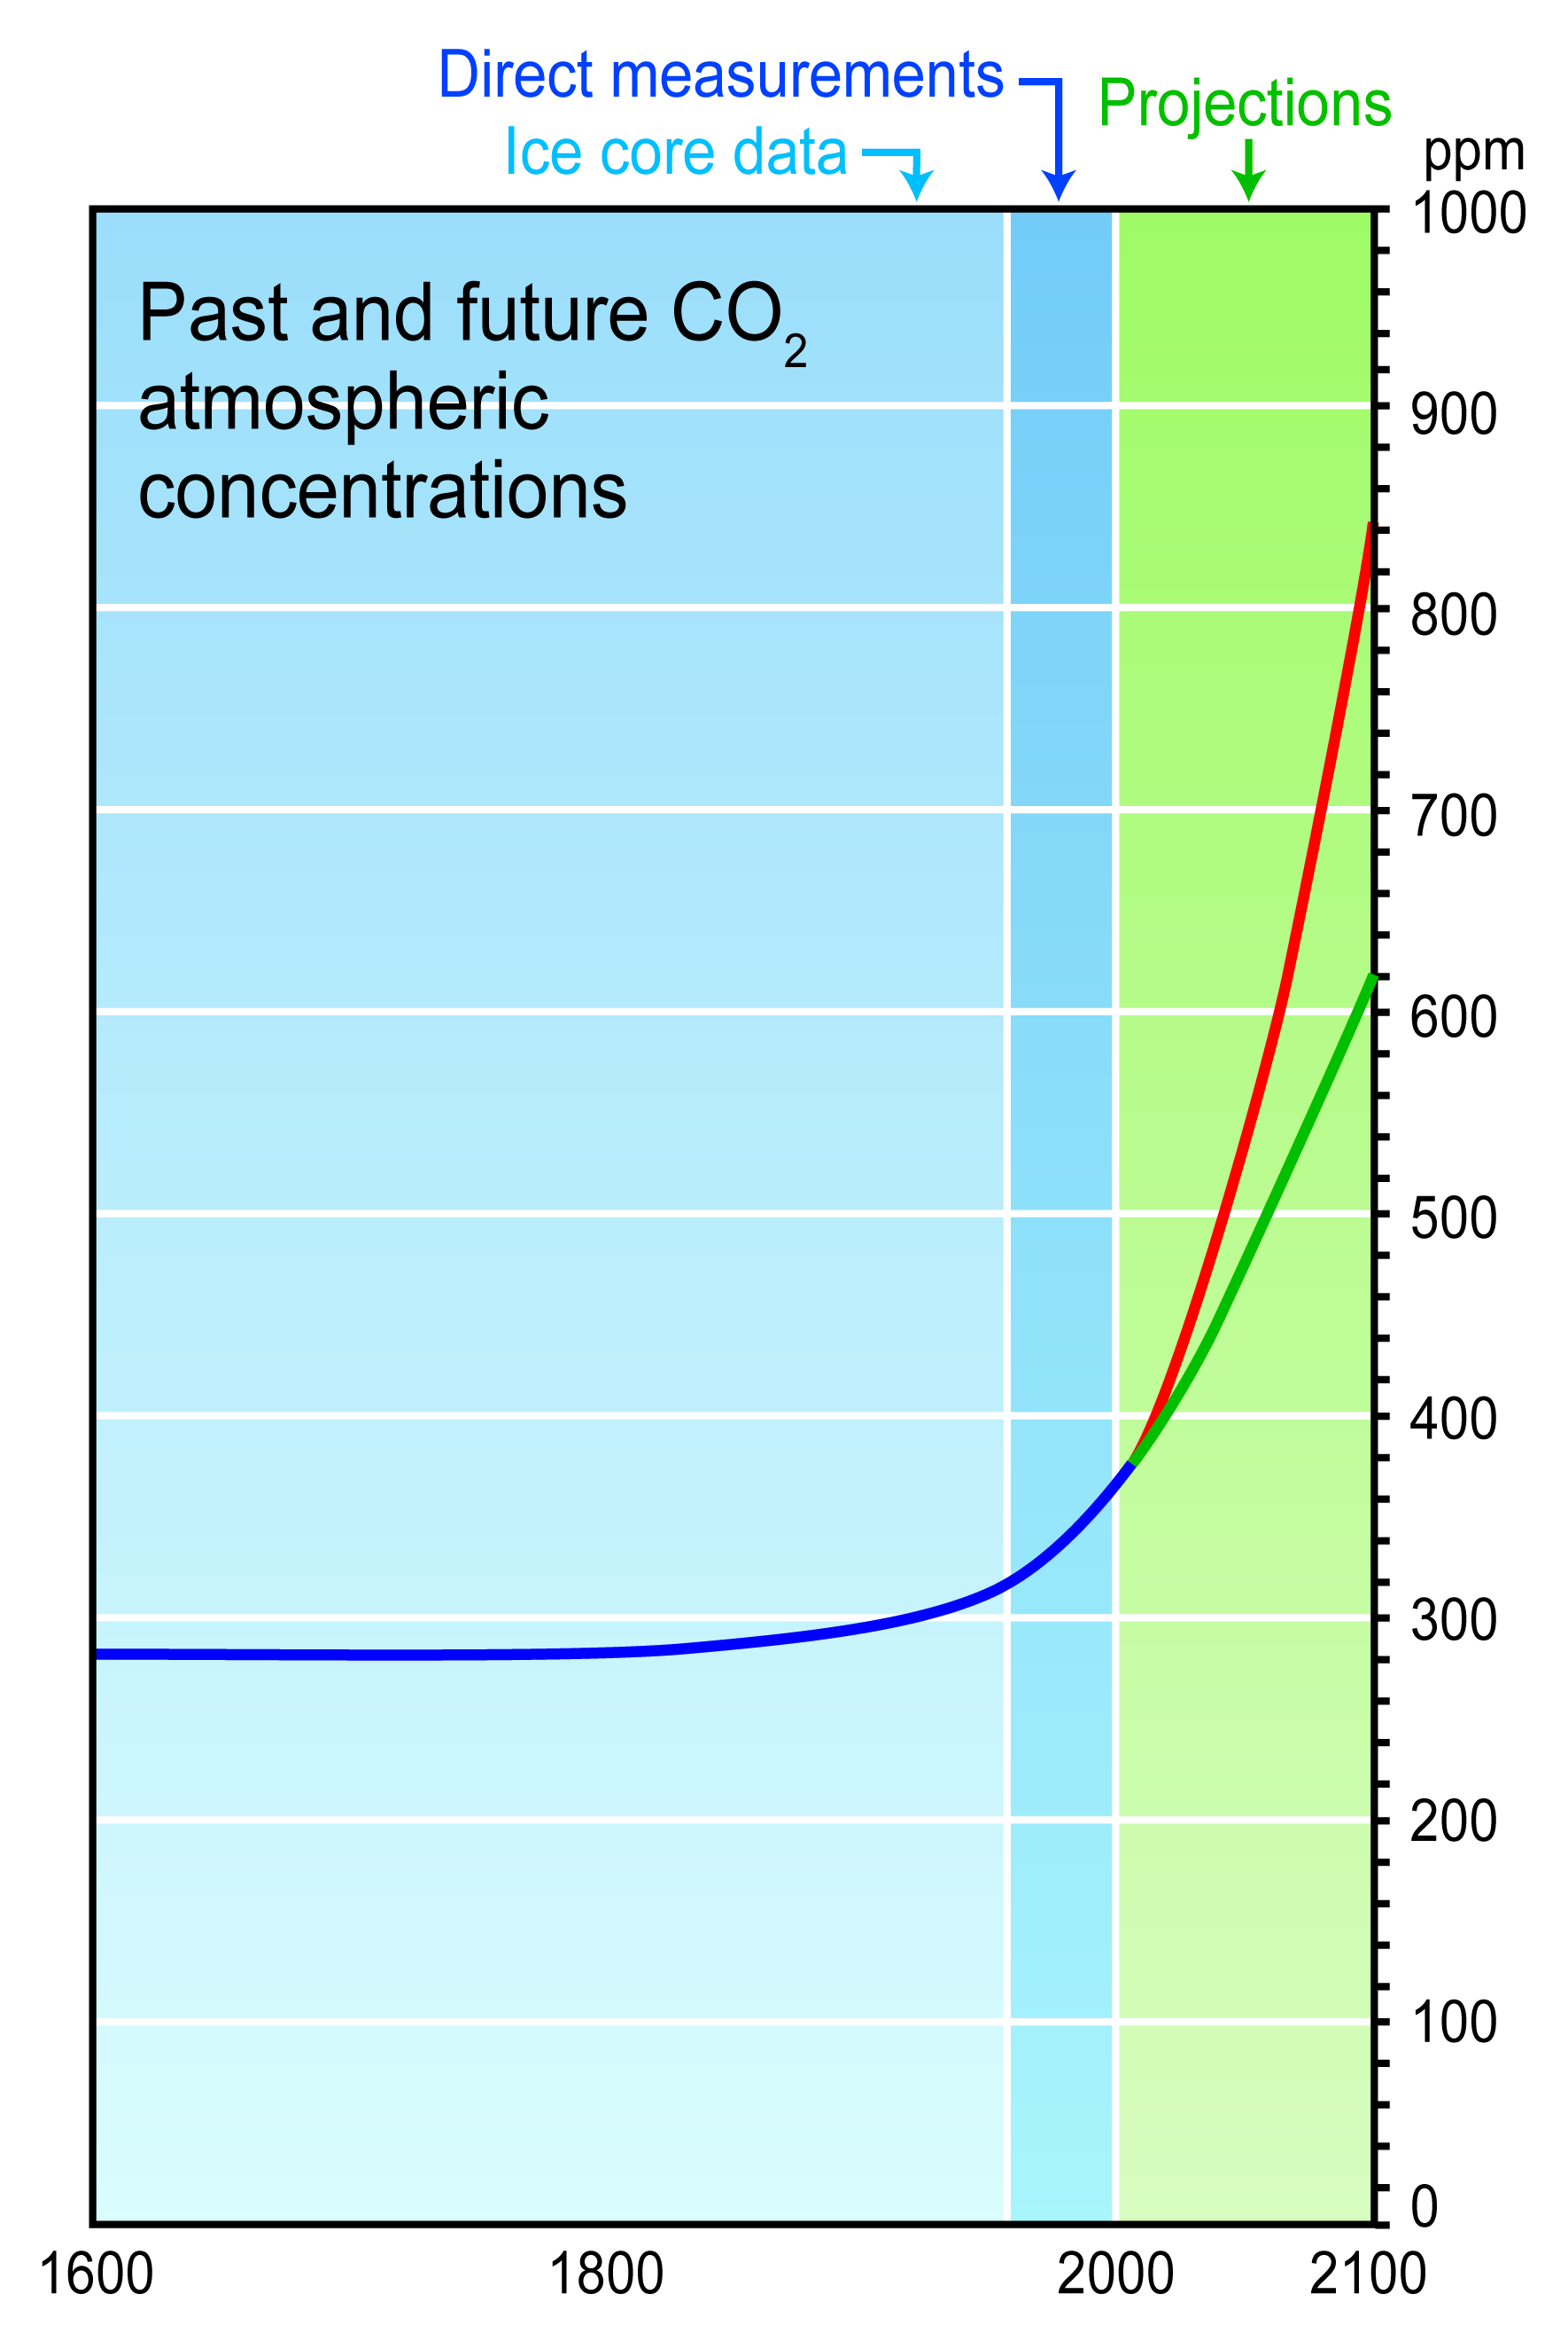
Anthropogenic Climate Change Resulting from Increasing Greenhouse Gases

Slide 24
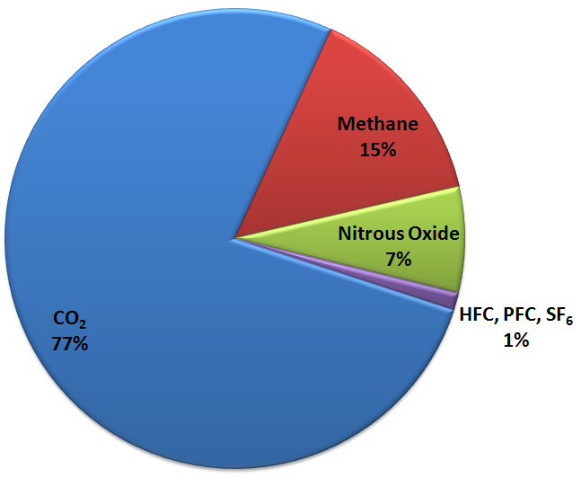
Greenhouse gases warm the planet
Carbon Dioxide
Water Vapor
Methane
Nitrous Oxide
… and others
Greenhouse Gas Emissions

Slide 25
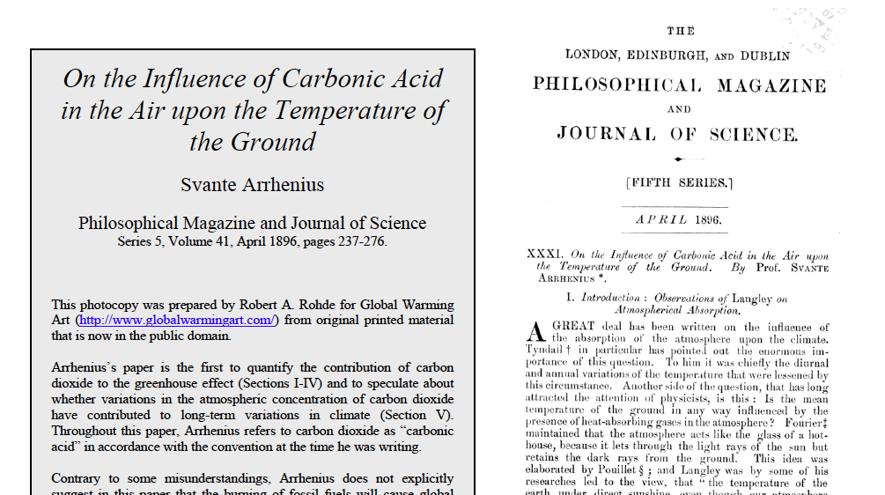
The basic physics has been known for a long time Svante Arrhenius, 1896

Slide 26
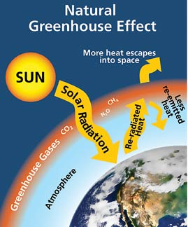
We understand the greenhouse effect
Graphic courtesy of the National Park Service

Slide 27
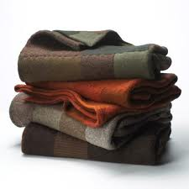
Greenhouse gases act like a blanket Thicker blankets (or more of them) make you warmer

Slide 28
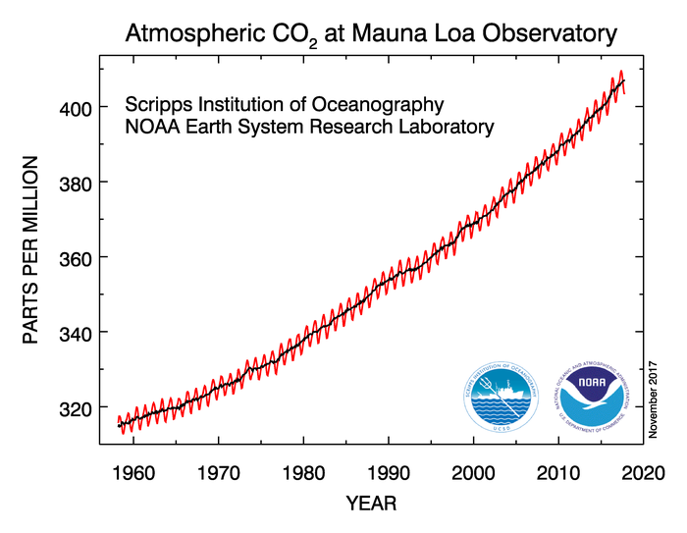
CO2 concentrations are increasing rapidly

Slide 29
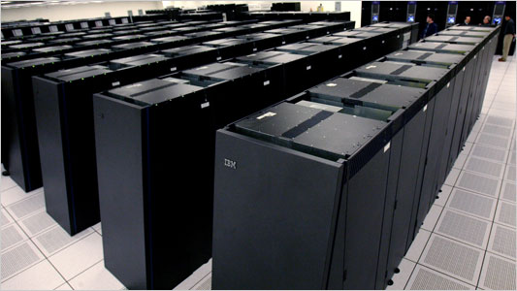
We can predict the impacts of increasing greenhouse gases using global climate models
Sophisticated computer simulations based on the physics of the atmosphere and ocean.
Atmospheric parts are nearly identical to weather prediction models, which are tested every day, but with atmospheric gases vary in time.

Slide 30
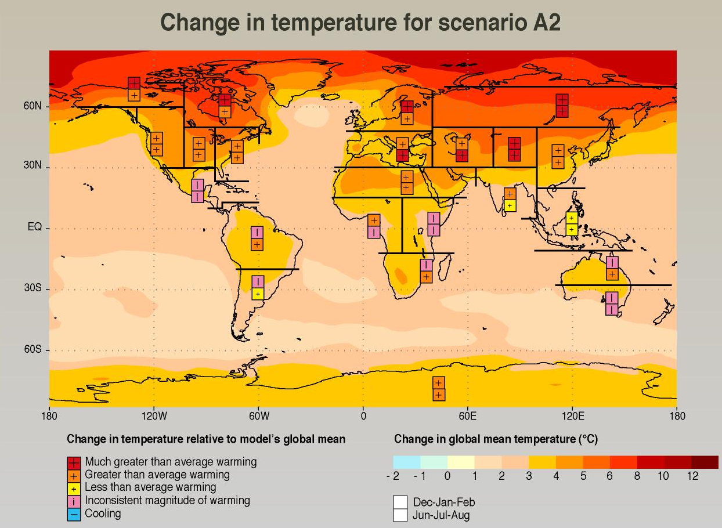
Climate Model Output for 2100
Notes:
30

Slide 31
Global Warming is NOT Uniform
Arctic warms quickly for a number of reasons, including the melting of sea ice.
Continents warm up more than oceans.
Eastern oceans up less than western oceans.
In general, the dry areas (e.g., the SW U.S.) get drier and wet areas (e.g., British Columbia) get wetter.

Slide 32
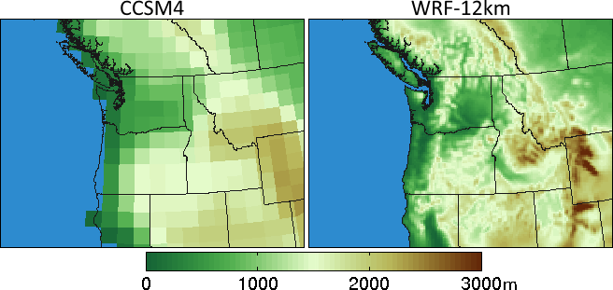
Problem: Global climate models are too coarse to simulate the effects of critical Northwest terrain
Climate Model Terrain

Slide 33
A new technology to solve the resolution issue: Regional Climate Modeling Where we run high-resolution local models driven by global climate simulations.

Slide 34
A View of What Could Happen If Mankind Continues Its Current Course Worst case

Slide 35
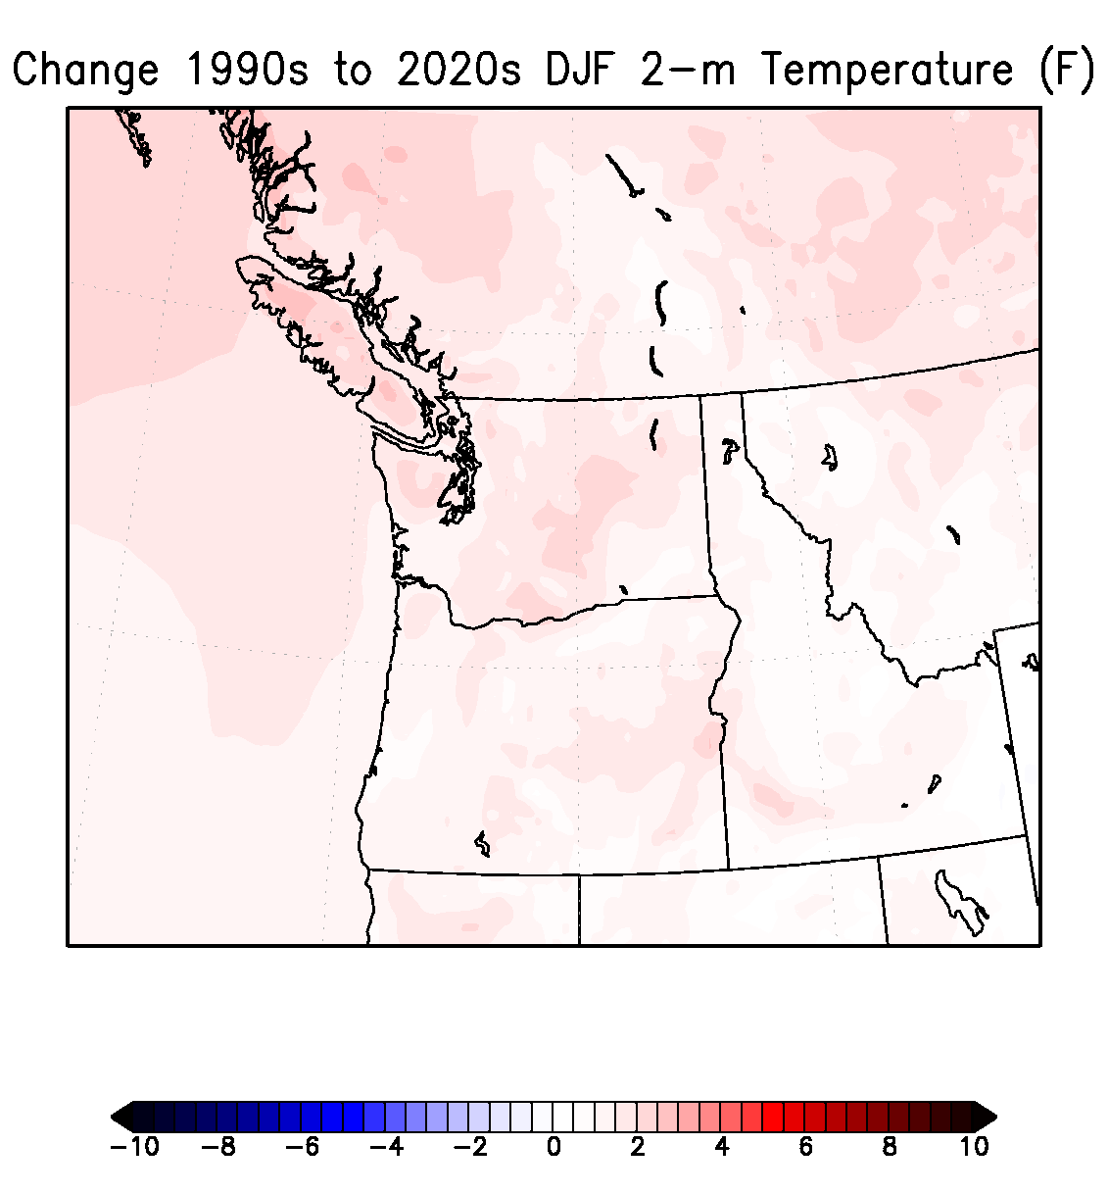
Change in Winter Surface Air Temperatures (F)
Notes:
35

Slide 36
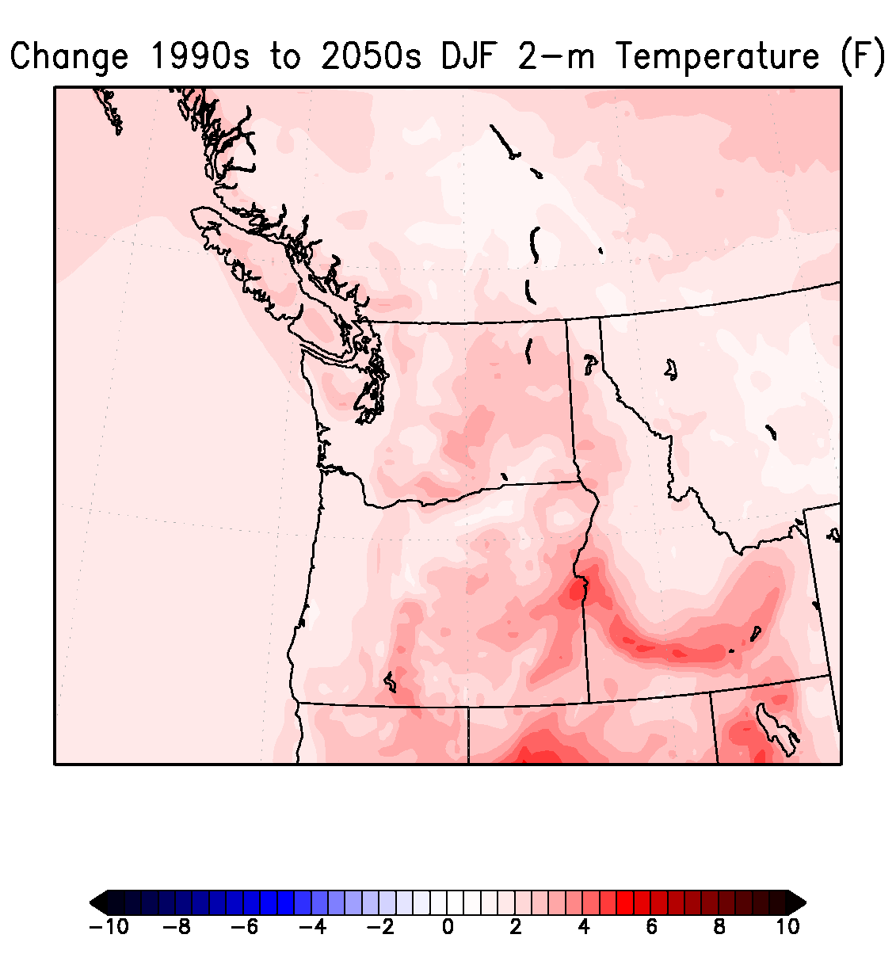
Notes:
36

Slide 37
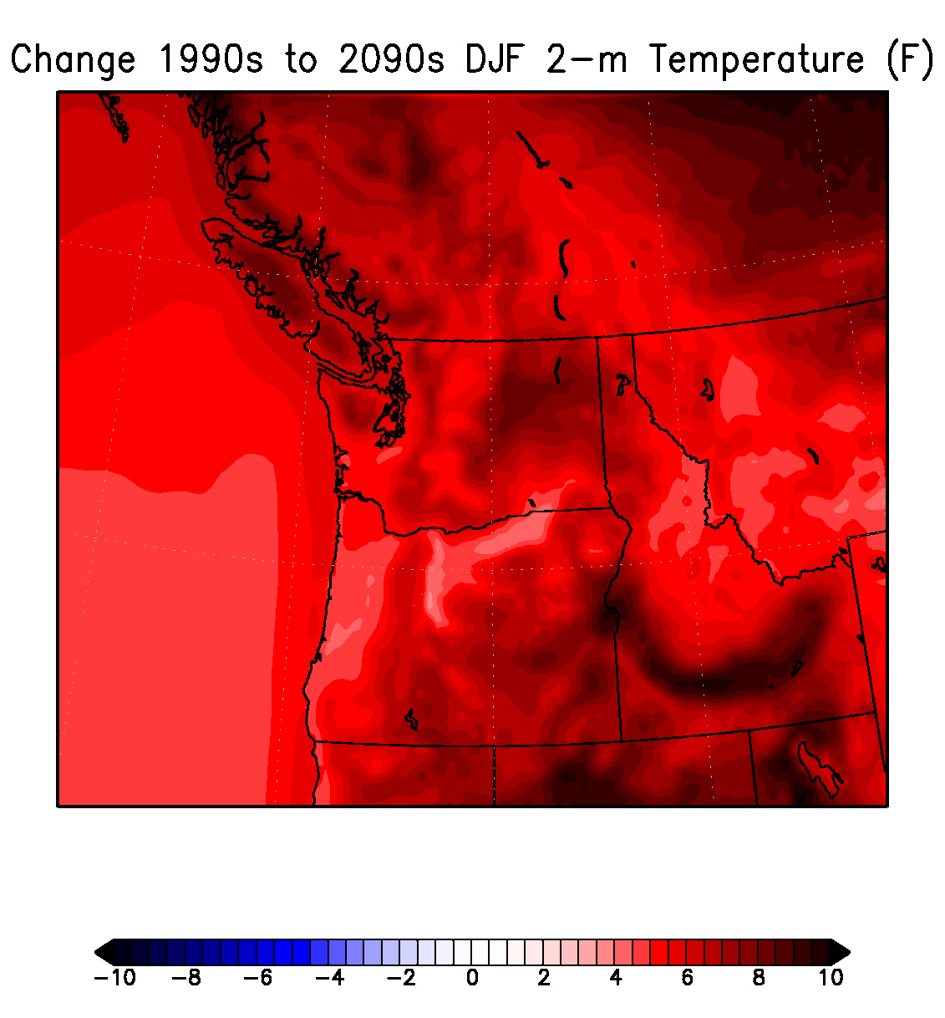
Notes:
37

Slide 38
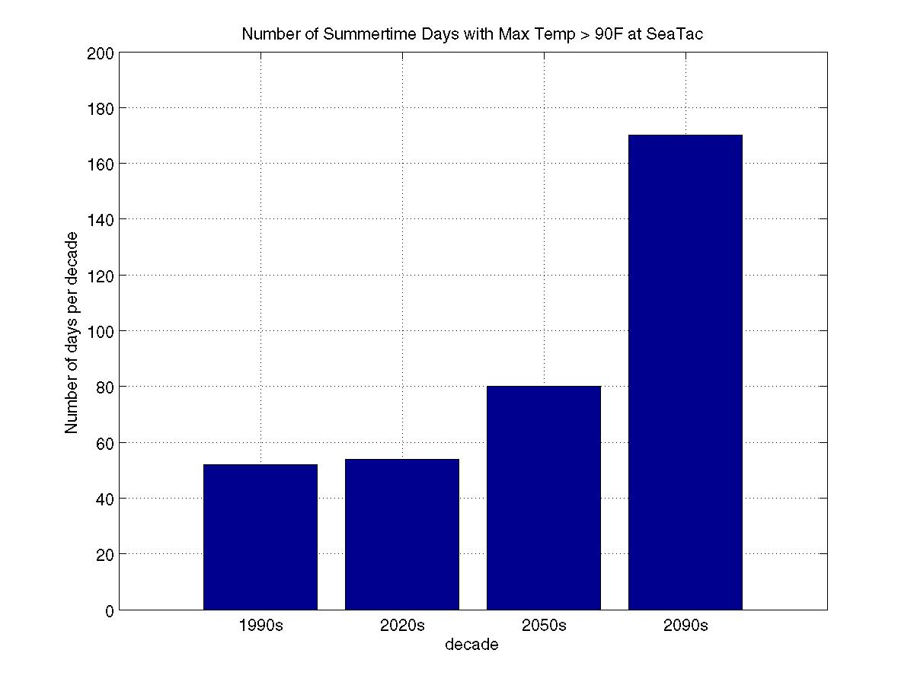
Notes:
38

Slide 39
Warming is slowed in our region Why??

Slide 40
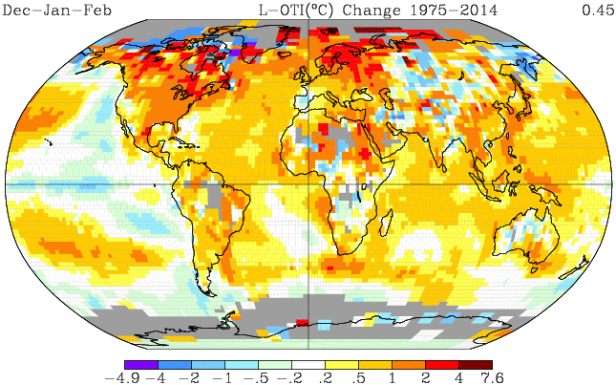
Northwest warming delayed and slowed by the Pacific Ocean
Observed Winter Surface Temperature Change (1975-2014)

Slide 41
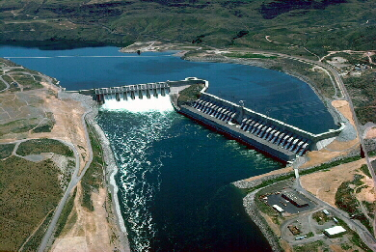
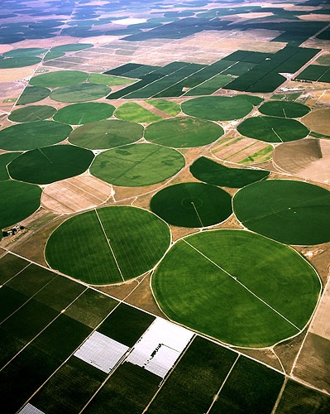
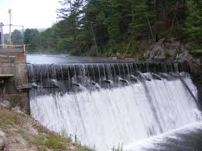
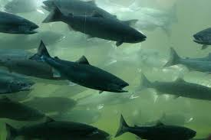
What about water, our most precious resource?

Slide 42
Good news for average precipitation
Unlike some areas, we will still have plenty of precipitation, just more rain and less snow

Slide 43
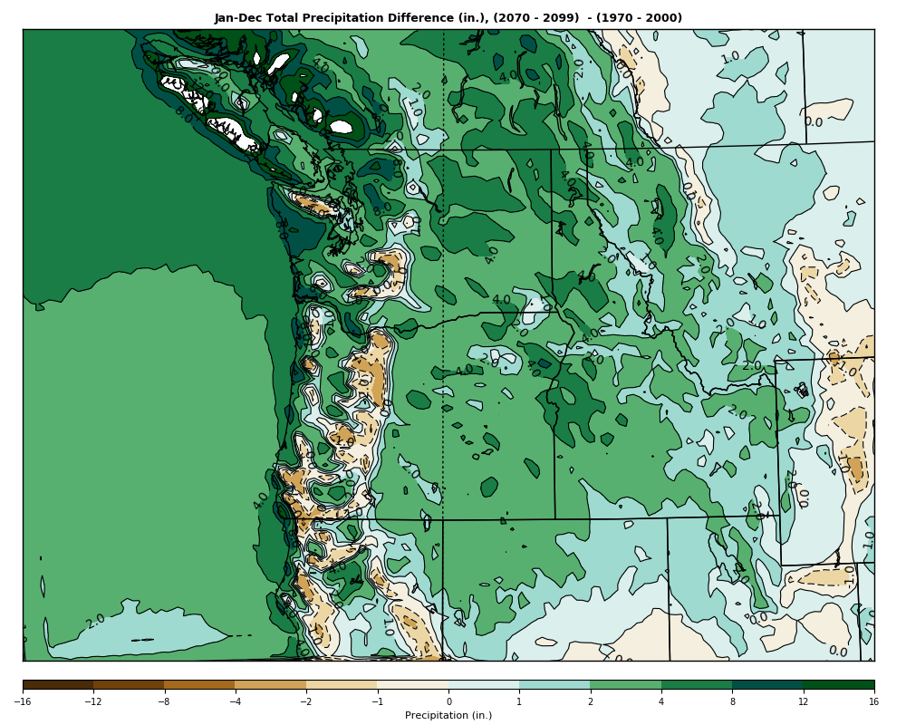
Change in Regional Precipitation

Slide 44
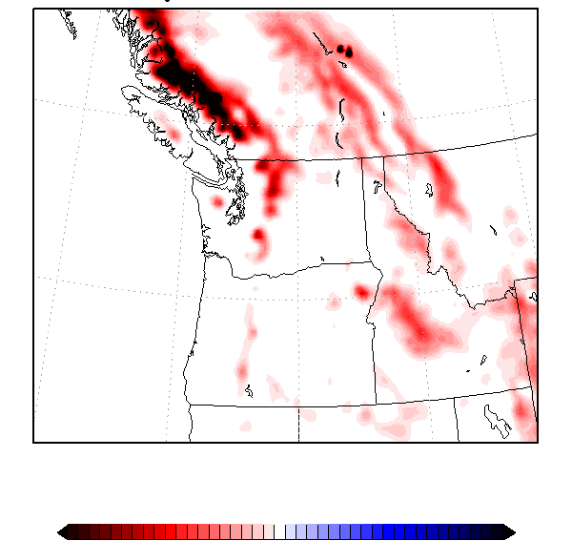
But warming will result in more precipitation falling as rain rather than snow
Change in Snowpack from 1990 to 2090
Lower
0%
Higher

Slide 45


Risk Reduction Advice: DON’T BUY THIS IN 2050

Slide 46
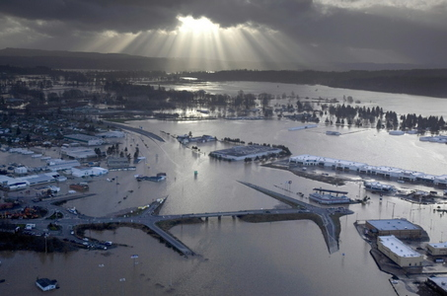
But there is a dark side to the our future warmth: more extreme precipitation and flooding

Slide 47
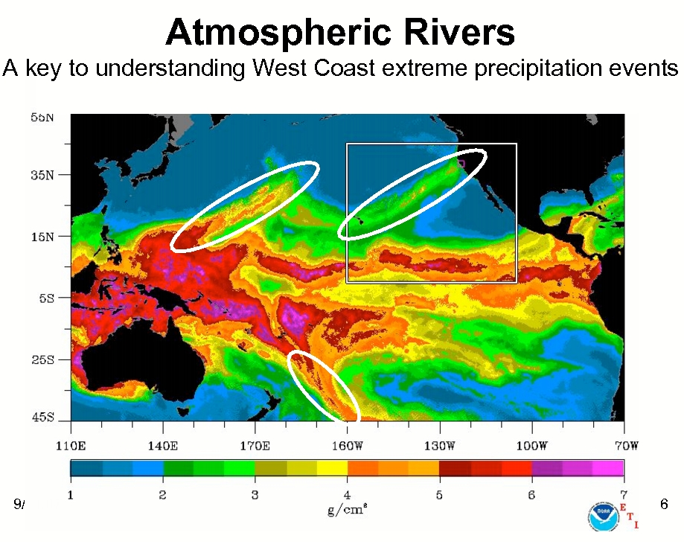
Super Atmospheric Rivers

Slide 48
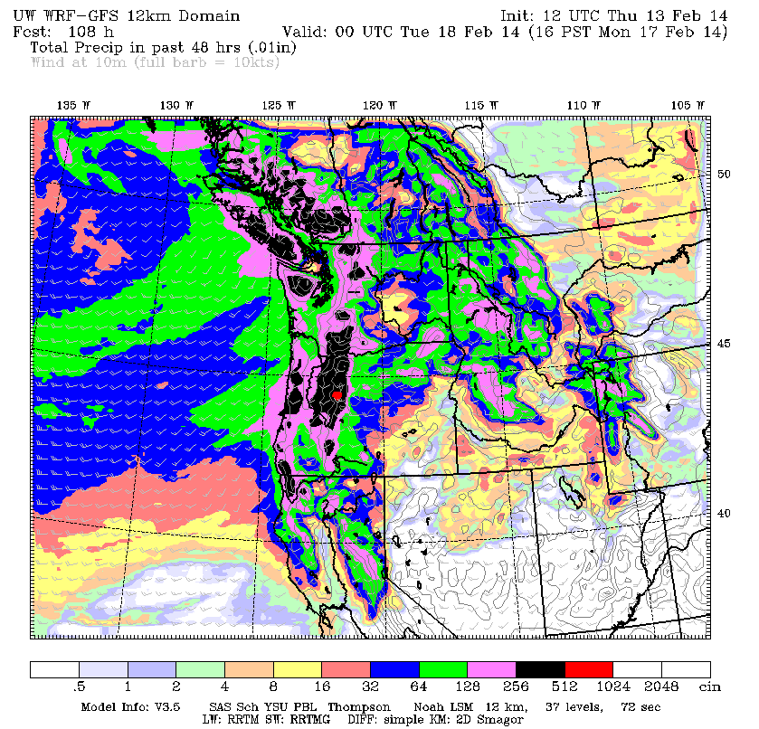
When atmospheric rivers hit our terrain, intense precipitation falls

Slide 49
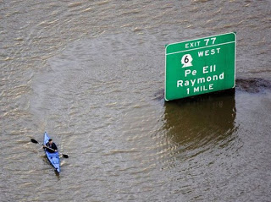
Global warming will intensify atmospheric rivers and heavy precipitation
Warmer air holds more water vapor.
Climate model simulations based on “business as usual” greenhouse gas emissions.
Precipitation on extreme atmospheric river days increases by 15-39% by the end of the century.

Slide 50
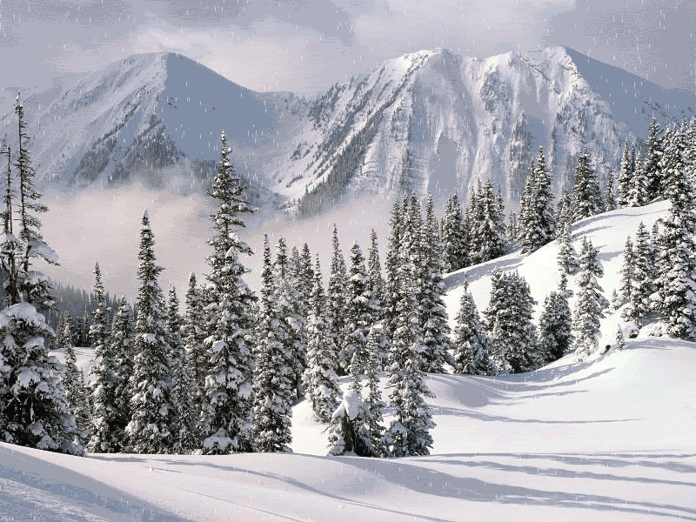
Flooding Potential Increases
Snow absorbs rain.
With less snow, there will be less “protection.”
Thus, heavier rainfall could lead to greater flooding on major rivers.

Slide 51
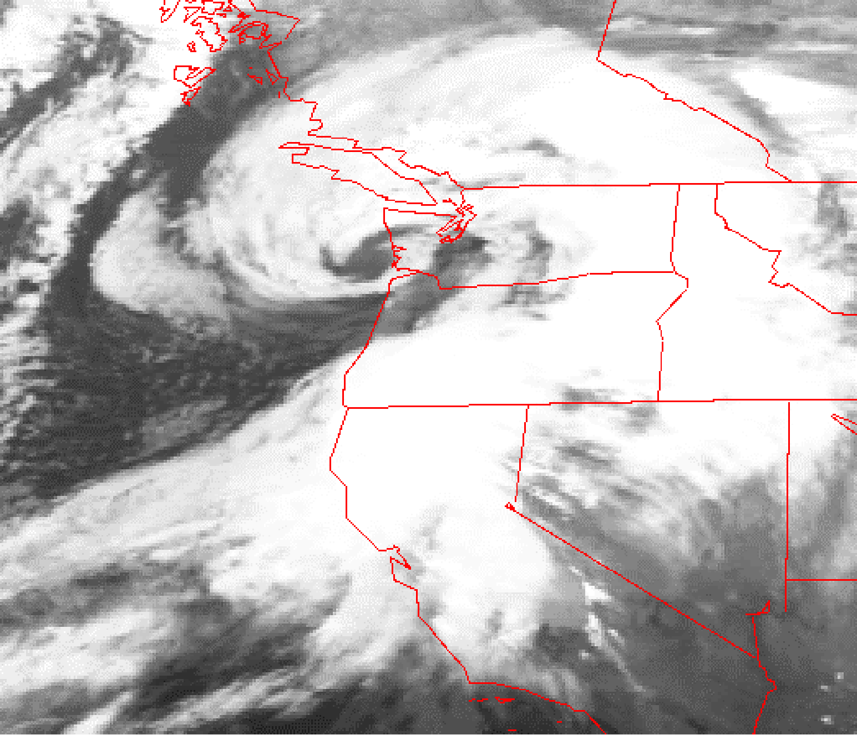
Northwest Windstorms
Will there be more of them?
Will they become more intense?
The Inauguration Day Storm
1993

Slide 52


Slide 53

Northwest Windstorms
The real answer appears to be no. No increasing trend in observations and none suggested by climate models.
UW investigated this issue for Seattle City Light

Slide 54

Number of times per year winds exceed a high-wind threshold (DJF) at Seattle for several simulations

Slide 55

Sea Level Rise
Best estimates are 1-2 feet between 2000 and 2100, assuming continued greenhouse gas increases.

Slide 56

But Sea Level Is Going Down in Some NW Locations

Slide 57

Slow Rise (2 mm a year, 8 inches a century)

Slide 58

Relatively minor impacts overall because our land rises rapidly from the water in most locations

Slide 59

Wildfires in the Future
Later in the century, warming temperatures, less snowpack and drying summers could enhance wildfire probabilities on both sides of the Cascades.
We need to fix our forests and bring fire back.

Slide 60

Global Warming is a Technical Problem and Will Probably Be Solved with Technology
Fusion and safe fission power
Better energy storage
Removal of CO2 from the atmosphere (sequestration)
Energy efficiency and better wind/solar

Slide 61


The Global Warming Debate Has Divided Into Tribal Warfare
We must find a way to find rational middle ground

Slide 62

We must do this together as a nation in a bipartisan way

Slide 63

With some global warming guaranteed in the short term, must work on adaptation and resilience
Make civilization more robust to climate change
Here in the NW this means dealing with flooding, water resources (bigger reservoirs), and fixing our forests.

Slide 64

KING County West Point Treatment Plant We are NOT Resilient Now

Slide 65
The End

