Slide 1
Northwest Weather Prediction and Climate Change: An Appraisal of the Future
Cliff Mass
Department of Atmospheric Sciences
University of Washington

Slide 2
Take Home Messages
Weather prediction is considerably more skillful and specific than even 20 years ago
Human-caused global warming is real but is NOT the existential problem portrayed in the media

Slide 3
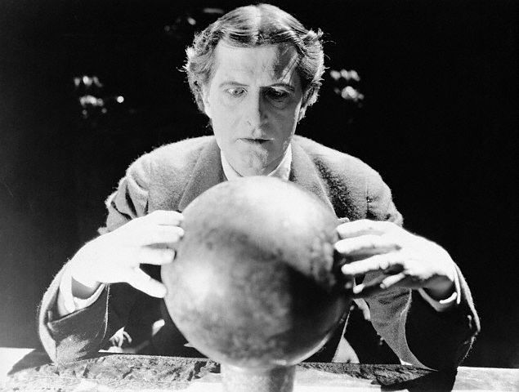
The Technology and Future of Weather Forecasting

Slide 4
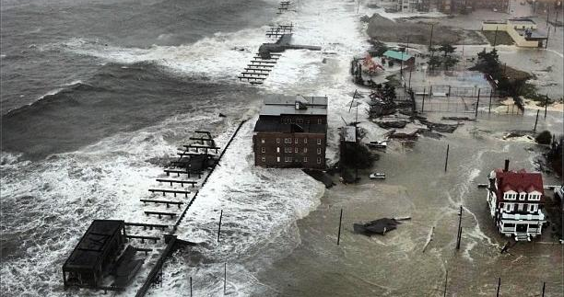
2012: Hurricane Sandy
125 dead, 60+ billion dollars damage in an area with a population of tens of millions.

Slide 5
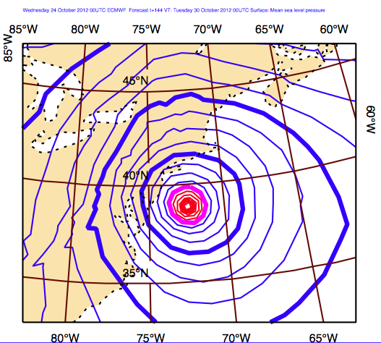
Well predicted, more than a week ahead
ECMWF 6-day Forecast of Sea Level Pressure

Slide 6
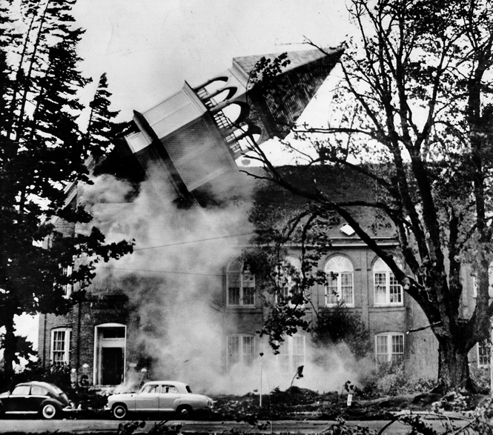
1962 Columbus Day Storm

Slide 7
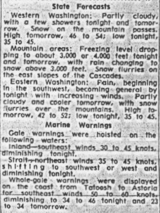
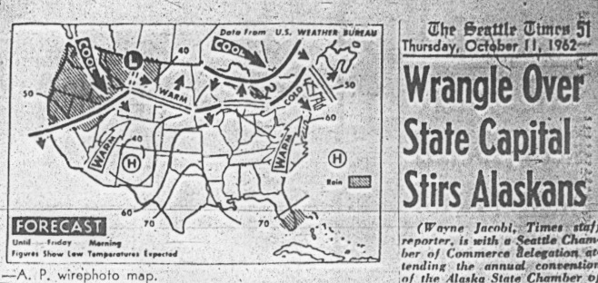
Not forecast the day before either
Seattle Times

Slide 8
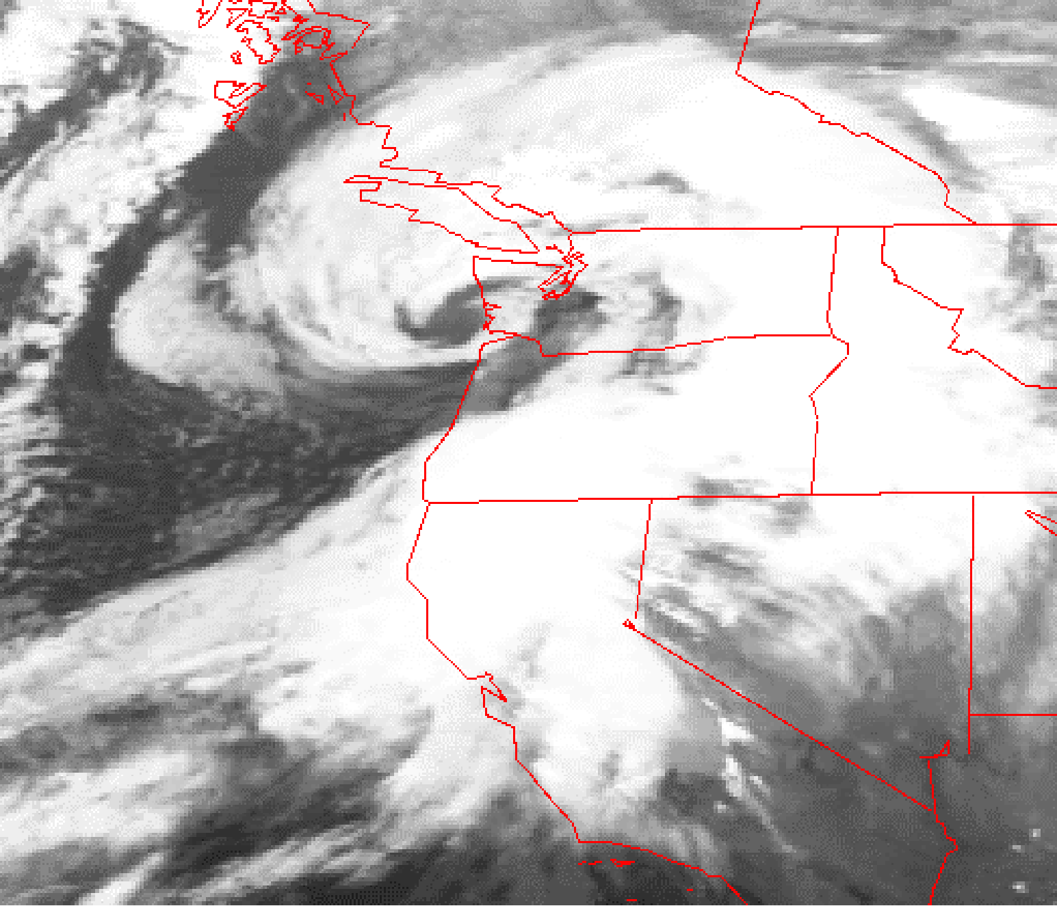
Jan 1993: Inauguration Day Storm: Near Perfect Forecast

Slide 9
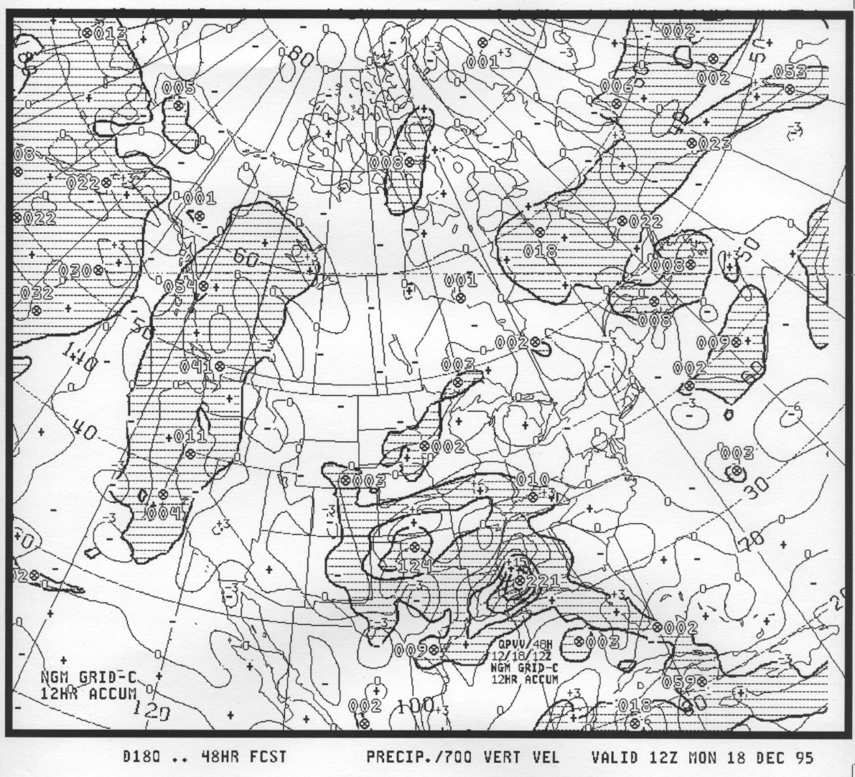
1995 Precipitation Prediction

Slide 10
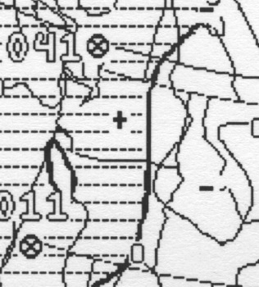
1995

Slide 11
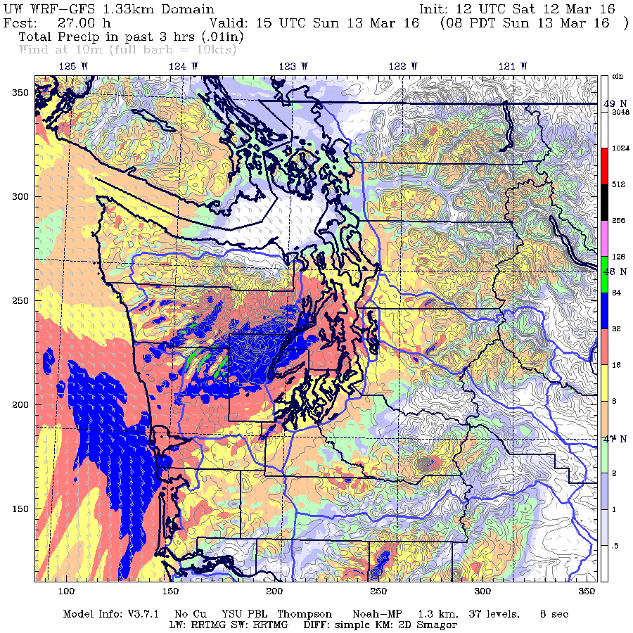
Today

Slide 12
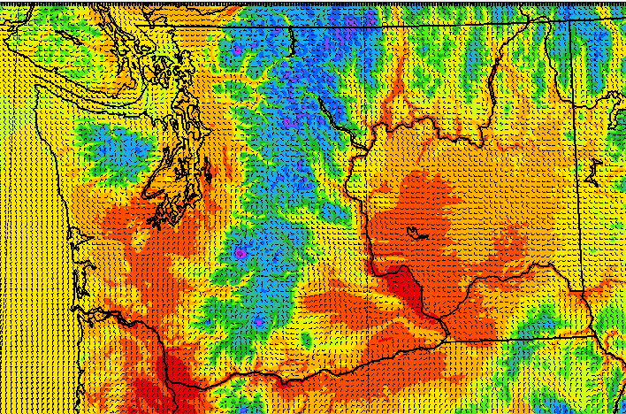
1.33 km resolution available on the UW web site

Slide 13
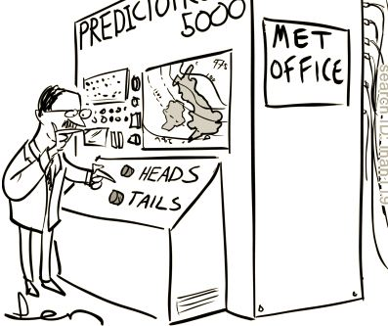
Weatherman Jokes Are No Longer Appropriate

Slide 14
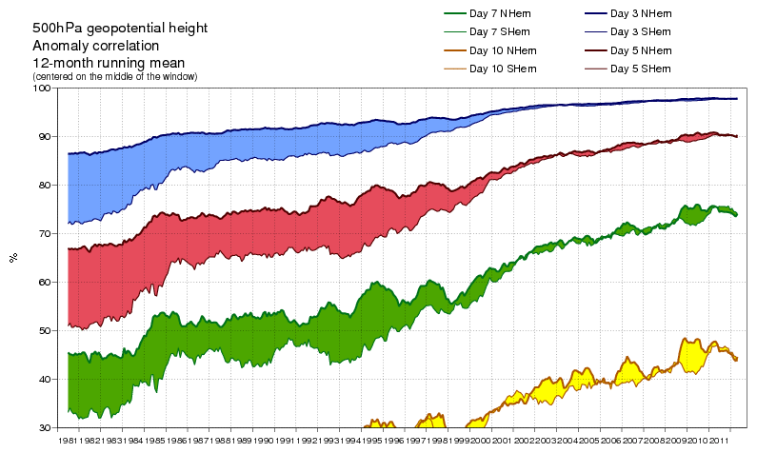
Skill Improvements (ECMWF)
Major improvements, mainly due to satellite data and
improved models

Slide 15
Why are weather forecasts getting more skillful and specific?
?

Slide 16
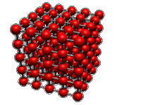
The Key Technology: Numerical Weather Prediction
Starting with the current state of the atmosphere (known as the initialization) , you can predict the future by solving equations that describe the physics of the atmosphere.
These equations can be solved on a three-dimensional grid.

Slide 17
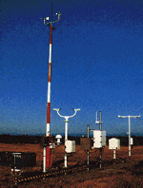
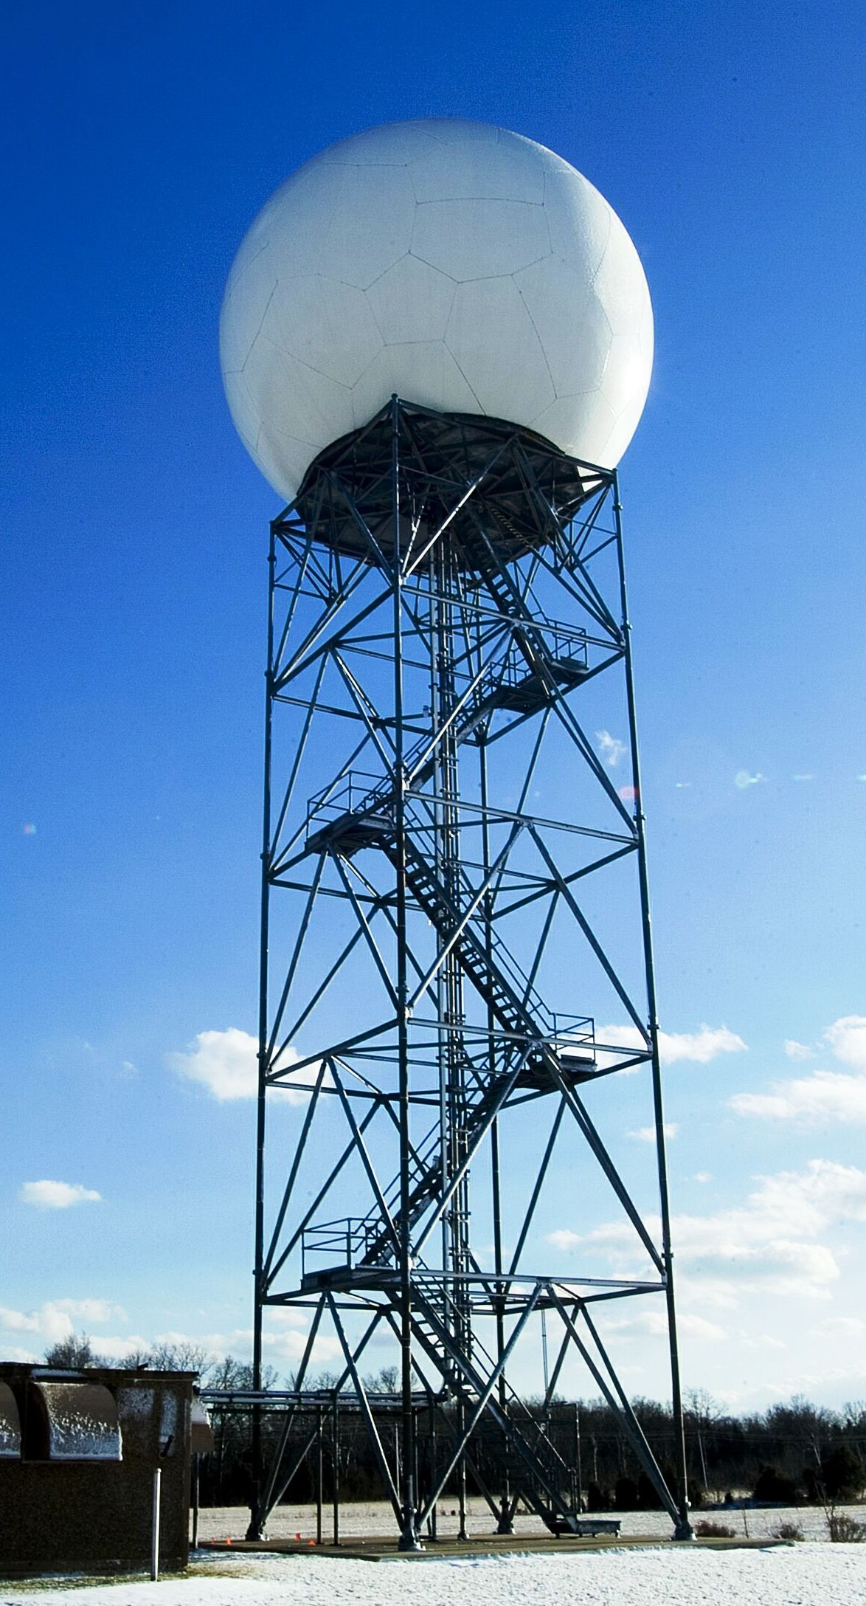


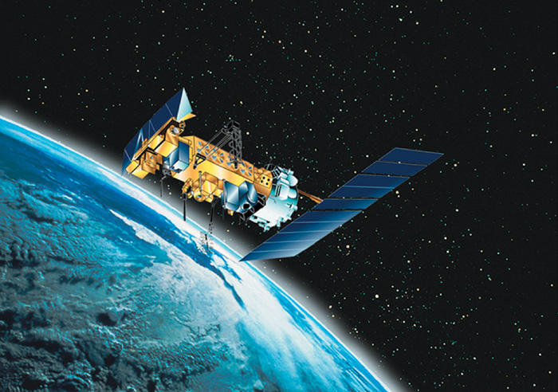
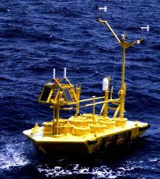
Observation Collection Needed to Create the Initialization

Slide 18
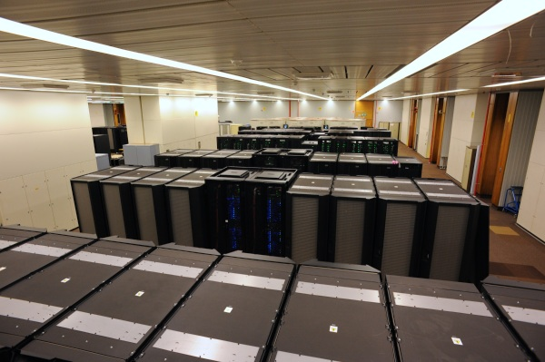
Numerical Weather Prediction
Numerical weather prediction uses the largest computers on the planet
As computer resources increase, the number of grid points increase.
More (and thus) closer grid points means we can simulate (forecast) smaller scale features.
National Weather
Service Weather
Prediction Computer

Slide 19
1.33 km resolution available on the UW web site

Slide 20
The Numerical Forecasts Can Be Improved by Statistical Means
Can reduce biases
Correct for systematic errors
Produce calibrated forecasts where observations are available
Recently, machine learning has been used

Slide 21

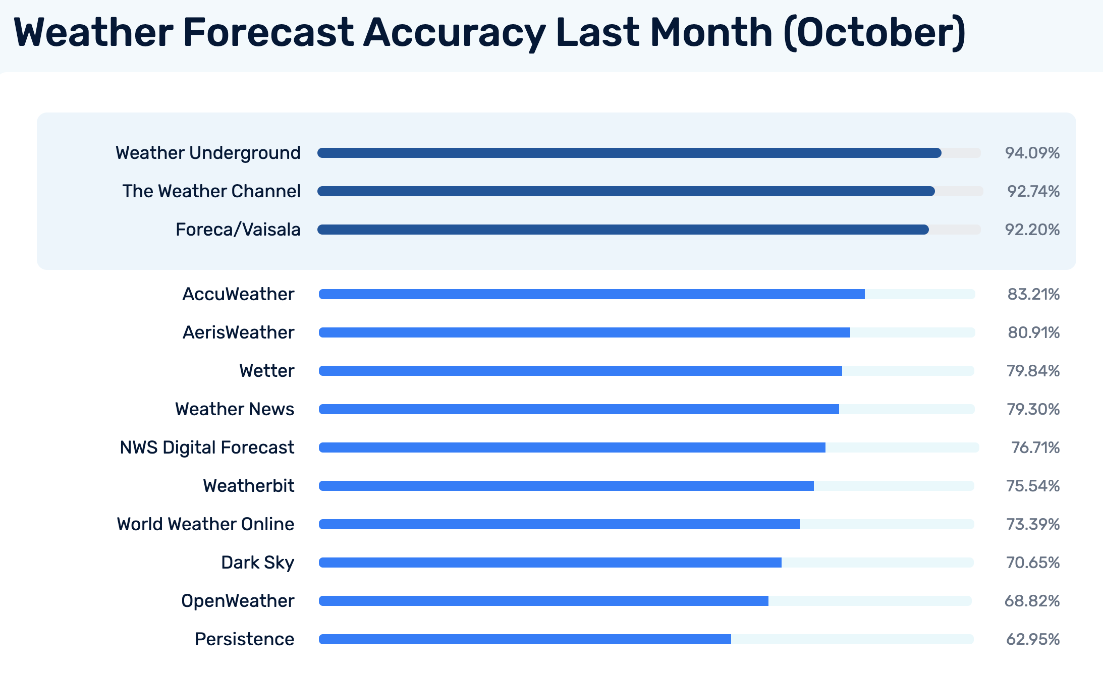
Better Statistical Post Processing Explains Why Some Private Sector Firms Have Superior Forecasts

Slide 22
A major advance in weather forecasting will be the increasing availability of probabilistic weather prediction

Slide 23
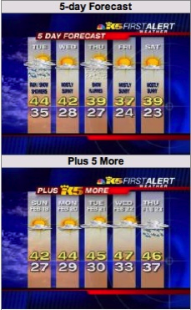
This is Ridiculous!

Slide 24

A Fundamental Problem
The way we have been forecasting has been essentially flawed.
Small differences in the initialization…well within observational error… can have large impacts on the forecasts, particularly for longer forecasts.
Produces increasing error and uncertainty in forecasts

Slide 25

A Fundamental Problem
Similarly, uncertainty in processes, like the development of clouds and precipitation, also produces uncertainty in forecasts.
Thus, all forecasts have uncertainty.
The uncertainty generally increases in time.

Slide 26
Forecast Probabilistically
We should be using probabilities for all our forecasts or at least providing the range of possibilities.
There is an approach to handling this issue that is being explored by the forecasting community…ensemble forecasts

Slide 27
Ensemble Prediction
Instead of making one forecast…make many…each with a slightly different initialization or different model physics.
Possible to do this now with the vastly greater computation resources that are available.

Slide 28
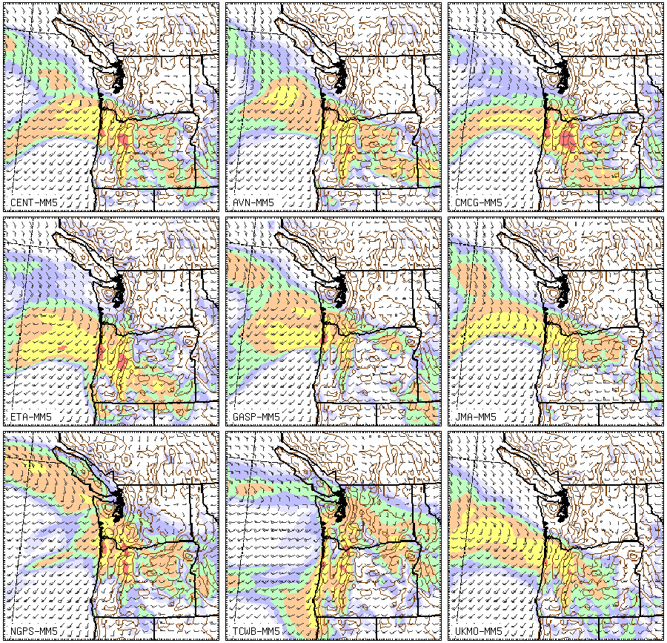

Slide 30
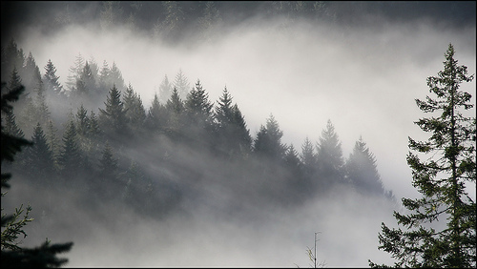
Global Warming over the Northwest

Slide 31
Key Messages
Global warming and its impacts are serious issues.
There has been substantial misinformation by the media, activist groups, and some politicians.
Climate change/global warming is a manageable technical problem.
It is not an existential threat to mankind, but one that needs to be dealt with by adaptation and mitigation.

Slide 32
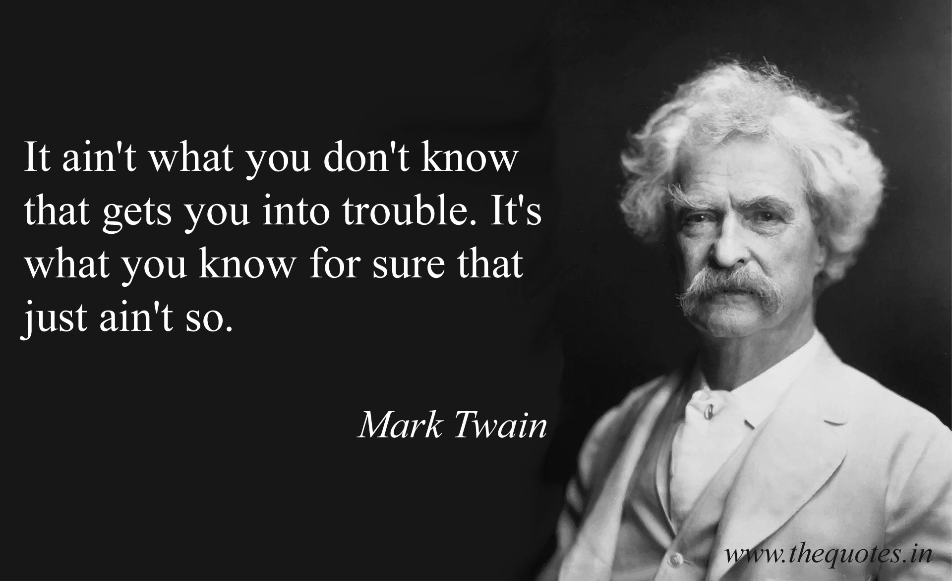

Slide 33
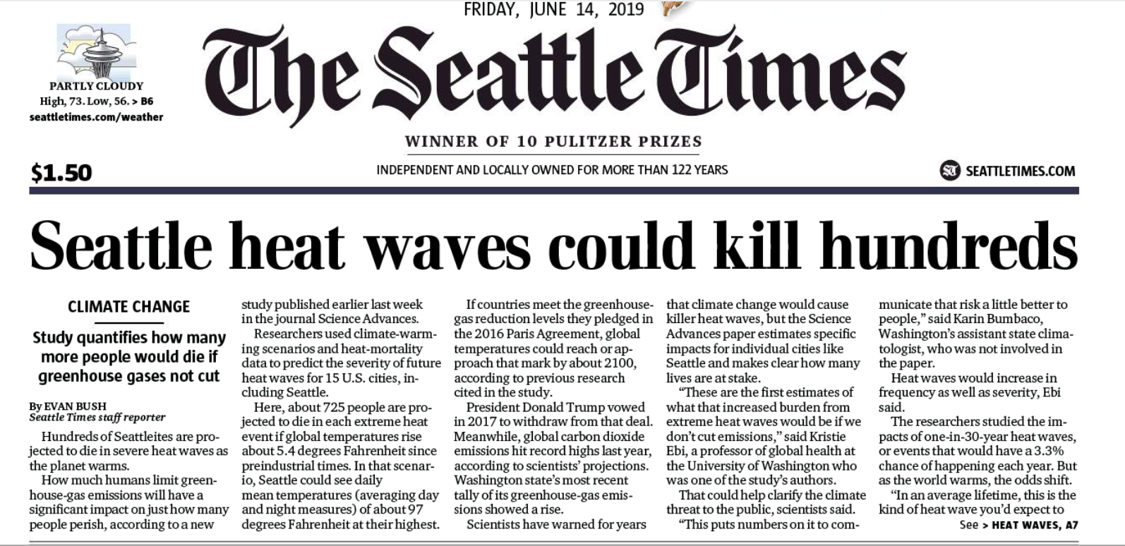
There has rarely been so much misinformation and exaggeration about any public issue of importance

Slide 34
Claim: 725 will day in Seattle from a single heat wave Nonsense: Assumes that no one buys an air conditioner plus unrealistic warming

Slide 35
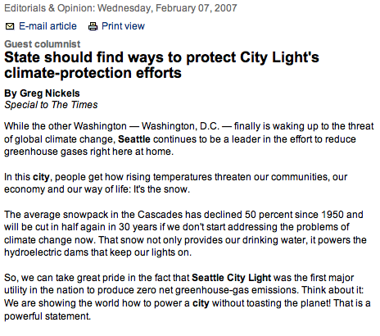
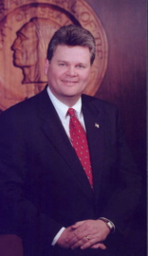
Seattle’s Mayor and others suggested our snowpack had declined by 50%

Slide 36
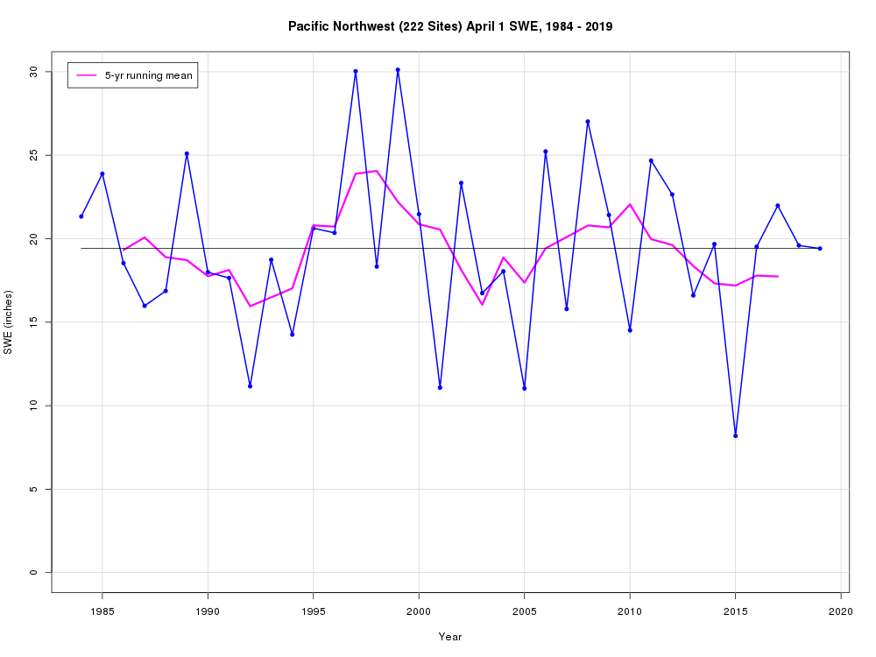
Little trend in Cascade snowpack over the last 30 years (Mark Albright UW)

Slide 37

West Coast Wildfires and Climate
Some politicians blame them on global warming (climate change)
“This has happened because we have changed the climate of the state of Washington in dramatic ways.”

Slide 38
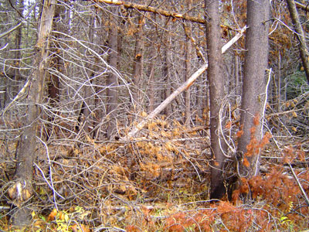
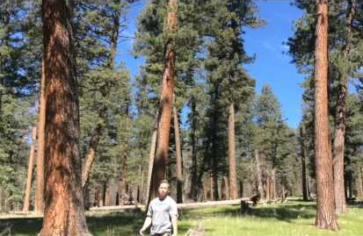
Increasing Risk of Major Wildfires
Climate change actually a small contributor
Wildfire suppression has produced unhealthy forests with lots of fuels ready to burn.
Human ignitions
Now
Original

Slide 39
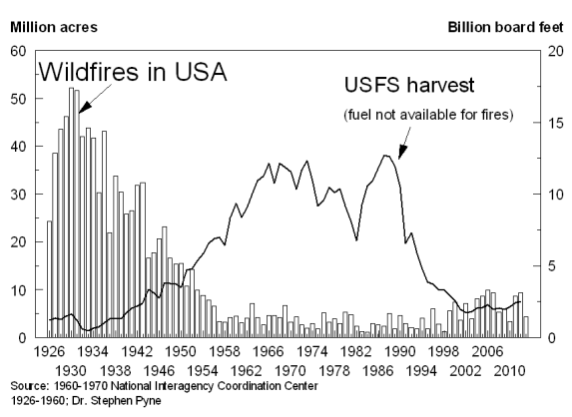
More fires in the early 20th century.

Slide 40
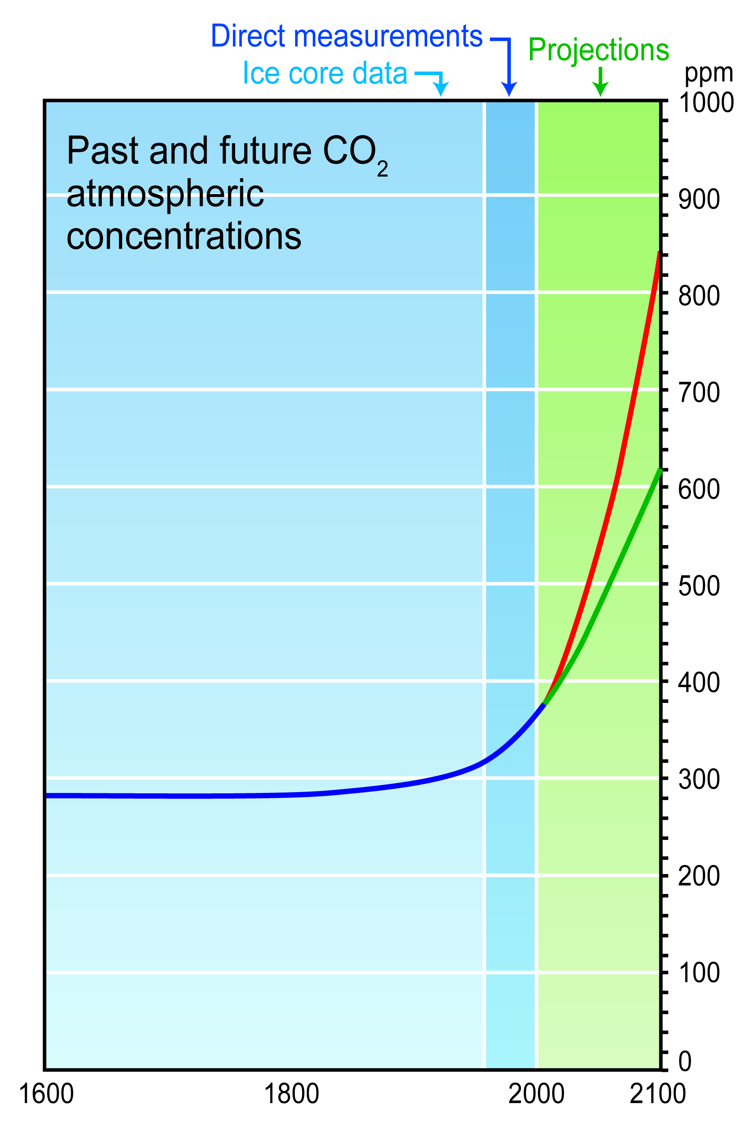
Anthropogenic Climate Change Resulting from Increasing Greenhouse Gases

Slide 41
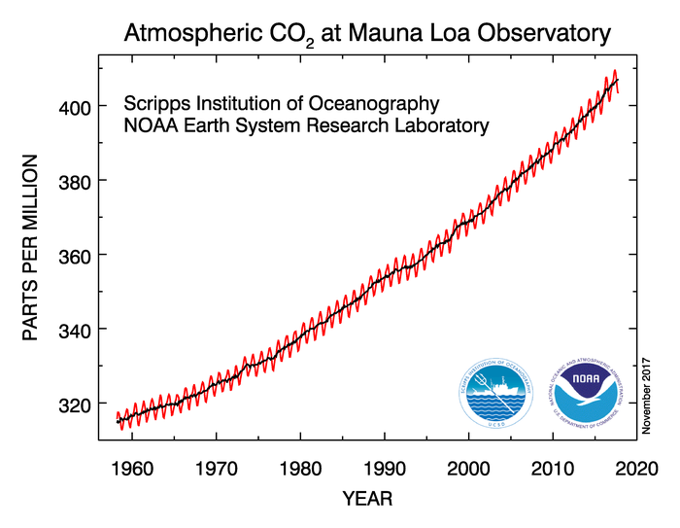
CO2 concentrations are increasing rapidly

Slide 42
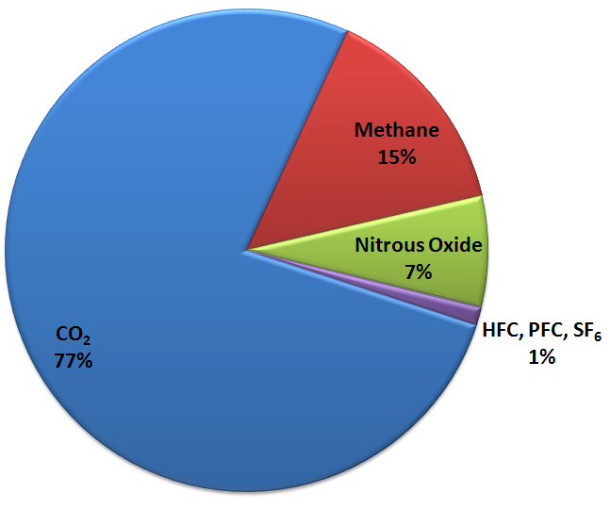
Greenhouse gases warm the planet
Carbon Dioxide
Water Vapor
Methane
Nitrous Oxide
… and others
Greenhouse Gas Emissions

Slide 43
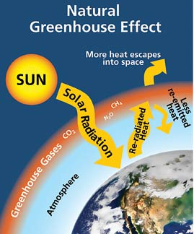
We understand the greenhouse effect
Graphic courtesy of the National Park Service

Slide 44
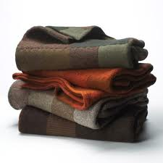
Greenhouse gases act like a blanket Thicker blankets (or more of them) make you warmer

Slide 45
Climate Change in the NW Has Been Modest So Far
Temperatures have warmed by about 1-2 F over the past 100 years. We have contributed to this.
There are also short-term ups and downs due to natural variability (e.g., the Pacific Decadal Oscillation, PDO)
There is no discernable trend in precipitation.

Slide 46
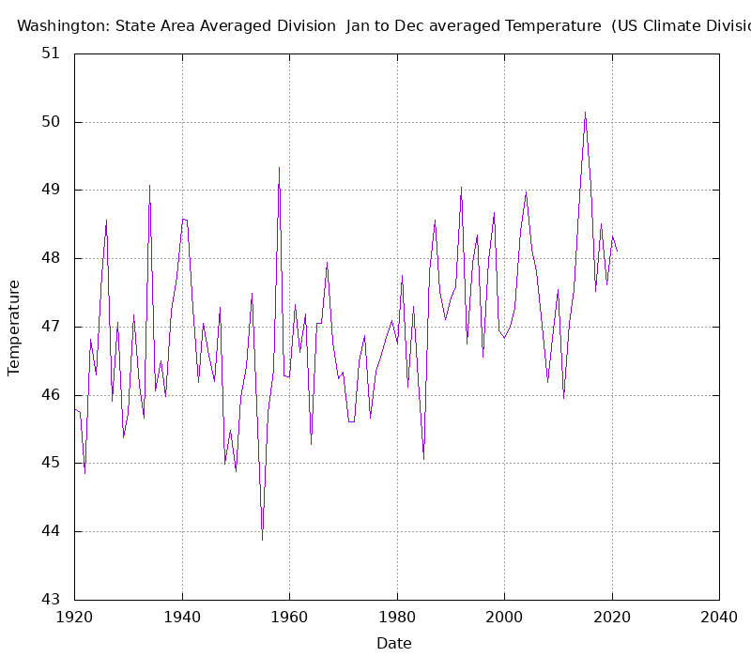
Temperature Trend for Washington
Mainly Natural
Natural & Anthropogenic

Slide 47
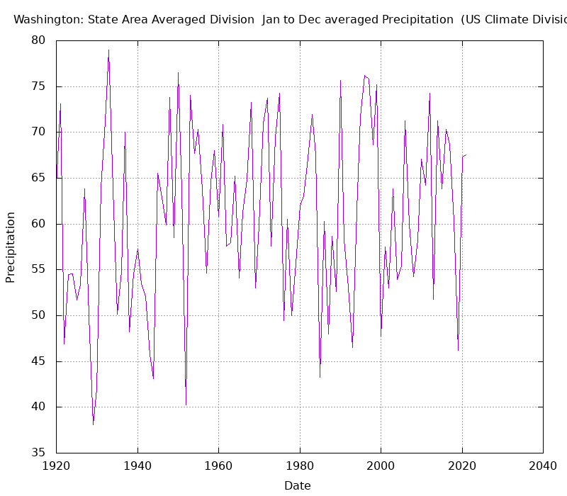
Precipitation Trend

Slide 48
Snowpack: Not Much Trend

Slide 49
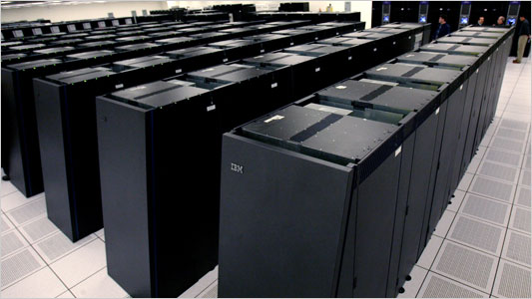
We predict the impacts of increasing greenhouse gases using global climate models
Sophisticated computer simulations based on the physics of the atmosphere and ocean.
Atmospheric parts are nearly identical to weather prediction models, which are tested every day, but with atmospheric gases vary in time.

Slide 50
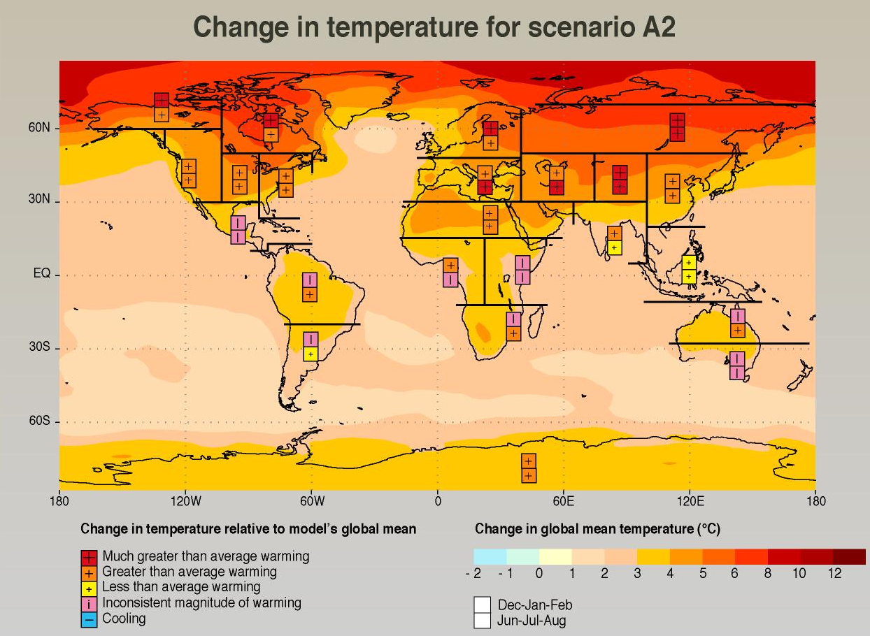
Climate Model Output for 2100 Assuming Unrealistic Increases in Greenhouse Gases
Notes:
50

Slide 51
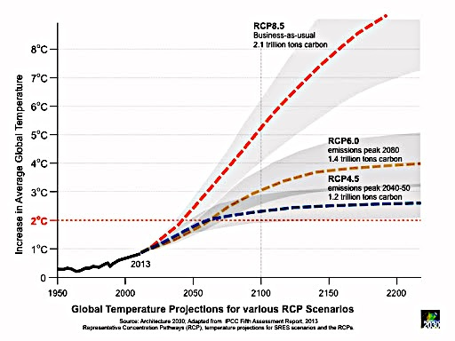
More Realistic Greenhouse Gas Future Scenarios Reduces the Warming

Slide 52
Some Local Implications of Global Warming

Slide 53
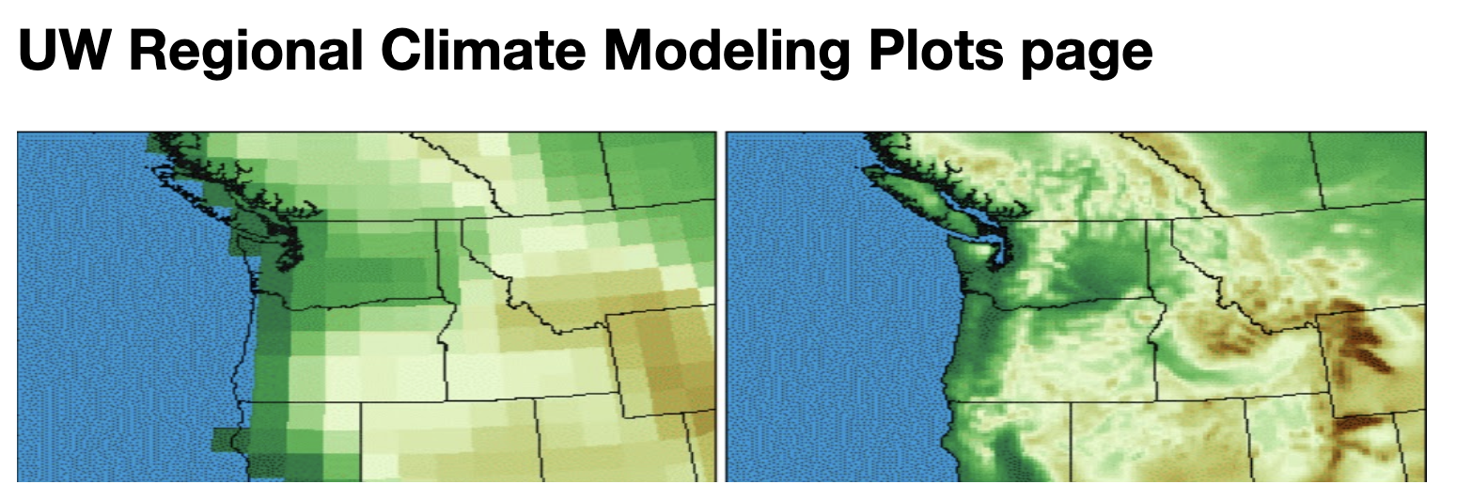
New Technology: Regional Climate Modeling

Slide 54
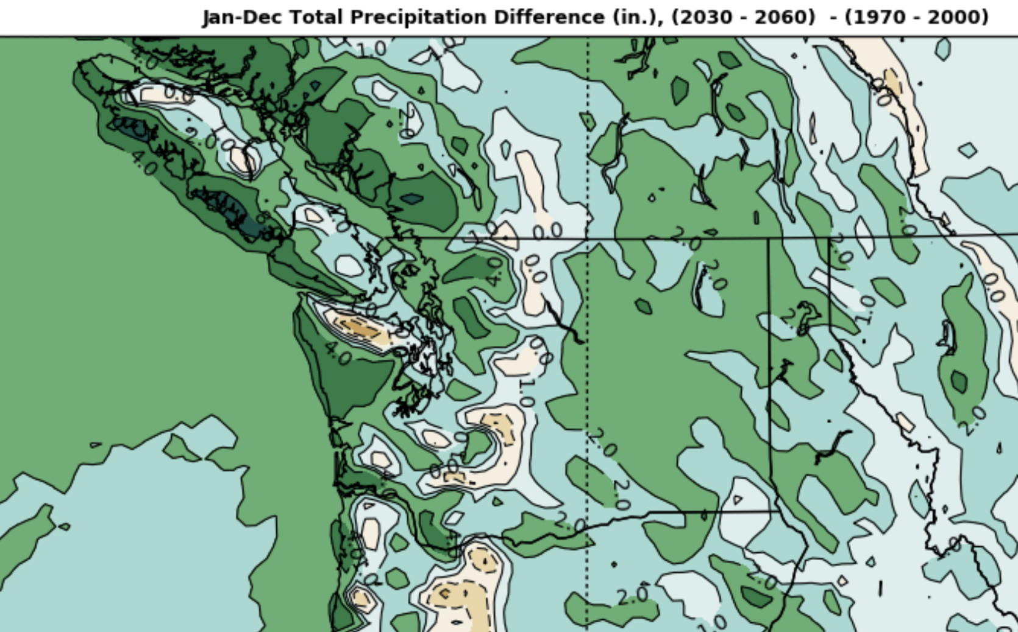
Assuming Worst Case CO2 Increases

Slide 55
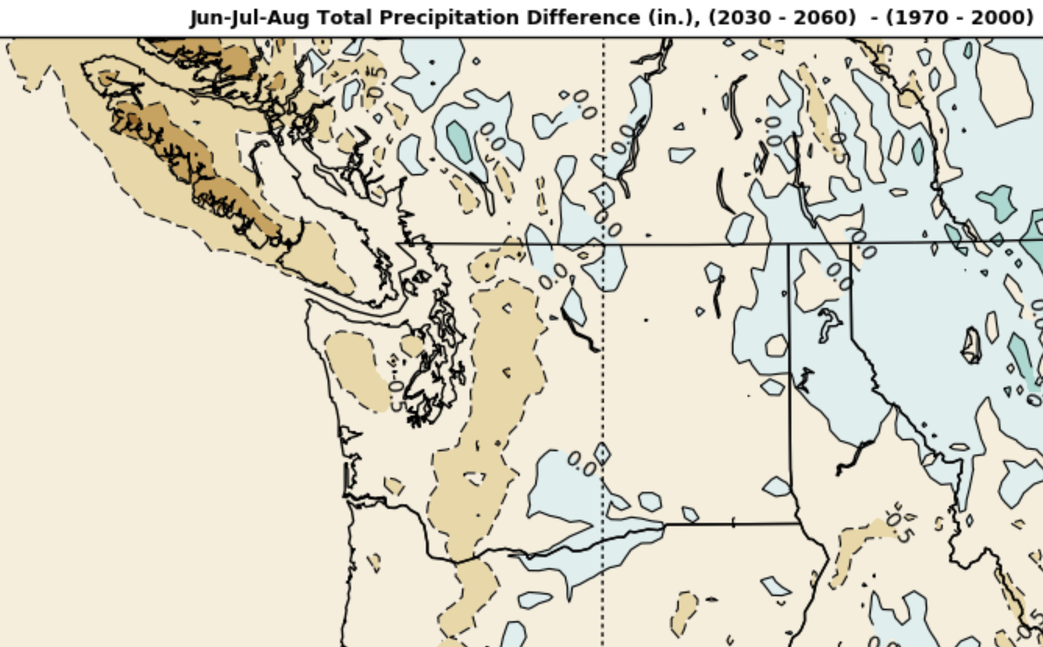

Slide 56
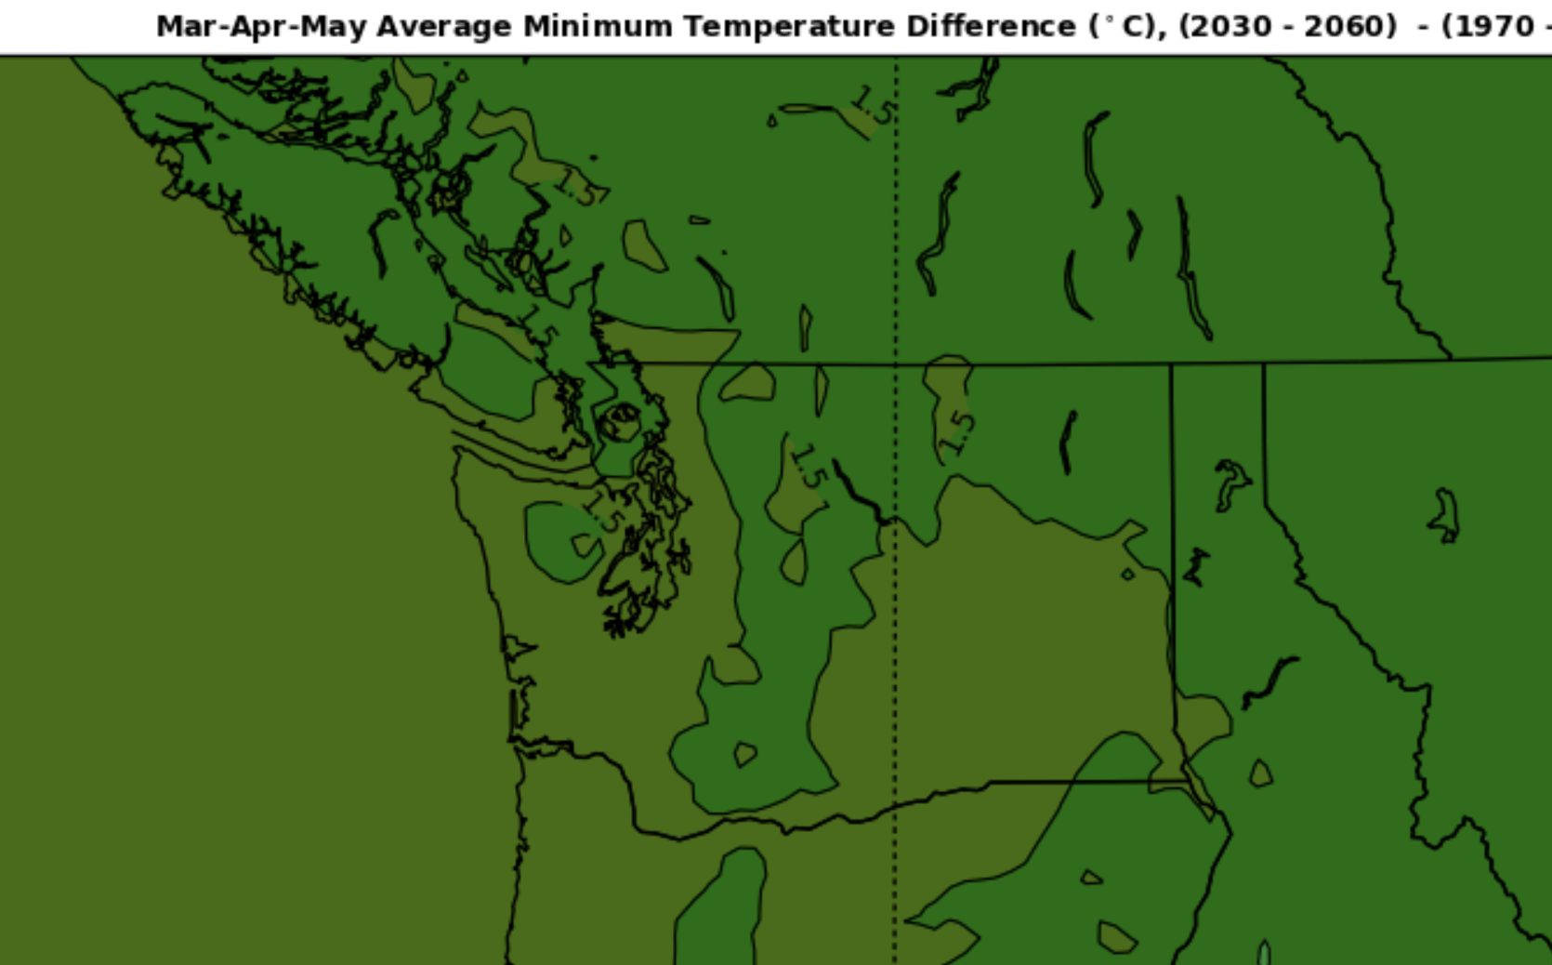

Slide 57
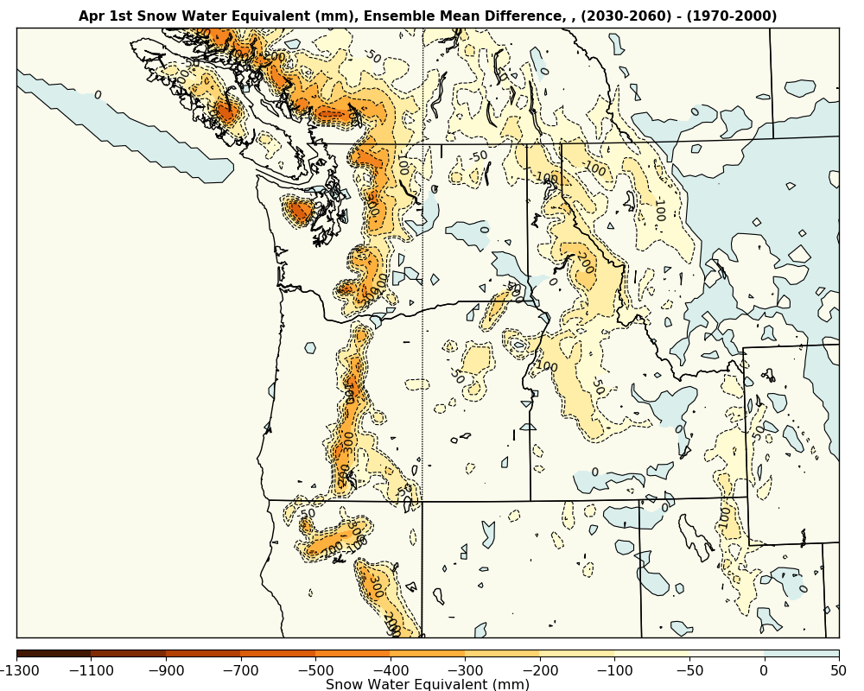
Snowpack will decline 30-50% by the end of the century

Slide 58
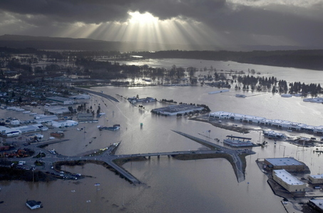
More extreme precipitation and flooding

Slide 59
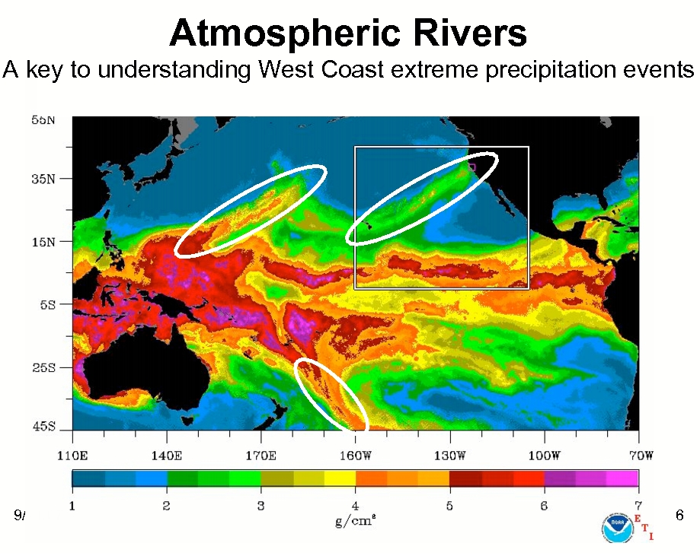
Enhanced Atmospheric Rivers

Slide 60
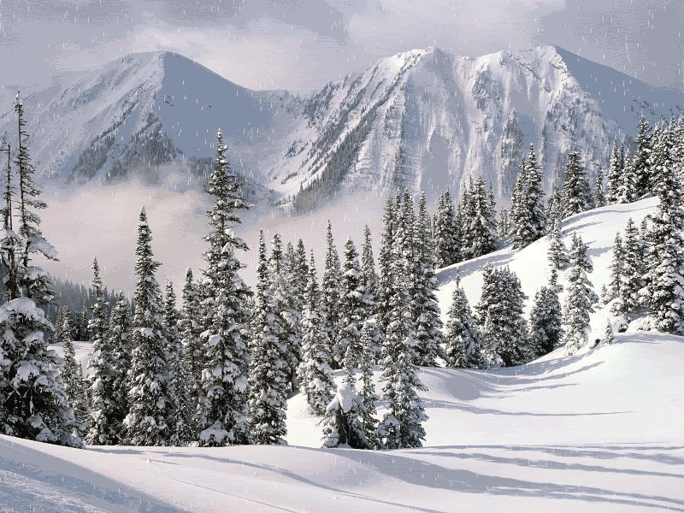
Global warming will intensify atmospheric rivers
Warmer air holds more water vapor.
Extreme precipitation will increase about 20% if we keep on the current pathway.
Less snow to absorb heavy rain in the mountains.
Both effects will lead to more
flooding

Slide 61
Are Recent Extreme Weather Situations the Result of Global Warming?
June 2021 Heat Wave
April 2022 cold wave
December 2021 Flooding

Slide 62
The Answer is Generally No
Natural variability is the dominant cause.

Slide 63
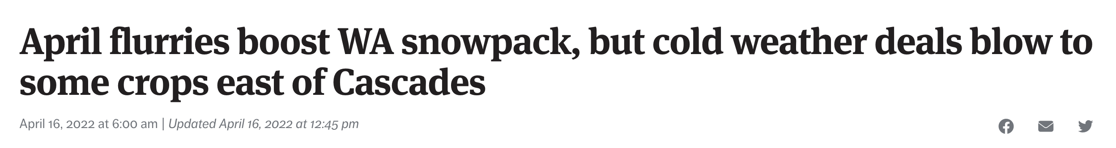
April 2022 Was Cold on the Eastern Slopes of the Cascades

Slide 64

Cold, But Not Unprecedented for Monthly Averages

Slide 65


But extreme lows for daily

Slide 66

Many folks are suggesting that these events are tied together, the result of climate change/global warming
What do observations and best science say about this?
What are the origins of these features?
How unusual are they?
To what degree does global warming contribute?

Slide 67

Extraordinary High Temperatures
SeaTac hit 108F, beating the previous record of 103F.
Olympia reached 109F, exceeding the previous record of 105F
Quillayute, on the WA coast, zoomed to 110F, absolutely smashing the previous record of 99F
Portland hit 116F, incinerating the previous record of 107F.
In eastern Washington, Dallesport tied the all-time state record of 118F
East of I5, many locations in western Washington exceeded 110F

Slide 68


How much of the heat wave was related to global warming?

Slide 69

High Temps Over the State Have Warmed 1-2F over the Past Century
A substantial proportion of that that temperature increase is probably due to global
warming

Slide 70

But temperatures on June 28th were approximately 30F above normal.
Global warming contributed a small amount to the heat wave but we would have still had a record-breaking extreme heat wave with it.
A number of moving pieces came together randomly to create record breaking heat.

Slide 71

Another way to see that global warming was not the cause: there is no trend toward more record high temperatures in the region

Slide 72

Northwest Washington Flooding: November 15-30

Slide 73

Associated with heavy rainfall from a moderate atmospheric river

Slide 74


Flooding is Not New to the Region
February 2, 2020

Slide 75

Huge Three Day Totals (Nov 13-16)

Slide 76

Very Well Forecast by Forecast Models

Slide 77


No trend in annual maximum daily precipitation in the region

Slide 78

Regional Climate Models Driven By Increased Greenhouse Gases Don’t Suggest Wetter Conditions at this Time

Slide 79


No Factual Support for these Headlines

Slide 80

Global Warming is NOT an Existential Threat
International Panel on Climate Change (IPCC), a consensus view of many scientists and nations
GWP would be reduced 2.4% for a substantially greater income in 2100.
Fourth U.S. National Climate Assessment
Damage to the U.S. economy in 2100 would be about a 1% loss the substantially great GDP in 2100.

Slide 81

With some global warming guaranteed in the short term, can work on adaptation and resilience
Make civilization more robust to climate change
Here in the NW this means dealing with flooding, water resources (bigger reservoirs), and fixing our forests.

Slide 82

May Need to Build More Reservoirs

Slide 83

Need to Expand Nuclear Power and Renewables Where Viable

Slide 84
The End

