Slide 1
Upper Air Observations
The atmosphere is 3D and cannot be understood or forecast using surface data alone
How do we know what is happening aloft?
ATM 101Y2025

Slide 2
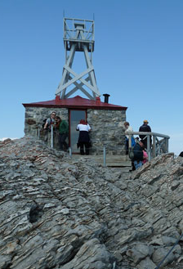
Early Upper-Air Observations
(late 1800s, early 1900s)
Mountain weather stations
Manned balloons
Weather kites

Slide 3
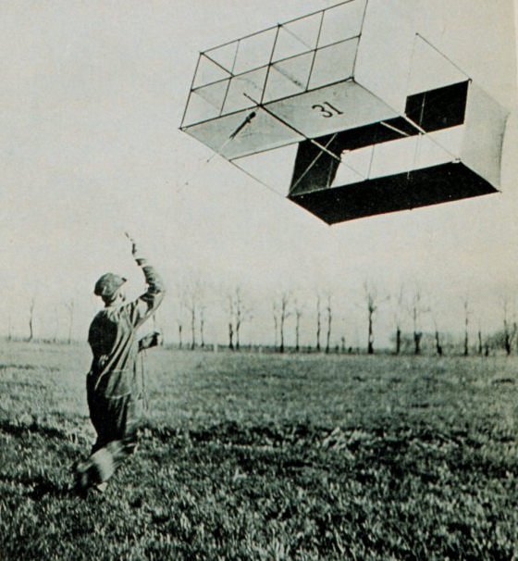
Weather Kite

Slide 4
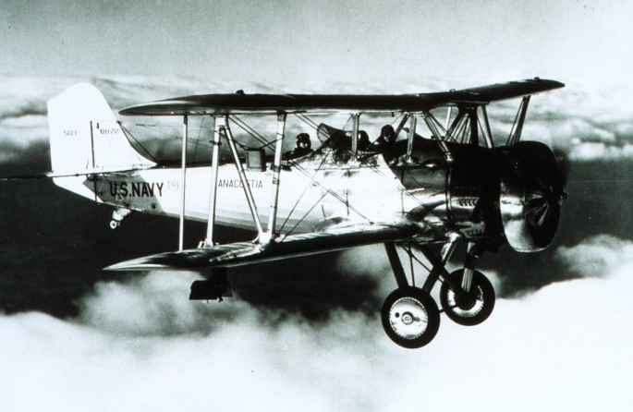
Aircraft Observations
Manned aircraft observations (1905-1940)
Problem: could not fly in stormy weather
Problem: Didn’t go that high
Navy bi-plane with meteograph on the wing, taking meteorological measurements for pressure, temperature, and humidity

Slide 5
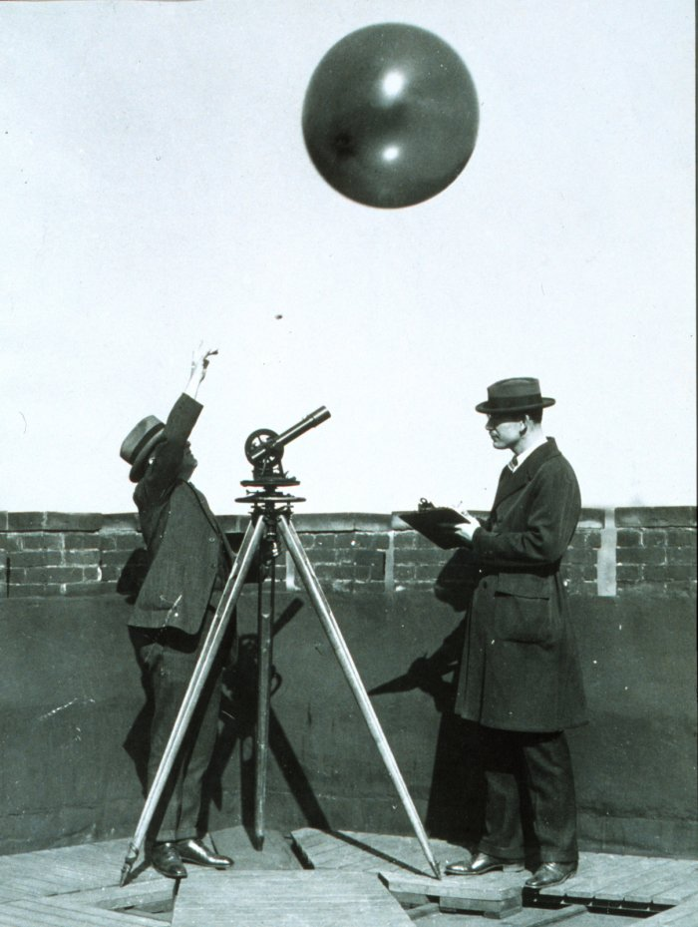
Pilot Balloons (PIBALS) Provided Winds Aloft

Slide 6
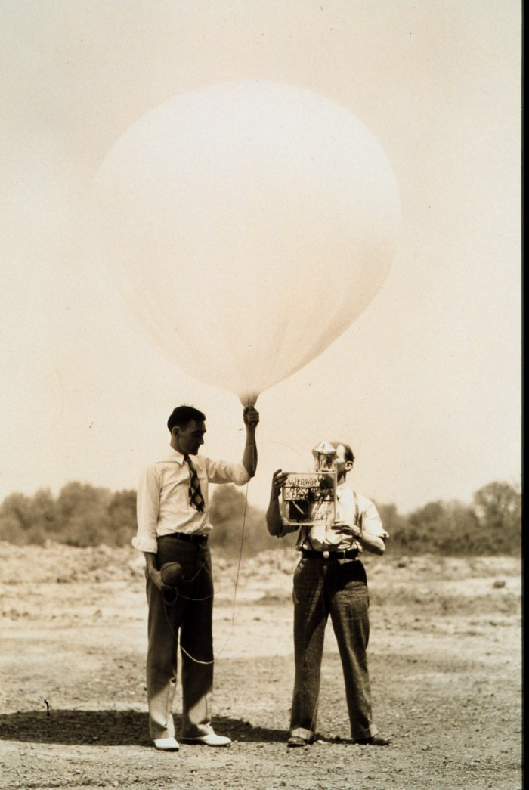
The Big Breakthrough: The Radiosonde
A radiosonde is a portable weather station lifted by a balloon.
Sends observations back by radio.
The first instrument launched on January 7, 1929.

Slide 7
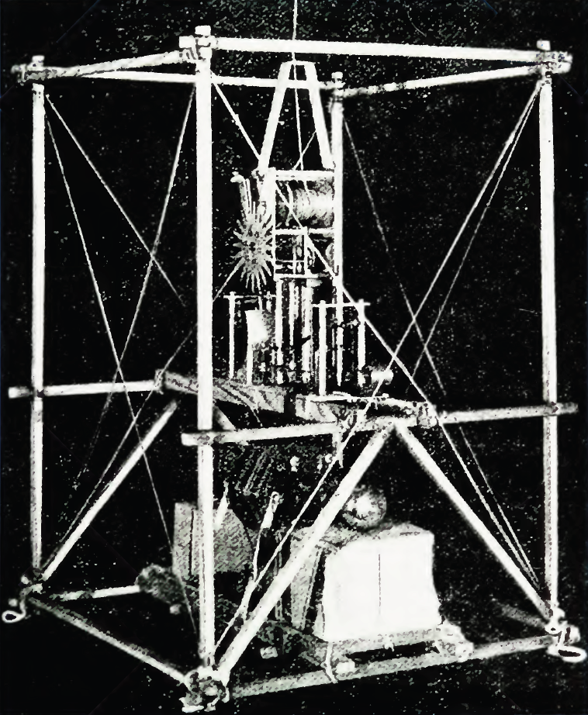
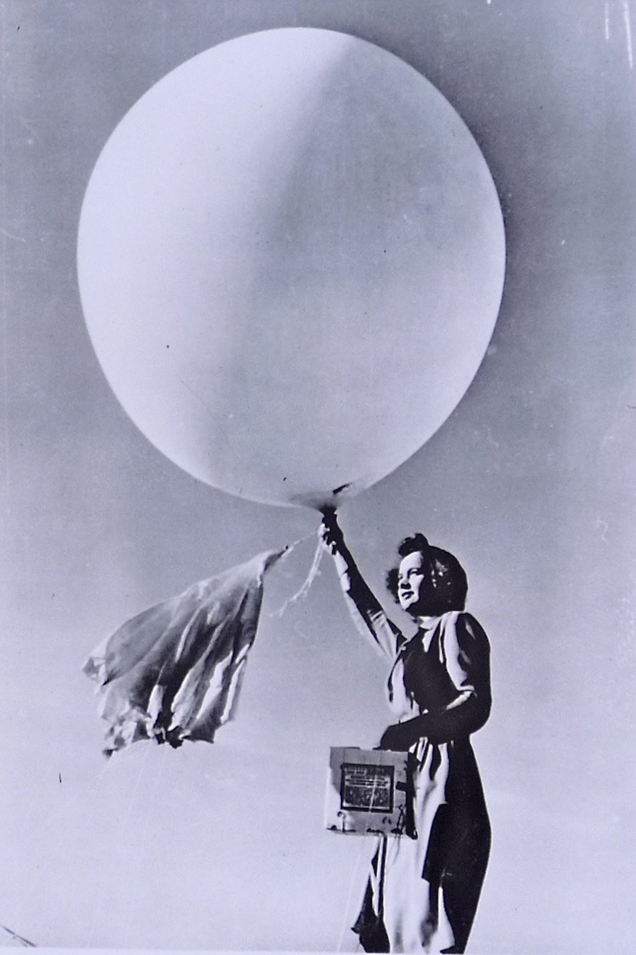
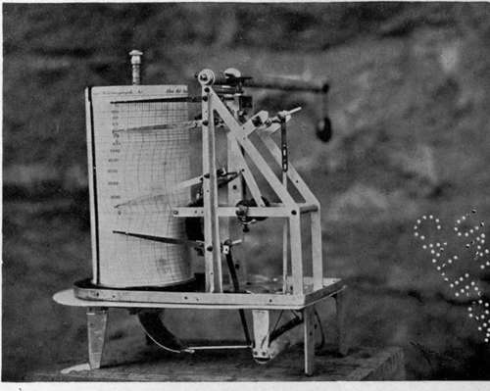

Slide 8
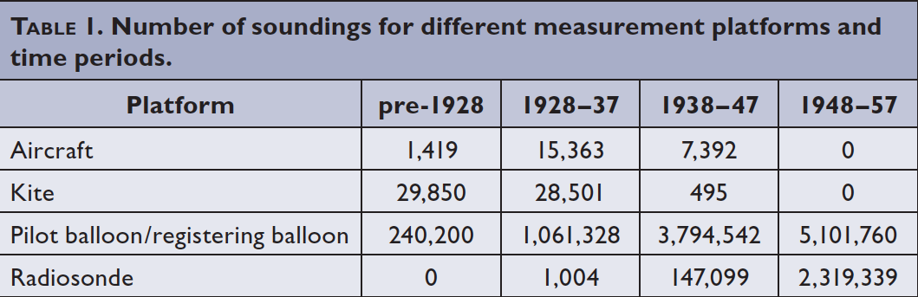
Rapid Expansion of the Upper Air Network During the 1930s and 1940s.

Slide 9
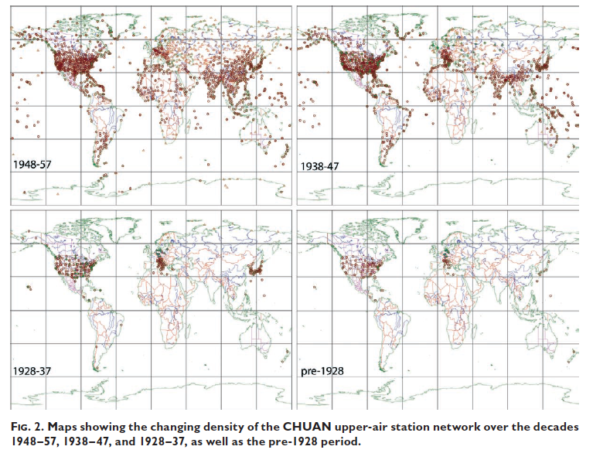

Slide 10
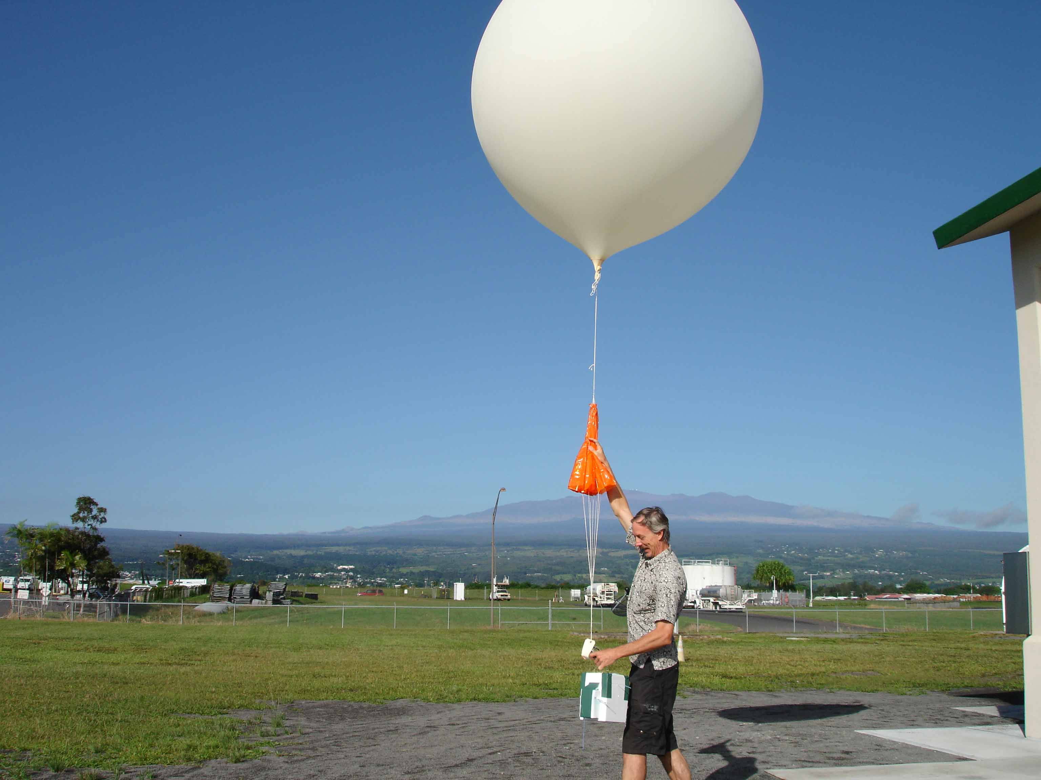
Modern Radiosonde

Slide 11
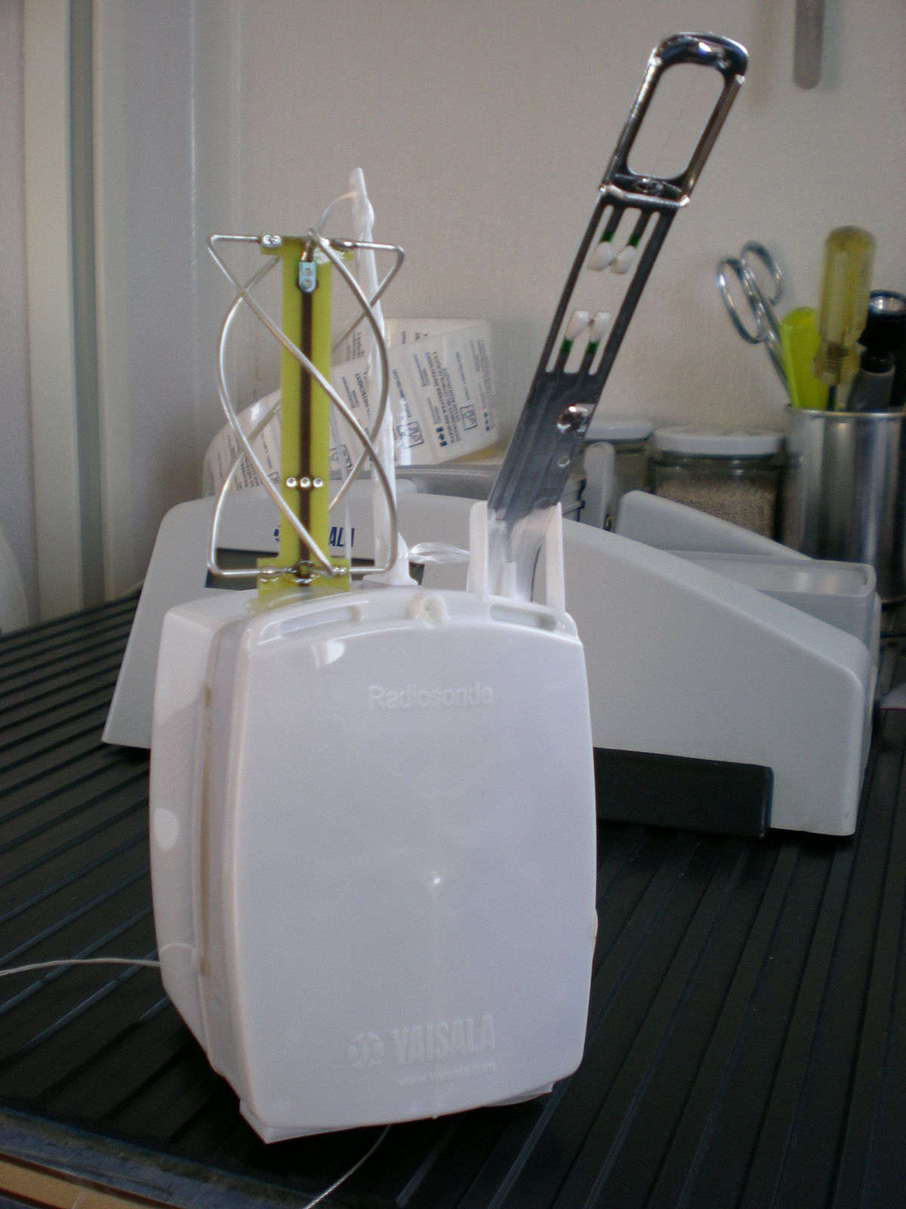

Slide 12
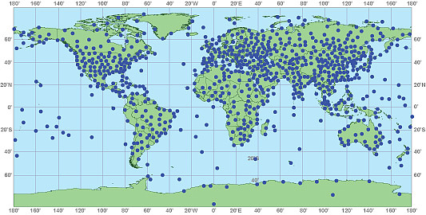
Generally twice a day at 00 and 12 UTC
About 1000 locations around the world

Slide 13
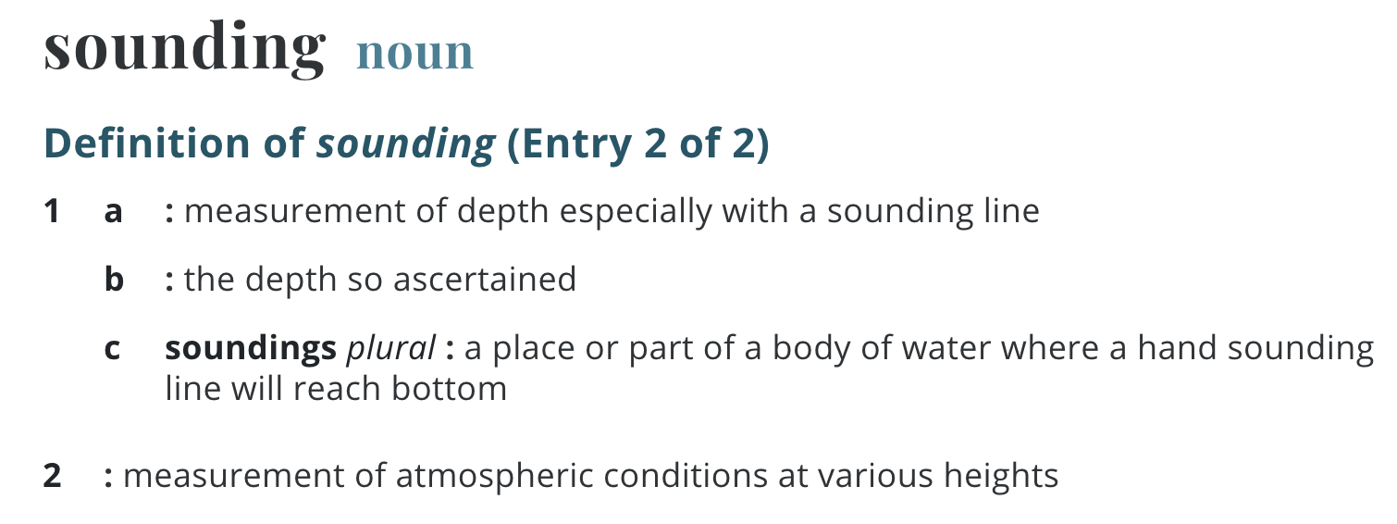
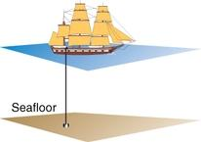
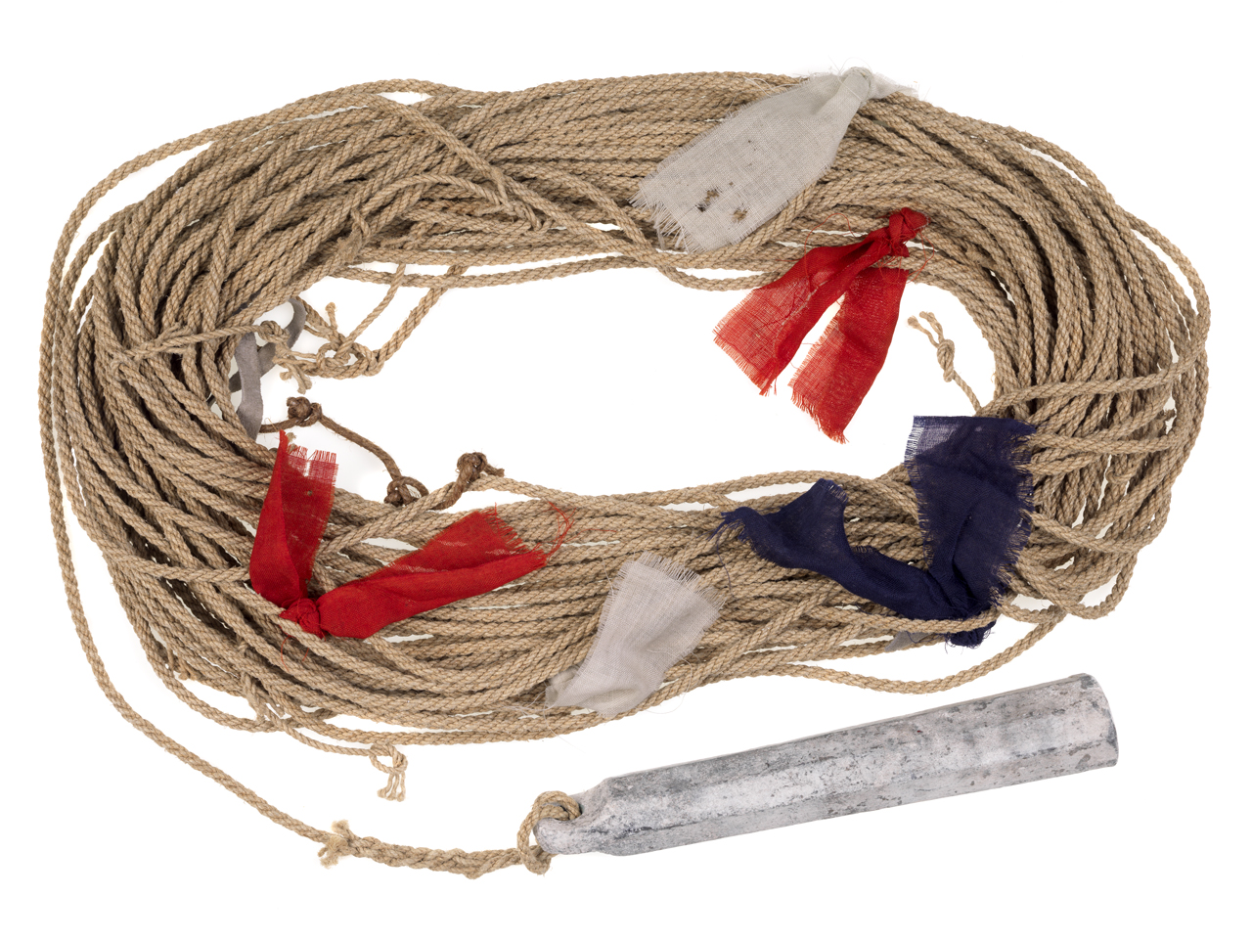
Terminology: vertical sounding

Slide 14
Radiosonde believe it or not…
A typical NWS radiosonde sounding ascent can last in excess of two hours.
In that time, the radiosonde can ascend to an altitude exceeding 35 km (about 115,000 feet) and drift more than 300 km (about 180 miles) from the release point.
Typical pressure at balloon burst is about 5 hPa (1/200th of surface pressure).

Slide 15
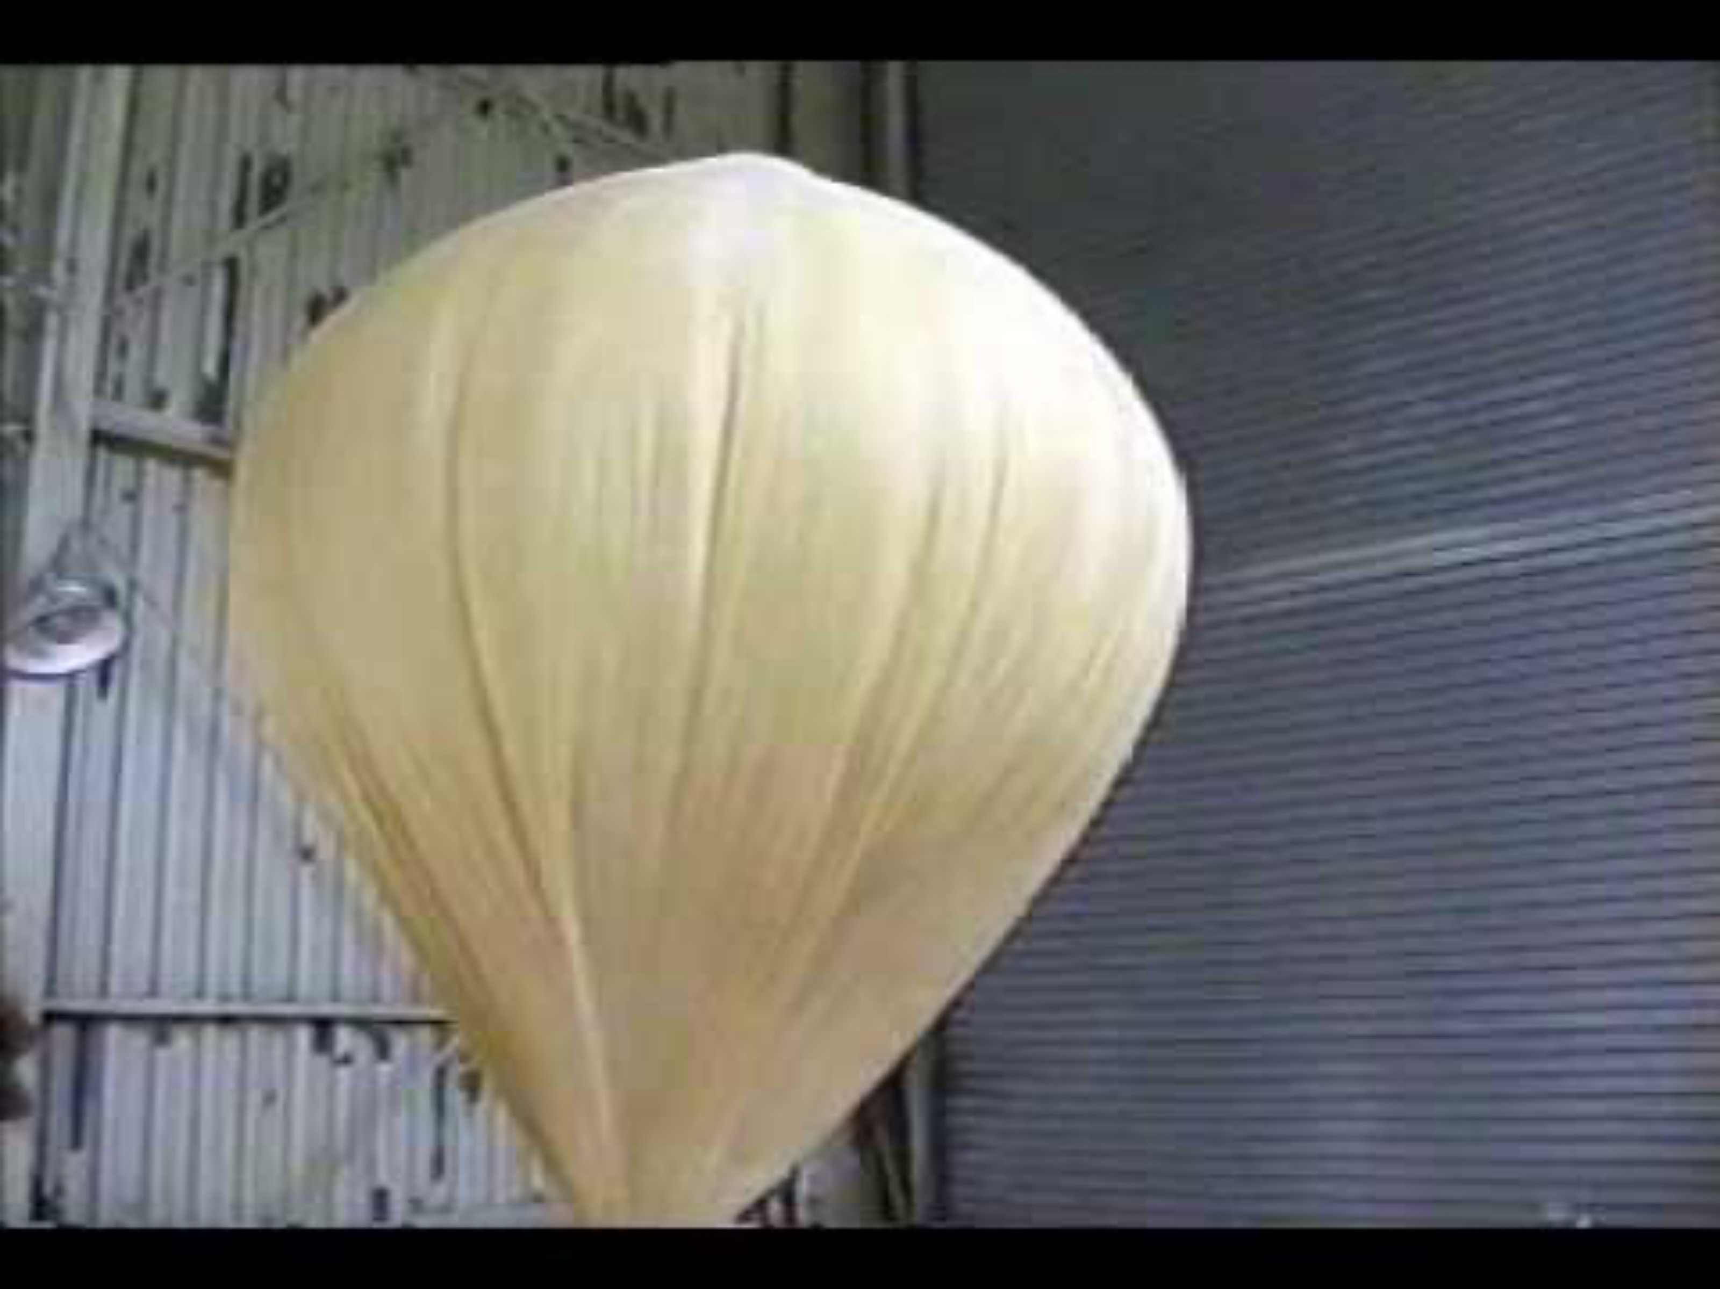

Slide 16
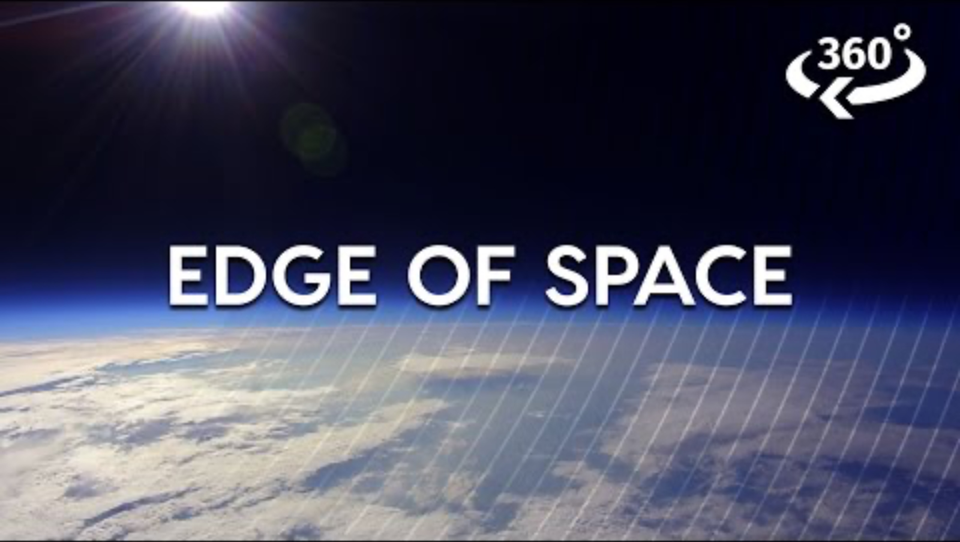

Slide 17
Radiosonde Videos
http://www.youtube.com/watch?v=jGQWUFEMxT8
Cam on radiosonde
https://www.youtube.com/watch?v=pCve1w1GFOs
https://www.youtube.com/watch?v=jXP-va2t4D8
Full flight:
https://www.youtube.com/watch?v=xkFsy-u3dDo
https://www.youtube.com/watch?v=9CjjbauSvBE

Slide 18

ACARS: Aircraft Observations
Aircraft Communications Addressing and Reporting System

Slide 20
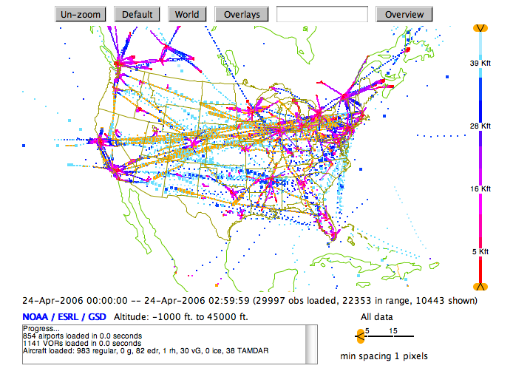

Slide 21
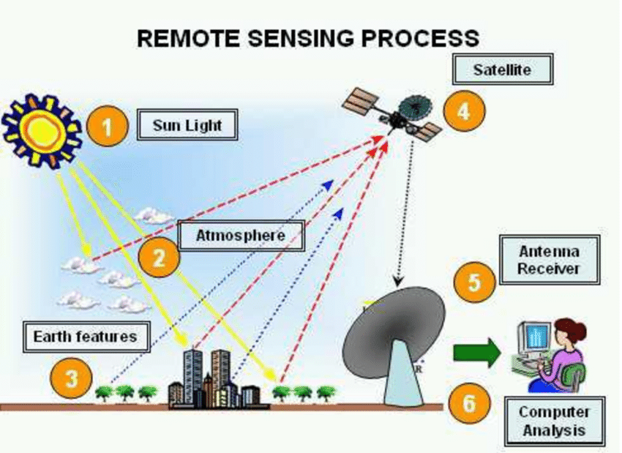
Remote Sensing of Upper Atmosphere
Remote Sensing: determining atmospheric properties remotely

Slide 22
Satellite Data
Geostationary and Polar Orbiting Satellites

Slide 23
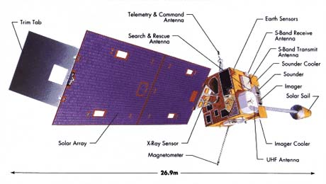
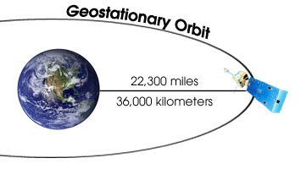

Slide 24
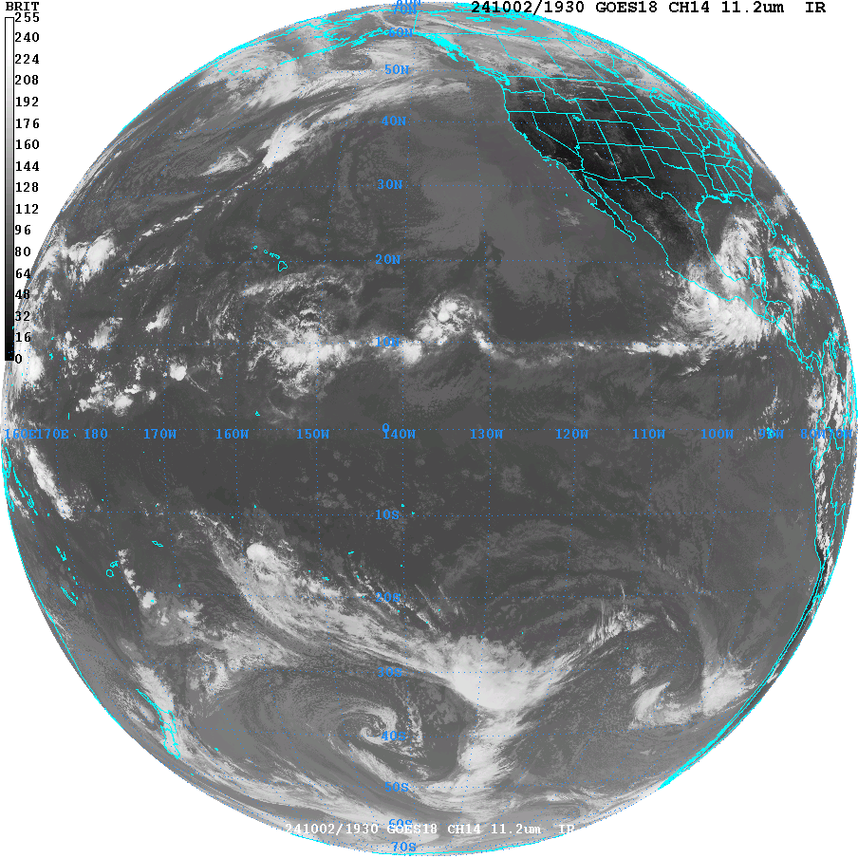
Satellite Can Tell Us Where Clouds and Storms are Found

Slide 25
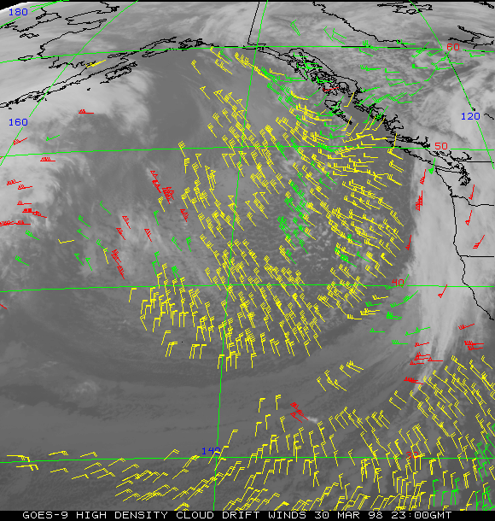
And much more: Cloud and
Water Vapor
Track Winds
Based on Geostationary Weather Satellites

Slide 26
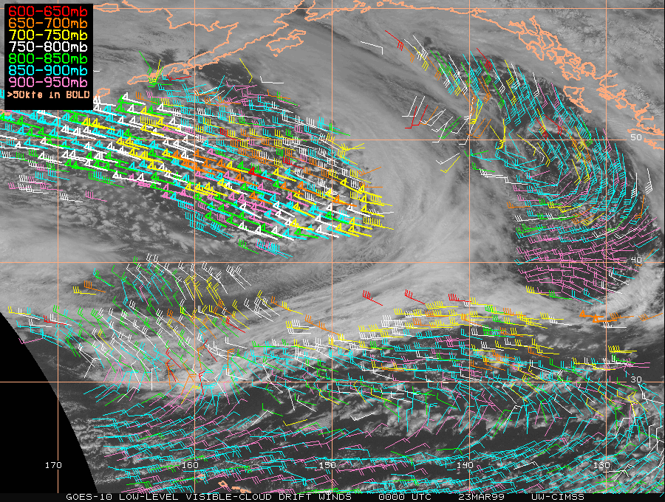

Slide 27
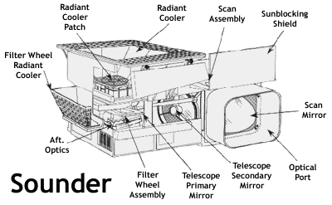
Satellite sounder unit: senses radiation coming up from the atmosphere below and relates that to atmospheric structure

Slide 28
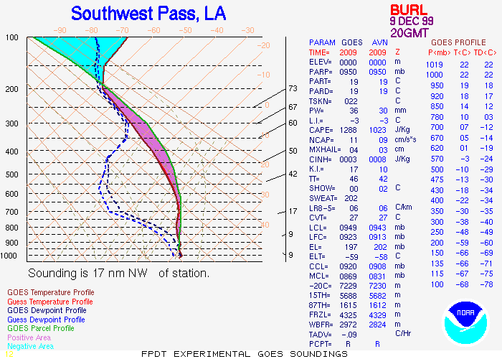
Satellite Temperature and Humidity Soundings

Slide 29
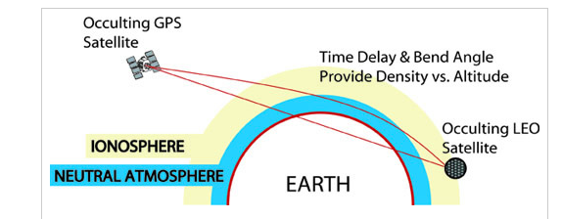
Global Positioning System (GPS) Soundings
A constellation of GPS satellites orbit the earth.
Other satellites can receive the GPS signal
By measuring the delay in time as the GPS signal is bent by the earth’s atmosphere, one can acquire density information that can be used to create temperature and humidity soundings.

Slide 30
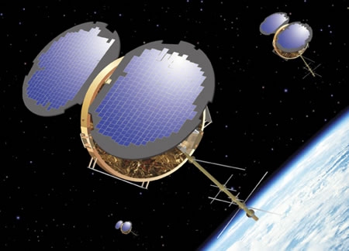
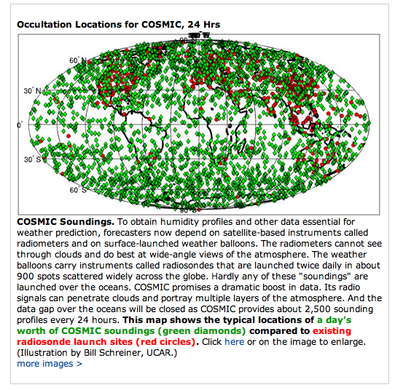

Slide 31

With radiosondes, aircraft data, and satellite data, meteorologists have a fully three-dimensional picture of atmosphere structure, for the ENTIRE planet.

Slide 32
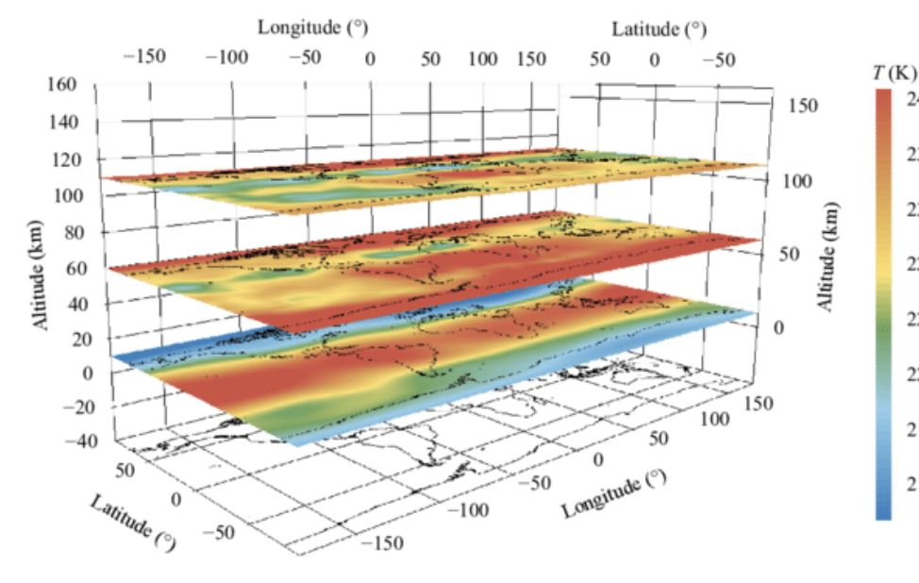
Meteorologists Use Upper Level Charts to Visualize the 3D Atmosphere

Slide 33
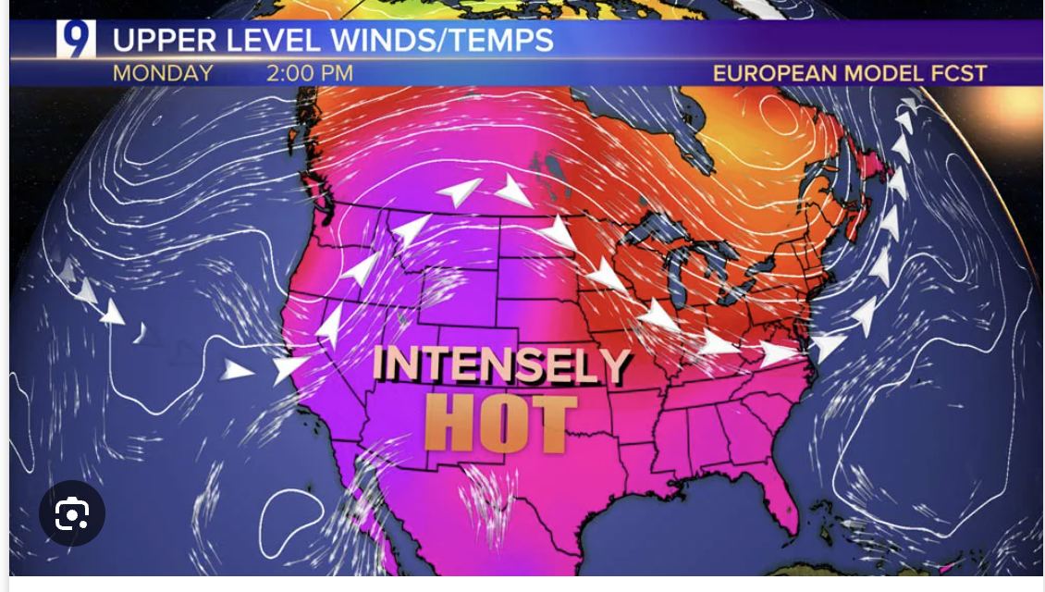
Sometimes upper level weather maps on shown on TV

Slide 34
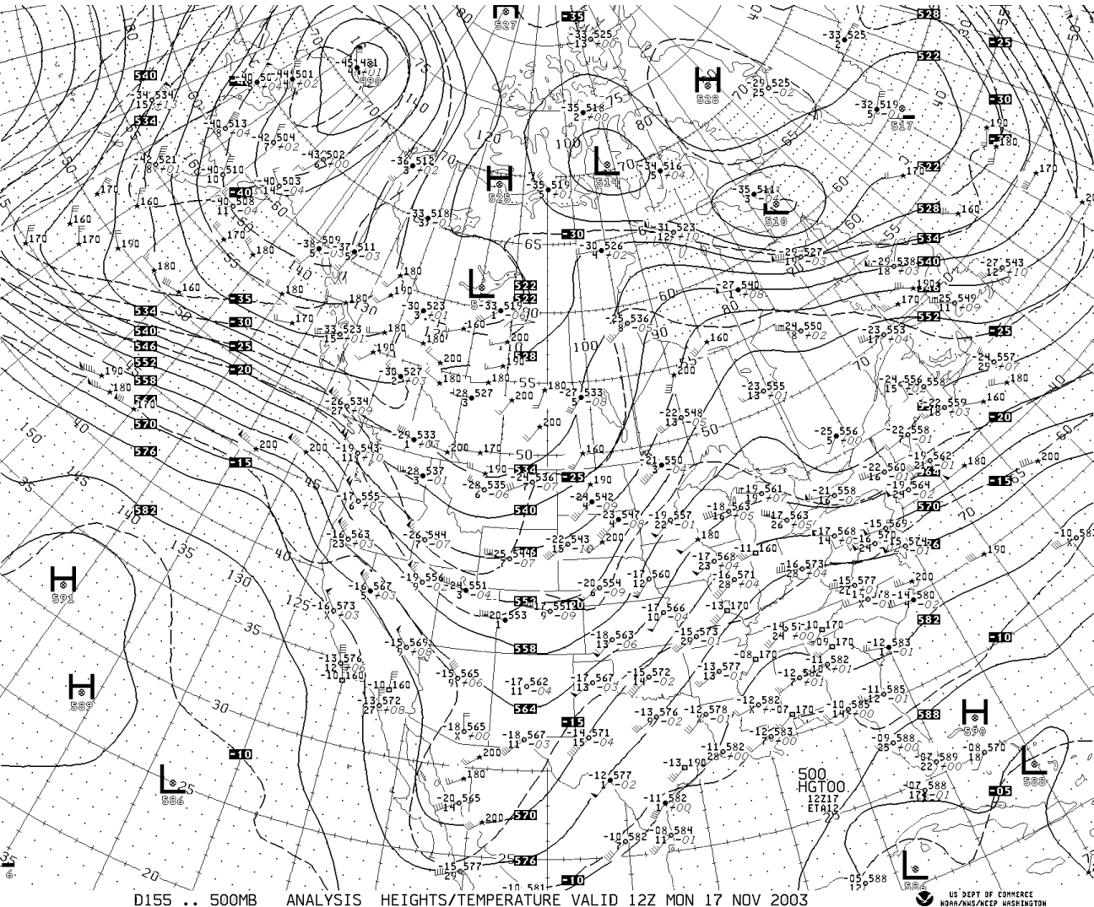
Upper
Level
Chart

Slide 35
Upper-Level Charts or Maps
Upper-level charts describe atmospheric structures aloft.
They have one major difference with surface charts
  Surface charts present pressure at a constant height (sea level)
  Upper-level charts give the height of a pressure surface above sea level.

Slide 36
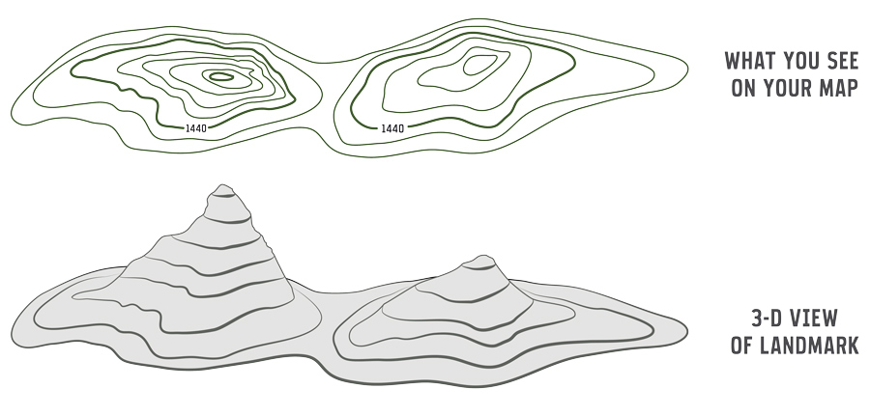
Like a topographic map

Slide 37
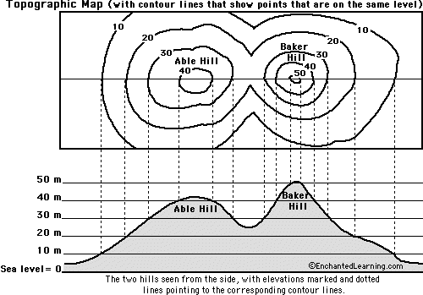

Slide 38
On an upper level chart we give the height of a certain pressure above sea level.

Slide 39
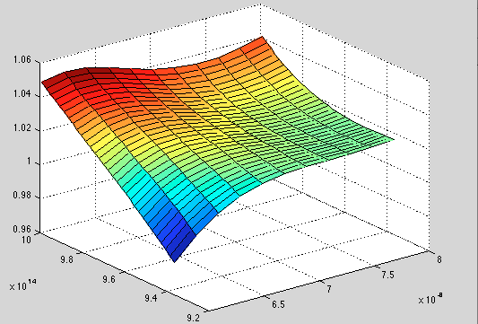
H
500 hPa
L
Sea level

Slide 40
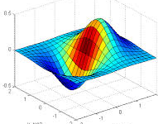
Ridge
H
Trough
L

Slide 41
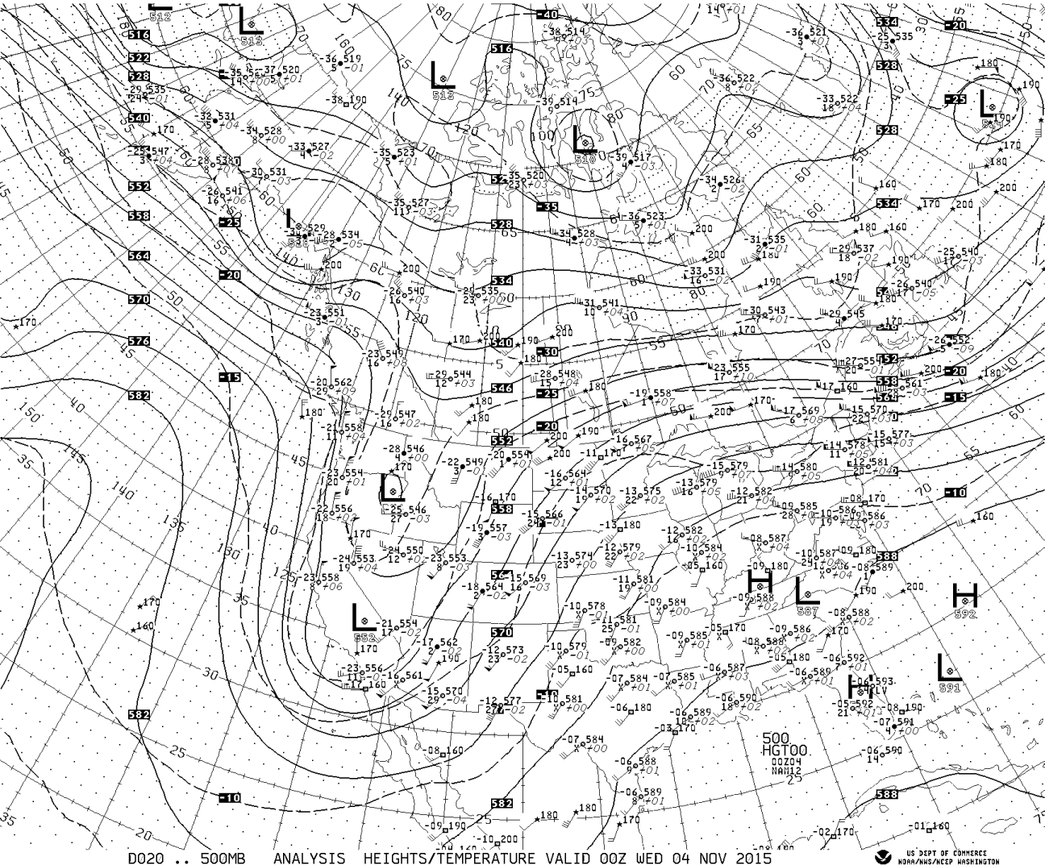
500 hPa (mb)

Slide 42
Upper Level Charts Give the Heights above Sea Level of a Certain Pressure
Essentially how a pressure level undulates in 3D space
Typical levels used for these charts include:
  850 hPa ~5000 ft, 1.5 km ASL (above sea level)
  700 hPa ~10,000 ft, 3 km ASL
  500 hPa ~18,000 ft, 5.5 km ASL
  250 hPa ~34,000 ft, 10.5 km ASL

Slide 43
500 hPa (mb, hPa)—lines are heights above SL

Slide 44
Upper Level Charts
Ridges are regions of higher heights (often indicated by a H). Where the pressure surface bulges upwards.
Troughs are regions of lower heights (often indicated by L). Where the pressure surface bulges downward.
Also show temperature (C) with dashed lines.
Upper level station model

Slide 45
Ridge
Ridge
Trough
500 hPa (mb, hPa)—lines are heights above SL

Slide 46
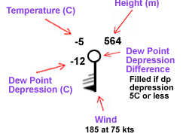
Upper level charts have their own station model
Heights in decameters-multiply by ten to get meters (solid lines)
Temperatures in Celcius/Centigrade (C)-dashed lines.
Dew point depression is shown (difference between temperature and dew point)

Slide 47
500 hPa (mb)

Slide 48
Key Ideas about Upper-Level Charts
Height lines are very nearly parallel to the wind direction, with higher heights to the right of wind direction
L
500 hPa upper chart
5460 m
5520 m
H

Slide 49
Key Ideas
The closer the height lines, and thus the greater the horizonal gradient, the stronger the winds (note the lines have a standard contour interval, 60 m at 500 hPa)
Thus, areas of strong winds aloft, such as the jet stream, can be easily spotted using height lines on upper level charts!

Slide 50
STRONG WINDS
WEAK WINDS
500 hPa (mb)

Slide 51
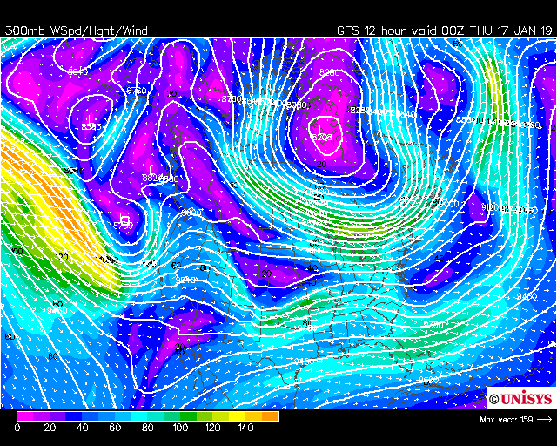

Slide 52
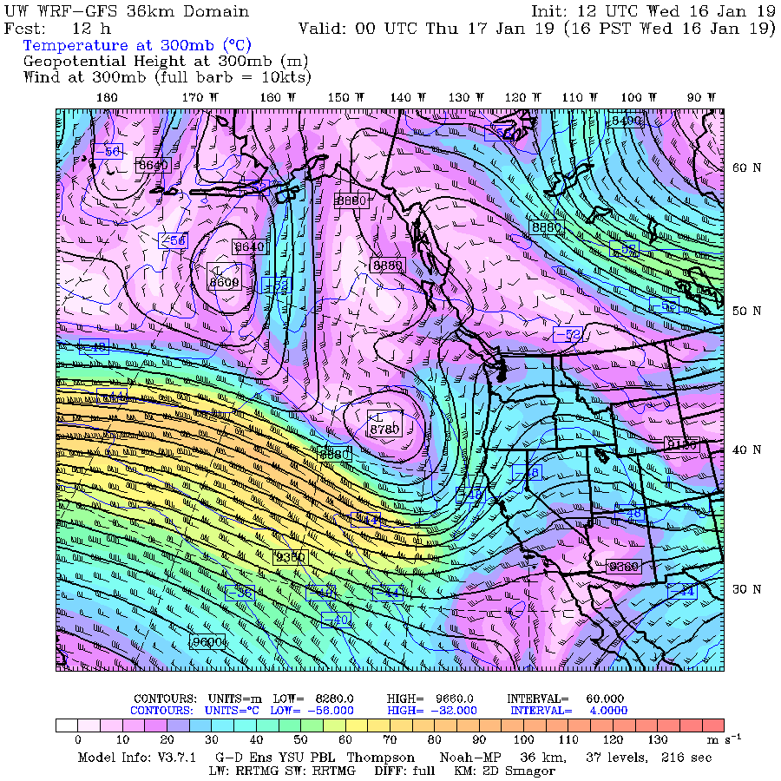

Slide 53
Often wave-like undulations in the height lines, with ridges and troughs

Slide 54
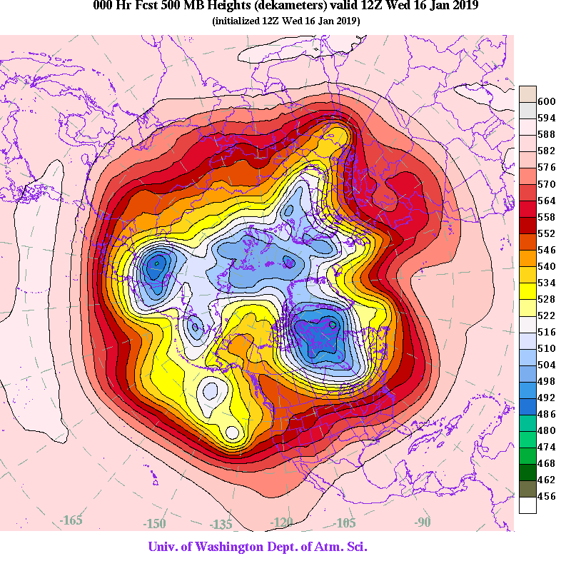

Slide 55
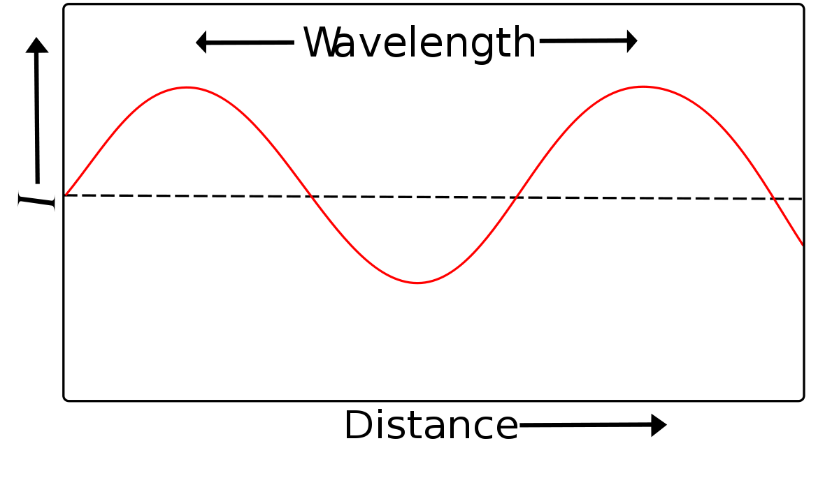
These wavelike undulations can be characterized by their wavelength
(distance from ridge to ridge or trough to trough)

Slide 56
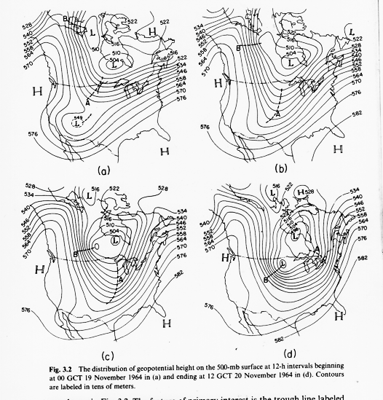
Appears to be two distinct scales of upper level waves
Long waves: wavelength (λ) of 5-10K km (3-6 K miles)
Short waves: wavelength (λ) of 1-4K km (.6-3 K miles)

Slide 57
Why do we care?
Short wave troughs are associated with low-level weather systems (e.g., midlatitude cyclones are associated with upper-level short wave troughs)
Short waves tend to move through long waves, thus giving us an idea where weather systems will be moving!

Slide 59
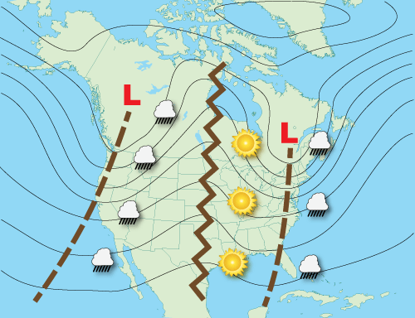
Upper Level Waves are Connected with Weather
Clouds and precipitation tend to be east of troughs
Sun and good weather east of ridges

Slide 60
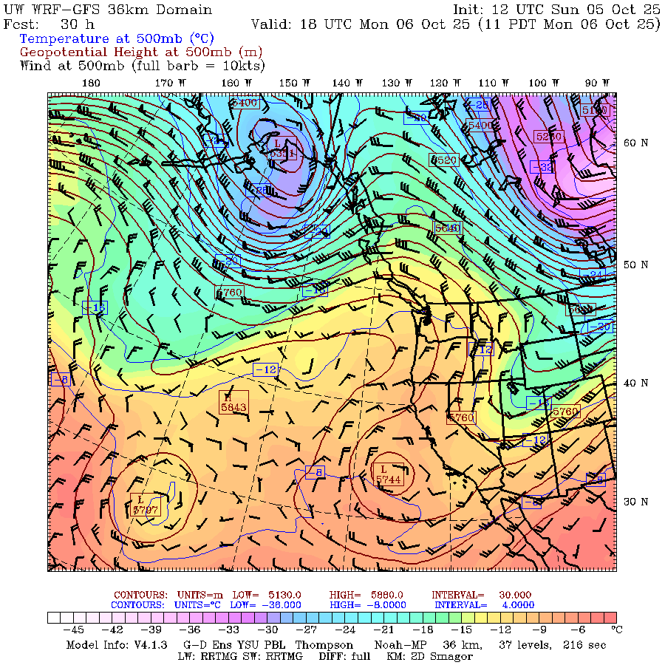

Slide 61
https://a.atmos.washington.edu/data/vmaproom/

