Slide 1
Vorticity
Atmospheric Sciences 370
Winter 2025

Slide 2
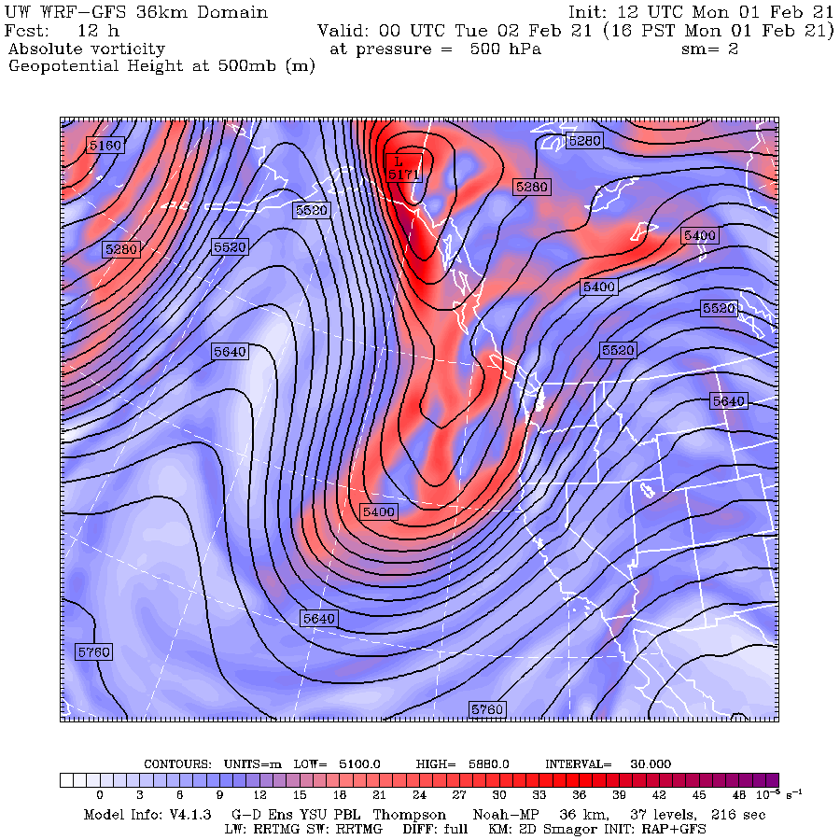
Many weather maps and forecast charts show vorticity—a measure of atmospheric rotation around a vertical axis.

Slide 3

Rotation is a fundamental aspect of the atmosphere
Cyclones rotate counterclockwise (NH)
Anticyclones rotate clockwise (NH)
Rotation is connected with other important aspects of the atmosphere (e.g., vertical motion)
As we shall see, vorticity is a measure of local rotation that is frequently used.

Slide 4
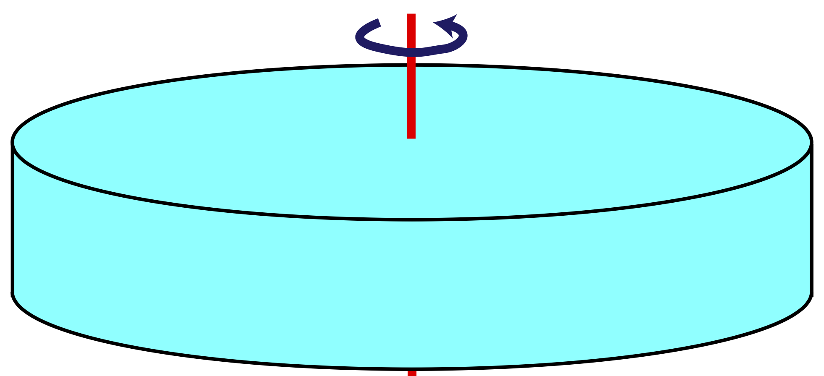
The rotation of a solid body is characterized by a single angular velocity (ω) about an axis of rotation
ω

Slide 5

The atmosphere is a fluid and each point of the fluid can move relative to others and possess different motions and angular velocities.
So, in the atmosphere we need to define rotation at individual points. Called vorticity.
Atmospheric rotation is a “microscopic” or a point quantity versus being a “macroscopic” quality, representative of a solid body

Slide 6
Local spin or vorticity can be defined for any direction but most frequently in synoptic meteorology we discuss vorticity around a vertical (z) axis
z

Slide 7
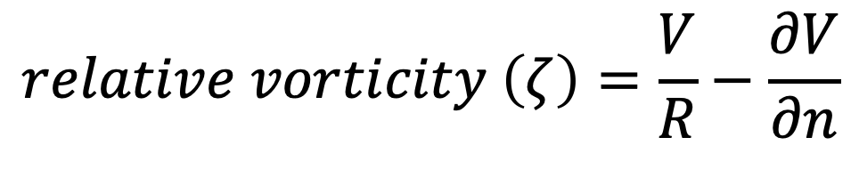
Relative vorticity: vorticity around a vertical axis relative to the earth’s surface
In natural coordinates, can be expressed as:
$$relative vorticity \left(ζ\right)=\frac{V}{R}−\frac{∂V}{∂n}$$
Where the Greek letter zeta represents relative vorticity, R is the radius of curvature of the parcel trajectory going through a point, V is the wind speed along the direction of motion and the n direction is normal to the direction of motion

Slide 8
Review: Natural Coordinates
n
V, Wind vector
s

Slide 9
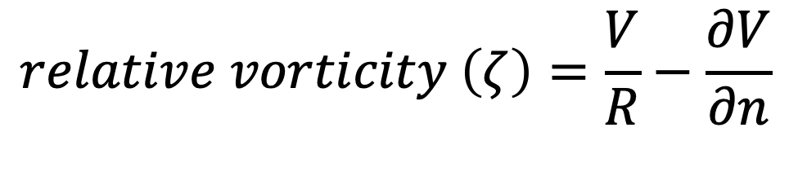
Relative vorticity has two major components: curvature and shear.
$$relative vorticity \left(ζ\right)=\frac{V}{R}−\frac{∂V}{∂n}$$
curvature
shear

Slide 10
Curvature Vorticity
R
Trajectory: black arrow

Slide 11
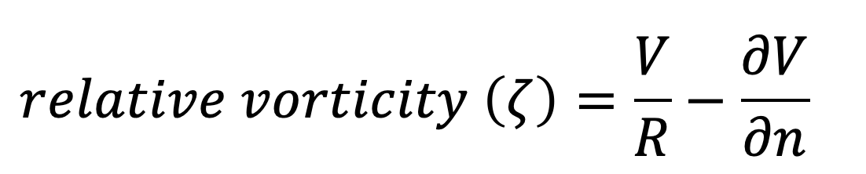
The smaller the R the greater the vorticity. The greater the speed the greater the vorticity
R
R

Slide 12

Shear Vorticity
North
South
Change over
time
1
2
3

Slide 13
What about jets? Lots of relative vorticity from shear!
cyclonic
Jet Core
anticyclone

Slide 14
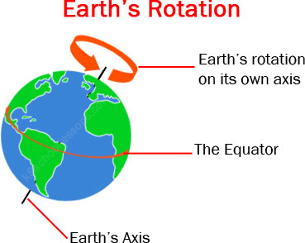
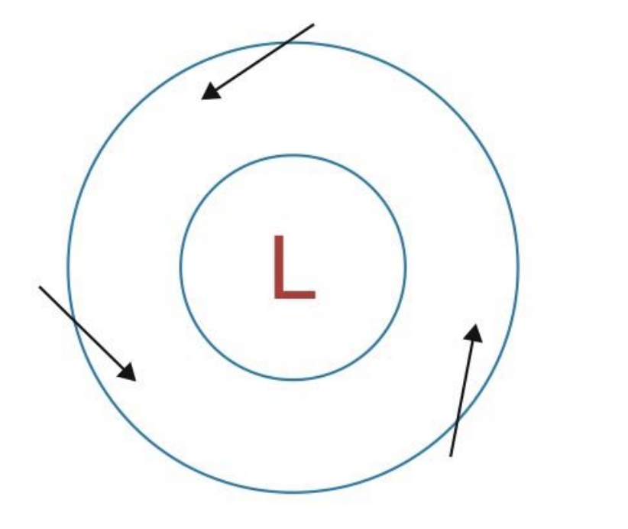
Relative Vorticity can either be
+ (cyclonic, counterclockwise-NH) or – (anticyclonic, clockwise)
Rotation in the same sense of the earth’s rotation is defined as +

Slide 15
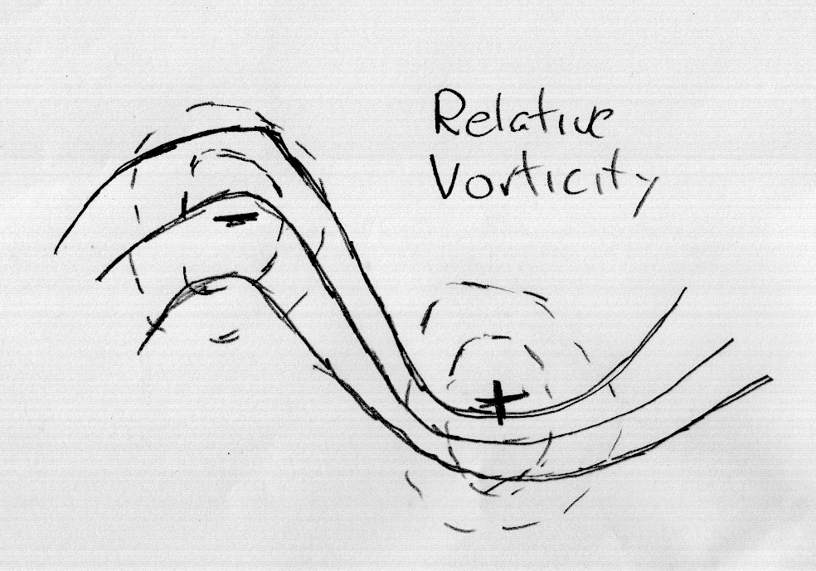
Relative vorticity with upper ridge and trough

Slide 16
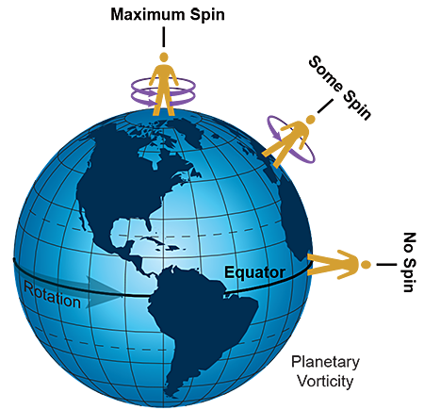
Relative Vorticity—rotation with respect to the earth-- is only part of the story
The earth itself is rotating, so there is some inherent “spin” even if there is no wind
The rotation at any location derived from the earth’s rotation is called planetary vorticity and denoted by the letter “f”

Slide 17
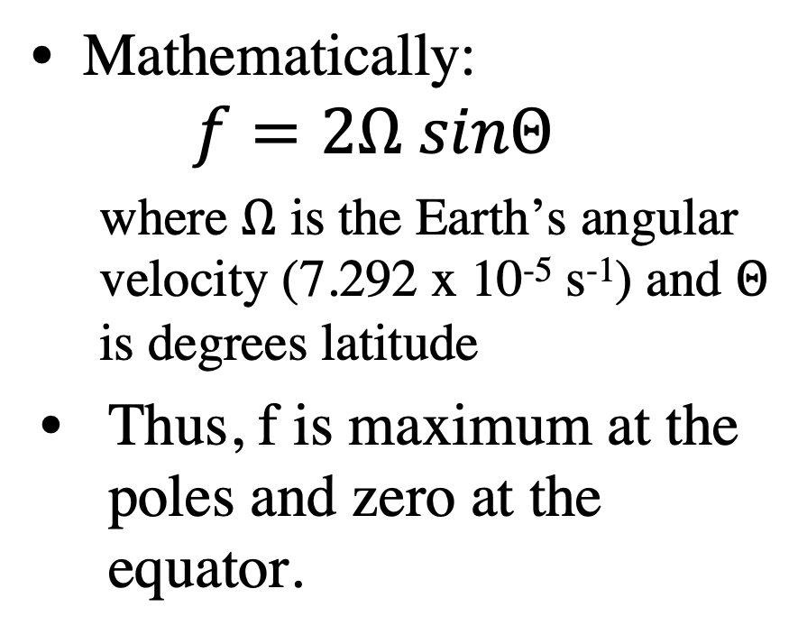
Planetary Vorticity
Mathematically:
  $$f=2Ω sinΘ$$
  where $Ω$ is the Earth’s angular velocity (7.292 x 10⁻⁵ s⁻¹) and $Θ$ is degrees latitude
Thus, f is maximum at the poles and zero at the equator.

Slide 18
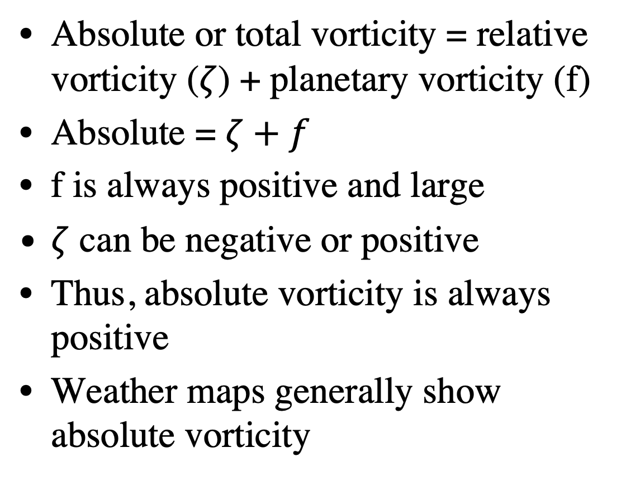
Absolute or Total Vorticity
Absolute or total vorticity = relative vorticity ($ζ$) + planetary vorticity (f)
Absolute = $ζ+f$
f is always positive and large
$ζ$ can be negative or positive
Thus, absolute vorticity is always positive
Weather maps generally show absolute vorticity

Slide 19
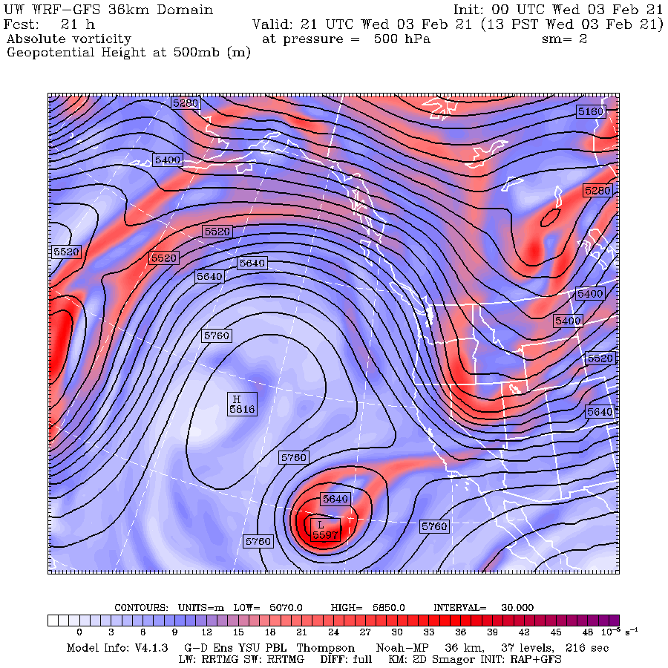
Absolute vorticity is small in ridges and large in troughs.
In ridges, planetary vorticity is ++, while relative vorticity is -. Total is small +
In troughs, planetary vorticity is ++, while relative vorticity is +. Total is large +

Slide 20
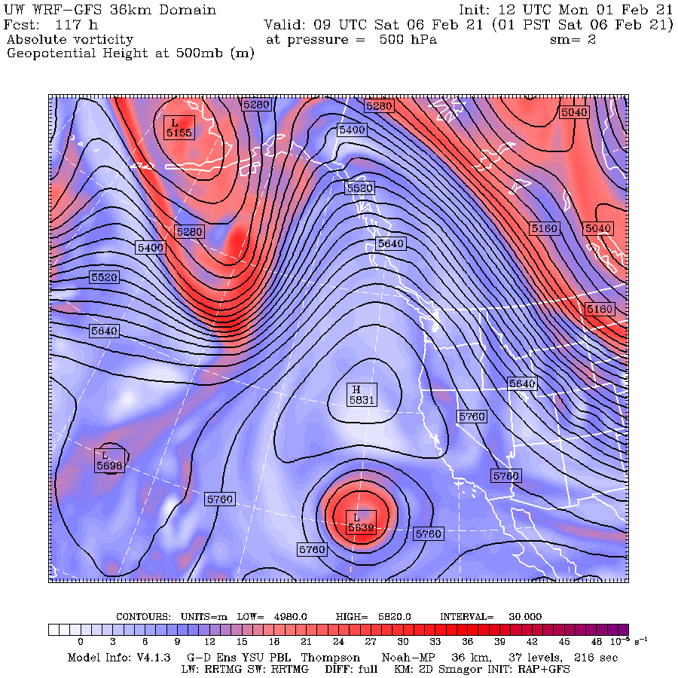

Slide 21
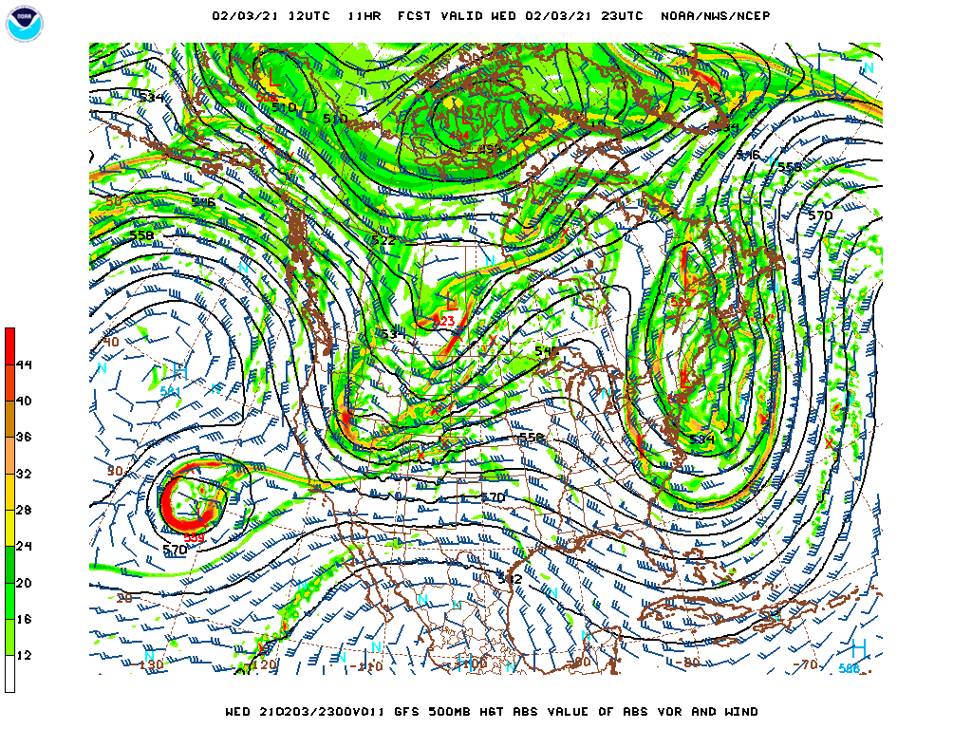

Slide 22
Absolute Vorticity is Useful for Tracking Troughs and Other Features
Particularly useful when a short-wave trough moves into a ridge
Why?Can be hard to see the curvature of height lines, but vorticity shows the feature.

Slide 23
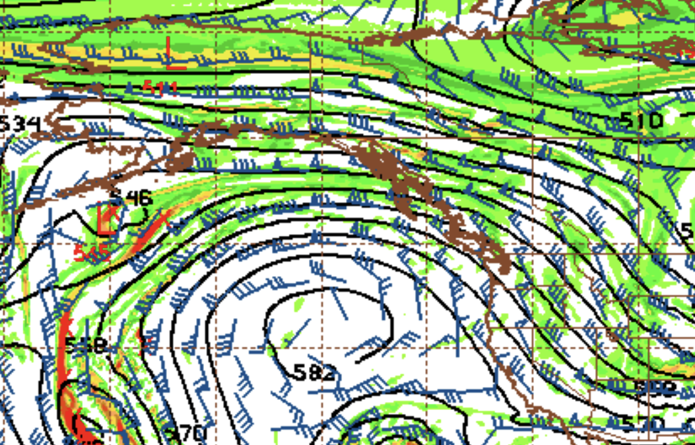
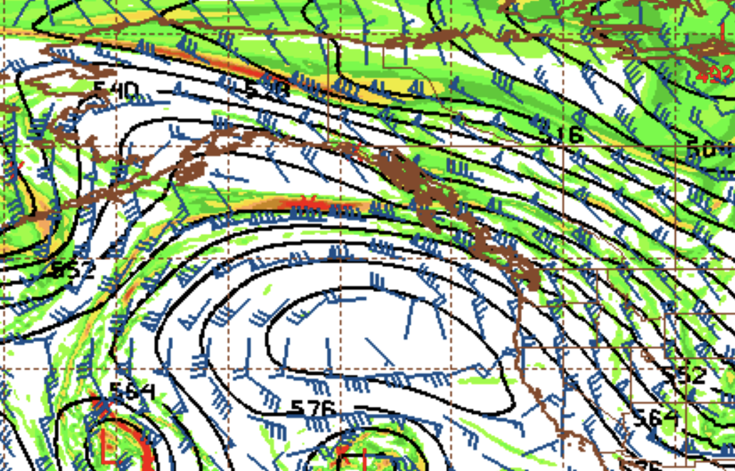
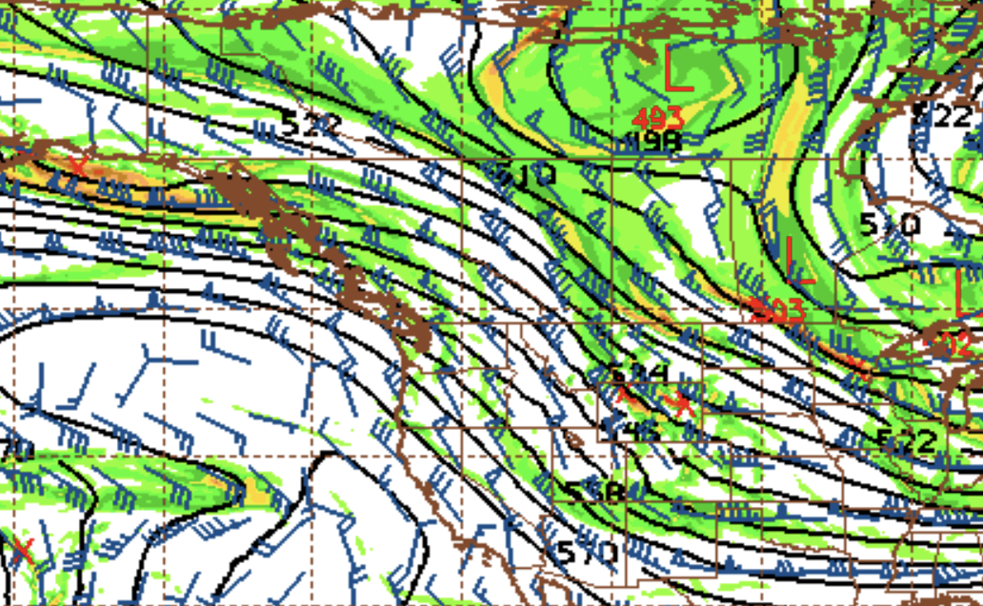

Slide 24
Remember Vorticity and Jets!
Differing relative vorticity on both sides
cyclonic
Jet Core
anticyclone

Slide 25
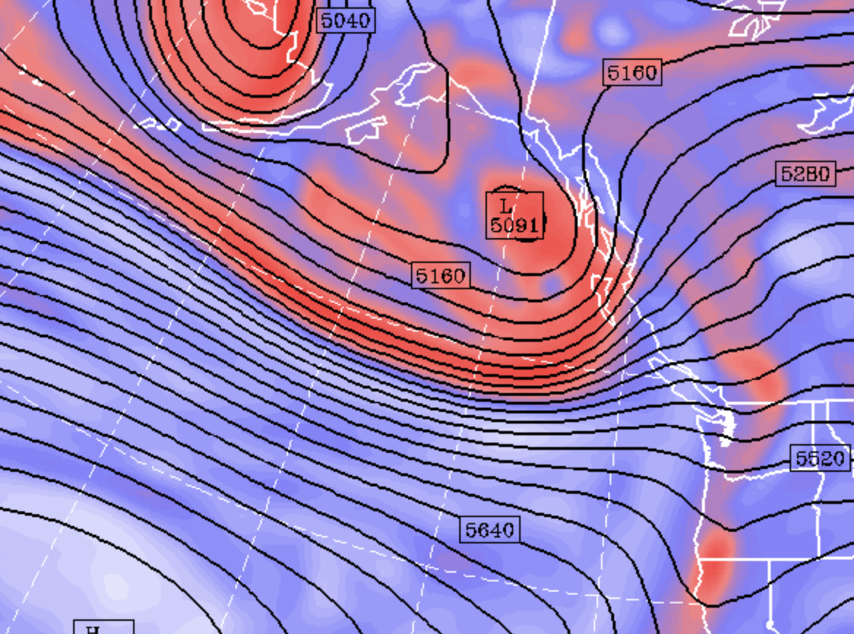

Slide 26
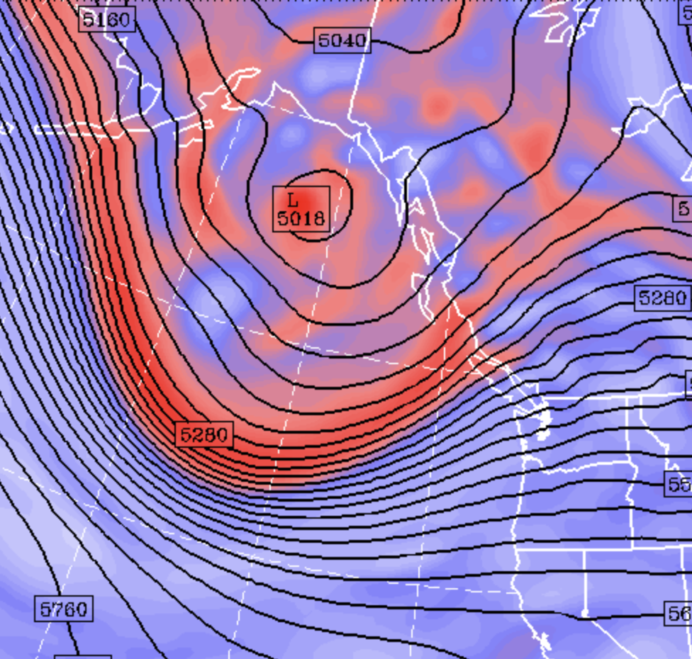

Slide 27
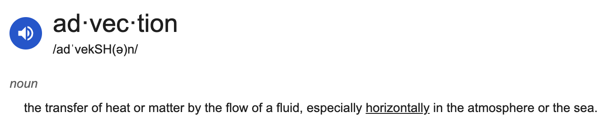
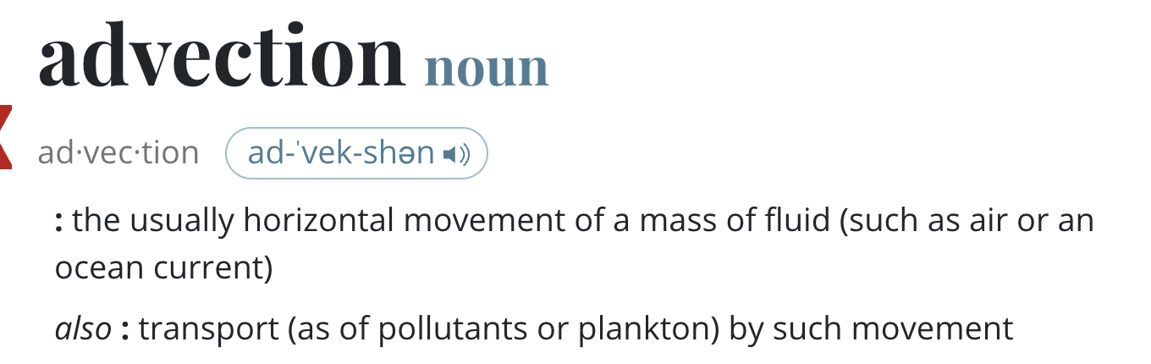

Slide 28
Vorticity Advection is Important
Vorticity advection is the movement of vorticity by the horizontal winds
Connected with vertical motion.
Positive vorticity advection: bringing in higher values. Associated with upward motion
Negative vorticity advection: bringing in lower values. Associated with downward motion

Slide 29
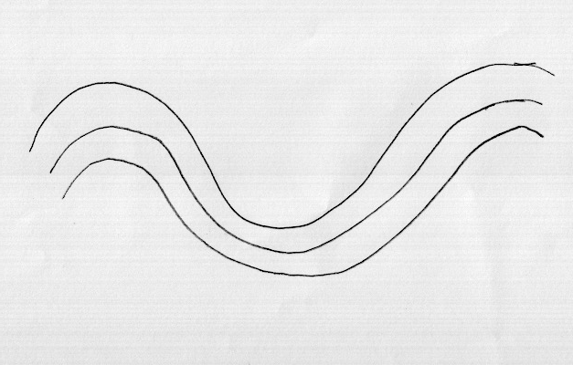
Positive
Vorticity
Positive
Vorticity
Advection
+
Negative
Vorticity
Advection
Sinking motion
Rising motion

Slide 30
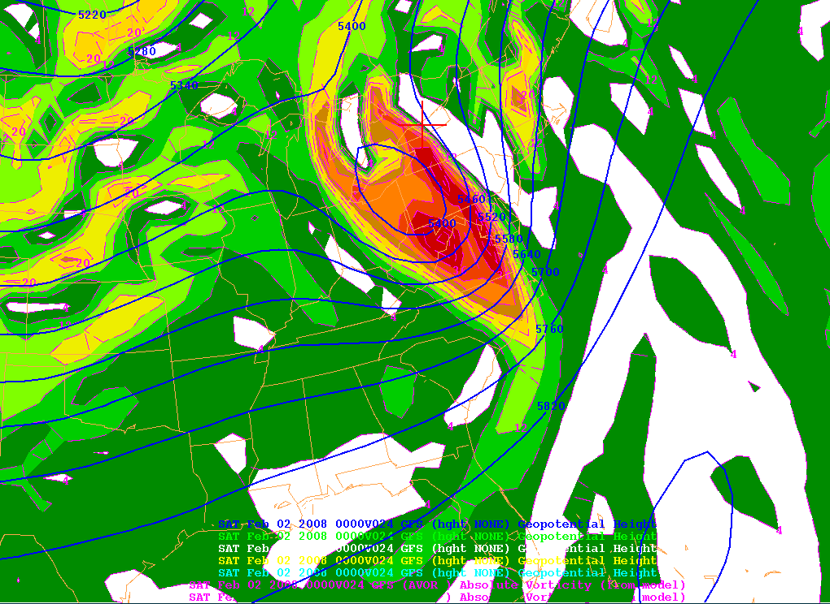
Vorticity

Slide 31
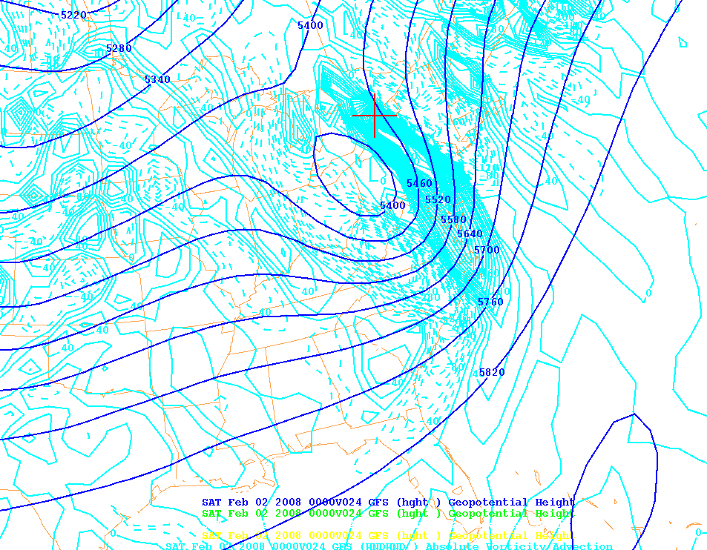
Vorticity Advection

Slide 32
Positive Vorticity Advection is Associated with Upward Motion and Often Precipitation

Slide 33
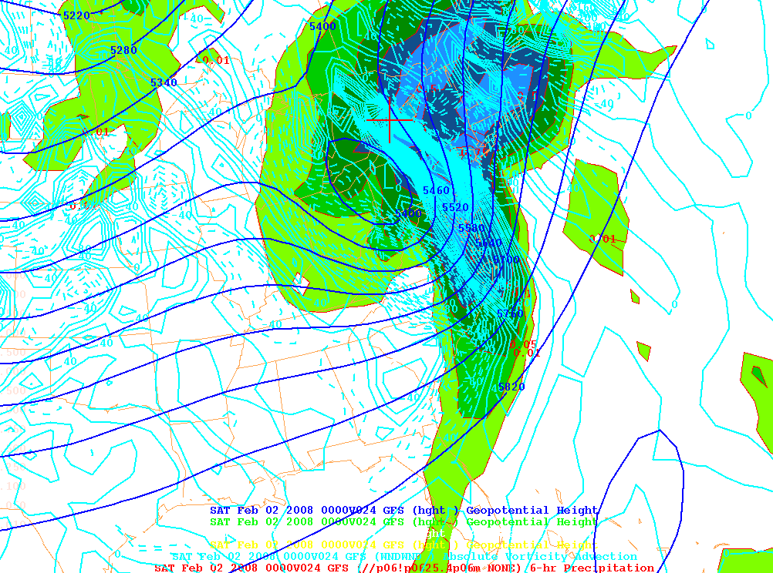
Vorticity Advection and Precipitation

Slide 34
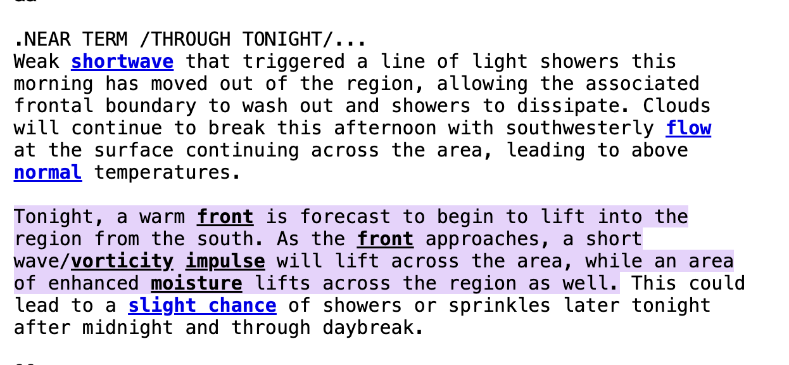
National Weather Service Forecast Discussions Frequently Mention Vorticity

Slide 35
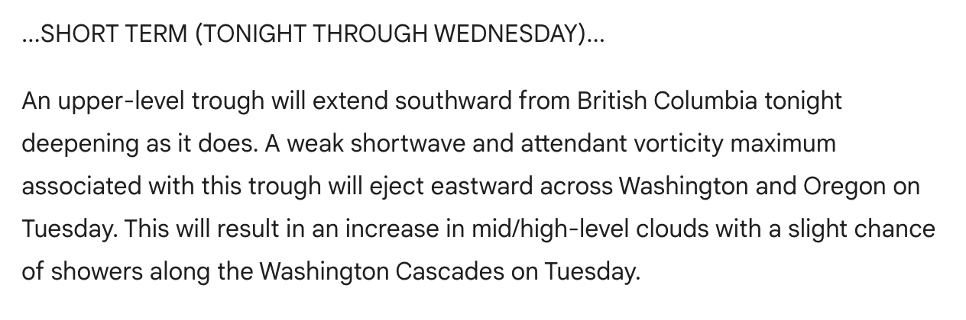
National Weather Service Forecast Discussions Frequently Mention Vorticity

Slide 36
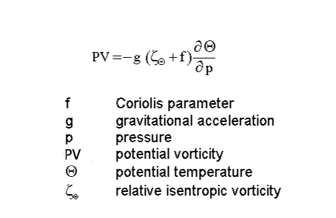
Potential Vorticity: very important dynamical quantity in the atmosphere

Slide 37
Potential Vorticity combines absolute vorticity and stability
Absolute
Vorticity
Stability

Slide 38
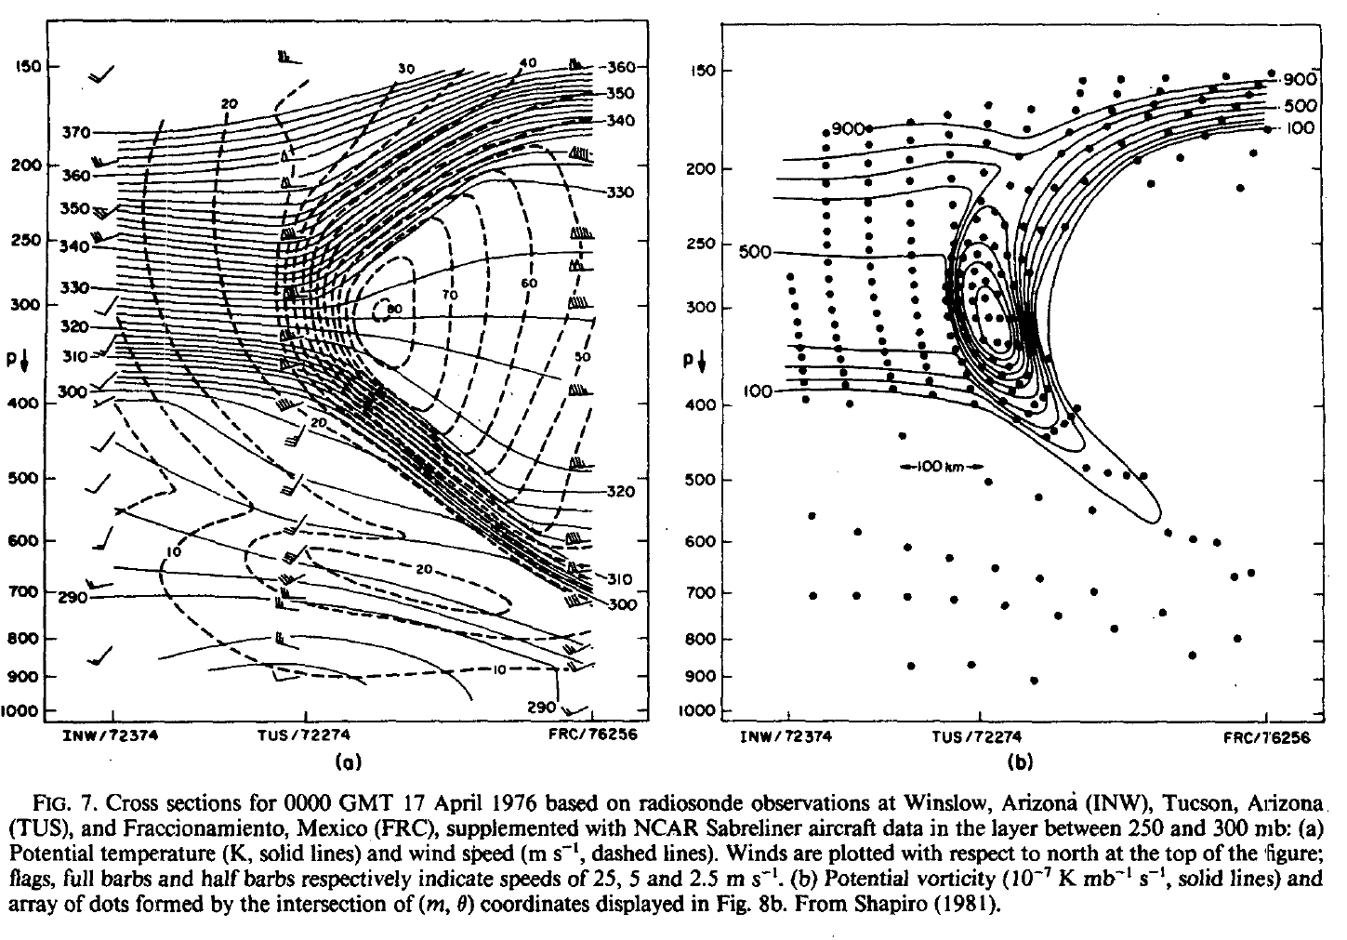
Potential Vorticity is Large In the Stratosphere.

Slide 39
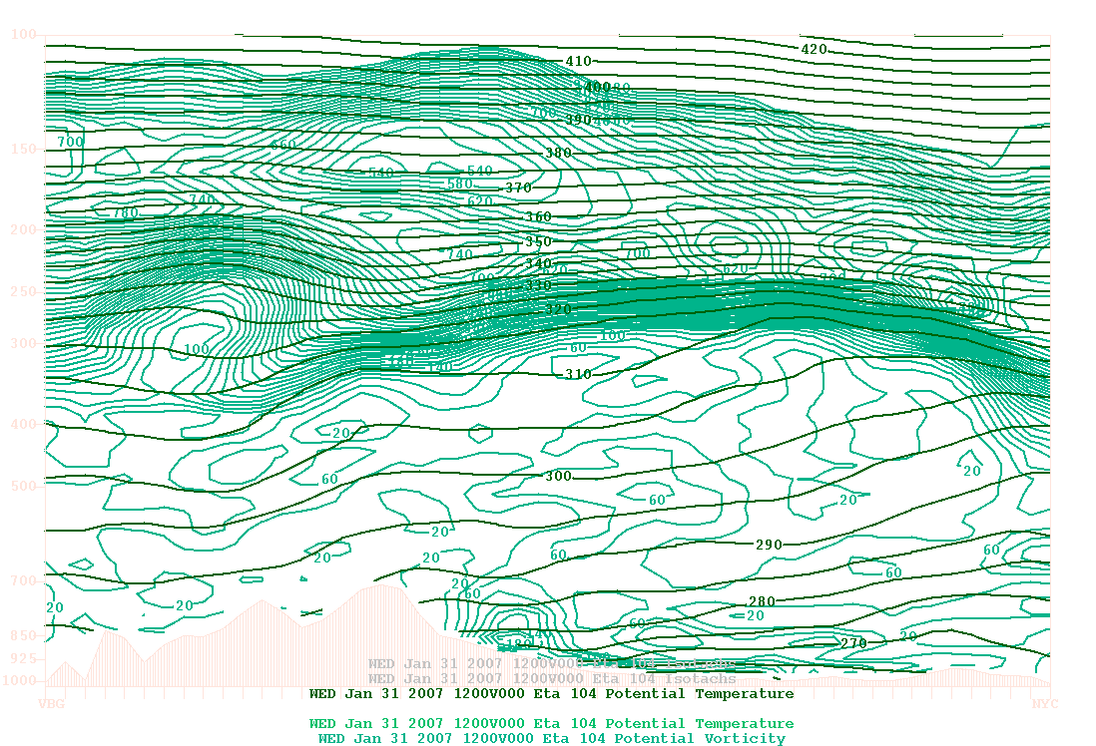
Vertical Cross section Potential Vorticity and Potential Temperature
250
500
CA
NY

Slide 40
Why is potential vorticity high in the stratosphere?

Slide 41
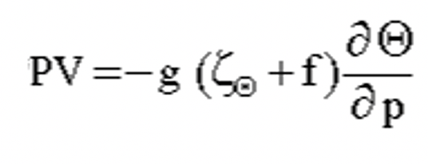
Answer
PV is usually large in the stratosphere.
Why? Because stability is large

Slide 42
PV can be used to track the tropopause
Tropopause is often defined by PV. PVU=2
1.0 × 10⁻⁶ m² s⁻¹K kg⁻¹ is one potential vorticity unit (1 PVU).

Slide 43
More PV Facts
Potential vorticity tends to be conserved when diabatic heating (e.g., condensation) and drag/friction are small.
A very good tracer of air parcels
Large near lows and troughs, and in upper fronts.

Slide 44
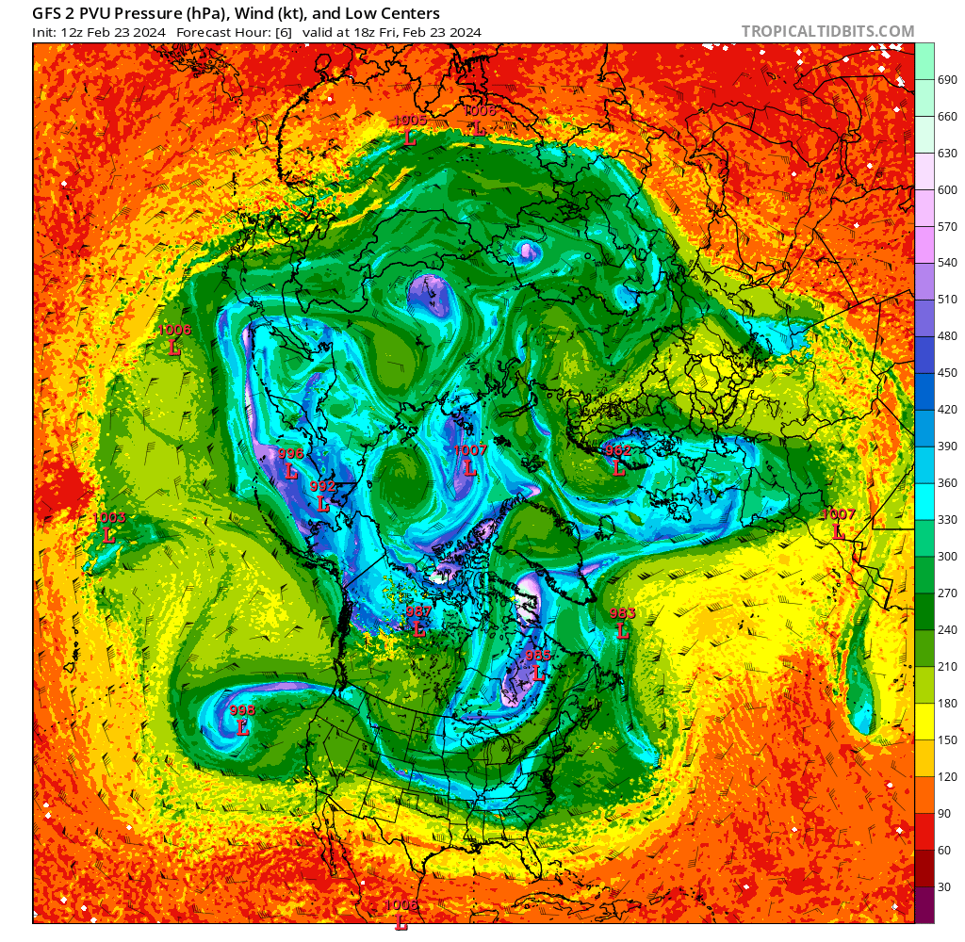
Real Time PV Diagnostics
https://www.tropicaltidbits.com/analysis/models/?model=gfs&region=nhem&pkg=DTpres&runtime=2024022312&fh=6

Slide 45
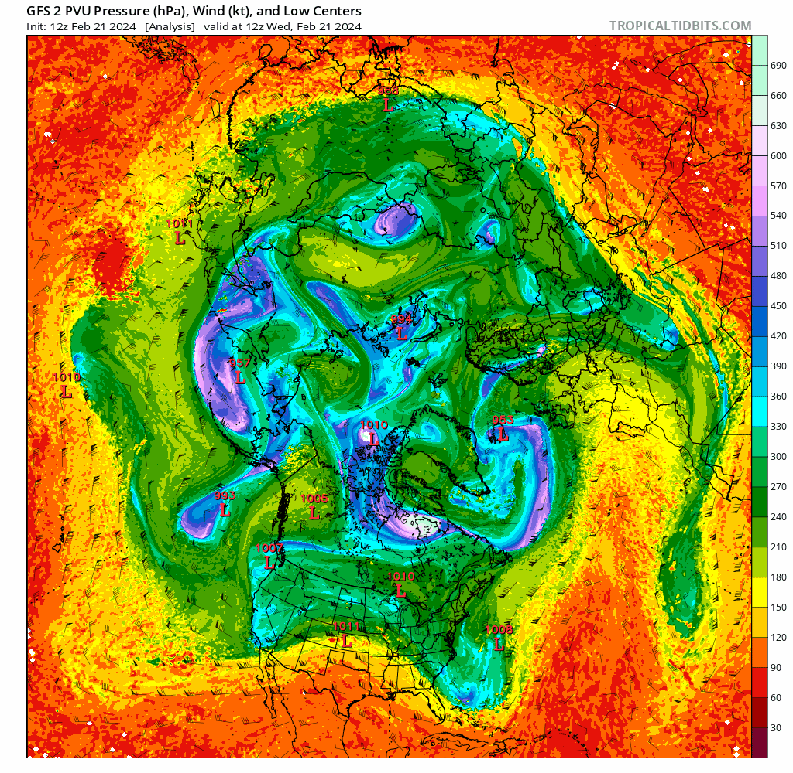

Slide 46
https://www.tropicaltidbits.com/analysis/models/?model=gfs&region=nhem&pkg=DTpres&runtime=2024022312&fh=6

Slide 47
You can spot upper-level fronts where the tropopause plummets downward

