Slide 1
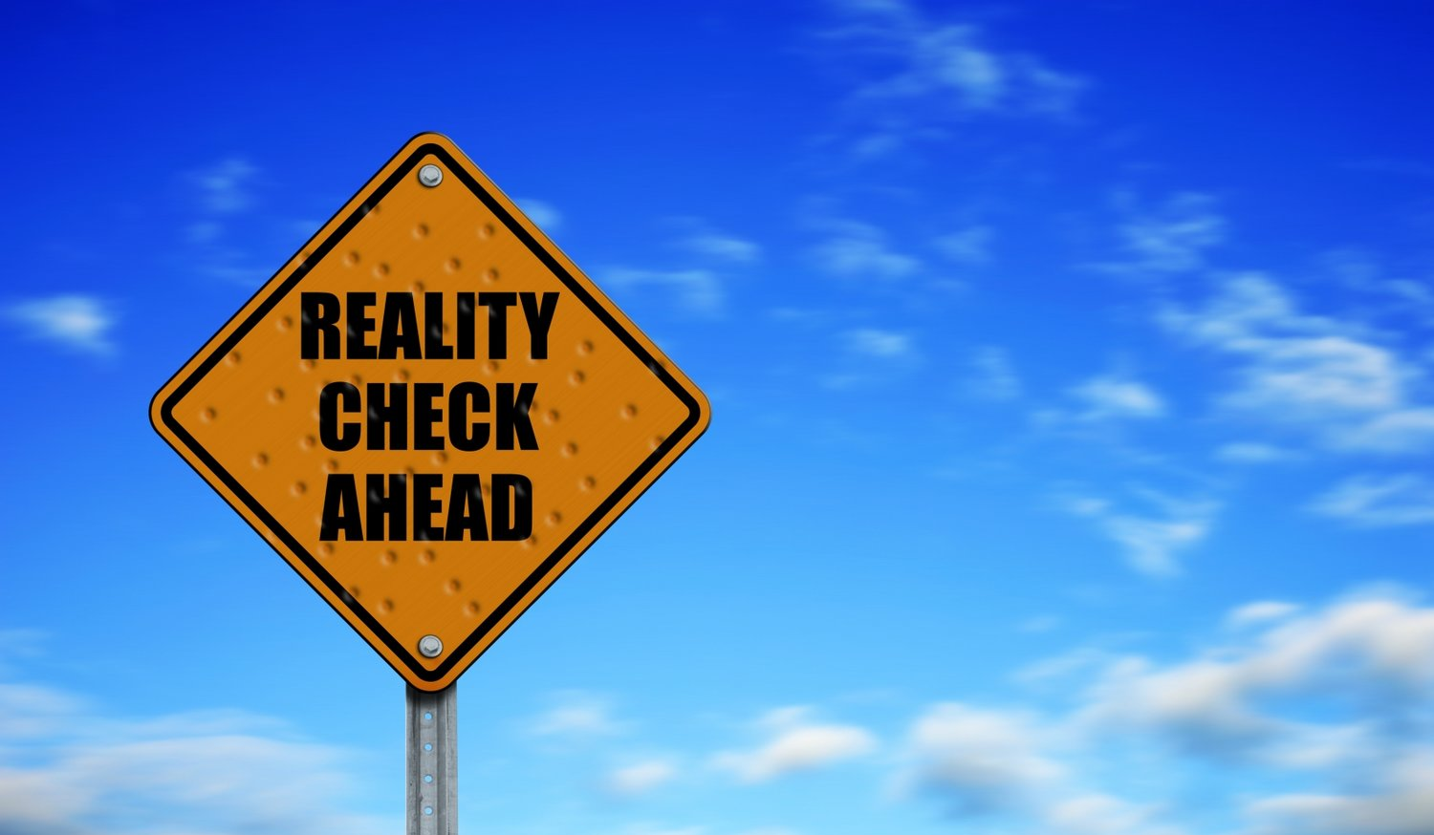
How Effective is Washington State’s Response to Global Warming?
A Reality Check
Cliff Mass
University of Washington

Slide 2
To deal effectively with global warming, our state needs to do three things
Secure the best information on how global warming will influence WA, and accurately communicate this information to decision makers and the public.
Make our state resilient to the current climate as well as the effects of global warming (adaptation).
Reduce our carbon emissions (mitigation), serving as an example to the nation and the world.

Slide 3

A Non-Political Report Card on Progress

Slide 4
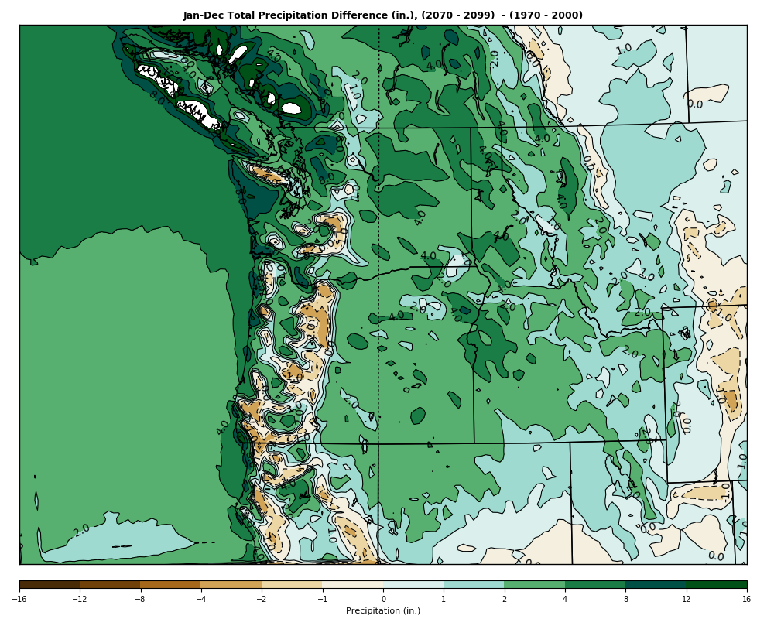
Information on How Global Warming Will Impact the State
Some basic information is available, but much more needs to be done, particularly to describe uncertainties and how impacts will vary around the state.
The state has not sufficiently invested in such research

Slide 5
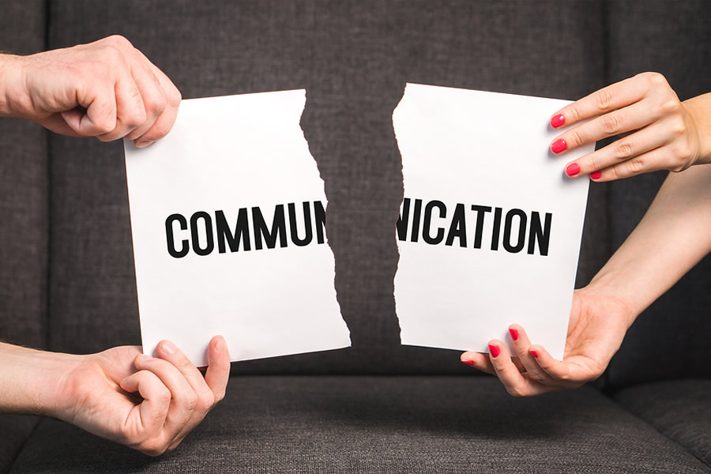
The Global Warming Communication Failure Mode
Some media and politicians are providing patently false or problematic information
This includes exaggeration of current and past impacts of global warming.
Particularly egregious have been claims that recent wildfires are predominantly the result of global warming.

Slide 6
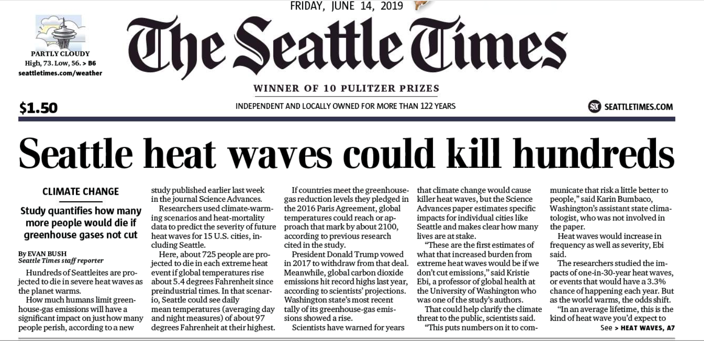
There has rarely been so much misinformation and exaggeration about any public issue of importance

Slide 7
725 will die in each heat wave!
Assumes unreasonable warming and that no one will buy an air conditioner during this century

Slide 8
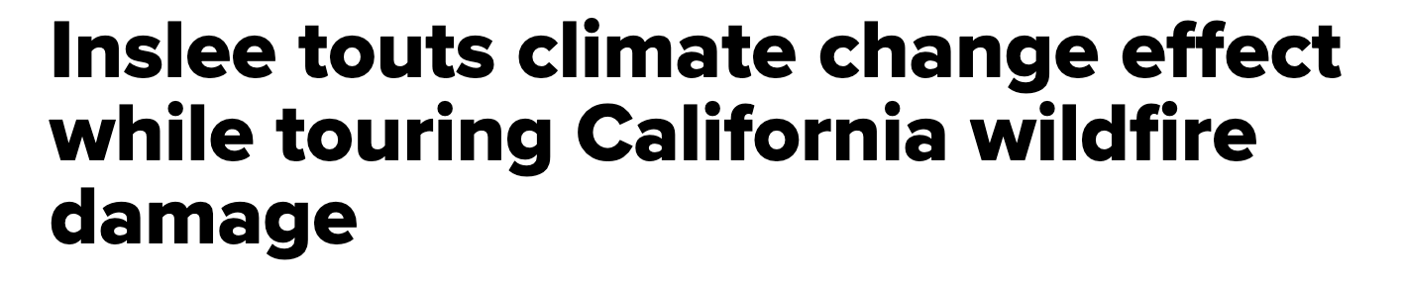
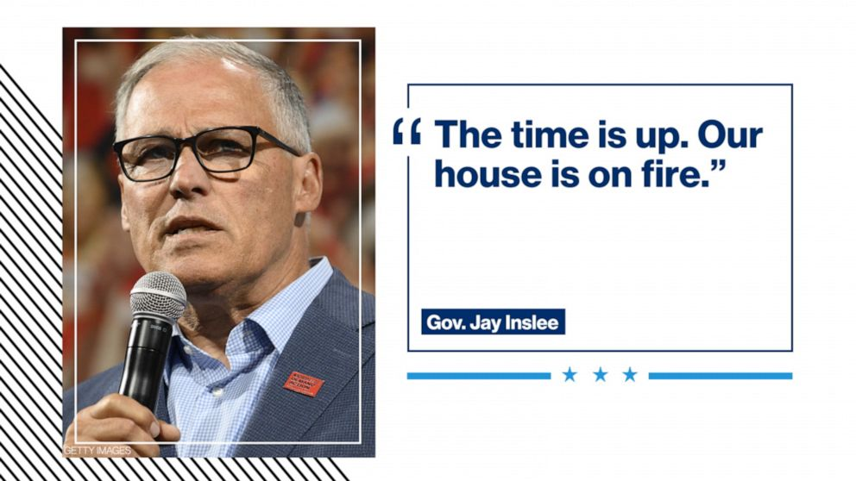
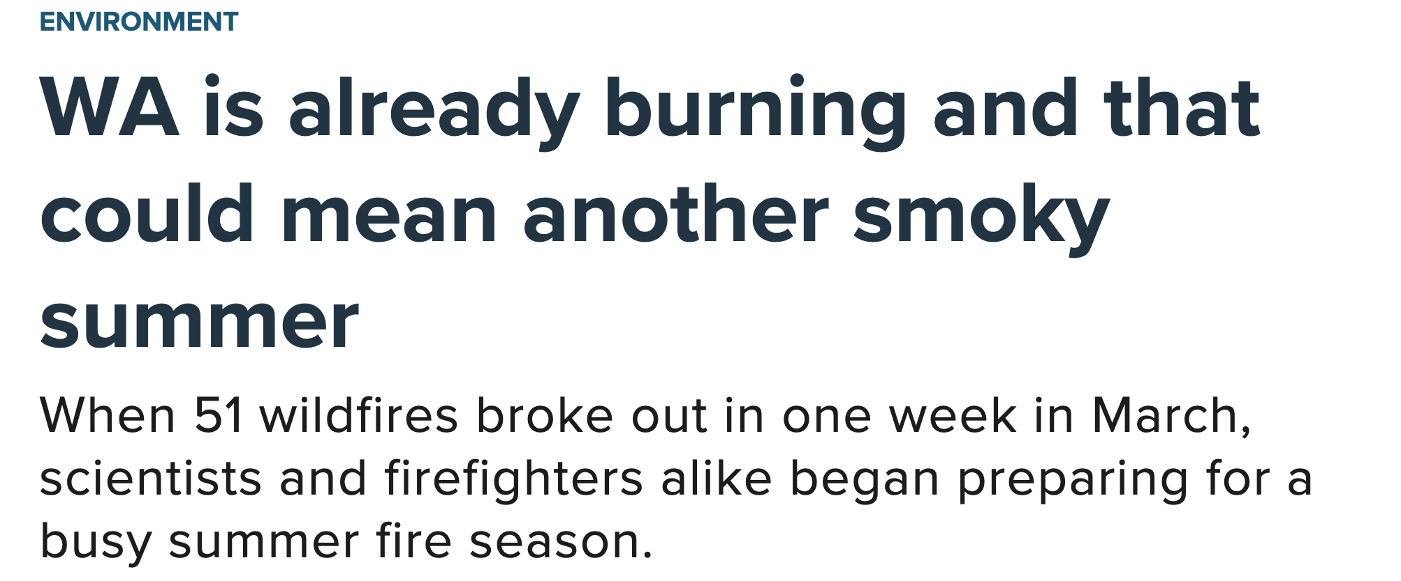
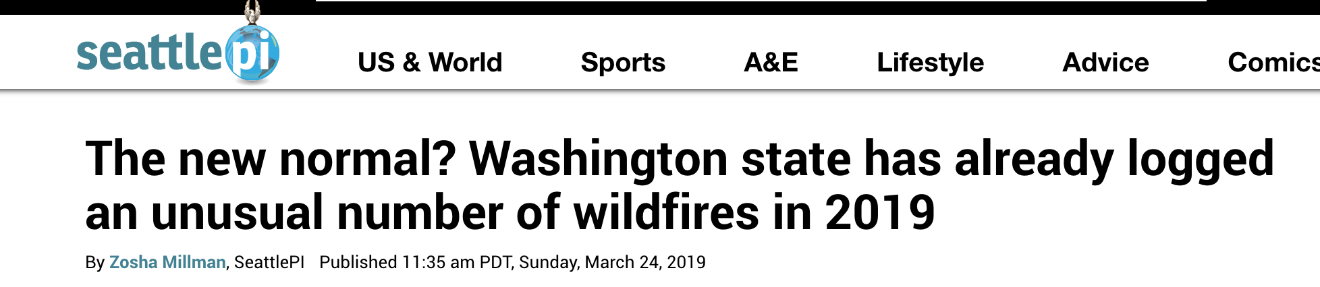
Wildfire and Climate

Slide 9
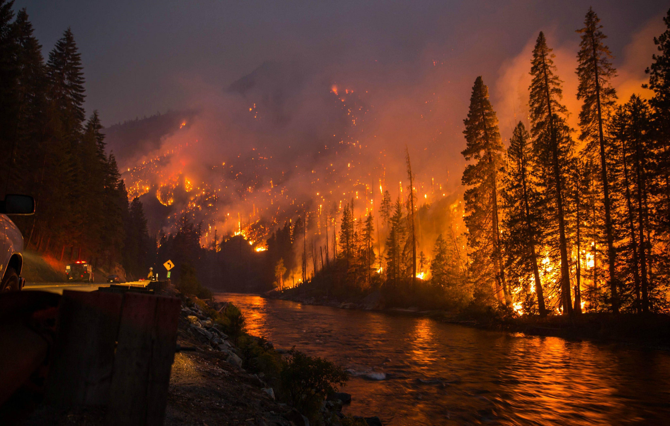
The Truth?
Historically, there used to be many more wildfires. Our ecological systems depend on it.
Mismanagement of our forests have made them vulnerable to catastrophic fires
Flammable invasive grasses have invaded the State
Western WA wildfires are associated with easterly winds that should LESSEN under global warming
There is poor correlation between climate parameters and WA wildfires

Slide 10
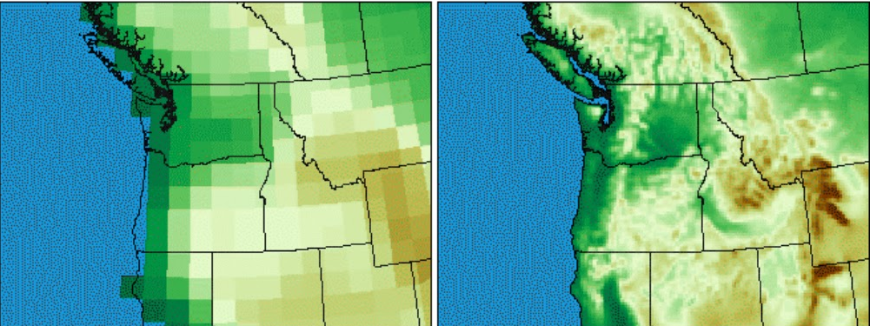
What needs to be done
The state must invest in essential research to better clarify the regional implications of global warming
The hype and exaggeration by the media and certain politicians needs to be reduced.
Those suggesting there is no future problem should rethink their claims
We need a non-political consensus on the science.

Slide 11
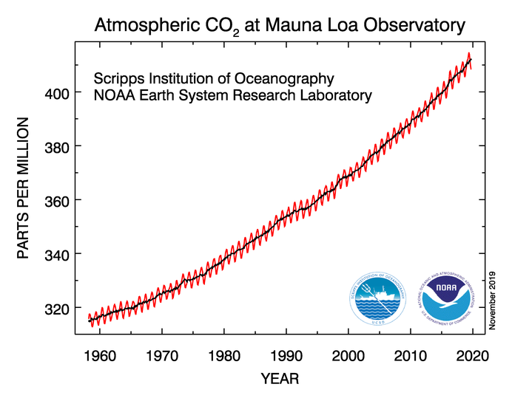
Resilience and Adaptation
Substantial warming is unavoidable.
The atmosphere/ocean has not caught up with what is up there now.
Human emissions of CO2 is accelerating.

Slide 12
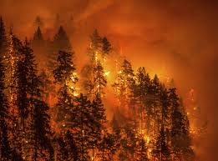
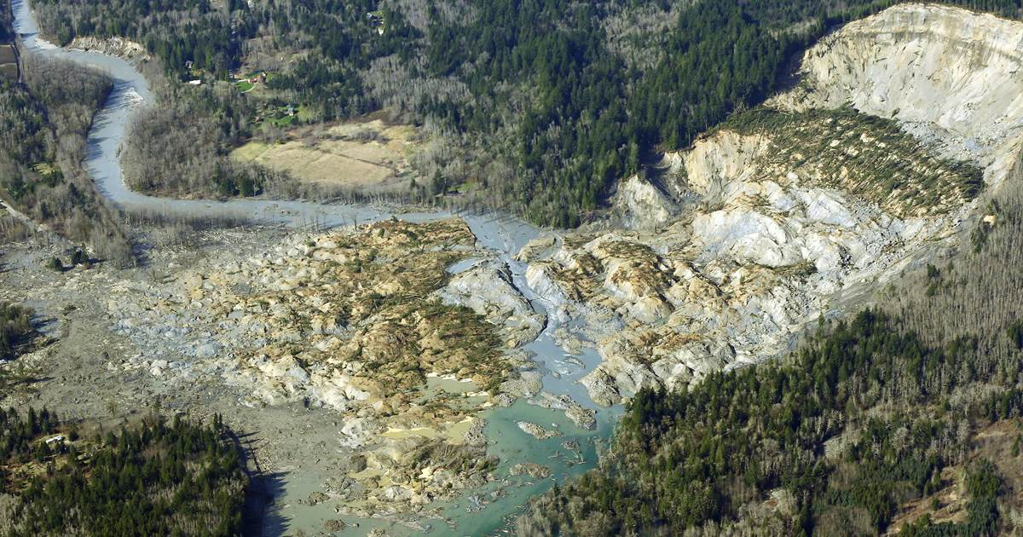
Resilience and Adaptation
We must make our state more resilient to future climate change.
We are neither resilient or adapted to the CURRENT climate.
Overgrown and Poorly Managed Forests
Too many living in vulnerable areas (slopes, near rivers)

Slide 13
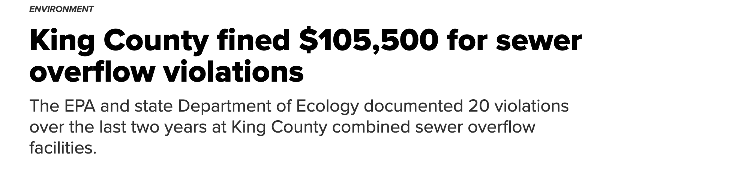
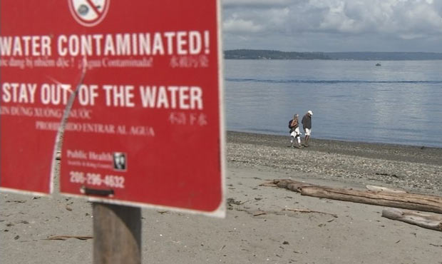
Not Resilient to Current Conditions

Slide 14
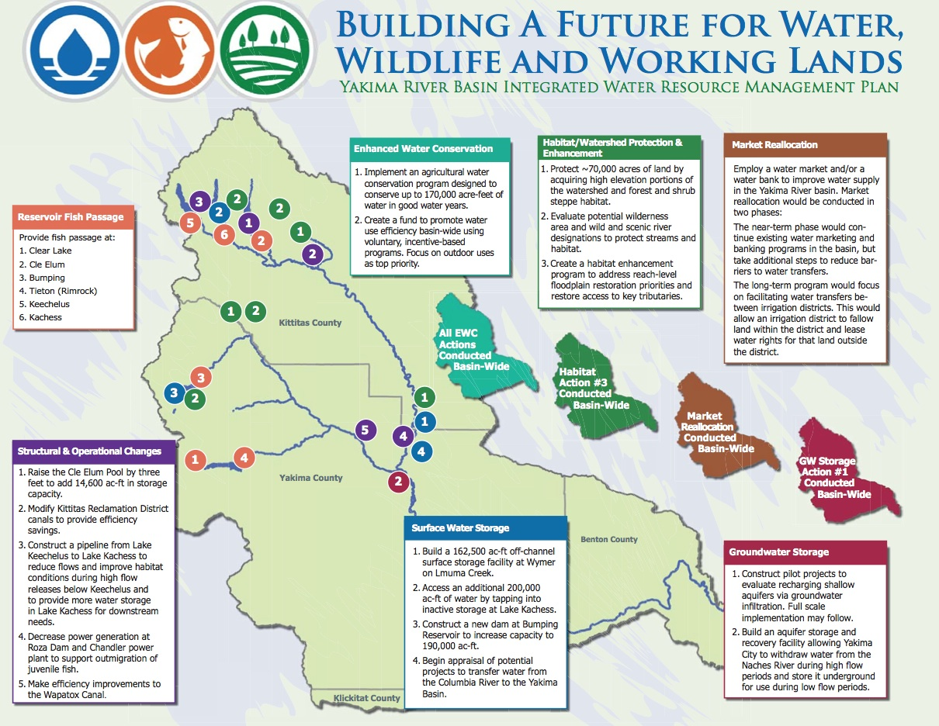
The State Needs to Take Resilience Seriously
Massive program to thin the eastside forests and bring back fire
Move people away from rivers and vulnerable slopes
Build reservoir capacity that will enable the State to deal with less snowpack (there will be plenty of precipitation, just less snowpack)
Encourage agriculture to move away from water-thirsty crops and figure out the water rights issue.

Slide 15
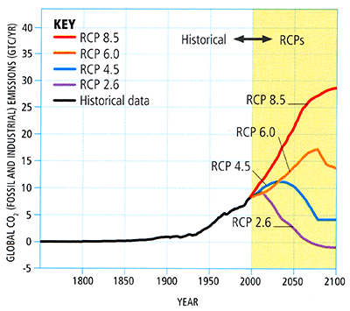
Mitigation: Reducing Carbon Emissions

Slide 16
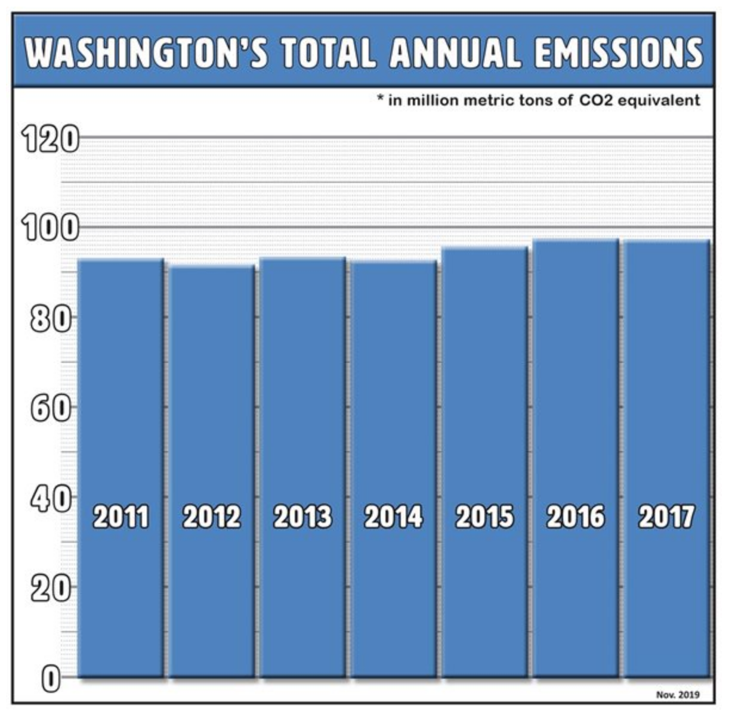
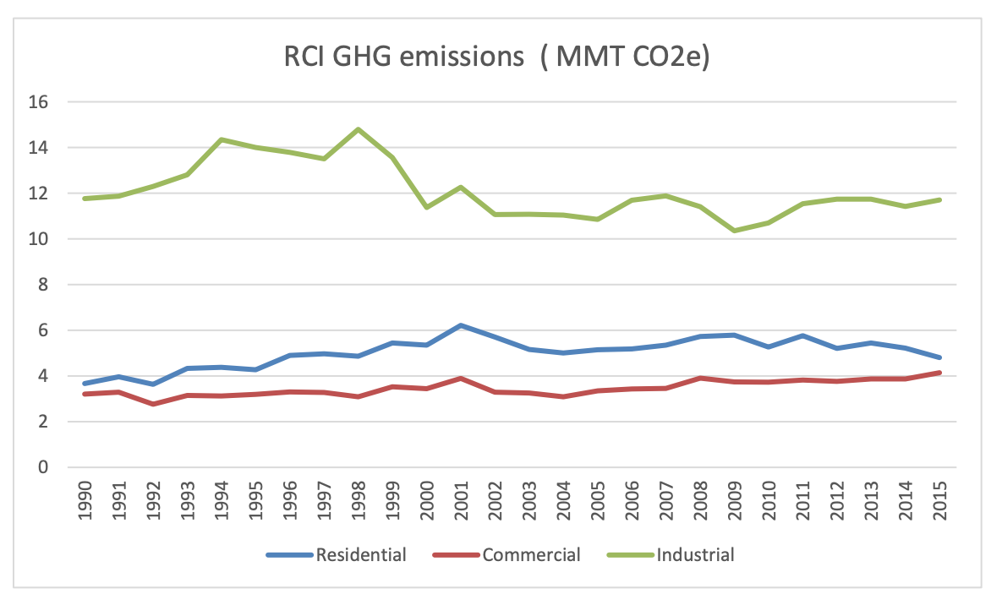
Washington is making little progress in reducing net carbon emissions

Slide 17
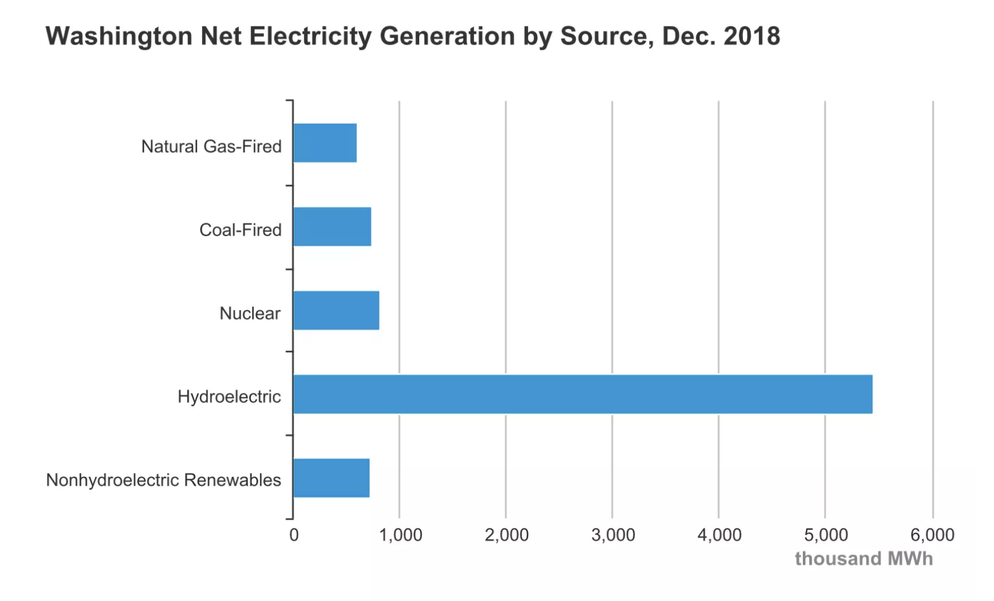
Legislation for carbon-free electricity will not help much
Already get most of electricity from carbon free sources: hydropower, wind energy, and one nuclear plant.

Slide 18
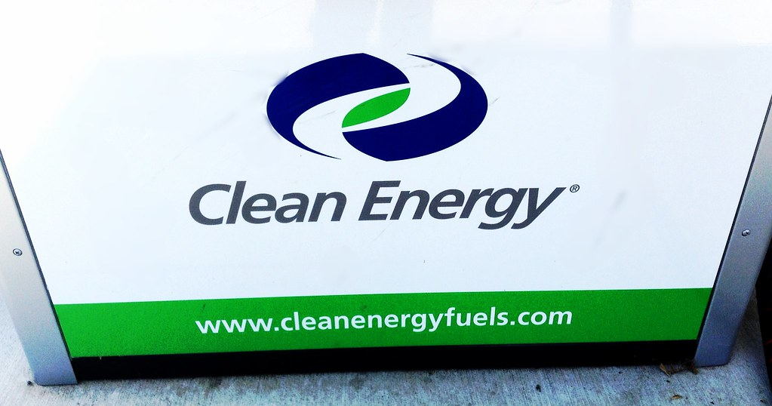
And the effect of “clean fuels” legislation would be small
Proposed reduction of emissions by 20-25% by 2035.
Very expensive way to get a small reduction in emissions.

Slide 19
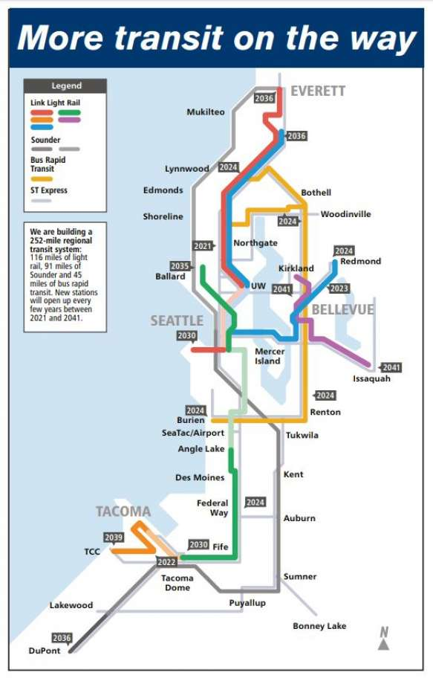
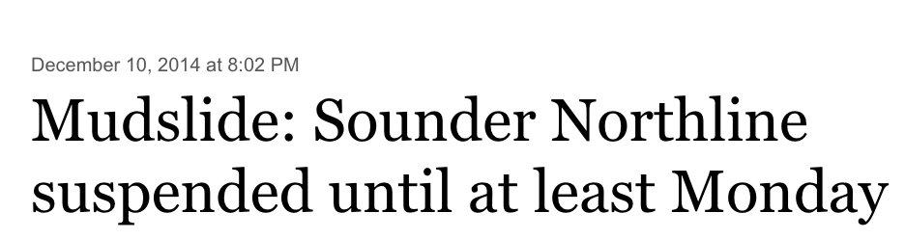
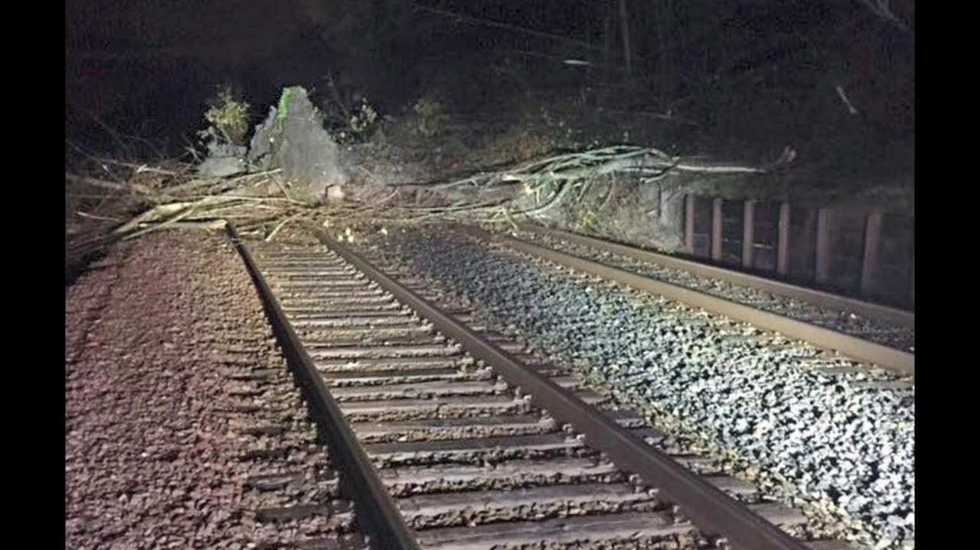
The Move to Effective Mass Transit Has Been Slow Motion
Finished in 2041!

Slide 20
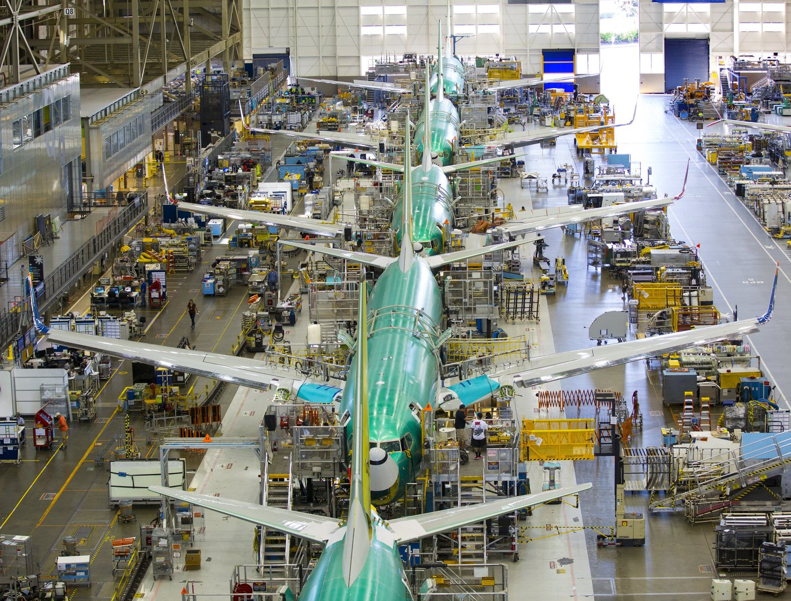
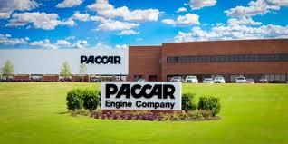
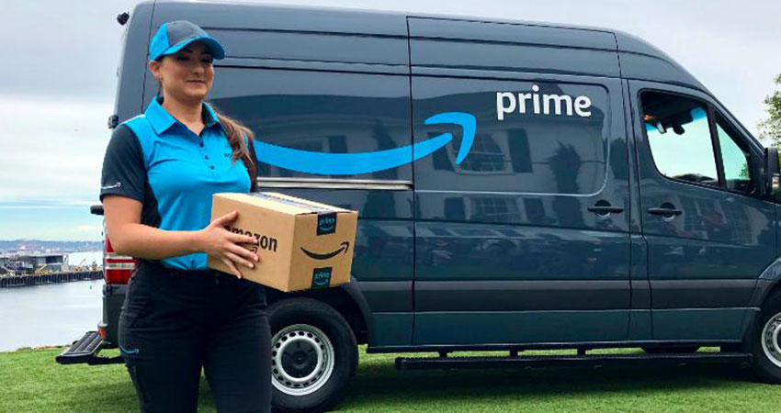
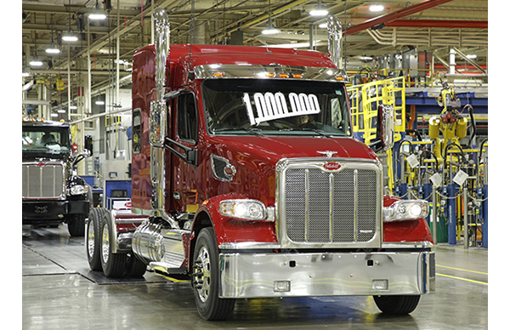
And no one seems to want to talk about our huge contributions to global warming from our local businesses

Slide 21
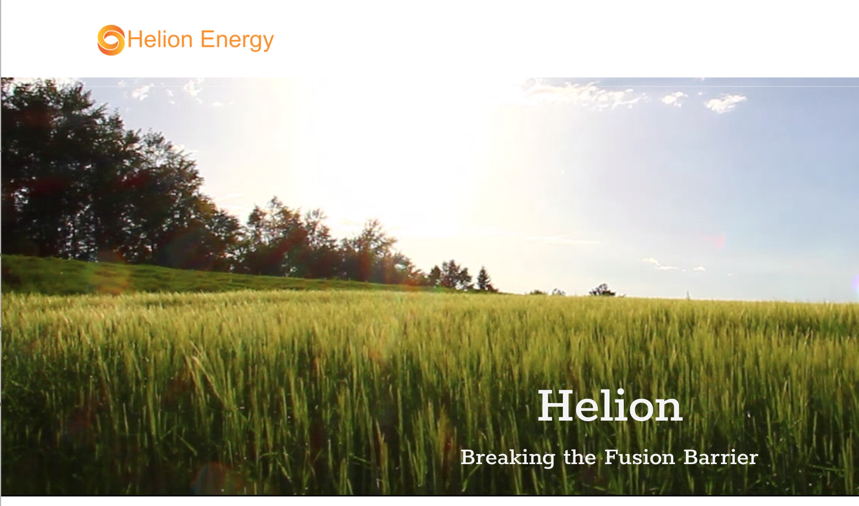
If we want to do something meaningful, we must develop and use technologies that can be applied worldwide
New-Technology Fission and Fusion Power
Sequestration of carbon
Improved battery technologies
And yes, improved renewables.

Slide 22
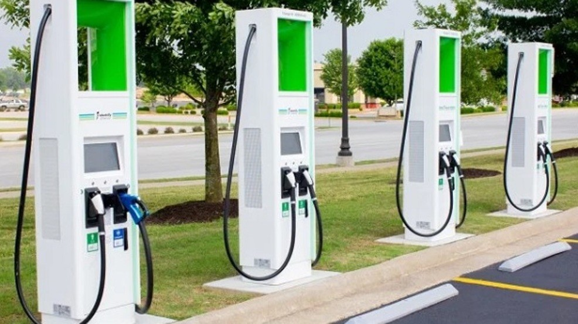
And we should work on mitigation efforts that make sense financially and have other benefits
Much more rapid development of rail and mass transit
Promotion of the infrastructure that will facilitate electric vehicles
Denser development to reduce long commutes.
Economical carbon capture
Make reasonable compromises in use of natural gas (e.g., Tacoma LNG)

Slide 23

Final Note
We must depoliticize the issue of global warming.
Democrats, Republicans, and Independents care about this issue.
Only bipartisan action will succeed and be transferable to the rest of the nation
Should not bring in ancillary political issues.
In the end, it is a technical issue (too much of a certain gas) that will be solved with technological/scientific advances.

