Slide 1
Forecasting Ocean Waves
Problem: Given observed or expected weather, what will be the sea state?
Ships are sunk not by winds, but by waves!

Slide 2
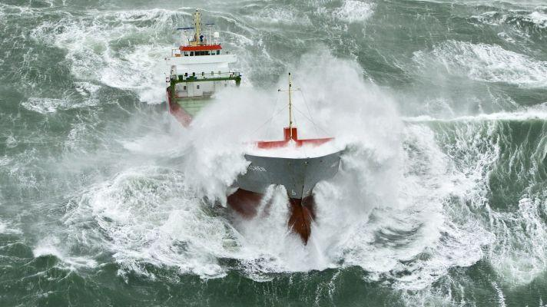

Slide 3
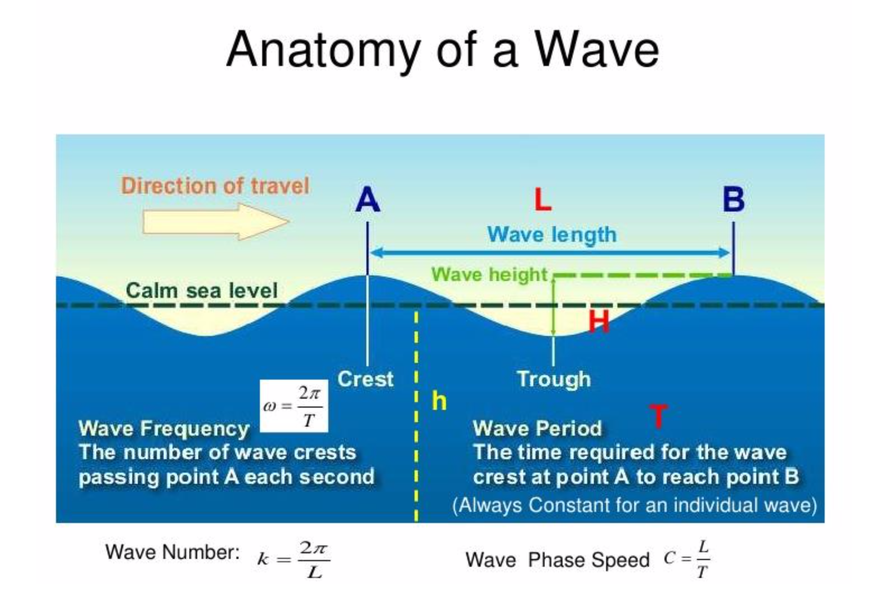

Slide 4
Definitions
Period (T) - The time for one complete cycle of a process, e.g., the time between wave crests at a point.
Frequency (f) - The reciprocal of the period, f = 1/T.
Wavelength (L) - The distance between successive crests or troughs.
Wave Height (H) - The vertical distance between crest and trough. Not the same as wave amplitude, which is the distance from the mean water level to crest or trough.
Significant Wave Height (H_{1/3}) - The average wave height of the 1/3 highest waves.

Slide 5
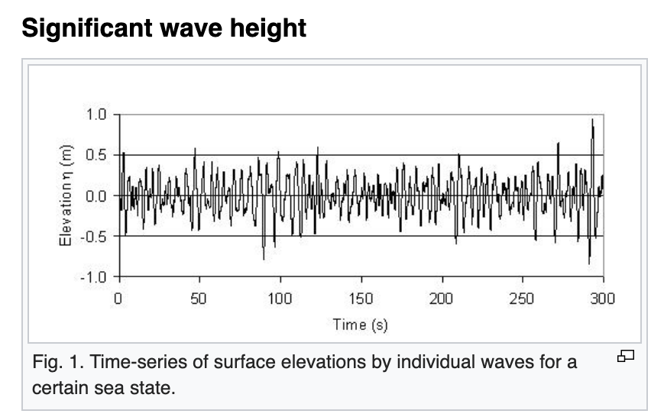

Slide 6
Wind Waves - Waves that are produced by local winds; relatively chaotic.
Swell - Waves that have traveled out of the generating area; relatively regular.
Seas - The combination of the wind waves and swell.
Wave Energy (E) - The variance in the height of the water surface (units: length²).
Fetch - The area over which a wind with constant direction and speed is blowing. Often used to mean the length of the region upwind of the point of interest.
Duration - The time over which a more-or-less steady wind has blown.

Slide 7
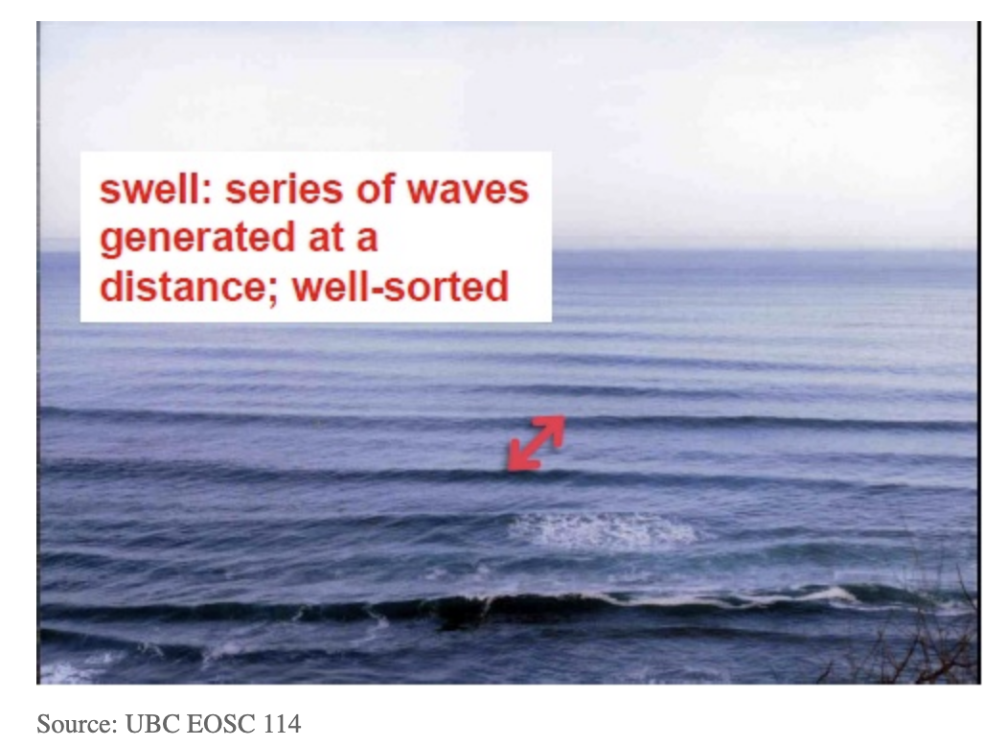
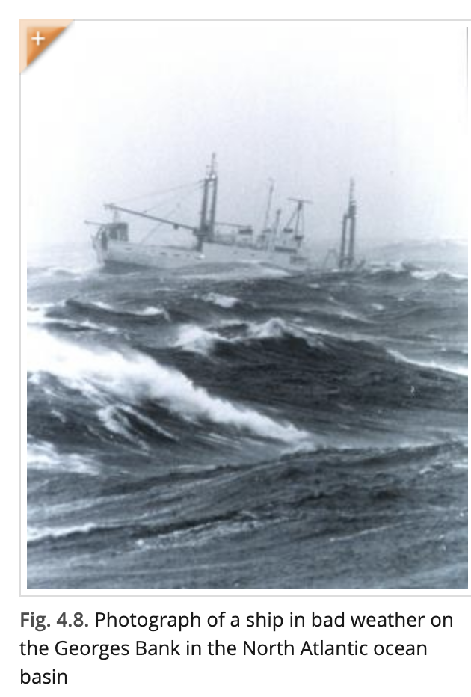
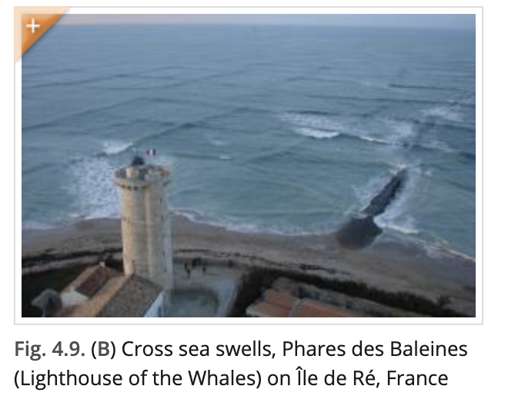

Slide 8
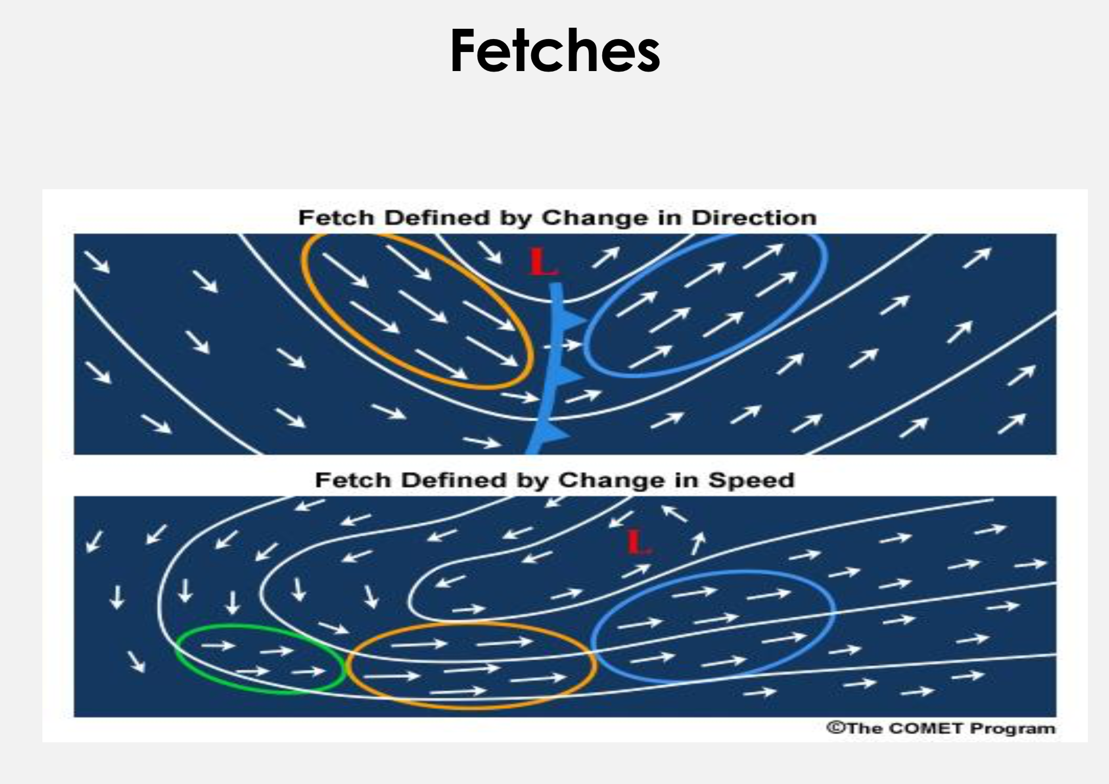

Slide 9
The Formation and Growth of Waves
Initial Wavelets - Form when a breeze comes up. These ripples are small and slow-moving.
Growth of Waves - The differential push of the wind on the windward versus leeward side of the wave increases the height and wavelength of the waves, as long as the wind is faster than the velocity of the waves.
Fully-developed Waves - Rate of energy supplied by the wind equals that dissipated.
Spectrum of Waves - As waves grow, increasing amounts of wave energy are at longer periods and wavelengths.

Slide 10
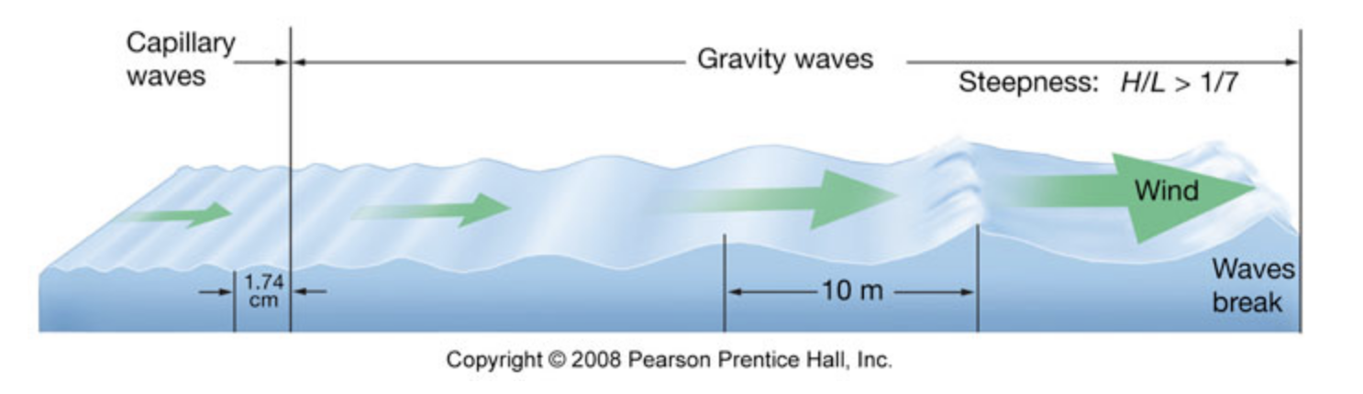
How waves grow
Wind
H L H L H L
t₀ t₁
Higher pressure and surface stress on windward flank of
waves versus leeward flank promotes growth of waves
(if wind speed exceeds wave speed)

Slide 11
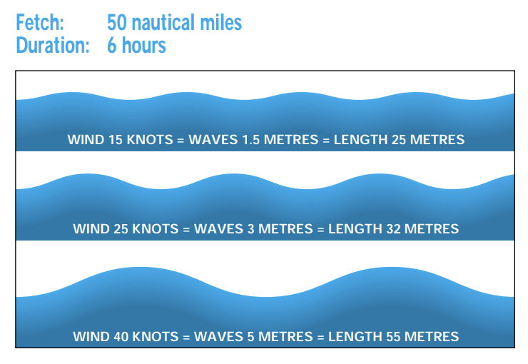

Slide 12
Some Relationships
Deep Water Waves - Depth > L/2
Phase Velocity (V_{p}) - Speed of individual crests or troughs. V_{p} = L/T
Group Velocity (V_{g}) - Speed of propagation of wave energy; V_{g} = 1/2 V_{p}
V_{p} ~ 3 T (knots); L ~ 5 T² (feet) for T in seconds
Fully Developed Sea
E ~ .25 (U/10)⁵ (U in knots); H_{1/3} ~ 2.8 (E)^{1/2}
Wind speeds > 40 knots, fetch or duration limitations generally prevent seas from becoming fully developed.
Speed Minimum Fetch Minimum Duration
30 kts. 280 nt. mi. 23 hours
40 710 42
50 1420 69

Slide 14
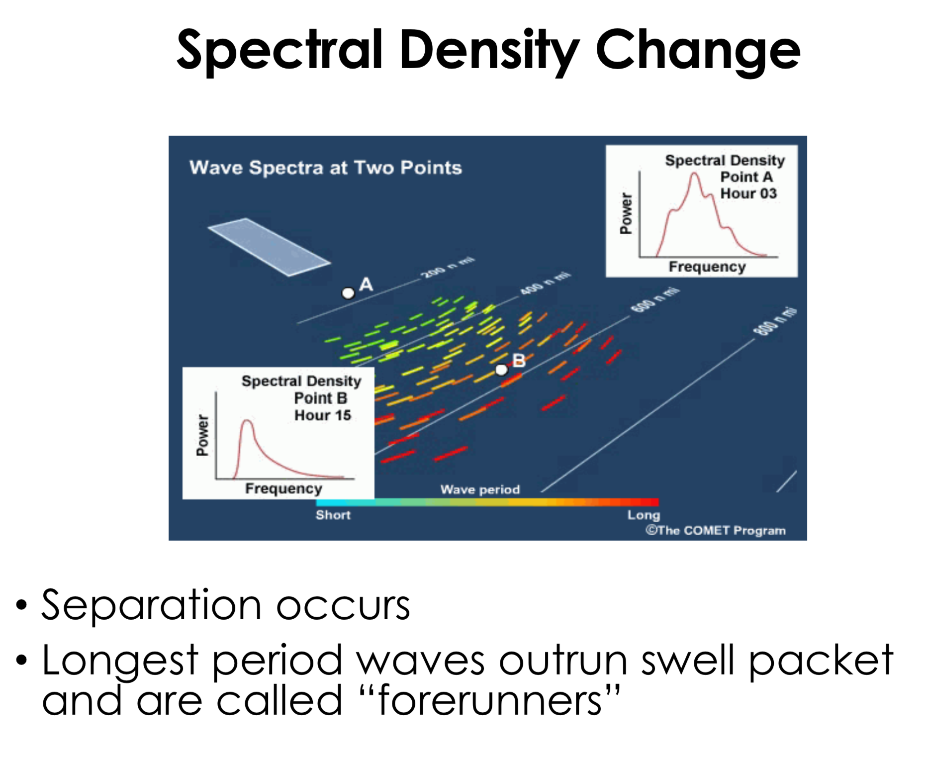

Slide 15
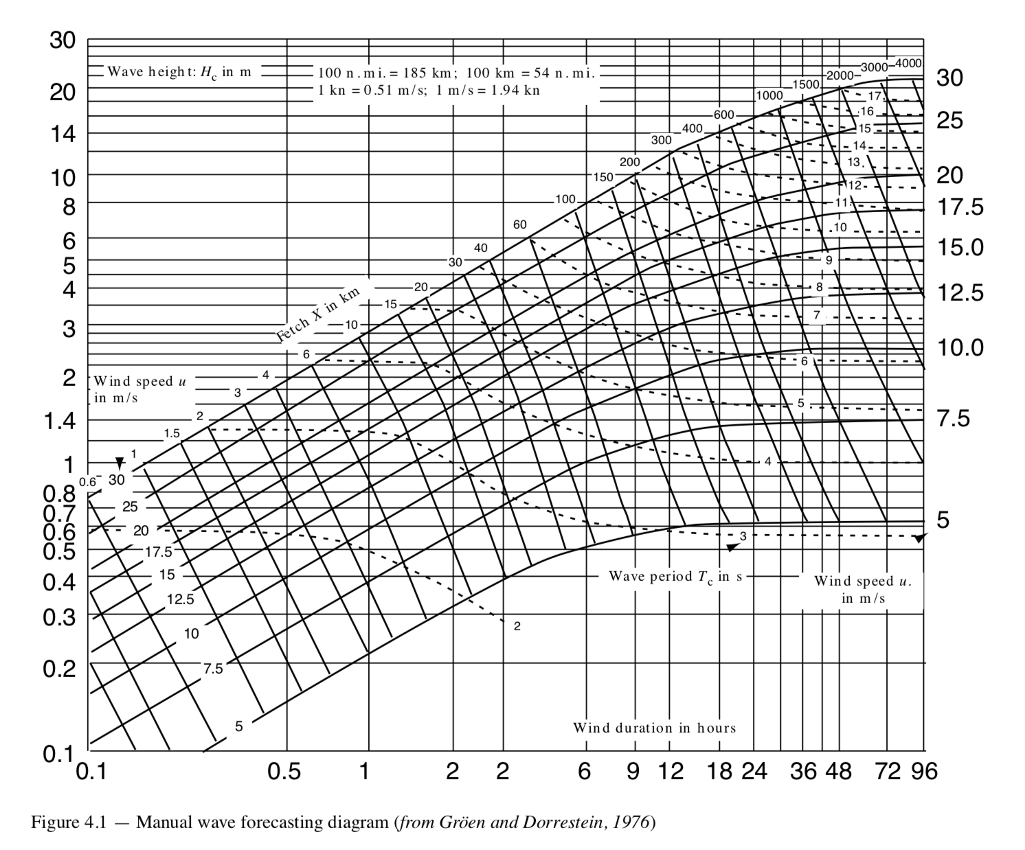
Estimating fetch and duration limitation effects on ocean waves
*
*
Wave Heights for winds of 20 m/s
for 6 hours and 12 hours

Slide 16
Effects of Air-Sea Temperature Difference - Surface stress/momentum transfer enhanced in conditions when T_{air} < SST. NW winds over the North Pacific in winter are especially effective at generating swell.
Steepness - As waves approach steepness of ~1/7, they typically begin to break. Wavelength grows faster than wave heights in most situations, which means that “young” waves are usually steeper than “old” waves.
Large, breaking waves can occur in situations where wavetrains from different directions are interfering with one another. Result: chaotic seas and large variations in wave heights with highly intermittent wave breaking possible. Example: The sinking of the Arctic Rose
L
*
Wind Waves and Swell
due to ESE 35
Swell due to
SW 30-35

Slide 17
Local, Nearshore Effects - Waves steepen when slowed and therefore are a greater hazard. (1) Shoals and bars due to bottom drag, (2) Opposing currents, generally due to tides. No coincidence that Coast Guard’s Lifeboat Training Program situated at the mouth of the Columbia River.
Numerical Modeling of Ocean Waves - Involves solving sets of complicated equations for estimating the fine-scale distributions of pressure and surface stress, and the wave-wave interactions responsible for transferring energy between various components of the wave spectra. Sea state can be important to atmosphere through impacts on surface fluxes of heat, moisture and momentum.
Garbage In, Garbage Out!

Slide 18
