Slide 1

The History and Technology of Weather Forecasting
Autumn 2025

Slide 2
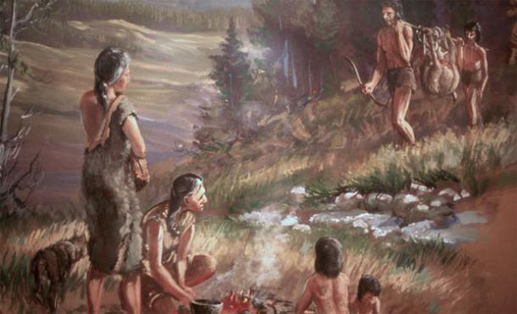
Weather forecasting is as old as our species

Slide 3
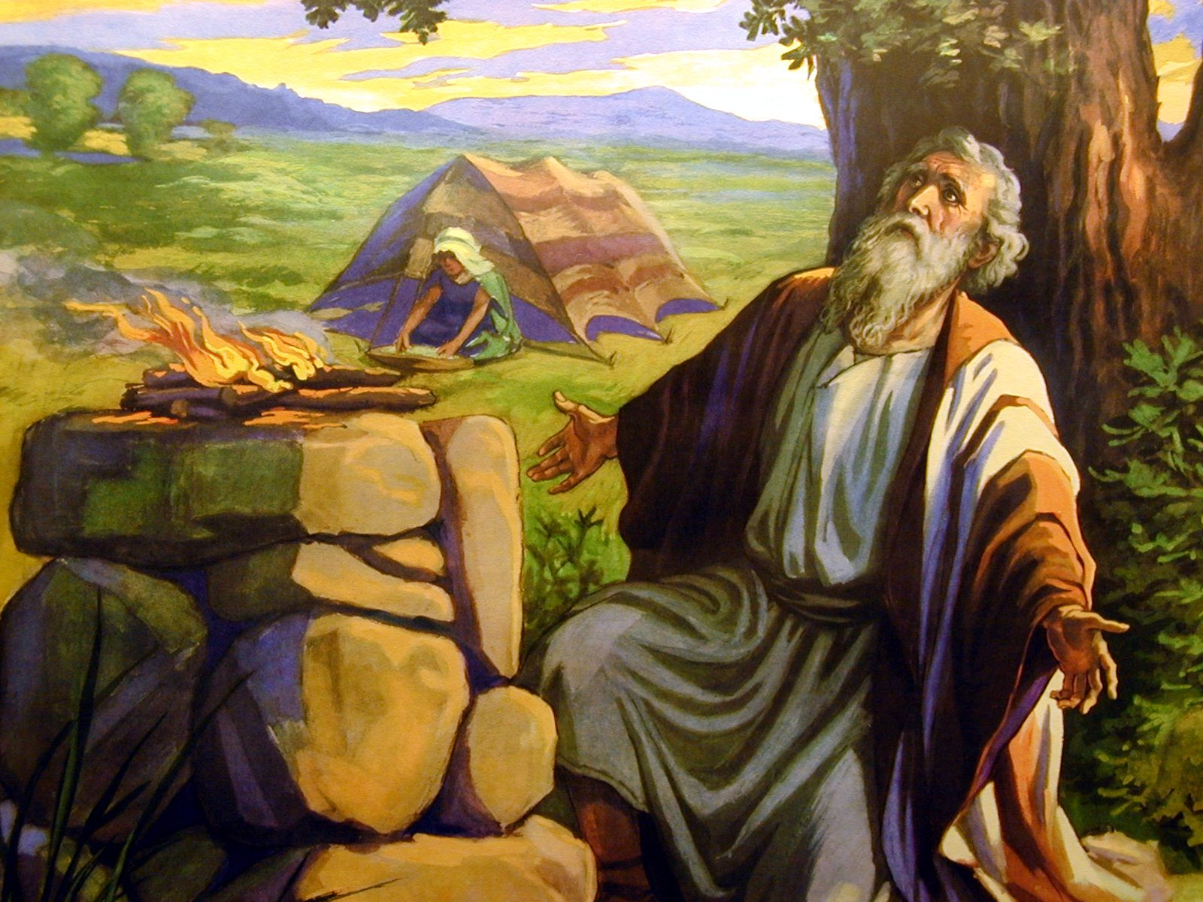
Our ancestors were keen observers of the sky and practical weather forecasting rules developed
Book of Job (37:22) states, “Fair weather cometh out of the north”
Which is true for many midlatitude locations where northerly flow is typically cool and dry.

Slide 4
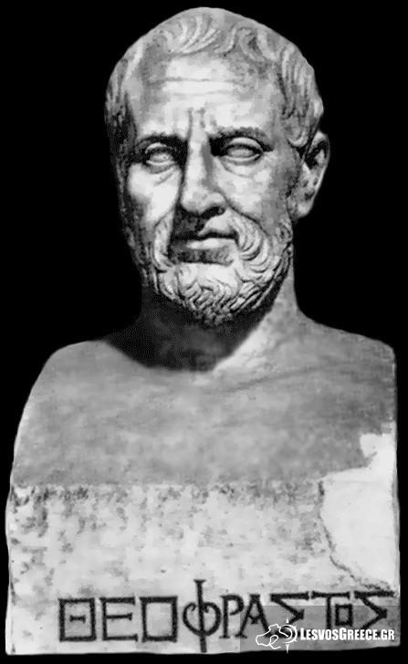
Ancient Greek Weather Advice
In Meteorologica, Aristotle suggested that a close examination of the sky could provide useful forecasts.
One of Aristotle’s pupils, Theophrastus of Ereos, wrote a volume On Weather Signs, which had many correct insights.

Slide 5
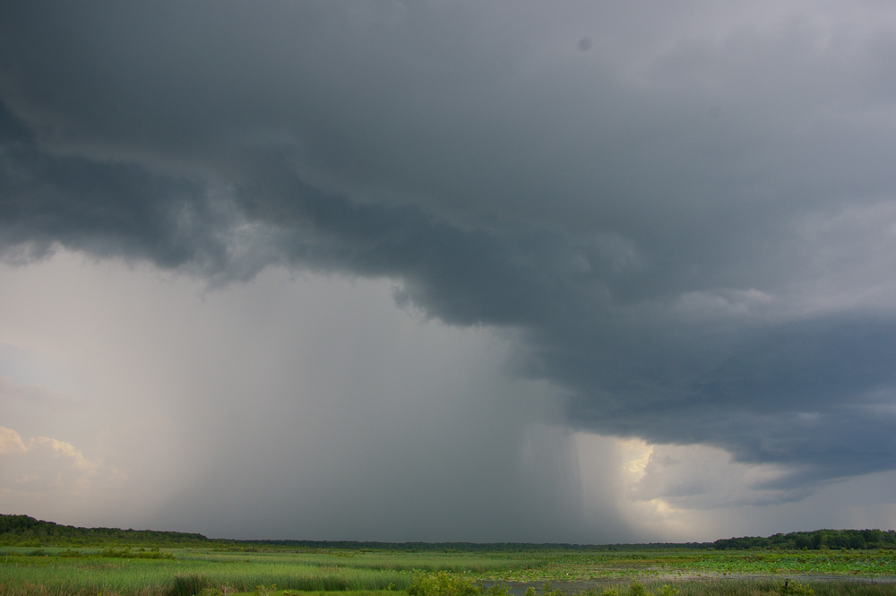
Theophrastus Example
“If the breezes come from the east or south, rain is indicated; if from the west or north, cold weather.” (generally true)

Slide 6

Ancient and Pre-Modern Societies Summarized Forecasting Wisdom in Proverbs
"Red sky at night, sailor's delight. Red sky in the morning, sailor take warning.”
"Clear moon, frost soon.”
"Halo around the sun or moon, rain or snow soon."

Slide 7
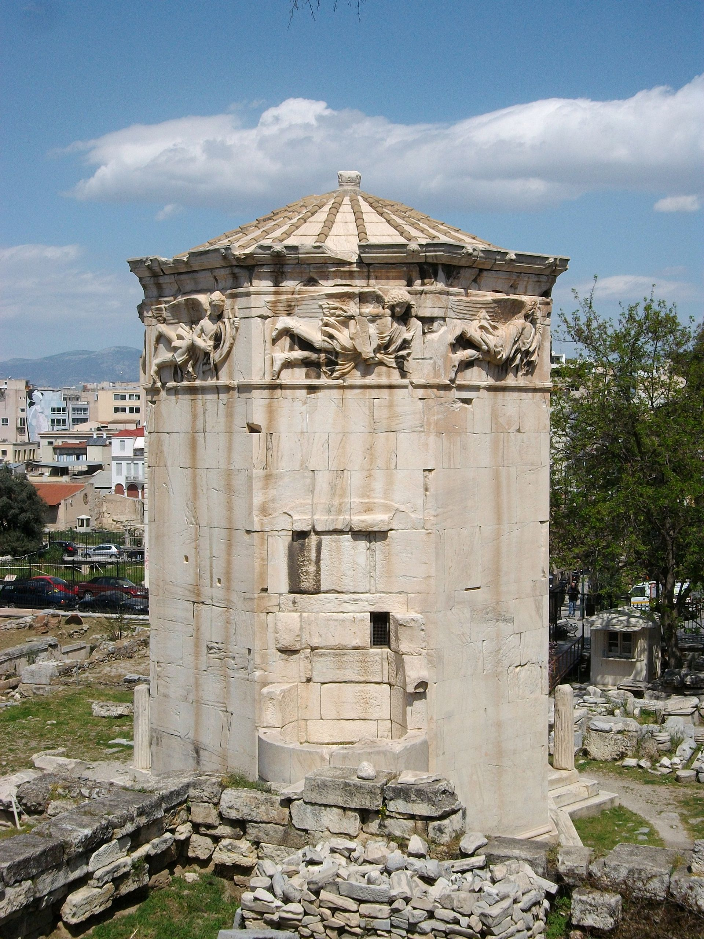
Ancient Weather Instruments
Wind vanes were perhaps the most ancient meteorological instruments.
Mesopotamian and Sumerian documents, dating back nearly 4,000 years, describe primitive wind vanes, and streamers.
Tower of the Winds, 50 BCE
Athens, Greece

Slide 8
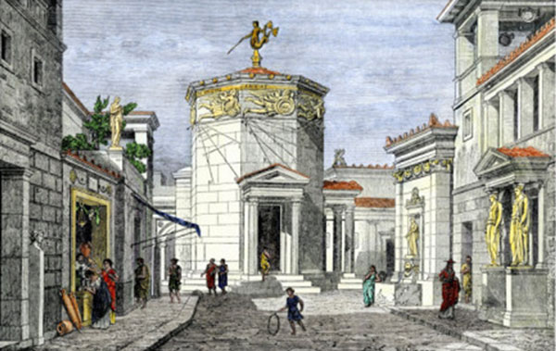
Tower of the Winds

Slide 9
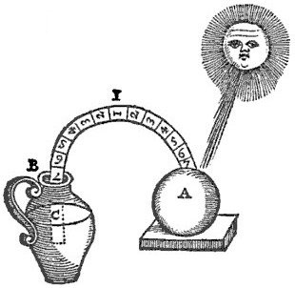
Ancient Weather Instruments
Bowls were used as rain gauges (India, 4th century BC)
First thermometer (Philo of Byzantium, 240 BC)
Philo’s
Thermometer

Slide 10
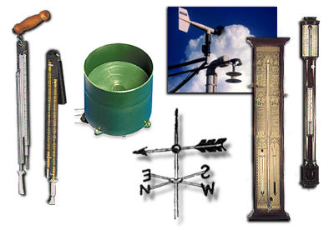
The Transition To Modern Weather Forecasting
Step 1: You need weather instruments with sufficient accuracy and reproducibility.

Slide 11

1450-1750
The Rise of Modern Weather Instruments
Around 1600 A.D., a number of experimenters, including Galileo Galilei, developed air-water thermoscopes
A tube and bulb was inserted into water; as temperature changes, the water level changes in the tube

Slide 12
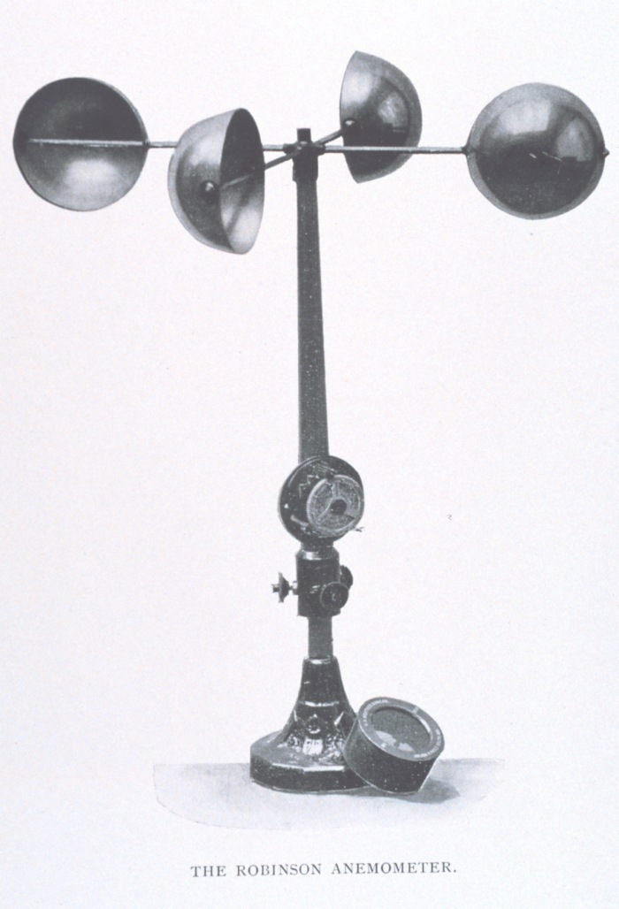
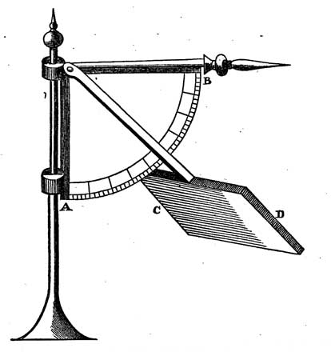
Robert Hooke (1660) Invented the Anemometer to Measure Wind Speed
In early 1800s, the cup anemometer was developed
Hooke, 1660
Anderson, 1840

Slide 13
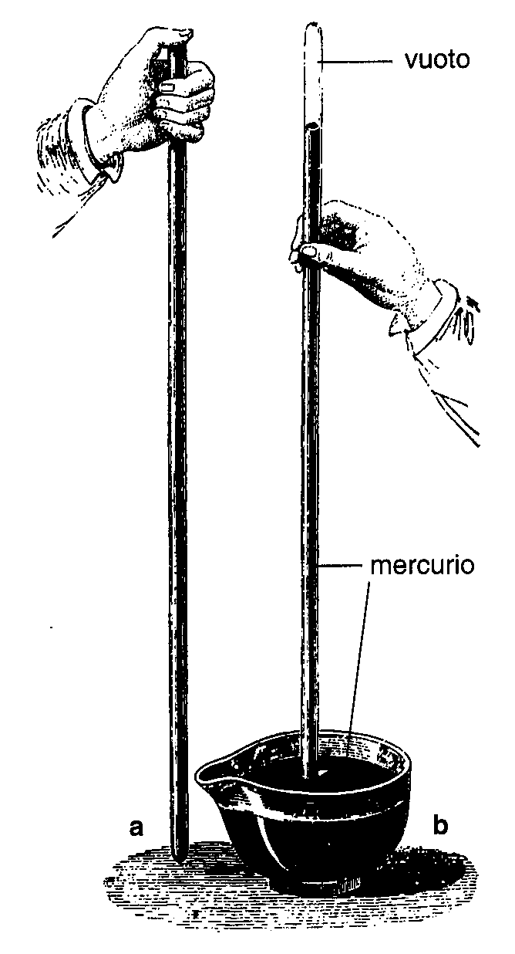
Torricelli Devised the Mercury Barometer to Measure Pressure (1644)

Slide 14
But there was a problem… the absence of universal scales for basic weather parameters such as temperature
Need universal scales to exchange weather data!

Slide 15
Solutions for Temperature
In 1665 Christian Huygens suggested using the freezing and boiling points of water as standards
1724 Daniel Fahrenheit proposed a scale with 32F for freezing and 212F for boiling and used this scale in the first mercury thermometers.
In 1742 Anders Celsius introduced the temperature scale using 0 and 100°C for freezing and boiling points.

Slide 16
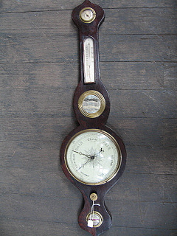
By the late 1700’s everything was in place: decent instruments and universal scales
The weather observing revolution was about to begin
Observing the weather became the high-tech craze of the period

Slide 17
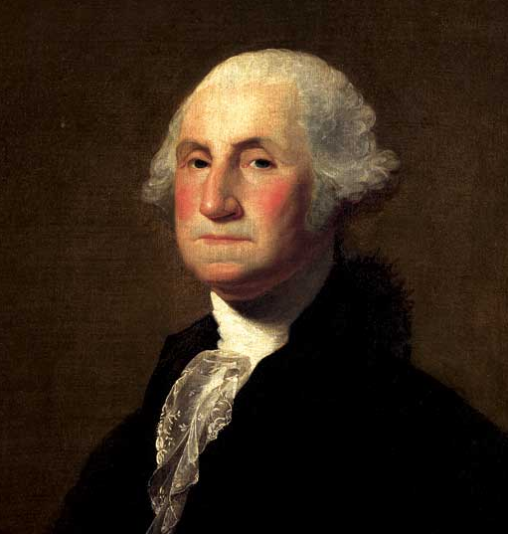
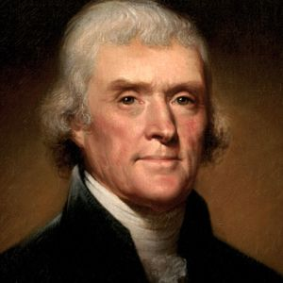
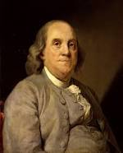
Early Weather Hobbyists
Thomas Jefferson maintained a nearly unbroken record of weather observations between 1776 and 1816. Four weather observations on July 4, 1776!
George Washington collected daily weather observations until only a few days before he died.

Slide 18
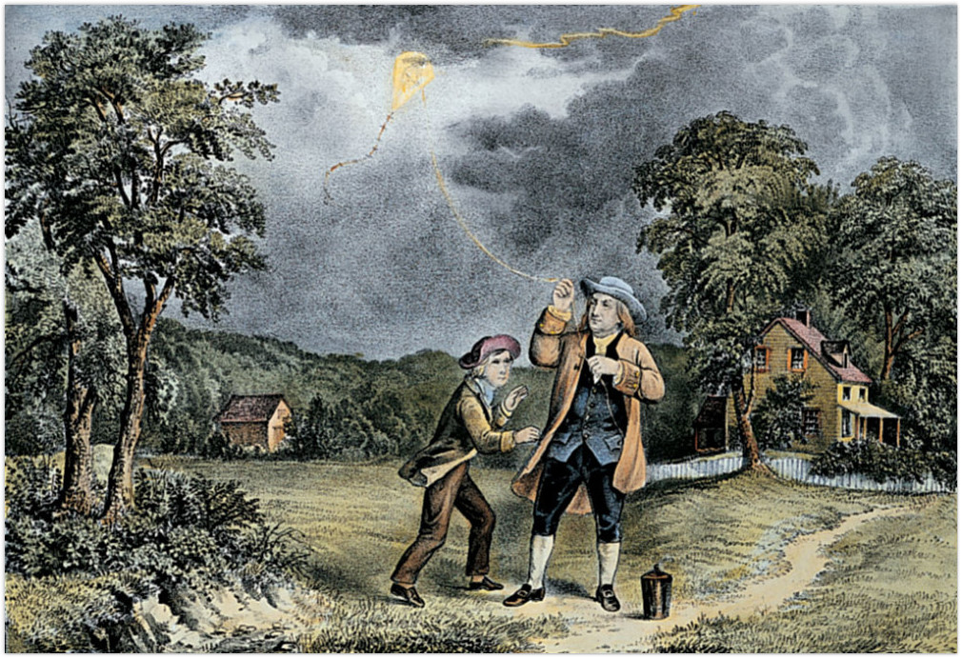
Franklin Foresaw Modern Weather Prediction

Slide 19
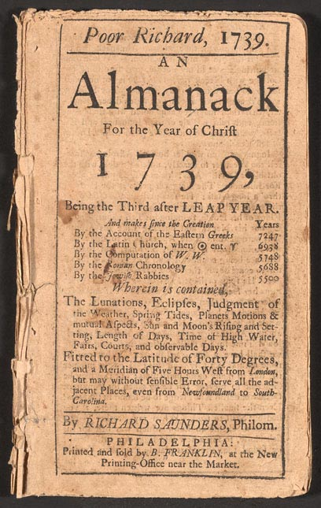
Ben Franklin, the Weather Forecaster
Franklin concluded, based on the visibility of a 1743 lunar eclipse at various locations, that a storm moved to the northeast.
Thus, it might be possible to predict storm movement if information could move faster than the storms.
Produced some of the first written weather forecasts in Poor Richard’s Almanac

Slide 20
The Weather Observing Craze
More people took weather observations in the late 1700s and early 1800s
Folks mailed weather observations to each other and the first weather networks were were begun
Example: 1792 the Mannheim (or Palatine) network included 39 stations from France, Germany, Italy, Scandinavia, Poland and Russia.

Slide 21
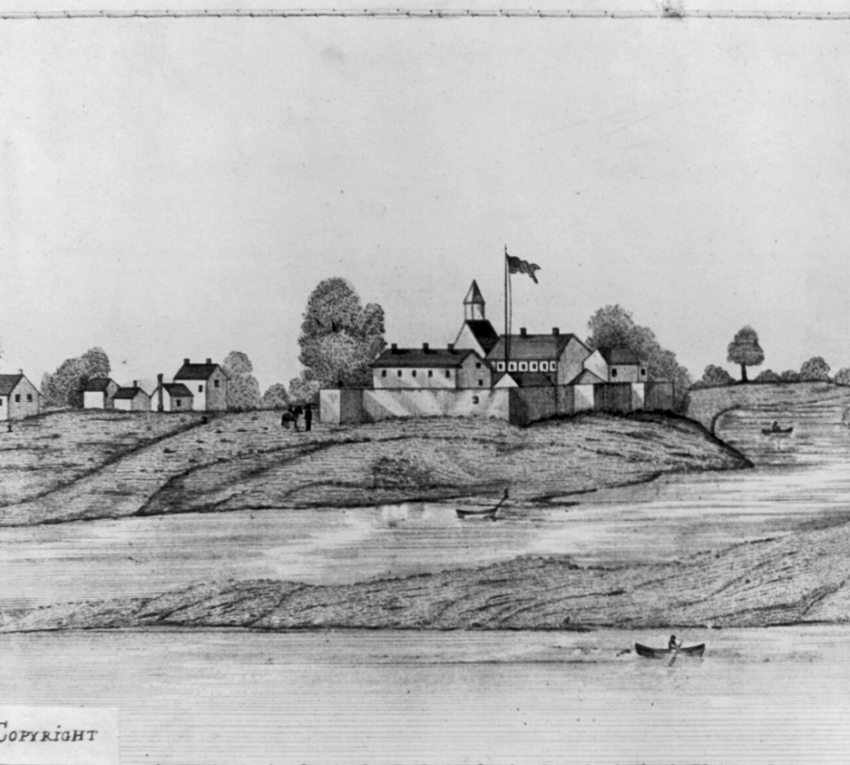
The U.S. Government Gets Involved
In 1816 all U.S. army surgeons were required to take three weather observations daily.
Other American weather networks were organized under the auspices of the U.S. Navy and the Smithsonian Institution

Slide 22
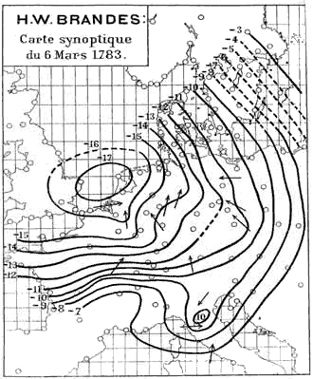
The First Weather Map (1820)
Created by H. W. Brandes for March 6, 1783.
The arrows indicate wind direction and the lines show the deviation of pressure from average conditions

Slide 23
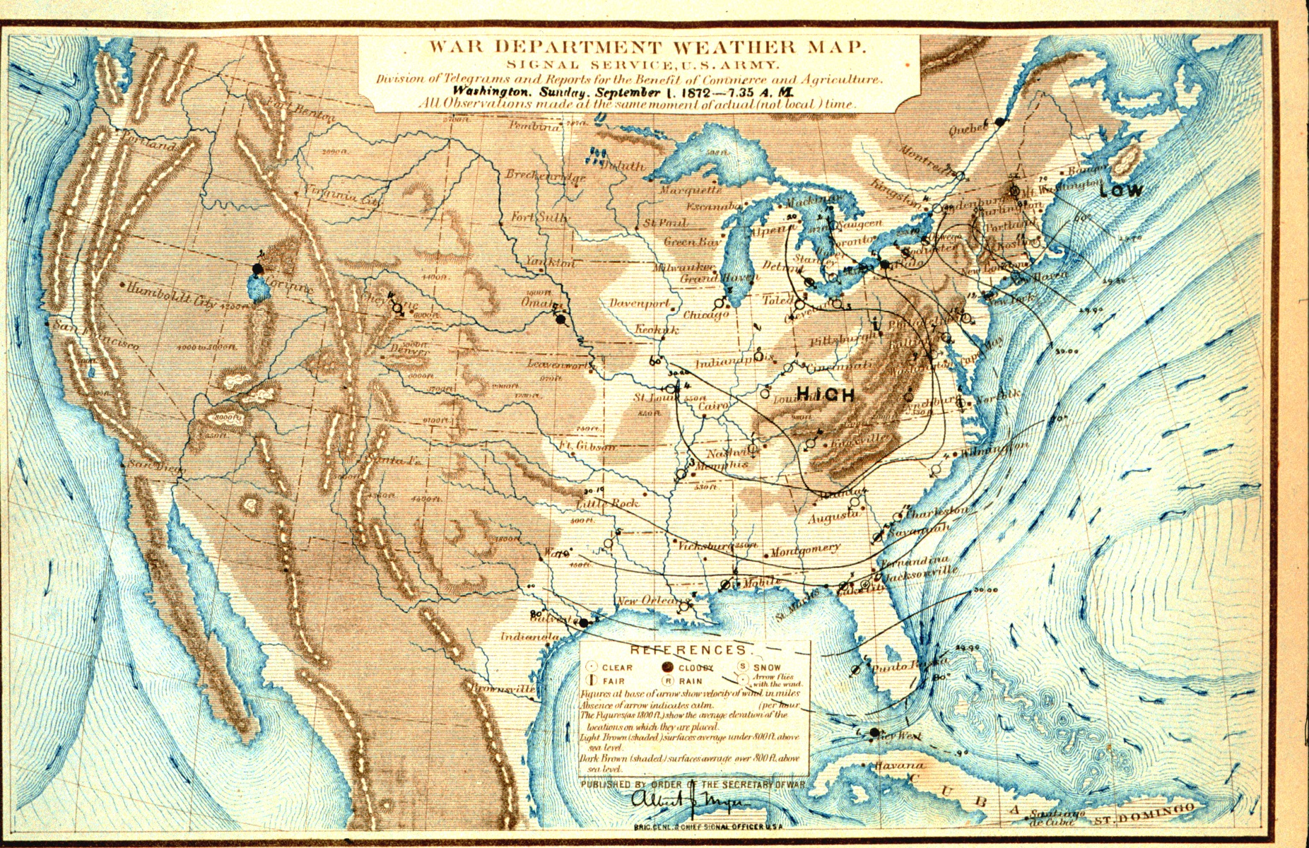
The Advent of Operational Weather Forecasting

Slide 24

There were lots of weather observations but their value was limited
Without a means for rapid communication, weather maps were created weeks or months after the observations were taken.
Weather forecasting was limited to the "local method," in which local surface and cloud observations were combined with past experience.

Slide 25
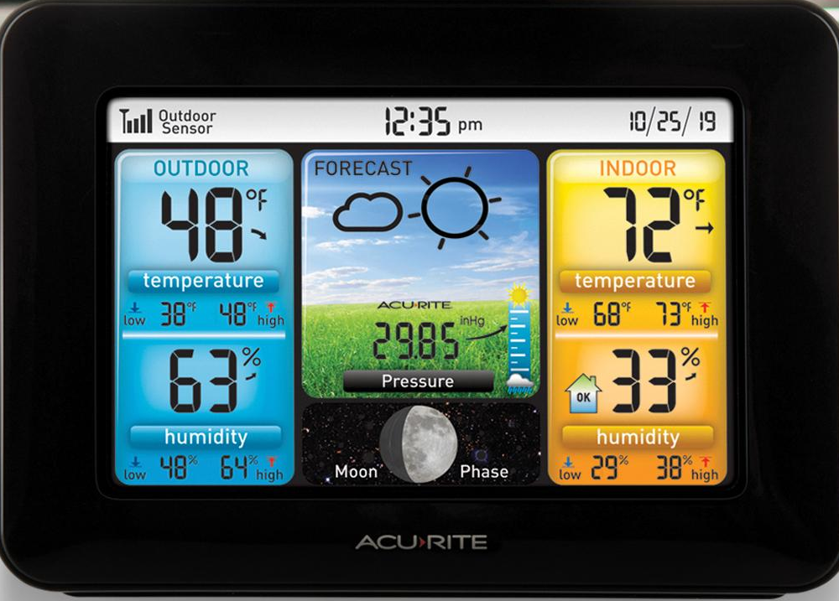
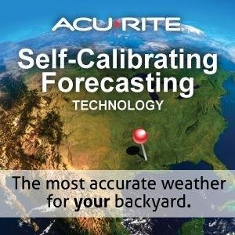
Similar Methodology Used Today for Inexpensive Weather Stations

Slide 26
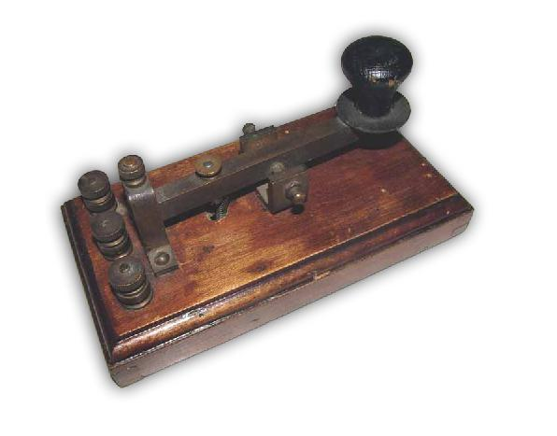
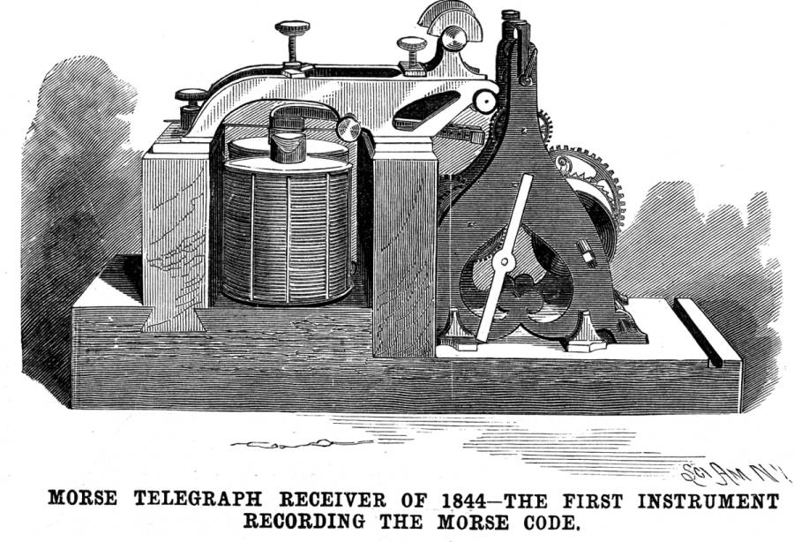
The Telegraph Changes Everything
The first practical electrical telegraph was built by Samuel Morse and Alfred Vail in 1837
In 1844, the “what hath God wrought?” message transmitted between Baltimore and Washington, D.C.
The Internet of the 1840s

Slide 27
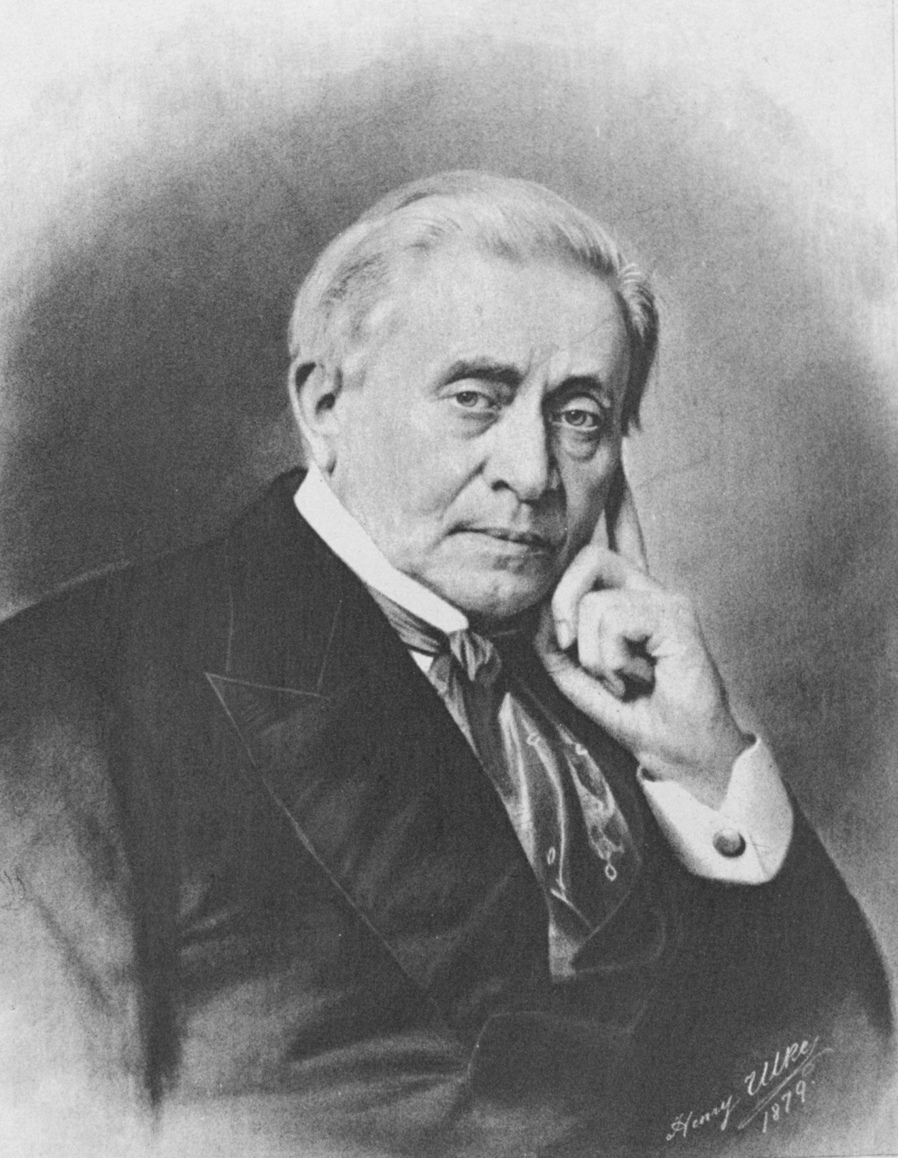
It was immediately recognized that the telegraph made weather prediction possible
Joseph Henry in 1847 provided the vision:
“… extended lines of telegraph will furnish a ready means of warning the more northern and eastern observers to be on the watch for the first appearance of an advancing storm.”

Slide 28
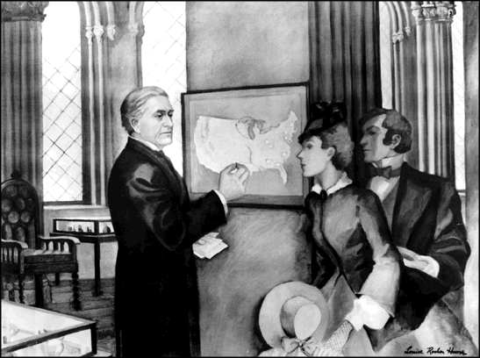
The Weather-Telegraph Revolution
In 1849, the Smithsonian created a network of roughly two-dozen telegraph operators/observers, distributing daily weather reports from around the nation.
A weather map, updated daily and based on telegraphic reports, was posted in the lobby of the Smithsonian Institution and Washington Evening Star newspaper published it in each issue.

Slide 29
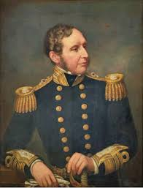
Operational Weather Prediction Begins
With telegraphic weather information, governments around the globe began to establish operational meteorological services.
In 1854 Admiral Fitzroy, famed captain of Darwin's ship the Beagle, was appointed head of the new British Meteorological Service
In 1861 began issuing daily forecasts and storm warnings.
Admiral Robert Fitzroy
Created term “weather forecast”

Slide 30
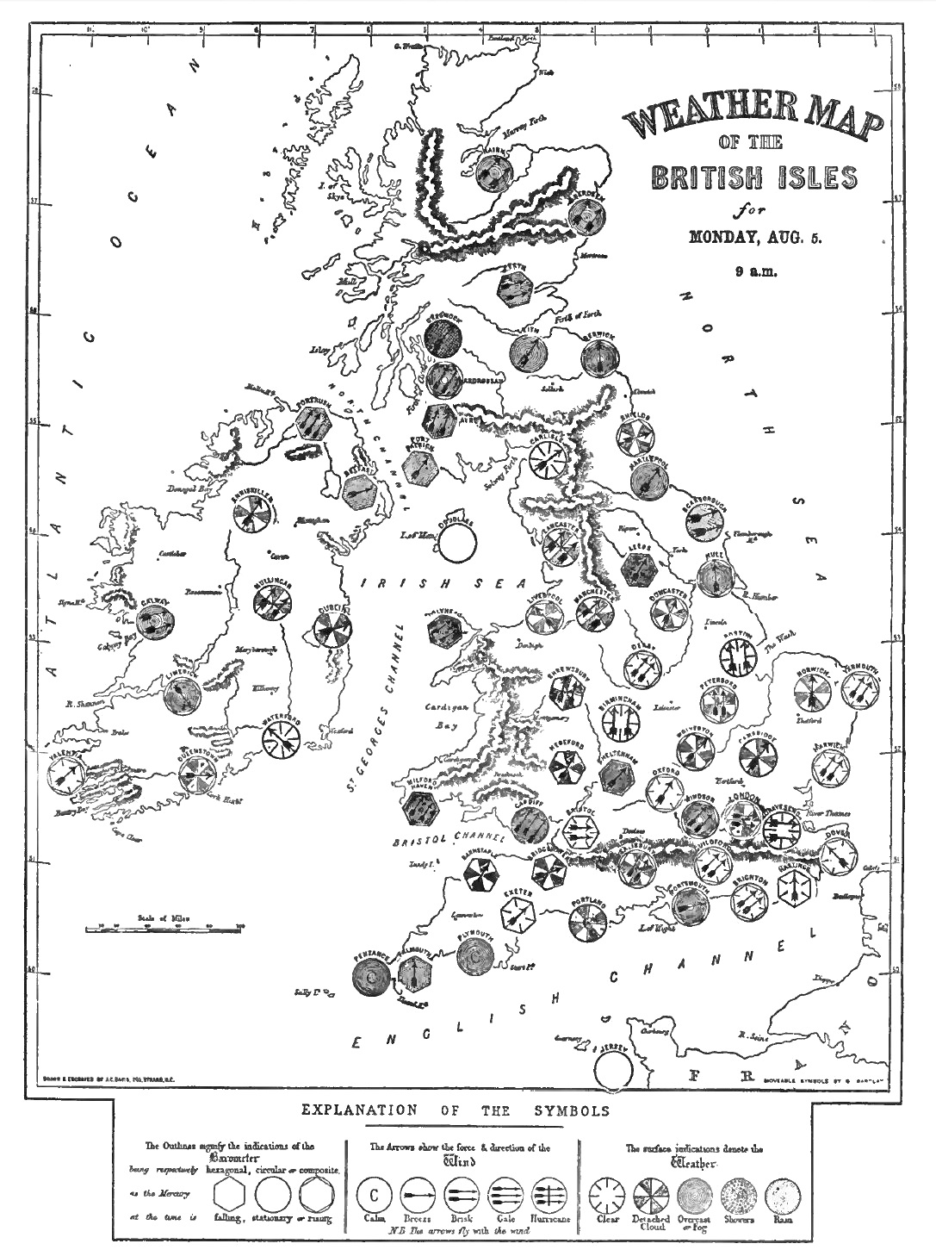
Push Back
The scientific establishment saw weather forecasting as inconsistent with proper scientific inquiry.
Fishing fleet owners objected to storm warnings, which kept ships in port.
A committee of the British Royal Society recommended that storm warnings and daily forecasts be discontinued, and in December 1866 they were terminated.
1861 Weather Map

Slide 31
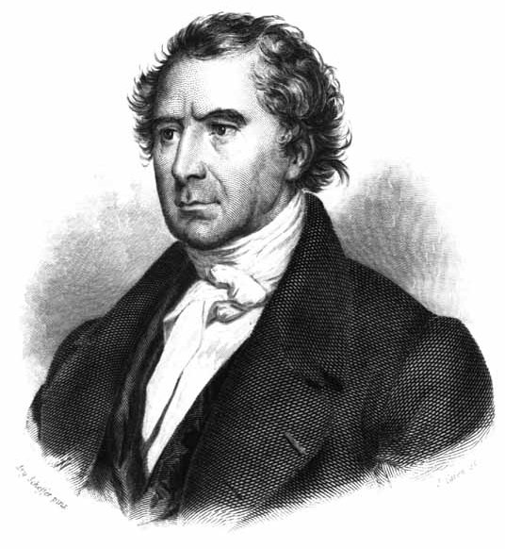
French physicist François Arago, the Director of the Paris Observatory
  “Whatever may be the progress of sciences, never will observers that are trustworthy, and careful of their reputation, venture to foretell the state of the weather.”

Slide 32
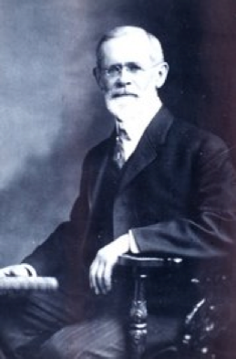
Forget Europe: The U.S. Moves Ahead
Meteorologist Cleveland Abbe, released the first U.S. public weather forecast on September 1, 1869 for Cincinnati, Ohio
In 1870, President Ulysses S. Grant authorized the establishment of a new national weather service located within the Signal Service of the U.S. Army
Ol’ Probs

Slide 33
On February 19, 1871, Abbe issued the first “official” public Weather Synopsis and Probabilities based on observations taken at 7:35 a.m.

Slide 34
"Synopsis for past twenty-four hours; the barometric pressure had diminished in the southern and Gulf states this morning; it has remained nearly stationary on the Lakes. A decided diminution has appeared unannounced in Missouri accompanied with a rapid rise in the thermometer which is felt as far east as Cincinnati; the barometer in Missouri is about four-tenths of an inch lower than on Erie and on the Gulf. Fresh north and west winds are prevailing in the north; southerly winds in the south. Probabilities [emphasis added]; it is probable that the low pressure in Missouri will make itself felt decidedly tomorrow with northerly winds and clouds on the Lakes, and brisk southerly winds on the Gulf."

Slide 35
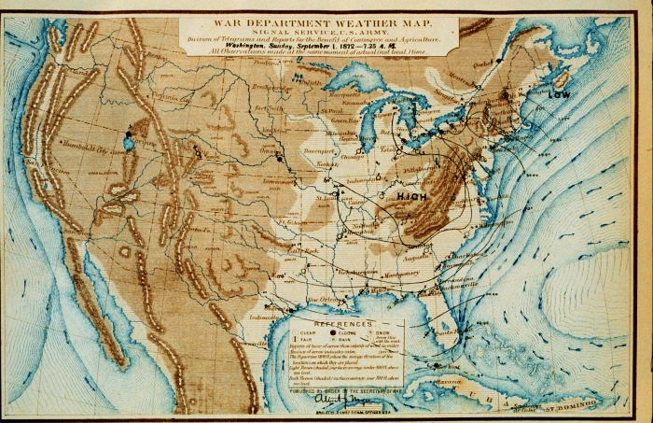
(1872) U.S. Operational Weather Maps

Slide 36
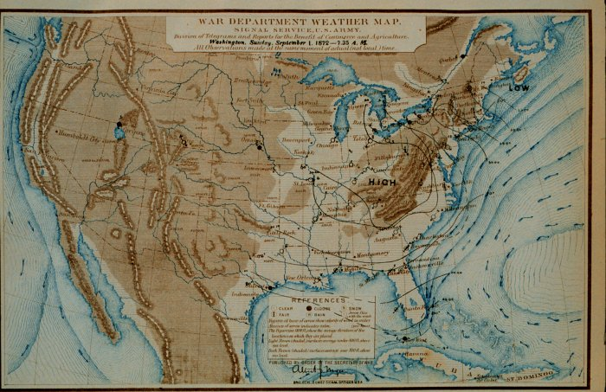
1880’s Forecasting Technology
L
L
L
Yesterday
Today
Tomorrow

Slide 37
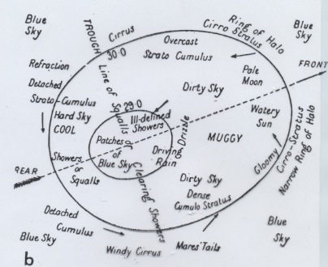
1890’s Atmospheric “Model”

Slide 38
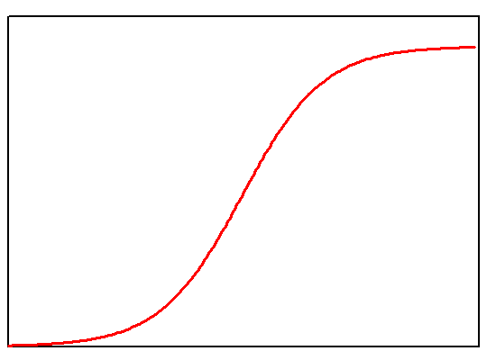
Forecast Skill Plateaus
Forecasting skill increased during the 1870s and 1880s as more observations became available.
Little understanding of the evolution of weather systems.
By the turn of the century, predictive skill had leveled off.

Slide 39
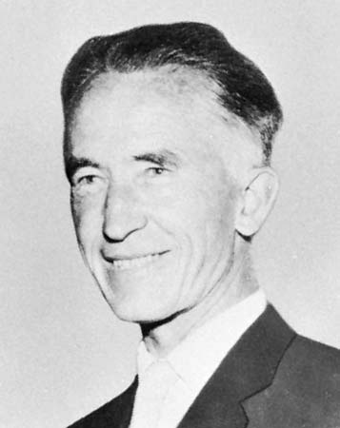
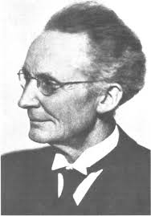
Norwegians to the Rescue (1915-1930)
Jacob Bjerknes
Vilhelm Bjerknes

Slide 40
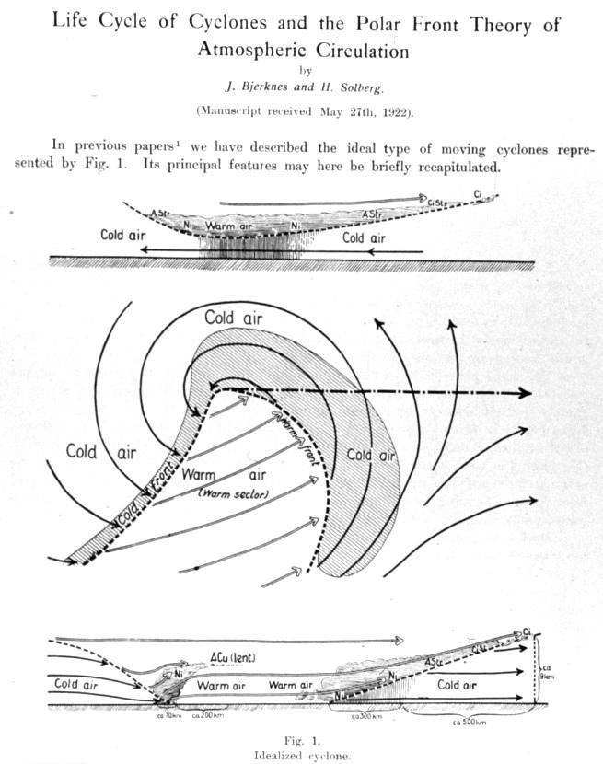
Norwegian Cyclone Model

Slide 41
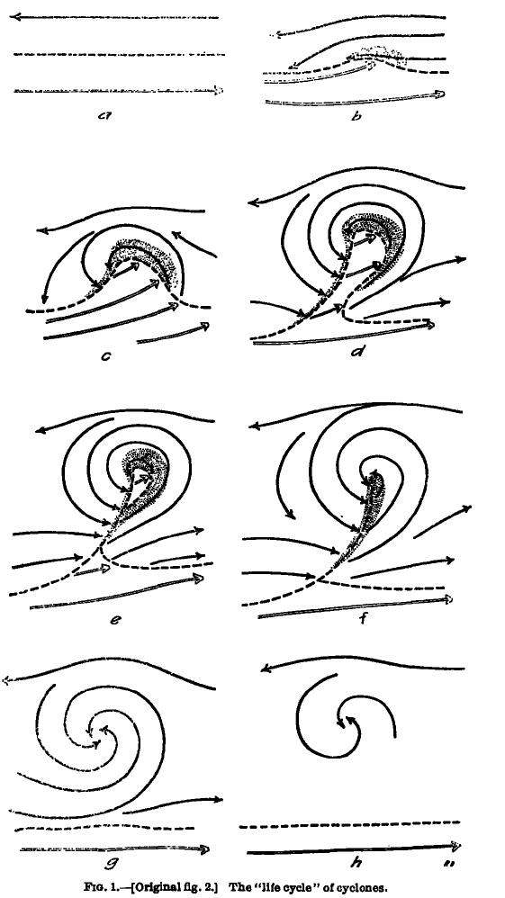
Concept of Evolution of Cyclones
Bjerknes and Solberg
1922

Slide 42
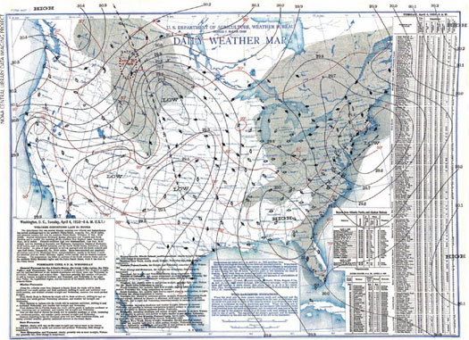
Norwegian Contribution
Now meteorologists had some idea how weather systems evolved in time.
And an idea of how fronts and weather are connected.
Major aid to weather prediction.
But still was basically qualitative.

Slide 43
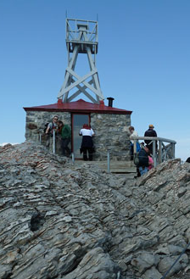
A Lack of Upper Air Observations Was Undermining Weather Prediction
The atmosphere is three dimensional and what happens aloft matters.
In 1920, a very sparse upper-air observational network:
  Mountain stations
  Kites and pilot balloons
  Limited aircraft observations.

Slide 44
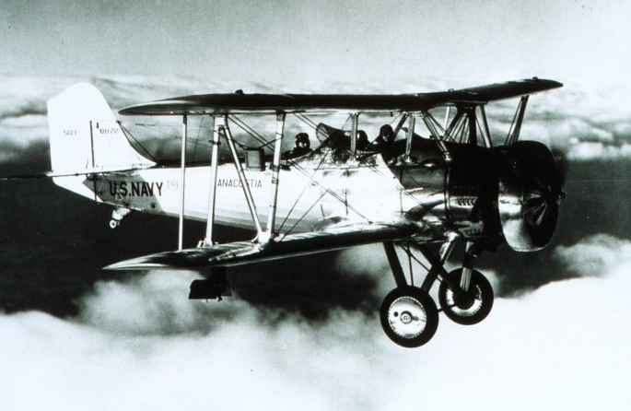
Navy bi-plane with meteorgraph on starboard wing strut, taking meteorological measurements for pressure, temperature, and humidity

Slide 45
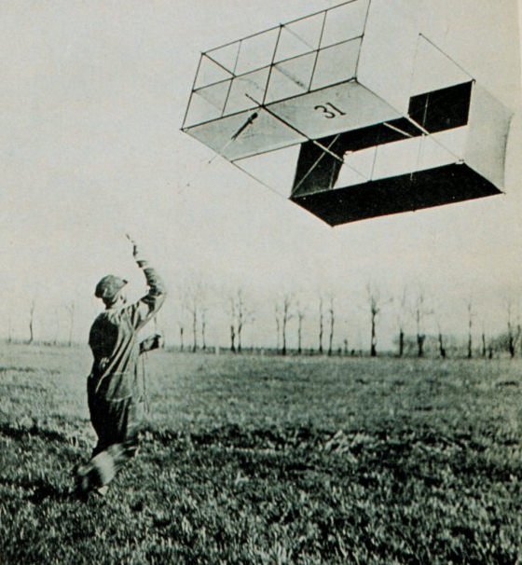
Weather Kite

Slide 46
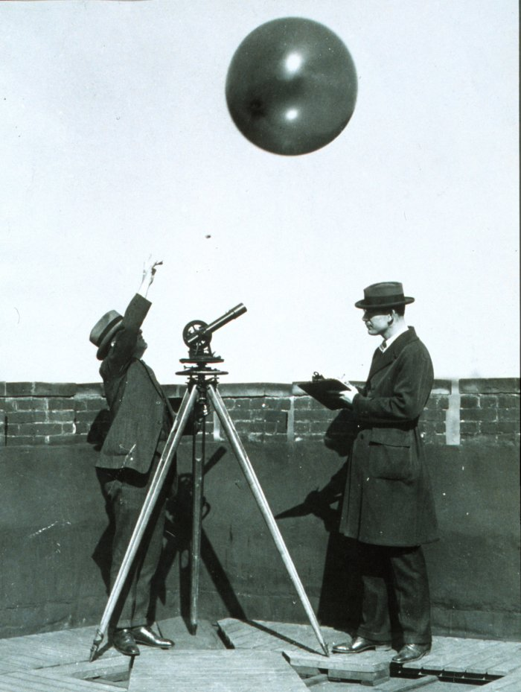
Pilot Balloons Provided Winds Aloft

Slide 47
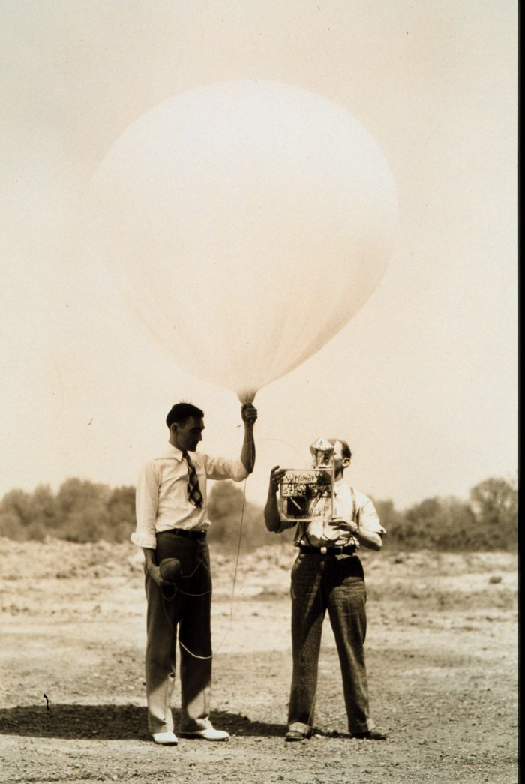
The Big Breakthrough: The Radiosonde
A radiosonde represented a portable weather station lofted by a balloon.
Sends observations back by radio.
The first instrument launched on January 7, 1929.

Slide 48
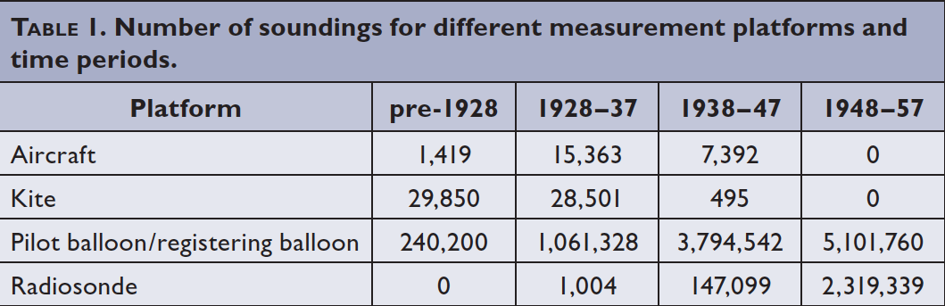
Rapid Expansion of the Upper Air Network During the 1930s and 1940s.

Slide 49
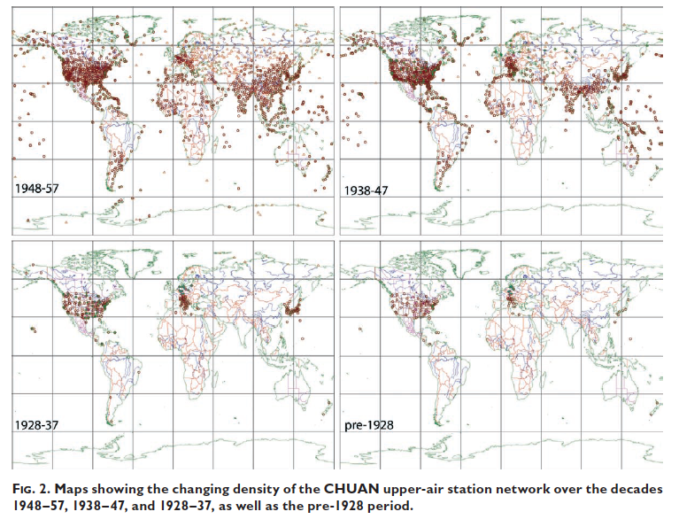

Slide 50
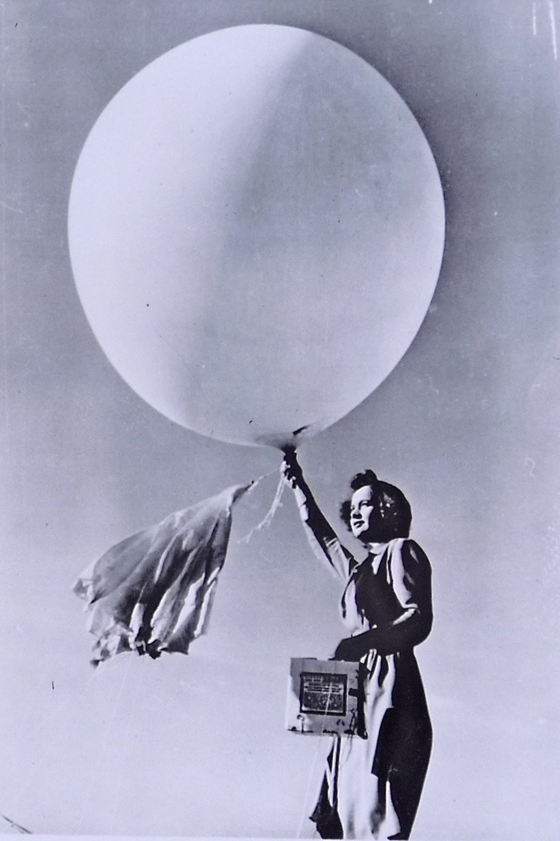
Radiosonde Data Changes Weather Prediction
Gave a 3D picture of what was happening aloft
Displayed upper-level disturbances and how they influence weather
Upper-level flow (e.g. jet streams) steered storms, and thus predicted storm movement.

Slide 51
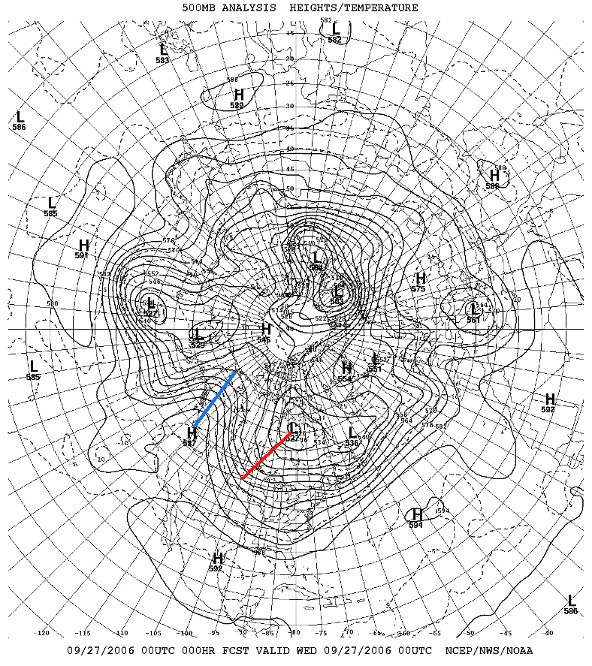
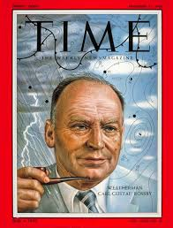
A Lot of the Seminal Work on Upper-Level Structures Done By the Chicago School (late 1940s and 1950s)
Long waves and short waves
Jet Streams
Carl-Gustof Rossby

Slide 52
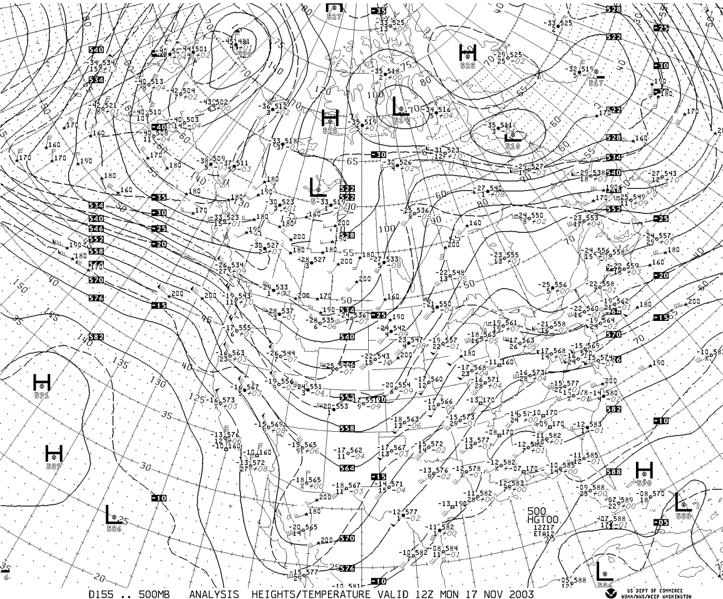
Upper
Level
Chart

Slide 53

The Development of Numerical Weather Prediction (NWP)

Slide 54

The Equations Are Revealed
During the 19th century, all the basic equations describing the physics of the atmosphere became known.
  Conservation of momentum
  Conservation of energy
  Conservation of mass
  Conservation of water

Slide 55

The “Primitive” Equations

Slide 56


The Idea is Born
In 1904, Vilhelm Bjerknes suggested that the primitive equations could predict the future atmosphere.
But NWP wasn’t practical because there was no way to do the computations quickly and 3D data for starting the forecasts did not exist.

Slide 57
Predicting the Future
F = ma
If we can observe the atmosphere, we know m, the amount of mass
We also can calculate all the forces, F (such as forces due to differences in pressure)
Thus, we can calculate the acceleration, a.
Acceleration is the change of velocity in time.
THUS, WE KNOW THE FUTURE!

Slide 58

Newton’s Second Law (F=ma) has a LOT of potential for atmospheric scientists
If we know the mass of an air parcel and the forces acting on it, we can calculate its acceleration, how velocity will change in time!

Slide 59

Numerical Weather Prediction
The basic idea is that if you can determine the current state of the atmosphere (known as the initialization) , you can predict the future using the equations that describe the physics of the atmosphere.
These equations can be solved on a three-dimensional grid.

Slide 60






Observations Collected to Create the Initialization

Slide 61

L. F. Richardson: An Insightful But Unsuccessful Attempt at Numerical Prediction
As a Quaker ambulance driver in WWI he worked on the problem.
In 1922 Richardson published a book Weather Prediction by Numerical Process that described an approach to using the primitive equations: solving the equations on a grid using finite differences

Slide 62

L. F. Richardson
He attempted to make a numerical forecast using a mechanical calculator
Unfortunately, the results were not good, probably because of problems with his initial conditions and long time step.

Slide 63

L. F. Richardson
He imagined a giant theater filled with humans using mechanical calculators…
Practical NWP had to wait until a way of doing the computations quickly was developed and more data…especially aloft… became available.

Slide 64

World War II: Radiosondes, Weather Radar, Observing Systems, Computers

Slide 65
The Dream of Numerical Weather Prediction Becomes Possible
By the mid to late 1940’s there was an extensive upper air radiosonde network. Thus, a reasonable 3-D description of the atmosphere was possible.
Also during this period digital programmable computers were becoming available …the first being the ENIAC

Slide 66

The Eniac

Slide 67

The First Successful Numerical Weather Prediction
Took place in April 1950, using the ENIAC
The prediction was for 500-mb height over North America, using a two-dimensional grid with 270 points about 700 km apart.
One level model The results were clearly superior to human subjective prediction.
The NWP era had begun.

Slide 68


Slide 69
Faster Computers Drove Better Weather Prediction
Resolution increases (distance between grid points decrease): 1958: 380 km, 1985: 80 km, 1995: 40 km, 2000: 22 km, 2002: 12 km, 2008: 4 km
Better description of physical processes. Like clouds and radiation.
Better use of observations: improved data assimilation

Slide 70


Slide 71

NGM, 80 km,
1995

Slide 72

1995

Slide 73

2007-2008
4-km grid spacing

Slide 74

1.3 km grid
spacing

Slide 75

But there was another revolution… in weather observations, with weather satellites taking the lead
There was little data over most of the planet (oceans, polar regions)
Storms could approach the coast without warning and numerical modeling was crippled by lack of data.
1938 Hurricane

Slide 76


TIROS-1: The First Weather Satellite (polar orbiter)

Slide 77

First
Weather
Satellite
Image

Slide 78

Starting in 1974, NOAA GOES (Geostationary) Satellite

Slide 79

Weather Satellites Now View the Entire Planet

Slide 80

Cloud Track Winds

Slide 81

Satellite Sensors Provide Thousands of High Quality Vertical Soundings Daily over the Pacific

Slide 82

Because of weather satellites, forecast skill is the same in the northern and southern hemispheres

Slide 83

Example: The Pacific Data Void No Longer Exists

Slide 84

Weather Radar Revolutionizes Short-Term Prediction

Slide 85


Radar was first used operationally in WWII by the British to track German planes
But heavy precipitation got in the way!

Slide 86


After WWII Meteorologists Experimented with Military Radars

Slide 87

Hurricane Radar Image

Slide 88


In the late 1950’s a meteorological radar network was established in the U.S.

Slide 89


In the late 1980s,
the NWS put in a network of Doppler weather radars

Slide 90

Hook Echo of Supercell Thunderstorm with Tornado

Slide 91
Weather Radar Data is Now Being Used for Initialization of High Resolution Weather Models, Such as HRRR

Slide 92

A Fundamental Problem
The way we have been forecasting has been essentially flawed.
The atmosphere is a chaotic system, in which small uncertainties in how we start the forecast (the initialization) have large impacts on the forecasts.
Not unlike a pinball game….

Slide 93

A Fundamental Problem
Similarly, there are uncertainties in processes, like the development of clouds and precipitation, which produce uncertainty in forecasts.
Thus, all forecasts have uncertainty.
The uncertainty generally increases in time.

Slide 94

This is Ridiculous!

Slide 95

Forecast Probabilistically
Weather forecasters need to tell users about the uncertainties in the forecast.
Give forecasts in terms of probabilities.
There is an approach to produce such guidance …ensemble forecasts

Slide 96

Ensemble Prediction
Instead of making one forecast…make many…each with a slightly different initializations or different model physics.
Possible to do this now with the vastly greater computation resources that are available.

Slide 97


Slide 98
Ensemble Prediction
Ensemble can give probabilities.
The ensemble mean is more accurate than any individual member.
Ensembles will dominate forecasting in the future.

Slide 99


Slide 100


Slide 101
The Numerical Forecasts Can Be Improved by Statistical Means
Called statistical post-processing
Can reduce biases and systematic errors
Recently, machine learning has been used to do this

Slide 102
Statistical Post-Processing
Start with forecasts from many difference groups (e.g., NWS, other countries, etc)
Obtain a history of their past performance
Combine these forecasts by weighting them based on past performance.
Can be much better than individual forecasts.

Slide 103


Better Statistical Post Processing Explains Why Some Private Sector Firms Have Superior Forecasts

Slide 104


Communication: From TV to Smartphones
Over a thousand weather apps are now available for smartphones

Slide 105
The Future of Weather Forecasting
As computer get faster, there will be a transition to higher resolution, more specific forecasts and more probabilistic information.
Forecast skill will be pushed out in time—more skill at longer projections.

Slide 106

The Future of Weather Forecasting
But there are theoretical limits and we will probably never be able to forecast specific weather features out past about 2 weeks.
Machine learning may be able to replace the equations we now use.

Slide 107

Probably not….

Slide 108

Although Star Trek Next Generation had this Technology!

