Slide 1
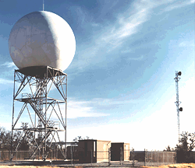
Weather Radar 101 Autumn 2025

Slide 2
Weather Radar 101
Weather radars determine where precipitation is falling
Can also tell the intensity of the precipitation
Doppler radars can also determine the speed/velocity of precipitation toward or away from the radar.
Radars can track storms, fronts, and other major features
An essential tool for the National Weather Service and other meteorologists.

Slide 3
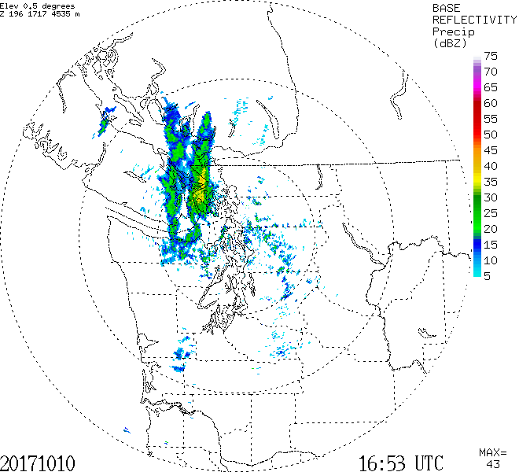
Weather Radar Can Enhance Your Life If You Know How to Interpret it (You will!)

Slide 4
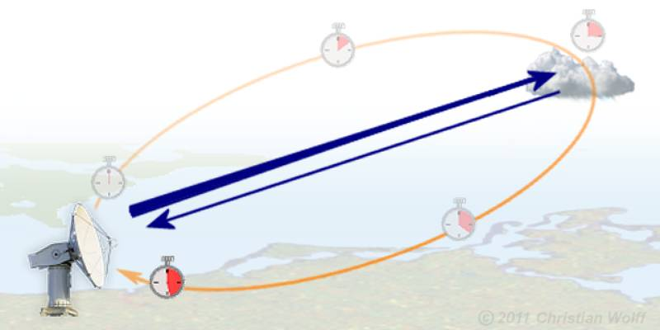
What is Radar?
RAdio Detection And Ranging
Weather radars emit pulses of electromagnetic radiation in the microwave part of the electromagnetic spectrum
Radar wave pulses hit and are reflected/scattered back from targets (often precipitation)

Slide 5
What is Radar?
RAdio Detection And Ranging
The time it takes to return tells the distance
The amount of return tells us about precipitation intensity and type

Slide 6
Radar waves move at the speed of light (186,000 miles per second in a vacuum). Thus, the time from emission to return tells how far the object is away.

Slide 7
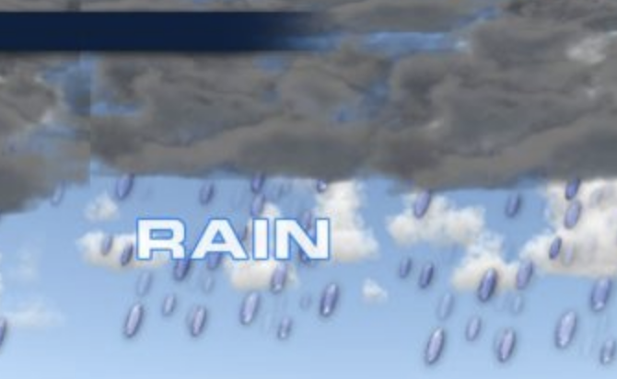
The amount of radar signal returned tells one about the nature of the object: type and intensity of precipitation
Amount scattered back ~ D⁶ where D is the diameter of the target
Big objects (e.g., large rain drops associated with heavy rain)---big radar return
Small objects (small droplets)—lesser return
More objects—more return

Slide 8
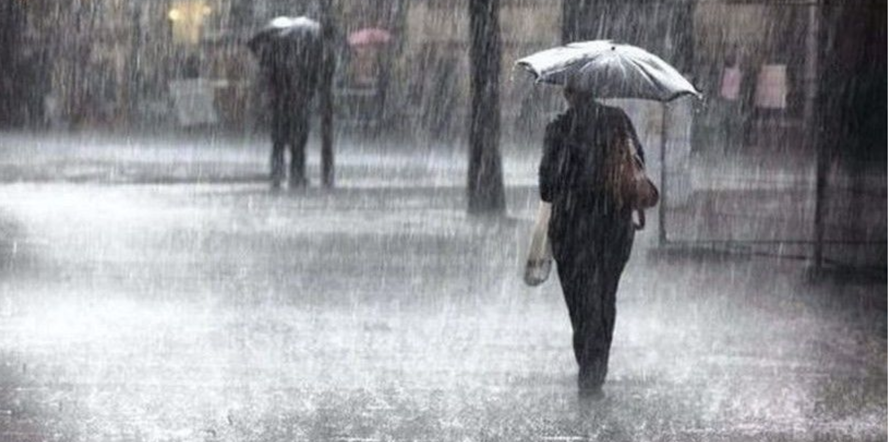
Thus, heavy rain with lots of big droplets give a big radar return!

Slide 9
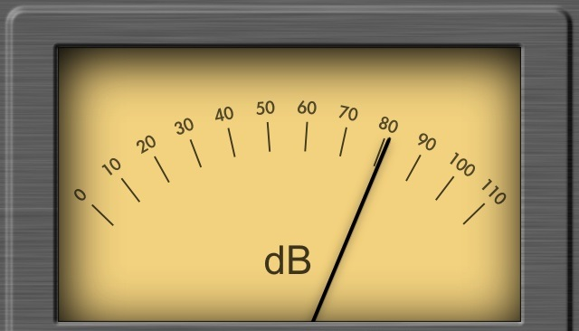
Reflectivity
A fancy name for the amount of radar signal that is returned by an object: reflectivity (Z) is given in units of dbZ
db or decibels-unit of power on a logarithmic scale
Precipitation intensity is proportional to Z (or dbZ)

Slide 10
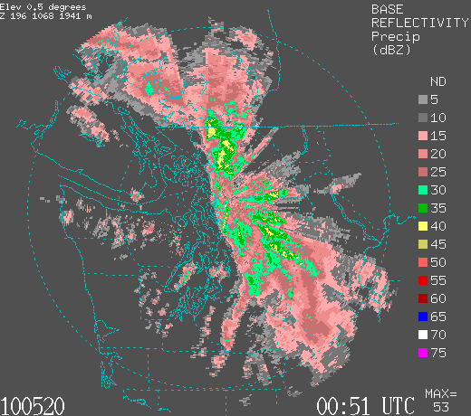
Reading a Radar Image
Intensity of precipitation is color coded (units—dbZ)

Slide 11
Reading a Radar Image (color scales can vary)
Black (white in some)-no precip
Grey and pink (5-20 dbZ)…light rain…not too bad.
Dark pink to green-moderate rain (20-35)
Yellows are heavy rain 40-50 (forget it)
Reds and higher (very heavy rain or hail)

Slide 12
Reading a Radar Image
Radar beam can be blocked by mountains
Time is in UTC (GMT).

Slide 13
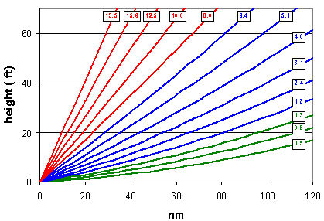
Radar Imagery is generally not observed or displayed for a level surface
Radars scan in azimuth ( 0 to 360 degrees) at a series of increasing scan angles from the horizontal.

Slide 14
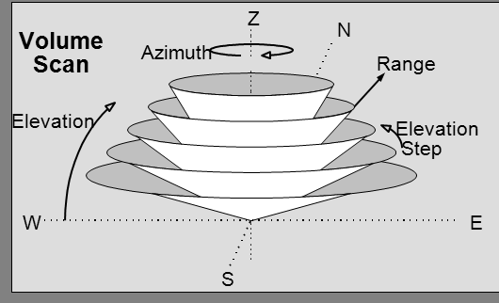

Slide 15
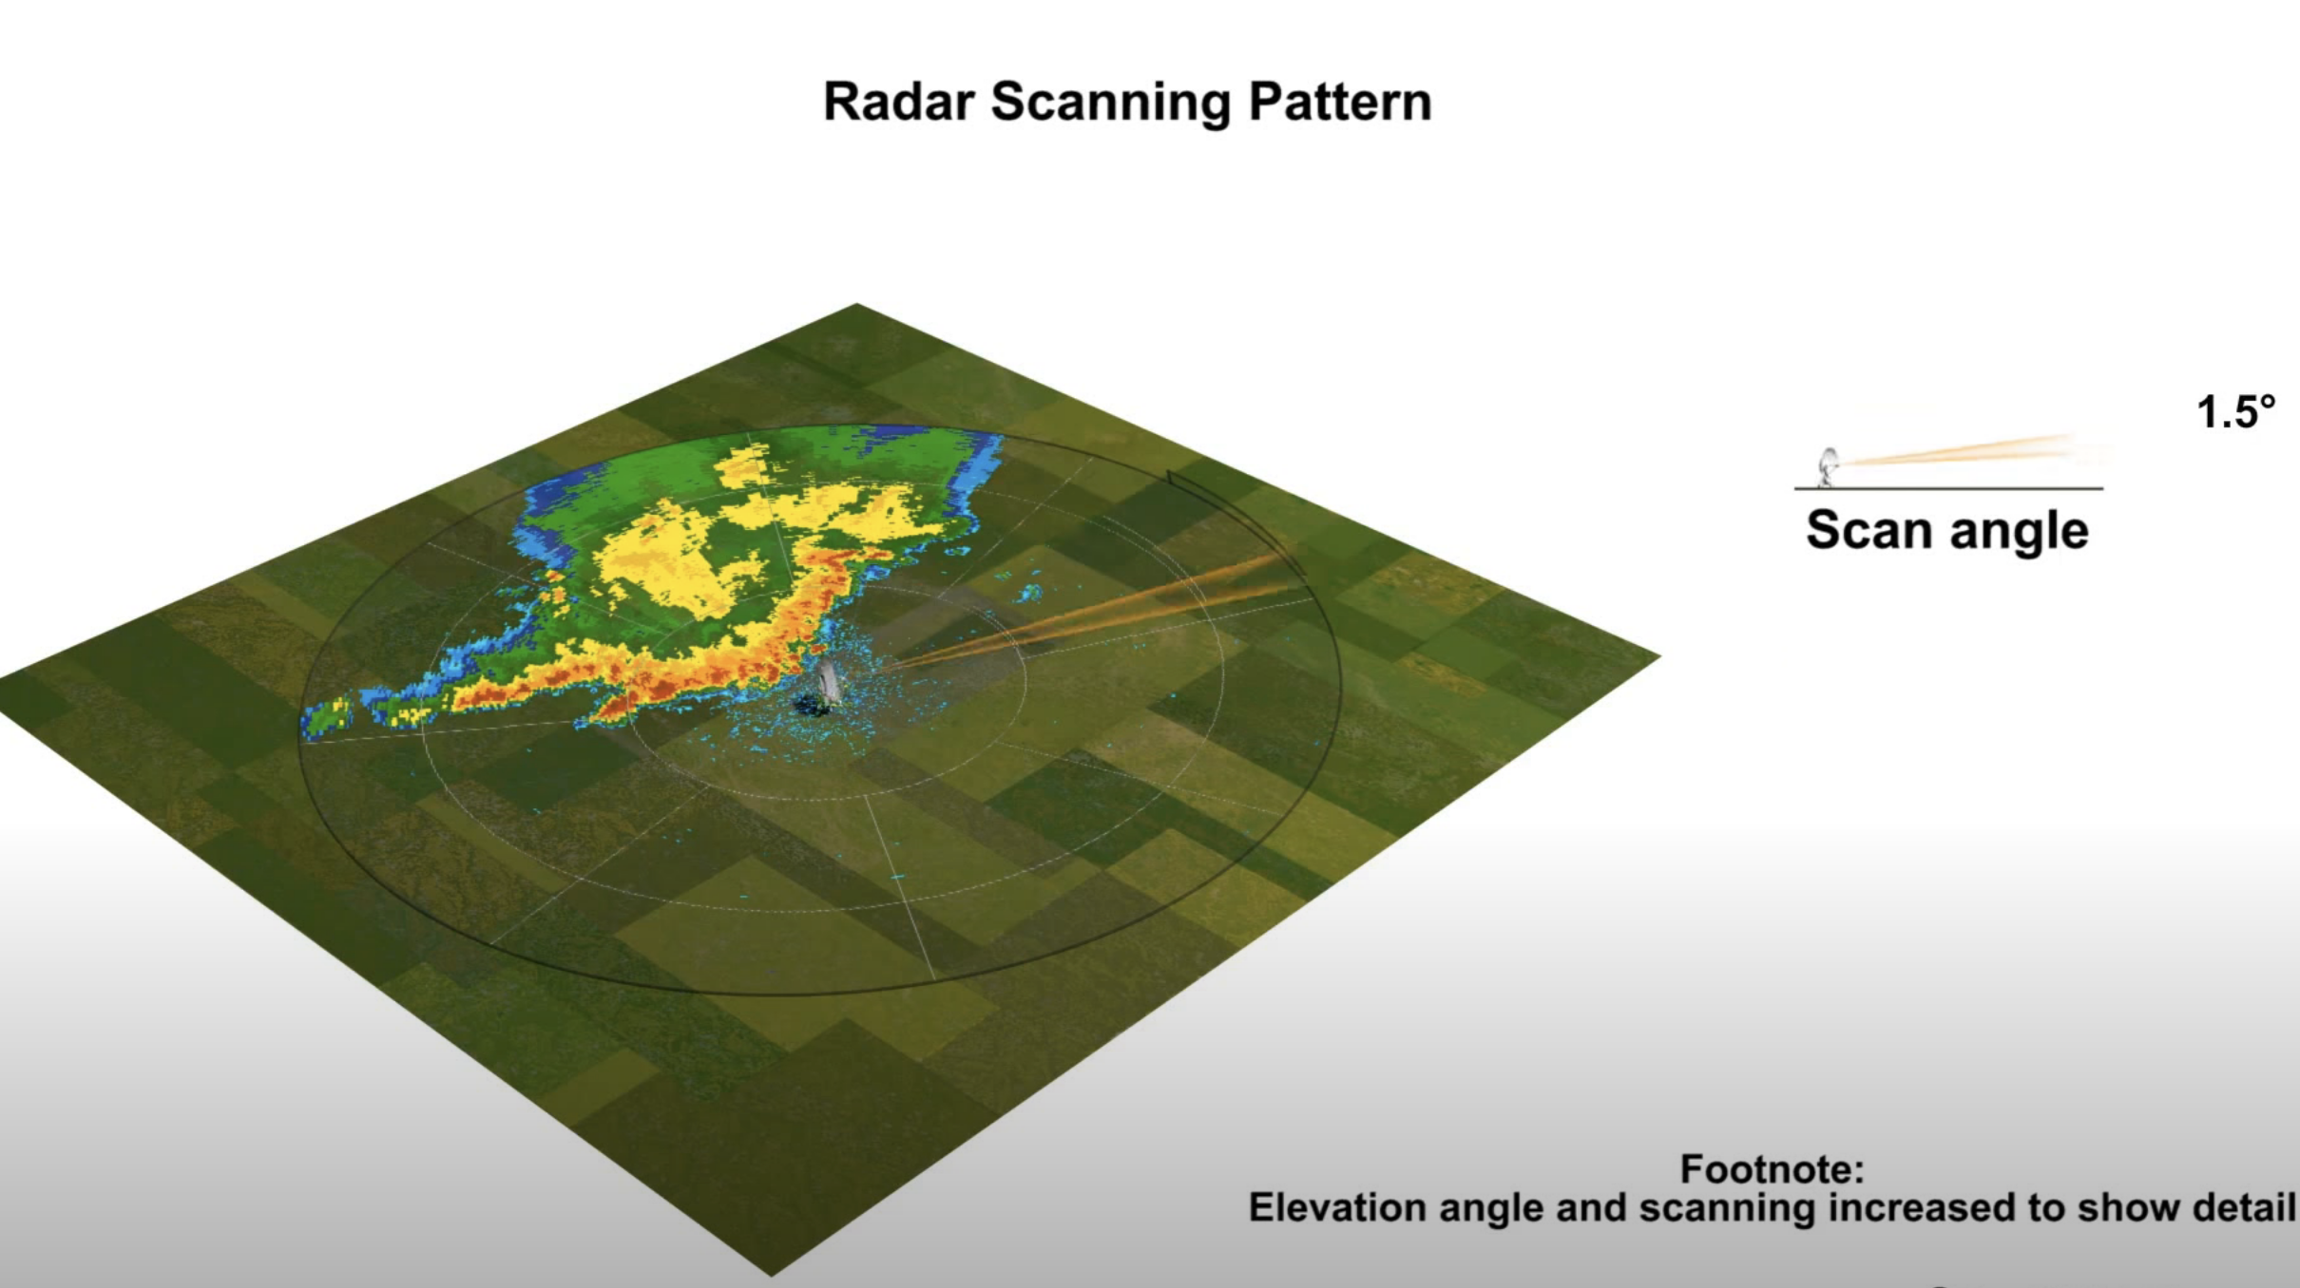
Radar image does not show a single level, but a sloping cut through the atmosphere
Thus, shows precipitation higher and higher in the atmosphere as you move away from the center of the radar image.
https://www.youtube.com/watch?v=Yrq2TVdM8HI

Slide 16
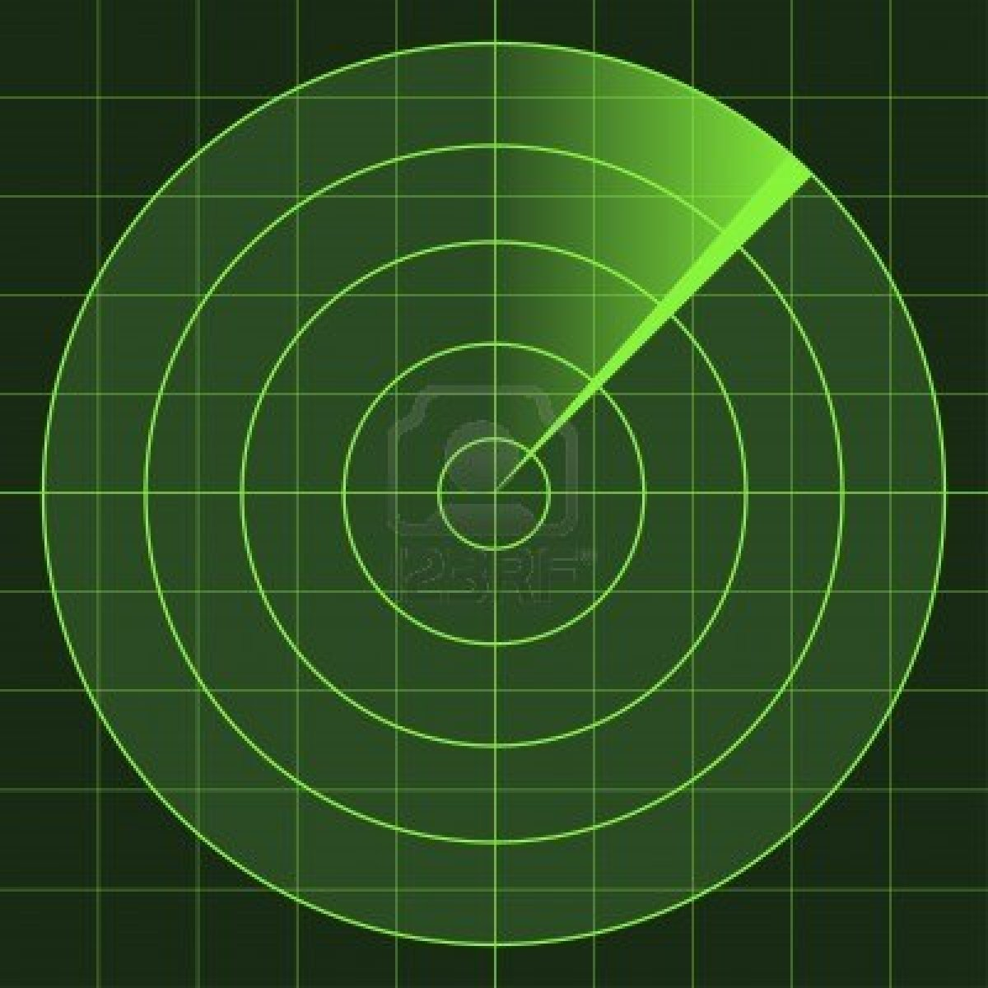
Radar imagery is generally shown on a polar-type chart with range circles at increasing distance
Radar
location
Higher
Lower

Slide 17
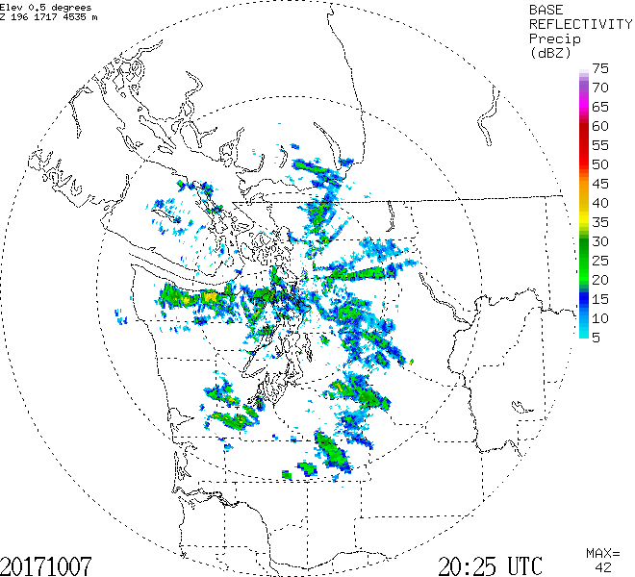
Range circle every 100 km (60 miles)

Slide 18
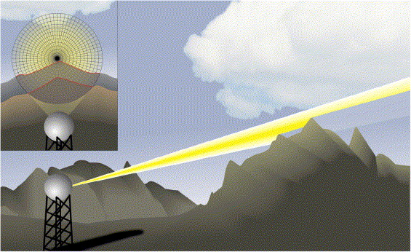
Important points
Shallow drizzle often does not appear on radar imagery, particularly when a distance away.
Can only see deep and high-level precipitation at a distance.
Radar beam can be blocked by local terrain.

Slide 19
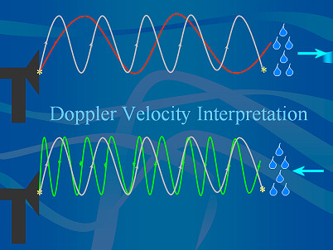
Modern Radars are Doppler Radars
Doppler radars can tell the speed of the target towards or away from the radar.
The wavelength/phase of the radar signal changes, depending the speed of the target towards or away from the radar.

Slide 20
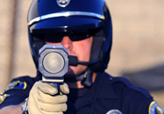
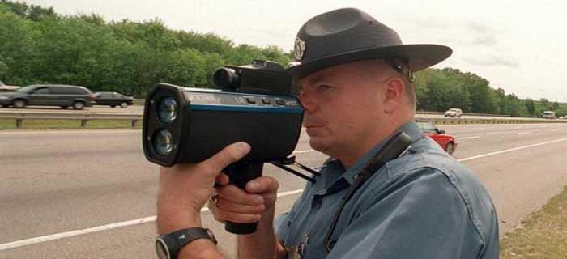
Same principle used in police radar guns

Slide 21
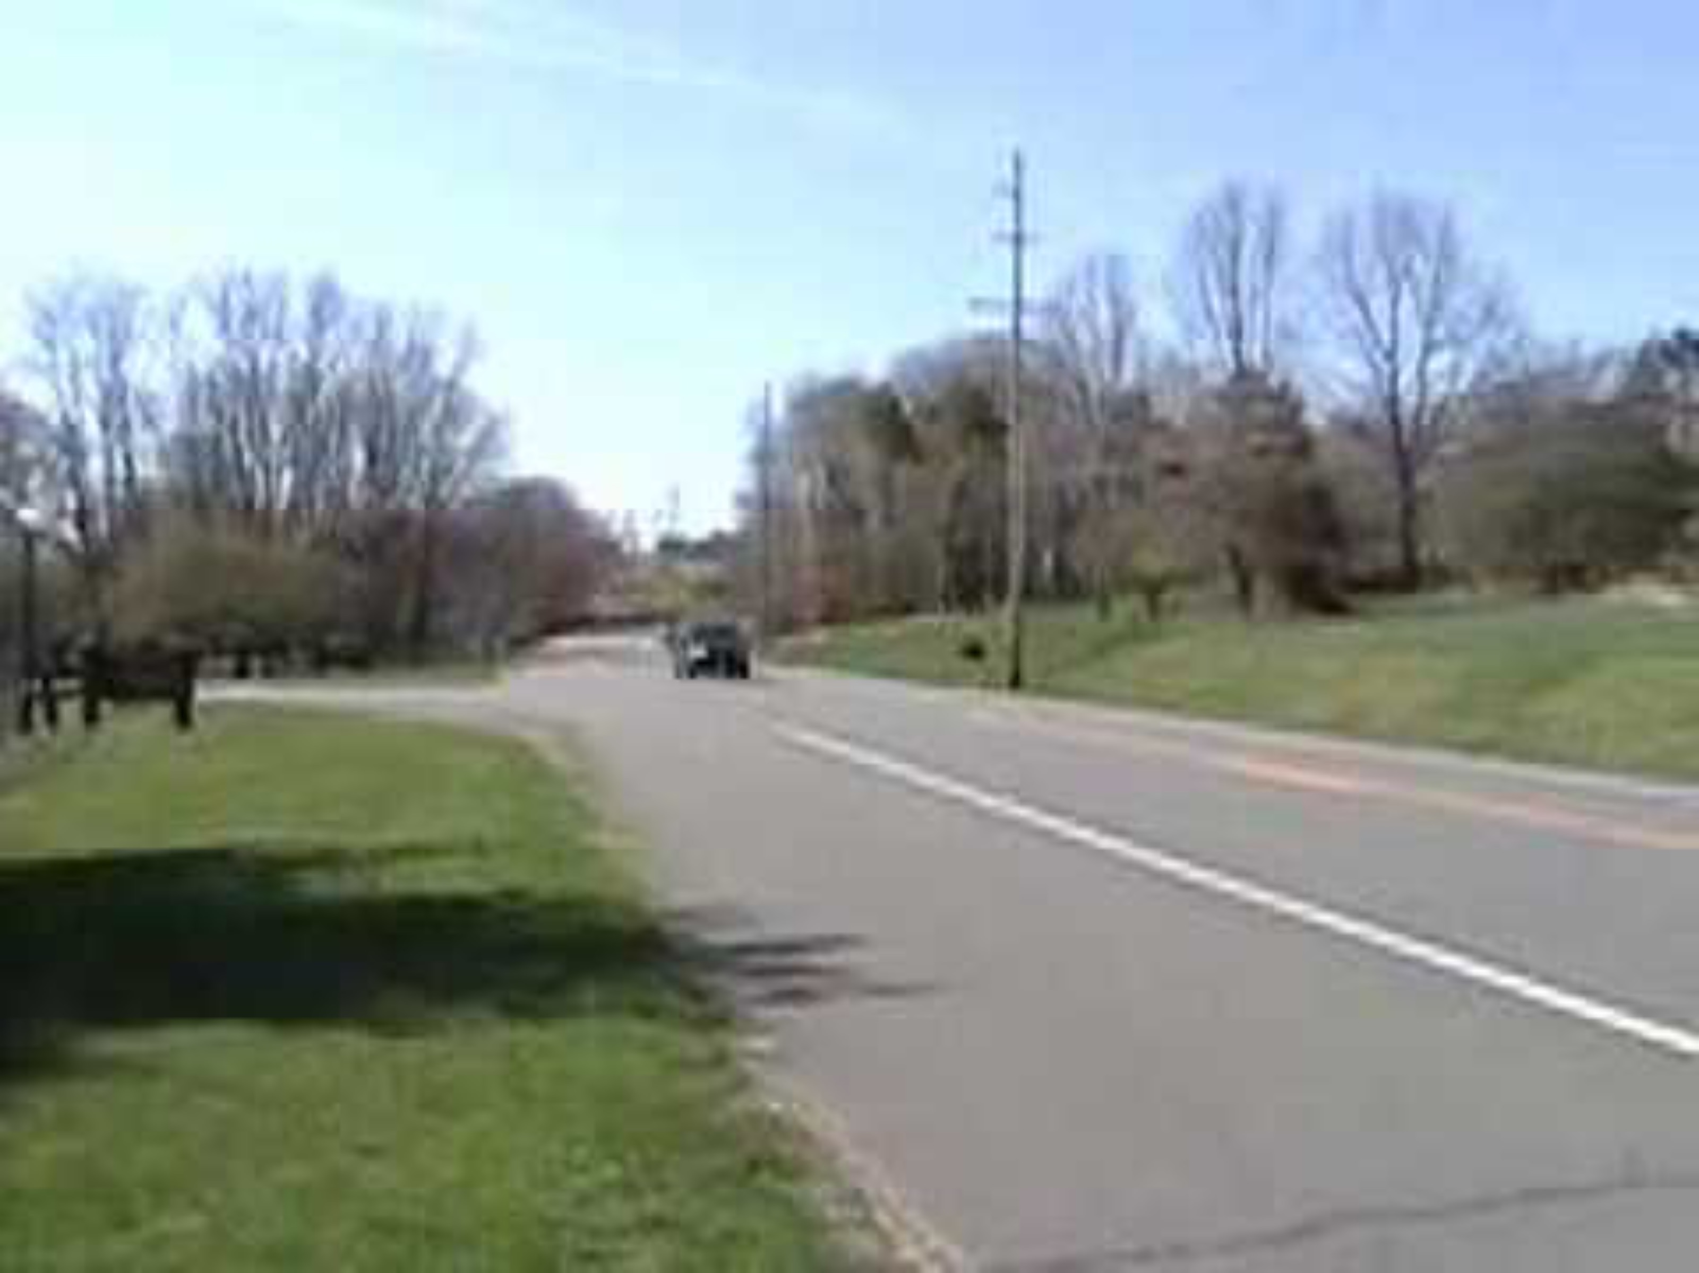
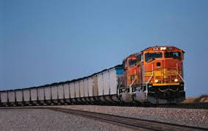
Based on Doppler Effect: evident when a train or car passes
https://www.youtube.com/watch?v=a3RfULw7aAY

Slide 22
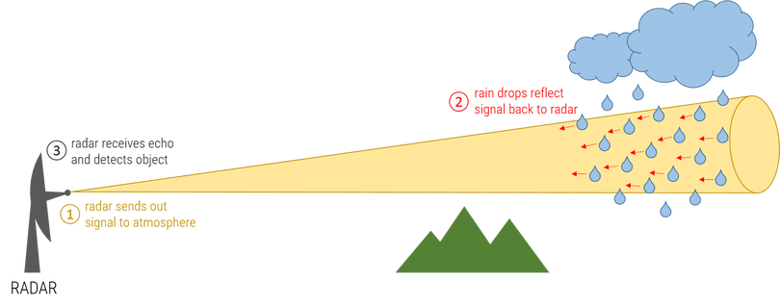
Doppler Effect for Weather Radars
The ”targets” are generally precipitation particles (rain drops, snowflakes)…but can include birds, bugs, and even tornado debris.
Meteorological targets generally move with the wind…so we get wind information from Doppler
radar.

Slide 23
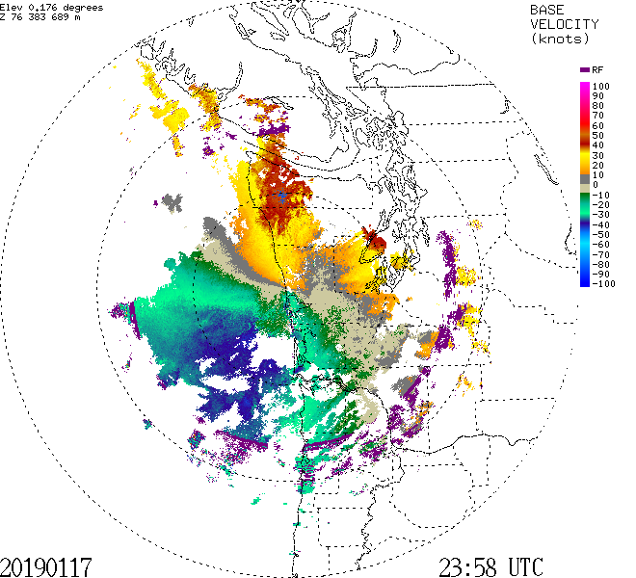
Doppler Radar Imagery: Rarely Shown by the Media

Slide 24
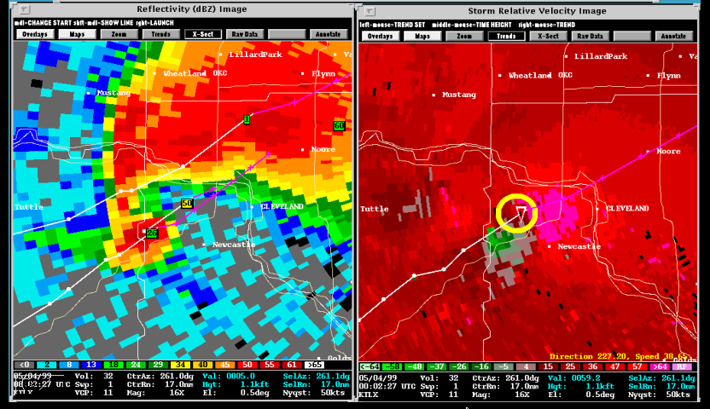
Lots of uses: such as seeing rotation associated with tornadic thunderstorms

Slide 25
Weather Radar History

Slide 26
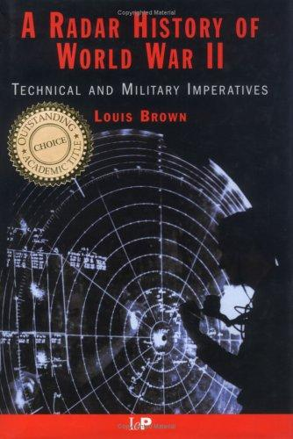
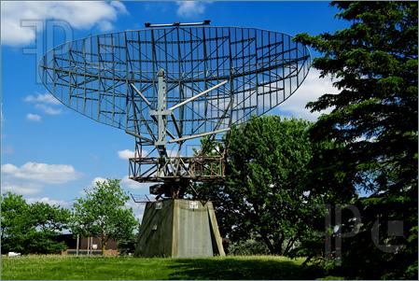
Radar Was An Important Tool in WWII: Had One Pesky Problem—Precipitation!

Slide 27
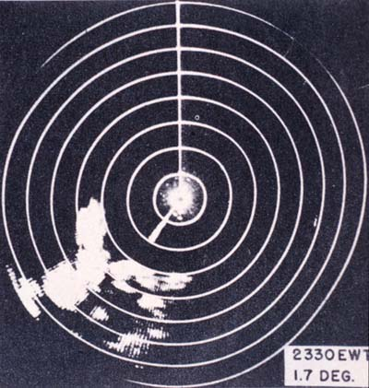
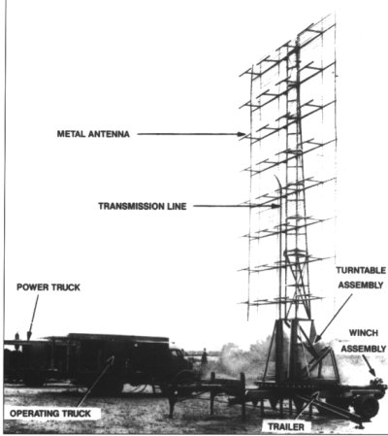
WWII Radars

Slide 28
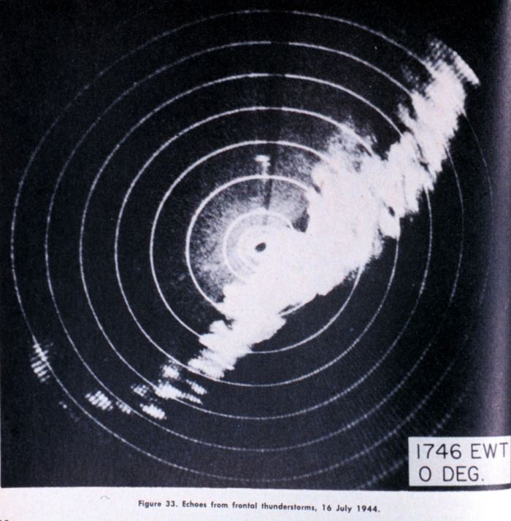
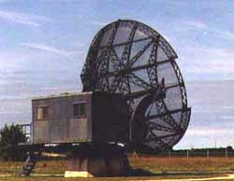
After WWII, Meteorologists Experimented with Military Radars: Thunderstorms and Convection Clearly Seen

Slide 29
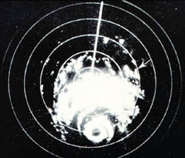
Hurricanes Also Apparent in Radar, Including Eye Walls, Rainbands

Slide 30
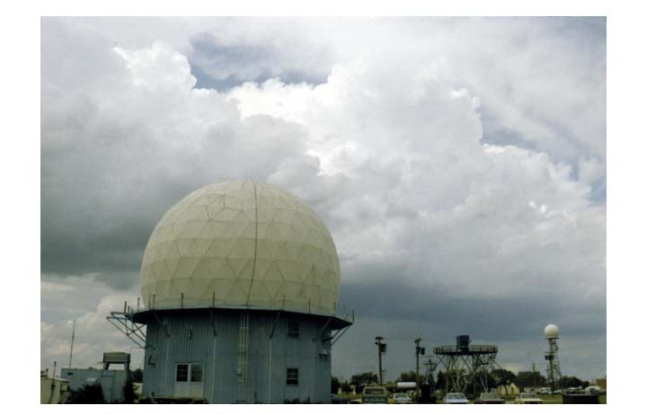
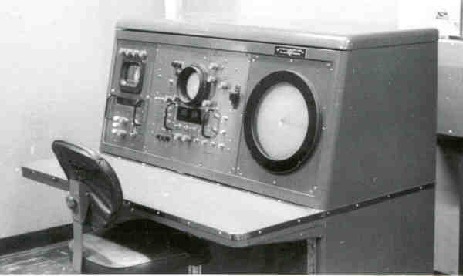
In the late 1950’s a national meteorological radar network was established (WSR-57).

Slide 31
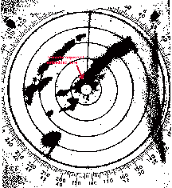
WSR-57 (no Doppler capability)

Slide 32
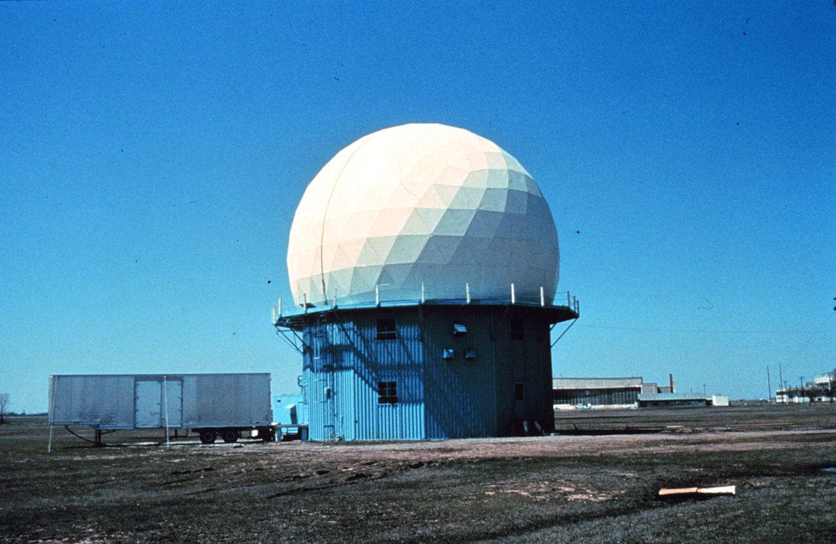
During the 1970s and early 80s there was a lot of experimentation with Doppler Weather Radars
Can show wind shifts and circulations
Diagnose how wind changes with height
Particularly useful for showing the rotation in severe convection—the mesocyclone

Slide 33
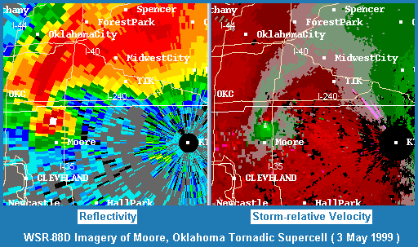

Slide 34
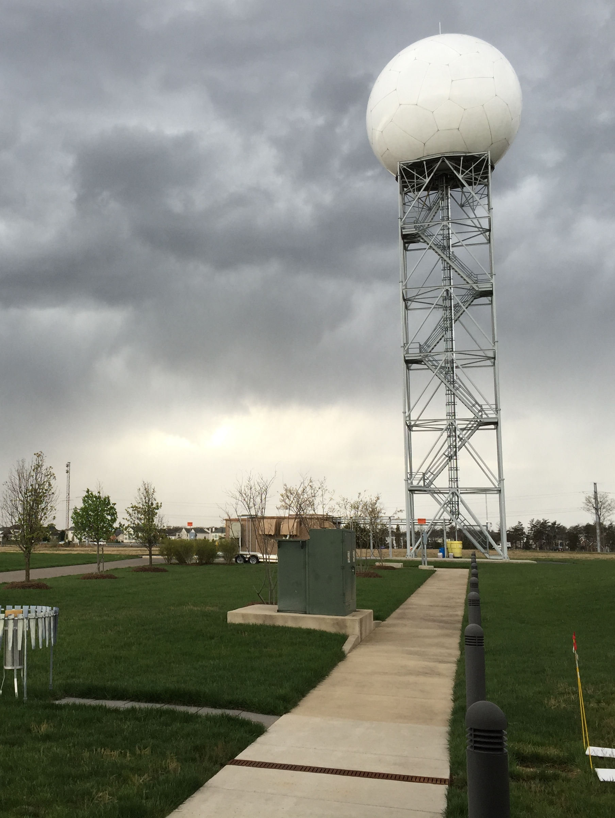
In the late 1980s,
the NWS put in a network of Doppler Weather
Radars:
NEXRAD
WSR88D
(Weather Surveillance Radar 88 Doppler)

Slide 35
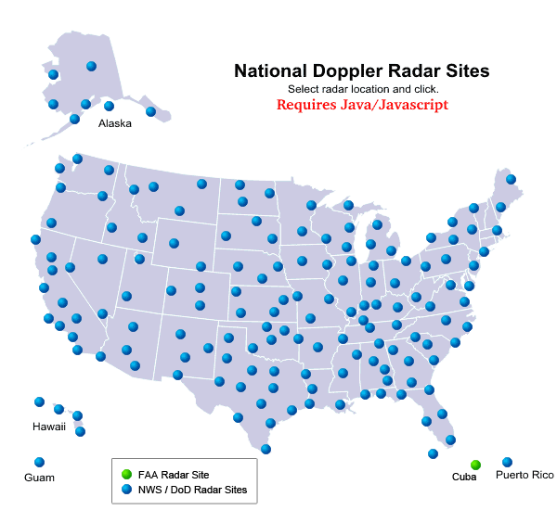

Slide 36
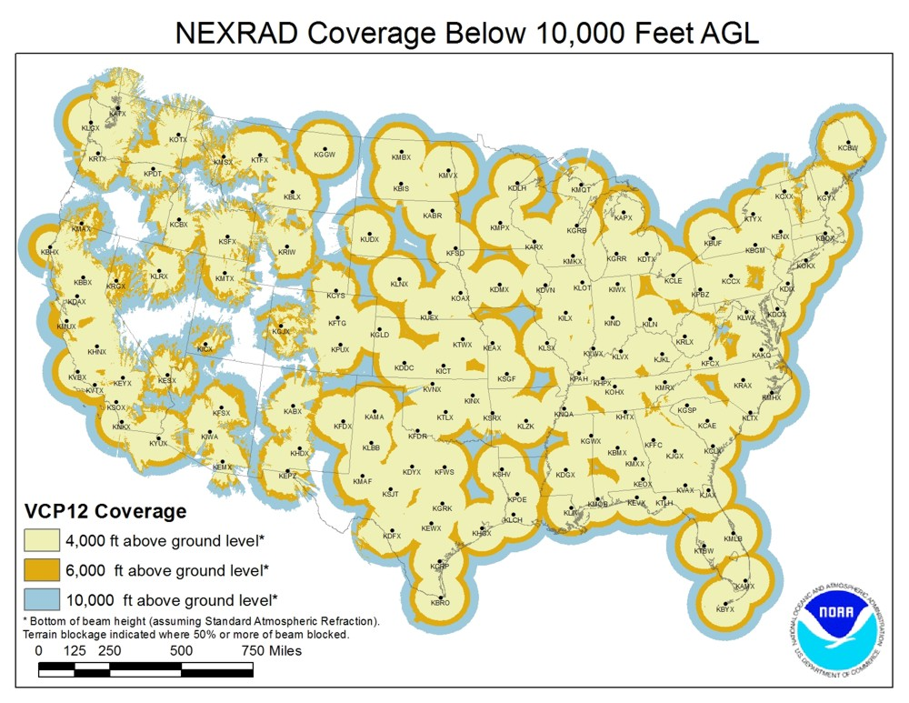
The National Weather Service has Installed Doppler Weather
Radars Across the Country
Available every 5-6 minutes

Slide 37
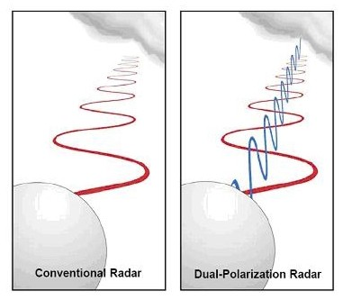
Big Radar Advance in 2011: Dual-Polarization

Slide 38
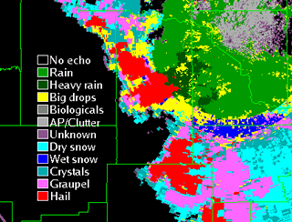
Can determine precipitation type and more

Slide 39
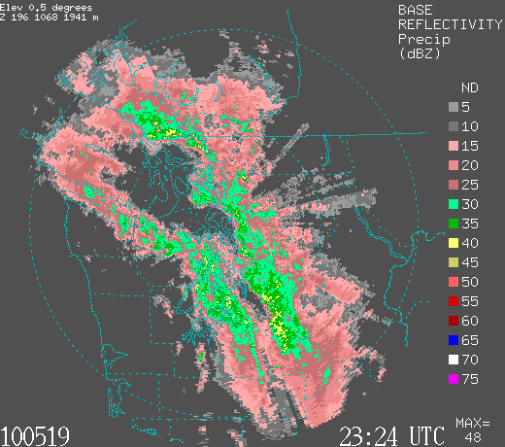
Weather Radar Can Change Your Life!

Slide 40
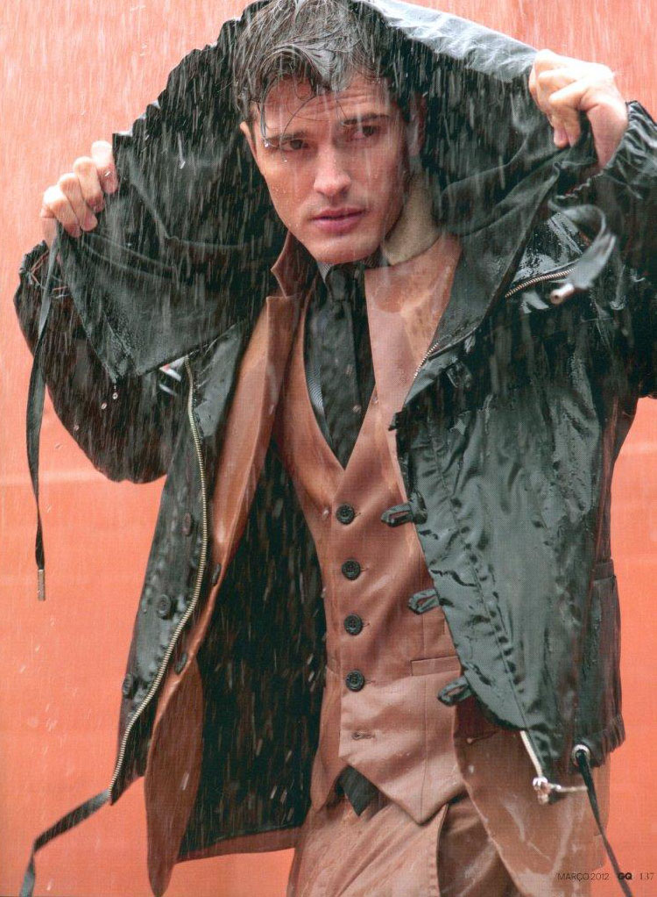
Weather Radar Can Help You Plan Outdoor Activities
Available every 5-6 minutes
Animations tell you what WILL happen
Since the National Weather Service put the Camano Island weather radar in place during the early 90s, I rarely get seriously soaked while commuting by bicycle.
With a little knowledge of NW precipitation and weather radar, you can protect yourself too.

Slide 41
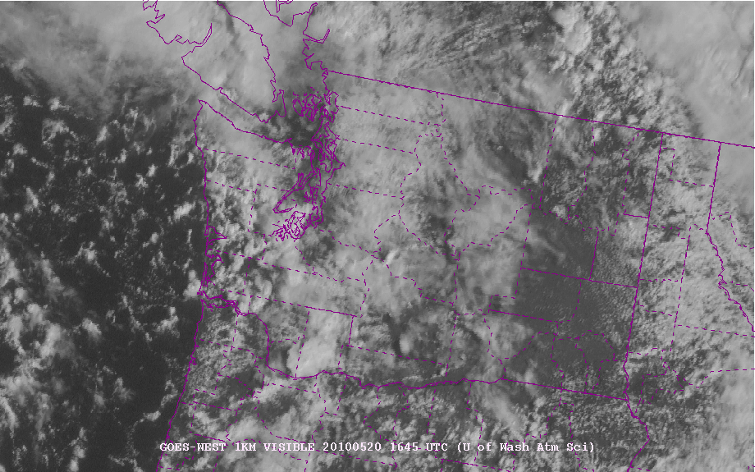
Examples
After fronts go through, we often have showers and sun breaks. Radar allows you to stay in the breaks

Slide 42
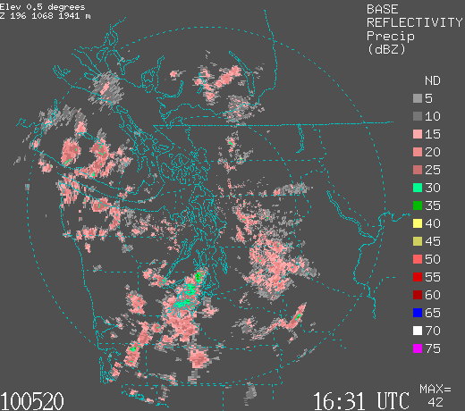
Showers as seen in weather radar, simply wait a few minutes for heavy rain to end

Slide 43
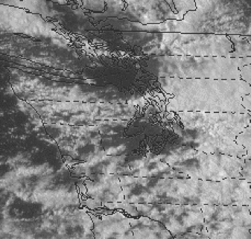
Puget Sound Convergence Zone: Go north or south to stay dry!

Slide 44
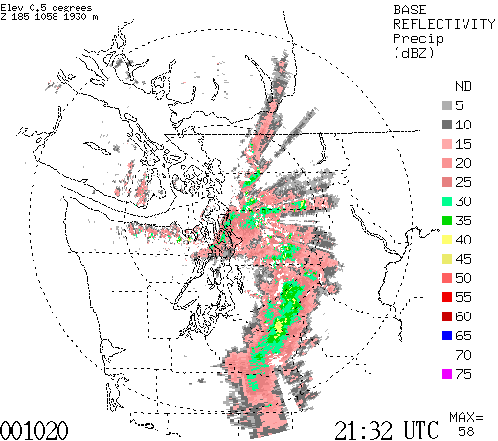
Puget Sound Convergence Zone: Very Narrow Zone of Rain

Slide 45
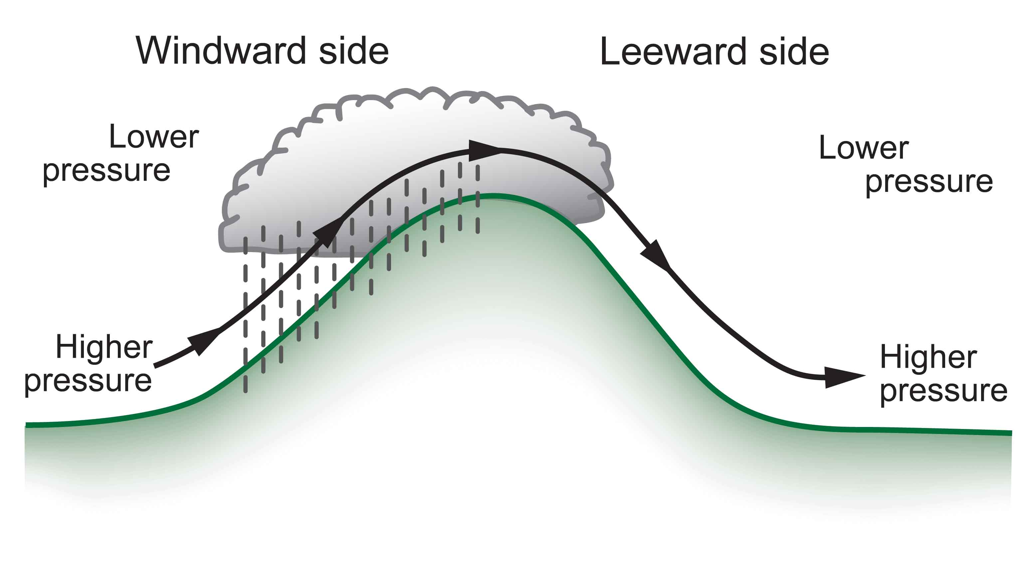
Rainshadows: Find them with weather radar
Windward
Enhancement
Rainshadow

Slide 46
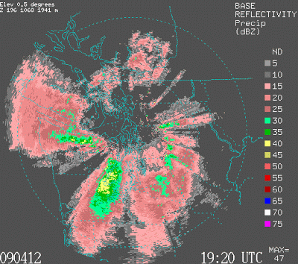

Slide 47
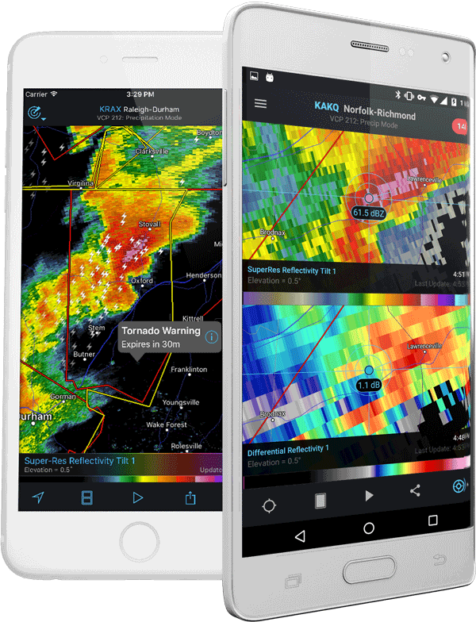
Where to view radar imagery
On TV
On the web
Dedicated app
Radarscope: My Favorite Radar App

Slide 48
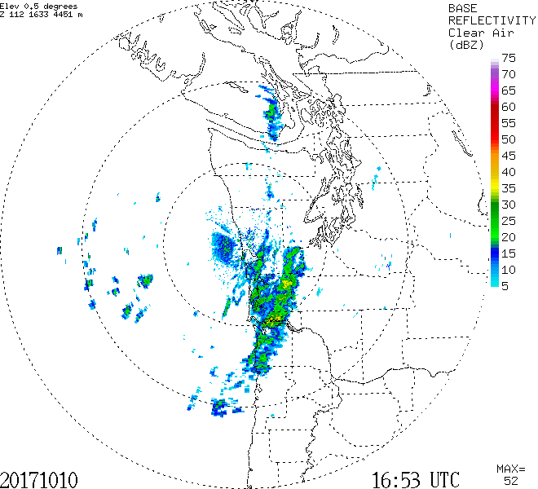
Radar Imagery Available on Atmospheric Sciences Department website

Slide 49
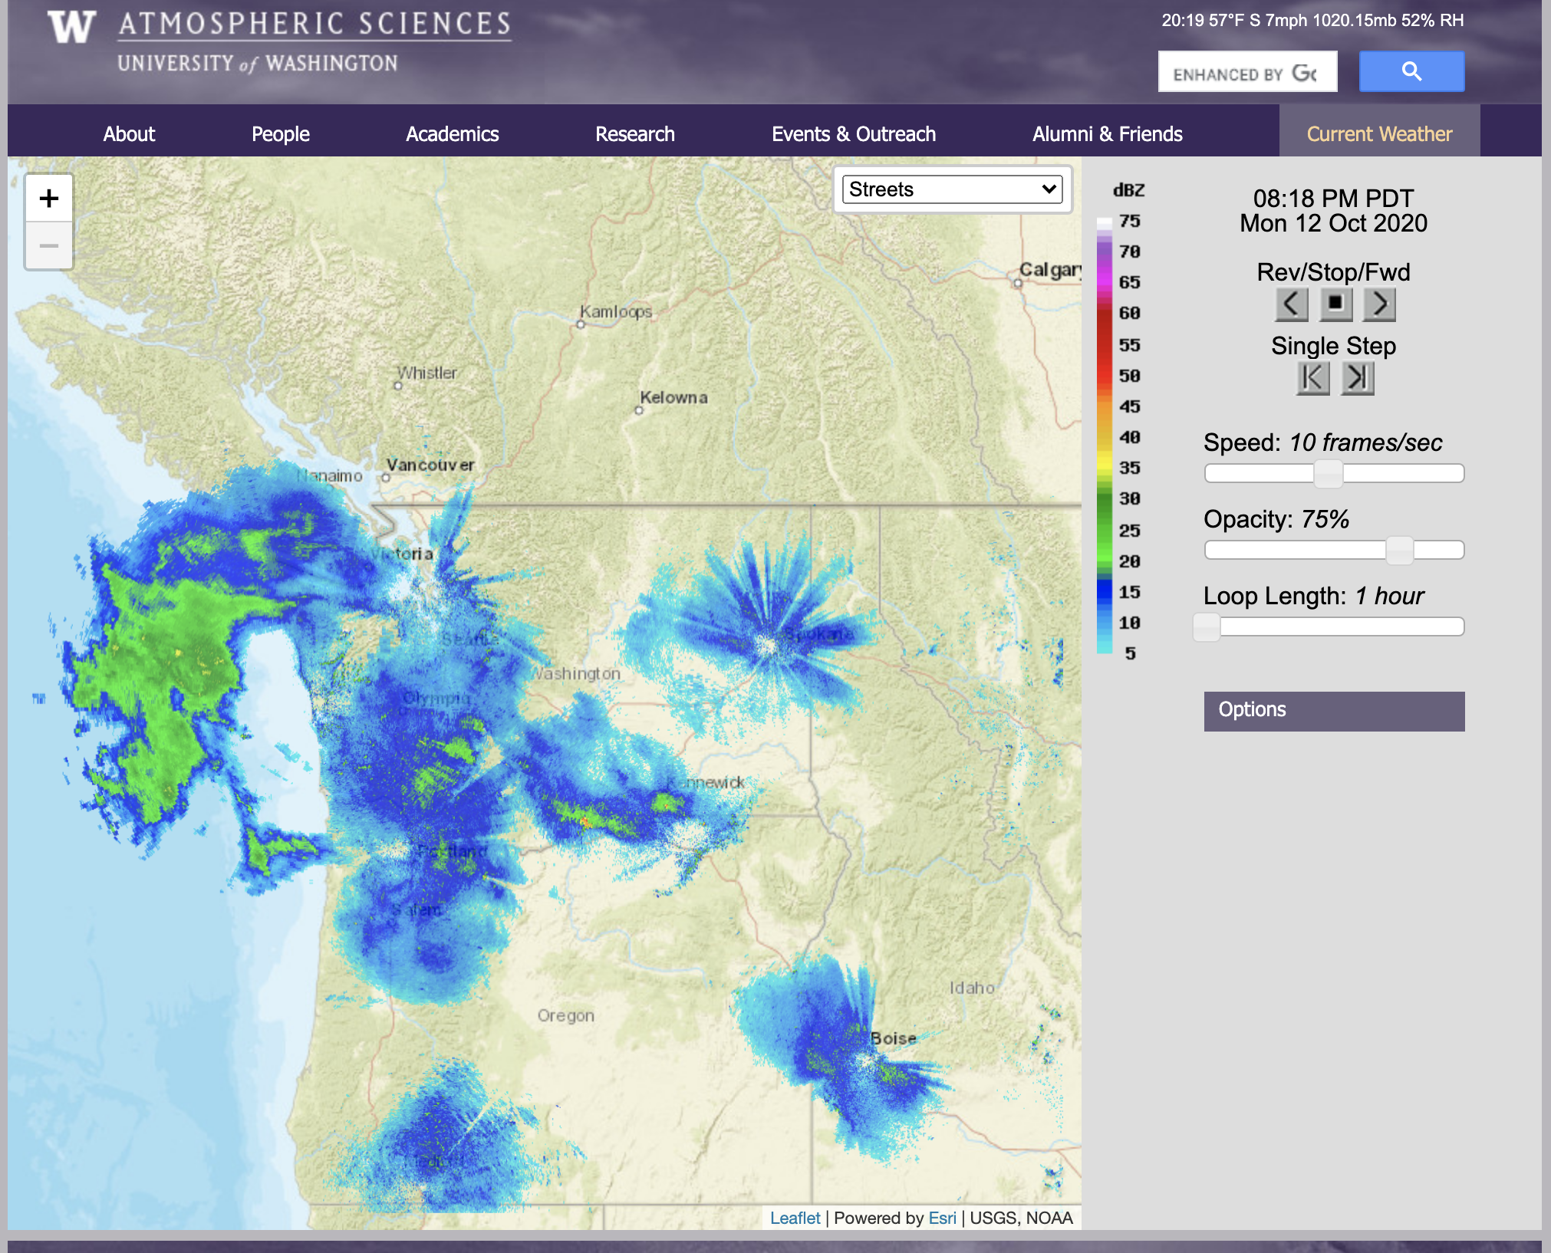
https://a.atmos.washington.edu/weather/radar.shtml

