Slide 1
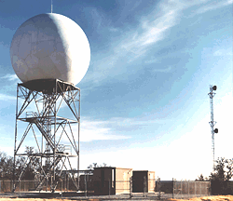
Weather Radar
ATMS 370

Slide 2
Weather Radar
Weather radars can determine where precipitation is falling
Can also tell the intensity of the precipitation
Doppler radars can also determine the speed/velocity of precipitation toward or away from the radar.
Dual-polarization radars can determine precipitation characteristics.
Radars can track storms, fronts, and other major features

Slide 3
RAdio Detection And Ranging
Weather radars emit pulses of electromagnetic radiation in the microwave part of the electromagnetic spectrum
Radar wave pulses hit and are reflected/scattered back from targets (often precipitation)
The time it takes to return tells the distance
The amount of return tells us about precipitation intensity and type

Slide 4
Weather Radar History

Slide 5

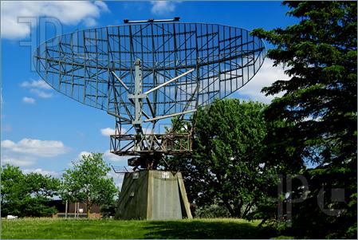
Radar Was An Important Tool in WWII for tracking aircraft. Serious Problem—Precipitation!

Slide 6
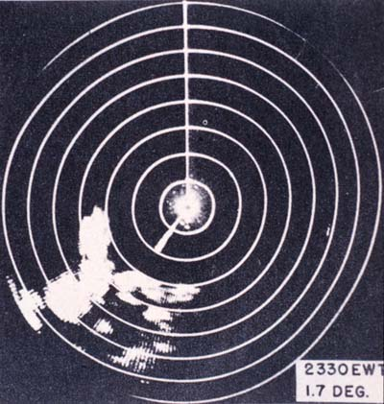
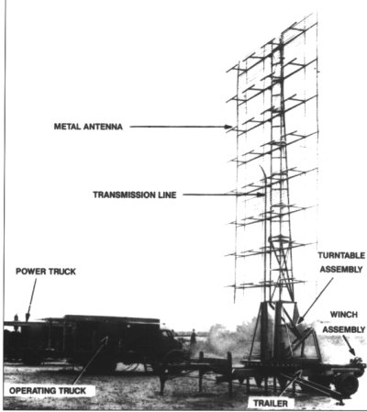
WWII Radars

Slide 7
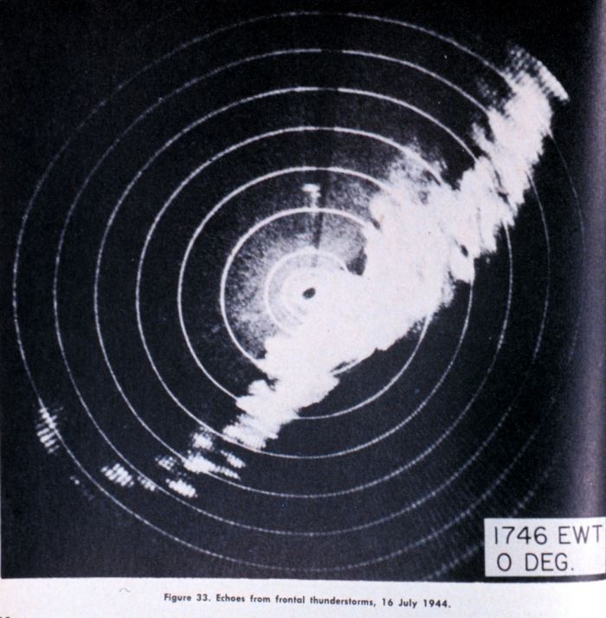
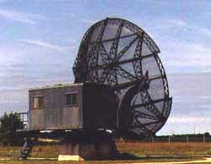
After WWII, Meteorologists Experimented with Military Radars: Thunderstorms and Convection Clearly Seen

Slide 8
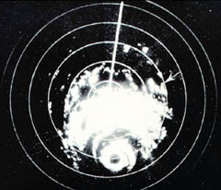
Hurricanes Also Apparent, Including Eye Walls, Rainbands

Slide 9
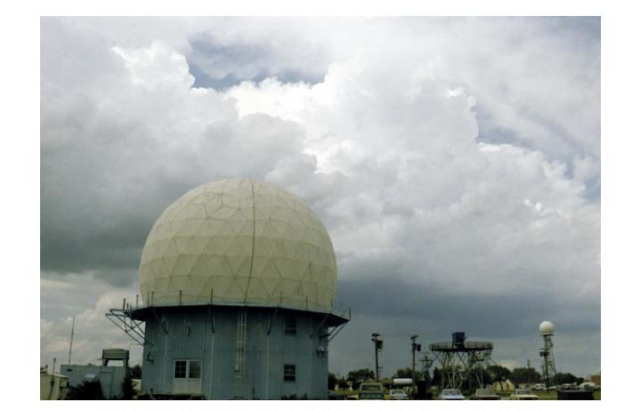
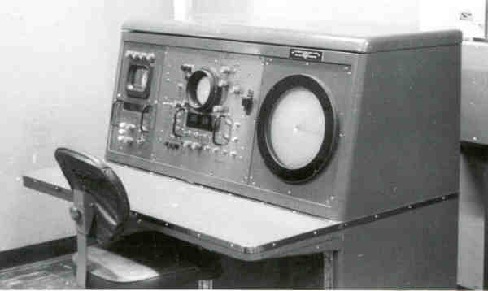
In the late 1950’s a national meteorological radar network was established (WSR-57).

Slide 10
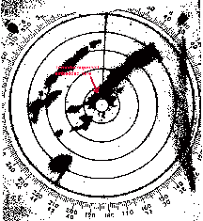
WSR-57 (no Doppler capability)

Slide 11
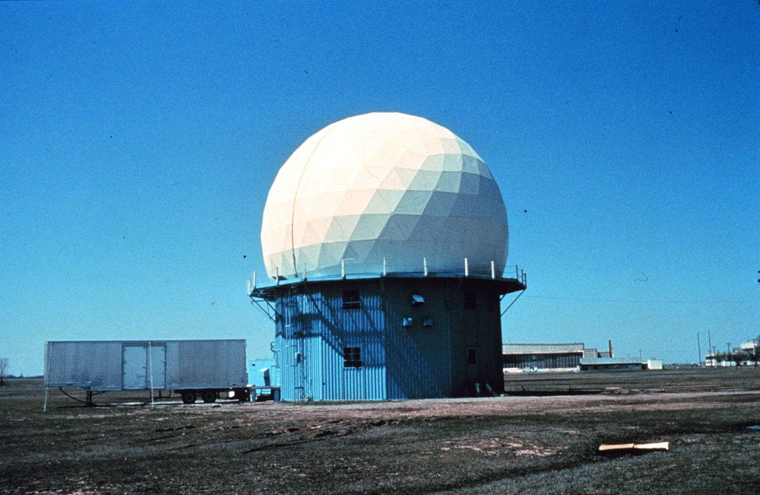
During the 1970s and early 80s a lot of experimentation with Doppler Weather Radars
Can show wind shifts and circulations
Diagnose how wind changes with height
Particularly useful for showing the rotation in severe convection—the mesocyclone

Slide 12
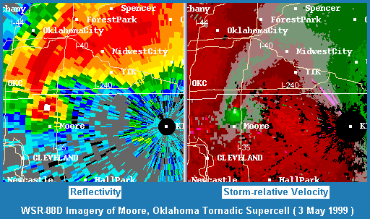

Slide 13
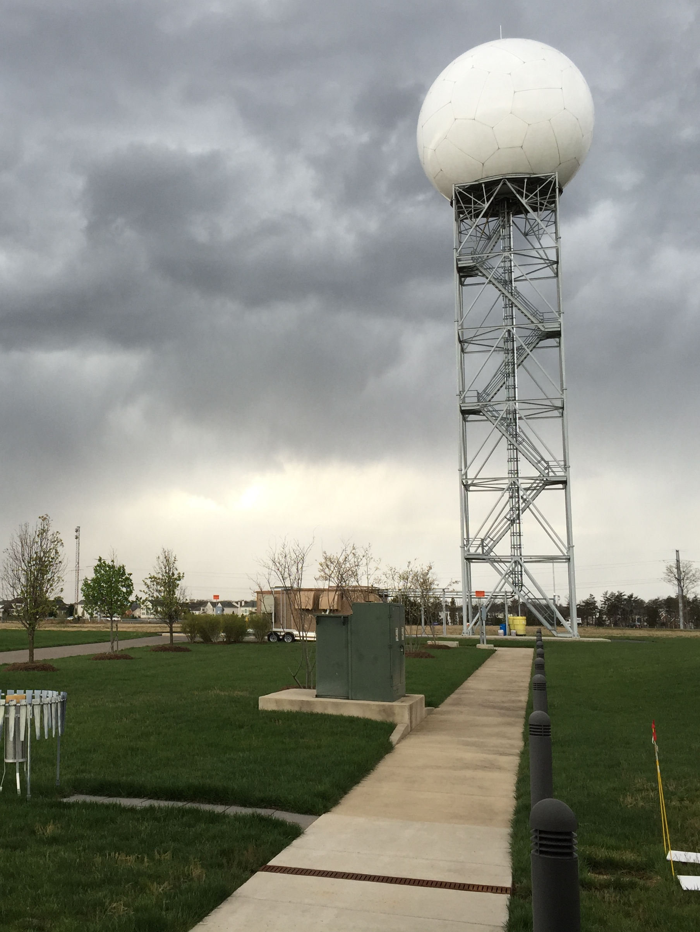
In the late 1980s,
the NWS put in a network of Doppler Weather
Radars:
NEXRAD
WSR88D
(Weather Surveillance Radar 88 Doppler)

Slide 14
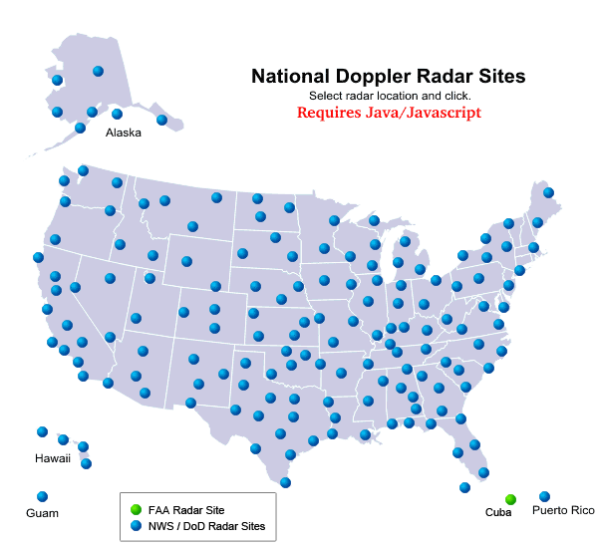

Slide 15
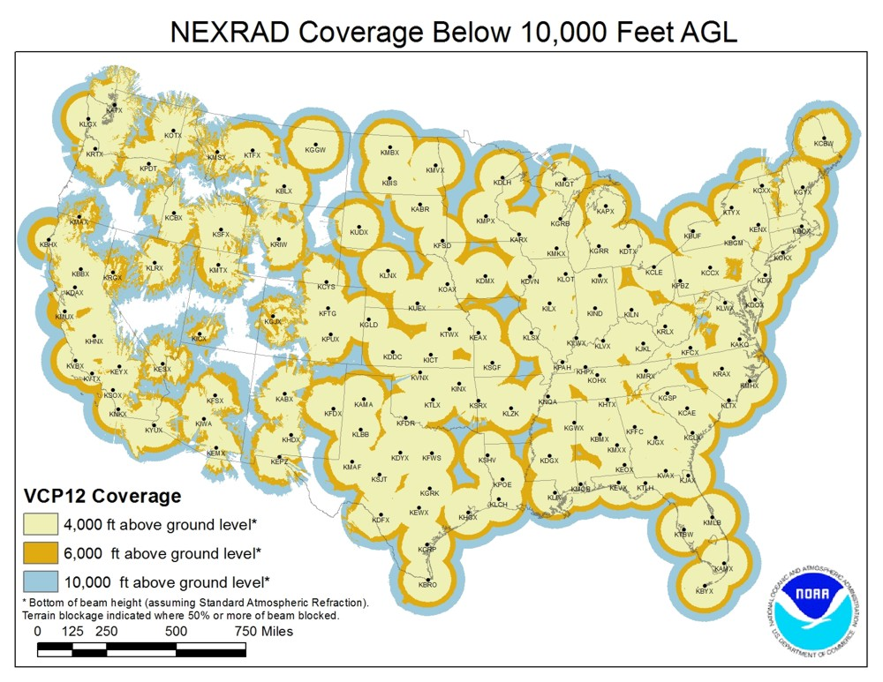
The National Weather Service has Installed Doppler Weather
Radars Across the Country
Available every 5-6 minutes

Slide 16
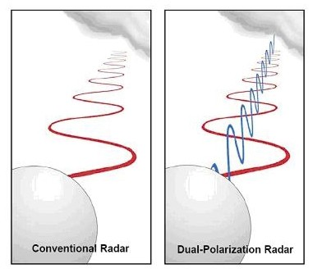
Big Radar Advance in 2011: Dual-Polarization

Slide 17
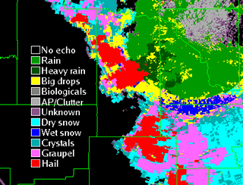
Can determine precipitation type and more

Slide 18
Basics of Weather Radar

Slide 19
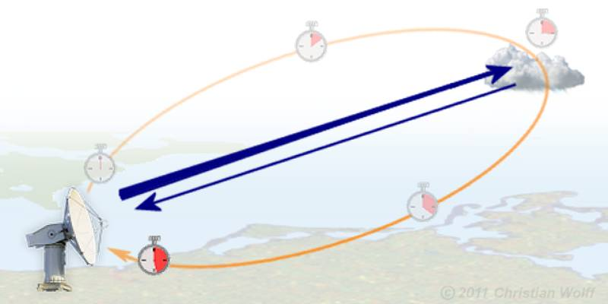
Radar waves move at the speed of light (186,000 miles per second in a vacuum).
Thus, the time from emission to return tells how far the object is away.

Slide 20
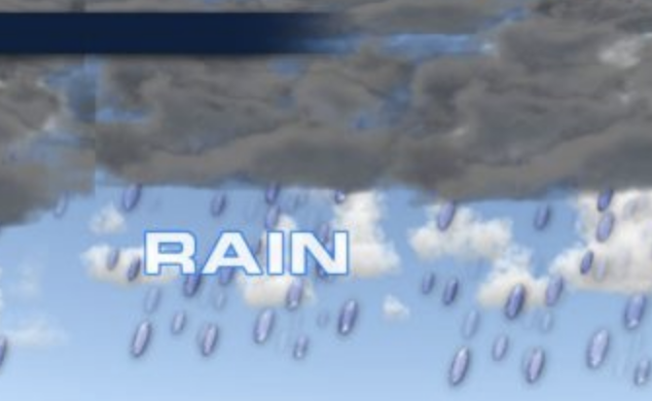
The amount of radar signal returned tells one about the nature of the object: type and intensity of precipitation
Amount scattered back ~ D⁶ where D is the diameter of the target
Big objects (e.g., large rain drops associated with heavy rain)---big radar return
Small objects (small droplets)—lesser return
More objects—more return

Slide 21
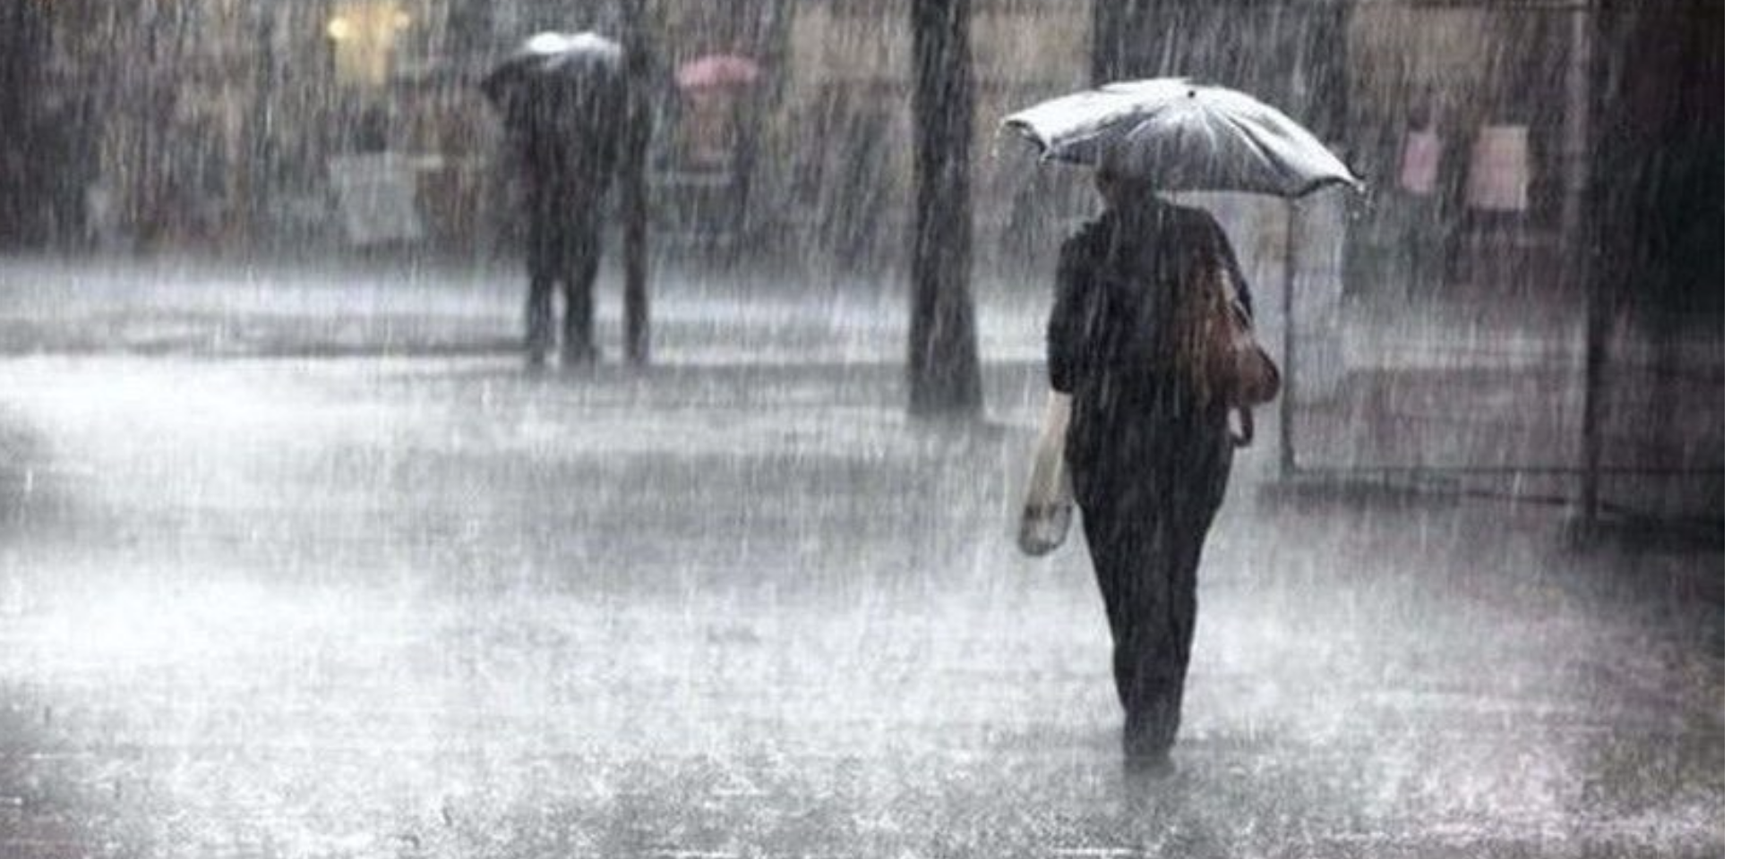
Thus, heavy rain with lots of big droplets give a big radar return!

Slide 22
P_{r} = C |k²| Z
r²
P_{r} is the received power
R is the distance to a target
|k²] depends on the refractive and absorptive properties of particles
Liquid H20 ~.93, ice ~.21. Liquid water is seen better than ice!
C depends on the characteristics of the radar (e.g., emitted power, antenna type, emission power
Z is the radar reflectivity factor

Slide 23
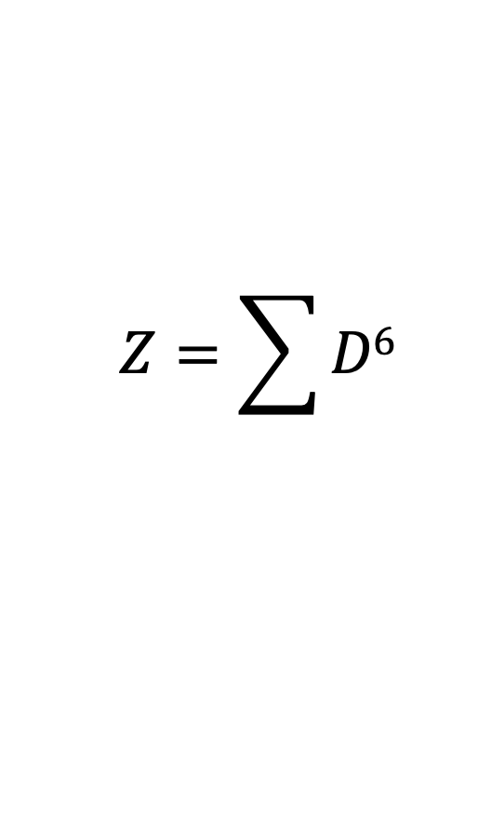
Z : Radar Reflectivity Factor
$$Z=\sum{D6}$$
Summed over some volume
Only valid for targets small compared to the wavelength (λ) of the emitted radiation
λ radar ~1-20 cm (microwave)
raindrops: .5 to 2 mm, cloud droplets ~ .02 mm

Slide 24
Z : Radar Reflectivity Factor
$$Z=\sum{D6}$$
Conclusions:
Big precipitation drops are seen better than small droplets
Cloud droplets not seen well
Big fat birds are seen well

Slide 25
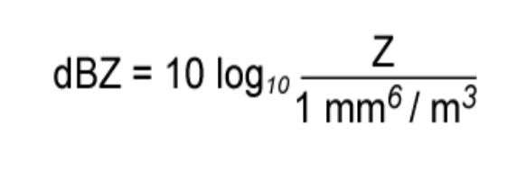
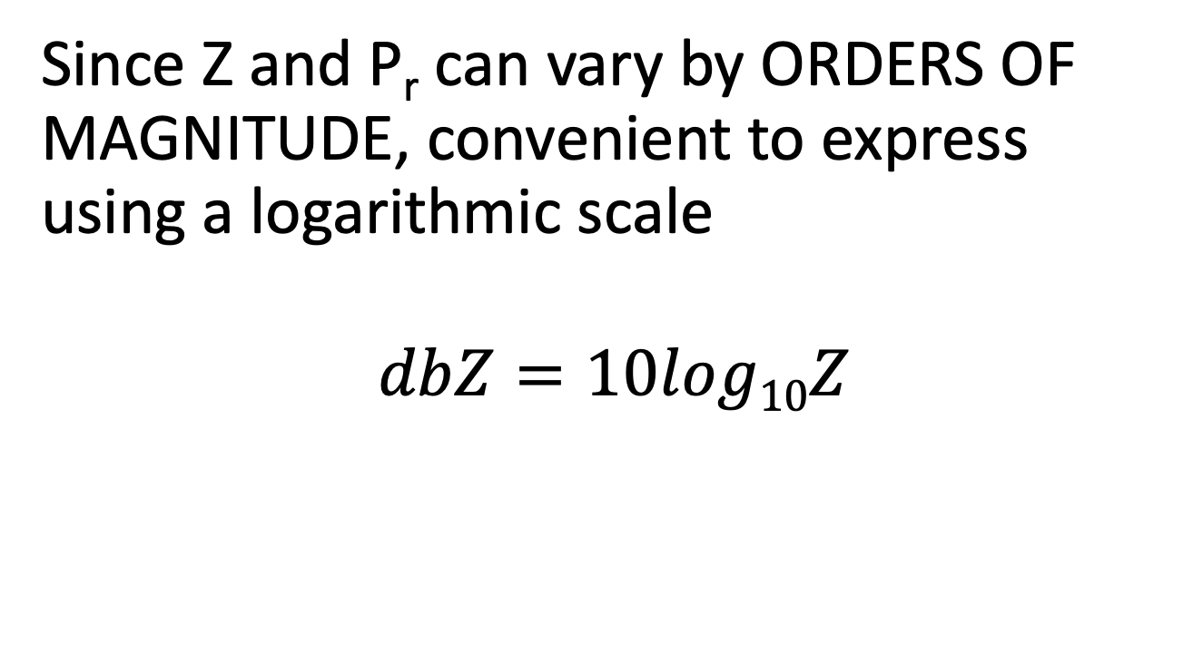
Need a logarithmic scale
Since Z and P_{r} can vary by ORDERS OF MAGNITUDE, convenient to express using a logarithmic scale
$$dbZ=10log10Z$$

Slide 26
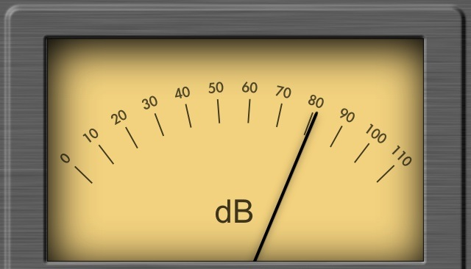
Reflectivity
A fancy name for the amount of radar signal that is returned by an object: reflectivity (Z) is given in units of dbZ
db or decibels-unit of power on a logarithmic scale
Precipitation intensity is proportional to Z (or dbZ)

Slide 27
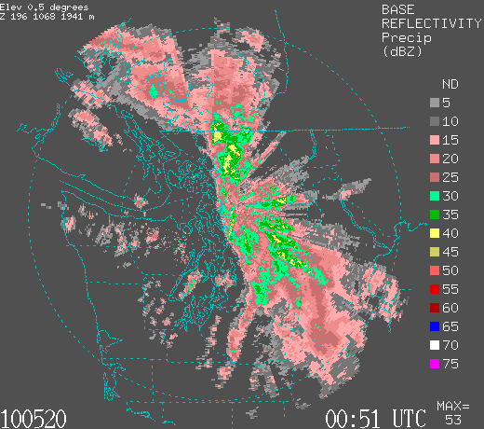
Example
Intensity of precipitation is color coded (units—dbZ)

Slide 28
Reading a Radar Image (color scales can vary)
Black (white in some)-no precip
Grey and pink (5-20 dbZ)…light rain…not too bad.
Dark pink to green-moderate rain (20-35)
Yellows are heavy rain 40-50 (forget it)
Reds and higher (very heavy rain or hail)

Slide 29
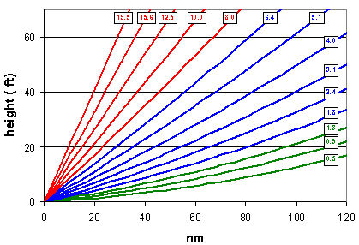
Radar Imagery is not observed or displayed for a level surface
Radars scan in azimuth ( 0 to 360 degrees) at a series of increasing scan angles from the horizontal.

Slide 30
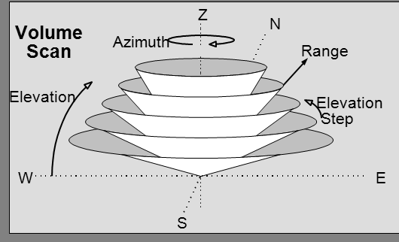

Slide 31
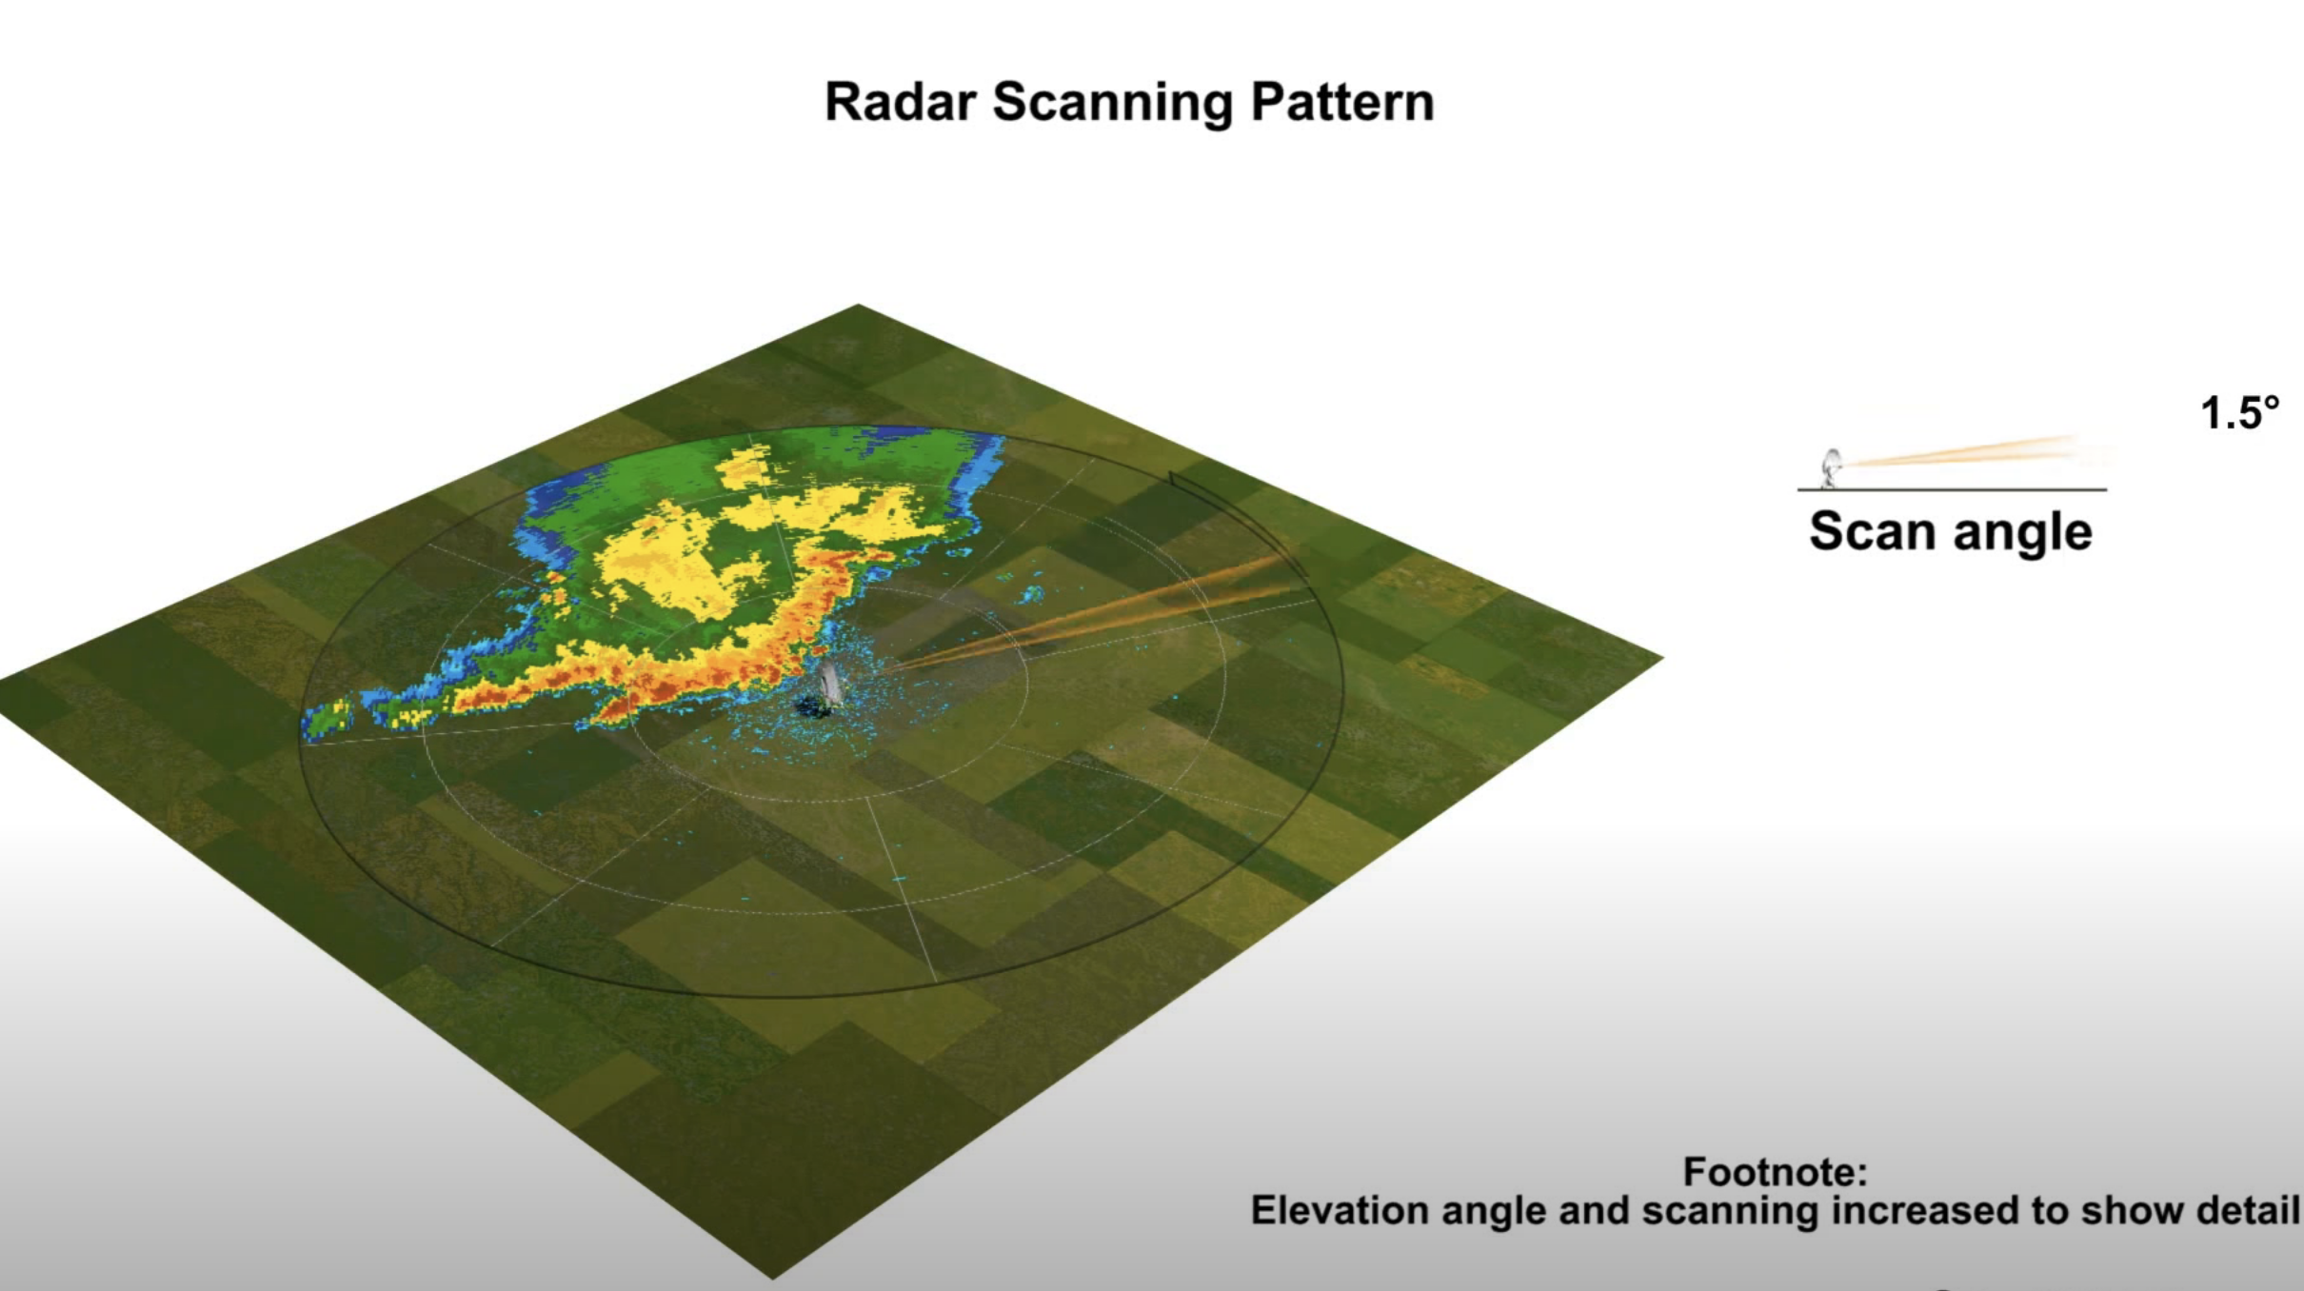
So radar image does not show a single level, but a sloping cut through the atmosphere
Thus, it is showing precipitation higher and higher up in the atmosphere as you move away from the center of the radar image.
https://www.youtube.com/watch?v=Yrq2TVdM8HI

Slide 32

Radar imagery is generally shown on a polar-type chart with range circles at increasing distance
Radar
location
Higher
Lower

Slide 33
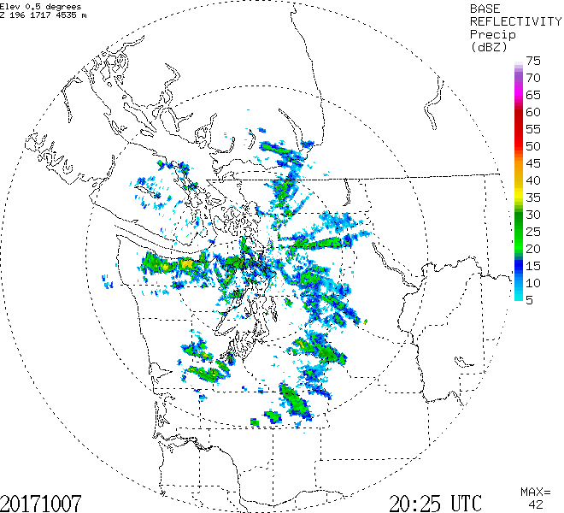
Range circle every 100 km (60 miles)

Slide 34
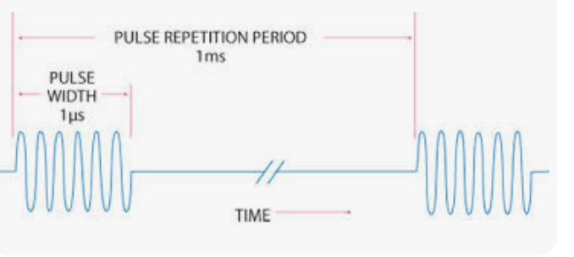
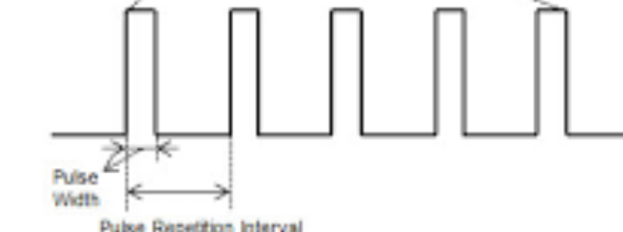
Radar Energy is Sent Out in Pulses
Pulse Repetition Frequency (PRF) of the radar system is the number of pulses that are transmitted per second.

Slide 35
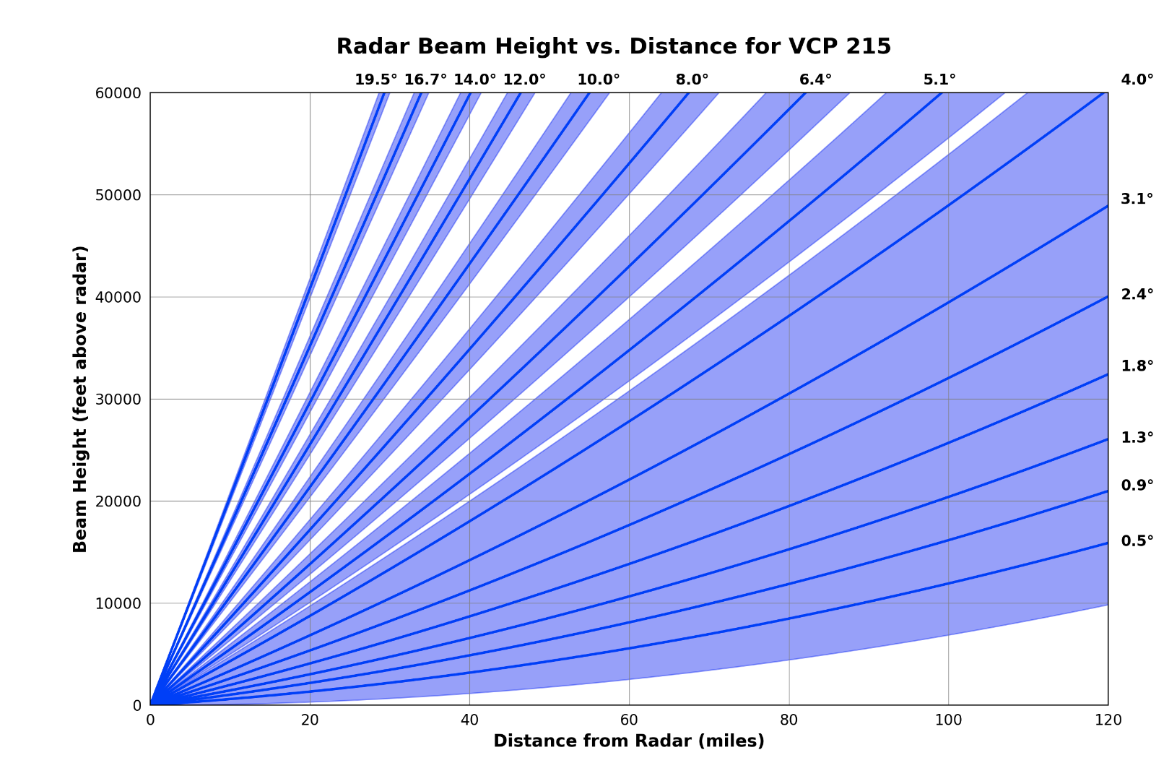
National Weather Service Scan Strategies (also called Volume Coverage Patterns, VCP). Takes 4-6 minutes for each VCP

Slide 36
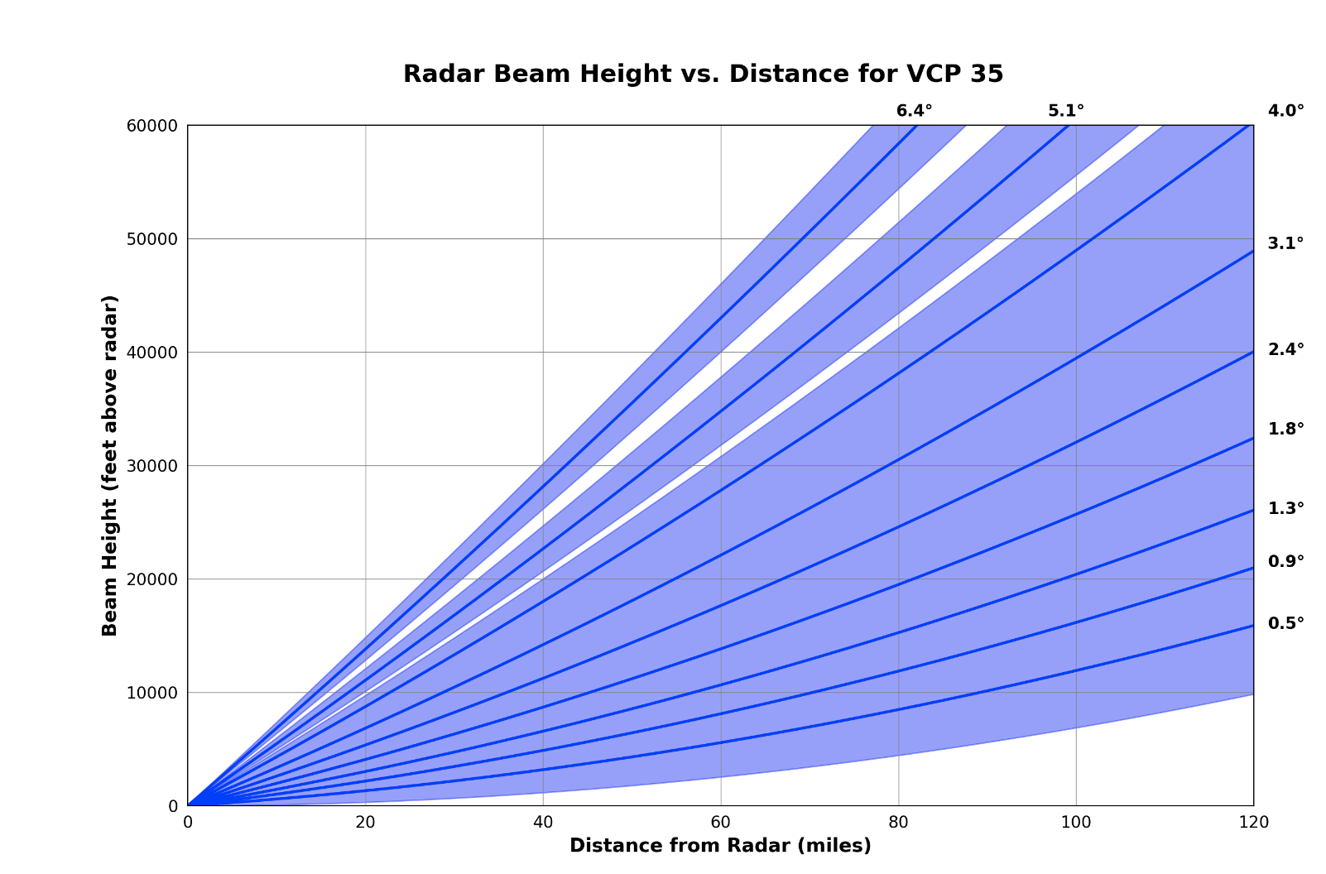
Also a clear air mode (VCP)
In clear air mode, the pulses are longer, resulting in more radar sensitivity
Scans take longer (about 10 minutes)
More coverage at lower elevation angles.

Slide 37
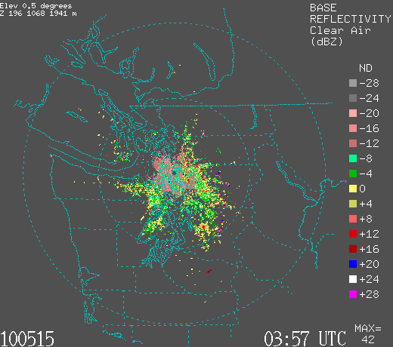
In Clear Air Mode Can See Bird, Insects, and More

Slide 38
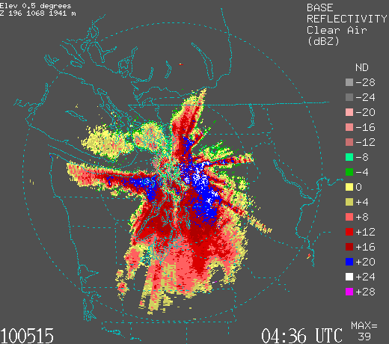

Slide 39
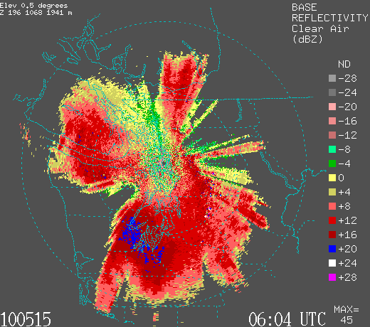

Slide 40
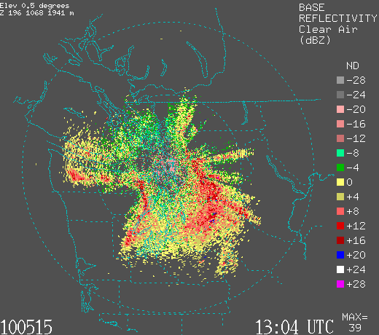

Slide 41
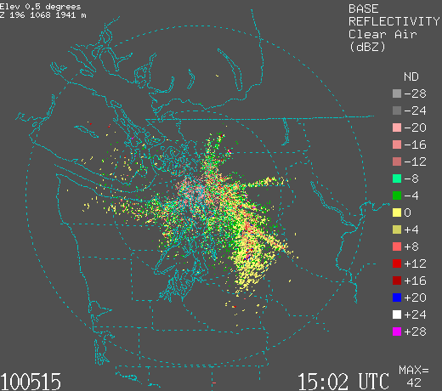

Slide 42
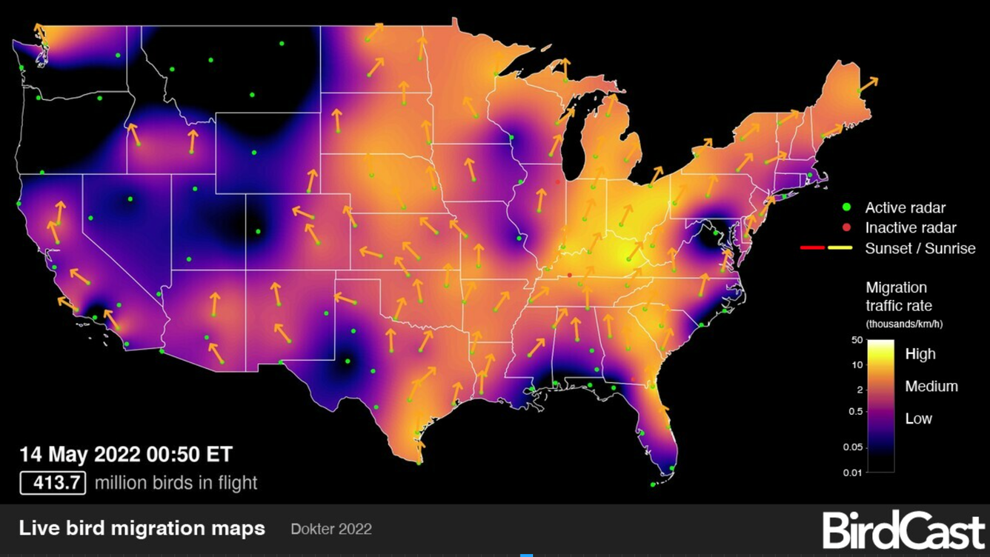
Ornithologists Love Weather Radar

Slide 43
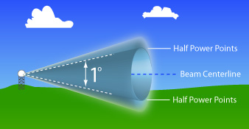
Radar Beam Width
Radar beams are cone shaped and get wider with distance

Slide 44
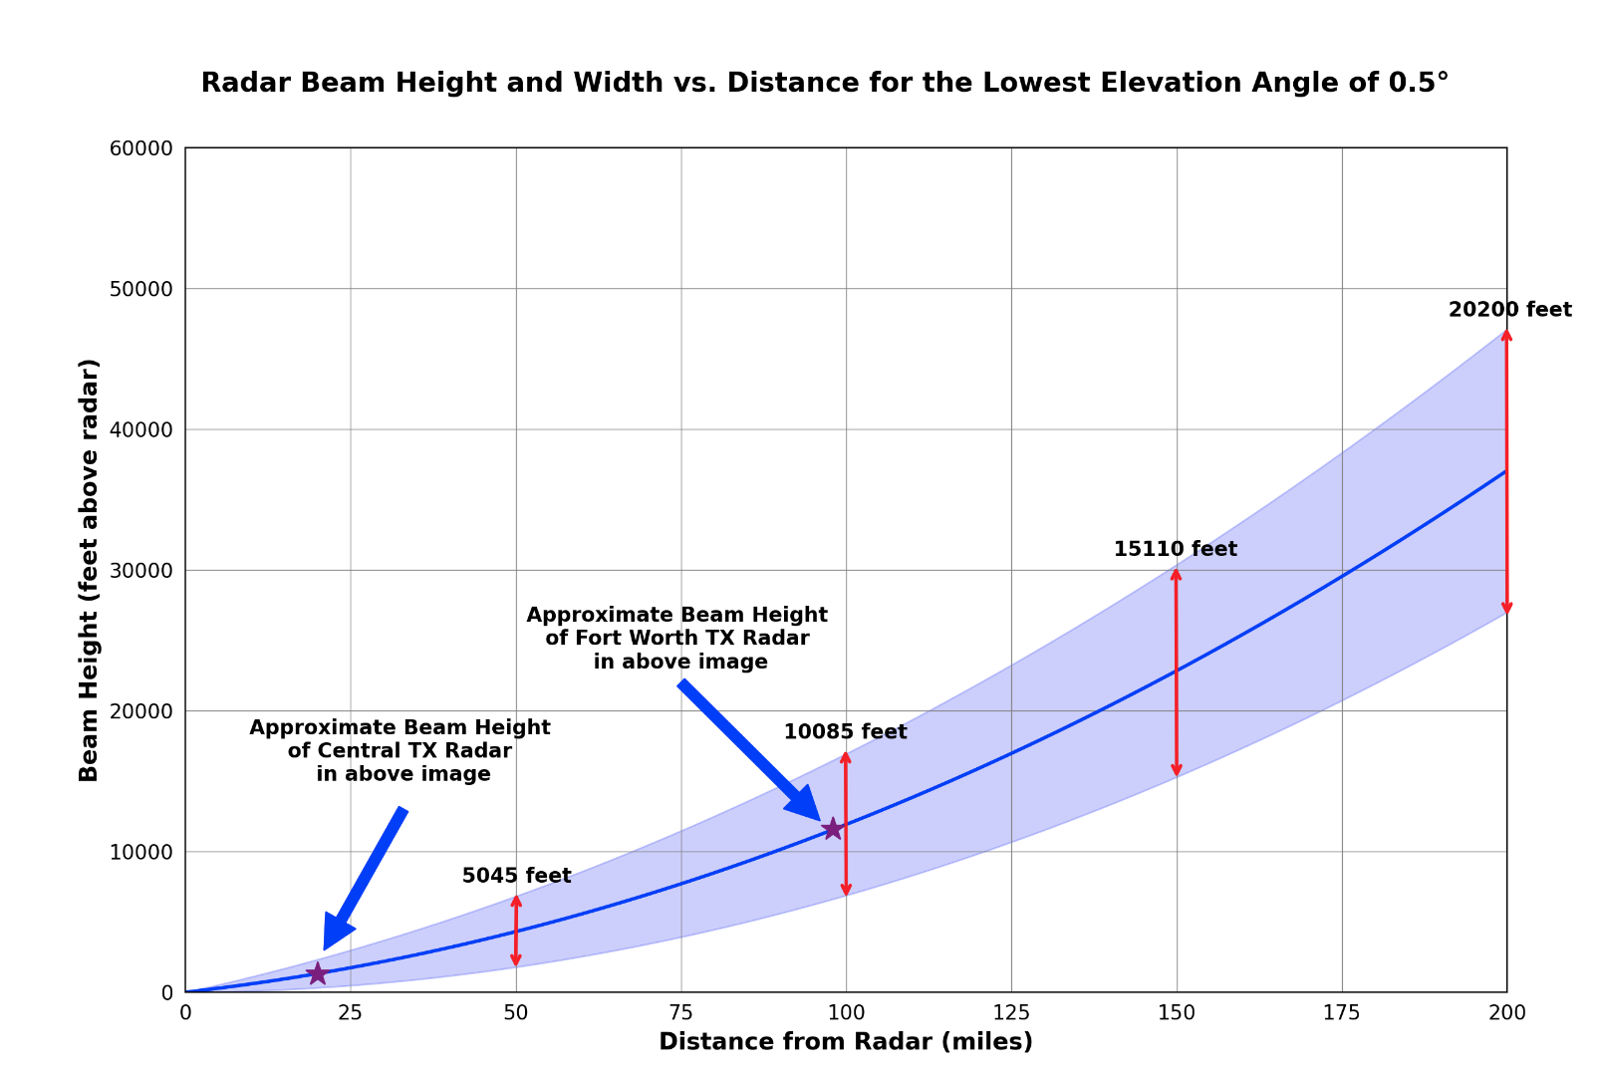
Vertical (and horizontal) resolution degrades rapidly with distance

Slide 45
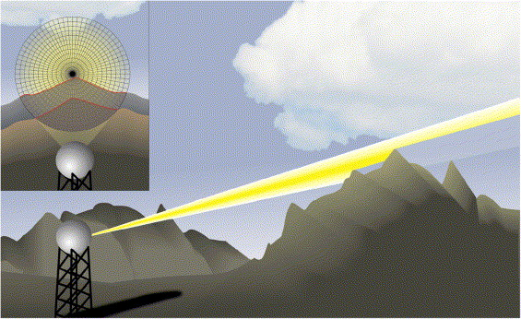
Important points
Shallow drizzle often does not appear on radar imagery, particularly when a distance away.
Can only see deep and high-level precipitation at a distance.
Radar beam can be blocked by local terrain.

Slide 46
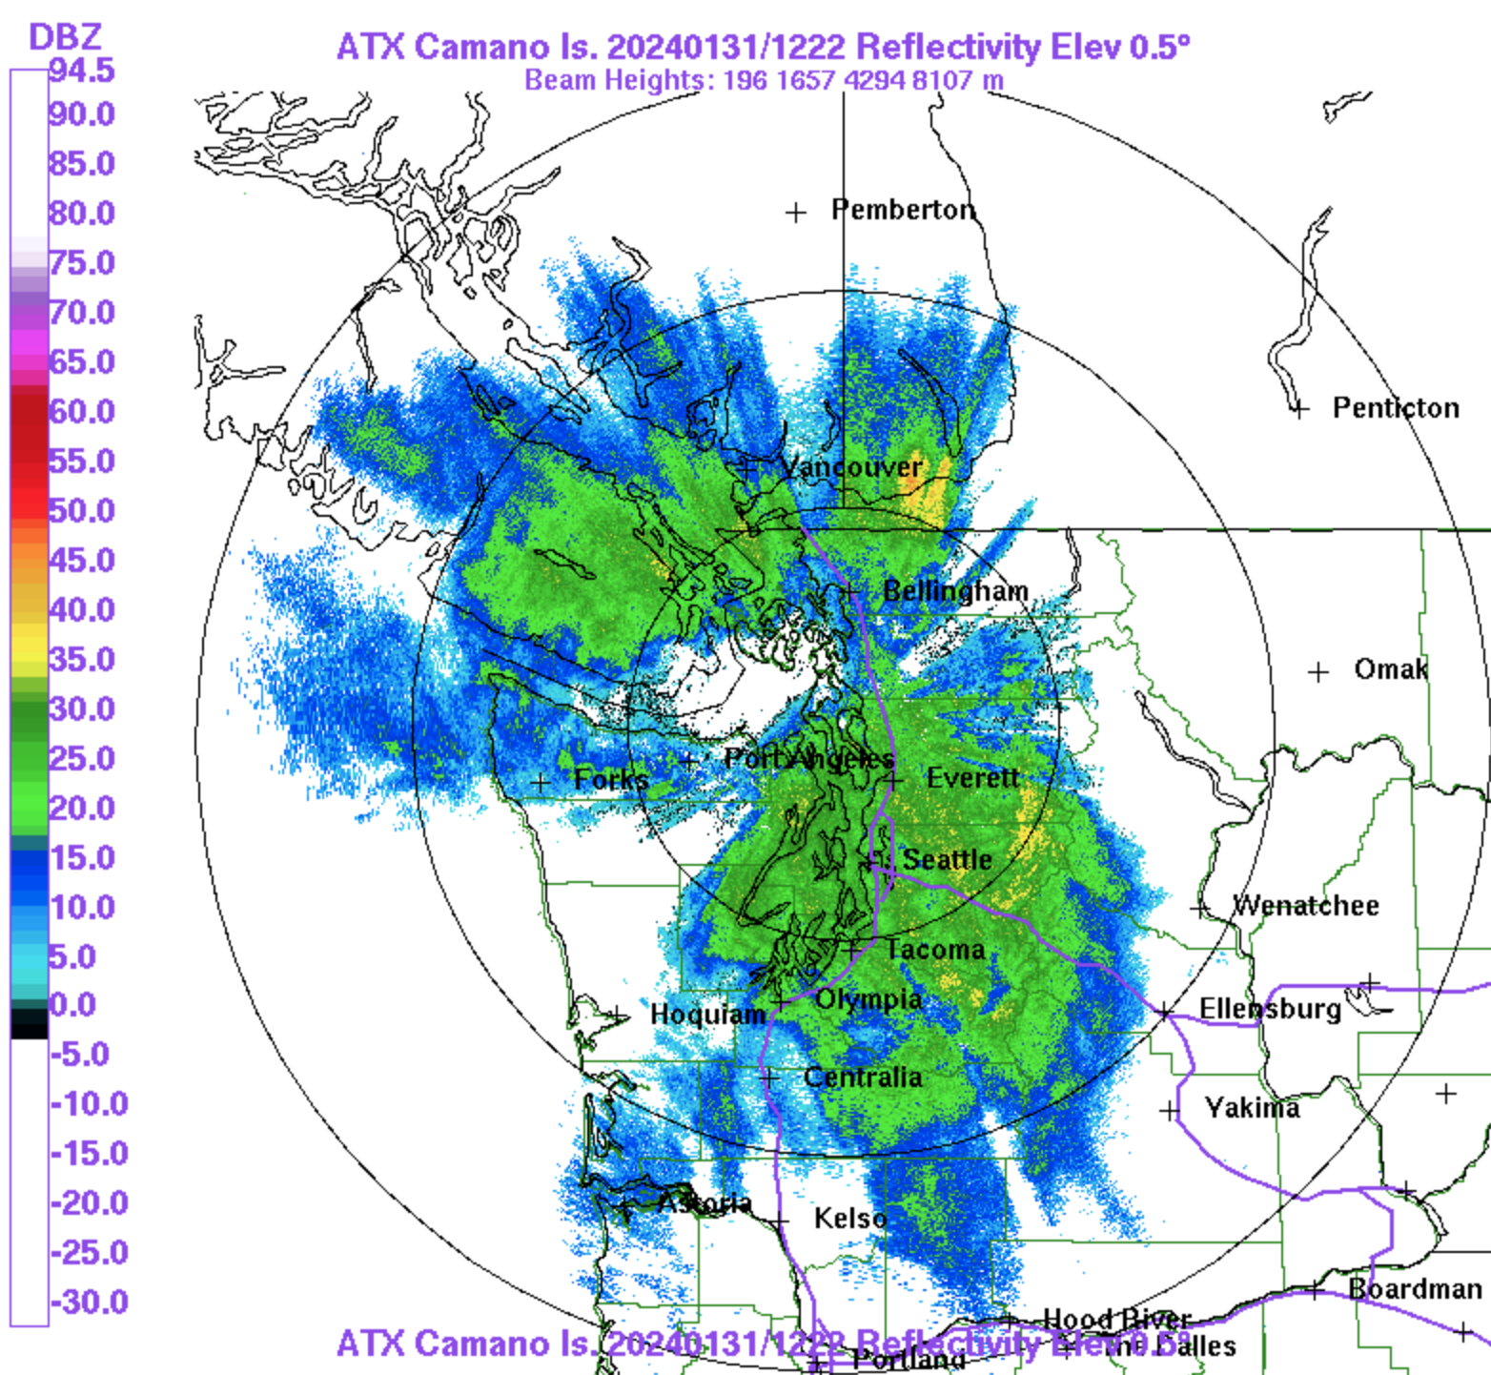
Beam Blockage

Slide 47
Beam Blockage Obvious in the West

Slide 48
Why You Generally Can’t See Drizzle: Beam Usually Too High

Slide 49
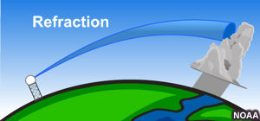
The Radar Beam Position is NOT Always the Same: Depends the Density Structure with Height

Slide 50
Less dense air
More dense air
Up

Slide 51
Why does radar beam swing down?
Less dense air
More dense air
Up

Slide 52
Radar beam moves faster in less dense air!
Less dense air
More dense air
Moves faster
Up
Moves slower

Slide 53
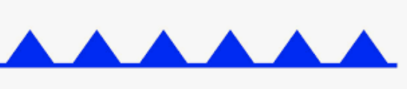
faster
slower

Slide 54
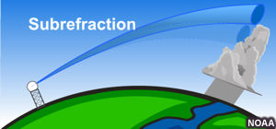
If air is warmer than normal (and less dense) near the surface, get subrefraction

Slide 55
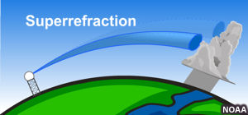
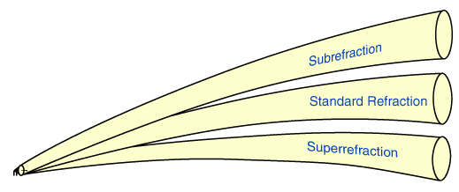
If cold air near the surface and warm air aloft (e.g., inversion) can get superrefraction

Slide 56
Superrefraction can cause the radar beam to hit the surface very quickly for the lower scan angles

Slide 57
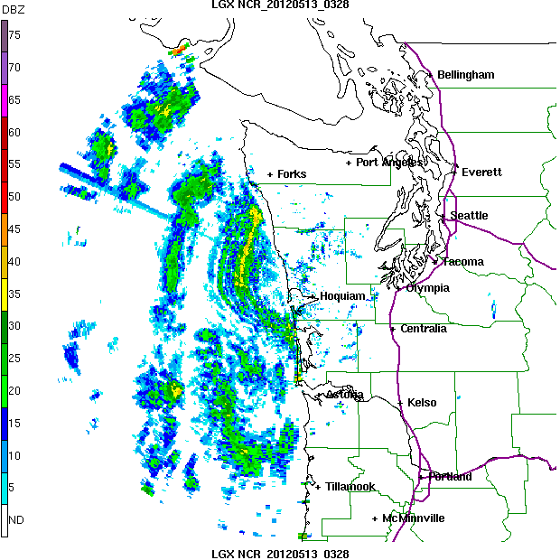

Slide 58
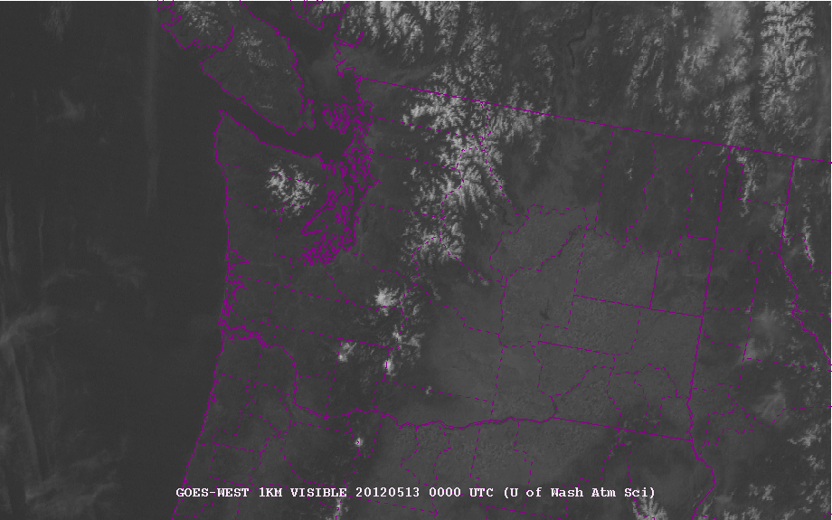

Slide 59


Slide 60


Even under normal conditions, the lower beam can hit the surface!

Slide 61

Composite Reflectivity: The Highest Reflectivity Above Each Point Using All Scan Angles

Slide 62


Slide 63

Radar-based Echo Tops
Useful for finding the strongest convection

Slide 64

Unambiguous Range (R_{u})
Distance the radar pulse can travel roundtrip between pulses
Clearly related to the pulse repetition frequency (PRF) we already talked about.
The lower the PRF, the farther the radar pulse can move until the next pulse
$Ru=C$/2PRF where C is the speed of light

Slide 65

Unambiguous Range (R_{u})
$Ru=C$/2PRF where C is the speed of light
As PRF increases, the unambiguous range goes down.
Makes sense: if there a less time between pulses, the pulse can’t go as far (and back) before the next pulse is sent out.
When a pulse is received at the radar, is it a return from the last pulse or from one before?

Slide 66

Modern Radars are Doppler Radars
Doppler radars can tell the speed of the target towards or away from the radar.
The wavelength/phase of the radar signal changes, depending the speed of the target towards or away from the radar.

Slide 67


Same principle used in police radar guns

Slide 68

Based on Doppler Effect: evident when a train or car passes. Frequency of sound changes.
https://www.youtube.com/watch?v=a3RfULw7aAY

Slide 69
The Doppler effect (also Doppler shift) is the change in the frequency of a wave in relation to an observer who is moving relative to the source of the wave

Slide 70

Doppler Effect for Weather Radars
The ”targets” are generally precipitation particles (rain drops, snow flakes)…but can include birds, bugs, and even tornado debris.
Meteorological targets generally move with the wind…so we get wind information from Doppler
radar.

Slide 71

Radar Doppler Velocities Give Radial Wind Component toward or away from radar
NOT the total velocity vector

Slide 72

Doppler Radar Imagery

Slide 73
Similar polar plot as reflectivity
Colors are wind speed towards or away from the radar

Slide 74
Standard:
Cold colors (blue/green) approaching, warm colors (yellow/red) leaving

Slide 75


Slide 76

Which way are birds flying?
Langley Hill Radar

Slide 77
Which way are birds flying?

Slide 78

No turning with height, no advection

Slide 79

“ S “ shape: veering, clockwise rotation with height, warm advection

Slide 80


Slide 81


Slide 82


Slide 83

Backing: Backwards S, cold advection
Cold Advection

Slide 84

Dopper radar can identify rotation associated with tornadic thunderstorms: mesocyclones

Slide 85

Rotation Seen on Doppler Radar

Slide 86
One can figure out the TOTAL wind vector above each radar!
How?

Slide 87

Velocity Azimuth Display: VAD Wind Profiles

Slide 88



Slide 89

VAD

Slide 90
Dual Polarization Radar

Slide 91


Slide 92

In addition to Reflectivity (Z), there are dual-polarization products such as ZDR, KDP, and CC

Slide 93

ZDR

Slide 94


Information about the shape and size of raindrops

Slide 95

Good for finding hail shafts (ZDR~ 0)

Slide 96

Correlation Coefficient (CC)
Measures the correlation between the horizontal and vertical back-scattered pulses from the scatterers within a sample volume scan of the radar

Slide 97


Slide 98

KDP
The difference in phase shift between horizontal and vertical polarized returned energy.

Slide 99

Dual-polarization information allows the determination of precipitation type and other characteristics

Slide 100

Radars as Rain Gauges
It is possible to estimate precipitation intensity and precipitation accumulation from radar data.
This relationship has been studied extensively in many regions, seasons, and precipitation regimes.

Slide 101

Z-R relationship (reflectivity-rainfall rate)
Different values can be used at various sites
Can calibrate using radar and rain gauge data

Slide 102
Also a dual-polarization algorithm for rain rate estimation
Rainfall retrievals using combinations of reflectivity (Z_{h}), differential reflectivity (Z_{dr}), and specific differential phase (K_{dp}) are made.
Have advantages over traditional Z–R methods because more information about the drop size distribution (DSD) and hydrometeor type are available.
Generally better accuracy

Slide 103


Dual Pol
Traditional Z-R

Slide 104


Slide 105

My Favorite Radar App: Radarscope

