Slide 1
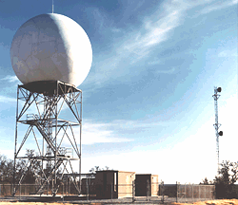
Weather Radar
ATMS 370
2026

Slide 2
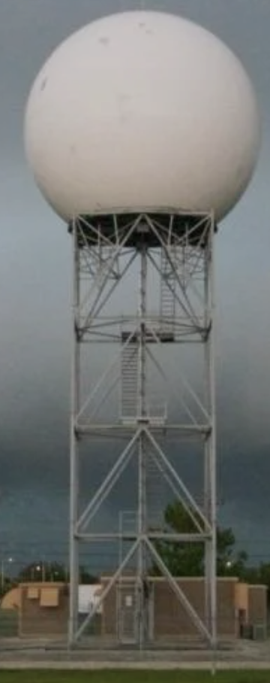
Weather Radar
Can determine where precipitation is falling
Can also tell the intensity of the precipitation
Doppler radars provide the speed/velocity of precipitation toward or away from a radar.
Dual-polarization radars can determine precipitation characteristics.
Radars can track storms, fronts, and other major features

Slide 3
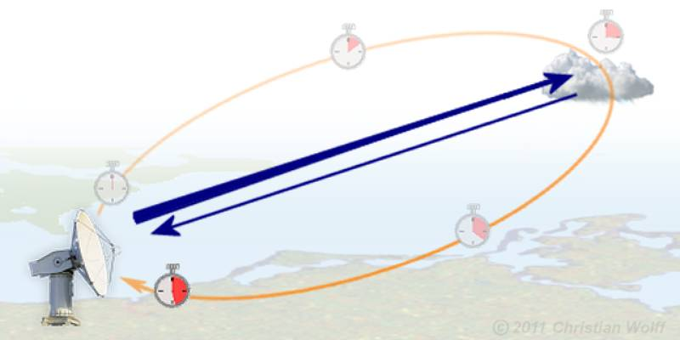
RAdio Detection And Ranging
Weather radars emit pulses of electromagnetic radiation in the microwave part of the electromagnetic spectrum
Radar wave pulses hit and are reflected/scattered back from targets (often precipitation)

Slide 4
Radar waves move at the speed of light (186,000 miles per second in a vacuum
Thus, the time from emission to return tells how far the object is away.
The amount of return tells us about precipitation intensity and type

Slide 5
Weather Radar History

Slide 6

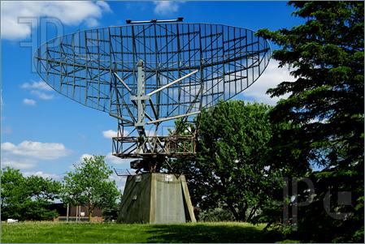
Radar Was An Important Tool in WWII for tracking aircraft. Serious Problem—Precipitation!

Slide 7
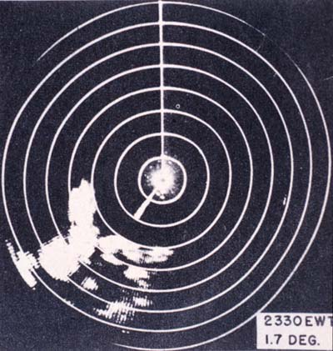
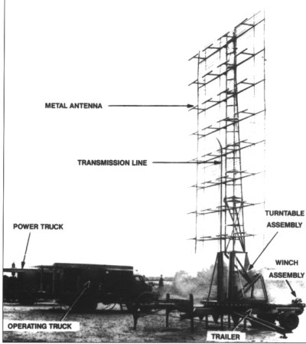
WWII Radars

Slide 8
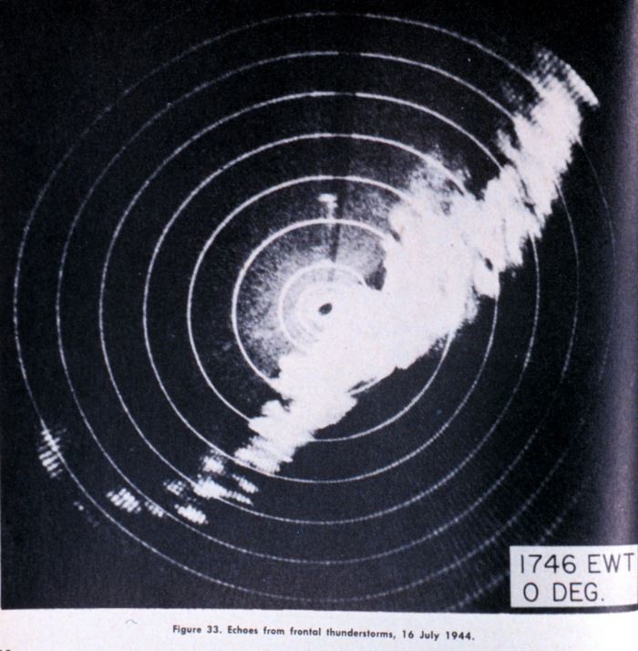
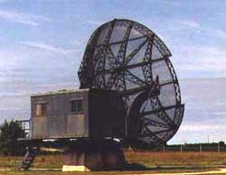
After WWII, Meteorologists Experimented with Military Radars: Thunderstorms and Convection Clearly Seen

Slide 9
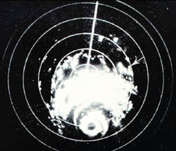
Hurricanes Also Apparent, Including Eye Walls, Rainbands

Slide 10
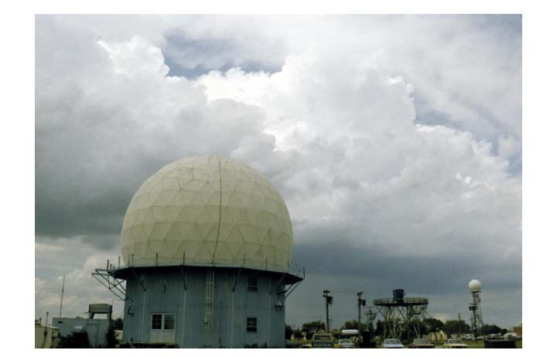
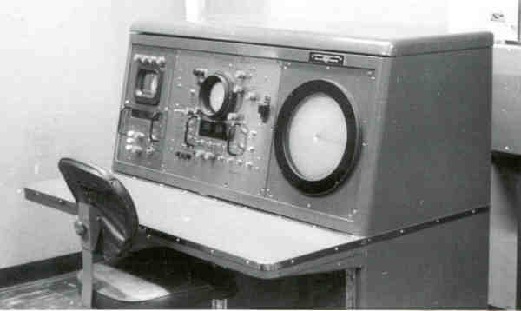
In the late 1950’s a national meteorological radar network was established (WSR-57).

Slide 11
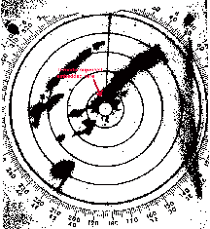
WSR-57 (no Doppler capability)

Slide 12
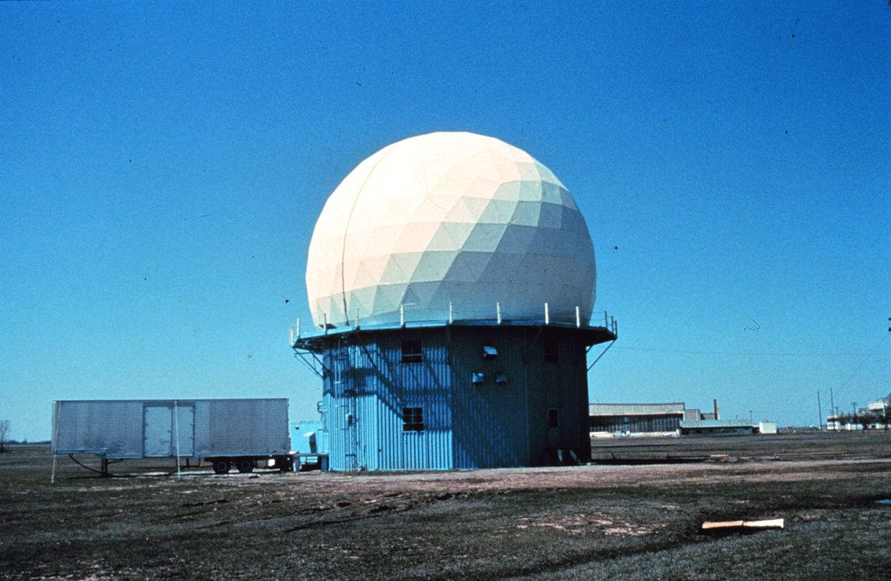
During the 1970s and early 80s a lot of experimentation with Doppler Weather Radars
Can show wind shifts and circulations
Diagnose how wind changes with height
Particularly useful for showing the rotation in severe convection—the mesocyclone

Slide 13
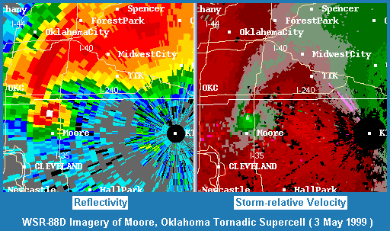

Slide 14
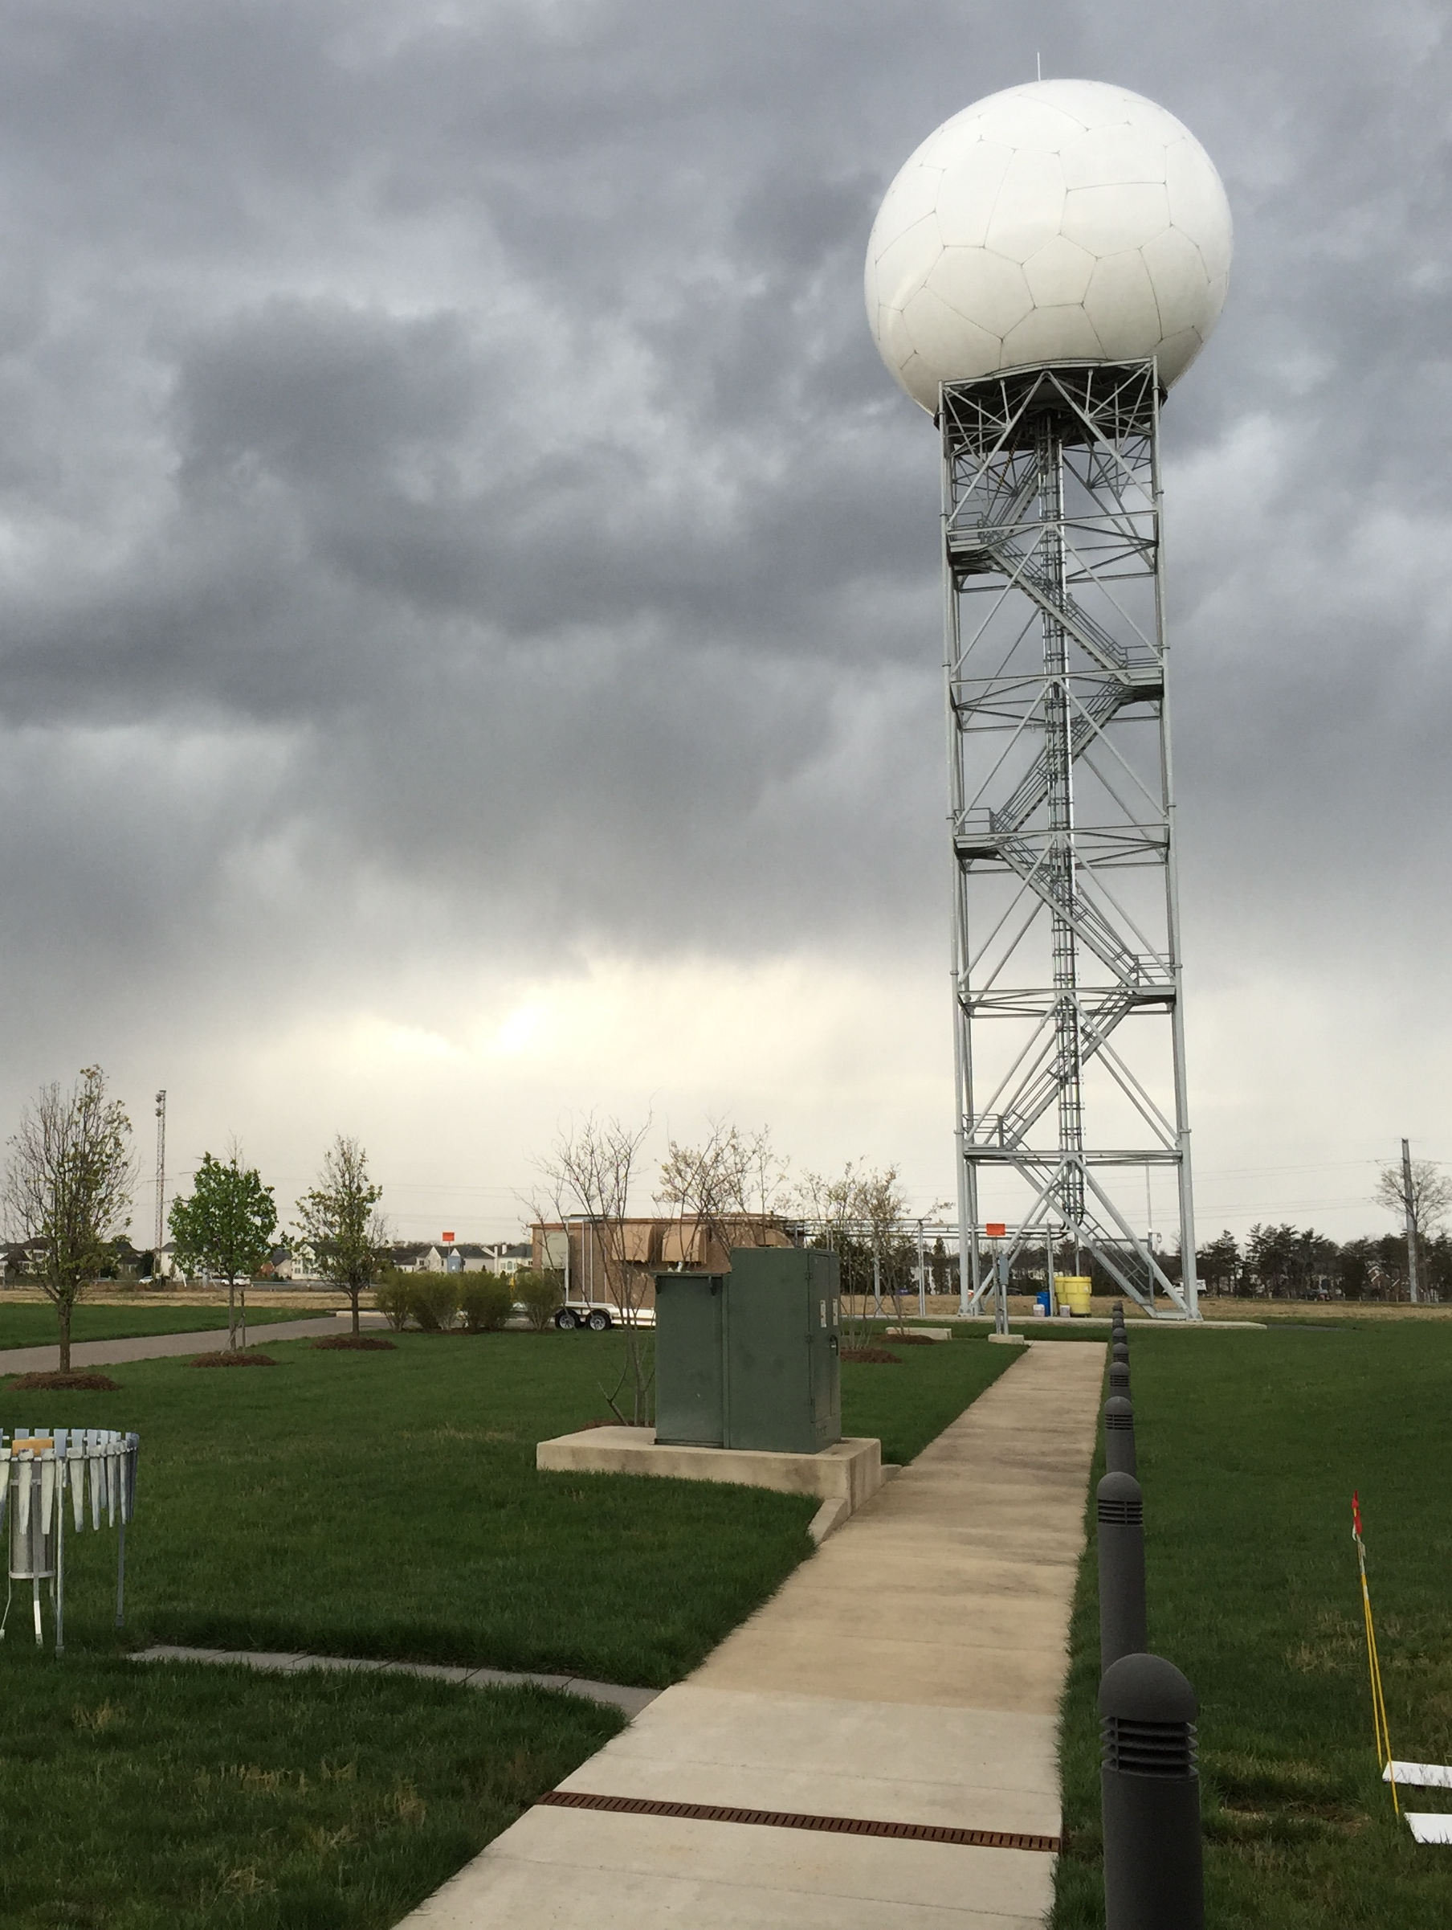
In the late 1980s,
the NWS put in a network of Doppler Weather
Radars:
NEXRAD
WSR88D
(Weather Surveillance Radar 88 Doppler)

Slide 15
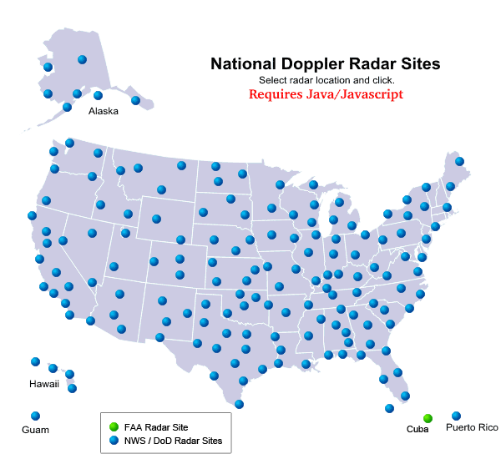

Slide 16
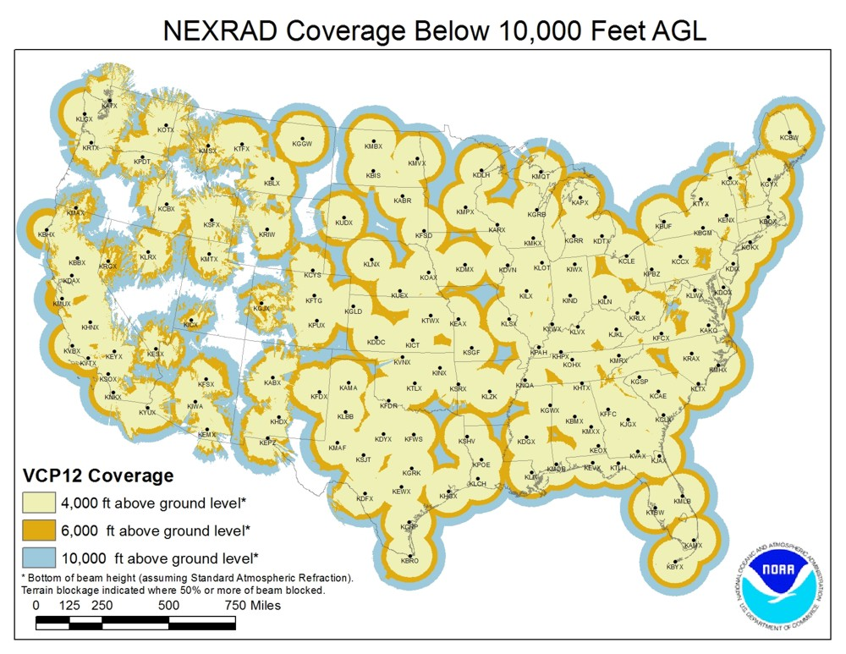
The National Weather Service has Installed Doppler Weather
Radars Across the Country
Available every 5-6 minutes

Slide 17
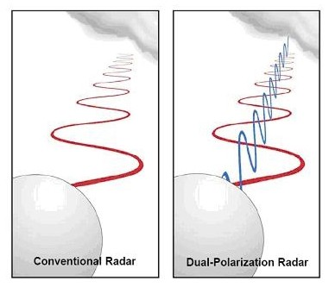
Big Radar Advance in 2011: Dual-Polarization
Sent out microwave beams with two orientations

Slide 18
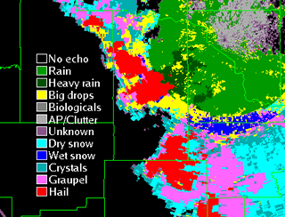
Can determine precipitation type and more

Slide 19
Basics of Weather Radar

Slide 20
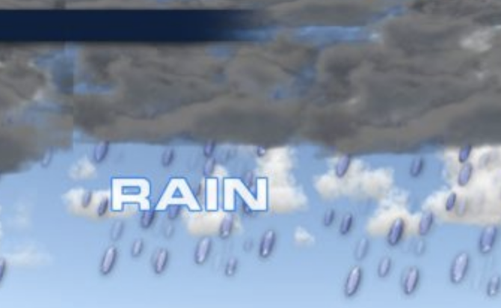
The amount of radar signal returned tells one about the nature of the object: type and intensity of precipitation
Amount scattered ~ D⁶ where D is the diameter of the target
Big objects (e.g., large rain drops associated with heavy rain)---big radar return
Small objects (small droplets)—lesser return
More objects—more return

Slide 21
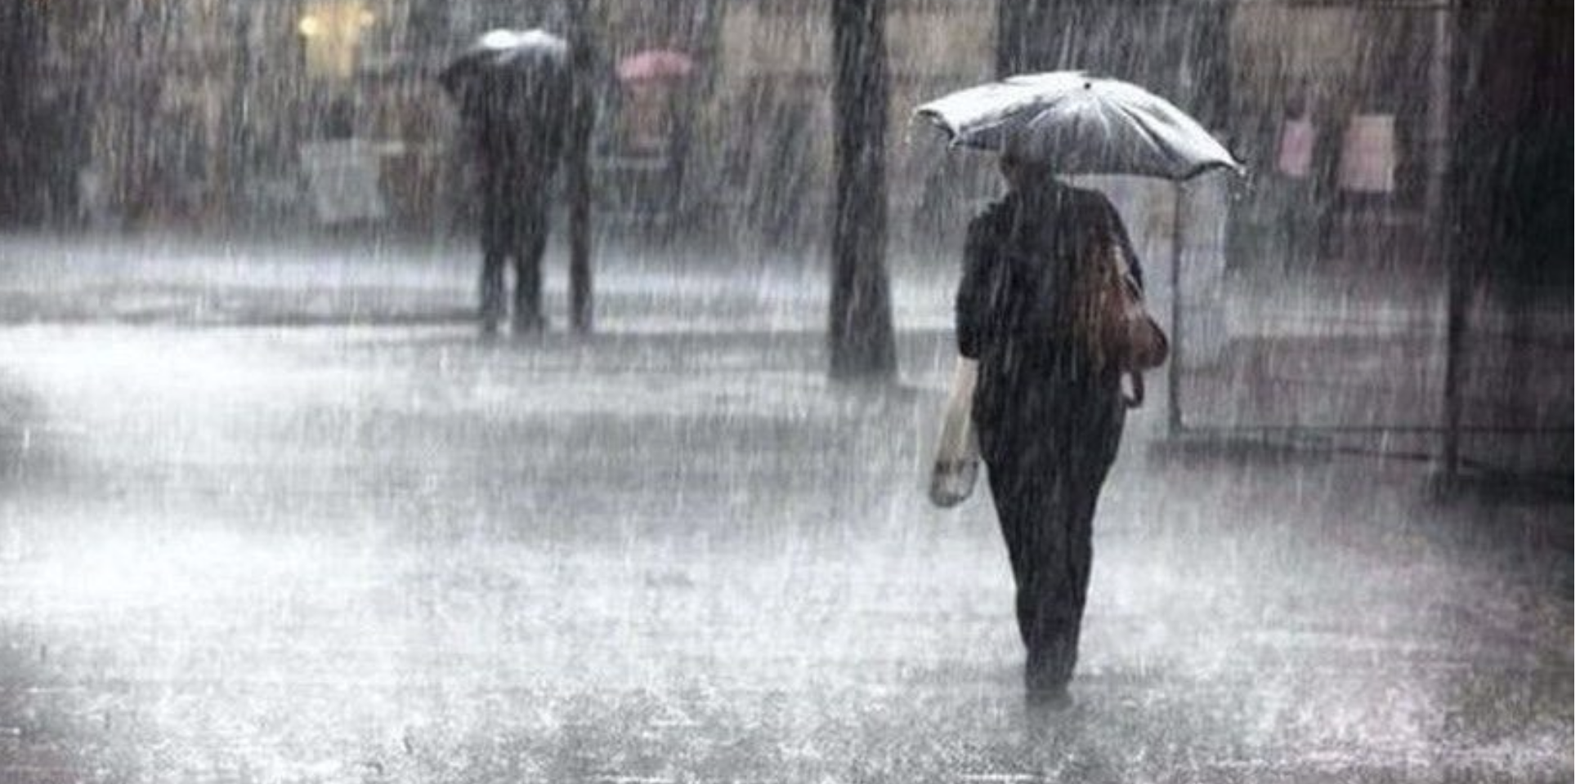
Thus, heavy rain with lots of big droplets give a big radar return!

Slide 22
The Radar Equation
P_{r} = C |k²| Z
r²
P_{r} is the received power
R is the distance to a target
|k²] depends on the refractive and absorptive properties of particles
Liquid H20 ~.93, ice ~.21. Liquid water is seen better than ice!
C depends on the characteristics of the radar (e.g., emitted power, antenna type, emission power
Z is the radar reflectivity factor (how well a target scatters radar)

Slide 23
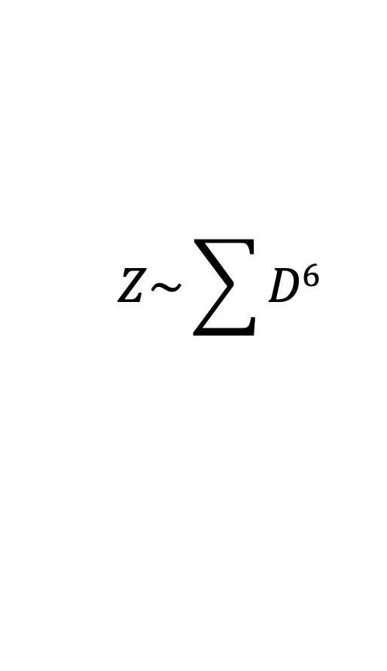
Z : Radar Reflectivity Factor
$$Z\sim \sum{D6}$$
Summed over volume
Only valid for targets that are small compared to the wavelength (λ) of the emitted radar radiation
radar ~1-20 cm (microwave)
raindrops: .5 to 2 mm, cloud droplets ~ .02 mm

Slide 24
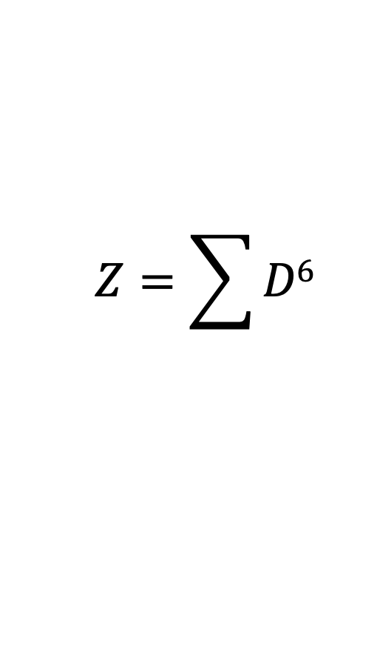
Z : Radar Reflectivity Factor
$$Z=\sum{D6}$$
Conclusions:
Big precipitation drops are MUCH seen better than small droplets
Cloud droplets not seen well
Big fat birds are seen well

Slide 25
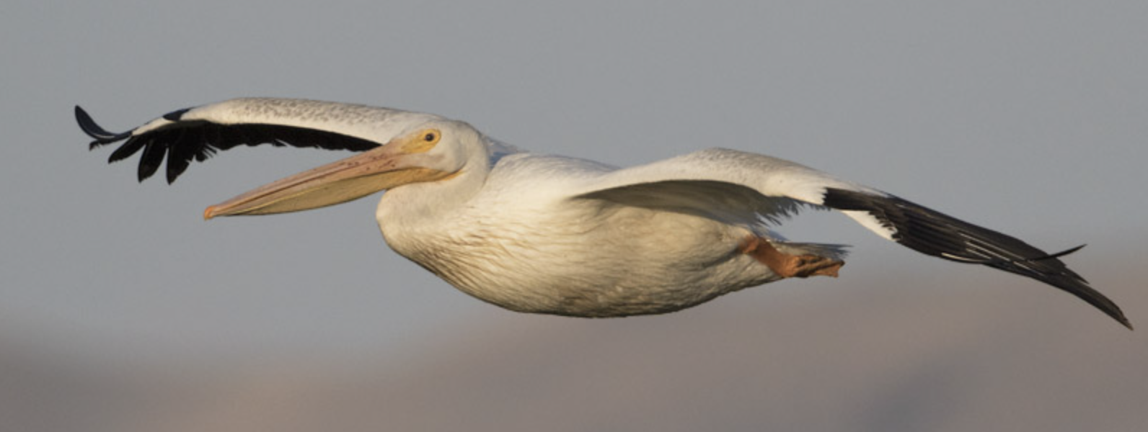
Big Radar Return

Slide 26
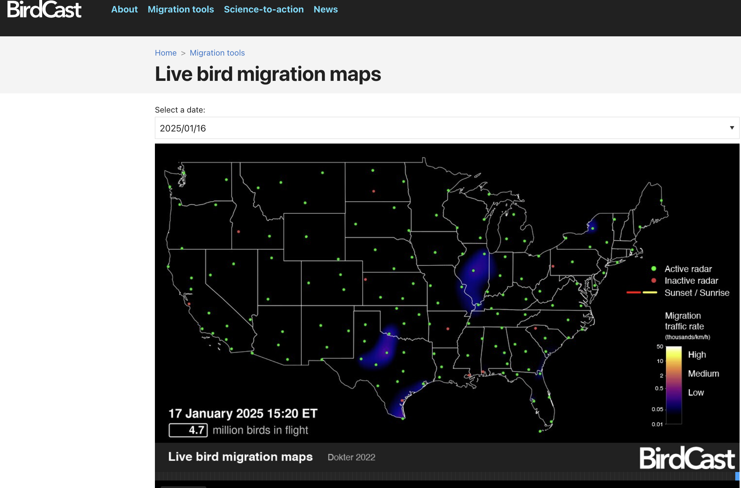

Slide 27
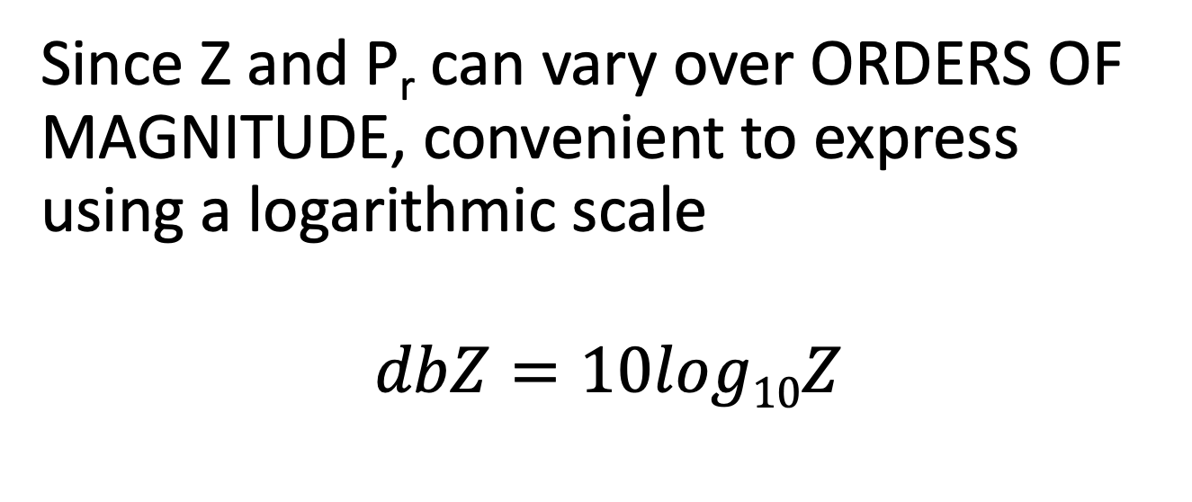
Need a logarithmic scale
Since Z and P_{r} can vary over ORDERS OF MAGNITUDE, convenient to express using a logarithmic scale
$$dbZ=10log10Z$$
Units of dBZ

Slide 28
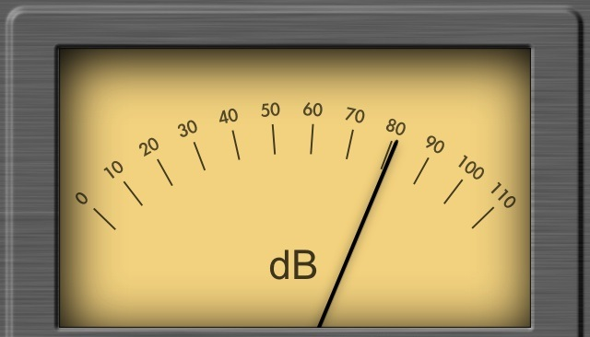
Reflectivity
A fancy name for the amount of radar signal that is returned by an object: reflectivity (Z) is given in units of dbZ
db or decibels-unit of power on a logarithmic scale
Precipitation intensity is proportional to Z (or dbZ)

Slide 29
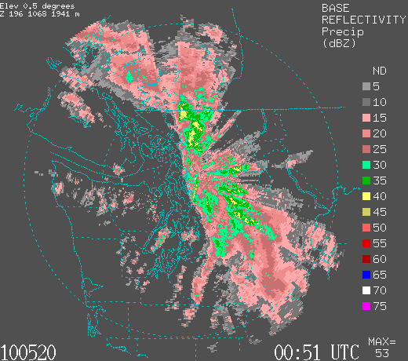
Example
Intensity of precipitation is color coded (units—dbZ)

Slide 30
Reading a Radar Image (color scales can vary)
Black (white in some)-no precip
Grey and pink (5-20 dbZ)…light rain
Dark pink to green-moderate rain (20-35)
Yellows are heavy rain 40-50 Reds and higher (very heavy rain or hail)

Slide 31
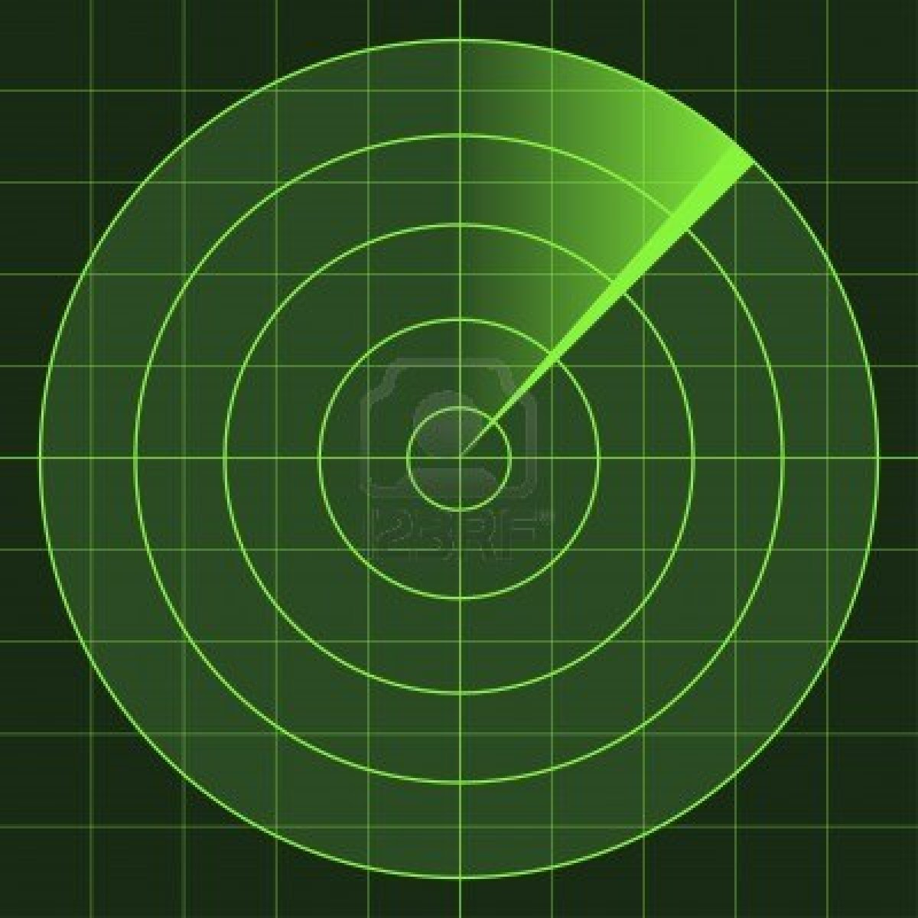
Radar imagery is generally shown on a polar-type chart with range circles at increasing distance
Radar
location
Higher
Lower

Slide 32
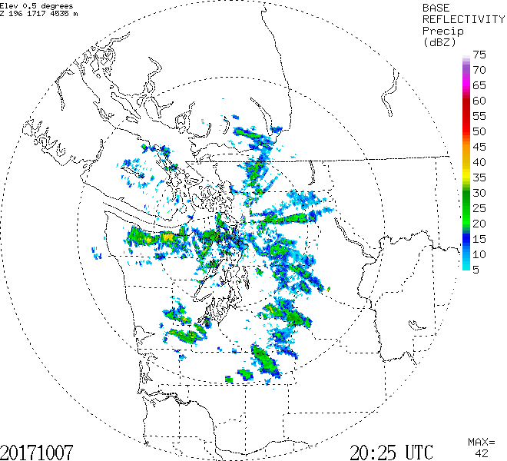
Range circle every 100 km (60 miles)

Slide 33
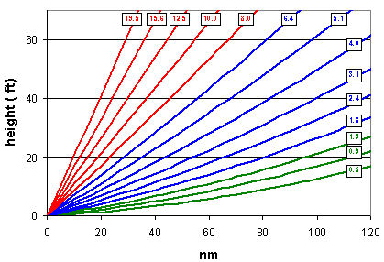
Radar Imagery is not observed or displayed for a level surface
Radars scan in azimuth ( 0 to 360 degrees) at a series of increasing scan angles from the horizontal.

Slide 34
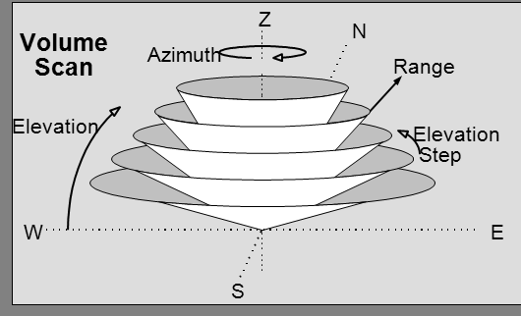

Slide 35
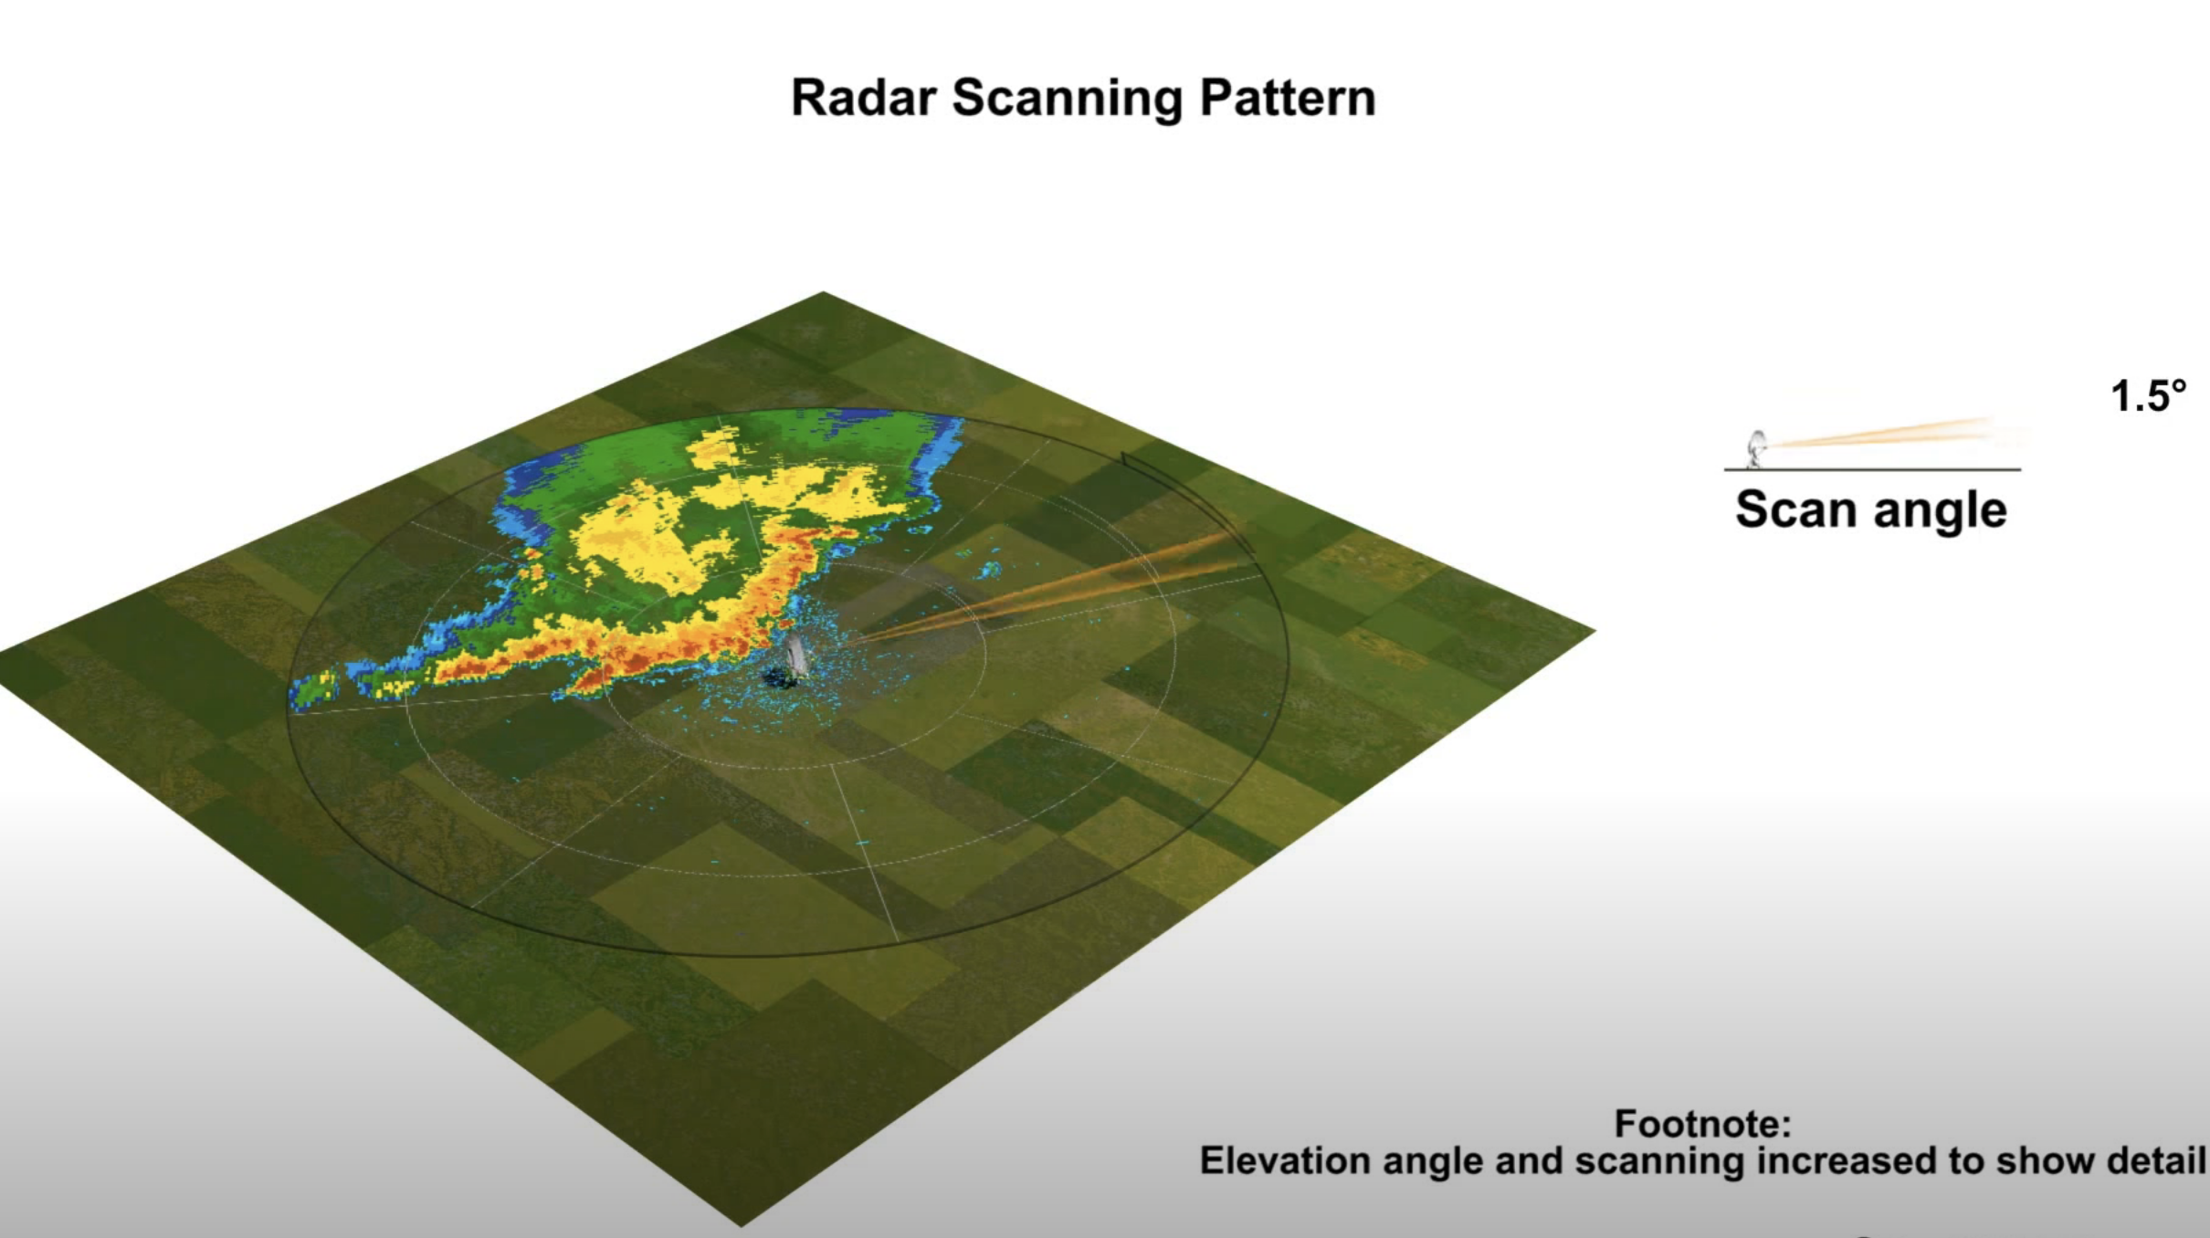
Radar images do not show a single level, but a sloping cut through the atmosphere
Thus, it is showing precipitation higher and higher up in the atmosphere as you move away from the center of the radar image.
https://www.youtube.com/watch?v=Yrq2TVdM8HI

Slide 36
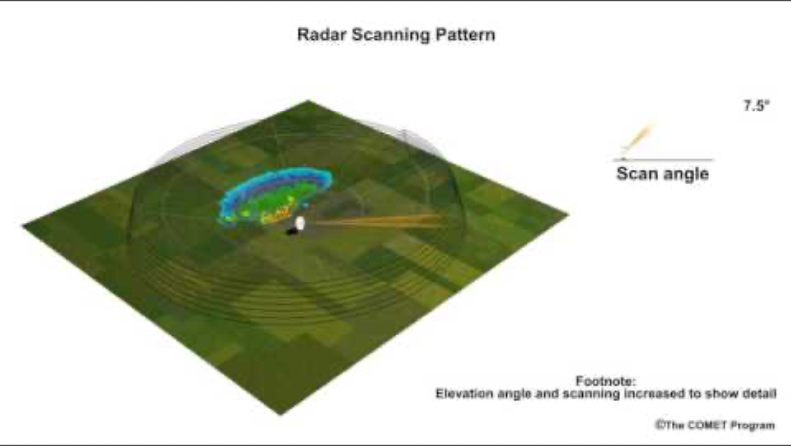

Slide 37
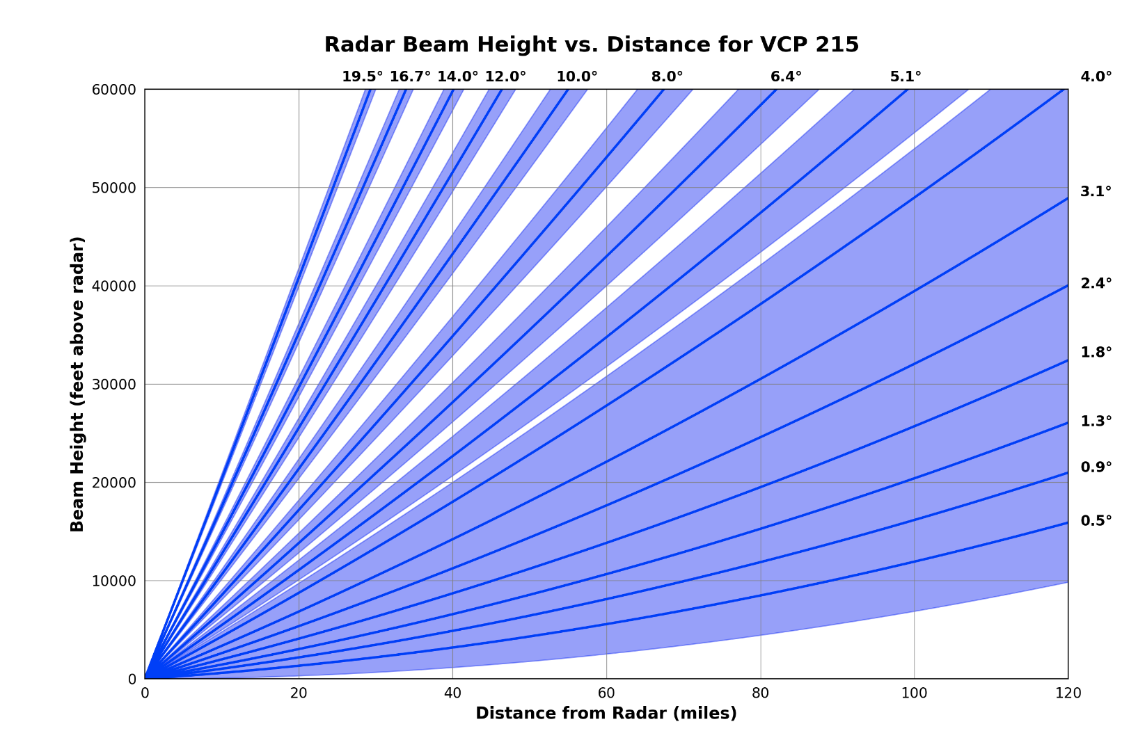
National Weather Service Scan Strategies (also called Volume Coverage Patterns, VCP). Takes 4-6 minutes for each VCP

Slide 38
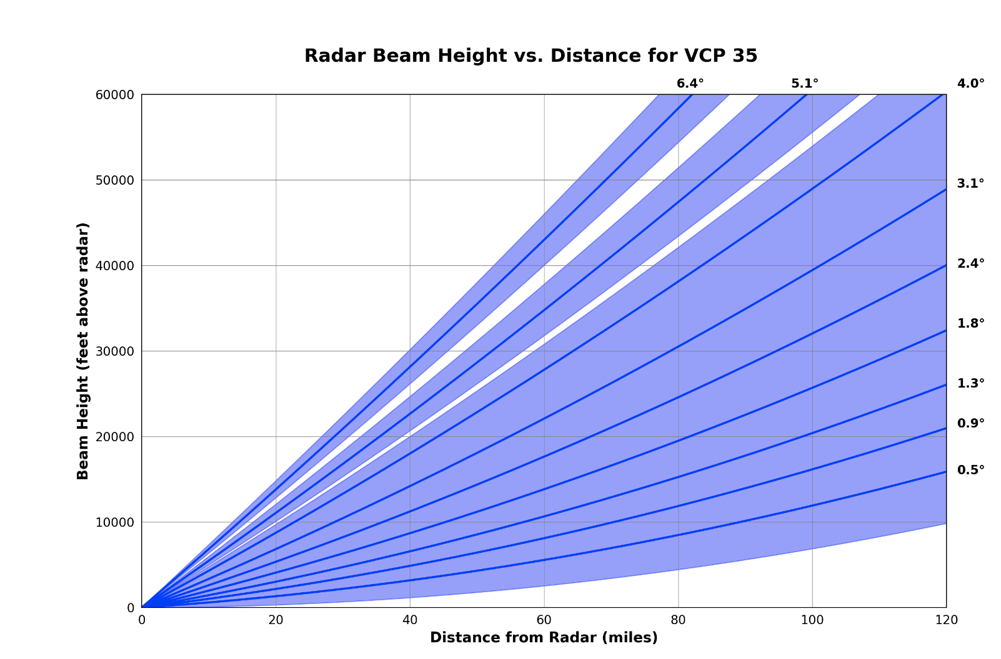
Also a clear air mode (VCP)
In clear air mode, the pulses are longer, resulting in more radar sensitivity
Scans take longer (about 10 minutes)
More coverage at lower elevation angles.

Slide 39
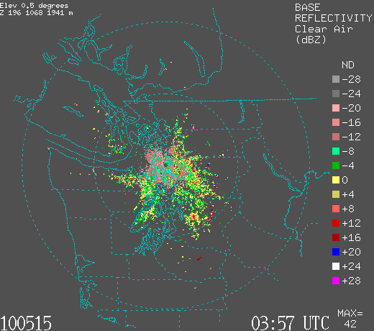
In Clear Air Mode Can See Bird, Insects, and More

Slide 40
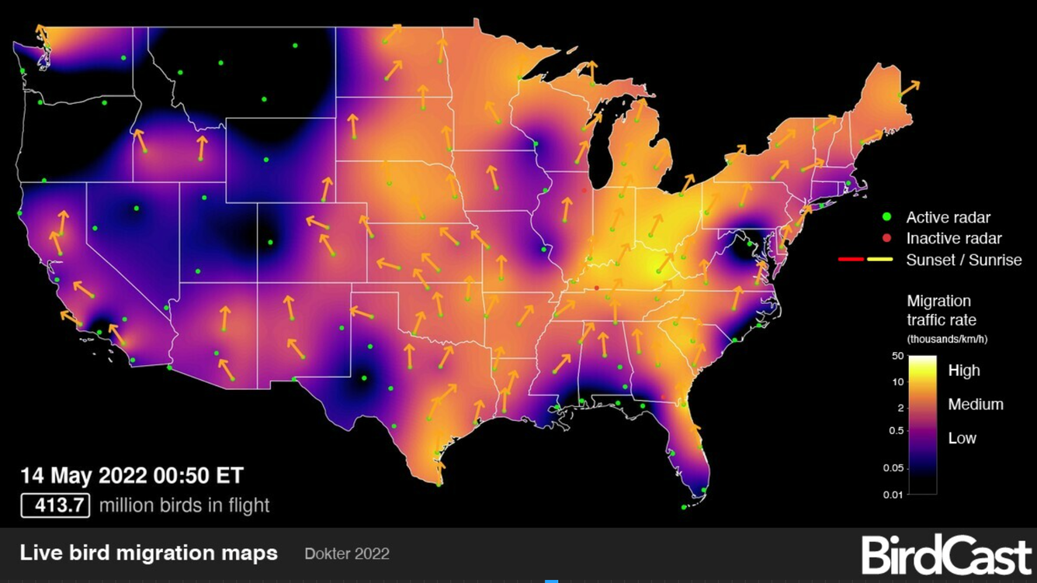
Ornithologists Love Weather Radar (Particularly in Clear Air Mode)

Slide 41
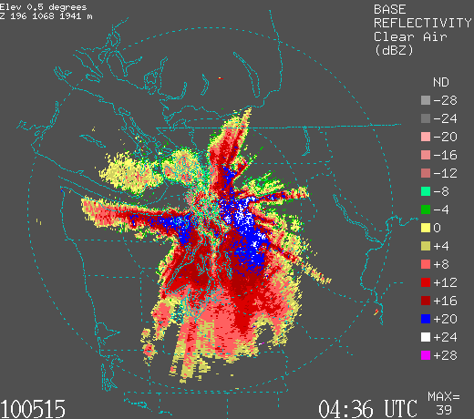
Clear Air Mode

Slide 42
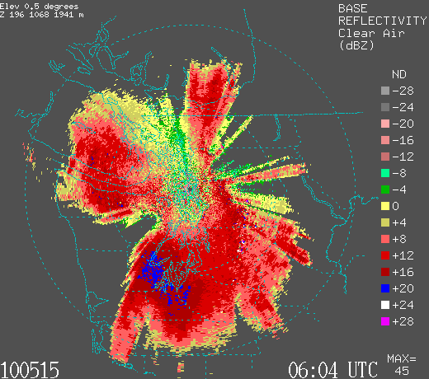

Slide 43
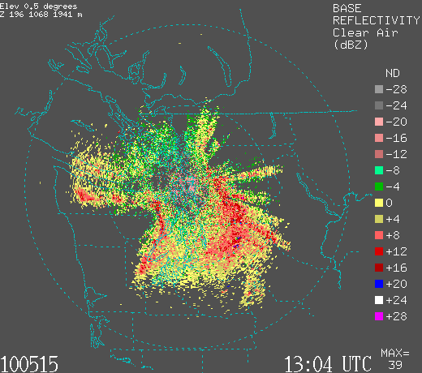

Slide 44
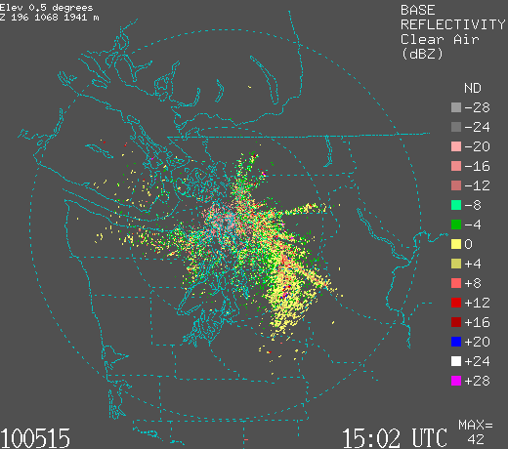

Slide 45
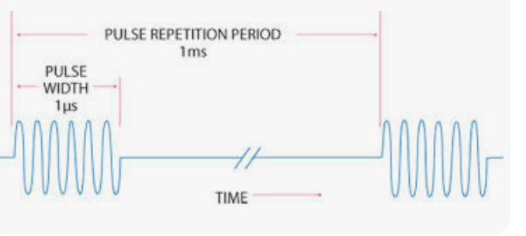
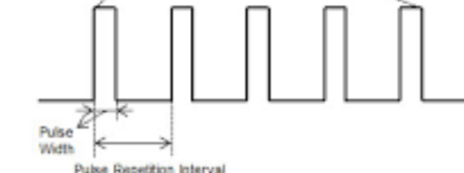
Radar Energy is Sent Out in Pulses
Pulse Repetition Frequency (PRF) of the radar system is the number of pulses that are transmitted per second.

Slide 46
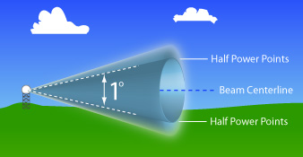
Radar Beam Width
Radar beams are cone shaped and get wider with distance

Slide 47
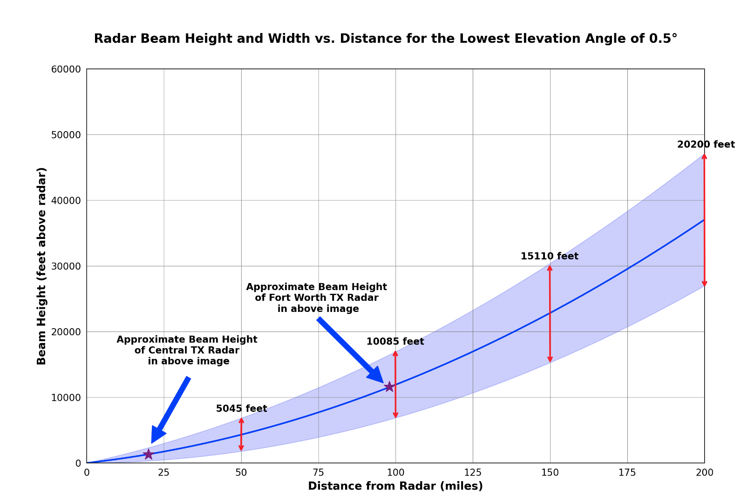
Vertical and horizontal resolution degrade rapidly with distance

Slide 48
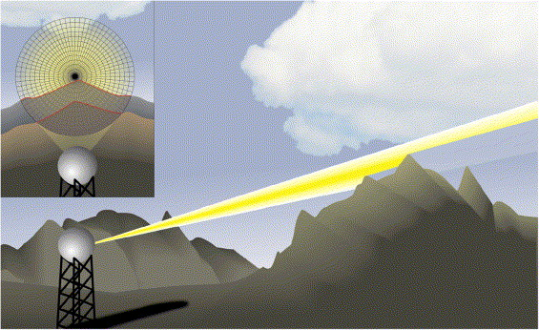
Important points
Shallow drizzle often does not appear on radar imagery, particularly when a distance away.
Can only see deep and high-level precipitation at a distance.
Radar beam can be blocked by local terrain.

Slide 49
Why You Generally Can’t See Drizzle: Beam Usually Too High

Slide 50
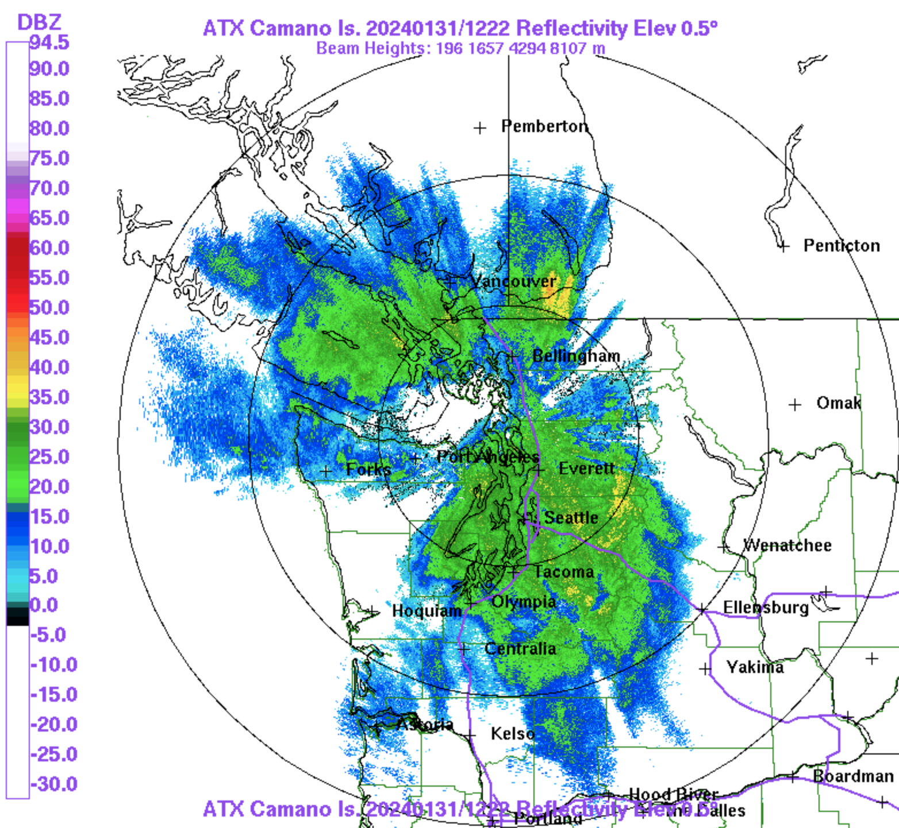
Beam Blockage by Terrain

Slide 51
Beam Blockage Obvious in the West

Slide 52
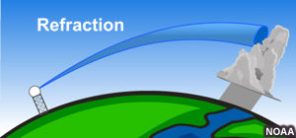
The Radar Beam Position is NOT Always the Same: Depends on the Density Structure with Height (which changes!)

Slide 53
Radar beams are refracted by density variations in the vertical
Less dense air
More dense air
Up

Slide 54
Why does radar beam swing down?
Less dense air
More dense air
Up

Slide 55
Radar beam moves faster in less dense air!
Less dense air
More dense air
Moves faster
Up
Moves slower

Slide 56
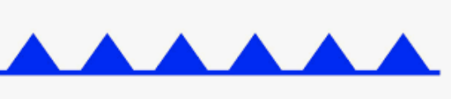
faster
LESS DENSE
Air
MORE DENSE
Air
slower

Slide 57

If air is warmer than normal (and less dense) near the surface, get subrefraction

Slide 58


If cold air near the surface and warm air aloft (e.g., inversion) can get superrefraction

Slide 59
Superrefraction can cause the radar beam to hit the surface very rapidly for the lower scan angles
Provides false echoes near the radar

Slide 60


Slide 61

Same time as previous radar echo.

Slide 62

Model sounding at same time…..cold air near the surface

Slide 63


Even under normal conditions, the bottom of the lower beam can hit the surface!

Slide 64

Composite Reflectivity: The Highest Reflectivity Above Each Point for All Scan Angles

Slide 65


Slide 66

Radar-based Echo Tops
Useful for finding the highest (and often strongest) convection

Slide 67

Unambiguous Range (R_{u})
Distance the radar pulse can travel roundtrip between pulses
Clearly related to the pulse repetition frequency (PRF) already talked about.
The lower the PRF, the farther the radar pulse can move until the next pulse
$Ru=C$/2PRF where C is the speed of light

Slide 68

Unambiguous Range (R_{u})
$Ru=C$/2PRF where C is the speed of light
As PRF increases, the unambiguous range goes down.
Makes sense: if there a less time between pulses, the pulse can’t go as far (and back) before the next pulse is sent out.
When a pulse is received at the radar, is it a return from the last pulse or from one before?

Slide 69

Modern Radars are Doppler Radars
Doppler radars can tell the speed of the target towards or away from the radar.
The wavelength/phase of the radar signal changes, depending the speed of the target towards or away from the radar.

Slide 70


Same principle used in police radar guns

Slide 71

Based on Doppler Effect: evident when a train or car passes. Frequency of sound changes.
https://www.youtube.com/watch?v=a3RfULw7aAY

Slide 72


Slide 73
The Doppler effect (also called the Doppler shift) is the change in the frequency of a wave in relation to an observer. The frequency change also produces a phase shift.

Slide 74

Doppler Effect for Weather Radars
The ”targets” are generally precipitation particles (rain drops, snow flakes)…but can include birds, bugs, and even tornado debris.
Meteorological targets generally move with the wind…so we get wind information from Doppler
radar.

Slide 75

Radar Doppler Velocities Give the Radial Wind Component toward or away from radar
NOT the total velocity vector

Slide 76

Doppler Radar Imagery

Slide 77
Similar polar plot as reflectivity
Colors are wind speed towards or away from the radar

Slide 78
Standard:
Cold colors (blue/green) approaching air, warm colors (yellow/red) exiting air

Slide 79

What is Wind
Direction near the radar?

Slide 80

Clear Air Return
With Bird Echoes
Which way are birds flying?
Langley Hill Radar

Slide 81
Which way are birds flying?

Slide 82
Reminder about thermal wind and rotation of the geostrophic wind with height

Slide 83
Temperature Advection and Wind Turning with Height
Backing (counterclockwise turning with height) of the the geostrophic wind: cold advection
Veering (clockwise turning with height) of the the geostrophic wind: warm advection
Thus, if the actual winds are ~geostrophic (not bad assumption above boundary layer) one can determine temperature advection from a single sounding—or Doppler Weather Radar

Slide 84

Doppler Velocities
No turning with height, no advection

Slide 85

“ S “ shape: clockwise rotation with height, called veering, associated with warm advection

Slide 86
“ S “ shape: veering

Slide 87


Slide 88


Slide 89


Slide 90

Backing: Backwards S, cold advection
Cold Advection

Slide 91

Doppler radar can identify rotation associated with tornadic thunderstorms: mesocyclones

Slide 92

Rotation Seen on Doppler Radar
radar

Slide 93
One can figure out the TOTAL wind vector above each radar!
How?

Slide 94


Measure the Doppler velocities around a radar by sweeping in azimuth

Slide 95

Velocity Azimuth Display: VAD Wind Profiles

Slide 96

VAD

Slide 97
Dual Polarization Radars

Slide 98


Slide 99

In addition to Reflectivity (Z), there are dual-polarization products such as ZDR, KDP, and CC

Slide 100

ZDR

Slide 101


Proves information on the shape of precipitation particles
Information about the shape and size of raindrops

Slide 102

Good for finding hail shafts (ZDR~ 0)

Slide 103

Correlation Coefficient (CC)
Measures the correlation between the horizontal and vertical back-scattered pulses from the scatterers within a sample volume scan of the radar

Slide 104


Slide 105

KDP
The difference in phase shift between horizontal and vertical polarized returned energy.

Slide 106

Dual-polarization information allows the determination of precipitation type and other characteristics

Slide 107

Radars as Rain Gauges
It is possible to estimate precipitation intensity and precipitation accumulation from radar data.
This relationship has been studied extensively in many regions, seasons, and precipitation regimes.

Slide 108

Z-R relationship (reflectivity-rainfall rate)
Can calibrate using radar and rain gauge data

Slide 109
Also a dual-polarization algorithm for rain rate estimation
Rainfall retrievals using combinations of reflectivity (Z_{h}), differential reflectivity (Z_{dr}), and specific differential phase (K_{dp}) are made.
Have advantages over traditional Z–R methods because more information about the drop size distribution (DSD) and hydrometeor type are available.
Generally better accuracy

Slide 110


Rainfall estimate from radar
Dual Pol
Traditional Z-R

Slide 111

Dual Pol
Better

Slide 112

My Favorite Radar App: Radarscope

