Slide 1
Wind Chill
Atmospheric Sciences 101
Autumn 2025
Wind chill is mentioned a lot in the media. What is it?

Slide 2
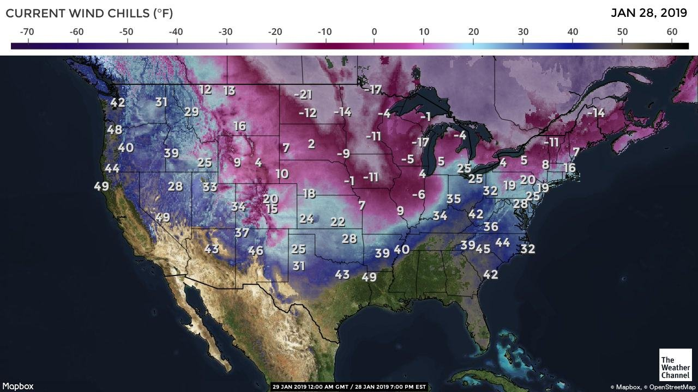
Weather Channel

Slide 3
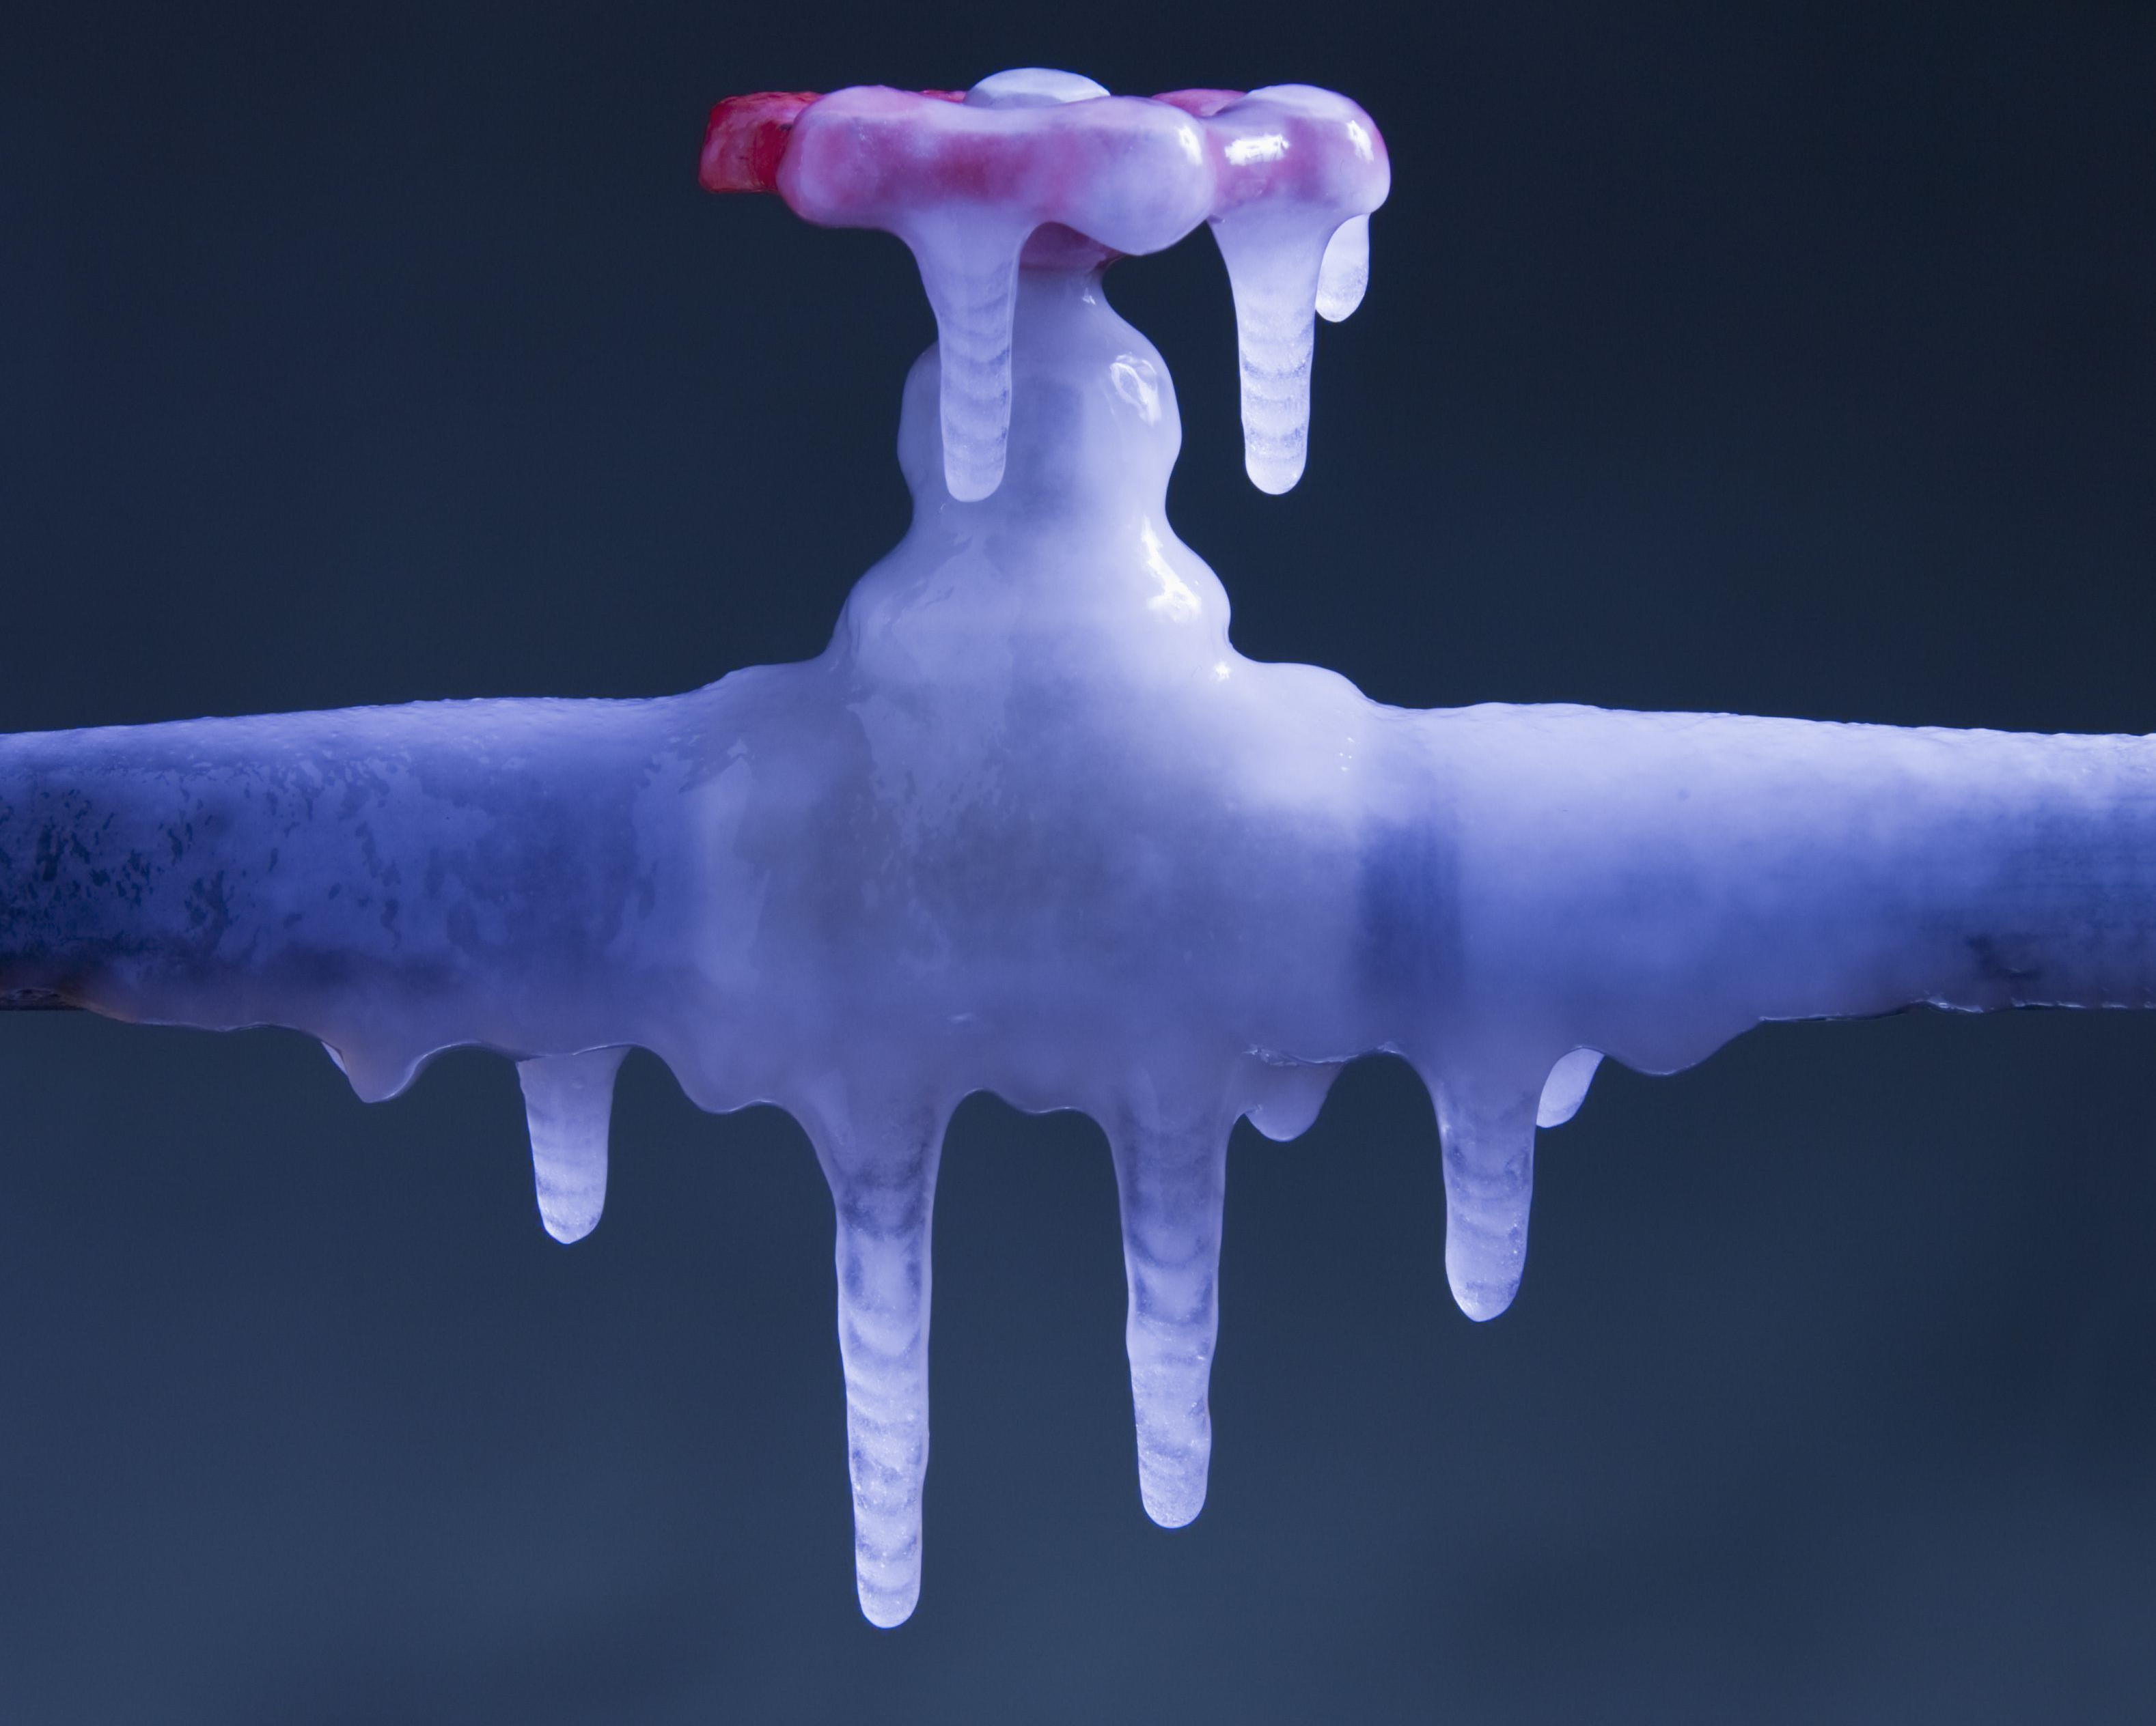
Wind Chill
Is a measure how cold you loose heat, considering the effects of winds.
How cold you feel.
There are a lot of misconceptions. For example, if the temperature is 35F and the wind chill is 29F, will water freeze?

Slide 4
NO!

Slide 5

Wind Chill
The first wind chill formulas developed in the Antarctic before the Second World War,
Wind chill info was first made available by the National Weather Service in the 1970s.

Slide 6
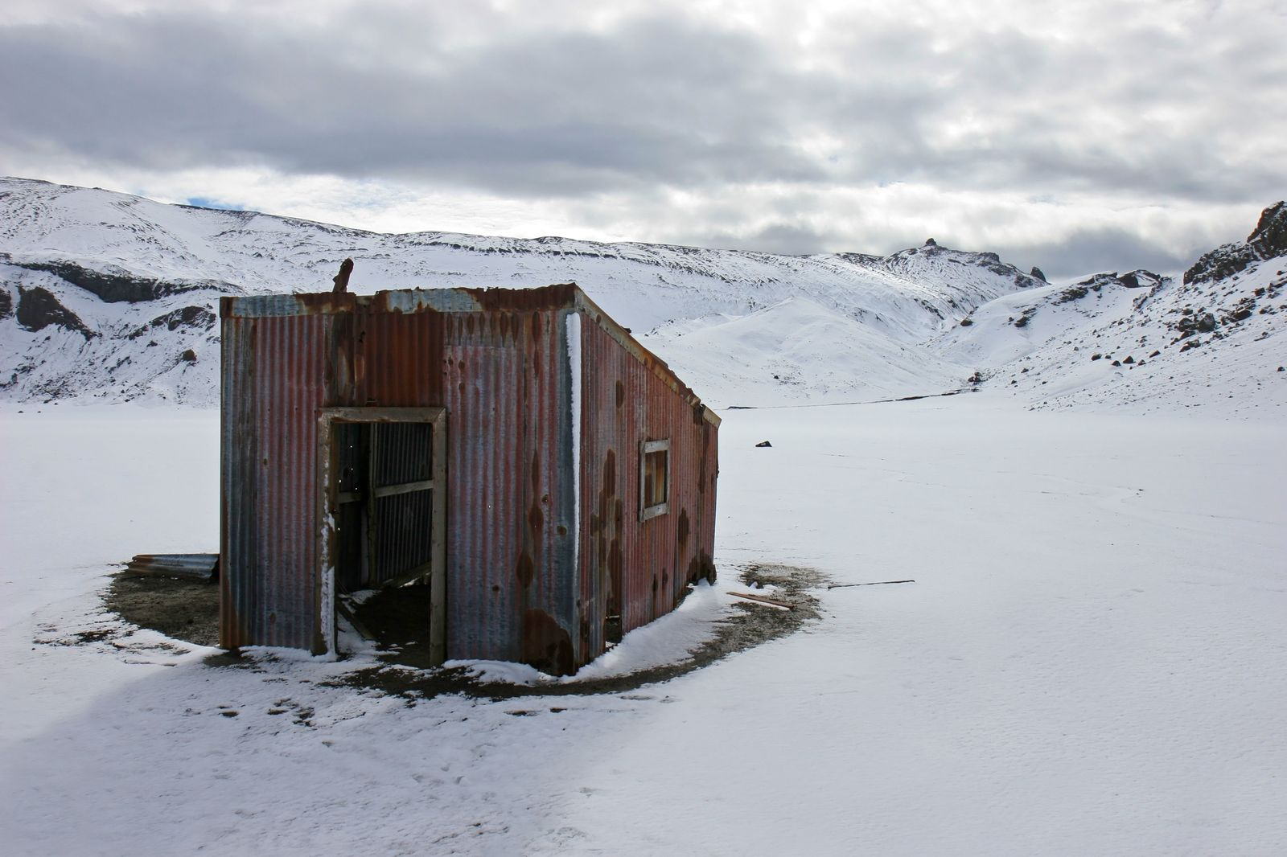
Wind Chill Was Based on Experiments
Measured cooling rates of bottles of water for various combinations of temperature and wind

Slide 7
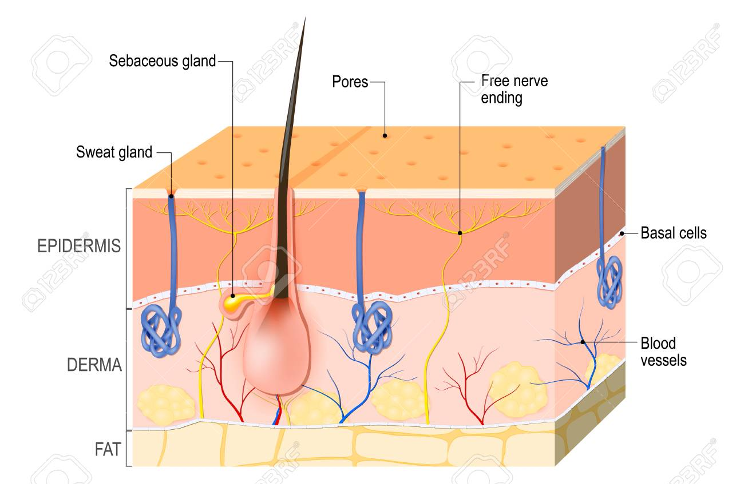
Cooling rate depends on both temperature and wind
Difference in temperature between bottle (or skin) and the environmental air
Wind speed, which controls how effectively cold air is mixed to the bottle/skin, and how rapidly warm air near bottle/skin is removed.

Slide 8
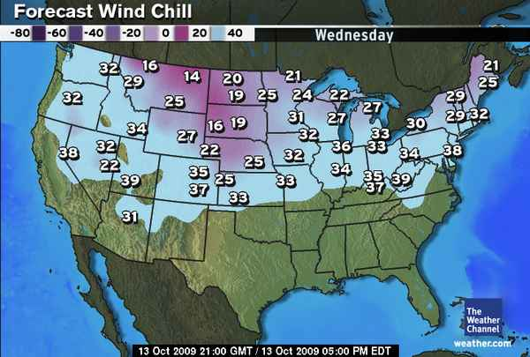
Led to the Wind Chill Formula Estimating Loss of Heat as a Function of Temperature and Wind Speed

Slide 9
Wind Chill Temperature
Definition: a still-air temperature that would have the same cooling effect on exposed human skin as a given combination of temperature and wind speed
Also called wind chill index and wind chill equivalent temperature

Slide 10
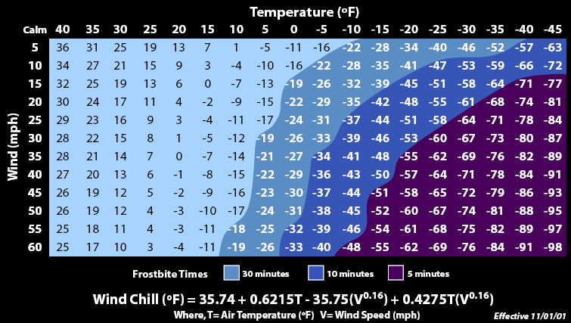

Slide 11
Will water freeze with a temperate of 35F and a wind chill of 30F?
?

Slide 12
No….

Slide 13
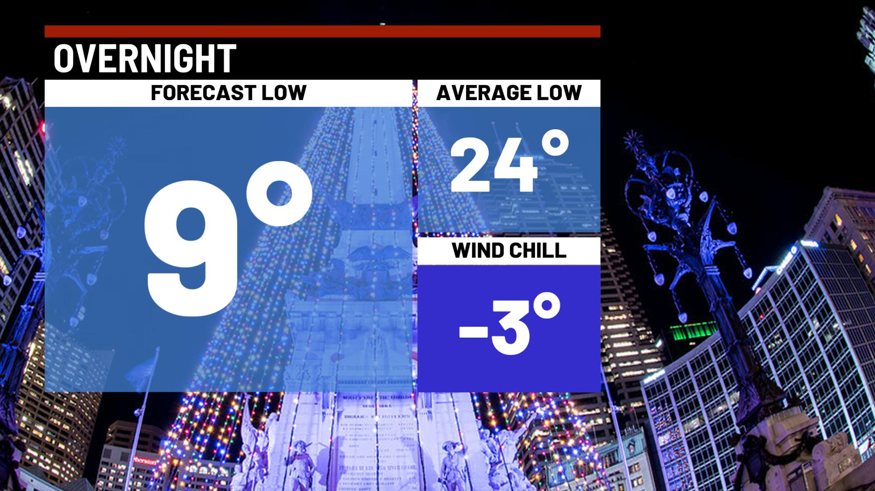
Wind Chill and Safety

Slide 14
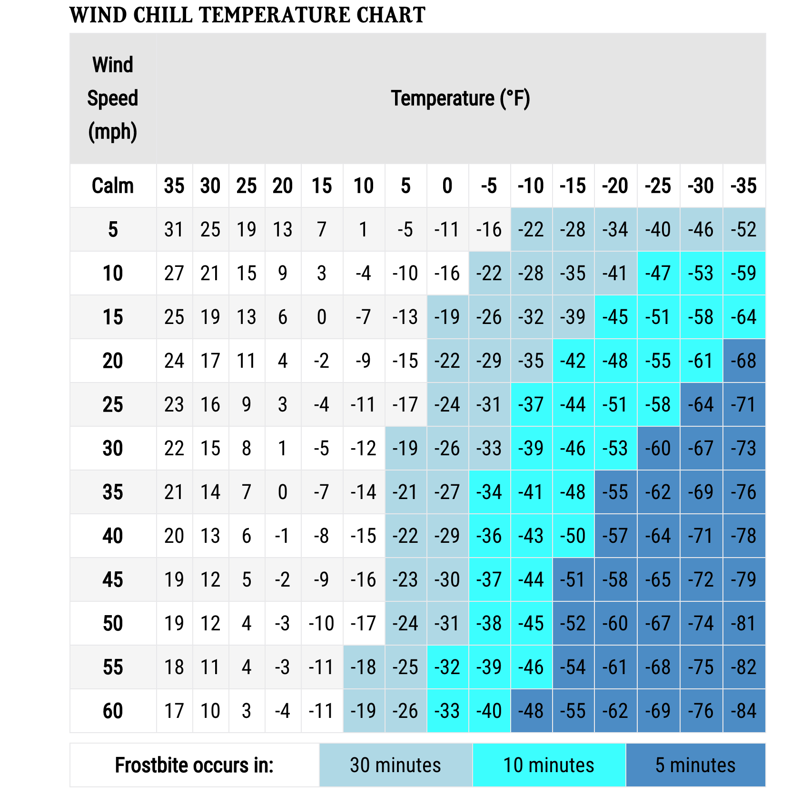
Frostbite Can Occur Rapidly at Low Windchill Temperatures

Slide 15
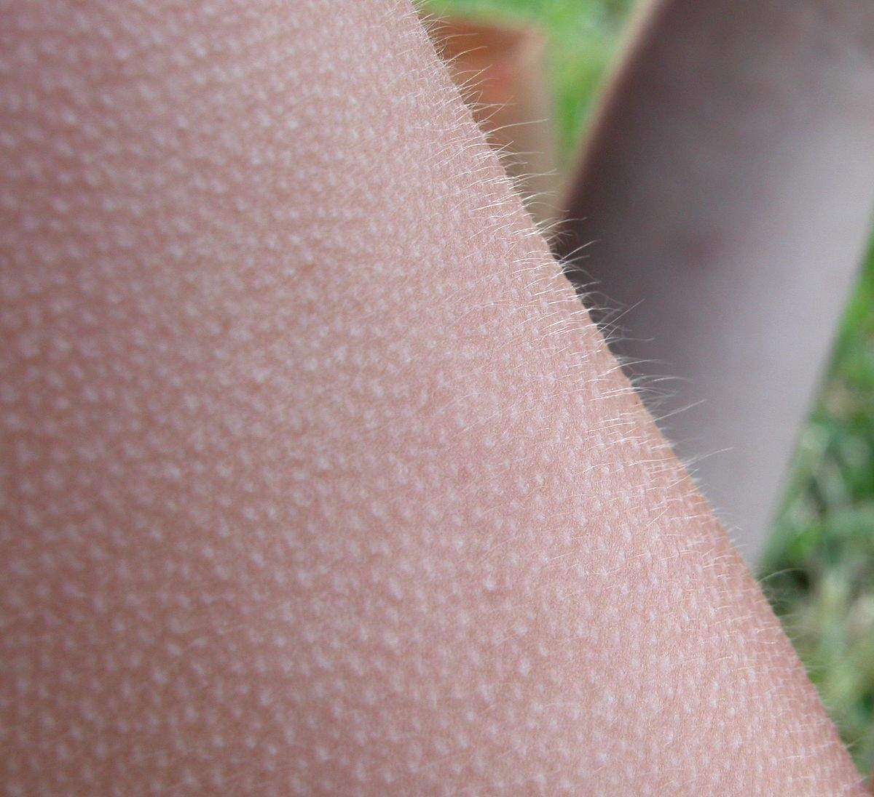
Why goosebumps when cold?

Slide 16
Cold air makes hairs stick up to slow air and help create an insolating dead-air layer

Slide 17
There is another factor that influences our comfort and how heat moves from our skin into the atmosphere.
Humidity!
Controls evaporation (cooling) and condensation (warming)
Can’t cool as well with higher humidity
We will talk about that later….

Slide 18
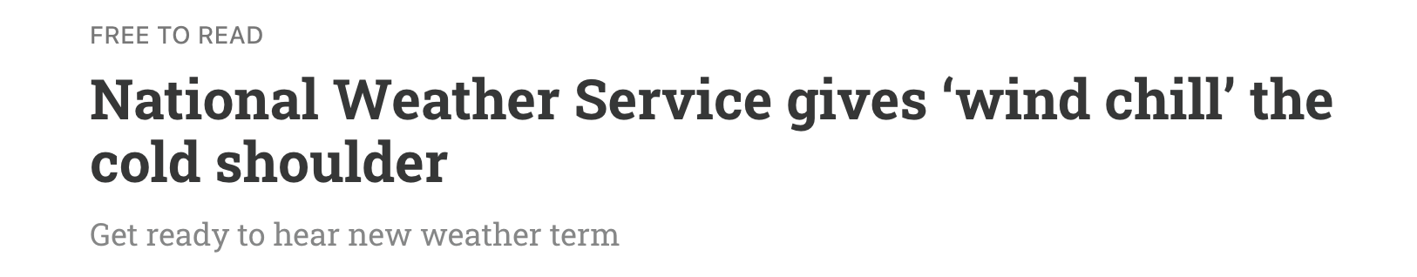
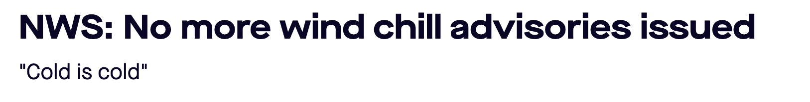
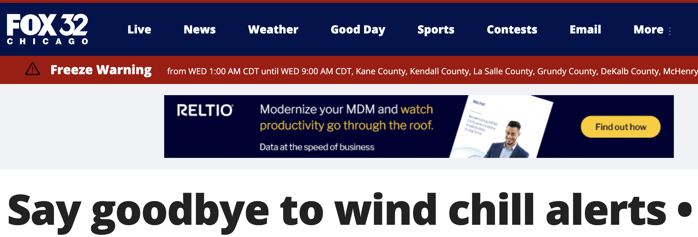
The National Weather Service is Dropping Wind Chill Warmings

Slide 19
