Slide 1
Winds and Forces
Atmospheric Sciences 101
Autumn 2025

Slide 2
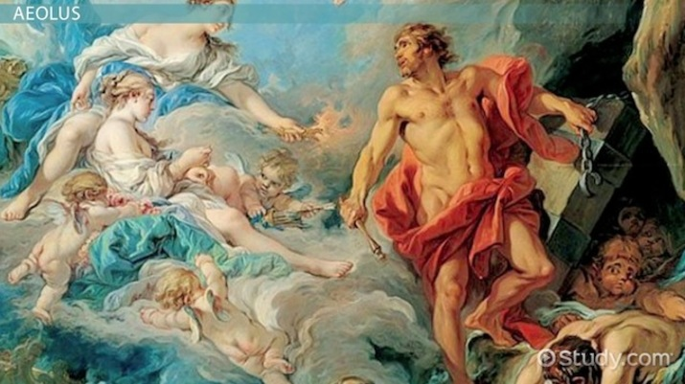
Origin of winds

Slide 3
Wind: the movement of air in the atmosphere
Why are there winds? Differences in pressure between locations
Why are there pressure differences? Differences in temperature
Why are there temperature differences? Fundamentally because of differences in solar heating.
The bottom line is that differences in solar heating cause winds. All the rest is detail.

Slide 4

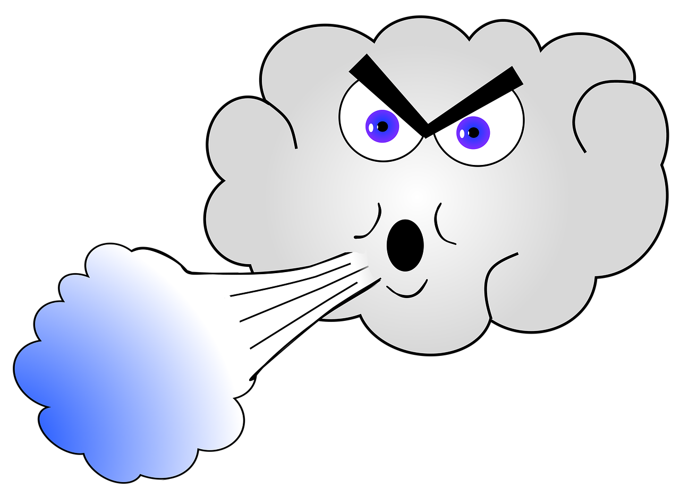
The Basic Story

Slide 5
To understand wind, one needs to understand basic concepts of force, velocity, and acceleration

Slide 6
Basics
Force, F: push or pull on an object. Units: Newtons (N) or pounds (lb). Examples: gravitational force, pressure gradient force
Mass, M: a measure of the quantity of matter. Units: kilogram (kg) or gram (g). NOT the same as weight!
An object’s mass usually remains the same, but the weight can vary. Example: your weight would be less on the moon, but your mass would be the same

Slide 7
Velocity, V: rate of change of position with time. It is a vector quantity, includes changes in both speed and direction.
A vector is a a quantity having direction as well as magnitude. Bold font or arrow indicates a vector quantity.

Slide 8
  Consider a car going around a circle. Speed can be constant, but direction is changing. Therefore, the velocity is constantly changing, resulting in acceleration.
Velocity vector

Slide 9
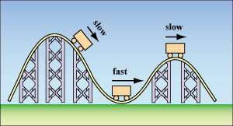
Basic Concepts
Acceleration, a, the rate of change of velocity in time. Can be associated with a change of speed, direction, or both.
  If you speed up or slow down while going in a straight line, you are accelerating
  If you maintain the same speed and change direction, you are accelerating.

Slide 10
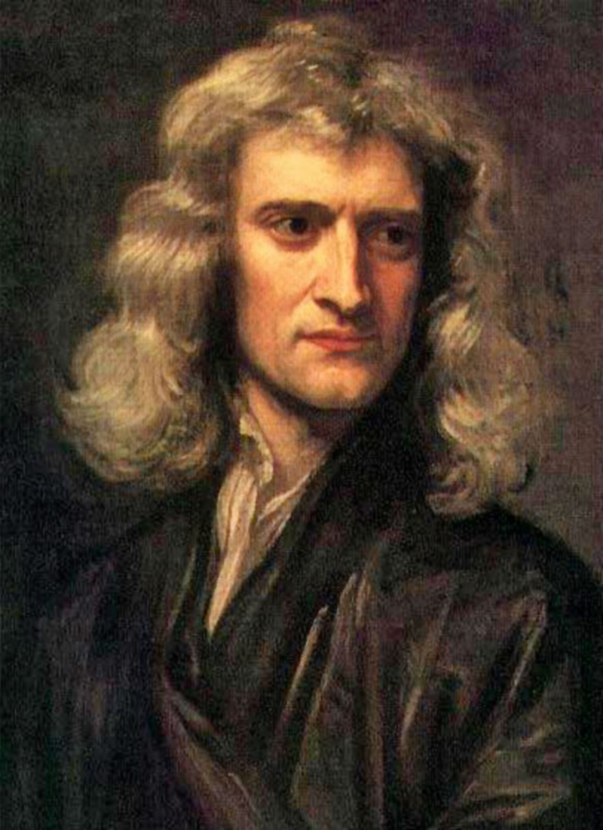
Sir Isaac Newton realized that the quantities of force, mass, and acceleration are not independent of each other and can be related.
Expressed in his famous Laws of Motion.

Slide 11
First Law of Motion
An object at rest will remain at rest, and an object in motion will remain in motion with constant velocity, as long as no force is exerted on the object.

Slide 12
His second law was the critical one for winds and atmospheric sciences
Newton’s Second Law: The force exerted on an object equals its mass times its acceleration.
F = ma

Slide 13
Newton’s Second Law: The force exerted on an object equals its mass times its acceleration.
F = ma
A force can speed up or slow down an object or change its direction of motion
Newton’s Second Law is only valid if our frame of reference is not accelerating (more later on this)

Slide 14
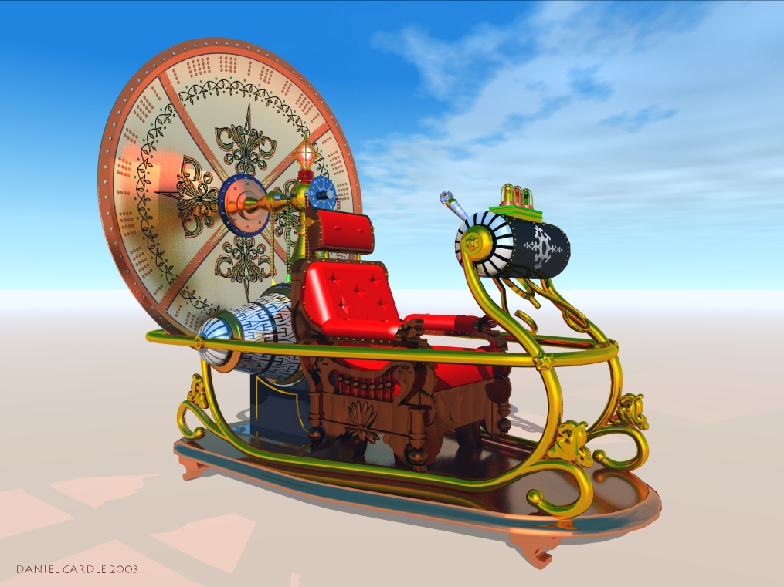
Newton’s Second Law (F=ma) has a LOT of potential for atmospheric scientists
If we know the mass of an air parcel and the forces acting on it, we can calculate its acceleration, how its velocity will change in time!

Slide 15
Newton’s Second Law (F=ma) is a Time Machine
Enables us to predict the future and is one of the foundations of weather prediction.
One of the key equations used in all weather prediction models.

Slide 16
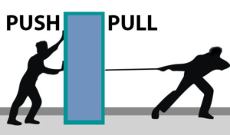
There are two types of forces considered in meteorology
Real forces: e.g., gravity, pressure gradient forces, friction/drag
Apparent forces: e.g., Coriolis force, centrifugal force

Slide 17
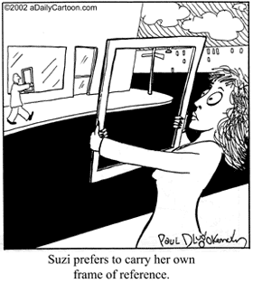
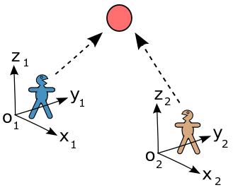
What are apparent forces?
Newton’s second law is only valid for non-accelerating or inertial frames of reference.
What is a frame of reference?
  It is the framework that we use to measure position and speed.
  Generally, our frame of reference is the rotating earth, which itself is rotating! So our frame of reference is accelerating!

Slide 18
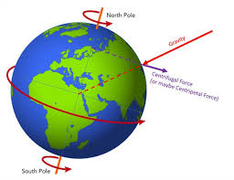


Slide 19

A Problem with Newton’s Second Law
  Thus, Newton’s second law in the form shown above (F = ma) is not valid on the surface of a rotating/accelerating planet.
  To fix this problem, we add “apparent forces”…. like the Coriolis and centrifugal forces.
  More later!
F = ma

Slide 20

Real Forces
Gravitational force
  Produces a constant acceleration near the surface of 9.8 ms⁻²
  F_{g} (or weight) = mass * acceleration
  = mass* 9.8 ms⁻² near sea level

Slide 21
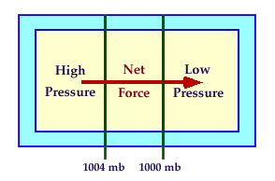
Real Forces
Pressure Gradient Force
  Definition: Horizontal Pressure Gradient =
  difference in pressure between two points
Distance between them

Slide 22
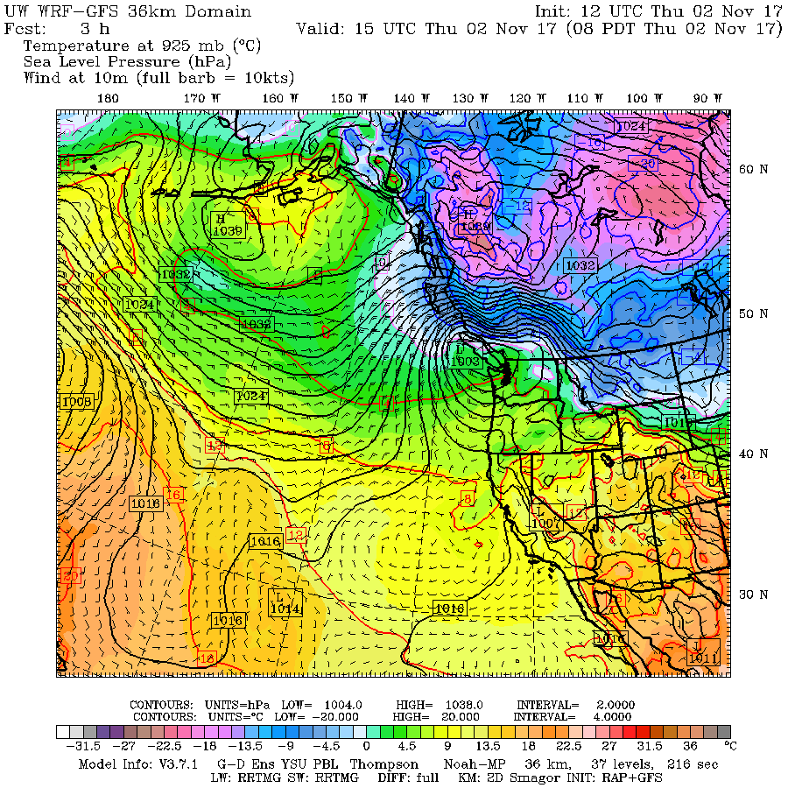
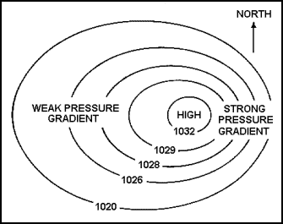
Strong Pressure
Gradient
Weak Pressure Gradient

Slide 23
Real Forces
Pressure Gradient Force
  The pressure gradient force is proportional to the horizontal pressure gradient
  Strong pressure gradients produce stronger pressure forces
  Directed from high to low pressure.

Slide 24
Pressure Gradient Force
Large pressure gradients result in strong pressure gradient forces which result in strong winds.

Slide 26
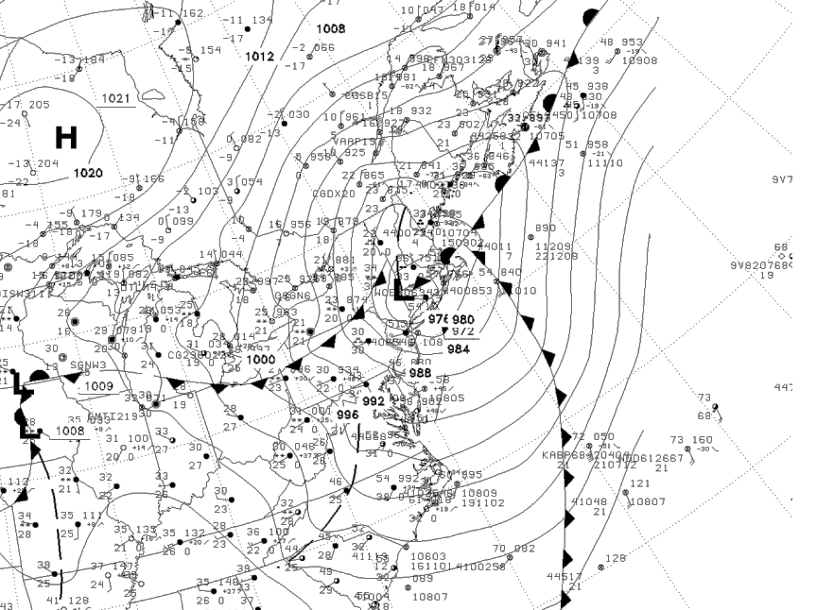

Slide 27
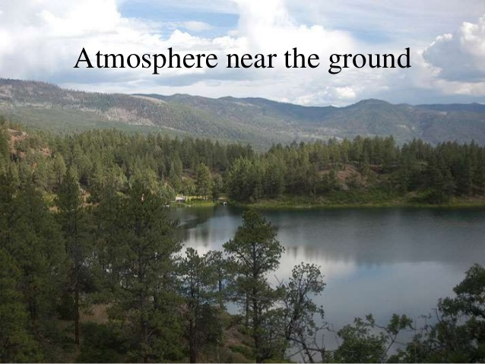
Friction or Drag Force
The rough surface produces a force that slows the air at low levels.
The land surface is rougher than water, since land has buildings, trees, hills, etc.
Water is aerodynamically smooth and thus produces less drag. Thus, winds are slower over land than water.

Slide 28
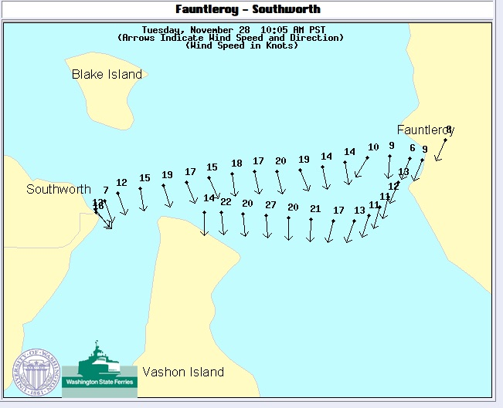
Winds are faster over
water where drag is less

Slide 29
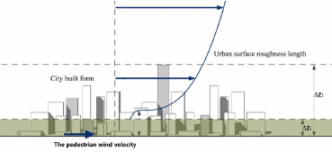
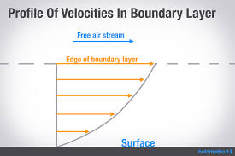
Because of surface drag winds generally increase with height above the surface

Slide 30
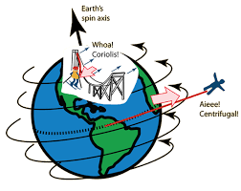
But we can’t simply plug in the real forces into Newton’s second law and go home, because it is valid only for a non-accelerating frame of reference.
Our frame of reference, the earth’s surface, is rotating.

Slide 31
Our frame of reference, the earth’s surface, is rotating
To use Newton’s second law, we need to add some corrections to compensate for our rotating frame of reference. We add two apparent forces:
  Centrifugal force
  Coriolis force

Slide 32
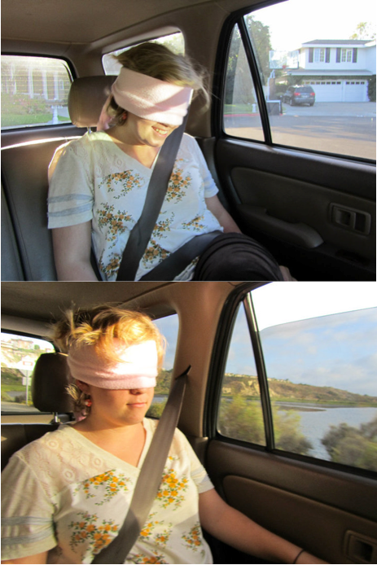
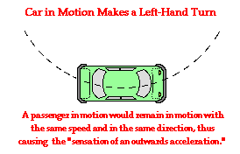
Centrifugal Force
Imagine you are in the back seat of a car with a blindfold on.
Someone else is driving
That person takes a sharp left turn.
You feel like a force is pulling you to the right side of the car!
But there is no real force pulling you!
car
you

Slide 33
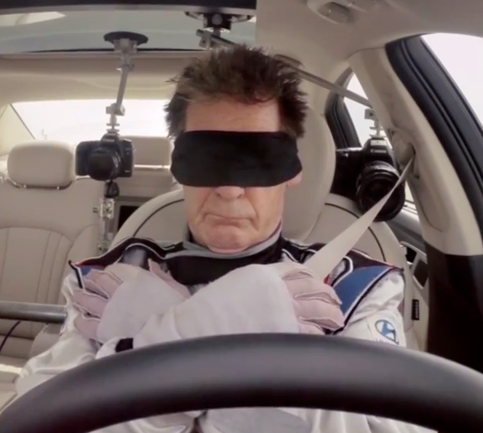
This
Not This

Slide 34
Centrifugal Force
But there is no real force pulling you…
Your body wants to go straight, but your frame of reference is accelerating.
To explain what is going on you invent a force! You imagine a centrifugal force is pulling you!
car
you

Slide 35
Centrifugal Force on a rotating planet
You are on a rotating planet and there is a small centrifugal force that you don’t notice (it reduces gravity slightly).
But there is another apparent force that is more noticeable and important…. the Coriolis Force.

Slide 36
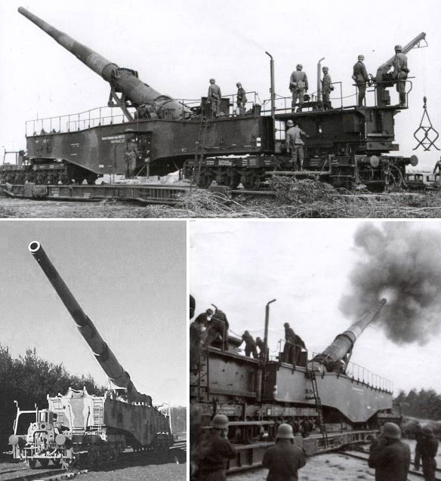
Some History: Big Guns and the Coriolis Force
During the late 1800s and early 1900s, big guns were developed that could shoot projectiles tens of miles.
The problem was the shells landed to the right of the targets!
Was there a real force deflecting the projectiles? No!
The issue: the Earth is rotating and they didn’t take that into account.

Slide 37
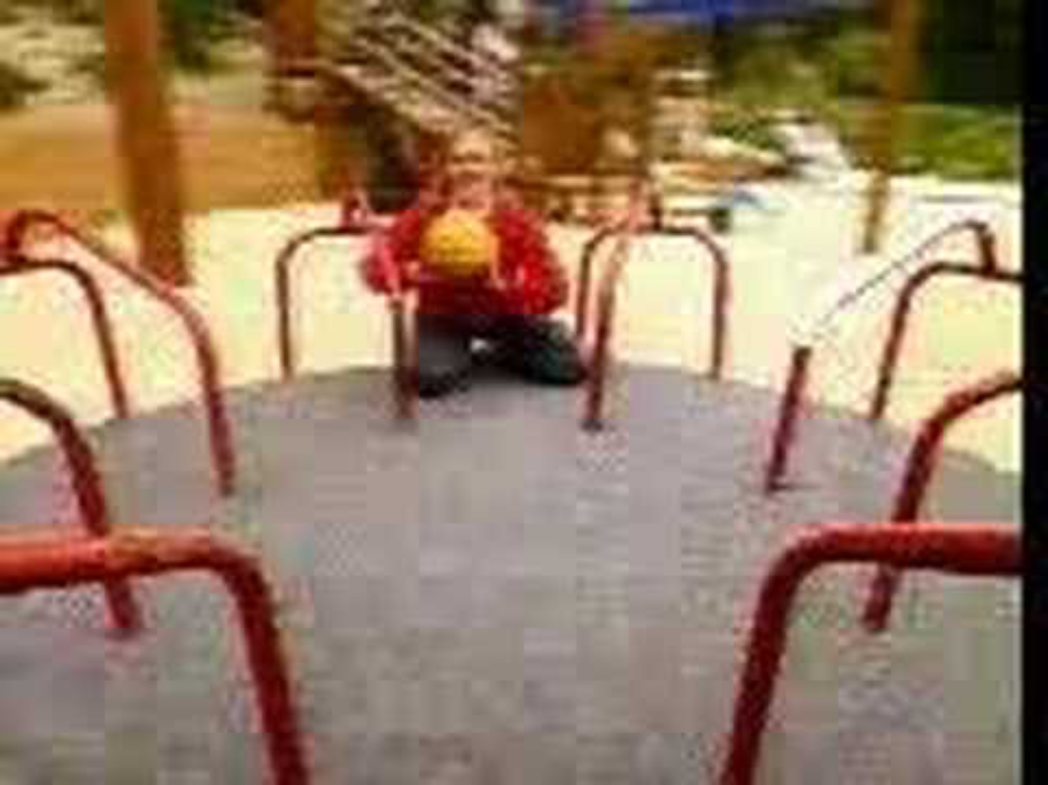
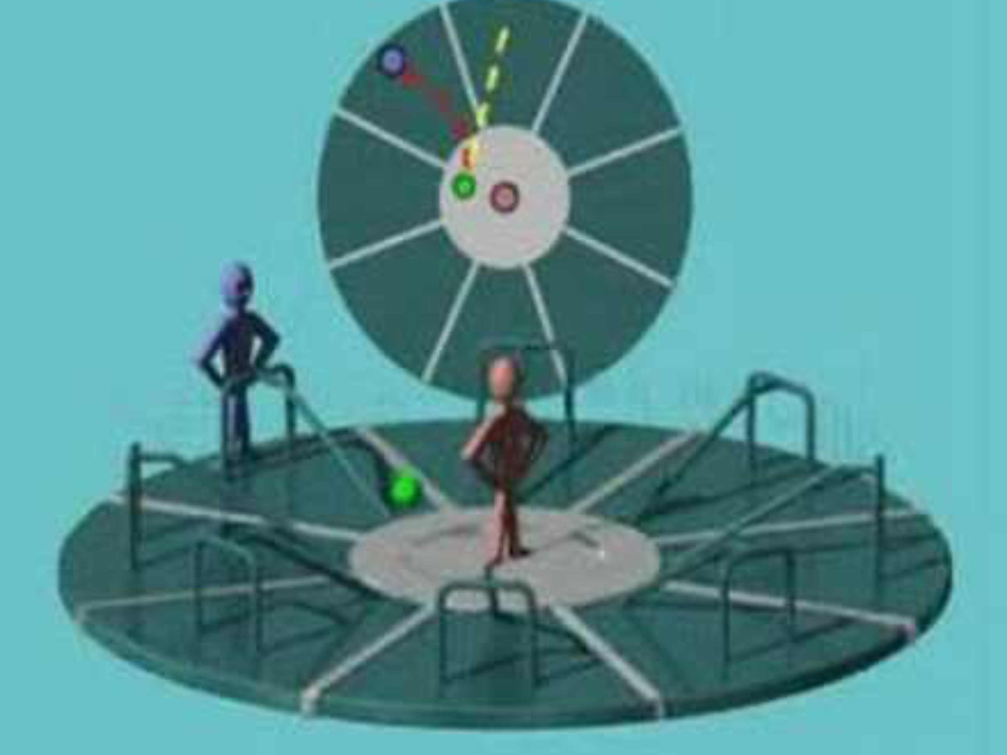
Some videos illustrate the issue: using a merry go round
In the frame of reference of folks on the merry-go-round, it appears there is a force moving objects to the right!
But there is no real force…their frame of reference is rotating. Same with the projectile from big guns.

Slide 38
Some videos illustrate the issue: using a merry go round
https://www.youtube.com/watch?v=_36MiCUS1ro
https://www.youtube.com/watch?v=mcPs_OdQOYU
In the frame of reference of folks on the merry-go-round, it appears there is a force moving objects to the right!
But there is no real force…their frame of reference is rotating. Same with the projectile from big guns.

Slide 39
We call that apparent force, the Coriolis Force, which appears to exist when objects move on a rotating frame of reference.

Slide 40
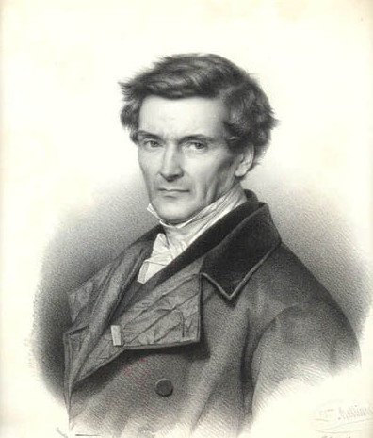
The Coriolis Force Was First Described by Garpard-Gustave de Coriolis -1835

Slide 41
In the Northern Hemisphere, the Coriolis force always acts to the right of the direction of motion and its magnitude depends on the speed of motion and the latitude. (in the Southern Hemisphere it acts to the left)
V
Coriolis Force

Slide 42
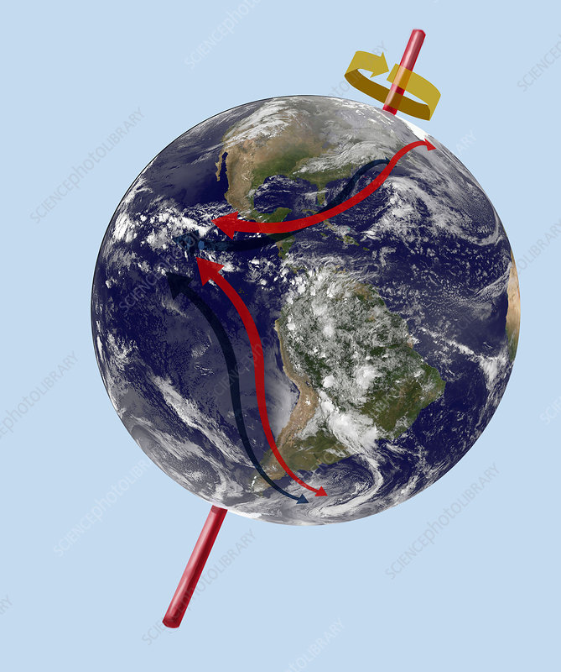
Coriolis Force Facts
The Coriolis force is zero near the equator and a maximum at the Pole.
Works only on moving objects
Coriolis Force magnitude = f |V|
  Where V is the velocity vectory, f = 2Ω sin(latitude), Ω= 7.292∗10⁻⁵ s⁻¹
The Coriolis force is much smaller in the tropics….this will have major implications!

Slide 43
Important Point:
If we consider both apparent and real forces, we can now apply Newton’s Second Law on a rotating planet.

Slide 44
Applying Newtons Second Law
Sum of all forces (real and apparent) = m * a
This is the basis for numerical weather prediction
If can use observations to calculate the forces and determine the mass of air, then we can calculate acceleration on a rotating planet.

Slide 45
If you can calculate acceleration, you can determine the FUTURE
Acceleration is how velocity changes with time
If you know the velocity NOW, then you can calculate the velocity IN THE FUTURE
More on this later!

Slide 46
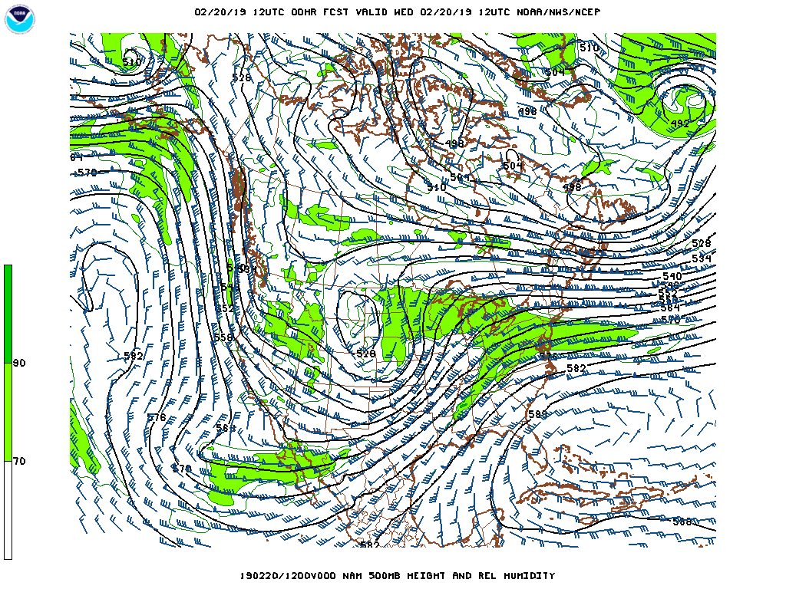
Geostrophic Wind
Why are winds oriented parallel to the height lines aloft?
Why are winds nearly parallel to the isobars over the ocean?
We can explain these and other important issues with the concept of the geostrophic wind.

Slide 47
Geostrophic Wind at 500 hPa
High

Slide 48
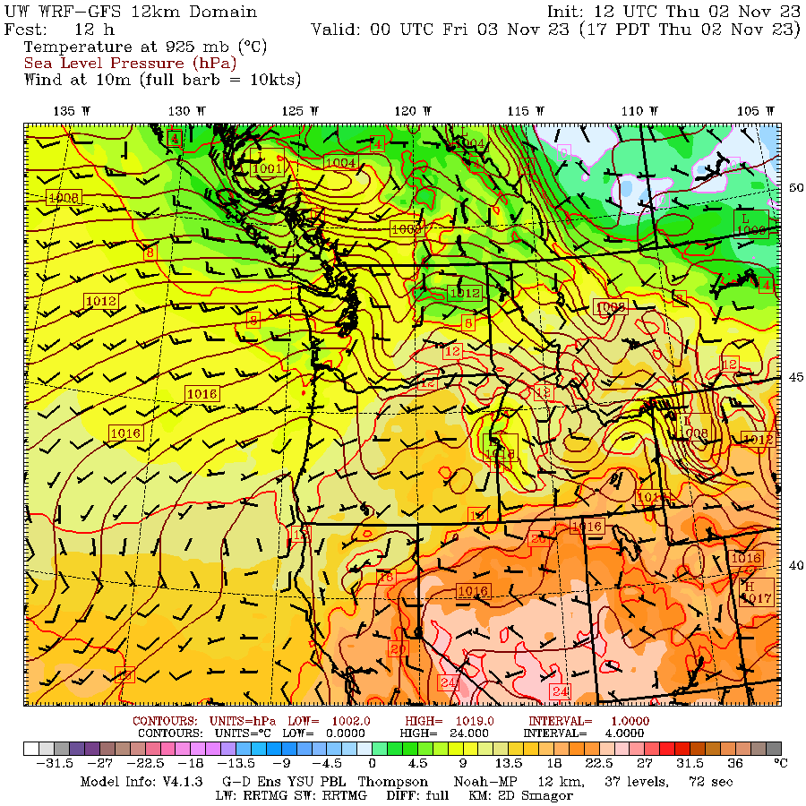
At the surface

Slide 49
Definition:
The geostrophic wind is the wind that occurs when there is an exact balance between the Coriolis and Pressure Gradient forces
Geo: earth, strophic: turning

Slide 50
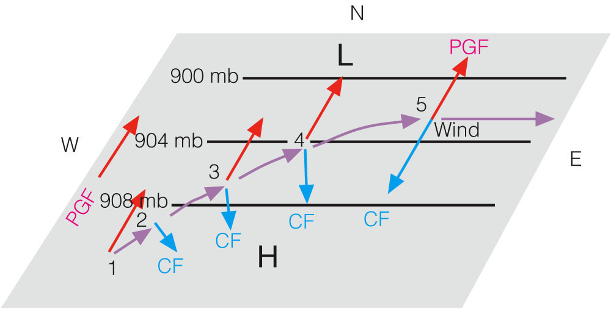
A thought experiment. Consider a rotating planet with a pressure gradient, starting with no wind and see what happens to a parcel of air starting at rest. No mountains or drag.
Geostrophic balance develops as the air parcel accelerates, resulting from an increasing Coriolis Force.

Slide 51
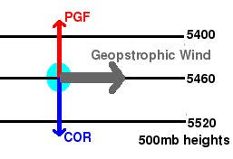
The final geostrophic force balance (N. Hemisphere)
Note that the winds are parallel to the height lines for upper-level chart or isobars for surface (sea level) chart. Lower pressure to the left.

Slide 52
The speed of the geostrophic wind depends on the horizontal pressure gradient.
The geostrophic wind occurs when there is a balance between the pressure gradient force and the Coriolis force
Pressure Gradient Force = Coriolis Force
Coriolis Force magnitude = f |V|
So, a big pressure gradient results in a strong geostrophic wind.

Slide 53
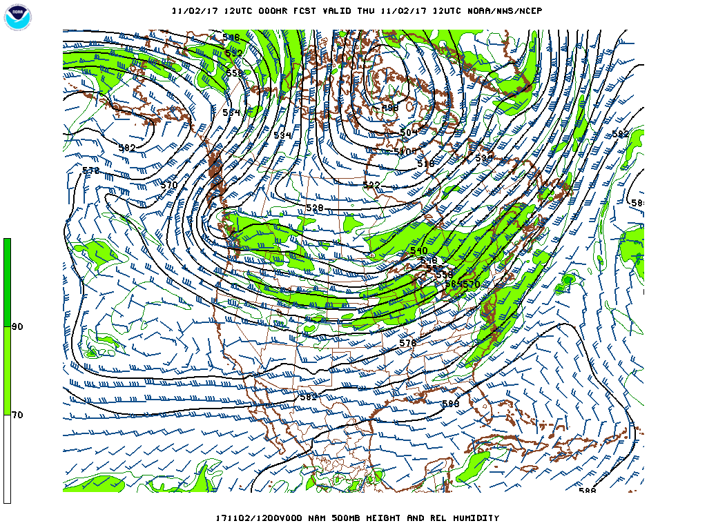
The winds aloft, where surface drag and mountains have little influence, are nearly geostrophic

Slide 54
Geostrophic Concept Explains Rotation around High and Low Centers
LOW
High

Slide 55
In the Northern Hemisphere, the winds rotate counterclockwise around low centers (or cyclones). This is also called cyclonic rotation.
Why counterclockwise? The only way you can get geostrophic wind balance.

Slide 56
In the Northern Hemisphere, the winds rotate clockwise around high centers (or anticyclones). This is also called anticyclonic rotation.
Why clockwise? The only way you can get geostrophic wind balance.

Slide 57
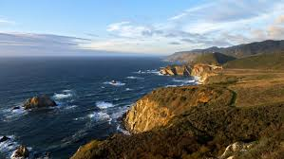
Near the surface, drag or friction can substantially slow wind speeds
Buildings, hills, trees, etc. slow the wind
Water is aerodynamically smooth with less drag, thus winds are stronger

Slide 58
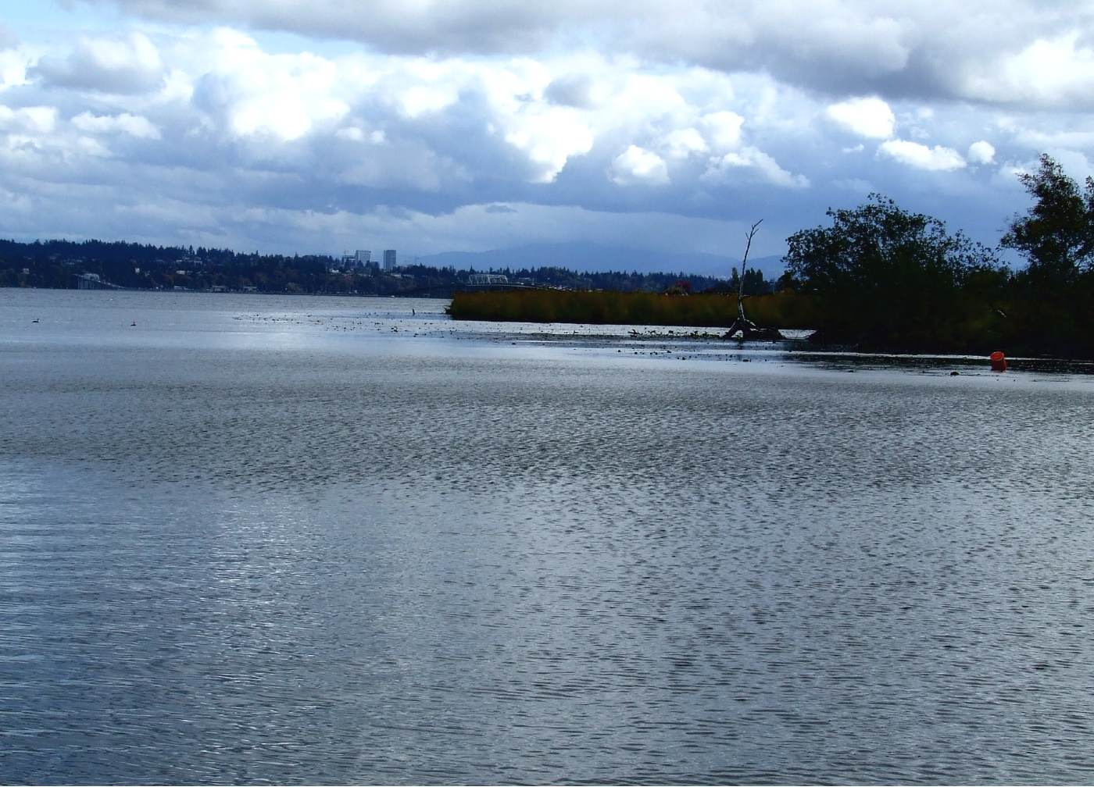
Relatively smooth surface results in strong winds

Slide 60
Because there is more drag near the surface, wind usually increases with height in the lower layer of the atmosphere, a regionl known as the boundary layer

Slide 61
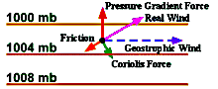
Near the surface there is three-way force balance between the Pressure Gradient Force, the Coriolis Force, and Surface Drag/Friction

Slide 62
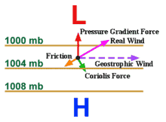
3-way balance near the surface
The winds are reduced from their geostrophic value depending on how rough the surface
  Reduced by 10-20% over water
  Approximately 20-30% over smooth land
  30-80% over rough land

Slide 63
3-way balance near the surface
The cross-isobar angle increases with roughness of the surface
Perhaps 10-20° over water
20-35° over smooth land
35+ over rough land

Slide 64
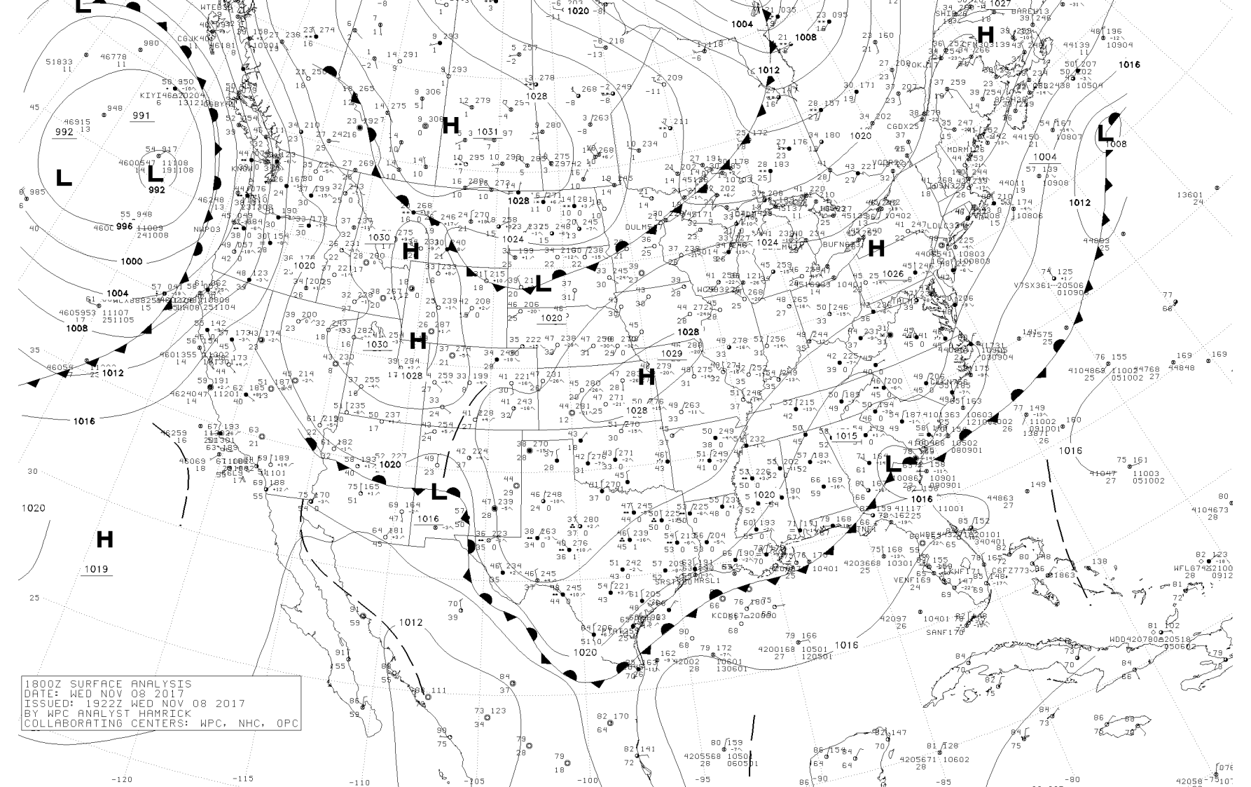

Slide 67
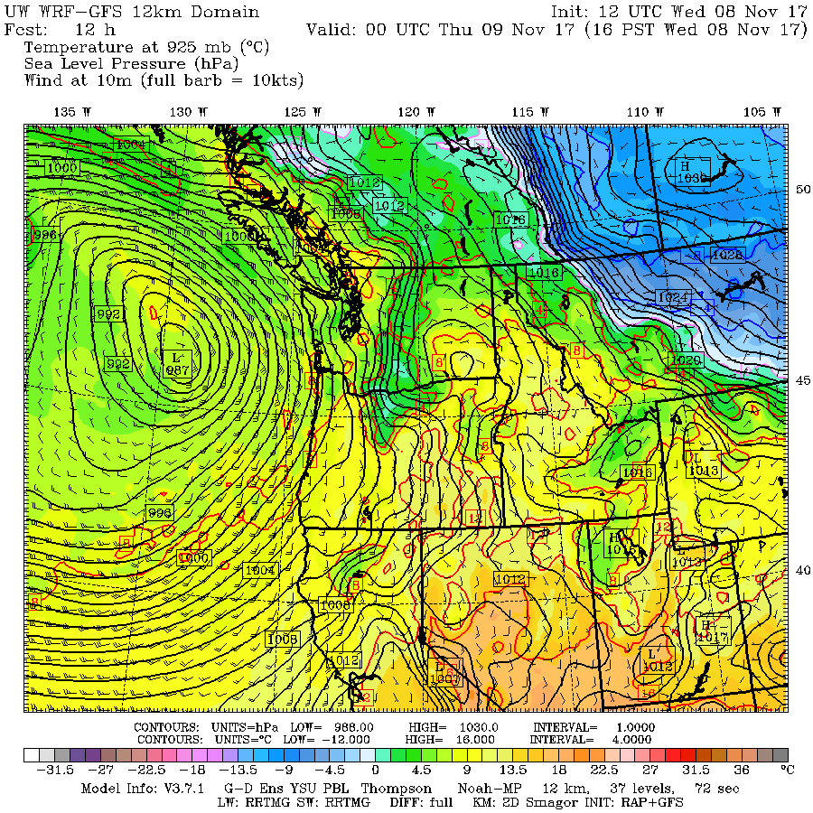

Slide 69
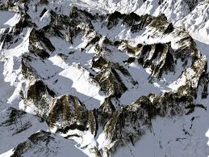
Winds Near Terrain
Not geostrophic
Wind tends to go directly from high to low pressure
Why? The blockage effects of mountains prevents the Coriolis force from working effectively.

Slide 70
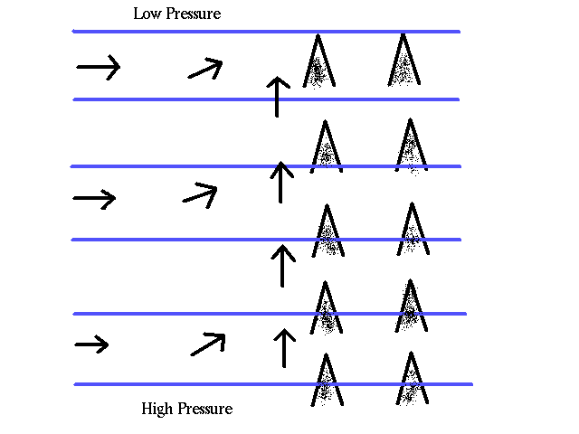

Slide 71
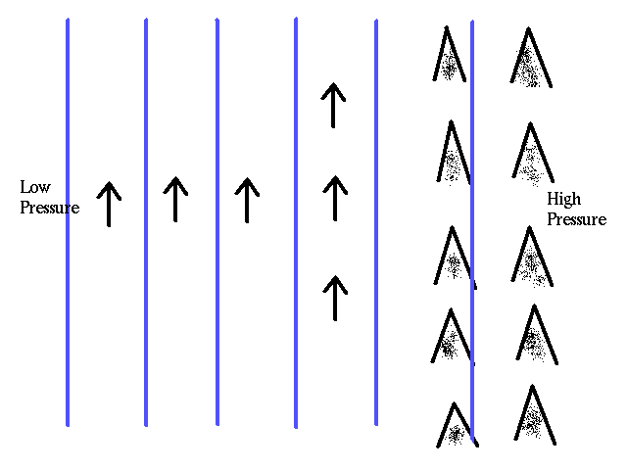
If winds are parallel to the mountains, little effect

Slide 72
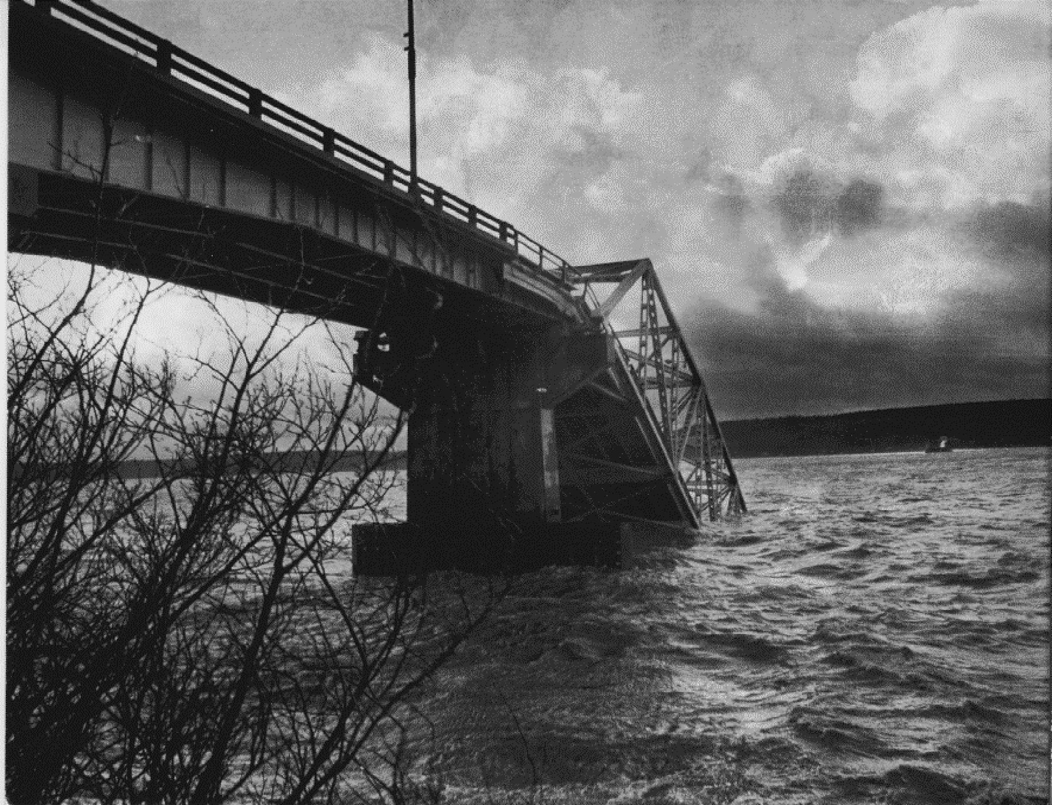
Winds over 100 kts destroyed the Hood Canal Bridge in 1979
Cost to replace: over 100 million dollars

Slide 73
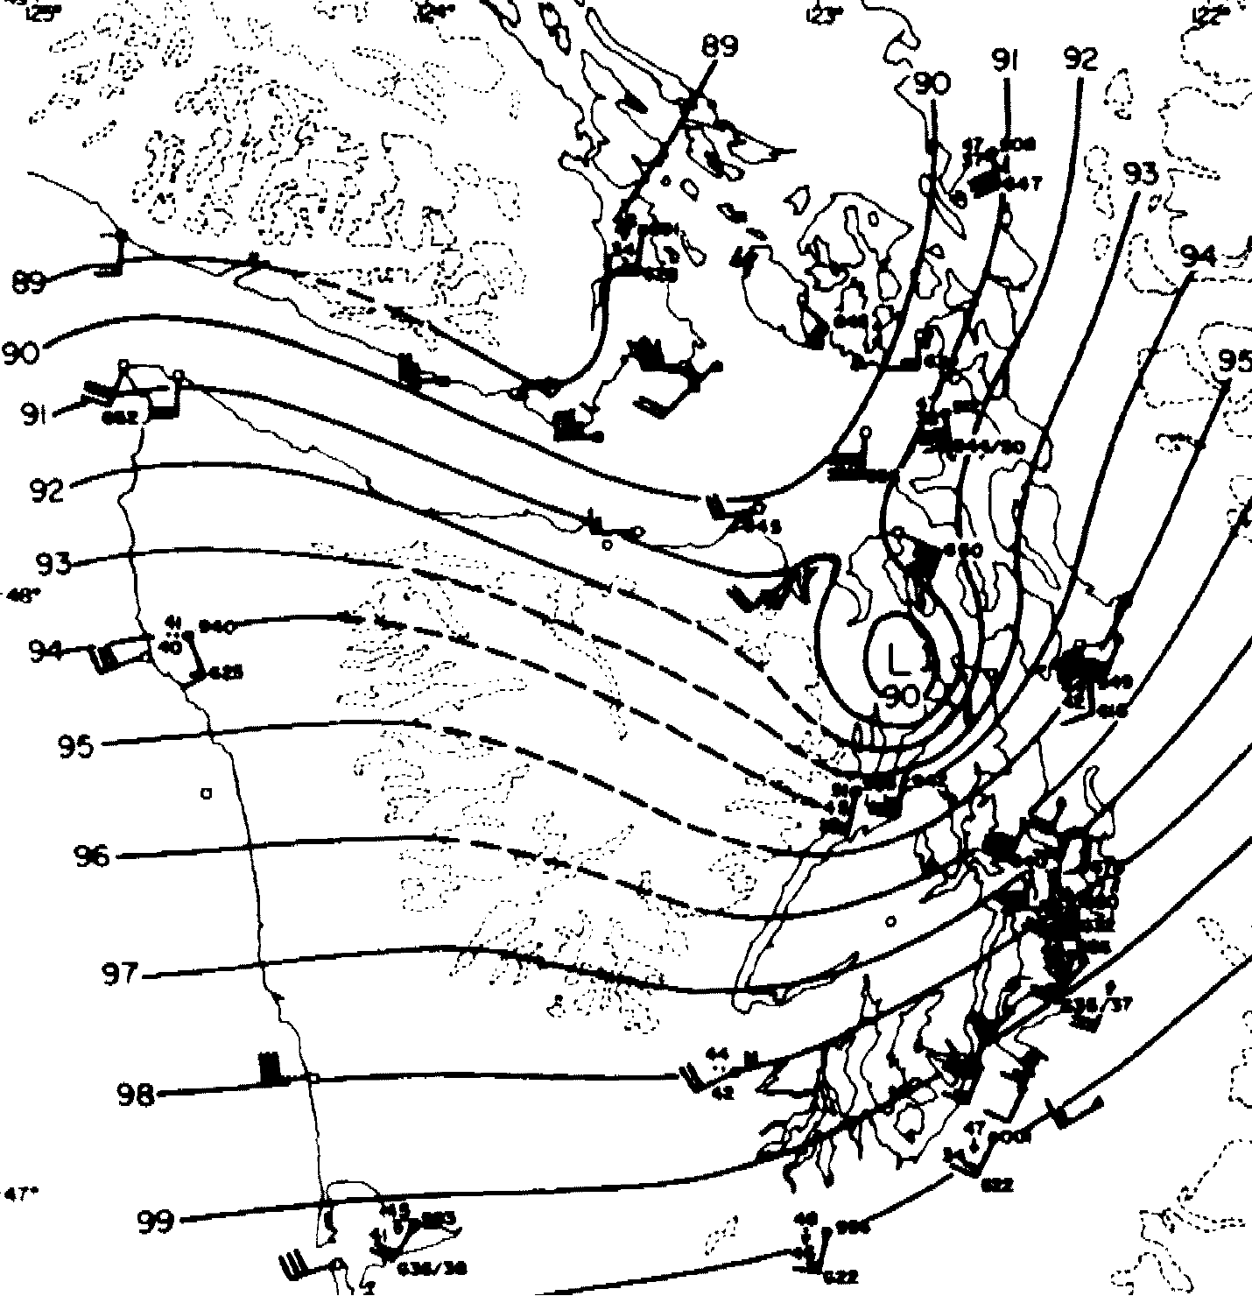
February 13
1979: The Hood Canal
Storm
Big winds south of low and near terrain

Slide 74
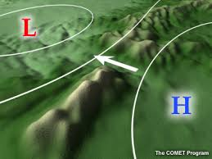
Winds tend to go directly from high to low pressure in terrain gaps: not geostrophic!

Slide 75
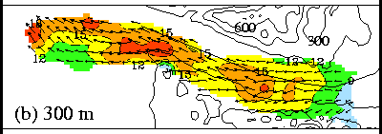
Winds tend to go directly from high to low pressure in gaps

Slide 76
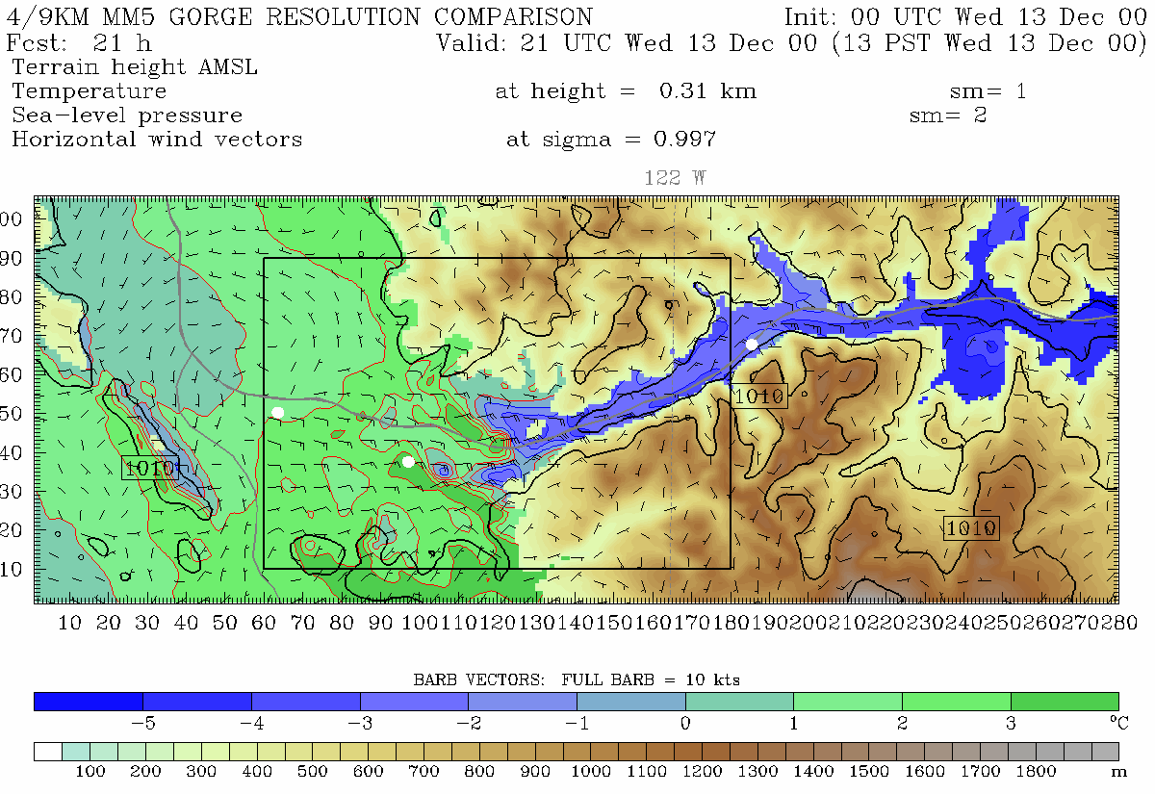
Portland
Troutdale
Cascade Locks
Notes:
Min pass height is at far right of domain near Cascade Locks (same place as 4/3 domain)
This plot is from 310 m. Note, vortex. See this on radar data too. Zoomed in plot will be from 150 m

Slide 77
The end

