Slide 1

CONGRATULATIONS!

Slide 2
Part II of Class
Understanding the Fundamentals

Slide 3
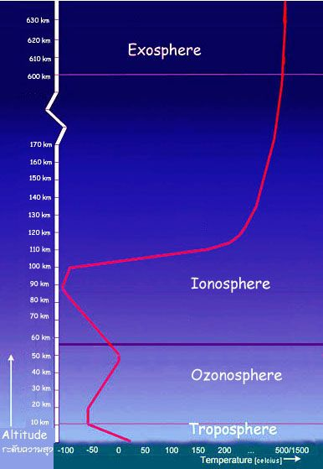
Composition of the Atmosphere
Atmosphere: the envelope of air surrounding the earth and bound to the earth by the earth’s gravitational attraction.
Extends from the surface into space with decreasing density with height.
No real top.

Slide 4
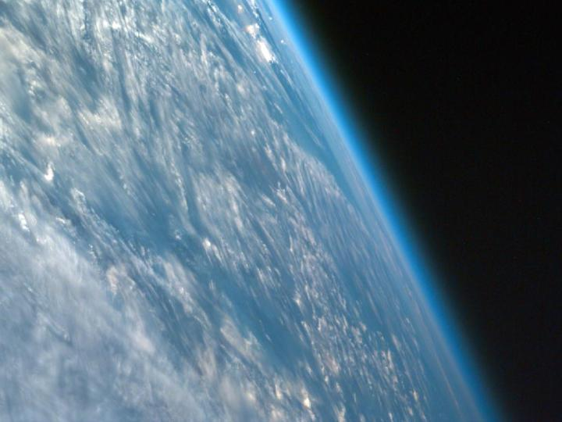
The atmosphere is very thin compared to the size of the planet
Just a thin veneer
¾ of the atmosphere by mass is in the lowest 33,000 ft (roughly 10 km)

Slide 5
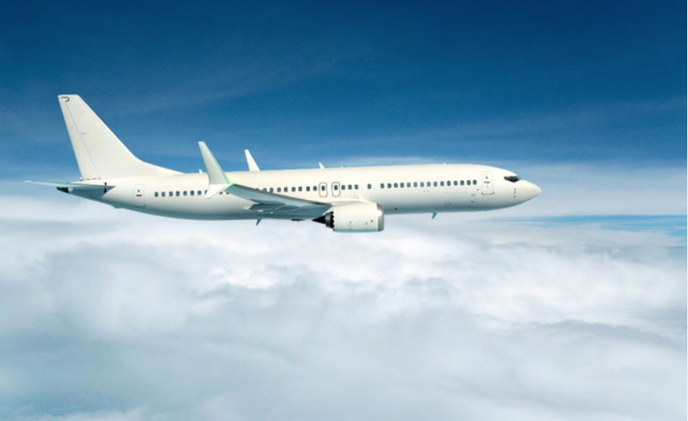
¾ of the atmosphere

Slide 6
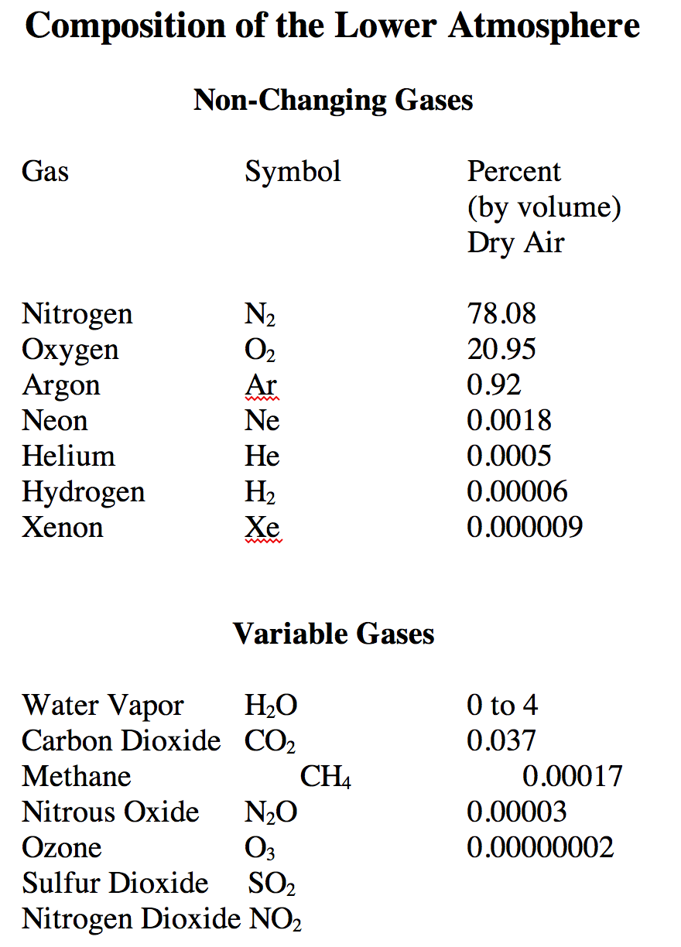
Atmospheric Constituents

Slide 7
(percent)

Slide 8
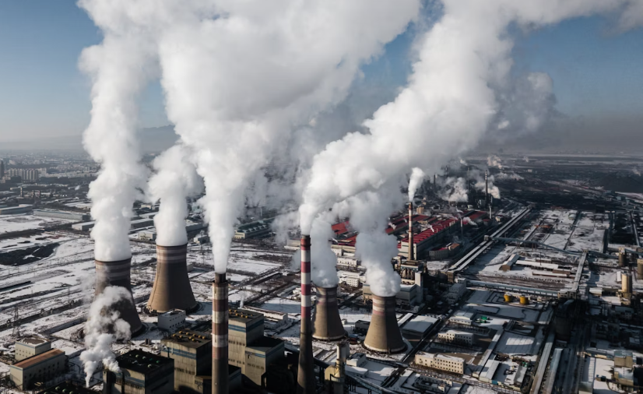
Variable Gases
CO₂ , carbon dioxide, a greenhouse gas (very effective absorber and emitter in the infrared).
O₃, ozone, good in stratosphere (protects us from UV), bad near the surface (corrosive to lungs and more)

Slide 9
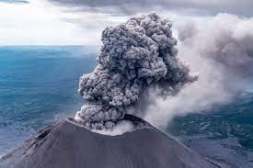
Variable Gases
SO₂, sulfur dioxide, emitted by volcanoes and combustion. Produces atmospheric particles and acid rain
NO₂, nitrogen dioxide, produced by combustion. Acid rain and smog.

Slide 10
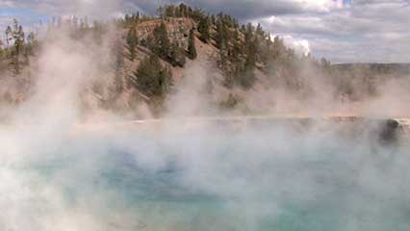
Variable gases (continued)
Water vapor (~0 to 4%). Critically important.
  Clouds and precipitation
  Important way to move energy around
  Major greenhouse gas
Methane (CH₄): major greenhouse gas

Slide 11
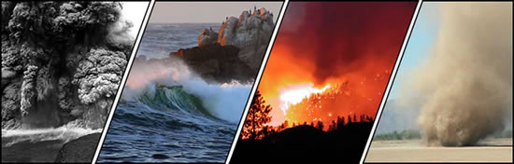
Non-Gas Constituents
Hydrometeors: rain clouds, hail
Particles and aerosols
  Aerosol is a liquid or solid dispersed in a gas, usually air
Particles can be
  Inorganic- soil, smoke, dirt, sea salt, volcanic dust, surface acid aerosol
  Organic- seeds, spores, pollen, bacteria

Slide 12
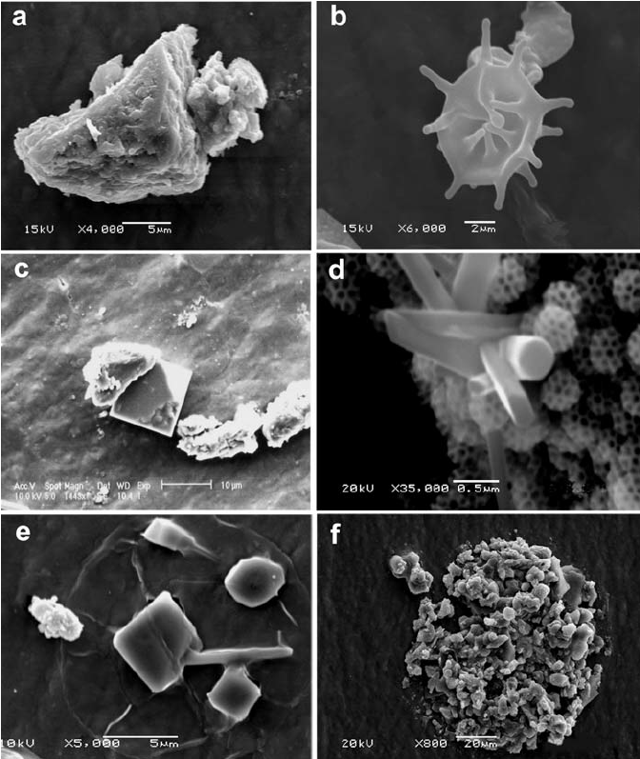
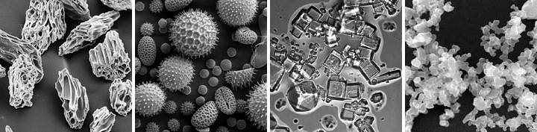
Particles in the air

Slide 13
Why are particles in the air important?
Act as condensation and freezing nuclei
  Water condenses or freezes on particles
Can absorb or scatter radiation
    Reduce visibility
    Can scatter solar radiation to space: cools the planet
Can impact human health.
  Can irritate lungs, initiate asthma, heart disease

Slide 14
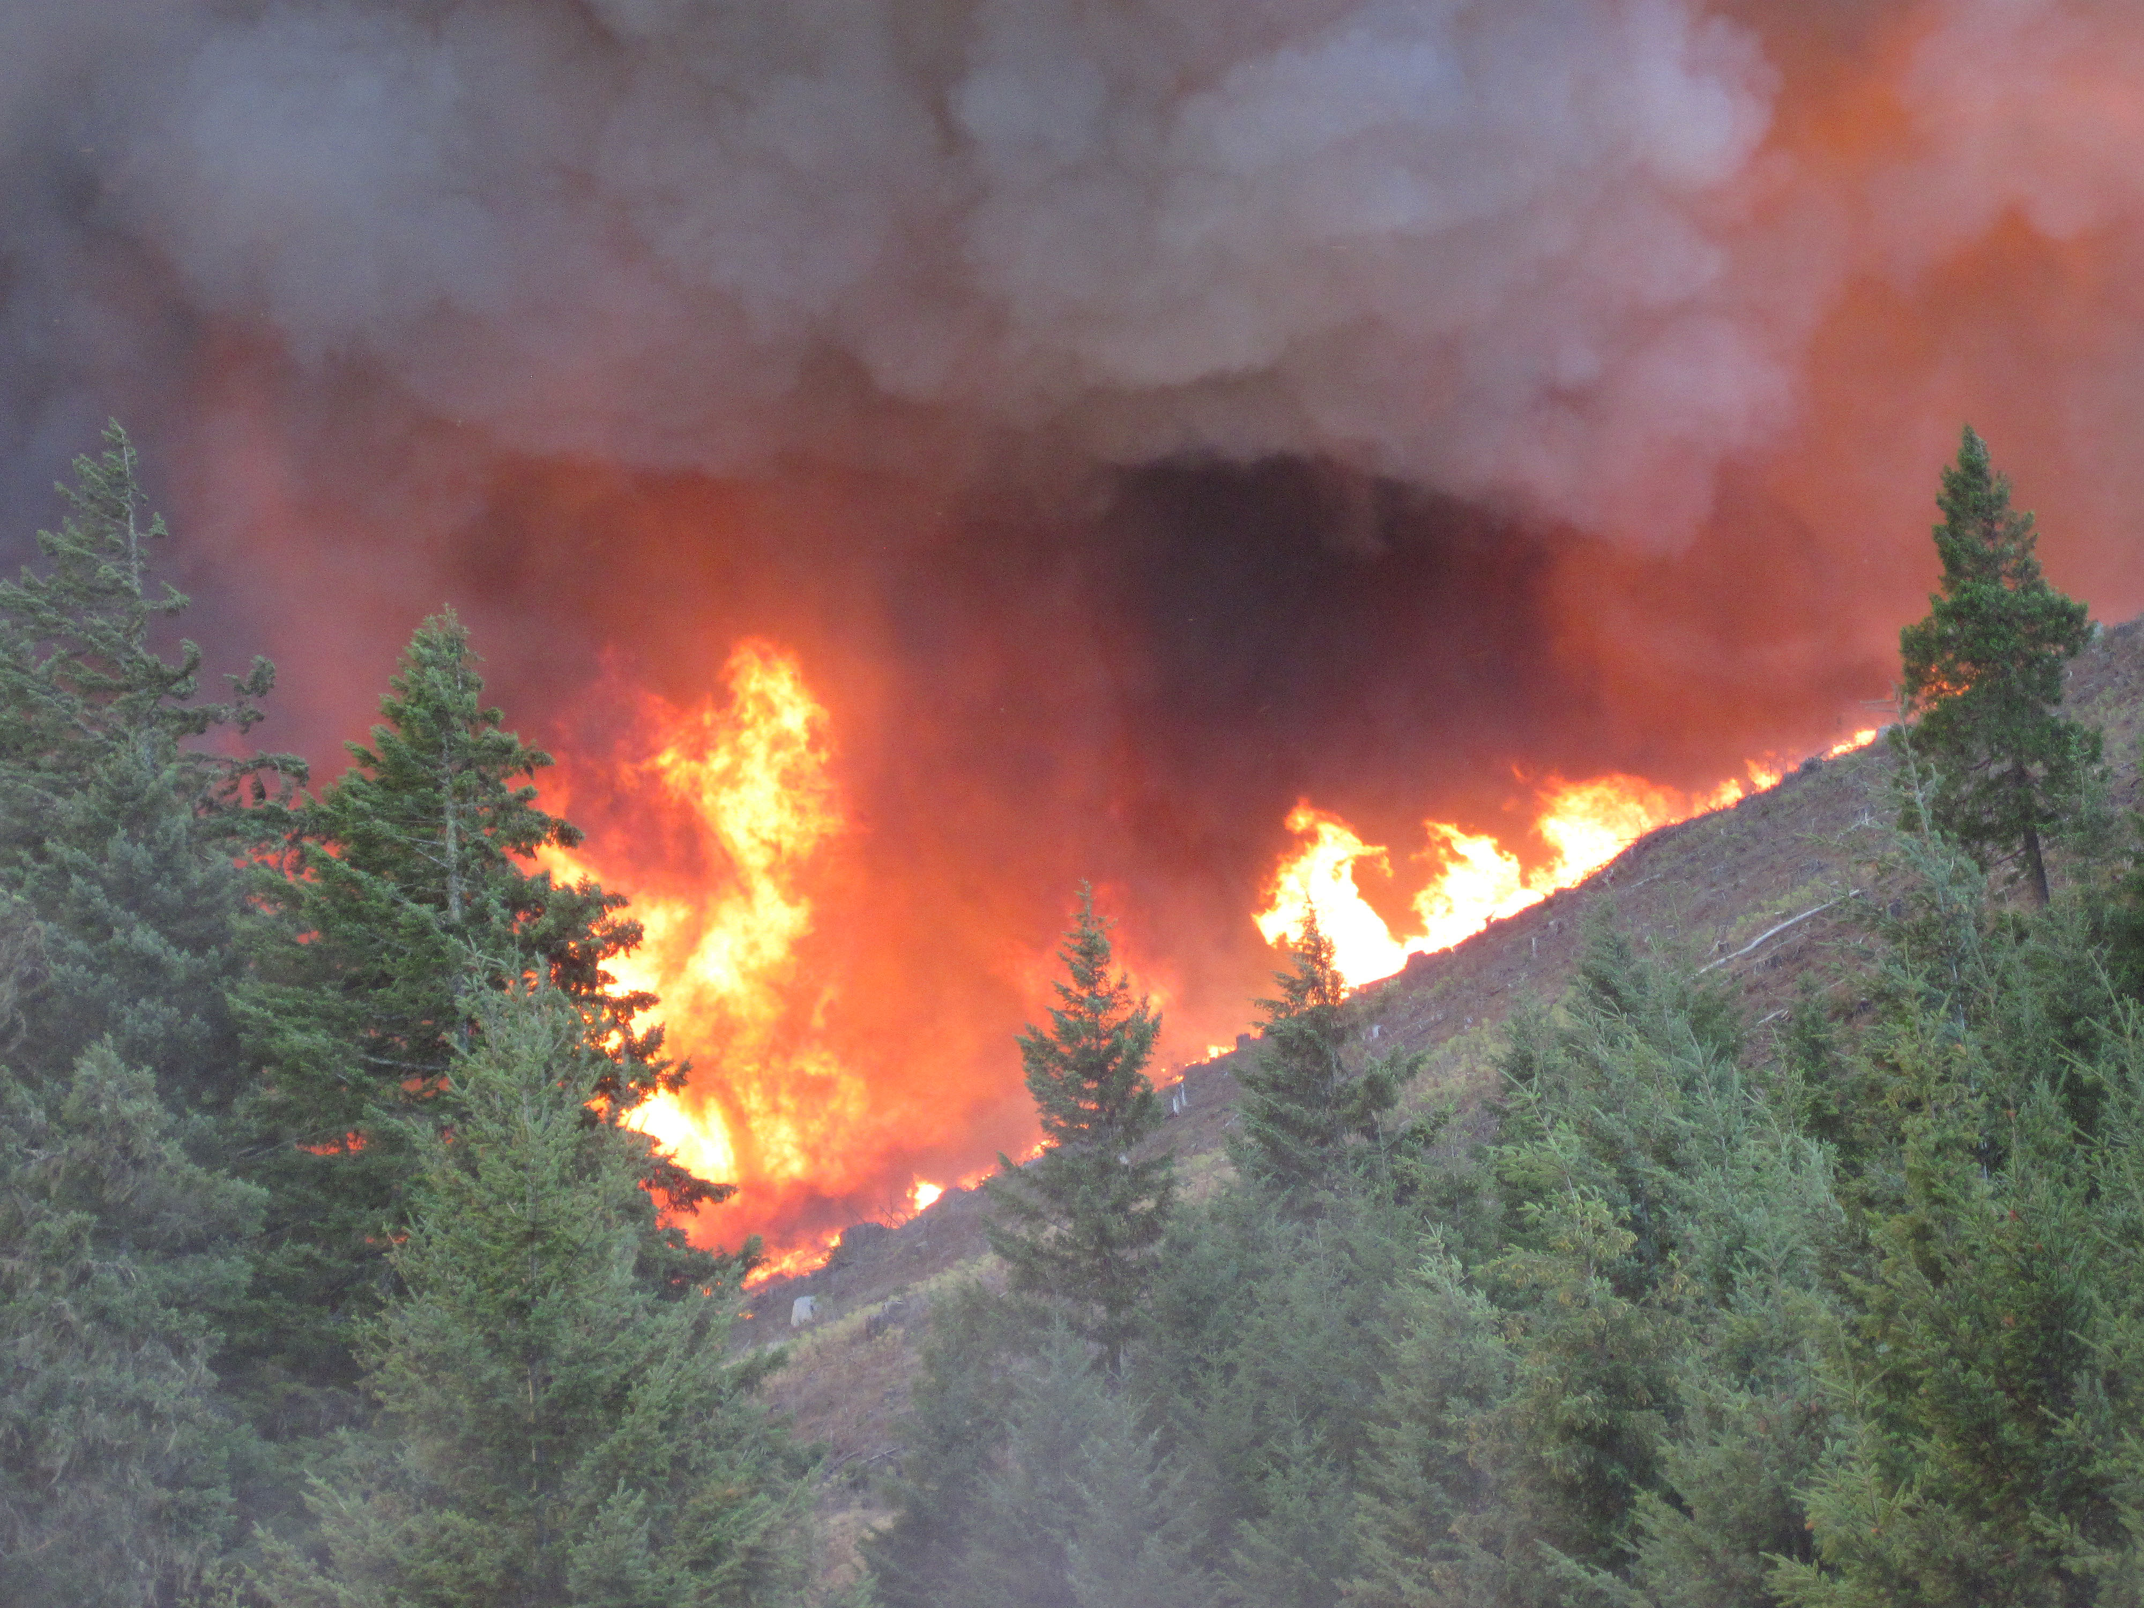

Slide 15
The Origin of the Earth’s Atmosphere
Still Many Uncertainties ….

Slide 16
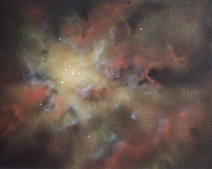
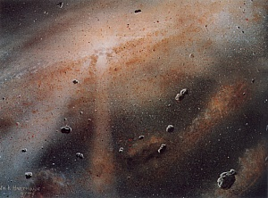
About 4.5 billion years ago, Earth formed out of nebula of gases and dust that were to become the solar system
Small objects--called planetoids-- combined together to build larger objects…such as planets

Slide 17
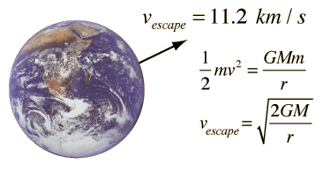
The First Atmosphere
The early atmosphere would have been similar to the Sun--mainly hydrogen and helium, but this atmosphere was lost quickly for at least two reasons:
  (1) The gravity of the modest size earth was not strong enough to prevent such light gases from escaping to space. Particularly since the early earth was hot!

Slide 18
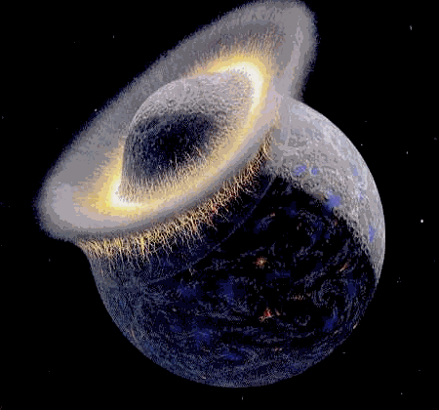
2) It appears that around 30 million years after earth’s formation, it was struck by a large object…the size of Mars. The result: the origin of the moon and loss of earth’s early H, He in the atmosphere.

Slide 19
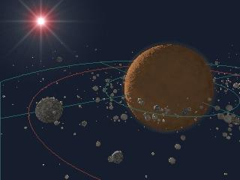
Formation of Moon from the Debris of the Collision

Slide 20
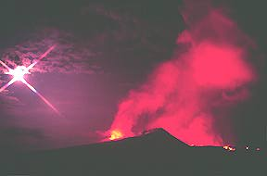
Earth as Hell
The surface of the earth during this early period was extremely hot with numerous volcanoes and near constant bombardment from space.
Subsequently, the earth started to cool down and the second atmosphere began to form.

Slide 21
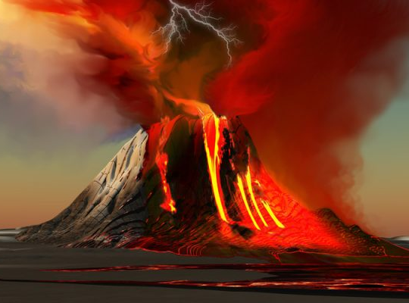
Earth’s Second Atmosphere
A new atmosphere was established by the outgassing of volcanoes…the mixture of gases was probably similar to those of today’s volcanoes:
  H₂0 vapor (roughly 80%)
  CO₂ (roughly 10%)
  N₂ (few percent)
  Small amounts of CO, HCL, HS (Hydrogen Sulfide), SO₂, CH₄ (Methane), Ammonia (NH₃), and other trace gases.

Slide 22
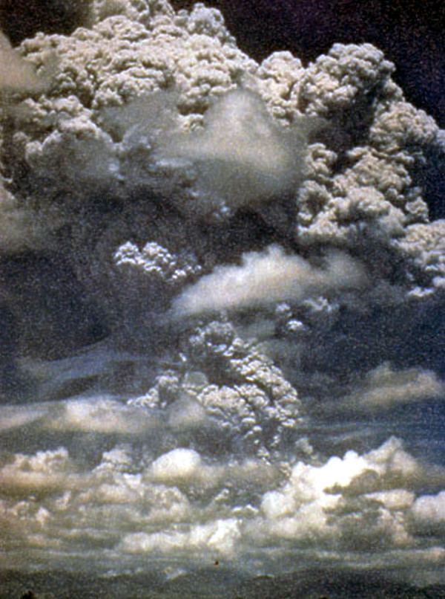

Slide 23
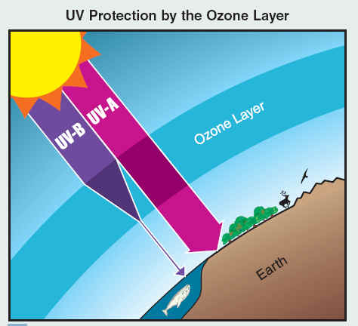
Earth’s Second Atmosphere
Virtually no oxygen in that second atmosphere.
Thus, no ozone layer (O₃), so ultraviolet radiation flooded the earth’s surface.

Slide 24
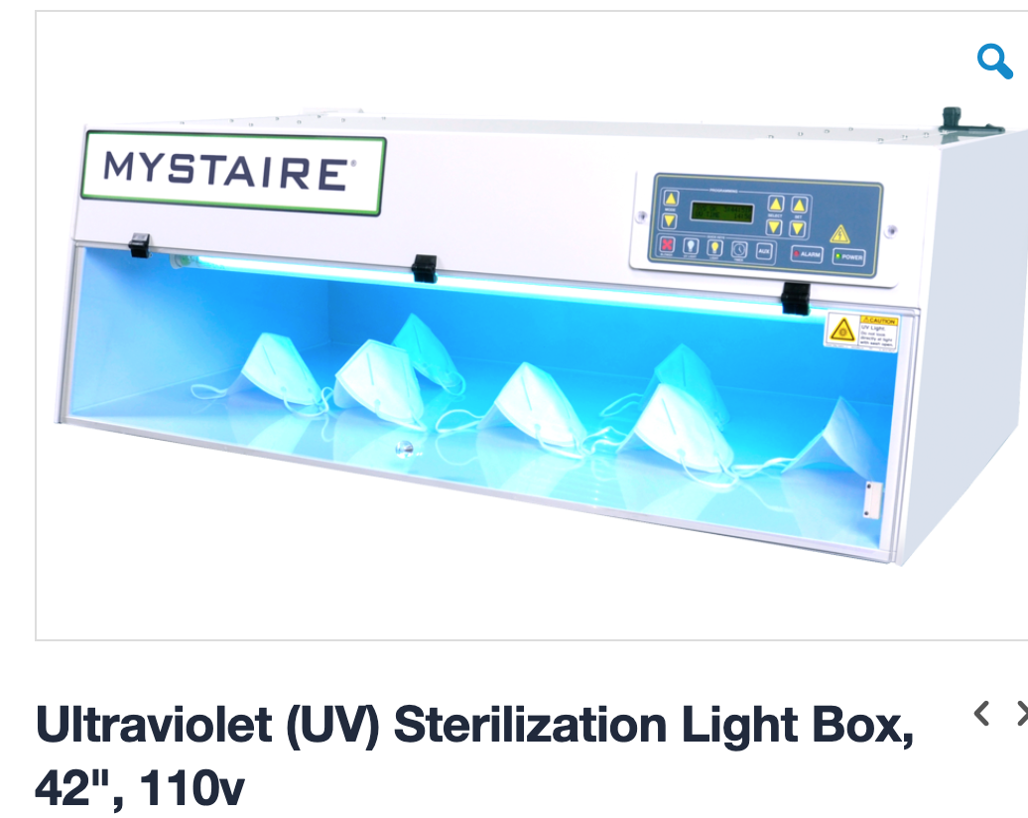

Slide 25
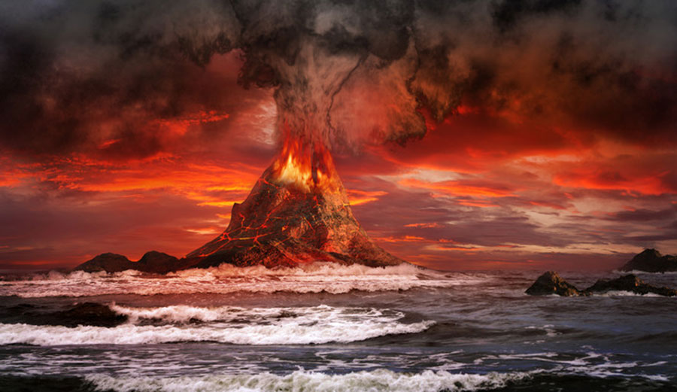
Second Atmosphere
With a huge influx of water vapor and the cooling of the planet, clouds and earth’s oceans formed.
At that time, the sun was about 30% weaker than today…why didn’t the earth freeze over?
The apparent reason: so much CO₂ so there was a very strong greenhouse effect.

Slide 26
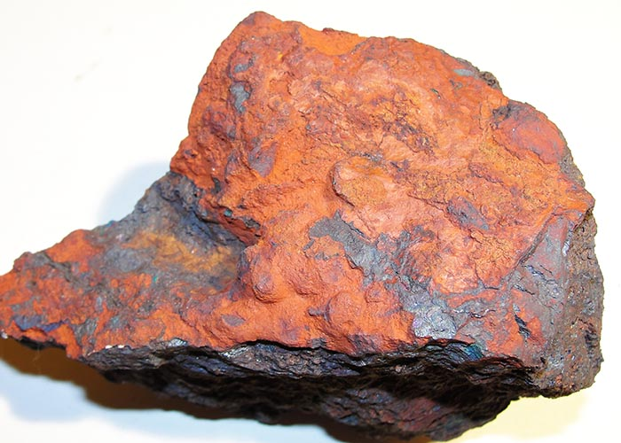
The Rise of Oxygen and the Third Atmosphere
In the first two billion years of the planet’s evolution, the atmosphere acquired a small amount of oxygen, probably by the splitting of water (H₂0) molecules by solar radiation.
Minor rusting in some early rocks.
The oxygen also led to the establishment of an ozone layer that reduced UV radiation at the surface.

Slide 27
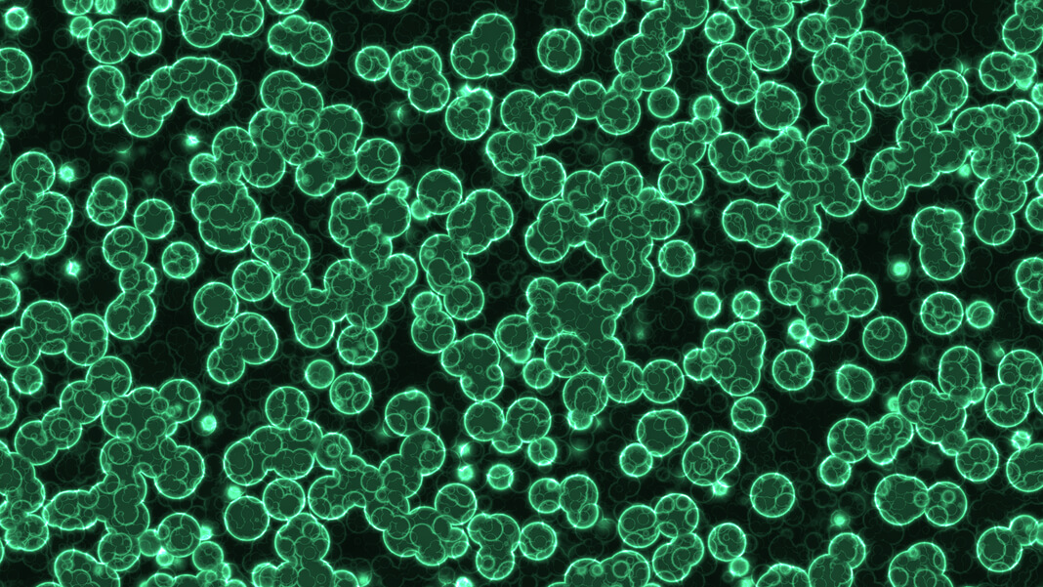
The Rise of Oxygen
With the development of photosynthetic bacteria (cyanobacteria) and early plants, oxygen levels began to rise rapidly as did indications of rust in rocks
Between 2.5 billion years ago (BYA) to about 500 bya, 0₂ rose to near current levels.

Slide 28
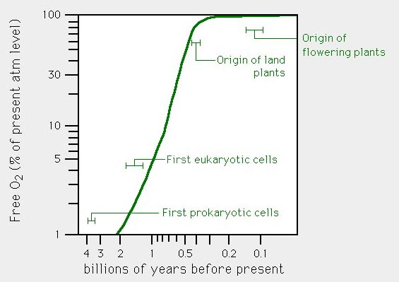

Slide 29
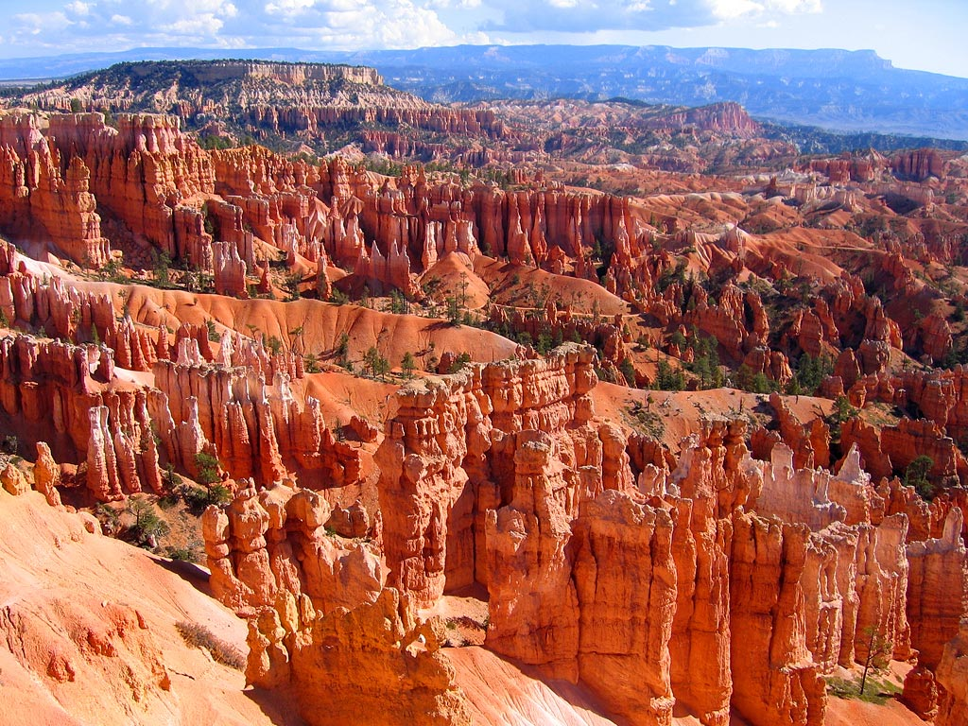
Rusted rocks…..

Slide 30
The Third Atmosphere
While O₂ was increasing, CO₂ decreased due to several reasons:
(1) In photosynthesis, CO₂ is used to produce organic matter, some of which is lost to the system (e.g., drops to the bottom of the ocean or is buried)
(2) chemical weathering, which removes CO₂

Slide 31
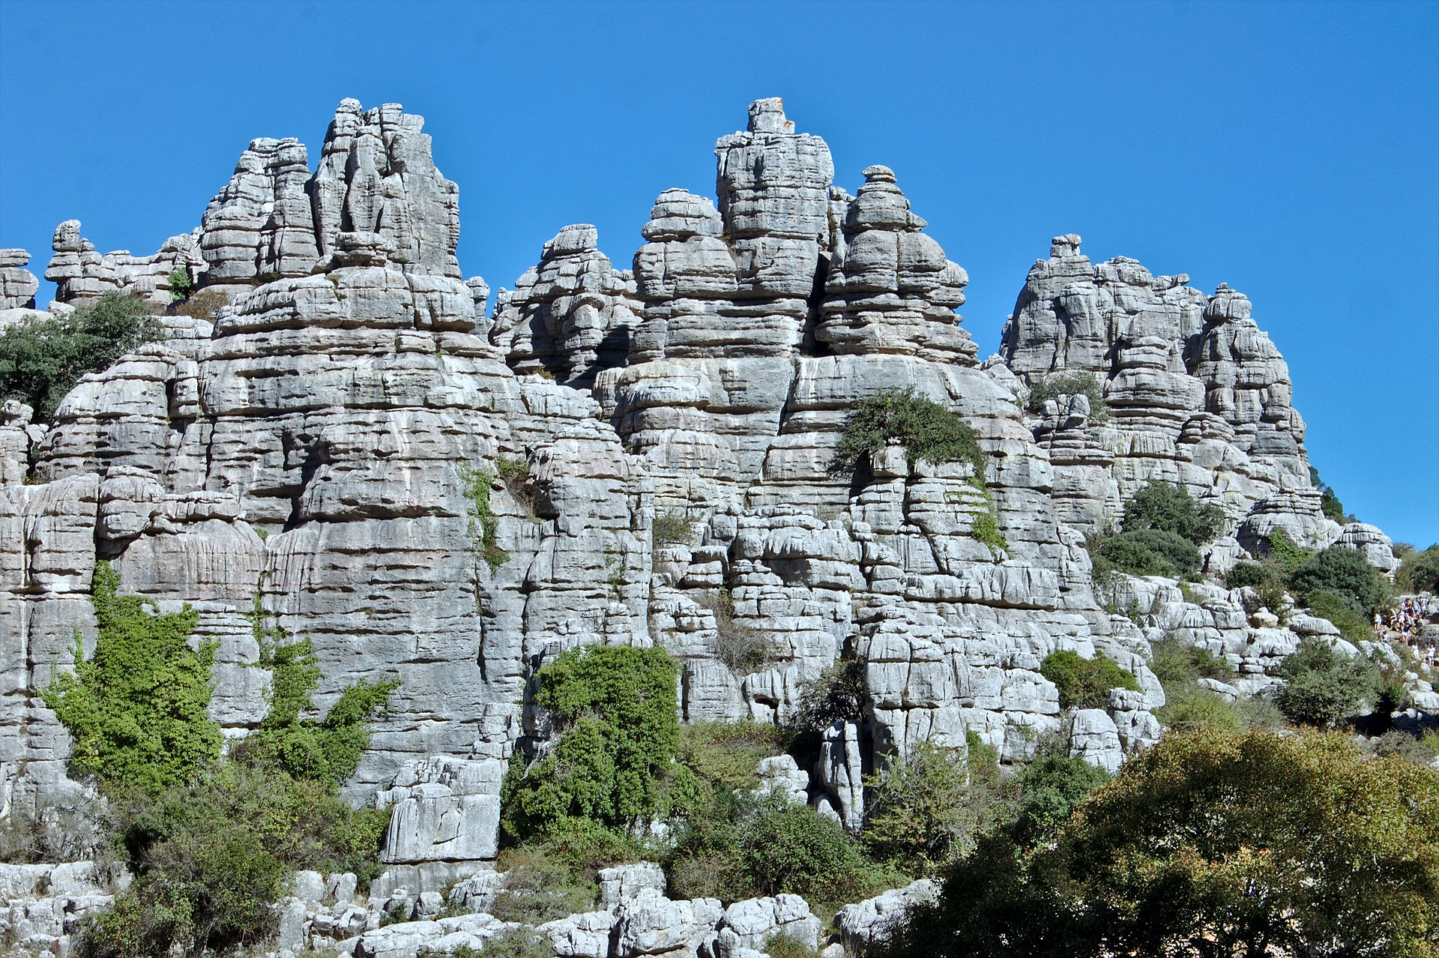
Chemical Weathering
H₂0 + CO₂ --> H₂CO₃ carbonic acid
CaSiO₃ + H₂CO₃ --> CaCO₃ + SiO₂ + H₂0
Silicate Rock Carbonate
At first this happened without life, but the process was sped up tremendously by living organisms

Slide 32
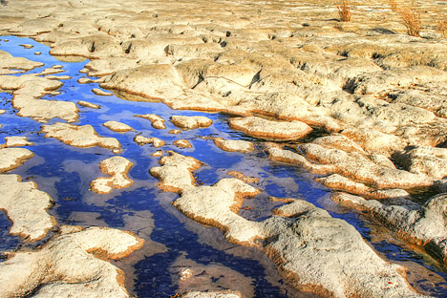
Chemical Weathering
Marine organisms would incorporate carbonate into their shells, which would fall to the ocean bottom when they died---thus, removing them from the system for a long time.
The bottom line…CO2 was being removed from the system.

Slide 33
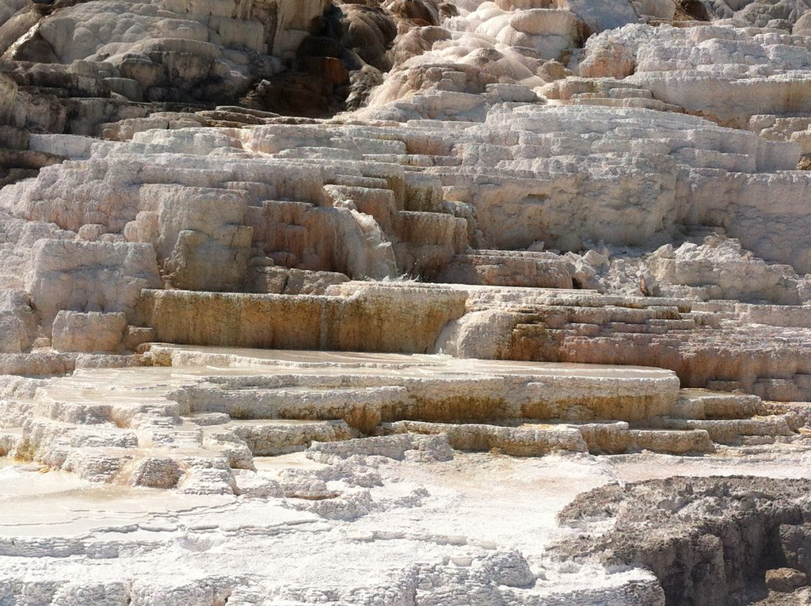

Slide 34
Even More
Sulfur compounds were taken out of the atmosphere as acid rain and were deposited on the ground as sulfates.
N₂ gas increased slowly but progressively since it was relatively inert.
Current composition of the atmosphere was established approximately a billion years ago.

Slide 35
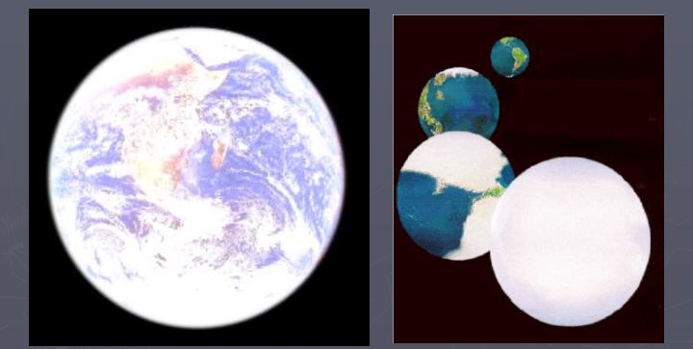
A Problem
With lower CO₂ levels the earth became more susceptible to ice ages when solar radiation decreases due to orbital variations,
It appears that around 750-550 million years ago the earth cooled down and became nearly entirely glaciated.

Slide 36
Note: one can get into a feedback with snow reflecting solar radiation, producing cooler temperatures and more snow, leading to less radiation, etc.

Slide 37
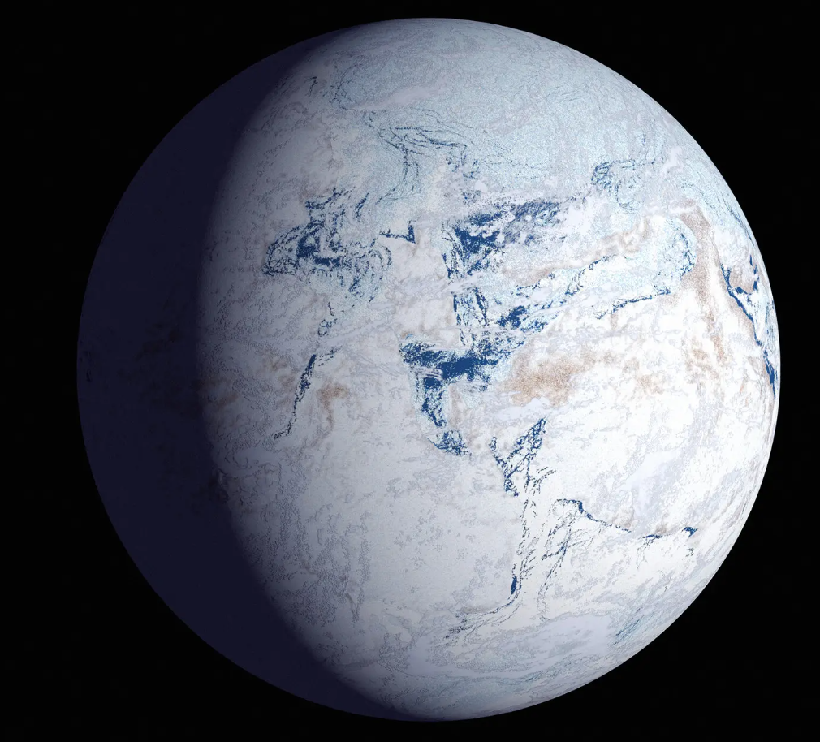

Slide 38
How Did We Get Unfrozen?
Volcanoes were still putting CO₂ into the atmosphere
Weathering was greatly reduced…since little liquid water.
So CO2 increased until the greenhouse effect was so large the earth warmed up.
Once warming started, it would have happened very rapidly.

Slide 39
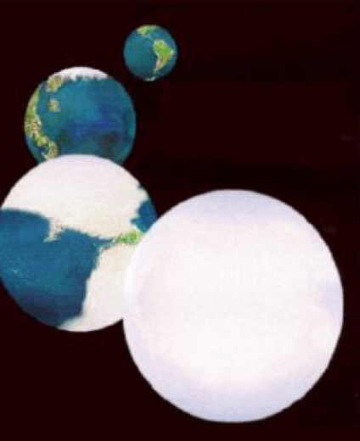
More Snowball Earths?
Less chance now
Sun is getting progressively stronger
Human’s can now stop it (increasing greenhouse gases)

Slide 40
The Last 500 million Years
The climate has not been constant, with warm periods interrupted by ice ages.
Much of the variability forced by changing solar radiation due to periodic changes in the earth’s orbital characteristics and tilt (Milankovitch cycles) and major volcanic eruptions (putting out massive CO2 that caused warming).

Slide 41
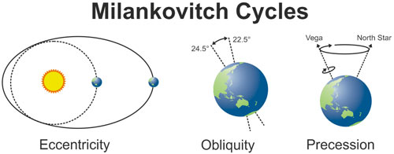

Slide 42
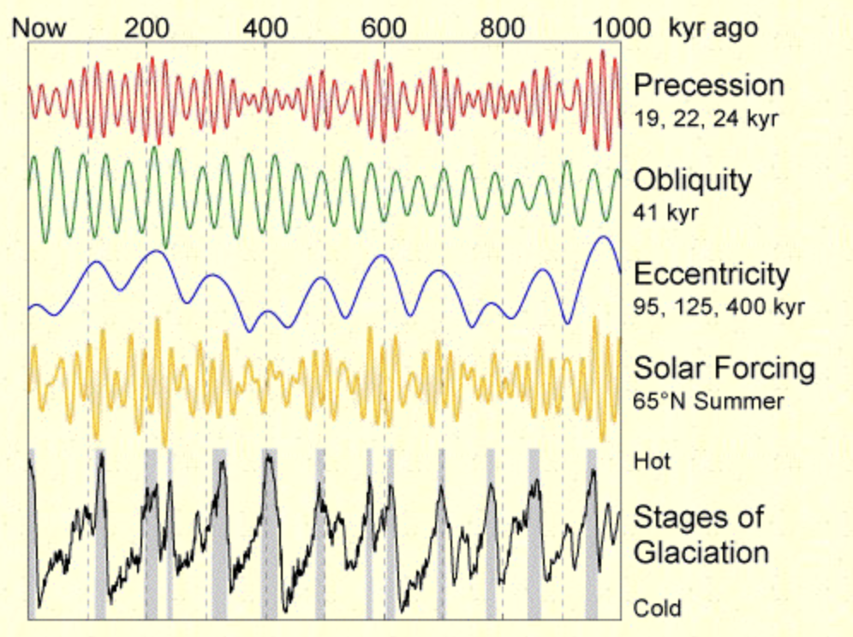

Slide 43
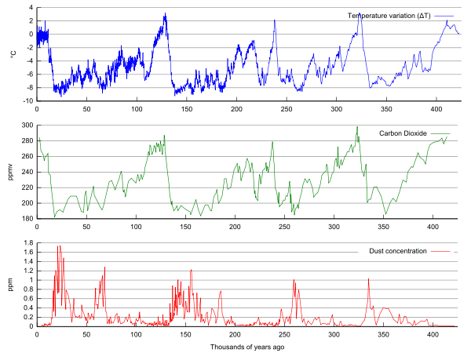

Slide 44
Atmospheres of Other Planets

Slide 45
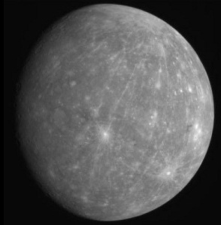
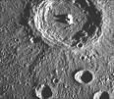
Mercury
No Atmosphere

Slide 46

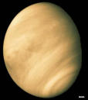
96% CO₂
Sulfuric acid clouds
Surface temp: 900F (470 C)
Surface pressure:
90 times greater than earth
Venus

Slide 47
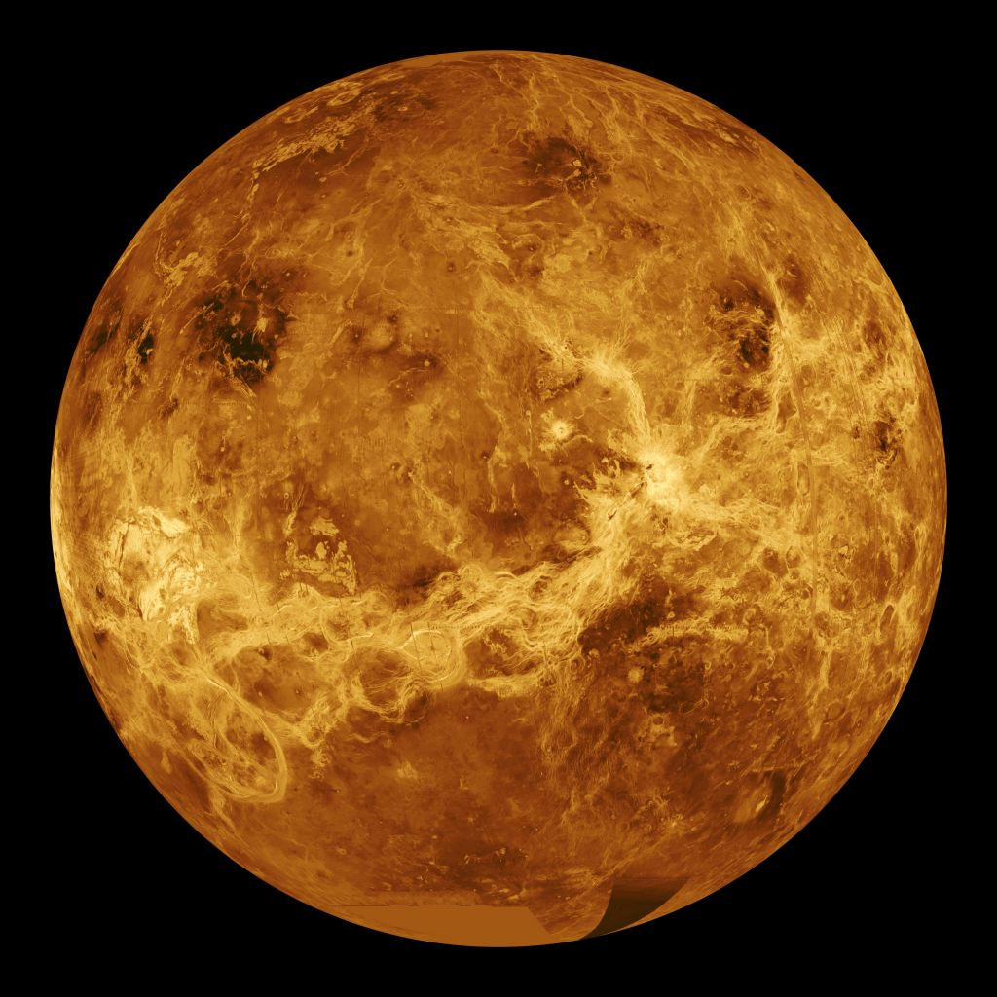
Venus
Beneath
The
Clouds
From
Radar

Slide 48
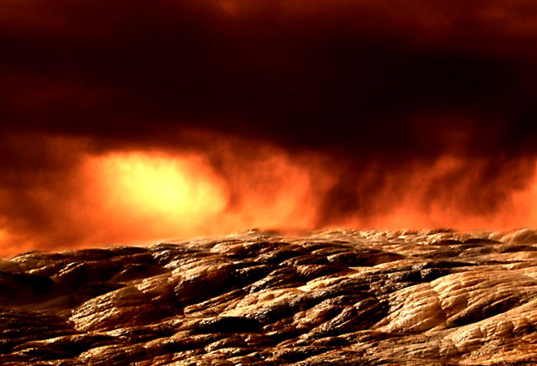

Slide 49
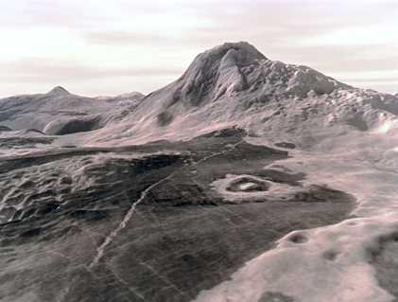

Slide 50
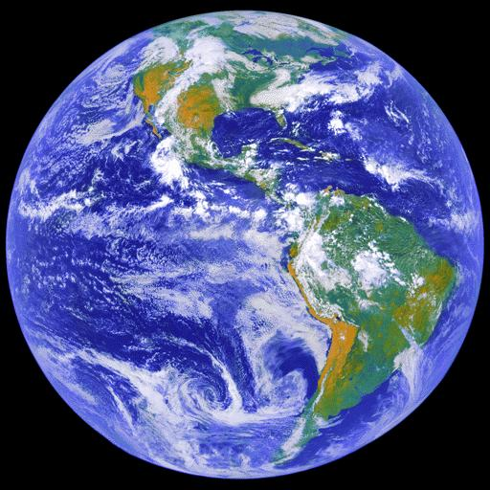
Earth

Slide 51
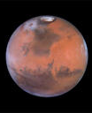

Surface Pressure: ~6 hPa
Mostly (~96%) CO2, small amounts of H20 vapor
CO₂ and H₂0 polar ice
Lots of dust
Average T: -80F but warmer near equator in summer (70F)
Mars

Slide 52


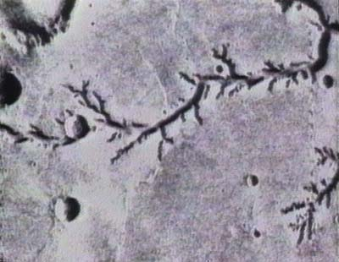
Water once flowed on the surface

Slide 53
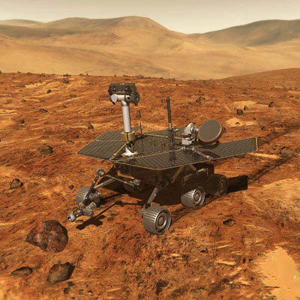

Slide 54
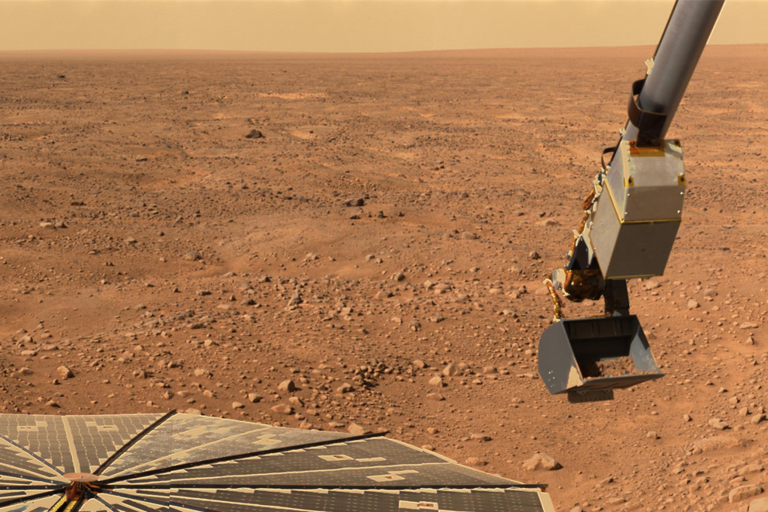

Slide 55
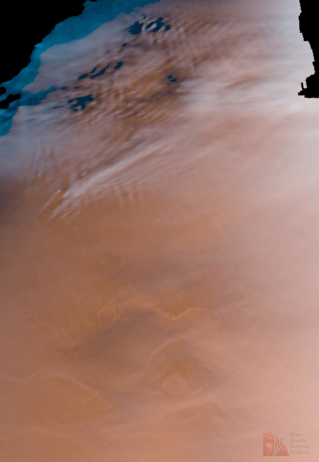
Martian
Clouds

Slide 56
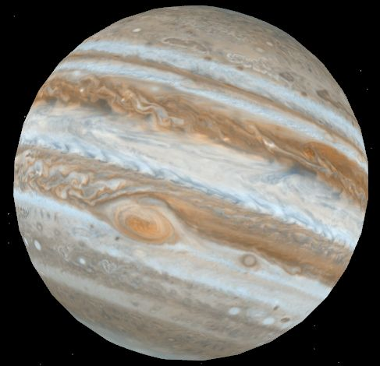
Atmosphere
Mainly hydrogen (90%)
and helium
Jupiter
No solid surface

Slide 57
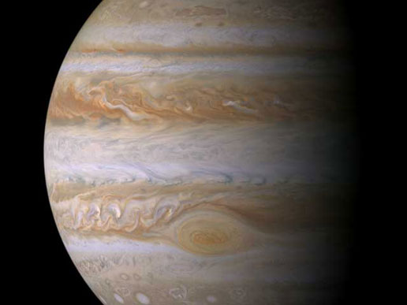
Jupiter’s atmosphere has jet streams and storms (e.g. red spot)

Slide 58
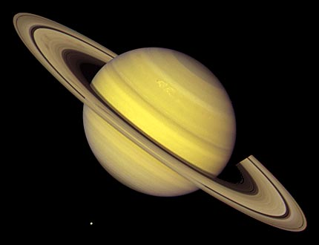
75% H₂ and 25% He
Saturn

Slide 59


Neptune
Both Gas Giants (H2 and He)
Uranus

Slide 60
Structure of the Atmosphere

Slide 61

Earth’s Atmosphere Is a Thin Veneer
Earth’s radius is about 6400 km (3840 miles)
Nearly all of the atmosphere is contained in the layer from the surface to 100 km (62 miles). Habitable atmosphere only the first 5 km (3 miles). 75% of atmosphere is in first 10 km (6 miles)

Slide 62
Earth’s Atmosphere Is a Thin Veneer
So the habitable atmosphere is only 5/6400 km
….or 1/1280th of the distance to the earth’s center. Much thinner than the peel on an orange.

Slide 63


This is obvious when viewed from space

Slide 64


The Vertical Structure of the Atmosphere
The Earth’s atmosphere is made of distinct layers
Complex variation of temperature with height
Main layers to know:
  Troposphere
  Stratosphere
  Mesosphere
  Thermosphere

Slide 65

Major
Atmospheric
Layers

Slide 66
Troposphere
Surface to roughly 10 km (~1000 hPa to ~ 250 hPa)
~3/4 of mass of atmosphere in this layer
Most weather occurs in the troposphere.
Temperature generally decreases with height in this layer (by ~6.5C per km, 3.6 F per 1000 ft)

Slide 67
Troposphere
The top of troposphere is called the tropopause.
Midlatitude jet stream tends to be strongest near the tropopause.
Above the tropopause is the stratosphere.

Slide 68

stratosphere
troposphere

Slide 69

Stratosphere
10-50 km above the surface
Temperature constant or INCREASING with height
Stable (not a lot of vertical mixing) and dry
Occasionally it is invaded by overshooting tops from convection pushing into this layer

Slide 70

Why constant temperature or warming with height in stratosphere?
Absorption of solar radiation by the stratospheric ozone layer

Slide 71

Stratospheric Ozone Layer
Maximum ozone (O₃) between 20 and 30 km.
Protects the surface from harmful ultraviolet (UV) radiation
Ozone is produced photochemically

Slide 72
A photochemical reaction is a chemical reaction in which radiation affects the chemical composition of a substance.
Simplified photochemical reaction for ozone
  UV +O₂ O + O
  O₂ + O + M O₃ + M
  O₃ + UV O₂ + O
M is some catalyst molecule. This reaction produces heat as UV radiation is absorbed . Warms stratosphere.

Slide 73

Like
A heater

Slide 74

You can see warming in the stratosphere in daily soundings

Slide 75


Slide 76

Ozone Destruction
Later is the class we will talk about the destruction of the ozone layer
Problems caused by chemicals such as chloroflurocarbons (e.g., Freon, refrigerants)
Produced the ozone hole.
Now being repaired by restrictions on chemical releases.

Slide 77
Stratosphere
Jet aircraft frequently enter the stratosphere, particularly during winter
Air becomes drier and sometimes have ozone in cabin
Can see the difference…getting above the clouds
Stratosphere ends at the stratopause, ~ 1hPa, 50 km

Slide 78
Mesosphere (50-80 km)
A second region of temperature decline with height
Why? Getting away from ozone heating
Noctilucent Clouds-ice coated meteor dust

Slide 79

Noctilucent
Clouds

Slide 80


Slide 81
Mesosphere
Ends at mesopause (~80 km ~.01 hPa), the coldest place in the atmosphere ~-90C)

Slide 82
Thermosphere
80-140 km
Region of warming with height
Warming produced by absorption of shortest wavelength ultraviolet radiation in upper troposphere by 0₂, N, N₂
Aurora (a.k.a. aurora borealis, northern lights) in this layer

Slide 83

Produced by solar particles ionizing molecules in upper atmosphere
Aurora borealis

Slide 84

Ionization: the process where an atom or molecule gains or loses electrons, becoming an electrically charged ion

Slide 85

Charged particles from the sun reach the earth’s orbit, causing ionization

Slide 86

Ionization can lead to emission of light

Slide 87


Slide 88
https://www.youtube.com/watch?v=fVsONlc3OUY

Slide 89
Exosphere
Above the thermosphere
Very low density of molecules

Slide 90

Ionosphere
Includes the Thermosphere and the Exosphere
In this layer, most molecules ionized by solar radiation (loses electrons)
Mainly electrically charged atoms and molecules
Able to reflect radio waves—allows long distance communication!

