Slide 1
Consortium Meeting
February 4, 2021
Cliff Mass and David Ovens
University of Washington

Slide 2

Replacement of Sage Head Node
Like doing brain surgery on someone that has to go running that day

Slide 3
Replacing the Sage Node
This node is communication node for all the computation nodes and for transferring data to storage and with the outside world
Was ten years old!
Installed Jan 26, 2021
32-core, Intel Xeon 6226R (increase of 20 cpus)
192 GB RAM (increase of 96 GB)
220 TB RAID disk capacity (increase of ~75 TB)
100 Gb/s EDR infiniband

Slide 4
Some Growing Pains
Will require kernel (software) upgrades on older nodes – transferring files through infiniband is too slow due to kernel discrepancies. (have a temporary workaround)
Will result in faster runs because pre-processing is faster. The extra CPUs will allow faster graphics generation.
Example, can prepare input and boundary files for 4/3-km domain on Sage vs running on 5 nodes before.
Will be optimizing processes during next month.

Slide 5
Splitting the Ensemble

Slide 6
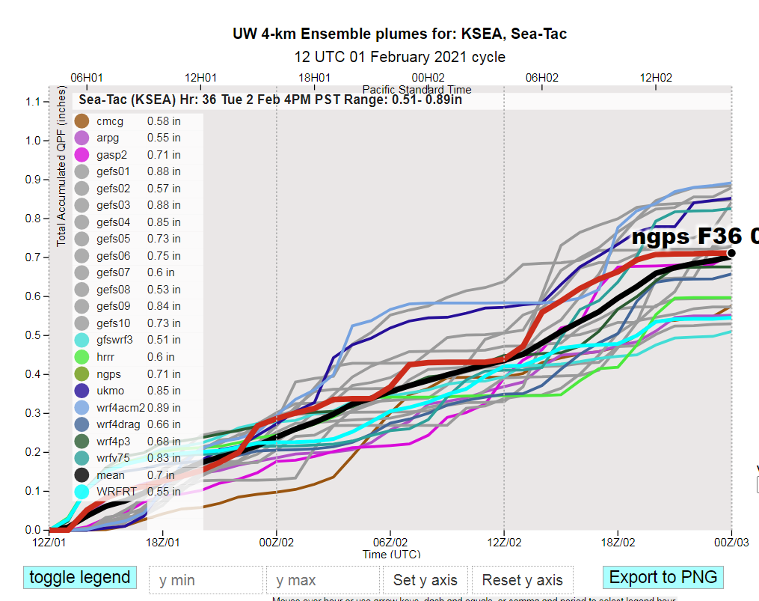
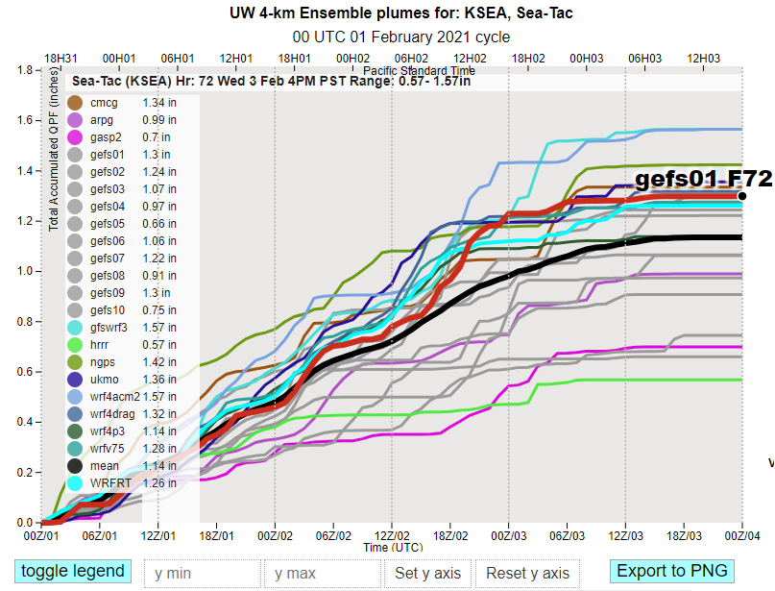
NWRMC Meeting, February 4, 2021
Dec 11: Ensemble runs split into 0-36 and 36-72 forecasts
Partially Complete 36-hr run
Completed 72-hr run

Slide 7
NWRMC Meeting, February 4, 2021
Dec 11: Ensemble runs split into 0-36 and 36-72 forecasts
Trade-offs to splitting ensembles
(since have to stop the model and run post-processing twice)
Product | Ready time Prior to split | Ready time After split
Mean and spread (0-36 hours) | 7:30 am/pm | 4:50 am/pm
Mean and spread (0-72 hours) | 7:30 am/pm | 7:55 am/pm
Plumes (0-36 hours) | 6:40 – 7:15 am/pm | 4:10 am/pm
Plumes (0-72 hours) | 6:40 – 7:15 am/pm | 7:30 am/pm
Air Quality Plumes (for WSU Machine learning and Idaho DEQ) | 6:40 – 7:15 am/pm | 7:15 – 7:40 am/pm

Slide 8
Other Changes of Note
October 21, 2020 – smoke and aerosol effect from GEOS model turned off for the season (until July).
October 2020 – wrfv75 (75 vertical level WRF-GFS) member had repeated CFL errors throughout October (nearly 1 in 3 runs). Diagnosed and fixed by switching to auto-generated vertical levels.

Slide 9
Other changes
November 19, 2020 – HRRR-member updates to more closely match FSL’s HRRR: aerosol-aware Thompson microphysics, no grid-nudging, simple horizontal diffusion (diff_opt=1) vs the full diffusion (diff_opt=2) that we use in real-time WRF and other members.
NOTE: still have to use Noah LSM instead of RUC LSM since do not have 9-layer soil data available for all 72 hours of forecast.
January 3, 2021 – lost access to Japanese Met Office model, ensemble member JMA or JMAG.

Slide 10
Forecast Verification Study for DNR/Ecology

Slide 11
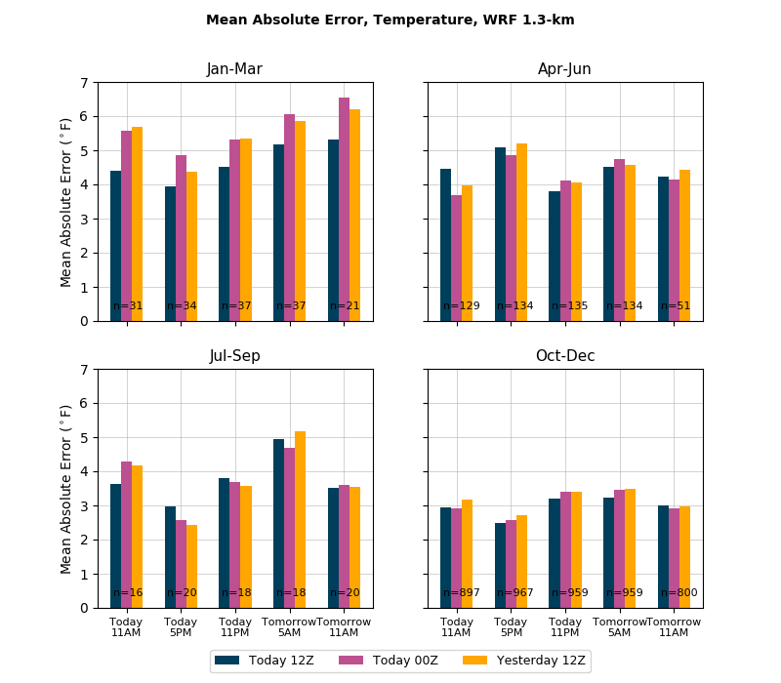

Slide 12
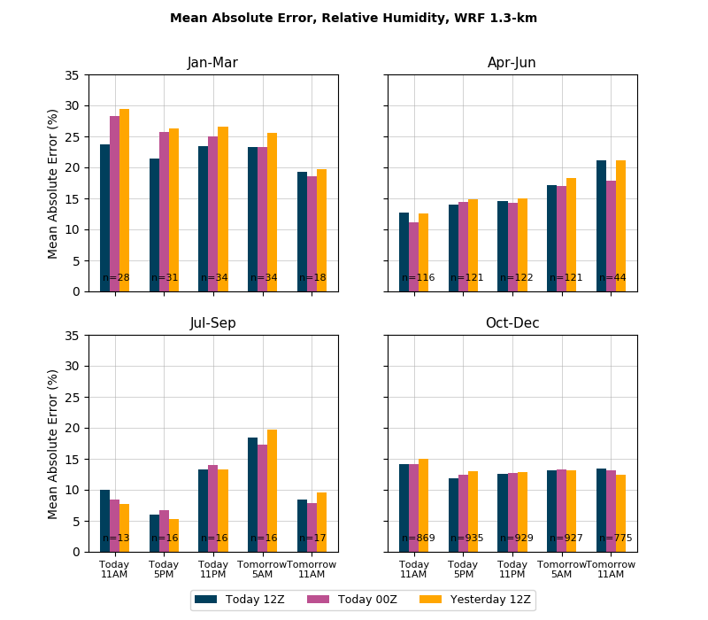

Slide 13
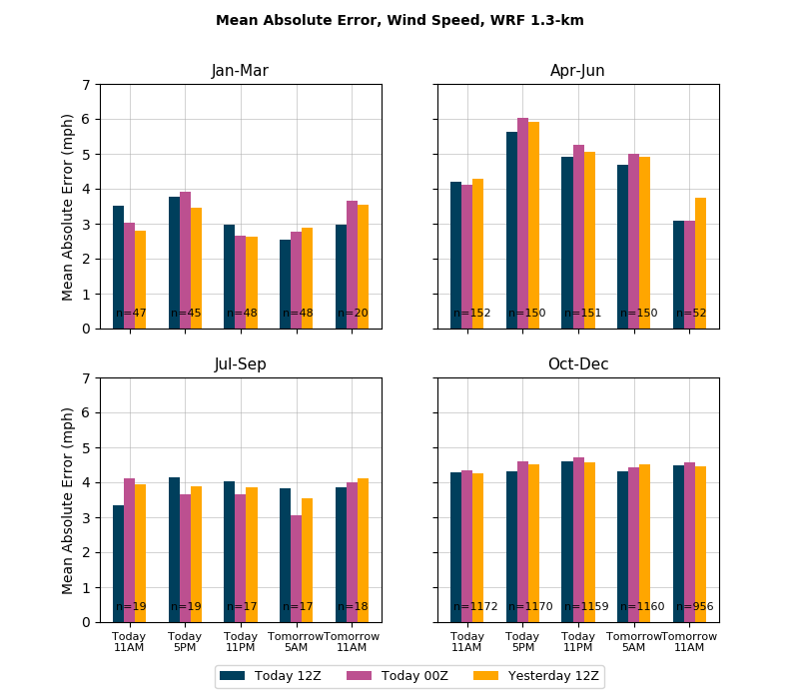

Slide 14
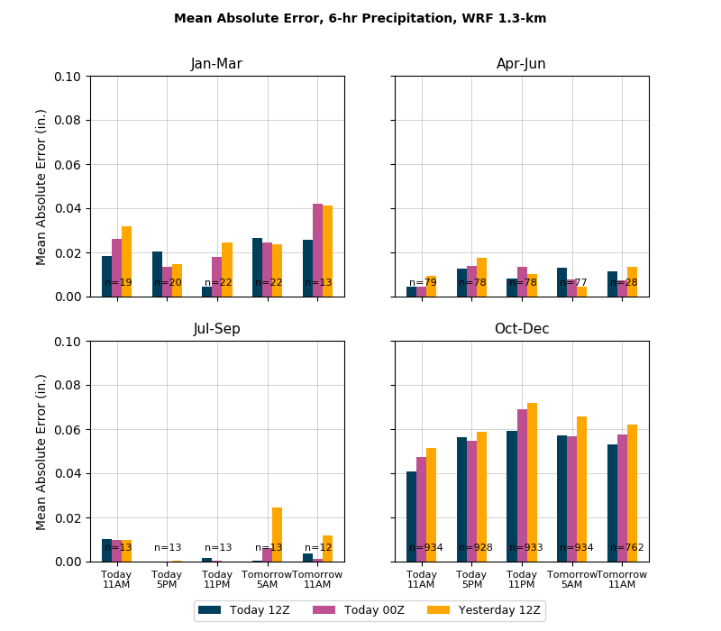

Slide 15
https://atmos.uw.edu/~jbaars/index_dnr.php

Slide 16
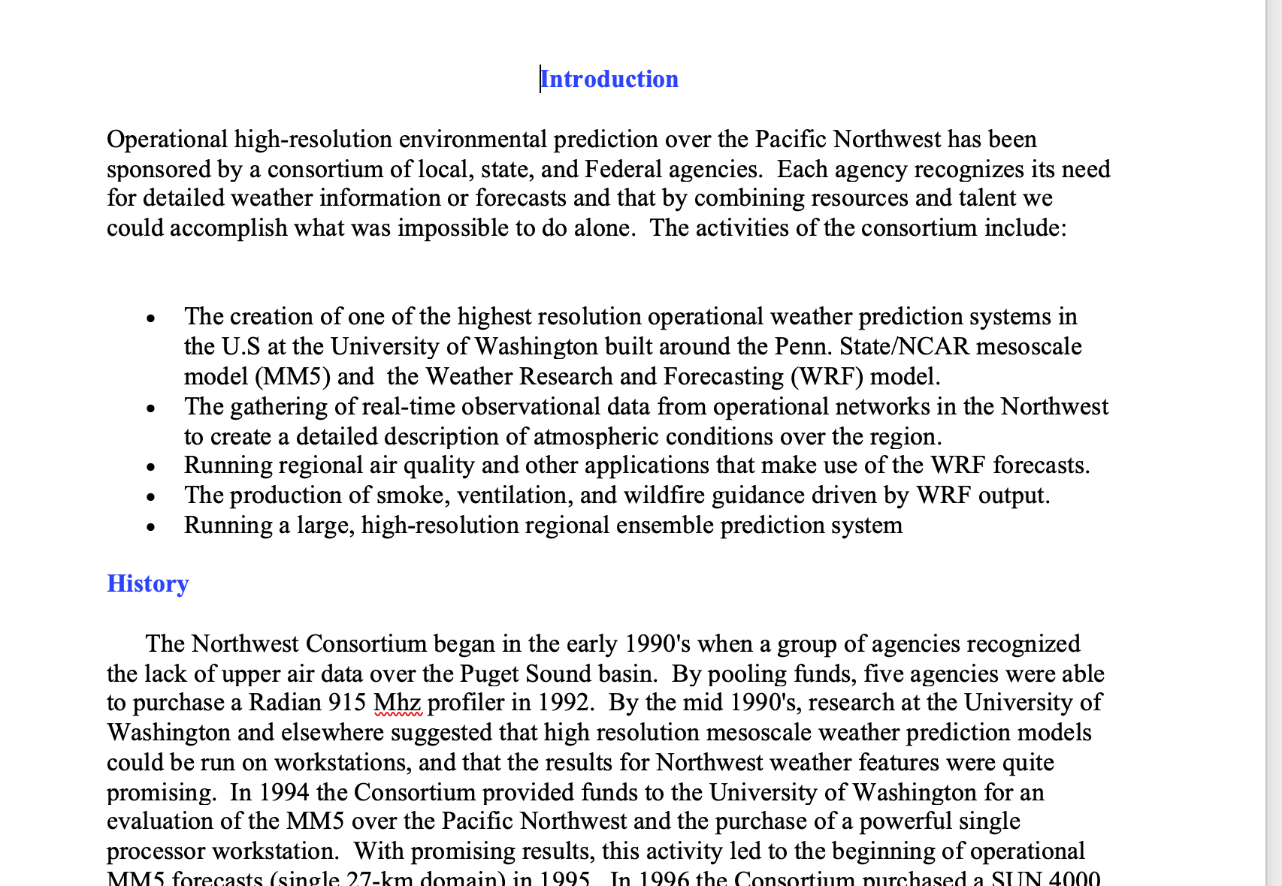
Updated Consortium Description

