Slide 1
Potential Temperature
The temperature that an unsaturated parcel of dry air would have if brought adiabatically and reversibly from its initial state to a standard pressure, p₀, typically 1000 hPa

Slide 2
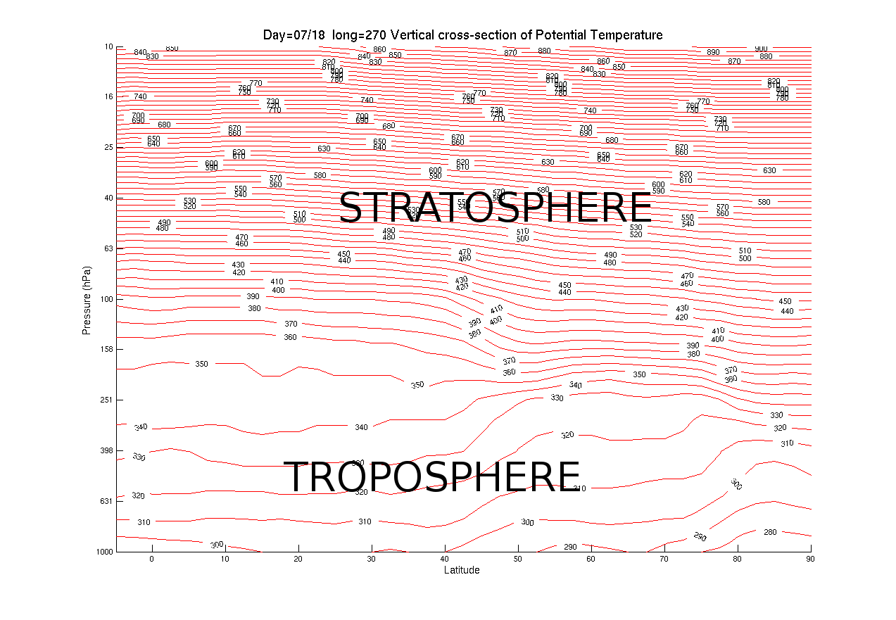

Slide 3
