Slide 1
Psychology of Weather Prediction
Atmospheric Sciences 452
Spring 2025

Slide 2
Psychology of Weather Prediction
Psychological elements are crucial. Must strive to be mentally neutral about forecasts.
In some ways, meteorologists are the last people you want making forecasts, because we love interesting weather and have a bias to forecast intense weather too frequently.
Sometimes forecasters with great technical knowledge have poor performance because of psychological reasons!

Slide 3
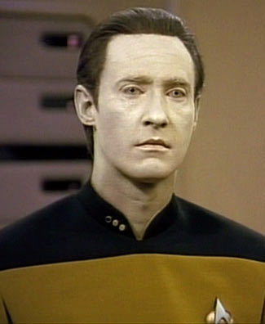
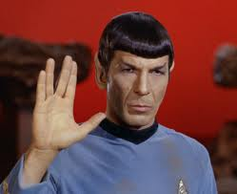
Potentially Good Forecasters

Slide 4
Psychology of Weather Prediction
When many things are happening at once, meteorologists often focus on one of them to the detriment of others.
Humans like conceptual models and often hold on to them even when reality is at odds with such models. (like fronts)
Humans are deterministic animals and often push uncertainty away when we shouldn’t.

Slide 5
Major Psychological Elements
LOVE
Meteorologists love interesting weather and tend to overforecast it
OVERCOMPENSATION
We tend to excessively compensate for previous errors. This can produce a classic sinusoidal error evolution.
MACHO
There is a tendency to go for extreme or improbable situations. If you hit, it is like meteorological cocaine high!
INSECURE
Going with MOS or NWS forecast or fearing to deviate from them substantially.

Slide 6
The Bottom Line
Forecasting is very important and critically affects people’s lives. It requires professional detachment.

Slide 7
Understanding How Our Customers Use Weather Forecasts
Psychological studies have examined how people interpret and use forecasts.
How can we express predictions in a way to maximize understanding and correct response?
A particular issue is probabilistic prediction. How to communicate uncertainty?

Slide 8
Communication Issue: Poor Icons

Slide 9
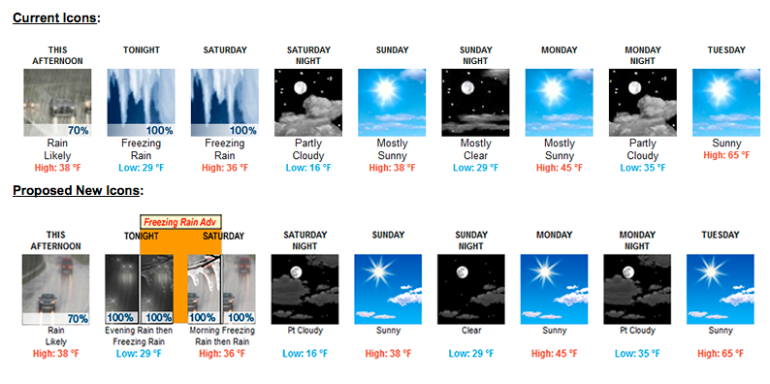
NWS Icons

Slide 10
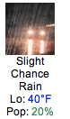


NWS Precipitation Icons

Slide 11

And a “slight” chance of freezing drizzle reminds one of a trip to Antarctica

Slide 12
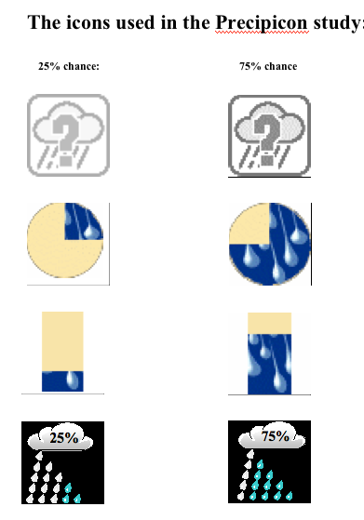
Study by Professor Joslyn and students

Slide 13
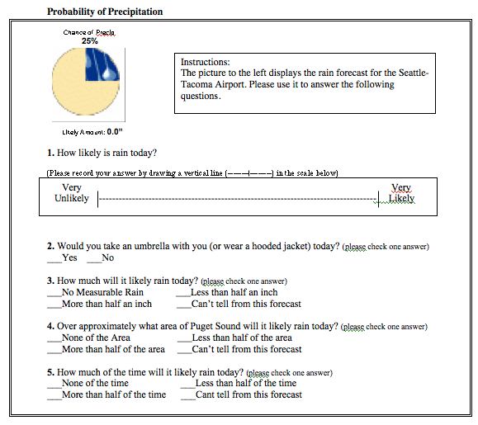

Slide 14

The Winner

Slide 15
Getting the Correct Response to Forecasts
Problem example: Excellent tornado forecasts (2011) in Joplin, MI were unable to stop massive deaths and injury.
Forecasts were very skillful but folks did not take the correct actions.
Shows the need for psychological studies.
Also true with Hurricane Katrina.
Many other examples

Slide 16
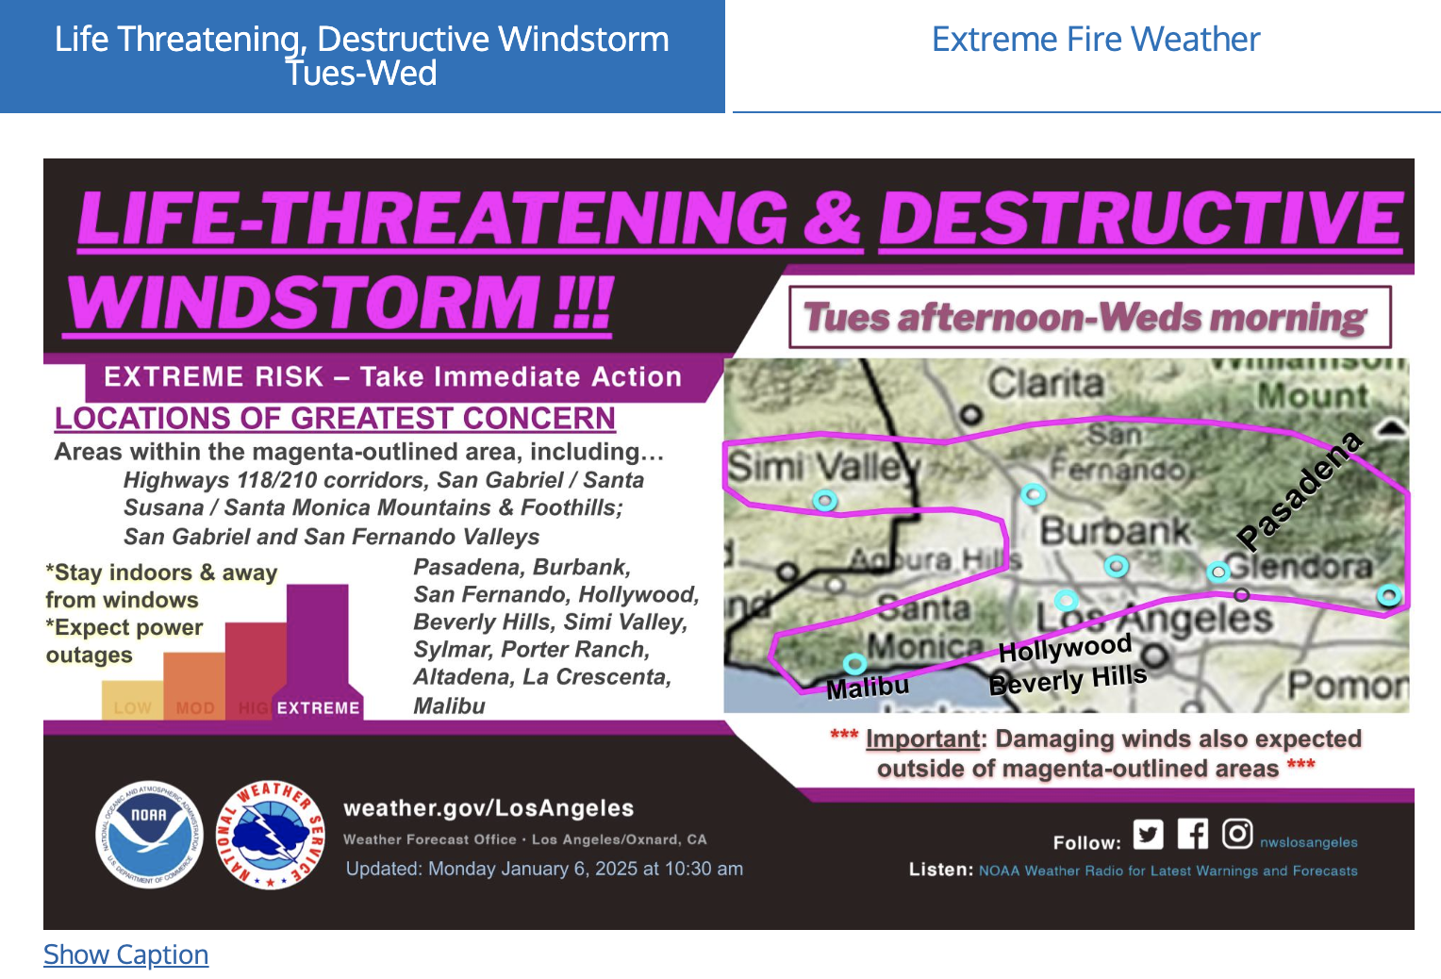
LA Wildfire: Excellent Meteorological Forecasts-Poor Outcome

Slide 17
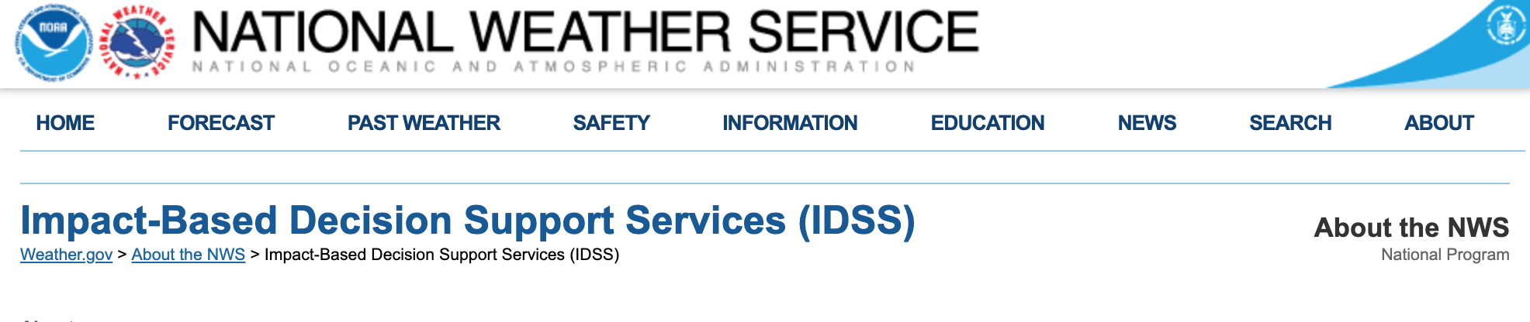
National Weather Service is Putting Increasing Emphasis on IDSS (Impact-Based Decision Support Services)
IDSS includes forecast advice and interpretative services that the NWS provides to help partners, such as emergency personnel and public safety officials, make decisions.

Slide 18
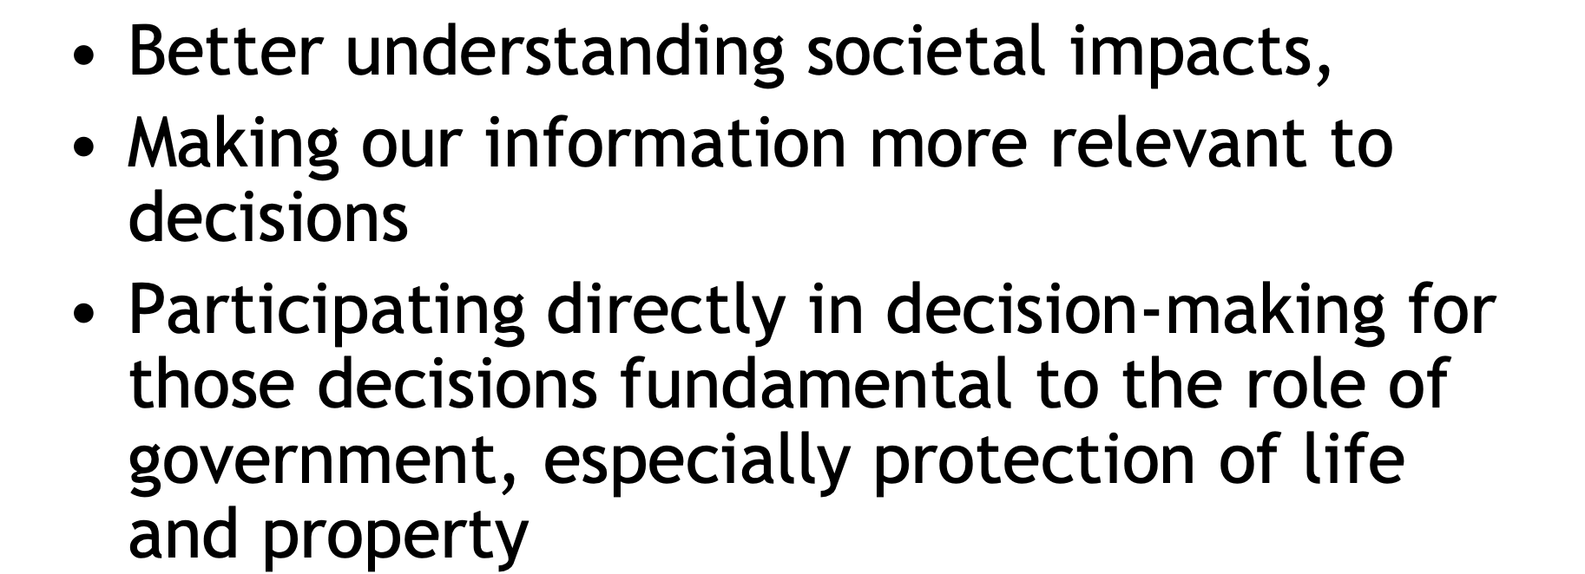
NWS IDSS Goals

Slide 19
Summary
Making skillful weather forecasts is only half the battle.
Just as important, and harder, is to:
  Communicate forecasts skillfully
  Get society to pay attention and to respond appropriately to save lives and property and to secure maximum economic benefit.

Slide 20
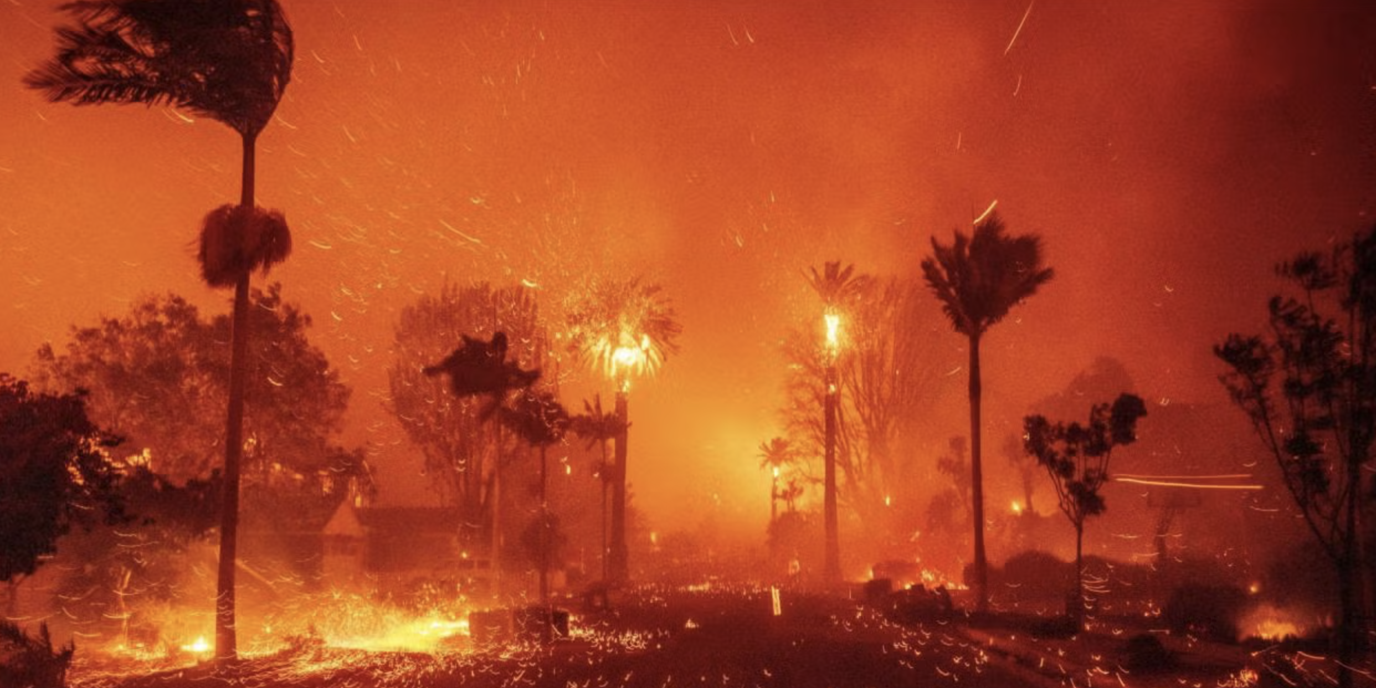
A Recent Example of Failure to Do So: LA Wildfire

