Slide 1
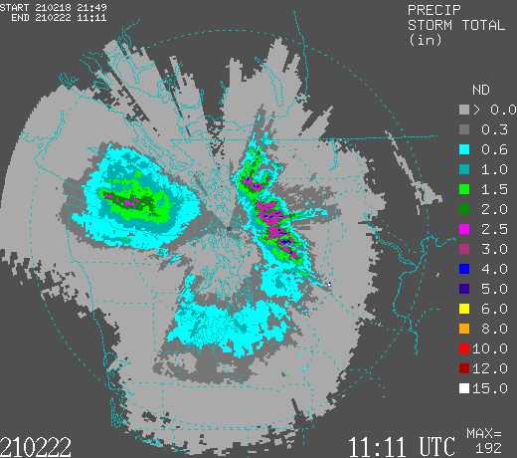
Radars as Rain Gauges
It is possible to estimate precipitation intensity and precipitation accumulation from radar data.
Very valuable because you can’t have rain gauges everywhere.
This relationship has been studied extensive in many regions, seasons, and precipitation regimes.

Slide 2
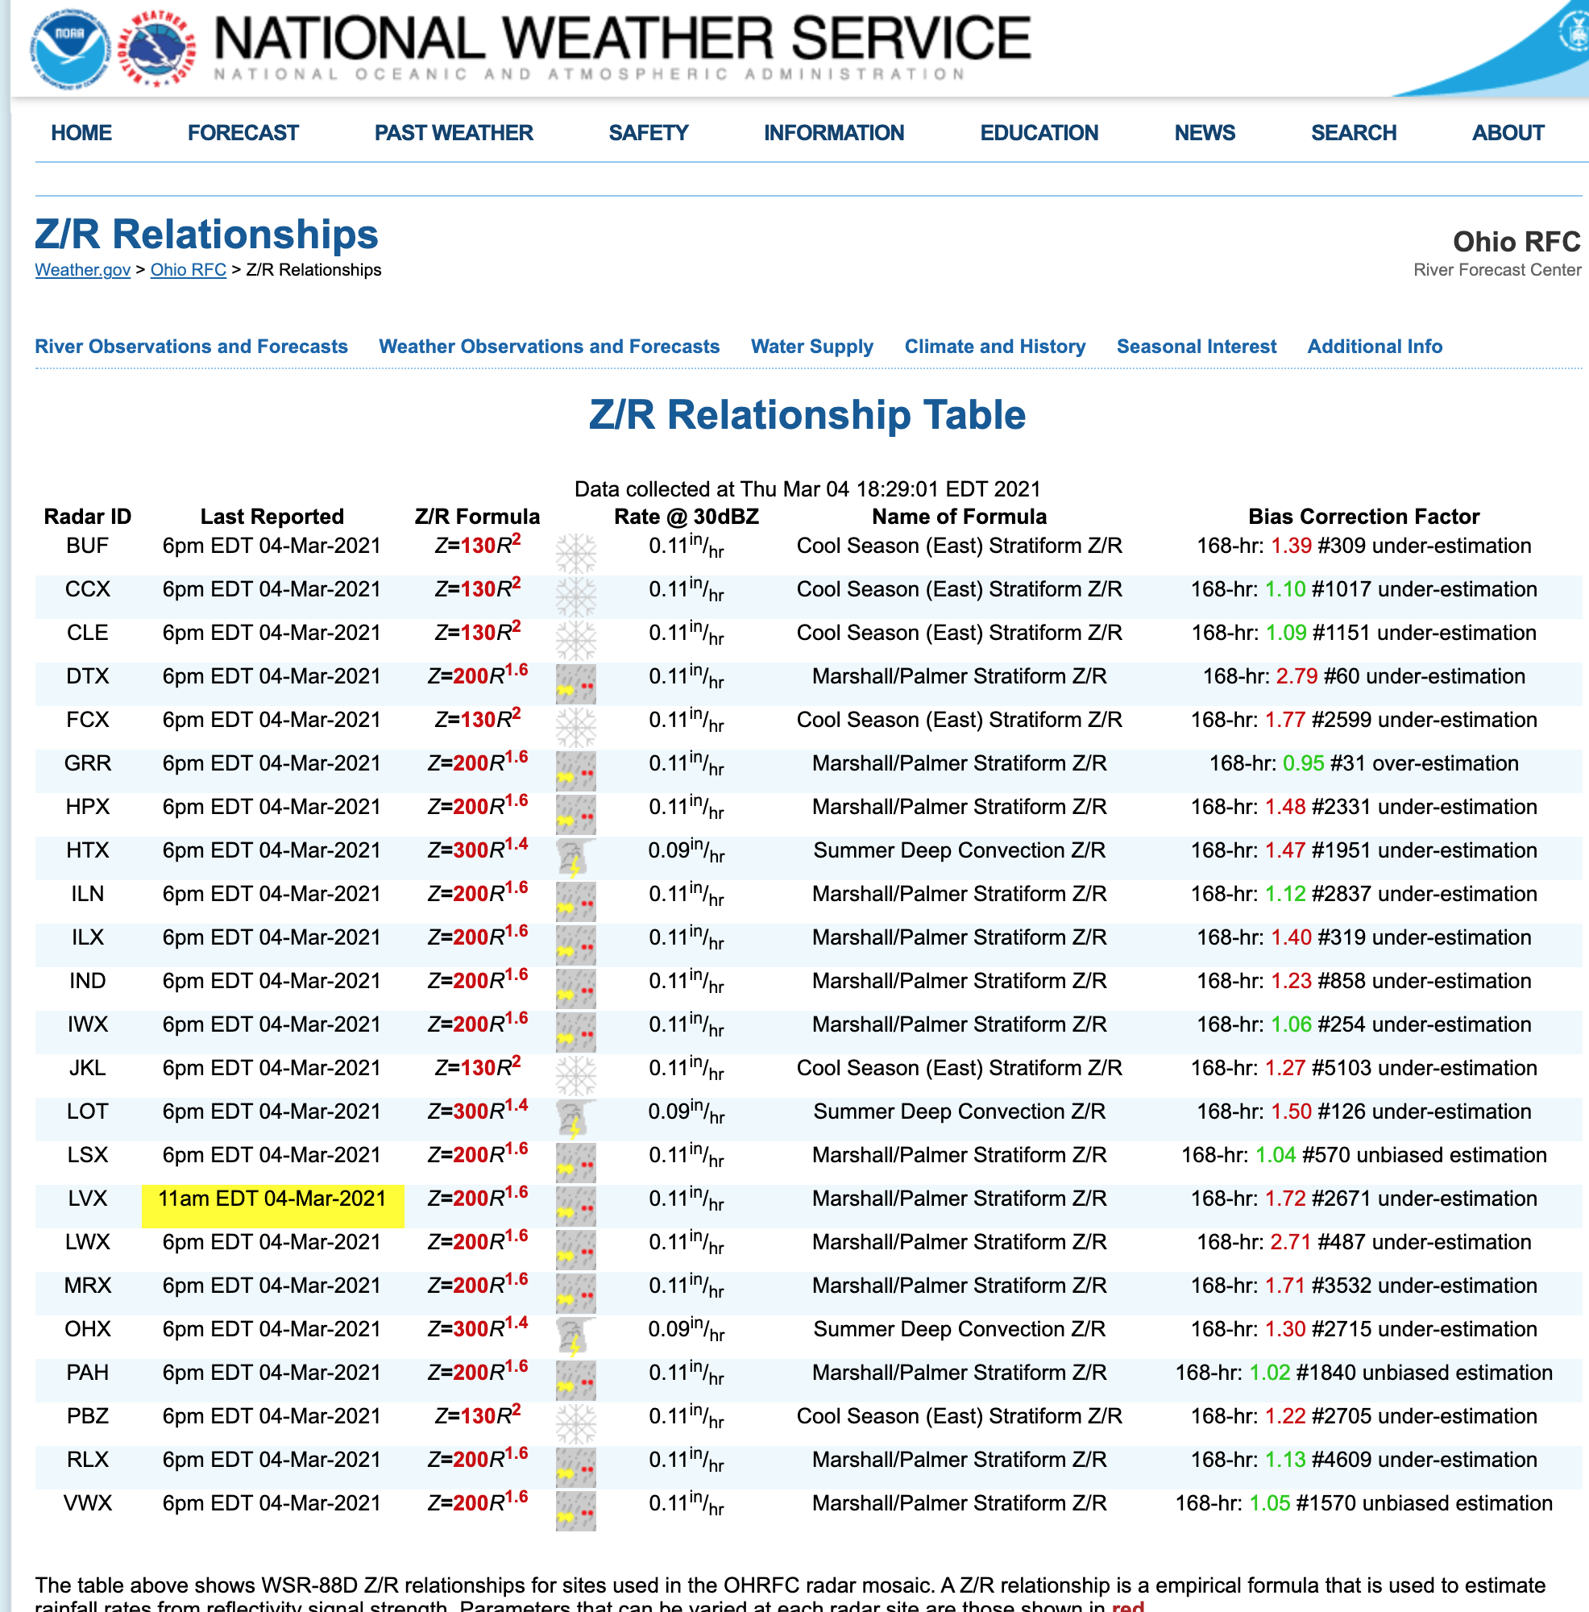
Z-R relationship (reflectivity-rainfall rate)
Different values used at various sites
Can calibrate using radar and rain gauge data

Slide 3
Also a dual-polarization algorithm for rain rate estimation
Rainfall retrievals using combinations of reflectivity (Z_{h}), differential reflectivity (Z_{dr}), and specific differential phase (K_{dp}) are made.
Have advantages over traditional Z–R methods because more information about the drop size distribution (DSD) and hydrometeor type are available.
Generally better

Slide 4
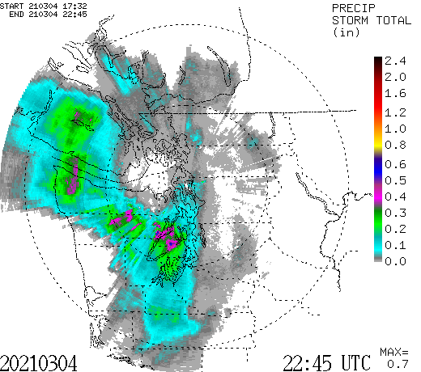
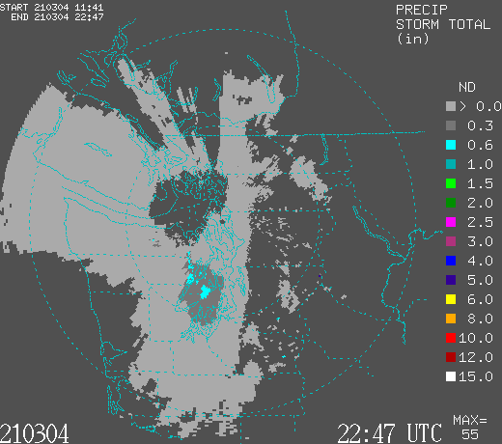
Dual Pol
Traditional Z-R

Slide 5
