Slide 1
Wind Balances and Applications in Synoptic Meteorology
Atmospheric Sciences 370

Slide 2

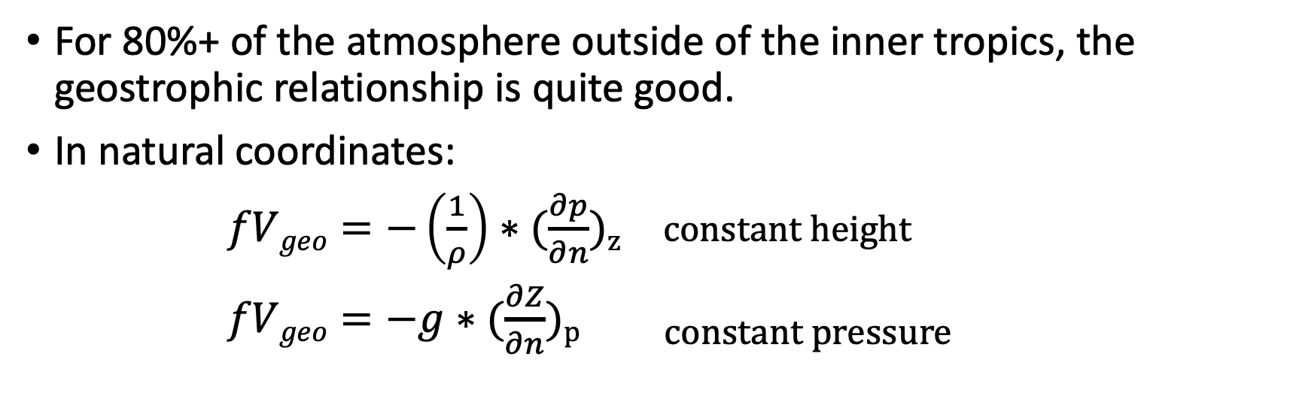


Heights and winds aloft are closely related by the geostrophic and gradient wind relationships
For 80%+ of the atmosphere outside of the inner tropics, the geostrophic relationship is quite good.
In natural coordinates:
$fVgeo=−\left(\frac{1}{ρ}\right)∗(\frac{∂p}{∂n}$)_{z} constant height
$fVgeo=−g∗(\frac{∂Z}{∂n}$)p constant pressure
$$\vec{n}$$
$$\overset{⃑}{s}$$
Coriolis Force Horizonal Pressure Gradient Force
$$f=2Ω\sin{Θ, Ω=7.292 ∗10 −5 s−1 }$$

Slide 3


Classic thought experiment
Start with a rotating planet and an atmosphere with pressure gradients and initially no winds
Assume no surface drag and mountains to keep it simple.
Low
$$∇p$$
Coriolis
$$∇p$$
High

Slide 4
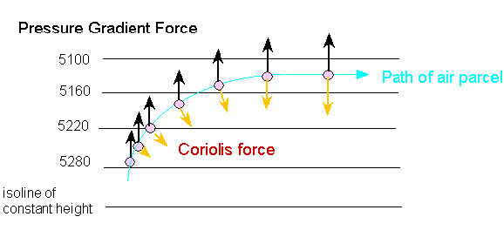

Slide 5
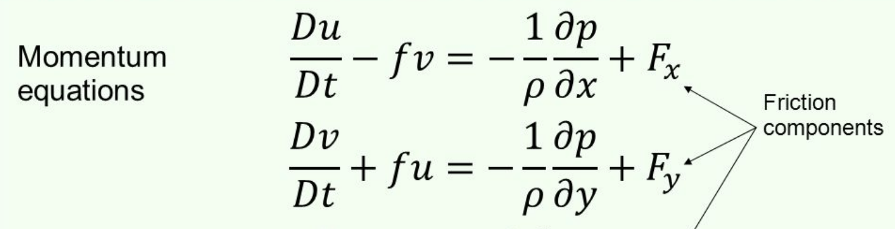
Geostrophic Balance
Needs sufficient space and time for the wind field to adjust to the pressure (mass) field.
If insufficient time (say a parcel hits a mountain), no geostrophy.
Advection and time rate of change of fields mush be small.
No friction.
Has to be zero

Slide 6
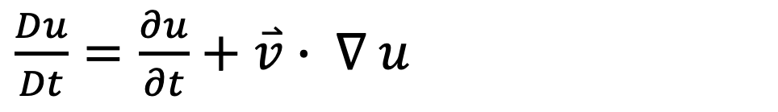
Need rate of change and advection to be small
$\frac{Du}{Dt}=\frac{∂u}{∂t}+\overset{⃑}{v}$ $∙ ∇ u$
Rate of change
advection

Slide 7
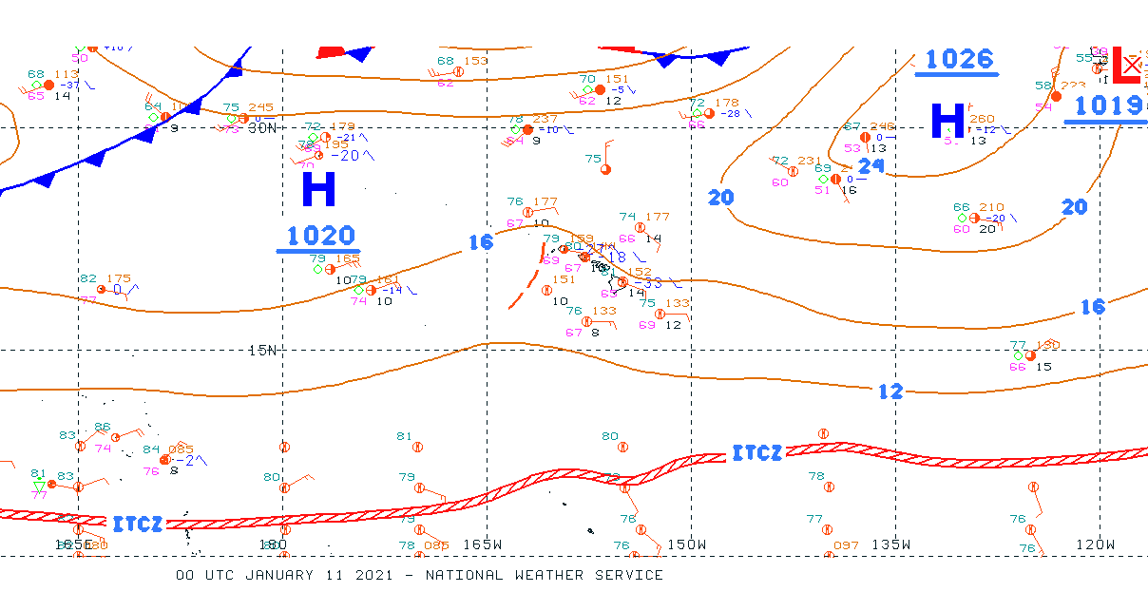
Deviations from geostrophic balance occur:
In the free atmosphere, in sharp troughs and ridges, where the centrifugal force is significant: (gradient wind balance)
Near the equator where f is small
Near terrain
Near surface where drag is important
When the flow or forces change rapidly
Amazing, geostrophic balance is very applicable in a large portion of atmosphere north and south of ~5N and S.

Slide 8
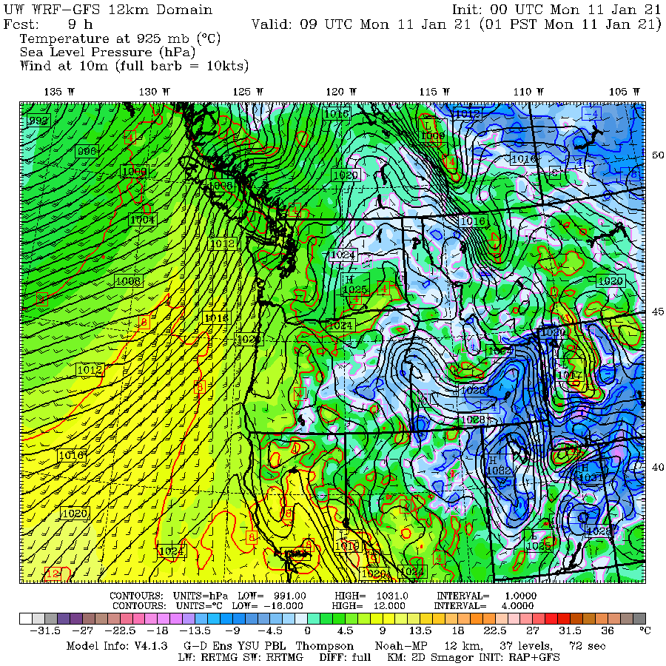

Slide 9
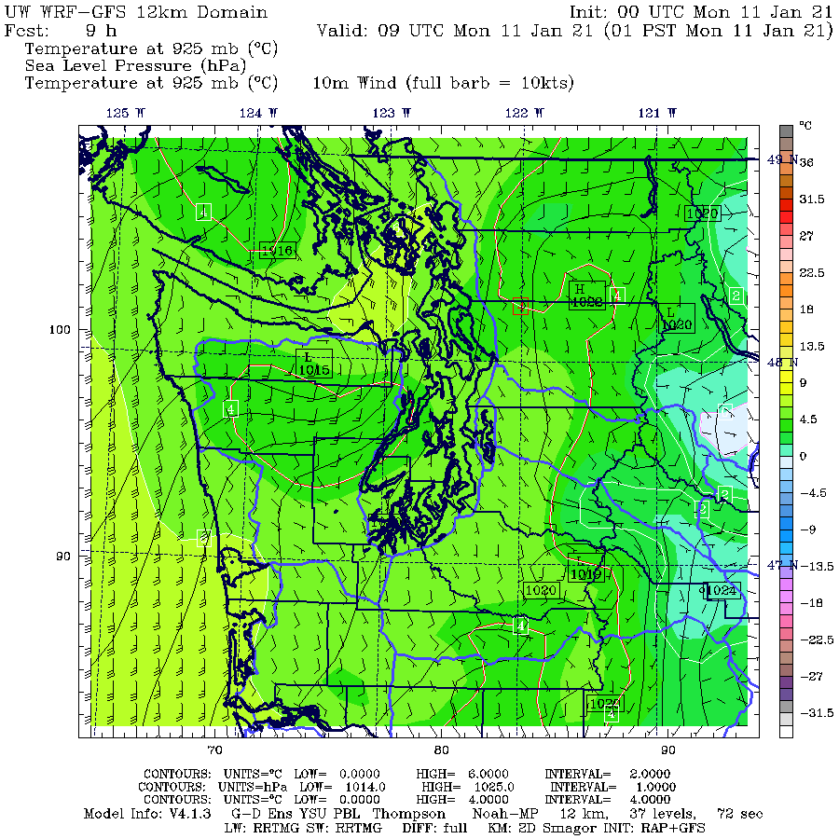

Slide 10
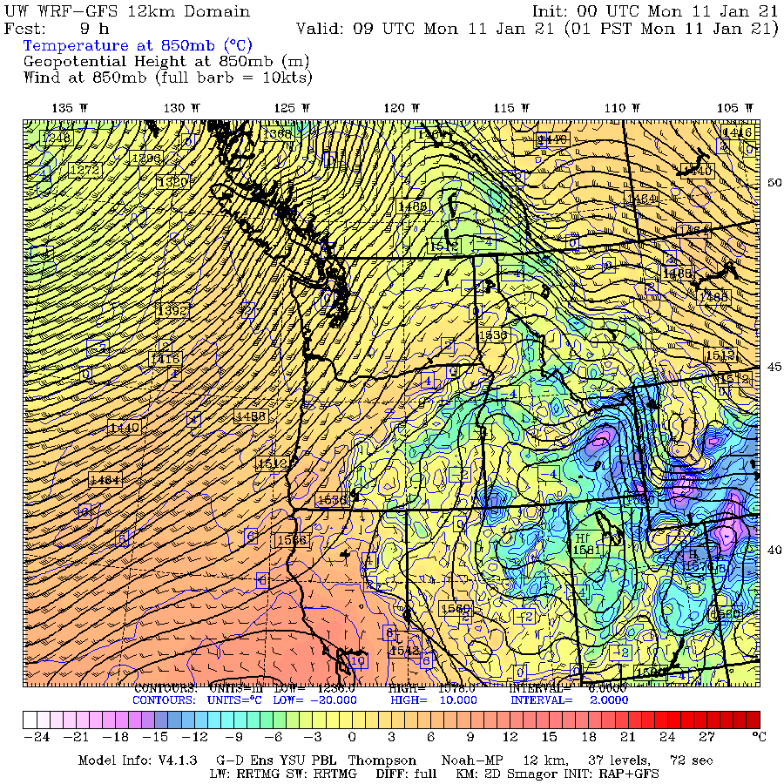
850 hPa

Slide 11
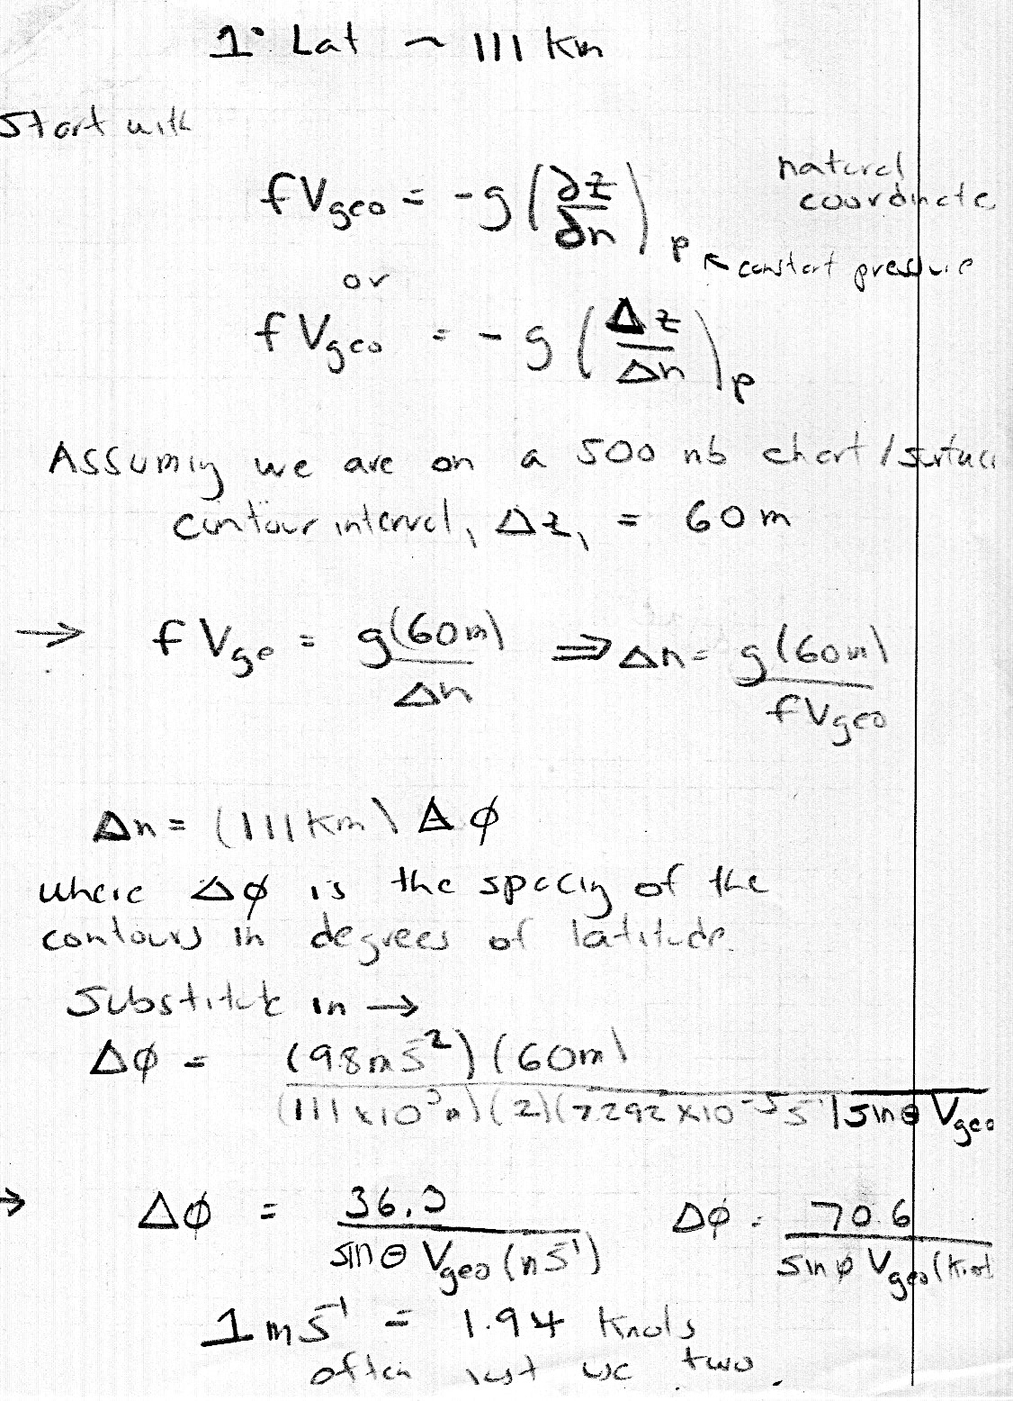
Can Develop a Relationship Between the Distance Between 500 hPa Contours (60 m interval) and wind speed

Slide 12
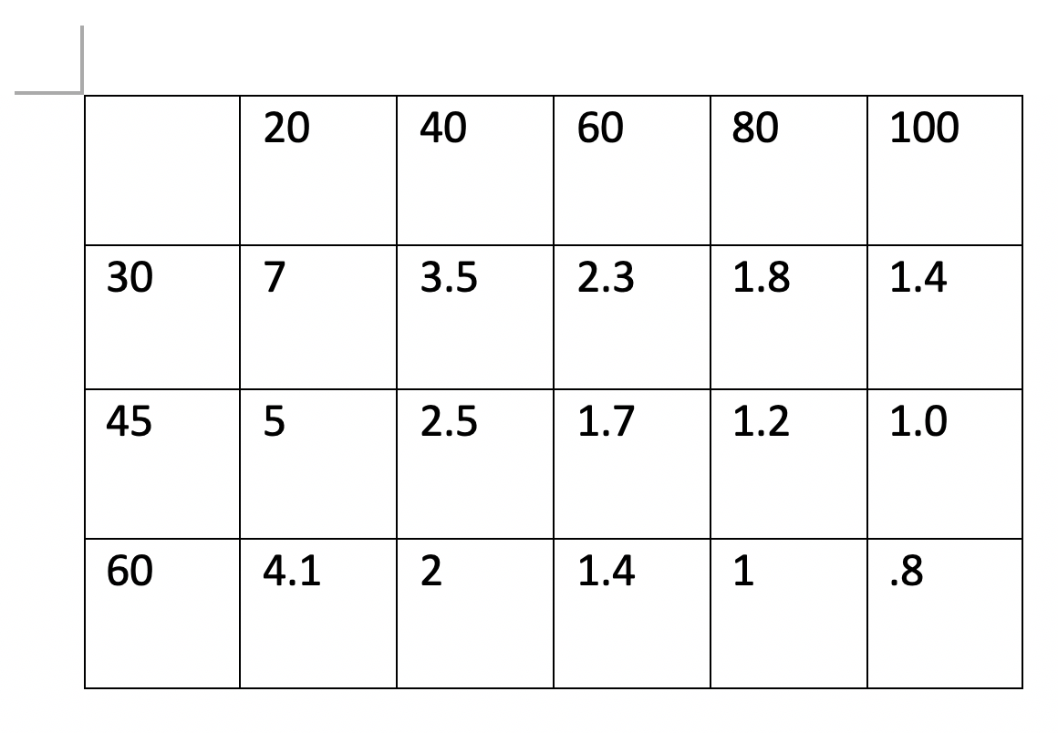
Contour Spacing (in degrees of latitude) Versus Wind Speed at 500 hPa (60 m contour interval)
Wind speed in knots
1 degree of latitude
is ~ 111 km
Latitude

Slide 13
Question
Wind speed increase as contour spacing decreases.
But why does contour spacing INCREASE for the same speed as one goes to the south?
Why need LESS height
gradient to get the same
wind speed?

Slide 14
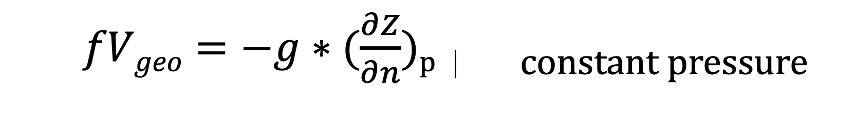
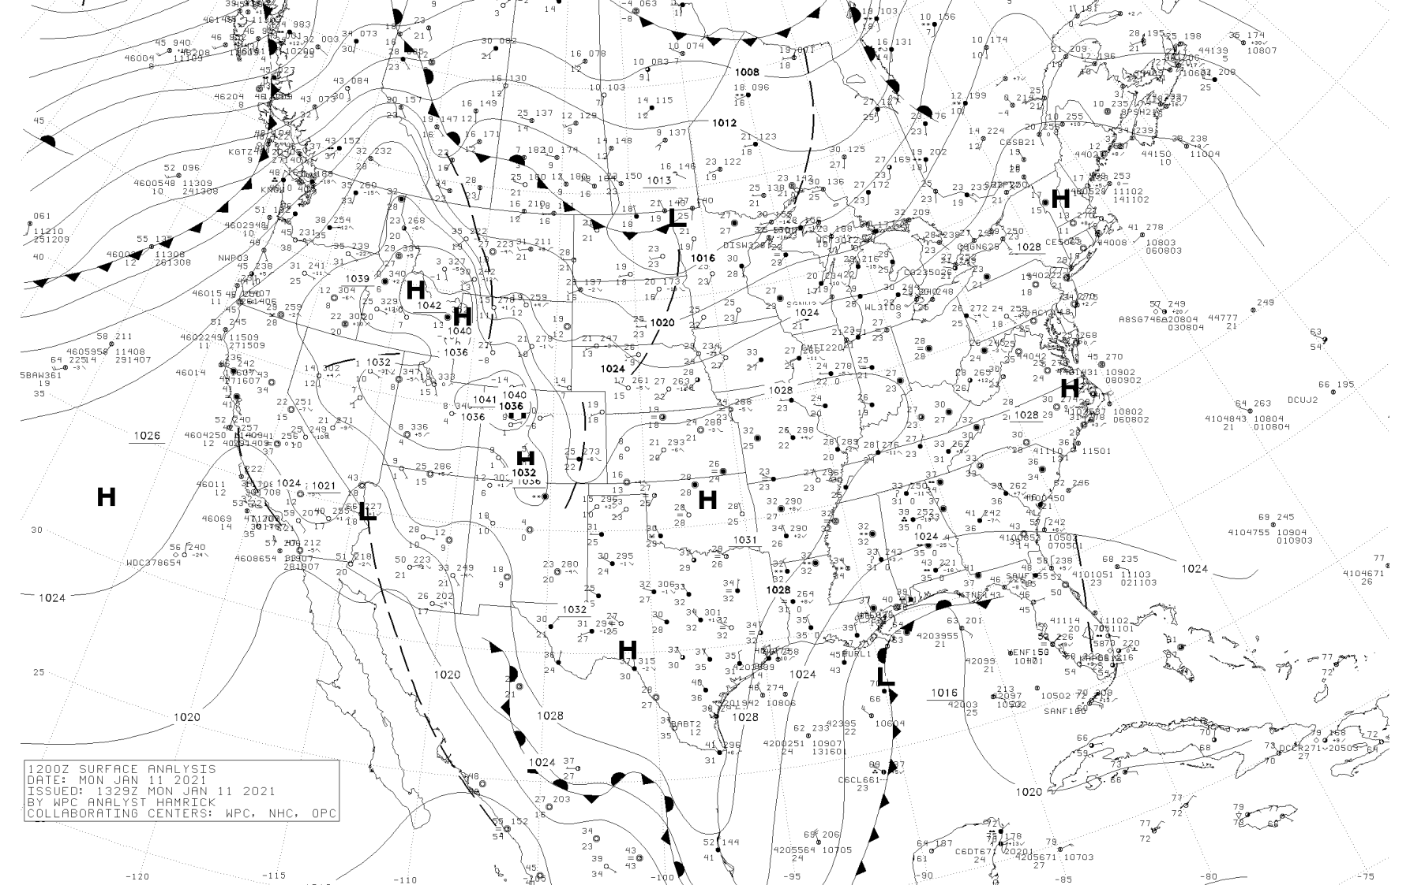
Answer: because f is less.

Slide 15
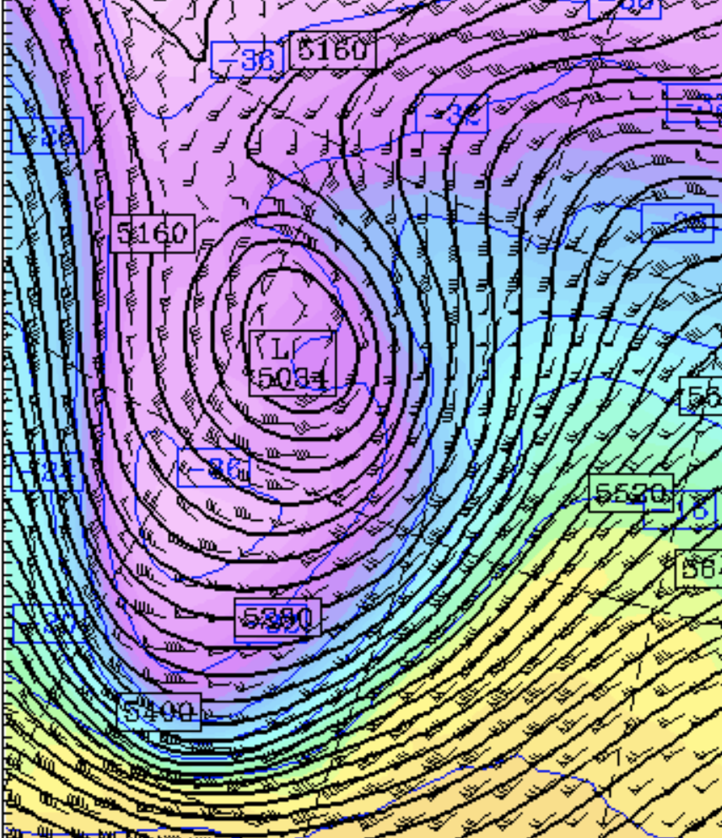
Geostrophic balance assumes that accelerations are small and that the centrifugal force is not appreciable
But in strong, sharply curved flow, the centrifugal force is important
In such situations, the gradient wind balance is more accurate.
Gradient wind balance assumes a balance between:
Pressure gradient force
Coriolis force
Centrifugal force
Still assumes relatively steady stat, no drag/friction, and no mountains

Slide 16
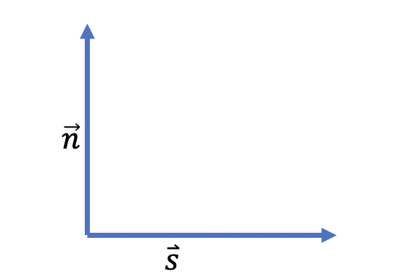
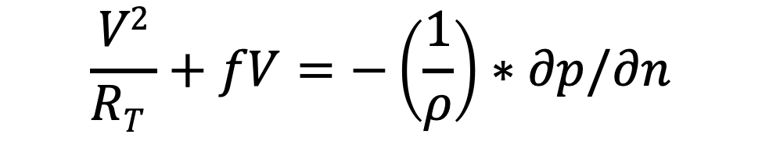
Gradient Wind Balance (natural coordinates)
$$\frac{V2}{RT }+fV=−\left(\frac{1}{ρ}\right)∗∂p/∂n$$
Centrifugal force Coriolis Pressure Gradient force
R_{T} is the radius of curvature of the the trajectory through point in question

Slide 17
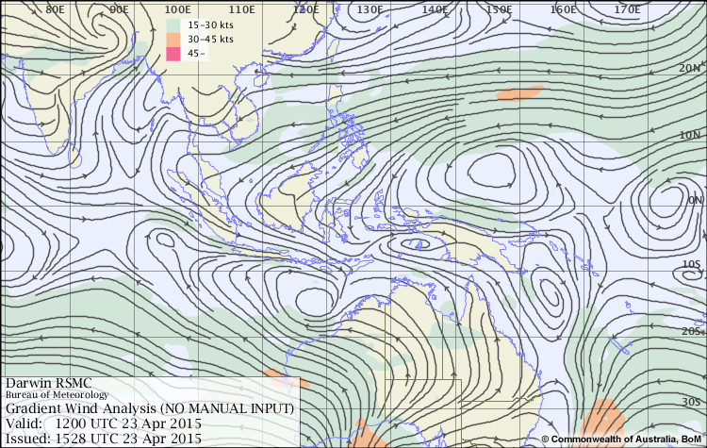
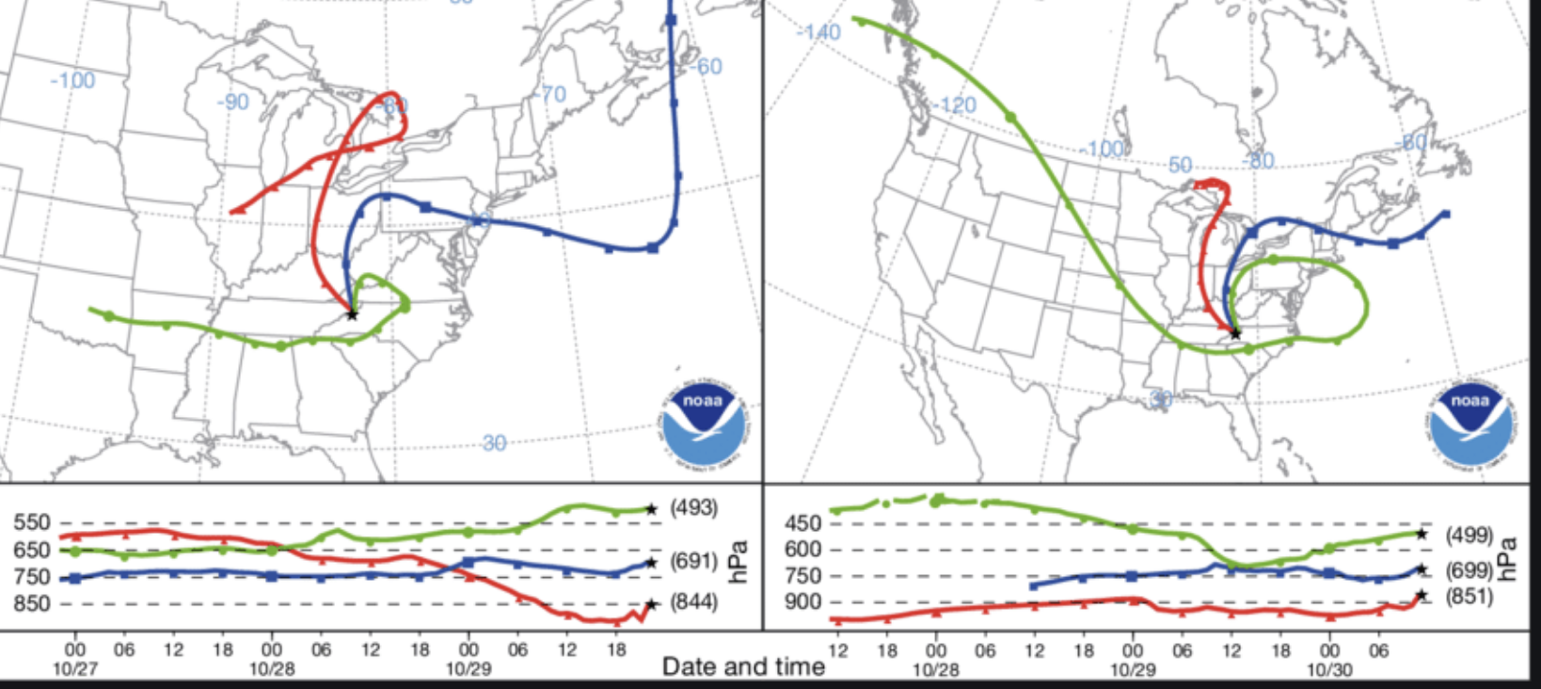
Trajectories Versus Streamlines
Streamlines are lines parallel to the flow at some time.
Trajectories show the three-dimensional path of air parcel over time ending or starting at a point.
Streamlines
Trajectories

Slide 18
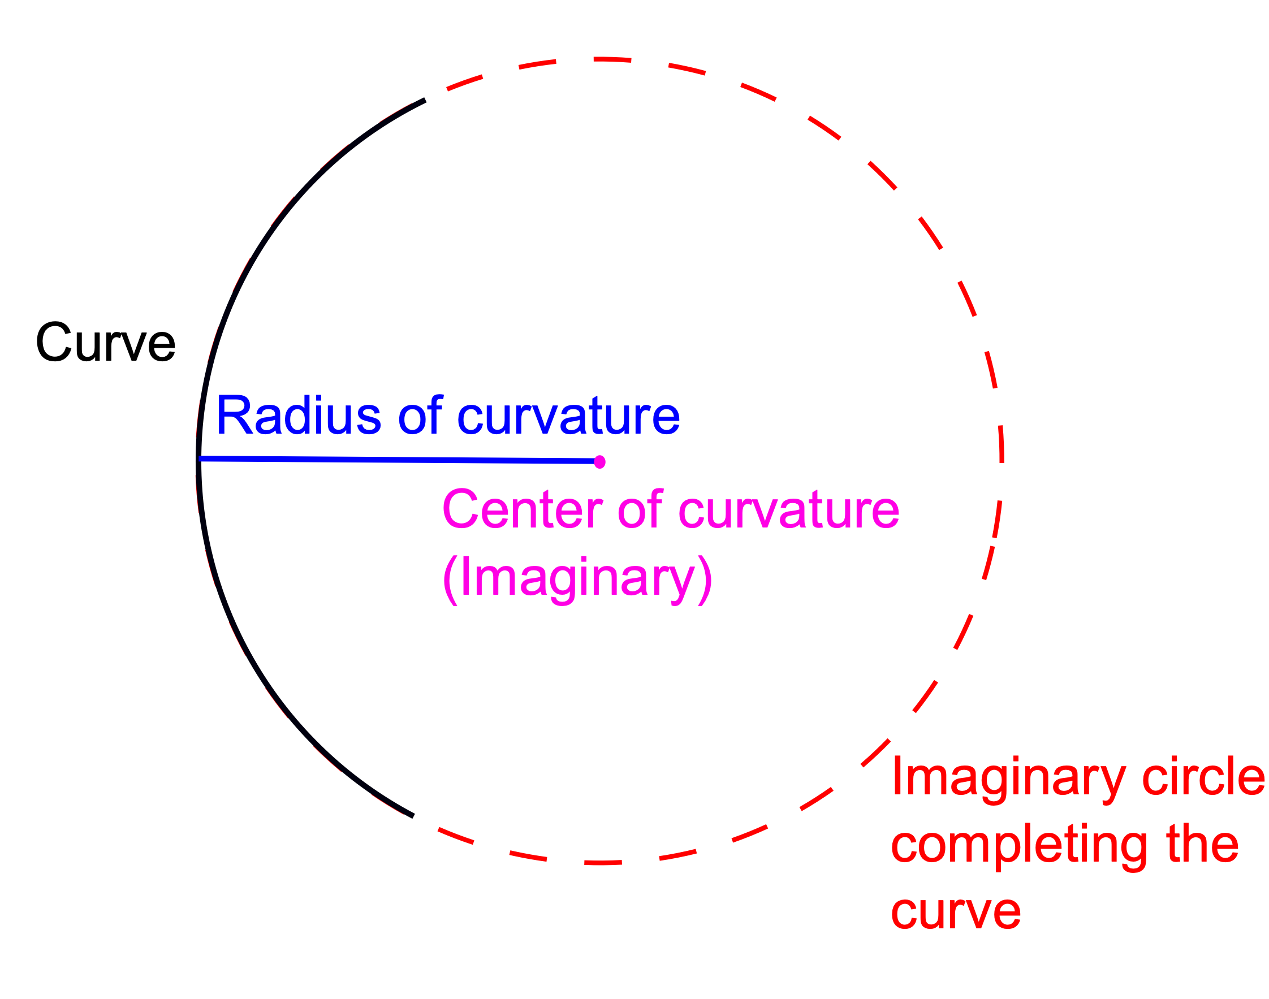
Radius of Curvature of Trajectories
trajectory
R_{T}

Slide 19
Can Understand the Qualitative Effects of the Centrifugal Force
Vgrad
Because Ce helps balance Pn, Co doesn’t have to be as large. Since Co= fV, then V does not have to be as large
Around a low or
trough
Vgeo
L
Co
P_{n}
Ce
P_{n} = Ce + Co
Thus, |Vgrad) < |Vgeo|
Wind are subgeostrophic in low and troughs
Pressure gradient force = Centrifugal force + Coriolis force

Slide 20
Opposite around Highs and Ridges
Because Ce supports P_{n}, Co has to be larges. Since Co= fV, then V needs to be larger
Around a low or
trough
H
Ce
Co
P_{n}
Vgeo
Vgrad
P_{n} + Ce = Co
Thus, |Vgrad) > |Vgeo|
Wind are supergeostrophic in low and troughs
Pressure gradient force = Centrifugal force + Coriolis force

Slide 21
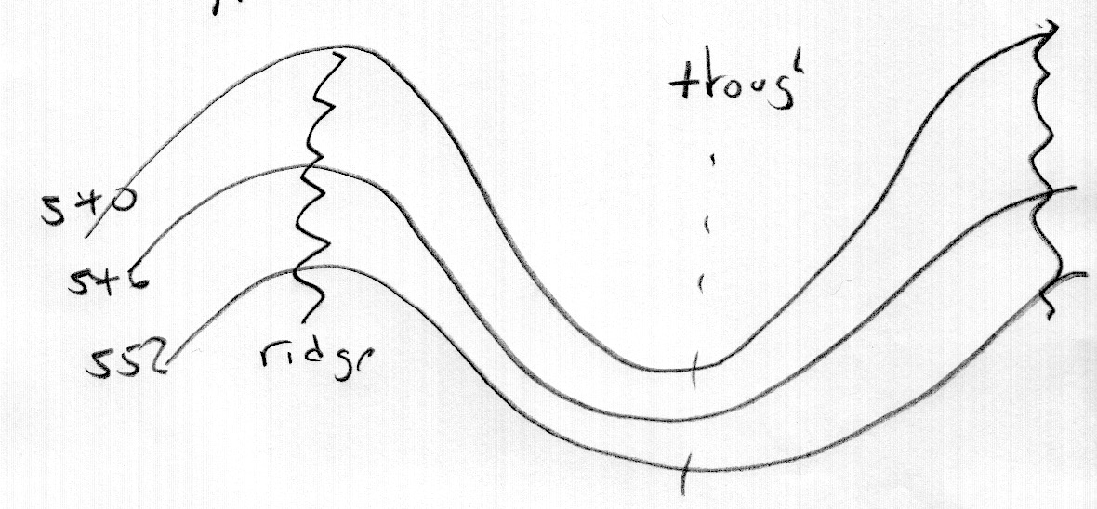
Explains an Interesting Phenomenon
Similar wind speed
Similar wind speed
supergeostrophic
subgeostrophic

Slide 22
Observed wind speeds in sharp troughs with high winds can be as much as 50% subgeostrophic, although most troughs are less.
Next I will show you a series of plots of heights, plus the ageostrophic wind vector.
Ageostrophic wind vector is the vector difference between the actual wind and the geostrophic wind

Slide 23
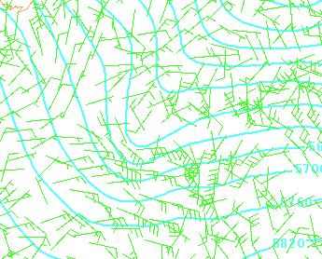

Slide 24
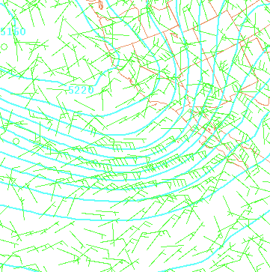

Slide 25
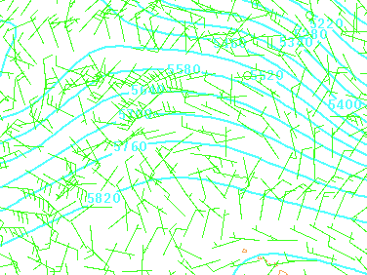

Slide 26
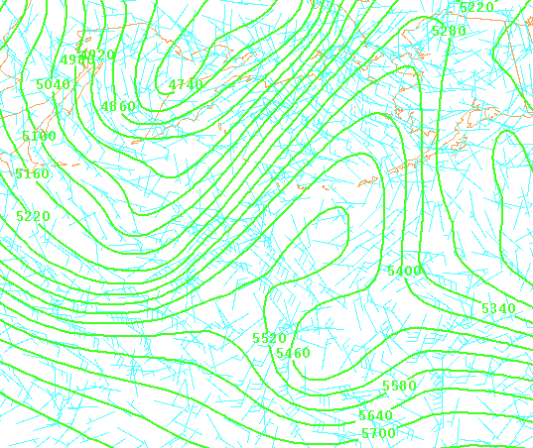

Slide 27
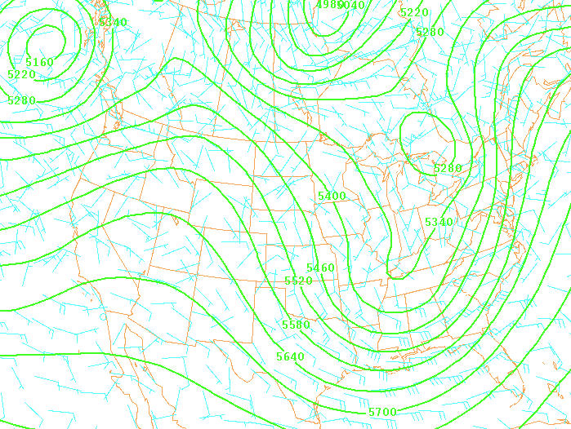

Slide 28
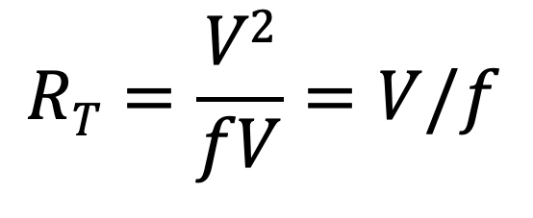
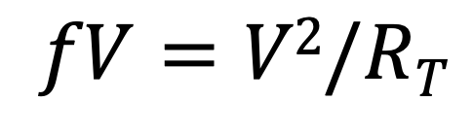
Inertial Wind Balance Coriolis Force Balanced by Centrifugal force in an environment with pressure gradient is weak or absent
$fV=V2/RT$
Coriolis Centrifugal
$$RT=\frac{V2}{fV}=V/f$$
Thus, one ends up with curved trajectories, whose radius of curvature depends on wind speed and latitude

Slide 29
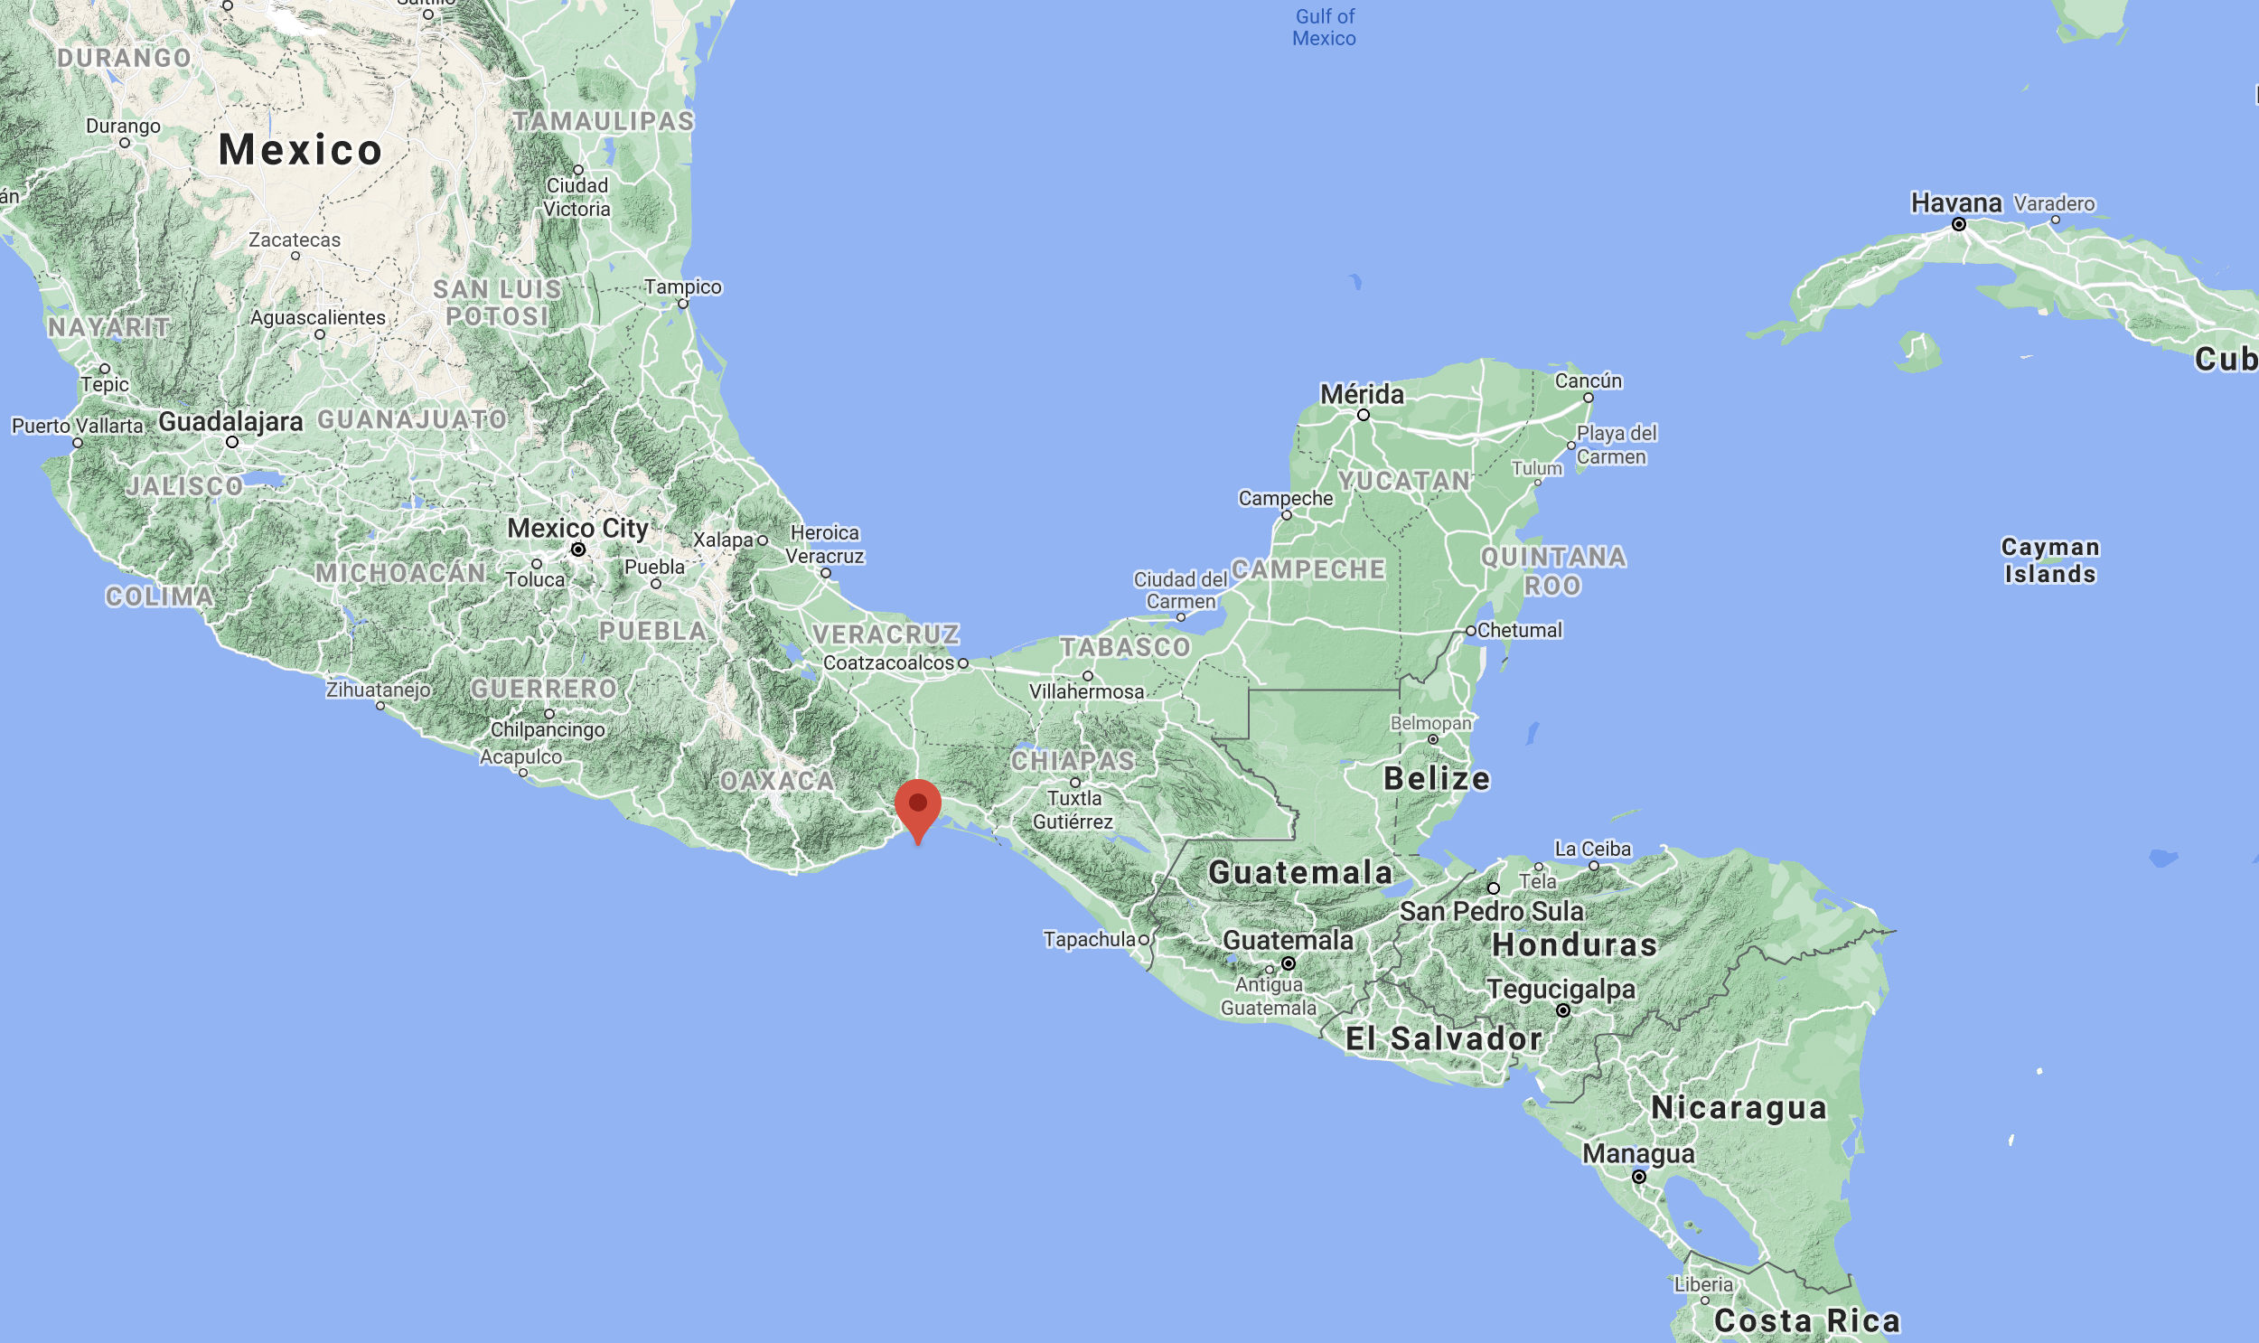
Inertial Wind Balance
Sometimes evident when flow escapes from a gap into the open ocean.
IW balance is only strictly followed at the center of the flow exiting the gap (there is often a pressure gradient on the side of the jet)
Great example: The Gulf of Tehuantepec

Slide 30
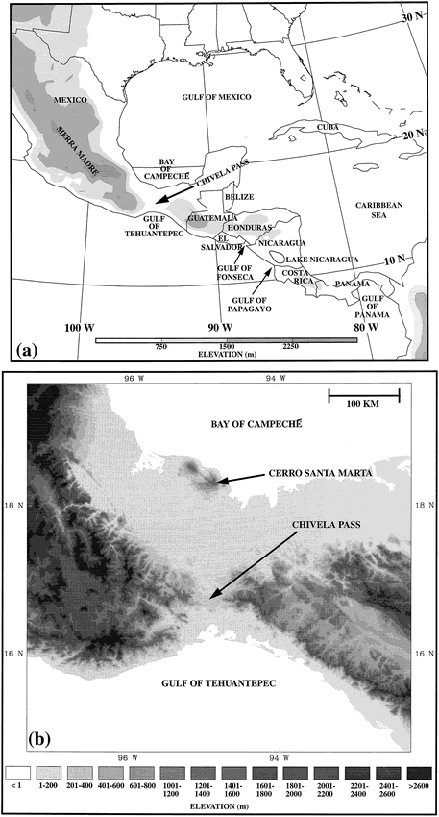
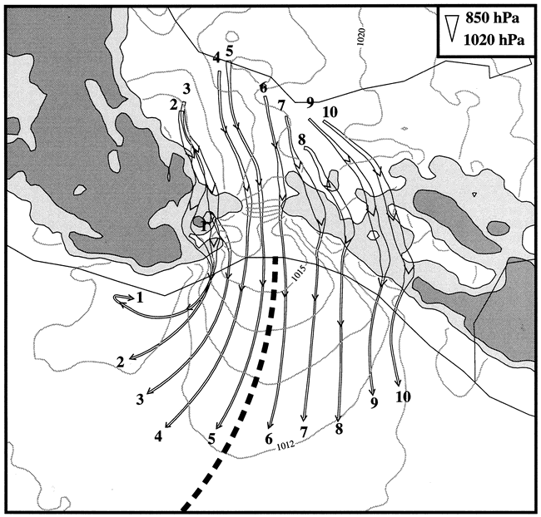

Slide 31
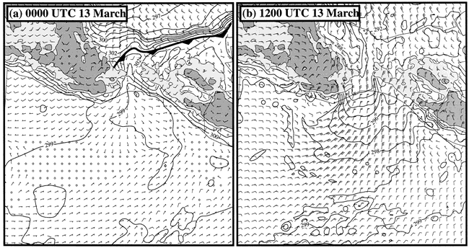
Model Simulation

Slide 32
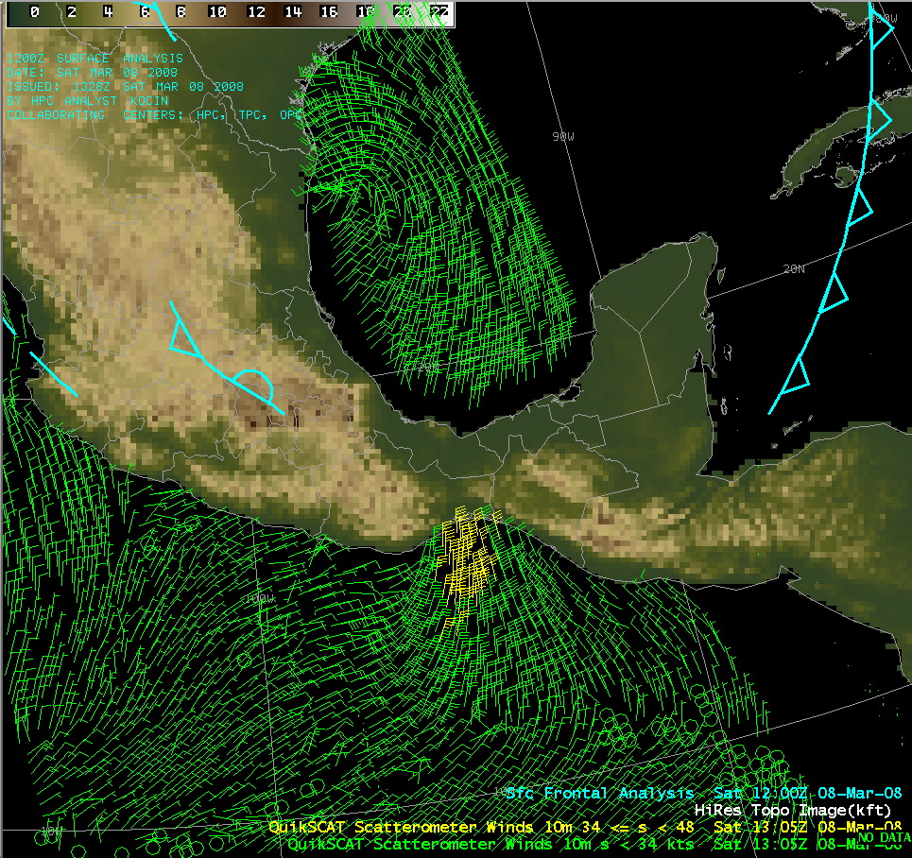
Observations Scatterometer Winds

Slide 33
Surface drag or friction

Slide 34
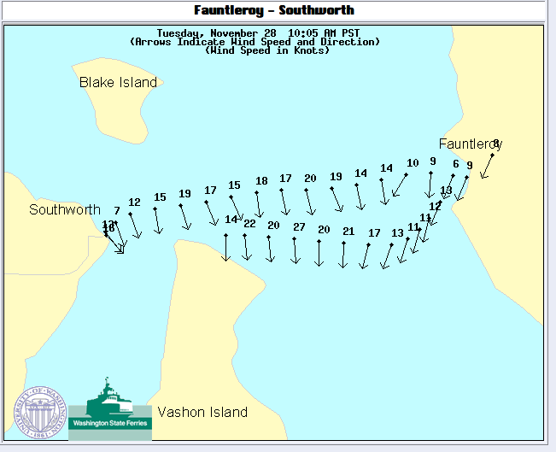

Slide 35
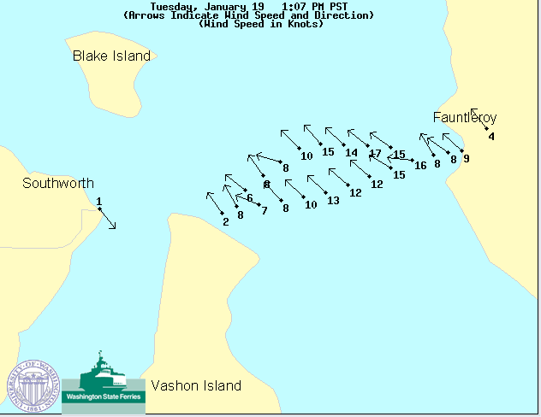

Slide 36
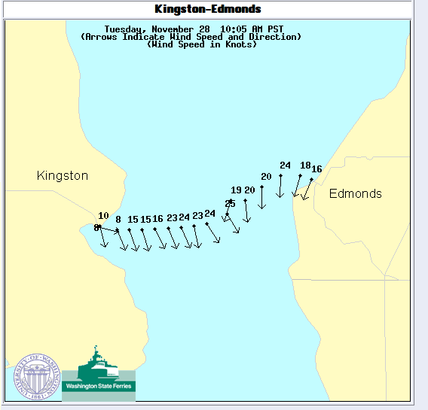

Slide 37
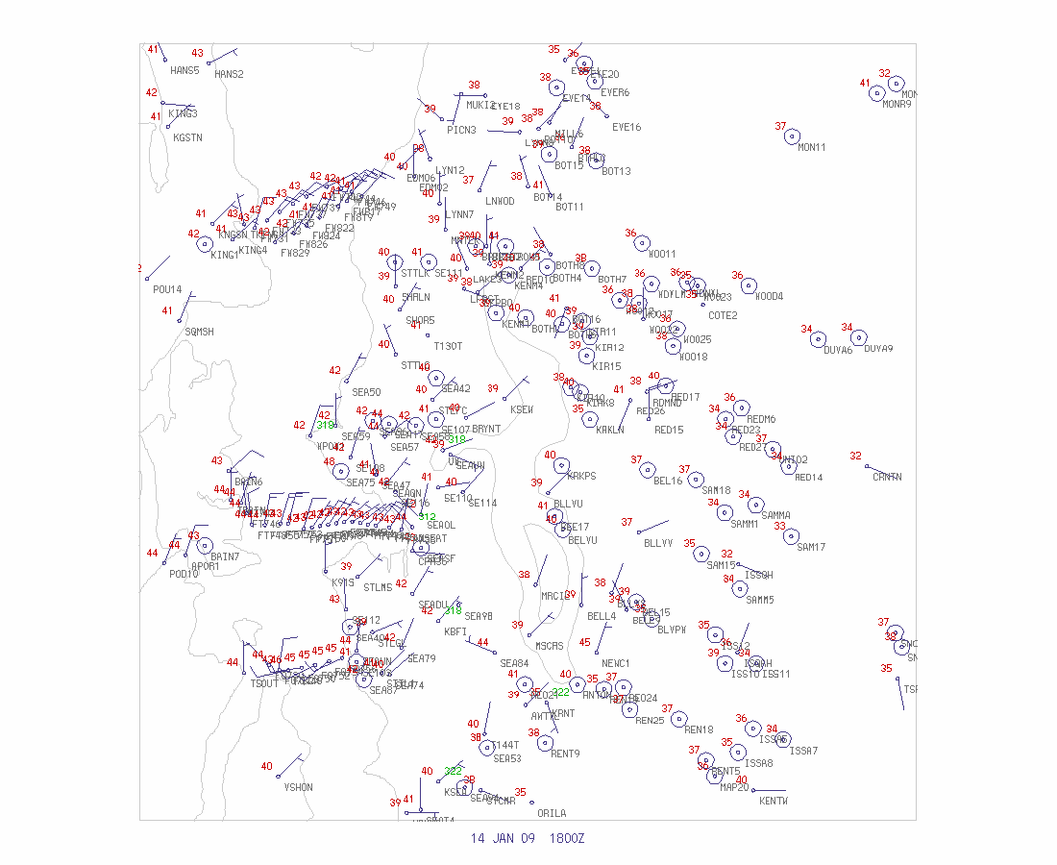

Slide 38
Terrain Effects

Slide 39
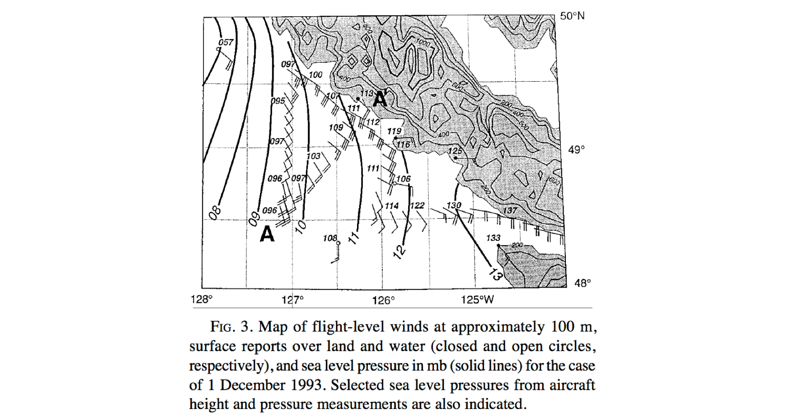

Slide 40
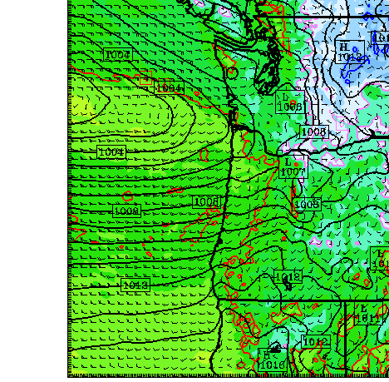

Slide 41
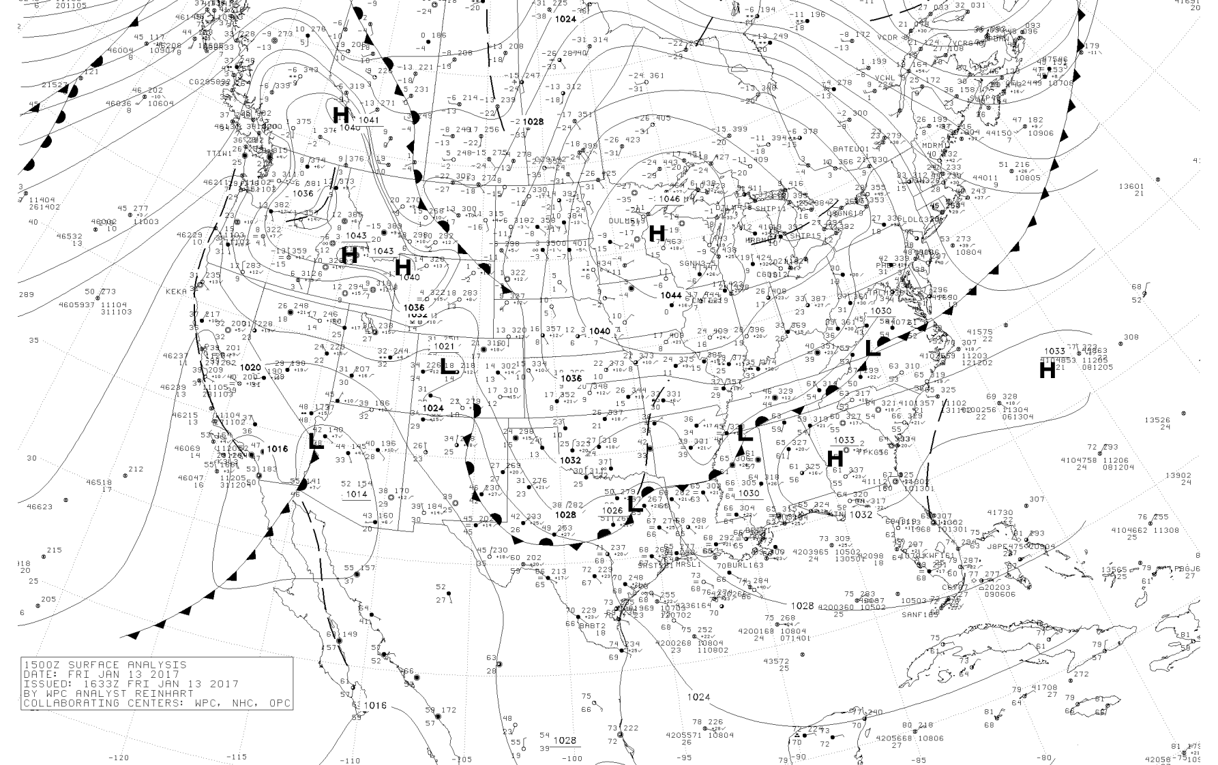

Slide 42
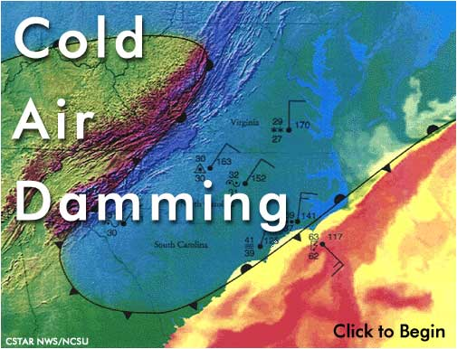
Cold Air Damming

Slide 43
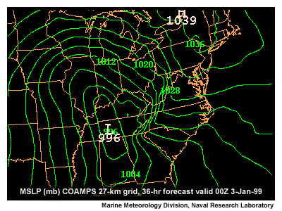

Slide 44
Cold Air Damming
Found around the world, where there is stable flow interacting with terrain.
Dependent on a semi-geostrophic balance. Geostrophic in one direction and ageostrophic in another.

Slide 46
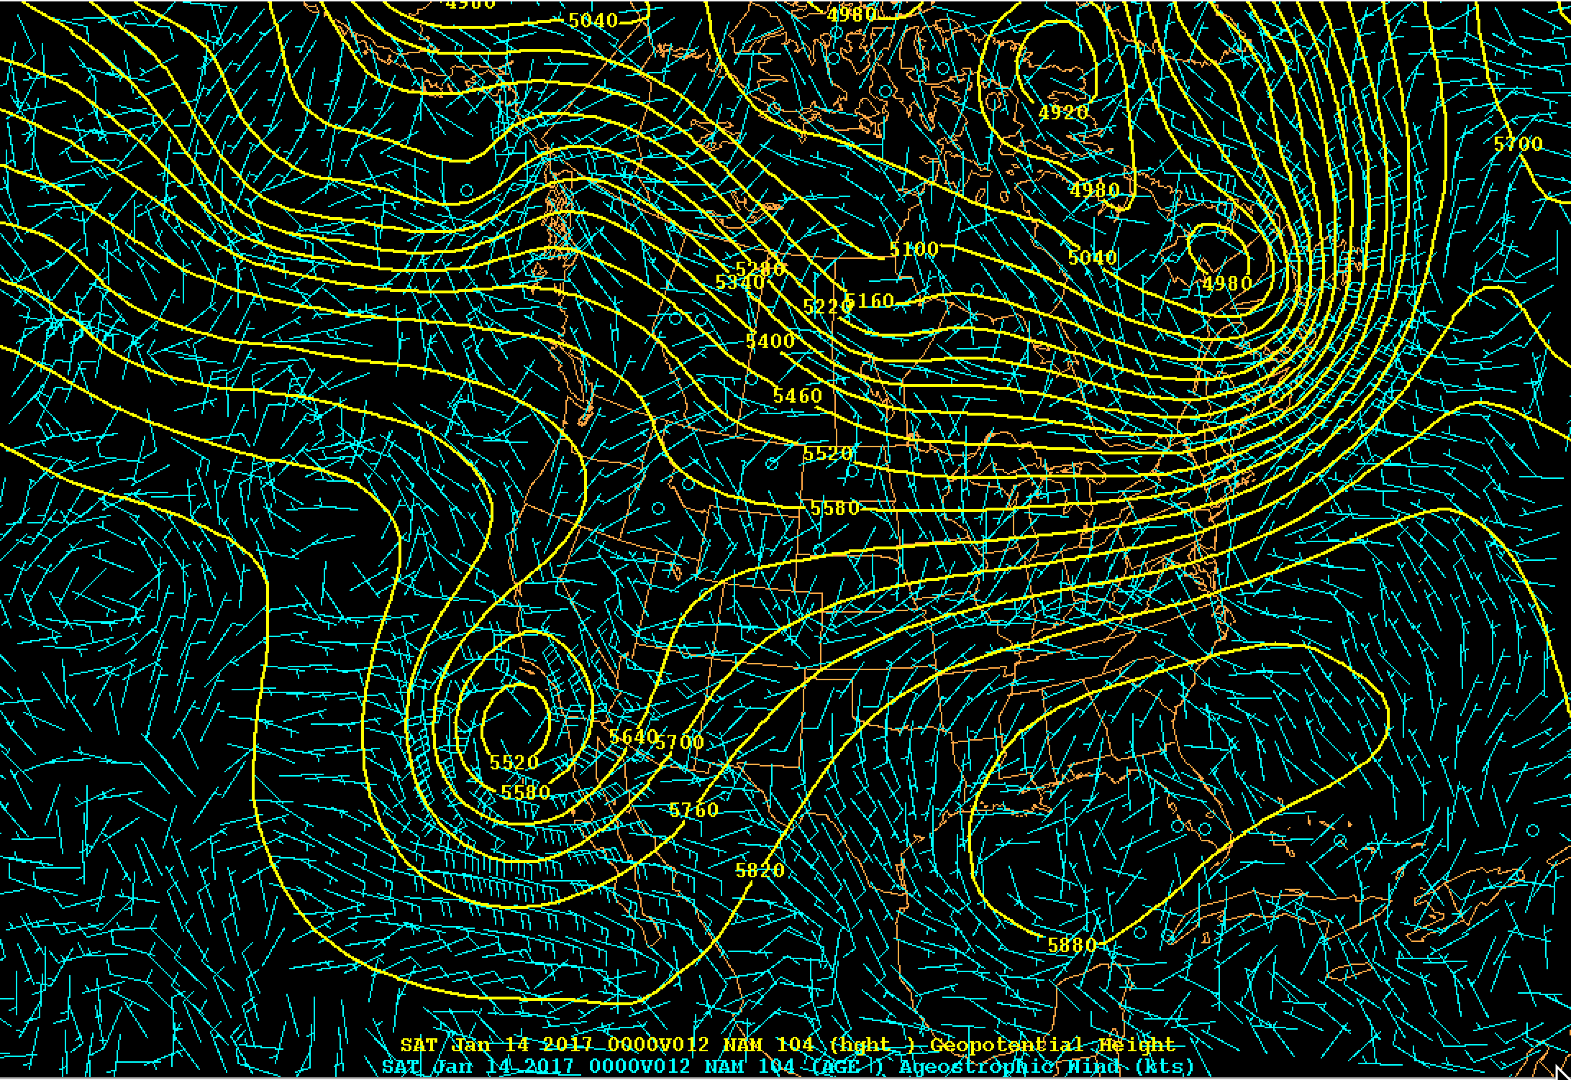

Slide 47
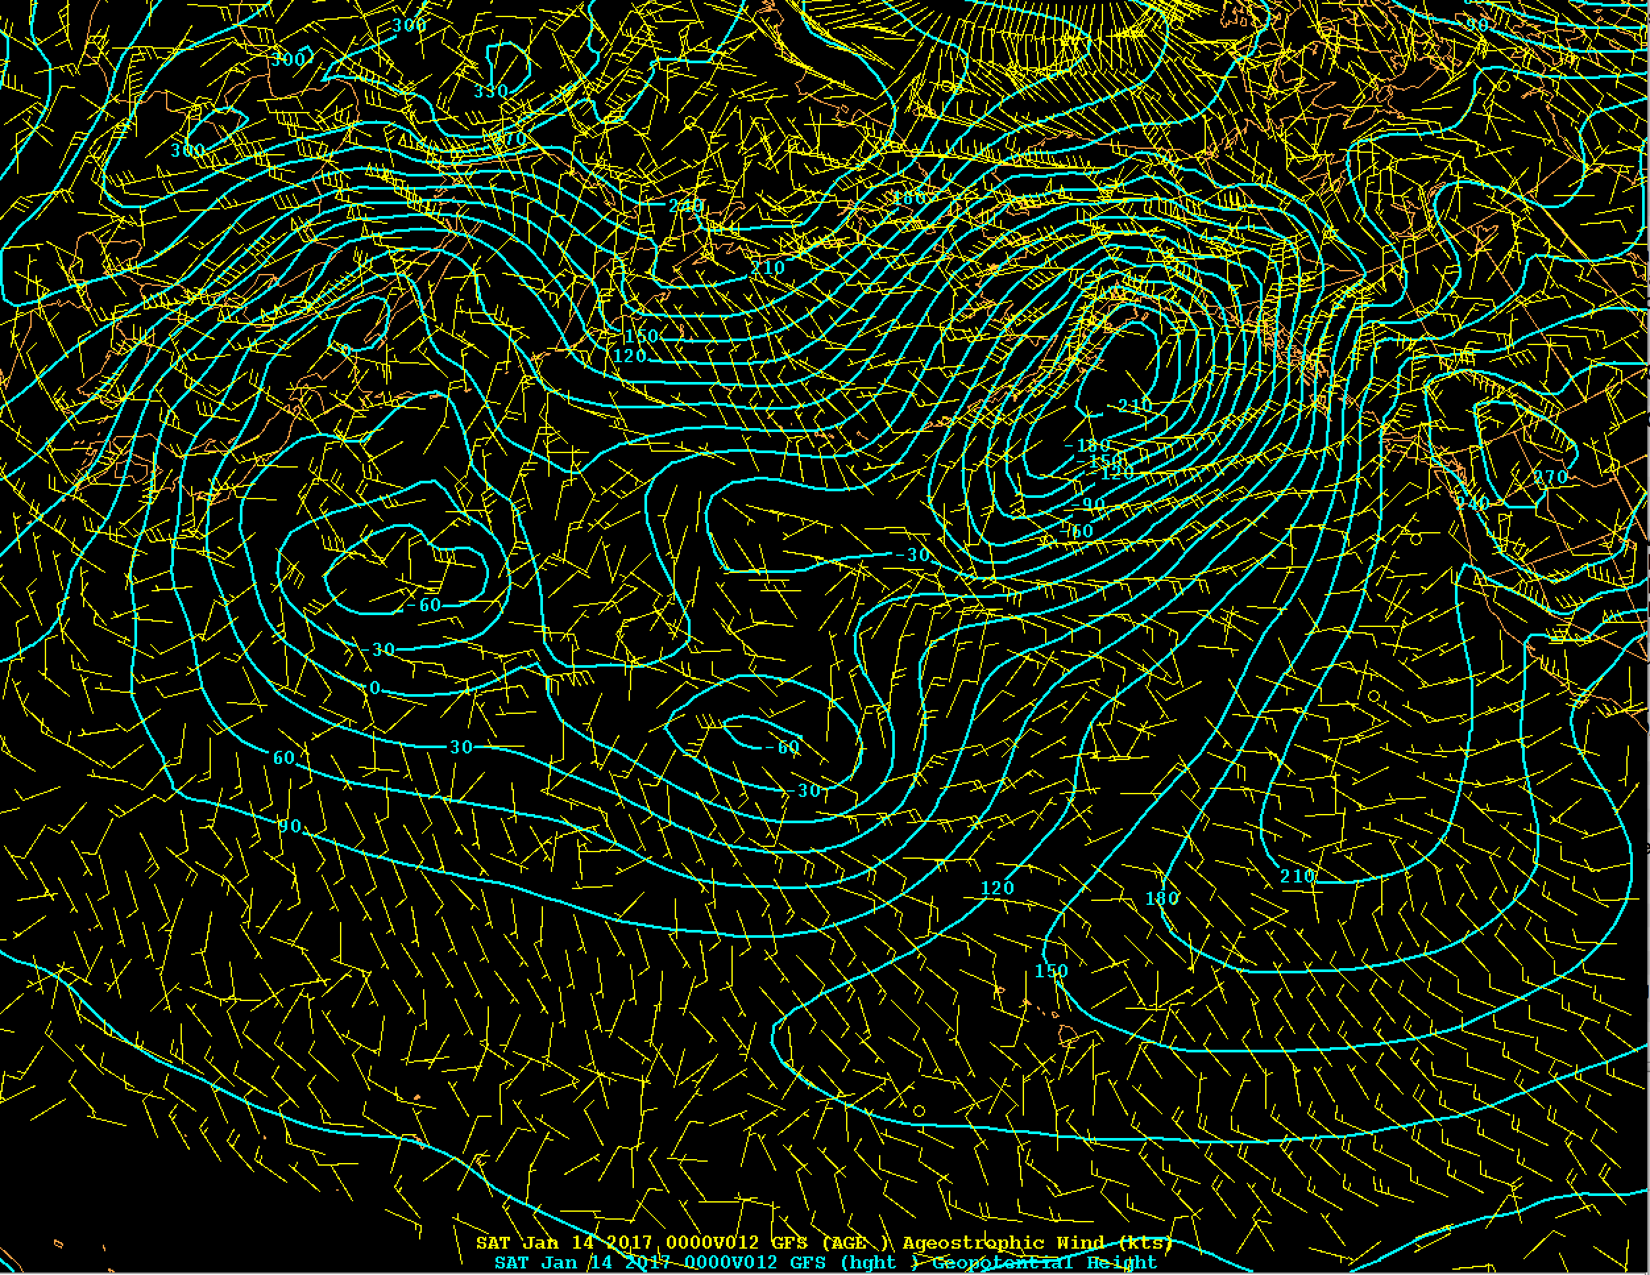
1000 hPa

