Slide 1
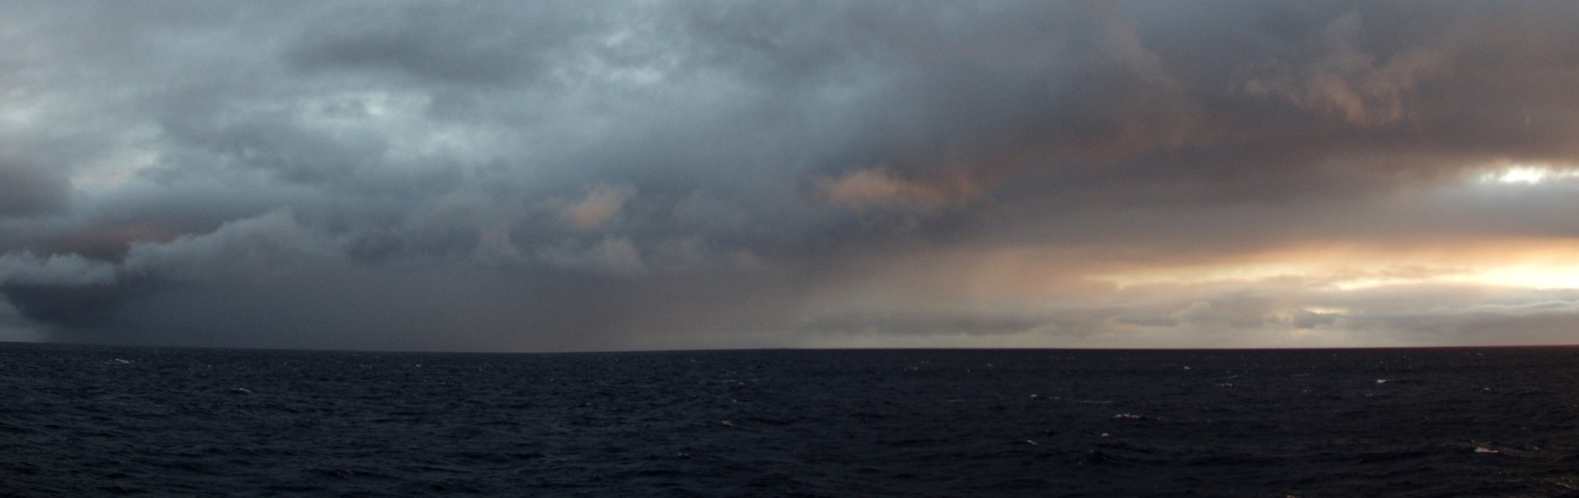
Warm rain and climate:
VOCALS, CloudSat, Models
Robert Wood
University of Washington

Slide 2
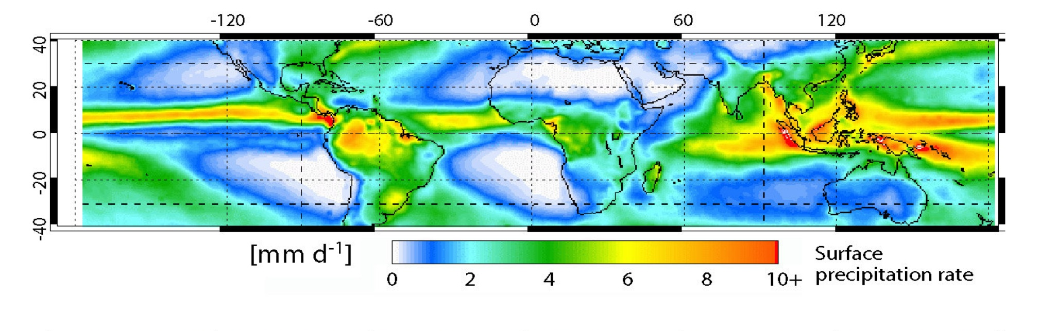
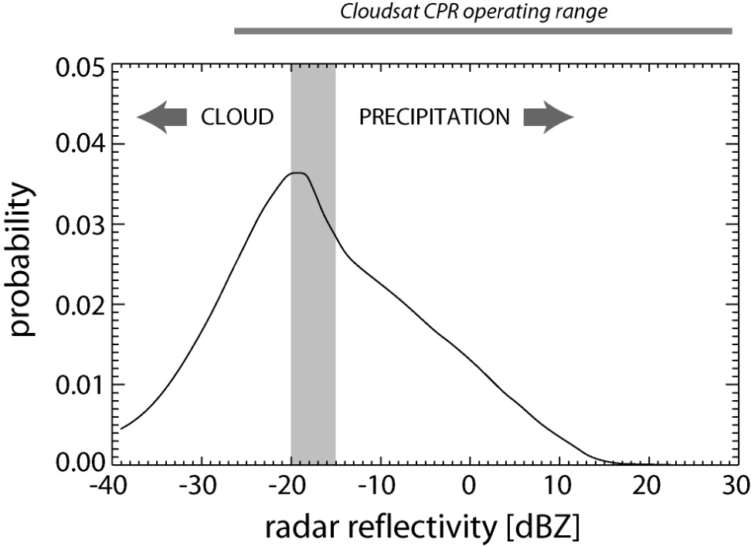
Warm rain – a missing climatology
Image: NASA GSFC
Shipboard remote-sensing shows frequent precipitation from shallow clouds
Many echoes below detection limit of current satellite sensors (passive or active)
TRMM PR

Slide 3
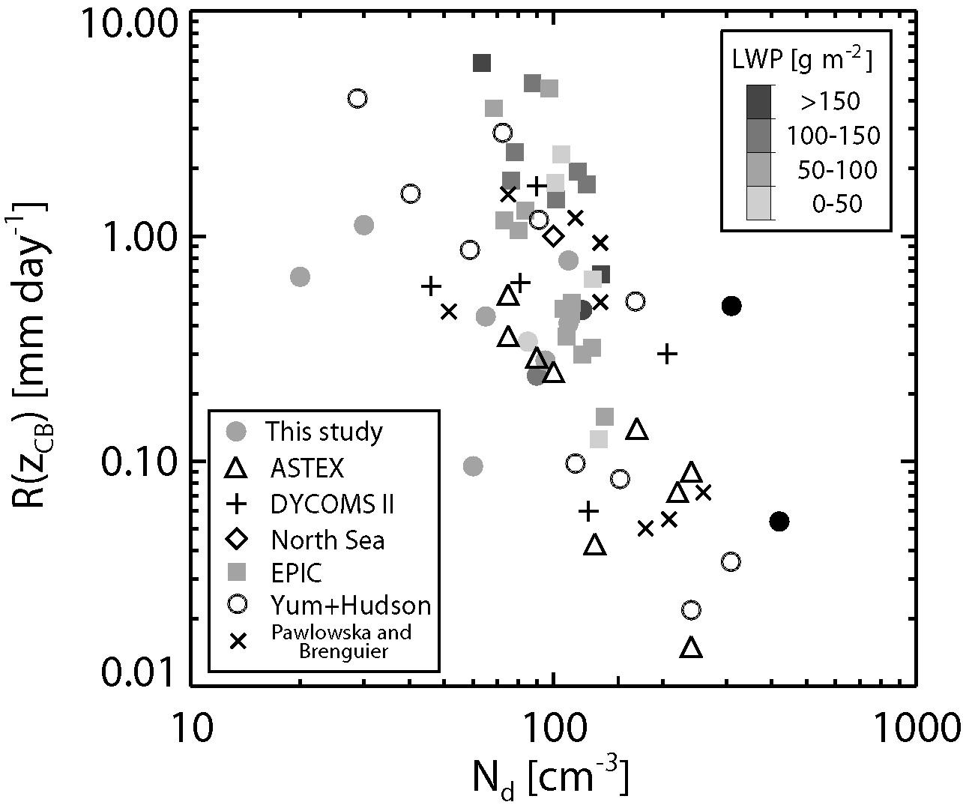
Warm rain – macrophysical vs microphysical control
In shallow stratocumulus-topped MBLs (z_{i} < 1500 m) recent studies indicate a dependence of drizzle rate upon cloud droplet concentration (see right)
In deeper trade wind boundary layers no definitive relationship between precipitation rate and microphysics has been observed (e.g. Nuijens et al. 2009)
Cloudbase drizzle rate
[mm d⁻¹]
Cloud droplet conc. N_{d} [cm⁻³]
R. Wood, J. Atmos. Sci. (2005)

Slide 4
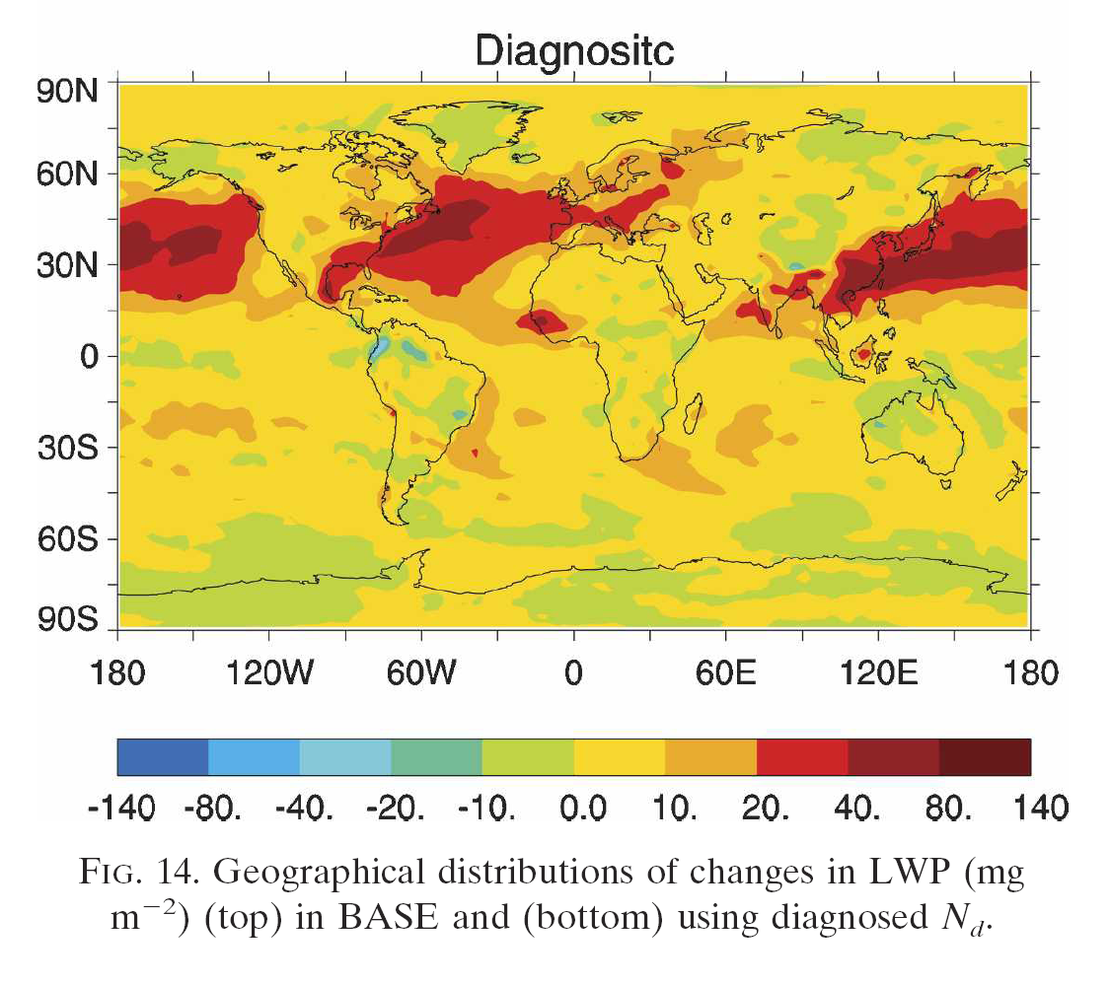
Warm rain – why do we care?
GCMs estimate that:
1st AIE: -0.5 to -1.9 W m⁻²
2nd AIE: -0.3 to -1.4 W m⁻²
Lohmann and Feichter (2005)
Change in LWP [g m⁻²] estimated using the GFDL AM2: Ming et al. (2008)
Warm rain rate and its sensitivity to aerosols/microphysics is important and unknown

Slide 5
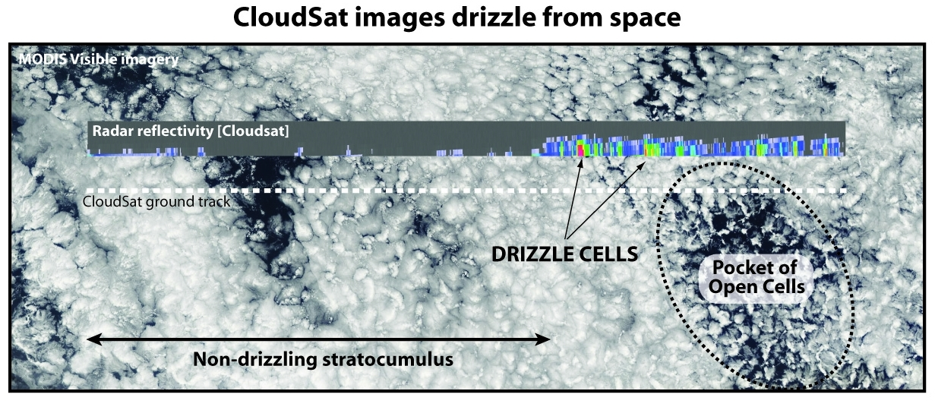
CloudSat now observes drizzle
SE Pacific

Slide 6
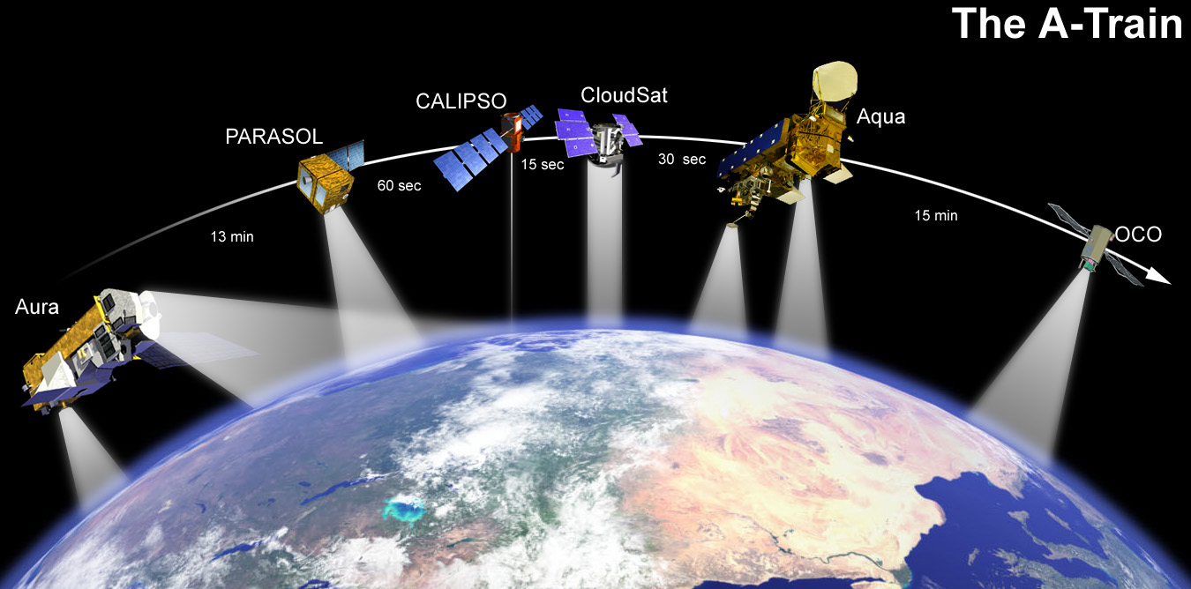
Data/Methods
Collocated CloudSat and Aqua-MODIS data:
  Daytime data only (∼13:30 local)
  Warm clouds
MODIS used to estimate LWP and N_{d}:
  N_{d} using method of Bennartz (2007), assuming adiabatic vertical cloud profile
CloudSat used to determine maximum Z in column. Classify > -15 dBZ as precipitating.
The A-Train

Slide 7
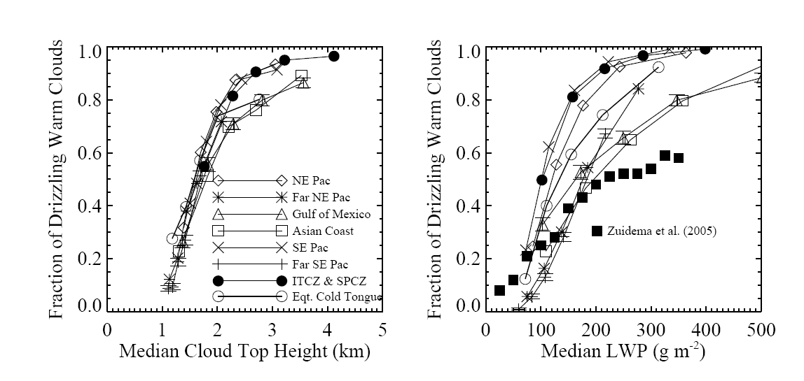
Fraction of clouds that are drizzling
(> -15 dBZ)
qualitatively consistent with Byers and Hall (1955)

Slide 8
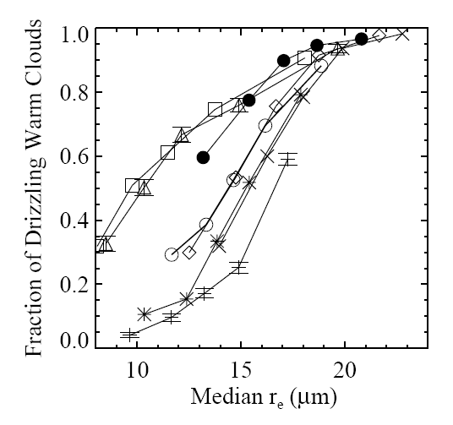
Effective radius not unique determinant of precipitation
decreasing LWP

Slide 9
Heuristic model
Goals:
  Attempt to reproduce salient features of A-Train data
  Minimal physics necessary
Continuous collection model:
  Given realistic assumed macro/micro-microphysical cloud structure, allow small fraction of largest cloud droplets at cloud top to fall through cloud collecting droplets (10 liter⁻¹ leads to Z-R consistent with obs.)
  Essential inputs are cloud liquid water path (LWP) and cloud droplet concentration (N_{d})
  Other free parameters constrained by observations

Slide 10
Model cloud structure
Subadiabatic to represent entrainment effects in precipitating trade-cumulus
Adiabaticity parameter f_{ad} decreases with height z above cloud base
f_{ad} ⁼ z₀/(z₀+z)
Adiabaticity height scale z₀=500 m (estimated from RICO observations)
Gives liquid water content as a function of height

Slide 11
Precipitation embryos
Assumed size distribution
(Gamma)
n(r)
Tail of distribution (10 liter⁻¹)
constitutes embryonic
precipitation drops
r
Gamma distribution of cloud drops determined from LWC at cloud top and cloud droplet concentration

Slide 12
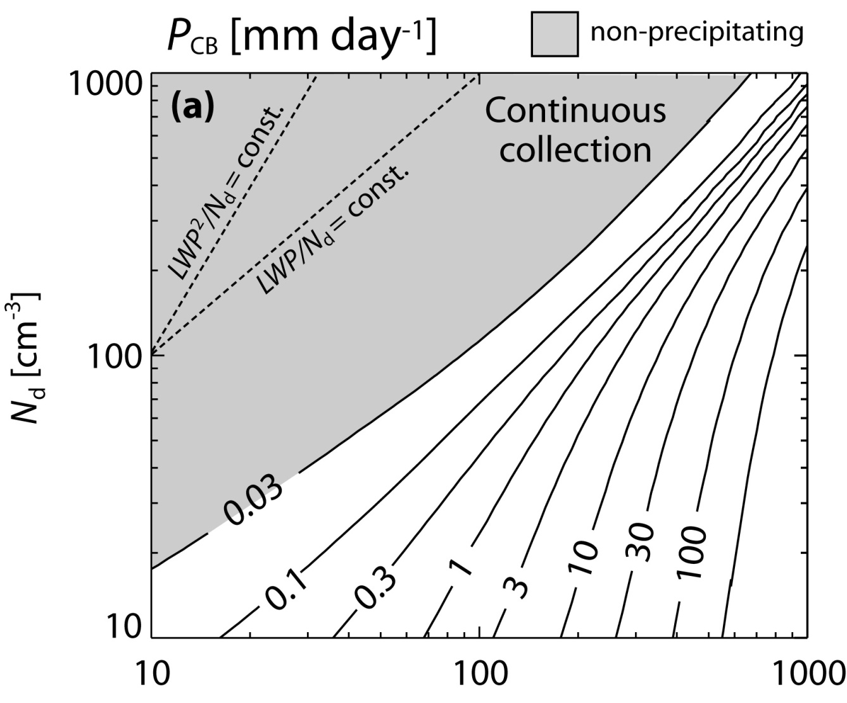
Microphysics vs macrophysics
Increasing relative importance of LWP over N_{d}
LWP [g m⁻²]

Slide 13
Rain rate-to-reflectivity (94 GHz)
Several steps need to be taken to compare model with CloudSat:
  Use model assumed precipitation DSD to determine radar reflectivity in Rayleigh limit
  Mie correction for 94 GHz reflectivity (Bohren-Huffman)
  Attenuate model 94 GHz reflectivity using two-way attenuation correction of 8.3 dBZ mm⁻¹ of cloud liquid water (Lhermitte 1990)

Slide 14
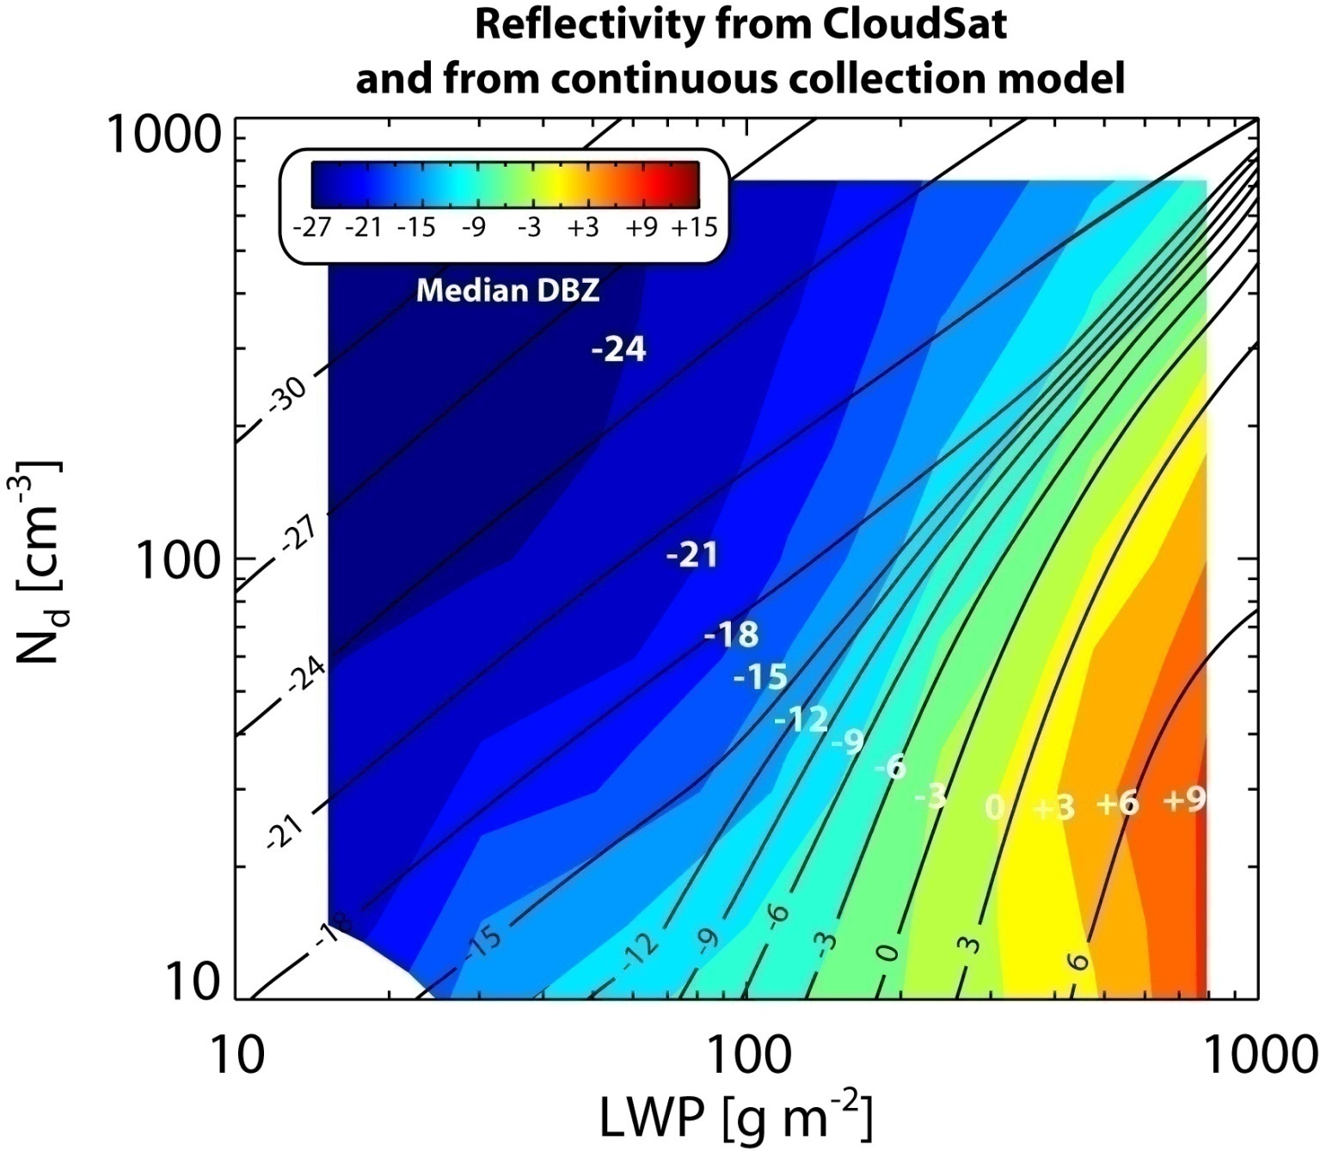
CloudSat: colors
Model: lines
Reflectivity
in [LWP, N_{d}]
space
Increasing relative importance of LWP over N_{d} at high rainrates
see also Suzuki and Stephens (2008)

Slide 15
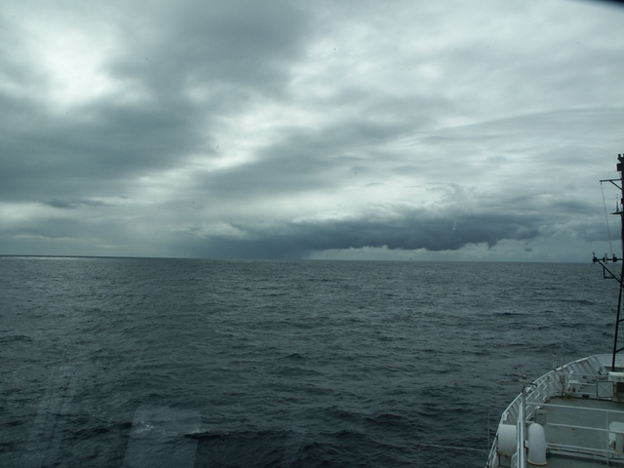
Warm rain, cloud structure and dynamics

Slide 16
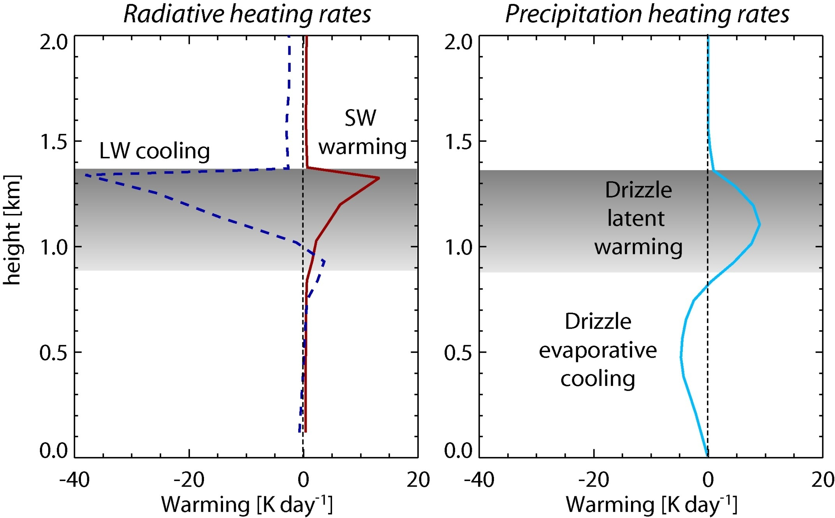
Drizzle affects MBL dynamics

Slide 17
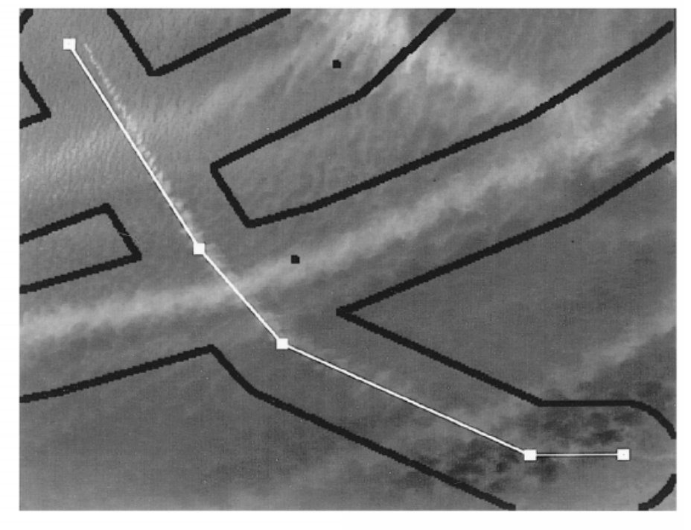
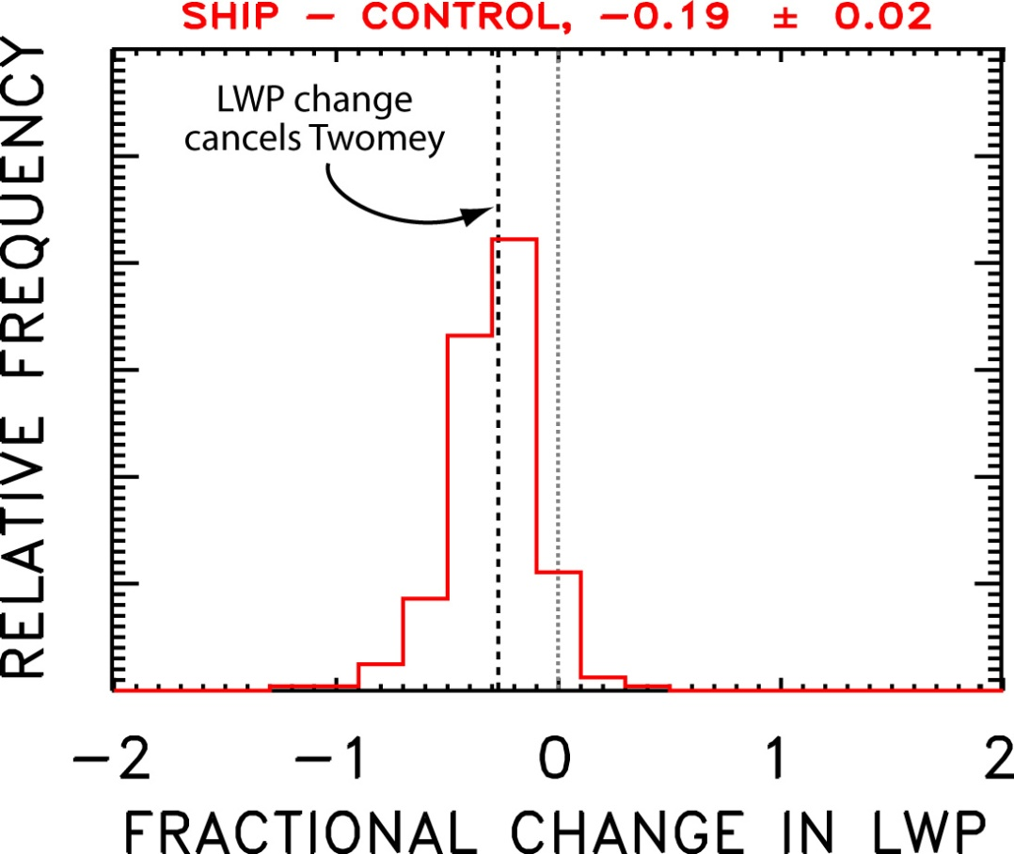
Shiptrack surprises!
3.7 μm
Liquid water content in shiptracks is typically reduced compared with surrounding cloud
Clear refutation of Albrecht’s hypothesis
courtesy Jim Coakley, see Coakley and Walsh (2002)

Slide 18
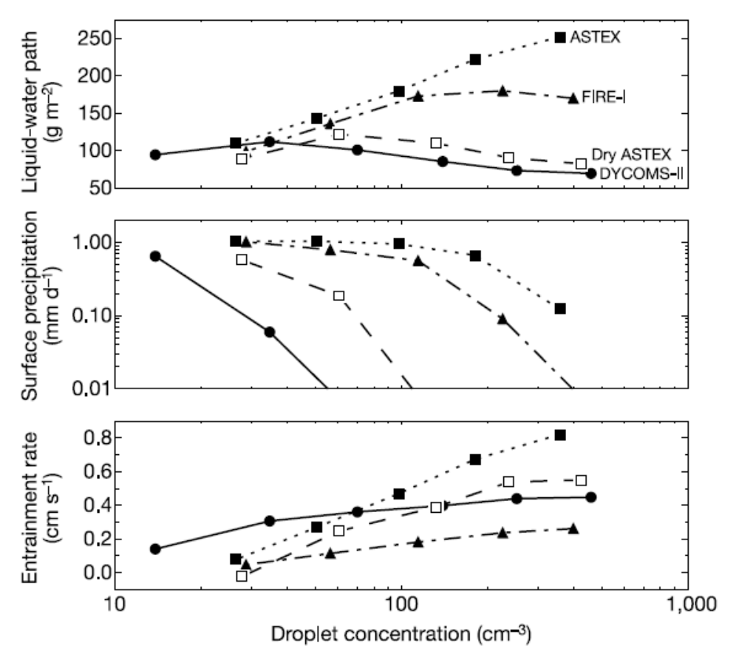
LES results
Ackerman et al. (2004)
Impact of aerosols simulated by varying N_{d}
Increased N_{d} ⇒ Reduced precipitation ⇒ increased TKE ⇒ increased entrainment w_{e}
Changes in w_{e} can sometimes result in cloud thinning (reduced LWP)
Also noted by Jiang et al. (2002)
LWP [g m-2]
P₀ [mm d-1]
w_{e} [cm s-1]
Cloud droplet concentration [cm-3]

Slide 19
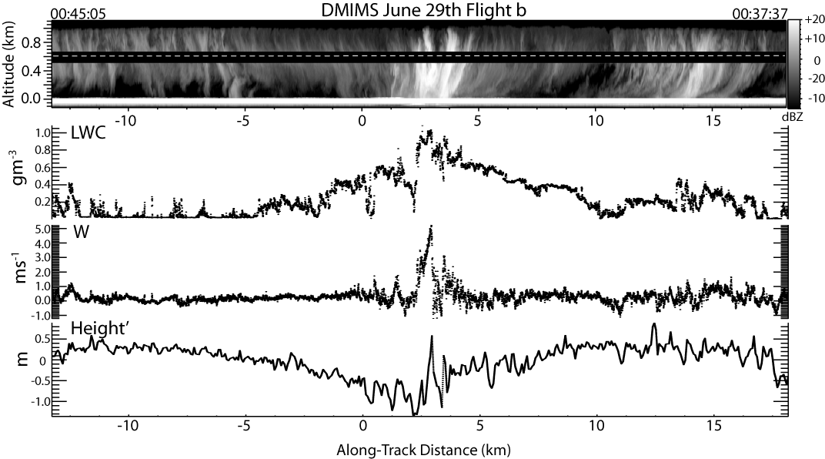
Drizzle and mesoscale cellularity
courtesy Dave Leon, U of Wyoming

Slide 20
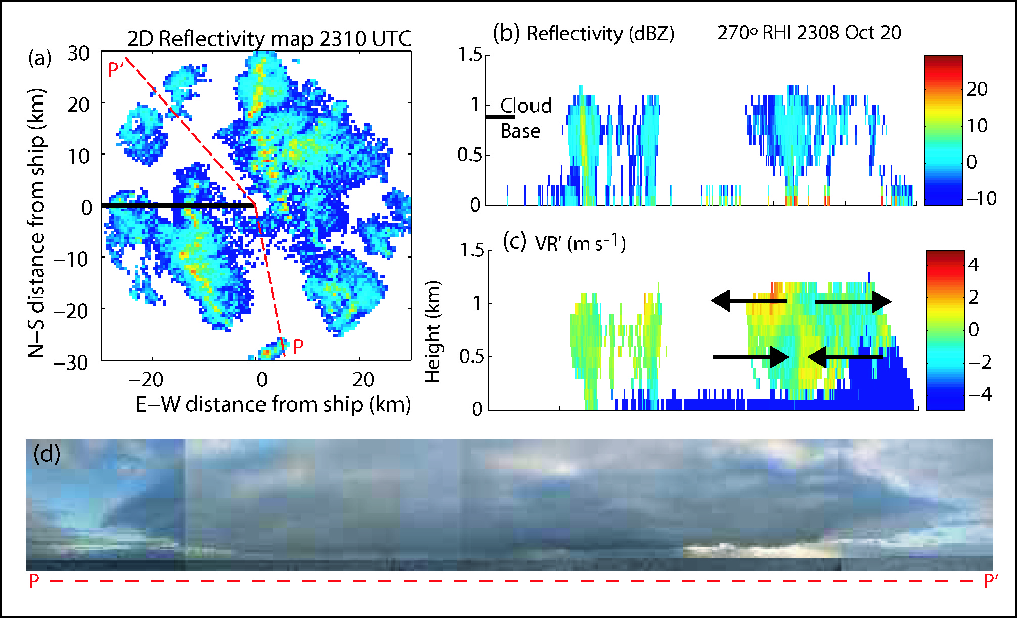
Drizzle and cellularity
Comstock et al. (2007, Mon Wea Rev)

Slide 21
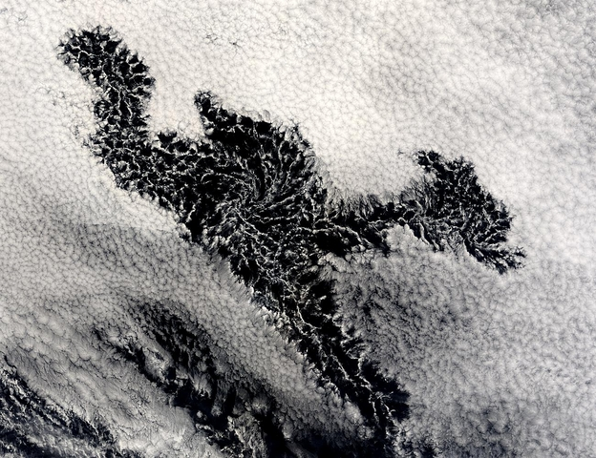
200 km
POCKETS of OPEN CELLS (POCs)
MODIS image courtesy of NASA

Slide 22
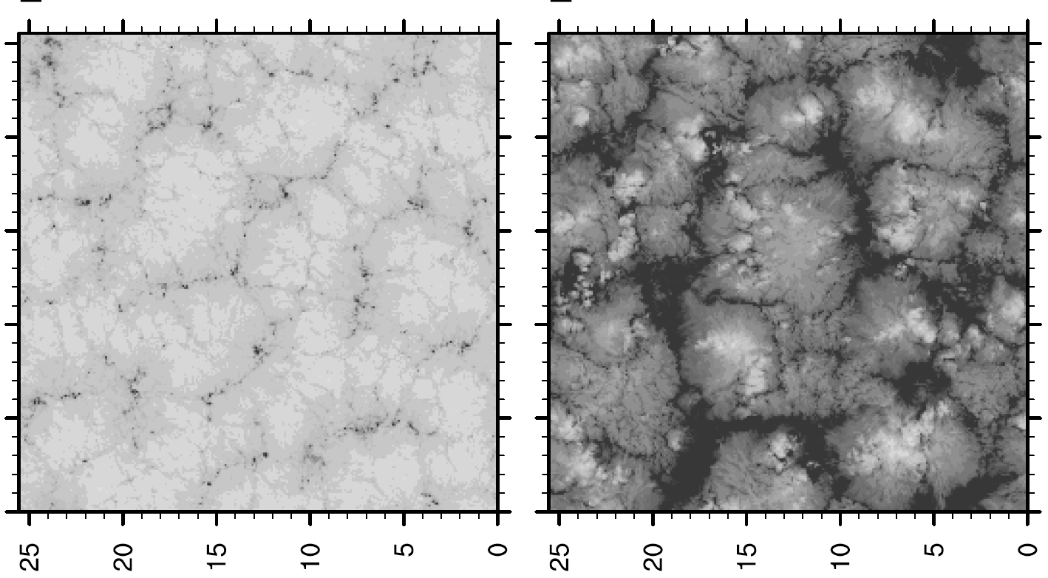
Drizzle and POCs
Drizzle can exert important forcing on the MBL
without drizzle with drizzle
Savic-Jovcic and Stevens (2007)

Slide 23
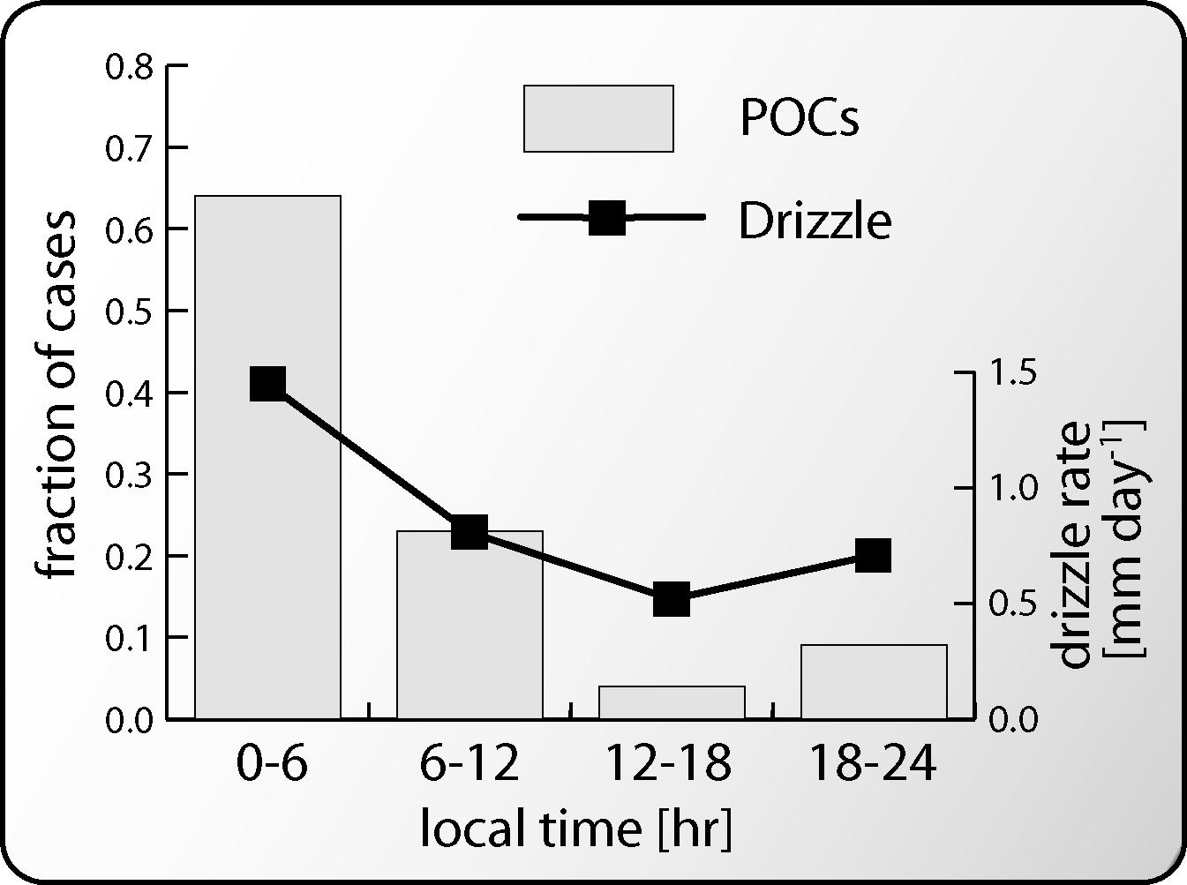
POCs prefer to form at night

Slide 24
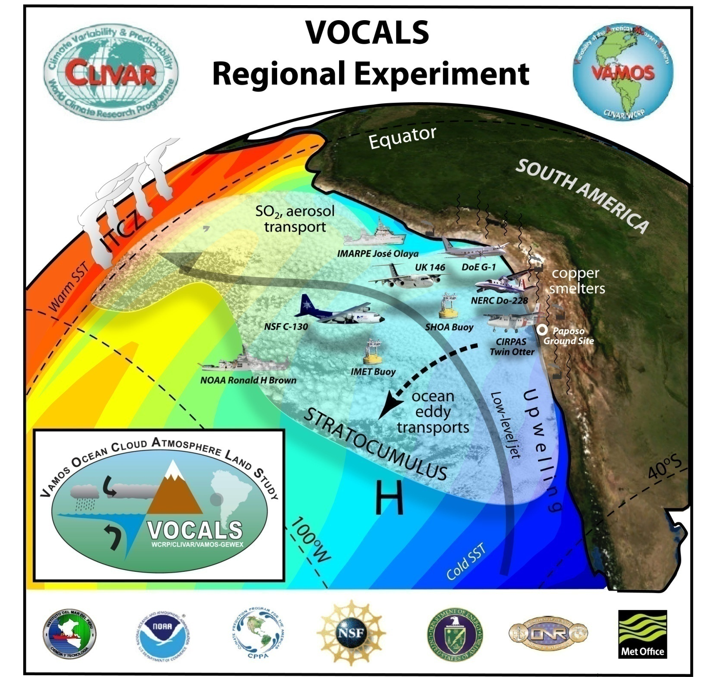
October-November 2008
SE Pacific

Slide 25

VOCALS Regional Experiment (REx)
VOCALS-Rex will collect datasets required to address a set of issues that are organized into two broad themes:
Aerosol-cloud-drizzle interactions in the marine boundary layer (MBL) and the physicochemical and spatiotemporal properties of aerosols
Chemical and physical couplings between the upper ocean, the land, and the atmosphere.

Slide 26
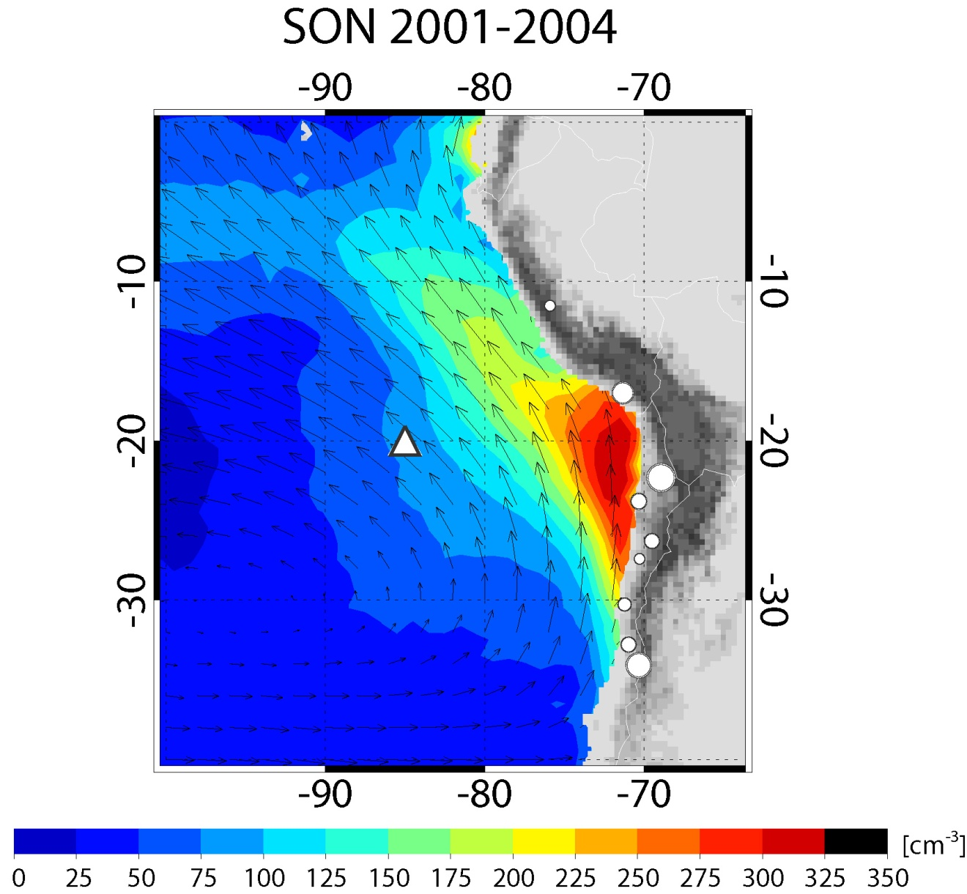
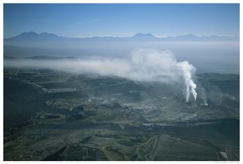
Aerosols and clouds
Chuquicamata, Chile
Cloud droplet concentration

Slide 27
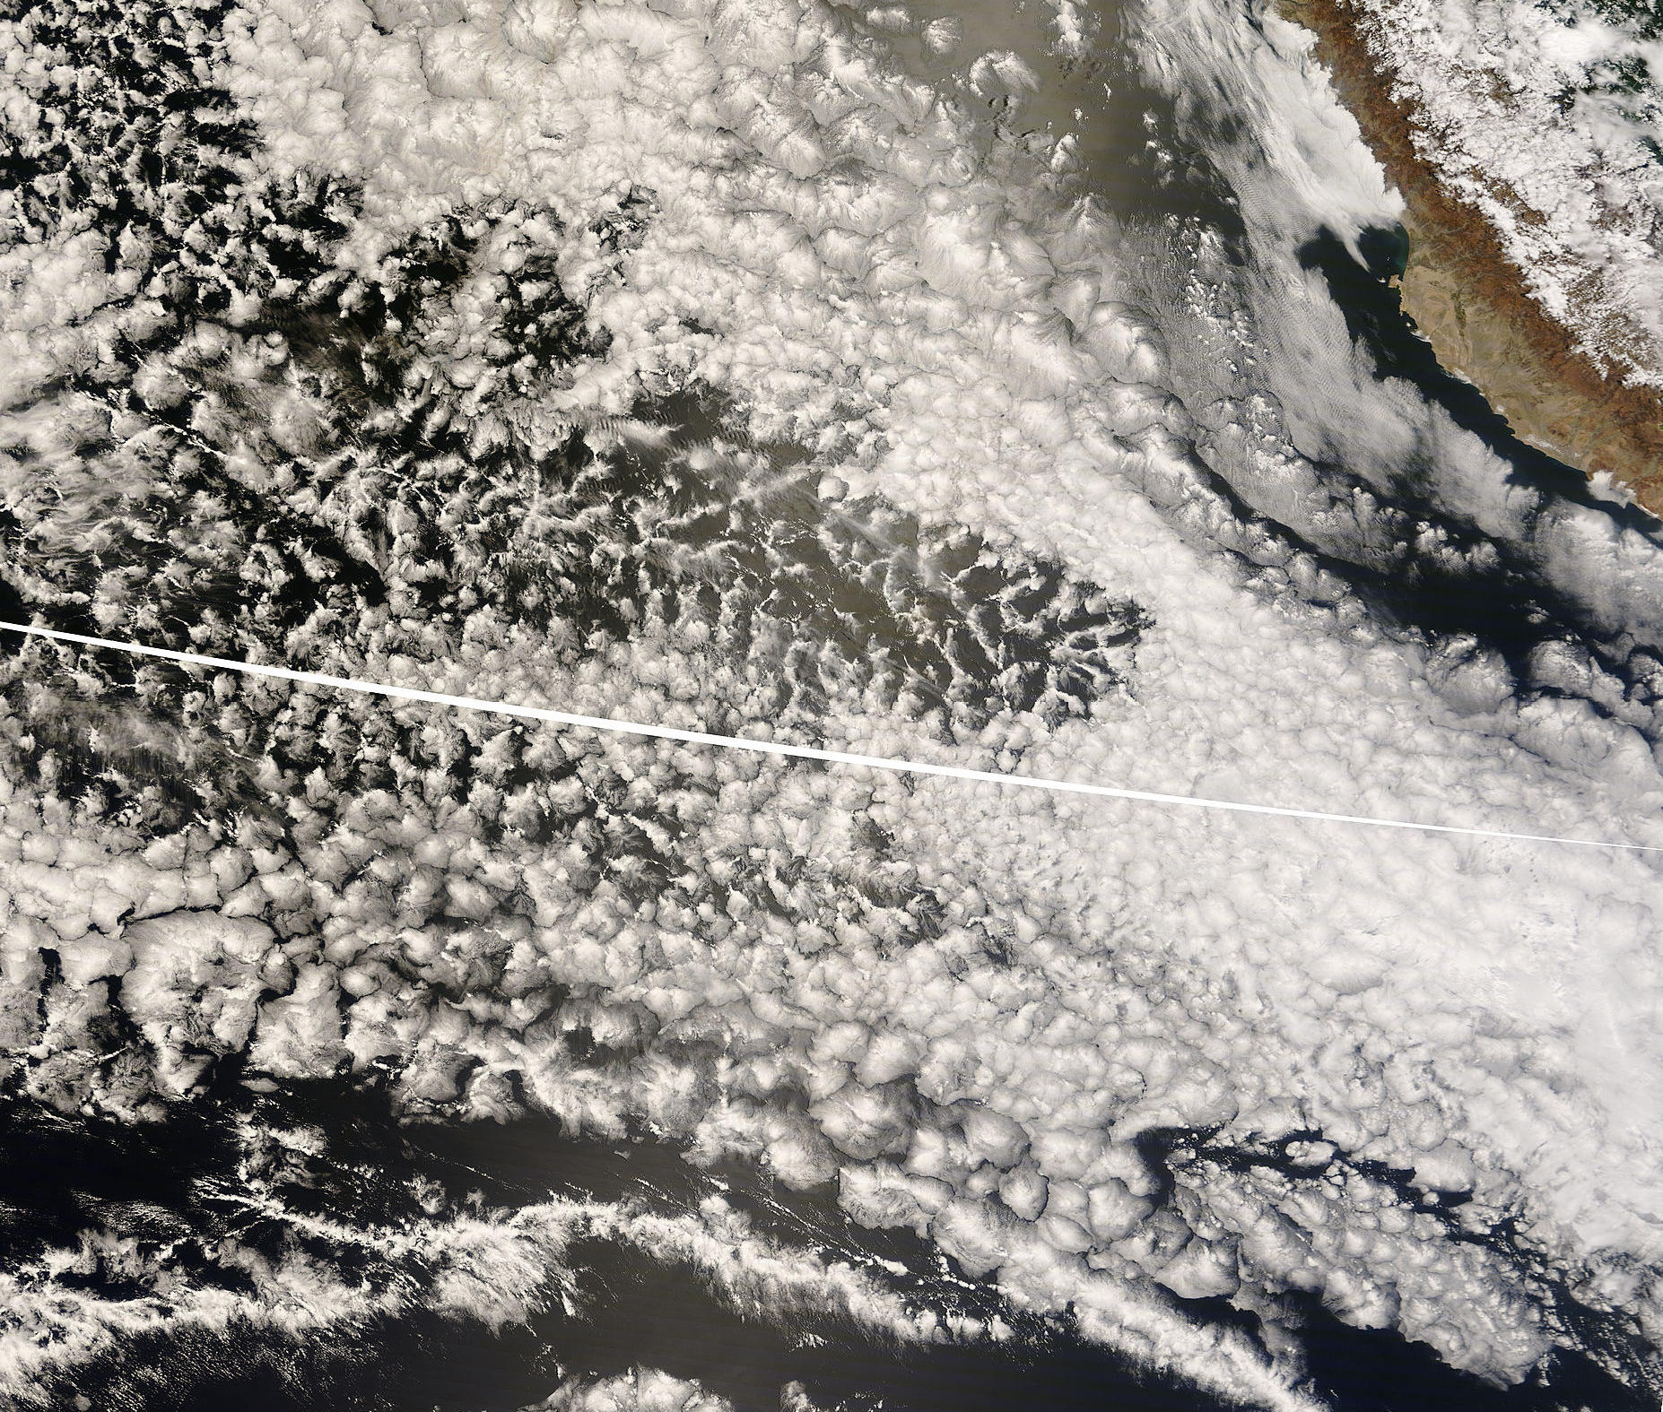
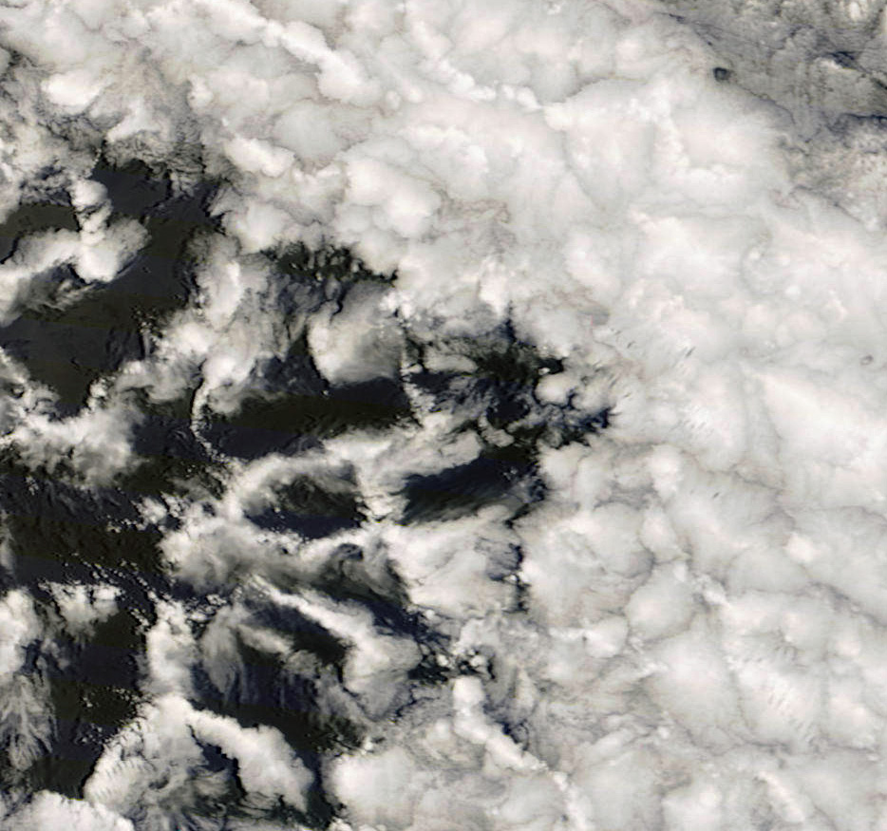
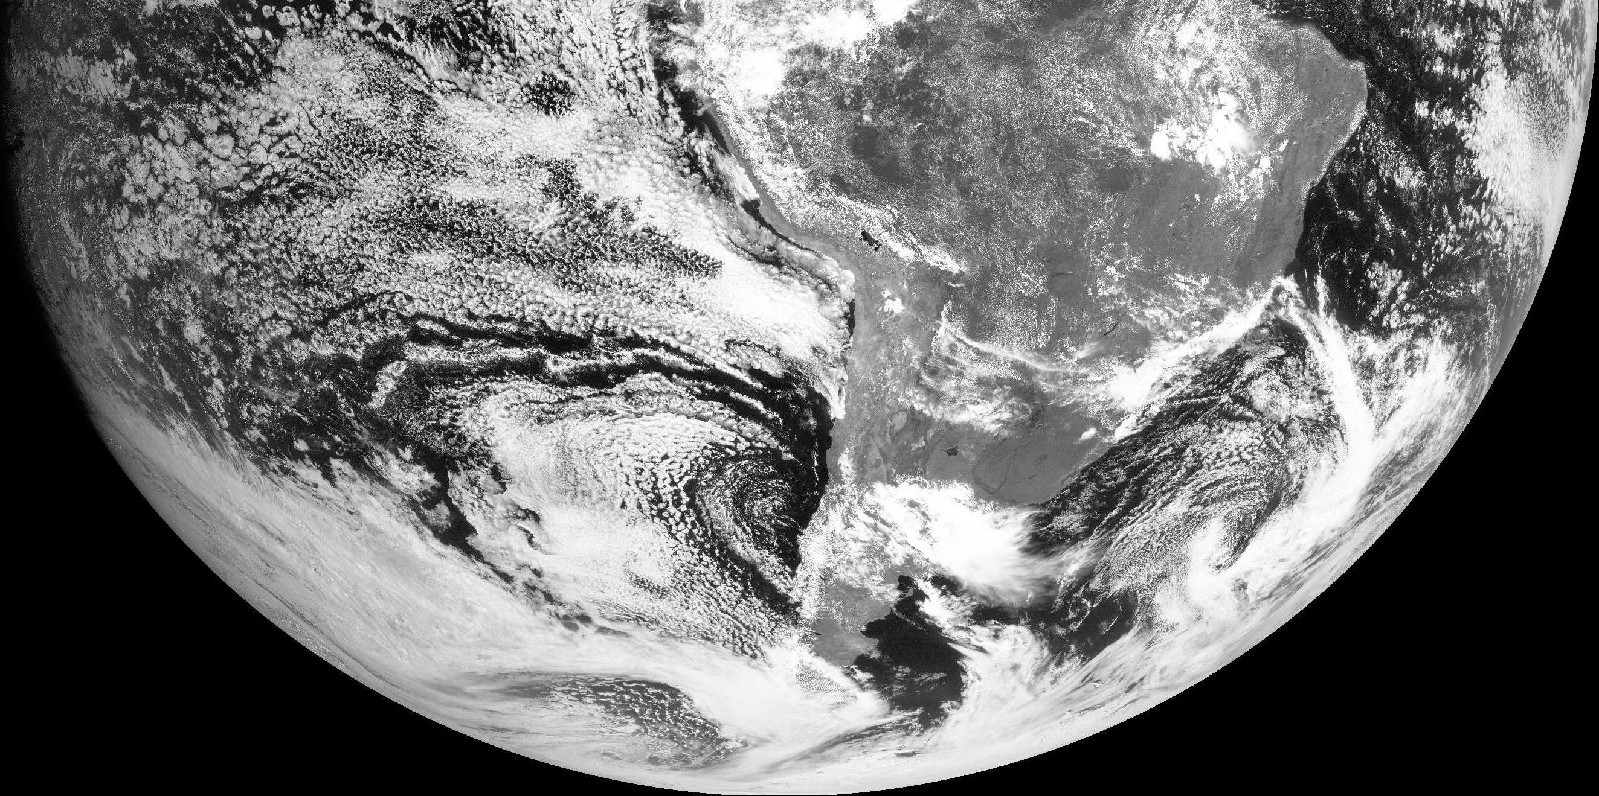
Visible imagery
100 km

Slide 28

October 27/28th 2008
POC Lagrangian - BAe-146 & NSF C-130
MODIS Terra, 250 m visible image
Photo from BAe-146, Hugh Coe

Slide 29
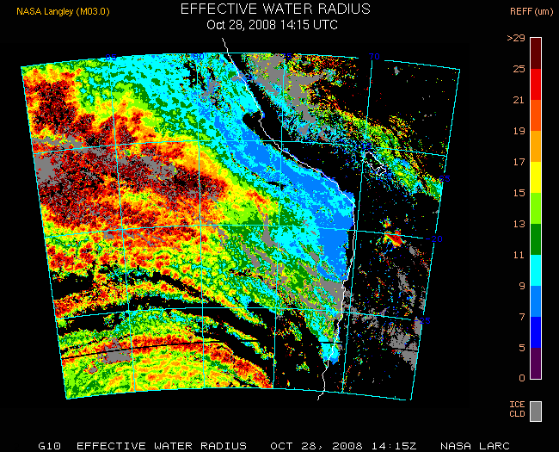
Cloud effective radius (Minnis)

Slide 30

OPEN CELL MORPHOLOGY
Optically thin
cell centers
10 km
Optically thick cell walls
VOCALS NSF C-130, RF06, October 28, 2008

Slide 31
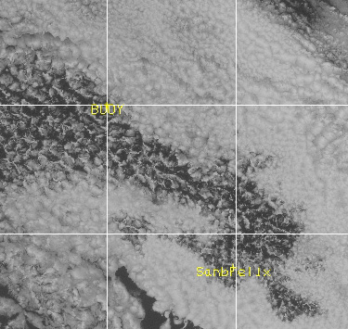
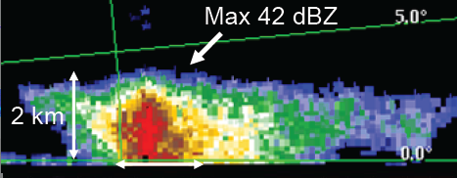
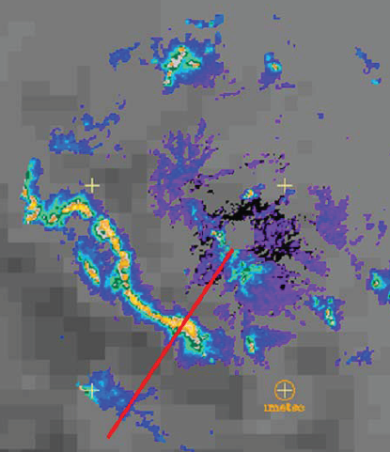

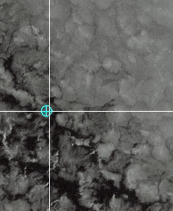
Boundary cells
POCKET of OPEN CELLS
60 km
C-band images
Matt Miller, NCSU

Slide 32
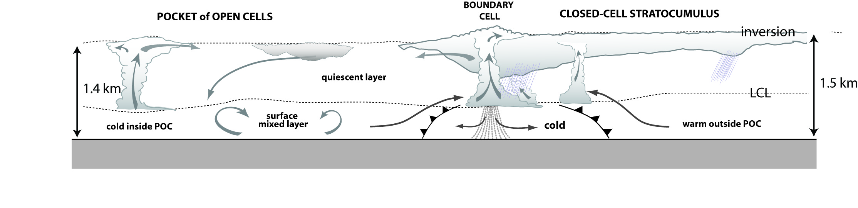

Conceptual model of POC edge
Decoupled MBL Relatively well-mixed MBL
Extremely clean
[CN = 20-50 cm⁻³, CCN = 5-20 cm⁻³]
Moderately polluted
[CN = 500-1000 cm⁻³, CCN = 100 cm⁻³]

Slide 33
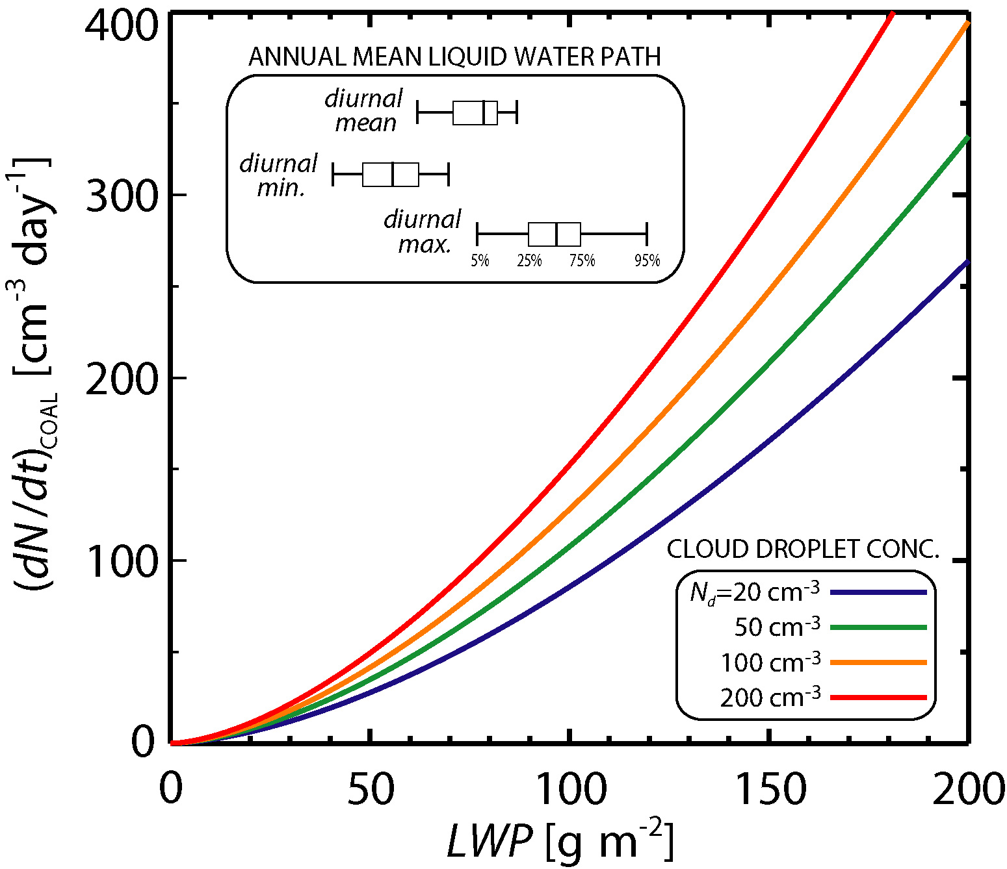
Coalescence and CCN depletion
Loss rate of CCN number concentration through coalescence
  LWP ²

Slide 34
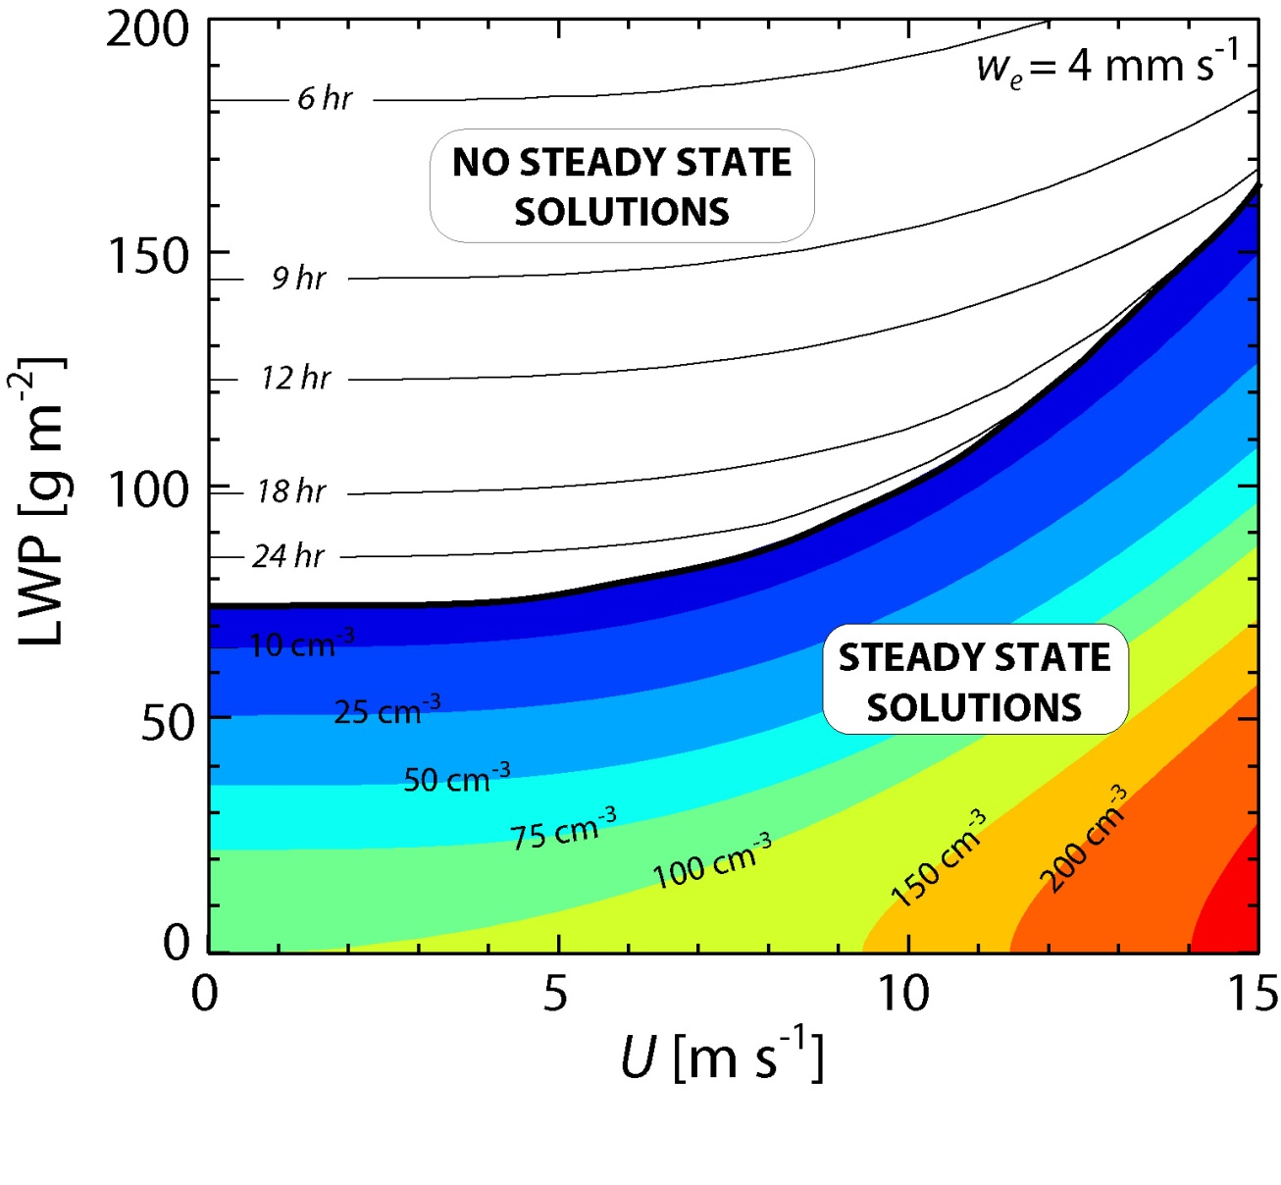
Steady-state cloud condensation nucleus (CCN) model
Assumptions:
1. Wind-driven sea-salt
production and entrainment of 100 cm⁻³ from free-troposphere
are only aerosol sources.
2. Coalescence scavenging is the only loss term
3. Examine steady state solution for CCN concentration

Slide 35
Take-home messages
Precipitation common in, and energetically important for, shallow marine boundary layers
Precipitation rate is macrophysically-determined but can be influenced microphysically
Precipitation important for organization of mesoscale structure in the stratocumulus-topped boundary layer
Precipitation important for controlling aerosol population within the marine boundary layer

Slide 36


Slide 38
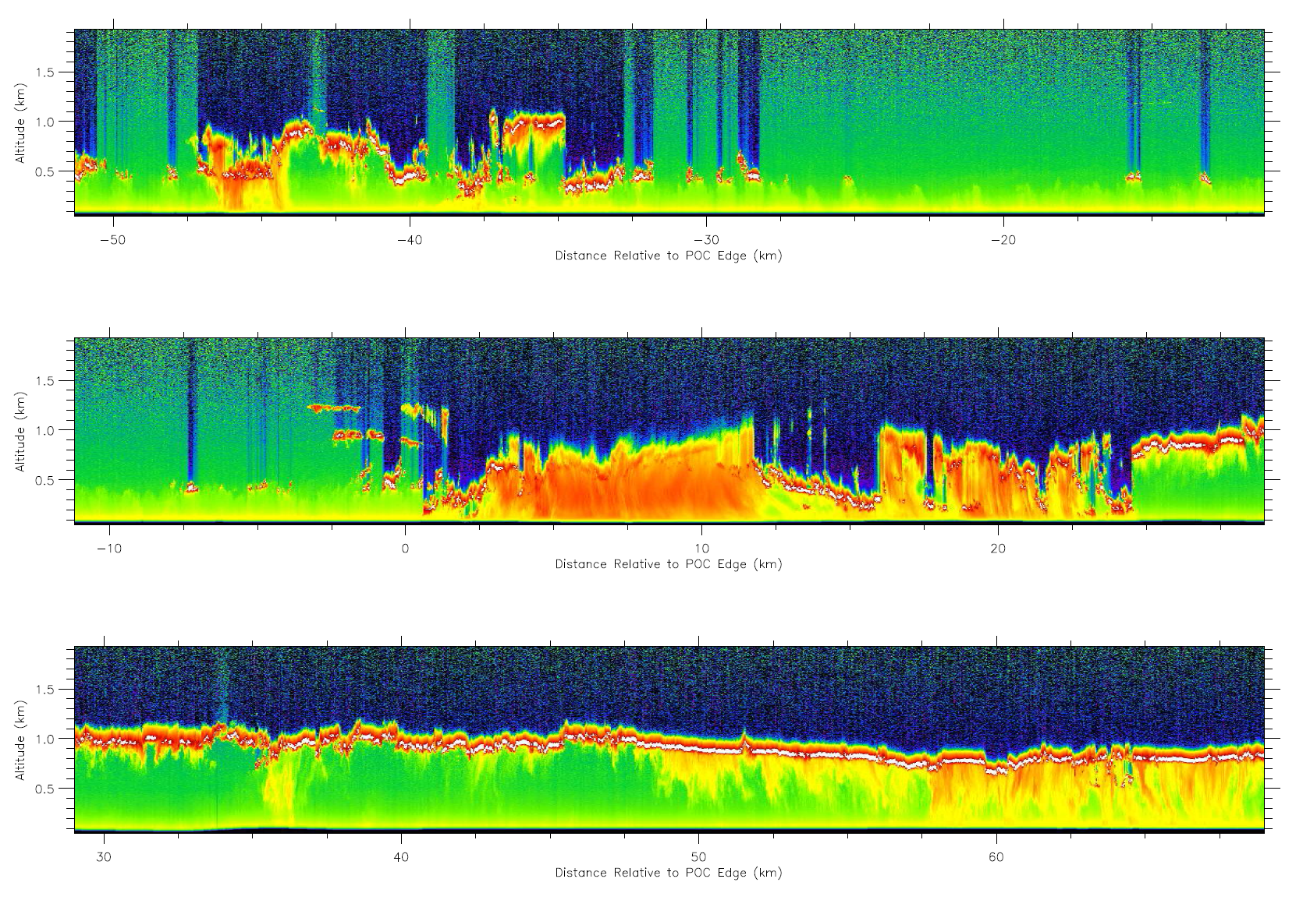

Slide 39


Slide 40
Data/Methods
Collocated CloudSat (GEOPROF) and Aqua-MODIS (MOD06) data:
  Daytime data only (∼13:30 local)
  CloudSat cloud top height below freezing level
  MODIS cloud top temperature > 0ºC
  MODIS cloud optical depth τ > 3
MODIS used to estimate LWP and N_{d}:
  LWP from standard MODIS cloud product
  N_{d} using method of Bennartz (2007), assuming adiabatic vertical cloud profile
CloudSat used to determine maximum Z in column. Classify > -15 dBZ as precipitating.

Slide 41
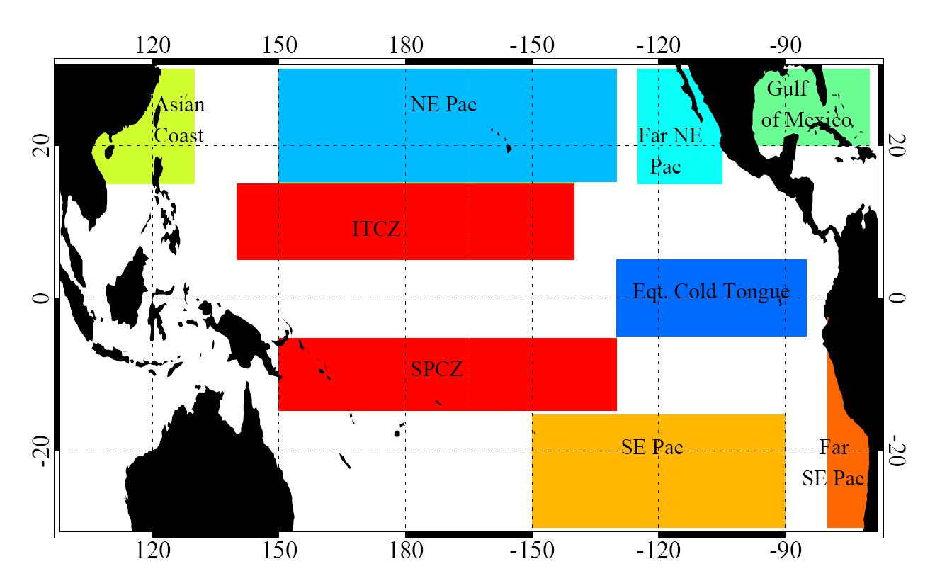
Regions Studied

Slide 42
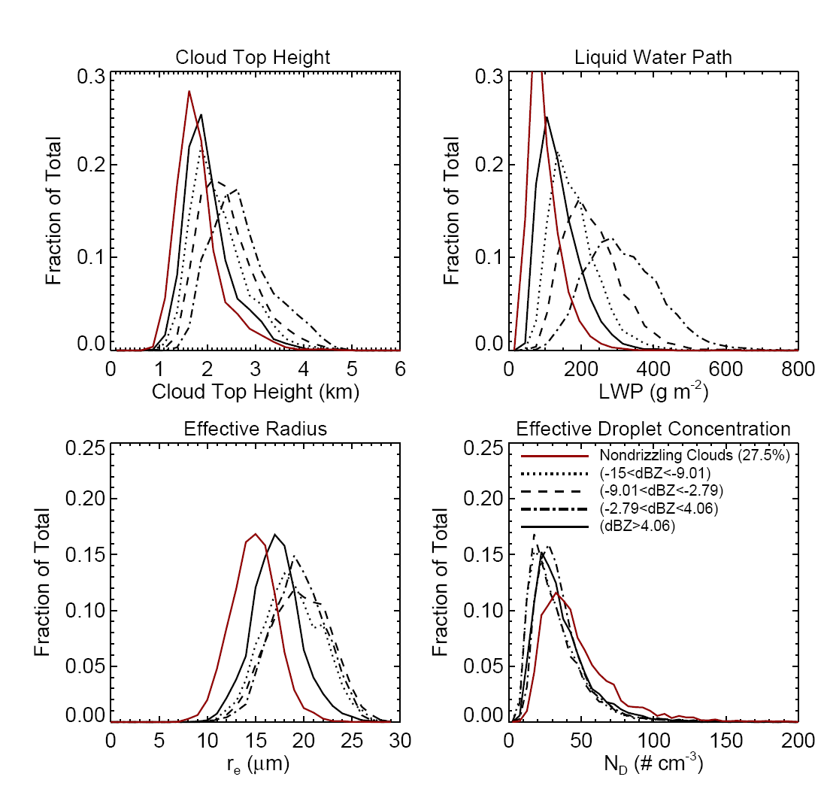

Cloud properties associated with different amounts of precipitation
SE Pacific
As clouds move from non-precipitating
to precipitating:
(1) LWP and cloud top height show
steady increases
(2) Microphysical parameters “saturate”

Slide 43
Fraction of clouds that are drizzling
(> -15 dBZ)
qualitatively consistent with Byers and Hall (1955)

Slide 44
Effective radius not unique determinant of precipitation
decreasing LWP

Slide 45
Heuristic model
Goals:
  Attempt to reproduce salient features of A-Train data
  Minimal physics necessary
Continuous collection model:
  Given realistic assumed macro/micro-microphysical cloud structure, allow small fraction of largest cloud droplets at cloud top to fall through cloud collecting droplets (10 liter⁻¹ leads to Z-R consistent with obs.)
  Essential inputs are cloud liquid water path (LWP) and cloud droplet concentration (N_{d})
  Other free parameters constrained by observations

Slide 46
Model cloud structure
Subadiabatic to represent entrainment effects in precipitating trade-cumulus
Adiabaticity parameter f_{ad} decreases with height z above cloud base
f_{ad} ⁼ z₀/(z₀+z)
Adiabaticity height scale z₀=500 m (estimated from RICO observations)
Gives liquid water content as a function of height

Slide 47
Precipitation embryos
Assumed size distribution
(Gamma)
n(r)
Tail of distribution (10 liter⁻¹)
constitutes embryonic
precipitation drops
r
Gamma distribution of cloud drops determined from LWC at cloud top and cloud droplet concentration

Slide 48
Microphysics vs macrophysics
Increasing relative importance of LWP over N_{d}
LWP [g m⁻²]

Slide 49
Rain rate-to-reflectivity (94 GHz)
Several steps need to be taken to compare model with CloudSat:
  Use model assumed precipitation DSD to determine radar reflectivity in Rayleigh limit
  Mie correction for 94 GHz reflectivity (Bohren-Huffman)
  Attenuate model 94 GHz reflectivity using two-way attenuation correction of 8.3 dBZ mm⁻¹ of cloud liquid water (Lhermitte 1990)

Slide 50
CloudSat: colors
Model: lines
Reflectivity
in [LWP, N_{d}]
space
Increasing relative importance of LWP over N_{d} at high rainrates
see also Suzuki and Stephens (2008)

Slide 51
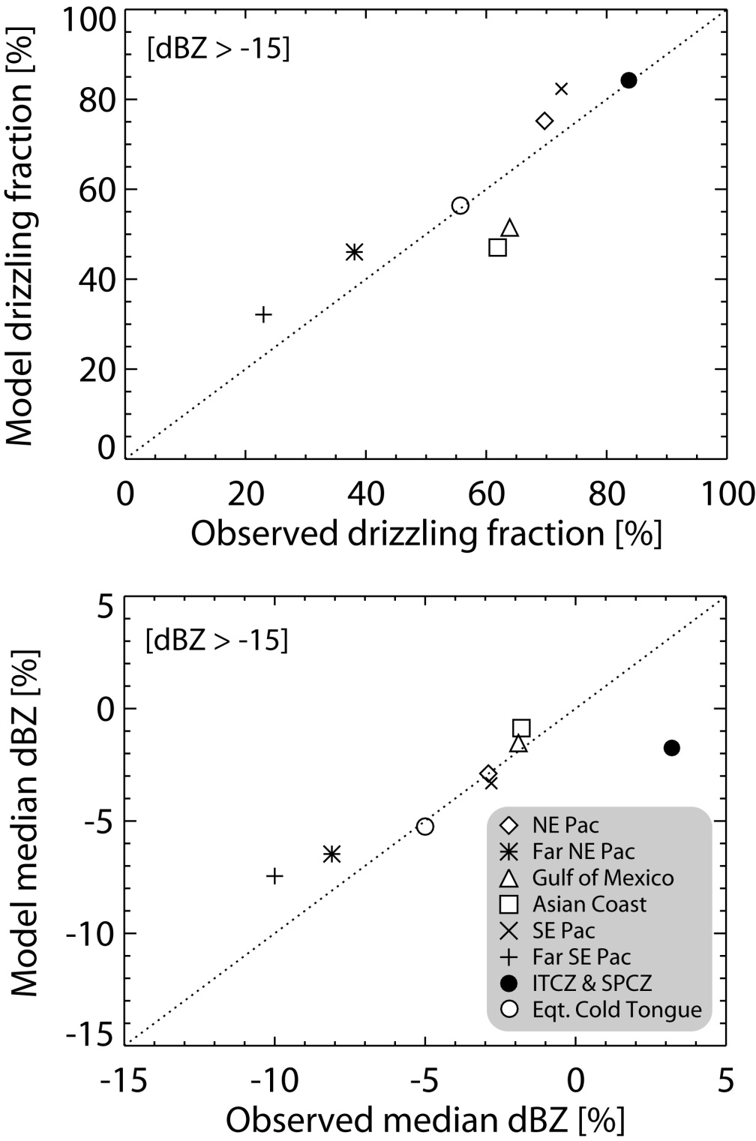
Model vs Obs drizzle fraction and intensity
Given [LWP,N_{d}] joint pdf, model can determine the drizzling fraction and intensity of drizzle in each region

Slide 52
Understanding the model behavior
Precipitation drop embryo formation
  depends very strongly upon microphysics (N_{d})
Accretion
  primarily limited by availability of cloud liquid water (not microphysics)
Clouds in which accretion dominates (thicker clouds, higher LWP) show reduced sensitivity to N_{d}

Slide 53
Conclusions
Observations and simple heuristic model show decreasing relative importance of microphysics as precipitation rate in warm clouds increases
Broadly consistent with field observations (DYCOMS, ACE-2, EPIC, RICO)
Implications for aerosol-cloud-precipitation interactions

Slide 54
October-November 2008
SE Pacific

Slide 55
VOCALS-CloudSat
VOCALS will yield a unique dataset detailing the properties of clouds, aerosols, and precipitation in the largest stratocumulus sheet on Earth
Development/testing of CloudSat/CALIPSO/A-Train retrievals of light precipitation and MBL microphysical and macrophysical structure
Near-surface issues
  technical: surface clutter
  physical: evaporation of drizzle

Slide 57
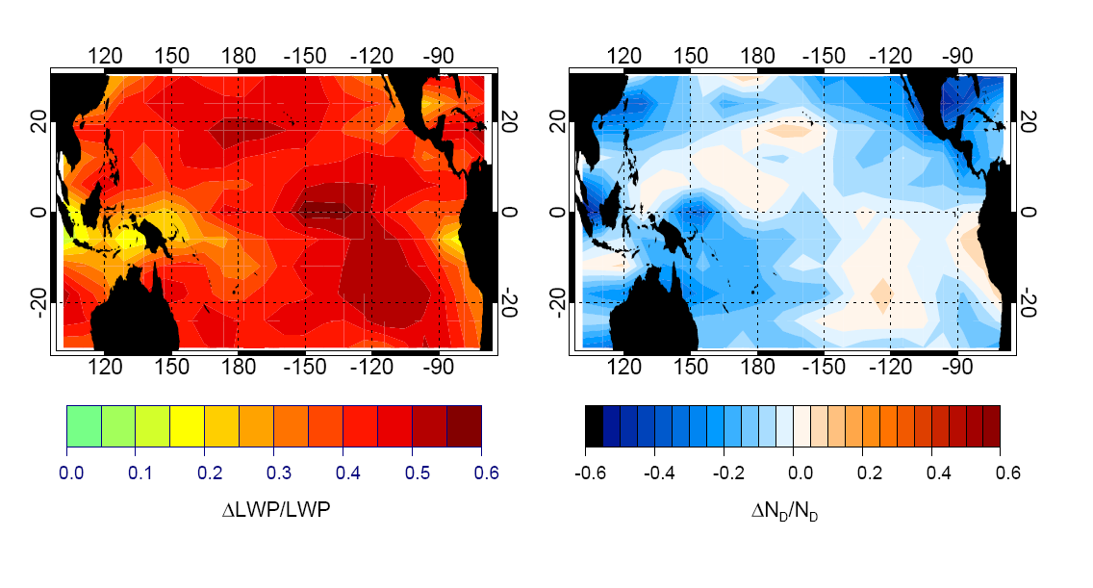

Slide 58
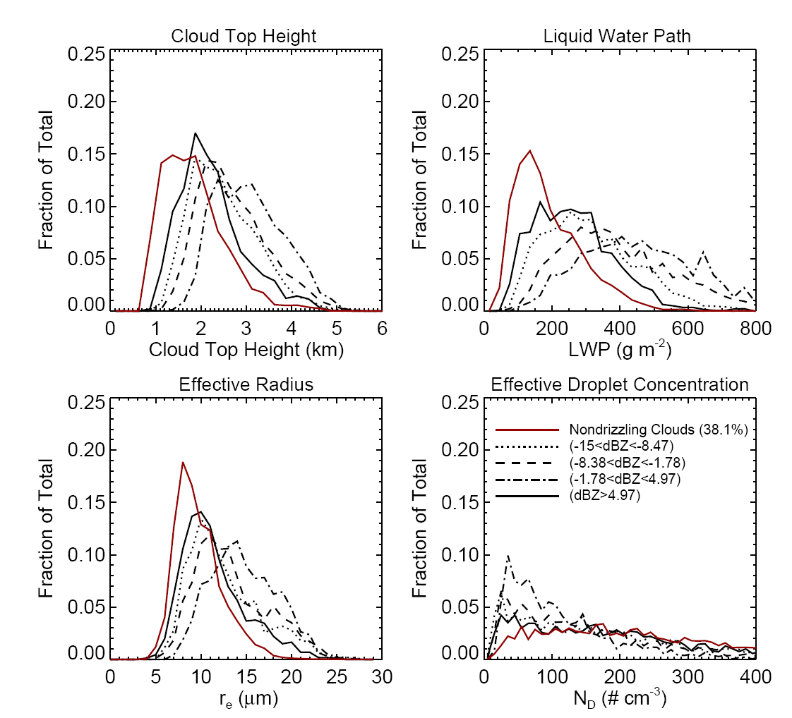
Cloud properties associated with different amounts of precipitation
Asian Coast

Slide 59
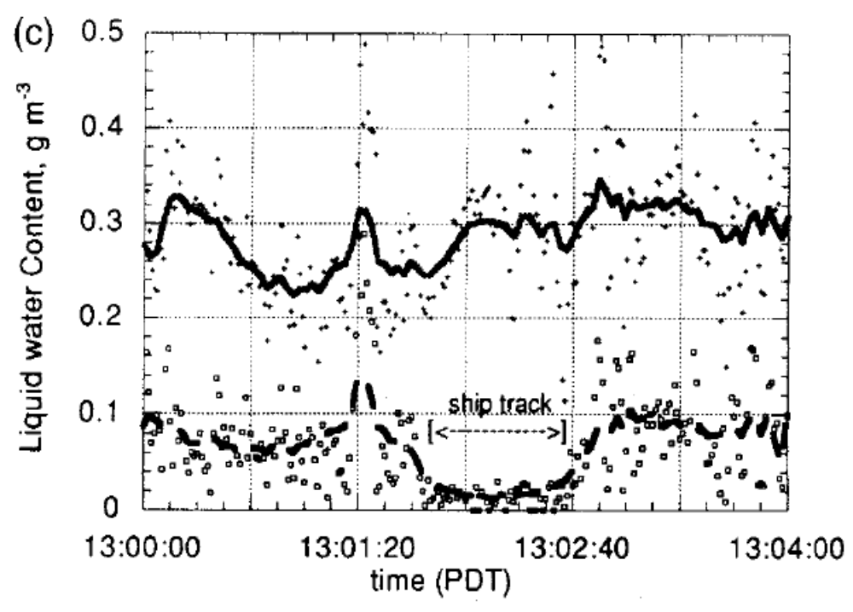
Drizzle suppression in shiptracks
Drizzle is frequently found to be suppressed in shiptracks
So what’s wrong with Albrecht’s hypothesis?
cloud
Liquid water content [g m-3]
drizzle
Ferek et al. 2000

