Slide 1
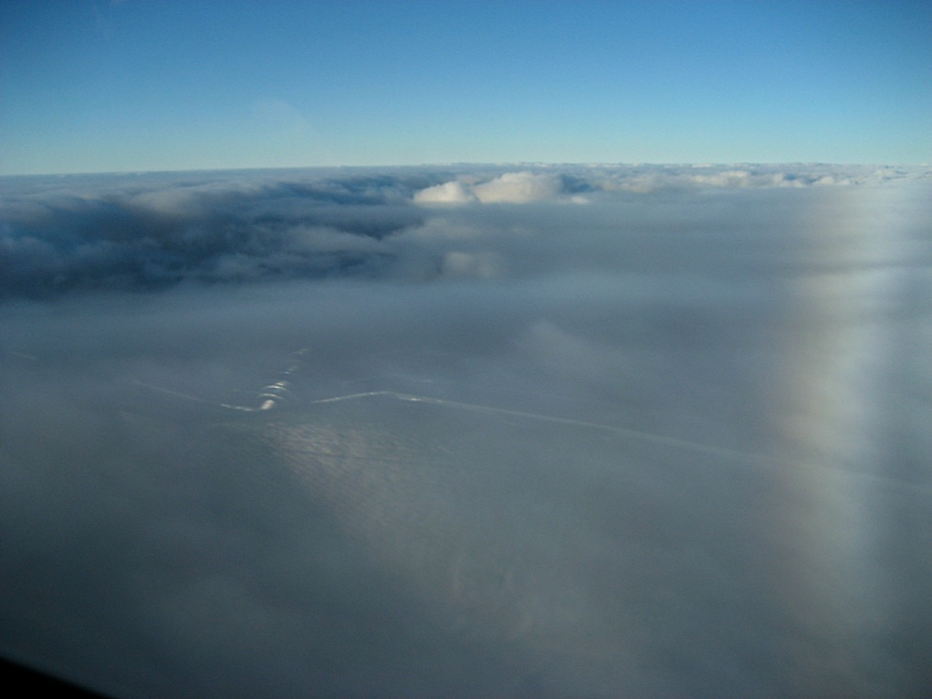
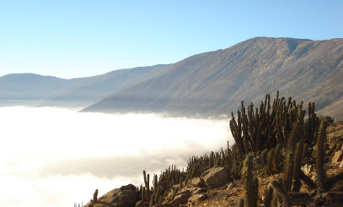
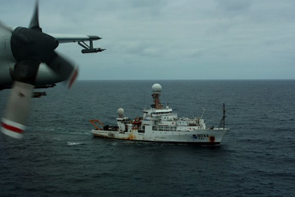
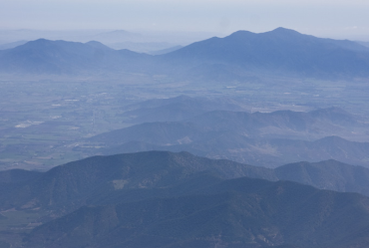
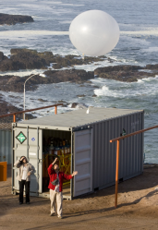
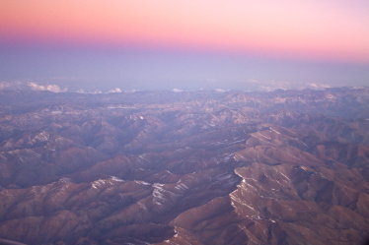
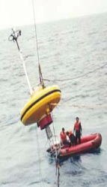
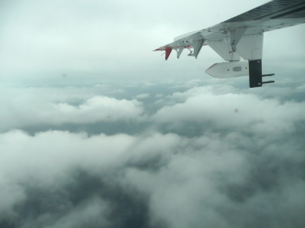
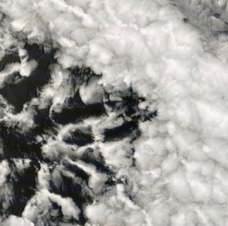
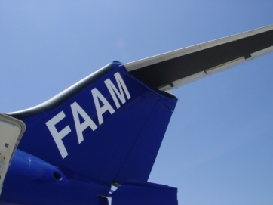
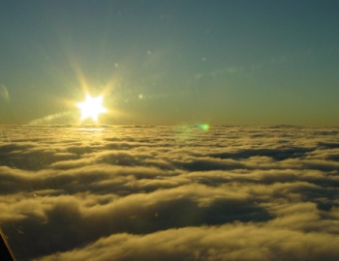
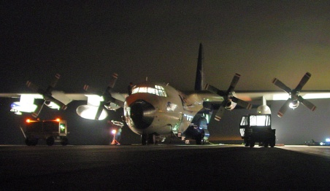
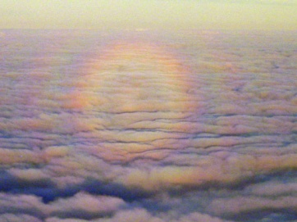
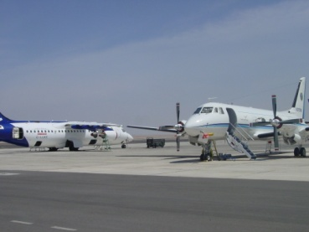
VOCALS Regional Experiment
Summary of Operations

Slide 2
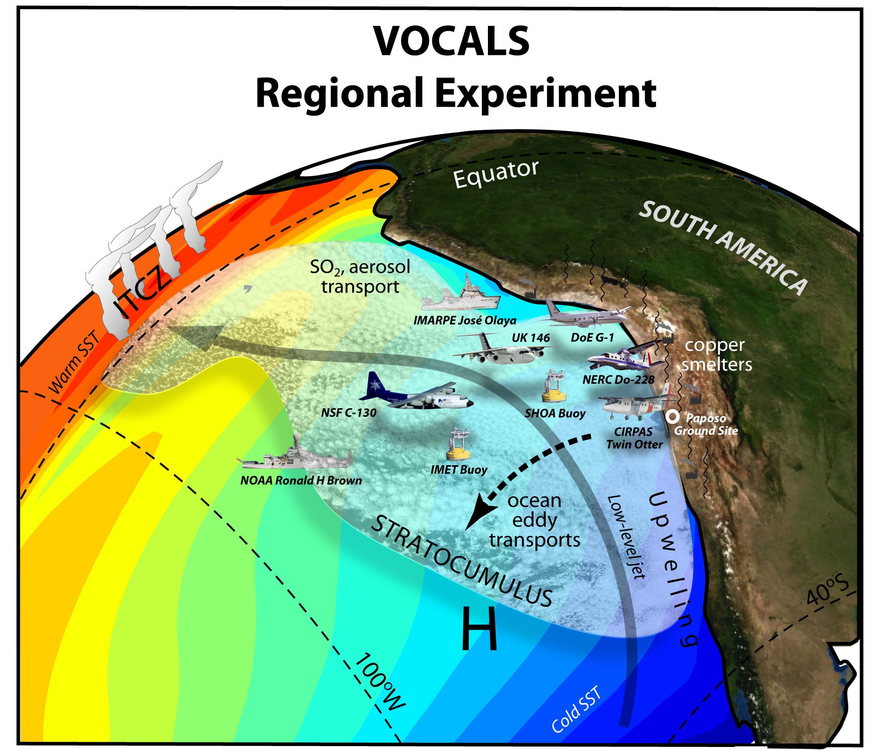

Slide 3
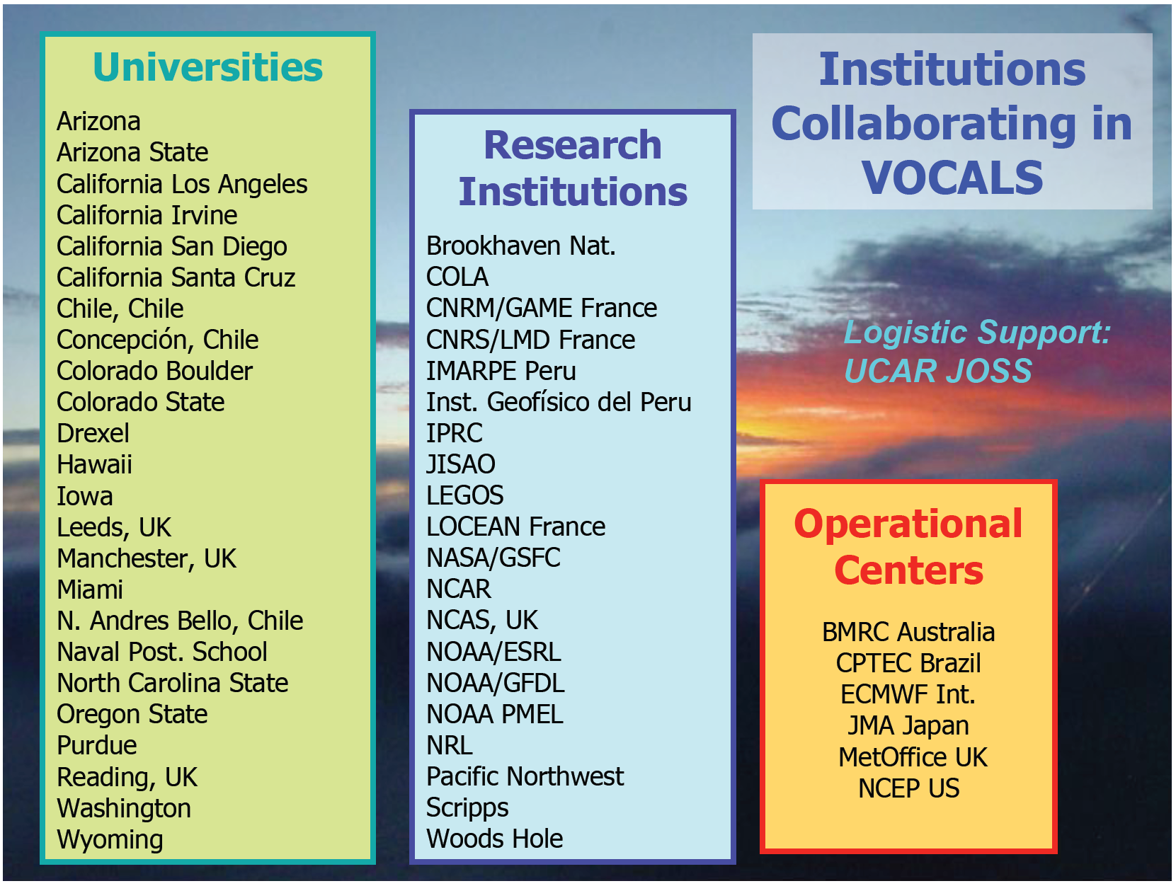

Slide 4
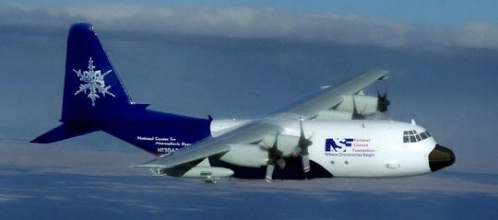
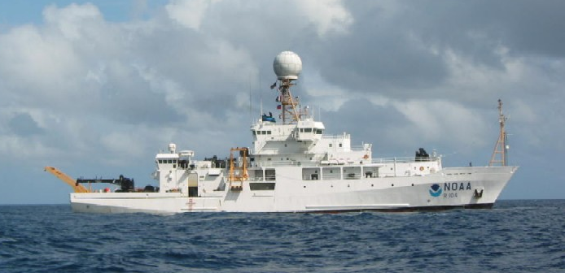

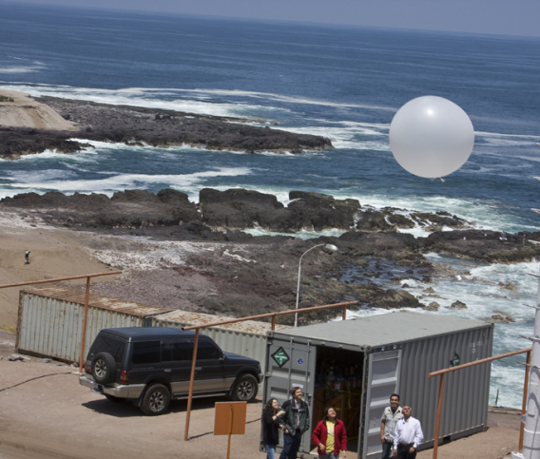
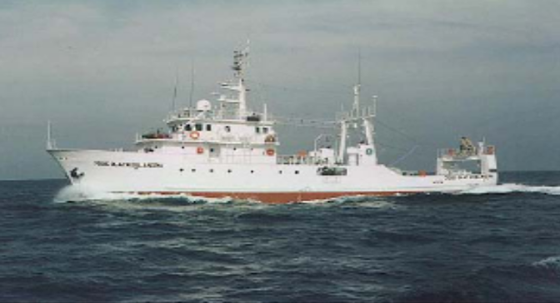
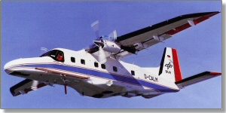
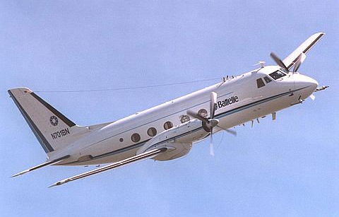
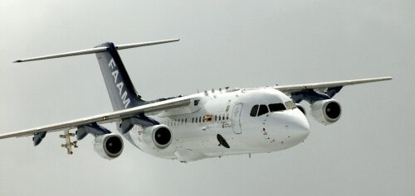
VOCALS-REx Platforms
NSF C-130
NOAA Ronald H Brown
Paposo
Iquique
IMARPE José Olaya
CIRPAS Twin Otter
NERC Dornier 228
UK FAAM BAe-146
DoE ASP G-1

Slide 5
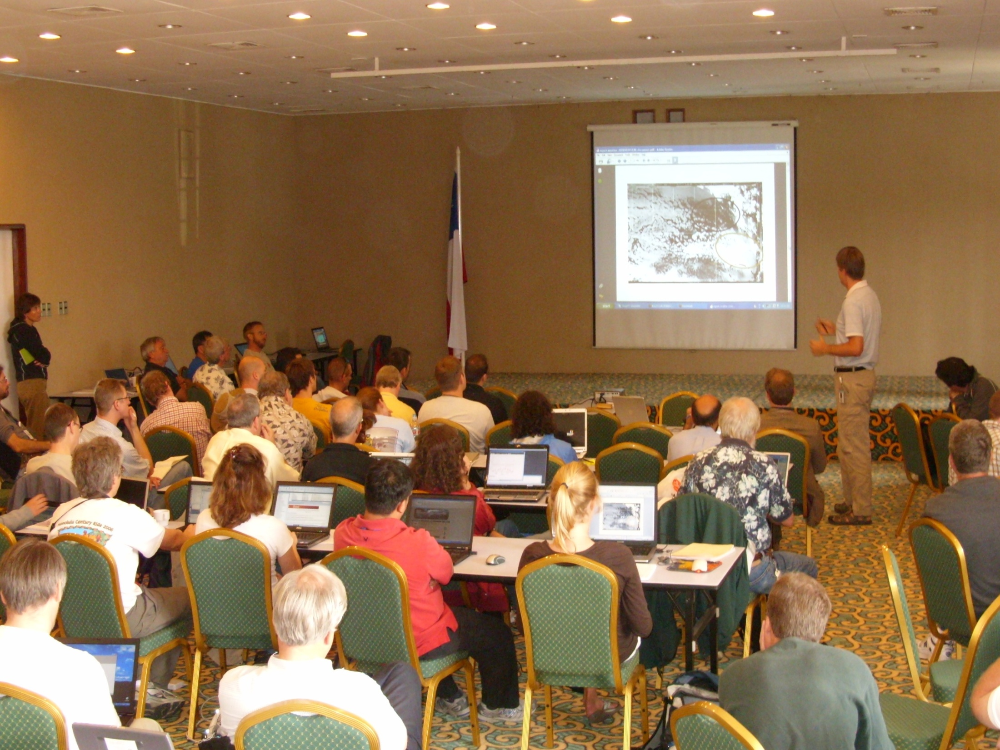
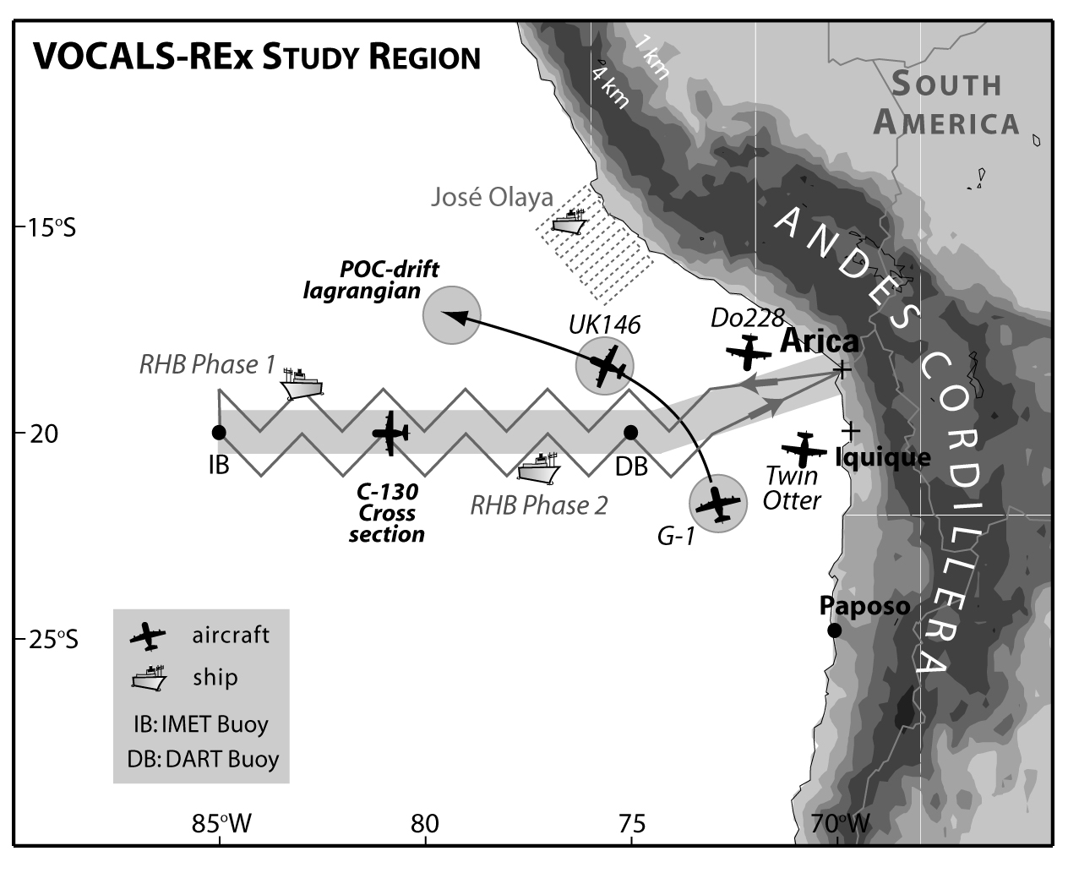
VOCALS-REx Study Region
VOCALS-REx Arica Operations Centre

Slide 6
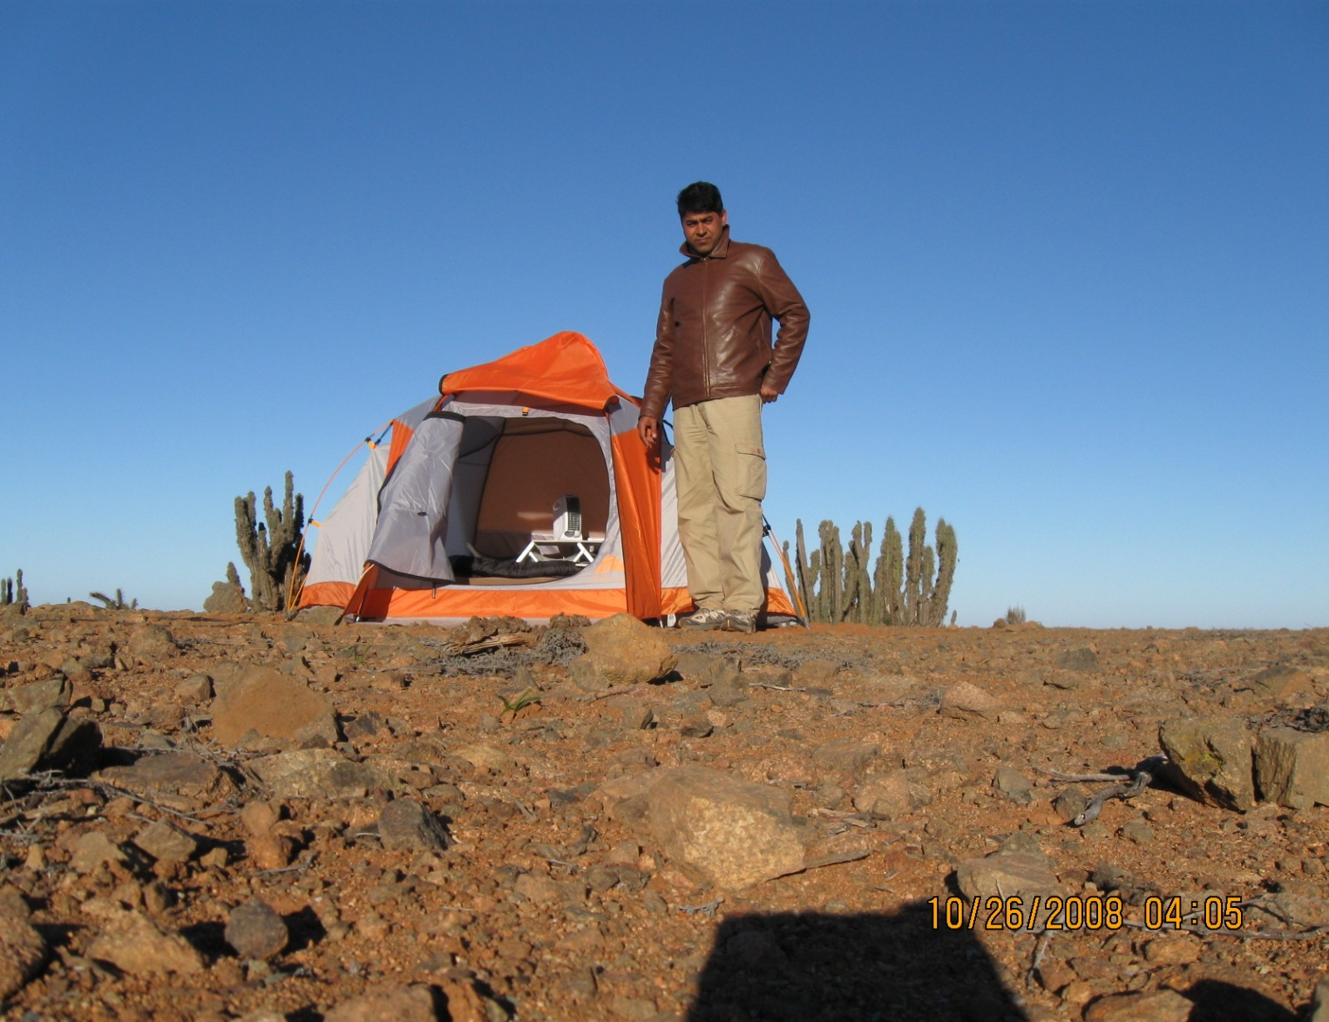
VOCALS-REx Paposo Operations Centre

Slide 7
VOCALS-REx Sampling Stats
AIRCRAFT [78 flights]
  Twin Otter (19 flights)
  G-1 (16 flights)
  C-130 (14 flights)
  BAe-146 (14 flights)
  Do-228 (15 flights)
SHIPS [54 cruise days]
  R/V José Olaya (15 day cruise)
  R/V Ronald H Brown (2 legs, 18 days + 21 days)
LAND SITES
  Paposo (30 days intensive, ? meteorology
  Iquique (31 days of soundings, 6 per day)

Slide 8
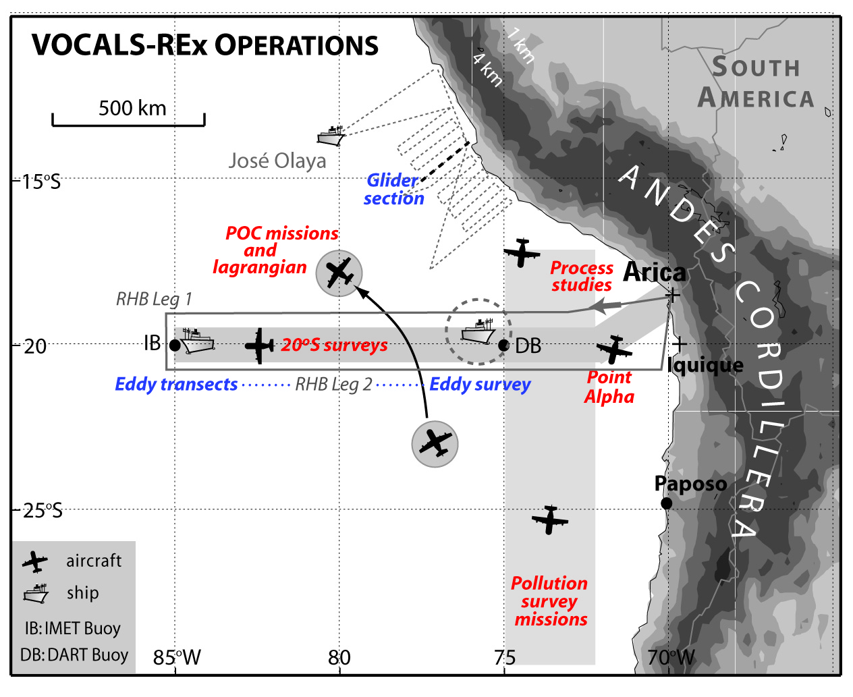

Slide 9
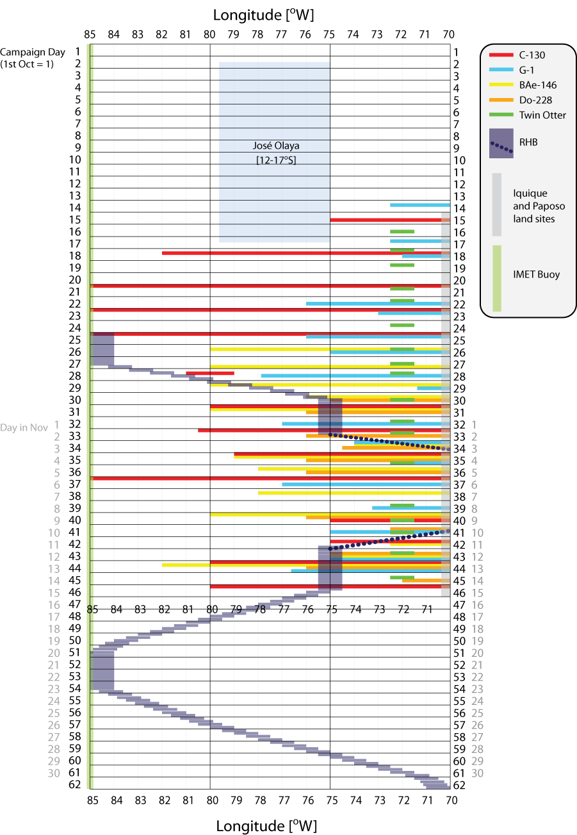
Complete REx period (Oct 1
-Dec 1)

Slide 10
Intensive aircraft period (Oct 15
-Nov 15)

Slide 11
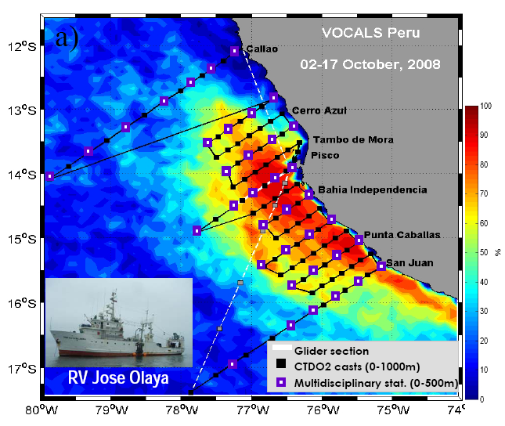
Peruvian R/V José Olaya
15 day cruise
(Oct 2-17)
atmospheric, hydrographic, biogeochemical
and fishery acoustic observations, glider,
and zooplankton experiments
Carmen Grados, INMARPE

Slide 12
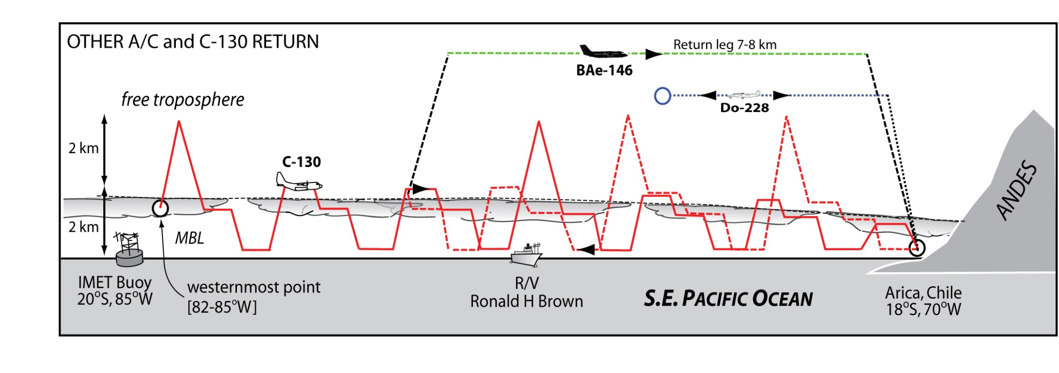
Collaborative 20ºS Missions with UK BAe-146, Dornier 228, RHB
C-130: MBL measurements, cloud physics, radar/lidar, aerosols, chemistry
BAe-146: Dropsondes and comprehensive radiation suite
Dornier-228: Aerosol lidar

Slide 13
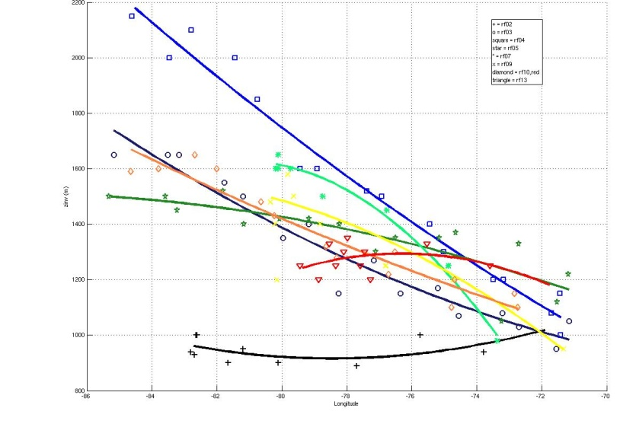
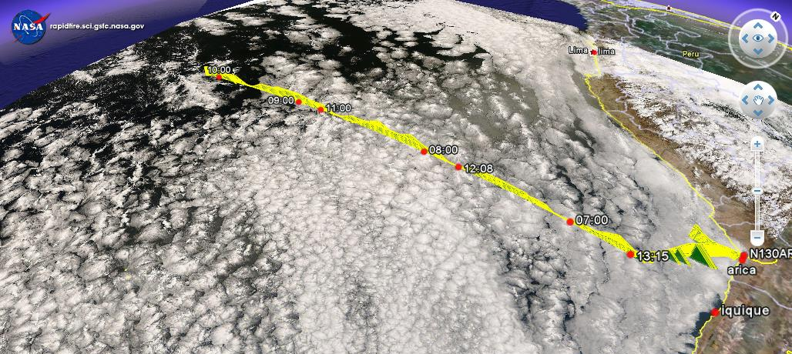
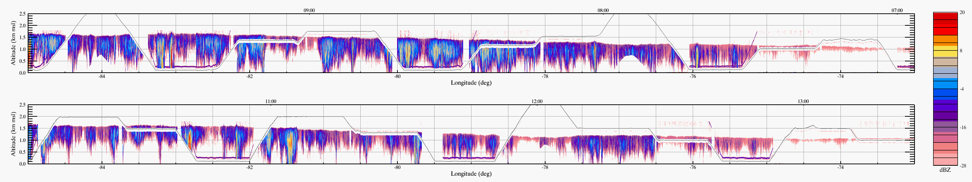
20ºS Missions
Boundary layer
depth
[all 20ºS missions]
2.0
1.6
1.2
0.8
20ºS/85ºW
20ºS parallel
height [km]
remarkable
synoptic
variability
86 82 78 74 70ºW
Wyoming cloud radar – widespread drizzle

Slide 14
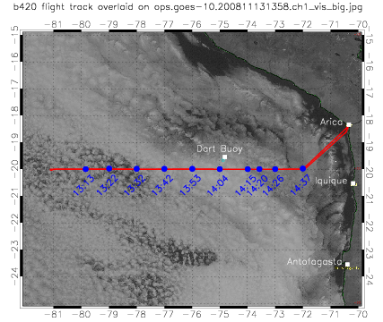
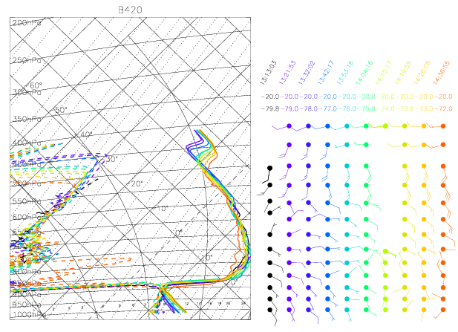
20ºS dropsonde curtains
BAe-146

Slide 15
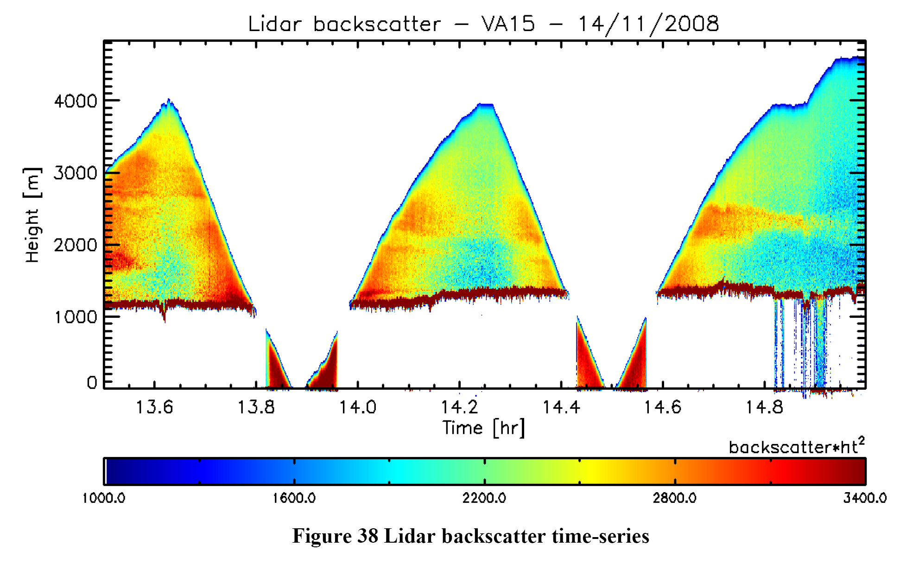
Dornier 228 – aerosol/cloud lidar

Slide 16
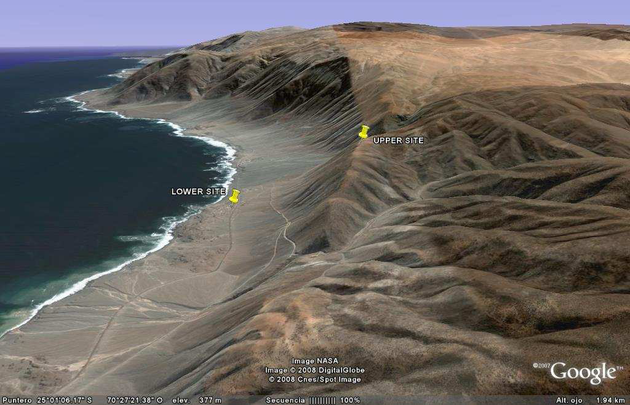
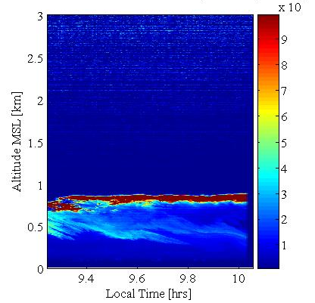
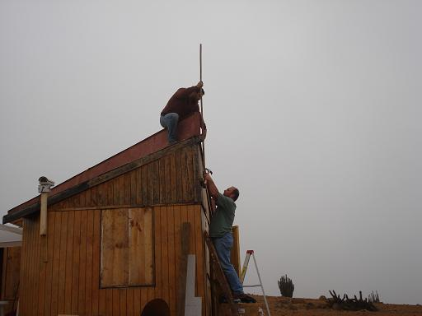
PAPOSO
25ºS, 70.3ºW; 690m altitude (upper site)
Antofagasta (180 km)
Paranal (45 km), 2600 m.a.s.l
LOWER SITE
UPPER SITE
Taltal (60 km)
Laura Gallardo, U de Chile

Slide 17
Paposo - measurements
http://www.dgf.uchile.cl/VOCALS_PAPOSO/
Radiosonde soundings
Surface Meteorology
Cloud base and frequency
Volcanic emissions
Regional assessment of sulfur dioxide using passive samplers
Cloud Condesation Nuclei
Aerosol loading, distribution and radiative properties
Observations of aerosol physical, chemical and optical properties
Black carbon observations at upper site

Slide 18
Paposo
Polarimetric aerosol/cloud lidar [U. Alaska]
Time [hr]

Slide 19
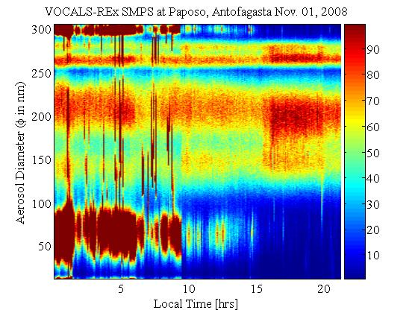
Offshore flow
Onshore flow

Slide 20
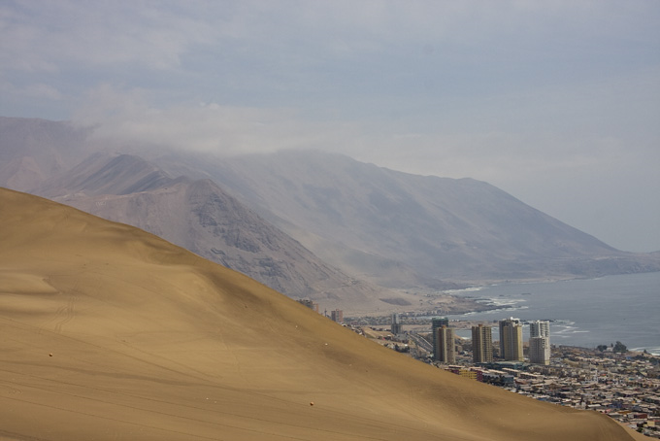
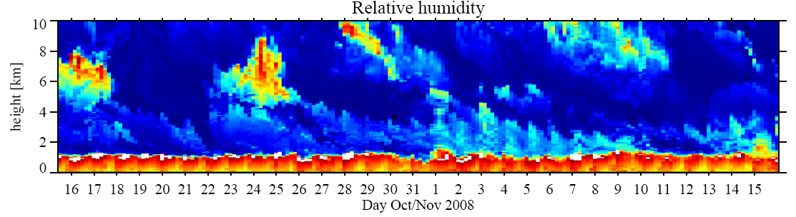
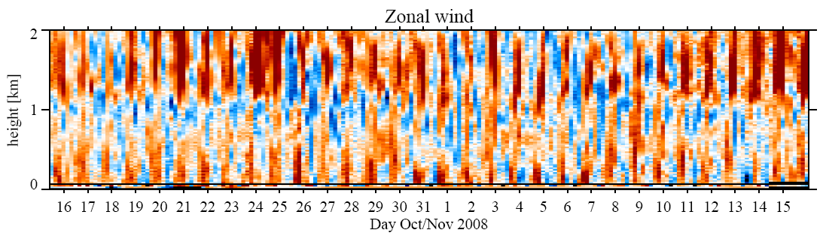
Iquique [20ºS, 70ºW]
GAUS Station
Twin Otter Aircraft
10 km
2 km

Slide 21
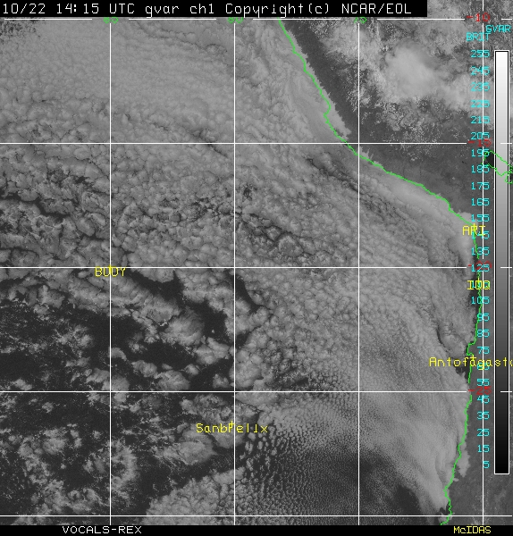
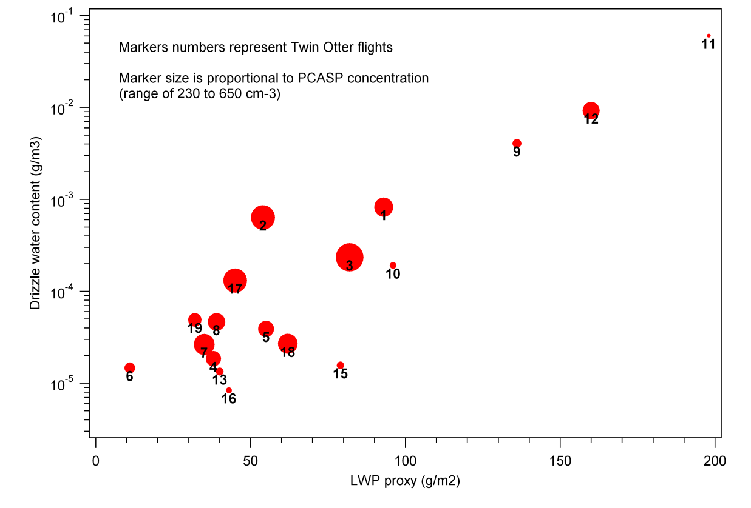
Twin Otter – routine sampling at “Point Alpha” (72ºW, 20ºS)
19 flights (93 flight hours) from 16 Oct to 13 November 2008
Boundary layer, turbulence and microphysical measurements were made at 20ºS; 72 ºW for all 19 flights.
Drizzle LWC (gm⁻³)
The wide range of aerosol, cloud, and boundary layer conditions observed at site will facilitate both process and modeling studies.
Drizzle LWP
LWP Proxy
LWP Proxy (gm⁻²)

Slide 22
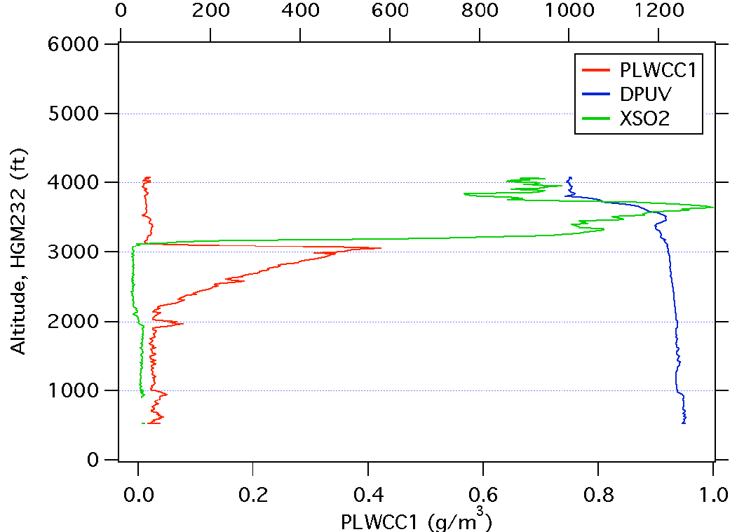
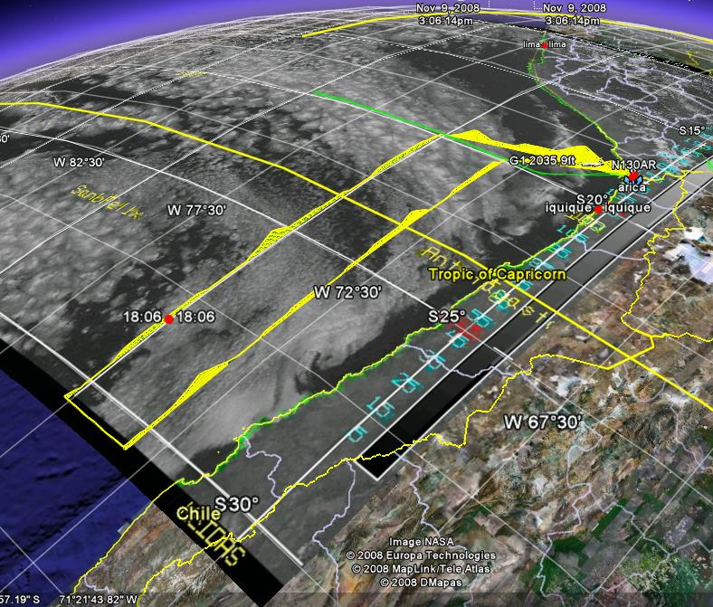
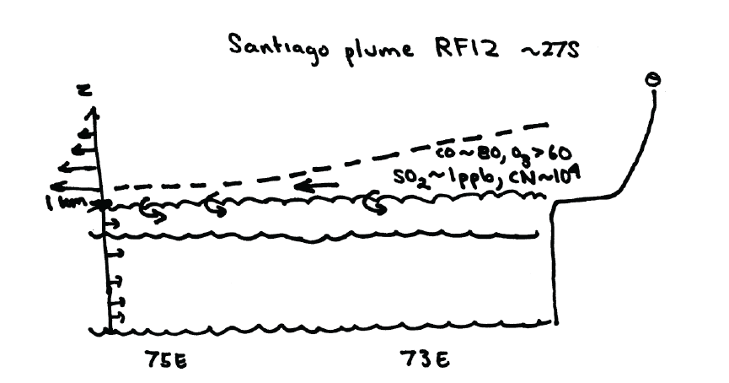
Pollution surveying
All platforms
[SO₂] ppt
RF12, November 11th 2008
Cloud
Santiago

Slide 23
POC Sampling
BAe-146, C-130, RHB

Slide 24
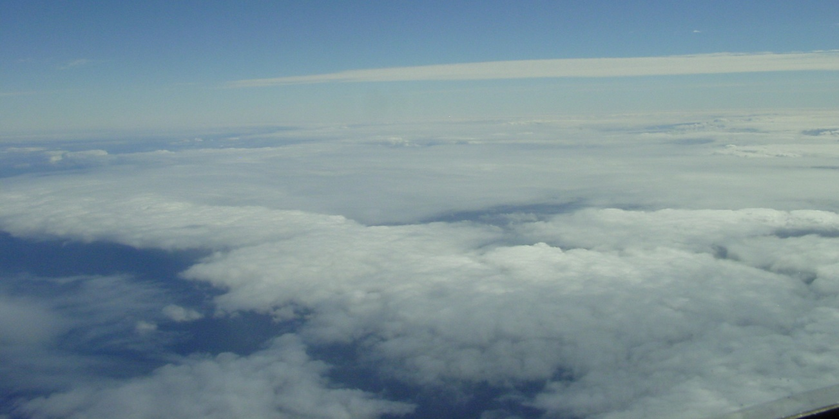
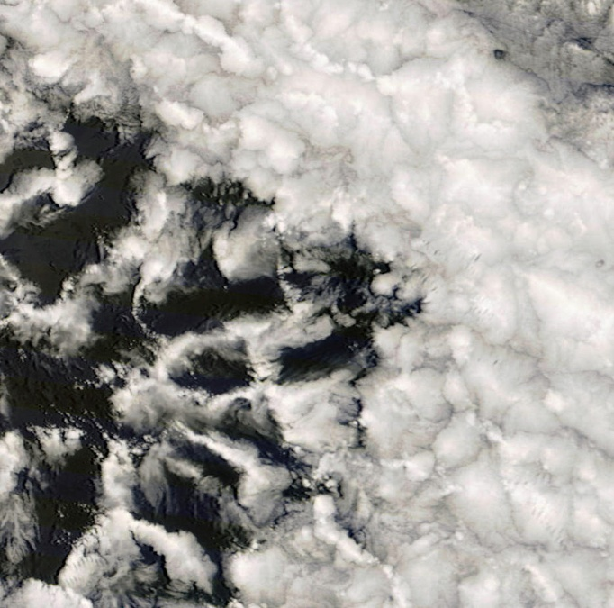

POC Missions
Optically thin
cell centers
10 km
Optically thick cell walls
Lowest CN concentration ever measured
Remarkable contrasts in microphysics and cloud dynamics across POC boundary [aerosols, drizzle, cloud structure and morphology, CO and O₃]
Ultraclean clouds in optically-thin cloud centers
Quasi-linear boundary cells with copious drizzle scavenge aerosols

Slide 25



Unprecedented observations of cloud and precipitation structure
OPEN CELLS CLOSED CELLS
MODIS visible image
[250 m resolution]
POC Edge
Boundary Cell
RADAR
2km
LIDAR
-100 -50 0 50 100
Distance [km]
Dave Leon, University of Wyoming

Slide 26





Boundary cells
POCKET of OPEN CELLS
60 km
C-band images
Matt Miller, NCSU

Slide 27
NOAA Ronald H Brown, Mesoscale Ocean Eddy Sampling
30 CTD (conductivity, temperature, depth) profiles (to 1000-2000m) were collected in eddies, fronts and the boundary currents
300 Underway CTD profiles (to 300-700m) were collected to map the large-scale, mesoscale and submesoscale structure of the upper ocean
Surface Drifters and Profiling SOLO floats were deployed in the center of eddies
VMP (vertical microstructure profiles) were collected to quantify mixing

Slide 28


Ronald H Brown Leg 2 track and eddies sampled
SST [ºC]
Latitude
Longitude
Fiamma Straneo, WHOI

Slide 29


Preliminary Results: Characteristics of the Cyclonic Eddies
eddy
eddy
3 Cyclonic eddies sampled in Leg 2
- cold SST anomaly
a shallow mixed layer
a sub-surface warm, salty core (300m)
Property Profiles
Eddy-blue, mean-black

Slide 30
Platform Intercomparisons
Platform | BAe-146 | G-1 | Twin Otter | Do-228 | RHB | Paposo
C-130 | 1. Cd31, 10/31 (RF07/B412) 2. Cd35,11/04 (RF09/B414) | 1. Cd23, 10/23 (RF04) 2. Cd35, 11/04 (RF09) 3. ? | None | None | 1. Cd25, 10/25 (RF05, IMET Buoy) 2. Cd33, 11/02 (RF08, SHOA Buoy) 3. Cd42, 11/11 (RF12, near SHOA buoy) | 1. Cd40, 11/9 (RF11, along 73W) 2. Cd42, 11/11 (RF12, along 73W)
BAe-146 |  | 1. Cd40 ground comparison 2. Cd43, 11/12 (B419) | ? | Cd44, 11/13 (B420/VA13) | 1. Cd30, 10/30 (near SHOA Buoy) 2. Cd43, 11/12 (near SHOA buoy) | -
G-1 |  |  | Cd26, 10/26 | - | None | -
Twin Otter |  |  |  | - | Cd41, 11/10 (near SHOA buoy) | -
Do-228 |  |  |  |  | Cd30, 10/30 VA03 | -

Slide 31

Education and Outreach
In-Field Instruments Talks
Mid-campaign Science Meeting
Windows to the Universe
~20 participating scientists
Multiple “Postcards from the Field”
Local and National Media
Institutional press releases,
departmental newsletters/web articles
Multiple local newspaper articles
Local television reports
National newspaper articles (Chile)
multiple newspaper/magazines (Peru)

Slide 32

Water
Everything on the earth bristled, the bramble
pricked and the green thread
nibbled away, the petal fell, falling
until the only flower was the falling itself.
Water is another matter,
has no direction but its own bright grace,
runs through all imaginable colors,
takes limpid lessons
from stone,
and in those functionings plays out
the unrealized ambitions of the foam.
Pablo Neruda

