Slide 1
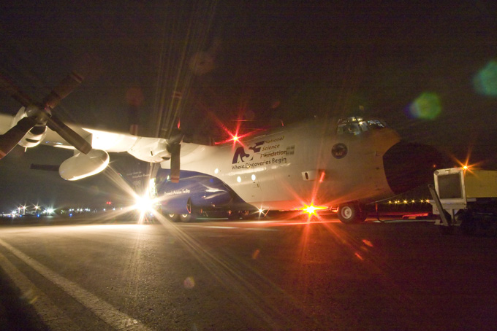
VOCALS REx: Drizzle, Aerosol, and ‘The World’s Largest Cloud’
Robert Wood
University of Washington

Slide 2
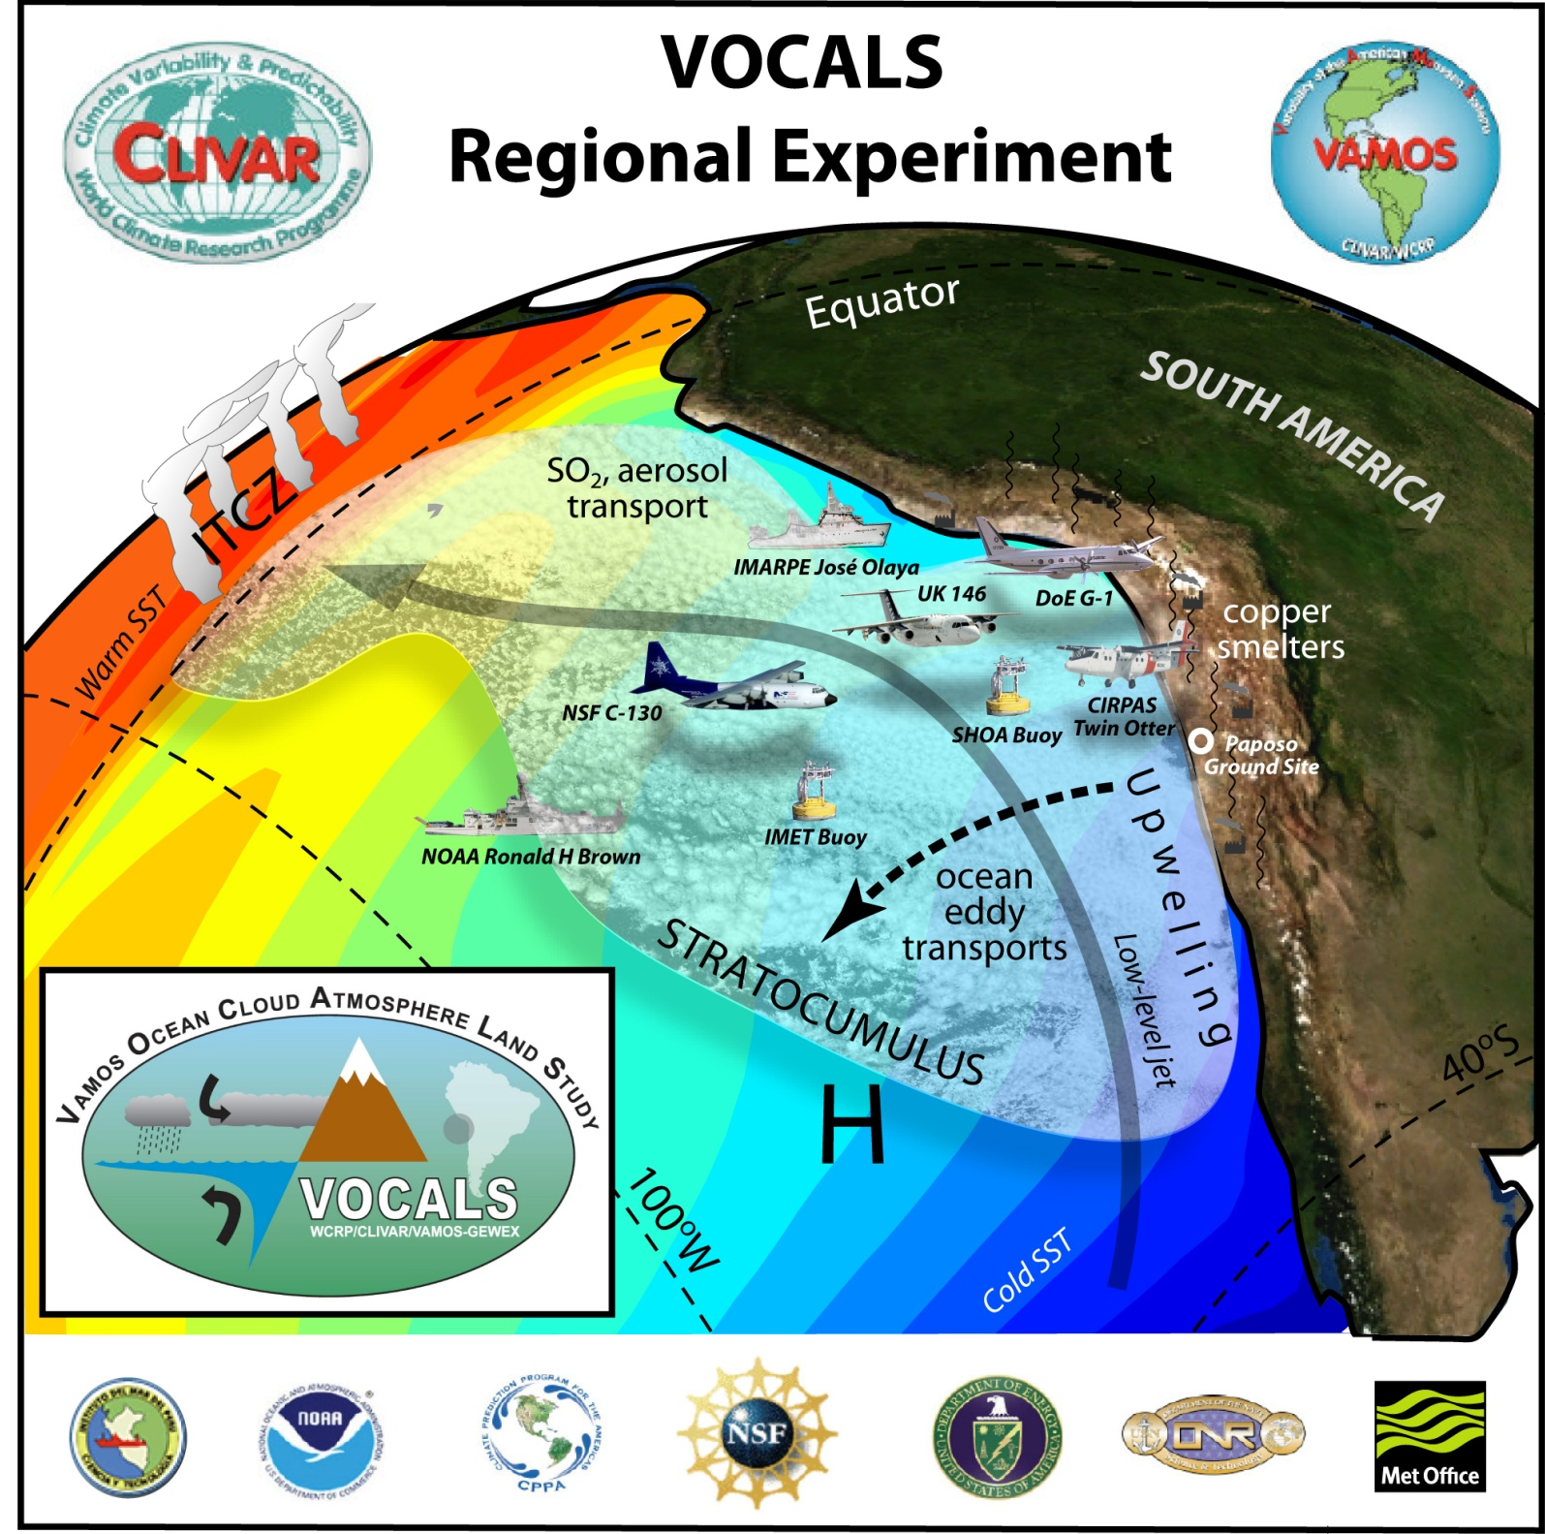
October-November 2008
SE Pacific

Slide 3
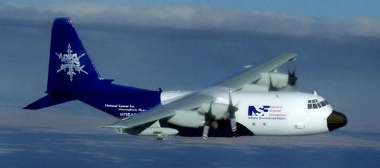
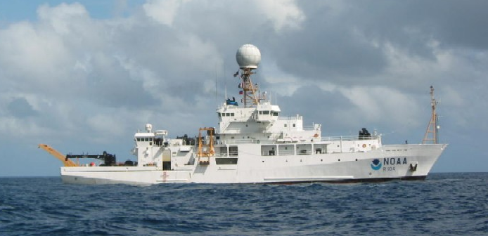
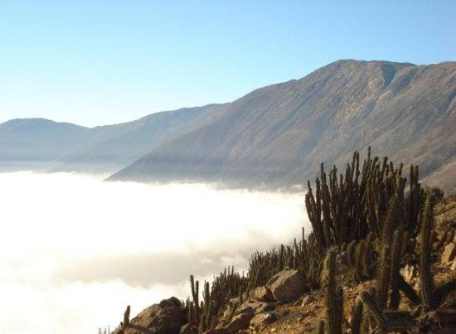
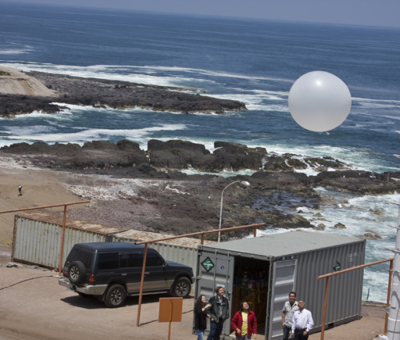
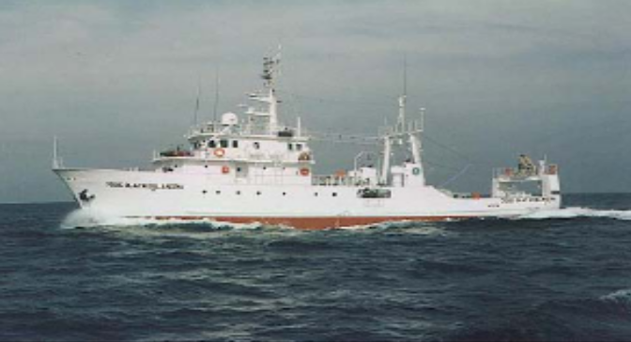

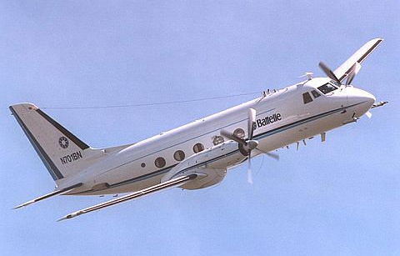
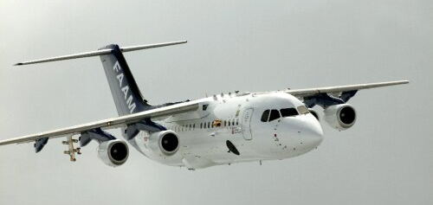
VOCALS-REx Platforms
NSF C-130
NOAA Ronald H Brown
Paposo
Iquique
IMARPE José Olaya
CIRPAS Twin Otter
NERC Dornier 228
UK FAAM BAe-146
DoE ASP G-1

Slide 4
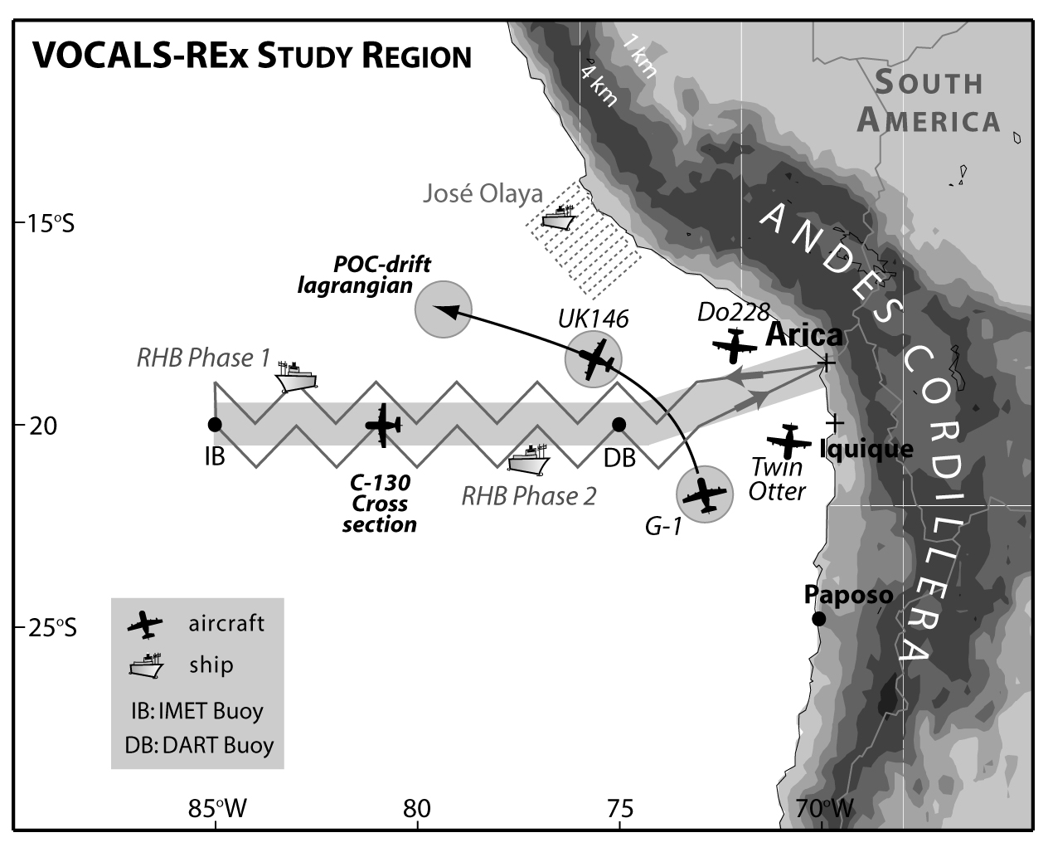
VOCALS-REx Platforms and Sampling
Oct-Nov 2008
Aircraft:
NSF C-130
CIRPAS Twin Otter
DoE G-1
UK BAe-146
UK Dornier 228
Ships:
NOAA Ronald H Brown
Peru - Jose Olaya
Paposo and Iquique land sites

Slide 5
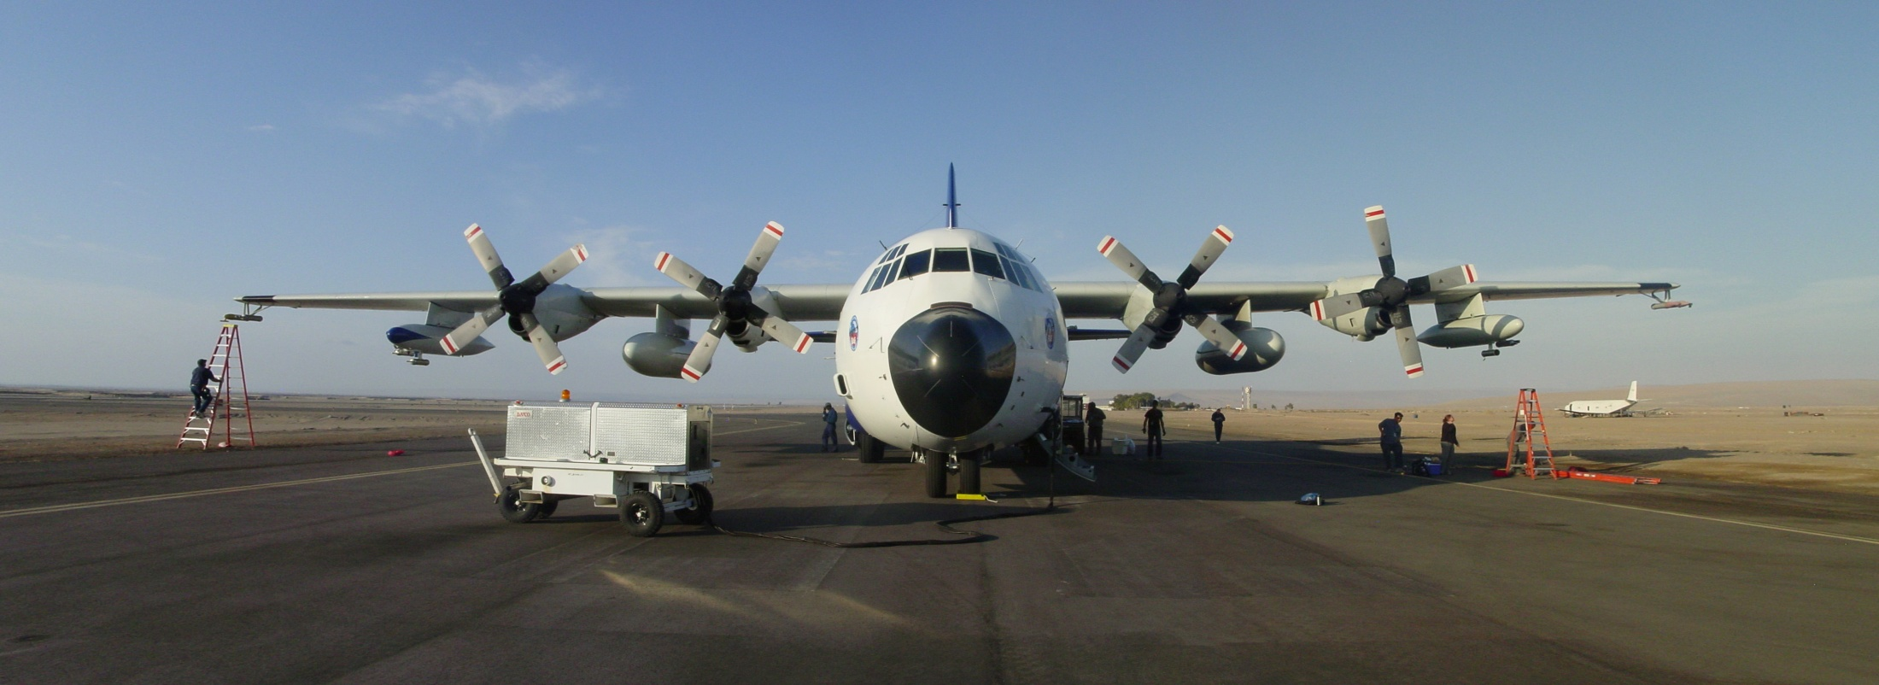
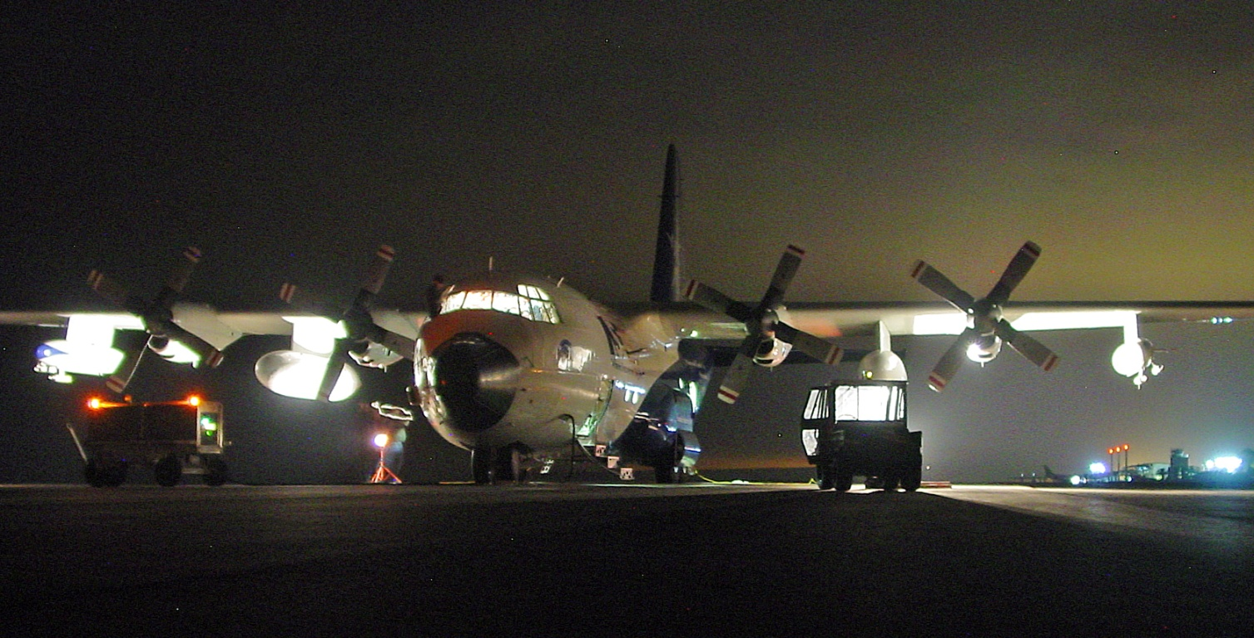

NSF/NCAR C-130

Slide 6
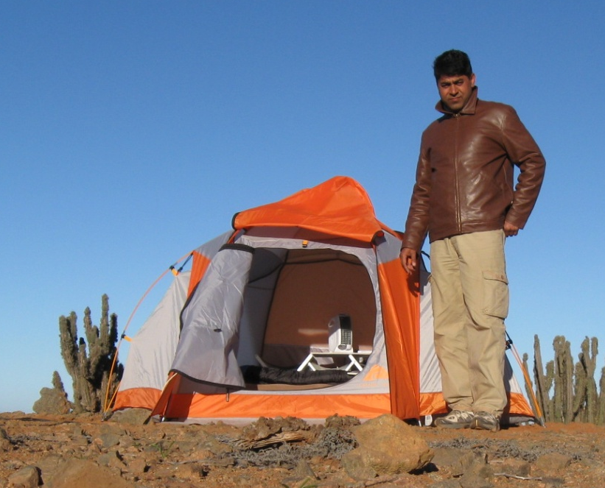
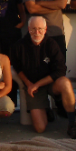

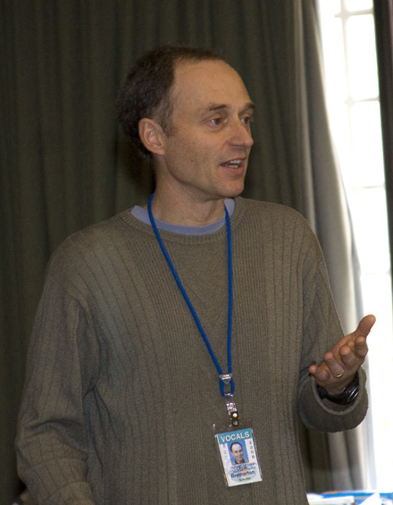

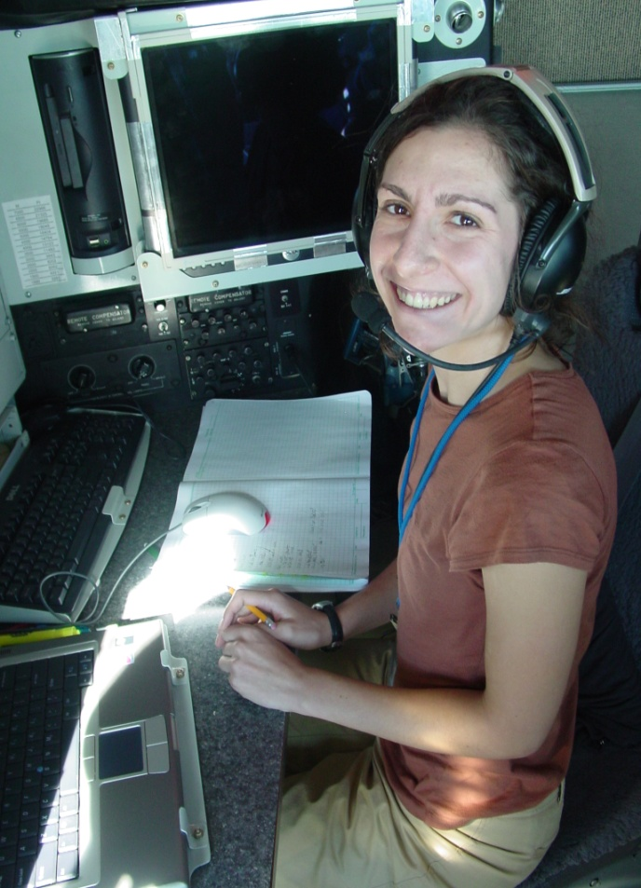
UW VOCALS Participants

Slide 7

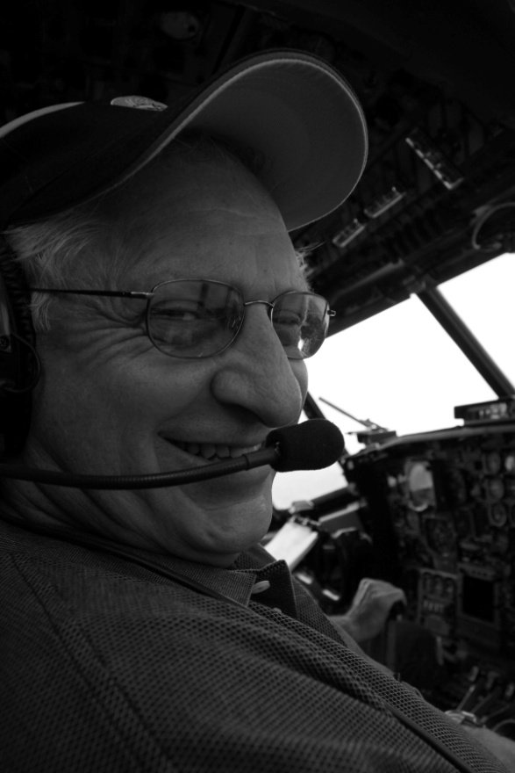

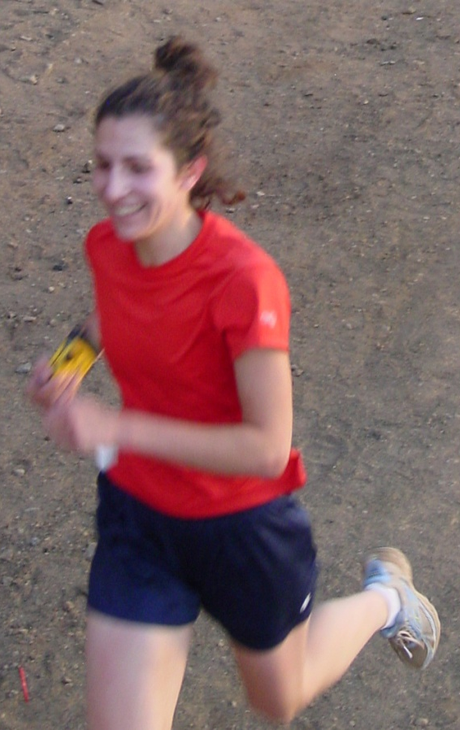
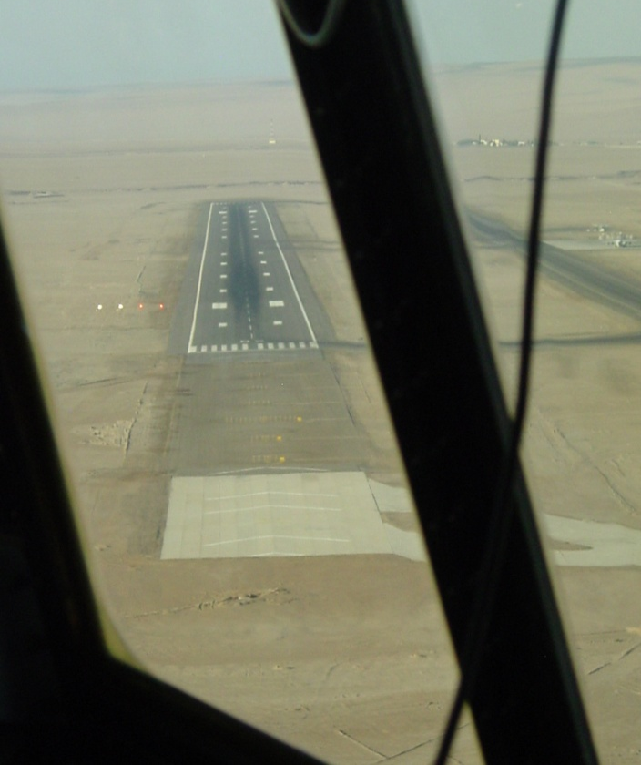
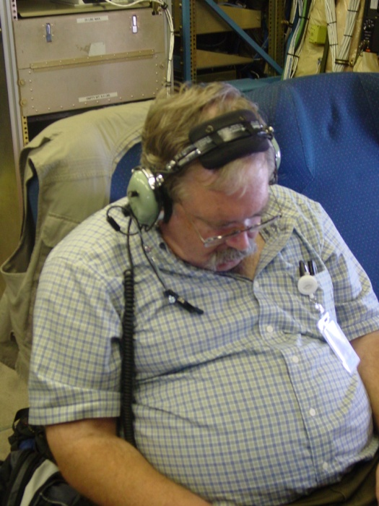

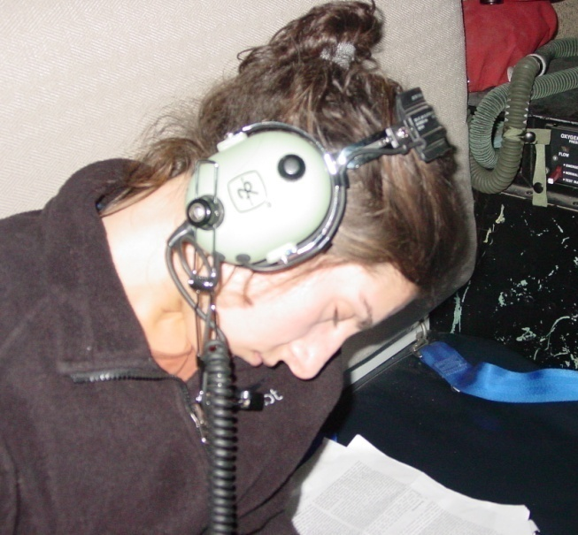
At the end of a 9 hour flight

Slide 8
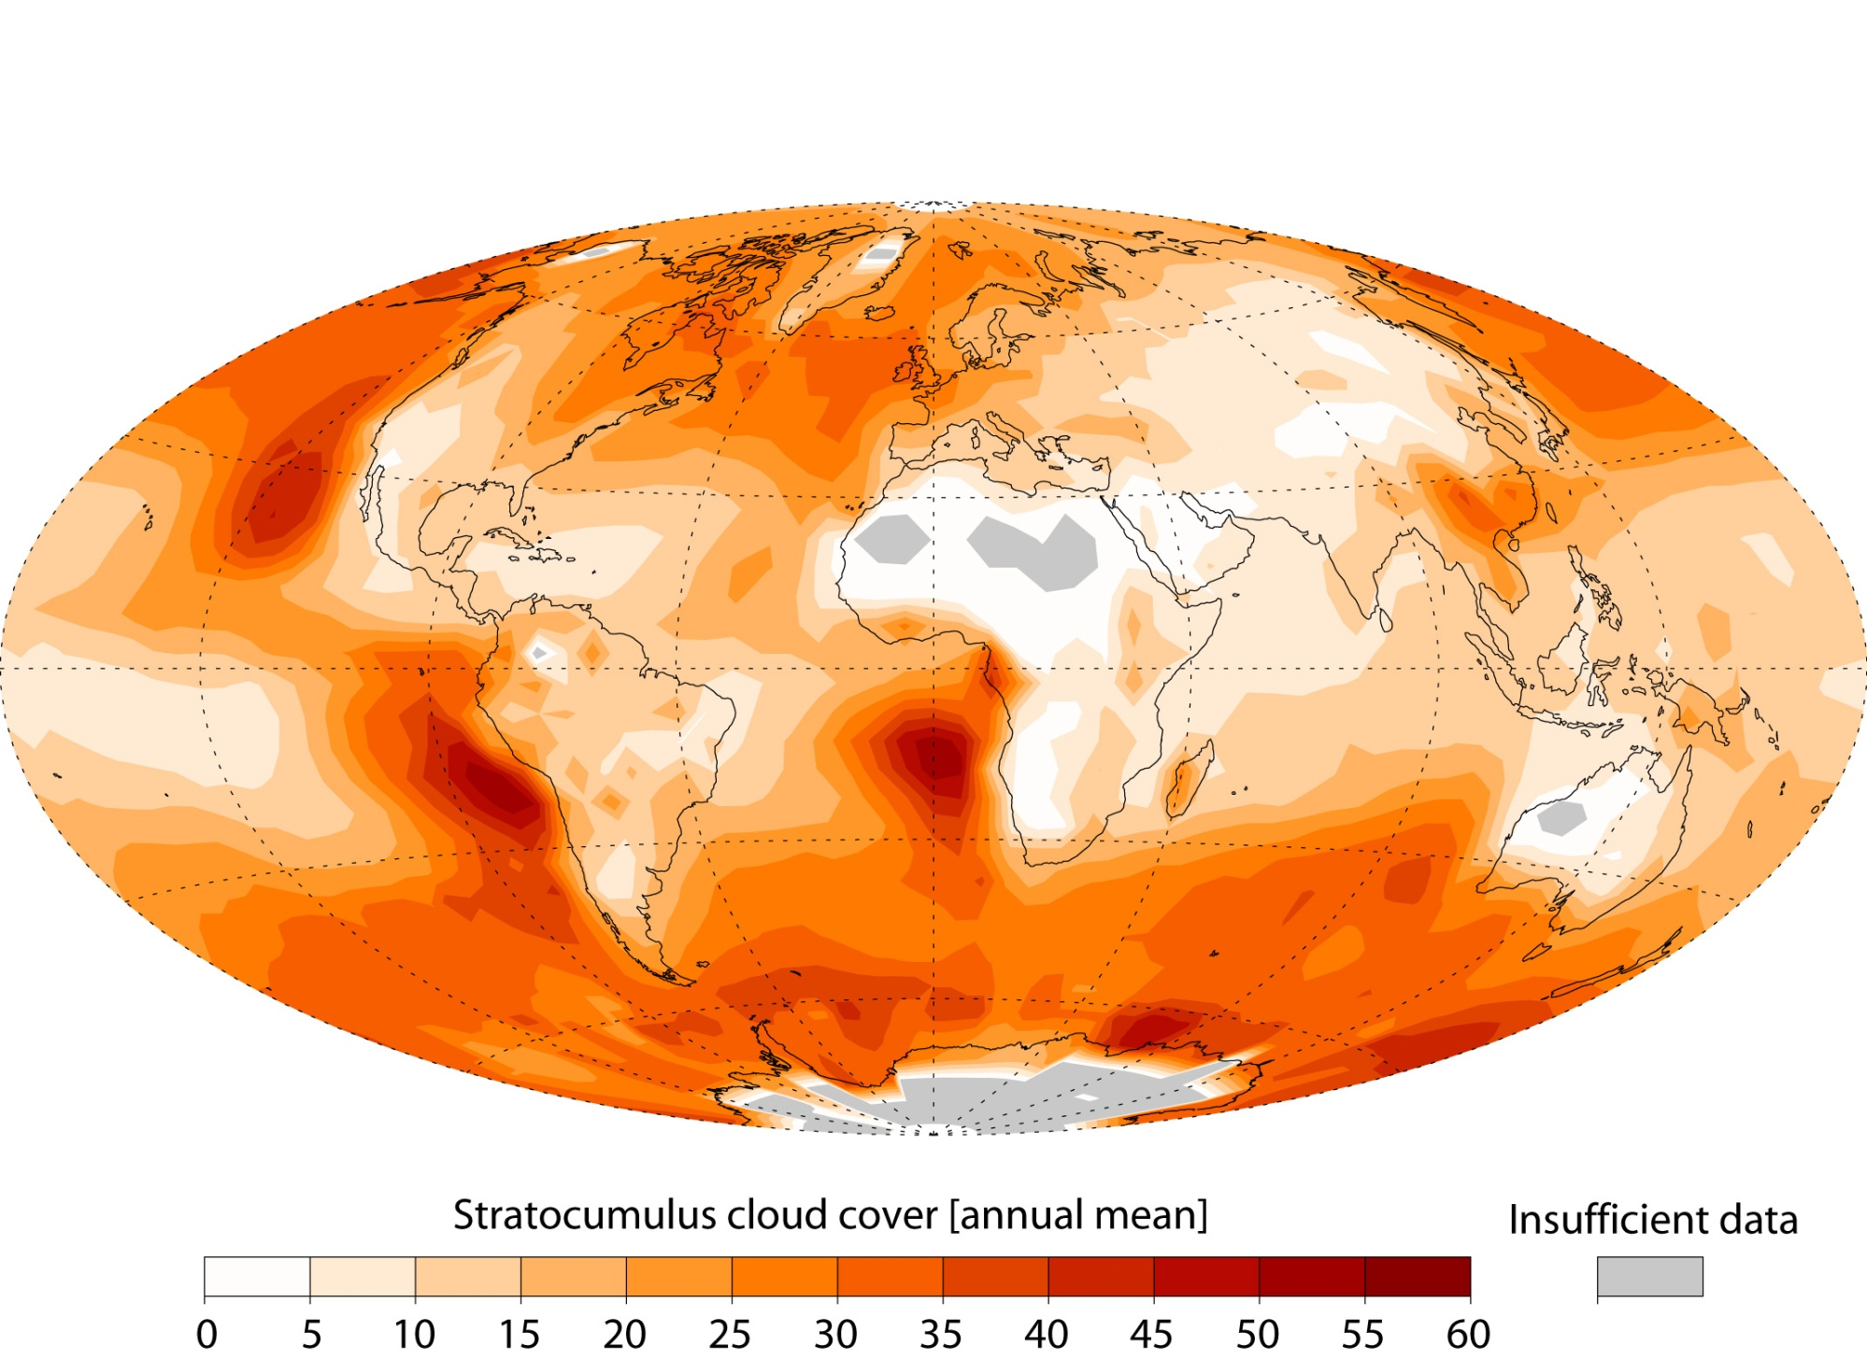
Stratocumulus cloud cover
[annual mean]

Slide 9
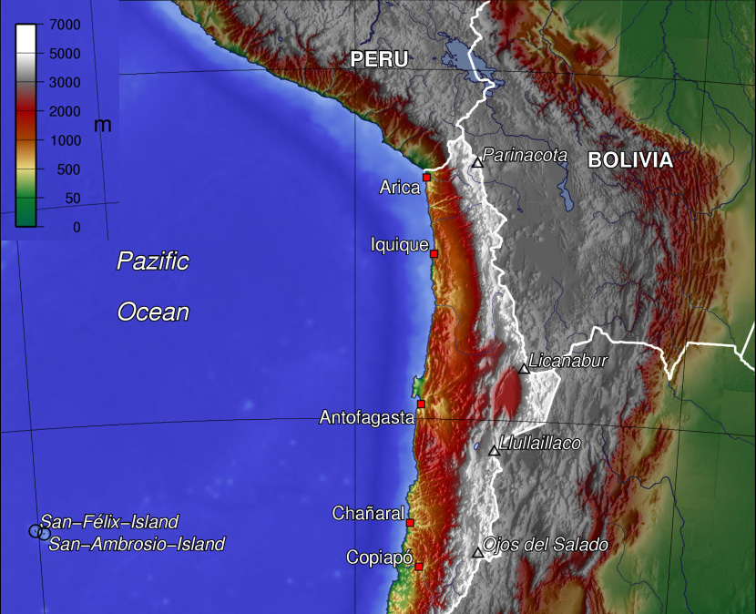
The orography of the SE Pacific rim

Slide 10
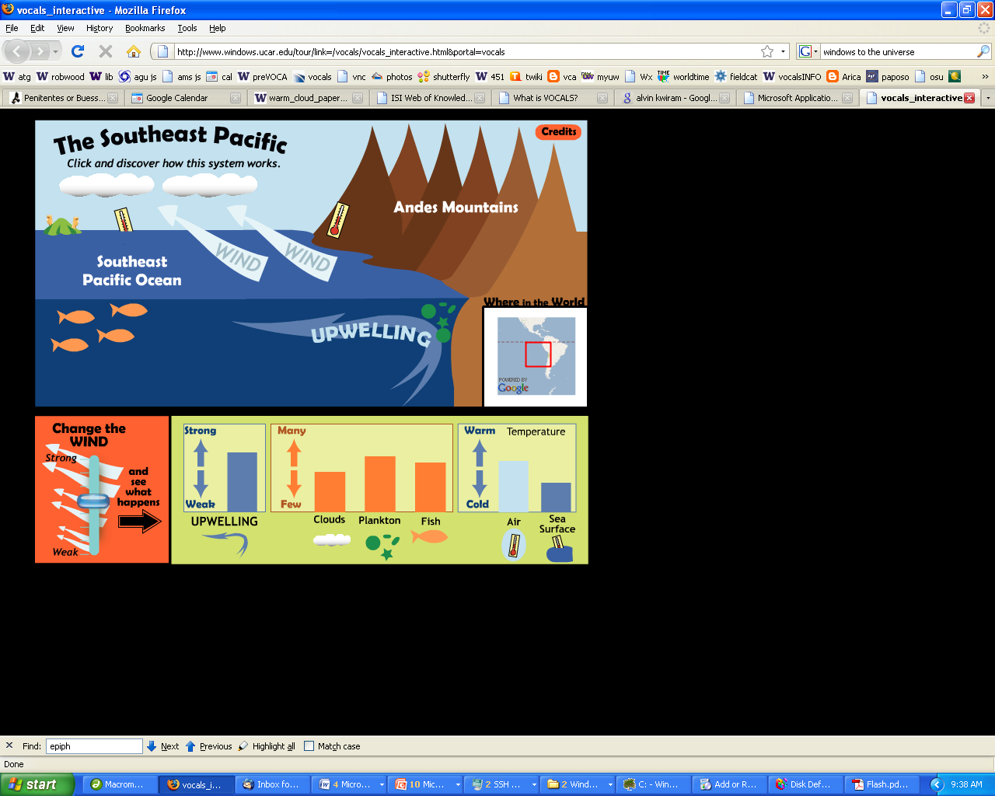

Slide 11
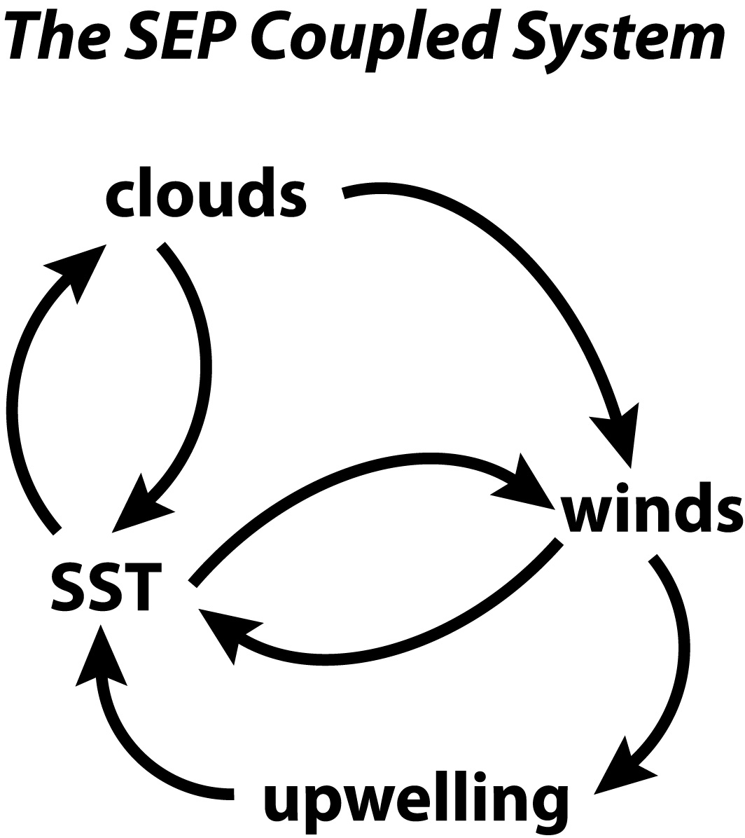

Slide 12
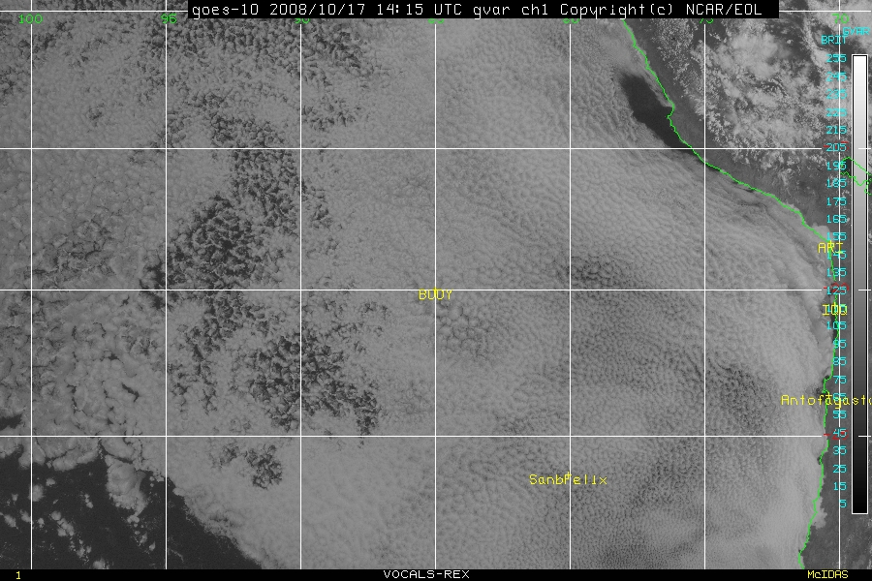
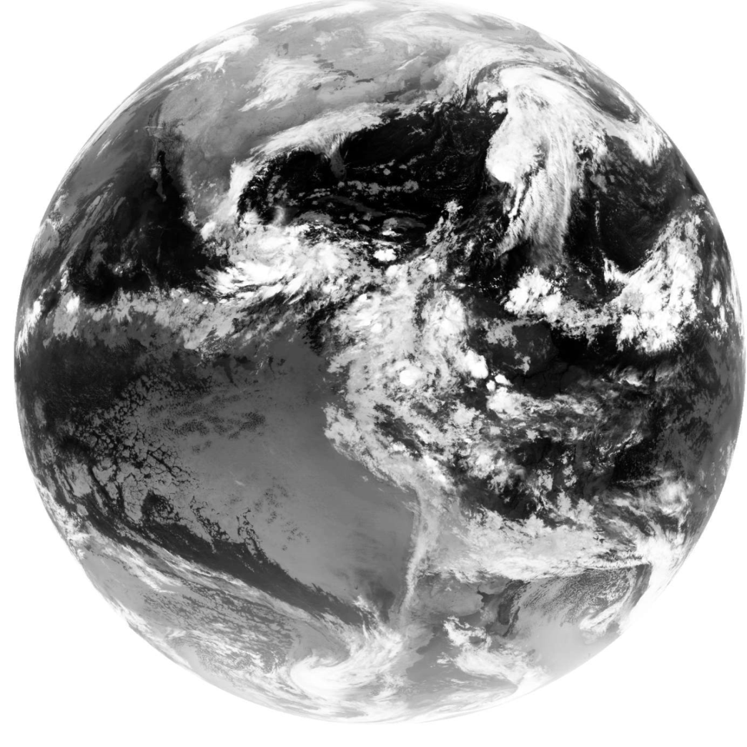
Big clouds
1500 km
range of C-130
Unbroken
for 4000 km

Slide 13
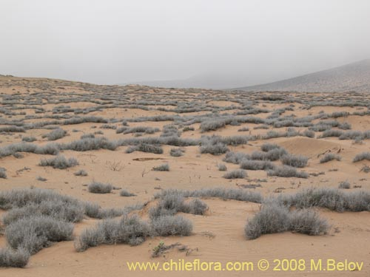
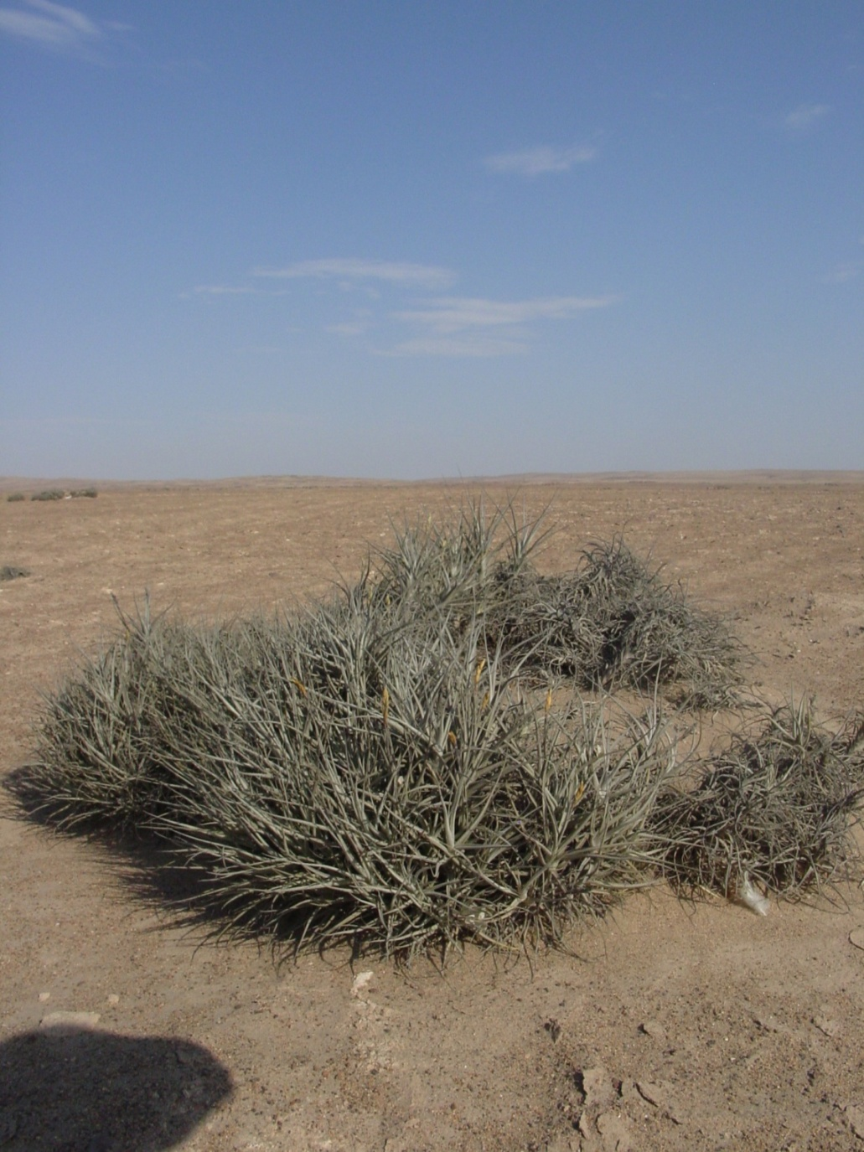
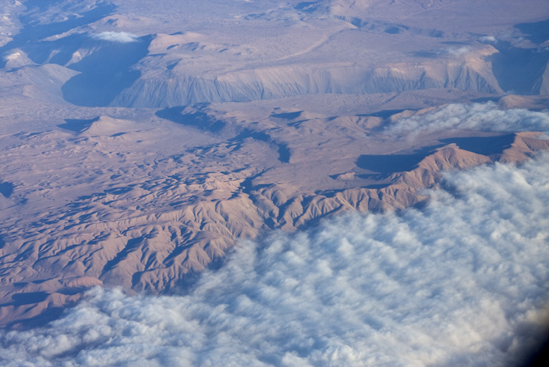
Cloud plants
Tillandsia landbeckii
one of many lomas of the Atacama region

Slide 14
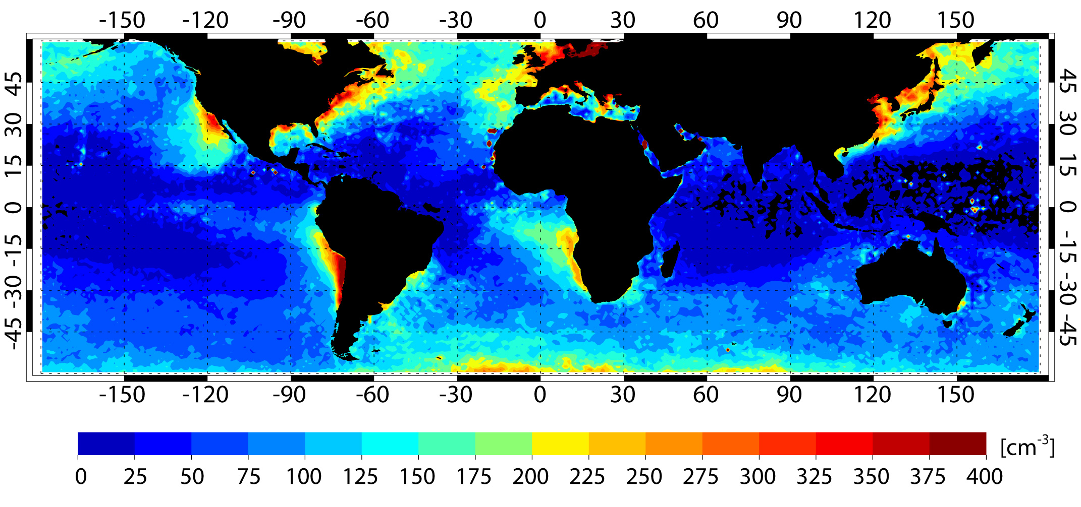
Global cloud droplet concentration (MODIS, annual mean 2001-2004)

Slide 15
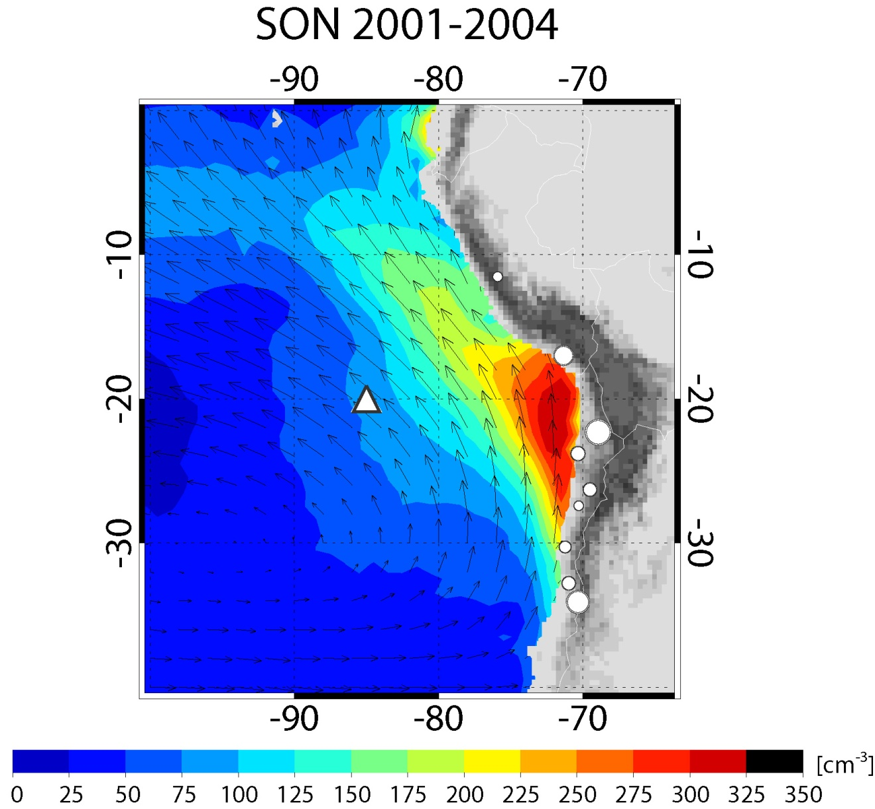
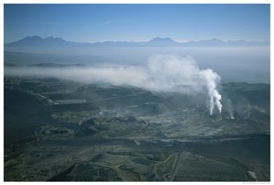
Aerosols and clouds
Chuquicamata, Chile
VOCALS-REx: DMS concentrations
insufficient to explain high aerosol/CCN concentrations
Cloud droplet concentration

Slide 16
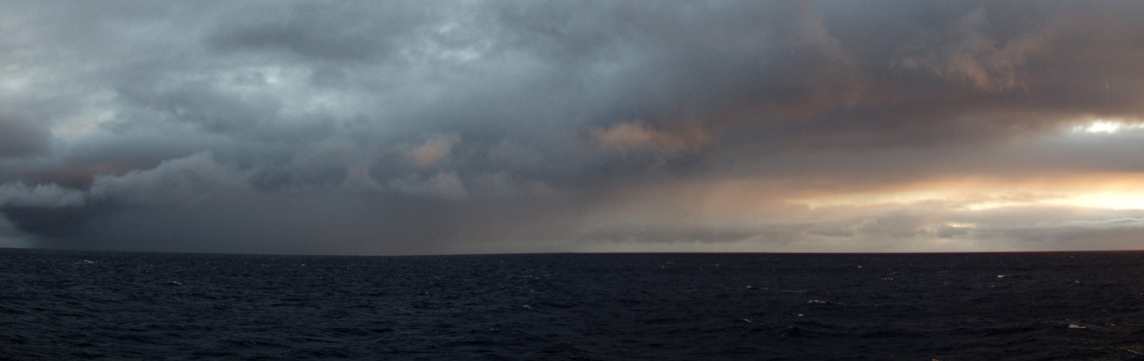
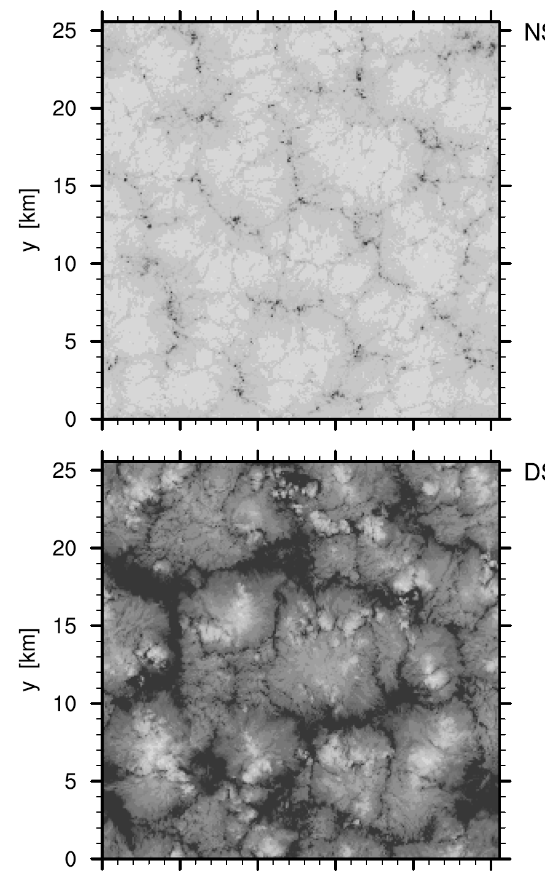
Drizzle
without drizzle with drizzle
Savic-Jovcic and Stevens (2007)

Slide 17
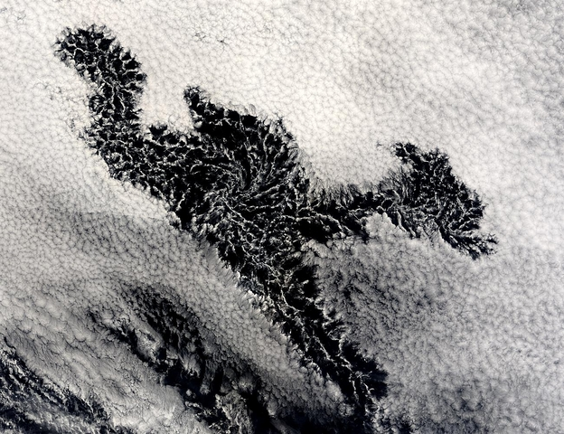
200 km
POCKETS of OPEN CELLS (POCs)
MODIS image courtesy of NASA

Slide 18
Bistable regimes for the boundary layer?
Baker and Charlson (1990) postulated the existence of two stable regimes for the boundary layer:
  a low CCN regime; balance between CCN production and loss by coalescence scavenging
  a high CCN regime; balance between CCN production and Brownian coagulation

Slide 19
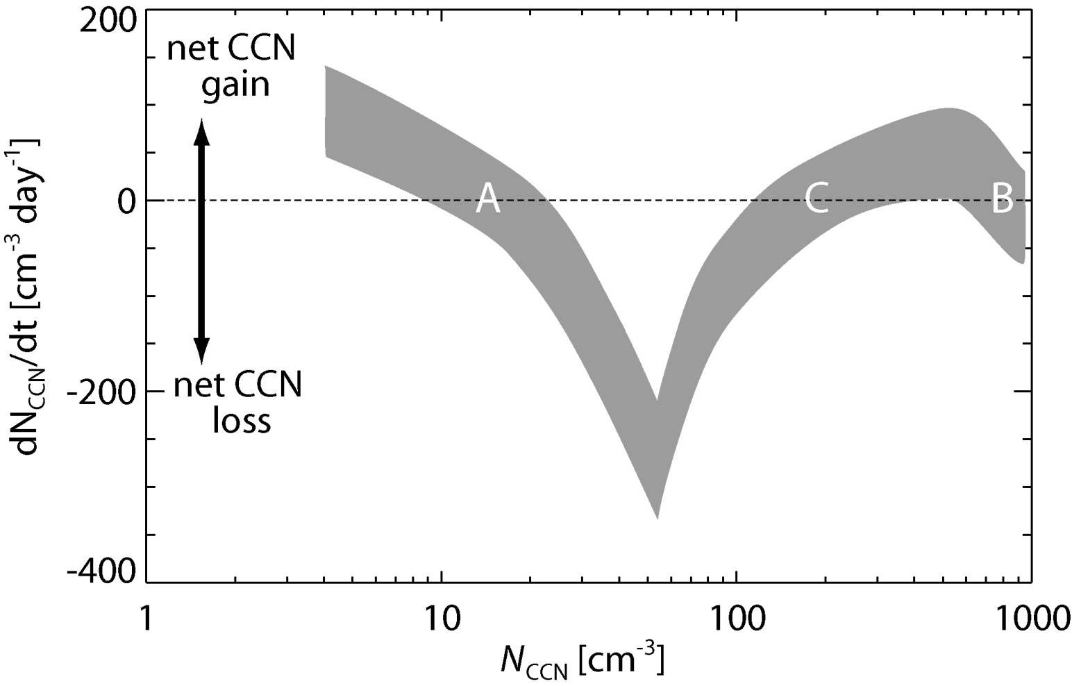
Baker and Charlson’s regimes
stable equilibria
unstable
equilibrium
reproduced from Baker and Charlson,
Nature, 345, 142-145, 1990

Slide 20
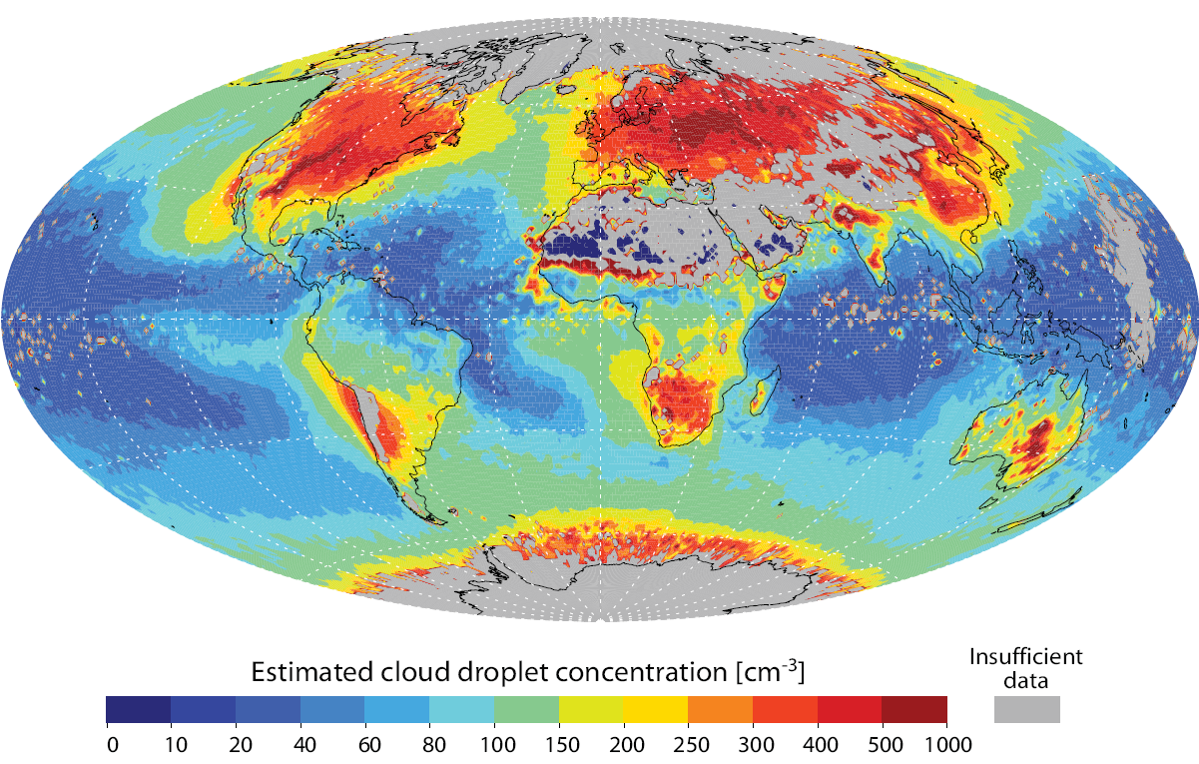
Mean cloud droplet concentration (MODIS)

Slide 21
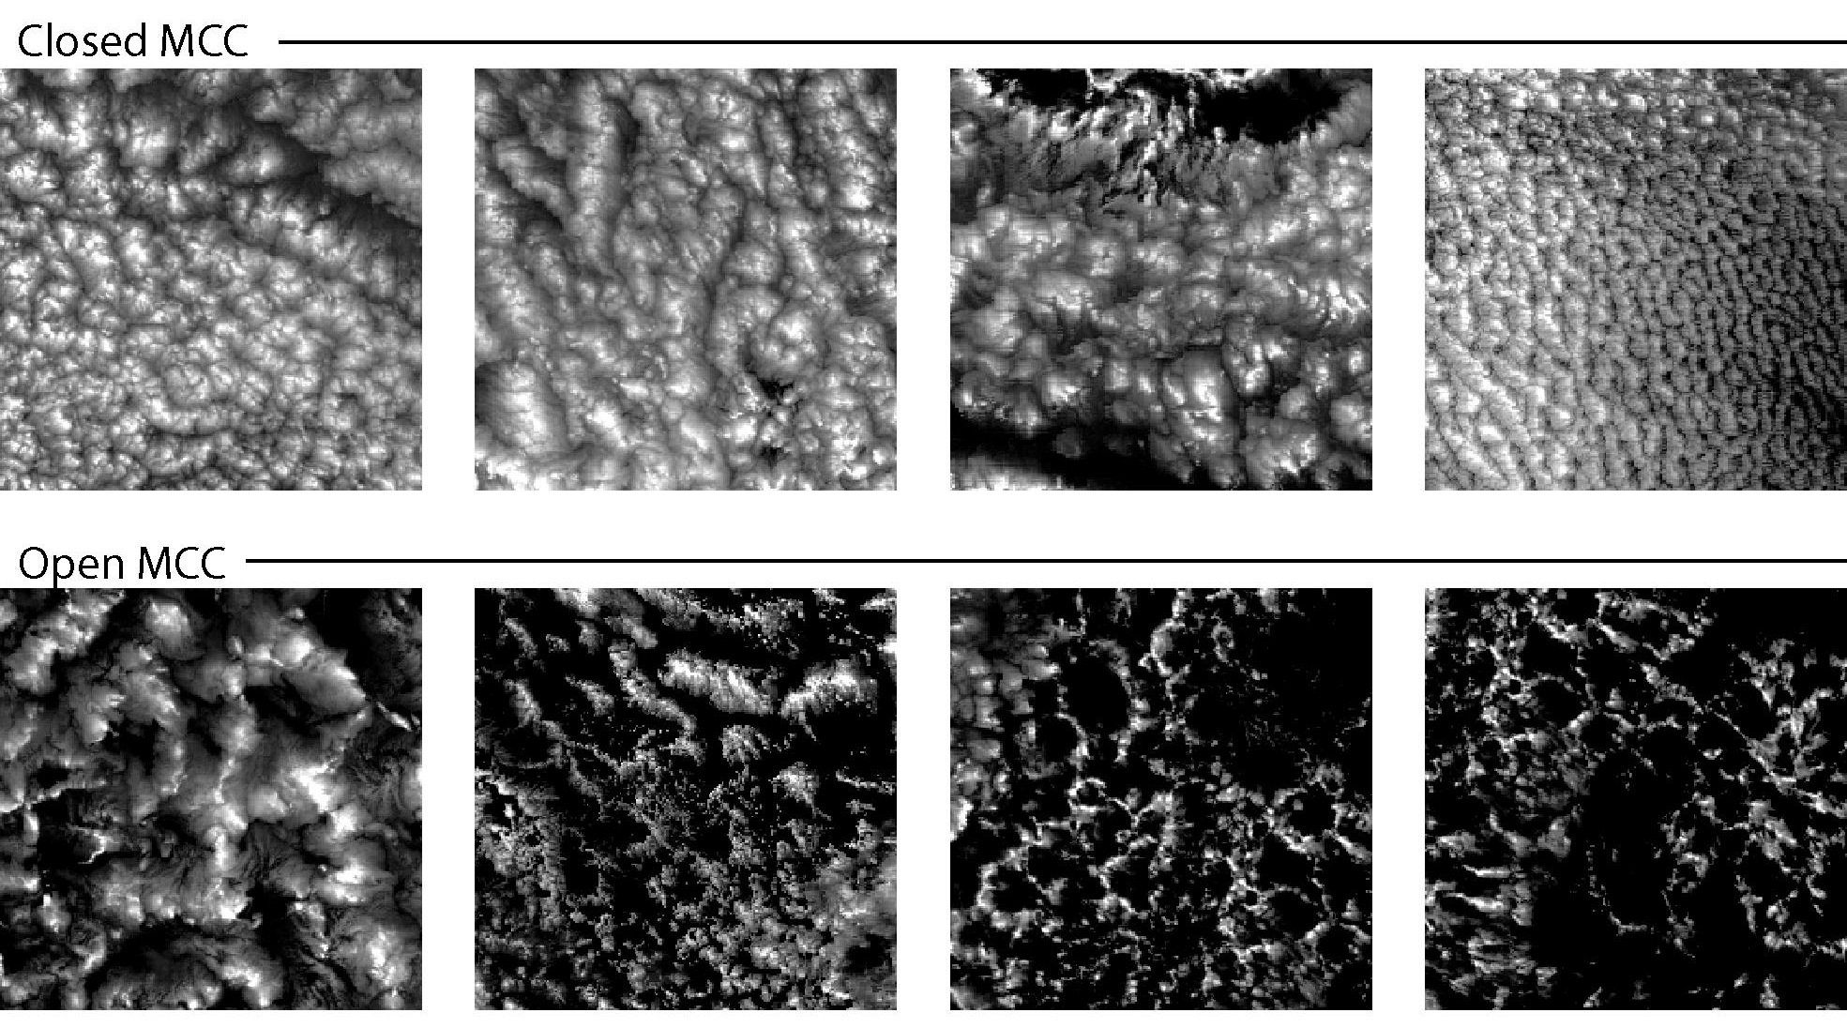
Shallow convection modes in the subtropical MBL
Wood and Hartmann, J. Clim., 2006

Slide 22
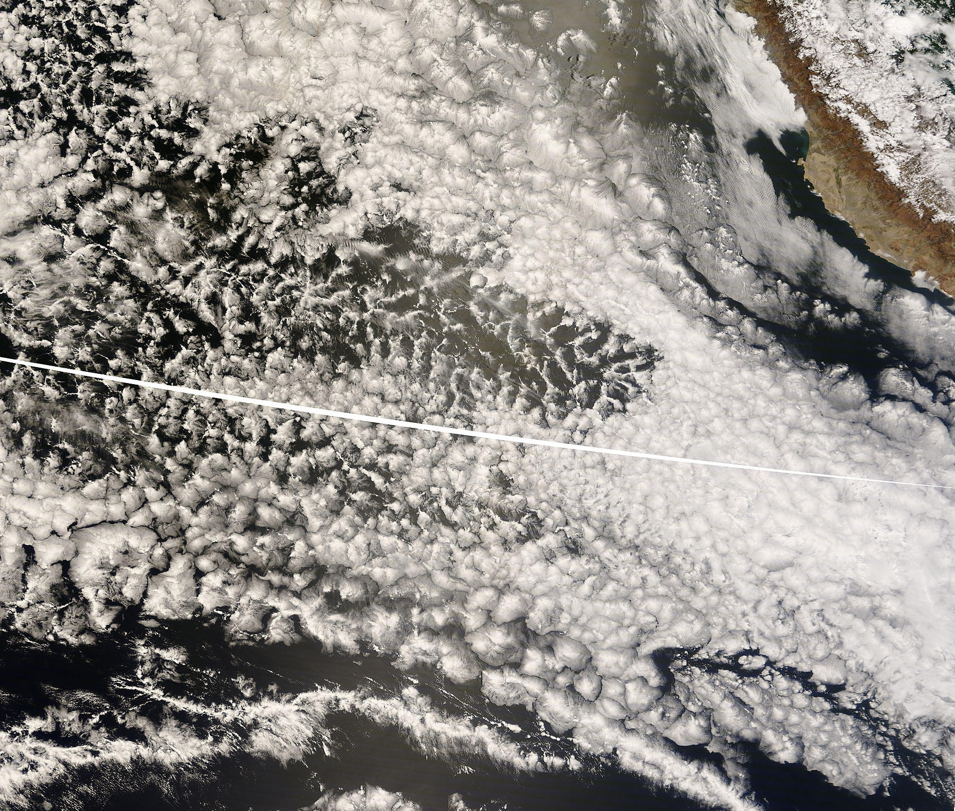
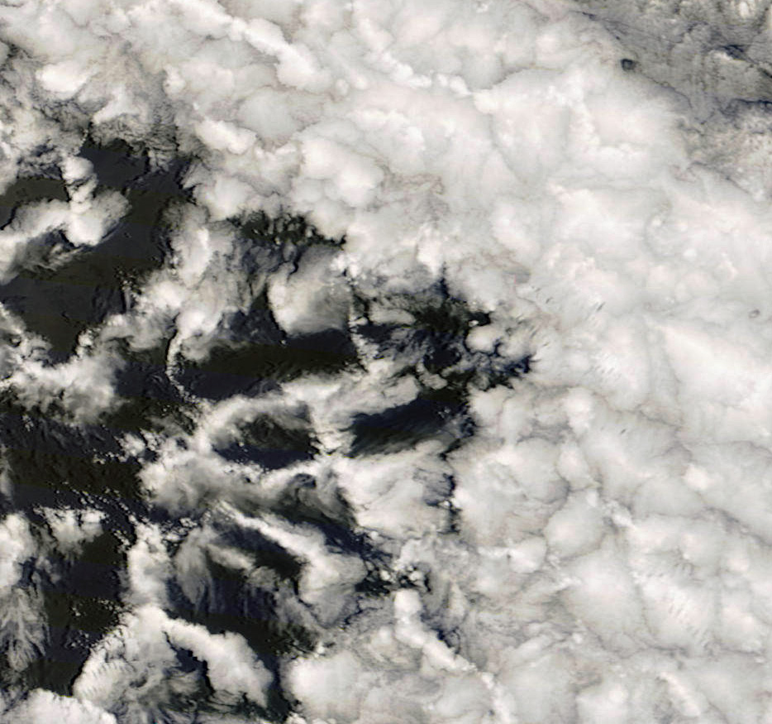
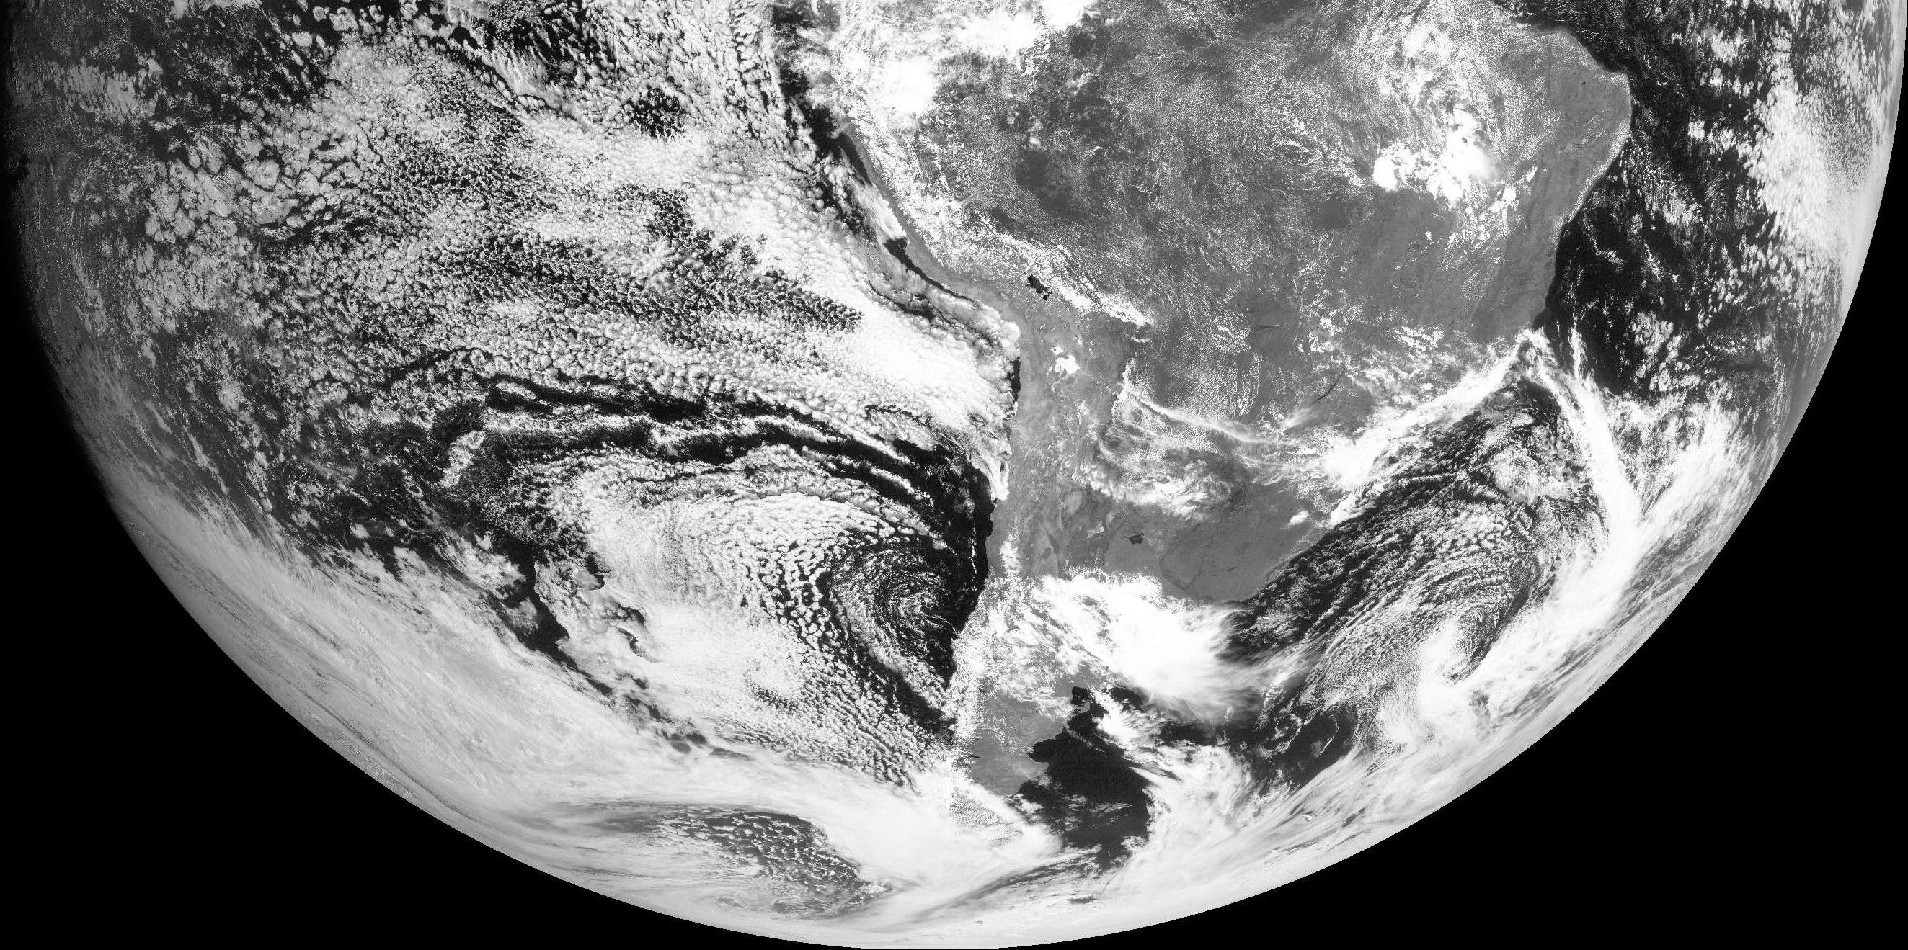
October 27/28th 2008
POC Lagrangian - BAe-146 & NSF C-130
100 km

Slide 23
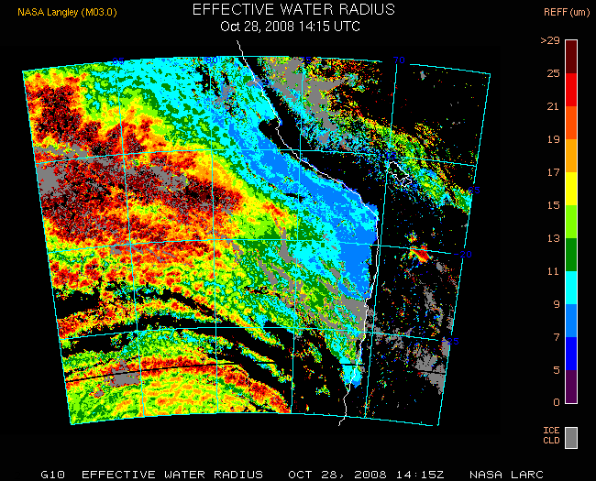
Cloud effective radius (Minnis)

Slide 24
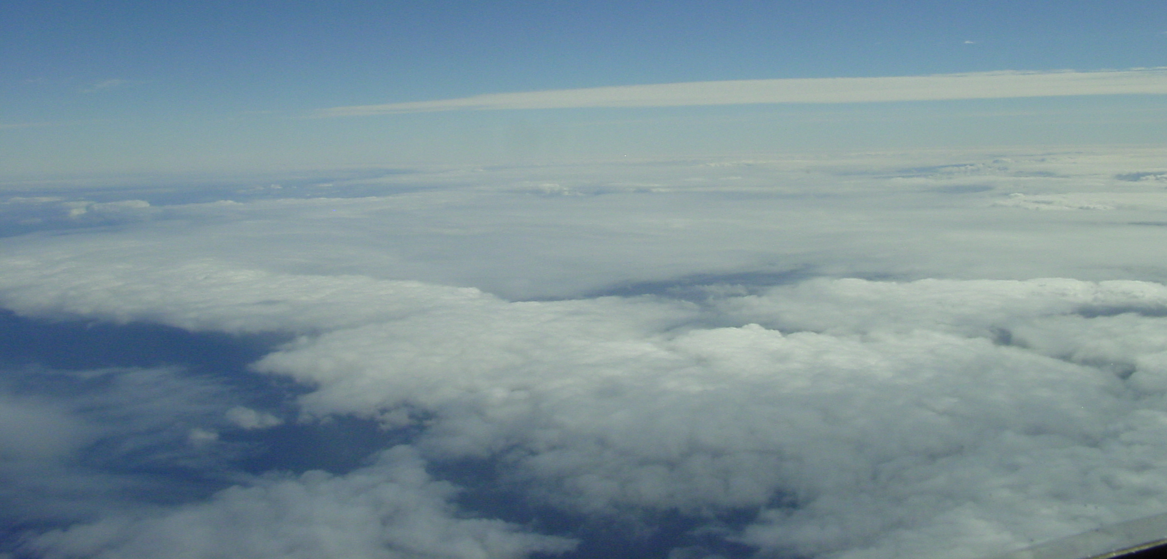
OPEN CELL MORPHOLOGY
Optically thin
cell centers
10 km
Optically thick cell walls
VOCALS NSF C-130, RF06, October 28, 2008

Slide 25
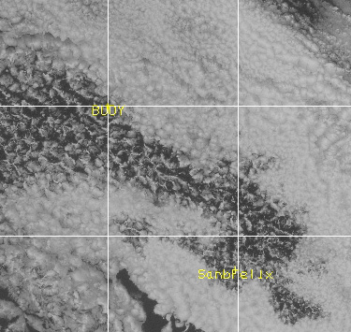
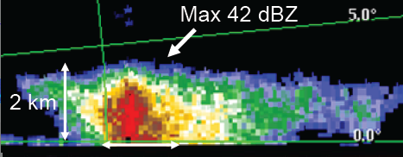
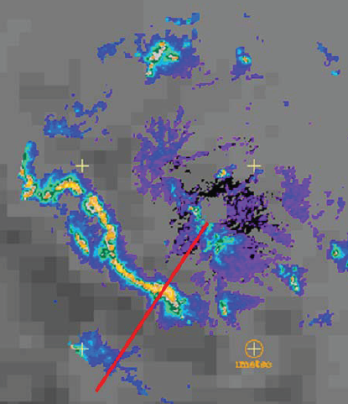

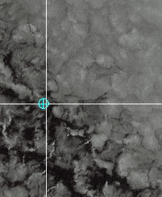
Boundary cells
POCKET of OPEN CELLS
60 km
C-band images
Matt Miller, NCSU

Slide 26
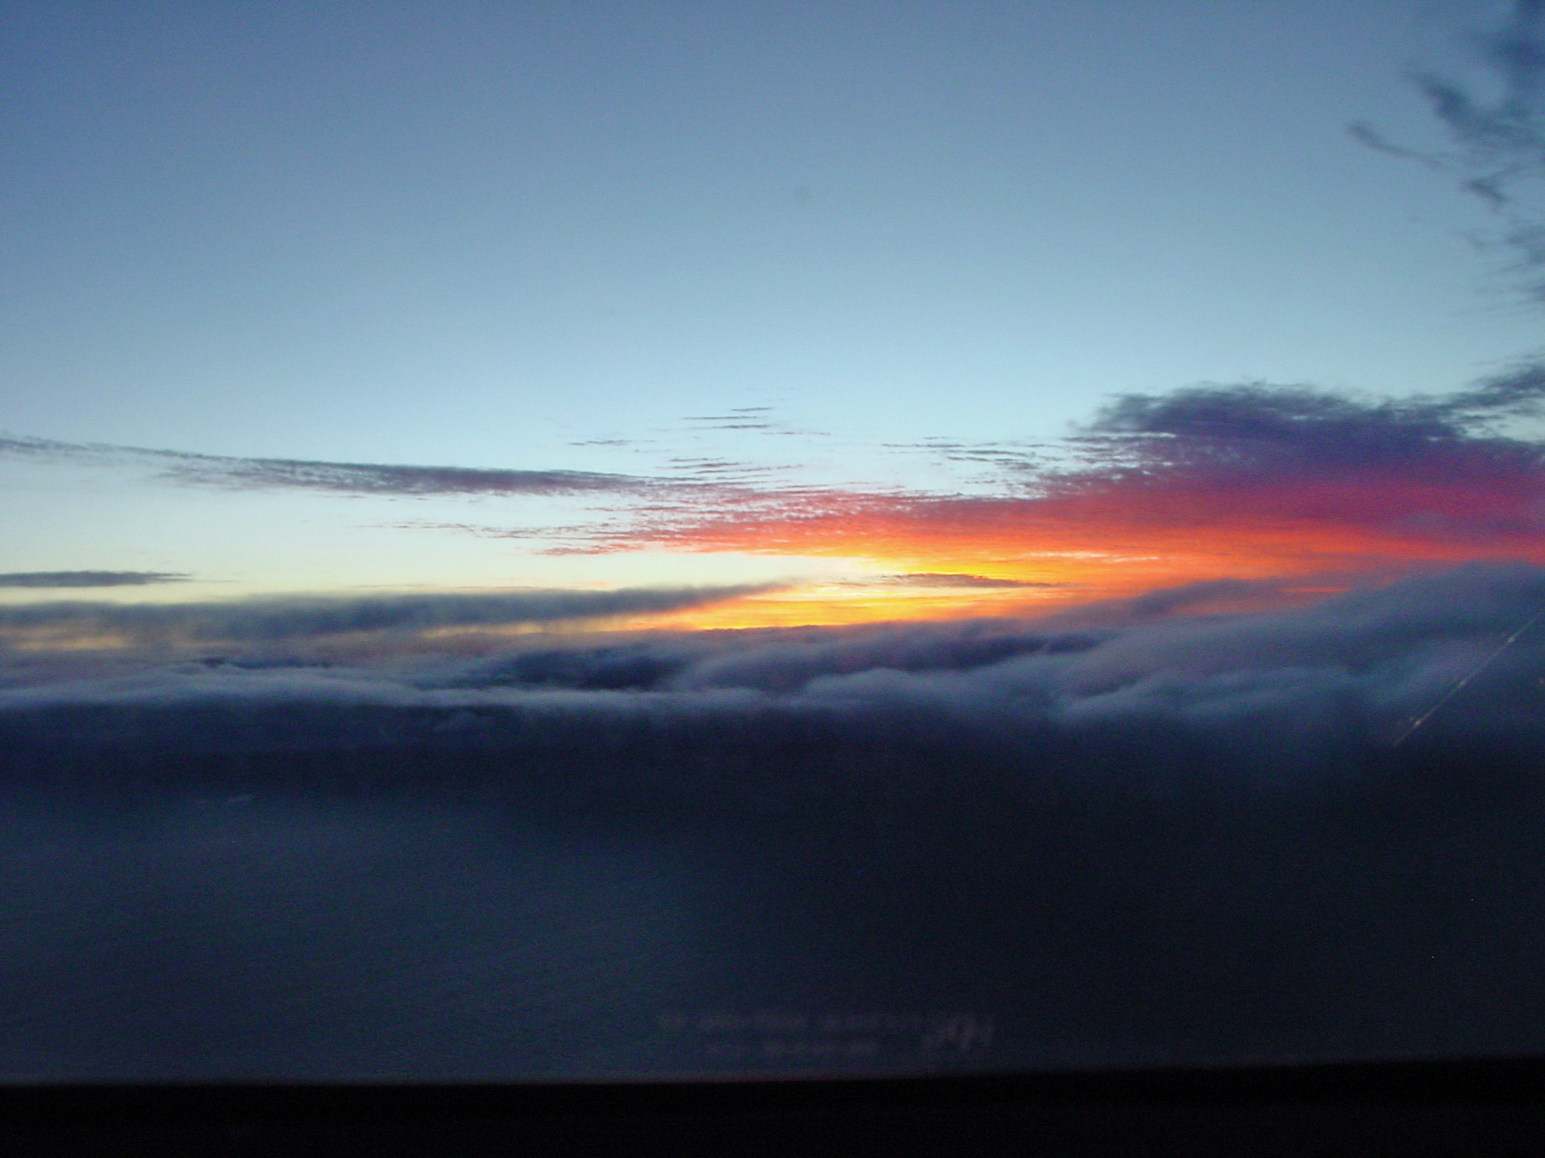
Boundary cell at dawn during RF06

Slide 27
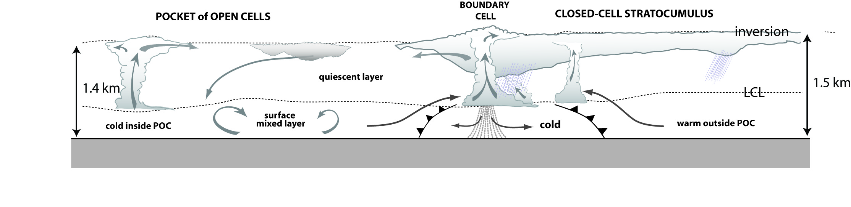

Conceptual model of POC edge
Decoupled MBL Relatively well-mixed MBL
Extremely clean
[CN = 20-50 cm⁻³, CCN = 5-20 cm⁻³]
Moderately polluted
[CN = 500-1000 cm⁻³, CCN = 100 cm⁻³]

Slide 28

AEROSOL NUMBER DISTRIBUTIONS
Nominal CCN @ 0.2%
Nominal CCN @ 0.2%
70/cc
70/cc
Droplet Shatter in Cloud
2/cc
15/cc
90/cc
10/cc
90/cc

Slide 29


Coalescence and CCN depletion
Loss rate of CCN number concentration through coalescence
  LWP ²

Slide 30

Steady-state cloud condensation nucleus (CCN) model
Assumptions:
1. Wind-driven sea-salt
production and entrainment of 100 cm⁻³ from free-troposphere
are only aerosol sources.
2. Coalescence scavenging is the only loss term
3. Examine steady state solution for CCN concentration

Slide 31




Pollution sources
Oct 19th
Hook mode
Oct 15th
Coastal mode
Two “modes”

Slide 32




Hook origin
Night-time brightness temperature difference (Ch4-Ch2)
- indicative of microphysical contrasts
17 Oct
10
20
30
18 Oct 19 Oct 20 Oct
90 80 70 ºW

Slide 33



Pollution survey missions
[SO₂] ppt
RF12, November 11th 2008
Cloud
Santiago

Slide 34

Summary
VOCALS-REx yielding important information to understand
  Role of drizzle in controlling cloud structure and dynamics
  Limits to the stability of marine stratocumulus decks
  Processes controlling distribution of aerosol pollution over the SE Pacific

Slide 36

Stratocumulus survey missions
(along 20ºS parallel)

Slide 37


20ºS Missions
20ºS/85ºW
20ºS parallel
RF04 10/23/2008 3-12 local
Relative humidity
10000
8000
6000
4000
2000
0
85 80 75 70ºW

Slide 38


Millimeter cloud radar, microphysics aerosol data
RF03
Courtesy Dave Leon

Slide 39




2.0
1.5
1.0
0.5
0.0
[km]
Oct 21
Oct 23
Altitude
Oct 25
Nov 6
85 84 83 82 81 80 79 78 77 76 75 74 73
Longitude [deg W]

Slide 40




Stratocumulus Funnel Clouds
20 Nov 2008, 85ºW 20ºS
5km
-10 0 10 20 30 40 dBZ
2km

Slide 41


Slide 42


Slide 43
Take-home messages
Precipitation common in, and energetically important for, shallow marine boundary layers
Precipitation rate is macrophysically-determined but can be influenced microphysically
Precipitation important for organization of mesoscale structure in the stratocumulus-topped boundary layer
Precipitation important for controlling aerosol population within the marine boundary layer

Slide 45


Slide 47


Slide 48

October 27/28th 2008
POC Lagrangian - BAe-146 & NSF C-130
MODIS Terra, 250 m visible image
Photo from BAe-146, Hugh Coe

