Slide 1
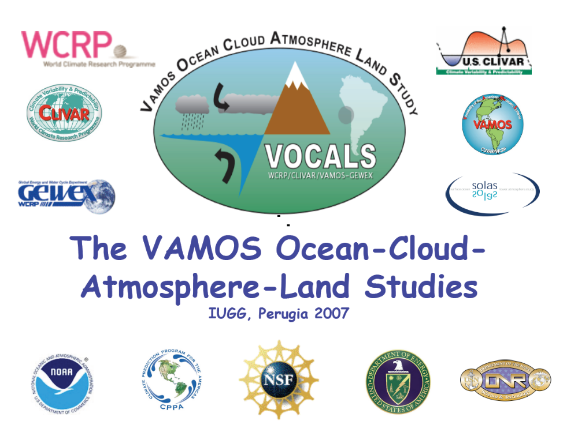
The VAMOS Ocean-Cloud-Atmosphere-Land Study
Regional Experiment (VOCALS-REx)

Slide 2
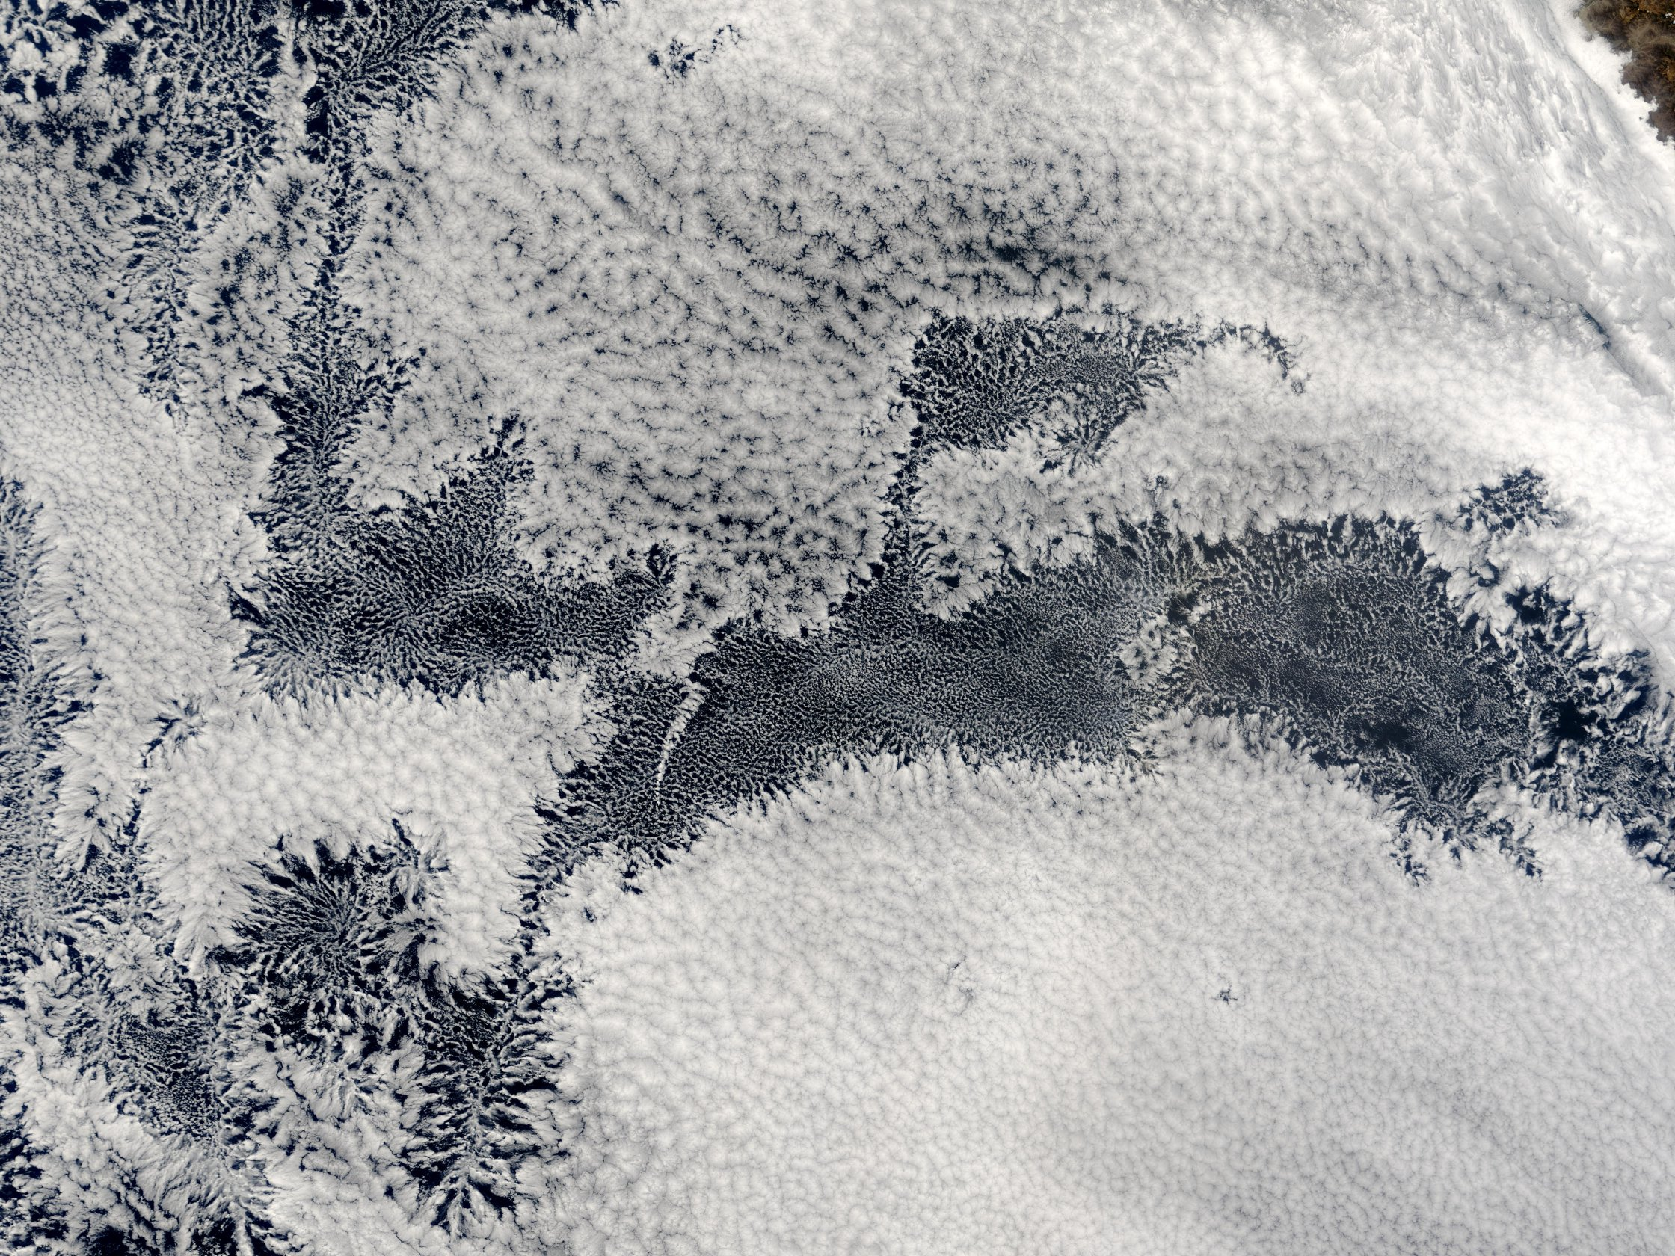
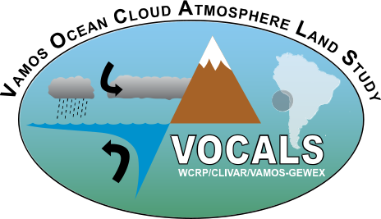
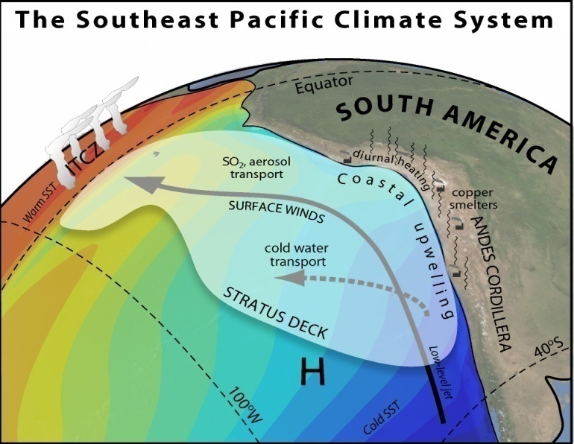
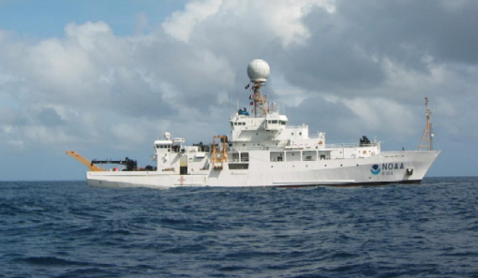

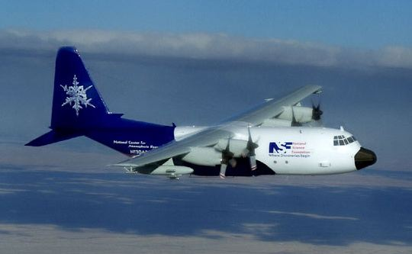
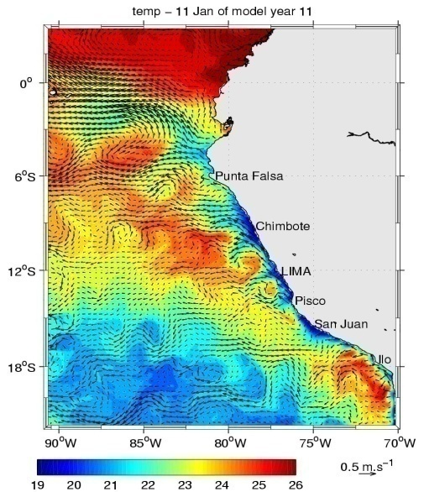
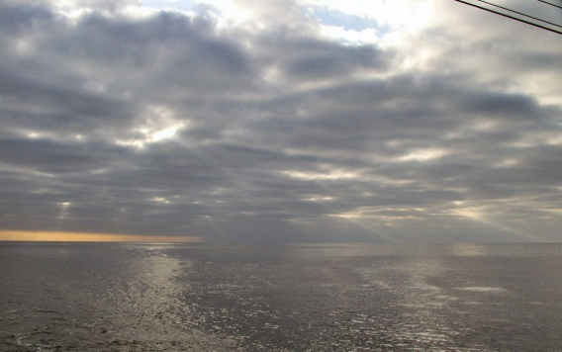
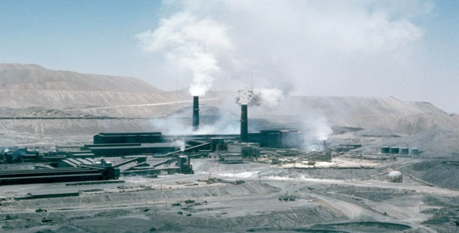
VOCALS Regional Experiment:
Hypotheses and Initial Results
Robert Wood, University of Washington
C Roberto Mechoso, Chris Bretherton, Bob Weller, Bruce Albrecht, Phil Brown, Hugh Coe, Pete Daum, Chris Fairall, Rene Garreaud, Laura Gallardo, Carmen Grados, Geraint Vaughan
Aircraft, ships,
and land sites
Stratocumulus clouds
Regional pollution
Mesoscale ocean eddies

Slide 3
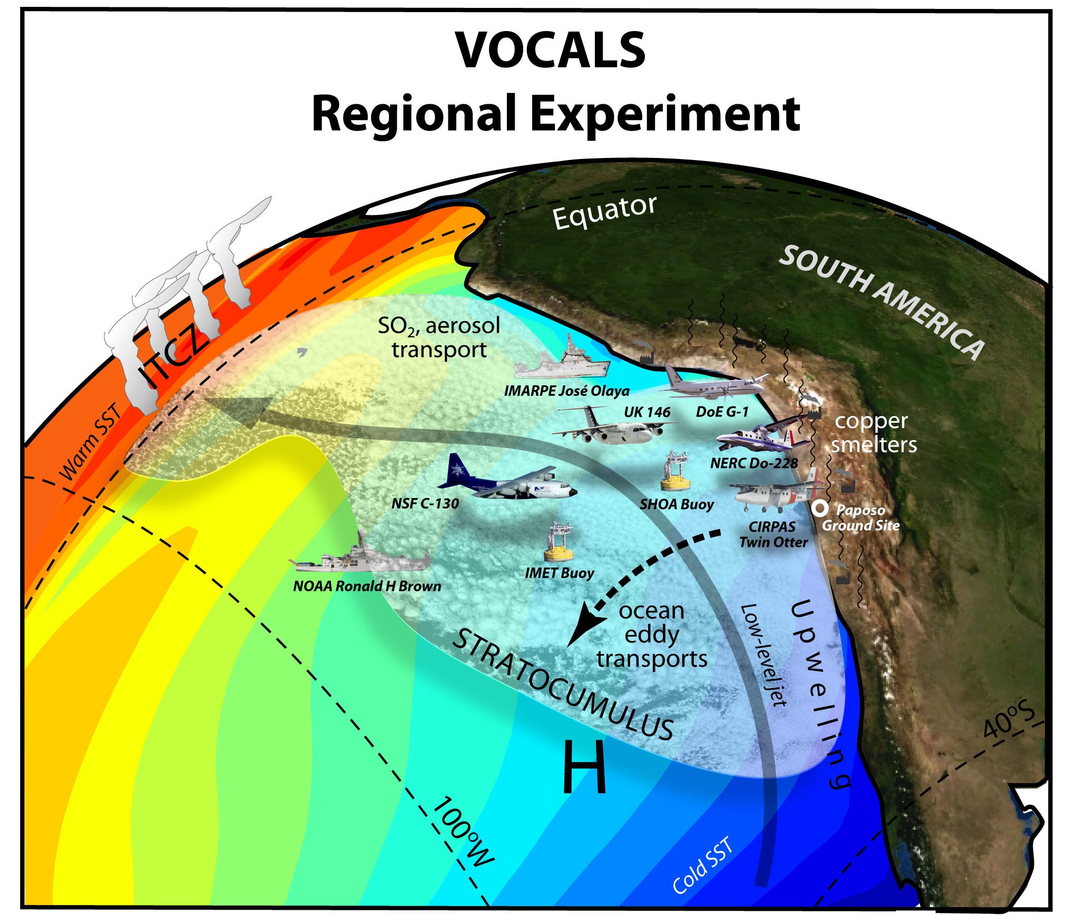

Slide 4
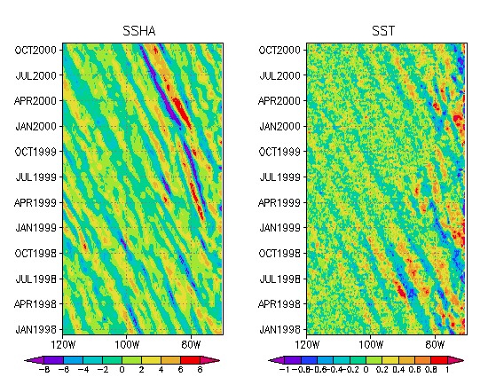
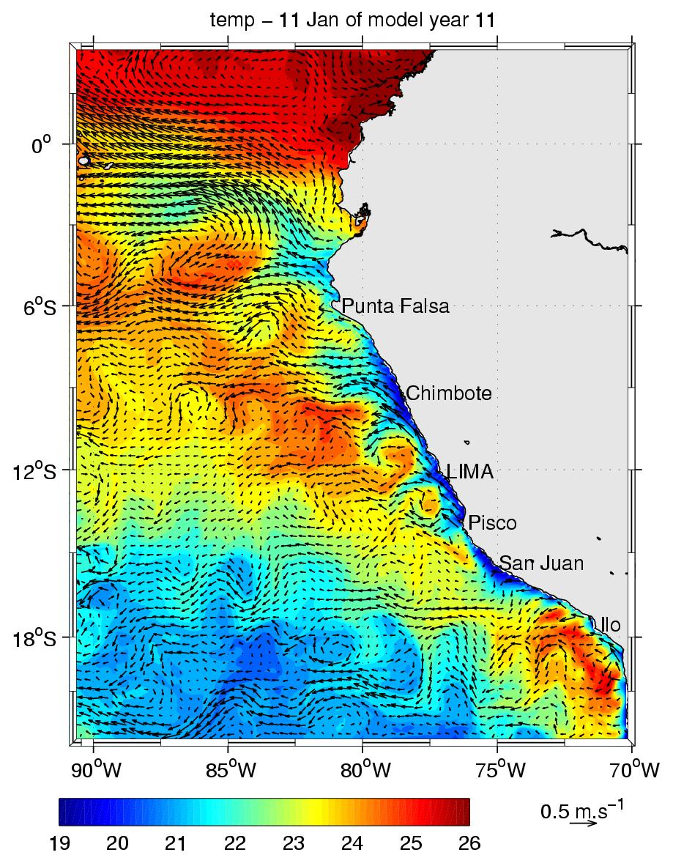
Oceanic processes
Height
SST

Slide 5
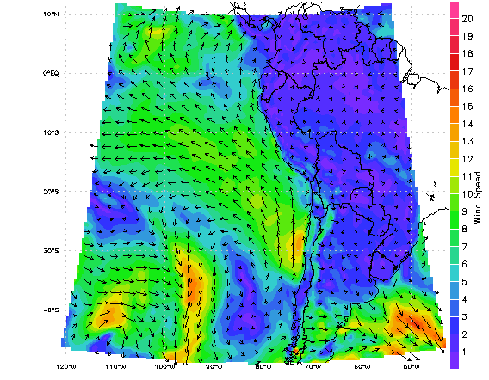
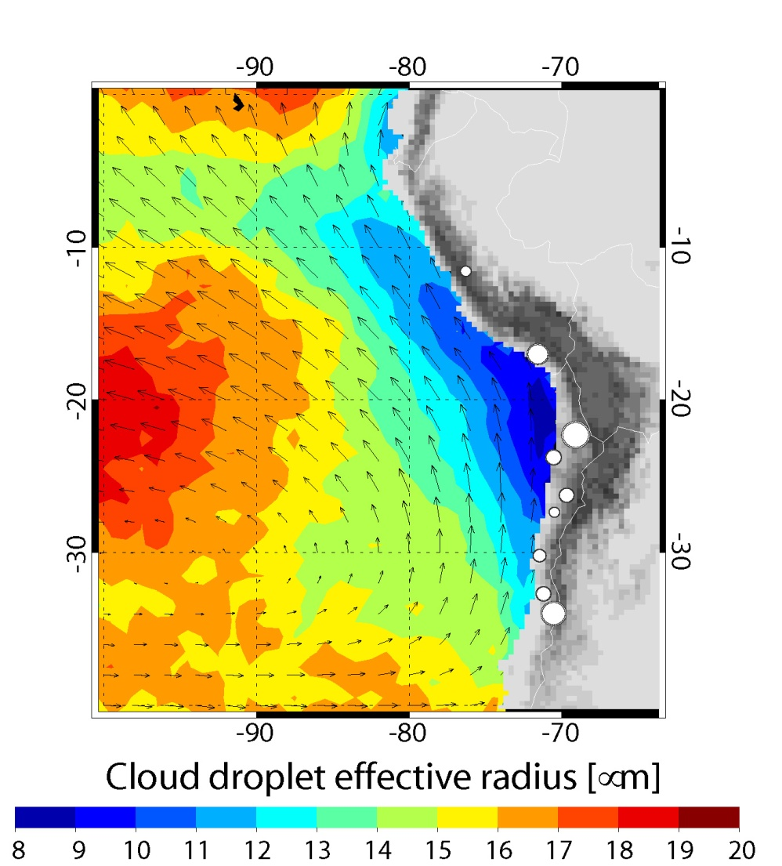
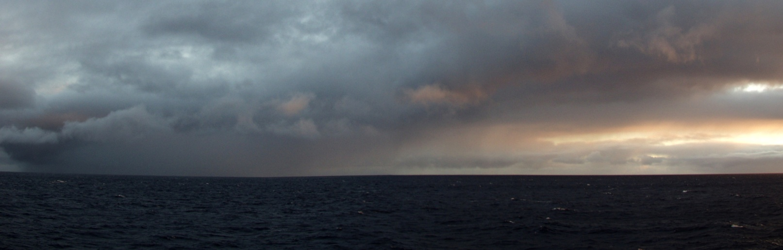
Atmospheric processes
Winds
Aerosols
μ
Clouds and precipitation

Slide 6
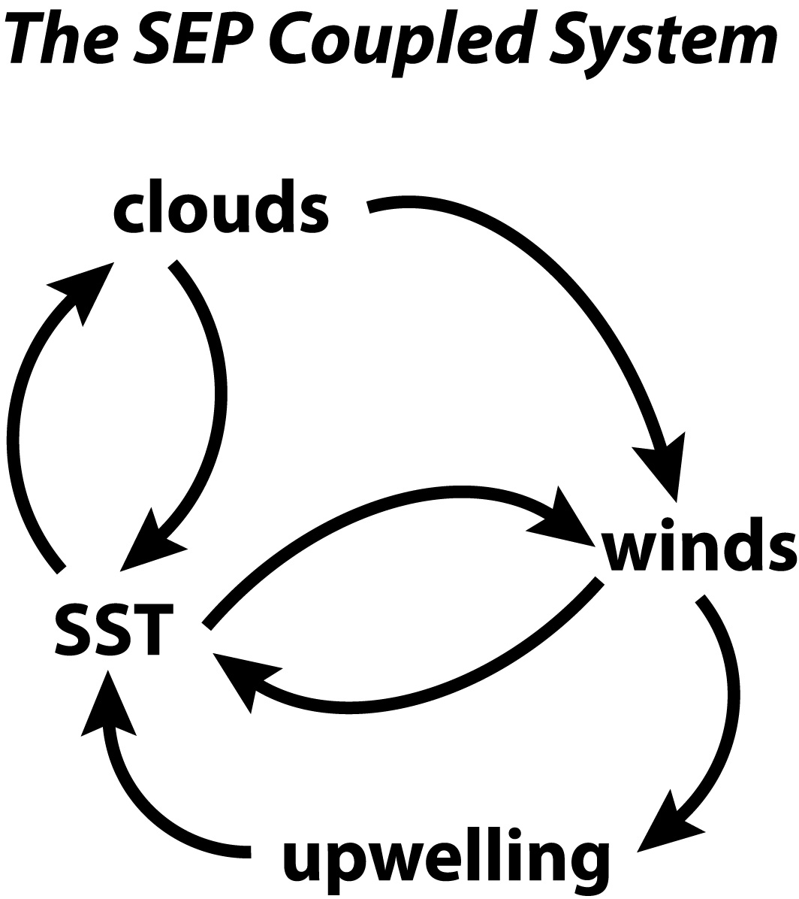
Climate models poorly represent several of these key processes

Slide 7
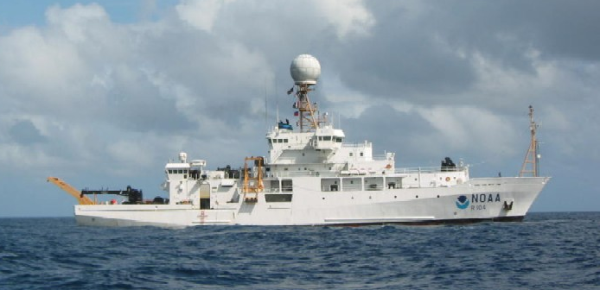
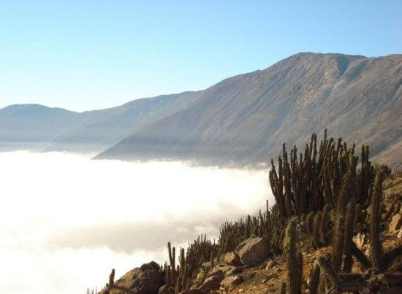
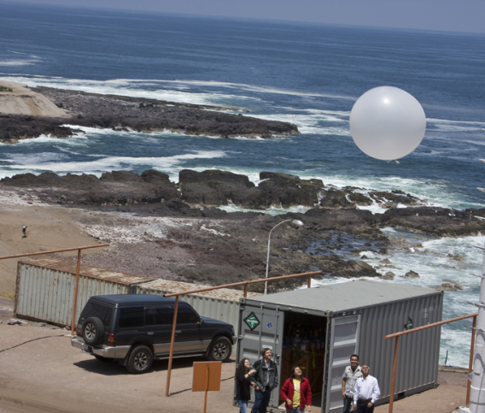
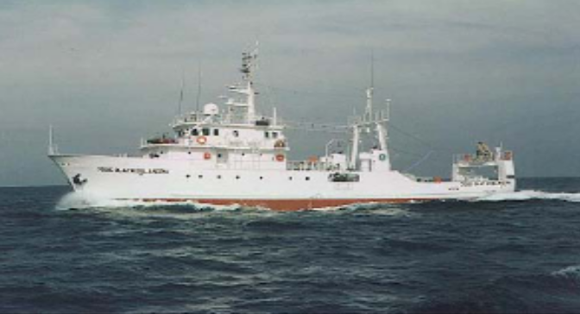
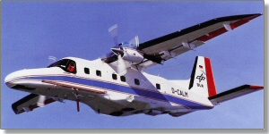
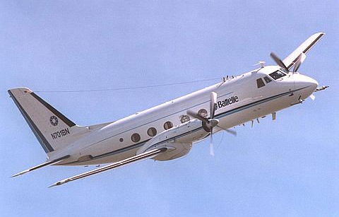
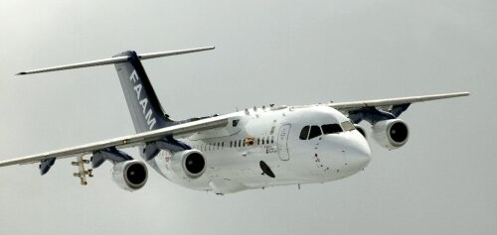
VOCALS-REx Platforms
NSF C-130
NOAA Ronald H Brown
Paposo
Iquique
IMARPE José Olaya
CIRPAS Twin Otter
NERC Dornier 228
UK FAAM BAe-146
DoE ASP G-1

Slide 8
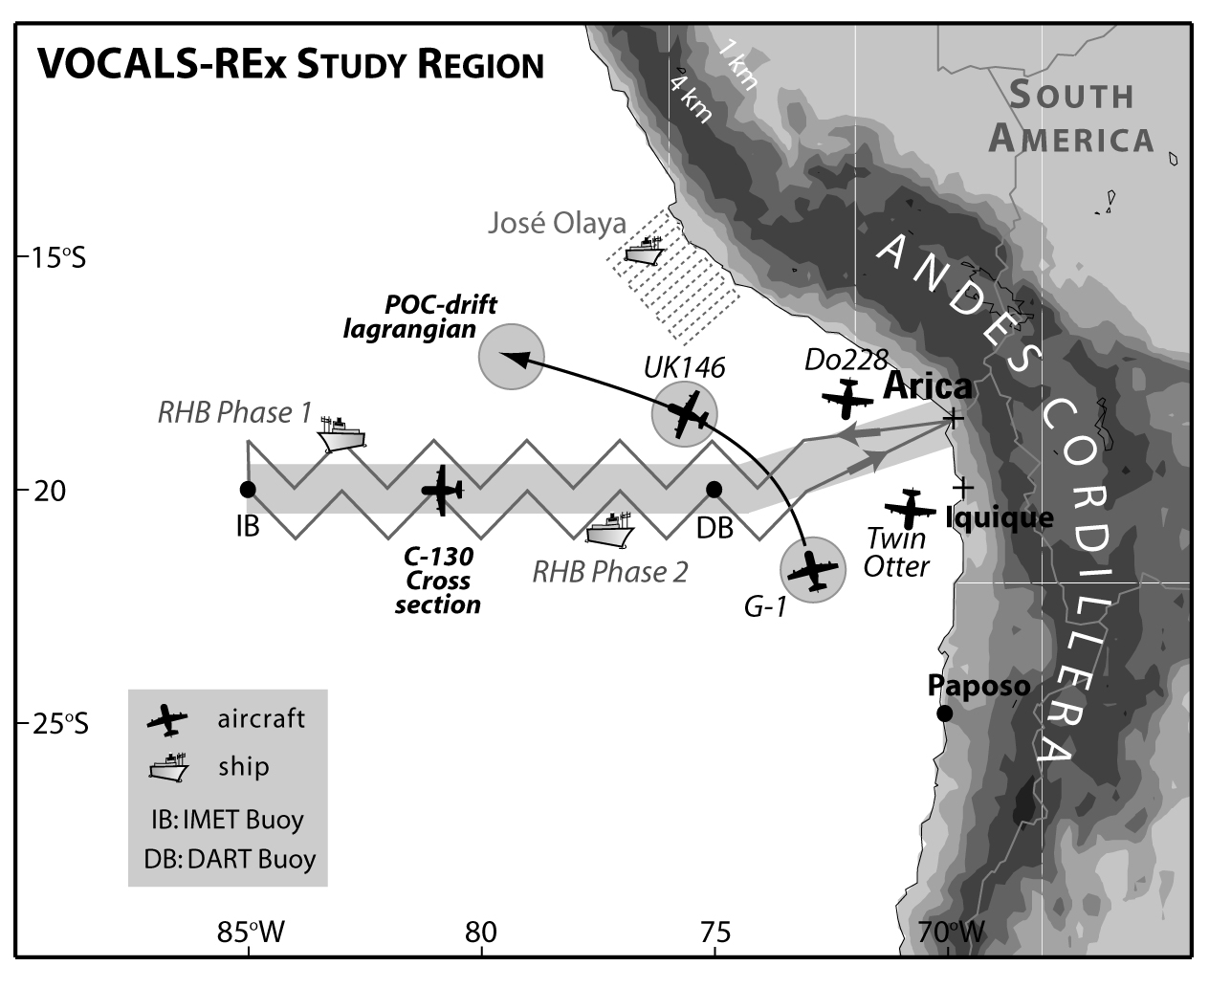
VOCALS-REx Study Region

Slide 9
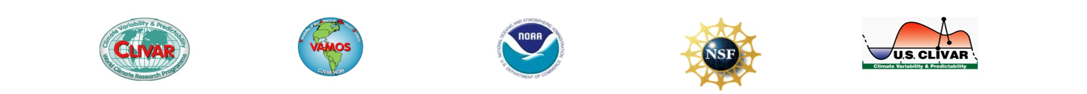
VOCALS Regional Experiment (REx)
Themes
Aerosol-cloud-drizzle interactions in the marine boundary layer (MBL) and the physicochemical and spatiotemporal properties of aerosols
Chemical and physical couplings between the upper ocean, the land, and the atmosphere.

Slide 10
AEROSOL-CLOUD-DRIZZLE HYPOTHESES
  Variability in the physicochemical properties of aerosols has a measurable impact upon the formation of drizzle in stratocumulus clouds over the SEP
  Precipitation is a necessary condition for the formation and maintenance of pockets of open cells (POCs) within stratocumulus clouds
  The small effective radii measured from space over the SEP are primarily controlled by anthropogenic, rather than natural, aerosol production, and entrainment of polluted air from the lower free-troposphere is an important source of cloud condensation nuclei (CCN)
  Depletion of aerosols by coalescence scavenging is necessary for the maintenance of POCs.

Slide 11
COUPLED-OCEAN-ATMOSPHERE-LAND HYPOTHESES
  Oceanic mesoscale eddies play a major role in the transport of heat and fresh water from coastally upwelled water to regions further offshore
  By changing the physical and chemical properties of the upper ocean, upwelling has a systematic and noticeable effect on aerosol precursor gases and the aerosol size distribution over the SEP
  The diurnal subsidence wave (“upsidence wave”) originating in northern Chile/southern Peru has an impact upon the diurnal cycle of clouds that is well-represented in numerical models
  The entrainment of cool fresh intermediate water from below
  the surface layer during mixing associated with energetic near-inertial oscillations generated by transients in the magnitude of the trade winds is an important process to maintain heat and salt balance of the surface layer of the ocean in the SEP.

Slide 12
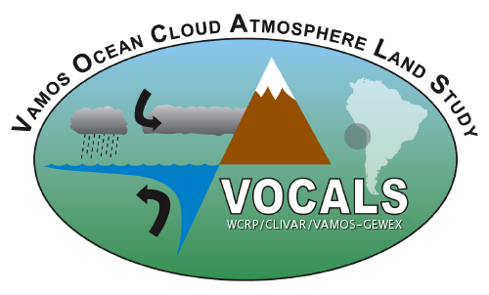
Operational Centers
BMRC Australia
CPTEC Brazil ECMWF Int.
JMA Japan
NCEP US
UKMO UK
Universities
Arizona State U.
U. Concepción, Ch
CSU
Drexel U.
U. Hawaii
U. Manchester UK
U. Miami
North Carolina State
Oregon State U.
U. Reading UK
U. Arizona
U. Chile
UCLA
U. Colorado
UCSD
U. Leeds UK
U. Washington
U. Wyoming
Research Labs
Brookhaven Nat. COLA
CNRS/LMD France
IMARPE
IPRC
LEGOS
NASA GSFC
NASA JPL
NCAR
NOAA/CIRES
NOAA/GFDL
NRL
Pacific Northwest
Woods Hole
Collaborating Institutions
C. R. Mechoso, Chair, VOCALS SWG
R. Wood, VOCALS-REx PI
Logistic Support: NCAR JOSS

Slide 13

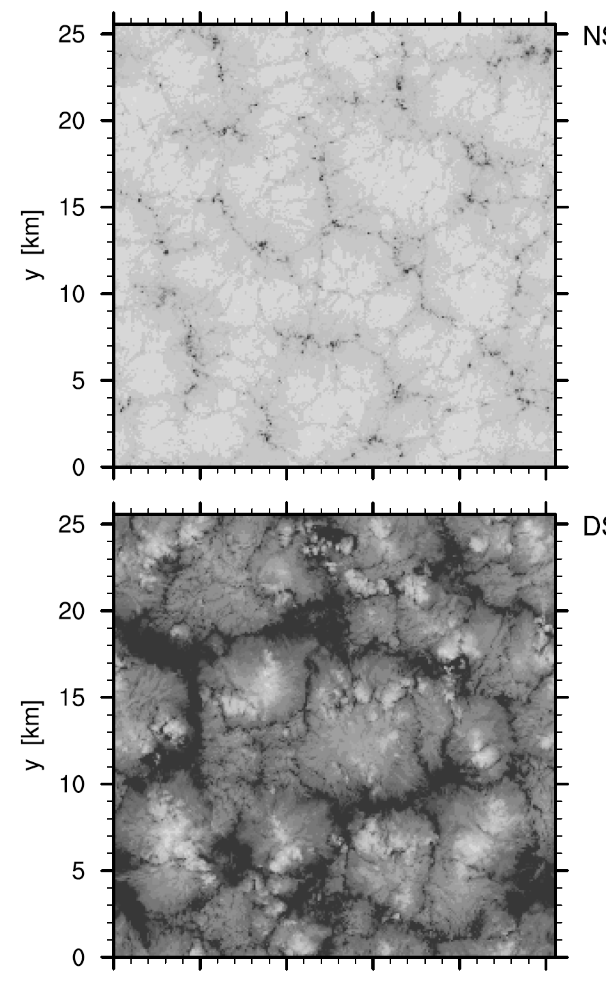
Precipitation and cloud mesoscale organization
without drizzle with drizzle
Savic-Jovcic and Stevens (2007)

Slide 14
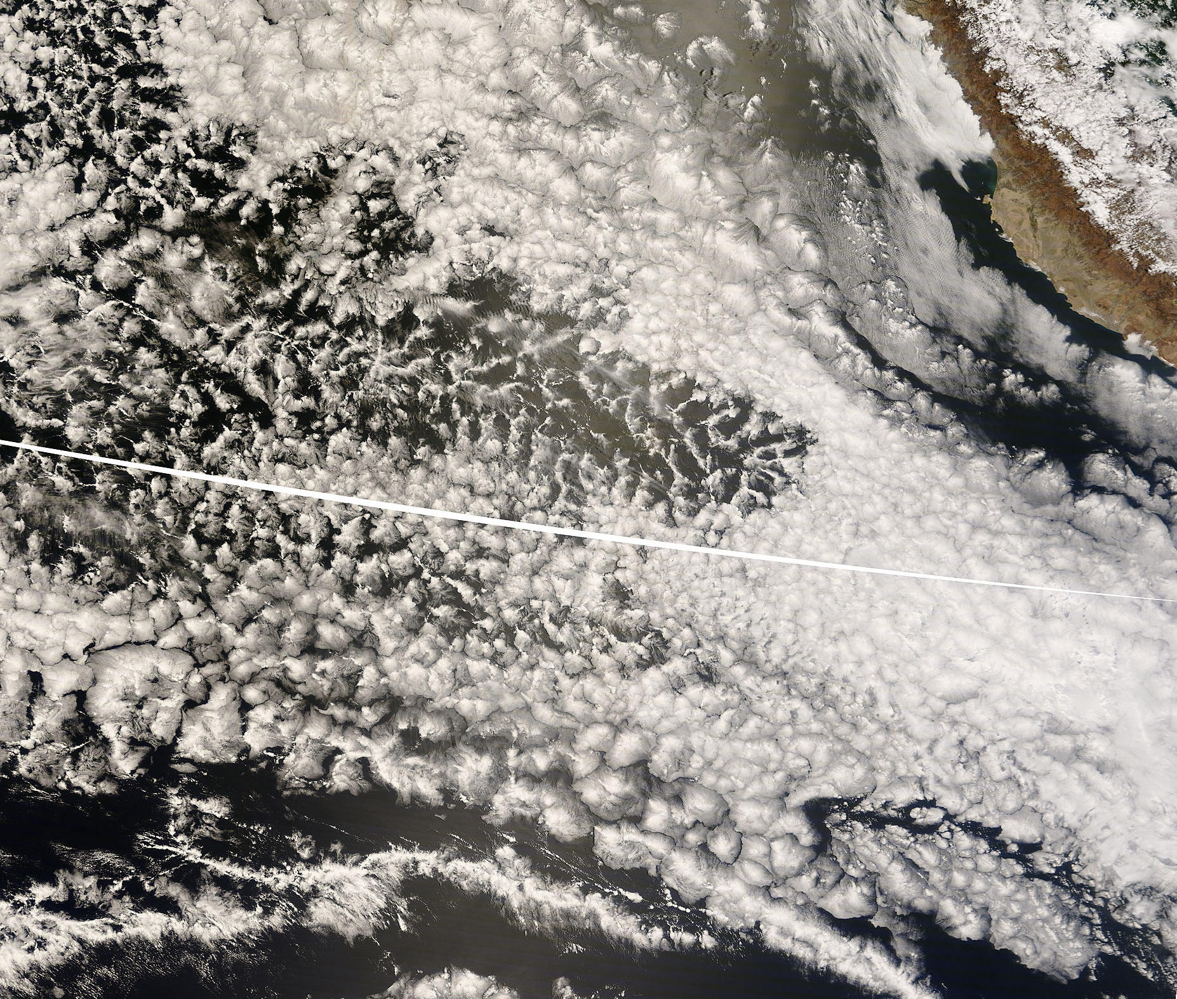
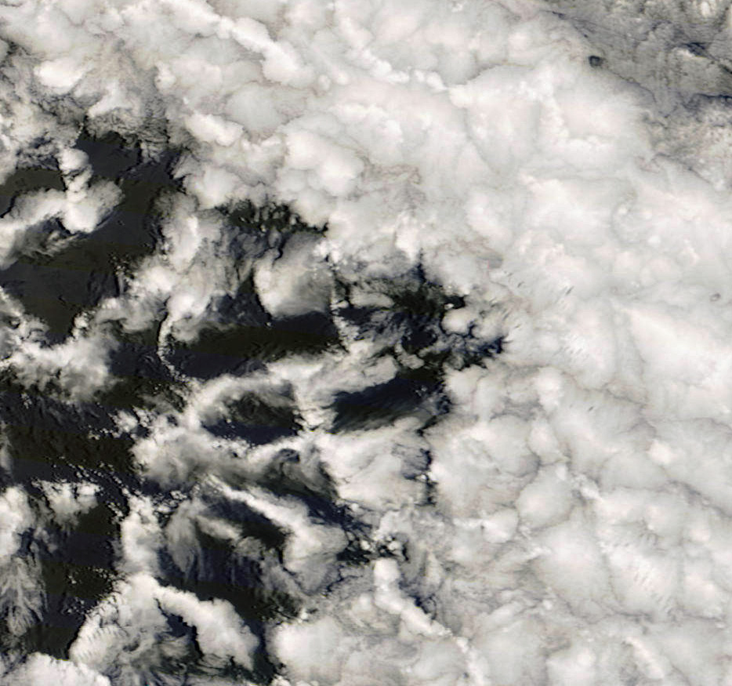
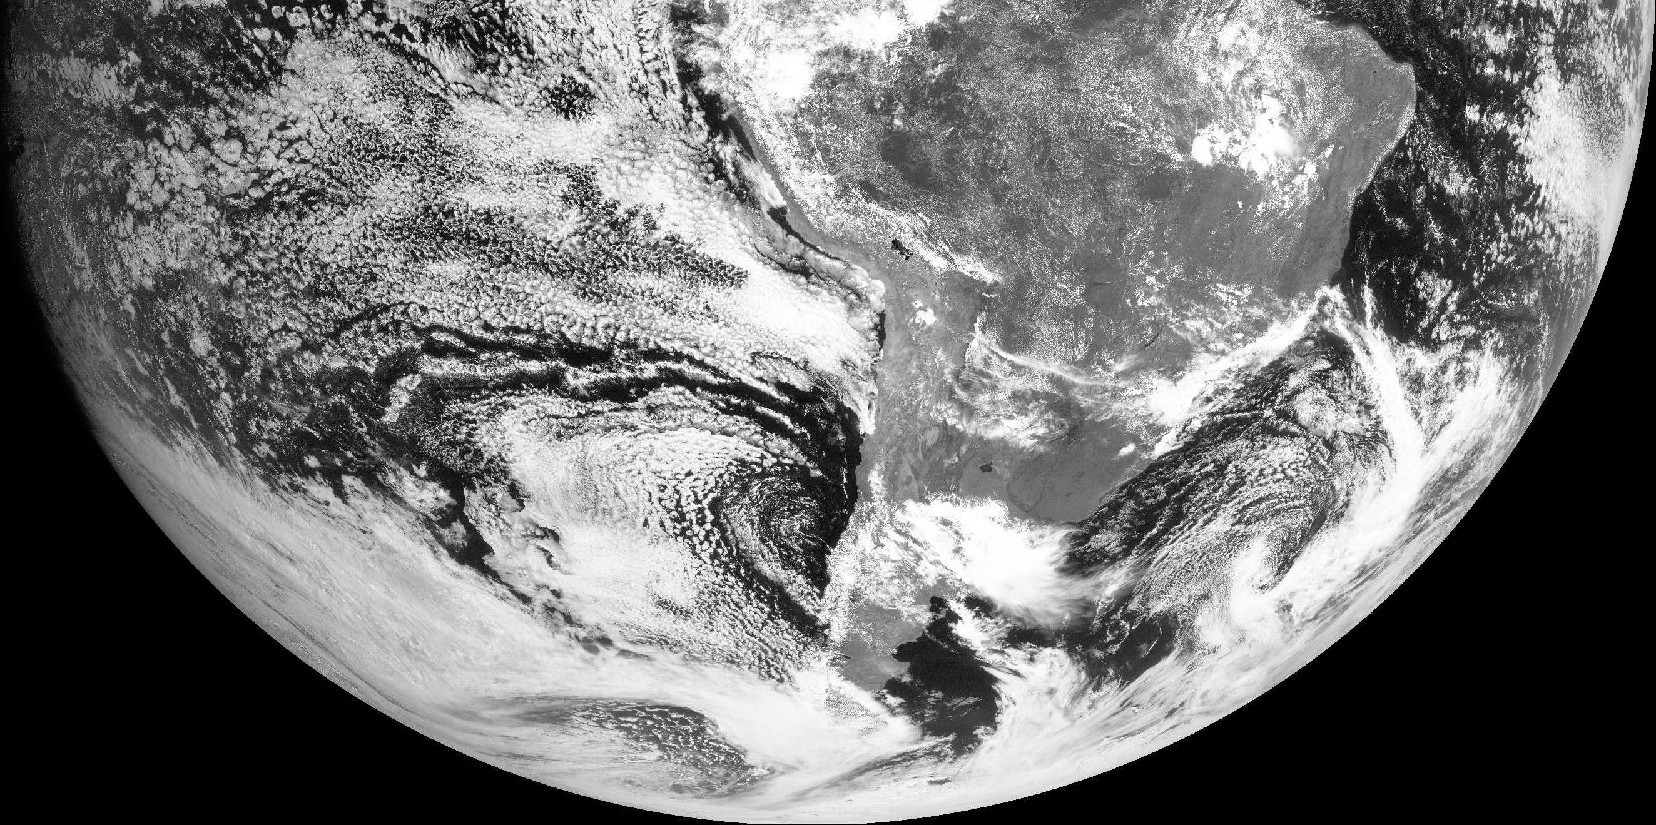
October 27/28th 2008
POC Lagrangian - BAe-146 & NSF C-130
100 km

Slide 15
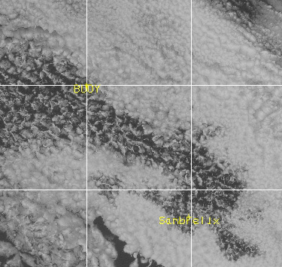
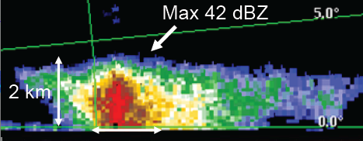
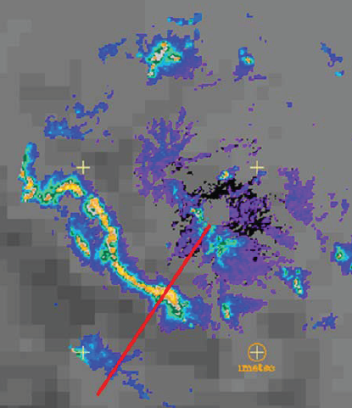

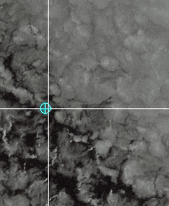
Boundary cells
POCKET of OPEN CELLS
60 km
C-band images
Matt Miller, NCSU

Slide 16
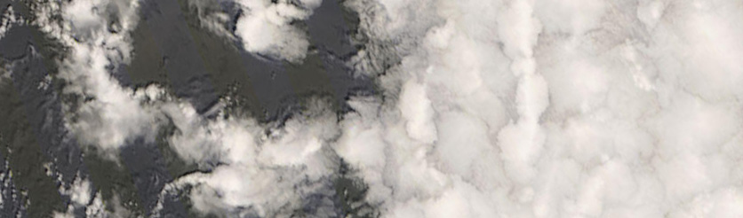
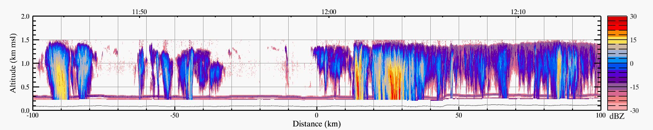
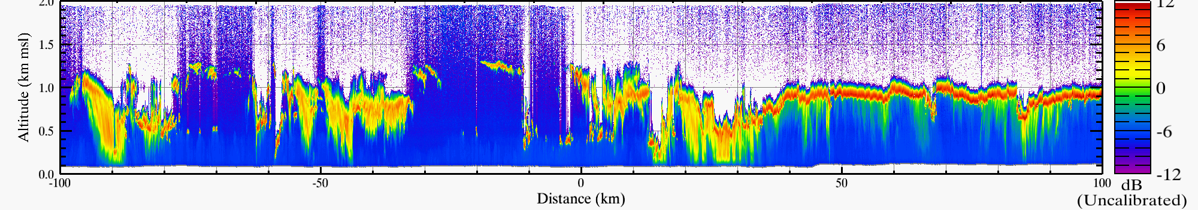
Unprecedented observations of cloud and precipitation structure
OPEN CELLS CLOSED CELLS
MODIS visible image
[250 m resolution]
POC Edge
Boundary Cell
RADAR
2km
LIDAR
-100 -50 0 50 100
Distance [km]
Dave Leon, University of Wyoming

Slide 17
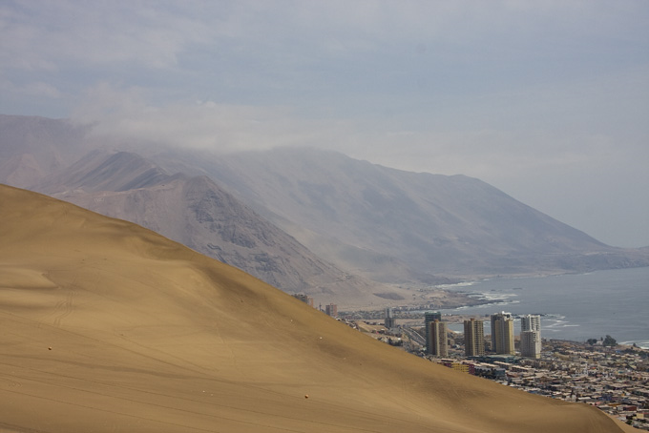
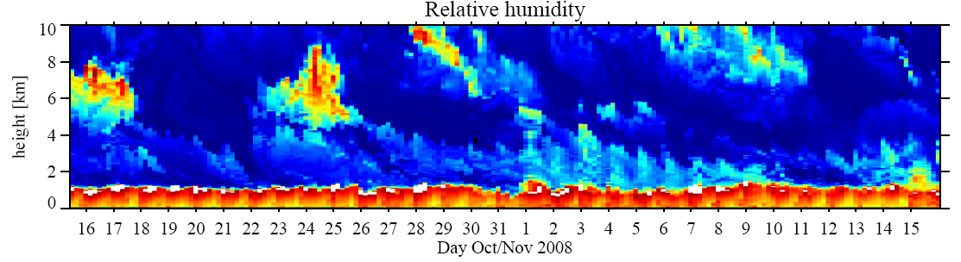
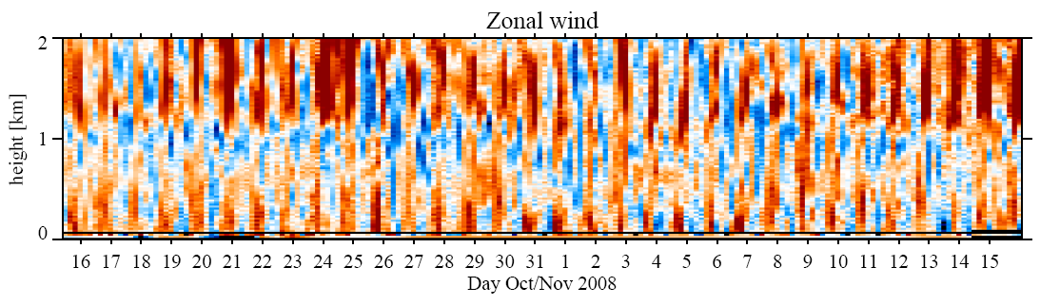
Iquique [20ºS, 70ºW]
GAUS Station
Twin Otter Aircraft
10 km
2 km

Slide 18
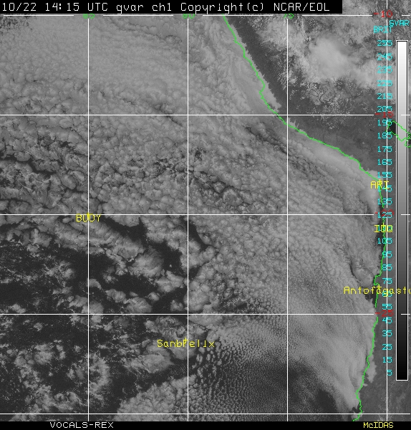
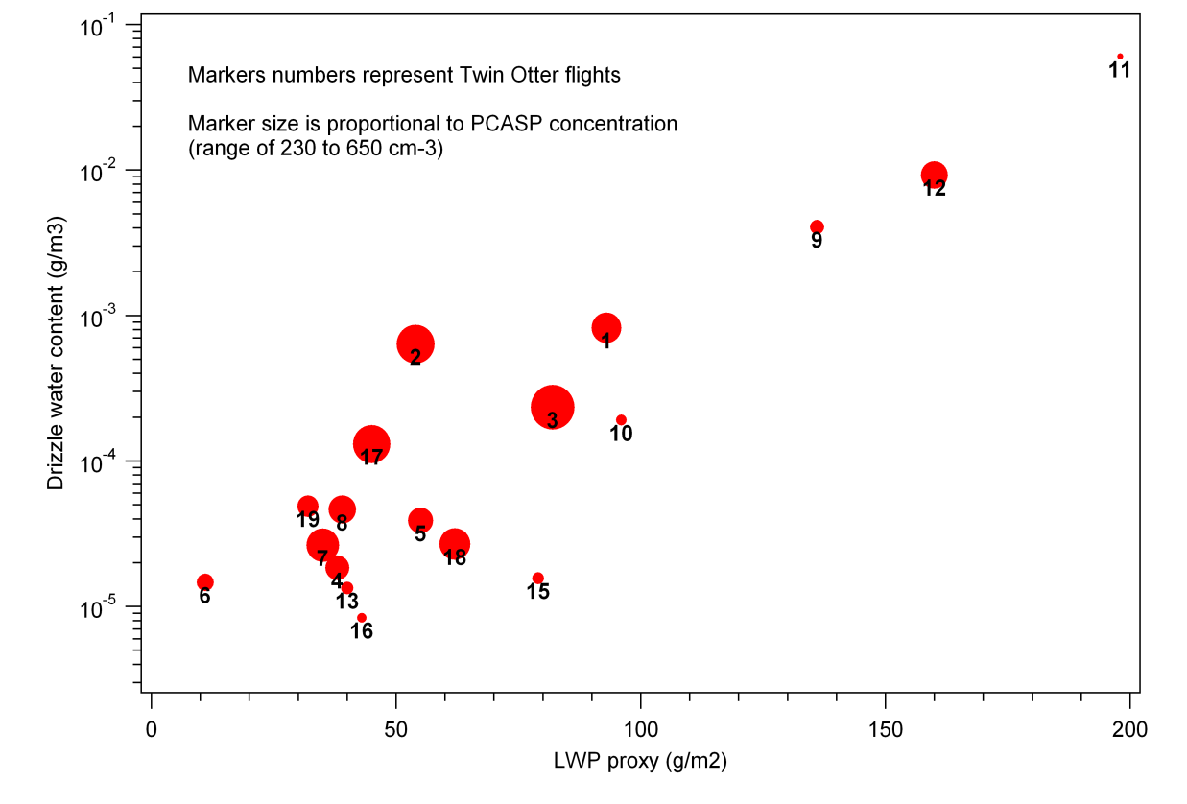
Twin Otter Research Flights
19 flights (93 flight hours) from 16 Oct to 13 November 2008
Boundary layer, turbulence and microphysical measurements were made at 20ºS; 72 ºW for all 19 flights.
Drizzle LWC (gm⁻³)
The wide range of aerosol, cloud, and boundary layer conditions observed at site will facilitate both process and modeling studies.
Drizzle LWP
LWP Proxy
LWP Proxy (gm⁻²)

Slide 19
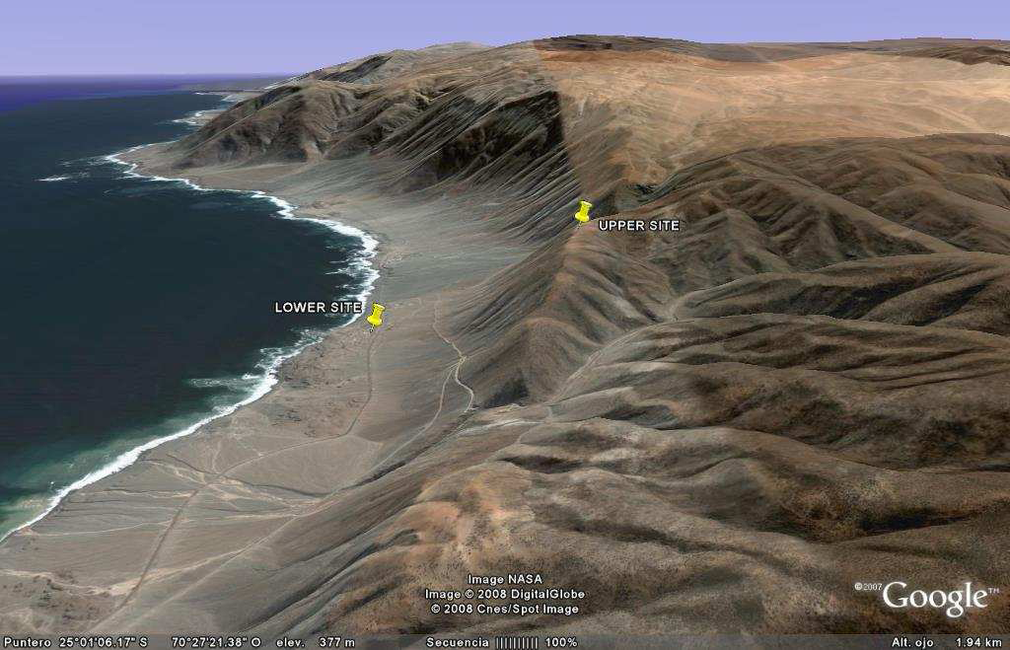
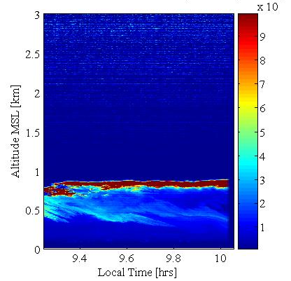
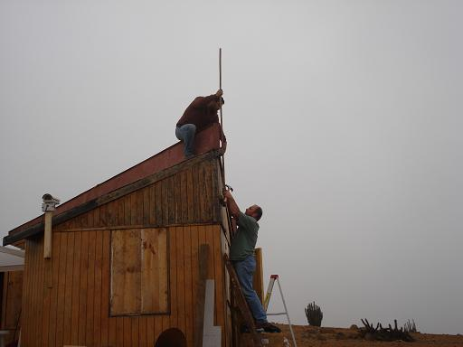
PAPOSO
25ºS, 70.3ºW; 690m altitude (upper site)
Antofagasta (180 km)
Paranal (45 km), 2600 m.a.s.l
LOWER SITE
UPPER SITE
Taltal (60 km)
Laura Gallardo, U de Chile

Slide 20
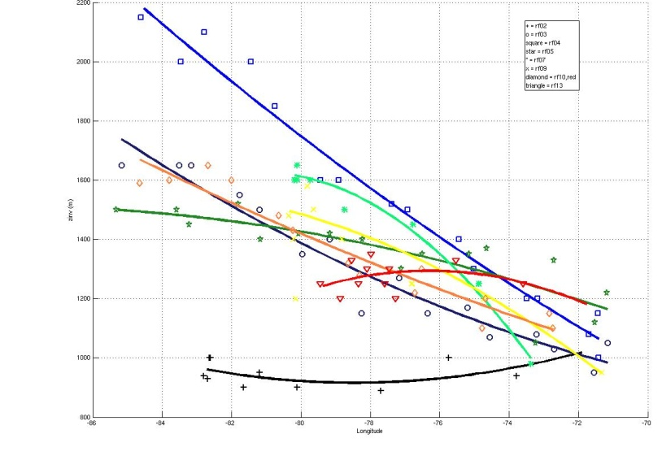
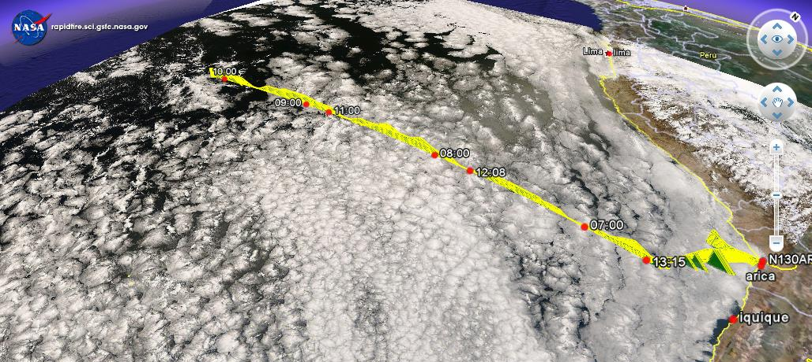
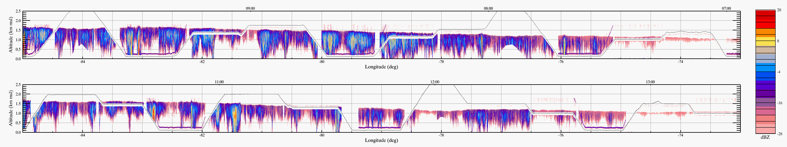
20ºS Missions
Boundary layer
depth
[all 20ºS missions]
2.0
1.6
1.2
0.8
20ºS/85ºW
20ºS parallel
height [km]
remarkable
synoptic
variability
86 82 78 74 70ºW
Wyoming cloud radar – widespread drizzle

Slide 21
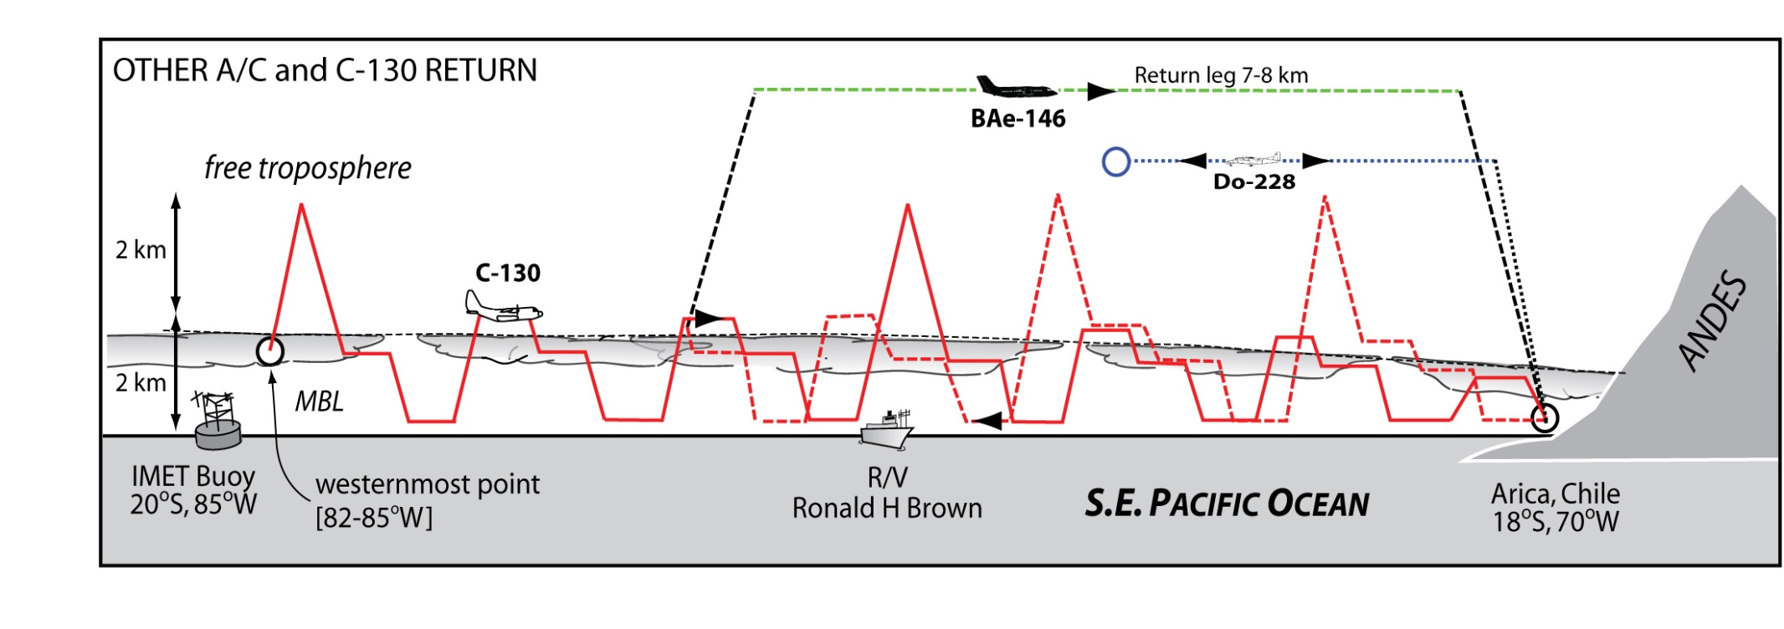
Collaborative 20oS Missions with UK BAe-146 and Dornier 228
C-130: MBL measurements, cloud physics, radar/lidar, aerosols, chemistry
BAe-146: Dropsondes and comprehensive radiation suite
Dornier-228: Aerosol lidar

Slide 22
NOAA Ronald H Brown, Mesoscale Ocean Eddy Sampling
30 CTD (conductivity, temperature, depth) profiles (to 1000-2000m) were collected in eddies, fronts and the boundary currents
300 Underway CTD profiles (to 300-700m) were collected to map the large-scale, mesoscale and submesoscale structure of the upper ocean
Surface Drifters and Profiling SOLO floats were deployed in the center of eddies
VMP (vertical microstructure profiles) were collected to quantify mixing

Slide 23
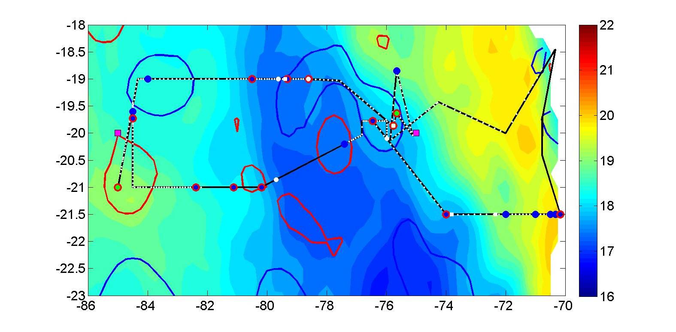

Ronald H Brown Leg 2 track and eddies sampled
SST [ºC]
Latitude
Longitude
Fiamma Straneo, WHOI

Slide 24


Preliminary Results: Characteristics of the Cyclonic Eddies
eddy
eddy
3 Cyclonic eddies sampled in Leg 2
- cold SST anomaly
a shallow mixed layer
a sub-surface warm, salty core (300m)
Property Profiles
Eddy-blue, mean-black

Slide 25

Coastal Upwelling Region and source of Eddies:
Figure shows an underway CTD section up to the coast of Chile.
Boundary current
with same properties
as the eddies’ core
Cyclonic eddy
with a warm
salty sub-surface
core
Upwelling of
fresh and cold waters of
subpolar origin to the surface

Slide 26

Peruvian R/V Jose Olaya
15 day cruise
atmospheric, hydrographic, biogeochemical
and fishery acoustic observations, glider and zooplankton experiments
Carmen Grados, INMARPE

Slide 27

Summary
VOCALS-REx yielding excellent datasets for hypothesis testing and for evaluation of process and large-scale models
VOCALS Data and Modeling Workshop to be held July 12-14 2009, Seattle
Tremendous thank you to all involved in planning, funding, and participation

Slide 29




Models in VOCALS
RAMS
AGCM
OGCM
ROMS
Trajectory Models
Large Eddy Simulation
Cloud Resolving Models

