Slide 1
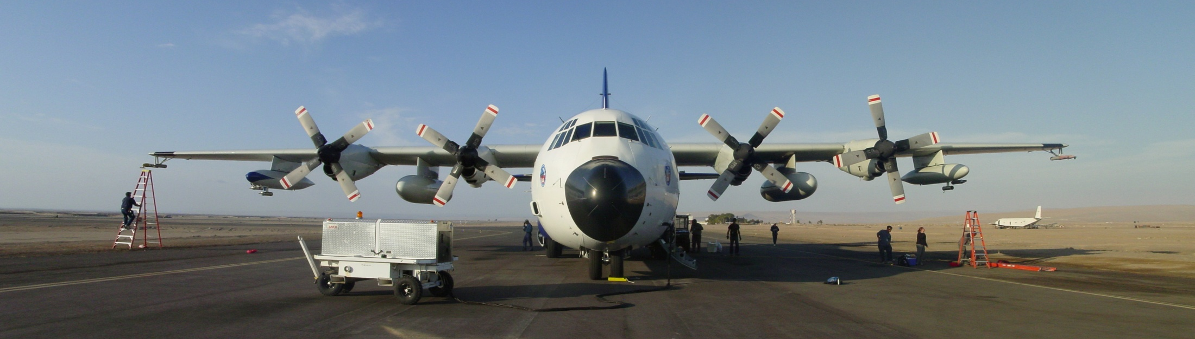
NSF C-130 Platform Report
Robert Wood
  (a) 20ºS Cross-Sections [4 full missions+5 partial missions]
    - to characterize structure of MBL, aerosols, clouds along the 20ºS parallel from 72-85ºW
    - collaborative (RHB, BAe-146, Do-228, G-1)
  (b) POC Drift missions [5 missions including 1 POC Lagrangian with BAe-146]
  - investigate structure of boundary between closed and open cellular stratocumulus
  (c) Pollution Surveys [2 missions total]
  - coast-parallel surveys to 30ºS to study how pollutants are transported into the MBL
MISSIONS
RAF instruments:
Microphysics, Turbulence, Thermodynamics suite, Radiation
Special Remote sensing:
Wyoming Cloud Radar (zenith+nadir+slant), Cloud Lidar (zenith), Microwave radiometer (GVR, 183 GHz, zenith)
Special Chemistry/aerosols/clouds:
CCN, CVI, Streakers, Giant CCN, Special CN counters (+ultrafine), LDMA, RDMA, Aerosol Mass Spec, volatility, nephelometer, SP2/PSAP, DMS/SO₂,Cloud water collector, CO/O₃, fast FSSP
INSTRUMENTS
Photo courtesy Carly Calvin, NCAR

Slide 2
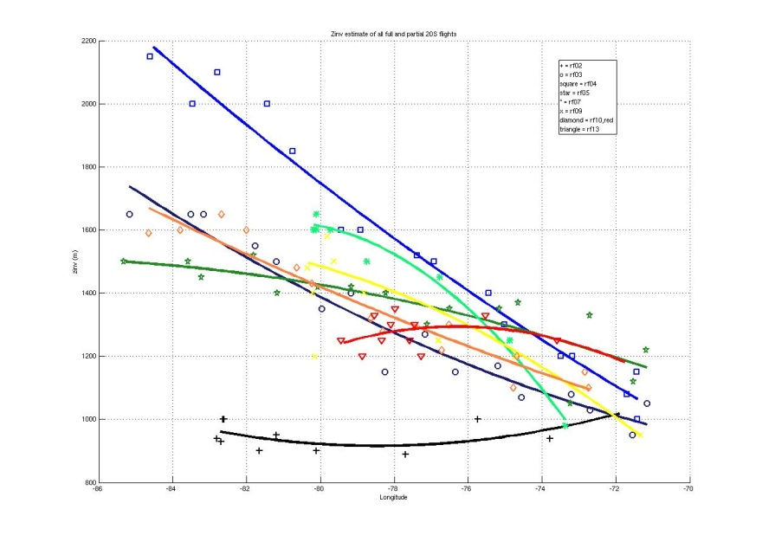
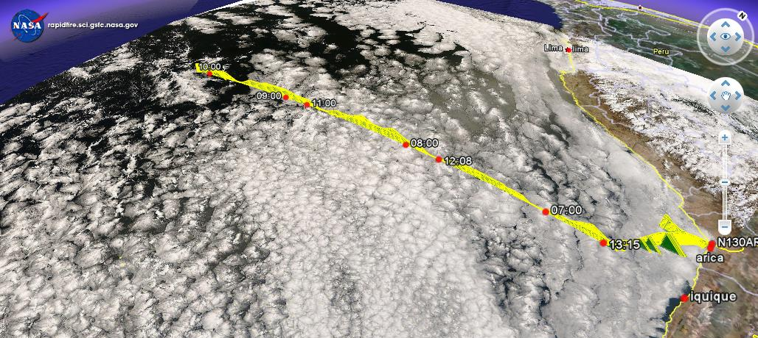
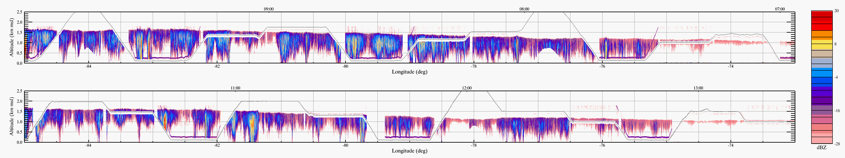
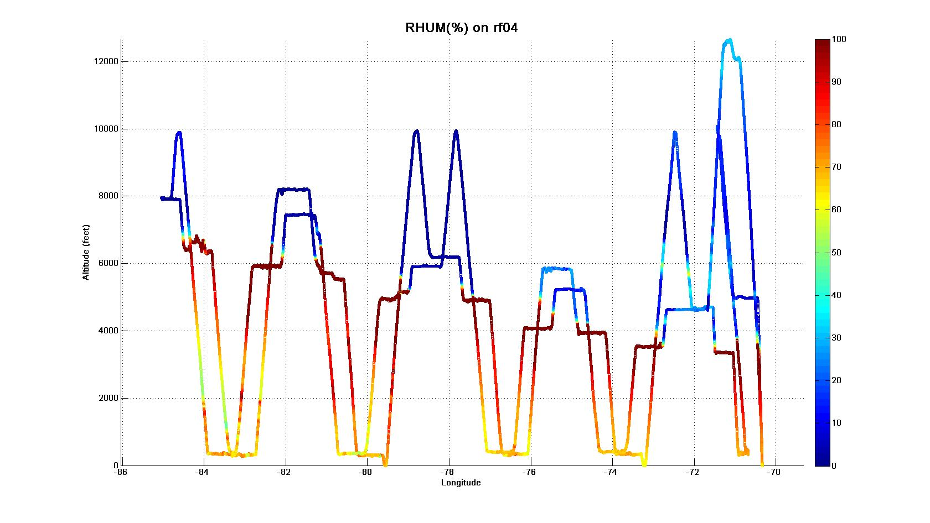
20ºS Missions
2.0
1.6
1.2
0.8
Boundary layer depth
[all 20ºS missions]
remarkable
synoptic
variability
20ºS/85ºW
height [km]
20ºS parallel
86 82 78 74 70ºW
Wyoming cloud radar – widespread drizzle
2.5
2.0
1.5
1.0
0.5
0
Relative humidity – very dry free troposphere
height [km]
85 80 75 70ºW

Slide 3
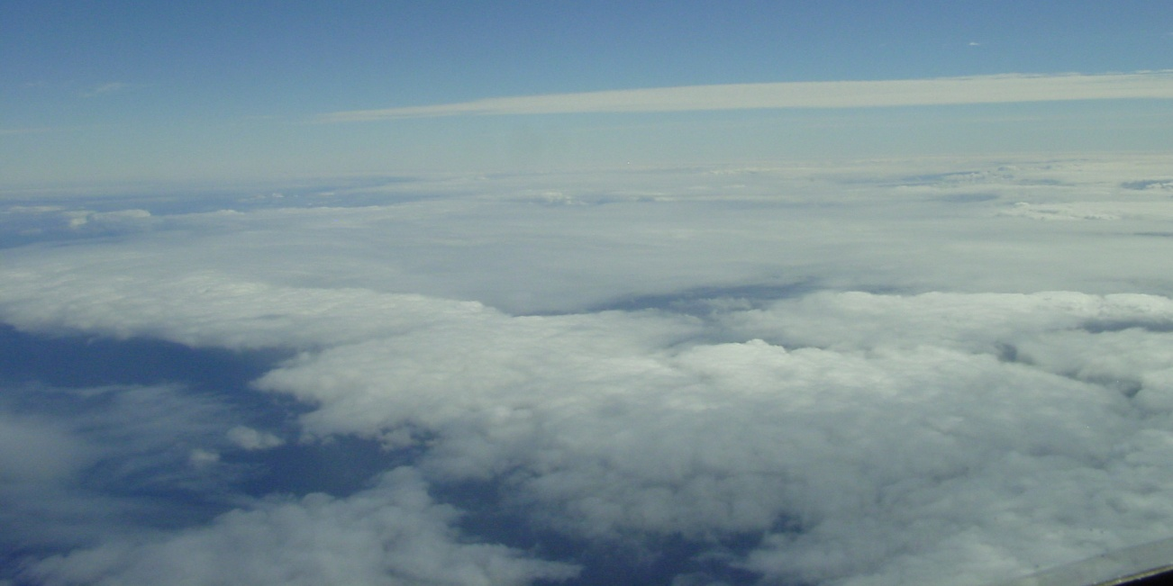
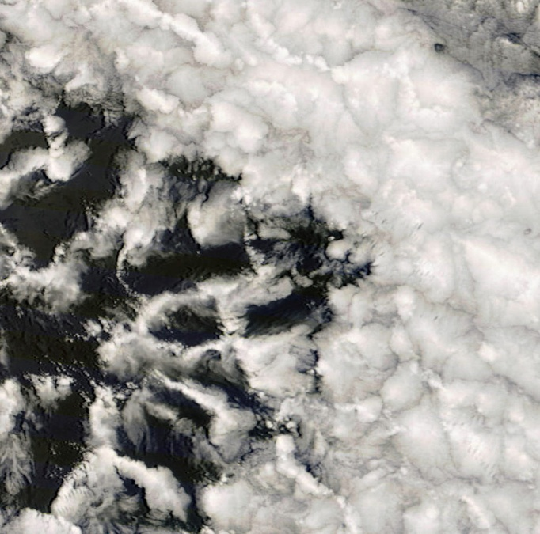
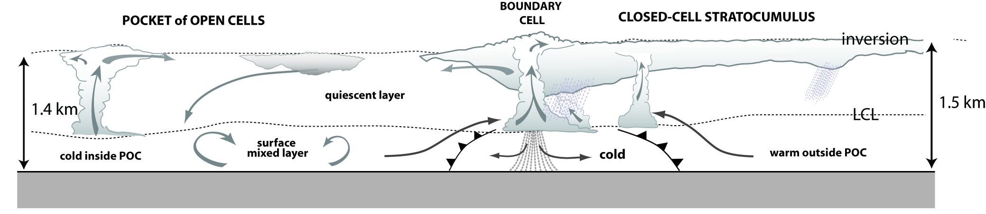
POC Missions
Optically thin
cell centers
10 km
Optically thick cell walls
Lowest CN concentration ever measured
Remarkable contrasts in microphysics and cloud dynamics across POC boundary [aerosols, drizzle, cloud structure and morphology, CO and O₃]
Ultraclean clouds in optically-thin cloud centers
Quasi-linear boundary cells with copious drizzle scavenge aerosols

Slide 4
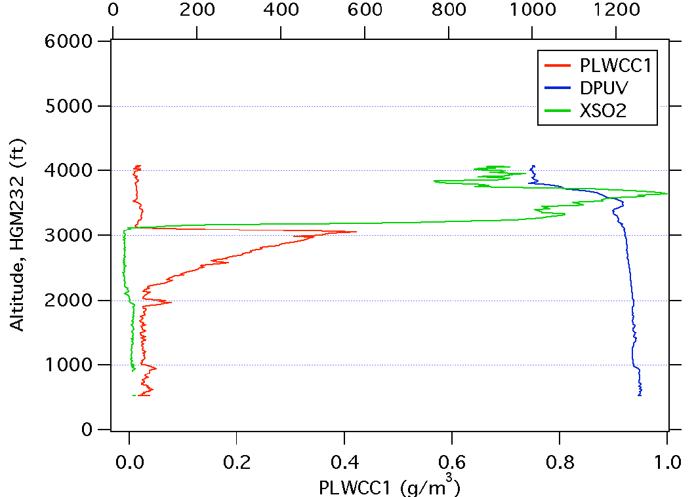
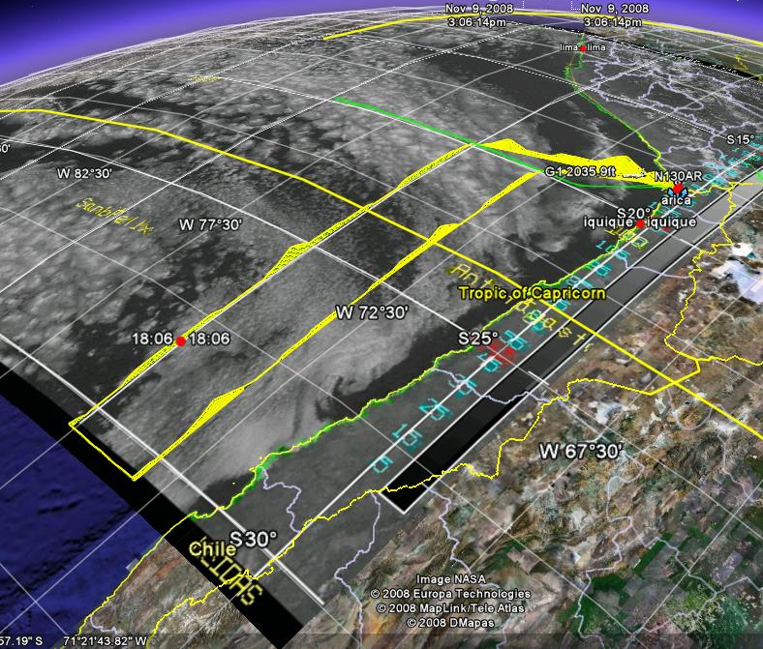
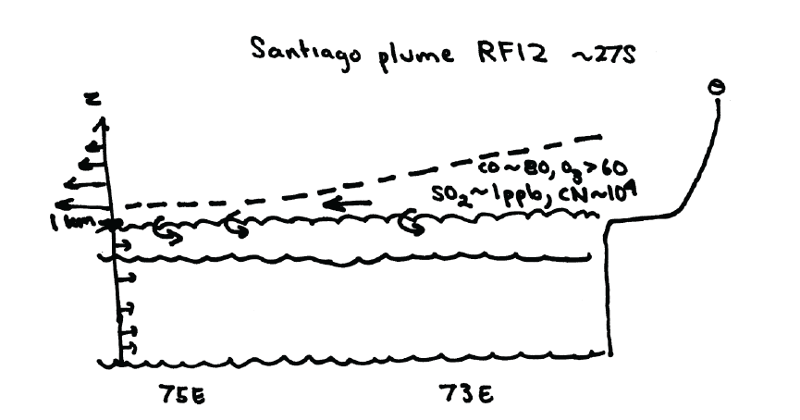
Pollution survey missions
[SO₂] ppt
Elevated SO₂ layers
entraining into MBL
RF12, November 11th 2008
Cloud
Diurnal flushing of
continental air
Santiago

