Slide 1
Clouds and climate change

Slide 2
Two key impacts
Cloud feedback
  Response of clouds to increased CO₂
Aerosol indirect effects (AIEs)
  Response of clouds to changes in aerosol particles

Slide 3

Cloud feedbacks

Slide 4
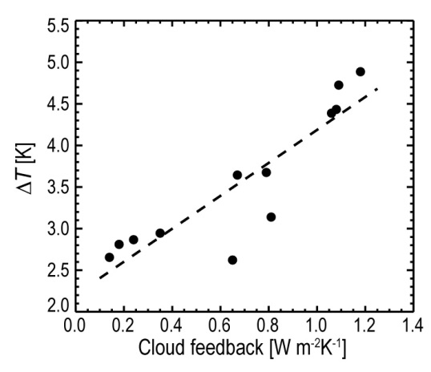
Uncertainty in cloud feedbacks is main source of uncertainty in climate sensitivity
Low clouds dominate uncertainty
Reproduced from Soden and Held (2006)
CMIP3 models
Soden and Vecchi (2011) - CMIP3 models

Slide 5
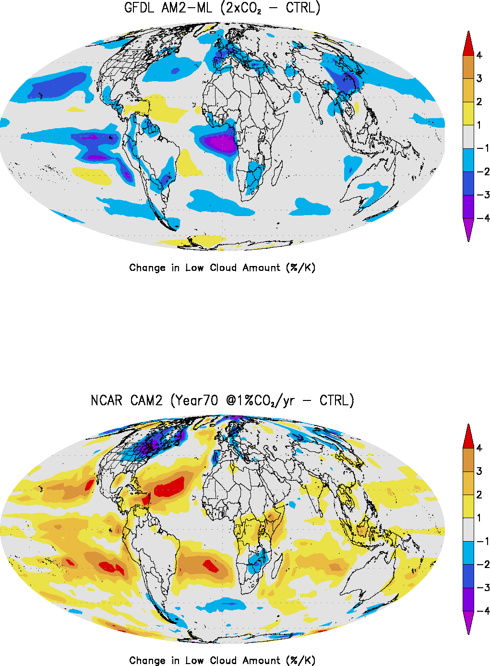
Cloud feedbacks in climate models
- change in low cloud amount for 2×CO₂
GFDL
CCM
model number
from Stephens (2005)

Slide 6
What regime controls global cloud feedback variability across models?
Soden and Vecchi (2011) - CMIP3 models

Slide 7
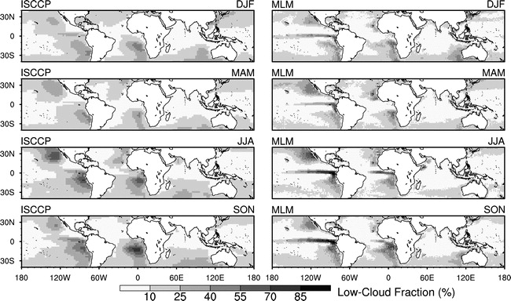
Using a mixed layer model to understand cloud feedback processes – Peter Caldwell (LLNL)
Mixed Layer Model (MLM)
CMIP model output (or reanalysis)
q_{t}=q_{v}+q_{l}
s_{l}=c_{p}T+gz-Lq_{l}
Cloud fraction, LWP, etc
mixed-layer model
ISCCP-Observed Sept-Nov Low Cldfrac (%)
Canary
(JClim 2009)
California
z_{i}
Strong LW cooling
at cloud top
destabilizes BL
Entrainment
warms, dries BL
Peru
Australia
Namibia
Drizzle
damps
mixing
Turbulence keep q_{t} and s_{l} well-mixed in boundary layer
Get from GCM output:
daily SST, surface pressure, winds, free-tropospheric T, q, and subsidence, advection of BL T and q
3. Calculate cloud fraction as % of time cloudy MLM solution is found (Zhang et al, JClim 2009)
Ocean
2. Run MLM to equilibrium using GCM model forcing for each day
We use years 1980-2000 from 20c3m as “current climate” and 2080-2100 from sresA1B as “future climate”
Notes:
mention CGILS

Slide 8
Validation: Current-Climate
Wood and Bretherton (JClim 2006) show that Estimated Inversion Strength (EIS, a measure of boundary-layer inversion strength) explains 85% of current-climate seasonal/regional stratocumulus variations ⇒ EIS is a compact measure of model skill
Wood & Breth obs (r² = 0.85)
GCM TOTAL cloud fraction (%)
MLM LOW cloud fraction (%)
CMIP3 GCMs display disturbingly little sensitivity to EIS
  due to cloud physics deficiencies – MLM runs reproduce obs when driven by these same large-scale forcings!
Notes:
since MLM is superior, it’s worth seeing how it predicts clouds will change.

Slide 9
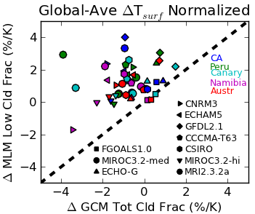
Climate Change Signal
MLM does not reduce inter-model spread in climate-change response
  fixing cloud physics is necessary but not sufficient for reducing low cloud uncertainty!
MLM predicts 1-3% increase in cloud fraction

Slide 10
Observational evidence for positive low cloud feedback?
1
2
3
4
5
6
Eastman, Warren, Hahn (2011)

Slide 11
Low clouds (SW forcing) dominate uncertainty
However, most “robust” changes in longwave (all models have positive feedback) and for high clouds
Soden and Vecchi (2011) - CMIP3 models

Slide 12
FAT
Hypothesis
Longwave cloud feedback
σT_{C}⁴
Non-Convective
Energy Budget
Horizontal
Convergence
Tc
Radiative
Cooling
Subsidence
Warming
T3
T2
Height →
T1
← Cooling Heating →
←Div. Conv.→
Courtesy Mark Zelinka, LLNL

Slide 13
FAT
Hypothesis
Non-Convective
Energy Budget
Horizontal
Convergence
σT_{C}⁴
Tc
Radiative
Cooling
Subsidence
Warming
T3
T2
T1
Height →
← Cooling Heating →
←Div. Conv.→
Courtesy Mark Zelinka, LLNL

Slide 14
Observational evidence
for FAT

Slide 15
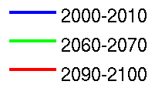
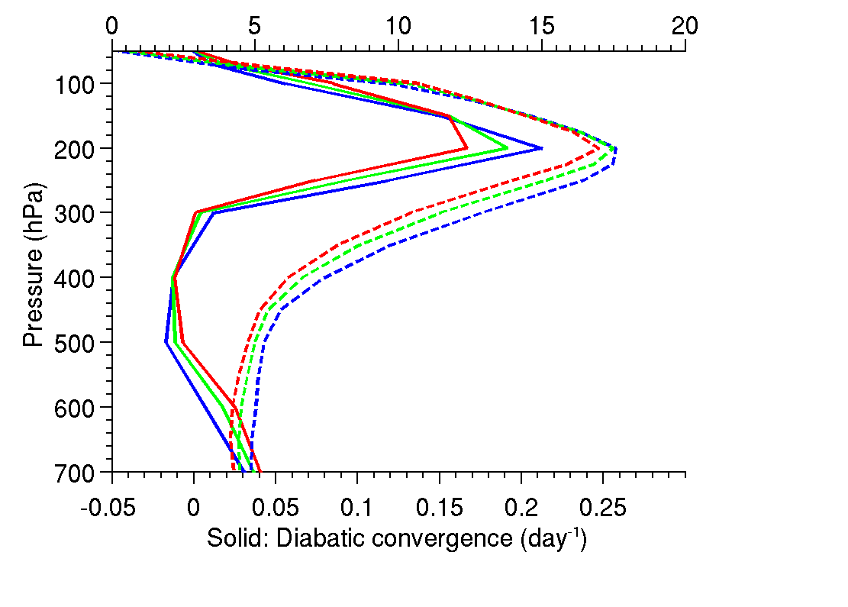
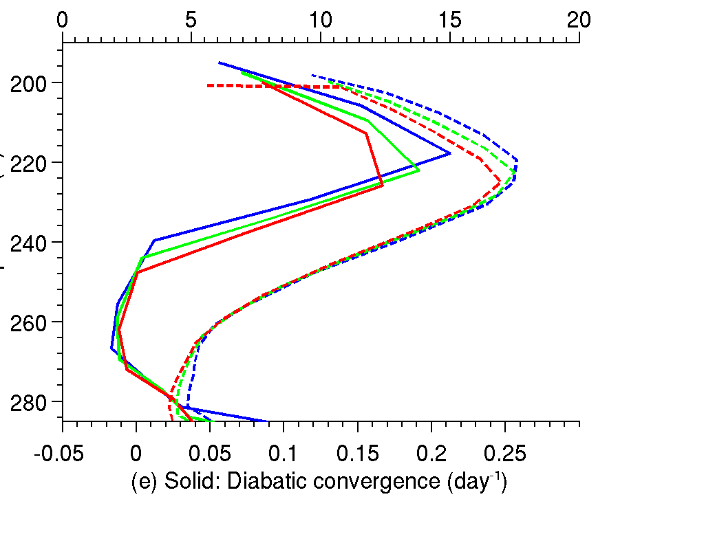
CMIP3 A2 Scenario: Multi-model mean
Cloud Fraction (%)
Cloud Fraction (%)
%
“PHAT”
Pressure (hPa)
Temperature (K)
Cloud fraction
Convergence
Cloud fraction
Convergence
Cloud fraction
Convergence
Convergence (dy⁻¹)
Convergence (dy⁻¹)
Courtesy Mark Zelinka, LLNL
Zelinka and Hartmann (2010)

Slide 16
Zelinka and Hartmann (2010)

Slide 17
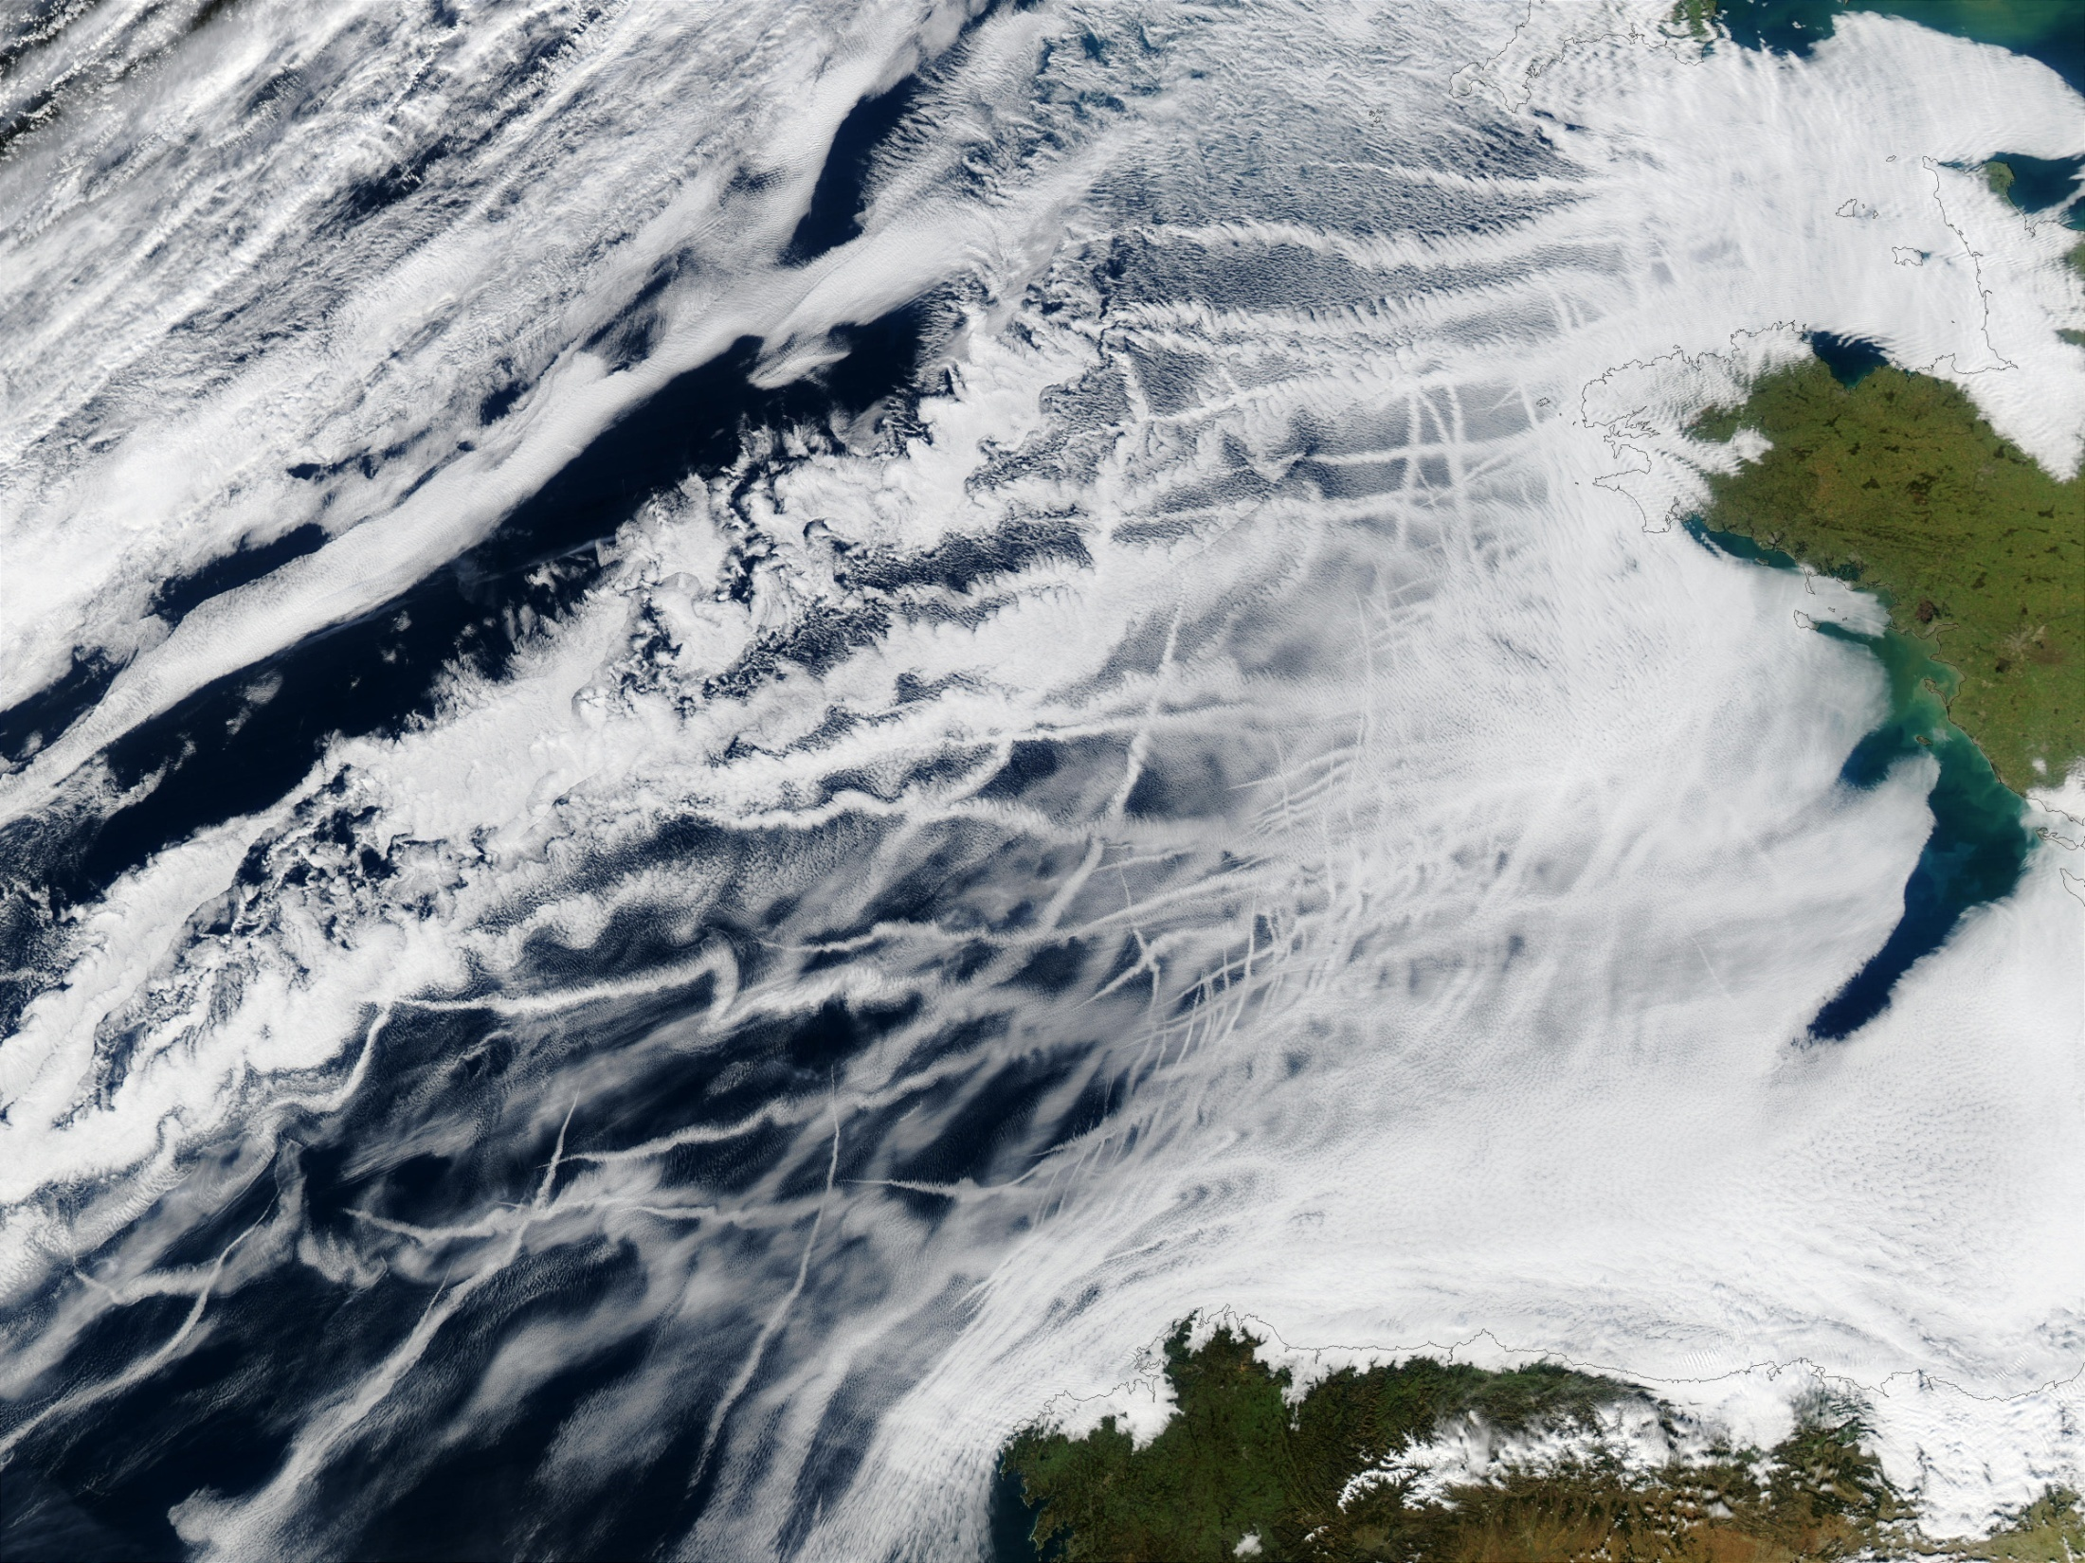
Aerosol
Indirect Effects

Slide 18
IPCC, 2007

Slide 19
Theoretical expression for AIE
Response of cloud optical thickness τ to change in some aerosol characteristic property A
Generally, because AIEs must be dominated by warm clouds and ice clouds formed by homogeneous freezing, the property most relevant to the problem is the cloud condensation nucleus concentration (CCN).
Aerosol size and composition effects can also play a role
primary feedback

Slide 20
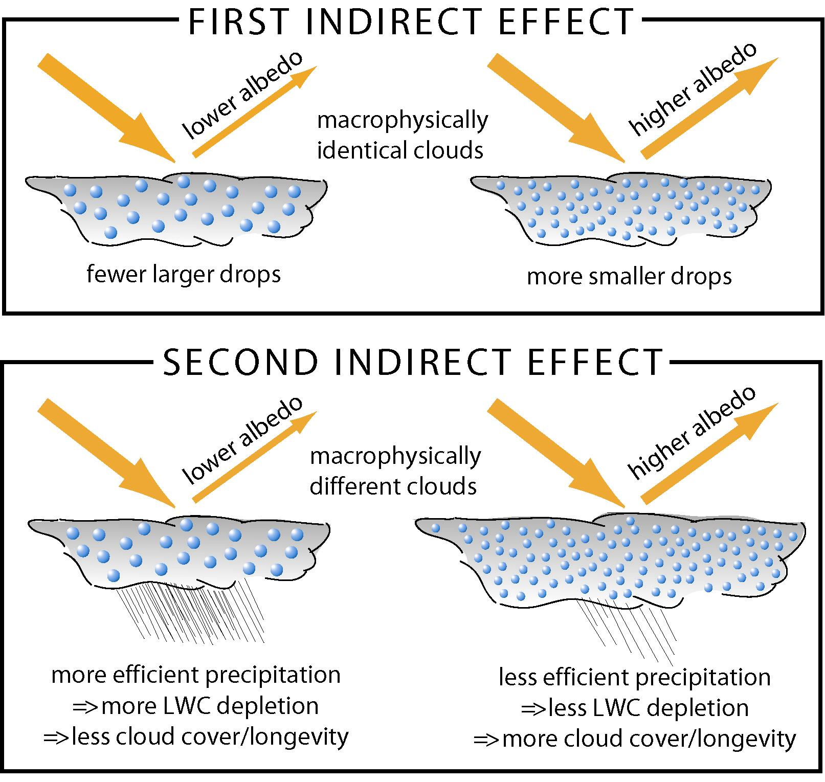
Twomey
Albrecht

Slide 21
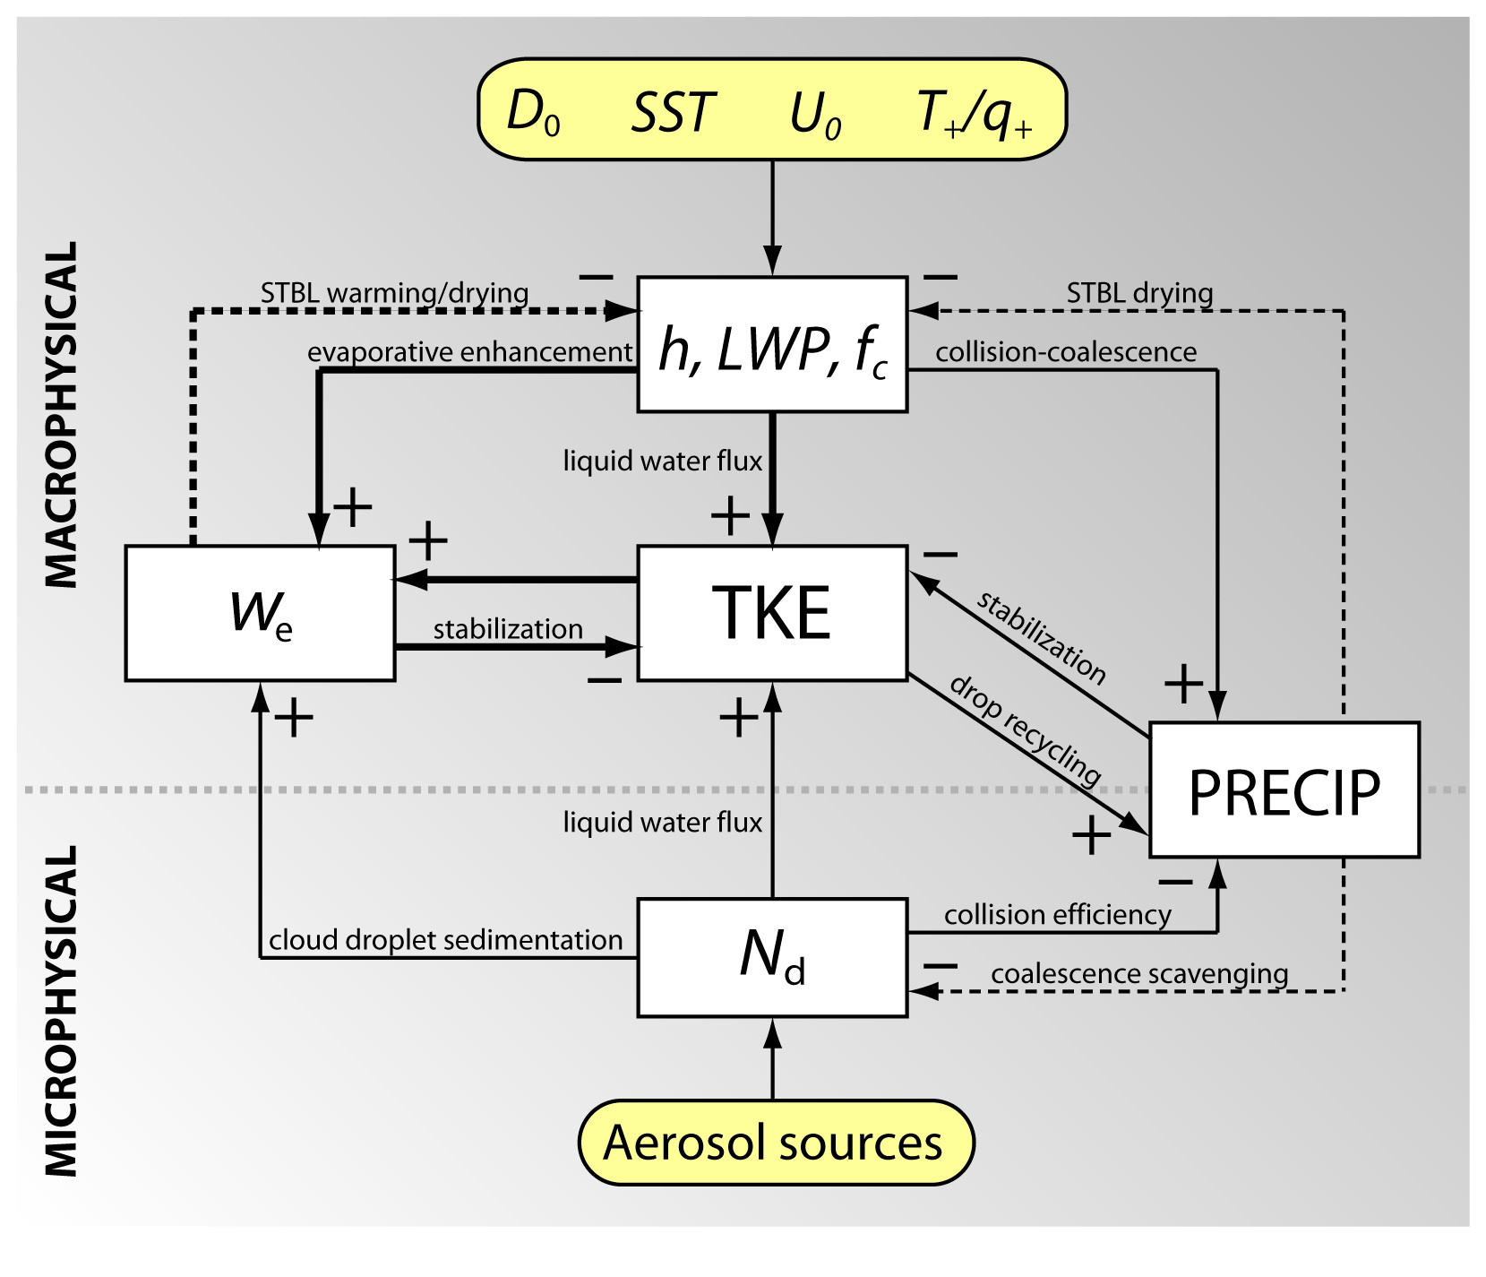
(Mostly) regulating feedbacks in stratocumulus

Slide 22
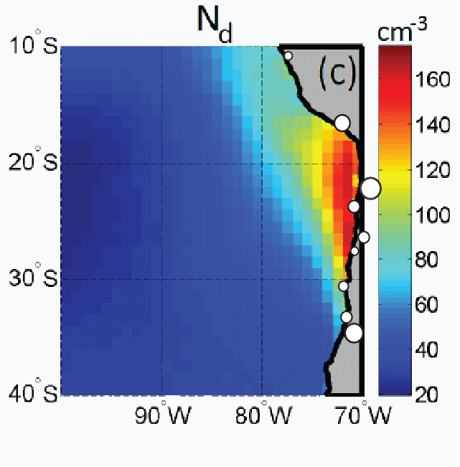
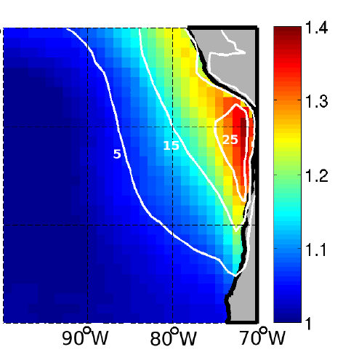
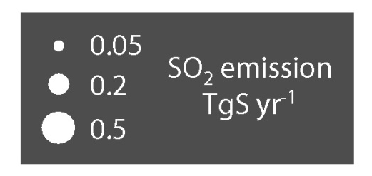
Regional gradients: Strong aerosol indirect effects in an extremely clean background
Satellite-derived cloud droplet
concentration N_{d}
Albedo enhancement
(fractional)
low level wind
George and Wood, Atmos. Chem. Phys., 2010

Slide 23
Observational evidence for the Twomey effect
Painemal and Minnis (2012)

Slide 24
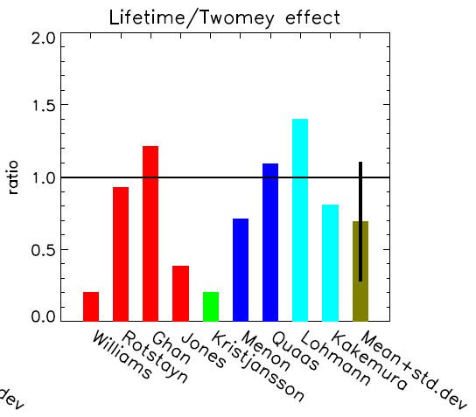
Model estimates of the two major aerosol indirect effects (AIEs)
Pincus and Baker (1994)
  – 1st and 2nd AIEs comparable
GCMs (Lohmann and Feichter 2005)
  1st AIE: -0.5 to -1.9 W m⁻²
  2nd AIE: -0.3 to -1.4 W m⁻²
Limited investigation of factors that control the relative importance of the two AIEs

Slide 25

Detecting aerosol impacts on cloud
An observed change in cloud property C is caused by changes due to meteorology M and aerosols A:
$$δC = {\left(\frac{∂C}{∂M}\right)}_{A}δM + {\left(\frac{∂C}{∂A}\right)}_{M}δA$$
meteorology-driven aerosol-driven
To determine aerosol-driven changes on C, one needs to measure meteorology-driven changes
This is a particularly arduous task
Stevens and Brenguier (2009)

Slide 26
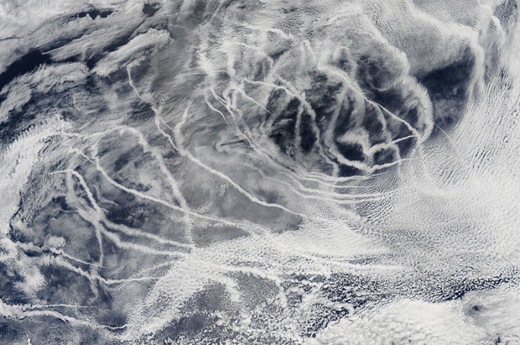
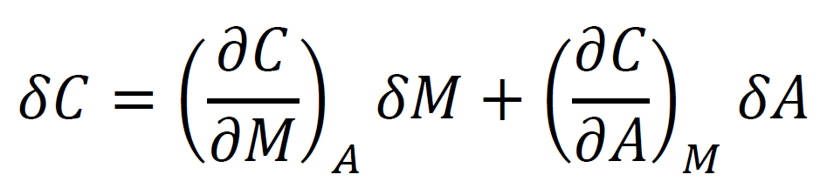
Shiptracks
= 0

Slide 27
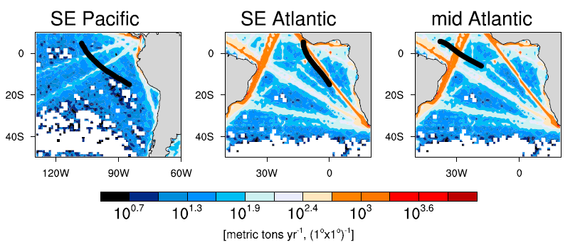

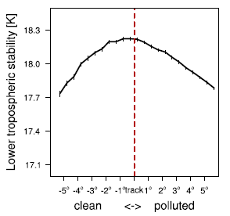
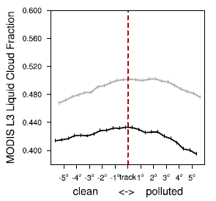
Shipping lanes
Shipping emissions increase along preferred lanes
Control clouds upstream; perturbed clouds downstream
Klein and Hartmann (1993)
= 0.06 K⁻¹ × 0.4 K = 0.024
Observed δf ≈ 0.02-0.03
A cloud cover increase of 0.02 represents a radiative forcing of 2 W m⁻²
Peters et al. (ACP, 2011)

Slide 28
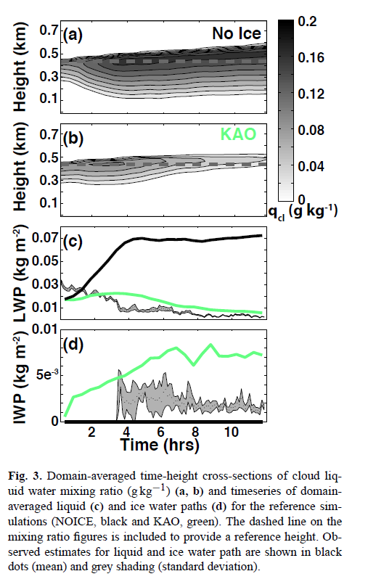
What about ice?
de Boer et al. (2013)

Slide 29
Summary
Uncertainty in equilibrium climate sensitivity largely controlled by uncertainty in how clouds will change.
  Low clouds constitute largest source of error, but high clouds show robust changes
Aerosol forcing, including effects on clouds, is likely a significant fraction of CO₂ forcing.
  Aerosol-cloud interactions important for determining overall aerosol forcing
  Low clouds primary culprits, but ice phase may be important

