Slide 1
The Climate Monks:
Can We See an End to the Dark Ages?
Bruce A. Wielicki
NASA Langley Research Center
Tom Ackerman Symposium
July 14, 2018
Seattle, WA

Slide 2

The Climate Monk Ponders…

Slide 3
The Climate Dark Ages
My deepest apologies to any offended historians. Mea culpa, mea culpa, mea maxima culpa…
The following is meant to be a controversial view of the last 40 years of climate research history
Its purpose is to foster discussion and deeper thought concerning where the climate research field is going and how it might ultimately plan and achieve its goals.
Finally: this is not purely an intellectual exercise: what we do will matter to the next 100 generations or so. The long lifetime of CO₂ in the atmosphere/ocean system will make it so…

Slide 4
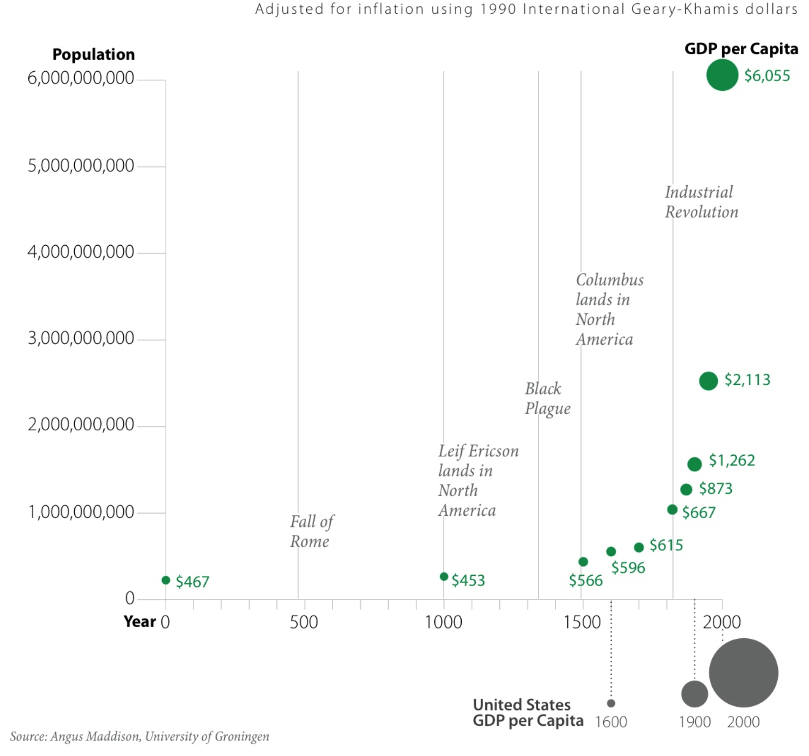
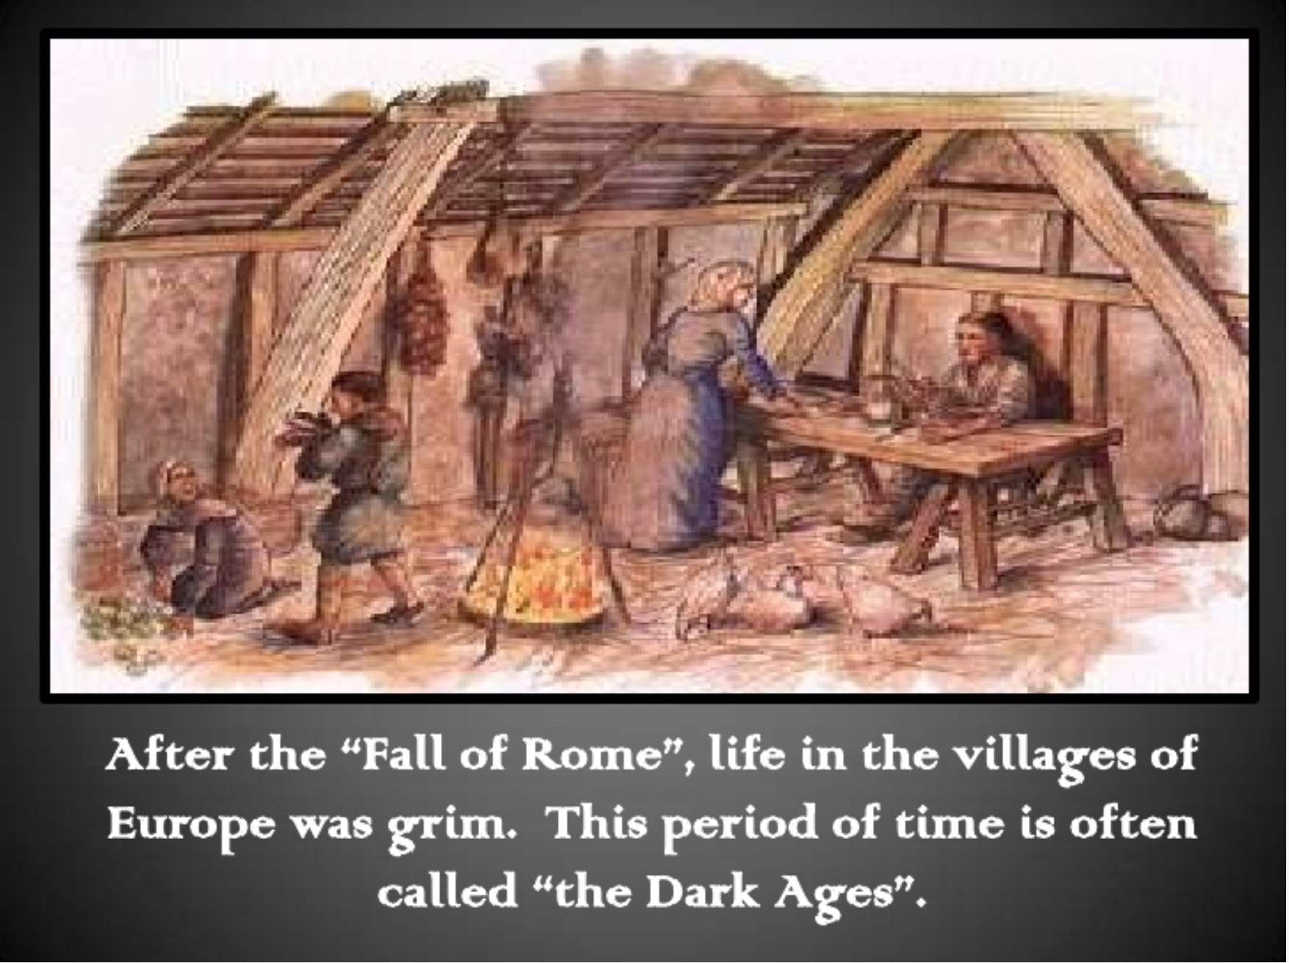
The Climate Dark Ages
What were the European Dark Ages or Medieval Ages?
Time of economic, technological, and cultural stagnation

Slide 5

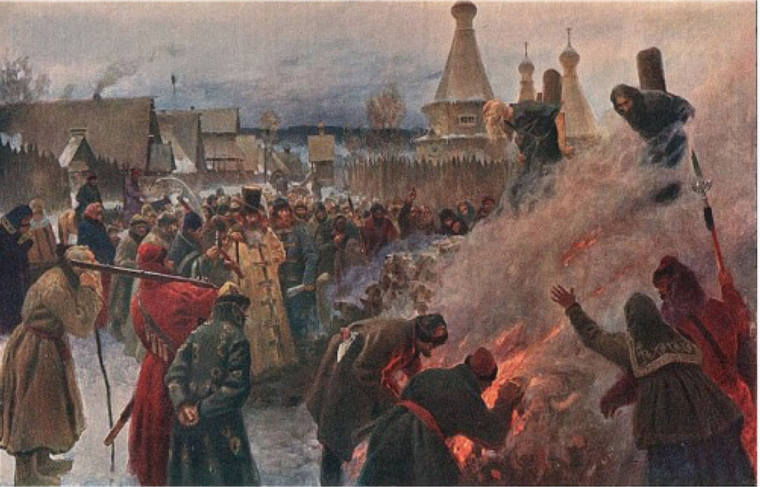

The Climate Dark Ages
What were the European Dark Ages or Medieval Ages?
Anti-reasoning, book burning, heretic burning, the Crusades….
While the Monks copied manuscripts for civilization’s return…
At the end of the Dark Ages (~ 500 to 1500AD) it was estimated that only 10% of people were literate.

Slide 6
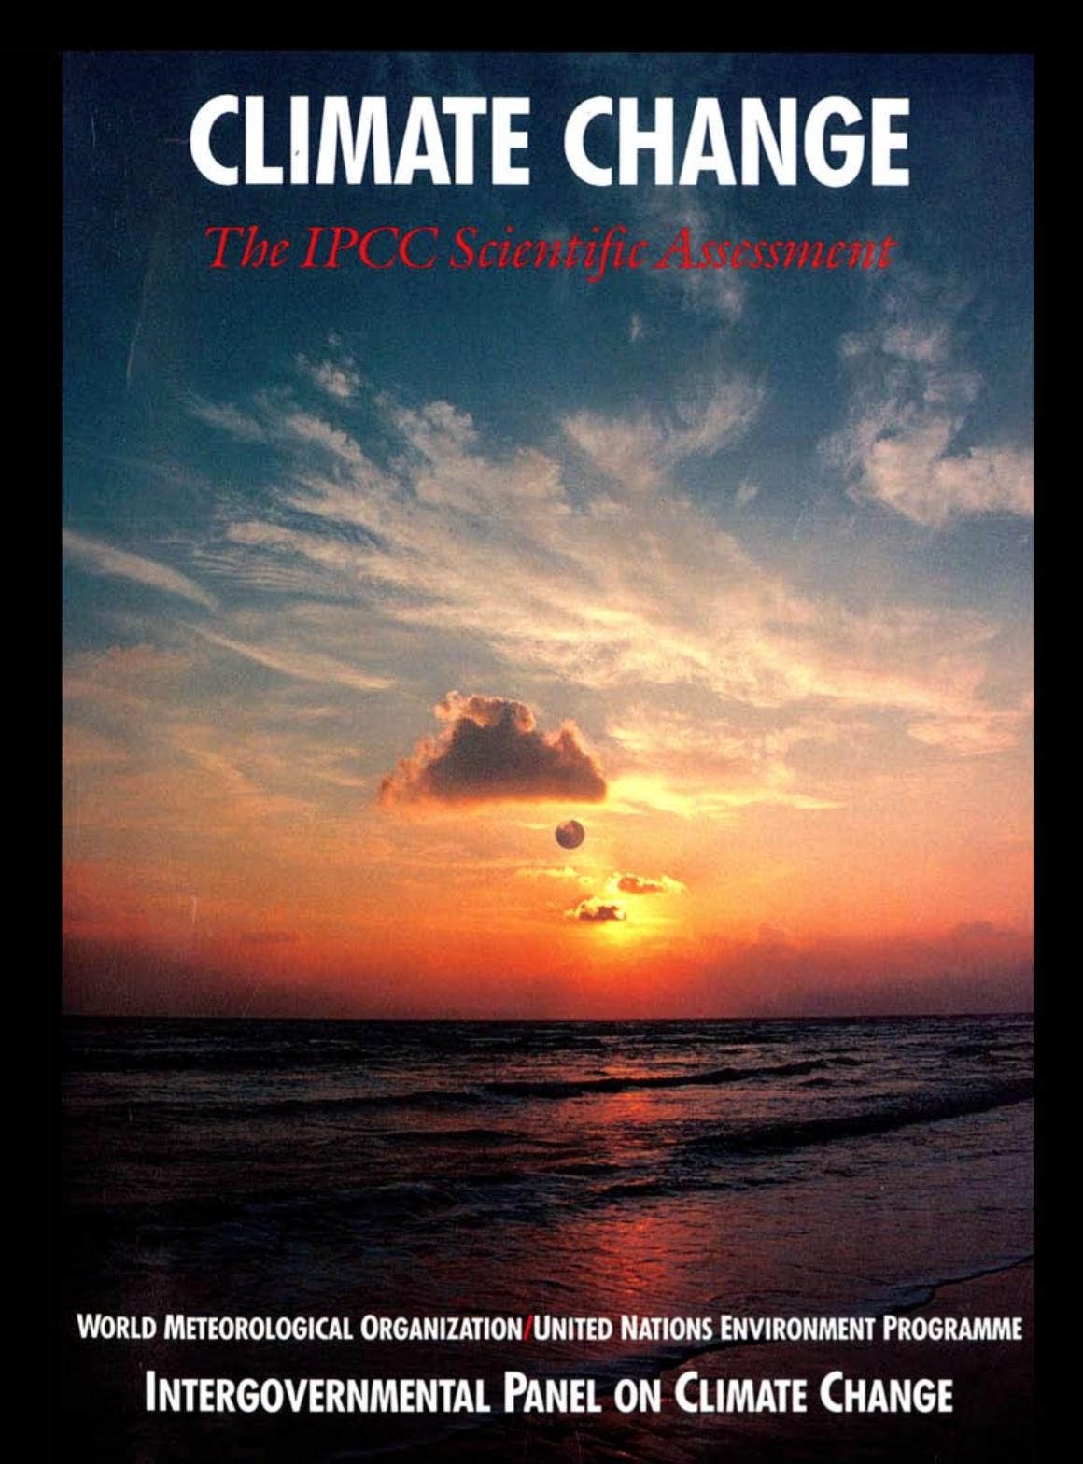
The Climate Dark Ages
The Climate Golden Age: late 1970s - early 1990s
1979 NRC Charney Report
1980 World Climate Research Program started
1989 U.S. Climate Change Research Program started
1989 DOE ARM program started
1990 First IPCC Report
1990 NASA Earth Observing System begins the first attempt at an integrated global climate observing system
1992 International Global Climate Observing System* started, defining 50 essential climate variables, and a set of climate observing principles
* GCOS consists of advisory plans, not a committed observing system, i.e. it is not like the global weather observing system.

Slide 7
The Climate Dark Ages
When did the Climate Dark Ages Start?
The mid 1990s in a time of U.S. budget deficits
The NASA EOS climate observing system was reduced in funding by a factor of 3. 3 successive platforms for climate time scale continuity were reduced to just a single exploratory platform (1 Terra/Aqua/Aura not 3).
Climate observations like TSIS, Radiation Budget and Ozone were given to the NPOESS weather satellite program. They then became contingency for the later NPOESS cost and schedule over-runs.
The only thing that saved climate data records was that Terra, Aqua, and SORCE lived far past expected lifetimes (18 vs 5 years). While the climate monks developed deep archives of climate data…

Slide 8
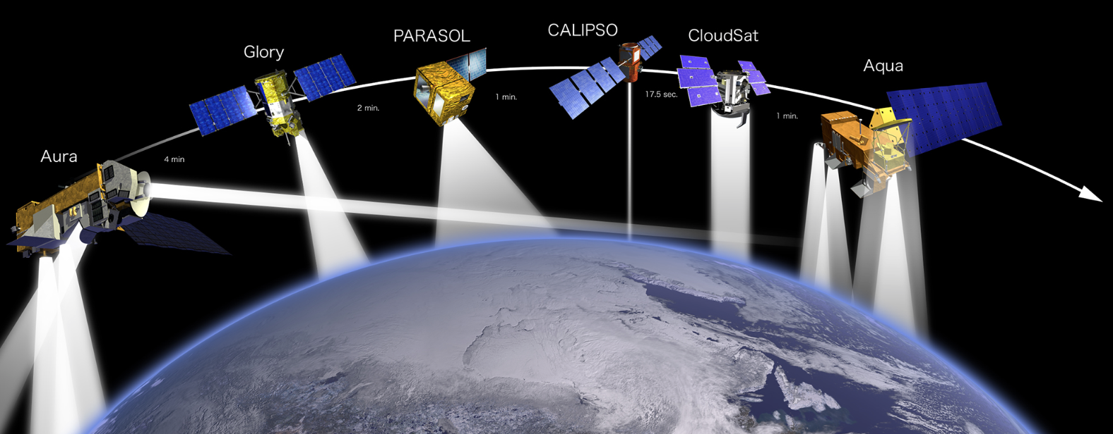
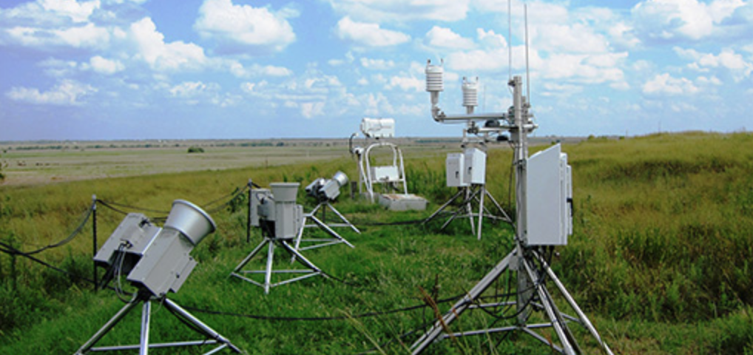
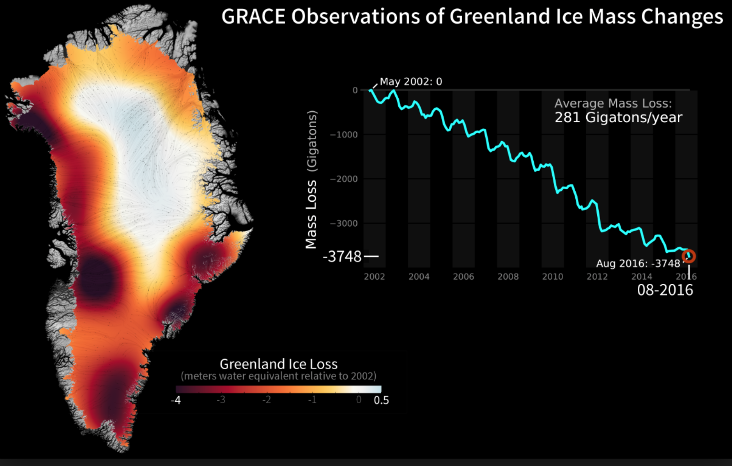
The Climate Dark Ages
How did the Climate Dark Ages Evolve?
Like the European Dark Ages, there were isolated bright spots:
The A-train lidar/radar/ radiometer constellation
DOE ARM successfully continued and expanded (with Tom’s help!)
GRACE enabled new ice mass observations
ARGO enabled new observations of ocean heat storage

Slide 9
The Climate Dark Ages
How did the Dark Ages Evolve?
But climate science in the U.S. continued under budget pressure with tight budgets when rapid expansion was in fact needed.
The USGCRP budget for all agencies for climate research increased from $0.1B in 1989 to $1.8B in 1994 (FY2000 dollars). Then it stagnated thereafter (Pielke, 2000). It remained in 2016 at the same funding (inflation adjusted). Zero progress in 22 years despite the growing issue of climate change
A designed and internationally committed climate observing system remains a dream and has not been planned. Continuity of existing observations (GCOS) was the best to hope for and even that existed only at constant high risk (2007 NRC Decadal Survey).
The Climate Dark Ages continue today: at least in the U.S….

Slide 10
The Climate Dark Ages
In the last few years its gotten darker…
Many people living in “echo chambers” online and on political agenda TV news channels. Where are the Walter Cronkites?
Attempts to eliminate climate satellite sensors (burn those books…)
EPA eliminating online links to climate change information or burying it in deep and difficult to access places (more book burning…)
Australian effort to eliminate CSIRO climate scientists (eliminate heretics?)
2017 Decadal Survey “punts” on giving the nation both an in-budget set of priorities and a vision for what is truly needed and why it is the best economic investment for the nation
Less than 1/3 of the “Very Important” and “Most Important” science objectives are supported in the Decadal Survey. Less than ½ of the “Most Important” science objectives are supported. None of the ”Important” objectives are supported

Slide 11
The Climate Dark Ages
How did the last Dark Ages End?
Guttenburg printing press developed ~ 1450. Enabled broad inexpensive and rapid sharing of knowledge
The Black Plaque (~ 1350) ended Feudalism due to a vast labor shortage
Protestant reformation eliminated Catholic Church power and political control (early 1500s to 1600s)
What might end the current Climate Dark Ages?
Expanded climate science and knowledge (higher investment in climate observing system, analysis, modeling, data
Technology advances in solar/wind/batteries/electric cars: the learning rate or cost reduction of these technologies is currently similar to that of the Ford Model T in the early 1900s
Resulting break up of the traditional “Church of the Fossil Fuel”.

Slide 12
The Climate Dark Ages
How did the last Dark Ages End?
Guttenburg printing press developed ~ 1450. Enabled broad inexpensive and rapid sharing of knowledge
The Black Plaque (~ 1350) ended Feudalism due to a vast labor shortage
Protestant reformation eliminated Catholic Church power and political control (early 1500s to 1600s)
What might end the current Climate Dark Ages?
Expanded climate science and knowledge (higher investment in climate observing system, analysis, modeling, data
Technology advances in solar/wind/batteries/electric cars: the learning rate or cost reduction of these technologies is currently similar to that of the Ford Model T in the early 1900s
Resulting break up of the traditional “Church of the Fossil Fuel”.

Slide 13
The Climate Dark Ages
How did the last Dark Ages End?
Guttenburg printing press developed ~ 1450. Enabled broad inexpensive and rapid sharing of knowledge
The Black Plaque (~ 1350) ended Feudalism due to a vast labor shortage
Protestant reformation eliminated Catholic Church power and political control (early 1500s to 1600s)
What might end the current Climate Dark Ages?
Expanded climate science and knowledge (higher investment in climate observing system, analysis, modeling, data
Technology advances in solar/wind/batteries/electric cars: the learning rate or cost reduction of these technologies is currently similar to that of the Ford Model T in the early 1900s
Resulting break up of the traditional “Church of the Fossil Fuel”.

Slide 14
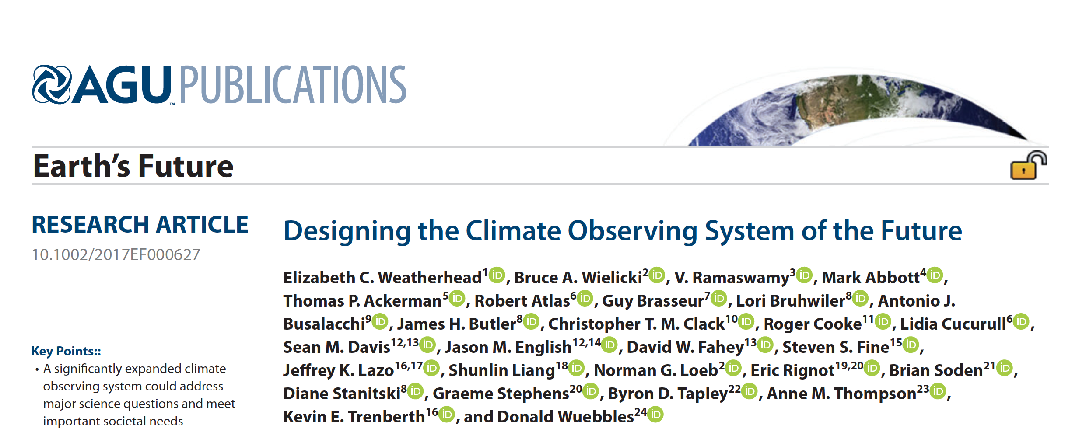
Ending The Climate Dark Ages
Arguing and planning for a global climate observing system: lets call it GCOS V2 or GCOS Realized.

Slide 15
Ending The Climate Dark Ages
Summary of Weatherhead et al. 2017:
We lack a designed and committed international climate observing system
The economic value to the world of such an improved system is very large: ~ $5 to $20 Trillion U.S. dollars
The return on investment is very large (~ 50:1) for 30 years of these observations
We lose ~ $500 Billion U.S. dollars every year we delay that system
The Appendix summarizes the economic results and provides references
Key elements in designing a rigorous climate observing system
Attack known critical uncertainties (e.g. IPCC, WCRP Grand Challenges)
Use Quantified Science Objectives (see NRC Continuity Report, 2015) and prioritize them (e.g. as in 2017 Decadal Survey Climate Panel Report)
Use Continuity Report concepts of Utility (e.g. OSSEs), Quality, Success Probability, and Affordability (inverse of cost)
Obtain independent observations and analysis of all key climate variables (2 principles currently missing from GCOS)

Slide 16
Ending The Climate Dark Ages
How do the Economic Values Compare to Weather Prediction?
Value of Current Weather Predictions: (all converted to 2015 U.S. dollars)
$17 Billion/yr U.S. alone (ROI: 10:1) Lazo, 2002 NPOESS report
$33 Billion/yr, U.S. alone (ROI: 6:1) Lazo et al. 2009
Value of Improving Weather Predictions
$2.3 Billion/yr U.S. alone Lazo, 2002 NPOESS report
$200 million/yr U.S. alone Lazo et al. 2010
Value of improving Climate Predictions
$10,000 Billion/6 = $1500 Billion U.S. alone integrated over time. (Note that U.S. economy is ~ 1/6th of global GDP at Purchasing Parity or PPP)
$500 Billion/6 per year = $80 Billion/yr U.S. alone
ROI over time: 50:1 world. U.S. per year ROI: 20:1 (U.S. extra $4B/yr investment)

Slide 17
Ending The Climate Dark Ages
So what are the roadblocks?
Climate prediction investments and emission reduction investments payback primarily in the future: your children and the next 2 generations.
Many people don’t care about the long term future
Evolution designed our genes to avoid short term threats to life: lions, tigers, and bears…. and severe storms, and attacking villages…
Existing infrastructure (oil, gas, current grid design, gas cars) all want to avoid change and will actively spend resources to do so
Supreme court ruling that companies could anonymously donate any amount of money to politicians they want: i.e. ok to buy political decisions
Gerrymandering of political boundaries reduces ability to change
Even scientists are relatively short term thinkers with narrow specialty focus: for example: WCRP “Grand Challenges” are 5-10 year plans.
Without change, we may still be in the same spot 40 years from now.

Slide 18
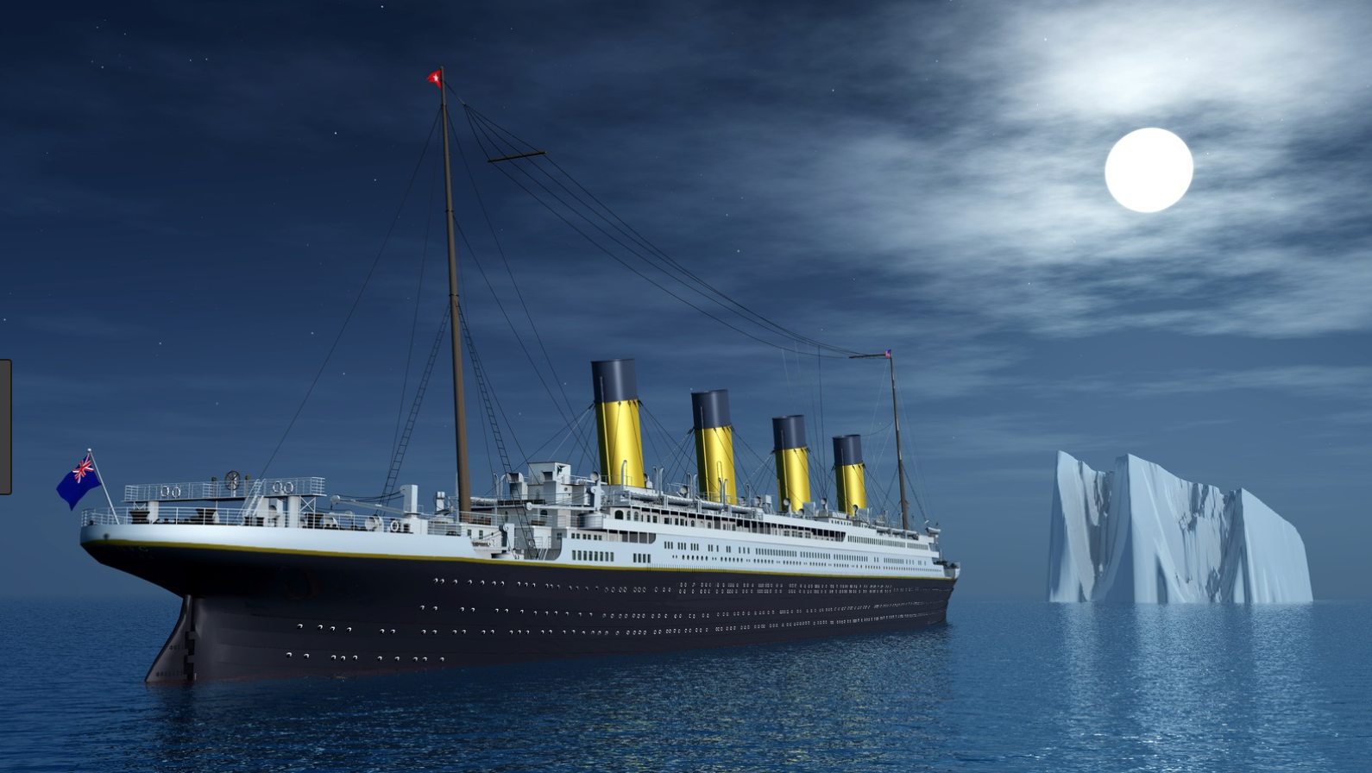
Ending The Climate Dark Ages
Shall we warn the captain, crew, and passengers?
Or just assume that they won’t listen anyway…

Slide 19
Accuracy Requirements of the Climate Observing System
The length of time required to detect a climate trend caused by human activities is determined by:
Natural variability
The magnitude of human driven climate change
The accuracy of the observing system
Magnitude of Observable Trend
Even a perfect observing system is limited by natural variability

Slide 20
Reflected Solar Accuracy and Climate Trends
Climate Sensitivity Uncertainty
is a factor of 4 (IPCC) which =
a factor of 16 uncertainty in climate
change economic impacts
Climate Sensitivity Uncertainty =
Cloud Feedback Uncertainty =
Low Cloud Feedback =
Changes in SW CRF/decade
(y-axis of figure)
Higher Accuracy Observations =
CLARREO reference intercal of
CERES = narrowed uncertainty
15 to 20 years earlier
Wielicki et al. 2013,
Bulletin of the American Meteorological Society
High accuracy is critical to more rapid understanding of climate change

Slide 21
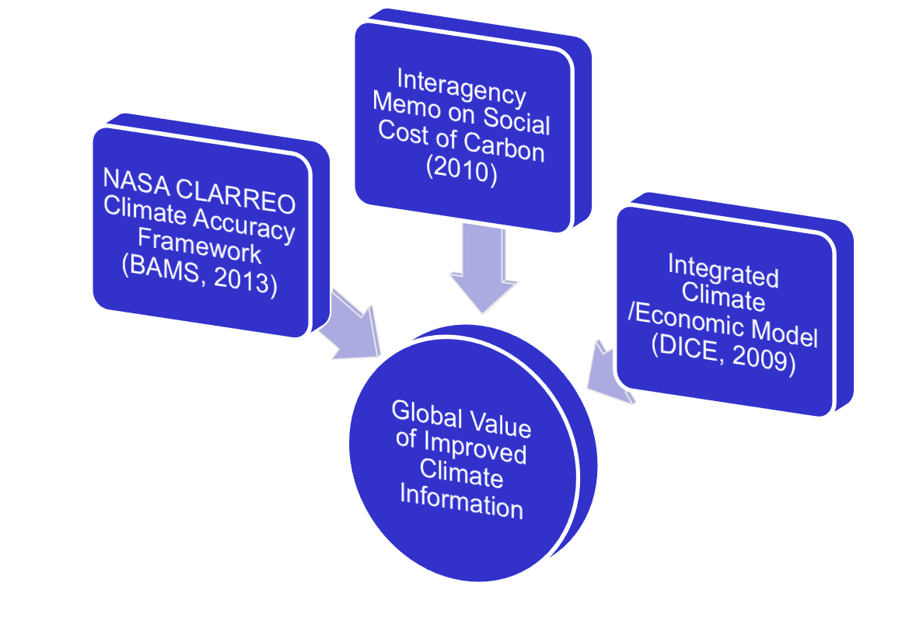
What is the right amount to invest in climate science?
Interdisciplinary Integration of Climate Science and Economics

Slide 22
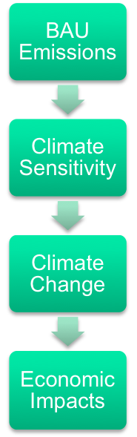
Value of Information Estimation Method
Emissions Reduction Costs

Slide 23
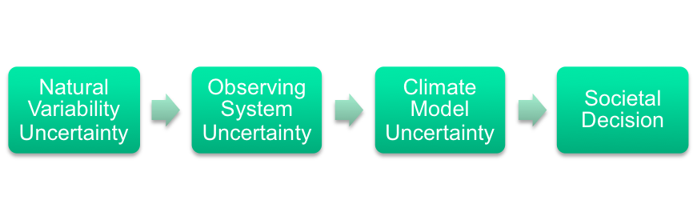
Value of Information Estimation Method
Fuzzy
Lens 1
Fuzzy
Lens 2
Fuzzy
Lens 3
Emissions Reduction Costs

Slide 24
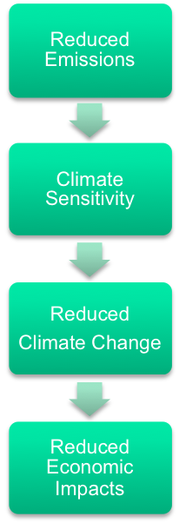
Value of Information Estimation Method
Fuzzy
Lens 1
Fuzzy
Lens 2
Fuzzy
Lens 3

Slide 25
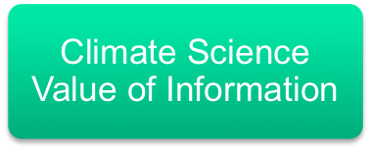
Value of Information Estimation Method
Fuzzy
Lens 1
Fuzzy
Lens 2
Fuzzy
Lens 3
Emissions Reduction Costs

Slide 26
Value of Information Estimation Method
Fuzzy
Lens 1
Fuzzy
Lens 2
Fuzzy
Lens 3
Emission Reduction Costs
Emissions Reduction Costs

Slide 27
Economics: The Big Picture
World GDP today ~ $80 Trillion US dollars
Net Present Value (NPV)
compare a current investment to other investments that could have been made with the same resources
Discount rate: 3%
10 years: discount future value by factor of 1.3
25 years: discount future value by factor of 2.1
50 years: discount future value by factor of 4.4
100 years: discount future value by factor of 21
Business as usual climate damages in 2050 to 2100: 0.5% to 5% of GDP/yr depending on climate sensitivity.

Slide 28
VOI vs. Discount Rate
Run 1000s of economic simulations and then average over
the full IPCC distribution of possible climate sensitivity
Discount Rate | CLARREO/Improved Climate Observations VOI (US 2015 dollars, net present value)
2.5% | $17.6 T
3% | $11.7 T
5% | $3.1 T
Additional Cost of an advanced climate observing system:
~ $10B/yr worldwide
Cost for 30 years of such observations is ~ $200 to $250B (NPV)
Even at the highest discount rate, return on investment is very large

Slide 29
VOI vs. Discount Rate
Run 1000s of economic simulations and then average over
the full IPCC distribution of possible climate sensitivity
Discount Rate | CLARREO/Improved Climate Observations VOI (US 2015 dollars, net present value)
2.5% | $17.6 T
3% | $11.7 T
5% | $3.1 T
Advanced Climate Observing System:
Return on Investment: $50 per $1
Even at the highest discount rate, return on investment is very large

Slide 30
Results and Sensitivity to Assumptions
World Wide Economic Benefits
Parameter Change | CLARREO/Improved Climate Observations VOI (Trillion US 2015 dollars, NPV) 3% discount rate
Baseline* | $11.7 T
BAU => AER | $9.8 T
0.3C/decade trigger | $14.4 T
2030 launch | $9.1 T
* Baseline uses 0.2C/decade trigger, 95% confidence in trend, BAU => DICE optimal emissions, 2020 launch
Delaying launch by 10 years reduces benefit by $2.6 T
Each year of delay we lose $260B of world benefits

